Slide 1
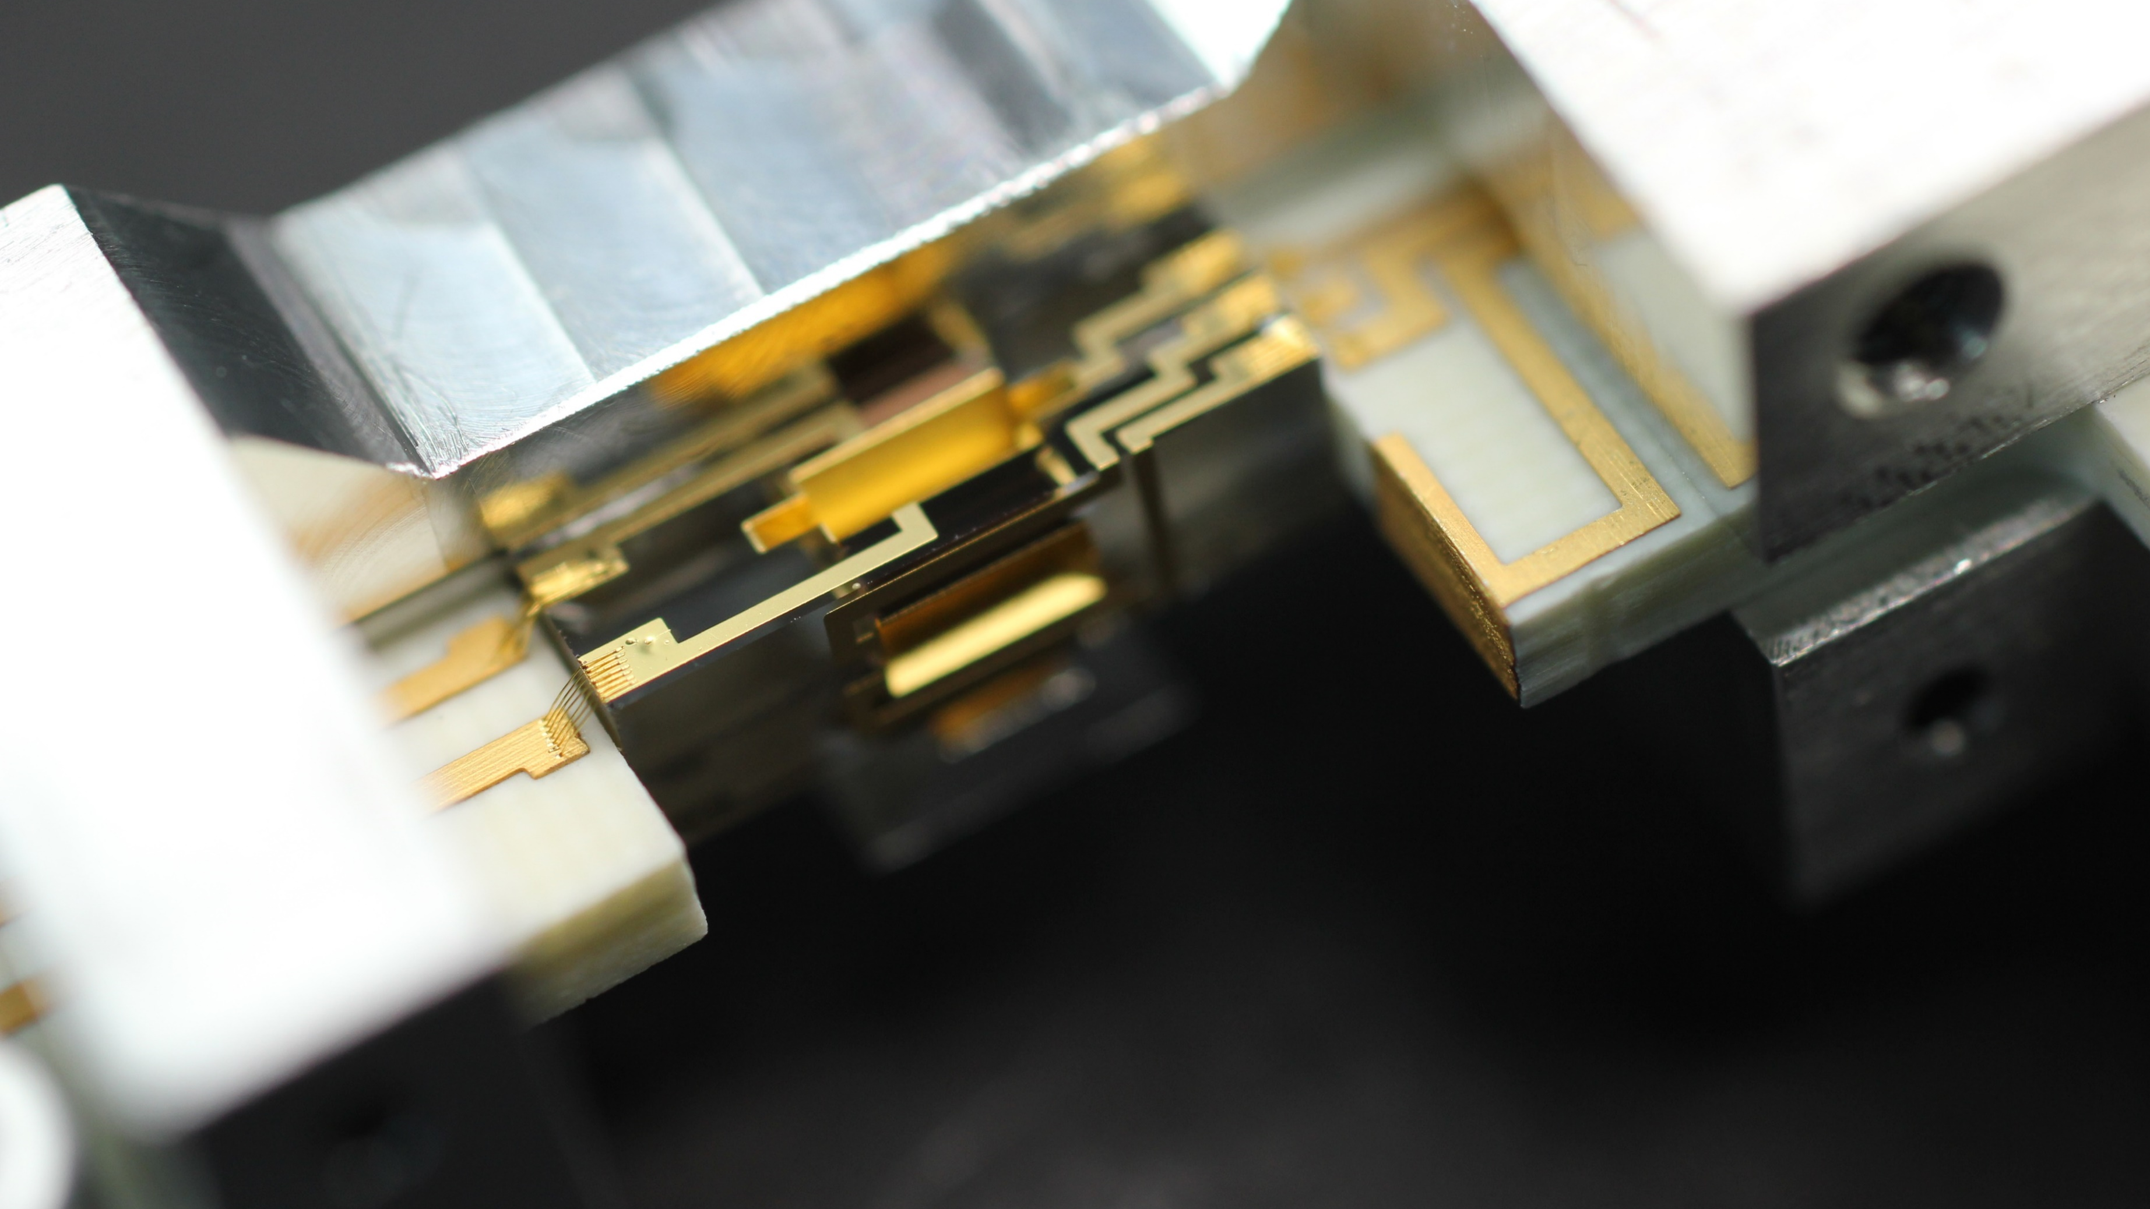
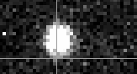

Quantum logic spectroscopy of the hydrogen molecular ion
Be⁺
H₂⁺
F. Schmid, D. Holzapfel, Q. He, F. Vouzinas, H. J. Kim, N. Schwegler, O. Stadler, M. Stadler, A. Ferk, J. P. Home, D. Kienzler
Trapped Ion Quantum Information Group
10.09.2025
PSI2025
N. Schwegler et al., PRL 131, 133003 (2023)
D. Holzapfel et al., PRX 15, 031009 (2025)
H. J. Kim et al., arXiv:2509.03625 (2025)

Slide 2
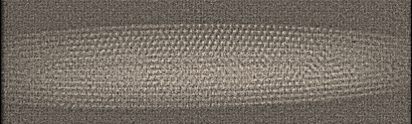
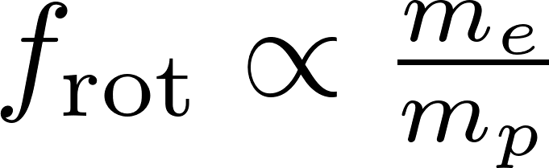
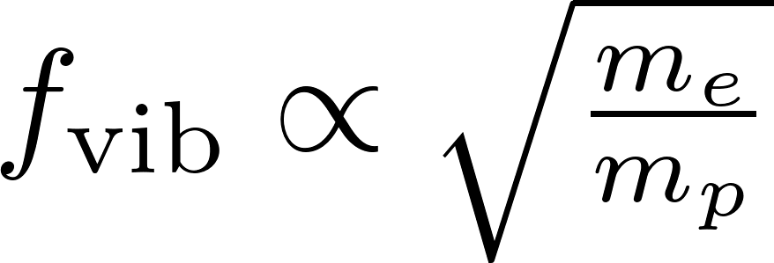
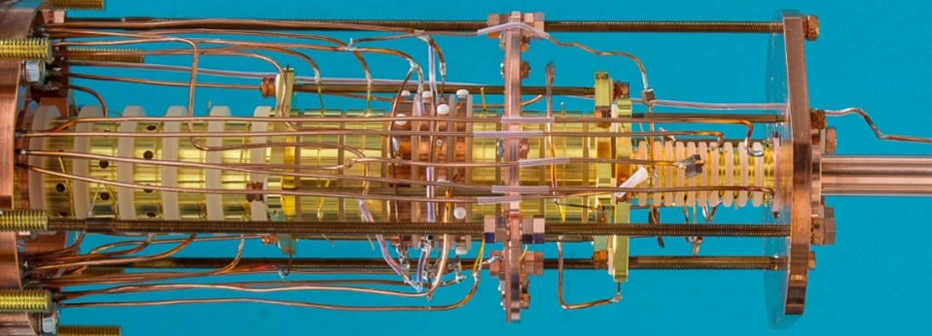

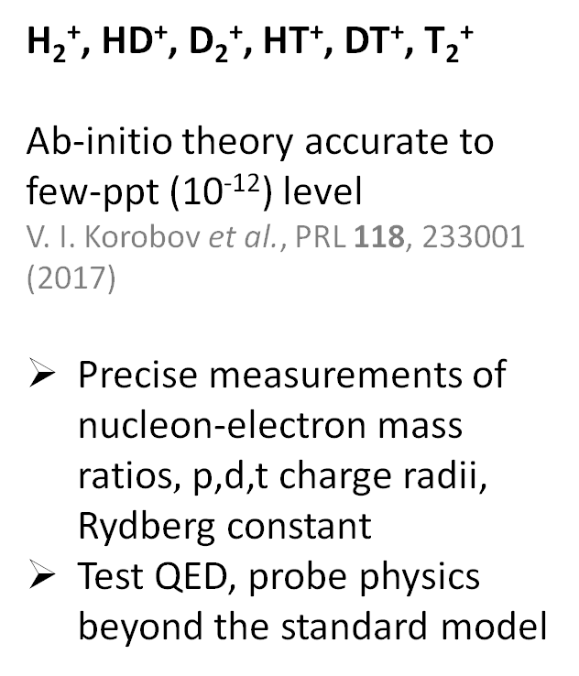
Hydrogen molecular ions
Düsseldorf, Schiller group
H₂⁺, HD⁺, D₂⁺, HT⁺, DT⁺, T₂⁺
Ab-initio theory accurate to few-ppt (10⁻¹²) level
V. I. Korobov et al., PRL 118, 233001 (2017)
Precise measurements of nucleon-electron mass ratios$,$p,d,t charge radii, Rydberg constant
Test QED, probe physics beyond the standard model
Ensembles - Paul traps
Düsseldorf, Amsterdam, Paris, Wuhan
Destructive state detection
Single-ion - Penning trap
MPIK Heidelberg + Düsseldorf
Spin orientation detection
Single-ion - Paul trap
ETH Zürich
Quantum logic spectroscopy
+
-
+
MPIK, Sturm/Blaum groups
Be⁺
H₂⁺

Slide 3
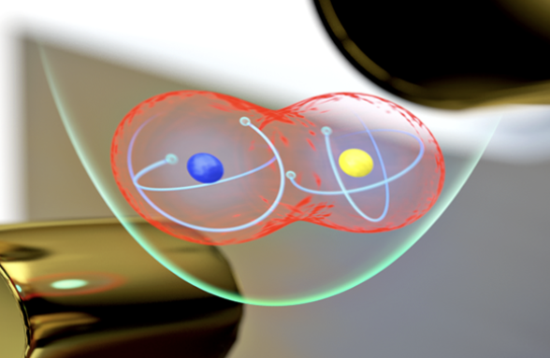
QLS - Quantum logic spectroscopy
H₂⁺
H₂⁺
cannot scatter photons
Single (Paul-)trapped-ion control
Laser cooling
State preparation (optical pumping)
Non-destructive readout
QLS - Quantum logic spectroscopy
Al⁺: P. O. Schmidt et al., Science 309, 749 (2005)
Al⁺: M. C. Marshall et al., PRL 135, 033201 (2025)
Al⁺ clock syst. uncertainty: 5.5 × 10⁻¹⁹
Highly charged ions (PTB, MPIK)
QLS of Molecules
MgH⁺: F. Wolf et al., Nature 530, 457 (2016)
CaH⁺: C.-W. Chou et al., Nature 545, 203 (2017)
N₂⁺: M. Sinhal et al., Science 367, 6483 (2020)
H₂⁺: D. Holzapfel et al., PRX 15, 031009 (2025)
H₂⁺ projected uncertainty with QLS: 10⁻¹⁷
S. Schiller et al., PRL 113, 023004 (2014)
J.-P. Karr et al., J. Phys. Conf. Ser. 723, 012048 (2016)
✗
Be⁺
Mg⁺
Al⁺
S. Burrows/JILA

Slide 4
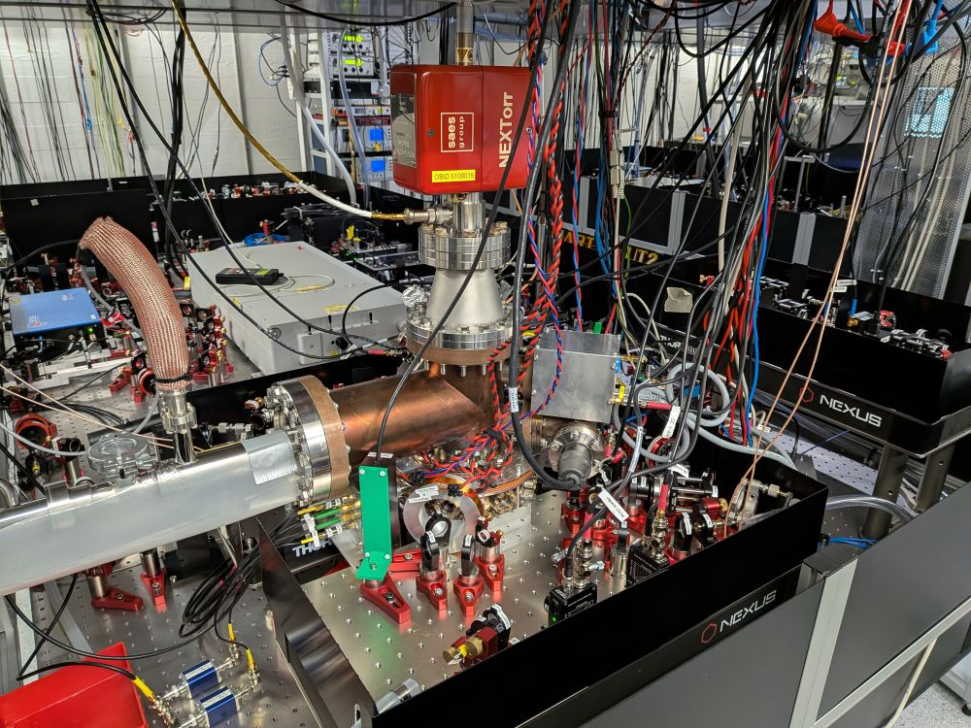
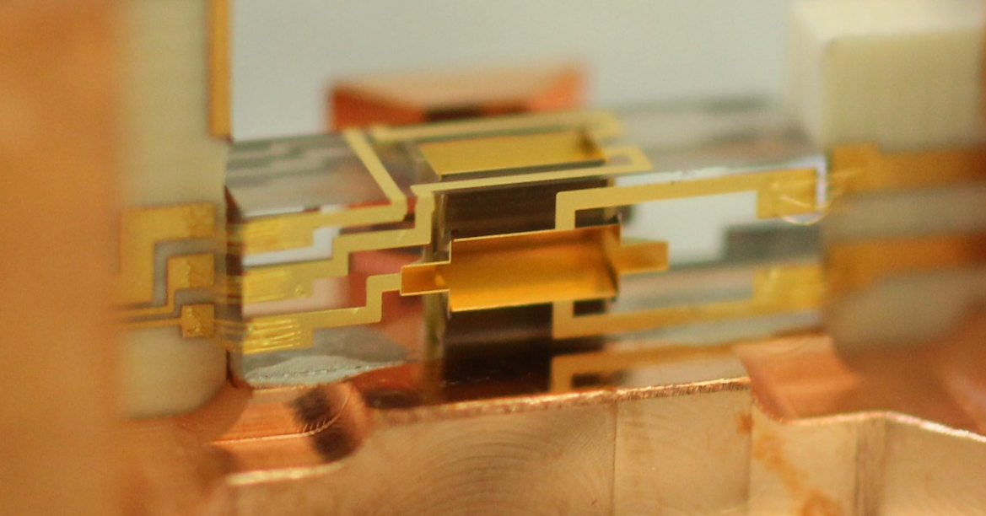
Apparatus
Tabletop experiment (~few m³)
Linear Paul trap
particle motion: harmonic oscillator with frequency O(1 MHz)
Loading procedure
Trap single Be⁺ (photo-ionization)
multiphoton ionization of H₂
Cryostat + UHV:
Prevent H₂⁺ reaction to H₃⁺
H₂ partial pressure ~10⁻¹⁵ mbar
N. Schwegler et al., PRL 131, 133003 (2023)
High-precision micro-fabricated ion trap
2.5 mm
H₂
Be⁺
H₂⁺
Be⁺
H₂⁺
202 nm

Slide 5
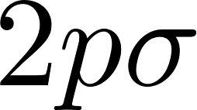
H₂⁺
E
m_{J}
-5/2
-3/2
-1/2
1/2
3/2
5/2
F = 3/2
J = 3/2
J = 5/2
Vibration
J= 1/2
Rotation
…
…
microwave
Raman 1050 nm
…
Hyperfine structure
(18 levels)
~1.4 GHz
66 THz
5 THz
J = 1/2
Ortho
(I = 1)
Para
(I = 0)
J = 3/2
R
F = 1/2

Slide 6

State selective REMPI loading
Not to scale
1050 nm
Master student:
Ho June Kim
Master student:
Ho June Kim
202 nm
Pulsed OPO:
3 ns, 0.2 mJ, 50 Hz
⁹Be⁺
H₂⁺
313 nm
202 nm
“Cold” H₂ (L’’ = 0): raise cryostat temperature
“Warm” H₂ (L’’ > 0): heat up getter pump / ion gauge
QLS L = 1:
85(6)% success
Theory: ~84%
Loading protocol
Burst of 50 REMPI laser pulses
Check Be⁺ ion position
Repeat
QLS L = 2:
Lifetime > 1 day
(no collisional quenching)
H. J. Kim et al., arXiv:2509.03625 (2025)

Slide 7
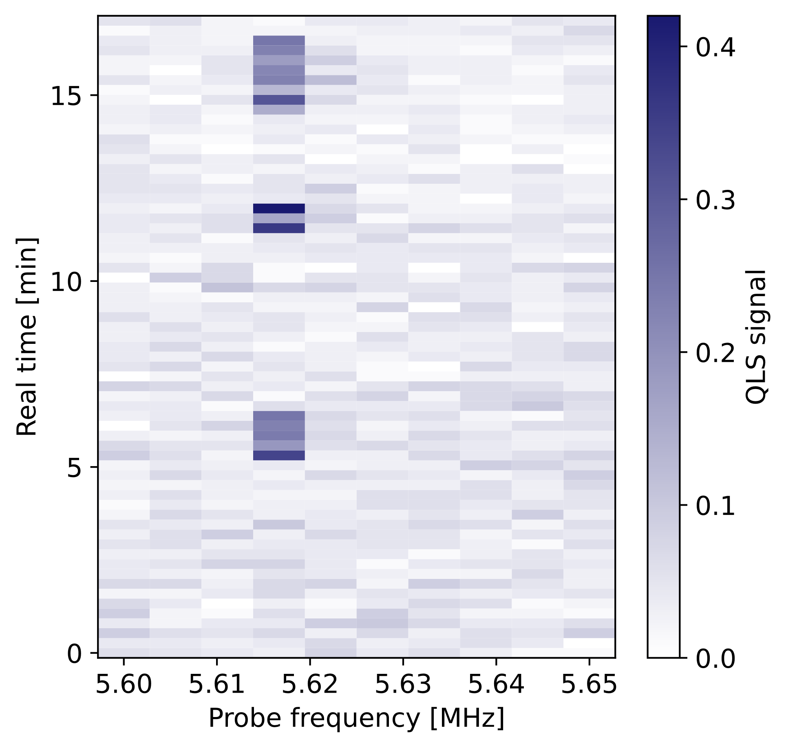


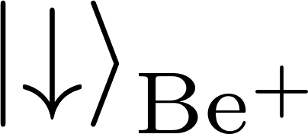
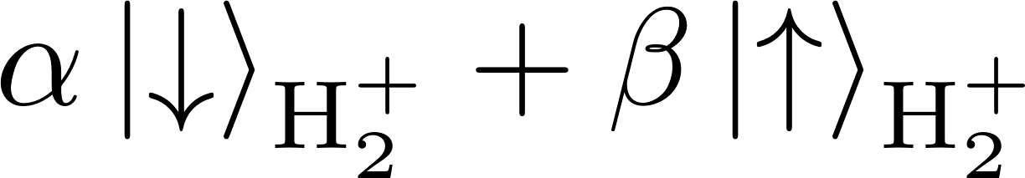
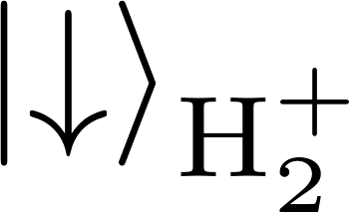
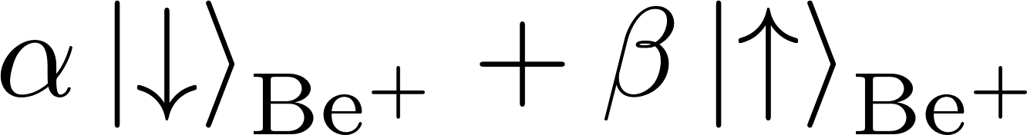
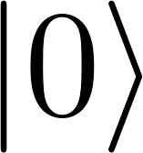
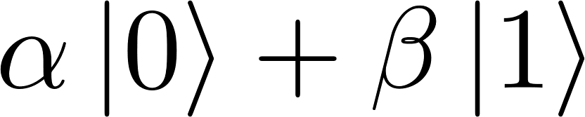
QLS detection
QLS
Collisions change hyperfine state
QLS
D. Holzapfel et al., PRX 15, 031009 (2025)

Slide 8
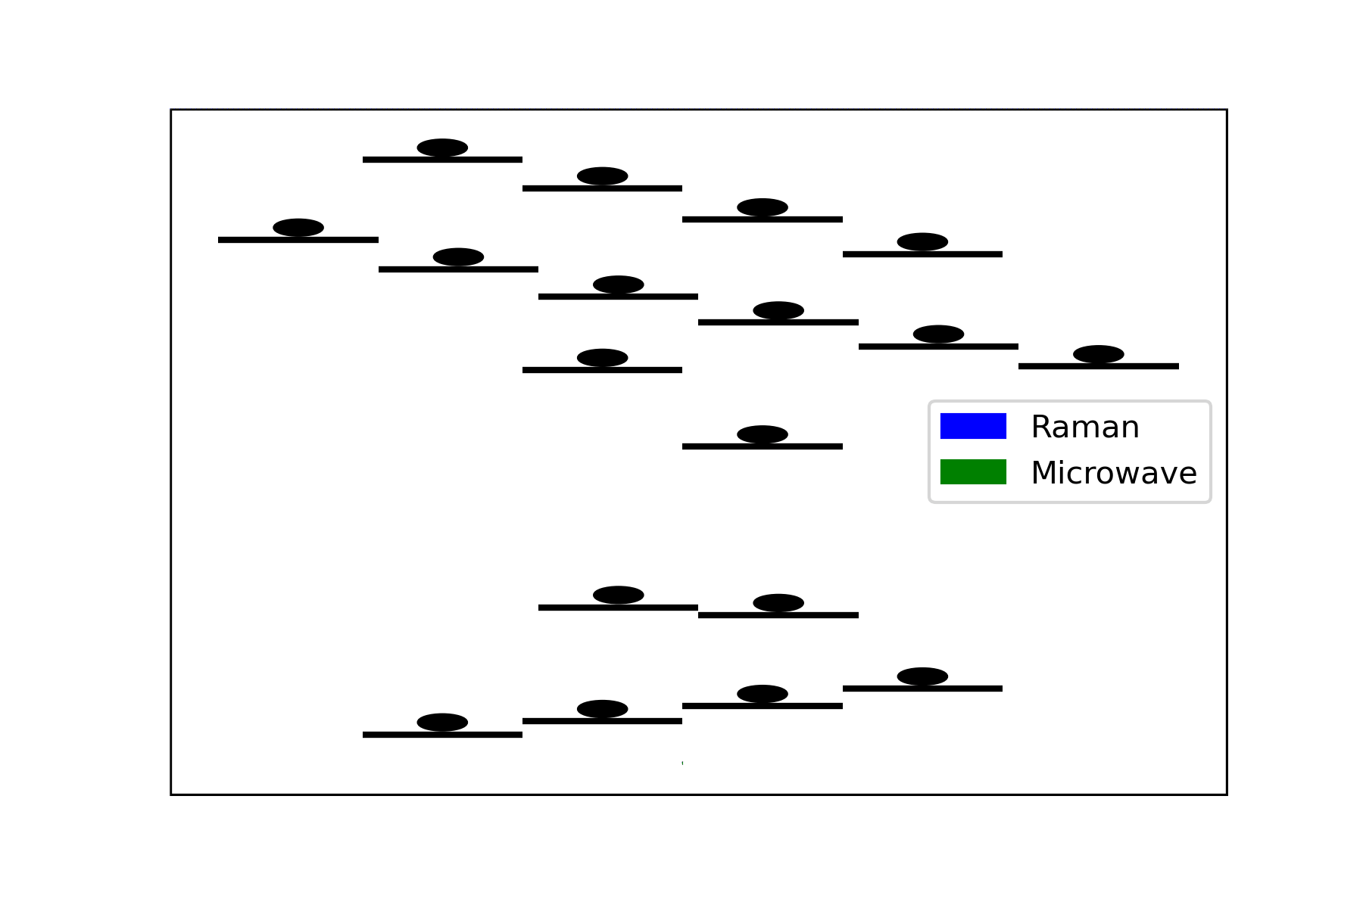
H₂⁺ state preparation
Quantum logic pumping
with Raman to combine populations
Microwave transitions
to connect to all states
Continue until state is prepared
QLS
D. Holzapfel et al., PRX 15, 031009 (2025)

Slide 9
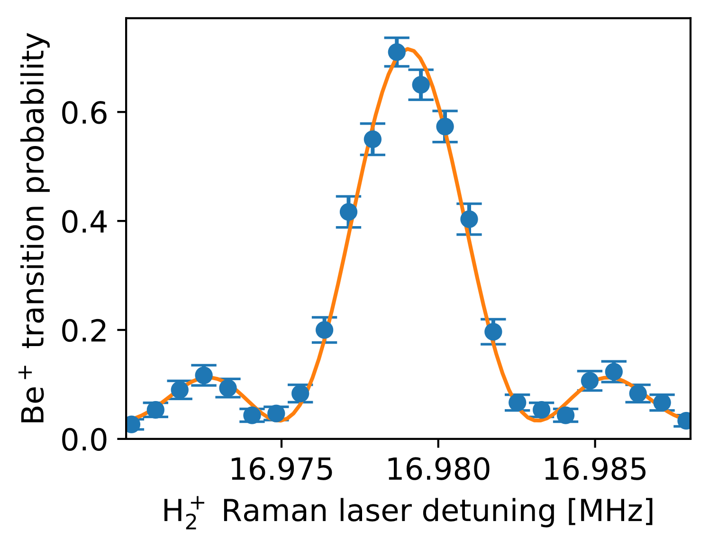
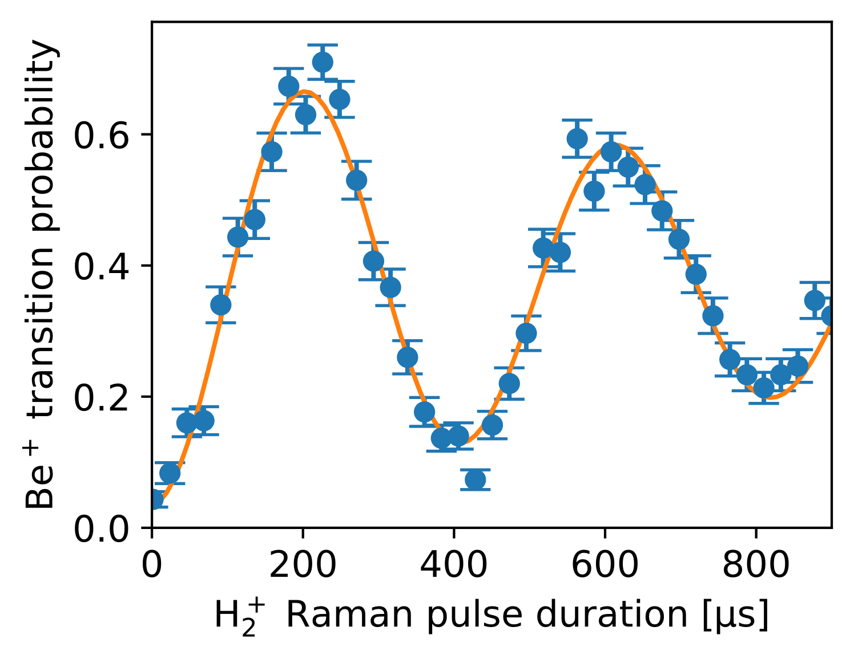
Quantum logic spectroscopy – Raman sideband
No post processing!
5
scan
?
QLS
D. Holzapfel et al., PRX 15, 031009 (2025)

Slide 10
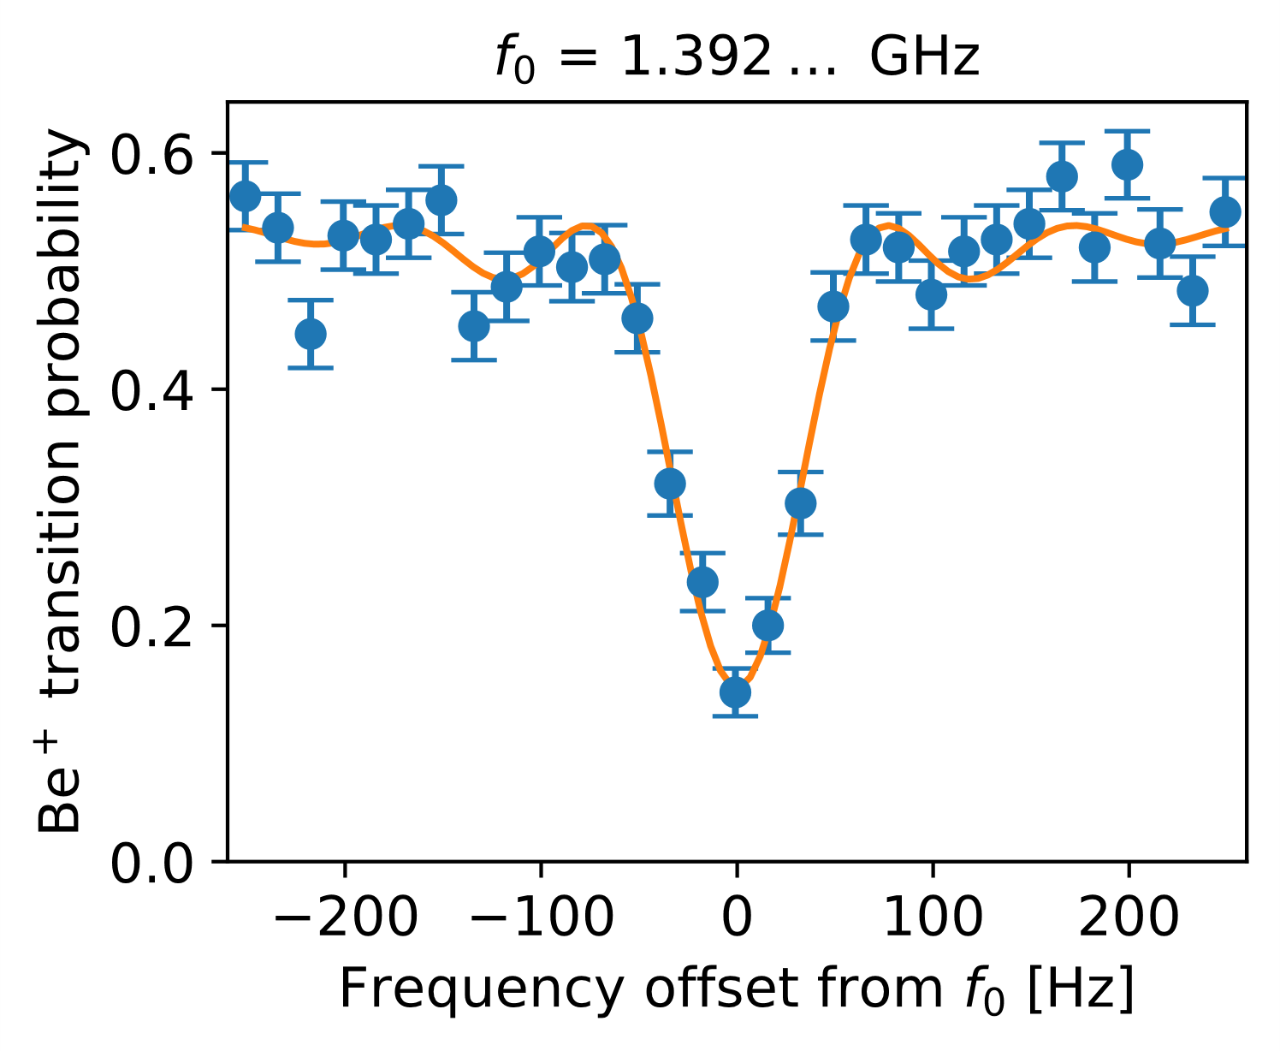
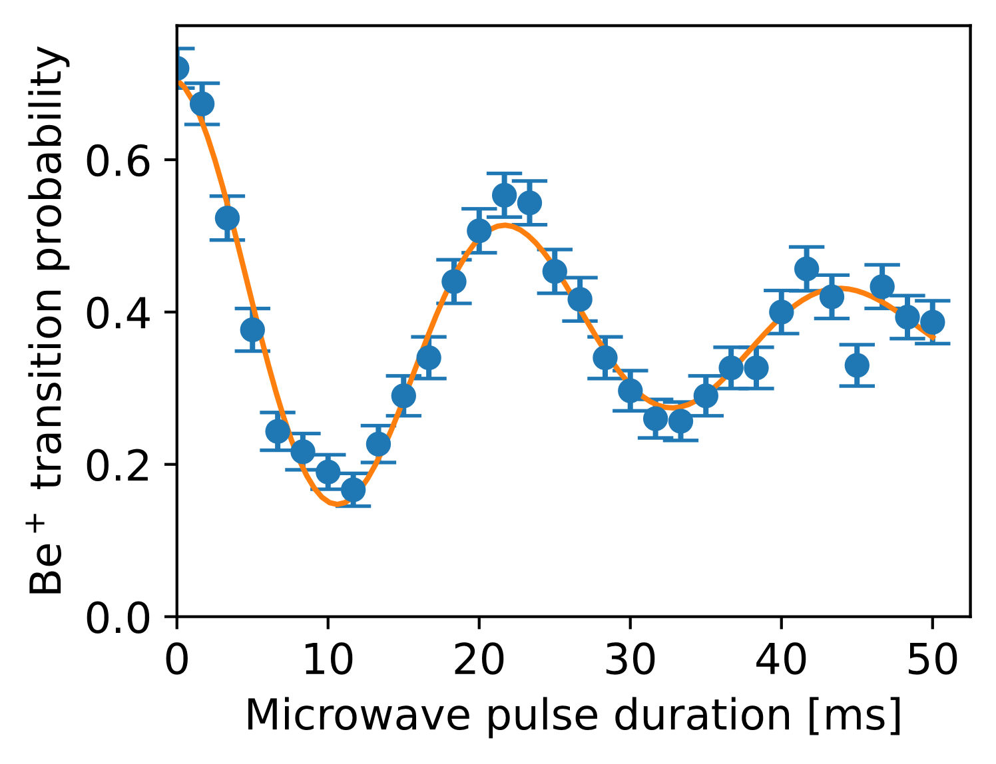
Quantum logic spectroscopy - microwave
?
scan
probe
QLS
D. Holzapfel et al., PRX 15, 031009 (2025)

Slide 11
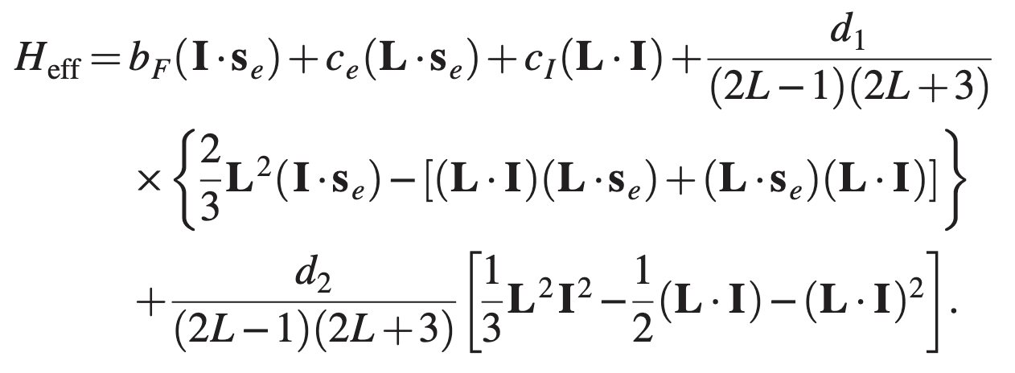
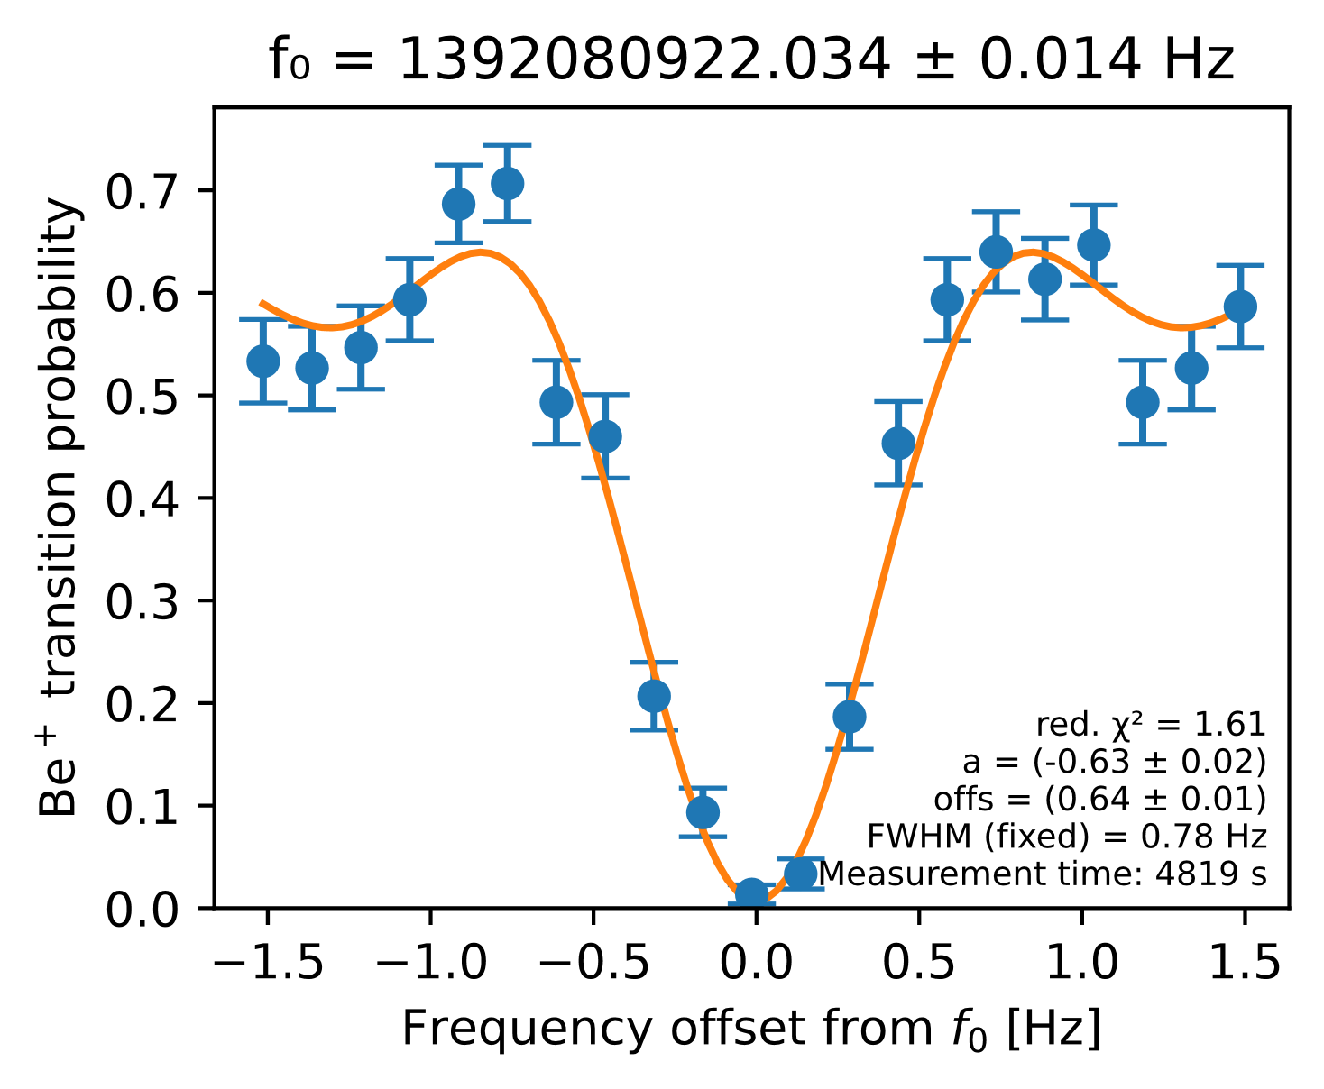
Hyperfine spectroscopy - Preliminary
Collaboration with J.-P. Karr (LKB, Paris)
H₂⁺ has strong magnetic coupling…
Use magnetic field insensitive transitions (50 – 1000 µT range)
proton-proton spin interaction
p
p
0.8 Hz
?
Test new physics, 5th force:
Additional spin-dependent proton-proton interaction
In H₂: N. F. Ramsey, Physica 96A, 285 (1979)
Review: L. Cong et al., RMP 97, 025005 (2025)
Systematic shifts
AC Zeeman shift (trap RF): ~few Hz
Quadrupole shift: ~ 0.1 Hz
Micromotion Stark shift: < mHz
2nd-order Doppler shift: << mHz
?
14 mHz precision in 80 min
Planned: Spectroscopy at different rf confinement to extrapolate to zero field

Slide 12


Outlook
Microwave hyperfine spectroscopy L = 1
Test of theory
Probe New Physics
…
Apply to other light molecules
Rovibrational single-photon transitions
ν,L: 0,0-3,2: 1576 nm quadrupole transition
J.-Ph. Karr et al., J. Phys.: Conf. Ser. 723, 012048 (2016)
ν,L: 0,0-3,1: 1600 nm ortho-para (dipole) transition
V. I. Korobov and D. Bakalov, PRA 107, 022812 (2023)
Deuteron quadrupole moment
Be⁺
H₃⁺
D₂⁺
T₂⁺
HeH⁺
He₂⁺
…
Triton charge radius
Fundamental constants, probe New Physics
Astrophysics,
benchmark quantum chemistry calculations
Rotational Raman transitions L: 0-2, 1-3 (5, 8 THz)
Theory
hyperfine
structure:
G. Avila et al., PRL 135, 043003 (2025)
CaH⁺ C.-W. Chou et al., Science 367, 1458 (2020), A. L. Collopy et al., PRL 130, 223201 (2023), K. H. Leung et al., Phys. Rev. X 13, 011047 (2023)
Collaboration on molecular ions with F. Wolf (PTB) & P. Schindler (Innsbruck)

Slide 13
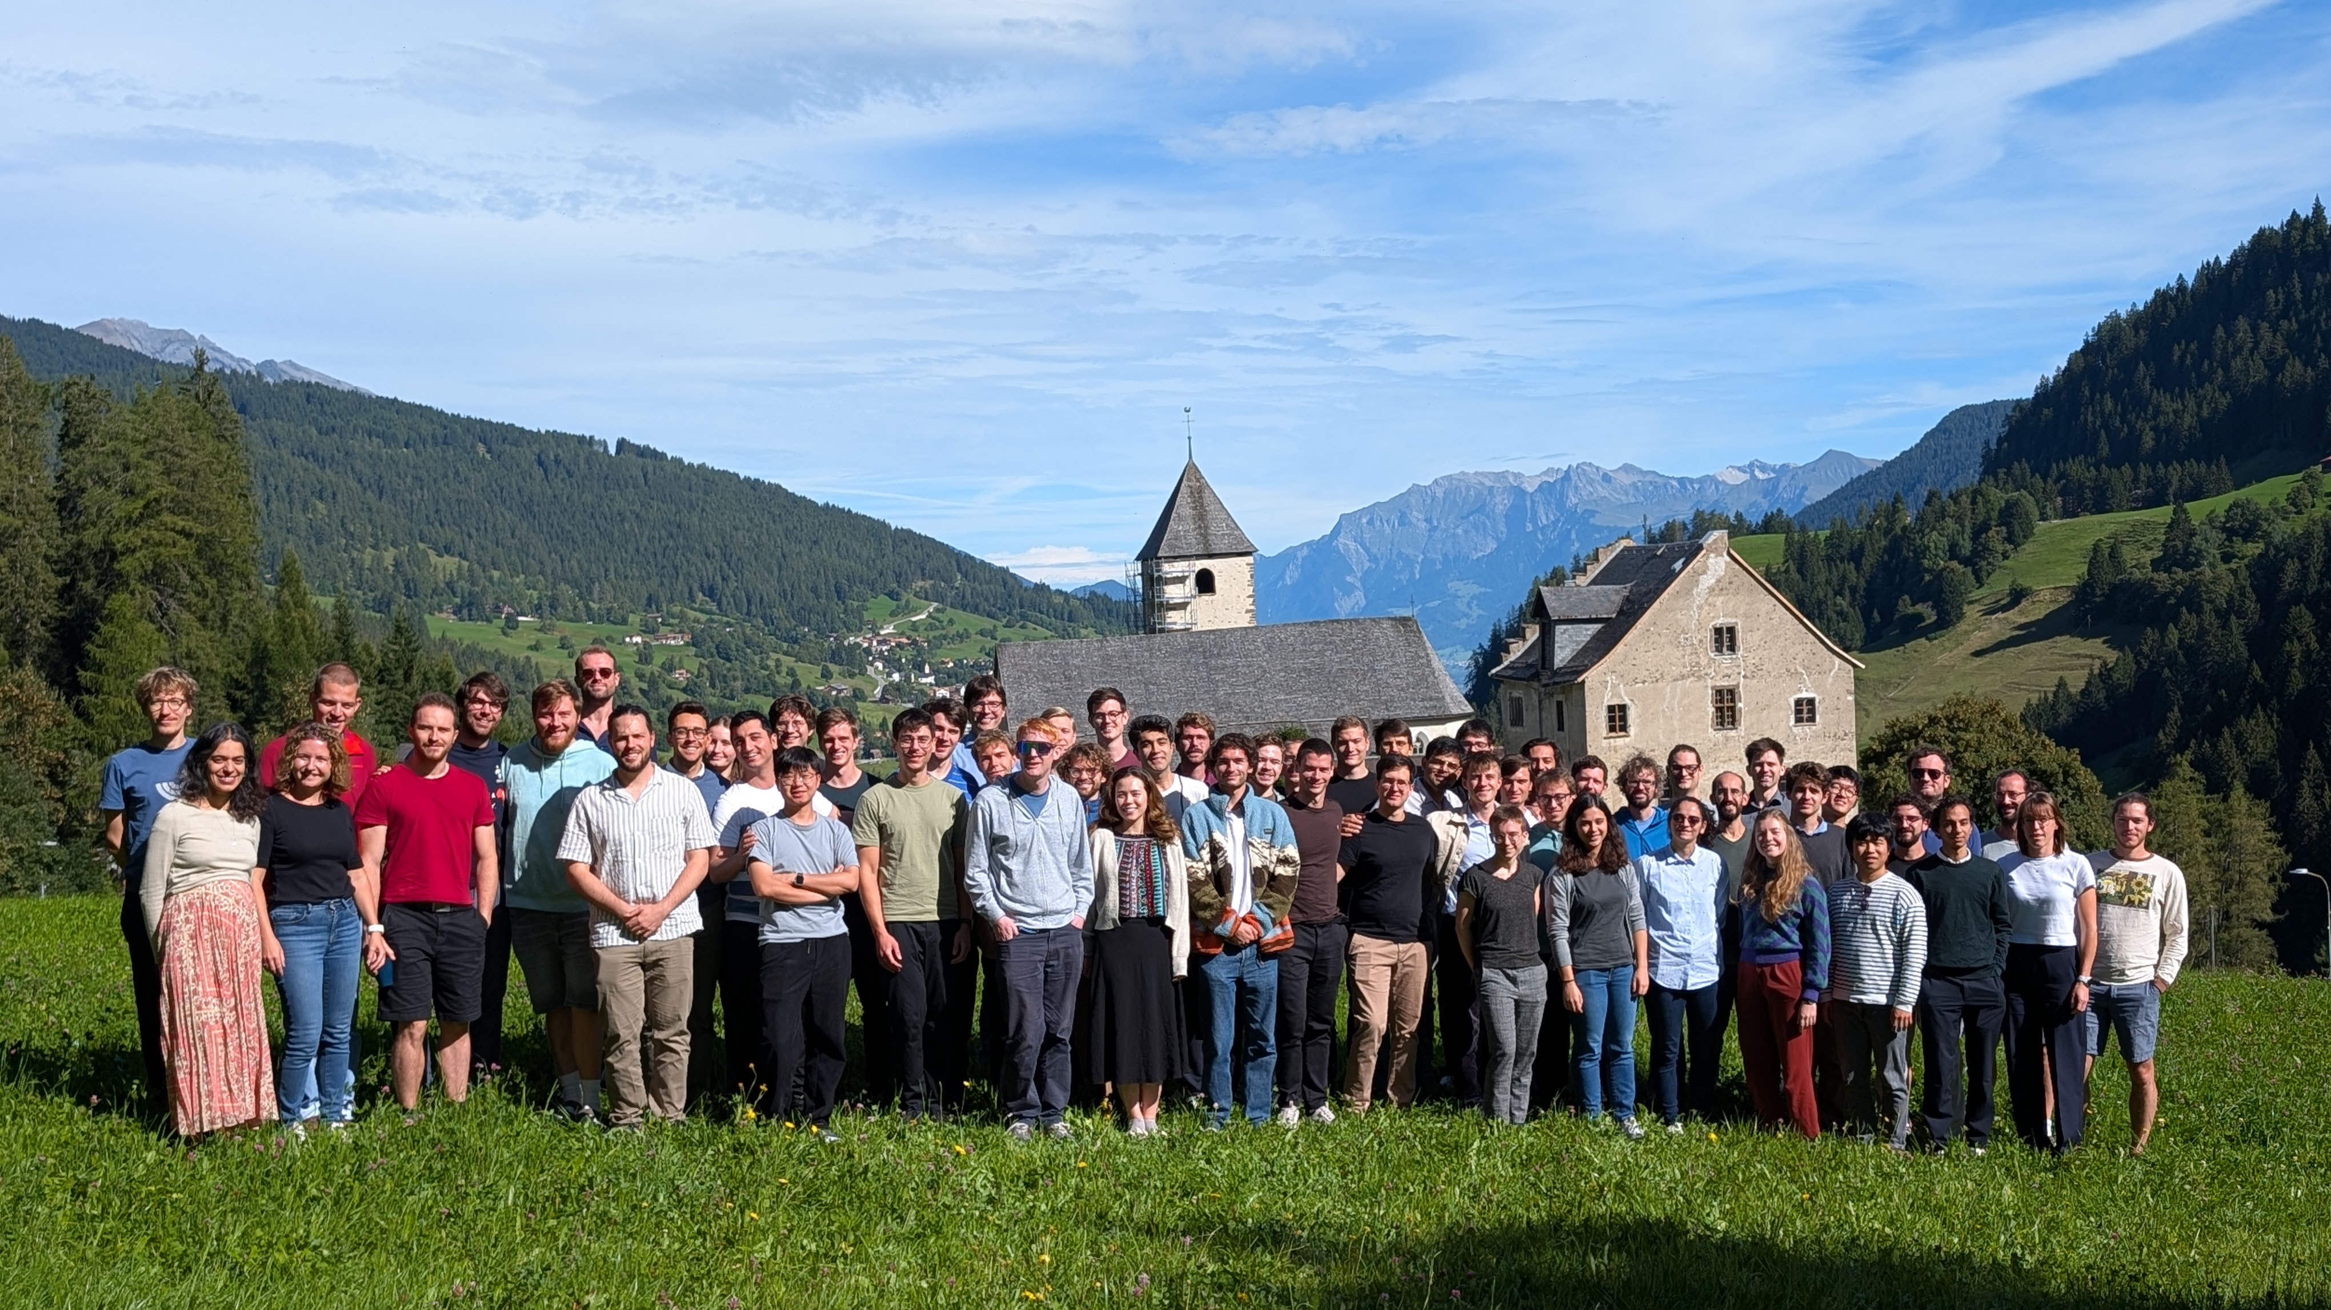

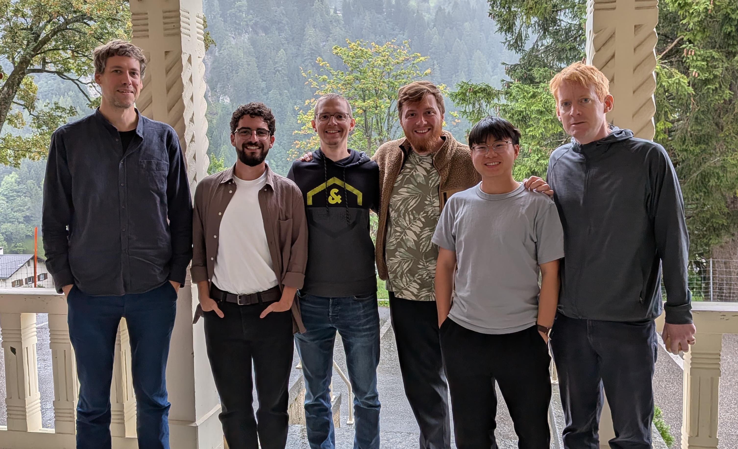
Jonathan Home
David Holzapfel
New group: Diana Aude Craik
Measuring parity violation and isotope shifts in entangled barium ions
Daniel Kienzler
Foivos Vouzinas
Qianlong He
tiqi.ethz.ch
Trapped Ion Quantum Information Group

Slide 14
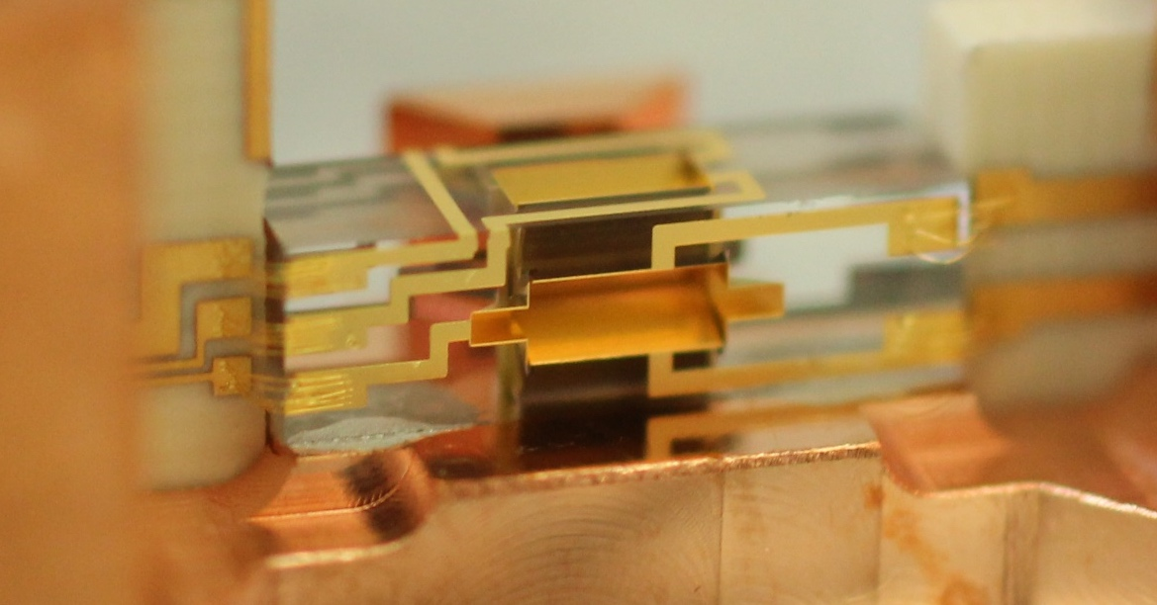
Thank you for your attention
N. Schwegler et al., PRL 131, 133003 (2023)
D. Holzapfel et al., PRX 15, 031009 (2025)
H. J. Kim et al., arXiv:2509.03625 (2025)
Be⁺
H₂⁺
0.8 Hz

Slide 15
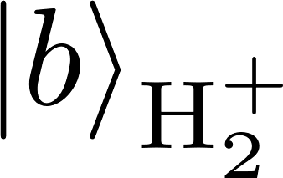

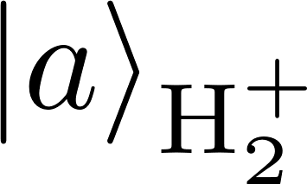
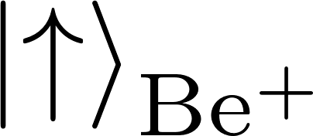

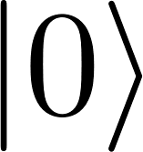

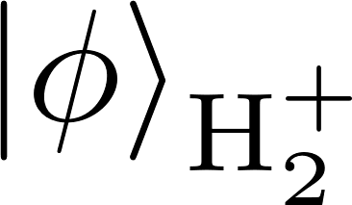
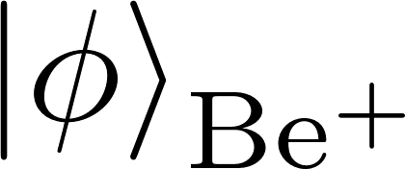
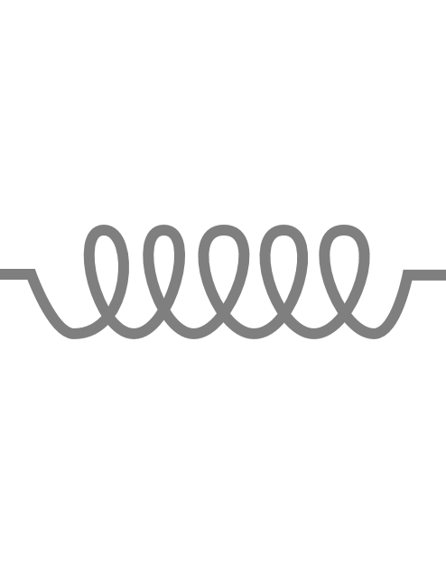
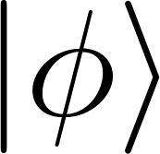
Quantum logic state detection
& pumping
H₂⁺
Be⁺
State-dependent
fluorescence
Repump
Shared motion
1050 nm
313 nm
Laser pulse maps internal state of H₂⁺ onto shared motion
Laser pulse maps motional state onto internal state of Be⁺
Motional ground state
P. O. Schmidt et al., Science 309, 749 (2005)

Slide 16

Radial motion: Exchange Doppler cooling
Large mass-mismatch between Be⁺ (9 amu) and H₂⁺ (2 amu)
Bad sympathetic cooling of H₂⁺ radial modes
Dephasing of signals (Debye-Waller effect)
H₂⁺
radial 1
axial
radial 2
Population
313 nm
Doppler cooling
Be⁺
1050 nm
1D optical lattice
Parametric drive at
$$δω_{EXCH}=ω_{radial}−ω_{axial}$$
Using electric fields: D. J. Gorman et al., Phys. Rev. A 89, 062332 (2014)
Using internal states: S. A. King et al., Phys. Rev. X 11, 041049 (2021)

Slide 17
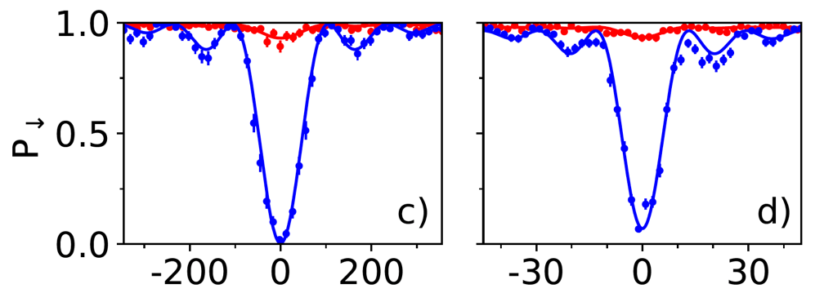

Ground state cooling and quantum logic
N. Schwegler et al., Phys. Rev. Lett 131, 133003 (2023)
Trap axis
in-phase mode
@ 1.3 MHz
out-of-phase mode
@ 3.4 MHz
Ground-state cooled
Raman
1050 nm
Raman
313 nm
Laser pulse maps internal state of H₂⁺ onto shared motion
Laser pulse maps motional state onto internal state of Be⁺
Motional ground state
P. O. Schmidt et al., Science 309, 749 (2005)

