Slide 1


Progress towards precision measurement of muon-electron elastic scattering: the MUonE experiment
Fred Gray for the MUonE Collaboration
PSI2025 Workshop
September 10, 2025
The Regis University group is funded by the National Science Foundation under grant number 2209486.

Slide 2
Connecting energy scales
Probe
Energy
Scale
Physics
Energy
Scale
2

Slide 3

Reminder: Muon g-2
Thanks to Simon Corrodi for a great talk on our final experimental result on Monday!
3

Slide 4
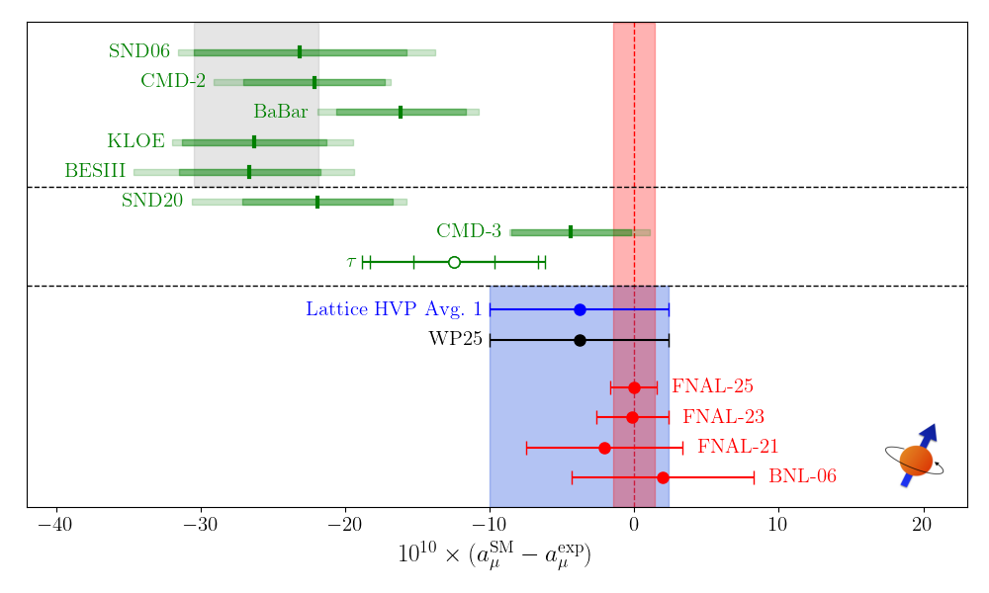
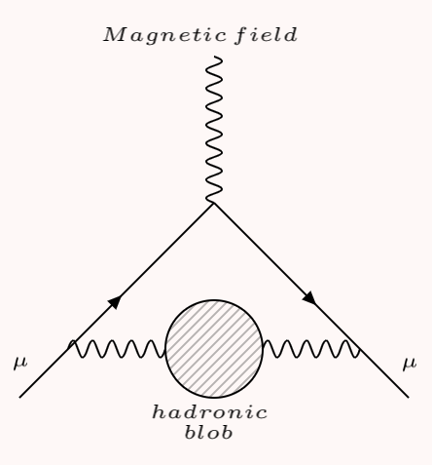
MUonE: Motivated by Muon g-2 anomaly
Different methods used to determine hadronic
vacuum polarization
contribution:
e⁺ e – → hadrons
hadronic τ decay
lattice QCD
Experimental results
~73%
from π⁺π –
Images:
R. Aliberti et al. [Muon g-2 Theory Initiative], https://muon-gm2-theory.illinois.edu/white-paper-25/#summary-plots
D. Garisto, “The Many Paths of Muon Math,” Symmetry (2020), https://www.symmetrymagazine.org/article/the-many-paths-of-muon-math
4

Slide 5
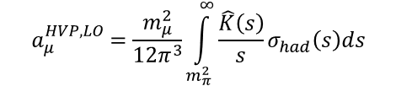
Data-driven evaluation from e⁺ e– collisions: resonances
$$R\left(s\right)= σhad/σ(e^{+} e^{−}→μ^{+} μ^{−})$$
Dispersion relation:
$$a_{μ}^{HVP,LO}=\frac{m_{μ}^{2}}{12π^{3}}\int_{m_{π}^{2}}^{∞}{\frac{\hat{K}\left(s\right)}{s}σ_{had}\left(s\right)ds}$$
Images:
D. Garisto, “The Many Paths of Muon Math,” Symmetry (2020), https://www.symmetrymagazine.org/article/the-many-paths-of-muon-math
T. Aoyama et al. [Muon g-2 Theory Initiative], Physics Reports 887 (2020)
5

Slide 6
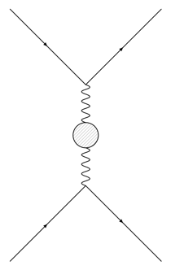
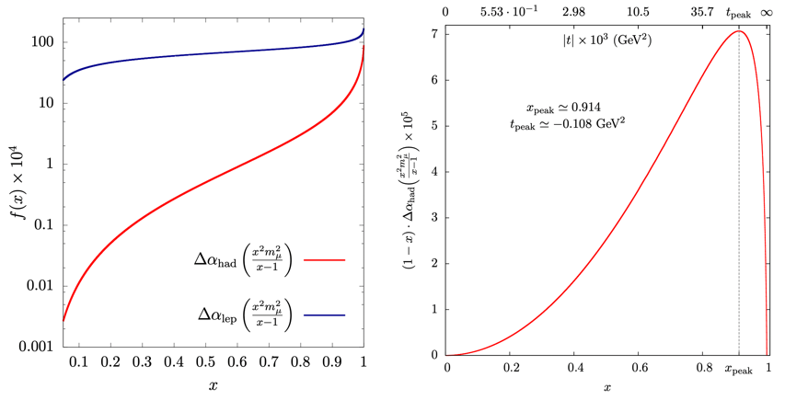
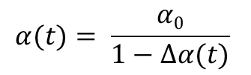
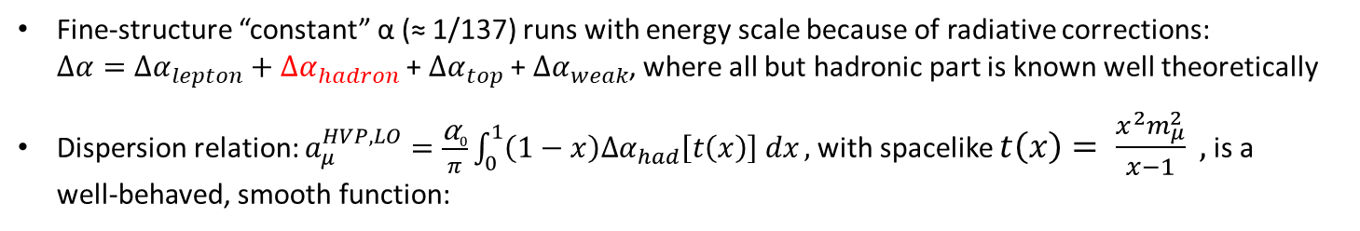
No resonances in running of ⍺
Fine-structure “constant” α (≈ 1/137) runs with energy scale because of radiative corrections:
$Δα={Δα}_{lepton}+{Δα}_{hadron}$ + ${Δα}_{top}$ + ${Δα}_{weak}$, where all but hadronic part is known well theoretically
Dispersion relation: $a_{μ}^{HVP,LO}=\frac{\text{⍺}0}{π}\int_{0}^{1}{\left(1−x\right){∆α}_{had}\left[t\left(x\right)\right] dx},$with spacelike $t\left(x\right)= \frac{x^{2}m_{μ}^{2}}{x−1} ,$ is a
well-behaved, smooth function:
t
Hadronic
blob
$$α(t)= \frac{α0}{1−Δα(t)}$$
6
Images: G. Abbiendi et al. (MUonE Collaboration), Letter of Intent: The MUonE Project

Slide 7
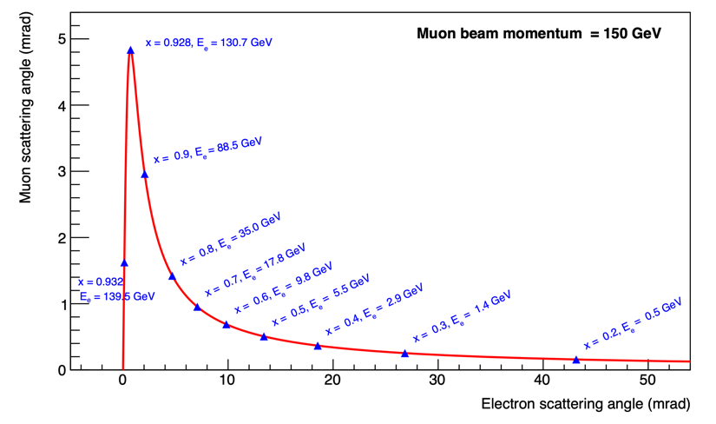

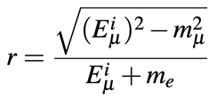

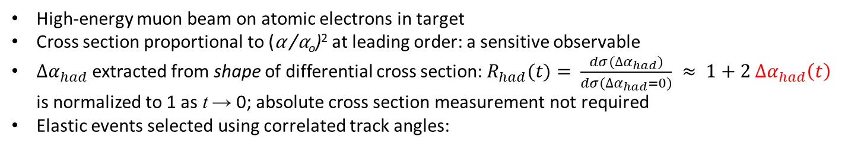
Measuring ⍺ via elastic muon-electron scattering
High-energy muon beam on atomic electrons in target
Cross section proportional to (⍺ /⍺_{o})² at leading order: a sensitive observable
${∆α}_{had}$ extracted from shape of differential cross section: $R_{had}(t)= \frac{dσ({∆α}_{had})}{dσ({∆α}_{had}=0)} ≈ 1+2 {∆α}_{had}\left(t\right)$
is normalized to 1 as t → 0; absolute cross section measurement not required
Elastic events selected using correlated track angles:
from experiment
from Monte Carlo
Elastic kinematics:
t is determined entirely by
electron energy:
electron energy is determined
by track angle and incident muon
energy:
μ-e track ambiguity region
7
Image: G. Abbiendi et al. (MUonE Collaboration), Letter of Intent: The MUonE Project

Slide 8
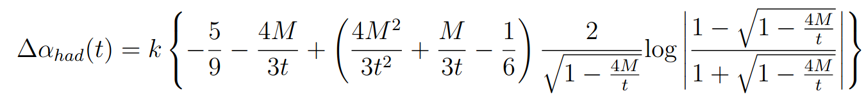
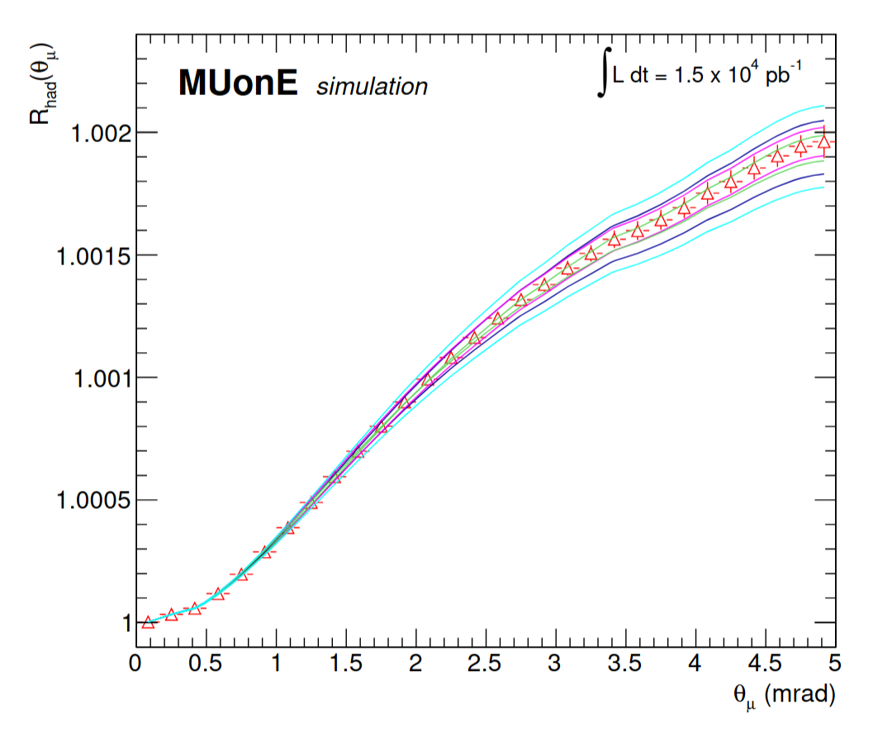
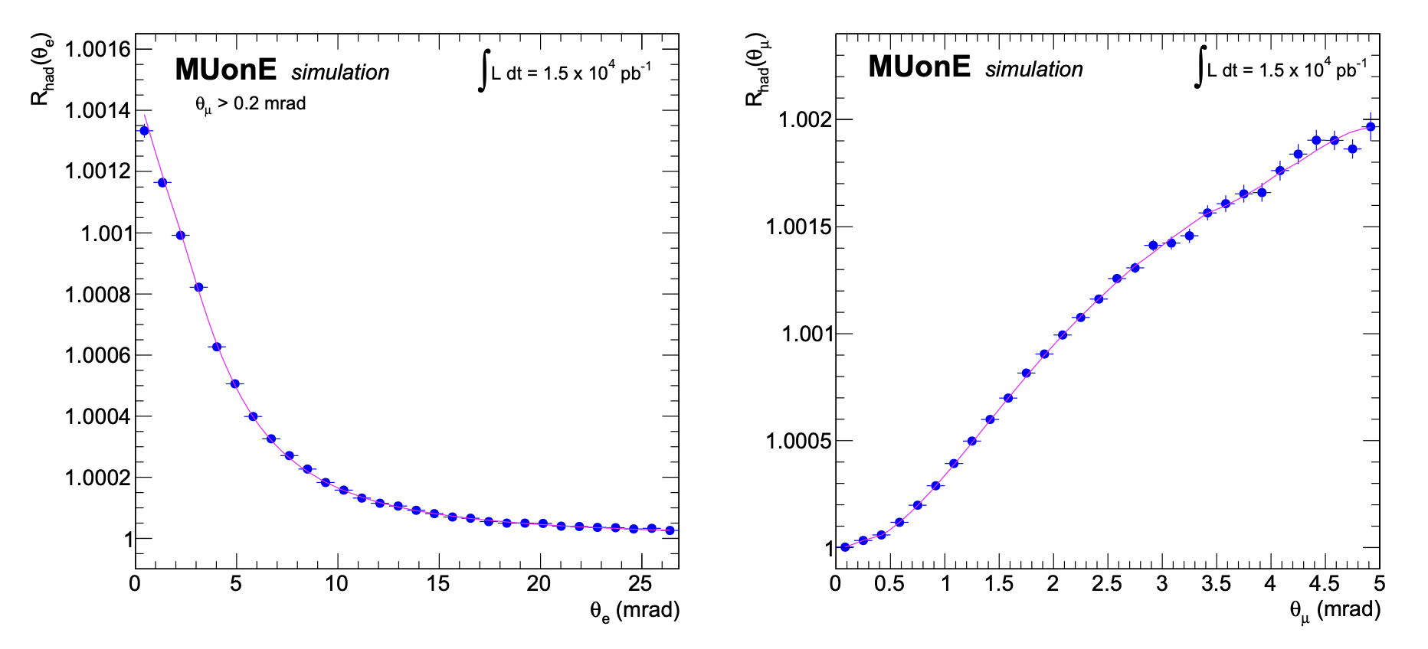
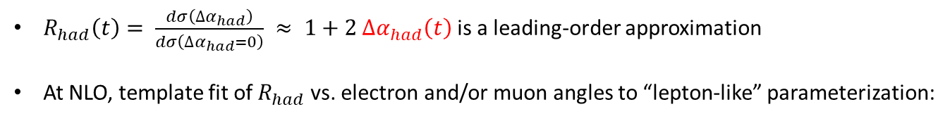
Template fit method
$R_{had}\left(t\right)= \frac{dσ\left({∆α}_{had}\right)}{dσ\left({∆α}_{had}=0\right)} ≈ 1+2 {∆α}_{had}\left(t\right)$ is a leading-order approximation
At NLO, template fit of $R_{had}$ vs. electron and/or muon angles to “lepton-like” parameterization:
8
Images: G. Abbiendi. “Status of the MUonE experiment,” Phys. Scripta 97.5 (2022), 054007

Slide 9
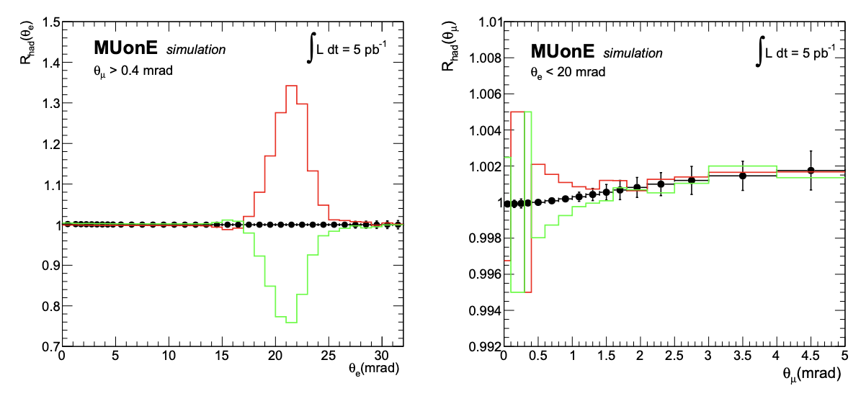
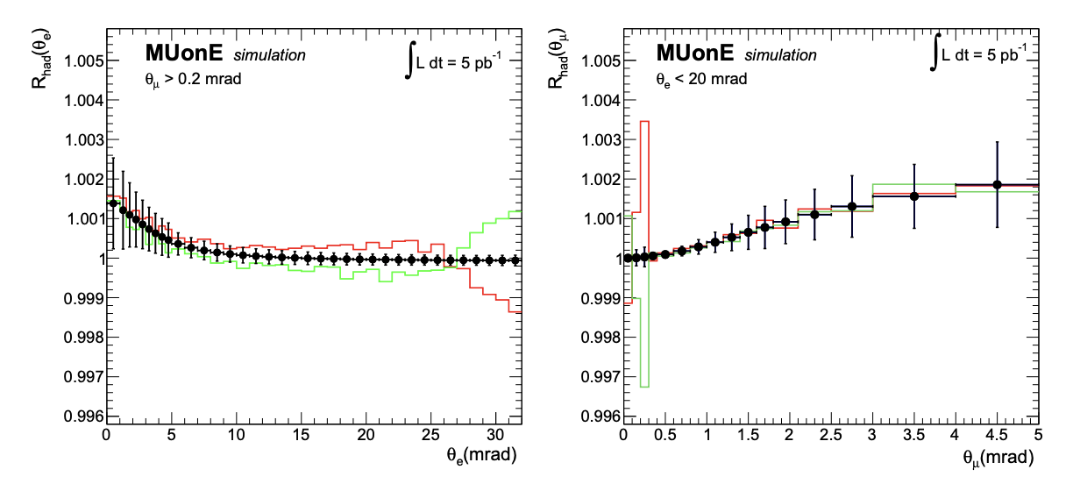
Backgrounds and systematics
Dominant background: lepton pair production from nuclear scattering and (less) from electron scattering
  Calculated exactly at tree level and included in MESMER Monte Carlo event generator
Beam energy needs to be known to few-MeV scale
  Added beam momentum spectrometer to last bend section of beamline
Mechanical stability of tracker needed at 10 µm scale
Angular resolution…
…but will also need to be characterized at 10 ppm level
..and multiple scattering errors have clear signatures:
+10%
-1%
-10%
+1%
9
Images: G. Abbiendi. “Status of the MUonE experiment,” Phys. Scripta 97.5 (2022), 054007

Slide 10
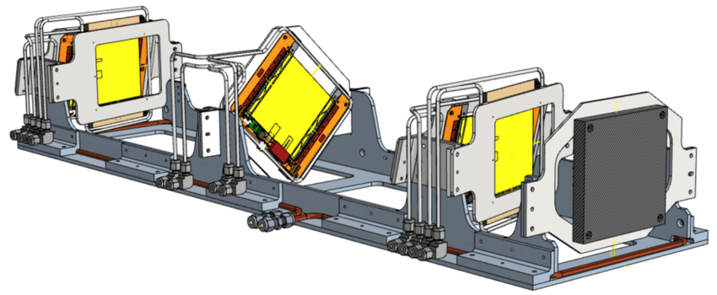
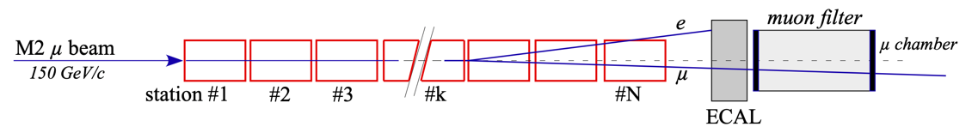
MUonE tracking stations
Scattering target: 20 mm graphite
3 pairs of “2S” silicon strip modules* for
CMS Phase-2 (HL-LHC) outer tracker upgrade,
assembled by the CMS collaboration
  10 × 10 cm² active area, 320 µm thick
  90 µm strip pitch
  26 µm nominal spatial resolution (σ_{x})
  two planes for same coordinate separated
  by 1.8 mm: rejects backgrounds and
  large-angle tracks
  x/y and u/v modules separated from each
  other by a few cm
~ 1 m
* CMS-TDR-014, https://cds.cern.ch/record/2272264
Some modules are tilted to reduce effective strip pitch and improve spatial resolution
Frames made from Invar iron/nickel alloy to maintain dimensional stability within 10 µm
Extensible design: Each station measures incident muon momentum for the one that follows:
160 GeV/c
50 MHz
10
Images: G. Abbiendi et al. (MUonE Collaboration), Letter of Intent: The MUonE Project

Slide 11
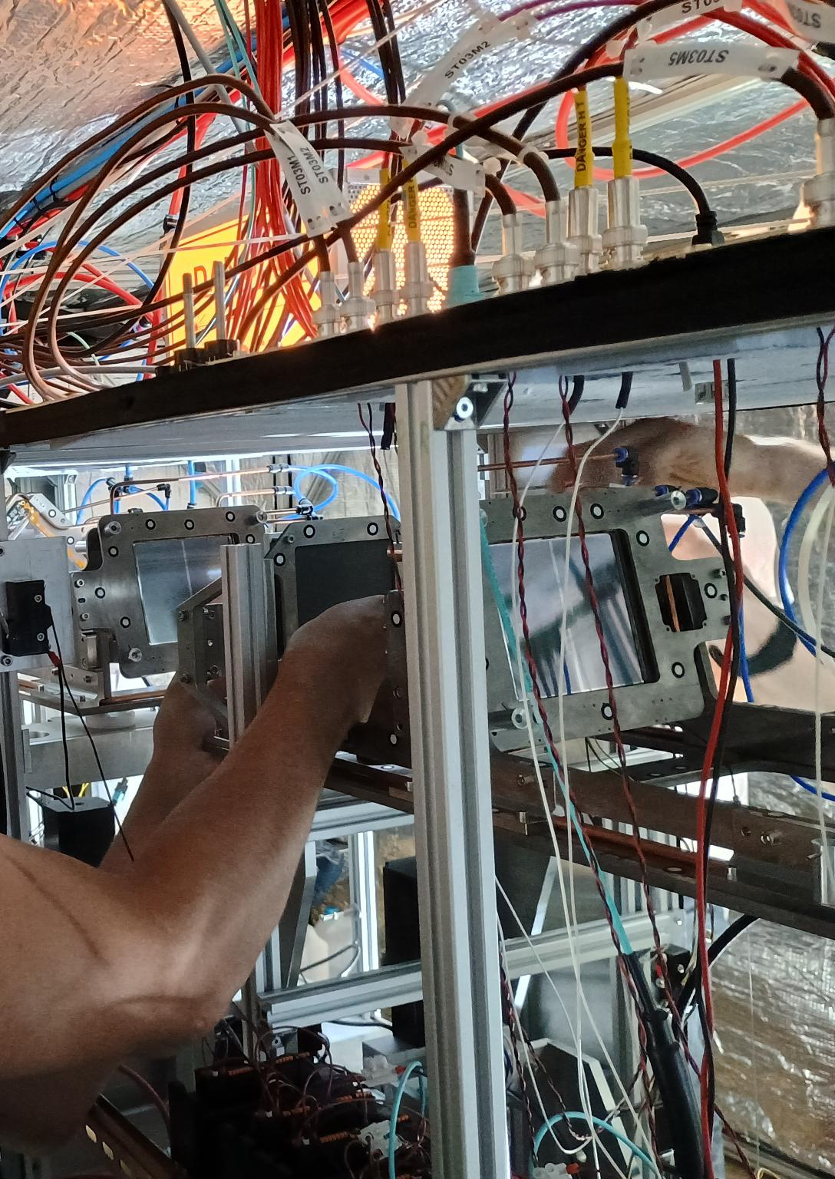
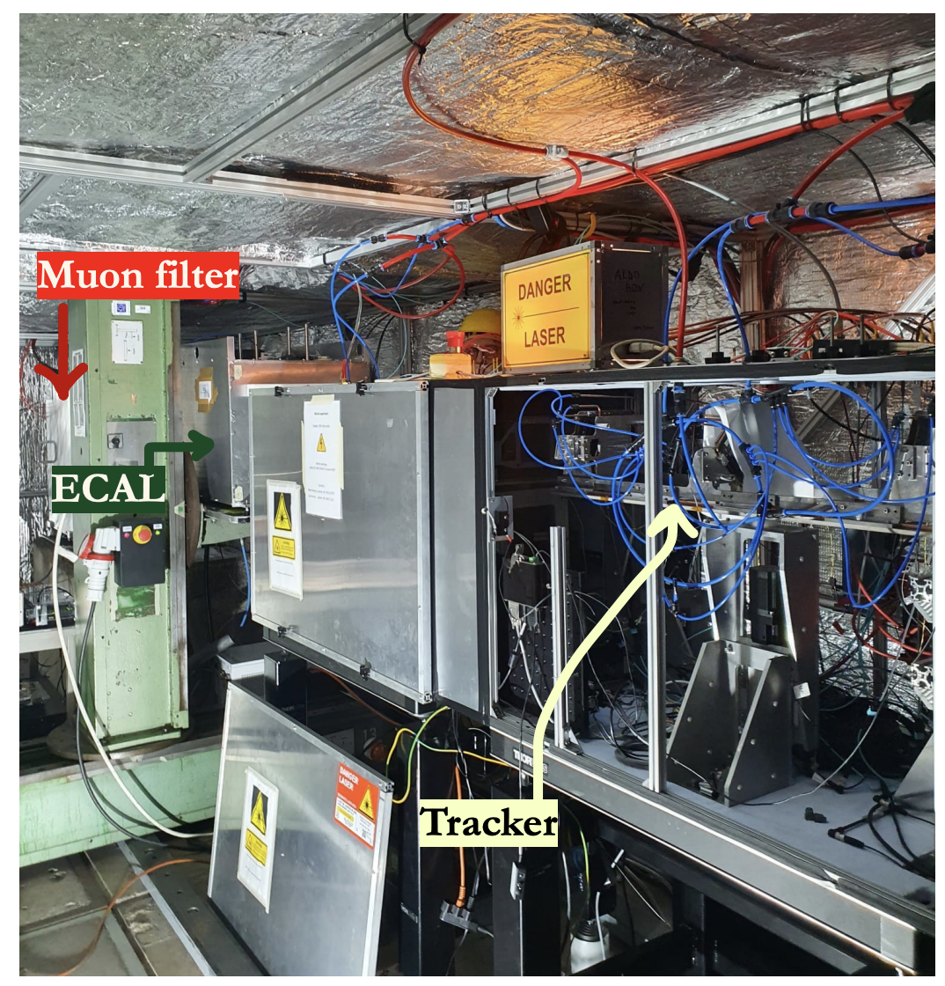
Beyond the CAD drawing…
11

Slide 12
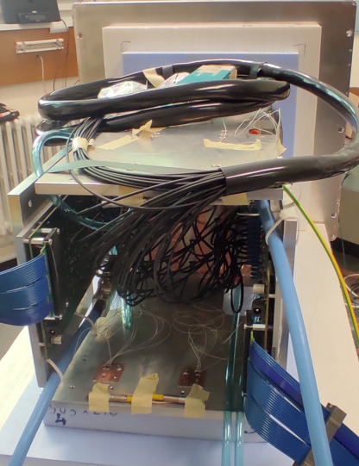
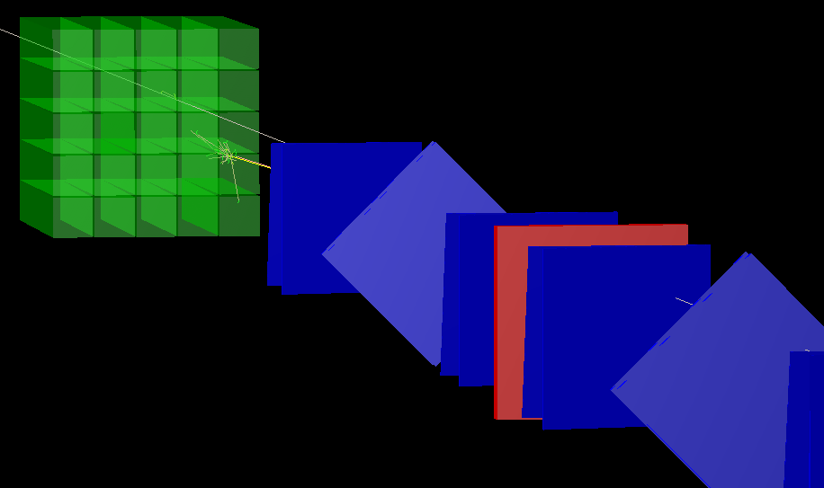
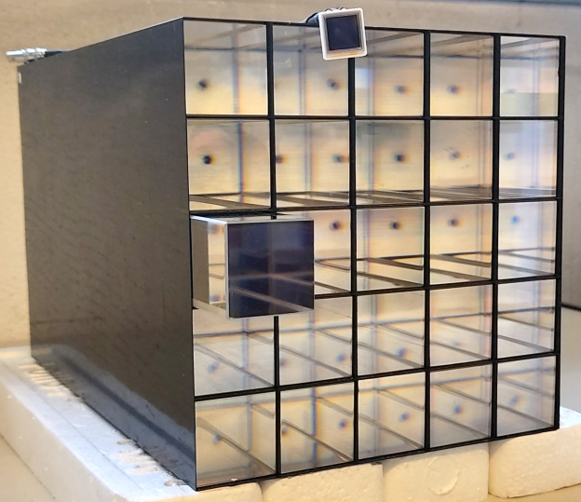
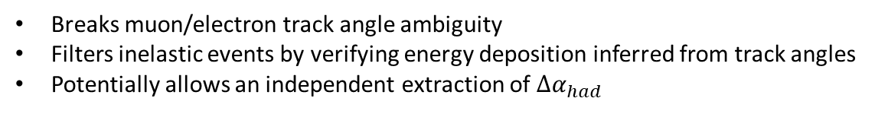
Electromagnetic calorimeter
Breaks muon/electron track angle ambiguity
Filters inelastic events by verifying energy deposition inferred from track angles
Potentially allows an independent extraction of ${∆α}_{had}$
Grey muon track
Yellow electron track
Red target
Lead tungstate (PbWO₄) crystals from CMS endcap: 2.85 × 2.85 cm², 22 cm long (25 X₀ ), read out by APDs
Current prototype is 5x5 crystals; final dimension being studied
12

Slide 13
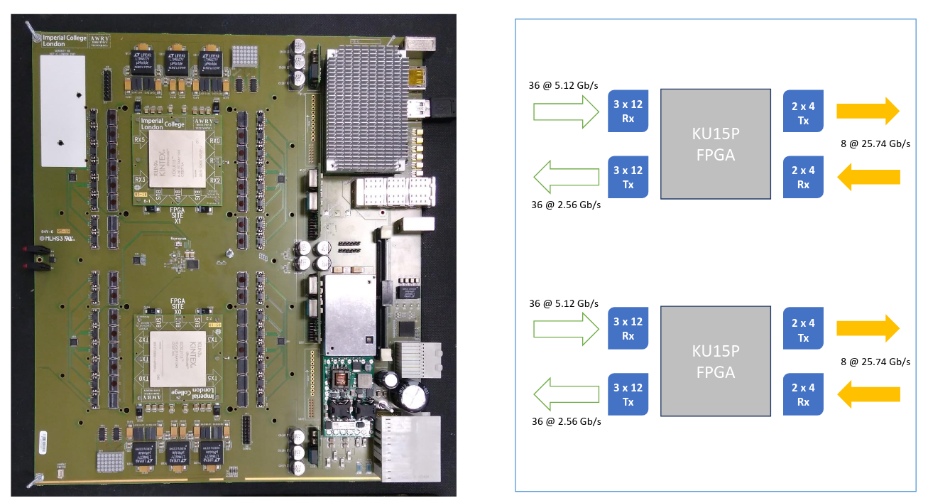
Data Acquisition
CMS Serenity platform:
Collects synchronous data at
40 MHz over lpGBT optical links from
  up to 30 2S modules
  ECAL (10 ADC samples/crystal)
  Timing scintillators
50 MHz muon beam, but most muons
do not interact.
Real-time event filtering categorizes muon interactions based on “stub” counts in each module,
with ~400 kHz total trigger rate:
  Single muon interactions in each target
  Pileup (2, 3, or 4 muon) interactions in each target
  Single passing muons (prescaled)
  Unbiased random sample
13

Slide 14
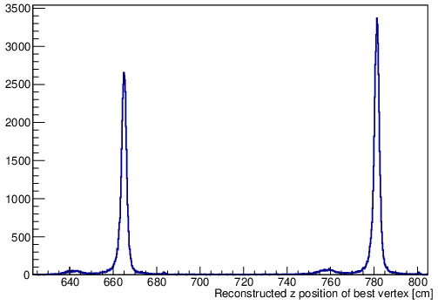
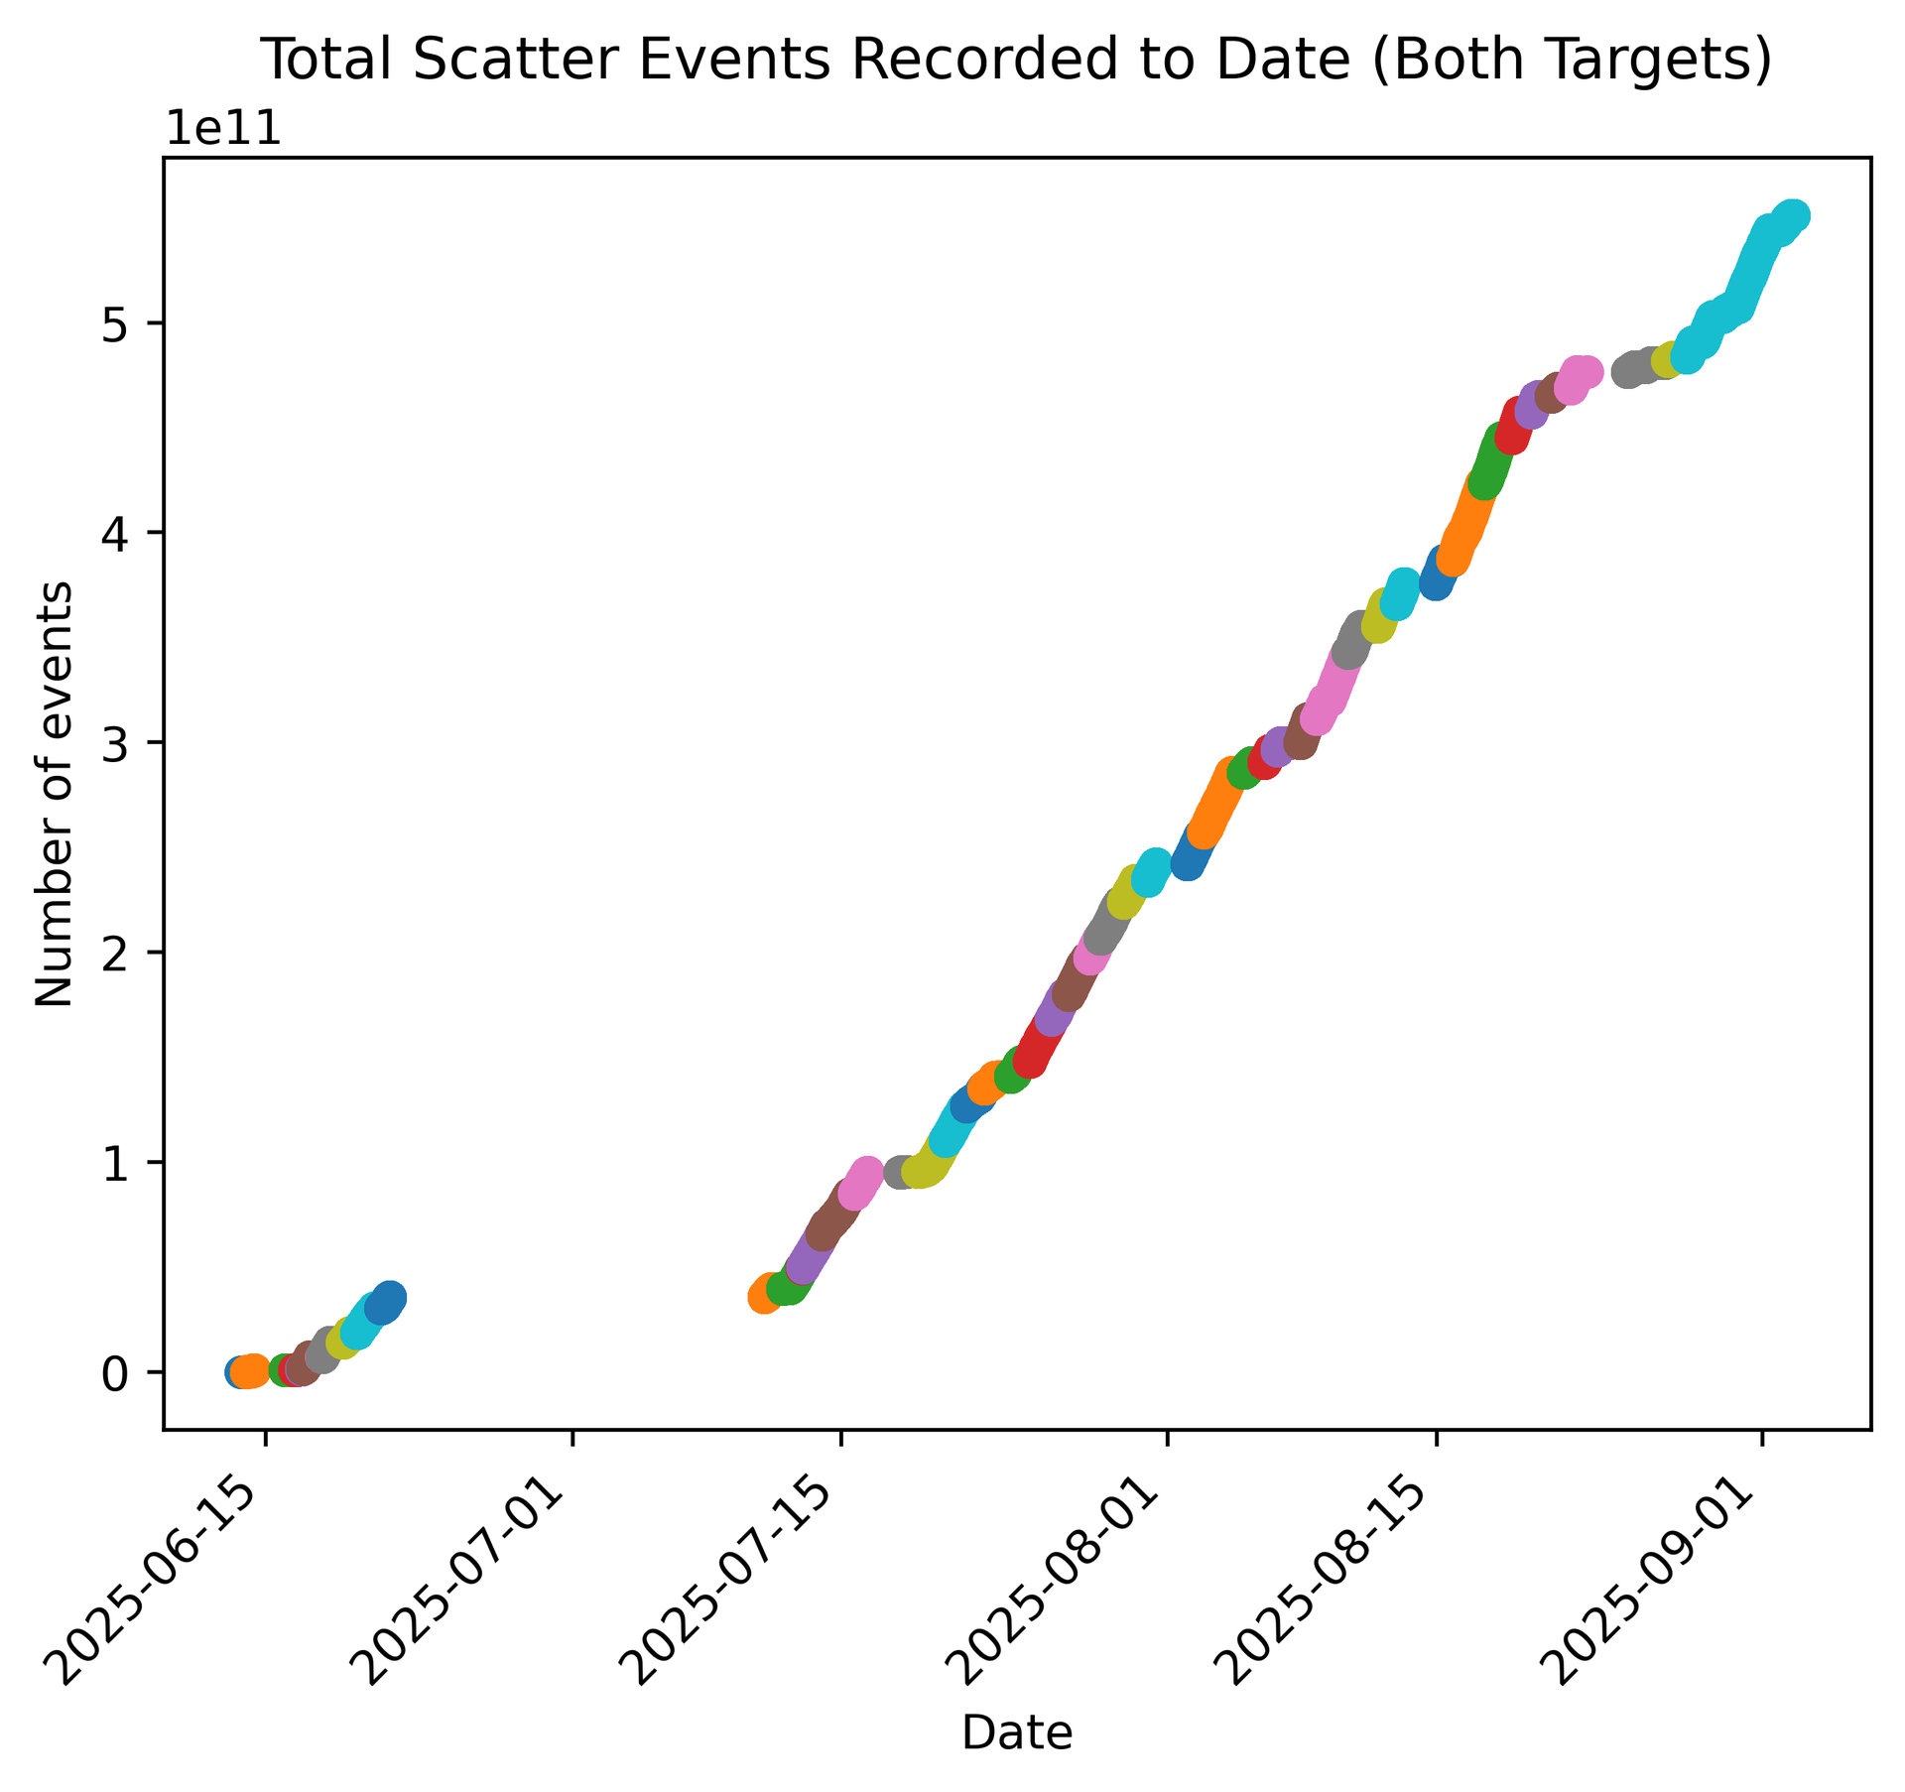
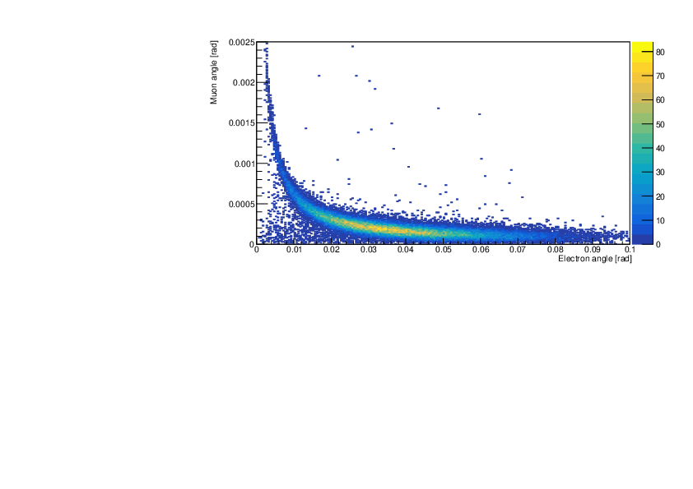
Phase 1 run just completed
Physics goals: confirmation of ${∆α}_{lepton}$ and ~20% measurement of ${∆α}_{had}$, requiring O(10⁹) events
Beam momentum spectrometer, 3 tracking stations (with 2 targets), ECAL, muon filter
Accumulated DAQ triggers
First look at small sample of
very new data
Single-muon interaction trigger plus simple cuts on
vertex χ² and track coplanarity
14

Slide 15
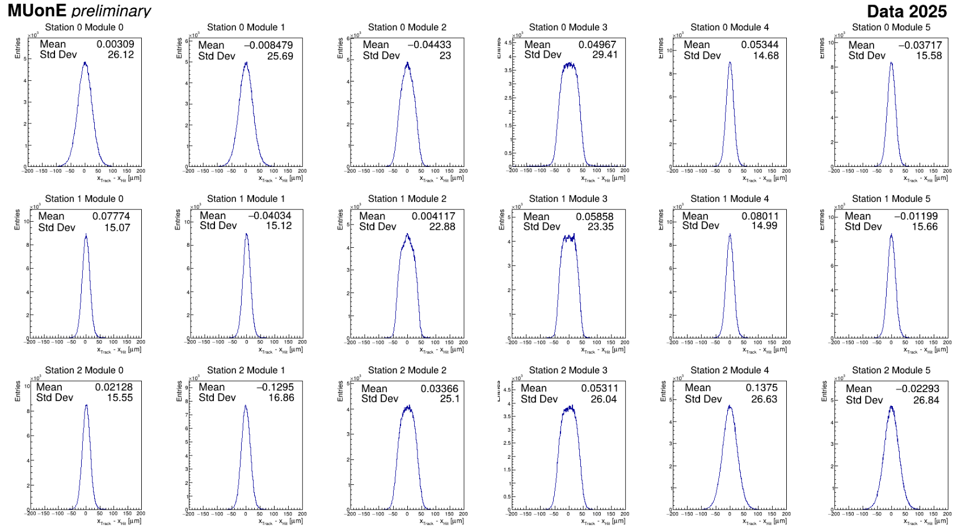
Excellent tracker performance
15

Slide 16
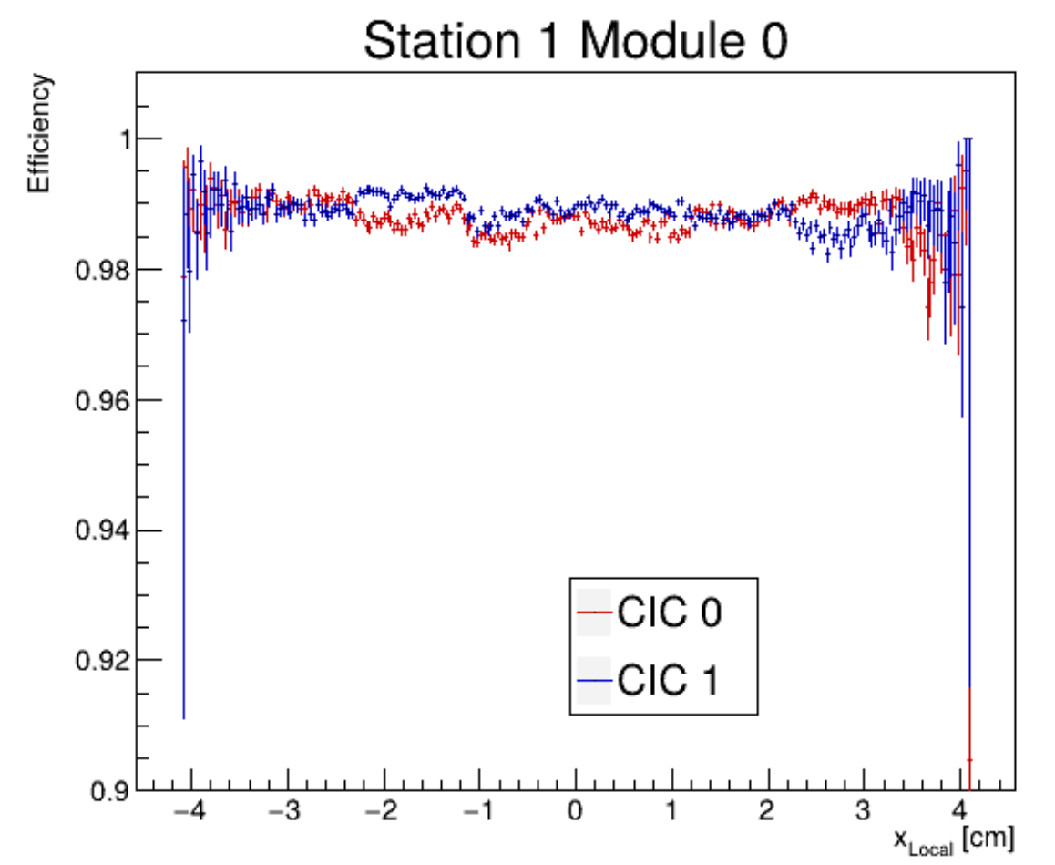
Excellent tracker performance
16

Slide 17
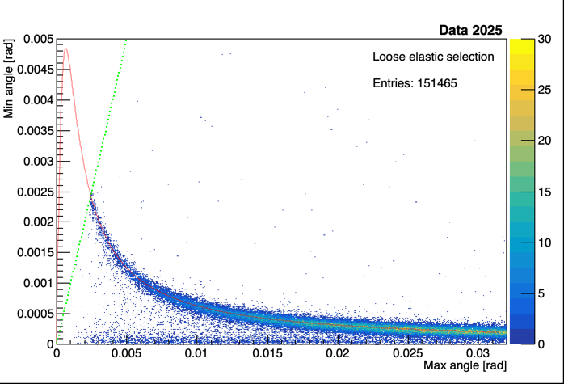
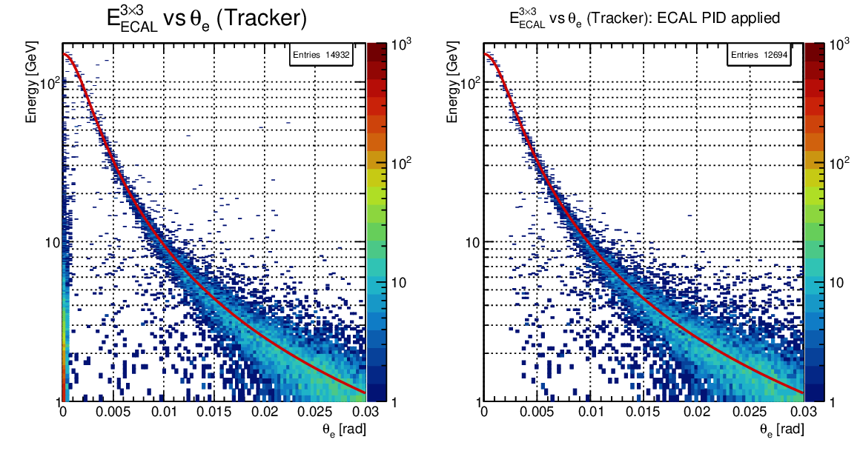
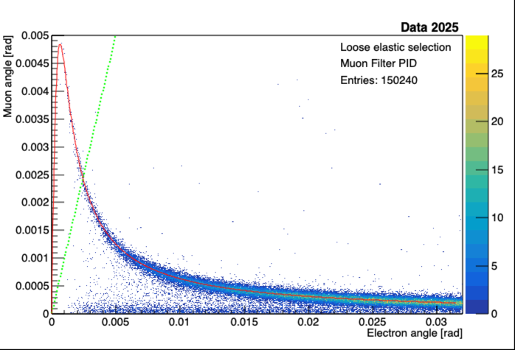
Particle ID with muon filter and with ECAL
All still very preliminary analysis!!!
17

Slide 18
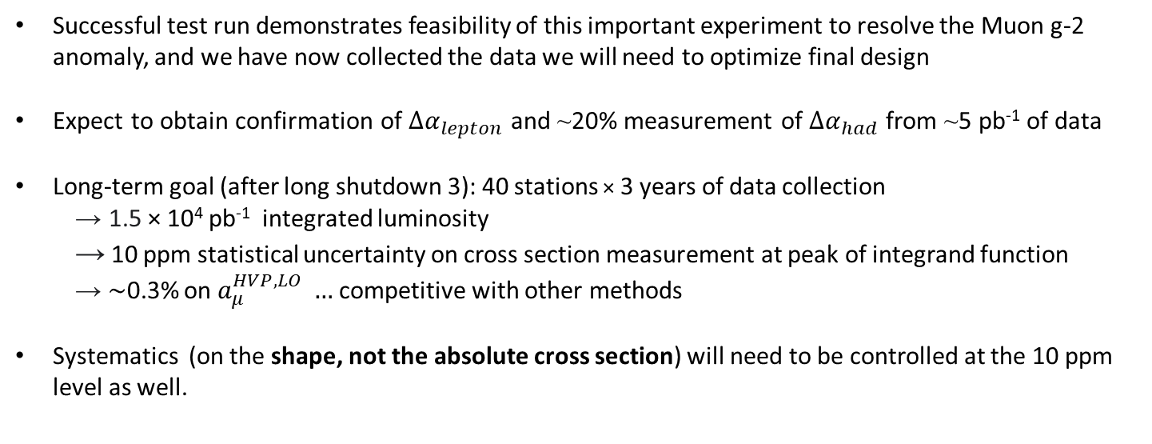
Conclusions and future plans
Successful test run demonstrates feasibility of this important experiment to resolve the Muon g-2 anomaly, and we have now collected the data we will need to optimize final design
Expect to obtain confirmation of ${∆α}_{lepton}$ and ~20% measurement of ${∆α}_{had}$ from ~5 pb⁻¹ of data
Long-term goal (after long shutdown 3): 40 stations × 3 years of data collection
→ 1.5 × 10⁴ pb⁻¹ integrated luminosity
→ 10 ppm statistical uncertainty on cross section measurement at peak of integrand function
→ ∼0.3% on $a_{μ}^{HVP,LO} …$ competitive with other methods
Systematics (on the shape, not the absolute cross section) will need to be controlled at the 10 ppm level as well.
18

Slide 19








A strong collaboration (but open to new members!)
INFN sections: Bologna, Milano-Bicocca, Padova, Perugia, Pisa, Trieste
CERN
Cornell U., Northwestern U., Regis U., U. of Virginia
Inst. of Nuclear and Particle Physics Demokritos
ETH Zürich, PSI (theory groups)
Imperial College, U. of Liverpool
Inst. of Nuclear Physics Kraków
Peking U., Shanghai Jiao Tong U.
19

