Slide 1
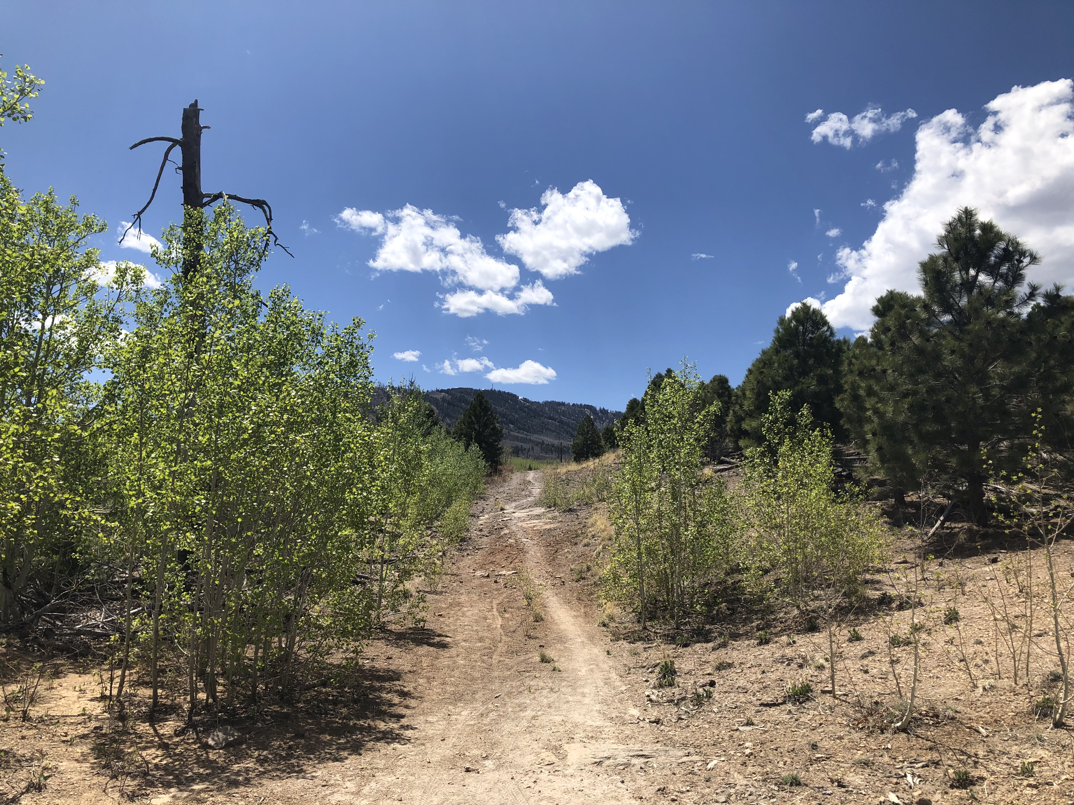

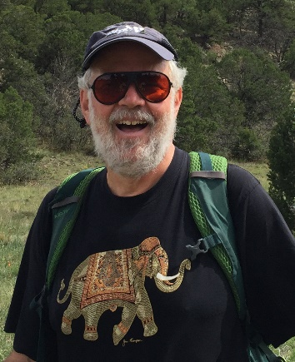

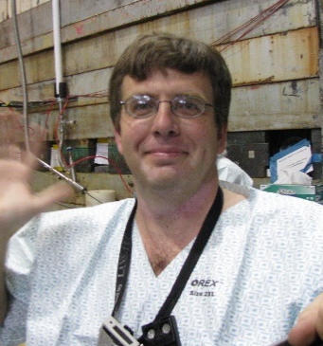
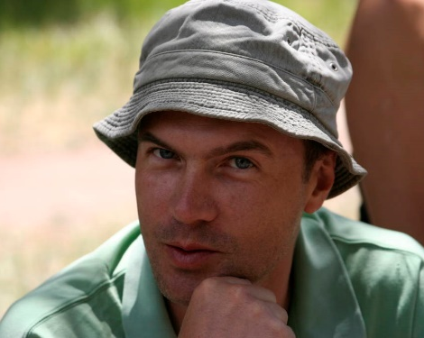
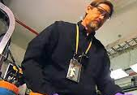


70 years of muon radiography: a biased historical overview
Physics of fundamental Symmetries and Interactions - PSI2025
Chris Morris
Los Alamos National Laboratory, Los Alamos, NM 87545
4 November 2024
Abstract The history and status of muon tomography and radiography will be presented.
Managed by Triad National Security, LLC, for the U.S. Department of Energy’s NNSA.

Slide 2
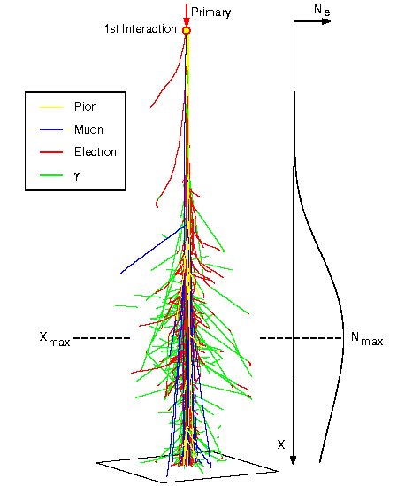
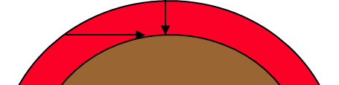
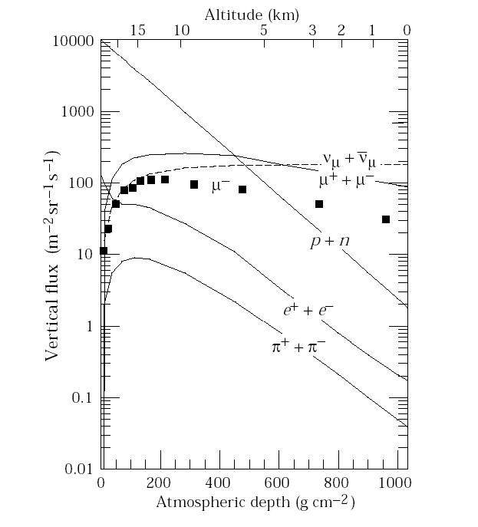
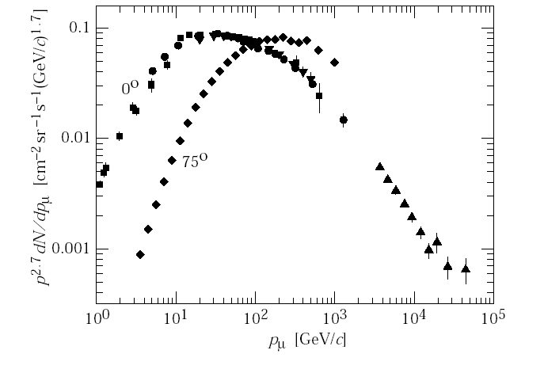
Cosmic-ray muons
• As cosmic rays (mostly protons) strike the upper atmosphere, they interact with atomic nuclei and produce particle cascades. Muons (leptons) can survive and make it to the surface.
• Muons have a large penetrating ability, being able to go through tens of meters of rock with low absorption.
• Muons arrive at a rate of 10,000 per square meter per minute (at sea level).
1936 Carl D. Anderson and Seth Neddermeyer identified but mislabeled muons as mesons
15-20 km

Slide 3
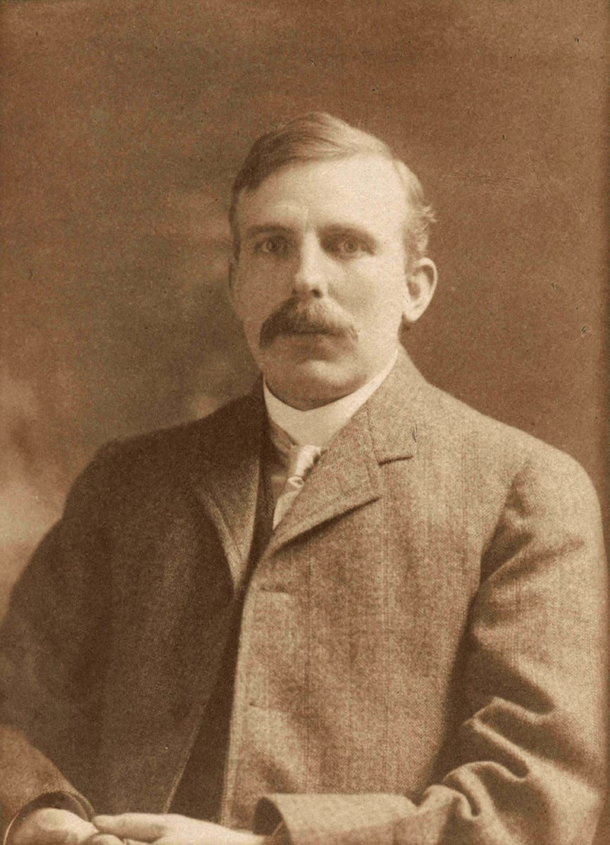
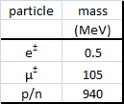
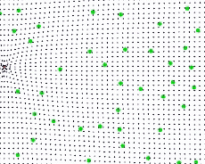

Muon Interaction with Matter
Ernest Rutherford
Kinematics
Coulomb Interaction

Slide 4
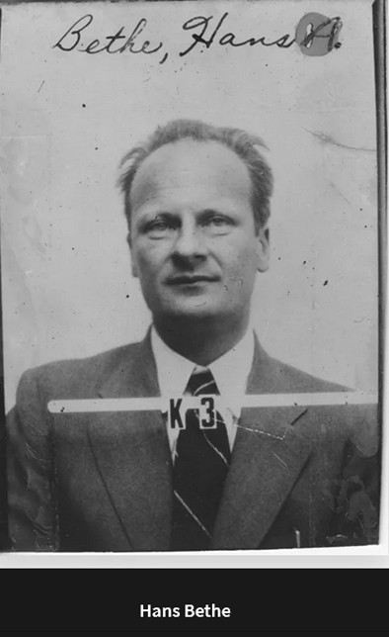
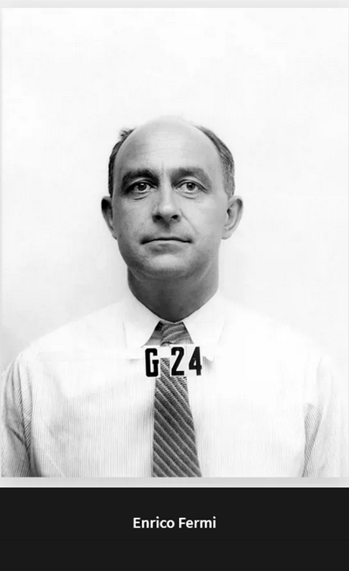
,
Energy Loss (Bethe)
Multiple Scattering (Moleère, Bethe, Fermi)
 | dx/dE | x
 | cm/GeV | cm
Reactor Core | 731.9 | 8.7
Concrete | 254.1 | 15.8
Fe | 88.4 | 9.5
water | 502.5 | 36.0

Slide 5
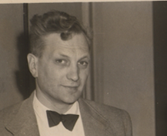
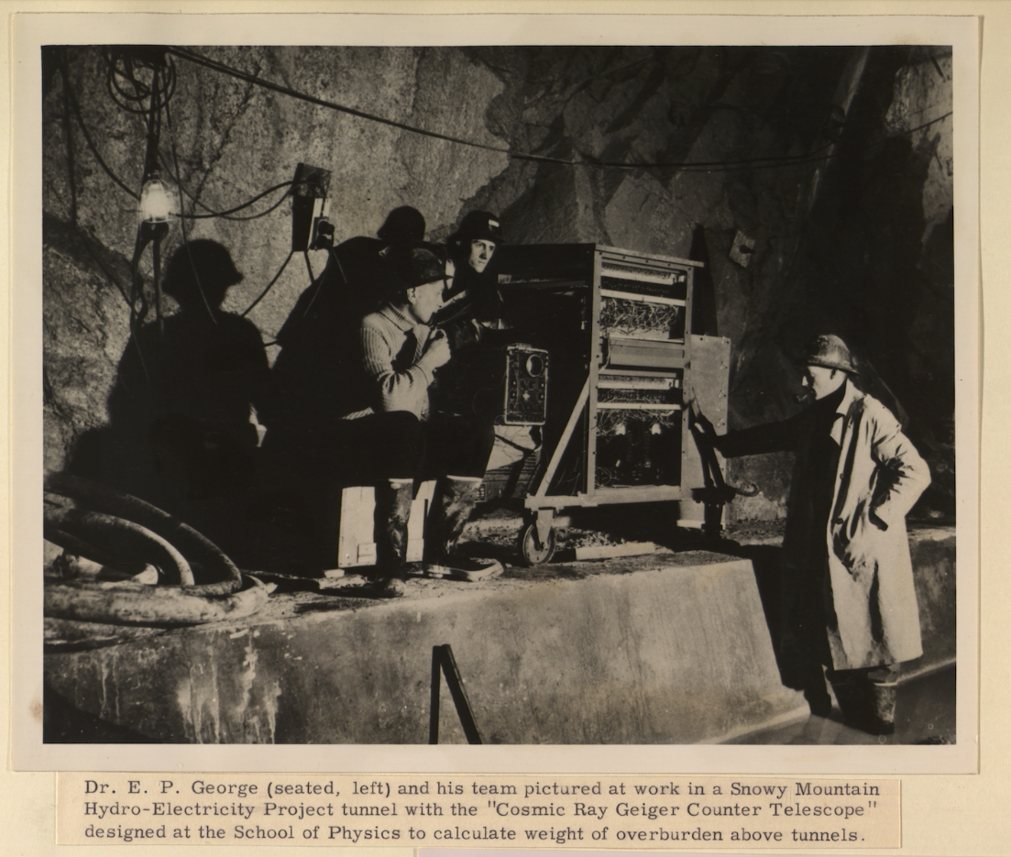
The first use of Muography (1955)
E. George, Commonwealth Engineer 455 (1955).
School of Physics, (1952 to 1966), [REF-00003167]. University of Sydney Archives

Slide 6
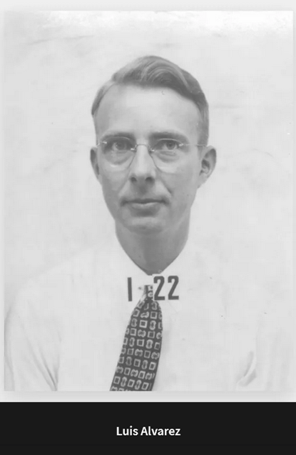
Muon mapping of Chephren’s Pyramid
Science, 167, 832 (1970)
left: actual image
right: simulated image,
with hidden chamber
as in Cheops
There are no hidden chambers of the size of the Kings chamber

Slide 7
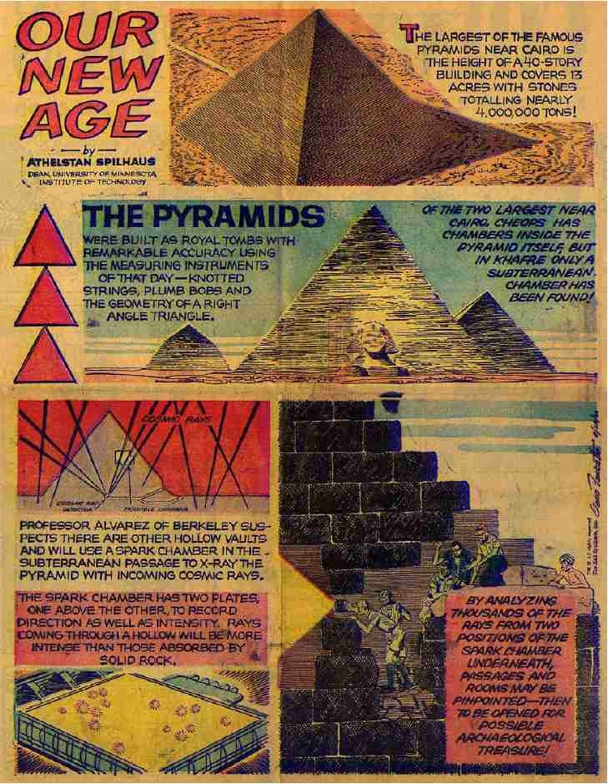
Muon mapping of Chephren’s Pyramid
Science, 167, 832 (1970)
left: actual image
right: simulated image,
with hidden chamber
as in Cheops
There are no hidden chambers of the size of the Kings chamber
Provided by: Roy Schwitters (Our new age 1957-1973)
through John McGill)

Slide 8
Cosmic radiography of a volcano (Nagamini 1994)
Method of probing inner-structure of geophysical substance
with the horizontal cosmic-ray muons and possible application
to volcanic eruption prediction
K. Nagamine a,bj * , M. Iwasaki a, K. Shimomura a, K. Ishida b
a Meson Science Laboratory, Faculty of Science, Uniniuersiloyf Tokyo (UT-ML), Hongo, Bunkyo-ku, Tokyo, Japan
b Muon Science Laboratory, The Institute of Physical and Chemical Research (RIKEN), Wake, Saitama, Japan
Received 4 July 1994; revised form received 12 September 1994

Slide 9
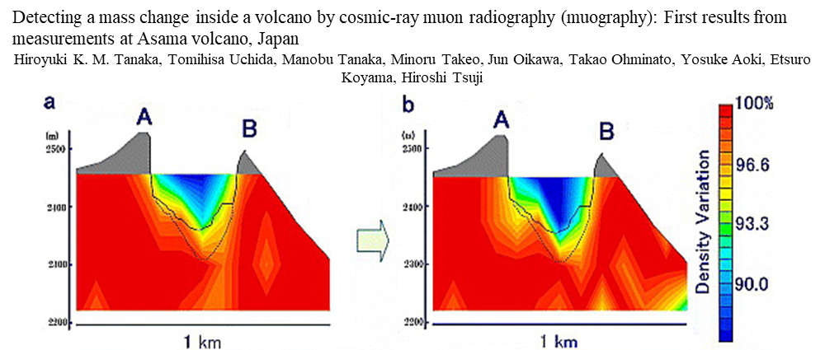
Cosmic radiography of a volcano (Nagamini 1994)
Method of probing inner-structure of geophysical substance
with the horizontal cosmic-ray muons and possible application
to volcanic eruption prediction
K. Nagamine a,bj * , M. Iwasaki a, K. Shimomura a, K. Ishida b
a Meson Science Laboratory, Faculty of Science, Uniniuersiloyf Tokyo (UT-ML), Hongo, Bunkyo-ku, Tokyo, Japan
b Muon Science Laboratory, The Institute of Physical and Chemical Research (RIKEN), Wake, Saitama, Japan
Received 4 July 1994; revised form received 12 September 1994

Slide 10
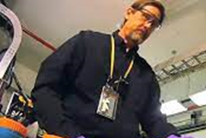
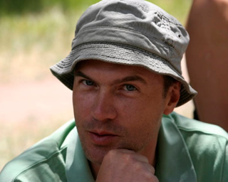
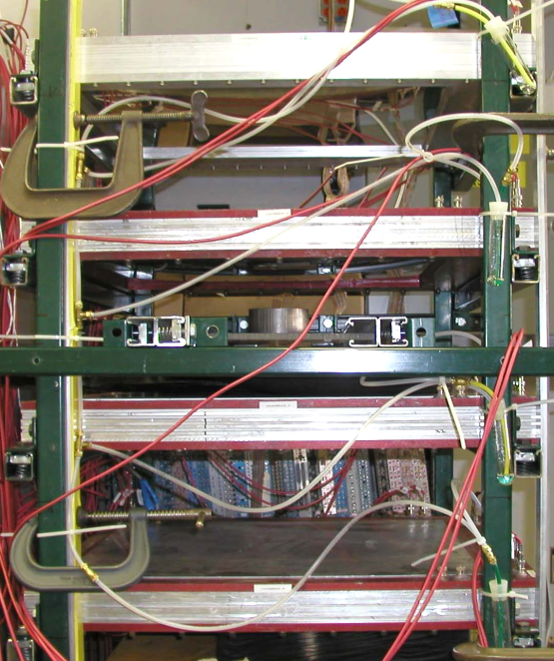
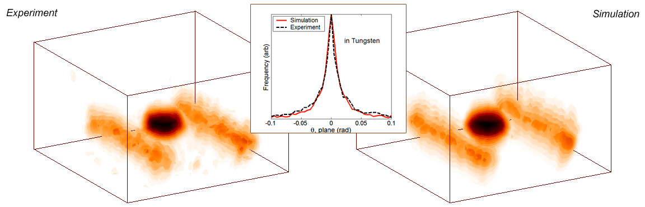
Cosmic ray muon tomography
Experiment
Simulation
K. N. Borozdin, G. E. Hogan, C. Morris, W. C. Priedhorsky, A. Saunders, L. J. Schultz, and M. E. Teasdale, Nature 422, 277 (2003).
X
X
X
X
D1
D1
D1
D1
D1
Y
D1
Y
Y
Y
27 cm spacing, all detectors
Cosmic ray muon generator / multiple scattering simulation.
Good agreement with experiment.
Allows for extrapolation to larger, more complex scenes.
X
X
X
X
D2
C2
C2
D2
D2
C2
D2
C2
D2
C2
D2
Y
D2
Y
Y
Y
W
W
W
W
W
B
W
B
B
B
B
B
B
B
B
B
B
B
L
L
L
L
L
L
L
X
X
X
X
X
C3
D3
C3
D3
D3
C3
C3
D3
D3
D3
Y
D3
Y
Y
Y
Y
X
X
X
X
X
D4
D4
D4
D4
D4
C4
C4
C4
C4
D4
Y
D4
Y
Y
Y
Y

Slide 11
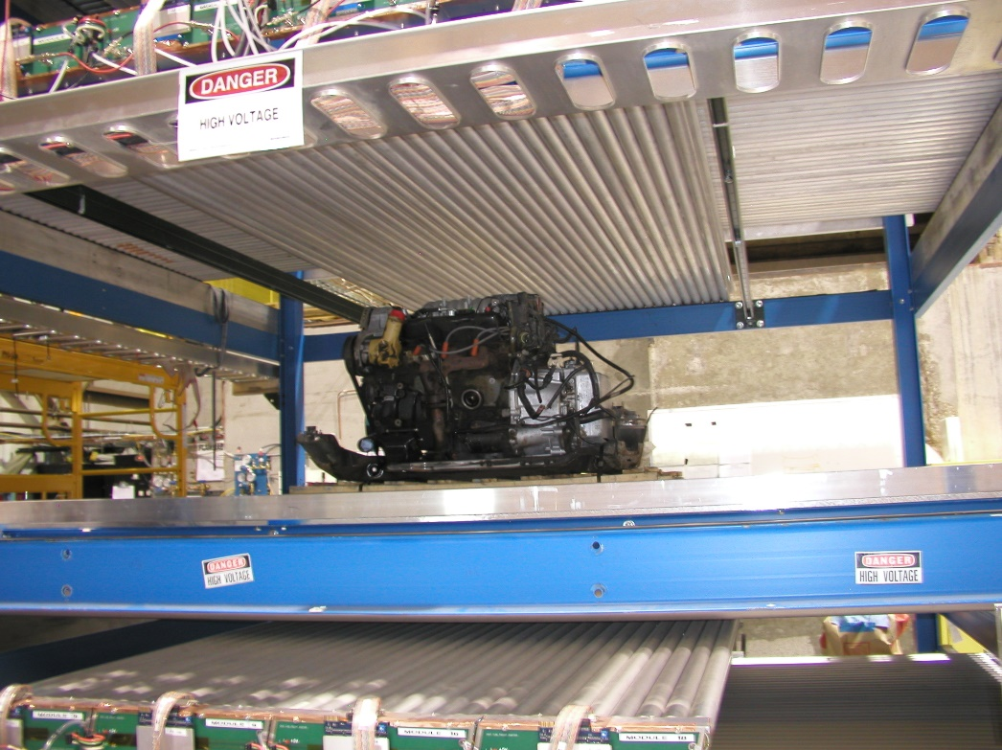
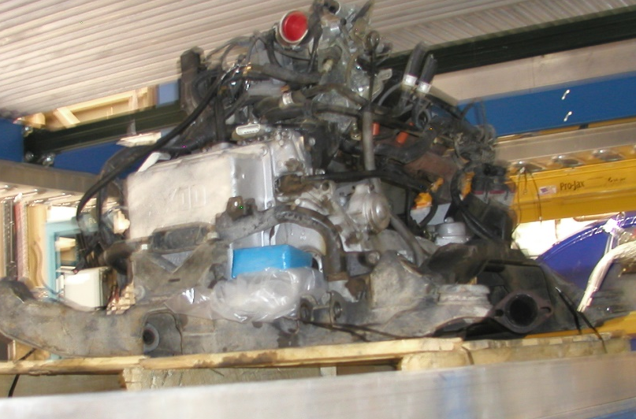

It really works! (Funded by Decision Sciences)
Uranium

Slide 12
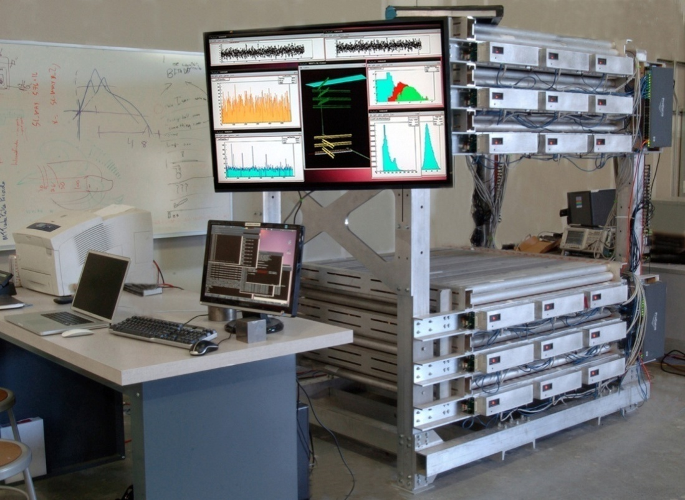
Four different kinds of radiography
in
in
in
Scattering
Transmission/Stopped
Tagged
out
out
out

Slide 13
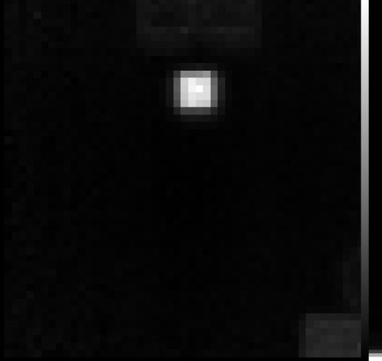
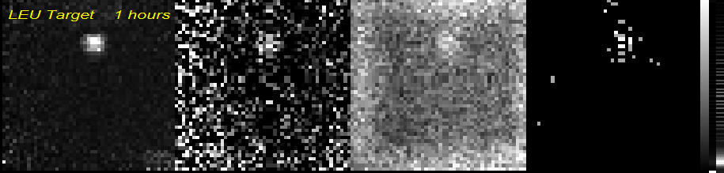
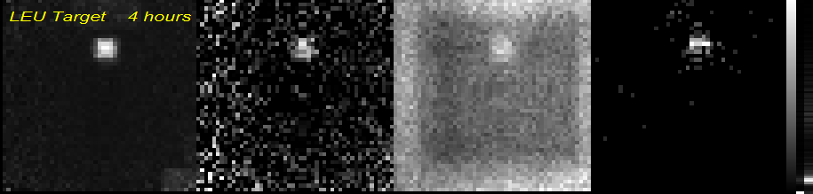
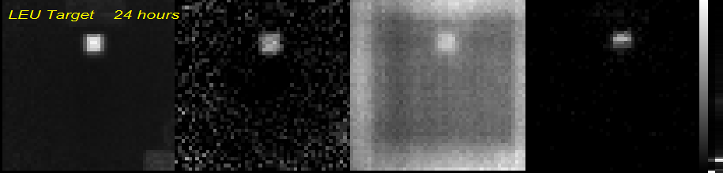
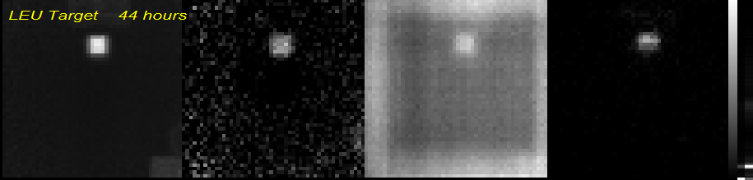
Four different kinds of radiography
2 5x12 cm EJ301
LEU (20 kg)
20x20x40 cm
concrete
Scattering
Ln(N/N₀)
Stopped (hr-1)
Tagged(hr-1)

Slide 14
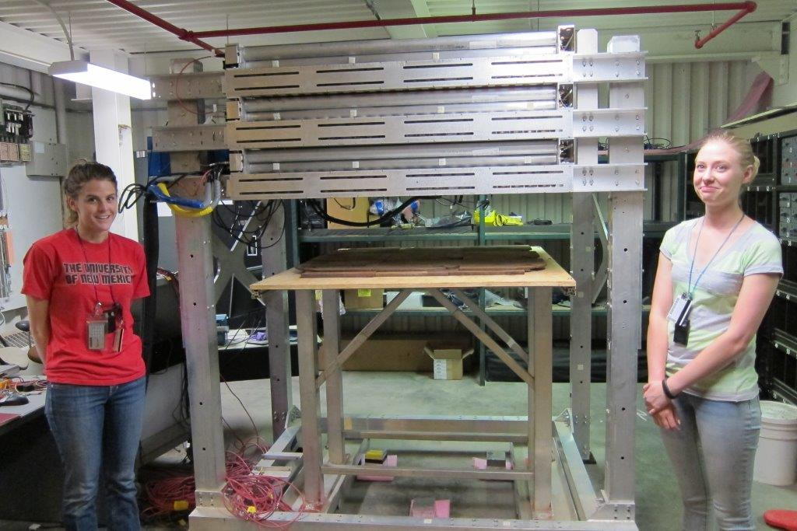
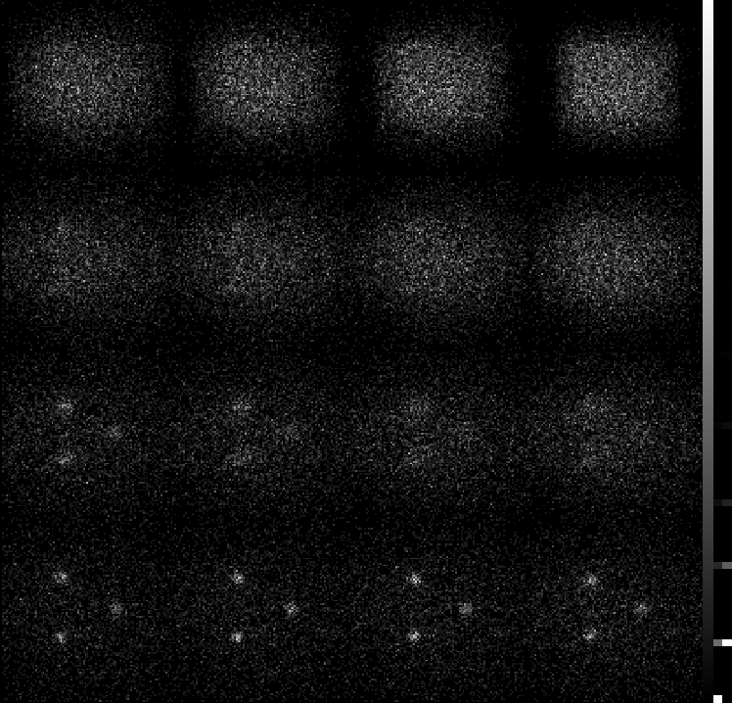
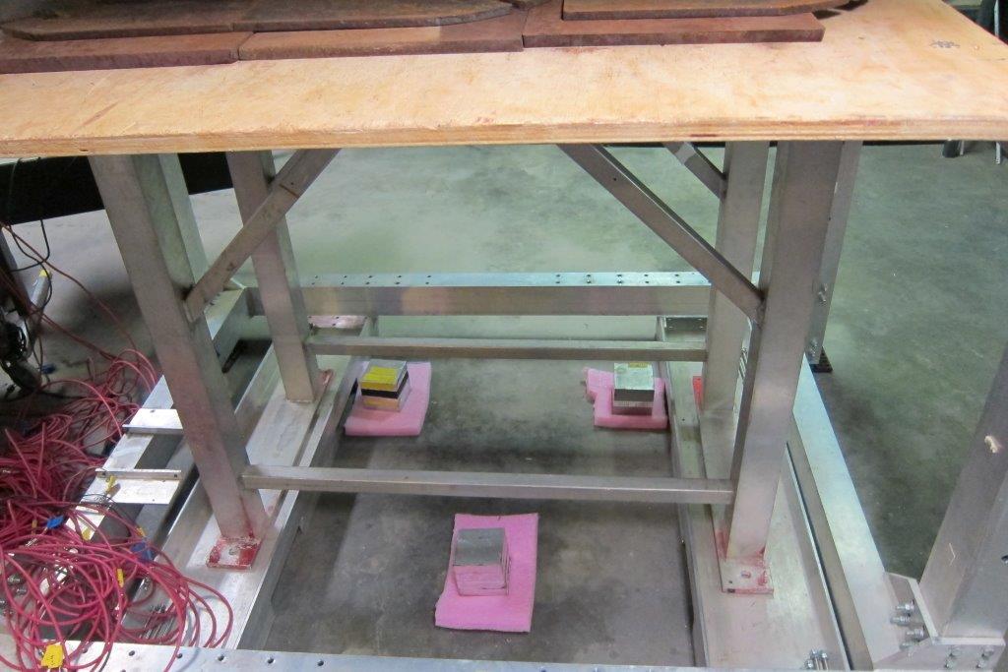
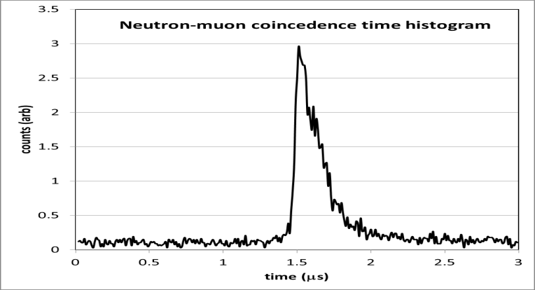
Neutron detectors were on the floor-same average distance as the front of the tracker from the cubes
3-d single sided tagged muon laminography image
Z=-40 cm
Z=-30 cm
Z=-20 cm
Z=-10cm
2.5 cm steel
Z=-80 cm
Z=-70 cm
Z=-60 cm
Z=-50cm
Z=-120 cm
Z=-110 cm
Z=-100 cm
Z=-90cm
U cubes
Z=-160 cm
Z=-150 cm
Z=-140 cm
Z=-130 cm
200 cm
U cubes
-160 cm

Slide 15
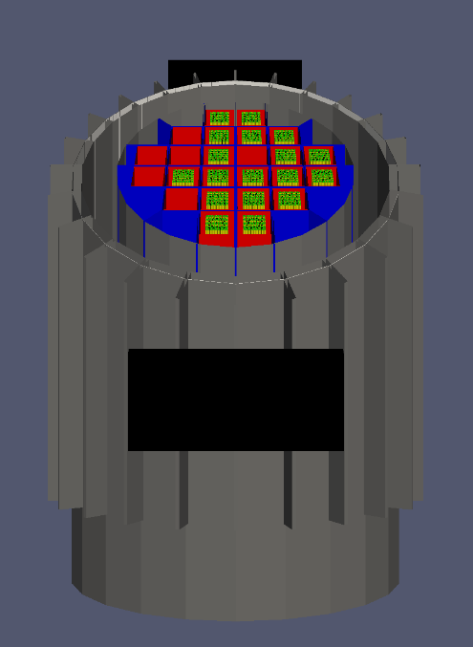
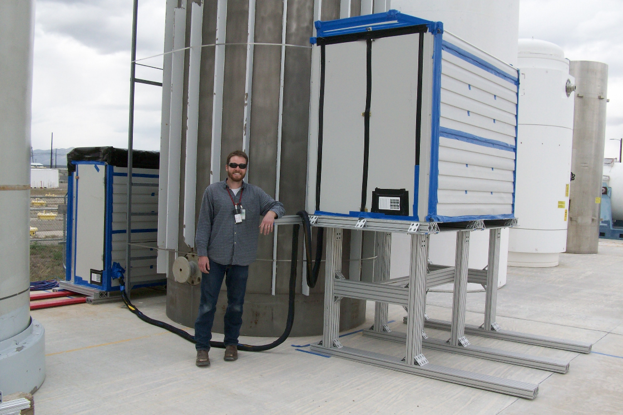
Fuel cask imaging for NA-22
Muon trackers in weatherproof enclosures. One side elevated to increase muon flux through both detectors (falls off as ~cos²Ɵ).
Westinghouse MC-10 cask

Slide 16
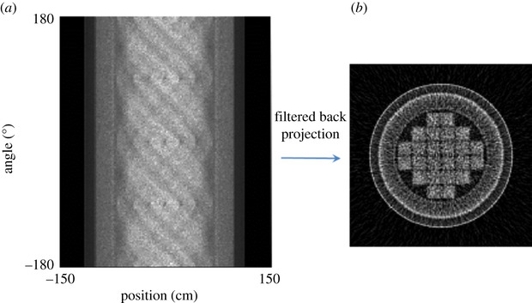
Fuel Cask Verification-GEANT model of diversion scenarios
1.00
14 day
Fresh
Missing
Lead
Steel
Fractiona change
0.10
0.01
Steel
2 weeks of exposure
Lead
Fresh
Missing
Application of muon tomography to fuel cask monitoring, Volume: 377, Issue: 2137, DOI: (10.1098/rsta.2018.0052)

Slide 17
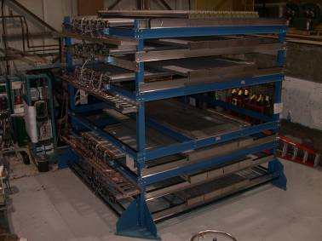
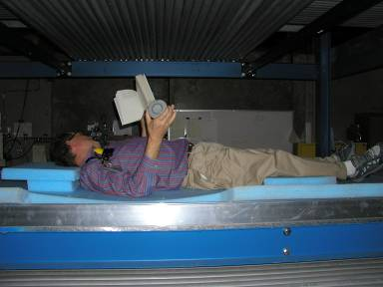
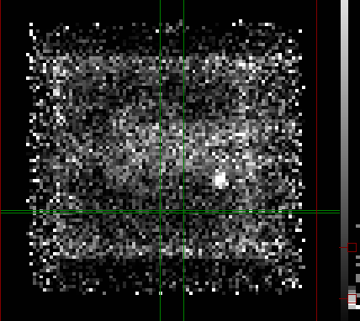
Human radiography
896 channels
Drift gas: 60% Ar/ 40% Isobutane
~100 Hz trigger rate at current geometry
1.5 m tall sample area
Lead
1.8 kg
Lead

Slide 18
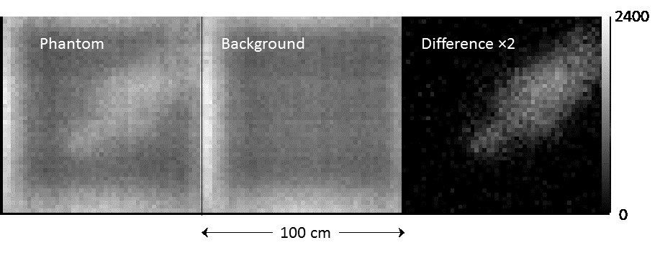

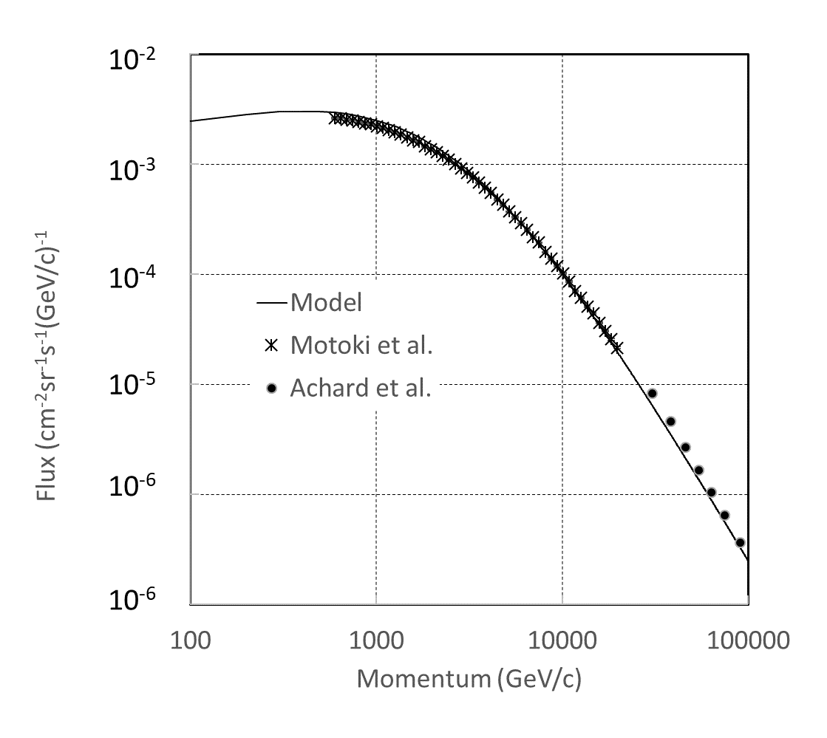
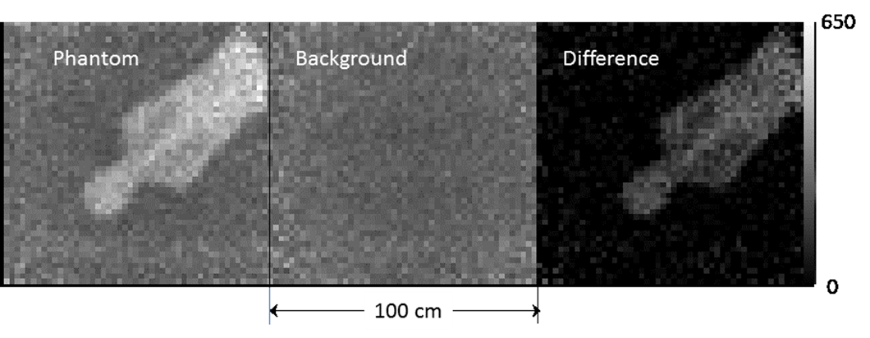
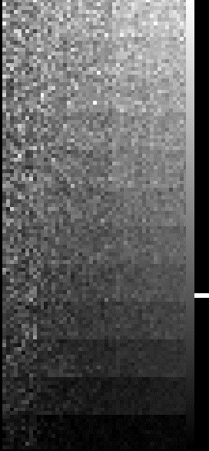
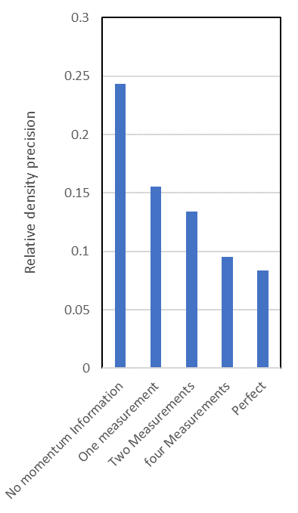
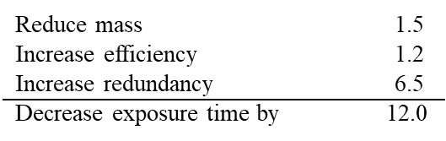
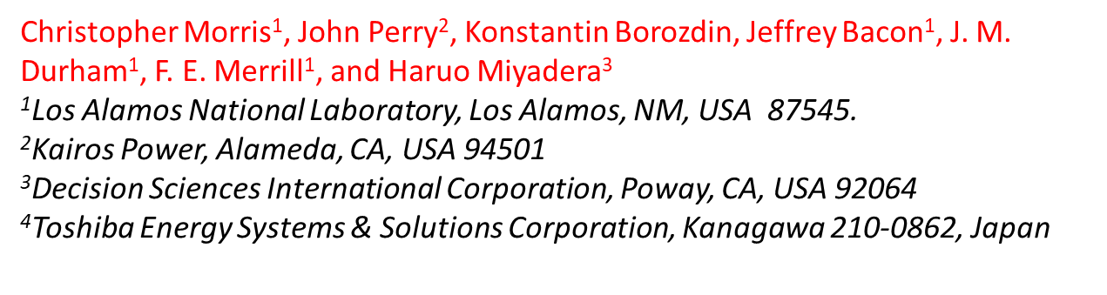
Cosmic ray radiography of a human phantom
Exposure 24 hours in MMT
Simple model
Power law source
Decay + stopping for transport
Cos²(θ)
2.2 rl
Combine weight multiple scattering and stopping to assess body composition.
Imagine what you can do with an artificial source
0 rl
0
1
2
4
Perfect
Momentum determination

Slide 19
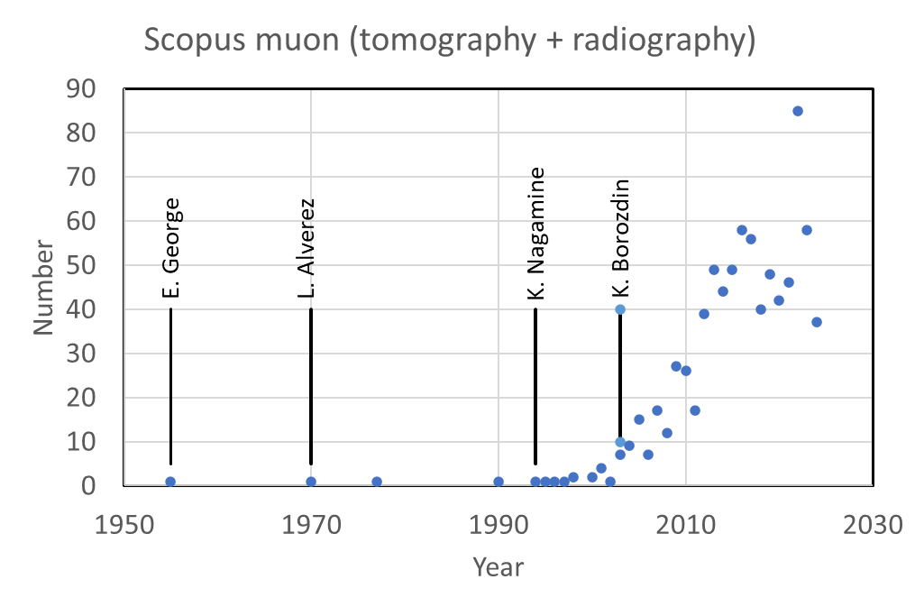
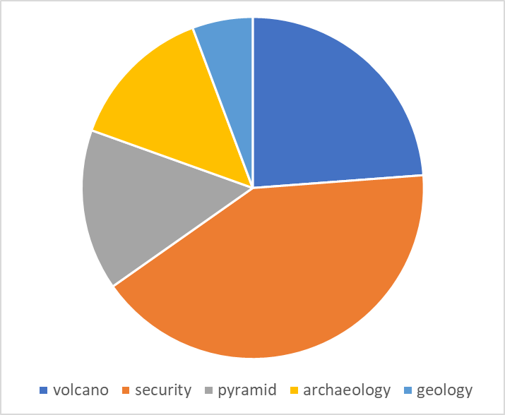

Conclusions
Cosmic ray radiography/tomography
The work of George, Alvarez, Nagamine, and Borozdin has led to a vital and growing field.
Many new areas of application in a growing field.
Detectors and analysis continue to advance.
There are exciting prospects for affordable artificial sources.
Decision sciences scanner

