Slide 1
EIDO Update
22 July 2024

Slide 2
SLS

Slide 3

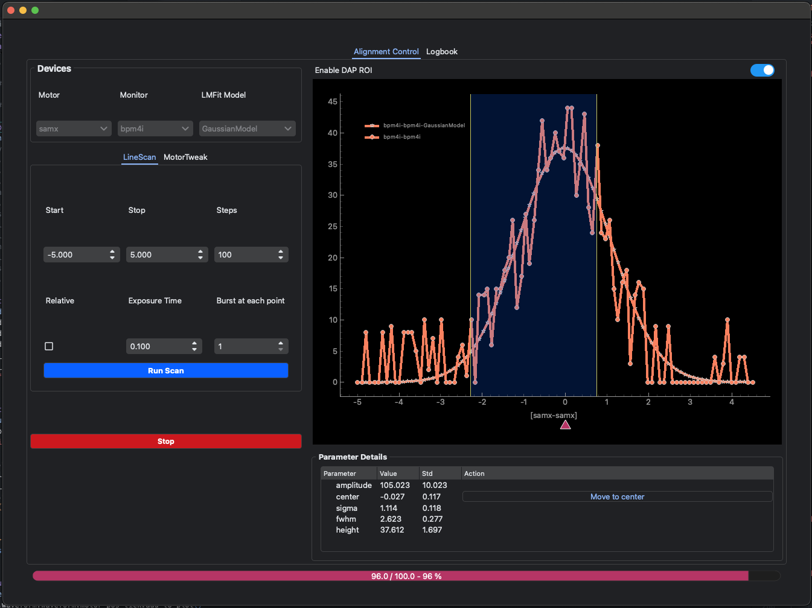

SLS
BEC rollout
Debye / NIDAQ continues
cSAXS training ongoing
BEC Core
blissdata integration
Improvements and minor bug fixes
BEC Widgets
Dedicated alignment GUI to assist BL commissioning
Feedback and requests from BLs
Refactoring and improvements to the code base

Slide 4
SwissFEL

Slide 5

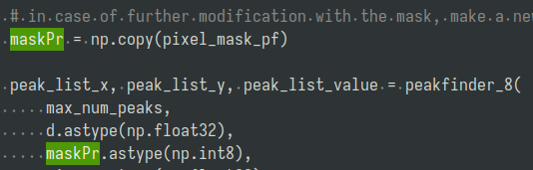
SwissFEL
sf-daq (Data Acquisition)
Version change for 3 (actually 2) detectors:
  Version is part of the detector name.
  Search/replace in 4 repos with dozens of occurrences. (needs simplification)
  Found and removed code referencing historic versions.
Collected all git repos into one gitlab group.
Deployment needs some love …
dap (Detector Analysis Pipeline)
Completed first round of refactor/rewrite/cleanup.
Was one function of 500 lines. Now broken apart into steps.
Removed several instances of needless copying of the image and mask data.
Need to test if results are the same and performance is better…

