Slide 1
Status of LYSO crystal testing and performance
Omar Beesley

Slide 2
Outline
Lutetium–yttrium oxyorthosilicate (LYSO):
By weight: 73% Lutetium, 18% Oxygen, 6% Silicon, ~0% Cerium (dopant), 3% Yttrium
X₀ = 1.14 cm , R_{M} = 2.07 cm
Decay time = 40 ns
Light yield 30,000 γ/MeV
λ_{peak} 420 nm -> conventional PMTs
Radioactive (< 1 MeV constant rumble)
Non hygroscopic, negligible temperature dependence, radiation hard
LYSO as a PIONEER calorimeter option
Measurements/Performance of LYSO crystals
LYSO crystals in the PIONEER demonstrator

Slide 3
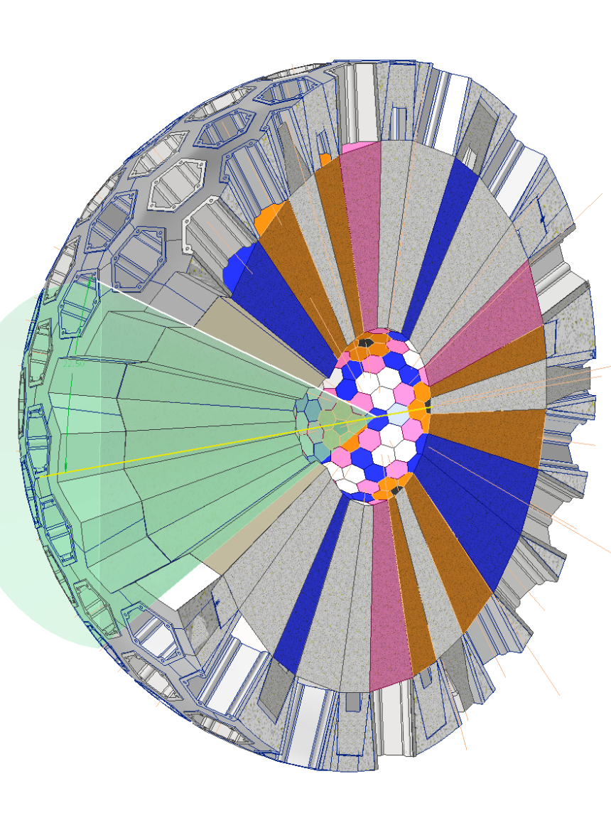
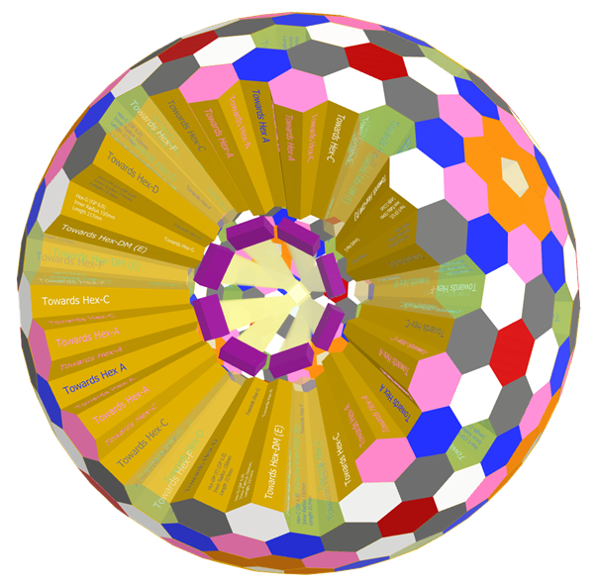
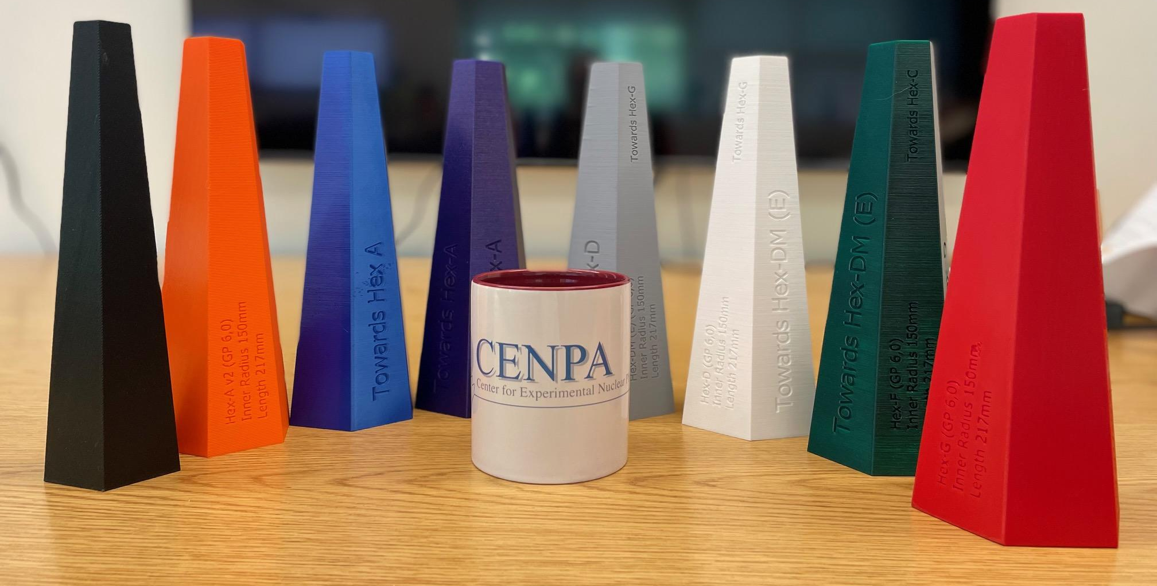
LYSO Calorimeter Design Overview
311 crystals in calorimeter w/ 8 different crystal shapes – SICCAS has demonstrated capability to grow largest Hex G crystal
19 radiation lengths (21.3 cm), 15 cm inner radius, intrinsically segmented
  Small size allows us to get closer to last quad → better focus
  Segmentation provides significant help in pileup identification
40 degree opening angle
Crystals supported by optical glue on back face to support structure. On rails, movable with mounted electronics (more from Ryan)

Slide 4
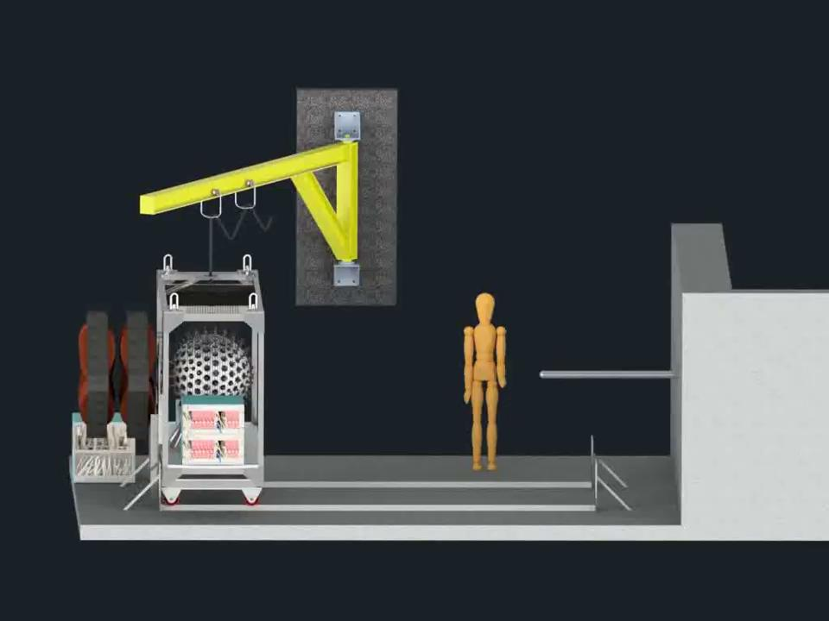
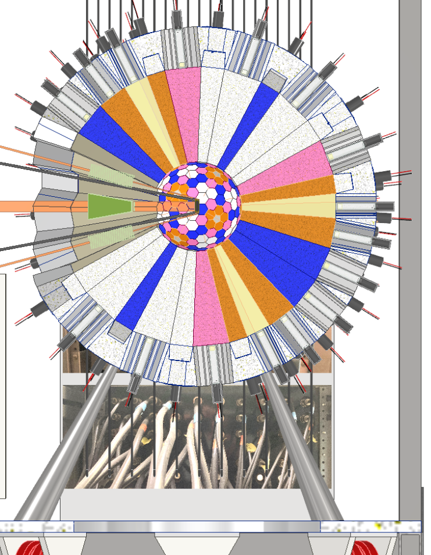
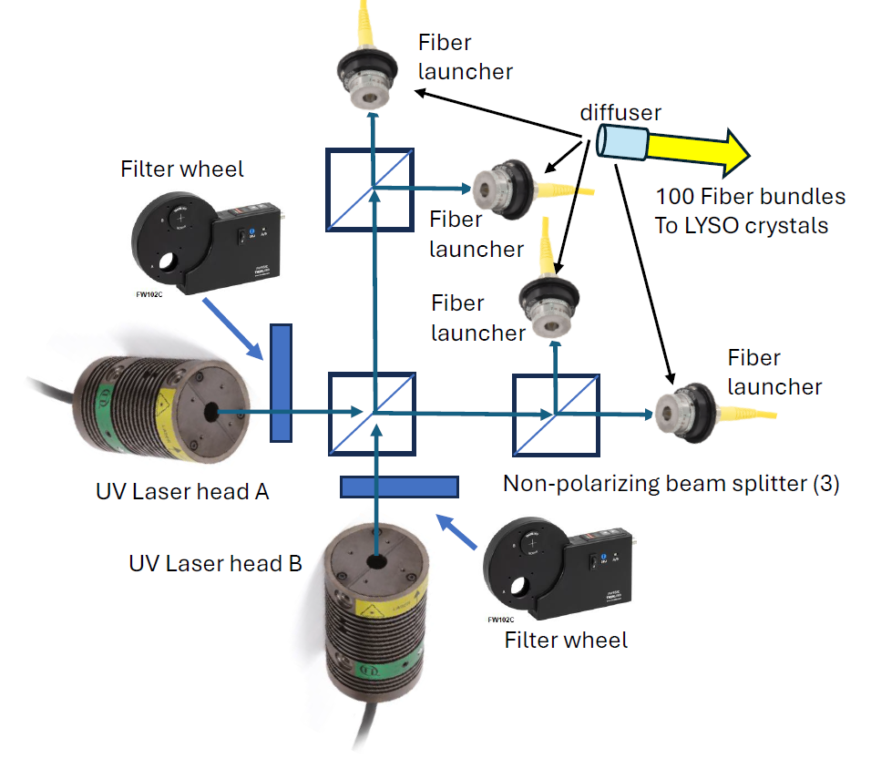
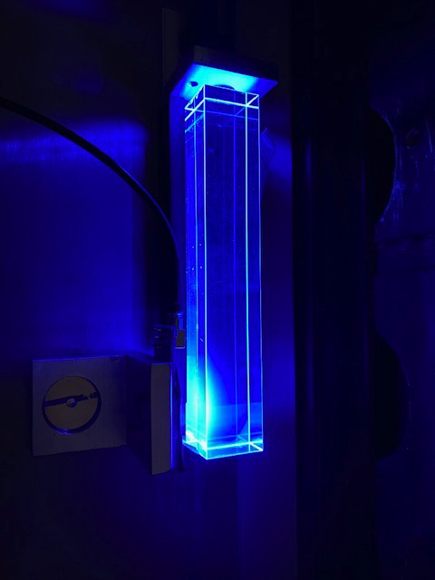
Calibrations for a LYSO calorimeter
p-Li reaction using Cockroft-Walton proton gun to calibrate w/ 17.6 MeV gammas
Used by L3 @ LEP and MEG-II
2.6% energy resolution obtained for LYSO array using same reaction
For higher energy absolute energy, adopt the successful charge-exchange method used by MEG: π⁻p → nπ⁰ → γγ, employ it once per running cycle
Remove 6 downstream crystals to insert LH2 arm; negative pions, remove ATAR
Two UVA laser system using to excite LYSO scintillation mechanism for gain stability monitoring + more (Erik will discuss in his talk)
LH2 arm
LH2 target

Slide 5
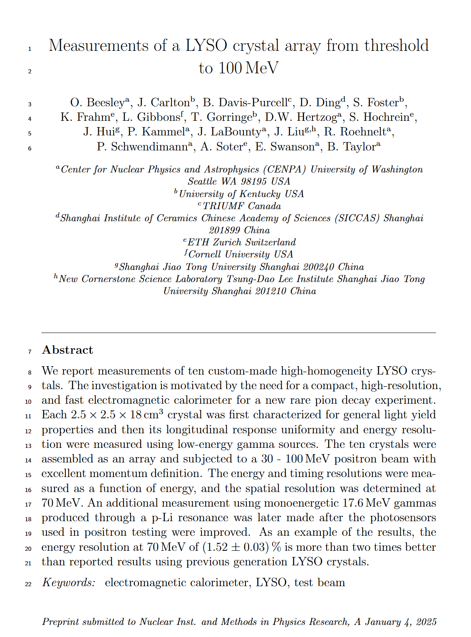
Brief Review of LYSO Measurements in Test Beams
arXiv: 2409.14691

Slide 6
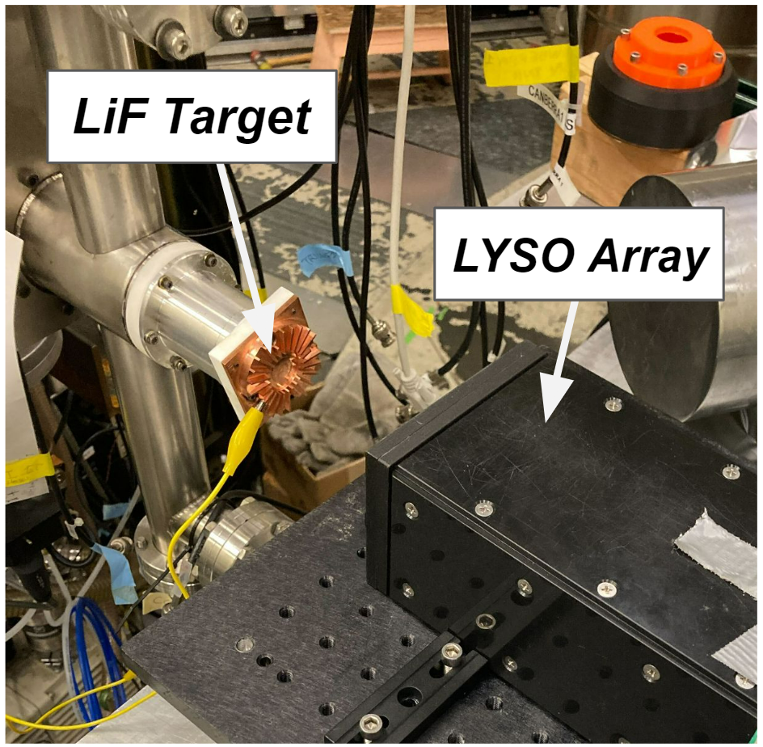
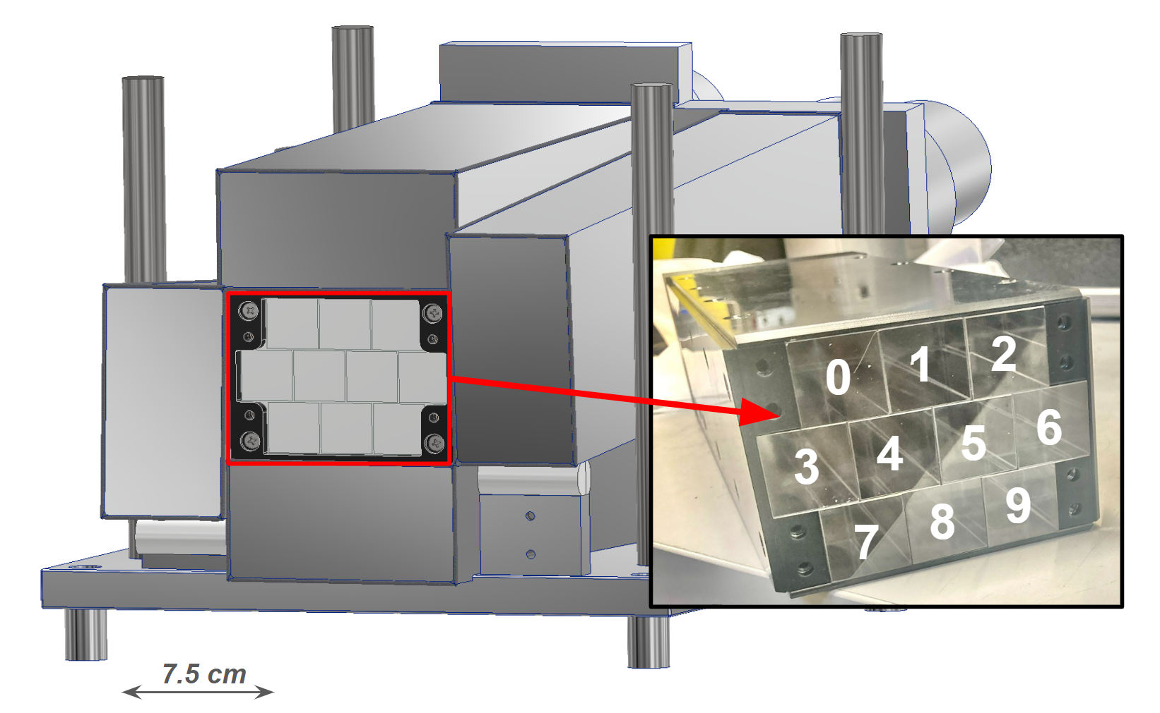
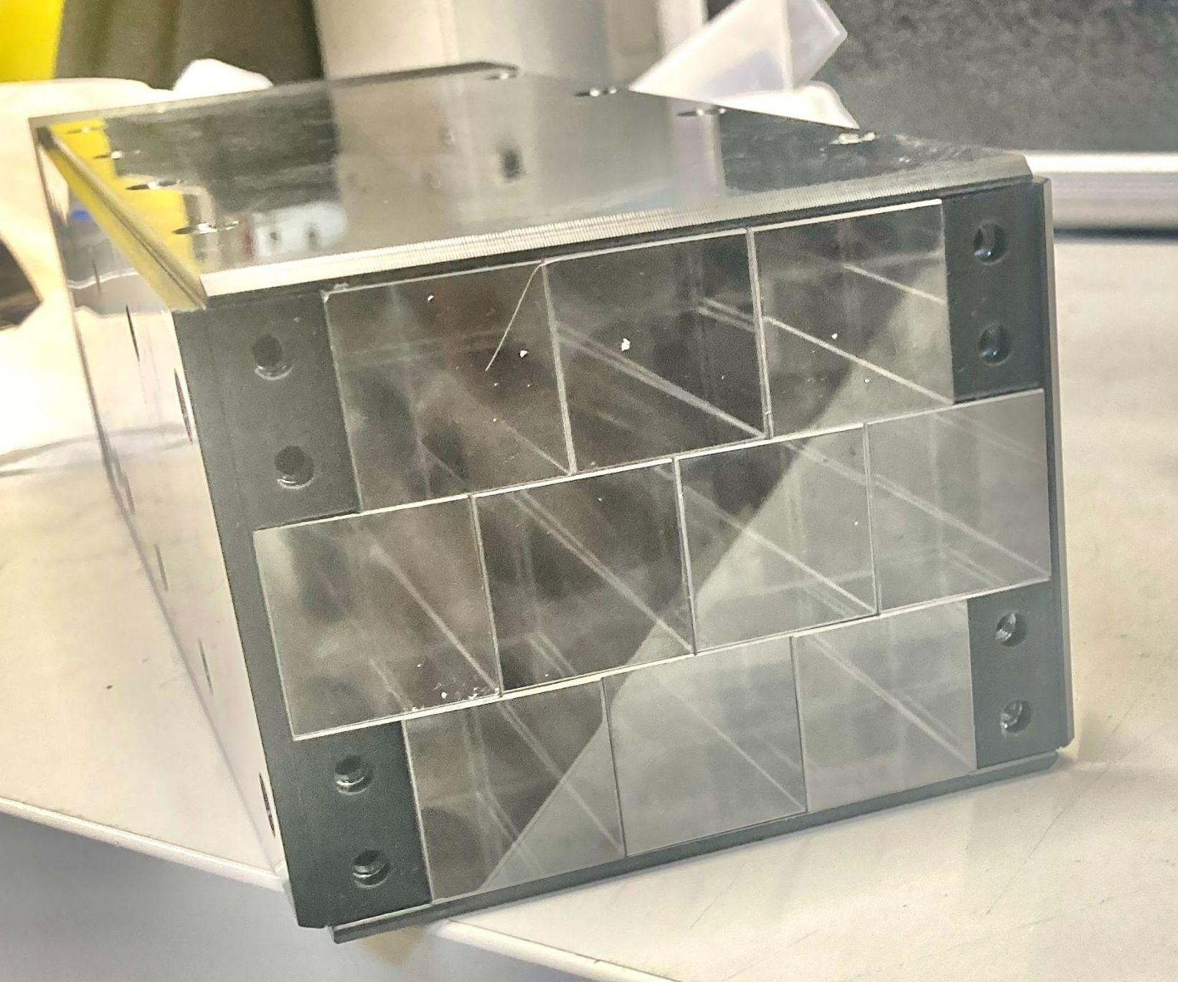
Overview of 10 array measurements
Ten 2.5 x 2.5 x 18 cm³ LYSO crystals wrapped in ESR tested with:
30-100 MeV positrons (and 210 MeV muons) at PiM1 beamline at PSI
17.6 MeV gammas at CENPA
Measurements of:
Longitudinal response uniformity (LRU)
Time resolution
Energy resolution
Spatial resolution (6 mm at 70 MeV)
17.6 MeV 𝜸 CENPA RUN
30-100 MeV e+ PSI RUN
LYSO
NaI(Tl)

Slide 7
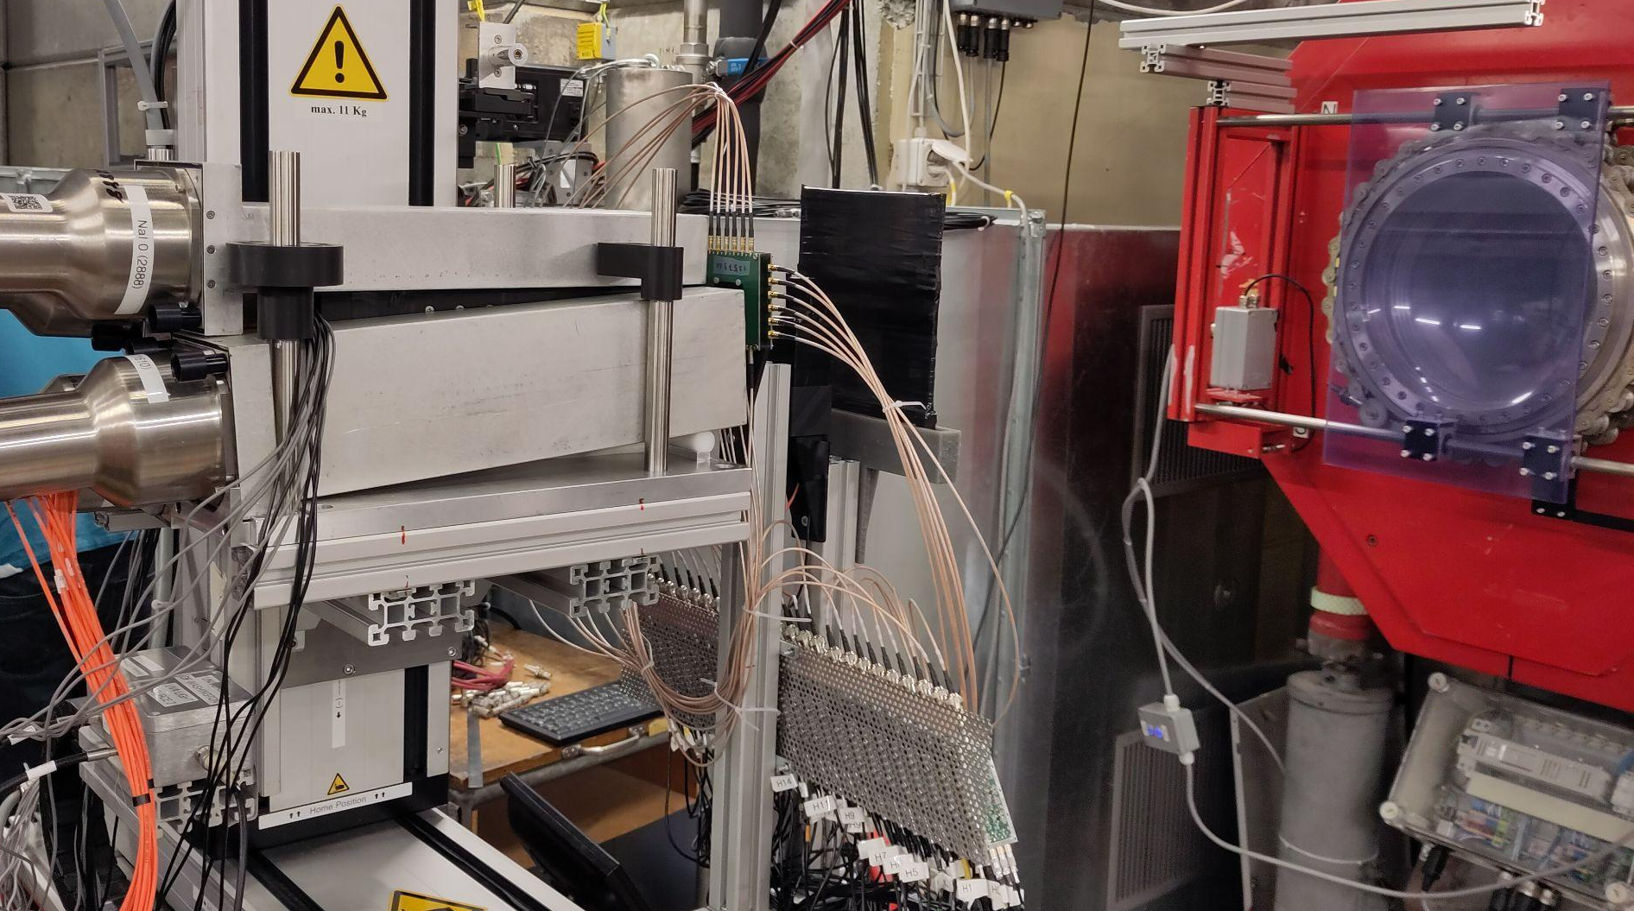
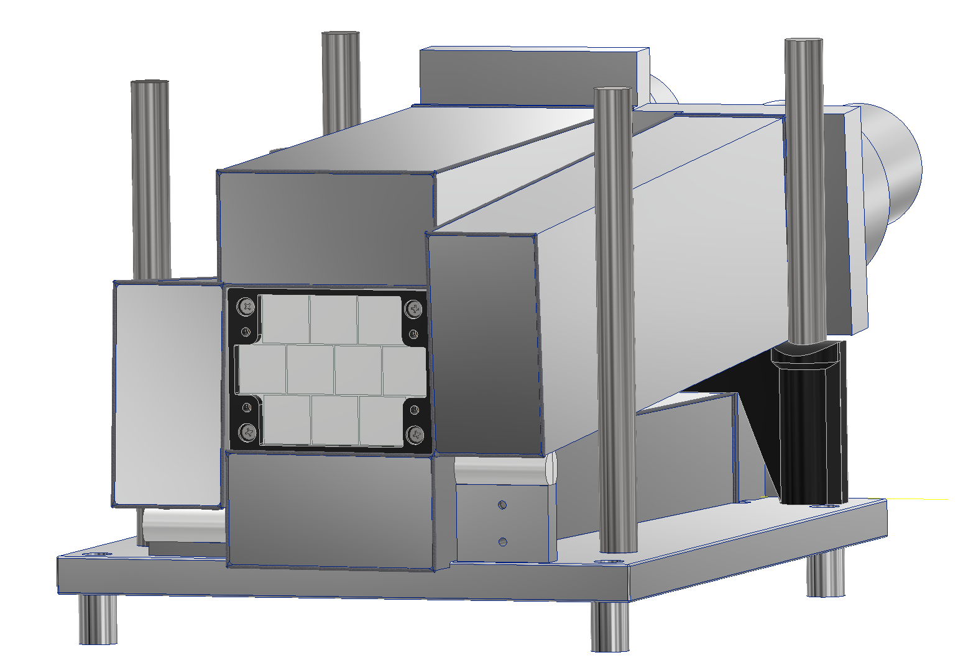

Detector setup at PSI
Detectors:
Positron beam exit
Veto detector
t0 detector
Beam hodoscope
LYSO array
NaI detectors
XY-table
⑦
④
②
①
⑤
③
⑥
⑤

Slide 8
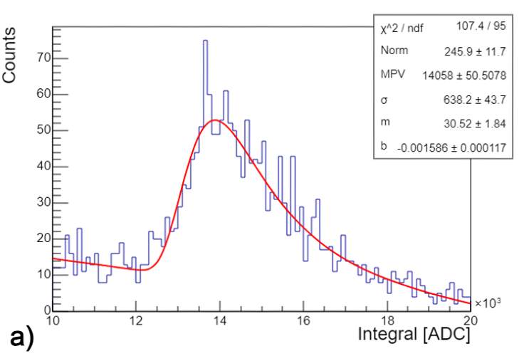
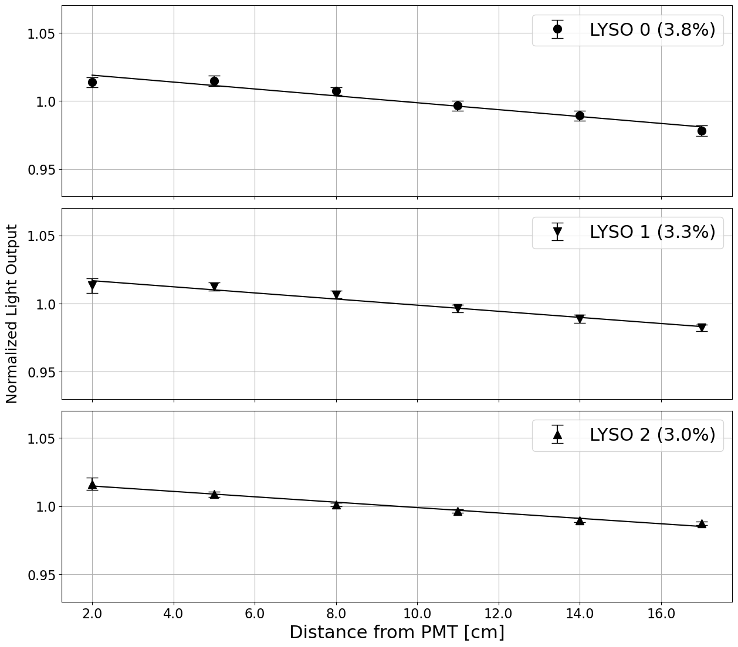
LRU using high energy muons
Peak tracked along longitude of crystal
PiM1 is ideal up to a few hundred MeV/c
  ΔP/P measured to be <0.65%
Muons @ 210 MeV/c used for transverse tomography
3-4% LRU – strong agreement with single crystal LRU measured in the lab
T0
23 MeV MIP deposit in each crystal
PMT
PMT
PMT
μ
Scint

Slide 9
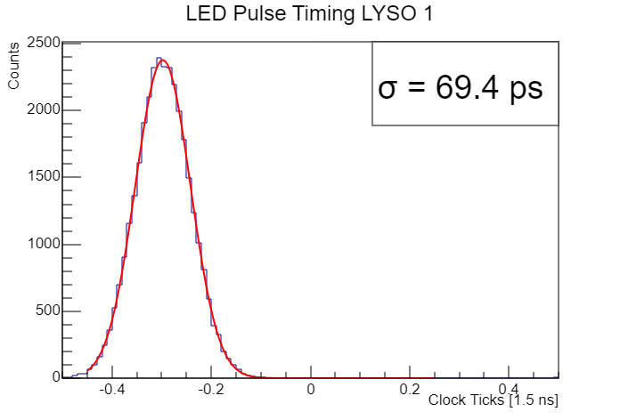
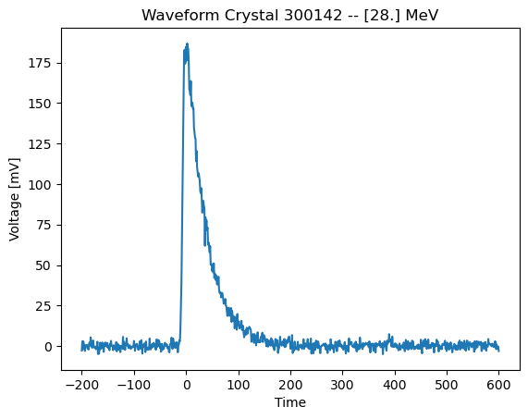
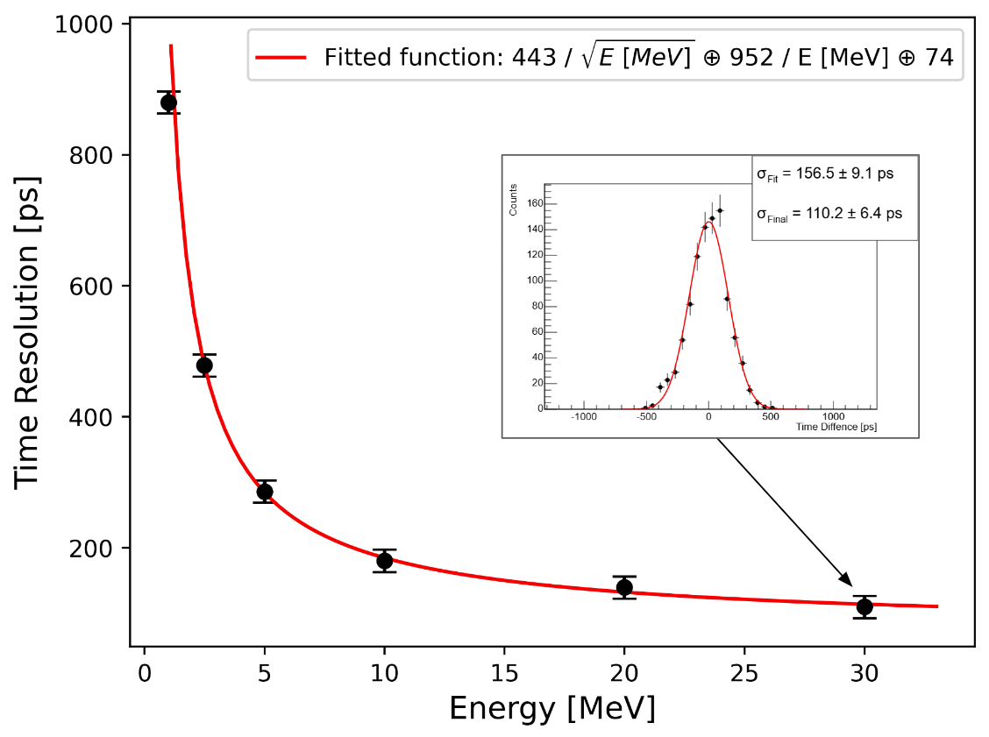
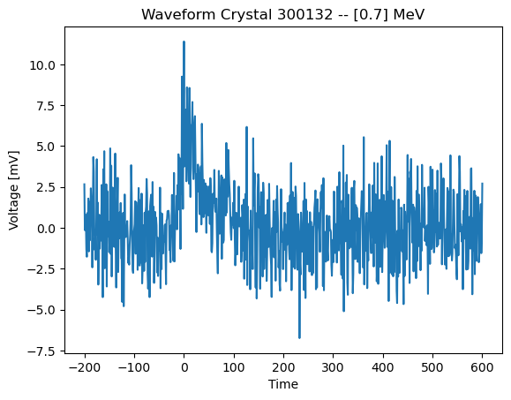
Time resolution of LYSO array w/ updated fitter
Time difference between the hit in the primary crystal in the array and less energetic secondary hit times was used to determine time resolution
70 ps w/ LED
74 ps constant term in fit
t1
t2
t1-t2

Slide 10
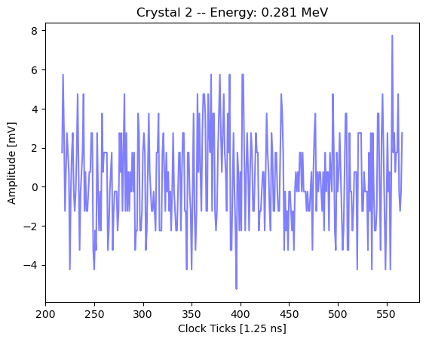
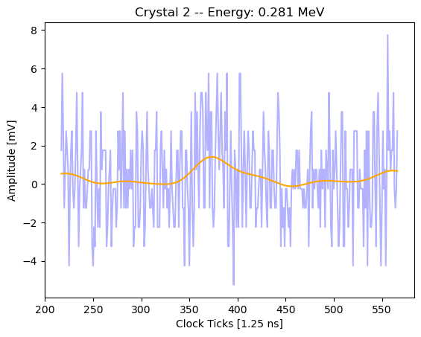
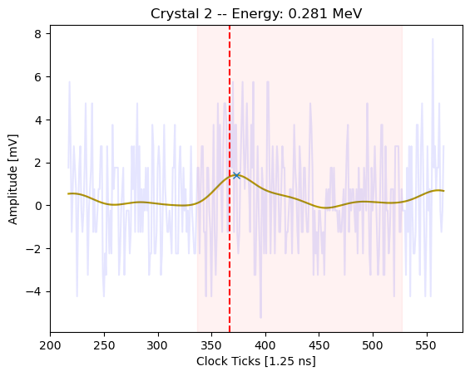
New reconstruction strategy for PSI data
New procedure uses updated integration strategy to calculate energies from window set by the largest pulse in the array and relies on new pulse tagger to determine whether a each crystal is included in the sum.
Pulse tagger is tuned to better handle high frequency noise and differentiate between noise/signal
Integration Window
Gaussian + SavGol filters
Search for prominent inflection points
Time set by seed pulse

Slide 11
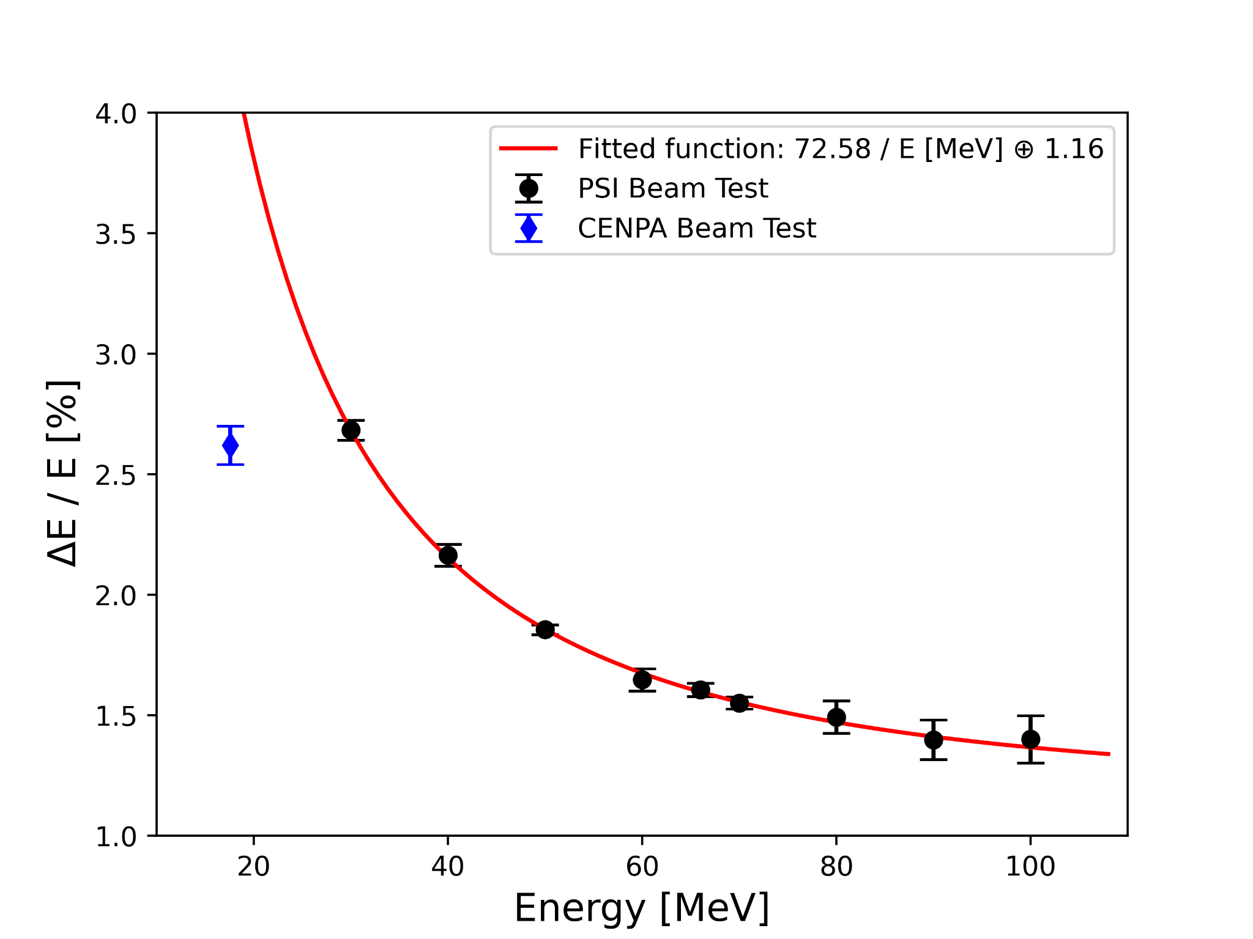
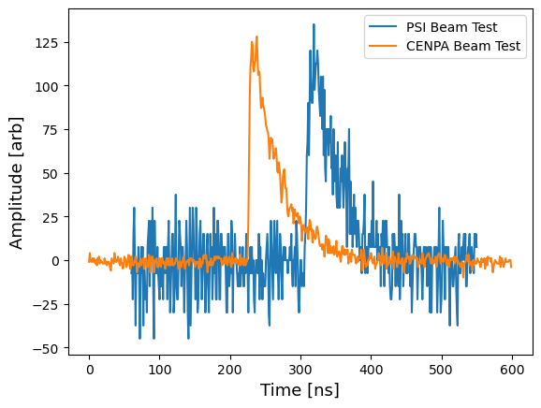
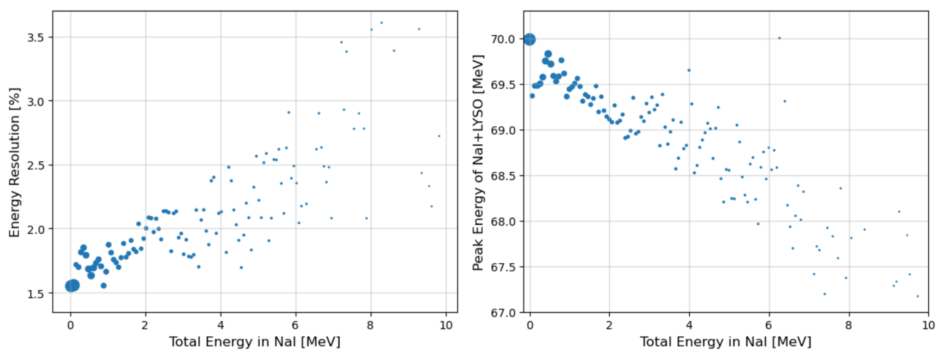
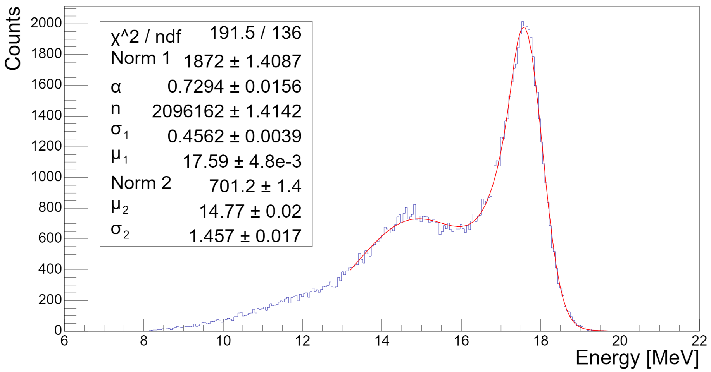
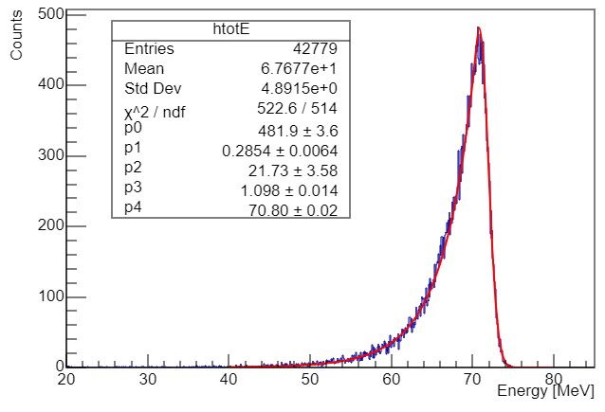
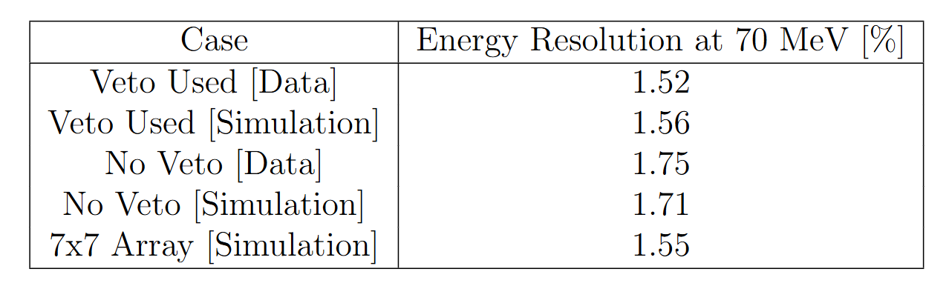
Energy resolution results
2 MeV pulses
High resolution observed even despite unoptimized PMTs resulting in high noise
NaI veto is well understood in simulation and better represents resolution for larger array
p-Li
e+ beam
2.6% @ 17.6 MeV
Improved PMT bases allowed for higher operational voltage that lowered noise
1.52% @ 70 MeV
High noise due to low PMT operational voltage degraded energy resolution, especially at low energies

Slide 12
Review of LYSO calorimeter simulations

Slide 13
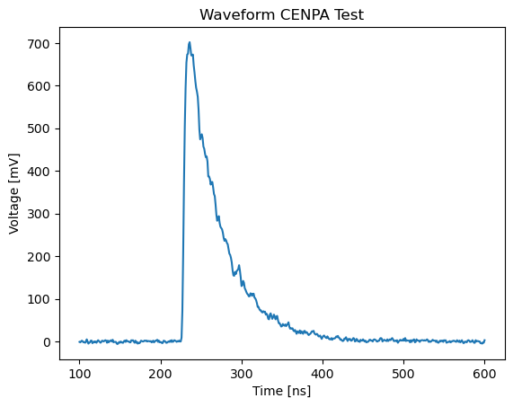
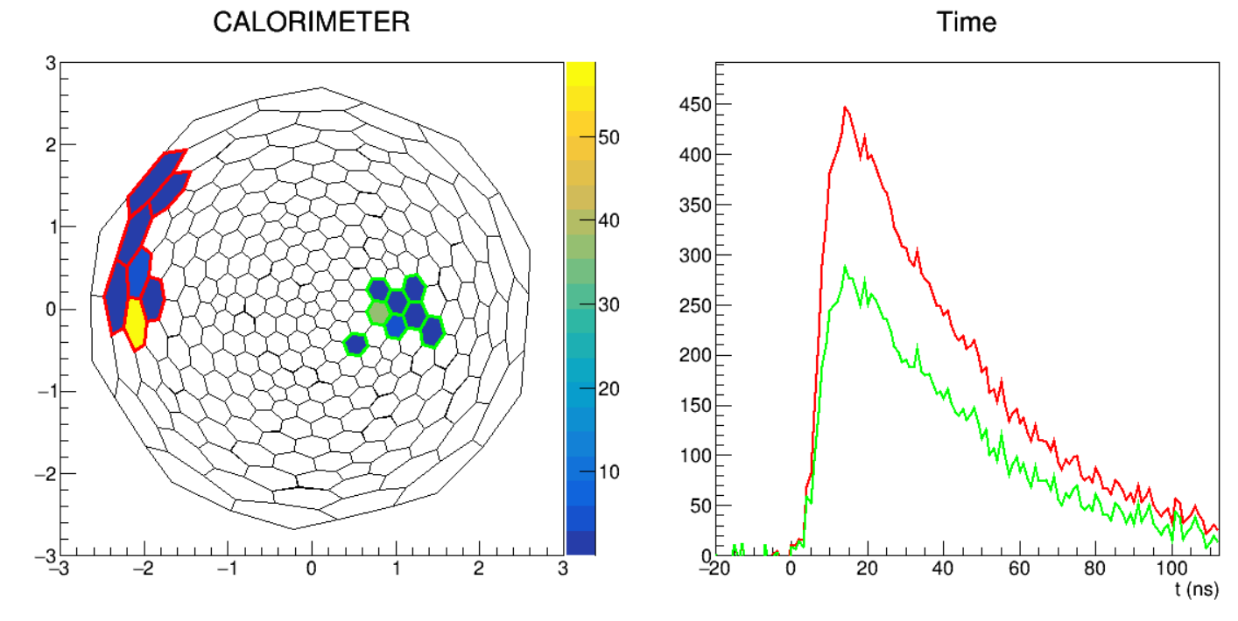
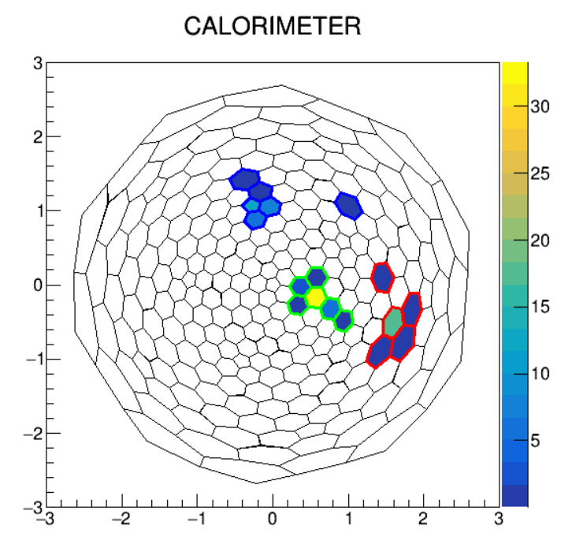
Current Status of LYSO reconstruction in Simulation
Complete Reconstruction of PiBeta Event
Truth Energies and Times
Waveforms
Detector Response
Detector response can be skipped
Waveform Fits
Reconstructed Energies and Times
Clustering Algorithm
Event Recon (Clusters + ATAR Info)
Approximately 6 crystals are lit up per event and most of the energy is deposited in a single crystal. Showers can be very asymmetric at the PIONEER energy scale.

Slide 14
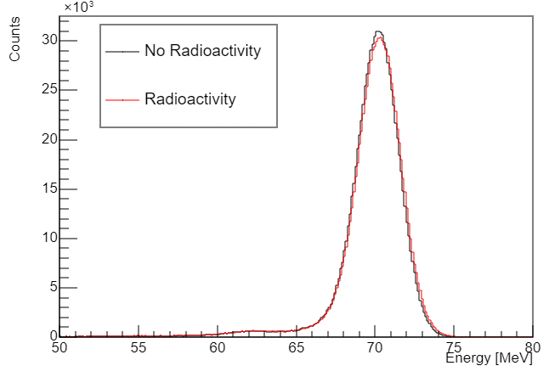
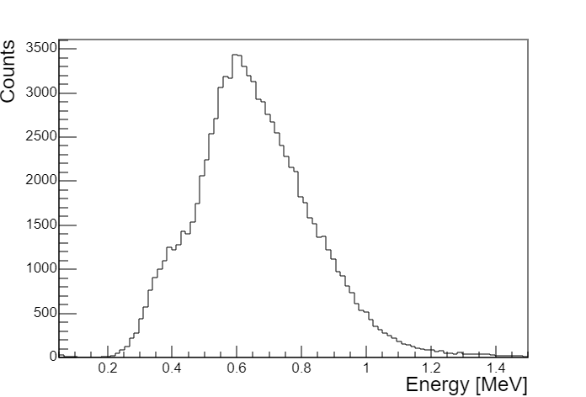
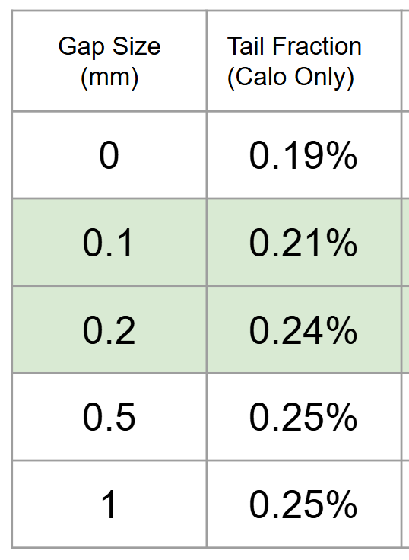
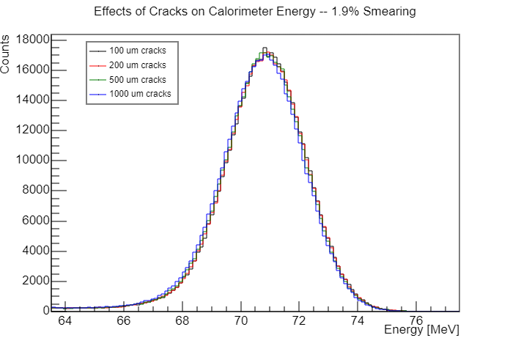
Effects of intrinsic radioactivity and crystal gaps
Intrinsic radioactivity:
Very minor impact on energy resolution and no impact on tail fraction
Cluster energy threshold of 1.5 MeV requires correction
Crystal gaps:
0.1-0.2 mm gaps typical for crystal calos
Minimal impact on tail fraction and energy resolution with slight additional 3 mm ATAR displacement from center
Details in calo review talk (https://indico.psi.ch/event/16633/contributions/52531/)
Radioactive Energy Spectrum
Radioactivity doesn’t directly affect resolution
Gaps don’t affect resolution

Slide 15
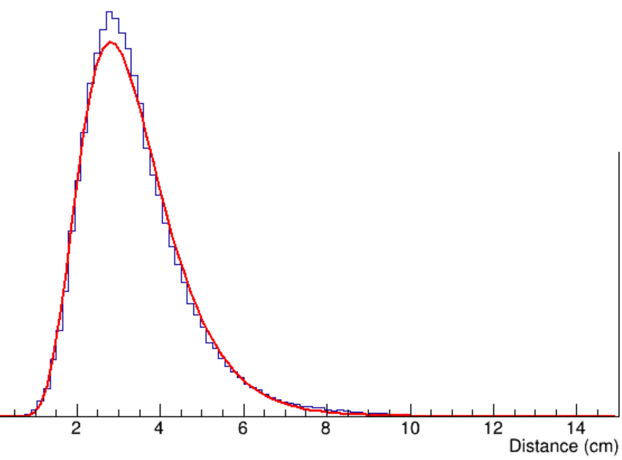
Effects of focusing effect in tapered crystals
Most energy deposition occurs in a small region at the front of the crystal
Due to shower concentration at the front of the LYSO crystal, PIONEER has a looser specification on uniformity than high energy experiments with large dynamic ranges spanning many orders of magnitude in energy.
To maintain an energy resolution <2%, PIONEER response uniformity must be only 1.0%/cm or better. (~20% along crystal length)
21.3 cm
Jiaqi will show that this is a non-issue

Slide 16
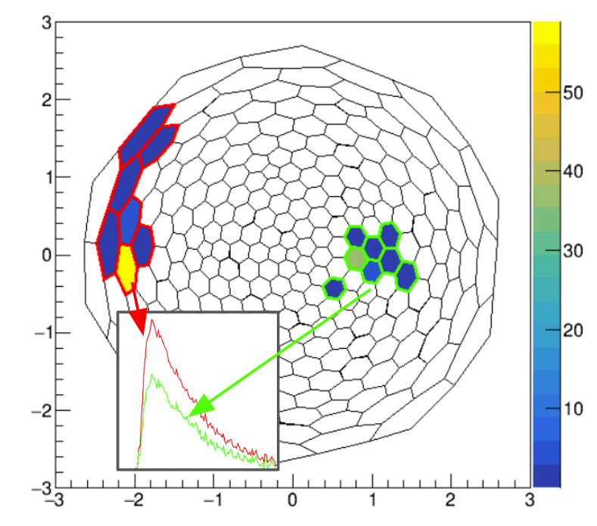
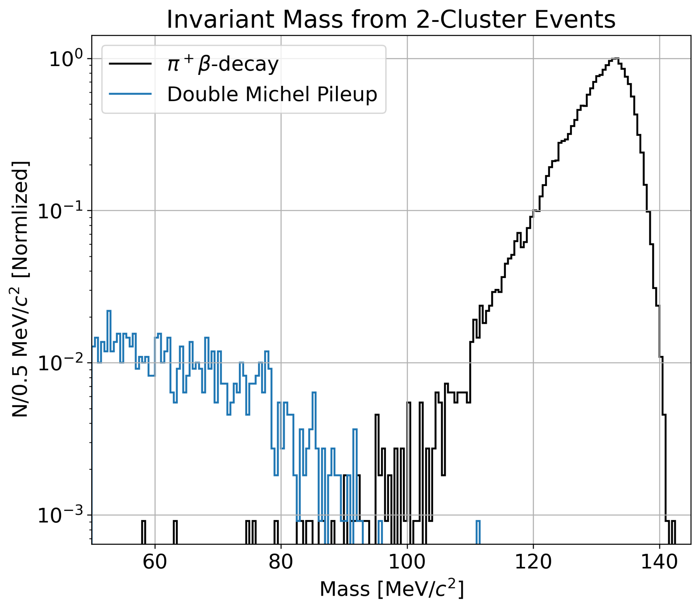
PiBeta is enabled w/ LYSO calo
π+ → π⁰e⁺𝜈; π⁰ → 𝛾𝛾
In Phases II/III, we plan to measure the pion beta decay branching ratio to 3/6 times improved precision
Simulations done by B. Taylor show excellent discrimination utilizing the intrinsic LYSO segmentation to perform invariant mass calculations on calorimeter clusters
Timing cut to remove dominant charge exchange background dominated previous systematic uncertainties
  Modern electronics/hardware will significantly reduce uncertainty
Invariant mass of 2 clusters separates pileup from signal

Slide 17
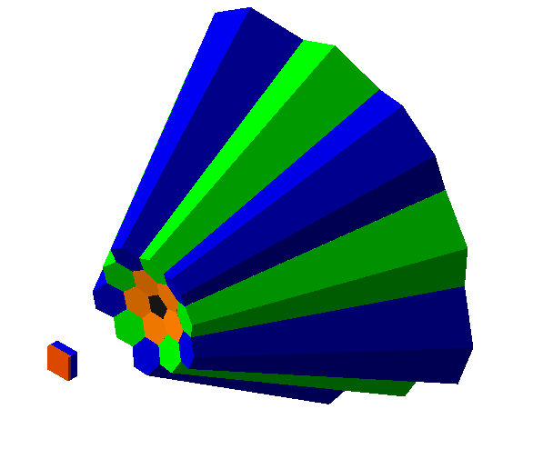
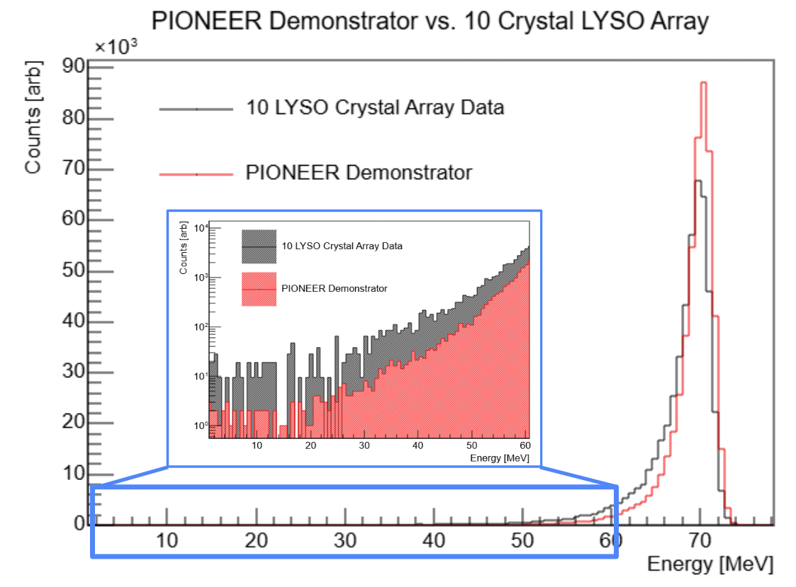
Goals for LYSO crystals in the PIONEER demonstrator
16 crystal array (Pent + Hex A,B,C) – 6 crystal array hopefully tested this year at PSI during student beam time
Confirm high resolution in tapered crystals
Measure sub 1% tail and validate with sim
Test crystal responses near their boundaries
Measure updated time/spatial resolution
Single crystal tomography with muon beam
Obtain updated waveforms for simulation
Test reconstruction strategies with other detectors (ATAR, Tracker?)

Slide 18
Summary
LYSO crystals meet the specifications for the PIONEER experiment
SICCAS has demonstrated a capability to grow crystals of the size type needed for the PIONEER calorimeter
Intrinsic segmentation allows for much simpler event reconstruction that:
  Significantly reduces pileup
  Enables the PiBeta measurement
The PIONEER demonstrator will allow for the testing of a 16 tapered crystal array to further:
  Characterize/optimize the performance of tapered LYSO crystals
  Test tapered crystal assembly and support
  Improve/verify Geant4 simulation to drive further experimental design

