Slide 1
LYSO calorimeter related topics
Erik Swanson UW
PIONEER collaboration meeting
TRIUMF, Vancouver BC, Canada 2025

Slide 2
Outline - LYSO Related Topics
Laser calibration/monitoring system
  Concept recap
  Leveraging on-going studies from muon g-2
Covering crystal polygon shapes
  Coatings or wraps?

Slide 3
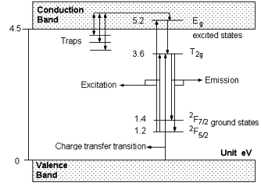
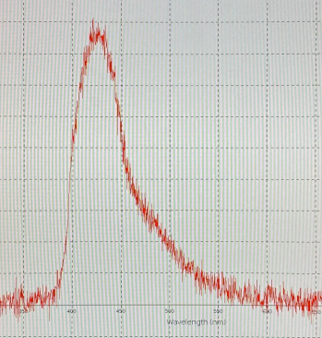
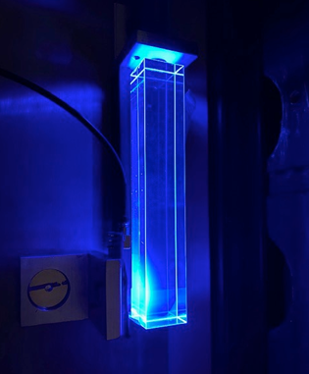
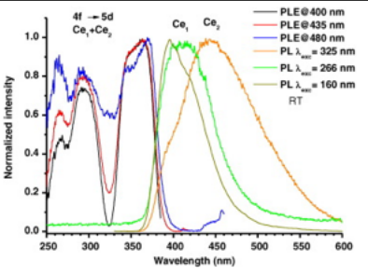
Concept recap
Monitoring LYSO light output with UV Laser
Ionizing radiation puts electrons in conduction band – excites Ce³⁺ ion
Directly excite Ce³⁺ ion with 355 nm UV laser light
De-excites with wavelength shifted blue light
Emission spectrum shape matches that of ionizing radiation
UV light absorption profile
Ce³⁺ energy levels in LYSO crystal
355 nm

Slide 4
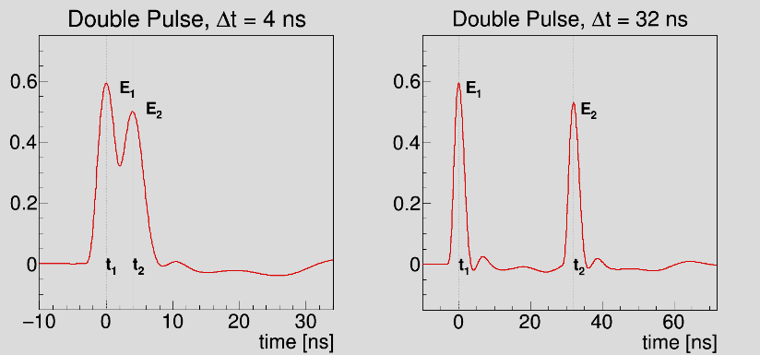
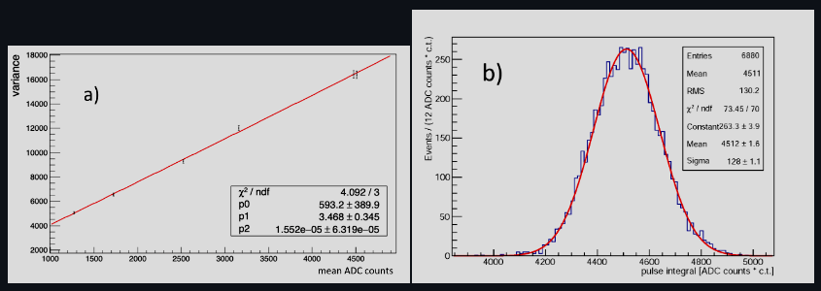
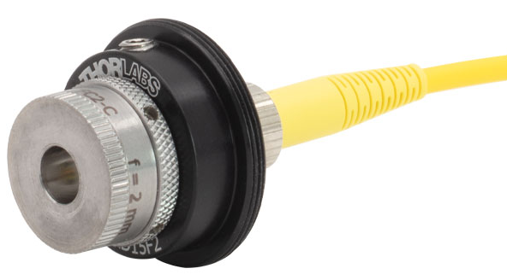
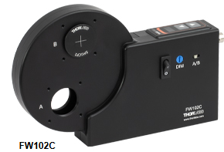
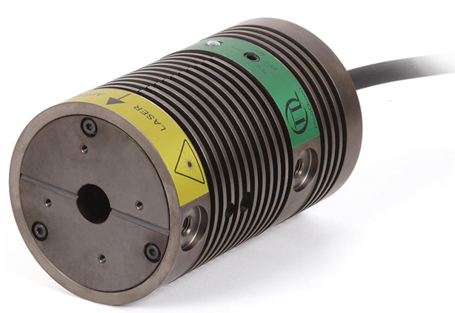
Concept implementation features
Double pulsing with two independent lasers
Fiber
launcher
diffuser
The slope of the variance/mean plot is the proportionality constant or gain of the PMT
Filter wheel
100 Fiber bundles
To LYSO crystals
Fiber
launcher
Outline
Fiber
launcher
Fiber
launcher
Two independent laser pulsing systems illuminate each crystal in the calorimeter
UV Laser head A
Non-polarizing beam splitter (3)
UV Laser head B
UV LED based system was demonstrated in Test Beam calorimeter, cost prohibits UV laser based prototyping at this time
Filter wheel

Slide 5
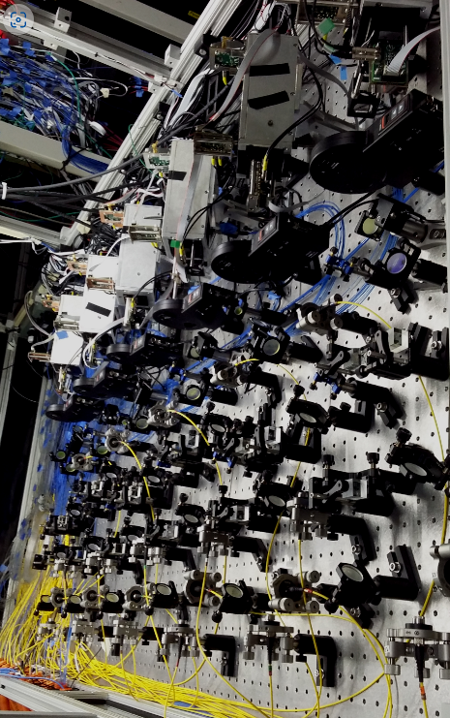
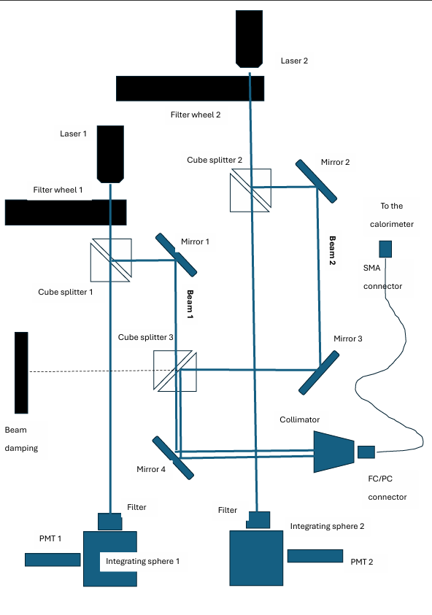
On-going systematic studies of g-2 calorimeter response to lasers
One of the calorimeter units was disassembled, sent to CENPA and reassembled for the studies
Optical components were borrowed from the breadboard and sent to CENPA to build the double pulser shown below
Subset of laser breadboard components needed to study SiPM responses in a single g-2 calorimeter unit
L2
FW 2
L1
FW 1
laser breadboard for all 24 g-2 calorimeter units

Slide 6
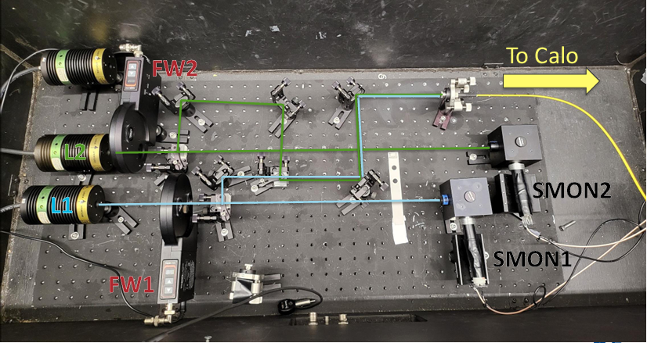
Dual laser pulser assembled from the optical components
While the laser wavelength is 403, not 355 nm, other optical components are equivalent, and we now have experience assembling and aligning a prototype calibration system

Slide 7
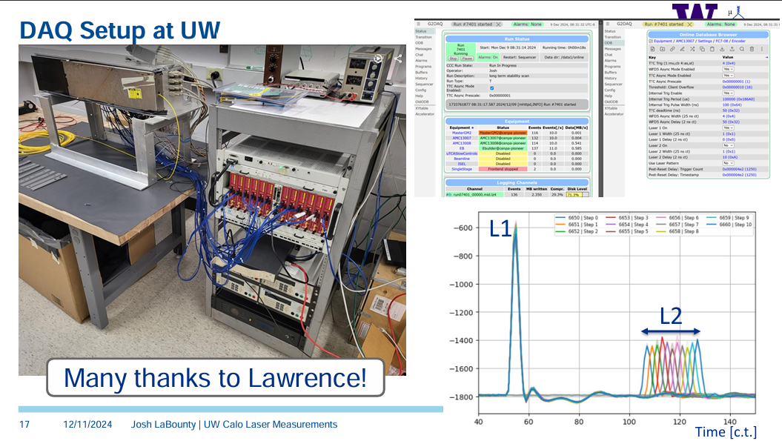

Slide 8
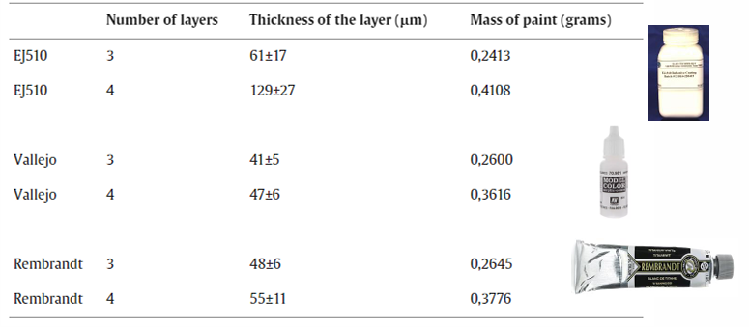
Covering crystal polygon shapes coatings
PiBETA Tapered CsI crystals (305 nm). Coated with wavelength shifting lacquer with chemical composition POP+POPOP+COUM.1
POP (305nm -> 385nm), POPOP (-> 410nm), COUM.1 ( -> 460nm)
L3 BGO calorimeter crystals (truncated pyramid shapes). Coated with reflective white paint (40 – 70 um thick)

Slide 9
Covering crystal polygon shapes
Wraps
BABAR - slightly tapered CsI(Tl) crystals(5x6, 6x6, 36 cm long) wrapped with Dupont Tyvek (porous chalk loaded polyethylene fleece)
BELLE - CsI truncated pyramid crystals wrapped with 200 um Goretex and 50 um aluminized polyethylene
PIONEER – previous rectangular LYSO crystals were wrapped with precut ESR (silvered polyethylene (76 um thick)) strips stacked between crystals
Not so easy with tapered LYSO polygon crystals. ESR is too stiff to bend around edges and adhesives may affect light uniformity (LU)

Slide 10
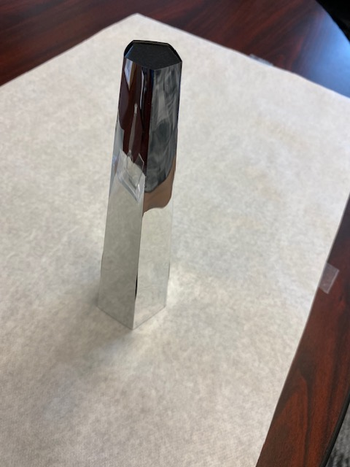
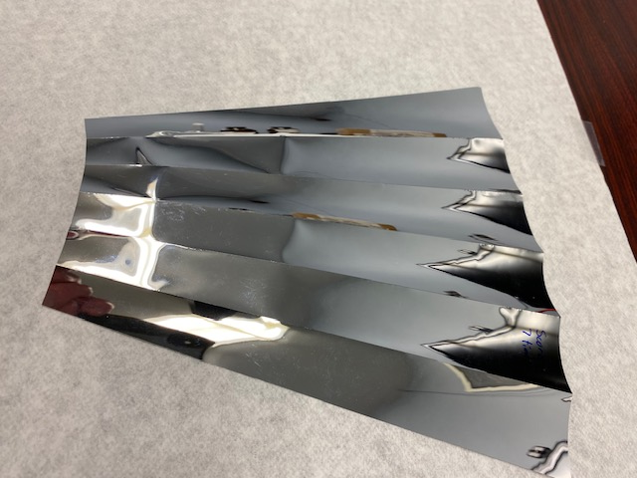
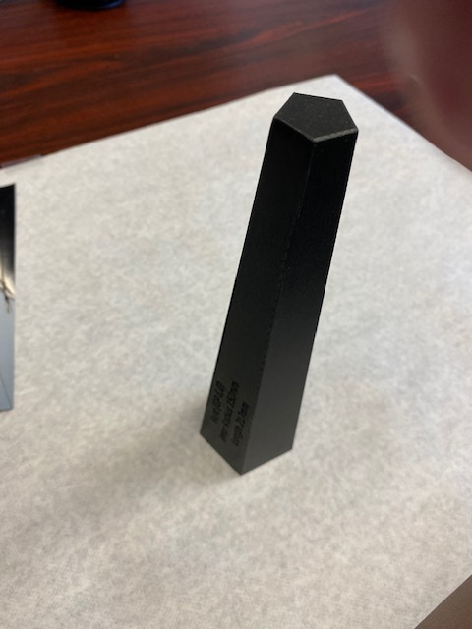
CAD drawing provides external surface of polygon unfolded as well as individual facet lines
Cutting the external shape out of ESR sheets takes 10 passes of the laser cutter
3D printed model of pentagon crystal shape
Using fewer passes, the laser cutter can scribe fold lines
Laser cut pentagon wrap with 6 pass fold scribe lines
3D pentagon model wrapped with ESR

Slide 13
