Slide 1
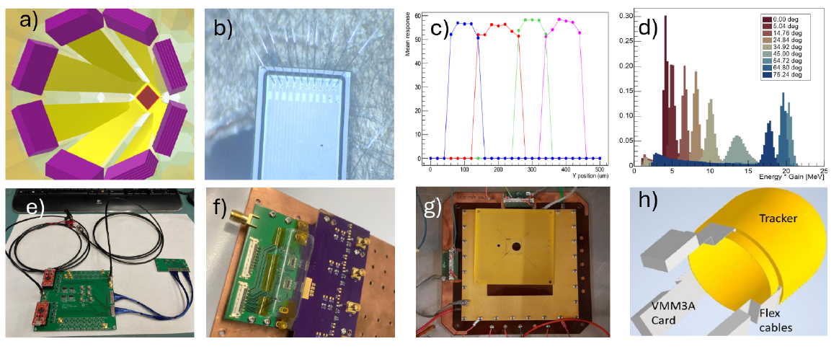
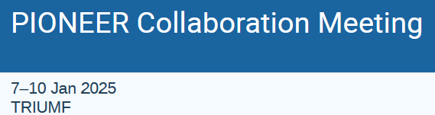
ATAR: Path to Demonstrator
Peter Kammel
Imaging System
Representing ATAR team: UCSC, UW, BNL
From NSF MidScale Preproposal

Slide 2
Outline
NSF Midscale goals
  Assemble realistic, large-scale prototypes of critical subsystems into a unified concept called the
  PIONEER Demonstrator and verify its performance through engineering runs.
  Develop each critical subsystem toward production readiness, validating scalability and
  ensuring quality control, documented assembly, commissioning protocols, and cost assessments.
This talk focuses on 1., but we have to keep 2. in mind.
  Compromise between readiness for 1 and achieving full requirements for 2.
Imaging system Demonstrator specs
Timeline
Tasks

Slide 3
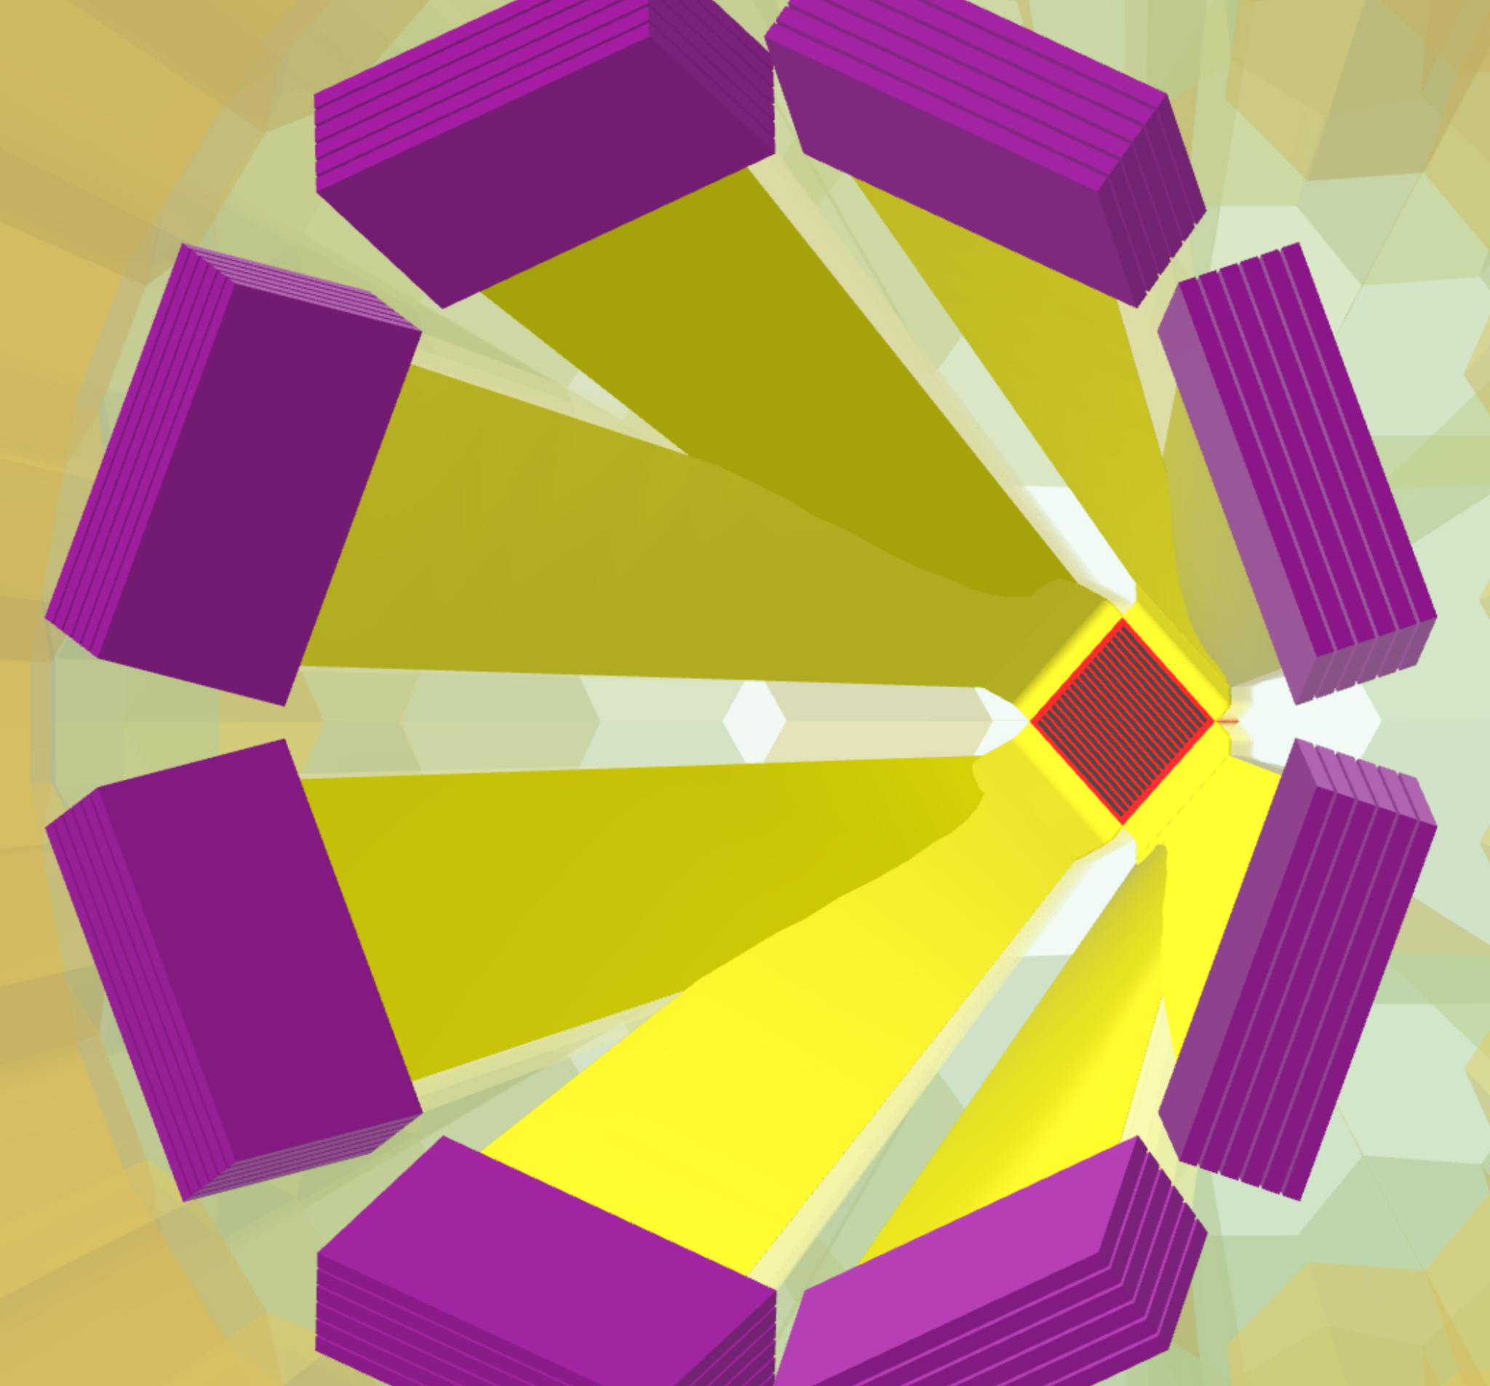
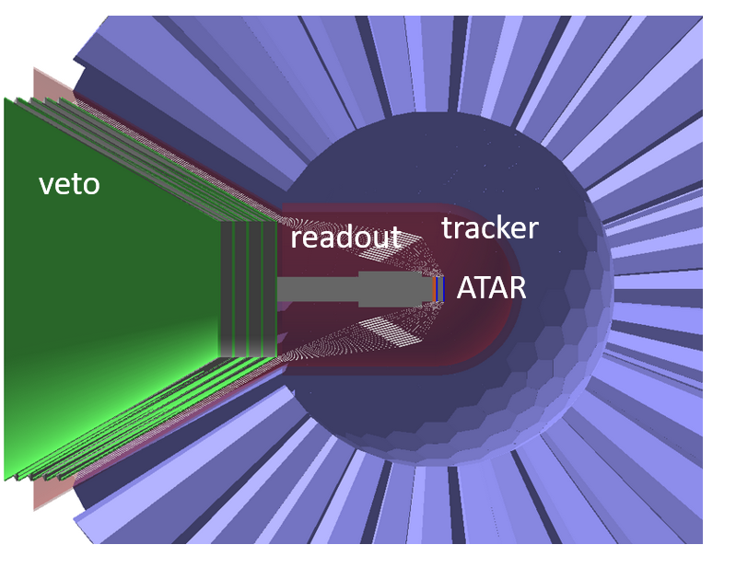
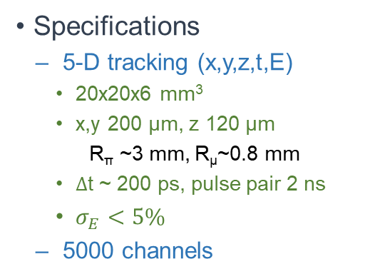
Overall Specs
ATAR (active target)
Integrated in beam entrance region
Specifications
  5-D tracking (x,y,z,t,E)
    20x20x6 mm³
    x,y 200 μm, z 120 μm
      R_{π} ~3 mm, R_{μ}~0.8 mm
    $Δ$t ~ 200 ps, pulse pair 2 ns
    $σ_{E}<5\%$
  5000 channels
PIONEER specific
  dynamic range few 100
      MIPS 40 keV – μ (4000 keV)
  minimal cross talk
  minimal dead material

Slide 4
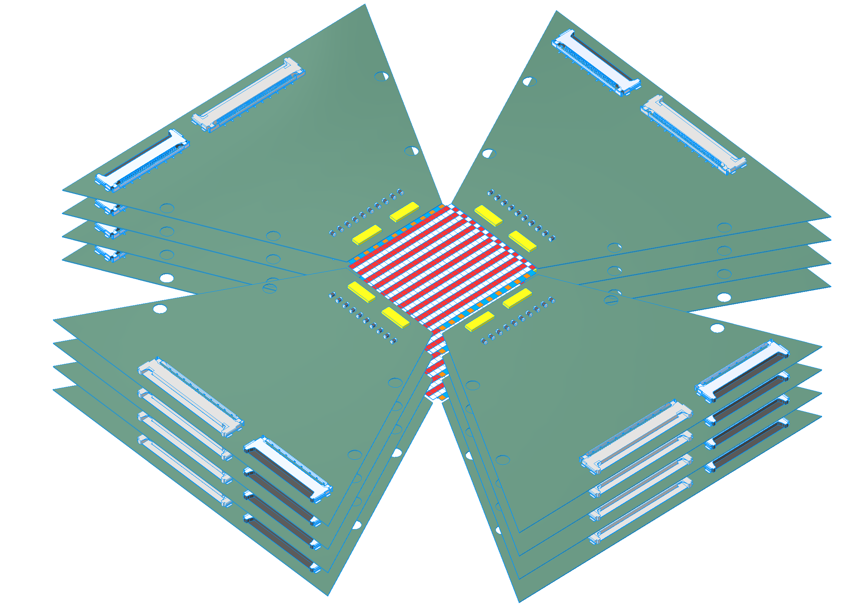
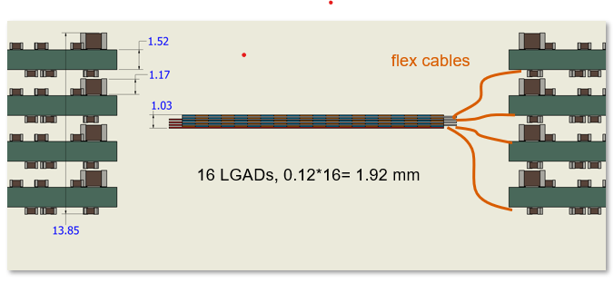
Imaging system Demonstrator specs
ATAR16
Tracker
  goal is nearly final version
  (definition ongoing)
Comments
  ATAR
    Sensor doping not ideal ?
    no flex or short 2-3 cm flex
      tight stack
      unobstructed sideways trajectories
    readout region simplest 6.4x6.4 mm, 1.6 mm thick
parameters | ATAR16 | ATAR | fraction of final
FAST3 per LGAD | 2 | 5
channel per FAST3 | 16 | 20
channels per LGAD | 32 | 100
strip pitch (mm) | 0.20 | 0.20
boards stack | 4 | 4
z LGAD (mm) | 0.10 | 0.12
x/y LGAD (mm) | 10 | 20
totals
LGADs | 16 | 48 | 0.33
FAST3 | 32 | 240 | 0.13
thickness (mm) | 1.60 | 5.76 | 0.28
channels | 512 | 4,800 | 0.11
not latest front-end board (FEB) design

Slide 5
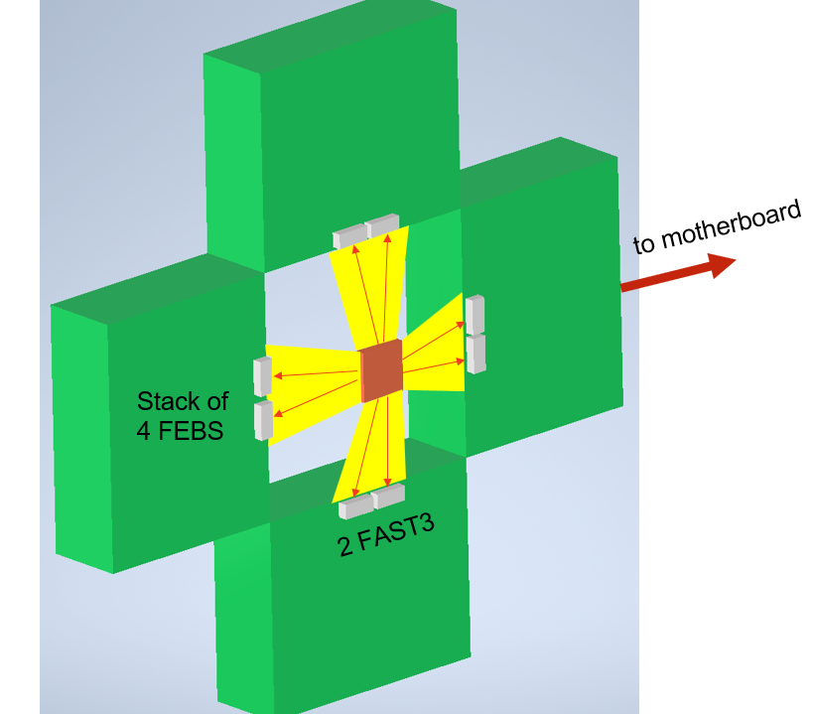
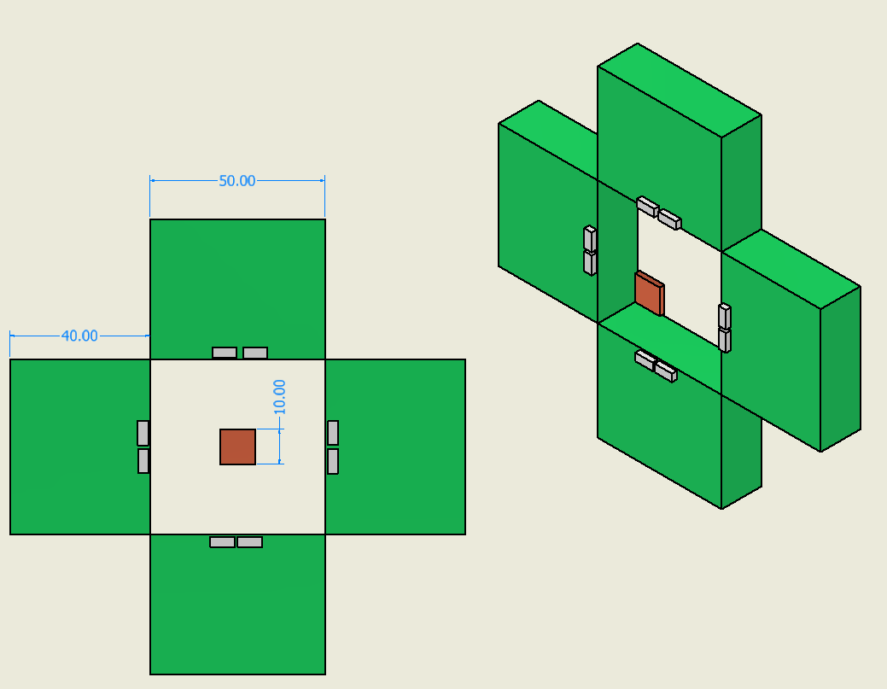
Baseline Design
my rough sketch, sorry Ryan

Slide 6
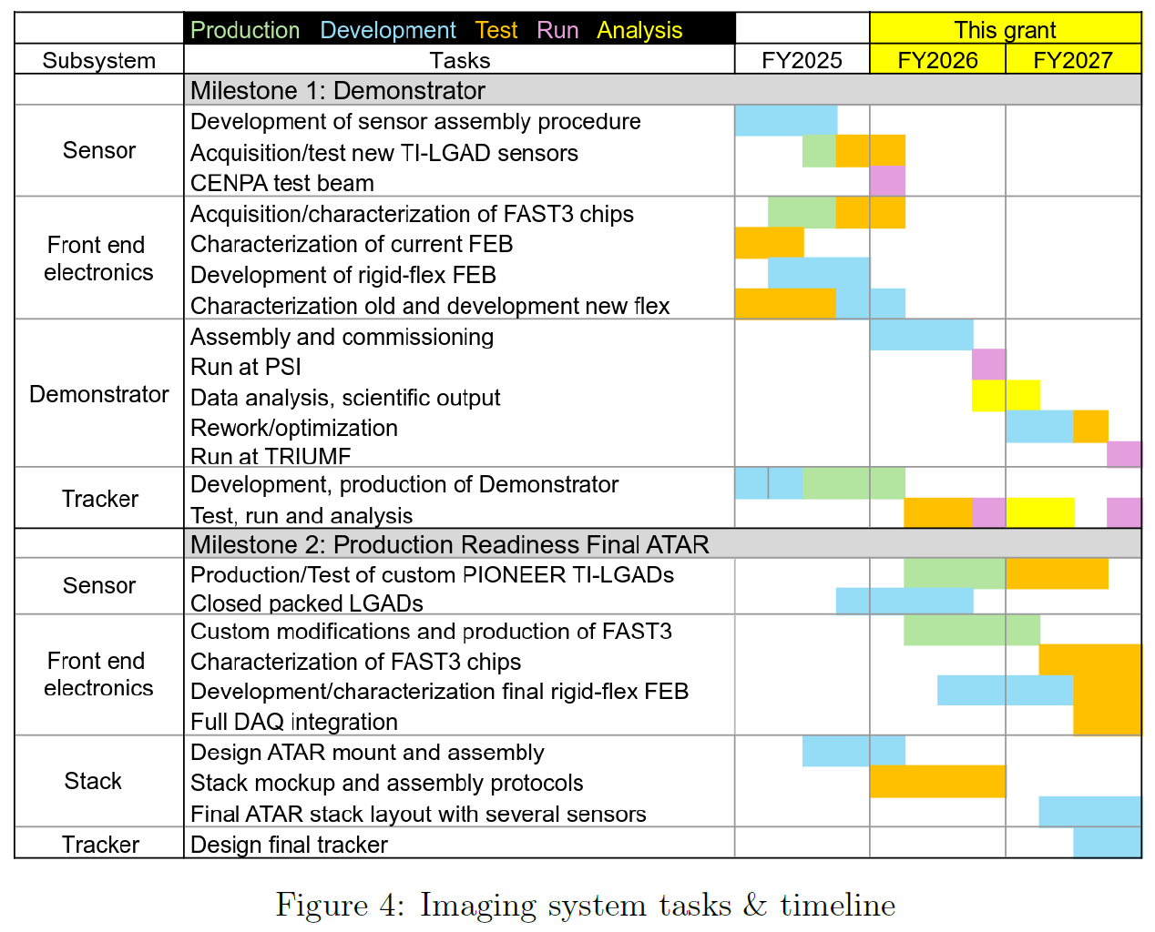
Tasks and Timeline
work packages:
Sensor
Front end electronics
Demonstrator
ATAR stack and integration
Tracker

Slide 7
Sensor
Demonstrator
Test flex bonding with wires, Sp-Tab or glueing
onto sensors
Build double, quadruple LGAD assemblies and characterize their performance
Test full strip detector in CENPA test beam with
proton extraction to air
Purchase 30 new TI LGADs, production by FBK
Production readiness
Gain saturation
  Current FBK sensor lacks in gain saturation
  Can that be improved for 2025 production?
  Need continued gain optimization
  improved TCAD modelling
  test various prototypes
  new doping ideas
  of course, impact via simulation
Sensor thinning iterations
Final dedicated FBK production
Definitely needs new funding

Slide 8
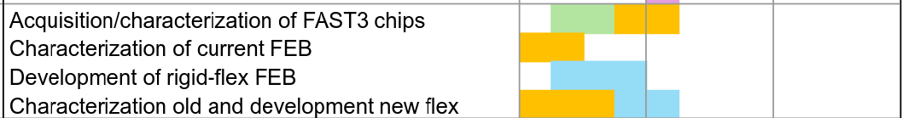
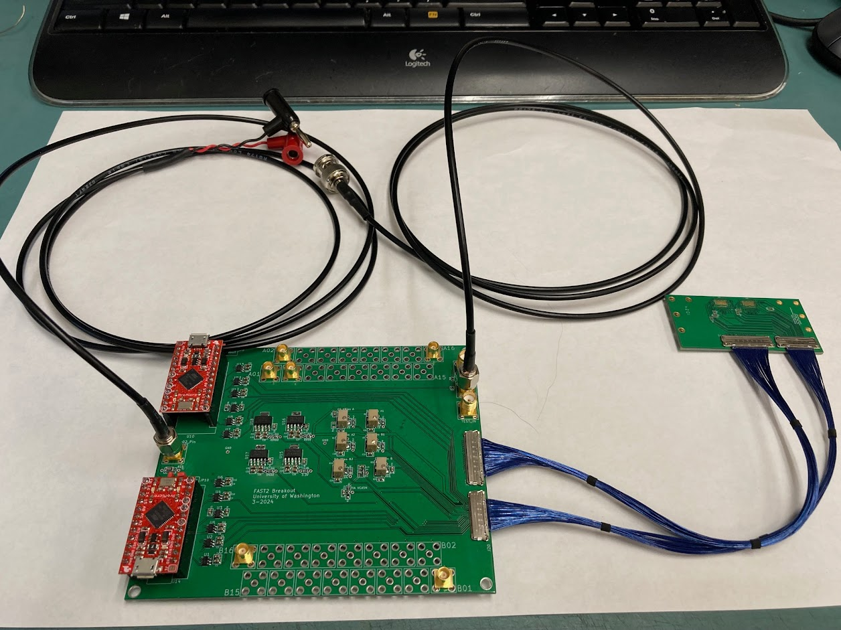
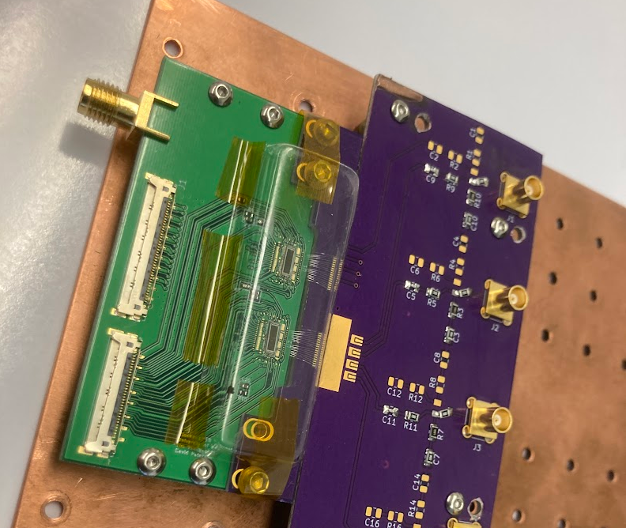
Front-end electronics
Demonstrator
FEB board with 32 developed at CENPA
  need test of full sensor
  debug gain control on FAST3
Construct new compact rigid-flex FEB towards final ATAR
Purchase packaged FAST3 chip from INFN Torino once available
Production readiness
FEB
  expand new FEB to full channel count
  after test full production quality boards and flexes
FAST3
  Torino agreed to modify to 20 ch/chip and other optional upgrades (input impedance, control logic)

Slide 9
Front-end electronics
FLEX
Demonstrator
FLEX issues
  flex impedance limited to ~50 Ohm
  cross talk under investigation (UCSC, UW)
  impedance FAST (UW studies)
    FAST2: impedance higher than spice simulation
    FAST3: issues with gain control logic
    measure FAST3 impedance
    input impedance highly gain dependent, need to fix gain
UW: way forward
  design variants of 3, 6, 15 cm flexes
    50 Ohm, different spacings, double sided option
  test with
    test signal and sensor
    input impedance matching network
Production readiness
Demonstrate 15 cm flex
Is impedance matching network required?
FEB
  expand new FEB to full channel count
  after test full production quality boards and flexes
FAST3
  Torino agreed to modify to 20 ch/chip and other optional upgrades (input impedance, control logic)

Slide 10
Stack
Demonstrator
Parylene coating for sensor stack
  full coating
  selective window frame masking
performance validation
  HV and signal integrity tests
Production readiness
Designing and assembling mechanical support
of fragile sensors with strain relief
Constructing mechanical mock-ups to gain hands-on experience
Conducting integration studies of the complete imaging system
within the spatial constraints of the beam entrance region.

Slide 11
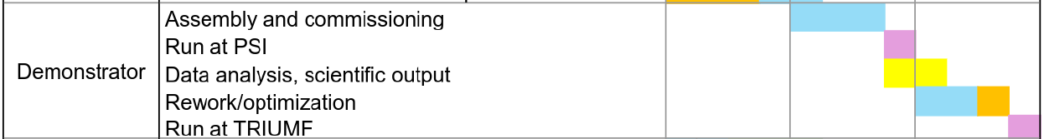
Demonstrator
Demonstrator
Main components available early 2026
  30 new TI_LGADs
  50 new packagedFAST3
  new 32ch rigid FLEX board
Assemble and fully commission at UW
  basic hardware systems
  readout development and debugging
  analysis
Run at PSI end 2026
This is super tight !

Slide 12
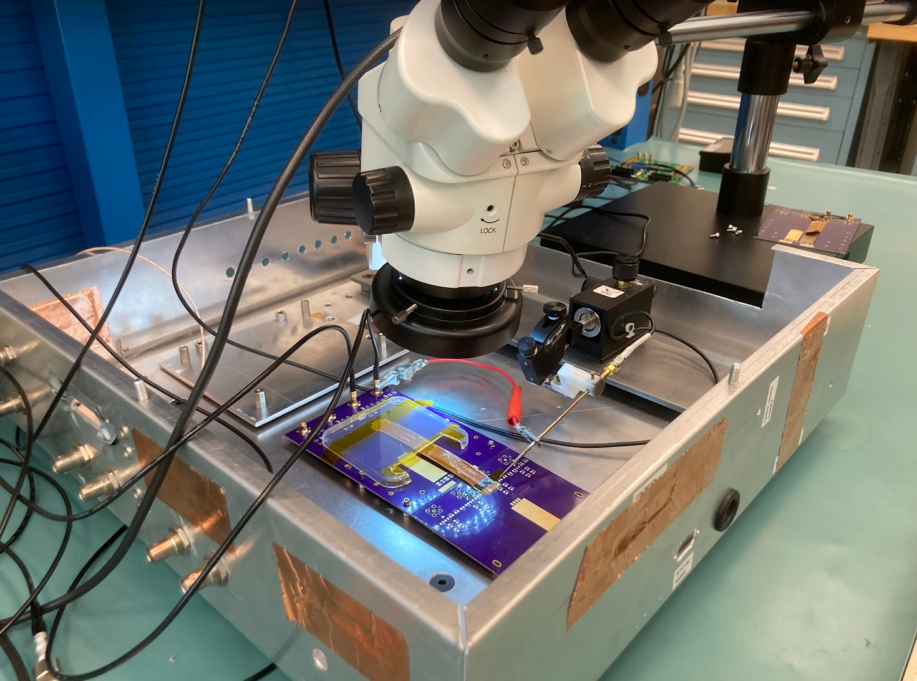
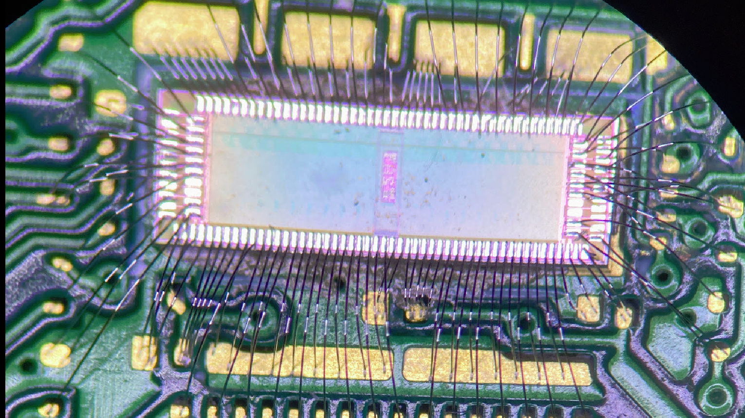
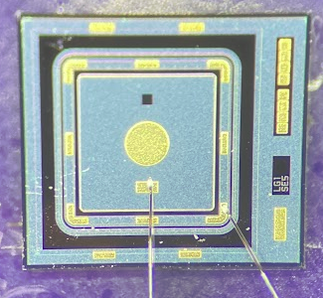
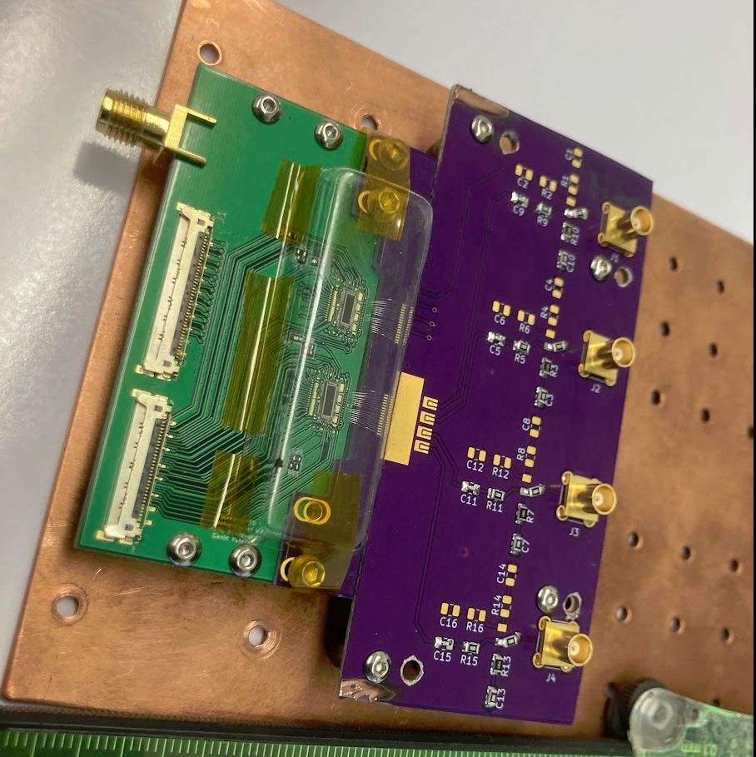
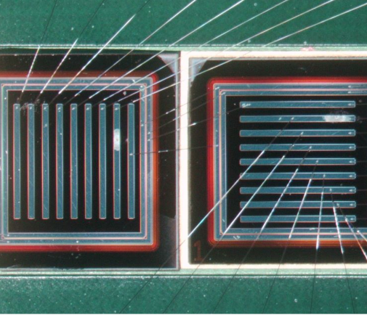
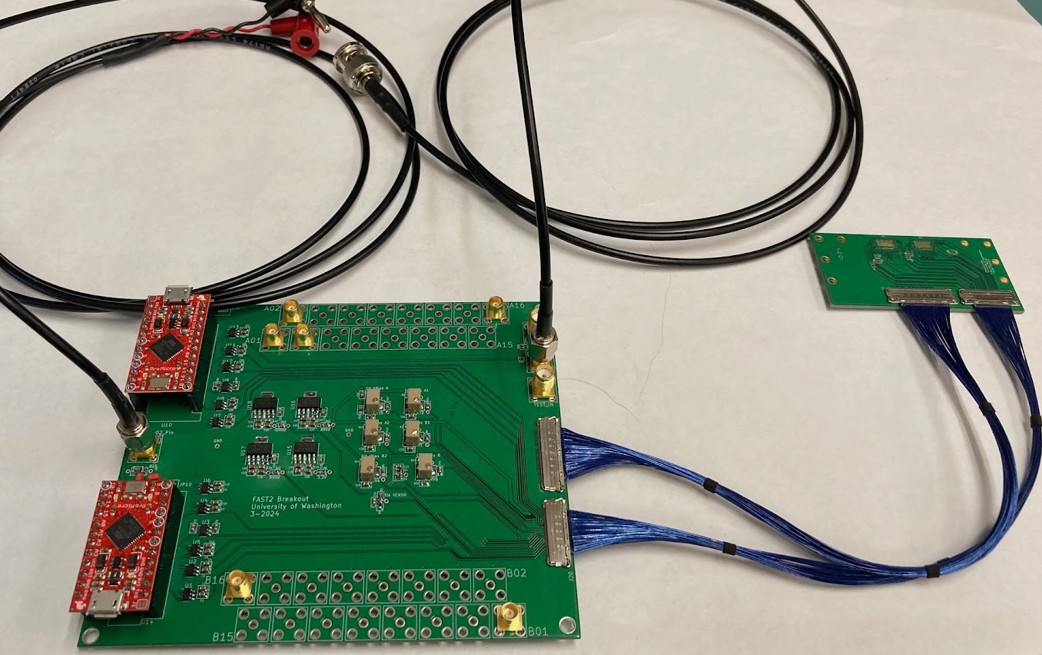
Final thoughts
A lot, but exciting work, very ambitious
Keeping UW and UCSC group strong is vital for progress
  For UCSC funding critical
  For UW strengthening ATAR team with
  young members critical
TRIUMF beam in 2027 gives us important
breathing space
Integration with simulation effort essential,
not covered here

Slide 13
Backup

Slide 14
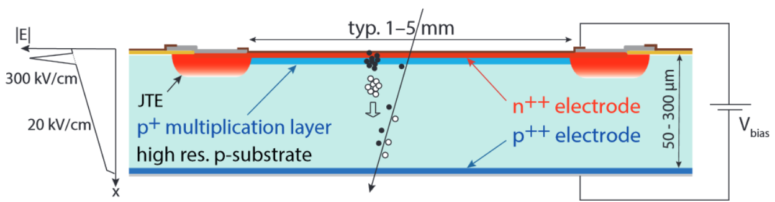
Scope: R&D components
Sensor
  Low Gain Avalanche Diodes LGADs
  R&D for PIONEER custom detector under way
Readout and electronics
  Front end chip
  Front end boards (FEBs)
  High density integration with rigid-flex
ATAR stack and integration
  Double/triple LGAD construction and characterization
  Stack assembly and mechanical support
Engineering runs
  @CENPA
  @PSI
LGAD schematic and
Electric field profile
  Si sensors with gain layer
  moderate gain (10-50), thin, fast
Main UW responsibilities, but tightly coupled with sensor development

Slide 15
Achievement and Infrastructure
At beginning of grant (2021) technology new to us
By now significant knowledge, infrastructure and experience
  Mini probe station at CENPA
  Produced FEB (front end board) prototype
  Debugged circuit on bond wire level, characterized FAST3 front end chip
  Prototyping setup for flex
  Parylene coating at Nanofabrication Facility
  Capable of handling sensor to electronic chain in house

Slide 16
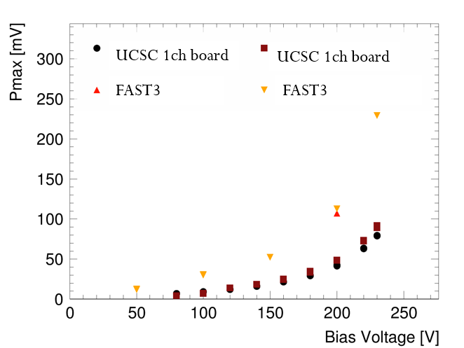
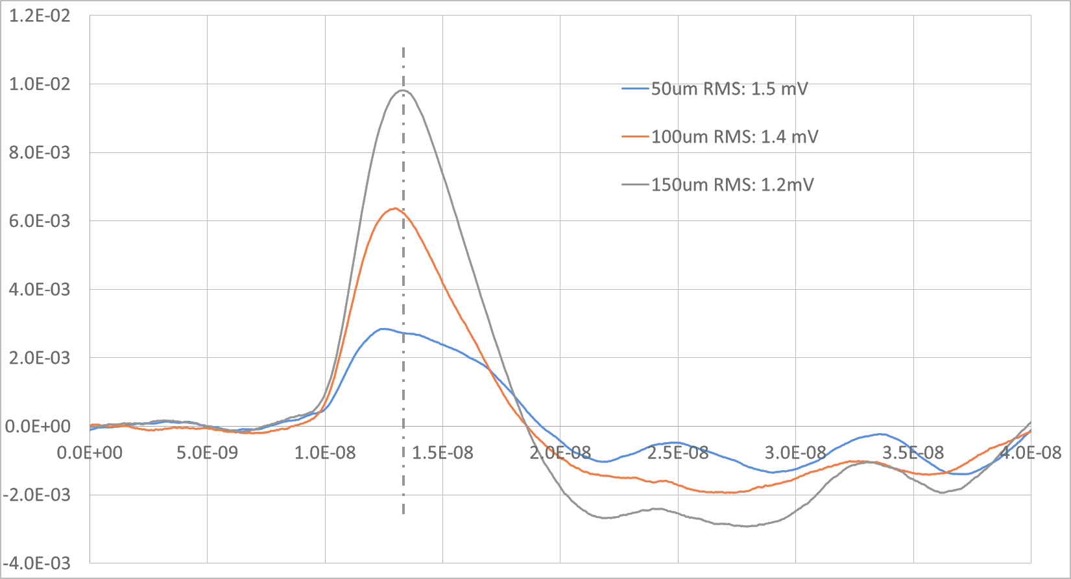
FAST3 dynamic testing
Tested FAST with HPK 3.1 50 um thick single pad LGAD sensors and same geometry PIN detector (4.2 pF input capacitance)
  RMS noise in both cases is around 1 mV
Response to LGAD better than expected
(~10-15 mV/fC, expected 10 mV/fC)
For 50 um PIN less than (naively) expected
  expect a signal >5mV (S/N > 5),
  observed S/N to 4
  probably ballistic deficit (PIN signal is too fast)
For a 150 um PIN device we get a S/N > 10!
  Possible option for PIN version using
  thicker ATAR layers?
  Pmax scales with thickness
Simone, UCSC

Slide 17
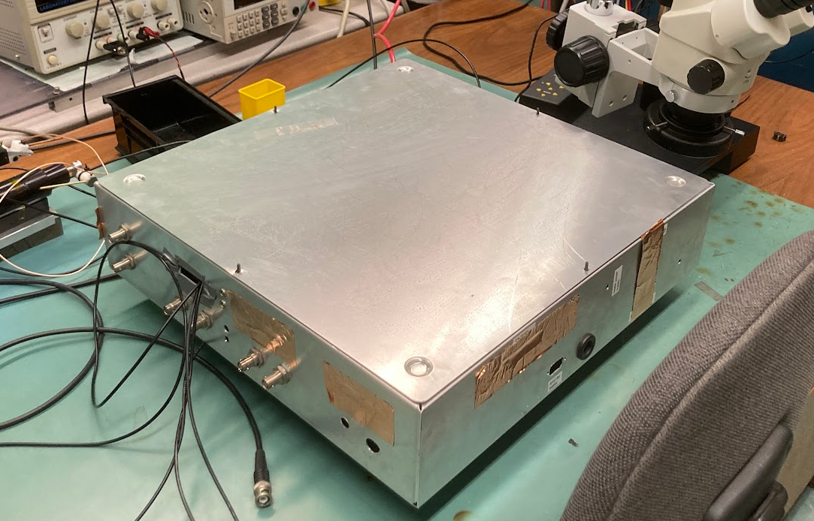
Infrastructure development @ UW
Mini Probe Station
  Shielded probe station
  3 probes on micro positioners, one “RF” probe
  Flexible and well-grounded mounting plate to
  test various LGAD-flex-electronics combination
Parylene coating
at Washington Nanofabrication Facility
Marcel
Powerful radio stations in Seattle

Slide 18
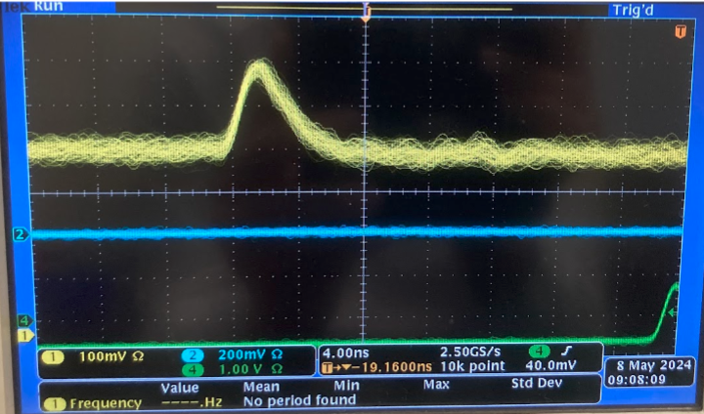
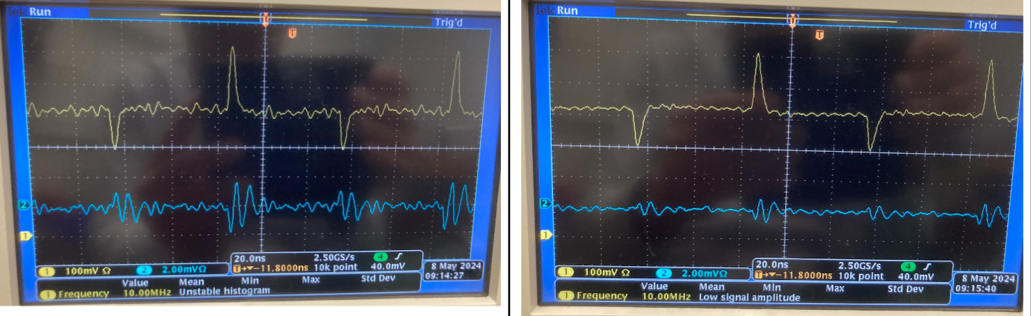
pFEB Status
Performance from initial tests
    basic functionality ok
    signal shape ok
    Cross talk sub percent
    noise 1.3-1.7 mV,
    somewhat better than UCSC board, lower bandwidth?
    dynamic range still problematic. Signal flattens out after 200 mV
    RF pickup with probe tricky
pFEB system
  Small front-end board for two FAST2 (32 channels)
  Low voltage periphery on mother board
  Connection analog and supply
    I-PEX CABLINE®-CA II
4ns
pFEB system
pFEB
Next channel
Far channel
100 mV scale
2 mV scale
Mother board

Slide 19
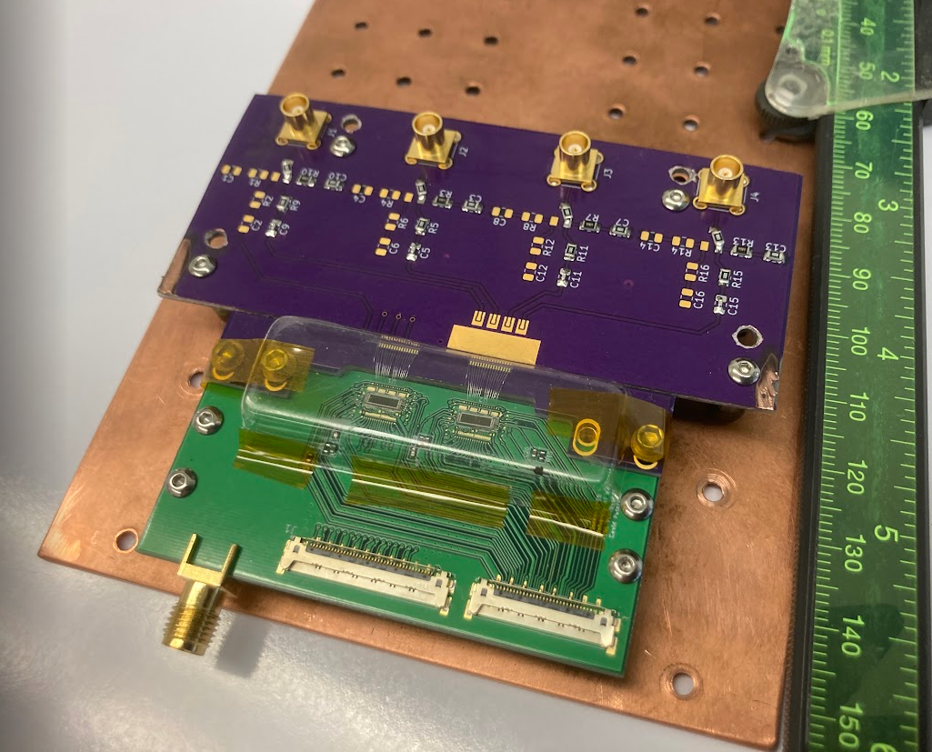
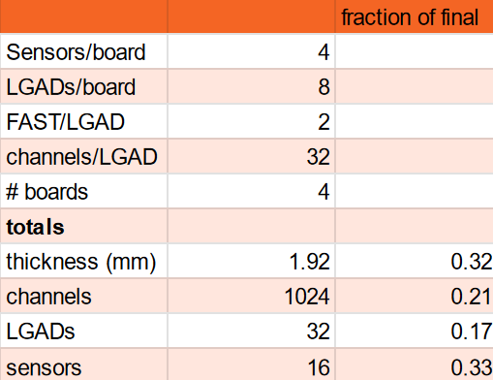
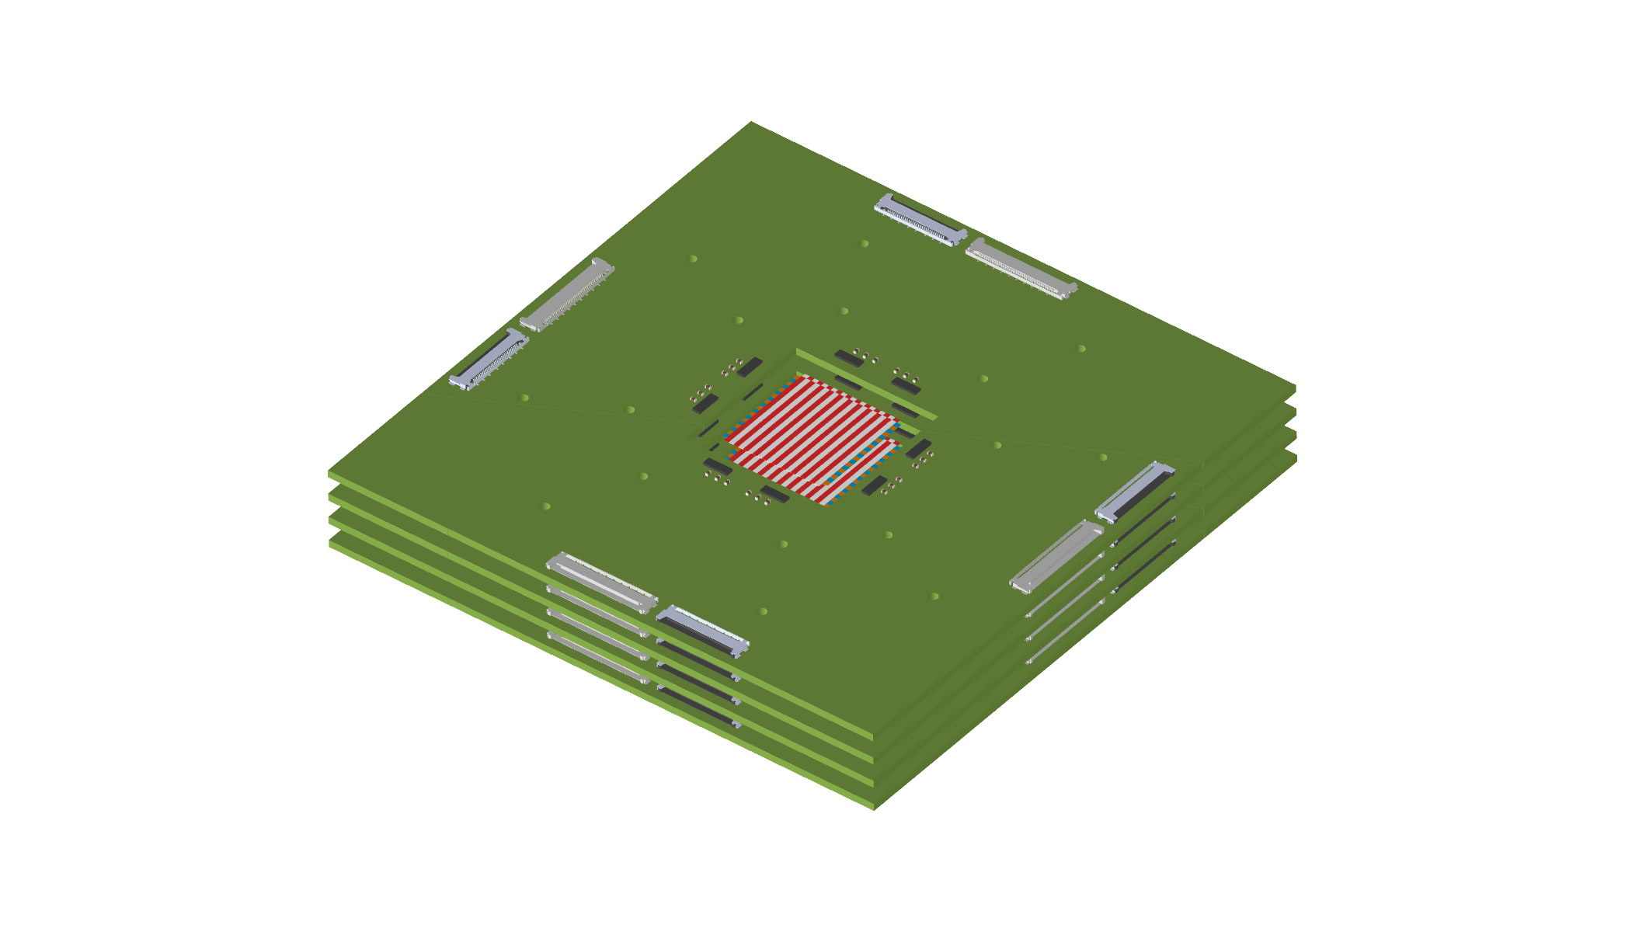
pFEB Plans
Testing
  Repeat basic tests with
  2nd board and SMA
  charge injection
  Advanced tests
    explore bit pattern gain control on Arduino, maybe hardware issue
    check all channels V vs charge, 4 SMA inputs
      measure cross talk as well
      measure FAST2 gain
      measure FAST input impedance (gain dependent)
    measure allowed range of V, I of low voltage supplies
      criteria
        pulse shape
        V vs charge
    establish DAQ with SAMPIC (11 bit, SCA cells, 1V, BW>1GHz)
    other commissioning tests ?
    strip LGAD - FEB, many channels
    strip LGAD - Flex - FEB
Recap 2026 configuration
test board
pFEB with test board
pFEB

Slide 20
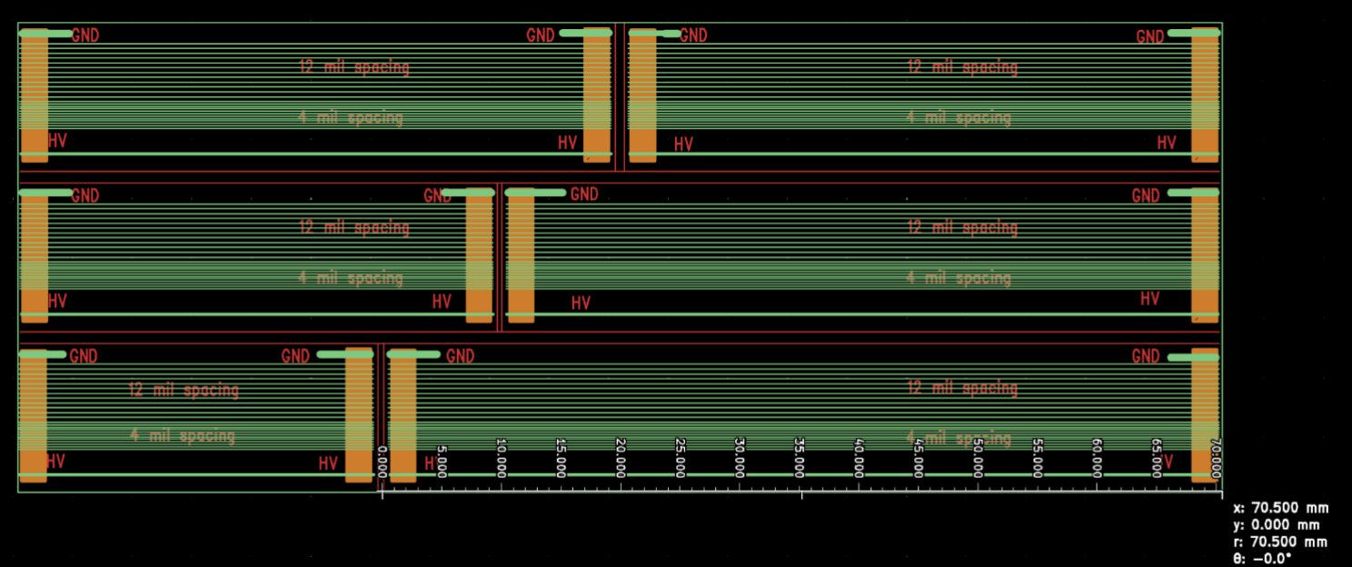
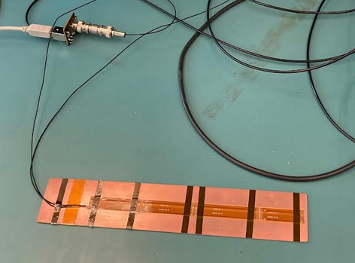
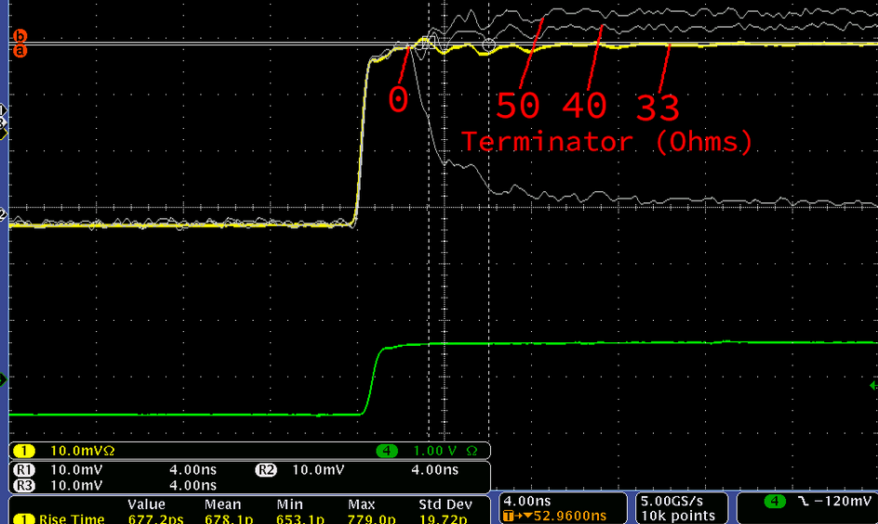
Flex
Flex between LGAD and electronics unusual,
but unavoidable for PIONEER
Independent studies at UCSC and UW
Issues
  Cross talk
    For a long time UCSC measured ~10% for 5cm cable,
    see discussion. Not expected from UW calculations
  Poor impedance matching of present flex design
    33 Ohm (Tim and David)
  Additional capacitance
    Calcs Peter and Tim: 1-2 pF/cm depending on design
  Noise pickup
Goal
  Understand and design optimal flex

Slide 21
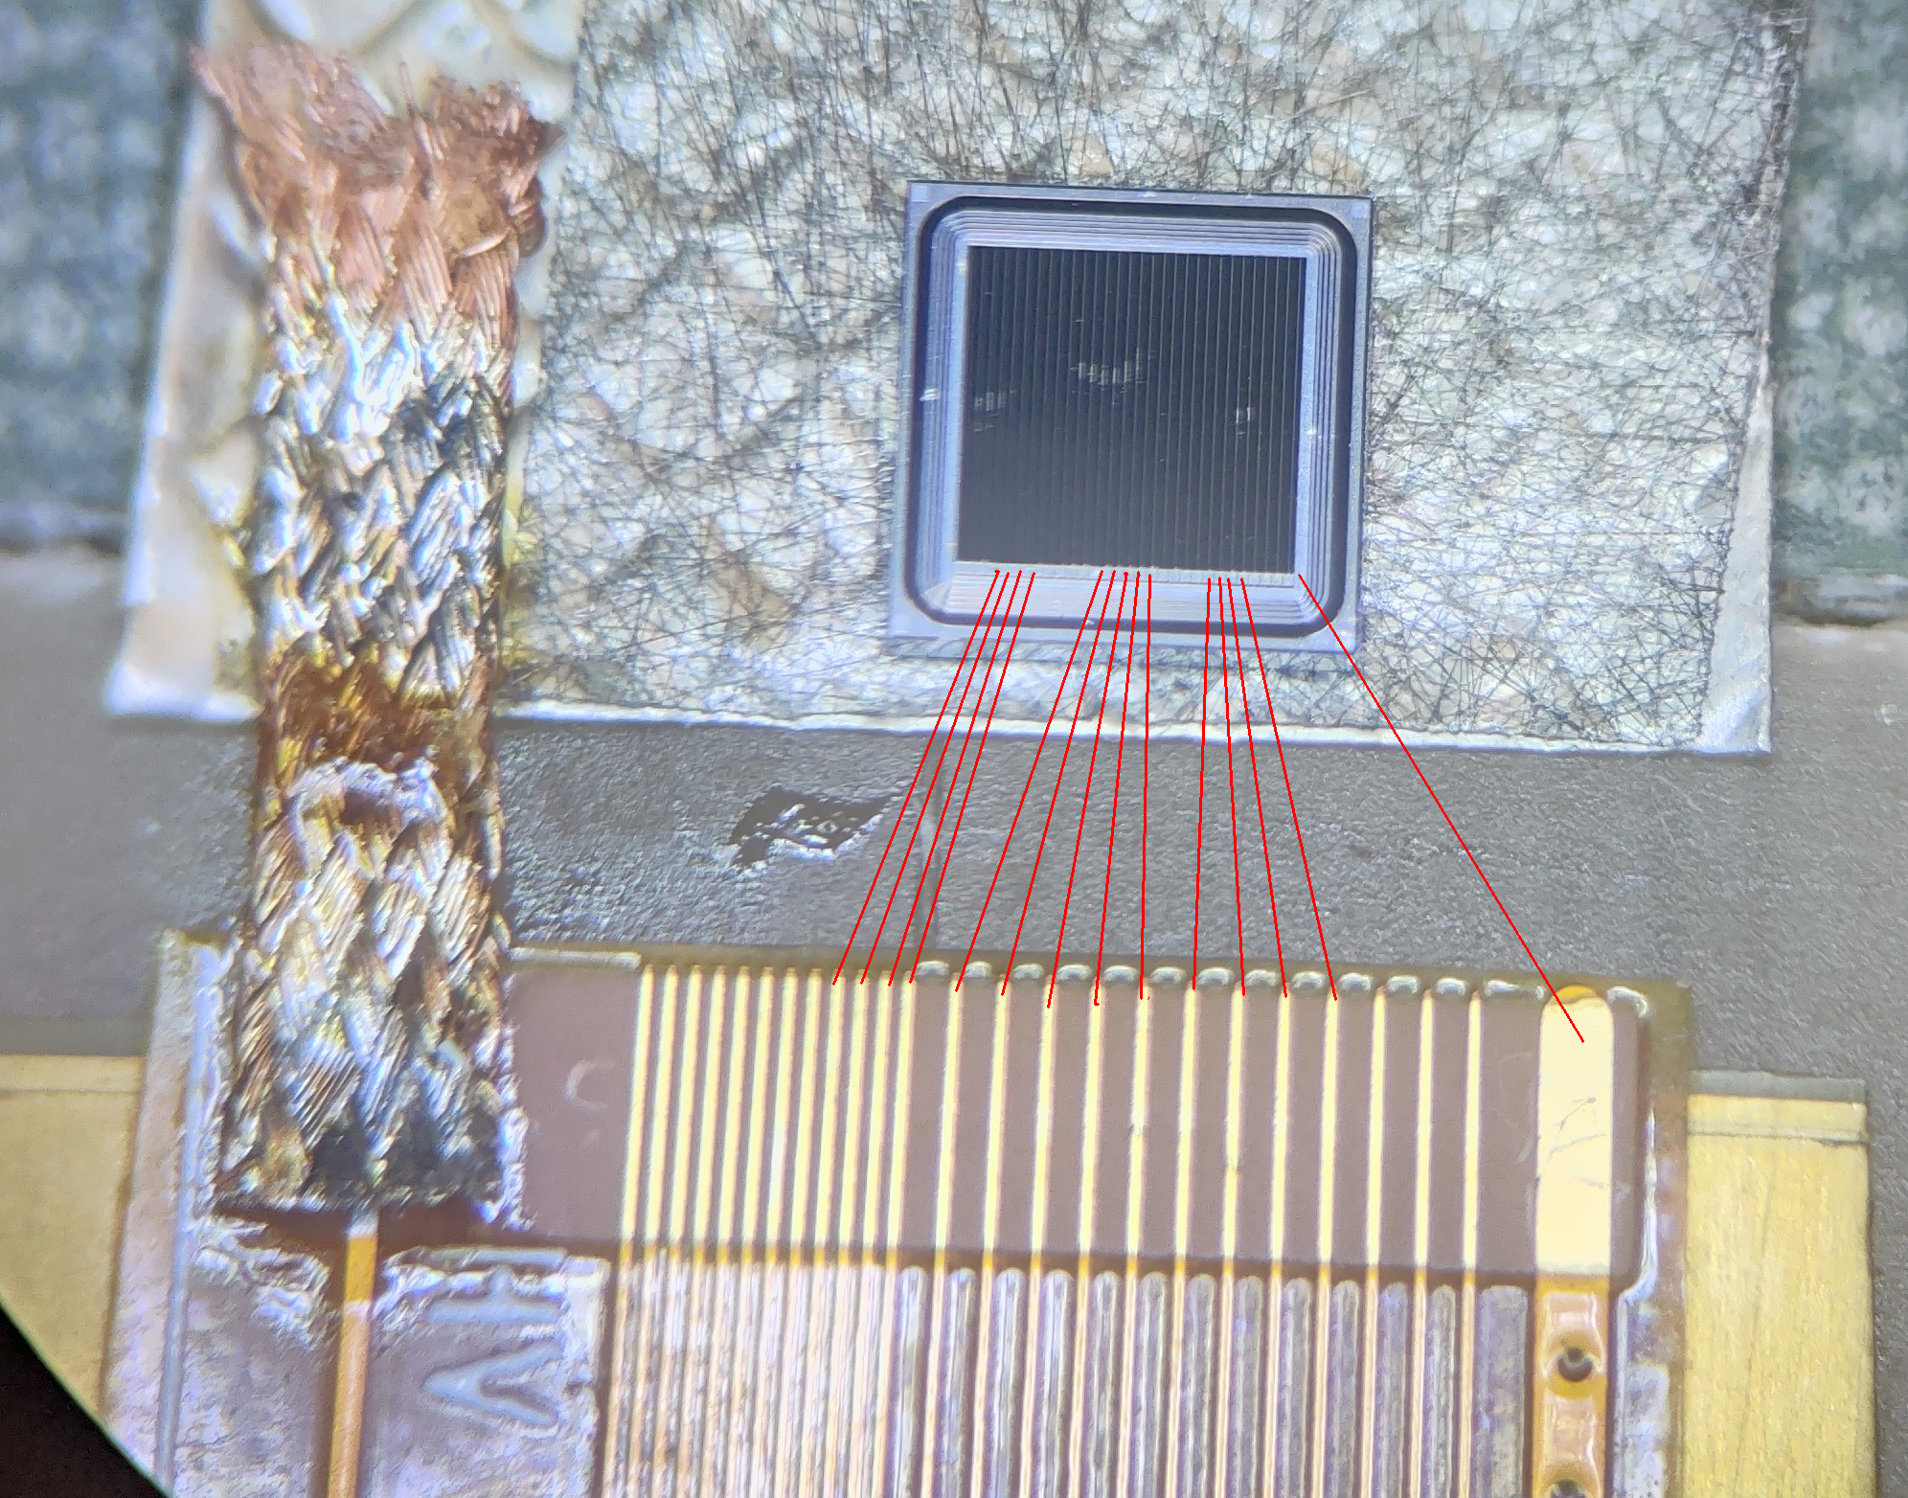
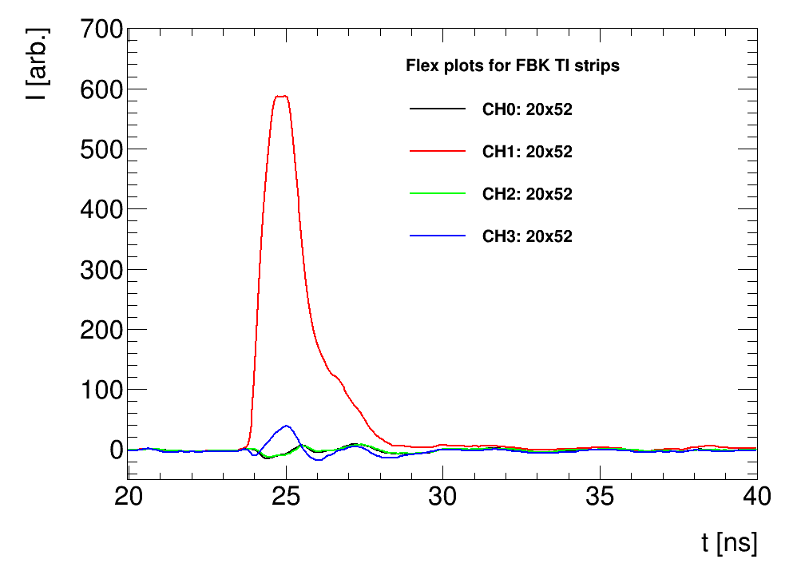
New Flex measurements UCSC
Issue of higher-than-expected cross talk in the flex over
long distance
Setup with injection probe had high external pickup and reflection issues
Tested again with mounted sensor to have cleaner (and more realistic) signal injection
  FBK TI-LGAD strip sensor
  Laser on top of CH1
  Ch3 neighbor, Ch1 and Ch2 far away strips
Results
  No cross talk from strips connected to the board (how it will be in PIONEER)
  Cross talk with first neighbor ~10%
  Long range cross talk is minimal
  Cross talk from the gold grounding pin that was also used for
  previous needle tests!
Long range crosstalk
Simone, UCSC

Slide 22
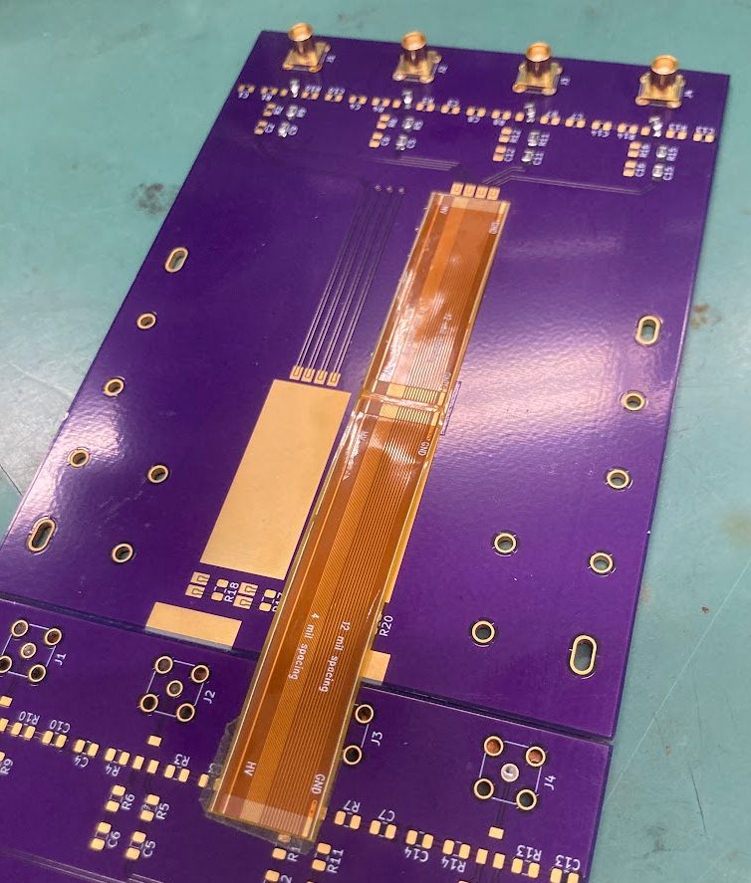
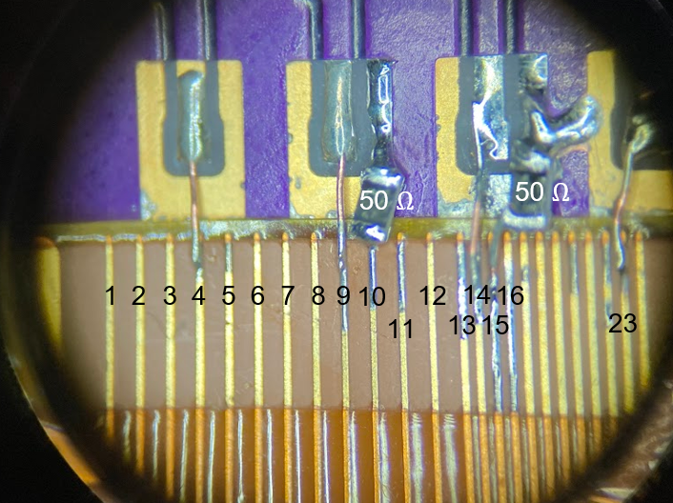
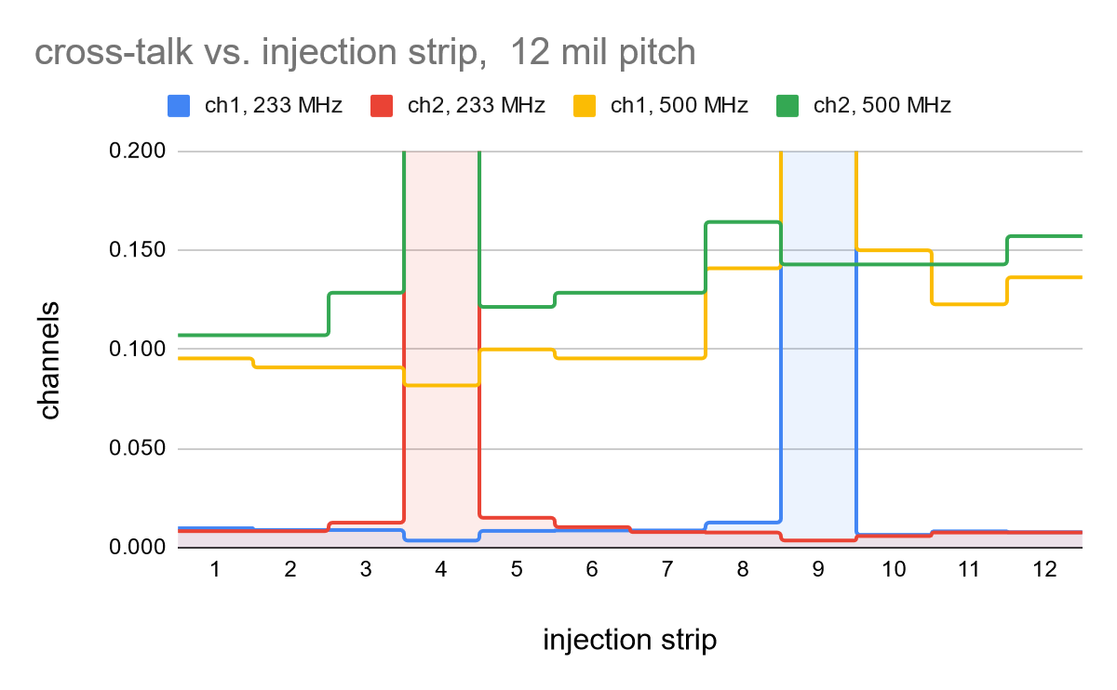
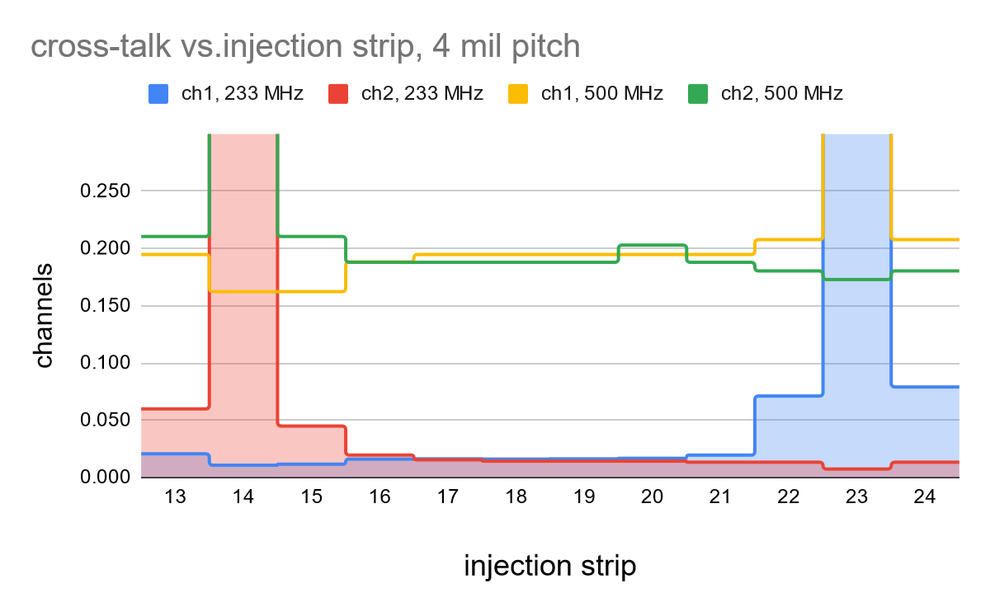
UW Flex Tests
Tests (clean set-up, 10 cm flex)
  Pulse injection
  RF generator
First prelim. Results
  233 MHz ~ 1.5 ns
    far cross talk and next neighbor <1%, 300µm pitch
    far cross talk < 1.6%, NN < 8%, 100µm pitch
  But strong frequency dependency
    We might get away, but better be careful
  syst. measurements with new setup starting
Further plans
  Match flex impedance
  Measure with pFEB and LGAD
  Design optimized flex
10 cm
Measurements 6/18/2024

Slide 23
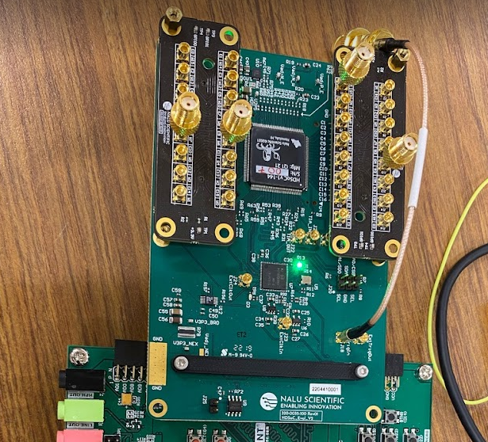
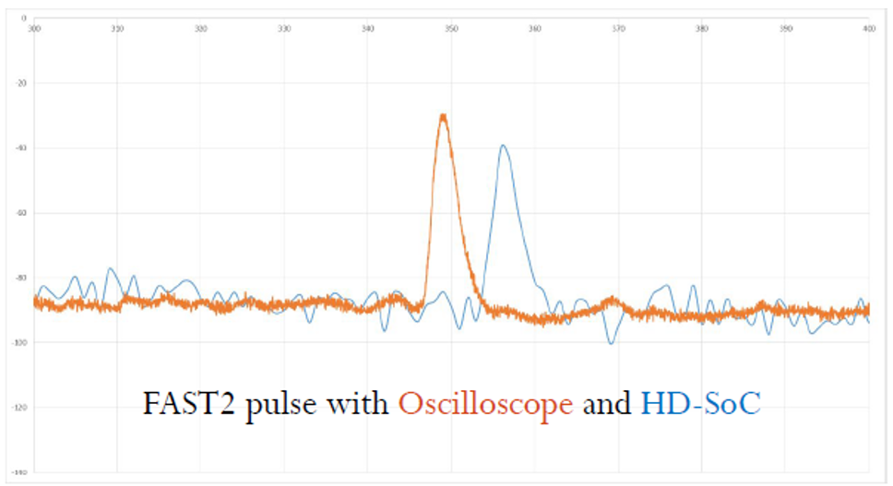
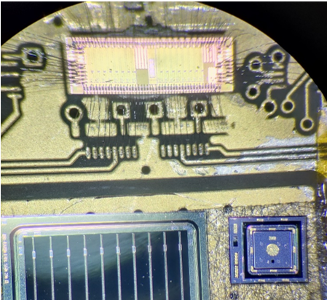
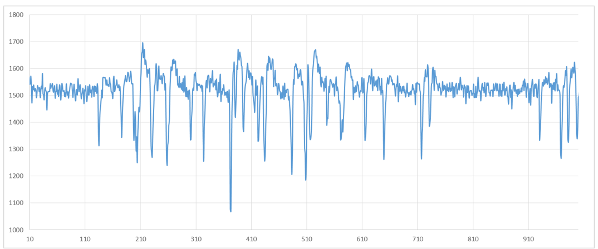
Digitizer HD-Soc from Nalu
HD-SoC from Nalu Scientific in evaluation at UCSC:
  32 channel (Next version: 64 channels)
  1Gs/s digitizer chip (might be up to 2Gs/s)
  Buffer length 1024: 1 us window
  2.5 Vpp, 12-bits
Collaboration with Nalu Scientific to understand the triggering capabilities of the chip
  Trying the right firmware/software recipe to get to 2Gs/s
FAST3 and HD-Soc tested at SSRL
  using oscilloscope and HD-SOC digitizer
    Test-beam two weeks ago, will analyze data in the next months
  Single pad HPK 3.1 and HPK AC-LGAD 2 cm strips
  Result of FAST3 and HD-SoC, 1us of time window
    Useful to test repetition rate capabilities of this setup
Simone, UCSC

Slide 24
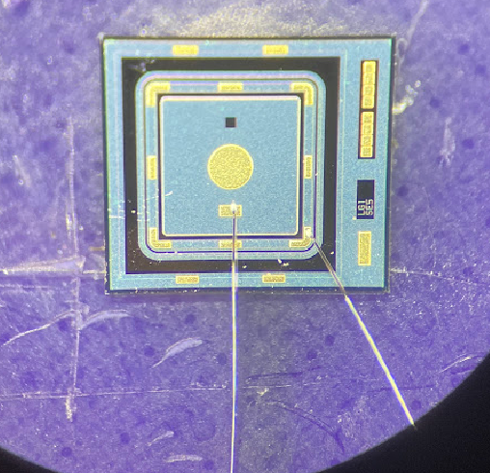
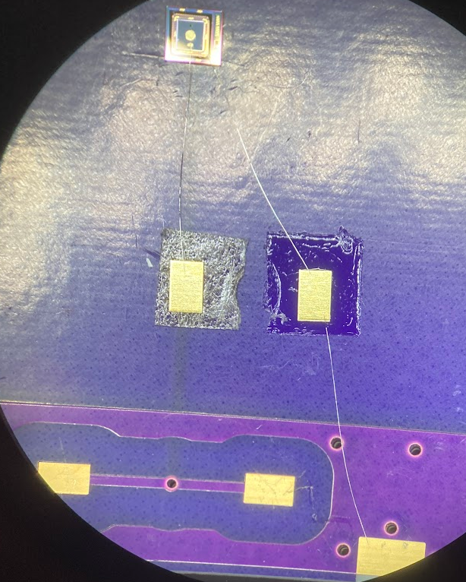
Parylene Coating
Marcel applied 5um parylene to copper plates at Washington Nanofabrication Facility
Peter’s tests
  First plate
  I placed the parylene covered plate on the bare plate and applied HV with a chamber power supply, with a fast trip. I could reach 500 V, then the HV tripped. Afterwards, it tripped at 400 and then at 350V.
  Second plate
  The 2nd plate was better (with the same bare copper plate). I left it on 500V for 30-40 min, and then ramped up to 800V, at which point it tripped. Afterwards it always tripped at 350V. Apparently the spark destroys the
  parylene cover, leading to lower dielectric strength.
  These are promising results and are reasonable relative to the quoted dielectric strength: 276 V/micron at
  25.4microns. Potential poorer performance can be due to our surface roughness. I suggest using 8 um in
  the future to play it safe.
Produced boards for parylene coating
  Example of Theresa’s board
  Will be coated after I-V test
Marcel will try photolithography on parylene
  That would allow selective coverage, no parylene over
  active LGAD region

Slide 25
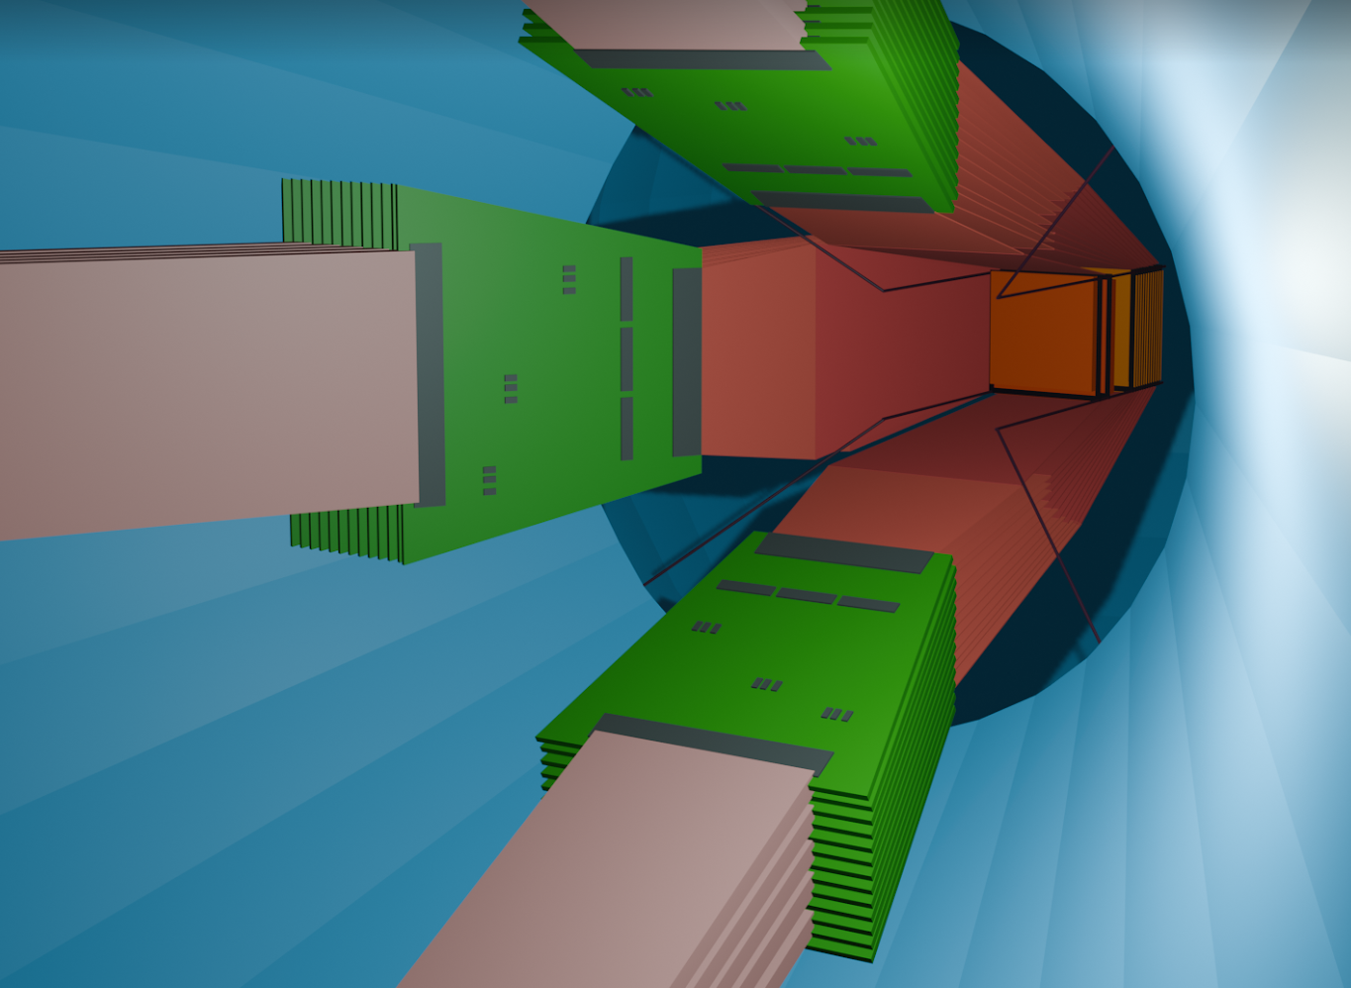
Read Out within Overall ATAR R&D
Update from my PSI BVR 2024 presentation
Development directions
  optimal customized PIONEER sensor
    fully depleted 120 µm sensor, minimal dead material
    minimal cross talk, small gain saturation, large dynamic range
  Interface and Electronics for 5000 channels
    frontend chips and board
    flex
    digitizer
  Integration into stack with minimal dead material
Goals 2024
  Sensors
    Characterization of
      new BNL sensors and
      TI-LGADs and thicker LGADs from FBK
    Acquisition of thin, double-sided Silicon sensors from Micron
    Study of new LGAD devices with test beams at SSRL and CENPA
    Conclude analysis of the PSI test beam data
  Electronics
    multi-sensor pFEB testing with sensors, towards sensor stack
    Testing readout chips for low-noise PIN readout ?
    Fabrication of improved flexes after tests and simulation
    Digitizer development based on Nalu HDSoc chip
  Integration
    Sensor thinning (good enough, alternatives?)
    Double LGAD
    Two sensors close packed and insulated by parylene

Slide 26
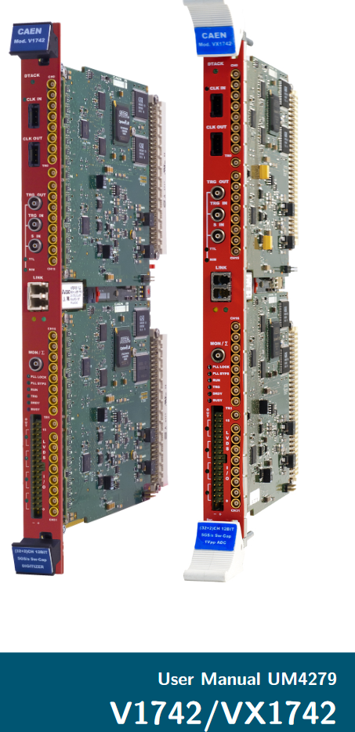
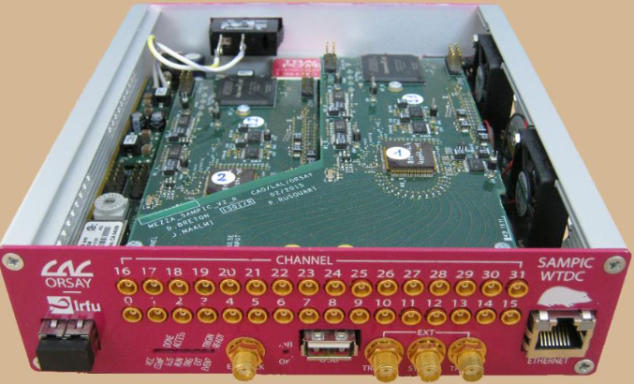
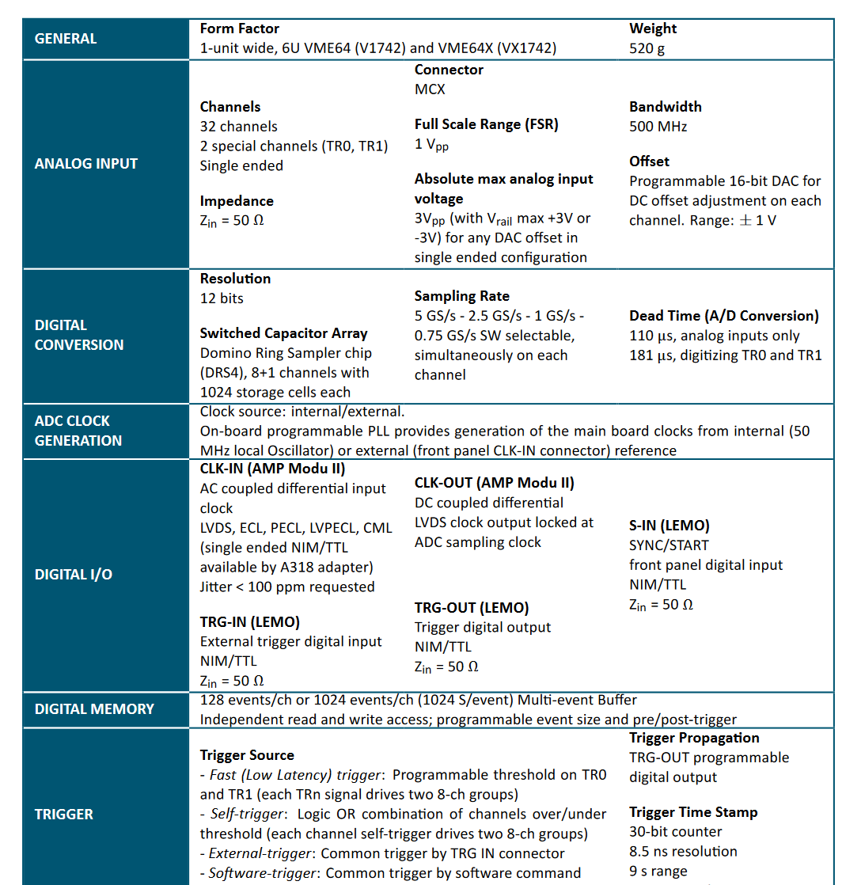
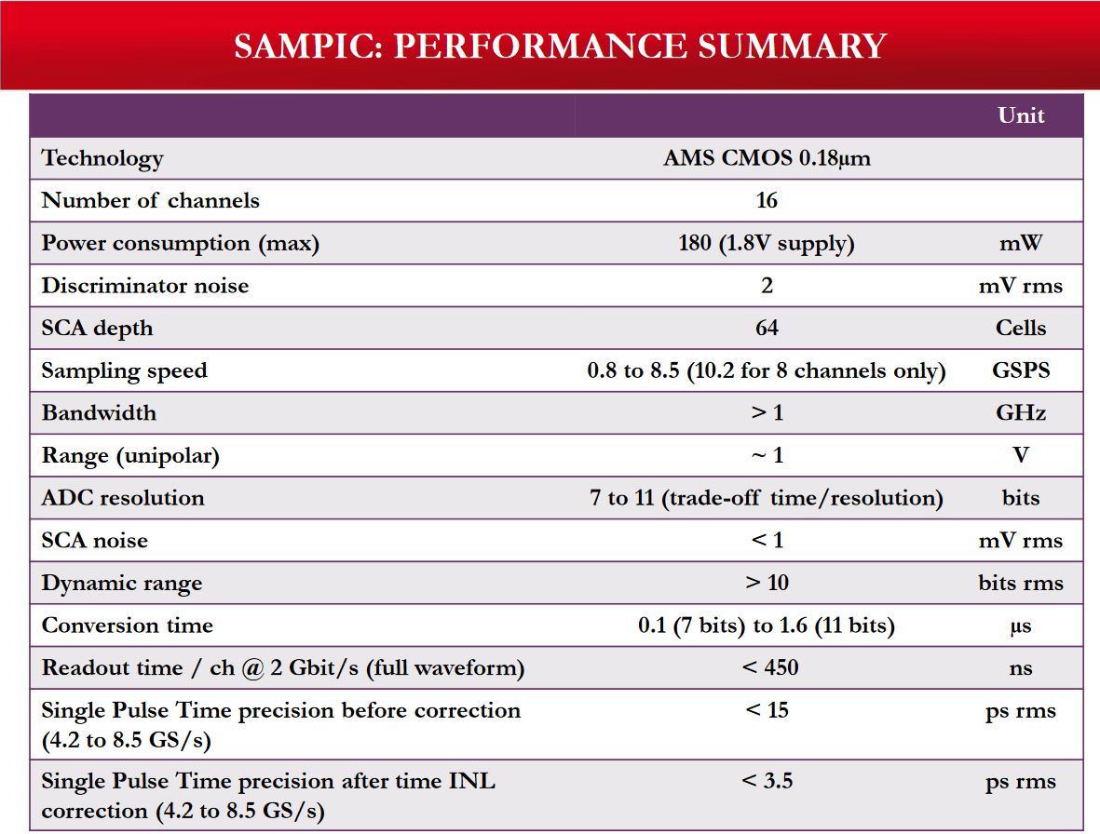
Digitizer
Sampic
V1742, domino chip

Slide 27
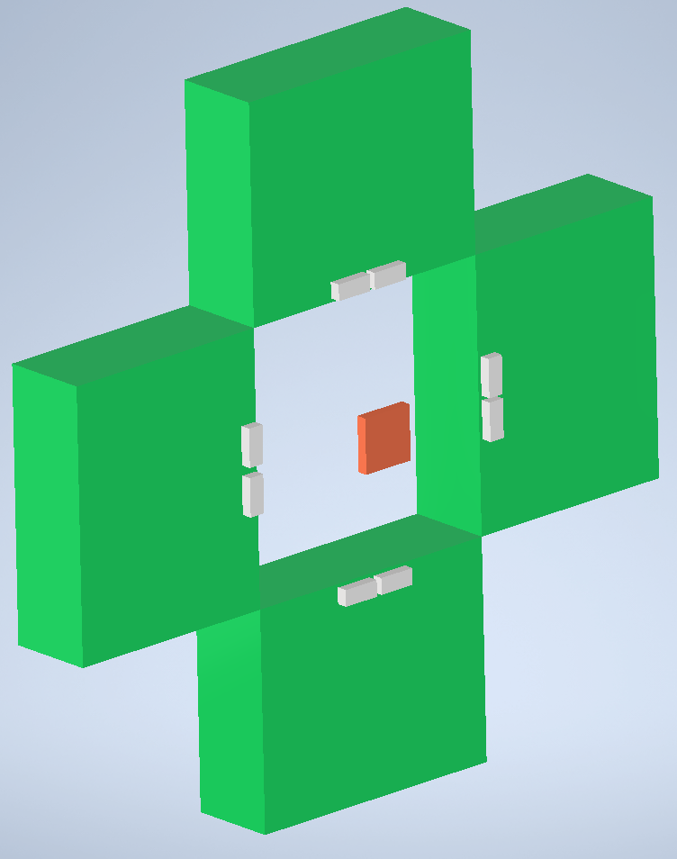
to motherboard
Stack of 4 FEBS
2 FAST3

