Slide 1
ATAR Sensor Development
Jessie Yang
University of Washington

Slide 2
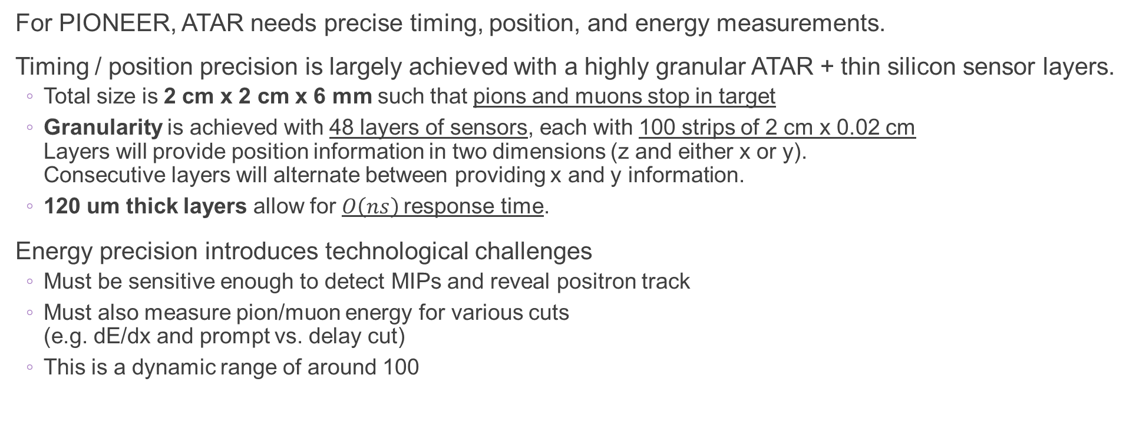
Current ATAR Design
For PIONEER, ATAR needs precise timing, position, and energy measurements.
Timing / position precision is largely achieved with a highly granular ATAR + thin silicon sensor layers.
  Total size is 2 cm x 2 cm x 6 mm such that pions and muons stop in target
  Granularity is achieved with 48 layers of sensors, each with 100 strips of 2 cm x 0.02 cm
  Layers will provide position information in two dimensions (z and either x or y).
  Consecutive layers will alternate between providing x and y information.
  120 um thick layers allow for $O\left(ns\right)$response time.
Energy precision introduces technological challenges
  Must be sensitive enough to detect MIPs and reveal positron track
  Must also measure pion/muon energy for various cuts
  (e.g. dE/dx and prompt vs. delay cut)
  This is a dynamic range of around 100
ATAR Sketch
Strips
Dead material

Slide 3
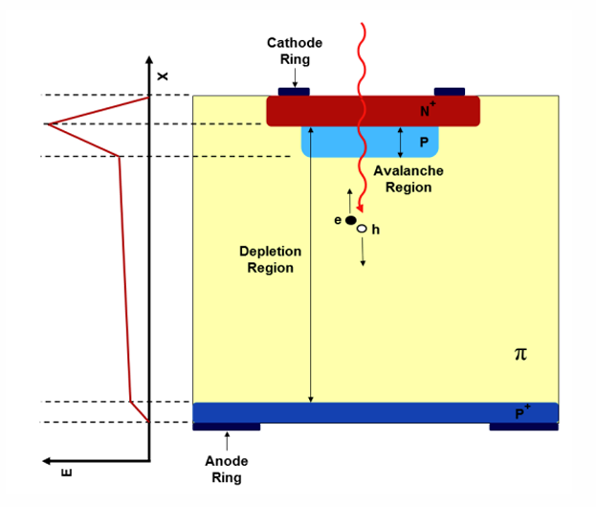
Low-Gain Avalanche Diodes
Based on silicon PIN diode
  P-N junction separated by an intrinsic layer (undoped silicon)
  Reverse bias maintains electrostatic equillibrium until incoming particle deposits energy
Incoming particle
  LGADs have an additional, highly p-doped layer close to the N-junction
  Increases electric field in this region
  Avalanche effect enhances the signal for a given sensor thickness
  Gain is the multiplication factor by which a signal is amplified
  A sensors gain depends on the bias voltage applied and the incident angle of the incoming particle
Reverse bias is applied to amplify electric field in all regions
Intrinsic layer (undoped)

Slide 4
Test Beam Goals
Studying detector response to high energy deposits (100 MiPs)
Pulse shape features
Timing
Energy
Gain saturation?
Gain saturation dependencies
Incident angle
Incident energy
Detector production
Bias voltage

Slide 5
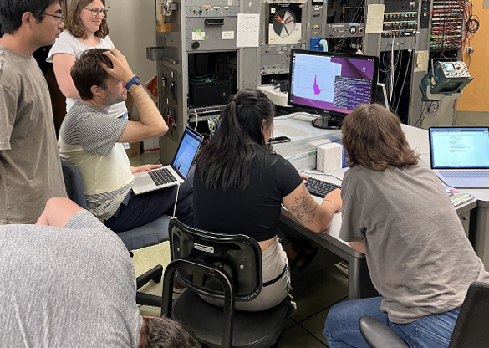
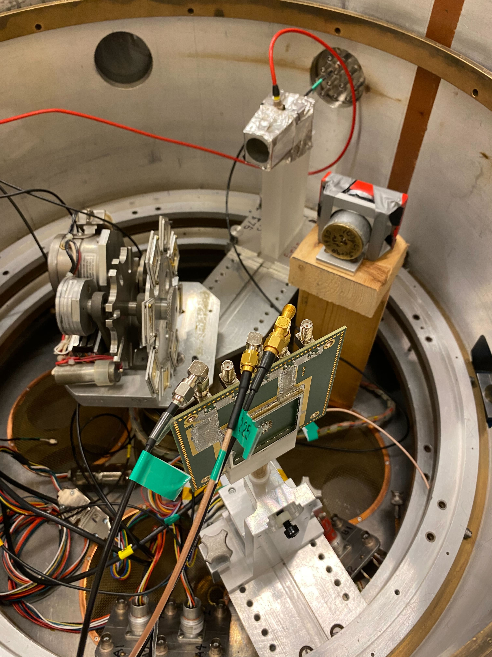
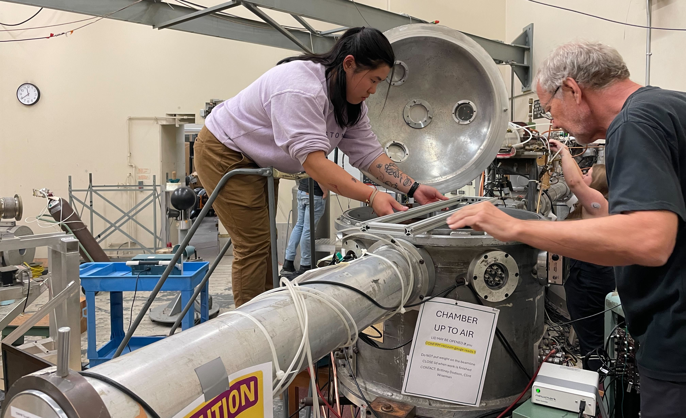
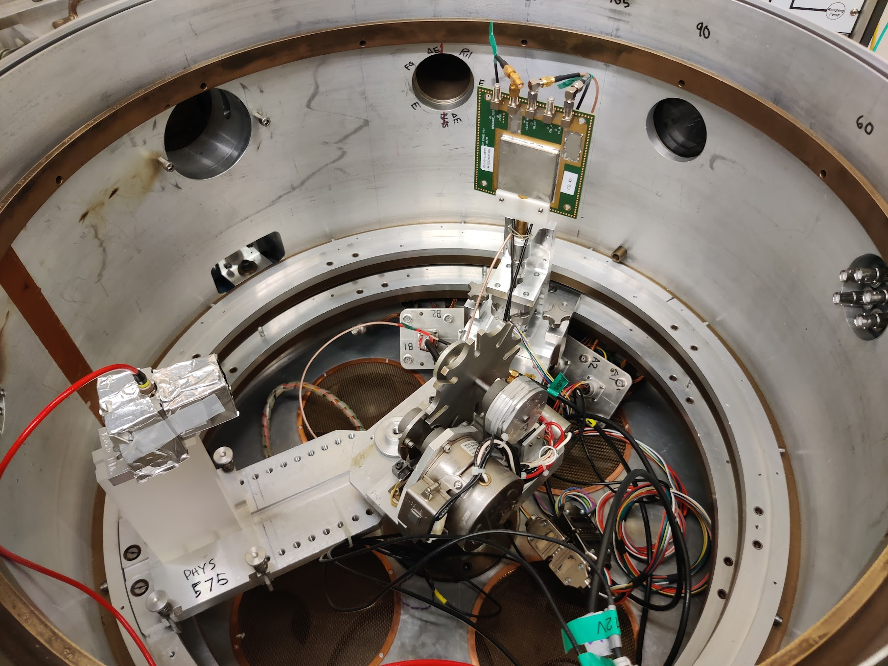
Using CENPA’s Tandem
Accelerator for PIONEER
Beta source tests
Beam direction
24” RBS Cahmber
Beam line
LGAD
SiMon
Gold foil target wheel

Slide 6
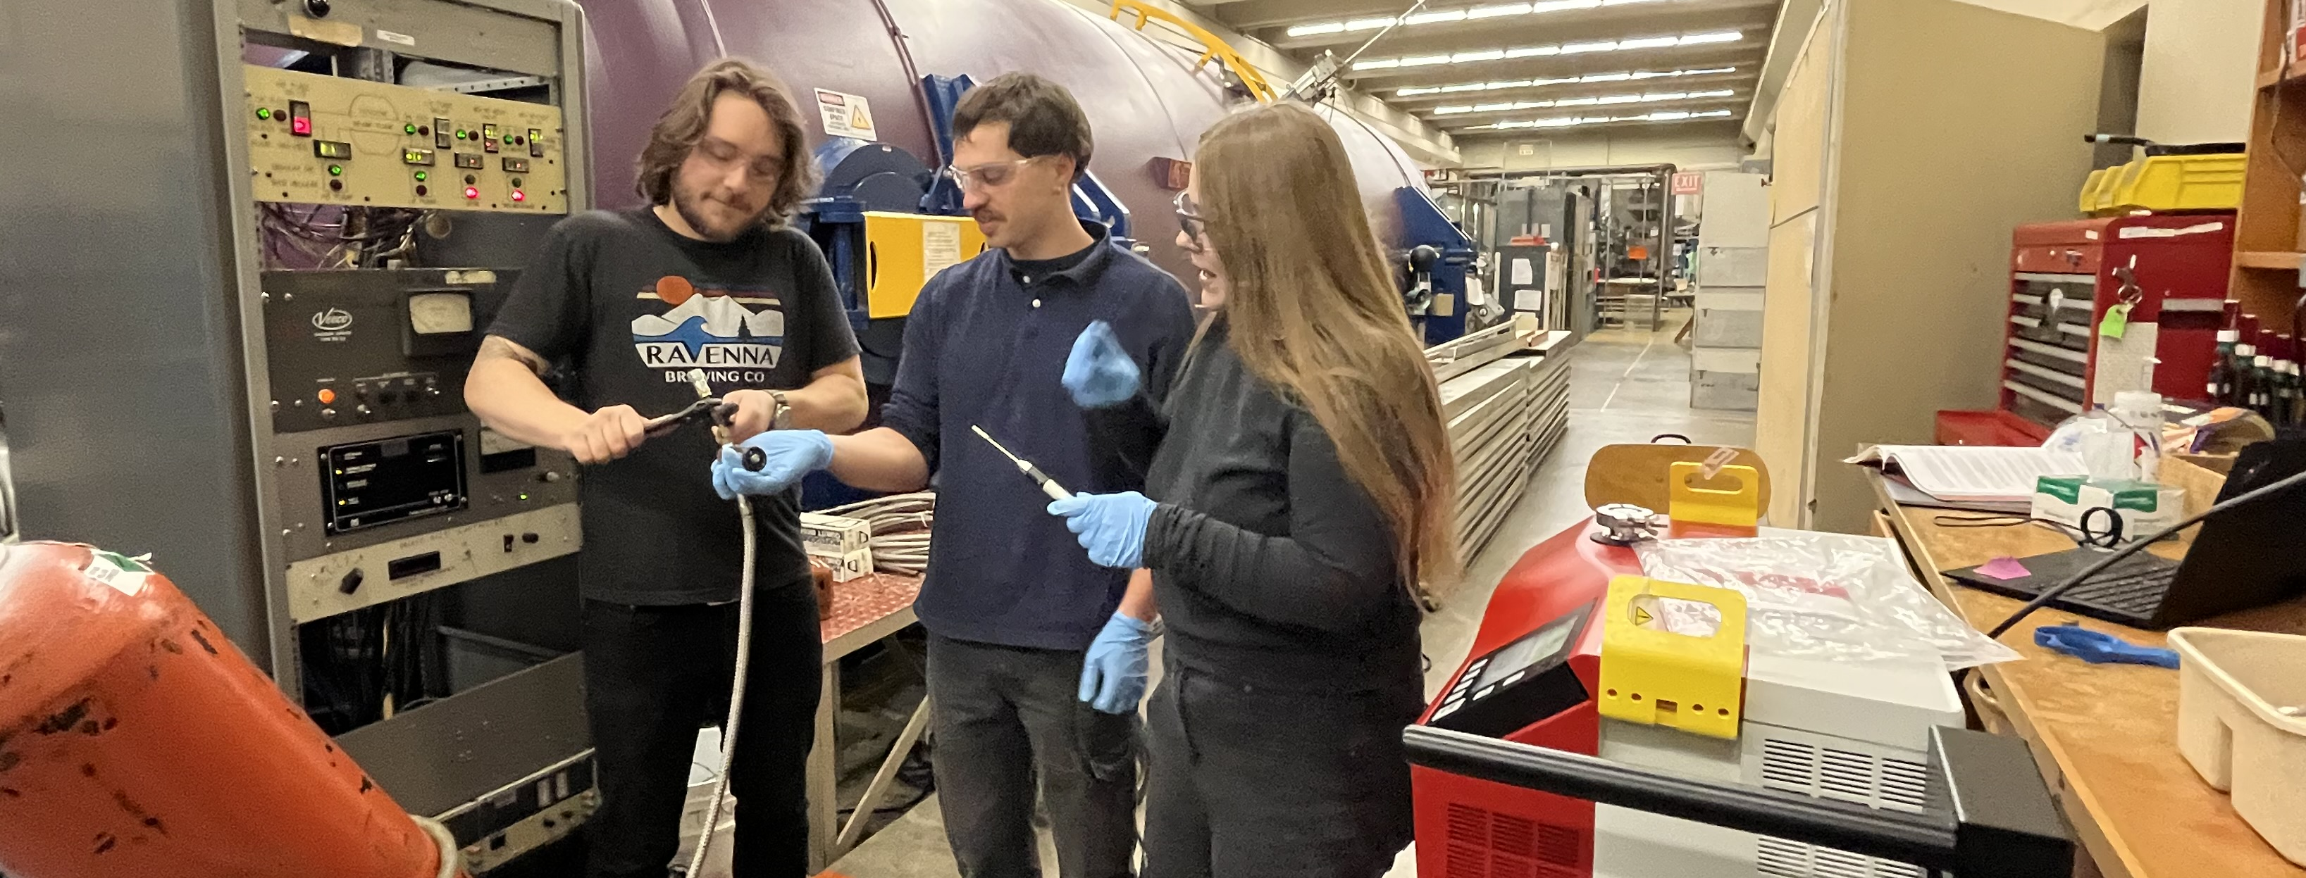

Over 1000 Runs with 100,000+ Events Each
New code was developed to automate data taking (e.g. bias voltage and angle).
Sensor | Thickness (um) | Beam energies (MeV) | Bias voltages (V)
FBK W1 | 50 | 1.8, 3 | 50, 150, 250
FBK PIN W1 | 50 | 1.8, 3 | 50, 100, 400
FBK W8 | 100 | 1.8, 3, 4.5 | 100, 200, 250, 350
FBK PIN W8 | 100 | 3, 4.5, 6.5 | 200, 300, 400
FBK W8 (thinned) | 100 | 6.5, 8 | 100, 200, 250, 300
FBK W11 | 150 | 3.8, 5.5 | 200, 400, 600
FBK PIN W14 | 150 | 3.8, 5.5, 6.5 | 300, 500
BNL | 200 | 1.8, 3, 4.5, 5.5 | 200, 300, 400
Beam energies chosen to study signals from both stopped and punch-through particles for each sensor thickness
scan of $\sim$10 different angles and sometimes through the backside
+
Huge thanks to the CENPA beam team for long hours, adaptability, and a consistent beam!

Slide 7
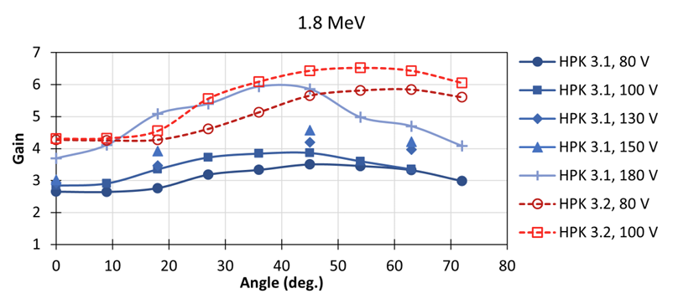
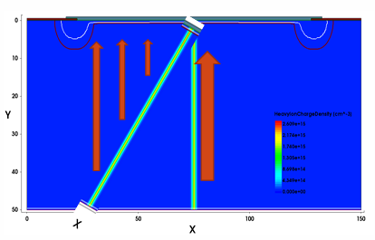
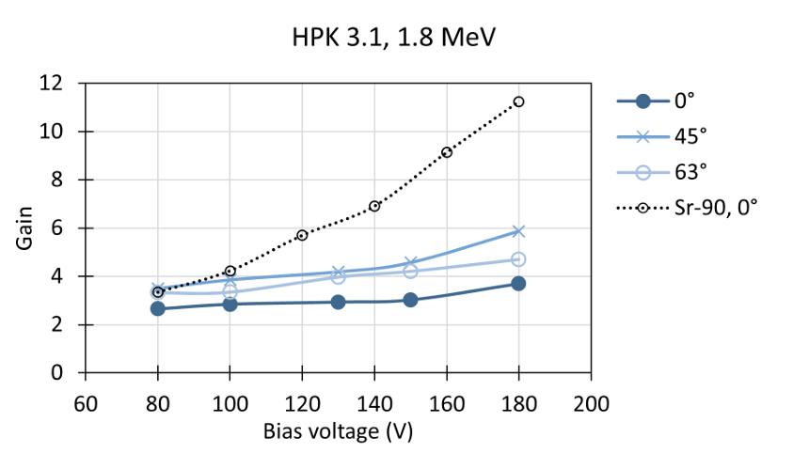
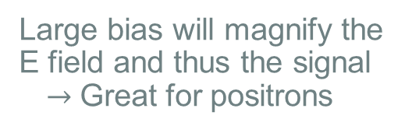
Trends from last years test beam
Gain increases with angle
These factors affect charge density within the sensor which shields a given region from the amplified electric field, suppressing the measured gain.
Gain decreases after some critical angle
Large bias will magnify the E field and thus the signal
$→$ Great for positrons

Slide 8
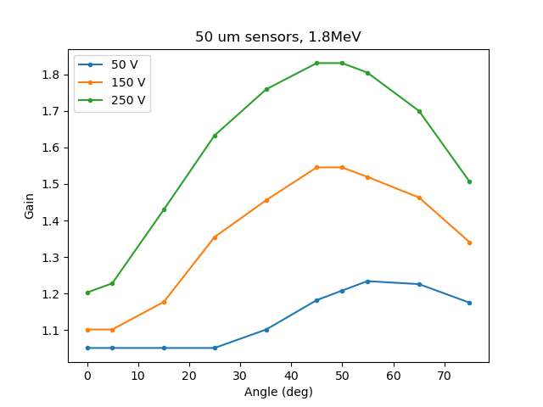
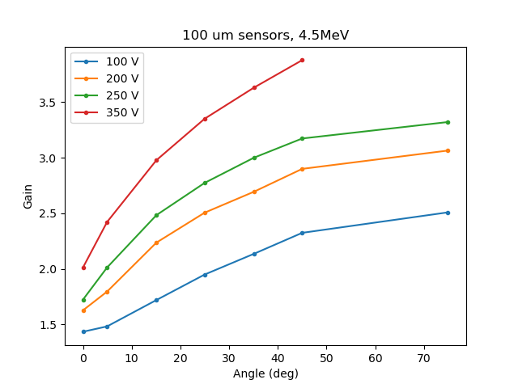
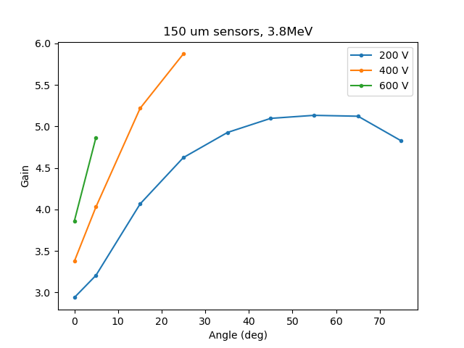
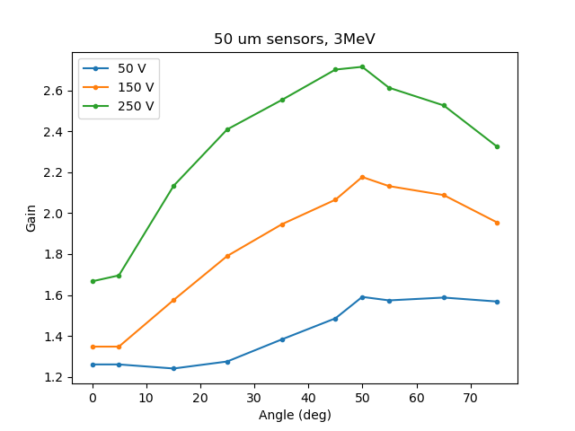
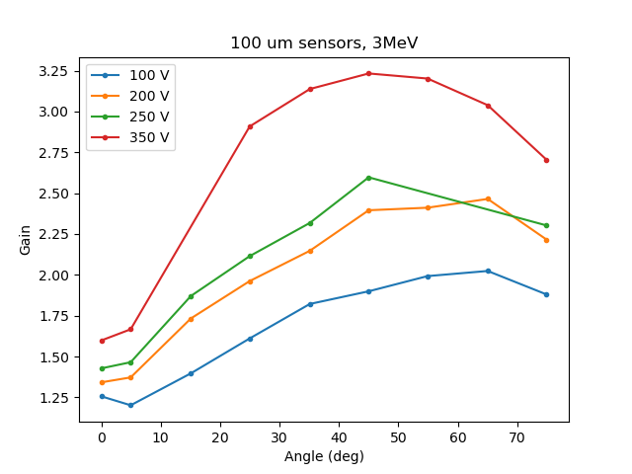
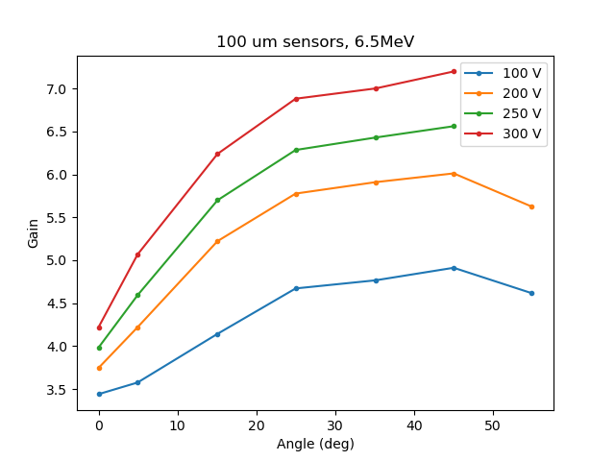
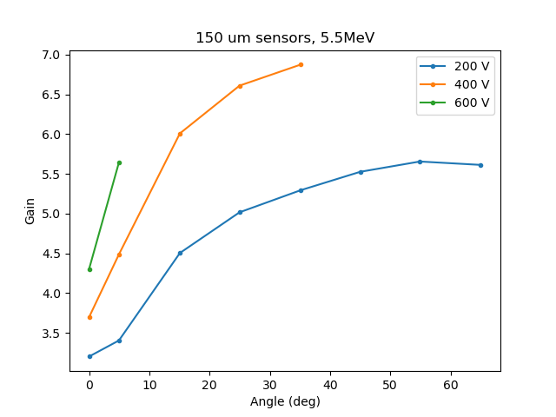
CENPA Test Beam 2024 Results
Gain = MPV of energy measurement of
LGAD / PIN

Slide 9
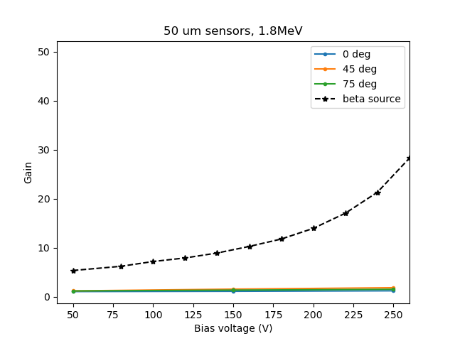
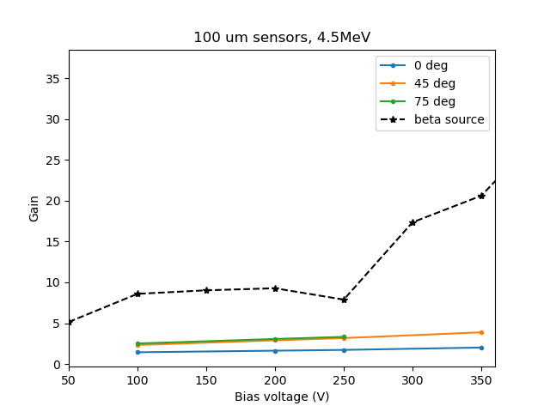
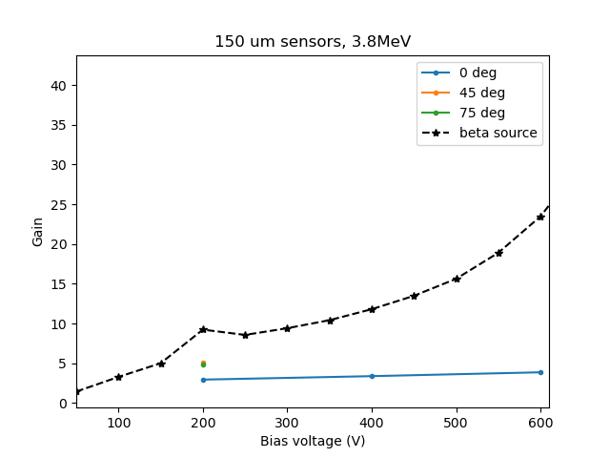
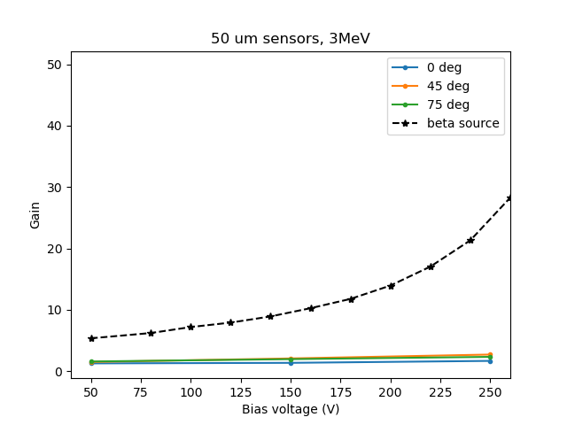
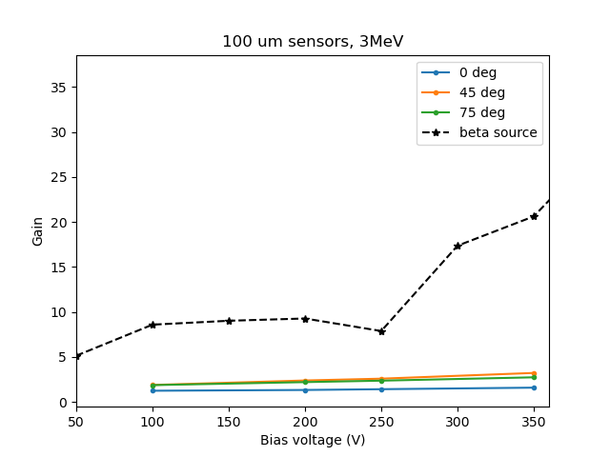
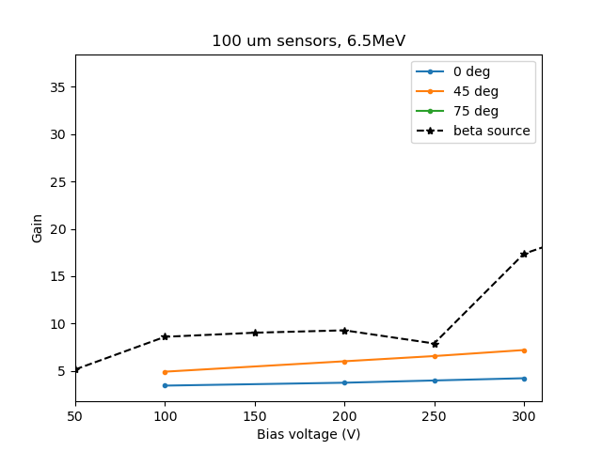
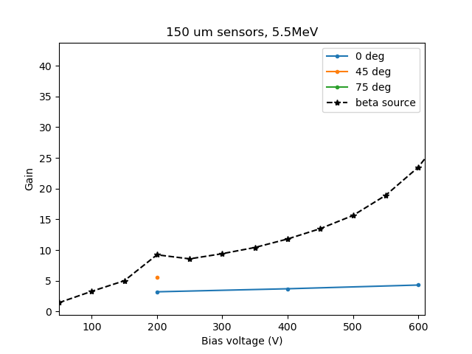
CENPA Test Beam 2024 Results
Gain = MPV of energy measurement of
LGAD / PIN

Slide 10
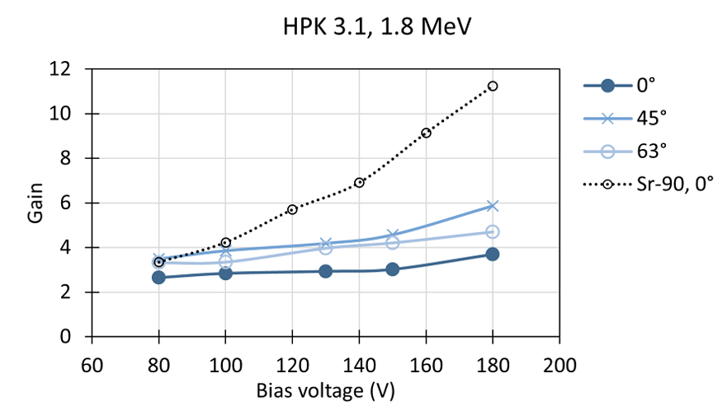
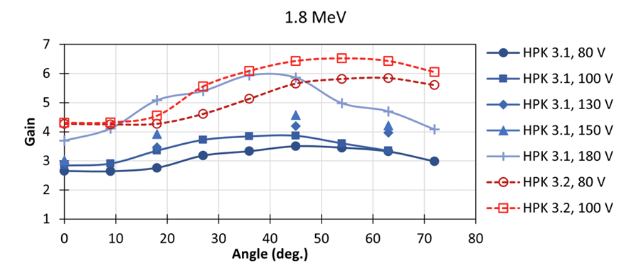
Comparing to 2023 Results (50 um sensors)
FBK sensors have more gain for MIPs but also more gain suppression for non-MIPs
  Even at the lowest biases/thinnest sensors/lowest energies, there is still significant gain suppression
Due to this suppression, the FBK boards have less gain for non-MIPs than HPK
The trends with respect to bias voltage and angle are still present
FBK W1, 1.8 MeV
FBK W1, 1.8 MeV

Slide 11
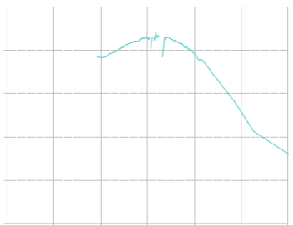
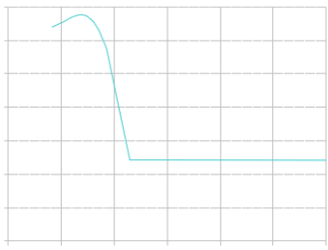
Comparing to 2023 Results (50 um sensors)
FBK sensors have a shallower but more highly doped gain layer
HPK
FBK
Doping concentration
Doping concentration
Depth
Depth
Simultations and future testing will help us better understand the individual affects of both depth and doping concentration on gain saturation

Slide 12
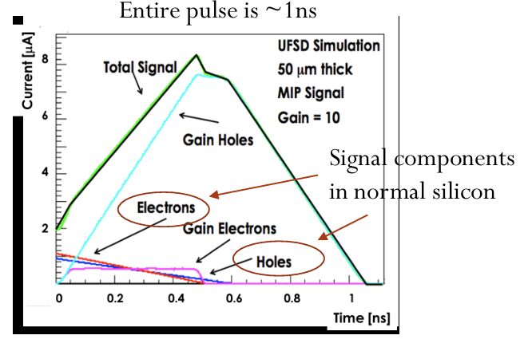
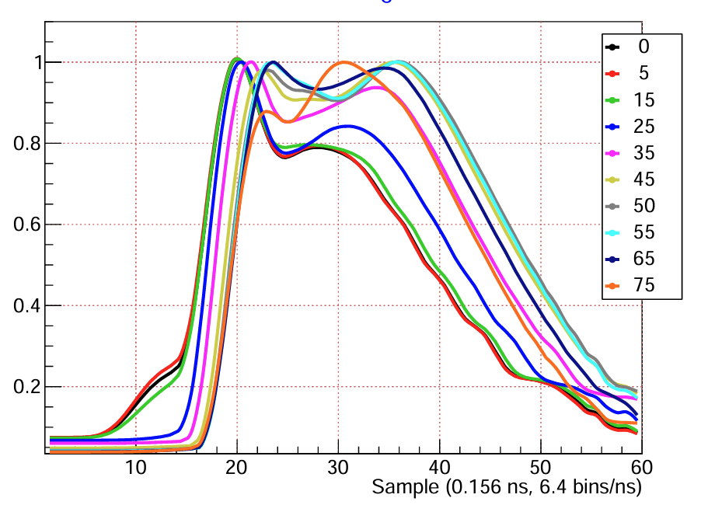
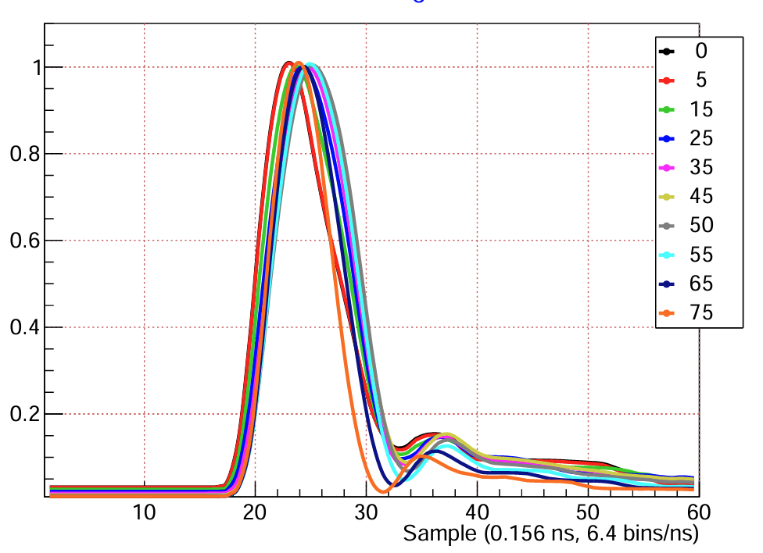
Understanding pulse shapes
Variety of sensor thicknesses
  Thicker sensors need larger voltage biases for clean pulses
  Simulations will also be used to study multi-peak pulses and charge drift mechanisms within the sensors
Example Average Pulses: FBK W1, 50 um, 3 MeV
50 V
150 V

Slide 13
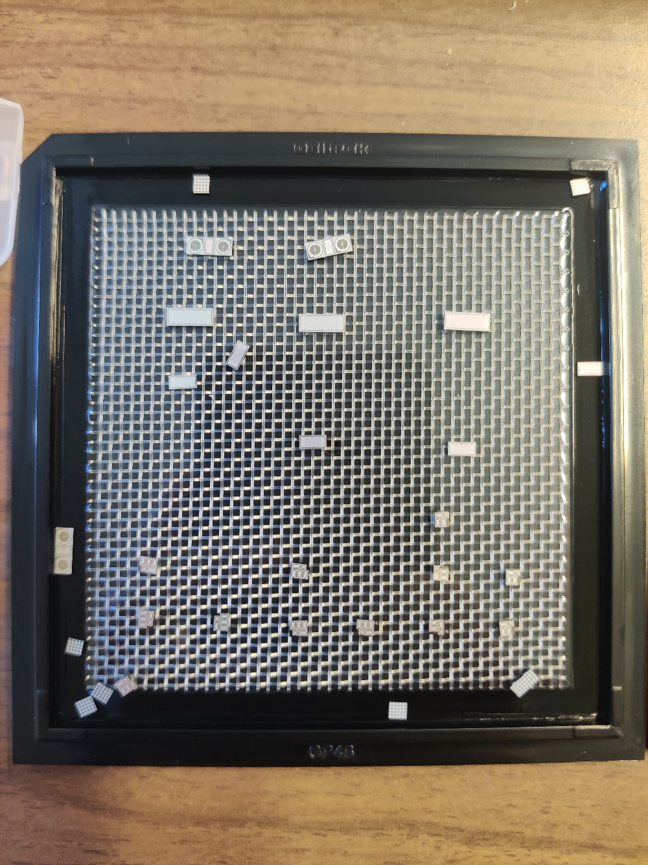
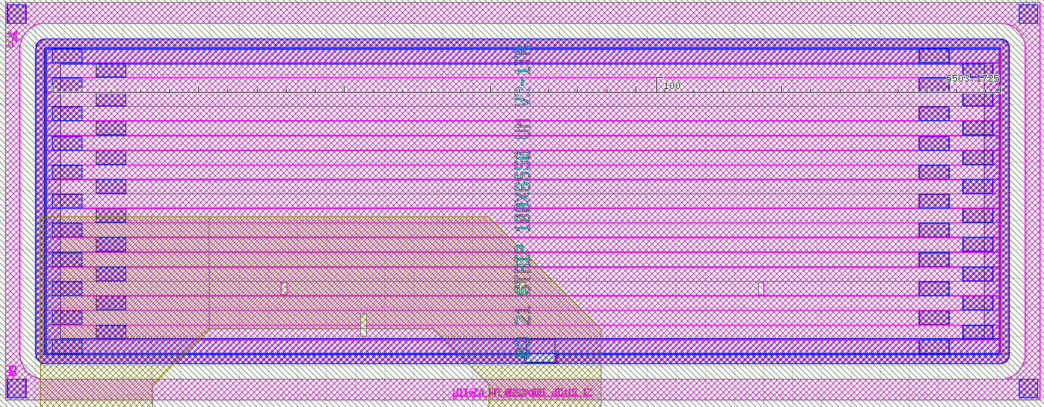
Received FBK Trench-Insulated LGADs
Production from AIDA 2020
Several devices, all 50um thick
  From the same wafer W10 (unsure about proprieties)
  Longest strips are 6mm with 100um pitch and other shorter strips
  Several 2x1 testing structures
Testing in progress
Slide curtesy of Dr. Simone Mazza

Slide 14
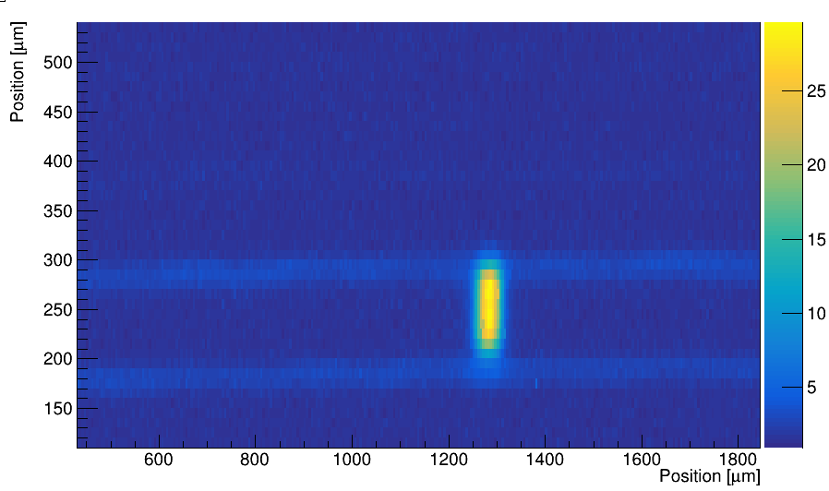
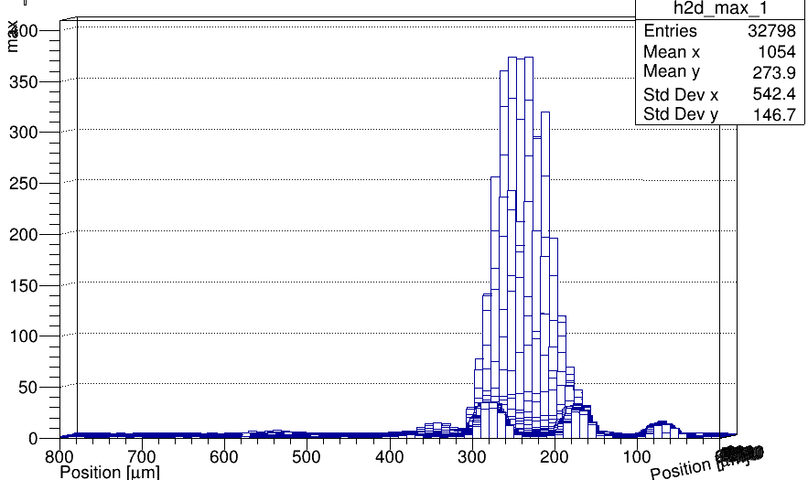
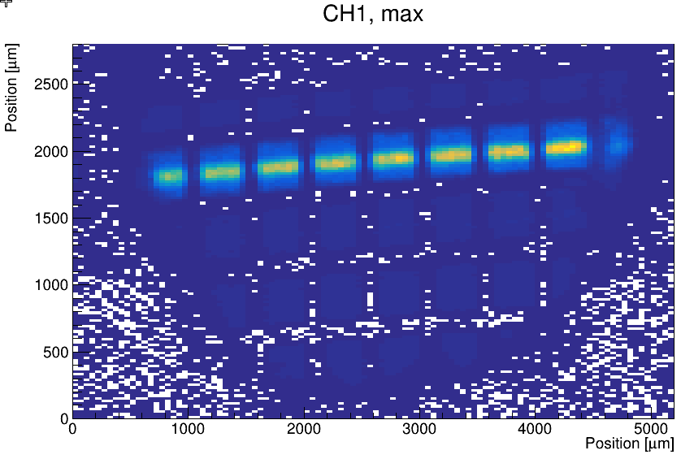
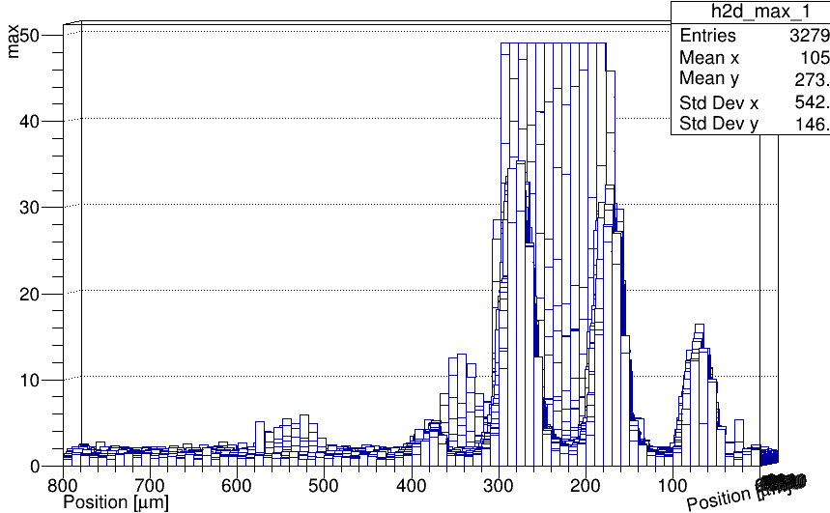
TI-LGAD laser TCT testing
  Laser TCT testing of the device with the opening on the front
    6mm long strip, 100um pitch
  Observed a 3% first neighbor cross-talk
  “Long range” crosstalk around 1%
  Backside open (grid) for testing
Slide curtesy of Dr. Simone Mazza

Slide 15
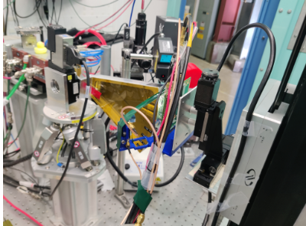
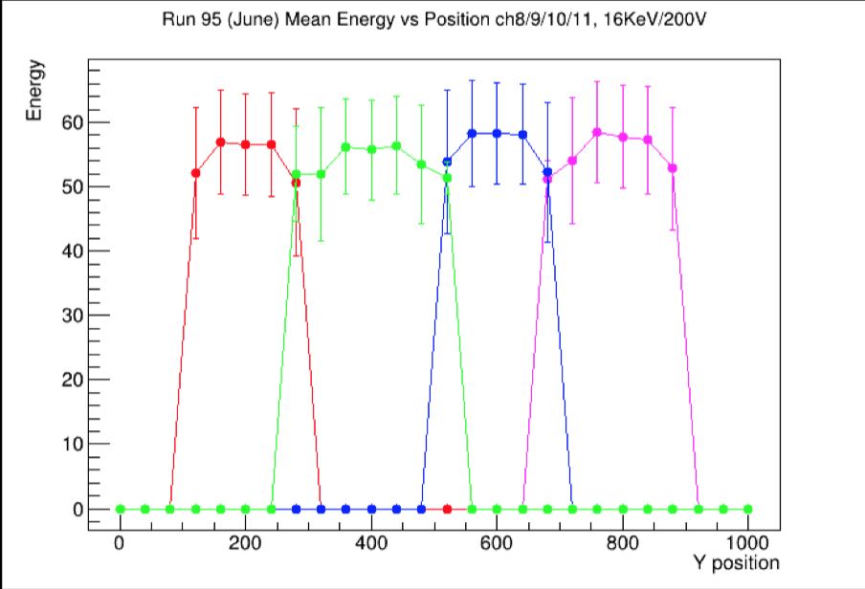
X-ray
  Tested another FBK TI-LGAD at the SSRL test beam
    Focused beam (BL 7-2)
  Shorter strips, 200um pitch
  For MIP the energy resolution is 10-15% as expected
Slide curtesy of Dr. Simone Mazza

Slide 16
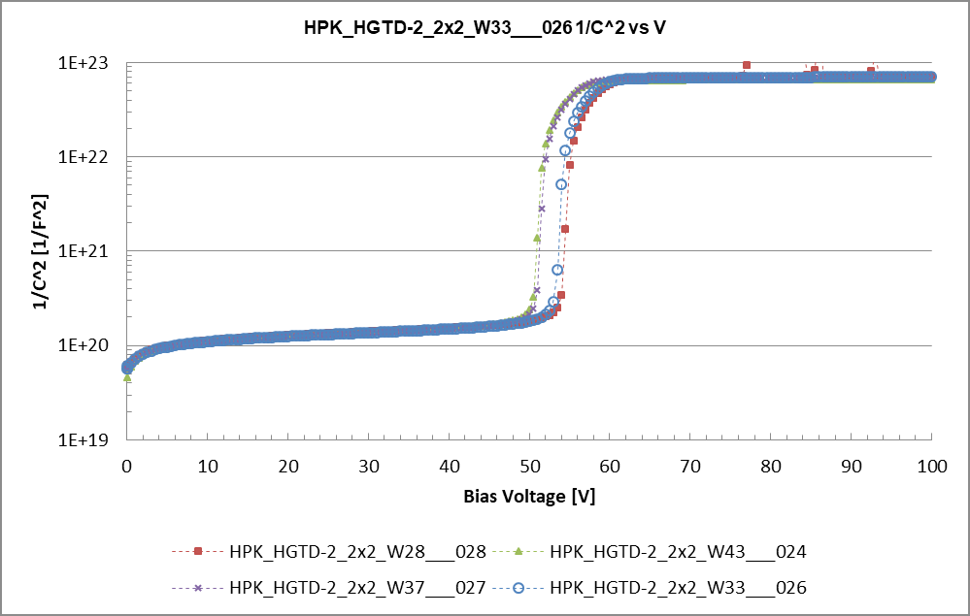
Plans
Continuing CENPA 2024 test beam analysis:
  Incident particles entering from the backside
  Quanitfy energy resolution and timing precision
  LGAD simulations
Next CENPA testing:
  Test FBK devices with deeper gain layer (from HGTD)
  Test HPK sensors with deep gain layer but varying doping concentration
We should receive mid-2025 a production of FBK TI-LGAD that are thicker (~100um active thickness)
  Strip geometry, pitch/length still to be decided
  Great option for the demonstrator
  See if it’s feasible to influence the gain layer doping to reduce doping and make the gain layer deeper
In the meantime continue to exercise thinning procedure
  Necessary for the demonstrator assembly

Slide 17
Backup Slides

Slide 18
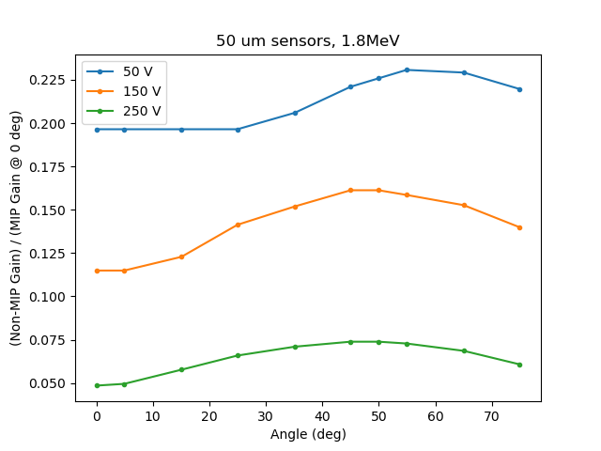
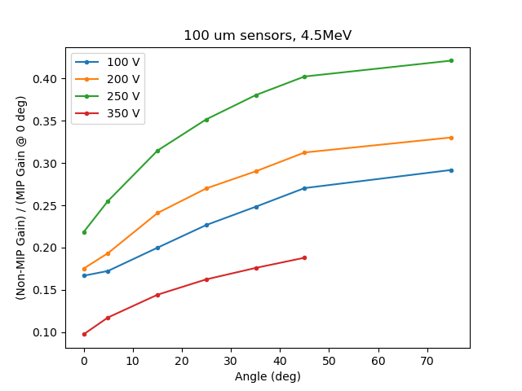
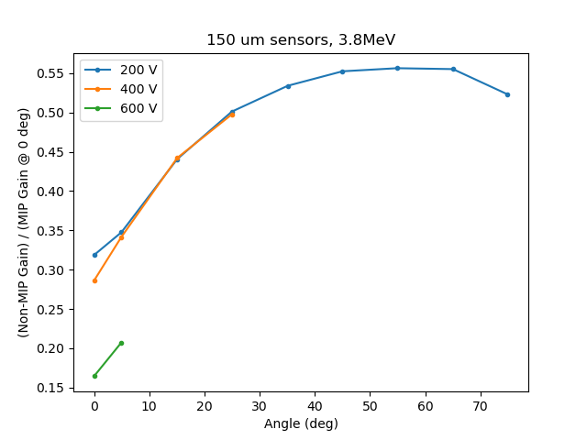
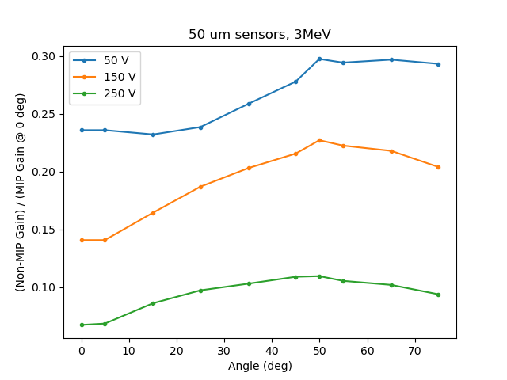
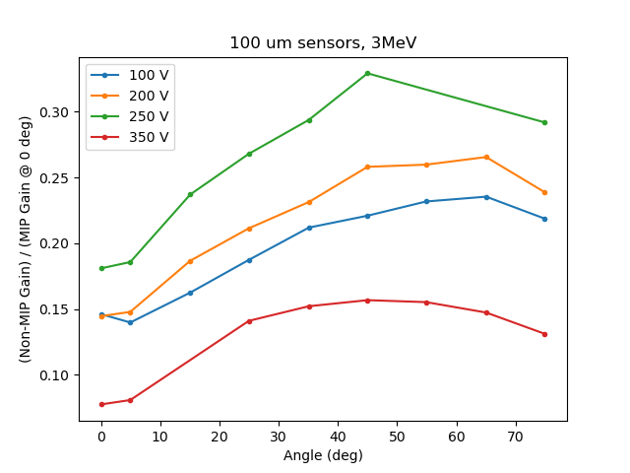
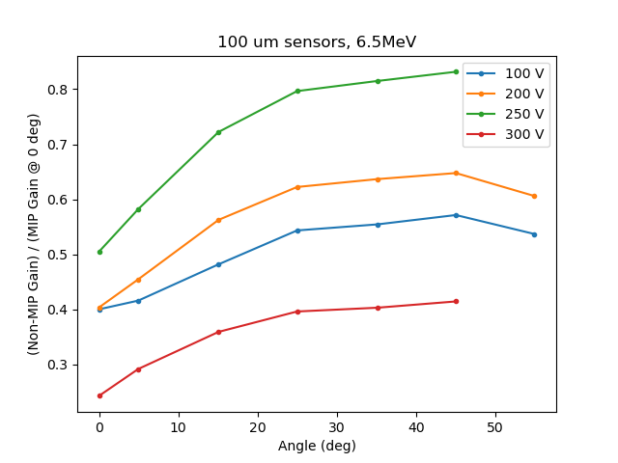
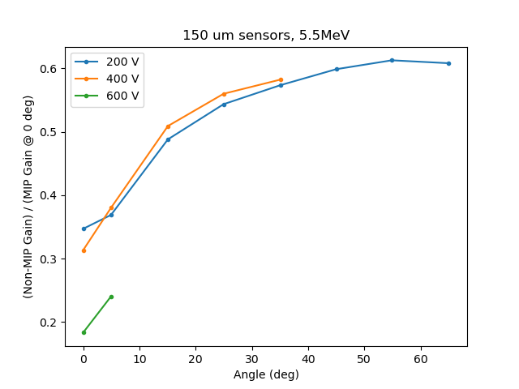
Trends in Gain Suppression
50 um: as expected, greater saturation at larger voltages
100 um: unexpected, but beta source tests are similarly odd

