Slide 1
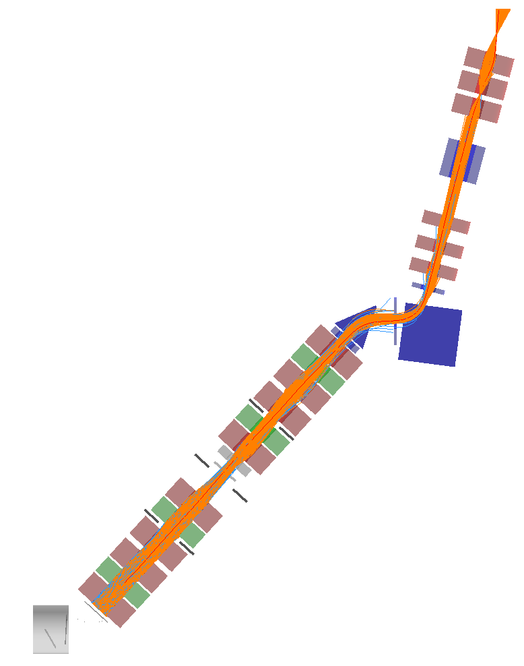
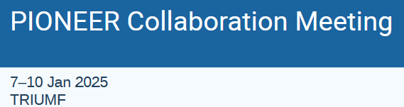
piE5 Beam
Beam specs and impact on key performance parameters
piE5 beamtest: Goals, sensitivity and plan
Anna Soter and
Peter Kammel
ReCap and KPPs
Progress and Tasks
  G4BL tuning
  see previous talks this session
  AI and machine learning*)
  Major beam design (Stefan)
Plans
  Beam request 2025
*) limited progress since last CM
not covered, but news in previous talks

Slide 2
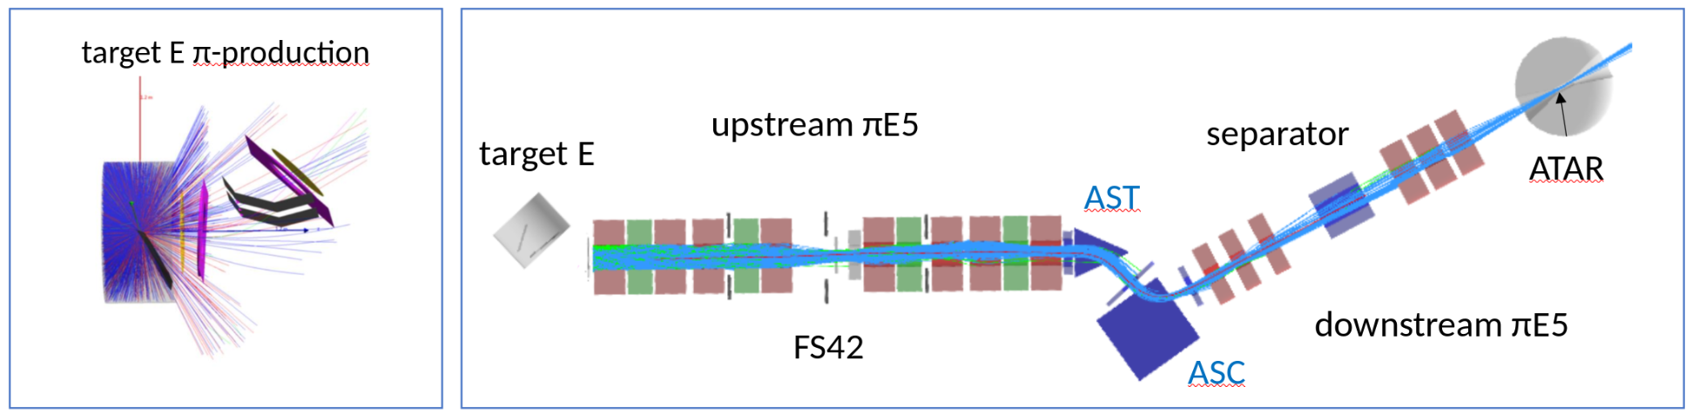
KPPs and achieved results from test run
KPP |  | test run results and future work | impact
Rate 300k π/s stopped in ATAR Momentum lowest p preferred 55-70 MeV/c | 😁 | ok at 65 MeV/c | but 55 MeV/c better, get rid of DTAR, better range width
Momentum bite ∆p/p <2% | 🙂 | Probably not, requires more data analysis/beam modeling | pi-mu range based separation
Spot size smaller than ATAR | 🙄 | only 50% stopped, difficult, requires beam design, modeling and hardware, experimental design, active veto | halo rate and pile-up
Particle contamination µ/e less than 10% | 🙂 | Not yet, requires additional magnets, beam modeling and design | background

Slide 3
G4BL modelling
History
  original piE5 model from PSI and Zach
  Urs and Peter established derived models
  results
    strong non-linear behavior in phase space (PS) observed
    additional effort required
      - grand solution:
      AI/ML surrogate model, first steps with Paul’s semester thesis
      but not follow up last year
      - full beam request for systematic AI based optimization not justified
Recent progress
  Peter
    included beam model from Giovanni’s thesis
    significantly developed my machinery towards real tuning
    together with ETH/PSI/StonyBrook effort that should be
    sufficient for beam request

Slide 4
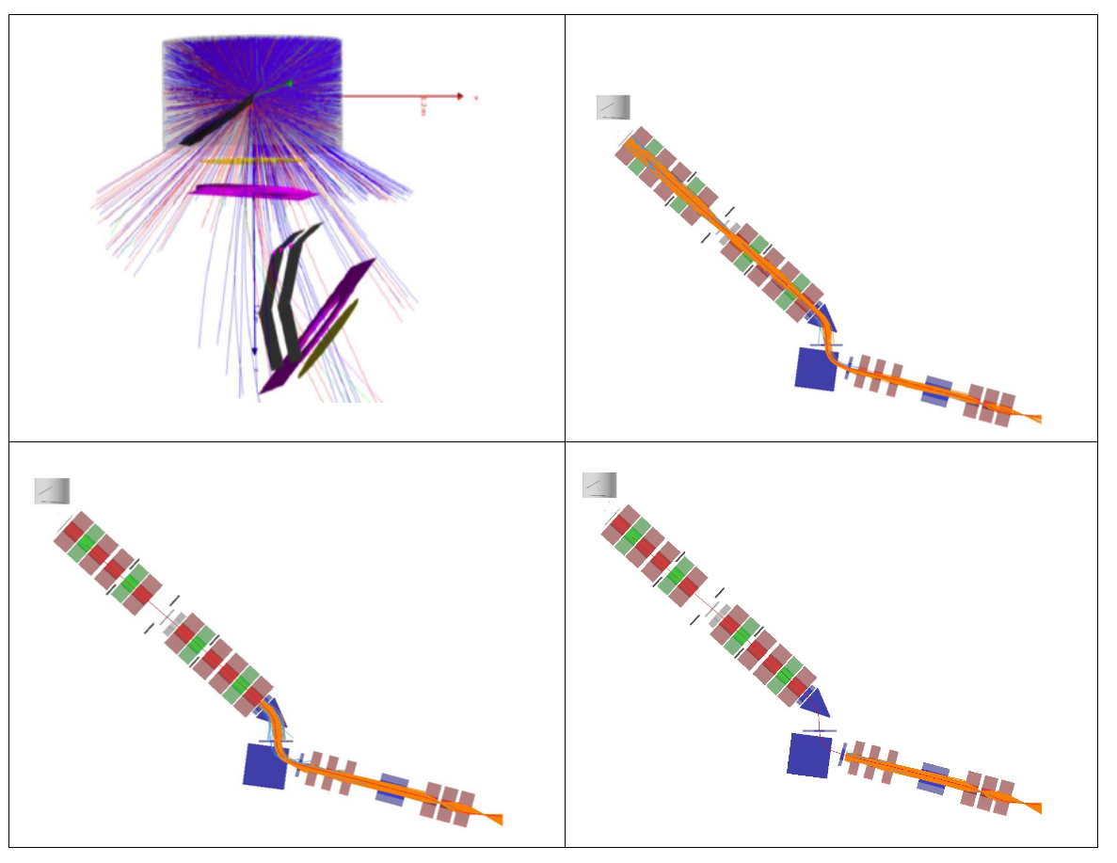
G4BL model updates: Procedure
USBL+DSBL
endUSBL+DSBL
DSBL

Slide 5
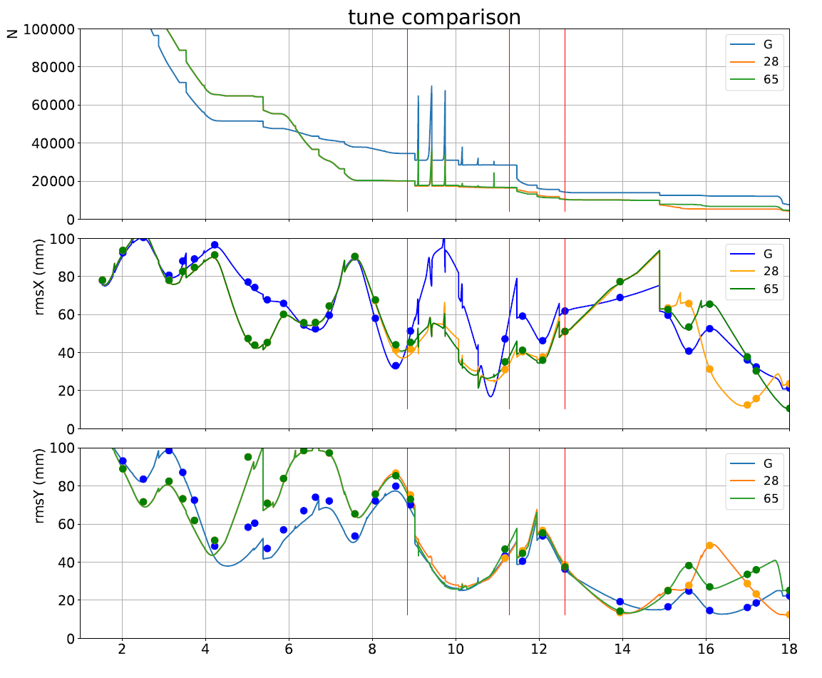
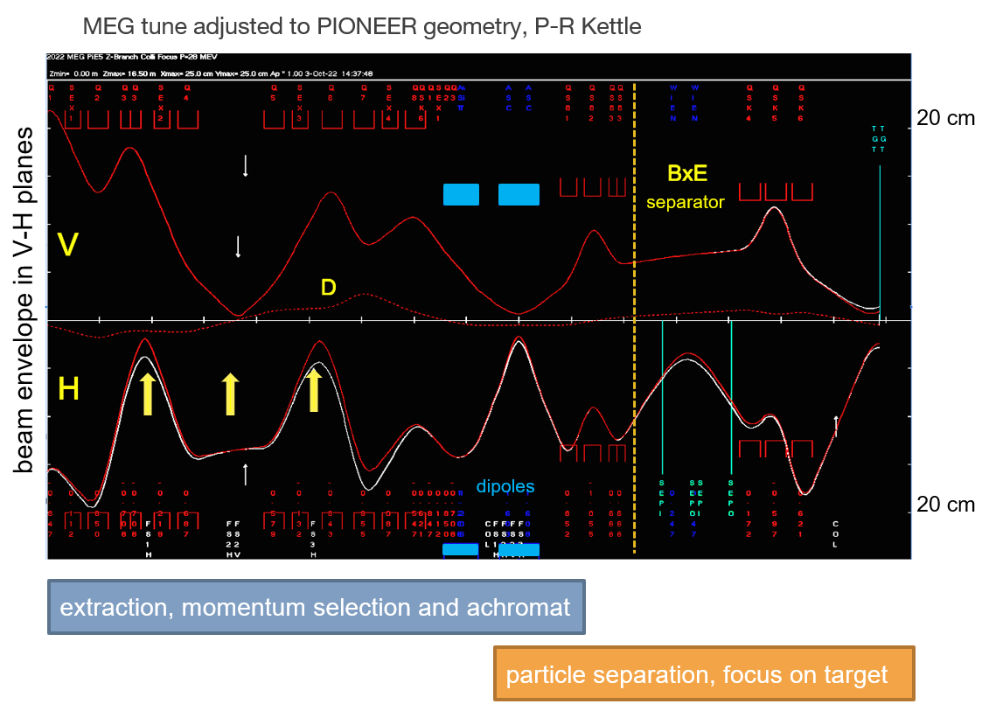
G4BL model updates: 3 tunes to compare
G4BL
TRANSPORT 1st order
Downstream needs tuning

Slide 6
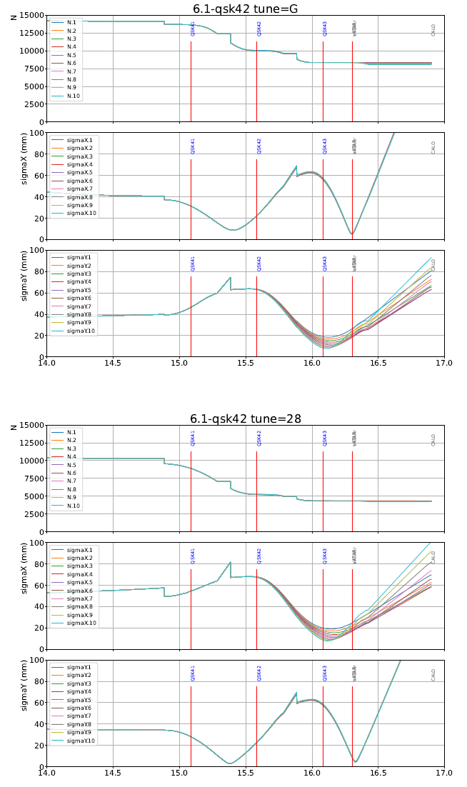
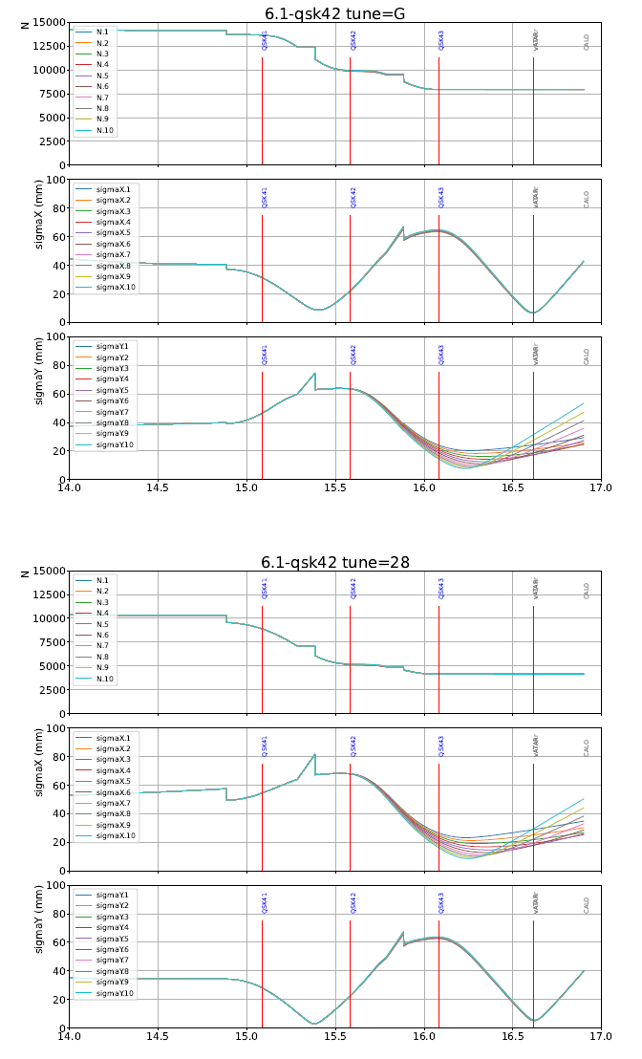
G4BL model updates: Focus after triplet
First time reasonable tune of full PIONEER beamline
“near” focus
22 cm to cQSK43
exercise only
“far” focus
53 cm to cQSK43
Giovanni
USBL tune
z (m)
z (m)
focus not elliptical per se (even if the x-PS is larger)
    depends on the tune
but the tune likely generates asymmetries
needs real beam design
MEG
USBL tune

Slide 7
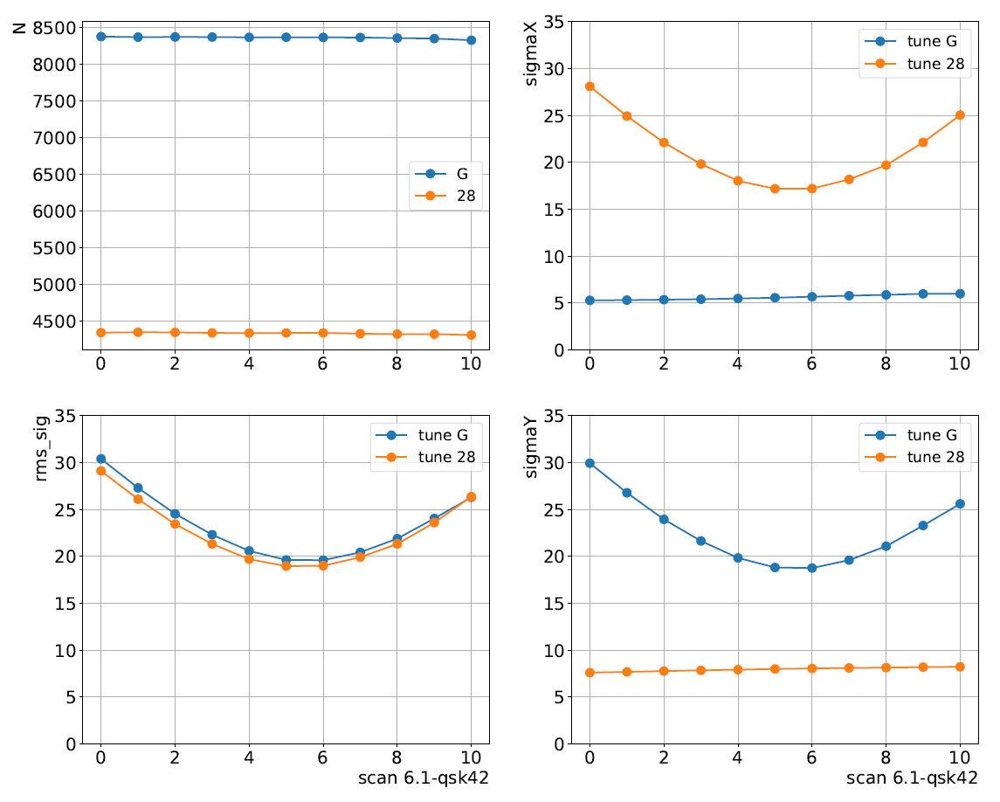
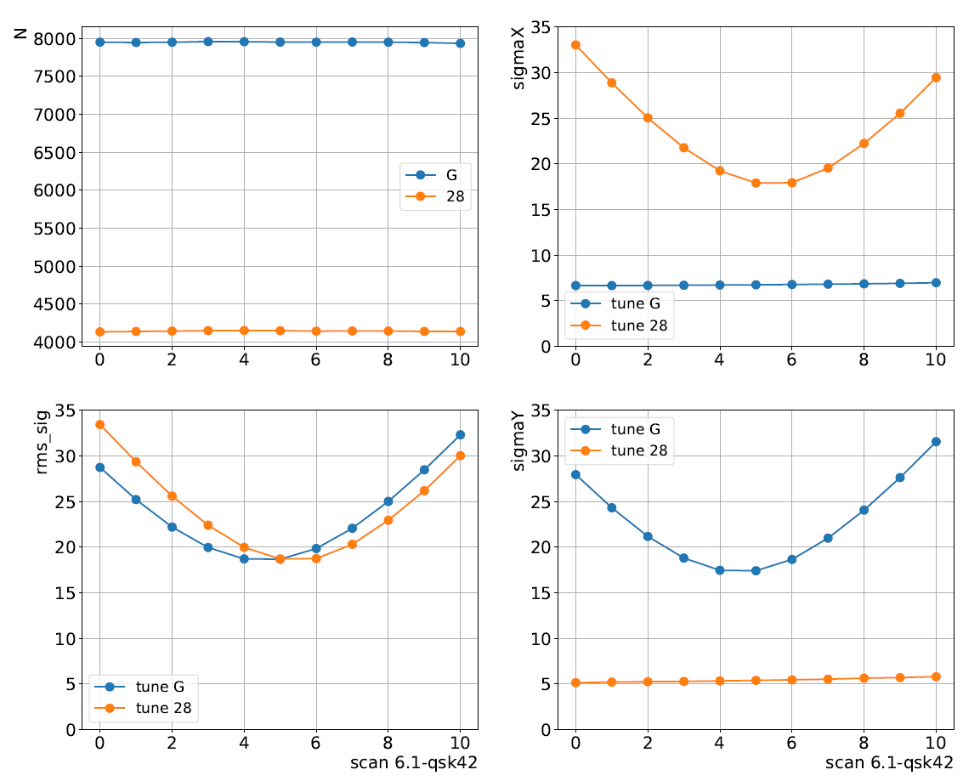
G4BL model updates: Focus after triplet
near focus
far focus
Giovanni
UBL tune
MEG
UBL tune
far focus not worse than near focus
Liouville’s theorem?

Slide 8
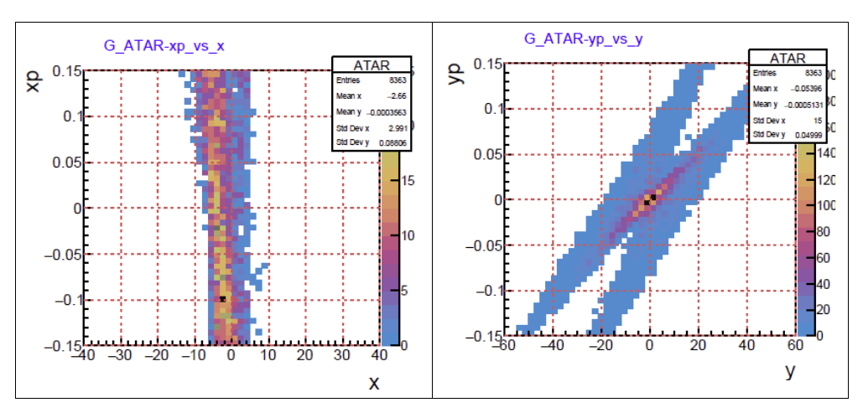
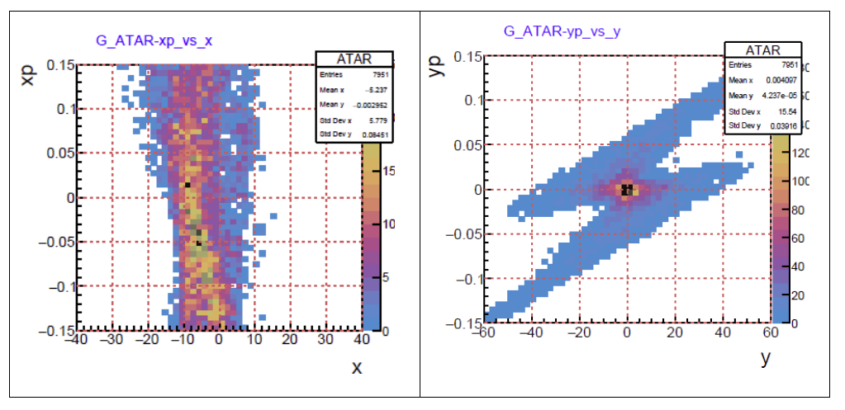
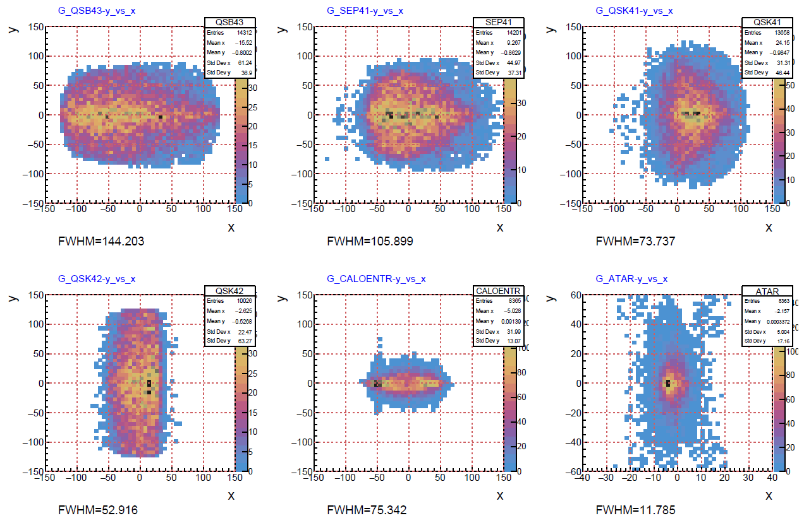
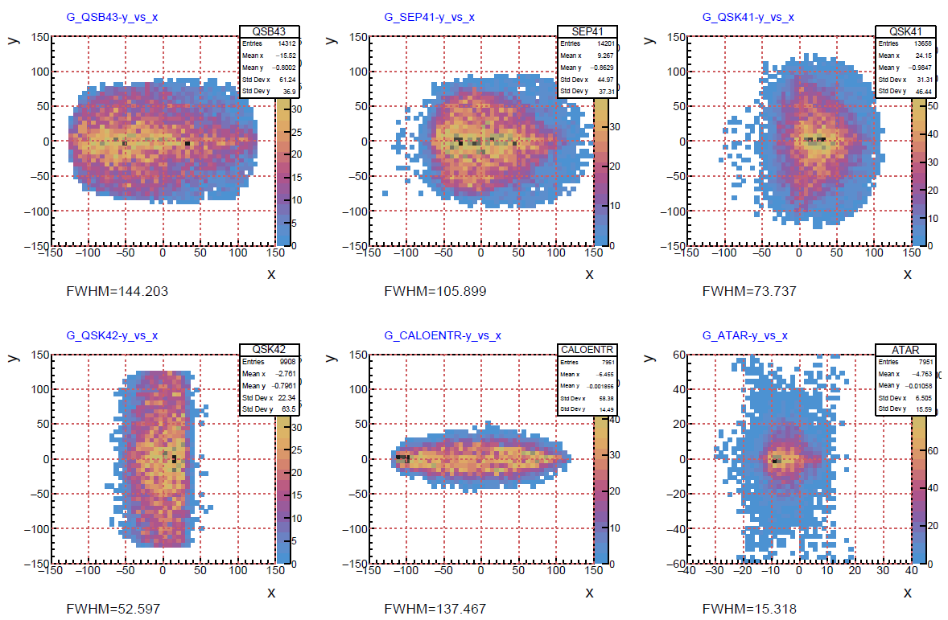
G4BL model updates: Focus after triplet
Giovanni
USBL tune
near focus
far focus
Caution: Beam optics design must allow full benefit of phase space
Non-Gaussian tails might affect conclusion

Slide 9
Summary and plans
Developments
  G4BL tuning infrastructure developed
  Applied to existing piE5 beam line
  “Realistic” (in MC sense) predictions possible
Results
  (At first sight) upstream tunes gives similar focus
  Focus properties can and need to be studied carefully
  Sufficient progress to support beam request
Plans
  Develop automatic G4BL optimizer, cpu cluster
  compare with simple TRANSPORT
  Tune DSBL for realistic scenarios
    CALO position
    explore collimator options
    explore large final focus magnets
  I can do that, but only after a few months
  Help very welcome
Extended Plans
  Full extended beamline design
  Attack USBL issues

Slide 10
Beam request: Justification and Goals
Justification
  Characterizing (and optimizing) the piE5 beam is critical to inform the overall piE5 detector setup and
  to design the required extension of this beam line with additional magnets to spatially separate the PID separation and target focus, and to achieve a smaller beam spot with large aperture final quadrupoles.
Goals
  Baseline
    Measure phase space with two thin x-y tracker planes for nominal settings with “required” precision
    Small variations in phases space and geometry as consistency checks
  Stretch
    Explore effect of bends and QSBs
    Extract phase space in separator
    Change USBL slits
    (Study USBL later)

Slide 11
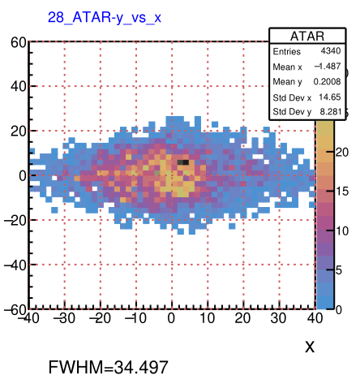
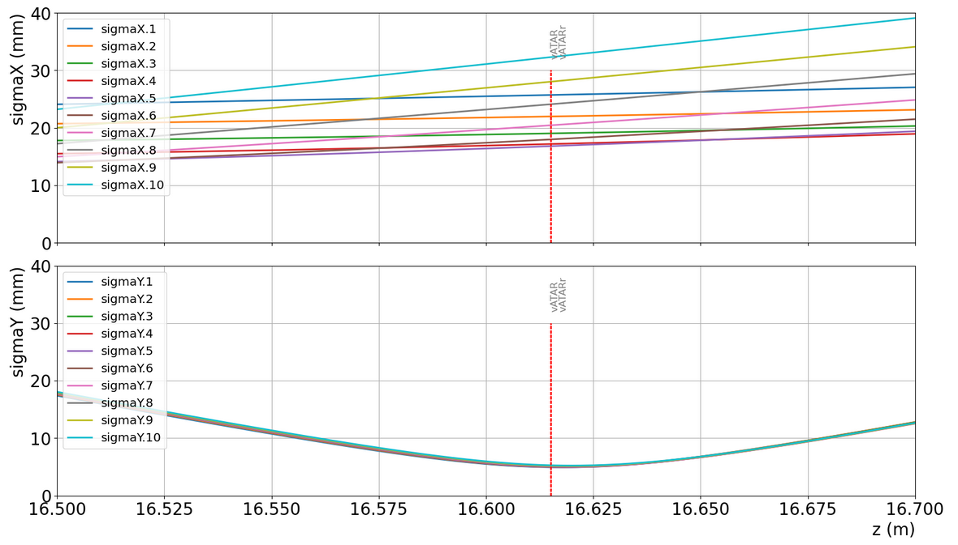
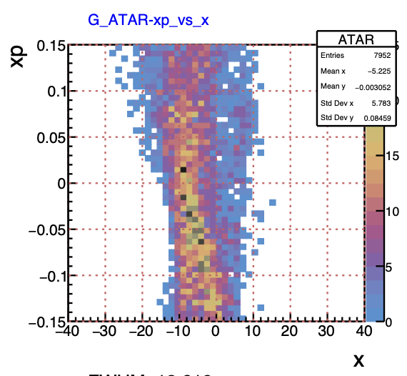
Beamtest: Phase Space, Geometry and Tasks
Phase space
Optimize measurement
  size and dependence of measurement uncertainties, subject to
  beam properties
  x,y resolution both planes
  multiple scattering first plane
Eliminate overwhelming e+ rate (collimator at 0.5 m after QSK43
Trigger with scintillator for PID
Prepare tracking detectors
Prepare beam tunes
Pepperpot as backup, but orders of magnitude less efficient

Slide 12
BVR Preparation
1 page beam request
Convincing presentation at BVR
  Requirements and KPPs, impact on PIONEER
  Beam dynamics studies
  Measurement hardware
    thin 2 plane tracker system with scintillator trigger
  Measurement plan and expected results

Slide 13
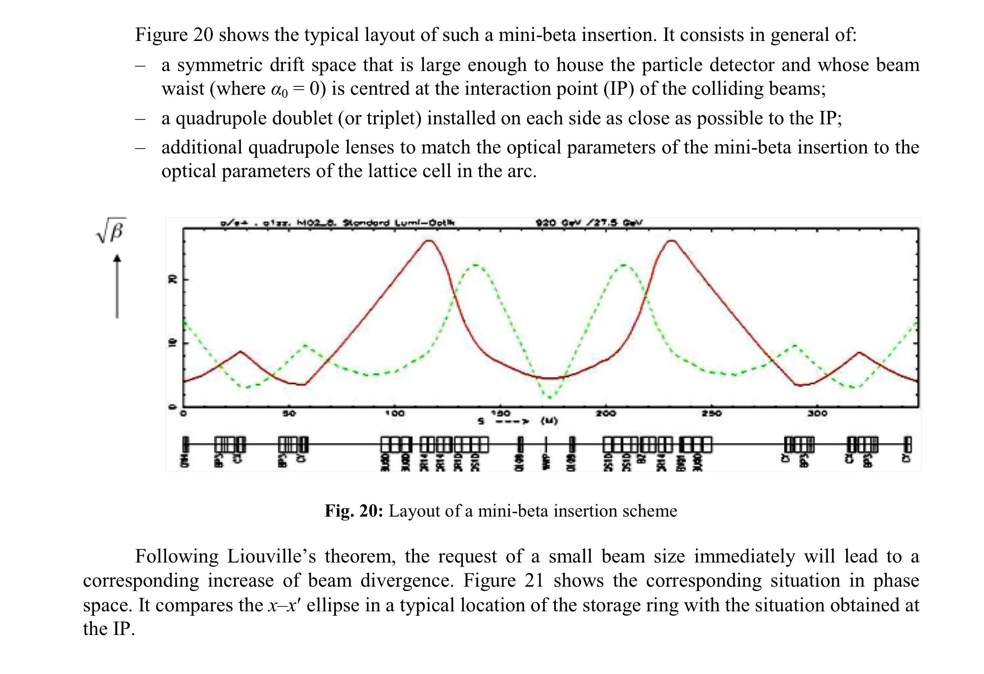
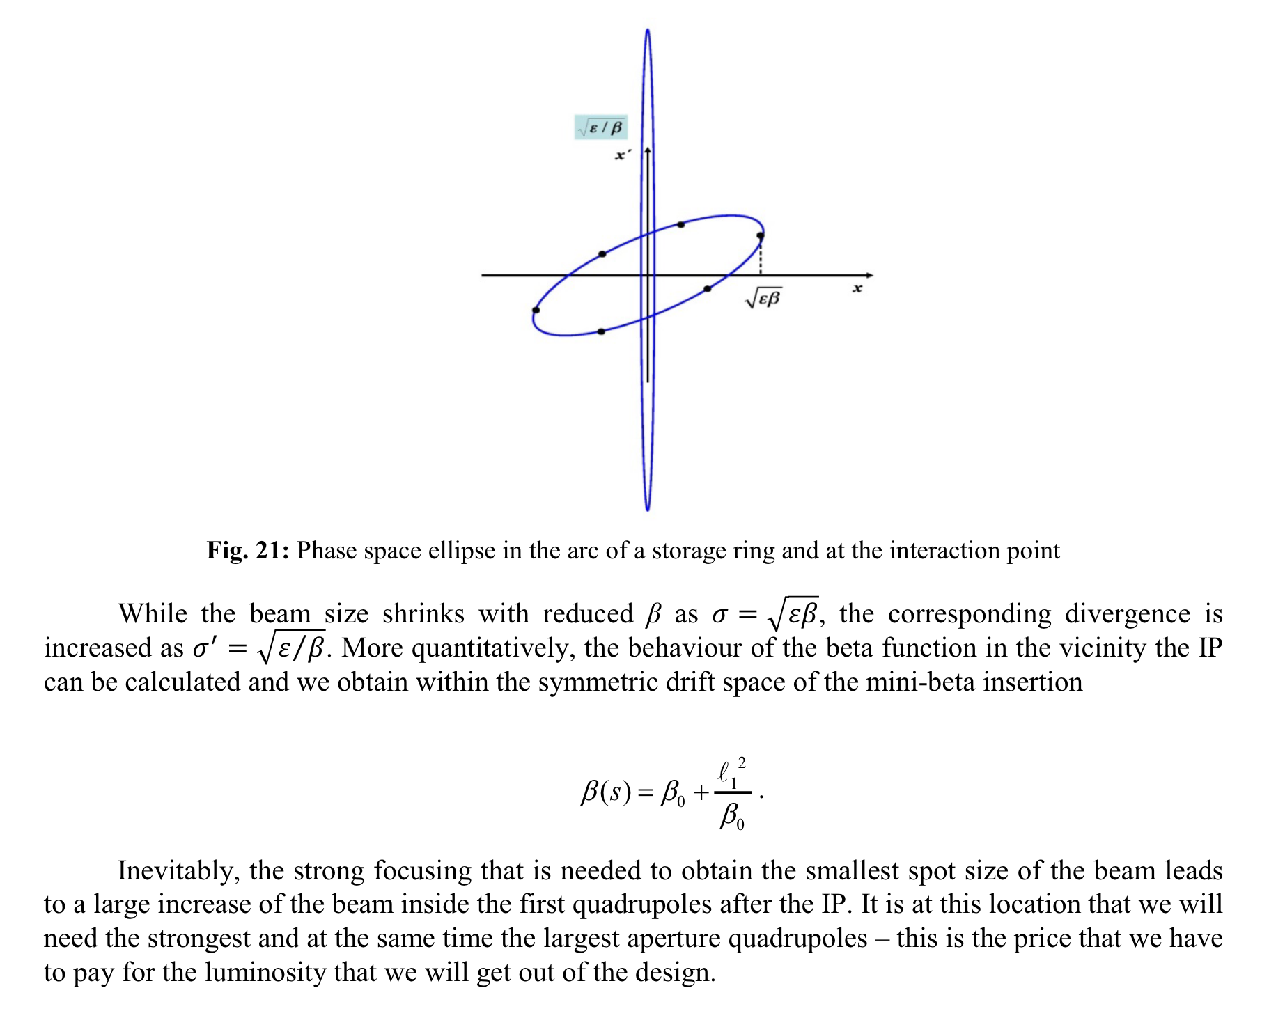
Holzer

Slide 15
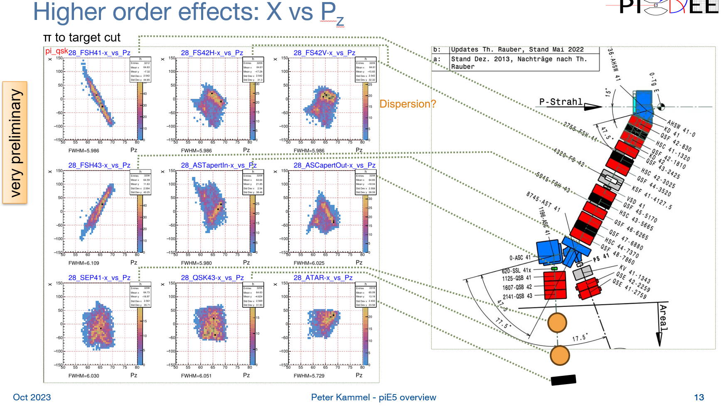
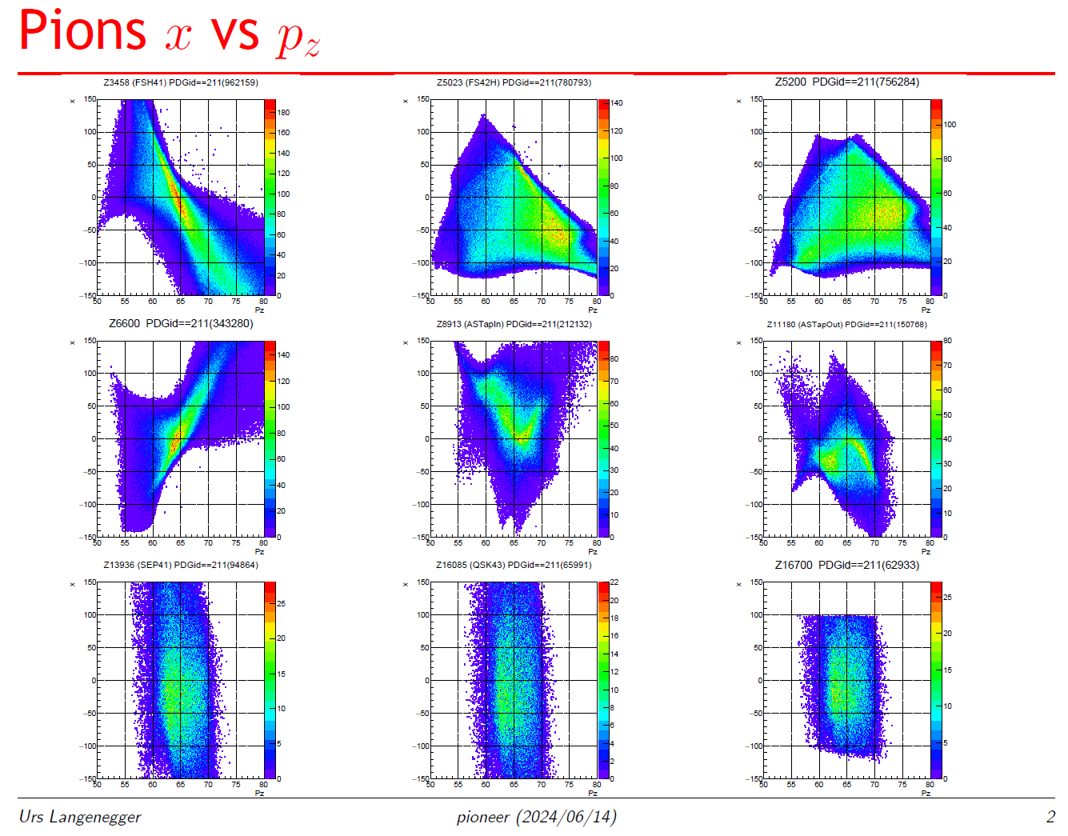
G4BL Model shows Strong Non-linear Effects
Peter 2023
Urs June 2024
All pions
Peter - Urs
  Not directly comparable, but non-linear behavior confirmed
  Compare magnet current/field conversion
More work
  Understand main non-linear matrix elements
  Rough beam tuning, currently it does not represent measured reality

Slide 16
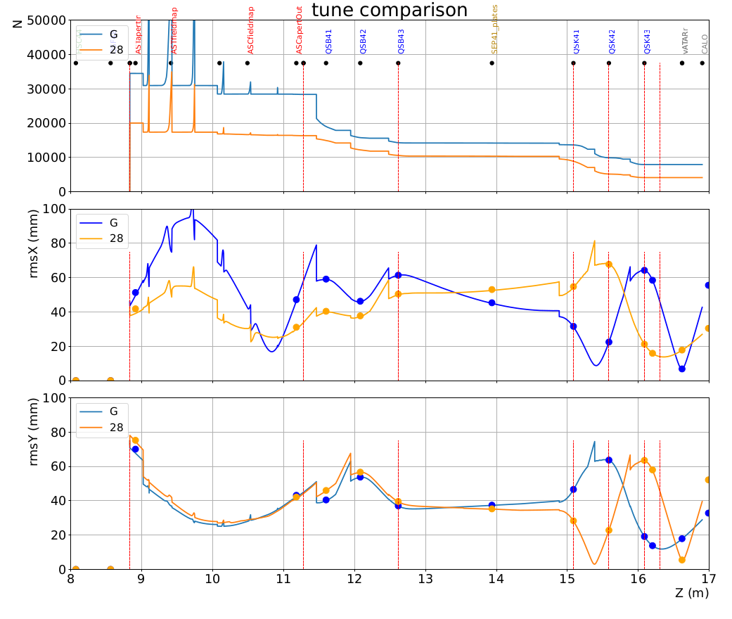
Far Focus: Tune Comparison

Slide 17
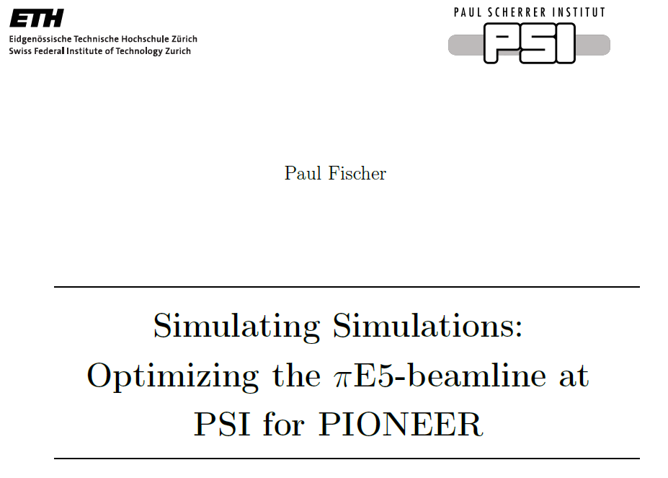
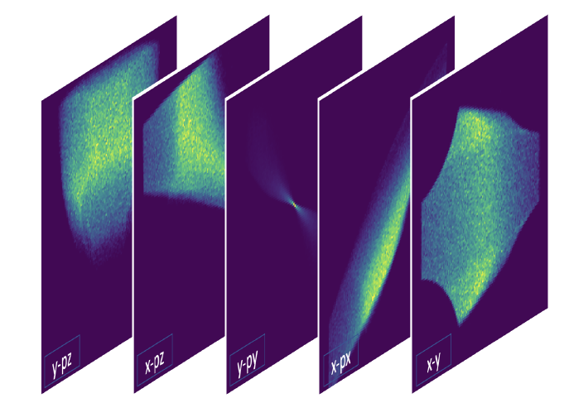
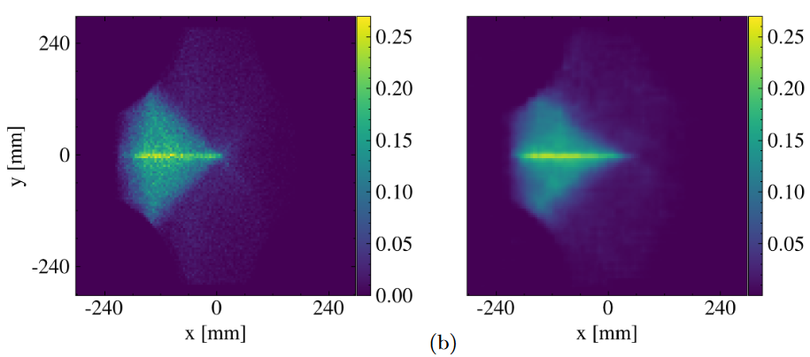
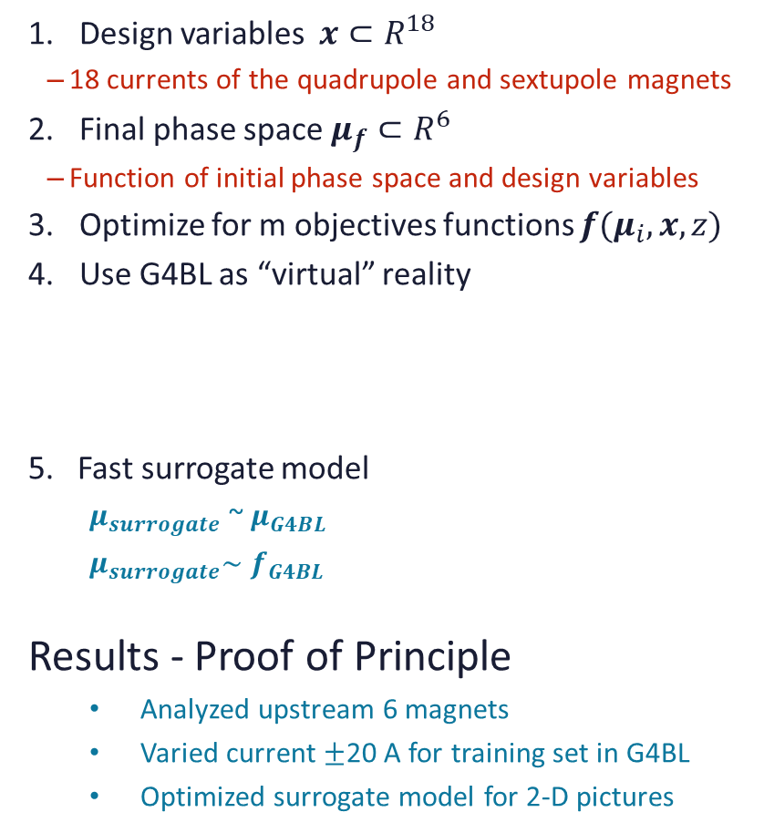
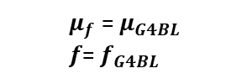
Paul’s AI/ML Work
Advisors: Andy A. and Sebastian H.
Design variables $x⊂R^{18}$
  18 currents of the quadrupole and sextupole magnets
Final phase space $μ_{f}⊂R^{6}$
  Function of initial phase space and design variables
Optimize for m objectives functions ${f(μ}_{i},x,z)$
Use G4BL as “virtual” reality
5. Fast surrogate model
    $μ_{surrogate}$ ~ $μ_{G4BL}$
    $μ_{surrogate}\sim$ $f_{G4BL}$
Results - Proof of Principle
    Analyzed upstream 6 magnets
    Varied current $±$20 A for training set in G4BL
    Optimized surrogate model for 2-D pictures
    $μ_{f}$ = $μ_{G4BL}$
    $f$= $f_{G4BL}$
x-y phase space
G4BL
surrogate model
~ 10⁴ faster

Slide 18

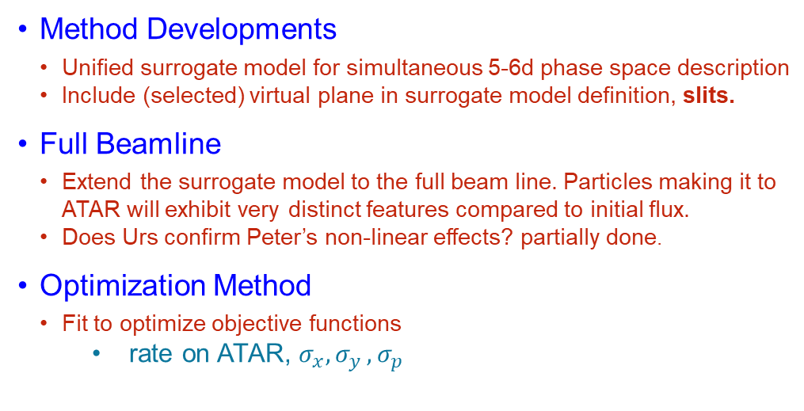
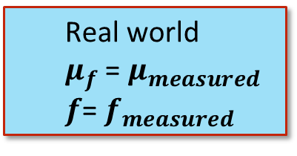
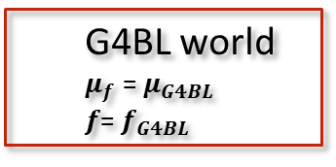
AI/ML Strategy
Anna: What does that have to do with reality?
Answer: 2 steps
  Step 1:
    Use G4BL as “virtual” reality to develop and establish method
    Importantly, study required input data set for robust prediction
  Step 2:
    Replace input-output relation with measured phase space
    (chamber tracker at ExB location)
    Re-optimize based on data
AI/ML Tuning strategy
  Full BL or DBL (downstream) only (Black box approach)
  DBL only probably not enough
  Step-by-Step optimization ?
UBL
DBL
Method Developments
  Unified surrogate model for simultaneous 5-6d phase space description
  Include (selected) virtual plane in surrogate model definition, slits.
Full Beamline
  Extend the surrogate model to the full beam line. Particles making it to ATAR will exhibit very distinct features compared to initial flux.
  Does Urs confirm Peter’s non-linear effects? partially done.
Optimization Method
  Fit to optimize objective functions
    rate on ATAR, $σ_{x}{, σ}_{y},σ_{p}$
    G4BL world
    $μ_{f}$ = $μ_{G4BL}$
    $f$= $f_{G4BL}$
    Real world
    $μ_{f}$ = $μ_{measured}$
    $f$= $f_{measured}$

Slide 19
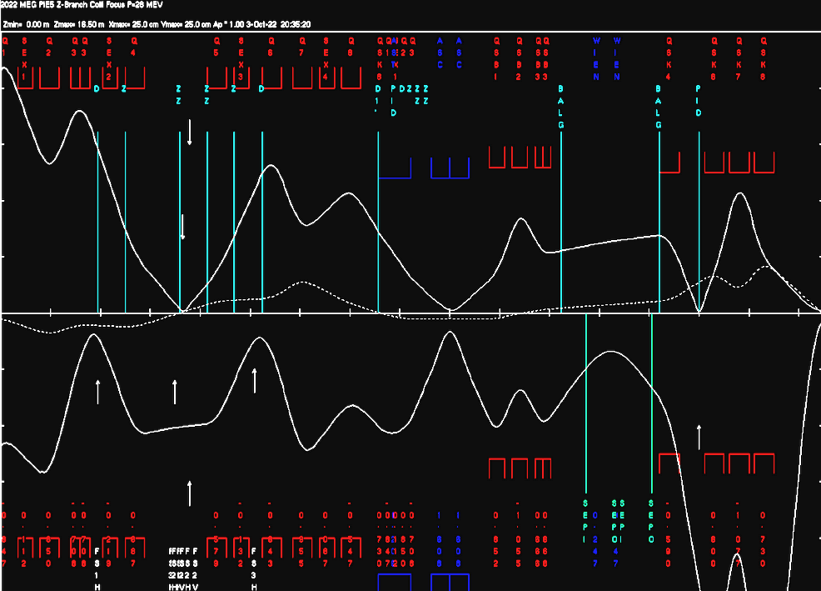
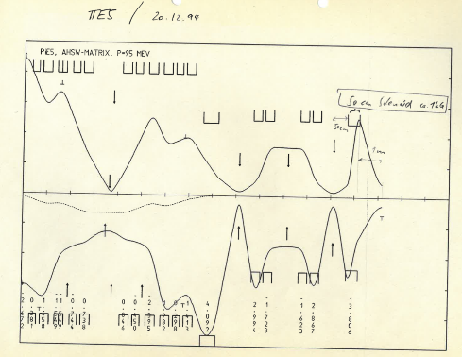
Major Design Upgrades
20 cm
Two separate foci required
so that background is rejected outside of detector
    1st focus separates particles after ExB velocity filter
    and reject μ and e on collimator
    2nd focus is a double x/y focus aimed at ATAR
  First attempt with singlet triplet promising
    but using only linear beam dynamics
  Large custom final quad?
Smaller momentum bite
  Retune upstream beam line to let dispersion grow
Degrader in dispersive section?
  Requires dispersive double focus
beam envelope in V-H planes
V
π⁺
H
20 cm

Slide 20
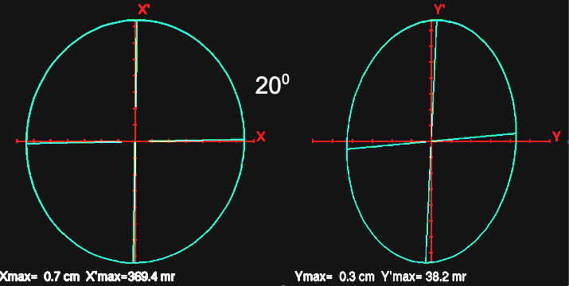
Major upgrade: Extend Beam with Two Vertical Foci
For particle separation and target focus two separate foci required,
so that background is rejected outside of detector
  1st focus separates particles after ExB velocity filter and reject μ and e on collimator
  2nd focus is a double x/y focus aimed at ATAR
First attempt with s-t promising
  large final magnet
  phase space
    initial x: 2.40 π mm r
    y: 0.09 π mm r
    promising final focus
20⁰
!

Slide 21
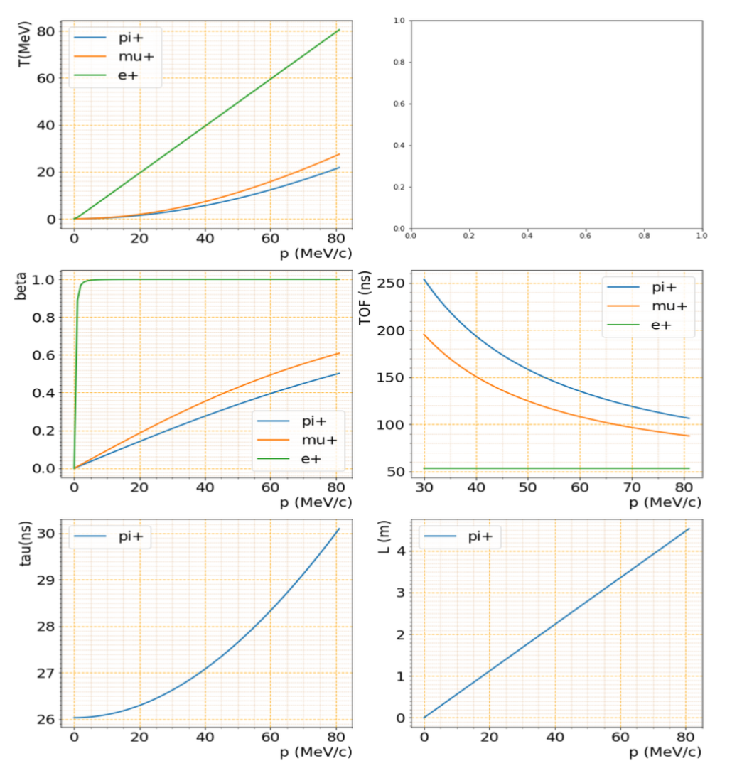
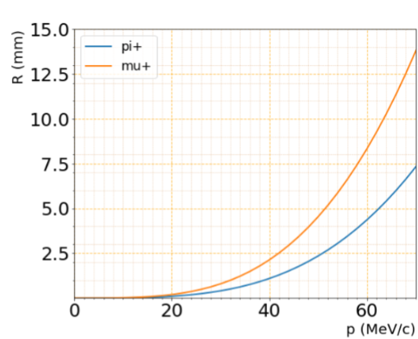
Kinematics
Si

Slide 22
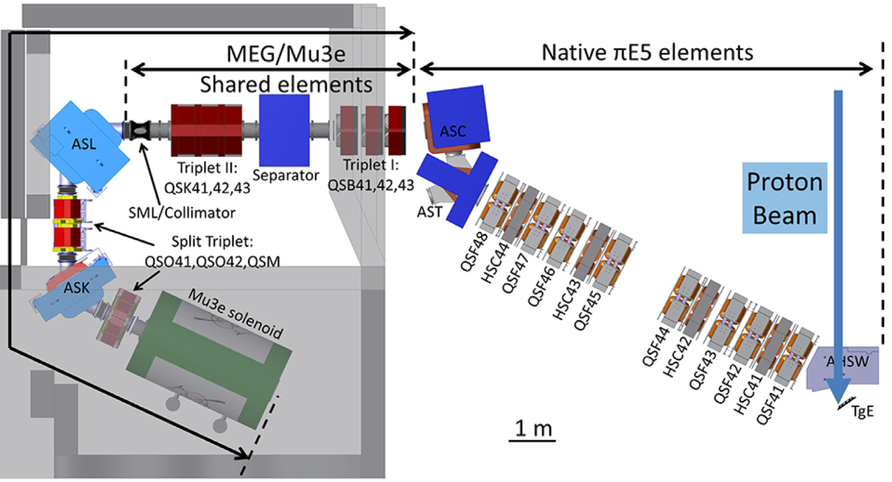

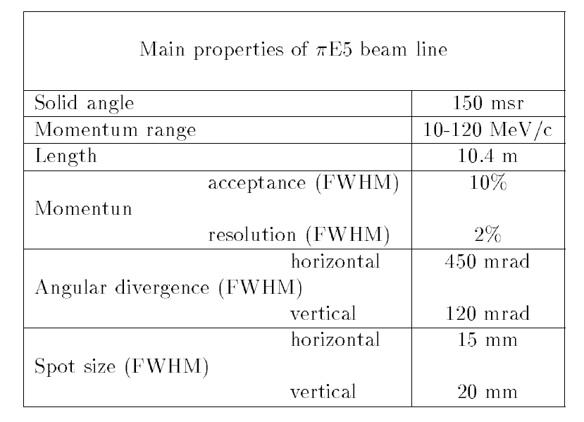

piE5 @ PSI - World’s Brightest Stopped Pion Beam
PIONEER
MEG
Mu3e
        carefully studied for fundamental muon experiments
still surprises for pions, unique PIONEER requirements
experimenters have full control over beam line (after first bend)

Slide 23
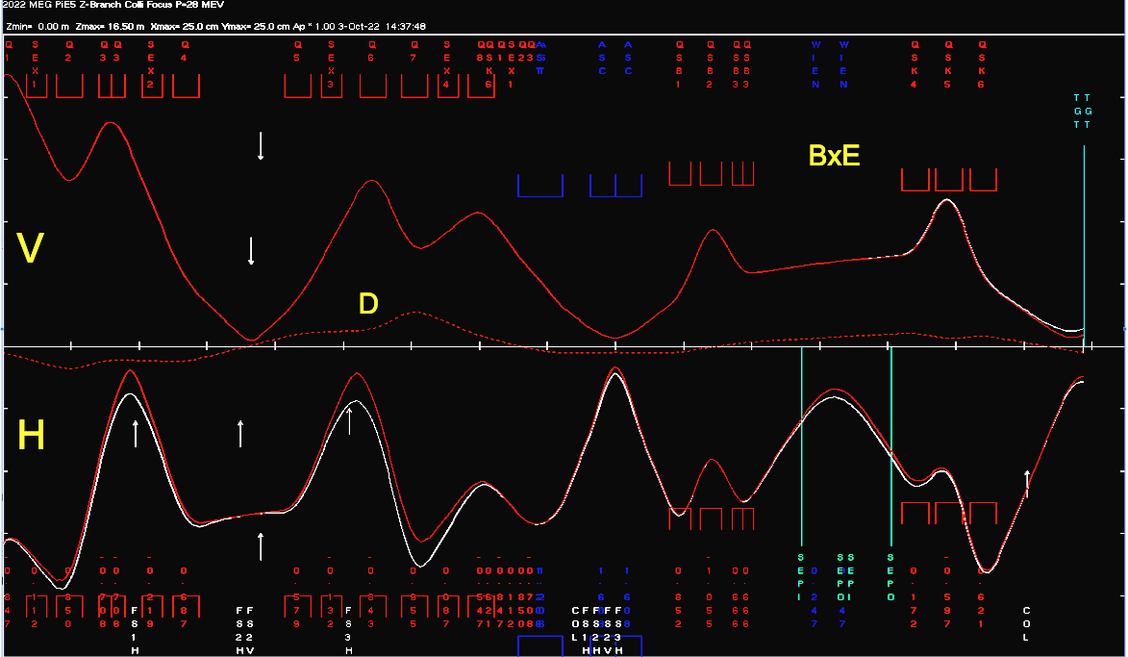
Simple Transport Model
MEG tune adjusted to PIONEER geometry, P-R Kettle
Compare Δp/p= 3/0 %
1st order only
  2nd order diverges
  other discrepancies to
  PIONEER Run ‘22
upstream part in shielding
    indirect diagnostics with slits
20 cm
BxE
separator
V
beam envelope in V-H planes
D
π⁺
H
dipoles
20 cm
extraction, momentum selection and achromat
particle separation, focus on target

Slide 24
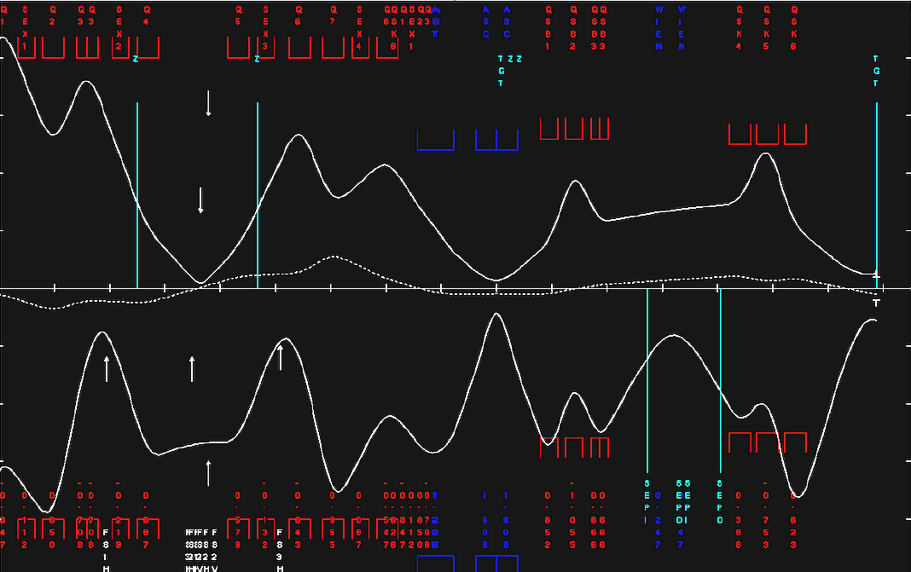
Puzzles from beam test
cannot achieve PID separation and target focus simultaneously
Explore/explain
most striking
puzzles, problems
beam meandering
significant
dispersion
strong
dispersion
insufficient focus

Slide 25
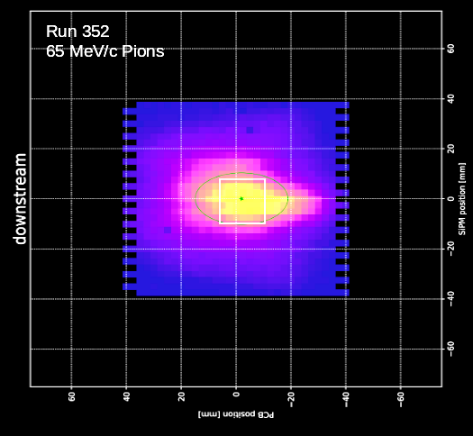
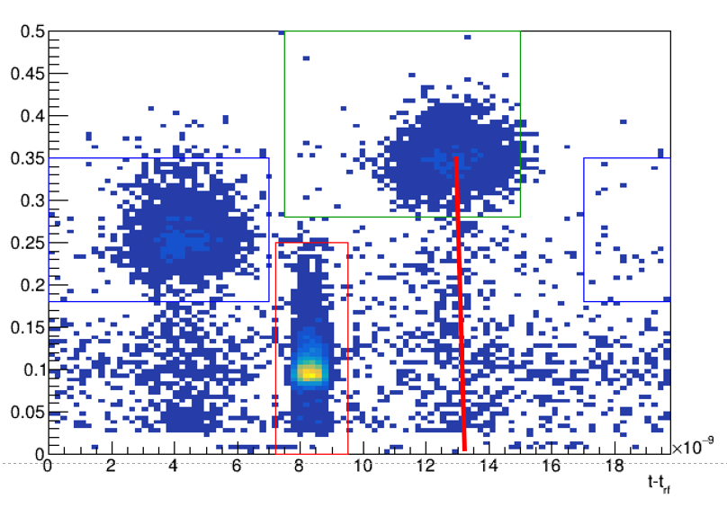
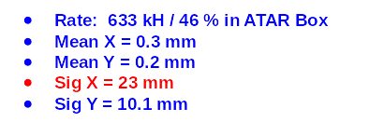
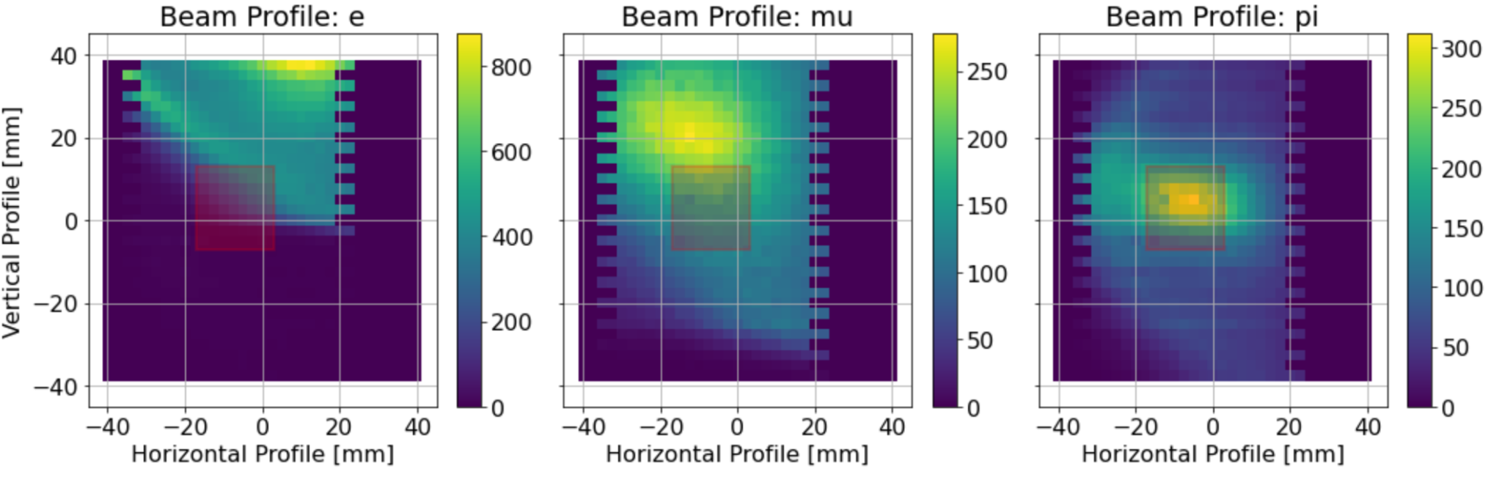
Summary of findings
Dispersion? at target
Final focus
PID
Δp/p two methods
  TOF
    16m beamline
    1% Δp/p ~ 1 ns (65 MeV/c)
  Direct stopping measurement
  with range curve
    pion signal amplitudes with different degraders
    use π→ μ sequence to identity stops
  analysis needed

Slide 26
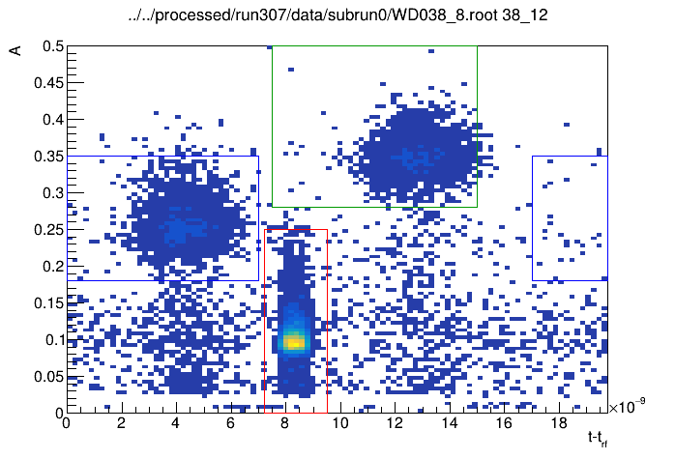
Particle Separation Good Enough?
μ
π
No
location of collimator !
Separator HV can be increased
In area restricted to ATAR
(optimistic accounting)
e: 25.0%
μ: 32.1%
π: 42.9%
amplitude in scint.
e
TOF (ns)
Patrick
Josh

Slide 27
Dispersion at Target Location?
Patrick
TOF changes when when detector moves 5 cm to the left
X=X(P), significant dispersion D at target location, deteriorates focus.

Slide 28
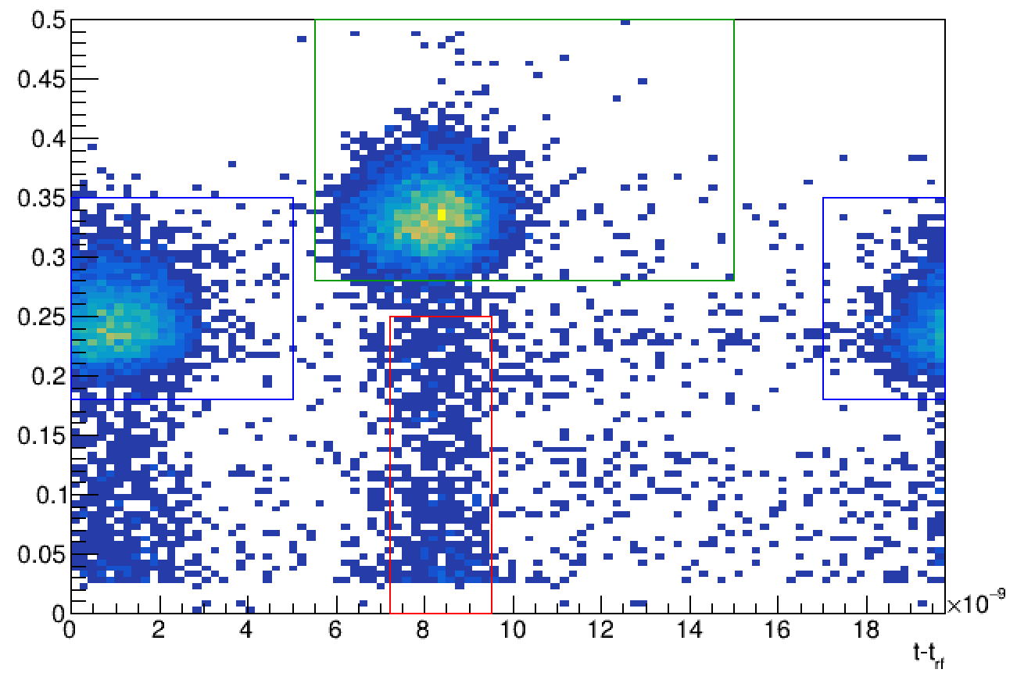
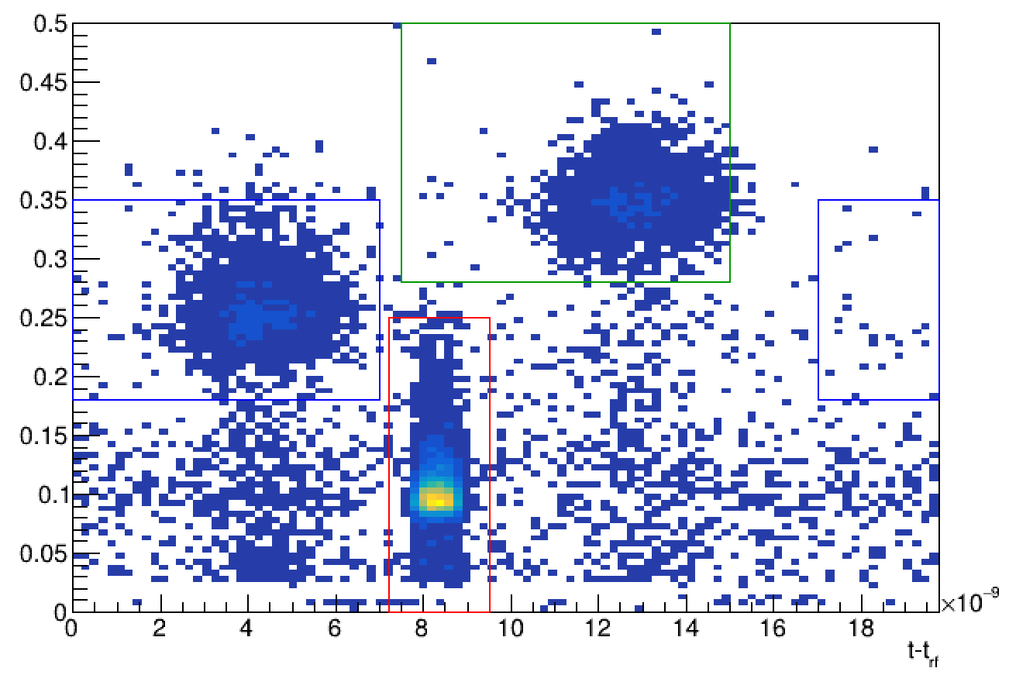

Dispersion at Target Location?
D~1 cm/%
similar to dispersive section??

Slide 29

Beam: piE5 @ PSI - World’s Brightest Stopped Pion Beam
Physics
oncept
Components
Summary
Progress 2023
  PIONEER requirements and test beam 2022 results
    Rate: 300k π/s stopped in ATAR: ok at 65 MeV/c
    Momentum bite: ∆p/p <2%: marginal
    Spot size: <2 cm FWHM: not achieved
    µ,e less than 10% π: needs second focus extension
  improved understanding and optimization
    non-linear effects due to large phase space
    beamline model with G4BL
    novel promising machine learning approach
    (Adelmann et al)
Plans 2024
  machine learning
    extend machine learning to full beam line
    optimization of beam properties
    prepare experimental verification
  beam design
    2nd focus extension
    better focus
    retune for smaller ∆p/p <2%
x-y phase space
request PSI support in design

Slide 30
People and Timeline
People
  Andy Adelmann
    No progress this year, needs student
    Kolja interested candidate
  David Tarazona
    1st rate beam physicist
    Currently work with Lawrence
    Applied for Cornell AI in Science Postdoctoral Fellowship
    Plans to model pE5 with BMAD
  Kolja also analyzing first beam test
  Remark concerning simulation
    Prediction won’t be ready on CDR timescale
    Include beam as parametrized input
  Hope that activity can resume in fall
  Other help more than welcome
Timeline
Fall 2026 | Beam test
Fall 2025 | AI/ML studies with G4BL finalized to justify πE5 2026 beam request. Extend the surrogate model to the full beam line running Optimization demonstrated Measurement strategy developed At the same time we should have tracker system available.
Fall 2025 | Beam design with extension ready To justify extension measurements
CDR | What do we need for that?

