Slide 1
PIONEER Calo Test Facility
2025 CFI application
Doug Bryman, Chloé Malbrunot
UBC/TRIUMF

Slide 2
Objectives
Design, build, test 1/10th scale LXe calorimeter test facility based on MEG large prototype
Confirm mechanical design for thin windows and COF MPPC arrangement
Confirm performance parameters relative to simulations for
  energy resolution
  timing resolution
  spatial resolution
  pileup identification
  UV light exposure degradation
Time scale: 2025-2028
New personell
Engineer Cryogenics, Proj. Management
Detector Physicist Photosensors, Data acquisition
Electro-mechanical Technologist Design, Assembly, and Installation

Slide 3
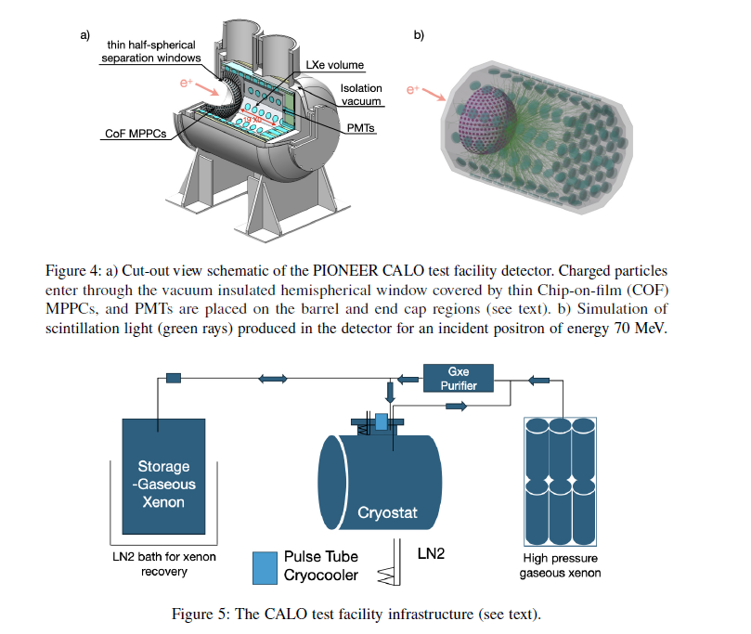

Slide 4
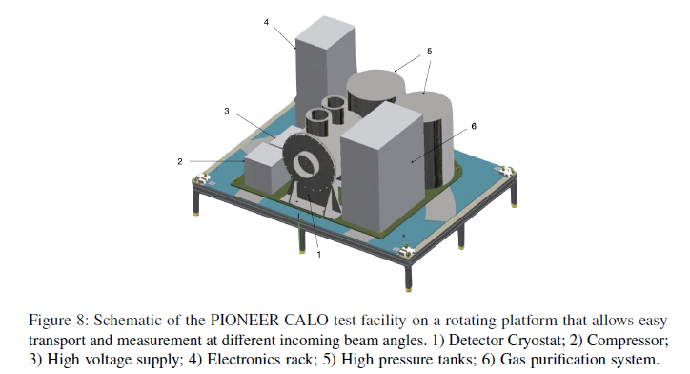

Slide 6
Process and Timeline
Application submission by UBC: Feb. 4, 2025
Evaluation: Technical/financial 25 pages
    Multidisciplary 3 pages
    National
    Result: Nov. 2025

