Slide 1
Machine Report
Week 43/2024
Tobias Weilbach
SwissFEL Exchange Meeting , 28 October 2024

Slide 2
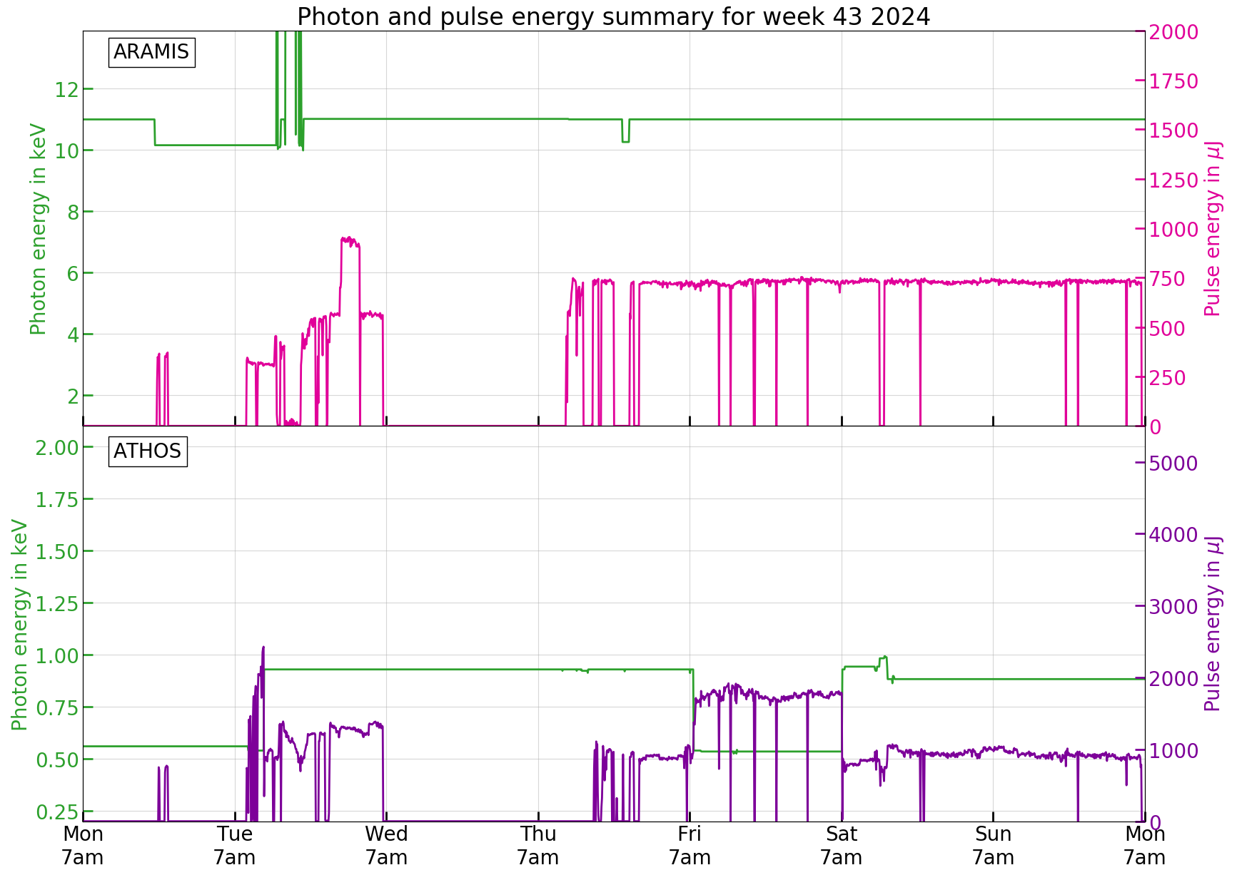
Performance during the Week
Mon: maintenance
Tue: Setup
Wed-Thu: MD
Fri-Mon: Cristallina
  11 keV, 560 µJ
Fri-Sun: Furka
  540 eV LV+, 1.8 mJ
  930 eV LV+, 900uJ
Setup
MD
Alcor LAM
Setup

Slide 3
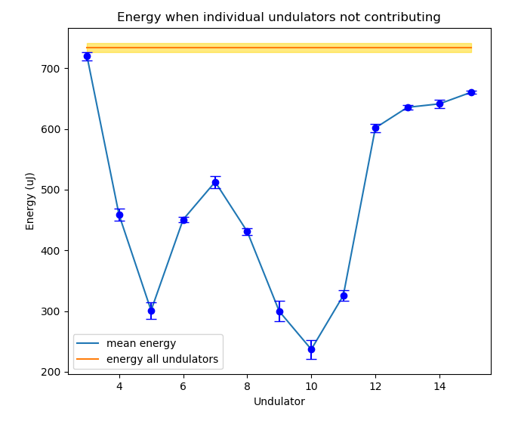
Set-up
Tunnel already closed on Monday, so we start Monday afternoon, but some RF issues
Setup on Tuesday:
  Optimized 540eV and 930eV settings for Furka
  After S30CB11 is back we check the undulator pointing:
    SARUN11 and onwards way off in x and y, correct pointing and get all undulators to contribute
MD (Wed-Thu):
  10pC setup for Alcor/Aramis (Wednesday)
    Wire scanner measurements
    Energy spread optimization at the Gun
  Revert setup to 200pC for Alcor/Aramis (Thursday)
    Broadband pickup measurements
    Armais Optimization: Optimize after undulator pointing changes and absorb Quad offsets in FB, we achieve 760uJ @11keV
    Injector RF arrival time tests
    Bunch 1 to Athos test
    Standard beam characterization

Slide 4
Issues during the week
Set-up:
SINSB03 state machine
S30CB11 needed PS replacement
Vacuum interlock around Athos Gas detector
Aramis gas detector power supply needed power cycling
MD:
DRPS detector 0302 caused alarms, was disabled and replaced today
User Operation:
SATUN21 needed power cycle on site (thanks to Liz for doing that)
Small issue with measuring RM for arrival time FB, was fixed with the help of Florian
Alcor vanished from VC and gun, fixed by laser Pikett (Ümit)
Alcor LAM alarm, needed several power cycles to come back, fixed by shift crew

