Slide 1
Requests for week of 28.10.2024-3.11.2024
Requests at week’s begin:
Aramis:
  Alvra: 2.5keV and 9keV
Athos:
  Furka: 580eV LH and LV, max pulse energy, 30fs, polarization shifts
  RC: Pavle Juranic, PC: Alvra, BD: Sven Reiche

Slide 2
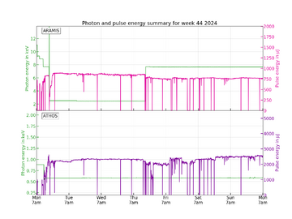
Performance
FEL performance was mostly stable and there were no major issues during beam delivery. There were a few minor instances of downtime and degraded performance, but they were resolved quickly.

Slide 3
Down time
Modules stuck on LH polarization change in Athos on 31.10.2024.
Alcor amplifier went down on 1.11.2024.
Short down time for an energy change on 1.11.2024.
A few short downtimes due to RF issues with alarms, voltage readings, and S30CB12 on 1.11.2024.

Slide 4
Degraded performance
Losses during Alcor optimization caused the need for re-optimization on 28.10.2024 by laser group.
SATUN21 got stuck on 28.10.2024, repaired by Carl Beard.

Slide 5
Special notes
SARUN02 and SARUN03 quads were not working and needed replacement for the power bricks during setup.
Some small issues with MPS alarms.
Some issue with bandwidth setup for 2.5 keV due to spectrum measurement issues.
CHIC server had to be restarted, no effect on FEL performance.

Slide 6
Plan for next week
Aramis:
  Bernina 5.-6.11. & 8.-11.11. 10 keV, pink beam, 1 mJ would be good
  Cristallina on 7.11
    11 keV
Athos:
  Maloja:
    Photon energy: 400 eV, 530 eV, and 660 eV
    Polarization linear horizontal
    Pulse length: standard and option to shorten to half by tilting -> SATSY, not SATCL -> check elog for docu, make sure you confirm with SATMA02, verify that this also works at 400 eV, setup should be sufficient at 530 eV
    Pulse energy: more than 1.5 mJ at full pulse length
    Bandwidth: as narrow as possible
  Furka:
    Furka 10.11, we would like to have 700 eV any polarization ideally with 1 mJ pulse energy, optimization beyond that is not needed. I will also move energy with the undulators +/-150 eV for commissioning the new beamline spectrometer and may ask to change the rep rate

Slide 7
Special thanks to
Laser Pikett (Andreas Dax) for the Alcor work on 1.11.2024.
Arturo Alarcon and Kurt Bitterli for getting the SATUN quads working again.
Carl Beard for quick response on SATUN21.
RF Pikett for responding quickly to the few times we had issues.
All the piketts that helped get and kept the machine working.

