Slide 1
SwissFEL RC report, week 49, G.L. Orlandi

Slide 2
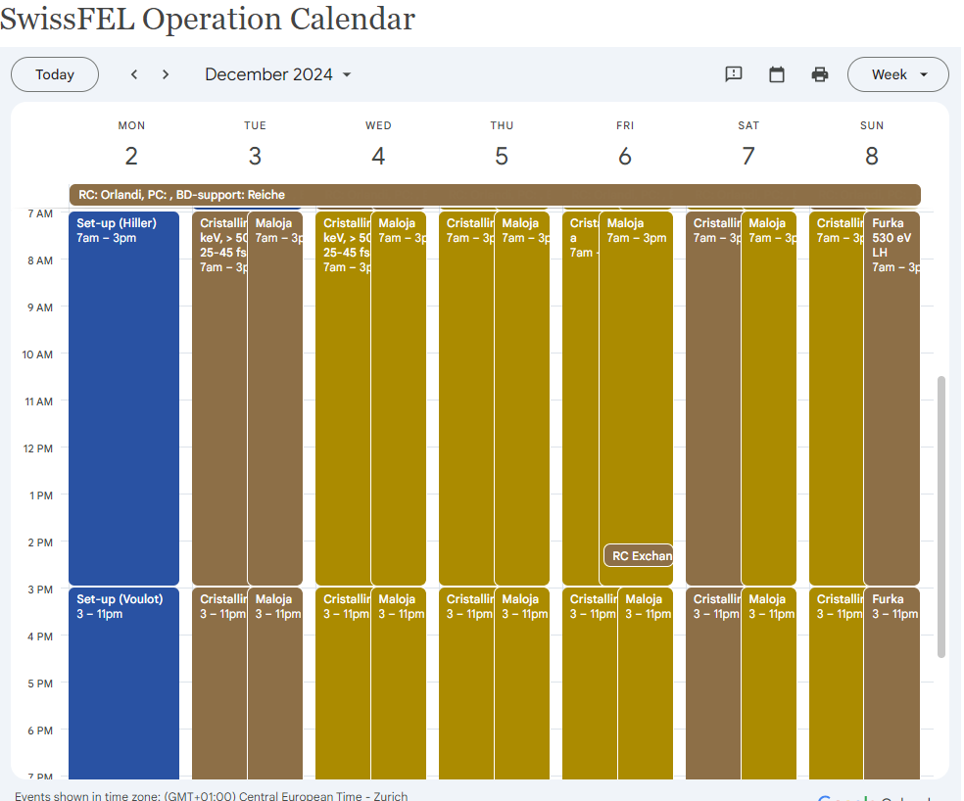

Slide 3
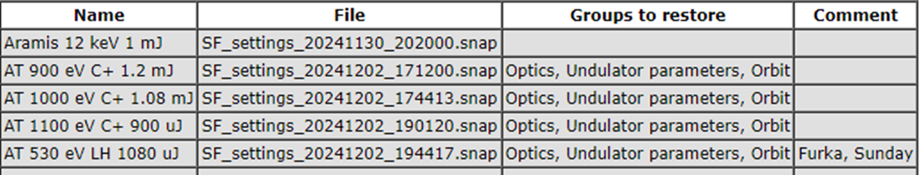
Machine set-up request for week 49

Slide 4
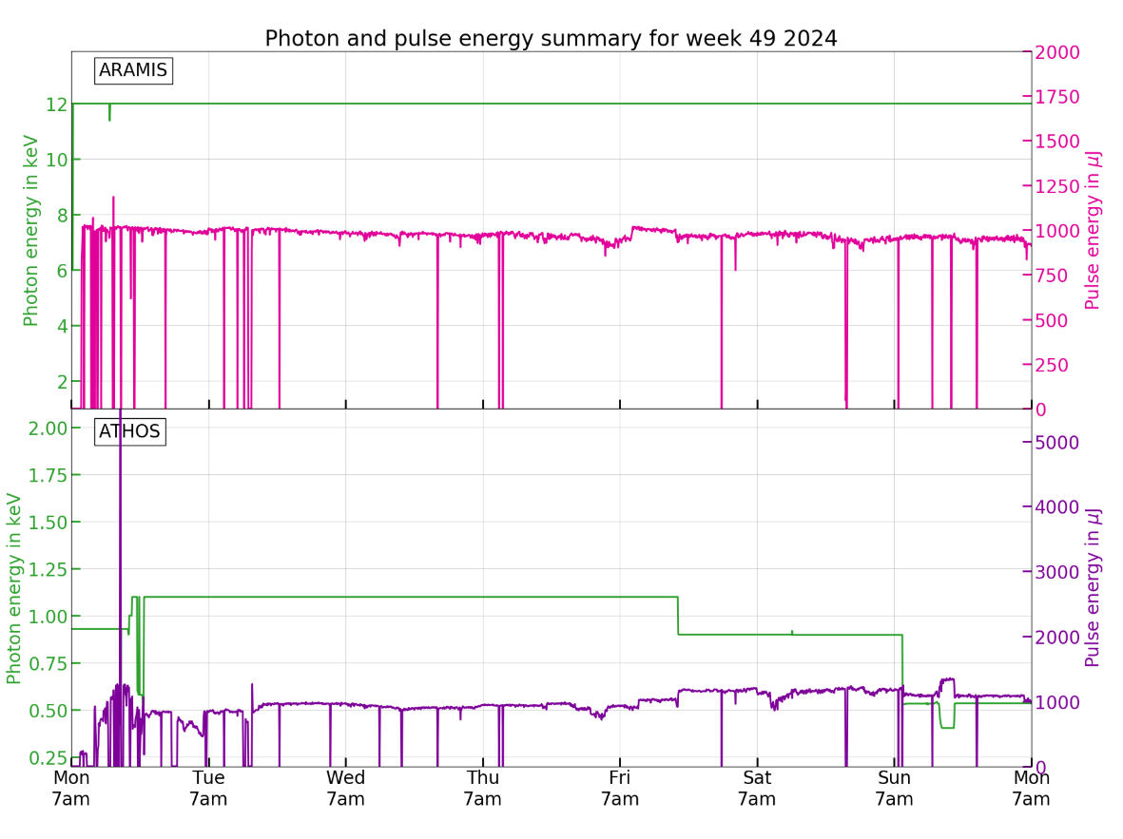
1100 eV
900 eV
530 eV

Slide 5
Issues
Low pulse energy performance of Athos below the expectation to be investigated: planned emittance and bunch-length characterization for Bunch-2
Tue Dec 3, 1 am: MPS LAM Alarm for Mizar. The machine recovery procedure accidentally also affected Aramis (Alcor) as well. Problem solved in a short time by CR and beam delivery in both lines recovered
Tue Dec 3, 1 pm: tunnel access for vacuum issue in Athos Gas Detector
Sat Dec 7, 10:30 pm: short machine activity interruption because of anomalous increase of the beam losses in both Aramis and Athos…reason drift of compression phase by 1 Deg in Linac 1…after restoring the right compression phase in Linac1, regular machine operations recovered
Sun Dec 8, 2pm: Furka request to reduce the pulse energy...☺

