Slide 1
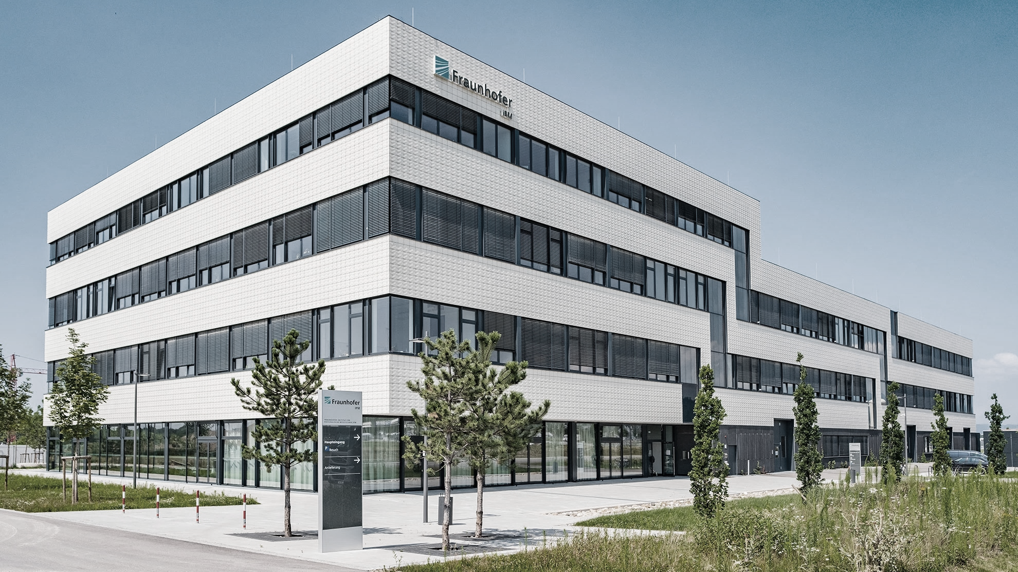

Logobereich
Industrial Application of OPM:
Flow Metering
  —
    08.08.2025
    Peter Koss and Leonhard Schmieder, Fraunhofer IPM
    Fraunhofer Model and Showcase Development
    Flow Metering with OPM
    Summary and Outlook

Slide 2
Fraunhofer Model and Showcase Development
Fraunhofer IPM in 2023
  Fraunhofer Institute for Physical Measurement Techniques (IPM)
  Operating budget: 26 Mio. €
        Industrial revenue share: 40 %
        Acquired projects: 40 %
        Basic Funding: 20 %
  Investments: 2 Mio. €
  Employees: 270

Slide 3
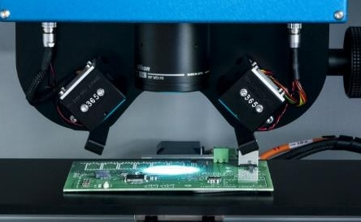
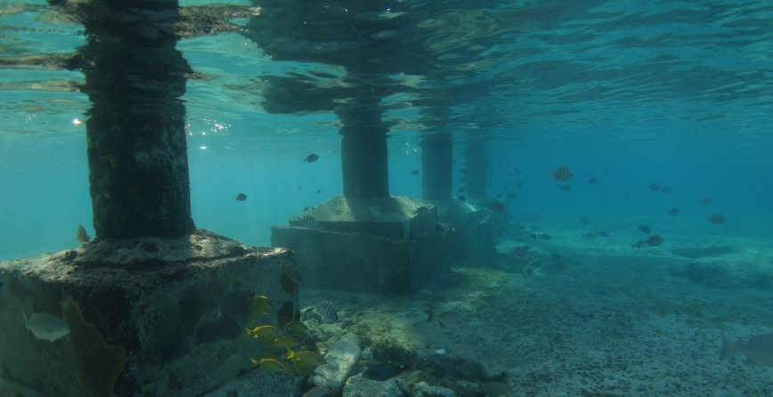
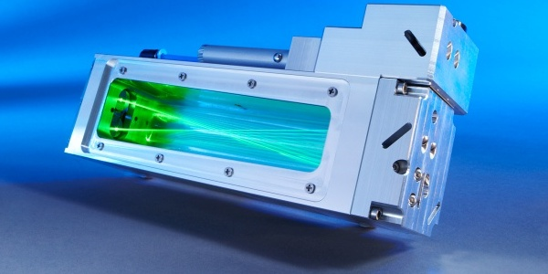
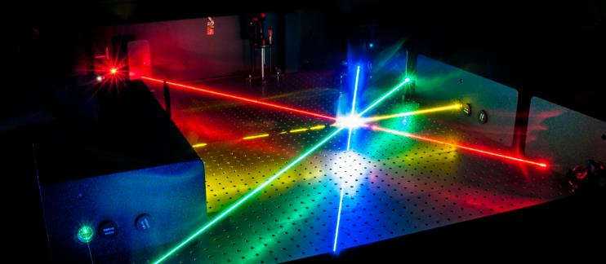
Fraunhofer Model and Showcase Development
Business units
Production Control
Object and Shape Detection
Inline microscopy
Capture underwater infrastructure
Gas and Process Technology
Photonic Systems
Trace gas analysis
Laser light sources

Slide 4
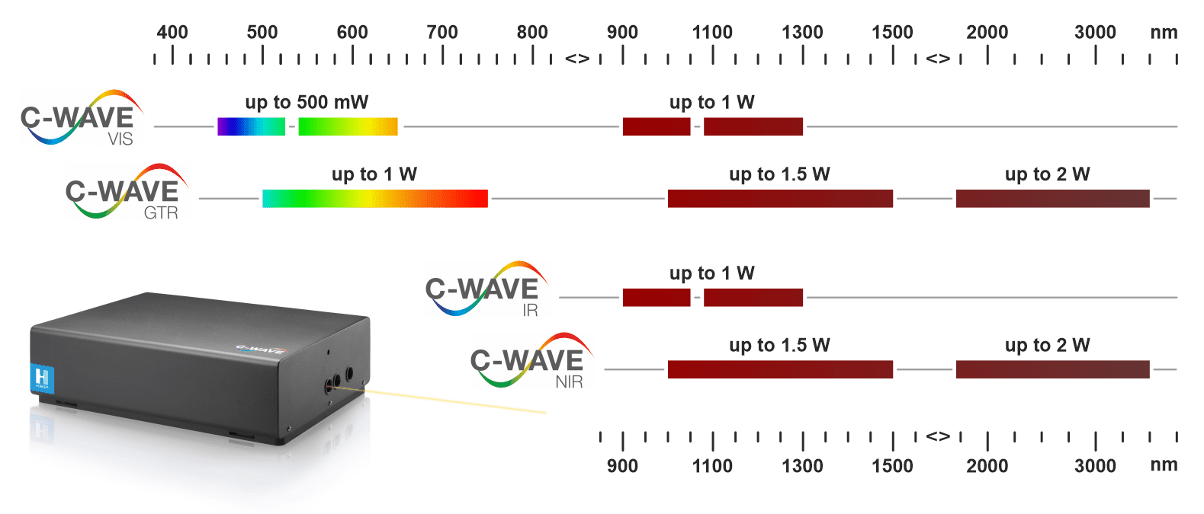

Fraunhofer Model and Showcase Development
Photonic Systems: Laser frequency converters
      Color change
      MIR-to-NIR conversion
      Tunable colors
      Use of non-linear optics in volume resonators or waveguides for frequency conversion
      High efficiency!!

Slide 5
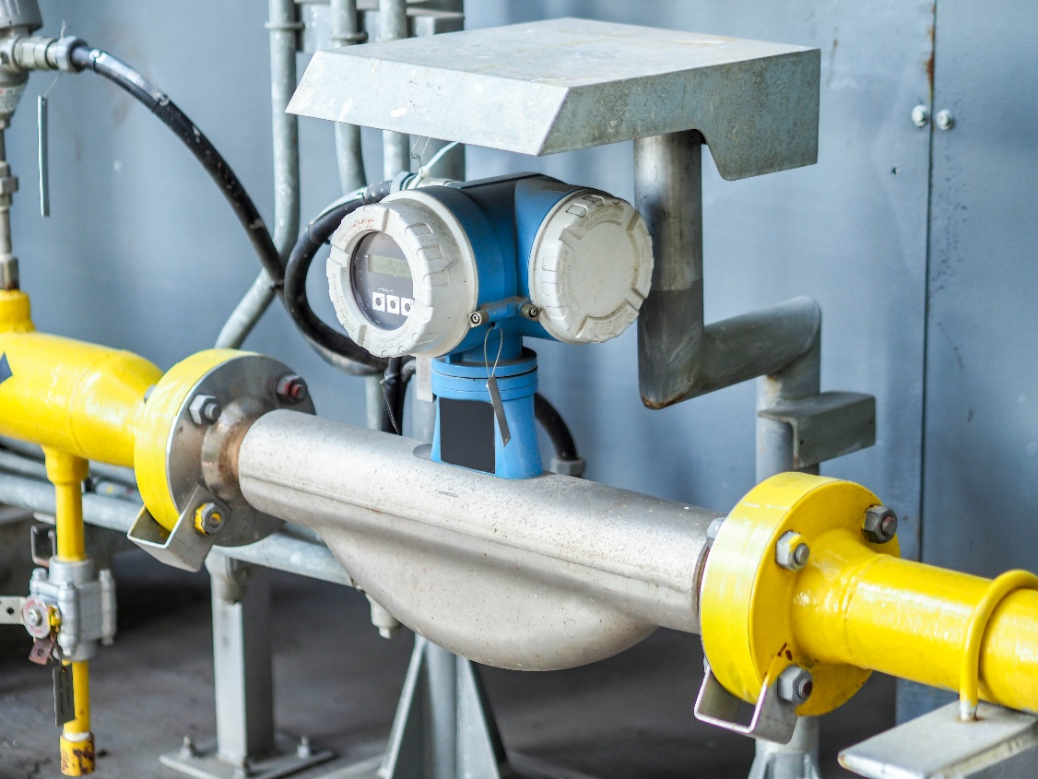
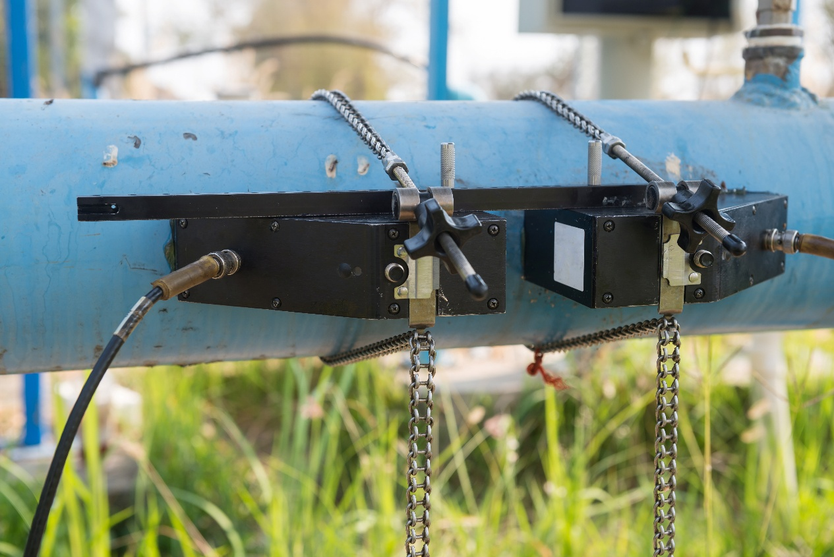
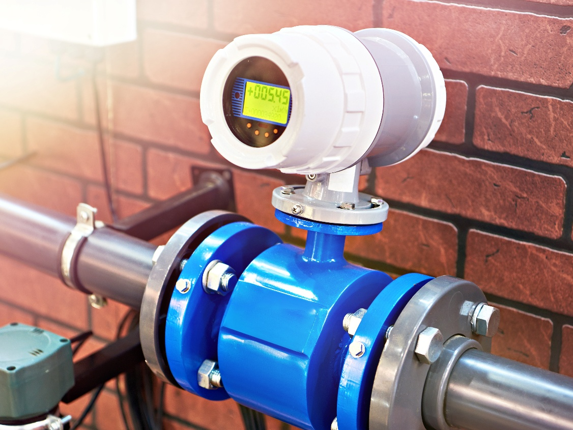
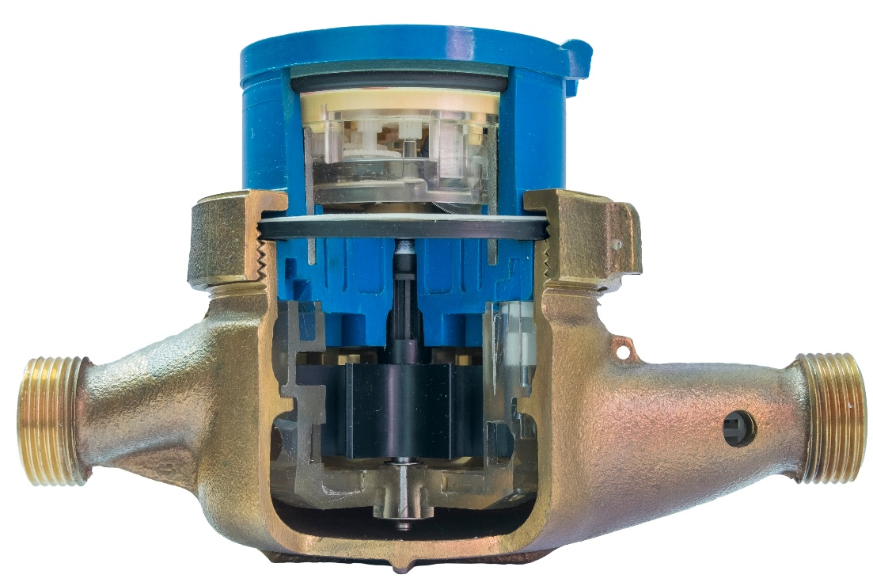
Flow Metering with OPM
State-of-the-art in industrial flow metering
      State-of-the-art
      Many different flowmetering technologies
      Wide range of application cases covered
      Current technologies are very robust and work in harsh environments
      ➔ Still some cases are not covered (requires a new solution)
Inertial Flowmeters: Very accurate
Ultrasound Flowmeters: clamp-on
Magnetic Flowmeters: large pipes
Mechanical Flowmeters: cheap

Slide 6
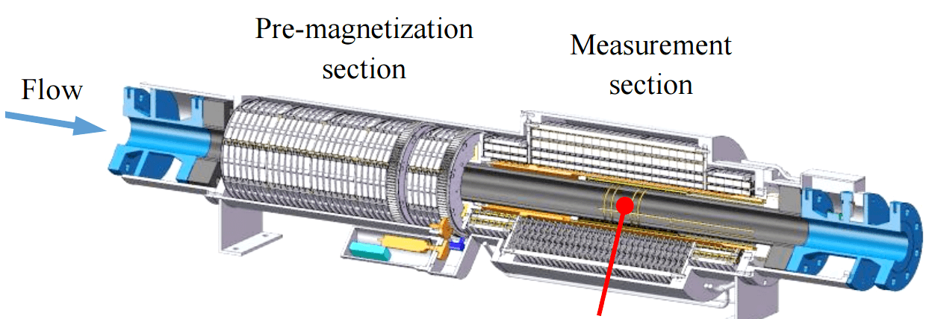
Flow Metering with OPM
State-of-the-art in industrial flow metering
Flow direction
RF-coil
      Krohne M-Phase 5000
      NMR based flow meter ➔ Multiphase measurement
      Skin effect ➔ Cannot measure through metallic pipes
1 m
Jankees Hogendoorn et al., Practical Experiences Obtained with the Magnetic Resonance Multiphase Flowmeter, KROHNE Messtechnik GmbH, 2015

Slide 7
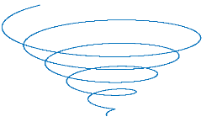

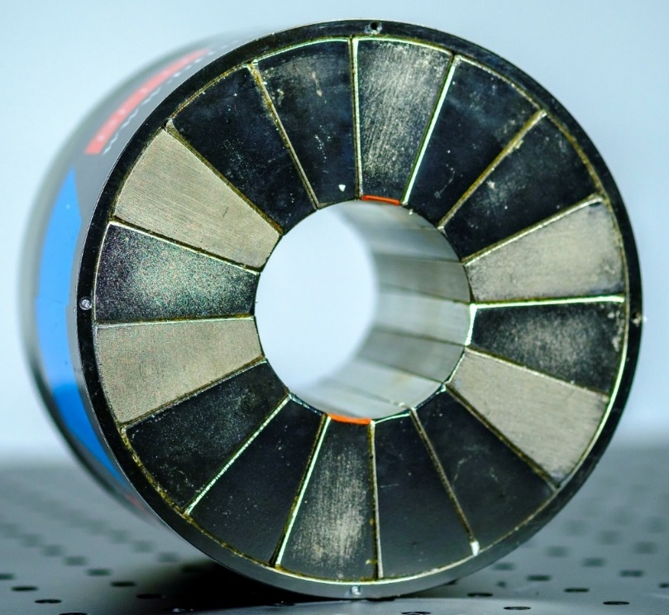
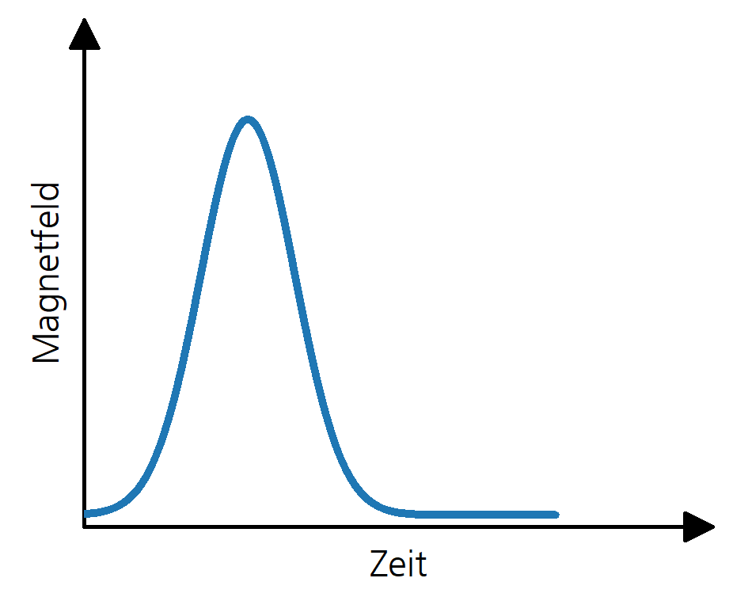






Flow Metering with OPM
Basic Idea
$${\vec{B}}_{H}$$
$$^{1}H$$
$$\vec{μ}$$
Voltage
Time
„classical“ NMR
$$^{1}H$$
$$\vec{μ}$$
1 Tesla
IPM-approach
Magnetic field
Hydrogen (¹H)
Strong magnet
Time

Slide 8
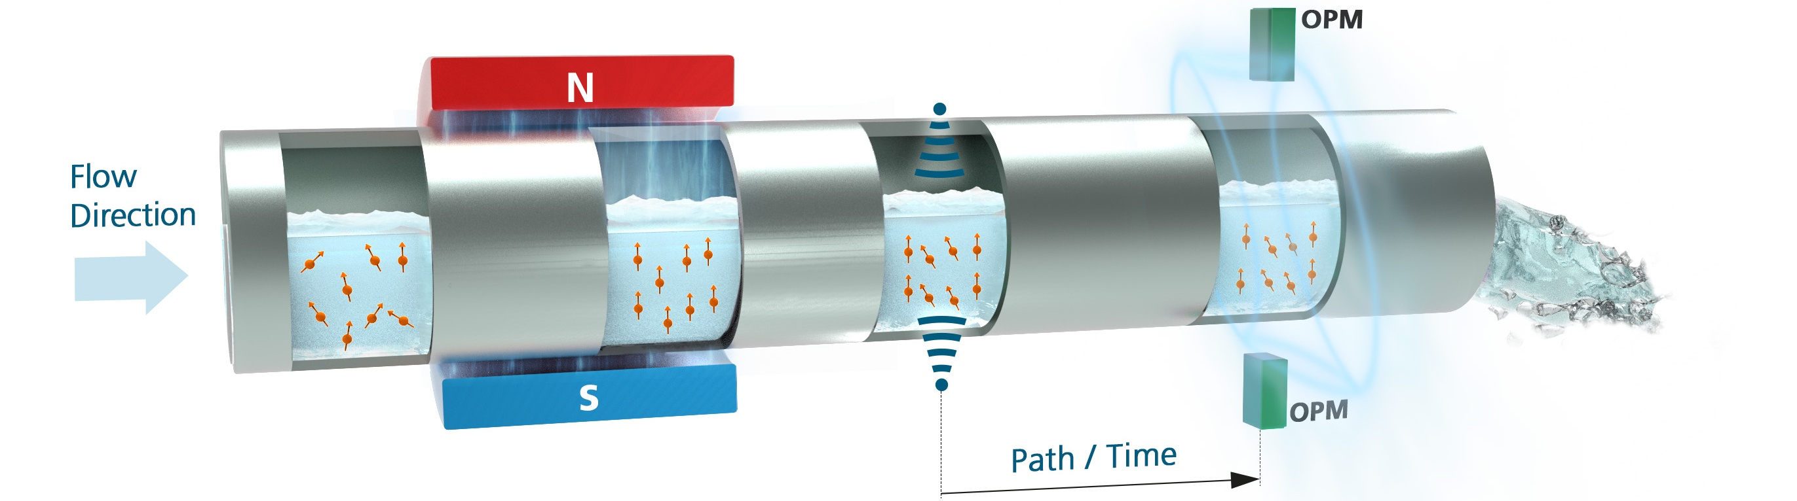
Flow Metering with OPM
Basic Idea

Slide 9
Flow Metering with OPM
Basic Idea
      Key advantages
      Contactless (no direct contact with fluid)
      Can measure through steel pipes
      Hydrogen nuclei are the magnetic marker ➔ wide range of fluids are measurable

Slide 10
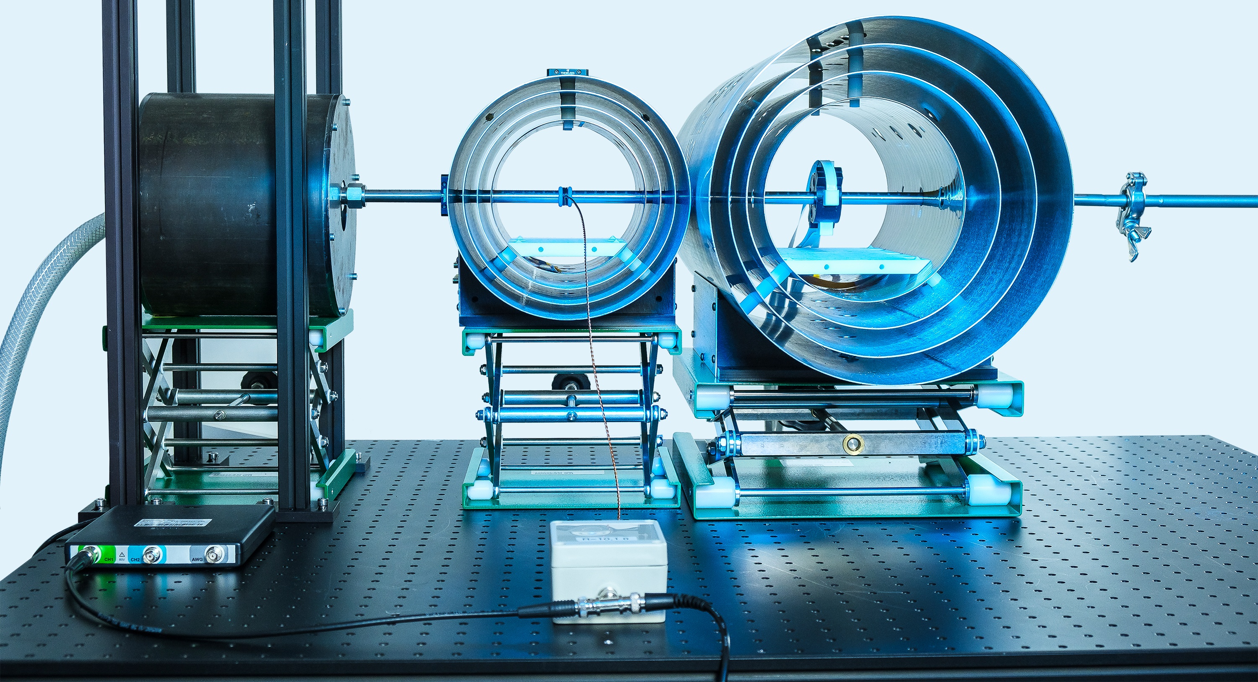
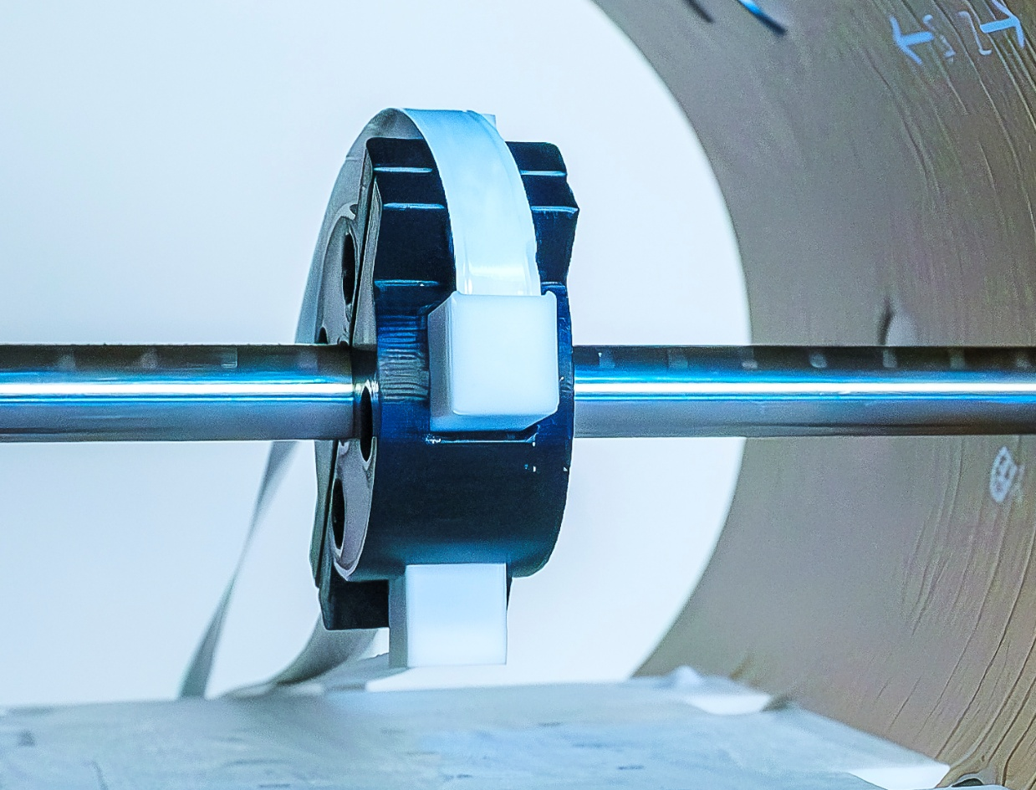
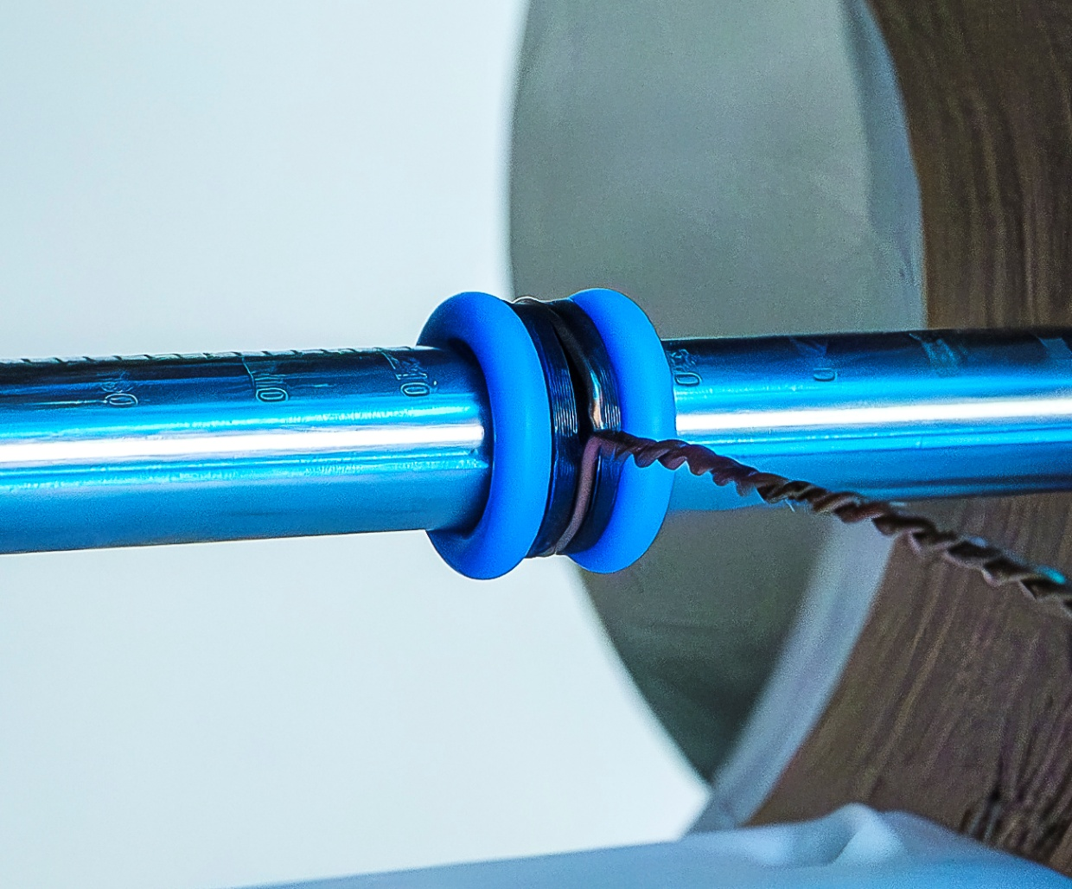

Flow Metering with OPM
Experimental Setup
coil
OPM
½‘‘ steel pipe
1T-Halbach magnet
magnetic shields
$$y$$
5 cm
$$x$$
$$z$$

Slide 11
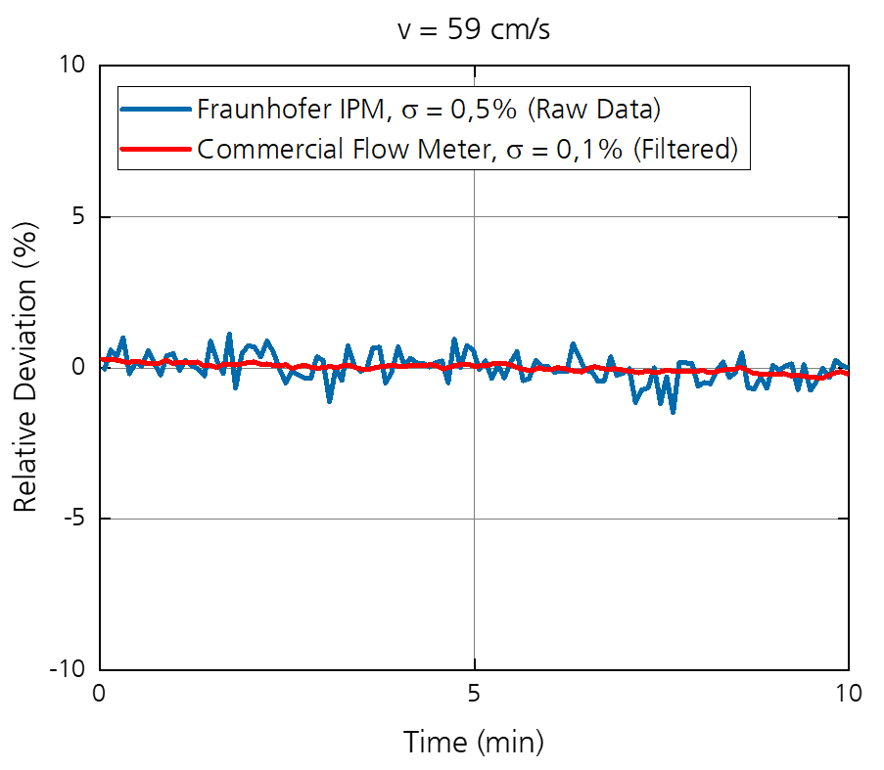
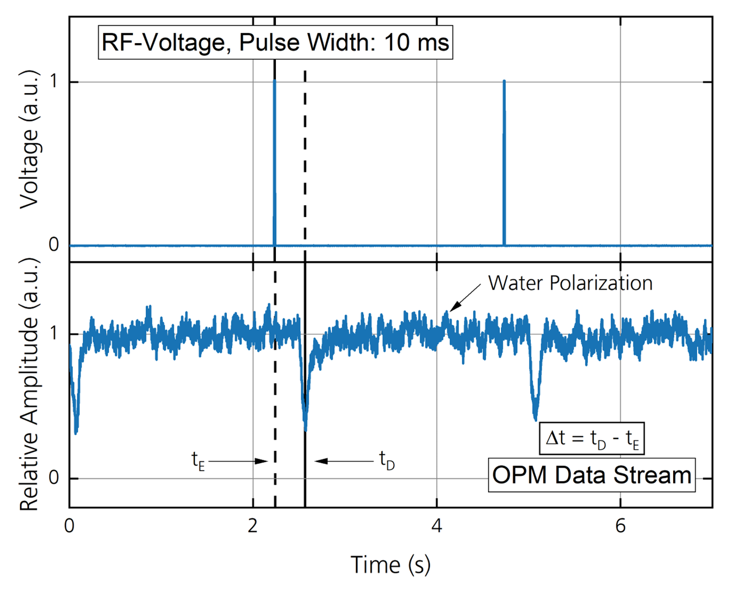
Flow Metering with OPM
Measuring the flow velocity

Slide 12
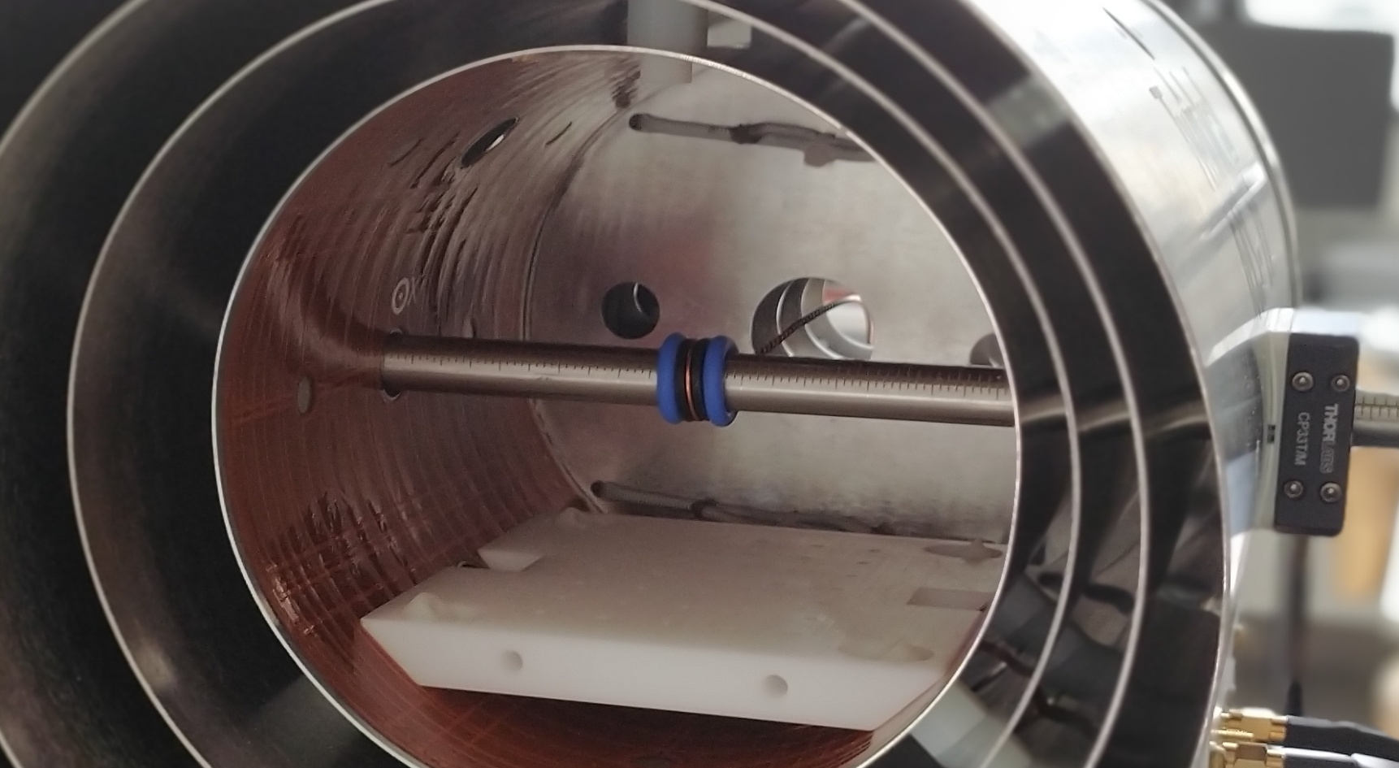
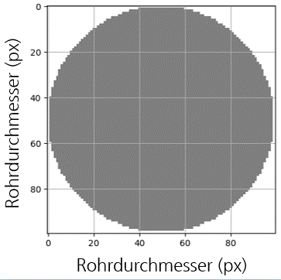
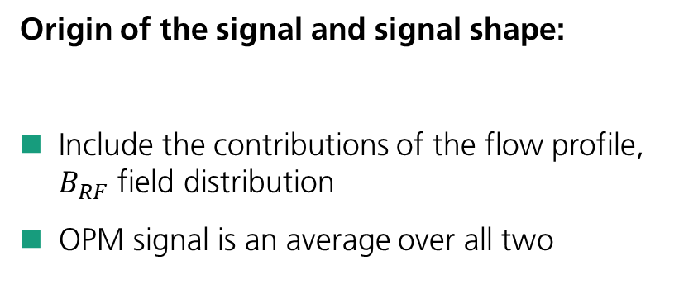

Flow Metering with OPM
Sensitivity to the flow profile
      Origin of the signal and signal shape:
      Include the contributions of the flow profile, $B_{RF}$ field distribution
      OPM signal is an average over all two
$$v$$
Pipe diameter (px)
Pipe diameter (px)
100x100px-mask

Slide 13
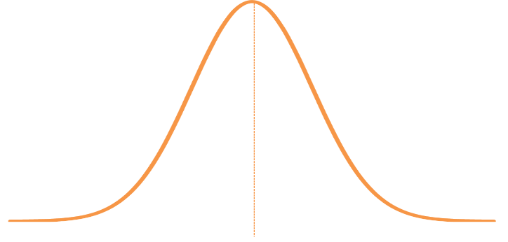



Flow Metering with OPM
Sensitivity to the flow profile
$$B_{RF}$$
Inner wall of the shield
RF-coil
$$v(r)$$
OPM

Slide 14


Flow Metering with OPM
Sensitivity to the flow profile
$$B_{RF}$$
Inner wall of the shield
RF-coil
$$v(r)$$
$$d$$
OPM
Pipe diameter (px)
$$α=γB_{RF}t_{p}$$
Pipe diameter (px)

Slide 15
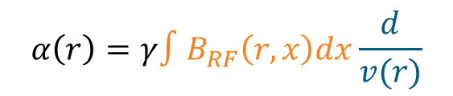

Flow Metering with OPM
Sensitivity to the flow profile
$$B_{RF}$$
Inner wall of the shield
RF-coil
$$v(r)$$
$$d$$
OPM
Pipe diameter (px)
$$α=γB_{RF}t_{p}$$
$$α\left(r\right)=γ∫B_{RF}\left(r,x\right)dx\frac{d}{v(r)}$$
Pipe diameter (px)

Slide 16
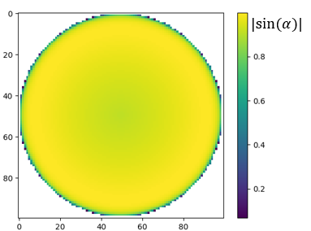
Flow Metering with OPM
Sensitivity to the flow profile
$$B_{RF}$$
Inner wall of the shield
RF-coil
$$d$$
OPM
Pipe diameter (px)
$$α=γB_{RF}t_{p}$$
Pipe diameter (px)
$$α\left(r\right)=γ∫B_{RF}\left(r,x\right)dx\frac{d}{v(r)}$$
Pipe diameter (px)
Pipe diameter (px)

Slide 17
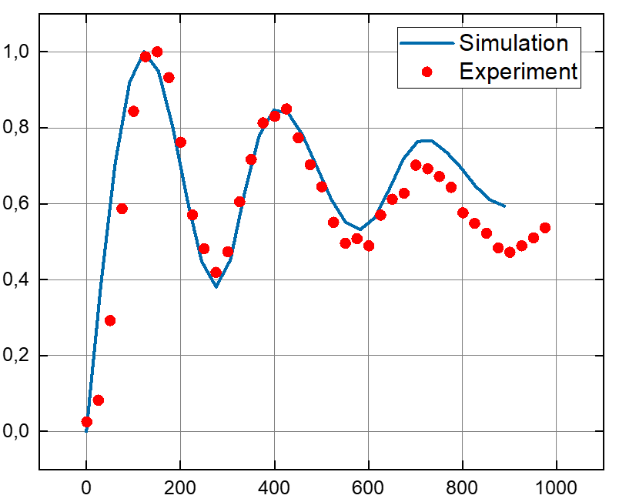
Flow Metering with OPM
Sensitivity to the flow profile
Relative amplitude
Voltage applied to coil (mV)

Slide 18
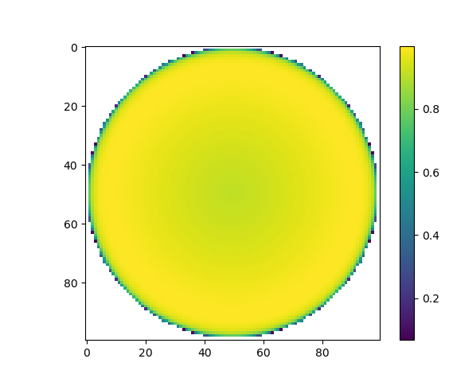
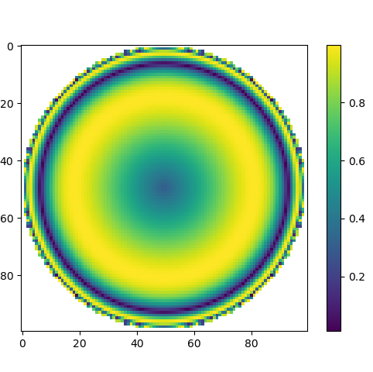
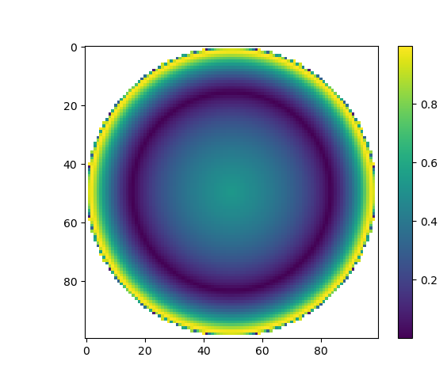


Flow Metering with OPM
Sensitivity to the flow profile
$$|sin⁡(α)|$$
$$|sin⁡(α)|$$
Pipe diameter (px)
Pipe diameter (px)
Relative amplitude
$$|sin⁡(α)|$$
Pipe diameter (px)
Pipe diameter (px)
Voltage applied to coil (mV)
Pipe diameter (px)

Slide 19
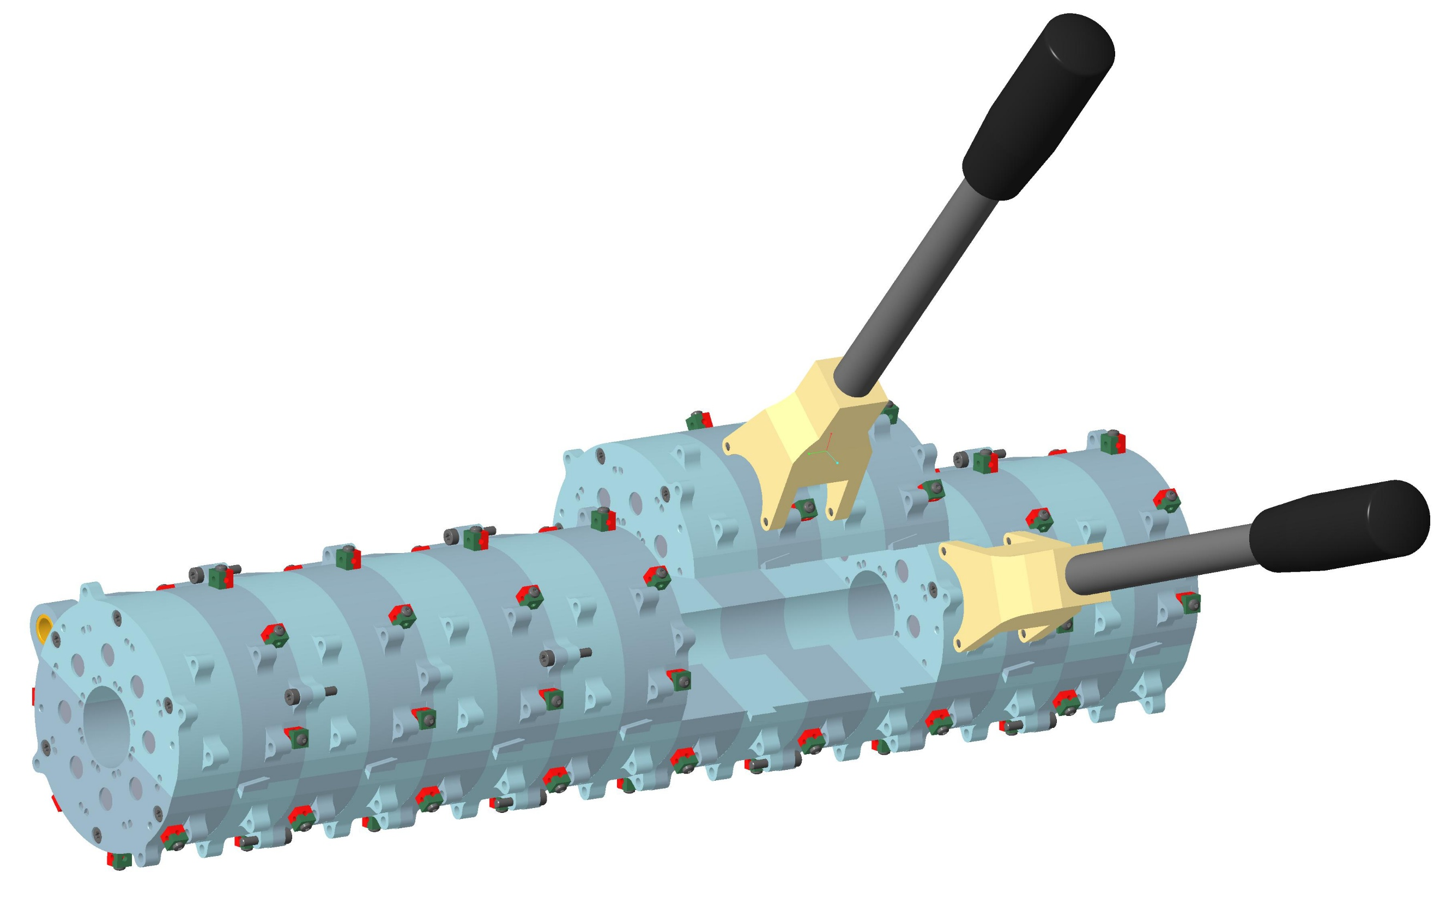
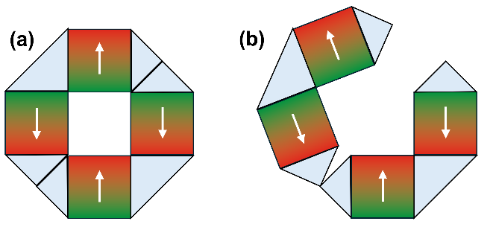
Flow Metering with OPM
A clamp-on magnetic flow meter: The Halbach magnet
Under the right angle a Halbach magnet can be opened without force.
42 cm
C. W. Windt et al., „A portable Halbach magnet that can be opened and closed without force: The NMR-CUFF,“ Journal of Magnetic Resonance, Bd. 208, pp. 27-33, 2011.

Slide 20
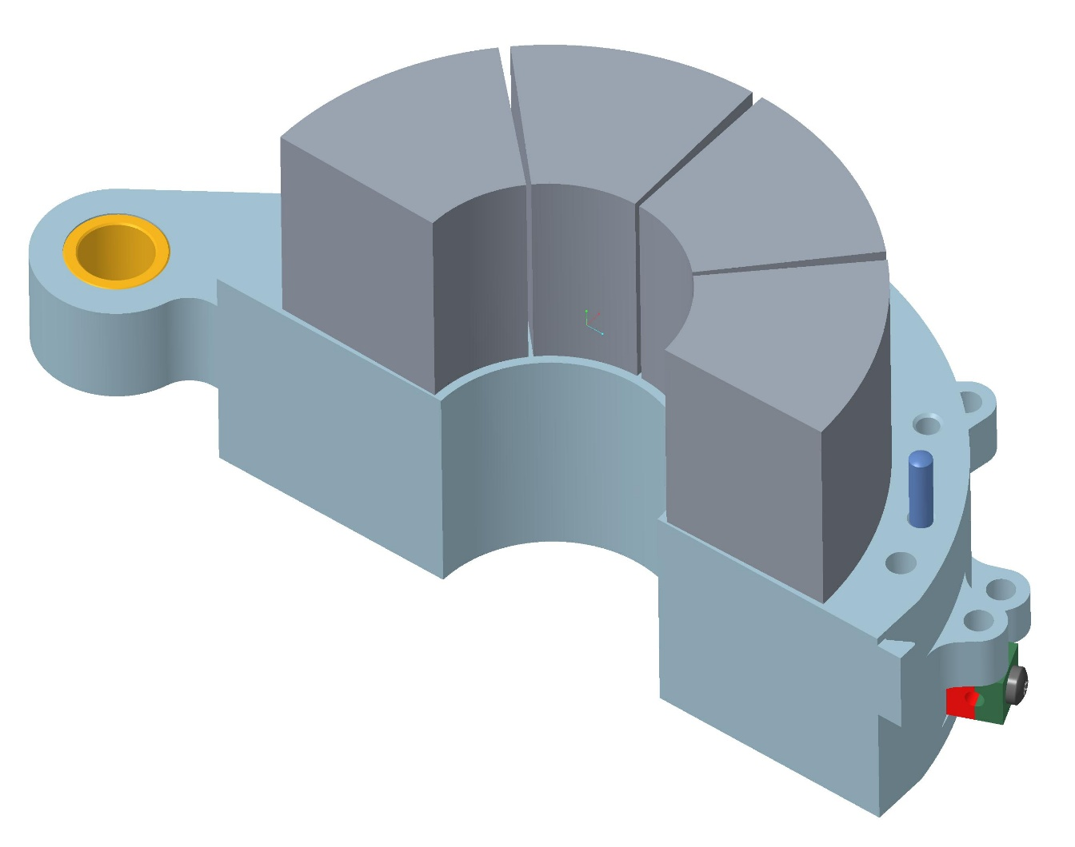

Flow Metering with OPM
Half shell segment
A clamp-on magnetic flow meter: The Halbach magnet
Hinge cylinder
      Magnets are housed in half shells
      Whole magnet can be longer by adding segments
42 cm

Slide 21
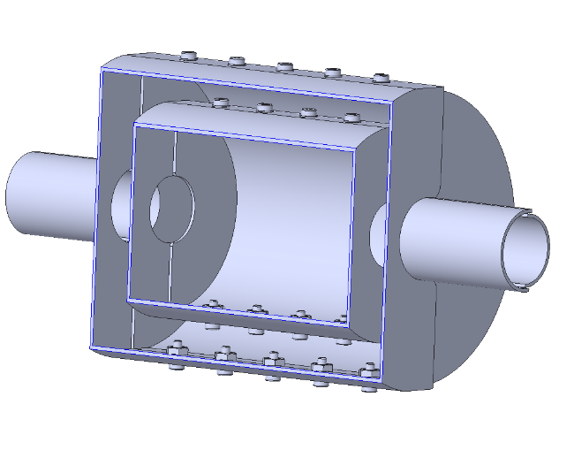
Flow Metering with OPM
A clamp-on magnetic flow meter: The shield
      Clamp on design with inlet diameter of 1“
      Two layer shield with shielding factor approx 10³
      System of coils will be added
© Sekels GmbH
28 cm

Slide 22
Summary
Current status and future opportunities
      Current status:
      Proof-of-principle of OPM based flow metering
      Has specific advantages compared to other flow metering technologies
      Next steps:
      Build a clamp-on demonstrator
      Make it usable in the field
      Far future ? (10+ years):
      Commercial OPM based flow meter

Slide 23

Logobereich
Contact
  —
    Peter Koss
    Gas and Process Technology
    Caloric Systems
    Fraunhofer Institute for Physical Measurement Techniques IPM
    Phone +49 761 8857 243
    peter.koss@ipm.fraunhofer.de
    http://www.ipm.fraunhofer.de/en | LinkedIn | YouTube

