Slide 1









Quantum noise in a squeezed-light-enhanced
multiparameter quantum sensor
Aleksandra Sierant
ICFO – Institute of Photonic Sciences
Atomic Quantum Optics Group (M. W. Mitchell)
Wokrshop on Optically Pumped Magnetometers
8th August 2025, Paul Scherrer Institute, Villigen, Switzerland

Slide 2
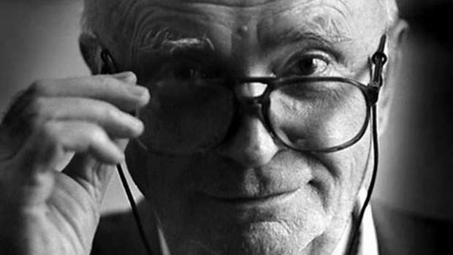
Braginsky or Helstrom?
Source: https://www.ligo.caltech.edu/news/ligo20160426

Slide 3
Braginsky or Helstrom?
Source: https://www.ligo.caltech.edu/news/ligo20160426
Vladimir Braginsky

Slide 4
quantum sensing – Braginsky approach
measuring x, perturbs p
Source: https://www.ligo.caltech.edu/news/ligo20160426
Vladimir Braginsky

Slide 5
quantum sensing – Braginsky approach
measuring x, perturbs p
Source: https://www.ligo.caltech.edu/news/ligo20160426
  perturbing p affects x
  measurement back-action (MBA)
Vladimir Braginsky

Slide 6
quantum sensing – Braginsky approach
measuring x, perturbs p
Source: https://www.ligo.caltech.edu/news/ligo20160426
  perturbing p affects x
  measurement back-action (MBA)
  Standard Quantum Limit (SQL)
Vladimir Braginsky

Slide 7
quantum sensing – Braginsky approach
measuring x, perturbs p
Source: https://www.ligo.caltech.edu/news/ligo20160426
  perturbing p affects x
  measurement back-action (MBA)
  Standard Quantum Limit (SQL)
Vladimir Braginsky
  quantum enhancement to improve sensor’s performance

Slide 8



Multiparameter sensor
Wollaston
prism
balanced
detector
$$B_{dc}$$
probe
-
⁸⁷Rb
$$B_{rf}$$
HWP
$S_{2}$ Stokes parameter

Slide 9
Multiparameter sensor
Wollaston
prism
balanced
detector
$$B_{dc}$$
probe
-
⁸⁷Rb
$$B_{rf}$$
HWP
$S_{2}$ Stokes parameter
spin projection noise measurements

Slide 10
Multiparameter sensor
Wollaston
prism
balanced
detector
$$B_{dc}$$
probe
-
⁸⁷Rb
$$B_{rf}$$
HWP
pump
$S_{2}$ Stokes parameter

Slide 11
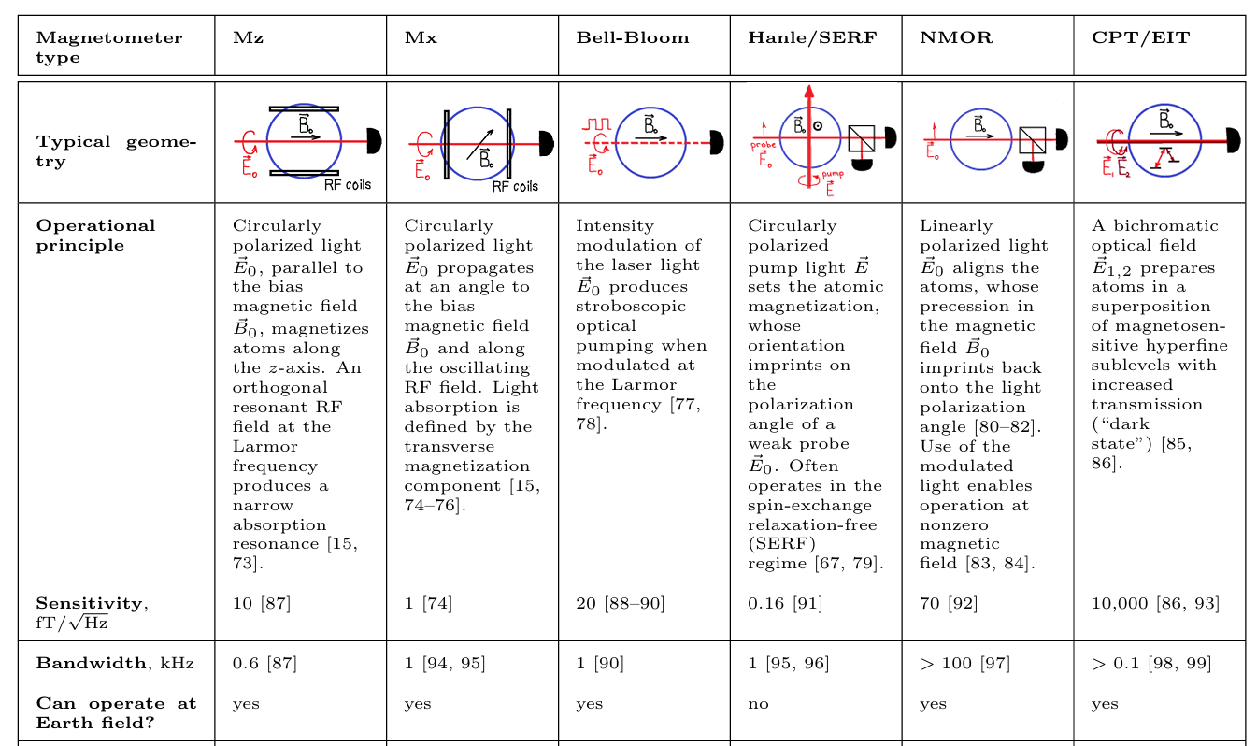
Multiparameter sensor
Wollaston
prism
balanced
detector
$$B_{dc}$$
probe
-
⁸⁷Rb
$$B_{rf}$$
HWP
pump
$S_{2}$ Stokes parameter
A.Fabricant, I. Novikova, and G. Bison. New Journal of Physics 25.2 (2023): 025001.

Slide 12
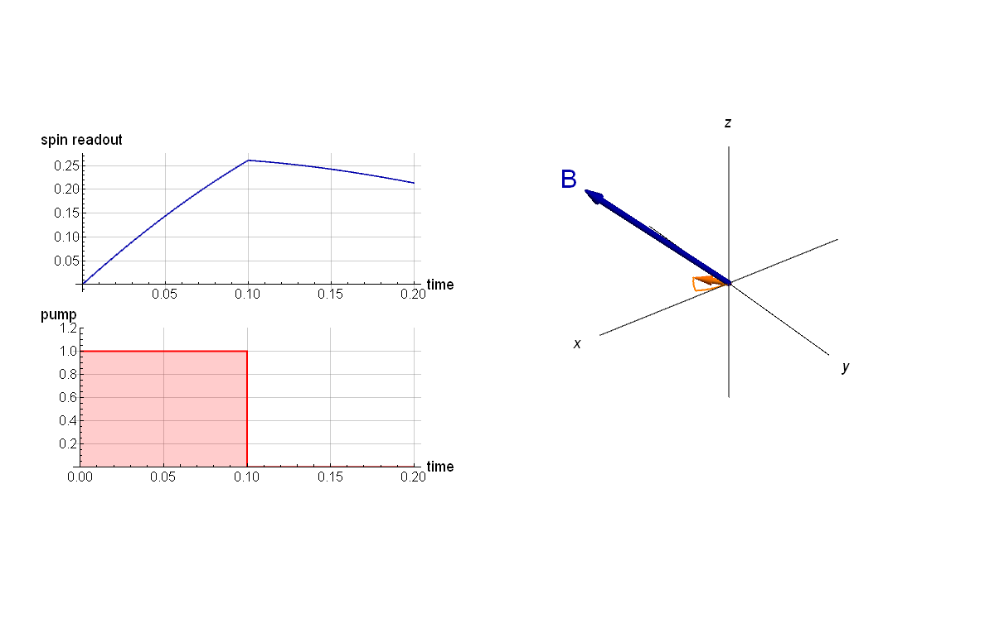
Multiparameter sensor
Wollaston
prism
balanced
detector
$$B_{dc}$$
probe
-
⁸⁷Rb
$$B_{rf}$$
HWP
pump
$S_{2}$ Stokes parameter
x
z
y

Slide 13
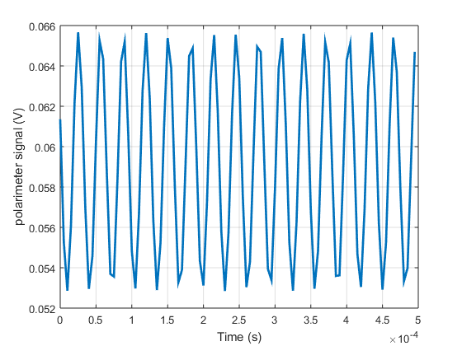
Multiparameter sensor
Wollaston
prism
balanced
detector
$$B_{dc}$$
probe
-
⁸⁷Rb
$$B_{rf}$$
HWP
pump
$S_{2}$ Stokes parameter
time domain

Slide 14
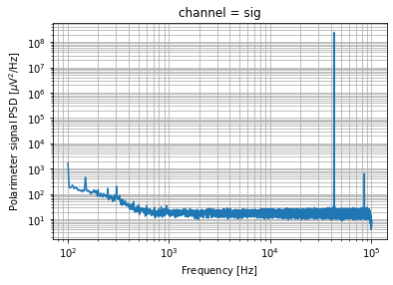
Multiparameter sensor
Wollaston
prism
balanced
detector
$$B_{dc}$$
probe
-
⁸⁷Rb
$$B_{rf}$$
HWP
pump
$S_{2}$ Stokes parameter
frequency domain
time domain
Fourier transform

Slide 15
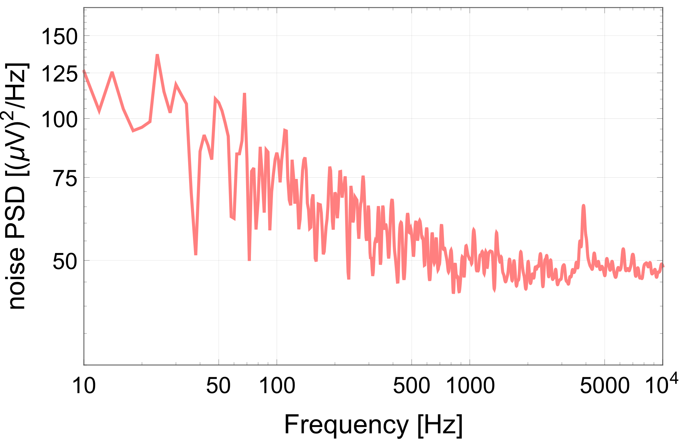
Multiparameter sensor
Wollaston
prism
balanced
detector
$$B_{dc}$$
probe
-
⁸⁷Rb
$$B_{rf}$$
HWP
pump
$S_{2}$ Stokes parameter
frequency domain
frequency domain
time domain
demodulation
Fourier transform

Slide 16
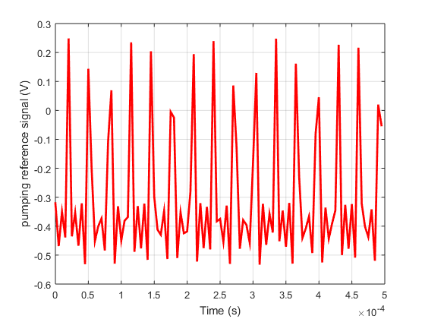
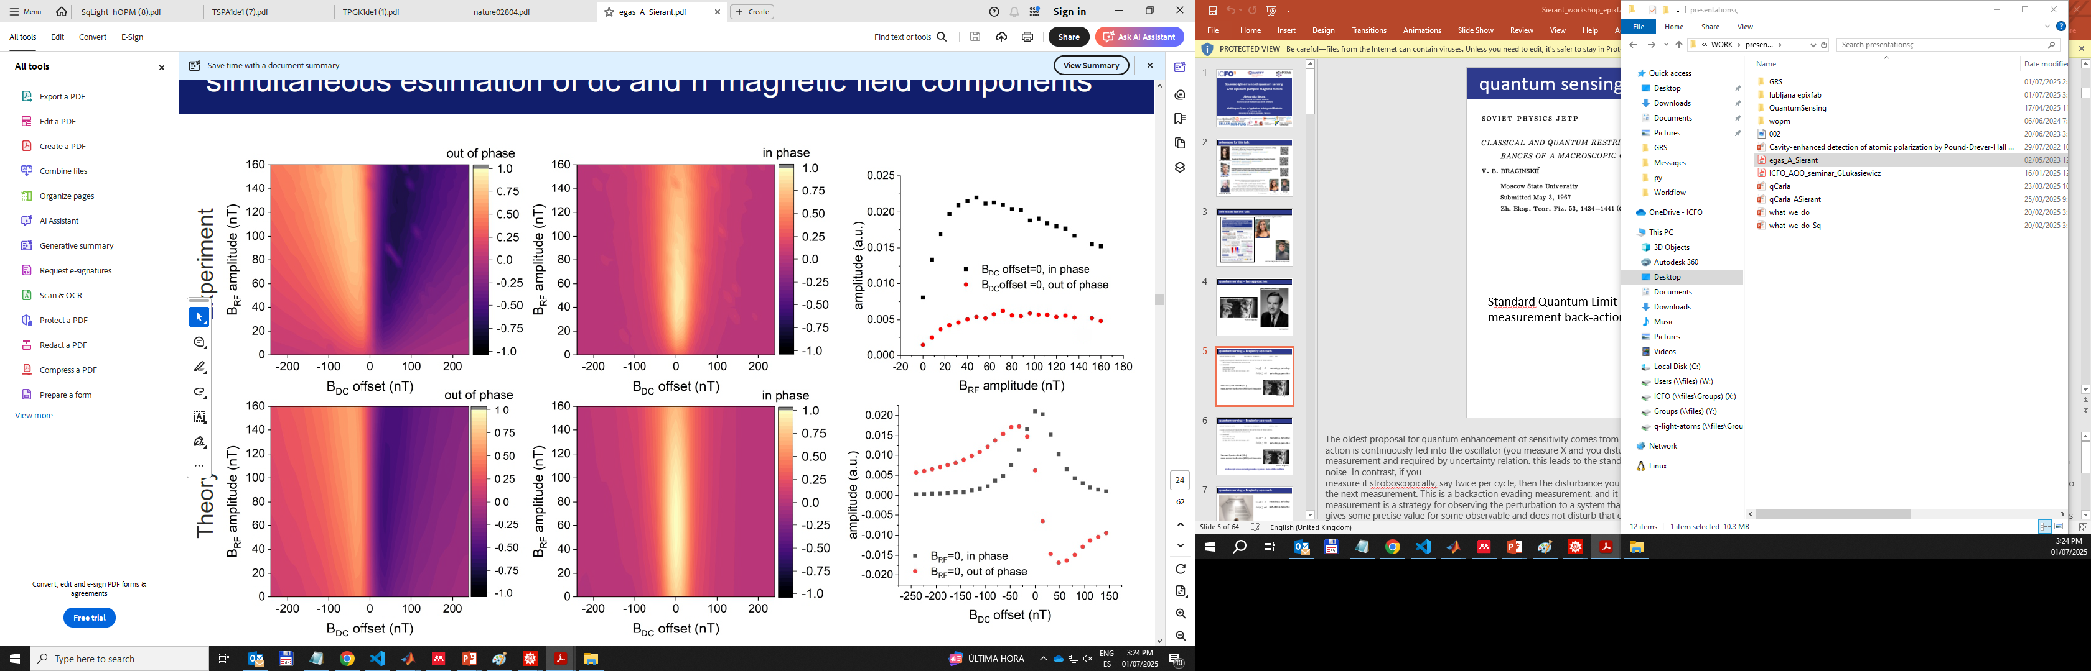
Multiparameter sensor
Wollaston
prism
balanced
detector
$$B_{dc}$$
probe
-
⁸⁷Rb
$$B_{rf}$$
HWP
pump
$S_{2}$ Stokes parameter
demodulation
in phase quadrature
out of phase
quadrature

Slide 17
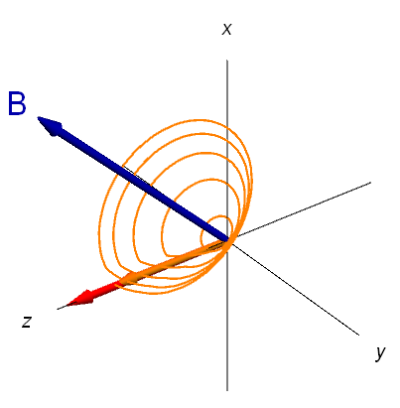
Stochastic spin dynamics
$\frac{d}{dt}F\left(t\right)=\left[−γB\left(t\right)+GS_{3}(t)\hat{z}\right]×$ $F\left(t\right)−ΓF\left(t\right)+R_{OP}\left(t\right)\left[F_{max}−F\left(t\right)\right]+N_{at}(t)$
collective
spin
Larmor
precession
light shift
relaxation
optical
pumping
spin noise
B
pump

Slide 18

Stochastic spin dynamics
$\frac{d}{dt}F\left(t\right)=\left[−γB\left(t\right)+GS_{3}(t)\hat{z}\right]×$ $F\left(t\right)−ΓF\left(t\right)+R_{OP}\left(t\right)\left[F_{max}−F\left(t\right)\right]+N_{at}(t)$
collective
spin
Larmor
precession
light shift
relaxation
optical
pumping
spin noise
spin projection noise (SPN)
$$N(t)=N_{at}\left(t\right)$$
B
pump

Slide 19

Stochastic spin dynamics
$\frac{d}{dt}F\left(t\right)=\left[−γB\left(t\right)+GS_{3}(t)\hat{z}\right]×$ $F\left(t\right)−ΓF\left(t\right)+R_{OP}\left(t\right)\left[F_{max}−F\left(t\right)\right]+N_{at}(t)$
collective
spin
Larmor
precession
light shift
relaxation
optical
pumping
spin noise
spin projection noise (SPN)
measurement backaction (MBA)
$$N(t)=N_{at}\left(t\right)+GS_{3}(t)\hat{z}×F(t)$$
B
atoms
quantum noise
pump

Slide 20
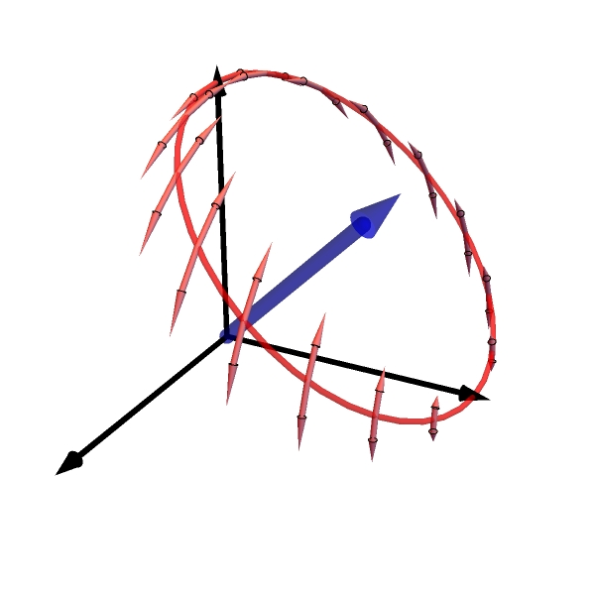
Stochastic spin dynamics
$\frac{d}{dt}F\left(t\right)=\left[−γB\left(t\right)+GS_{3}(t)\hat{z}\right]×$ $F\left(t\right)−ΓF\left(t\right)+R_{OP}\left(t\right)\left[F_{max}−F\left(t\right)\right]+N_{at}(t)$
collective
spin
Larmor
precession
light shift
relaxation
optical
pumping
spin noise
spin projection noise (SPN)
measurement backaction (MBA)
x
$$N(t)=N_{at}\left(t\right)+GS_{3}(t)\hat{z}×F(t)$$
B
atoms
quantum noise
z
y
random rotation around z

Slide 21
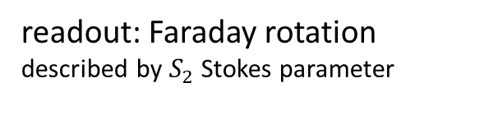

Stochastic spin dynamics
$\frac{d}{dt}F\left(t\right)=\left[−γB\left(t\right)+GS_{3}(t)\hat{z}\right]×$ $F\left(t\right)−ΓF\left(t\right)+R_{OP}\left(t\right)\left[F_{max}−F\left(t\right)\right]+N_{at}(t)$
collective
spin
Larmor
precession
light shift
relaxation
optical
pumping
spin noise
spin projection noise (SPN)
measurement backaction (MBA)
$$N(t)=N_{at}\left(t\right)+GS_{3}(t)\hat{z}×F(t)$$
B
atoms
quantum noise
pump
$$S_{2}=GS_{1}F_{z}+N_{S_{2}}$$
readout: Faraday rotation
described by $S_{2}$ Stokes parameter
Stokes parameters
photon shot noise (PSN)

Slide 22
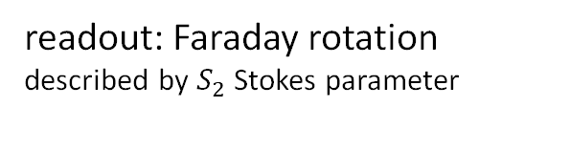
Stochastic spin dynamics
$\frac{d}{dt}F\left(t\right)=\left[−γB\left(t\right)+GS_{3}(t)\hat{z}\right]×$ $F\left(t\right)−ΓF\left(t\right)+R_{OP}\left(t\right)\left[F_{max}−F\left(t\right)\right]+N_{at}(t)$
collective
spin
Larmor
precession
light shift
relaxation
optical
pumping
spin noise
spin projection noise (SPN)
measurement backaction (MBA)
$$N(t)=N_{at}\left(t\right)+GS_{3}(t)\hat{z}×F(t)$$
atoms
quantum noise
light
pump
$$S_{2}=GS_{1}F_{z}+N_{S_{2}}$$
readout: Faraday rotation
described by $S_{2}$ Stokes parameter
Stokes parameters
photon shot noise (PSN)

Slide 23
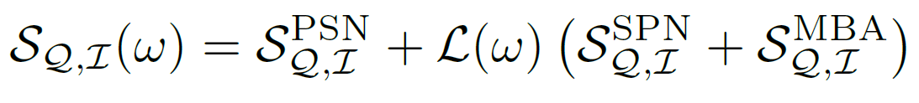
Stochastic spin dynamics
detected spectrum:
spin projection noise (SPN)
measurement backaction (MBA)
$$N(t)=N_{at}\left(t\right)+GS_{3}(t)\hat{z}×F(t)$$
atoms
quantum noise
light
pump
$$S_{2}=GS_{1}F_{z}+N_{S_{2}}$$
readout: Faraday rotation
described by $S_{2}$ Stokes parameter
Stokes parameters
photon shot noise (PSN)

Slide 24
Stochastic spin dynamics
detected spectrum:
instantaneous
accumulative
spin projection noise (SPN)
measurement backaction (MBA)
$$N(t)=N_{at}\left(t\right)+GS_{3}(t)\hat{z}×F(t)$$
atoms
quantum noise
light
pump
$$S_{2}=GS_{1}F_{z}+N_{S_{2}}$$
readout: Faraday rotation
described by $S_{2}$ Stokes parameter
Stokes parameters
photon shot noise (PSN)

Slide 25
Multiparameter sensor: quantum noise
detected spectrum:
unpumped atoms

Slide 26
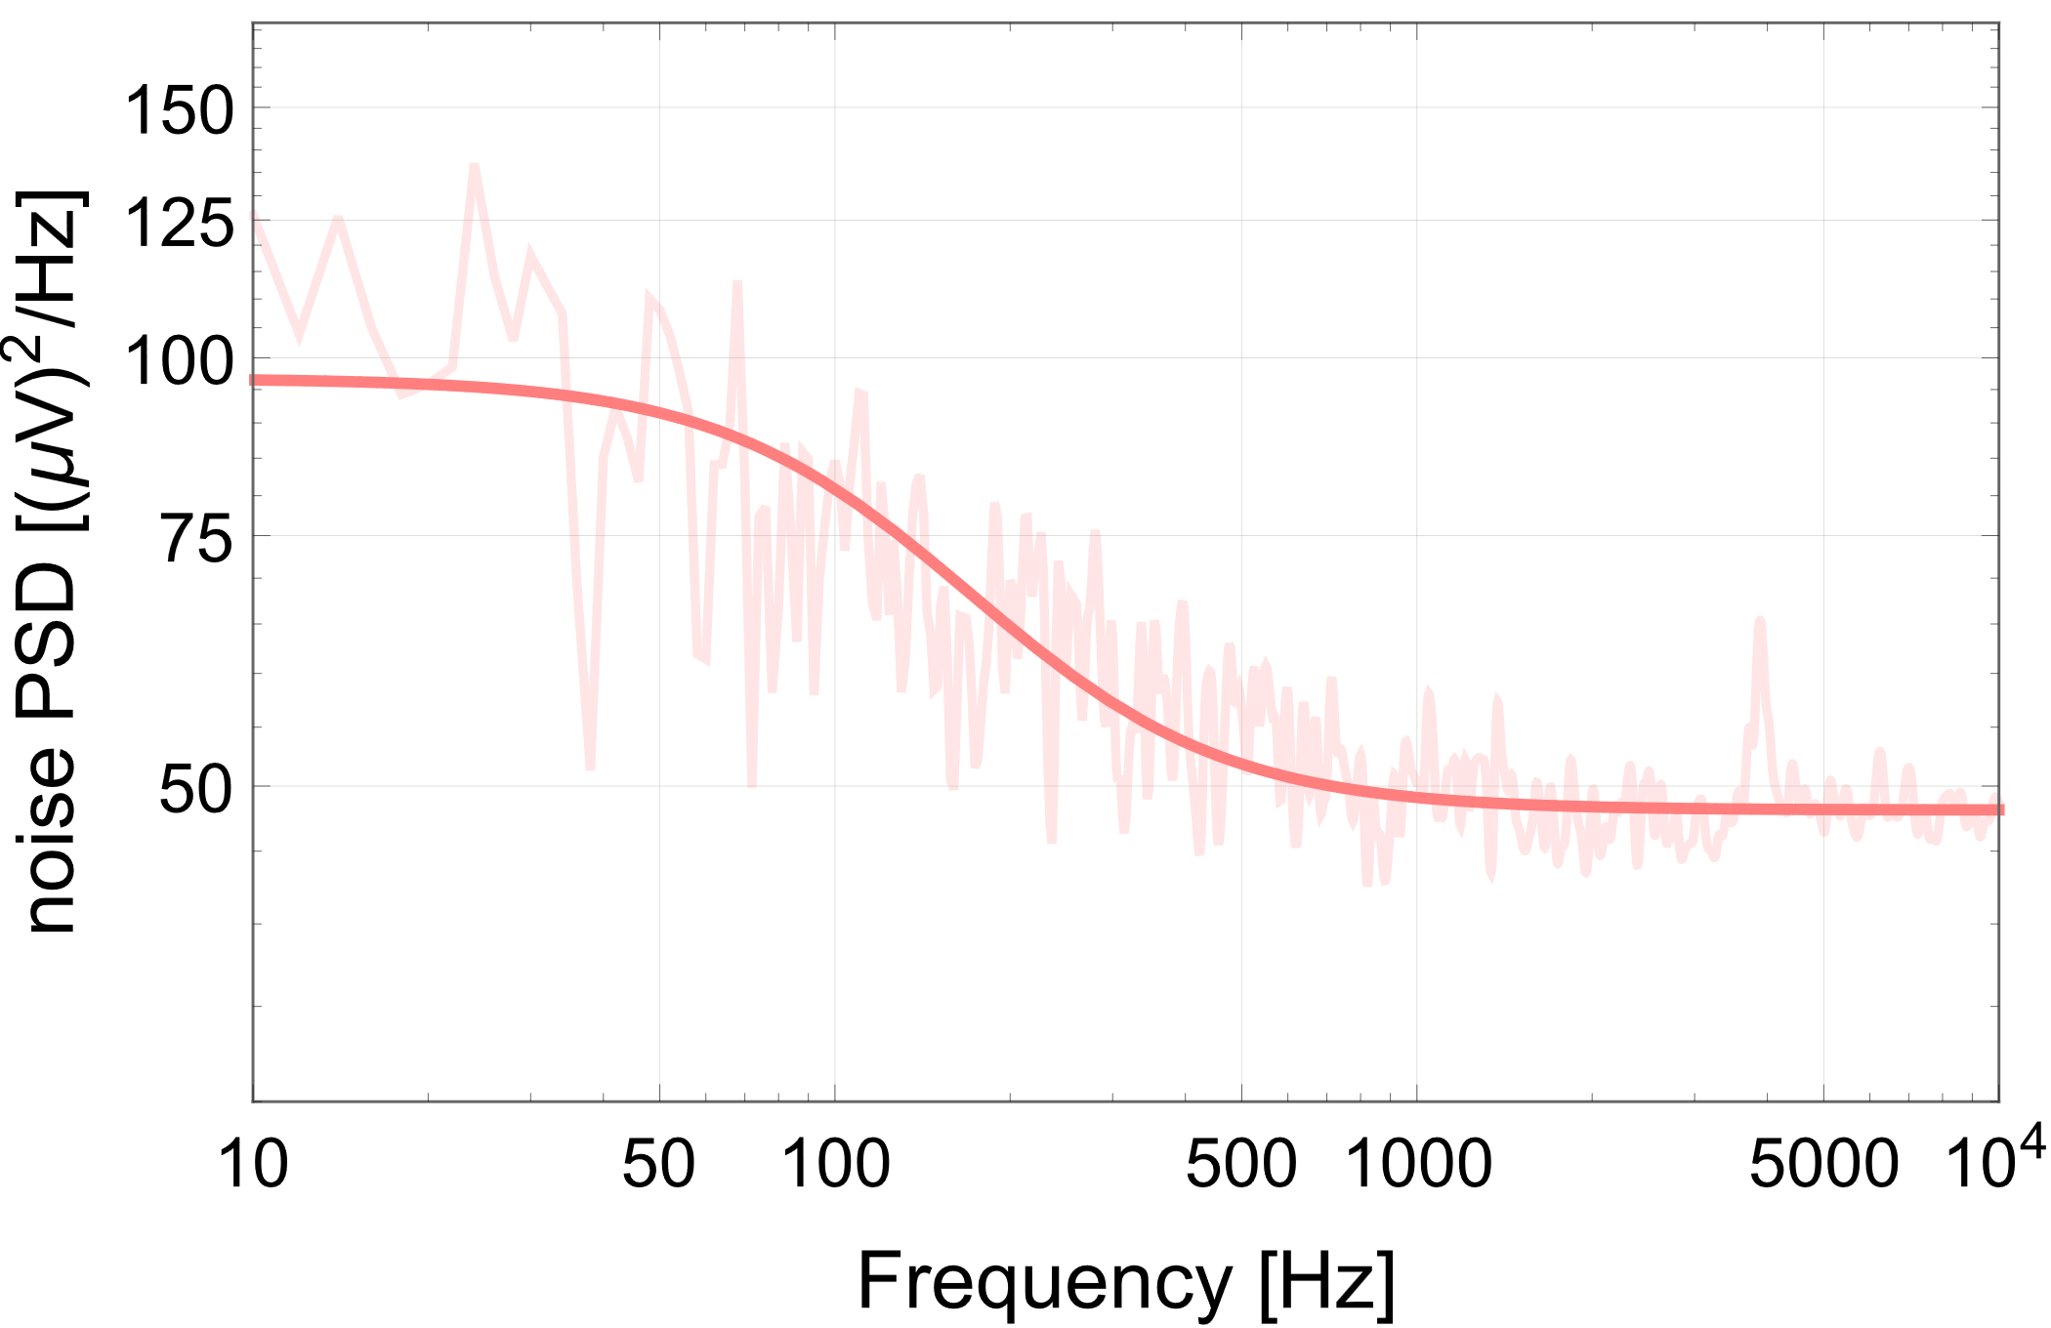
Multiparameter sensor: quantum noise
detected spectrum:
unpumped atoms

Slide 27
Multiparameter sensor: quantum noise
detected spectrum:
unpumped atoms
PSN

Slide 28
Multiparameter sensor: quantum noise
detected spectrum:
unpumped atoms
SPN
PSN

Slide 29
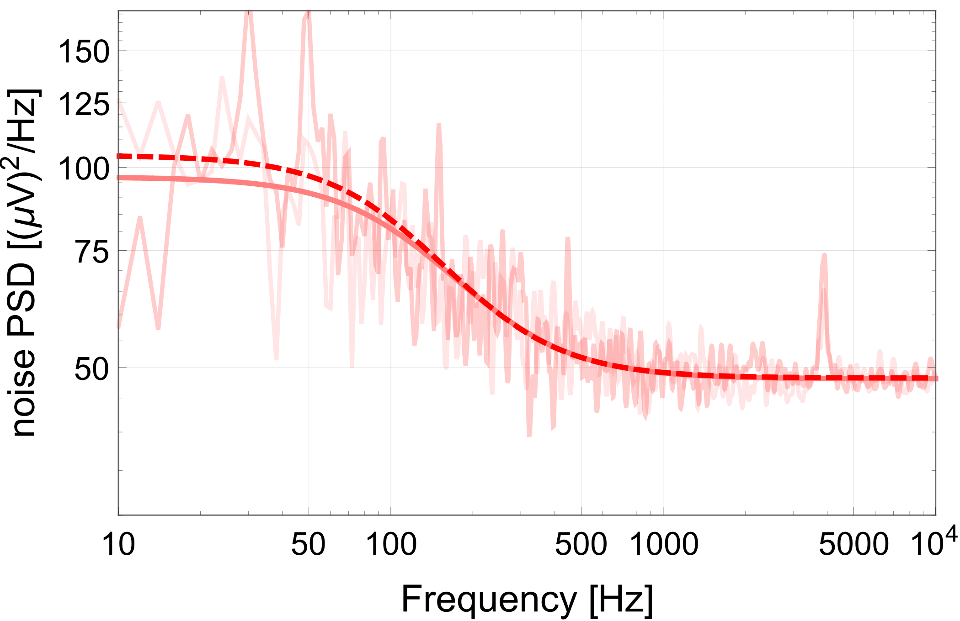
Multiparameter sensor: quantum noise
detected spectrum:
pumped atoms
SPN
PSN
unpumped atoms
pumped atoms

Slide 30
Multiparameter sensor: quantum noise
detected spectrum:
pumped atoms
MBA
SPN
PSN
unpumped atoms
pumped atoms

Slide 31
Multiparameter sensor: quantum noise
detected spectrum:
SPN dominated
PSN dominated
unpumped atoms
pumped atoms

Slide 32
Multiparameter sensor: sensitivity
polarisation noise PSD

Slide 33
Multiparameter sensor: sensitivity
polarisation noise PSD
magnetic sensitivity

Slide 34
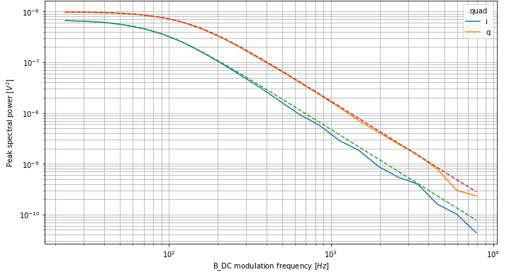
Multiparameter sensor: sensitivity
polarisation noise PSD
+ responsivity
10⁻⁶
Peak spectral density [V²]
10⁻⁷
10⁻⁸
dc
10⁻⁹
10⁻¹⁰
rf
10²
10³
10⁴
test field frequency [Hz]
magnetic sensitivity

Slide 35
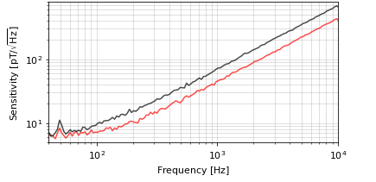
Multiparameter sensor: sensitivity
polarisation noise PSD
+ responsivity
10⁻⁶
Peak spectral density [V²]
10⁻⁷
10⁻⁸
dc
10⁻⁹
10⁻¹⁰
rf
rf
10²
10³
10⁴
Sensitivity [pT/√Hz]
dc
test field frequency [Hz]
10²
10¹
magnetic sensitivity
10²
10³
10⁴
Frequency [Hz]

Slide 36

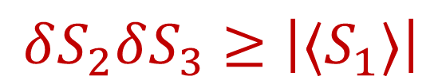
Photon shot noise (PSN)
squeezing parameter
antisqueezing parameter
detected spectrum:
x
$$δS_{2}δS_{3}≥\left|\text{⟨}S_{1}\text{⟩}\right|$$
B
photon shot noise (PSN)
measurement backaction (MBA)
$$GS_{3}(t)\hat{z}×F(t)$$
z
y

Slide 37
Multiparameter sensor: quantum noise
squeezing parameter
antisqueezing parameter
detected spectrum:
x

Slide 38
Multiparameter sensor: quantum noise
squeezing parameter
antisqueezing parameter
detected spectrum:
x
dc detection
coherent
unpumped atoms
pumped atoms

Slide 39
Multiparameter sensor: quantum noise
squeezing parameter
antisqueezing parameter
detected spectrum:
x
dc detection
coherent
unpumped atoms
pumped atoms

Slide 40
Multiparameter sensor: quantum noise
squeezing parameter
antisqueezing parameter
detected spectrum:
x
dc detection
coherent
unpumped atoms
pumped atoms

Slide 41
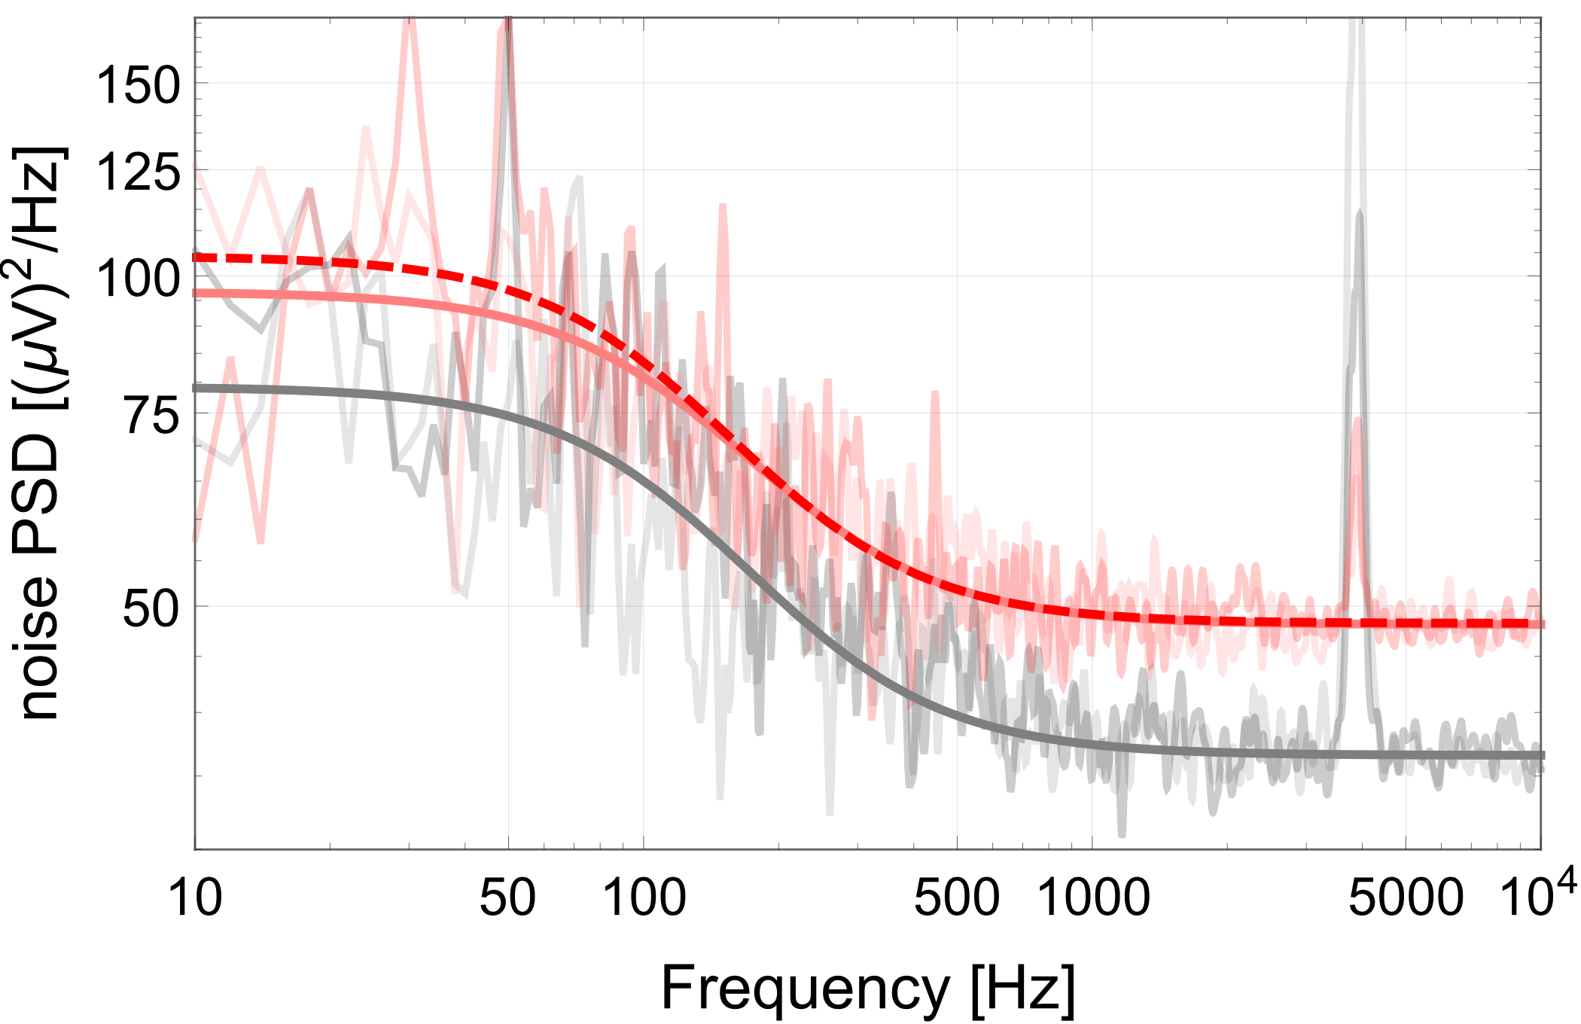
Multiparameter sensor: quantum noise
squeezing parameter
antisqueezing parameter
detected spectrum:
x
dc detection
coherent
squeezed
unpumped atoms
pumped atoms

Slide 42

Multiparameter sensor: quantum noise
squeezing parameter
antisqueezing parameter
detected spectrum:
x
dc detection
coherent
squeezed
unpumped atoms
pumped atoms

Slide 43
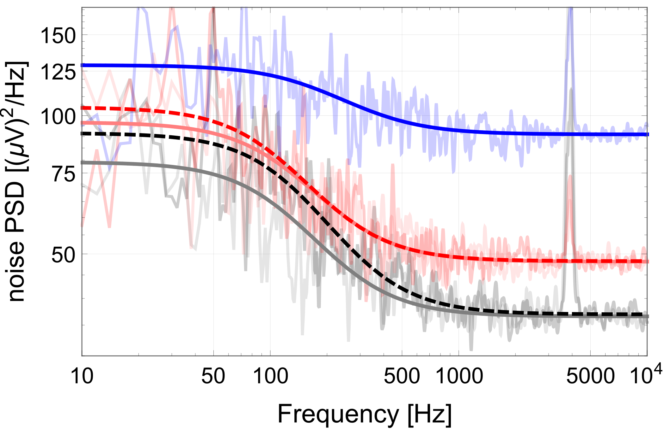
Multiparameter sensor: quantum noise
squeezing parameter
antisqueezing parameter
detected spectrum:
x
dc detection
antisqueezed
coherent
squeezed
unpumped atoms
pumped atoms

Slide 44
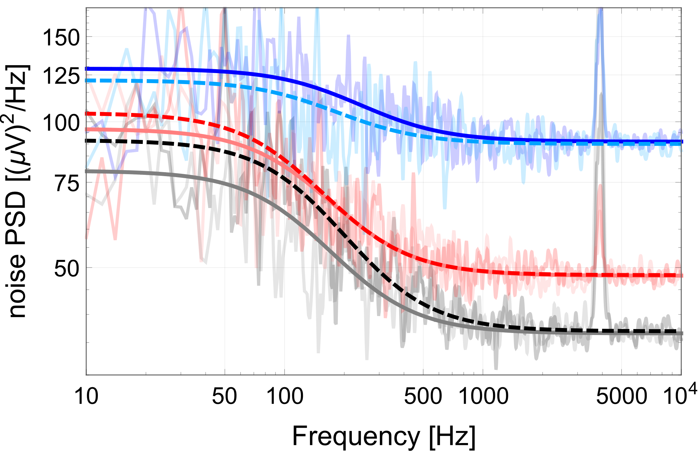
Multiparameter sensor: quantum noise
squeezing parameter
antisqueezing parameter
detected spectrum:
x
dc detection
antisqueezed
coherent
squeezed
unpumped atoms
pumped atoms

Slide 45
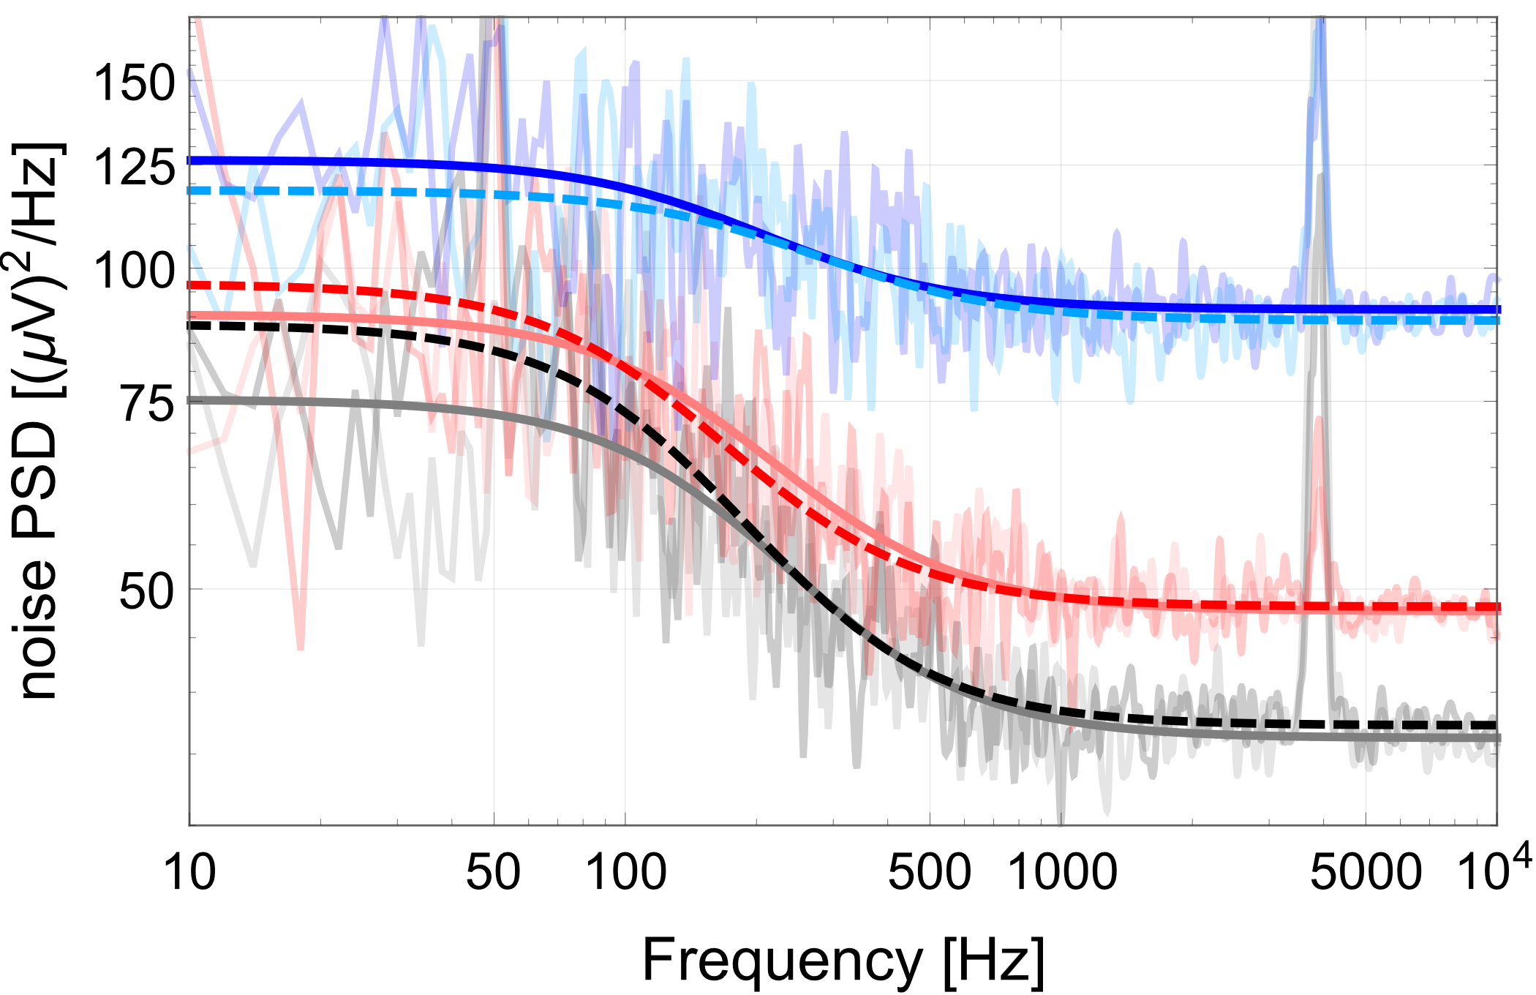
Multiparameter sensor: quantum noise
dc detection
rf detection
antisqueezed
antisqueezed
coherent
coherent
squeezed
squeezed
unpumped atoms
pumped atoms

Slide 46
Multiparameter sensor: quantum noise
squeezed light probing improves shot noise for both fields
dc detection
rf detection
antisqueezed
antisqueezed
coherent
coherent
squeezed
squeezed
unpumped atoms
pumped atoms

Slide 47
Multiparameter sensor: quantum-enhanced sensitivity
quantum enhancement of magnetic sensitivity with squeezed light for both fields
measurement bandwidth enhancement for both fields

Slide 48
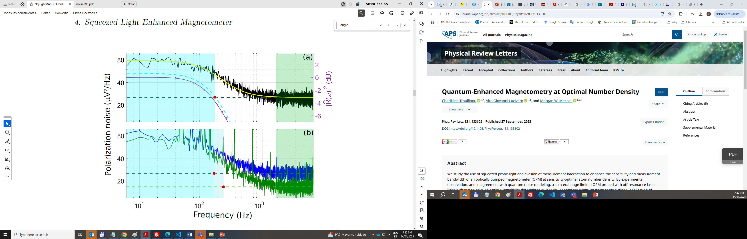
Single parameter sensor: quantum noise
unpumped (spin noise spectroscopy)
spin noise + photon shot noise
response
coherent light
photon shot noise
pumped (Bell-Bloom magnetometer)
coherent light
squeezed light
C. Troullinou et al. Phys. Rev. Lett. 127, 193601 (2021)

Slide 49
Single parameter sensor: quantum-enhanced sensitivity
unpumped (spin noise spectroscopy)
spin noise + photon shot noise
response
coherent light
photon shot noise
pumped (Bell-Bloom magnetometer)
coherent light
squeezed light
C. Troullinou et al. Phys. Rev. Lett. 127, 193601 (2021)

Slide 50
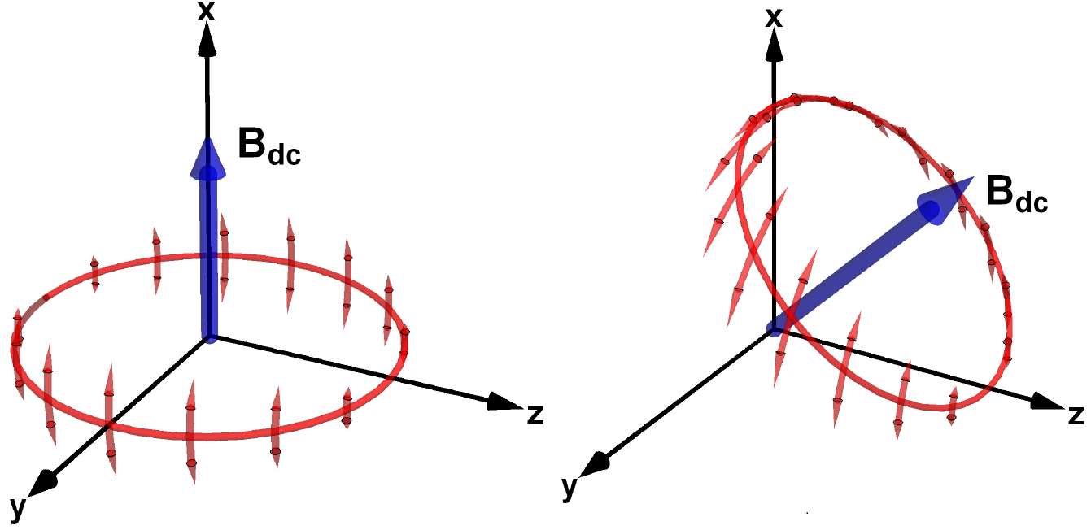

What about measurement backaction?
single-parameter sensor
multi-parameter sensor
$$GS_{3}(t)\hat{z}×F(t)$$

Slide 51
What about measurement backaction?
single-parameter sensor
multi-parameter sensor
$$GS_{3}(t)\hat{z}×F(t)$$
measurement backaction shunted into the unmeasured spin component

Slide 52
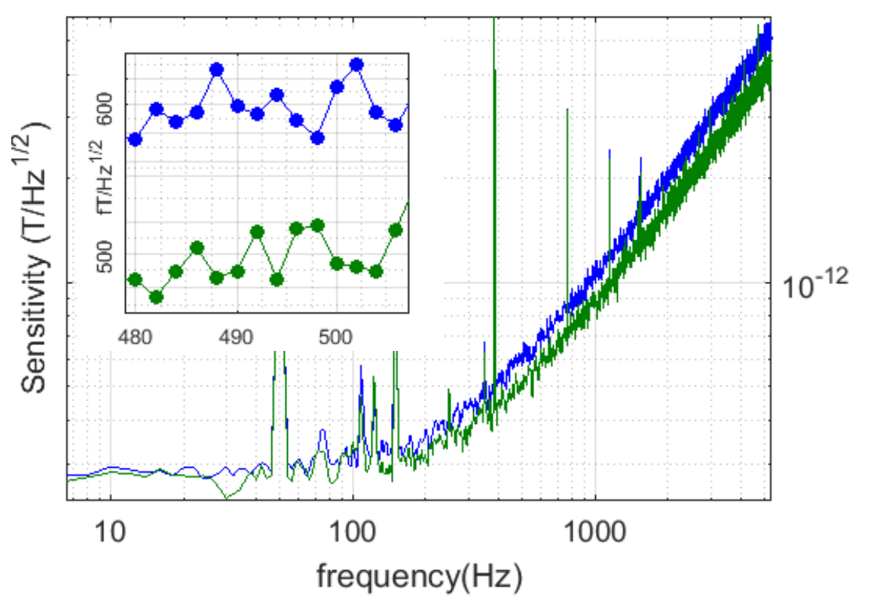
quantum-enhanced sensitivity
coherent light
squeezed light
300 fT/√Hz
1.6 dB quantum enhancement of magnetic sensitivity with 1.9 dB squeezed light
measurement bandwidth enhancement from 275 Hz to 320 Hz
C. Troullinou et al. Phys. Rev. Lett. 131, 133602 (2023)

Slide 53
Conclusions
demonstrated practical, multiparameter sensor based on OPM
  simultaneous detection of rf and dc magnetic fields
  quantum noise limited sensitivity
implemented quantum enhanced protocols
squeezed-light probing
improved sensitivity and measurement bandwidth
studied interplay between different quantum noise sources

Slide 54
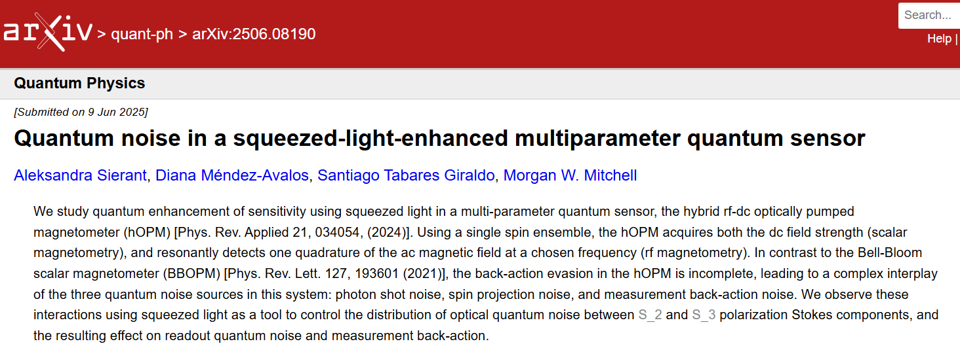
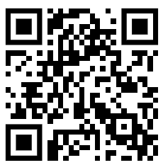
Conclusions
demonstrated practical, multiparameter sensor based on OPM
  simultaneous detection of rf and dc magnetic fields
  quantum noise limited sensitivity
implemented quantum enhanced protocols
squeezed-light probing
improved sensitivity and measurement bandwidth
studied interplay between different quantum noise sources
outlook
miniaturisation

Slide 55
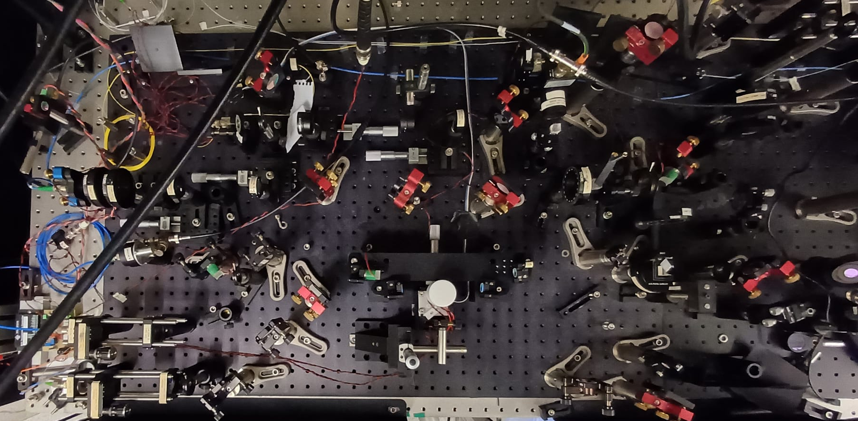
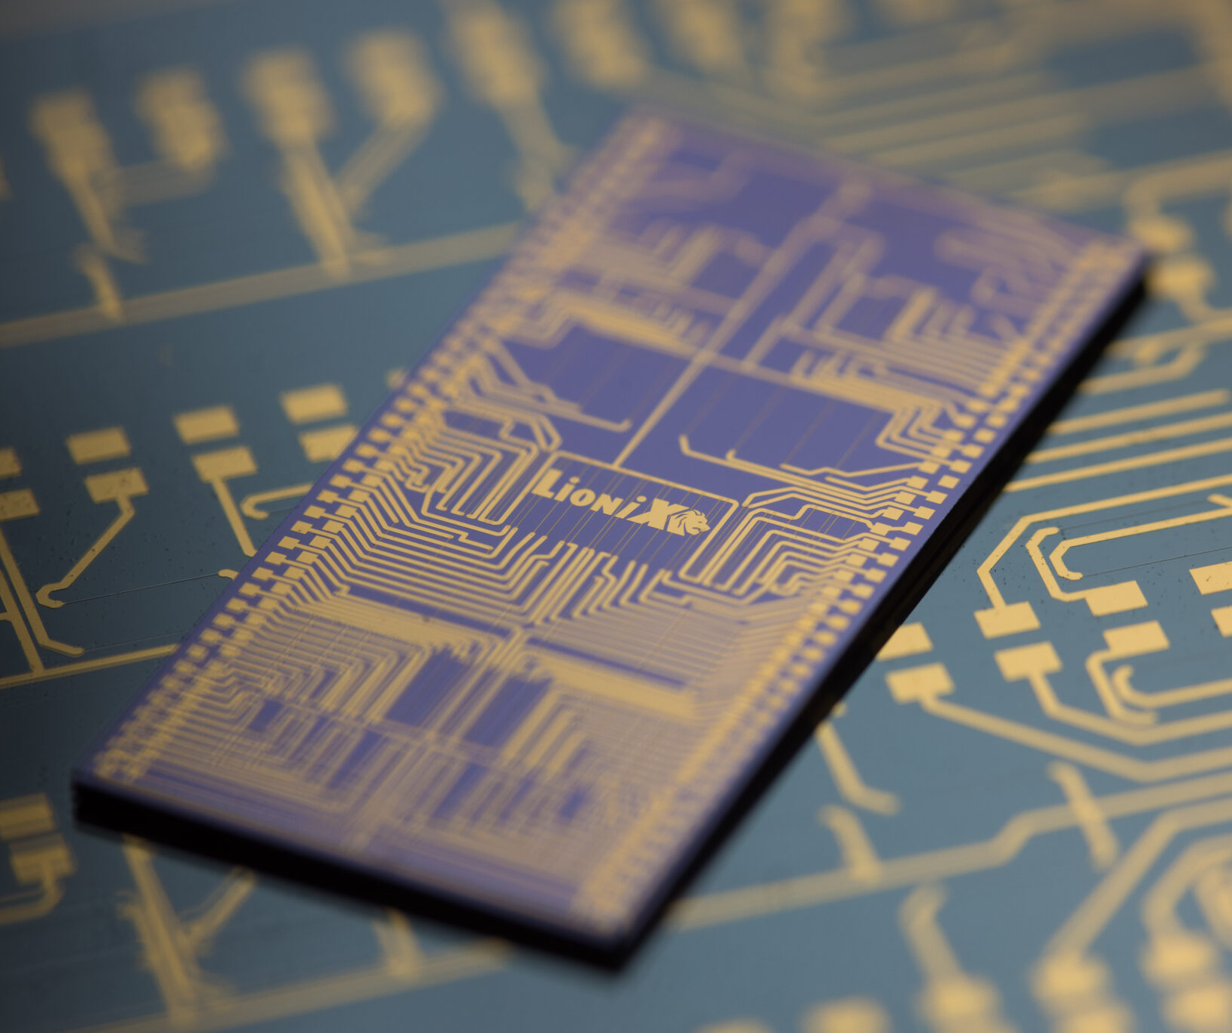
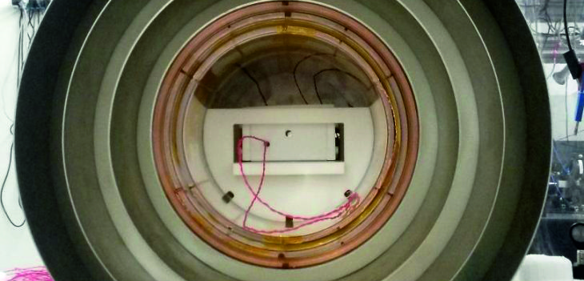
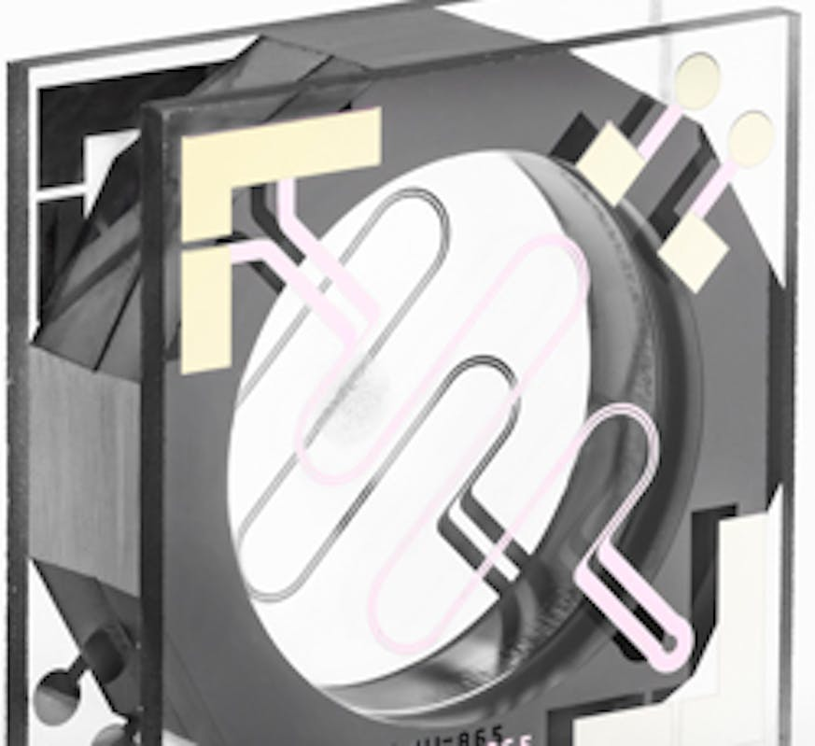
Outlook: miniaturisation
quantum-enhanced multi-parameter sensor
miniaturisation: QUANTIFY project
https://www.lionix-international.com/
photonic integrated squeezer
table top squeezer
macroscopic cell
MEMS cell (csem.ch)

Slide 56


OPM sensor - cd
  find Diana during poster session!
Diana Méndez Avalos
  Earth’s field operation
  QE via spin squeezing
  miniaturised OPM

Slide 57
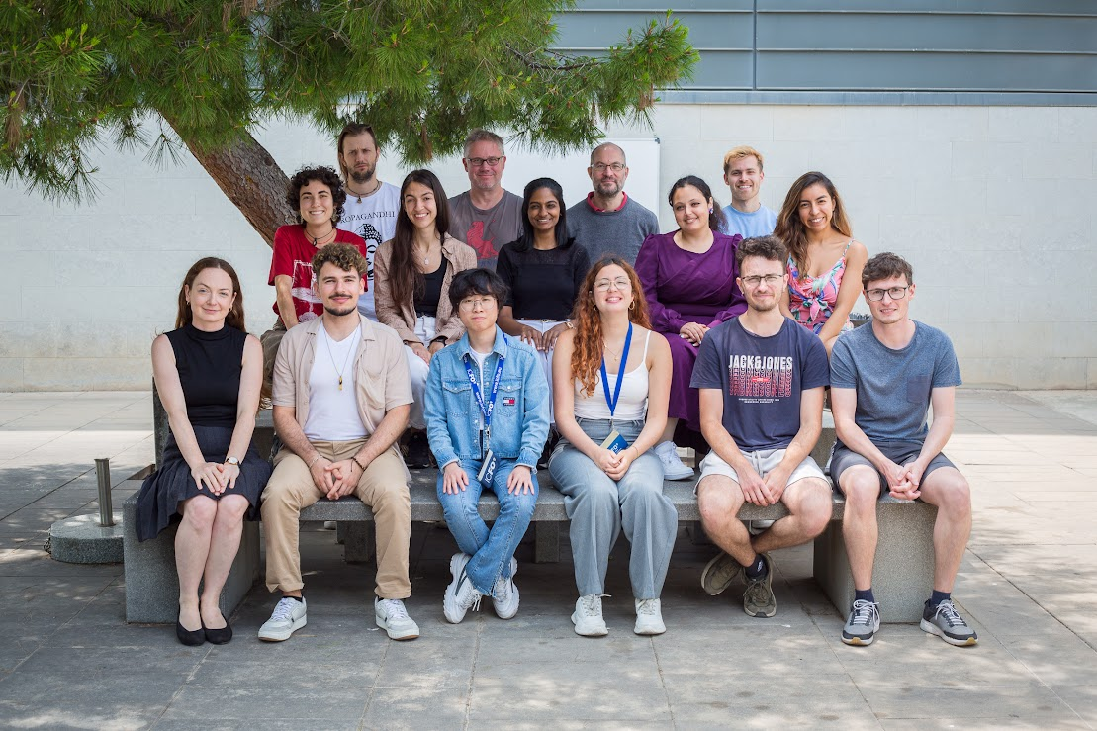
Atomic Quantum Optics group at ICFO

Slide 58
Atomic Quantum Optics group at ICFO
  Morgan
  Diana
  Santiago

Slide 59
Atomic Quantum Optics group at ICFO
  Morgan
  Diana
  Santiago
  Thank you!

Slide 60
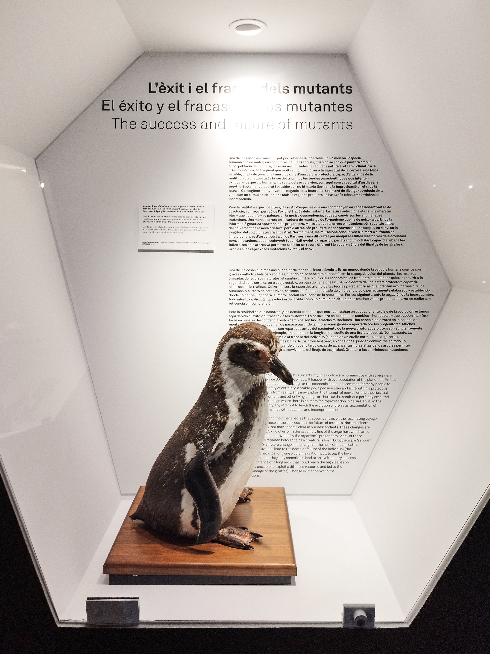
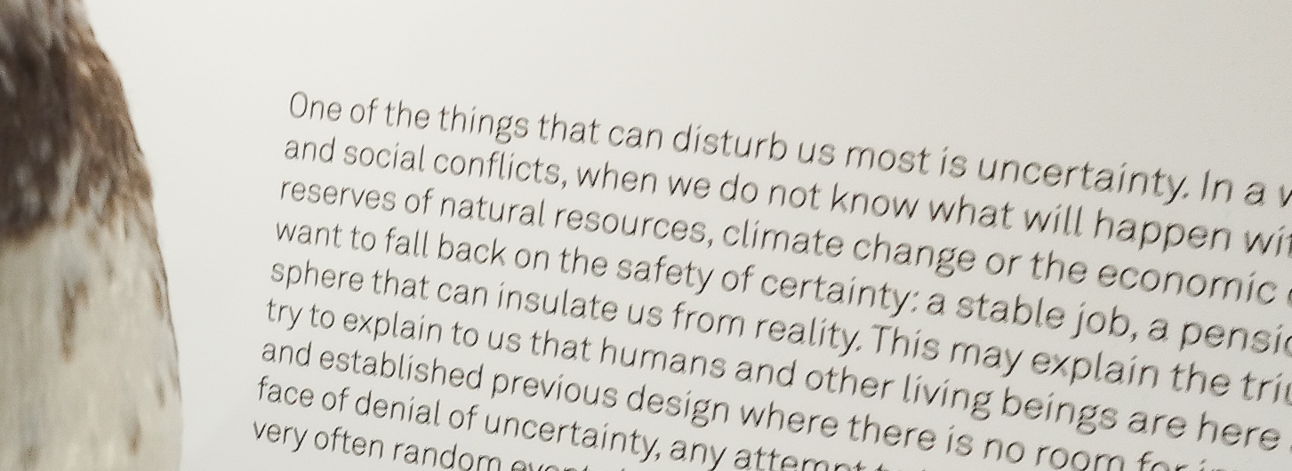
quantum sensing – Braginsky approach
measuring x, perturbs p
  perturbing p affects x
  measurement back-action (MBA)
  Standard Quantum Limit (SQL)
  quantum enhancement

Slide 61
Outlook 2: stroboscopic probing
B
measurement backaction evasion in a multiparameter sensor

Slide 62
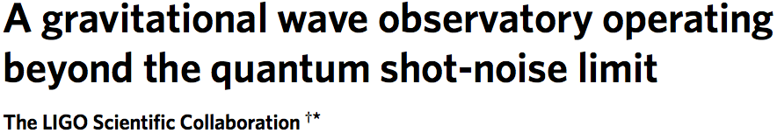
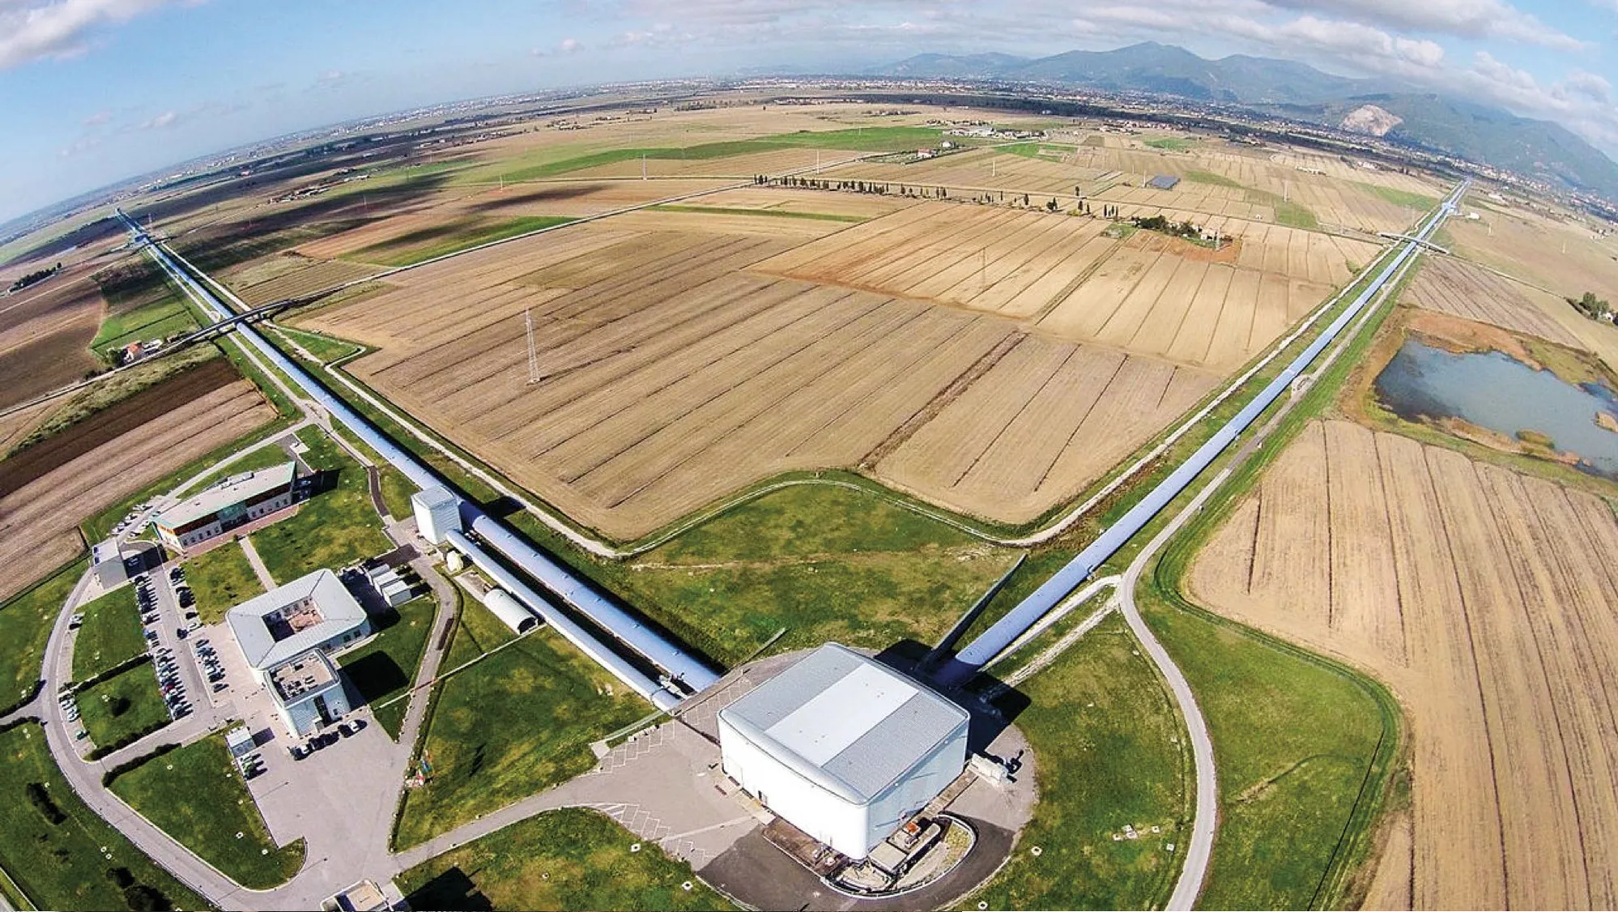
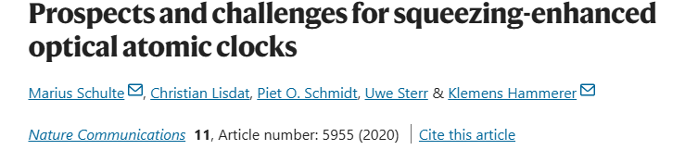
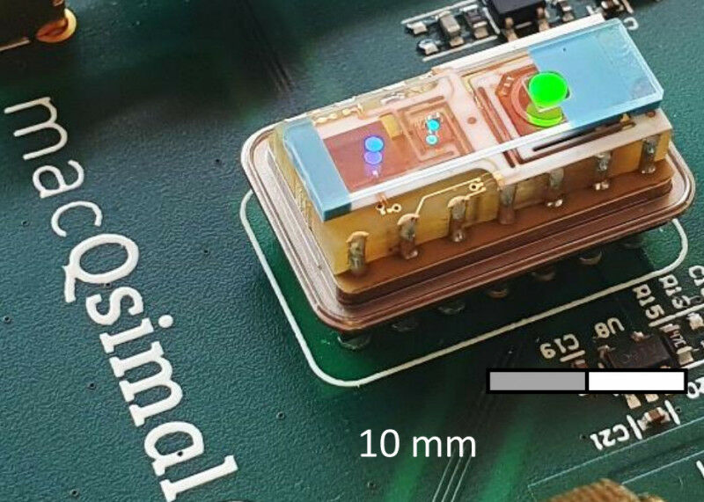
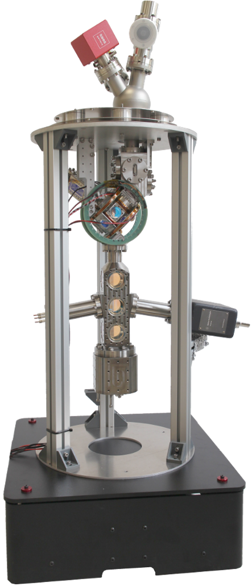
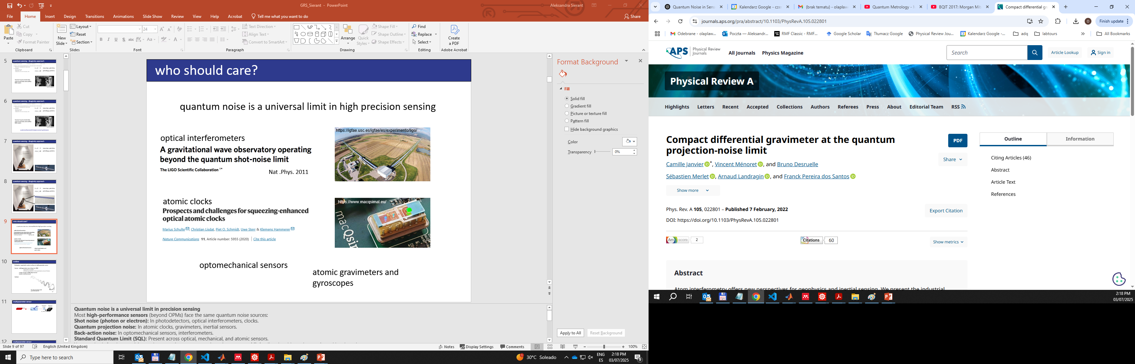
Who should care?
  Quantum noise affects high precision sensing
  optical interferometers
Nat .Phys. 2011
  atomic clocks
igfae.usc.es/igfae/es/experimento/ligo/
www.macqsimal.eu/
  atomic gravimeters and gyroscopes
www.iqo.uni-hannover.de

Slide 63
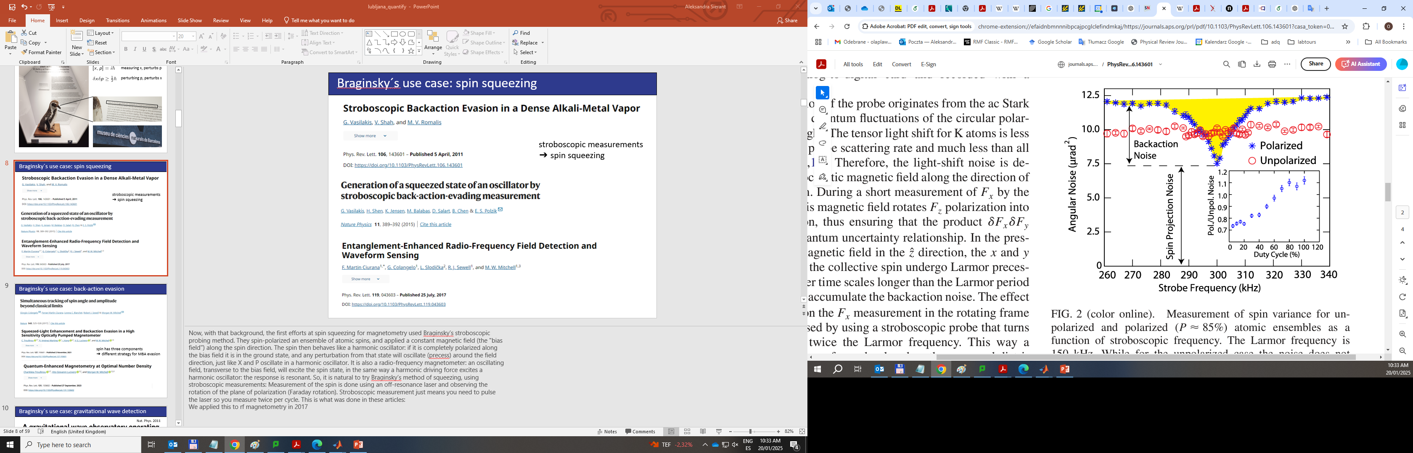
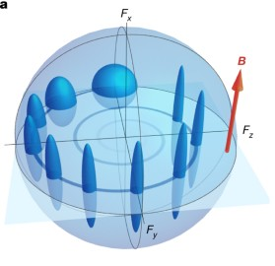
quantum sensing – Braginsky approach
spin squeezing
back-action evasion
spin has three components
➔ different strategy for MBA evasion
[1] Vasilakis, G., et al. "Generation of a squeezed state of an oscillator by stroboscopic back-action-evading measurement." Nature Physics 11.5 (2015): 389-392.
[2] Vasilakis, G., V. et al. "Stroboscopic backaction evasion in a dense alkali-metal vapor." Physical review letters 106.14 (2011): 143601.
[3] Ciurana, M., et al. "Entanglement-enhanced radio-frequency field detection and waveform sensing." Physical review letters 119.4 (2017): 043603.
[1] Colangelo, G., et al. "Simultaneous tracking of spin angle and amplitude beyond classical limits." Nature 543.7646 (2017): 525-528.
[2] Troullinou, C., et al. "Squeezed-light enhancement and backaction evasion in a high sensitivity optically pumped magnetometer." Physical Review Letters 127.19 (2021): 193601.
[3] Troullinou, C., et al. "Quantum-enhanced magnetometry at optimal number density." Physical Review Letters 131.13 (2023): 133602.

Slide 64
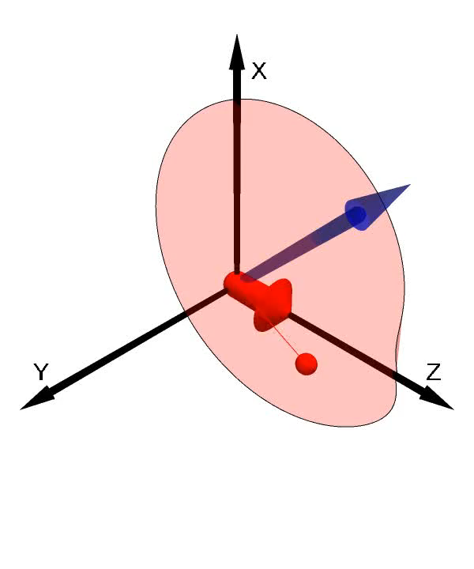
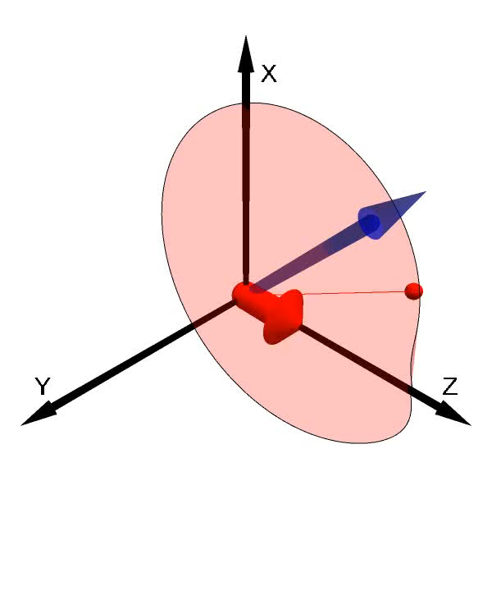
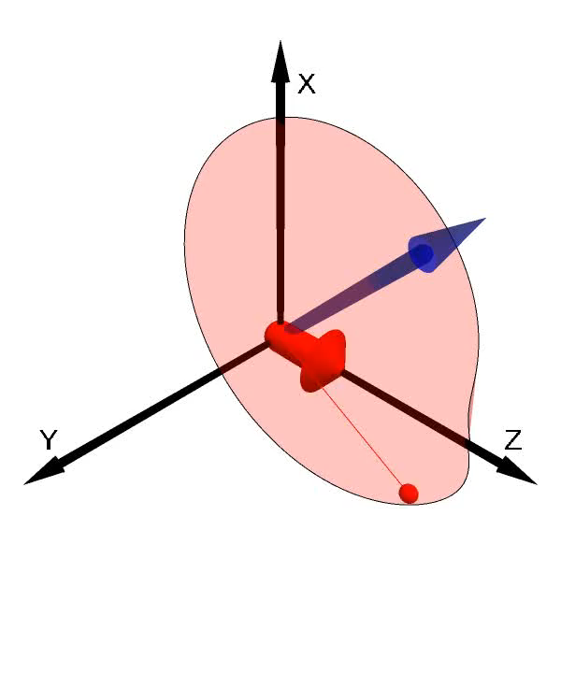
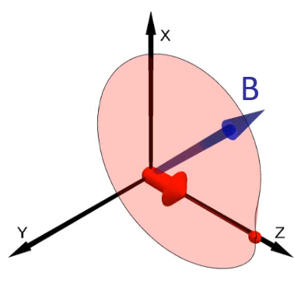

spin dynamics
strong dc
no rf
B
resonant dc
positive rf
resonant dc
negative rf
resonant dc
no rf
B
B
B
weak dc
no rf

Slide 65
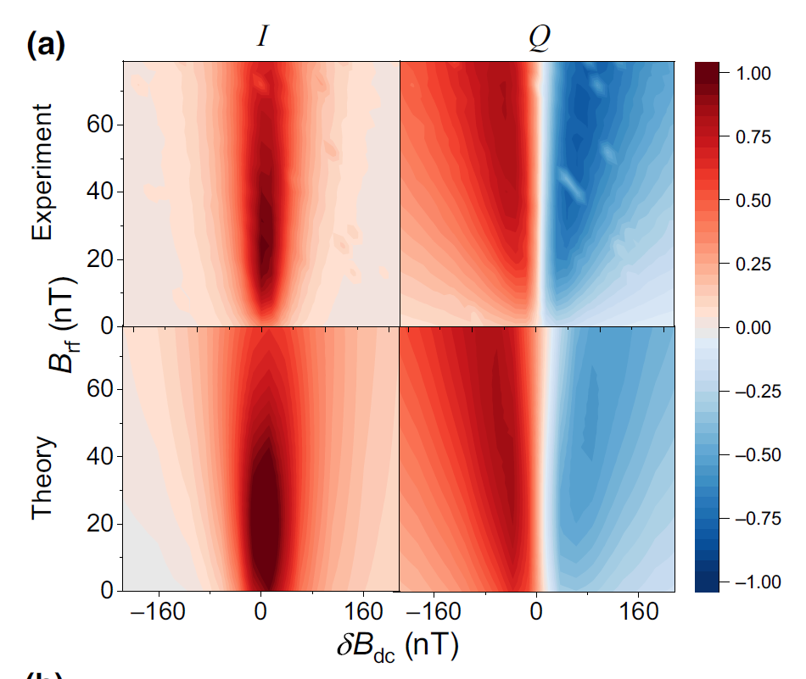
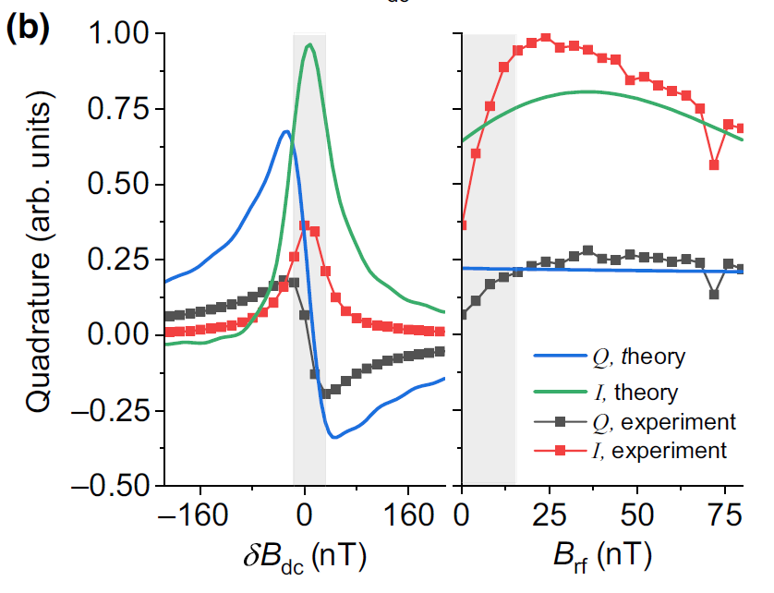
multiparameter sensor: I and Q quadratures
$\frac{d}{dt}F\left(t\right)=\left[−γB\left(t\right)+GS_{3}(t)\hat{z}\right]×$ $F\left(t\right)−ΓF\left(t\right)+R_{OP}\left(t\right)\left[F_{max}−F\left(t\right)\right]+N_{at}(t)$
collective
spin
Larmor
light shift
relaxation
optical
pumping
spin noise

Slide 66
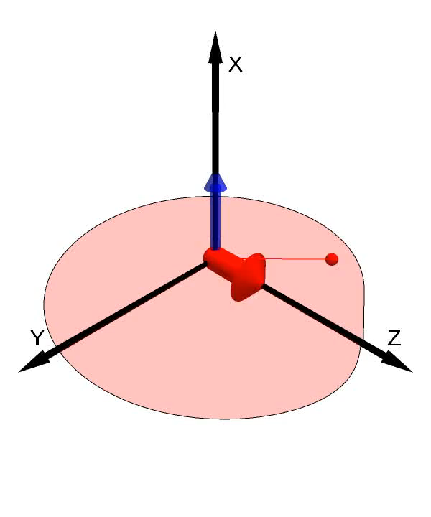
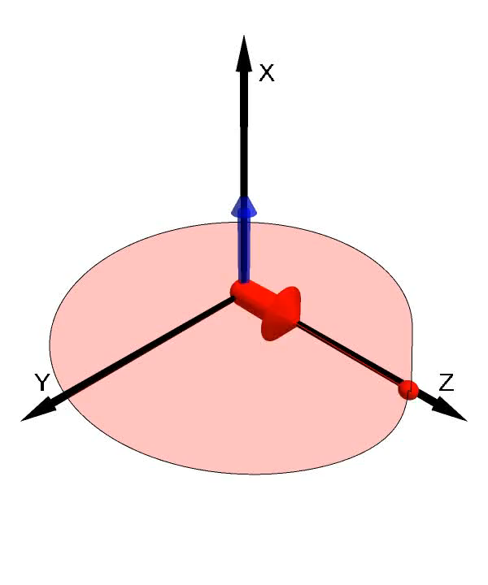

Bell-Bloom optical pumping
weaker field
resonant field
stronger field
B
B
B

Slide 67

Bell-Bloom optical pumping
weaker field
resonant field
stronger field
B
B
B
Q quadrature (90° out of phase) carries the signal

Slide 68
optimal number density
coherent light
squeezed light
300 fT/√Hz
C. Troullinou et al. Phys. Rev. Lett. 131, 133602 (2023)

Slide 69

Squeezer

Slide 70
quantum sensing – Braginsky approach
measuring x, perturbs p
  perturbing p affects x
  measurement back-action (MBA)
  Standard Quantum Limit (SQL)
  quantum enhancement

Slide 71
Multiparameter sensor
Wollaston
prism
balanced
detector
$$B_{dc}$$
probe
-
⁸⁷Rb
$$B_{rf}$$
HWP
pump
$S_{2}$ Stokes parameter
time domain

Slide 72
Photon shot noise (PSN)
detected spectrum:
R
B
W
3
0
k
H
z
M
a
r
k
e
r
1
[
T
*
V
B
1
]
W
1
0
H
z
-
6
9
.
6
2
d
R
e
B
m
f
-
6
5
.
7
d
B
m
*
A
t
t
1
0
d
B
S
W
T
1
.
4
5
s
1
.
4
5
0
0
0
0
s
-
6
6
U
N
C
A
L
A
1
A
P
-
6
7
antisqueezed
C
L
R
W
R
-
6
8
-
6
9
4 dB
1
noise (dB)
-
7
0
-
7
1
3
D
B
coherent
-
7
2
2 dB
-
7
3
squeezed
-
7
4
-
7
5
C
e
n
t
e
r
1
M
H
z
1
4
5
m
s
/
time (s)
time
Date: 16.APR.2003 00:10:26

Slide 73
Photon shot noise (PSN)
detected spectrum:
squeezing parameter
R
B
W
3
0
k
H
z
M
a
r
k
e
r
1
[
T
*
V
B
1
]
W
1
0
H
z
-
6
9
.
6
2
d
R
e
B
m
f
-
6
5
.
7
d
B
m
*
A
t
t
1
0
d
B
S
W
T
1
.
4
5
s
1
.
4
5
0
0
0
0
s
-
6
6
U
N
C
A
L
A
1
A
P
-
6
7
antisqueezed
C
L
R
W
R
-
6
8
-
6
9
4 dB
1
noise (dB)
-
7
0
-
7
1
3
D
B
coherent
-
7
2
2 dB
-
7
3
squeezed
-
7
4
-
7
5
C
e
n
t
e
r
1
M
H
z
1
4
5
m
s
/
time (s)
time
Date: 16.APR.2003 00:10:26

Slide 74











references for this talk
Charikleia Troullinou
Michał Lipka
in preparation
Diana
Méndez Avalos
Santiago
Tabares Giraldo
Morgan W. Mitchell

