Slide 1

Noninvasive, multichannel nuclear magnetic resonance chemical analysis via OPM arrays in the zero- to ultralow-field regime
Blake Andrews
Ajoy Lab
University of California, Berkeley

Slide 2
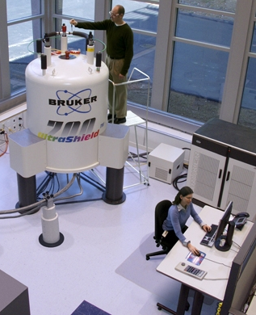
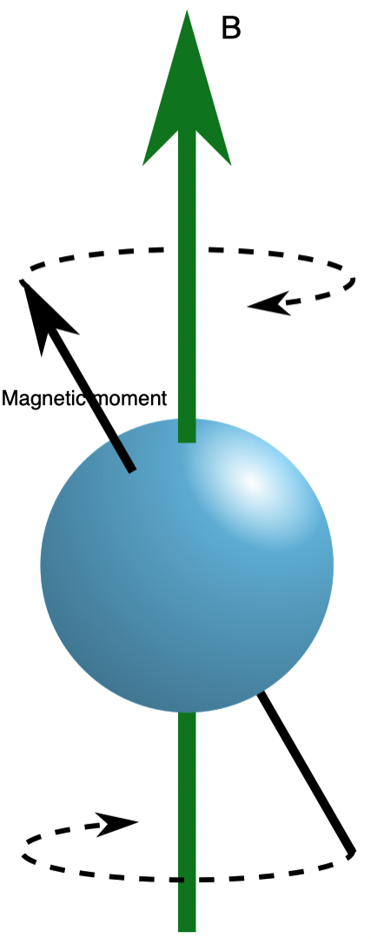

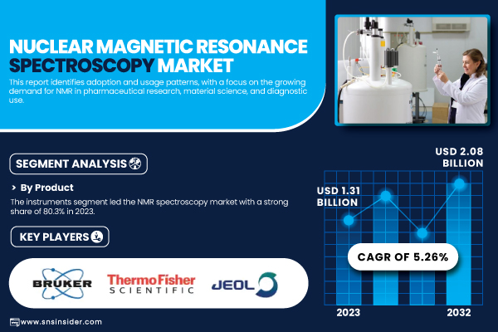
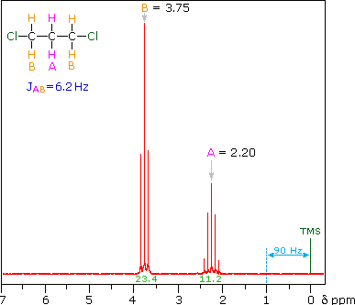
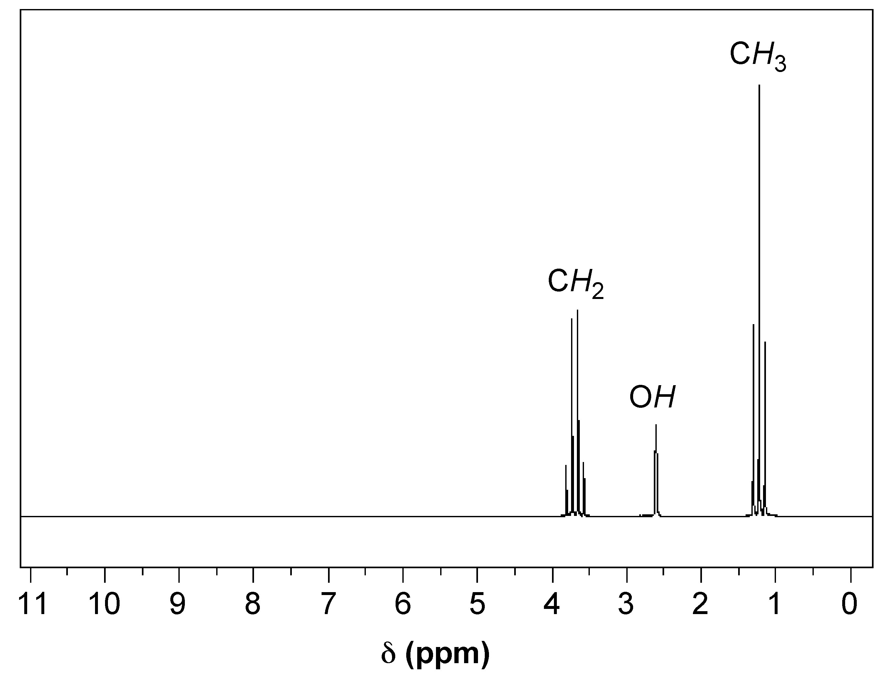
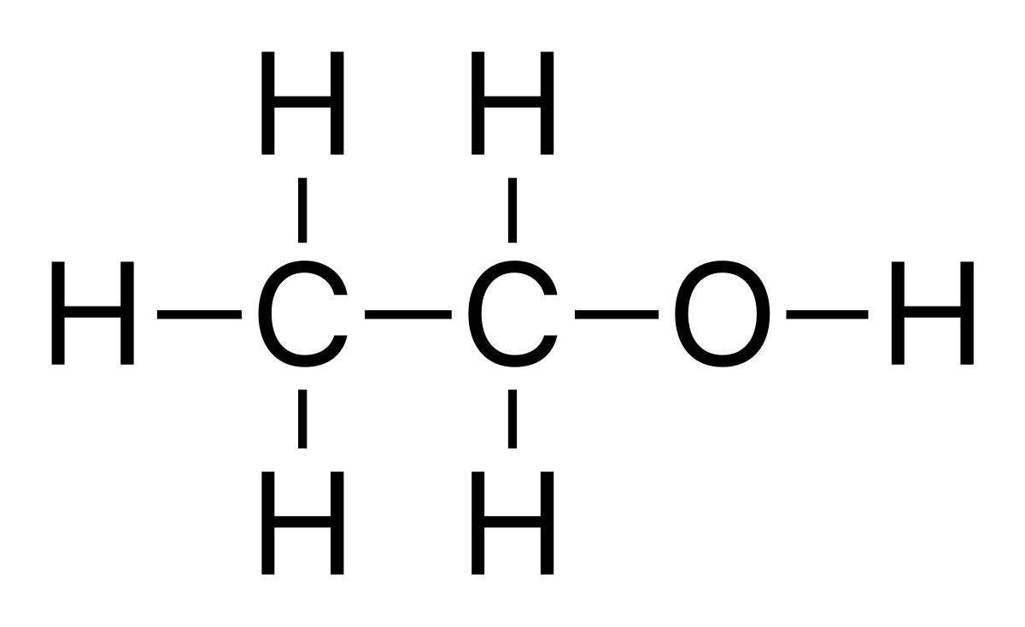
What is NMR?
- NMR examines nuclear spin behavior in a magnetic field.
Noninvasive:
Nuclear spins do not participate in chemistry.
“Silently listen in”
-Reveals chemical structure and environment. Quantifies chemicals present.
Slide 2

Slide 3
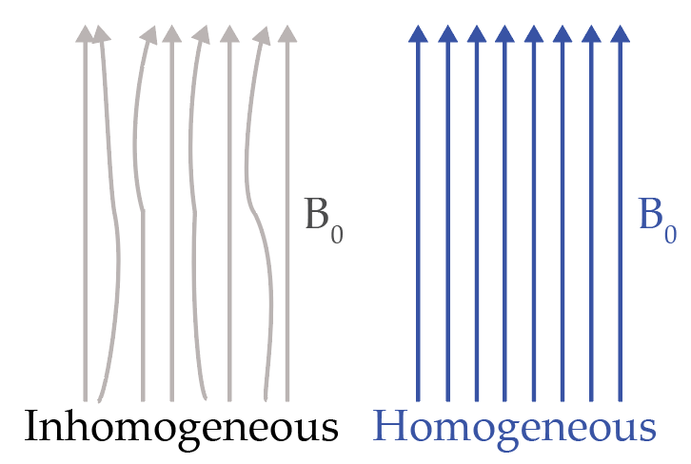
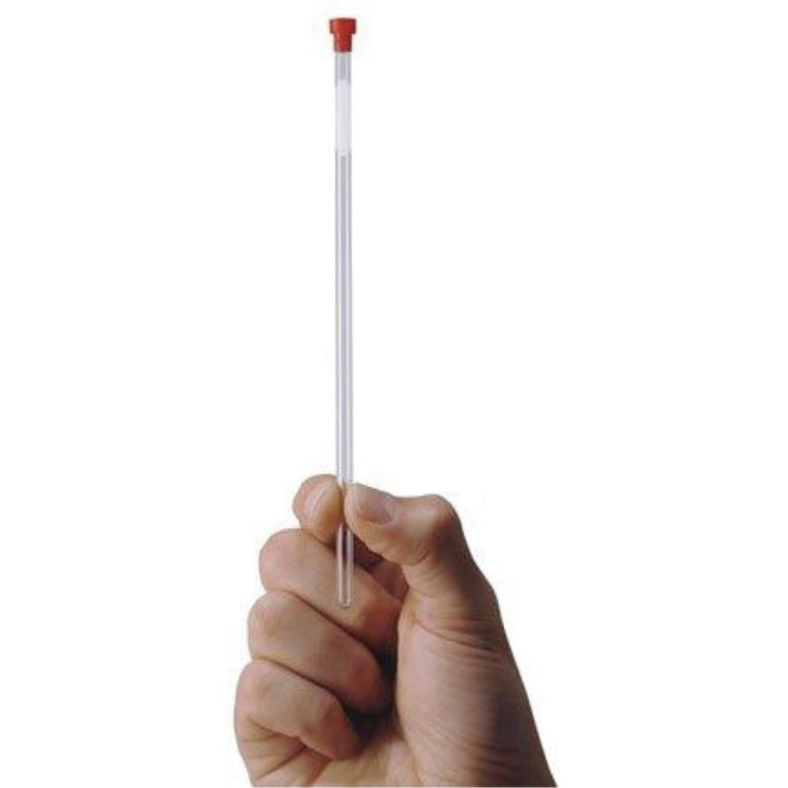
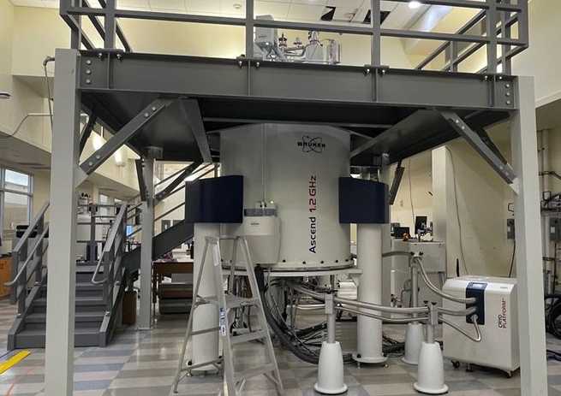
Limitations of NMR
- High field homogeneity (<10ppb): frequent calibration.
- Achieved in small “sweet spots” (<5cm³): one sample at a time
- High operating fields 9.4 - 28.2T (typical MRI: 1.5 - 3T) and expensive.
- Need specialized tubes.
28.2T NMR at Ohio State University
Slide 3

Slide 4
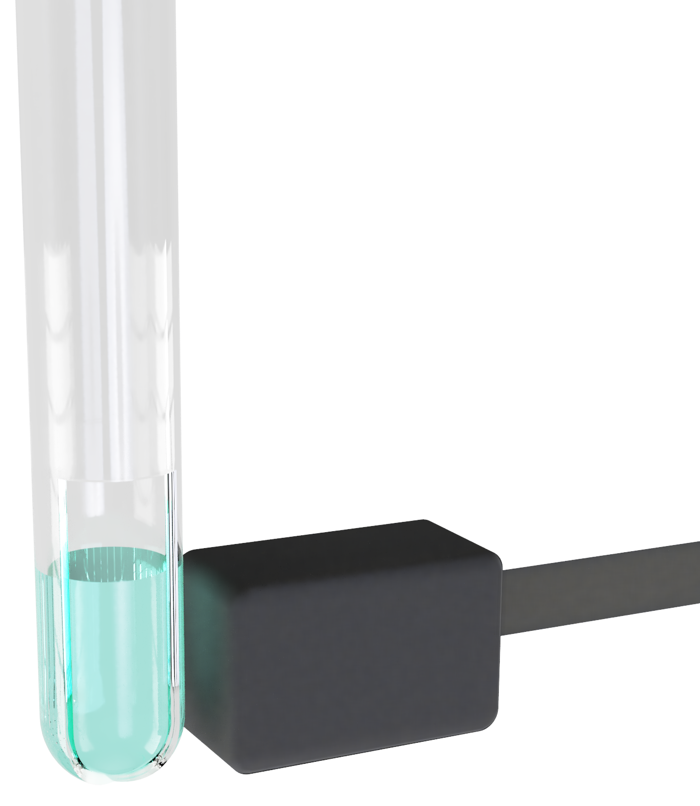
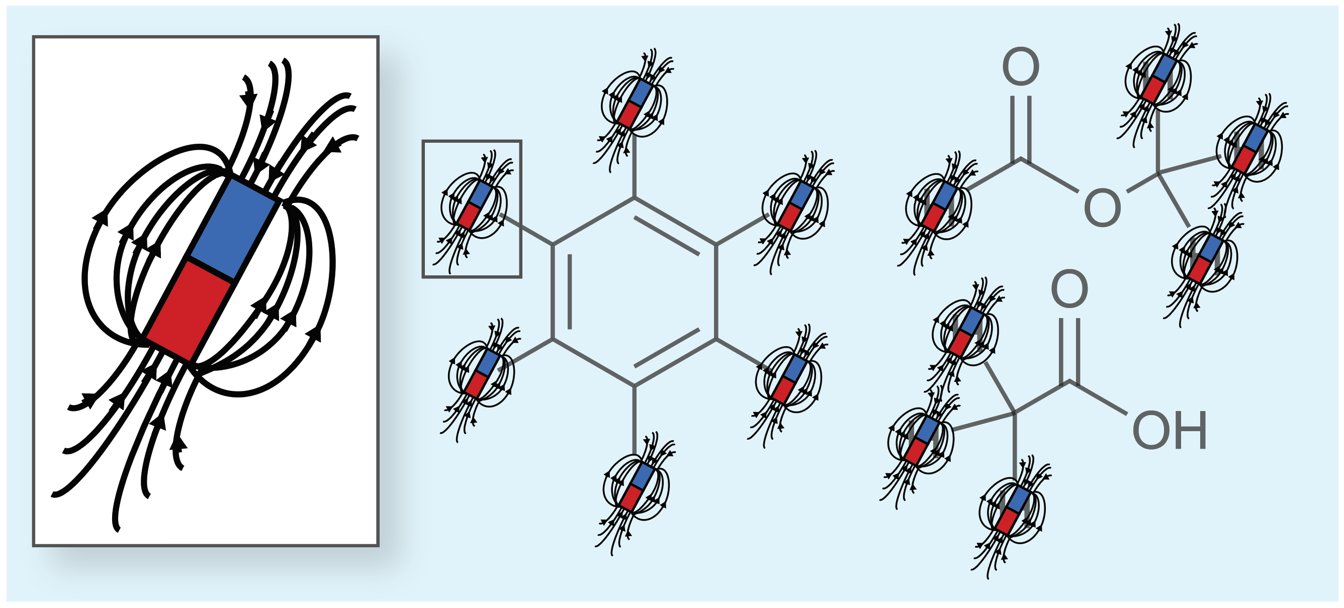
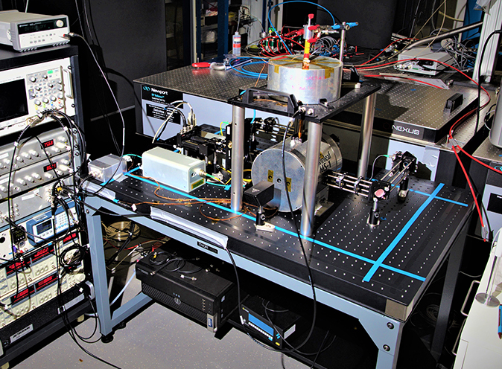
Alternative: OPM-based NMR
OPM-detected NMR subverts many of these challenges:
OPM-NMR
Previous:
- Simply a magnetic field measurement (100-1,000nT)
- Frequencies and amplitudes encode chemical information.
- Benefit from the strides taken in OPM development and its commercialization.
Slide 4

Slide 5
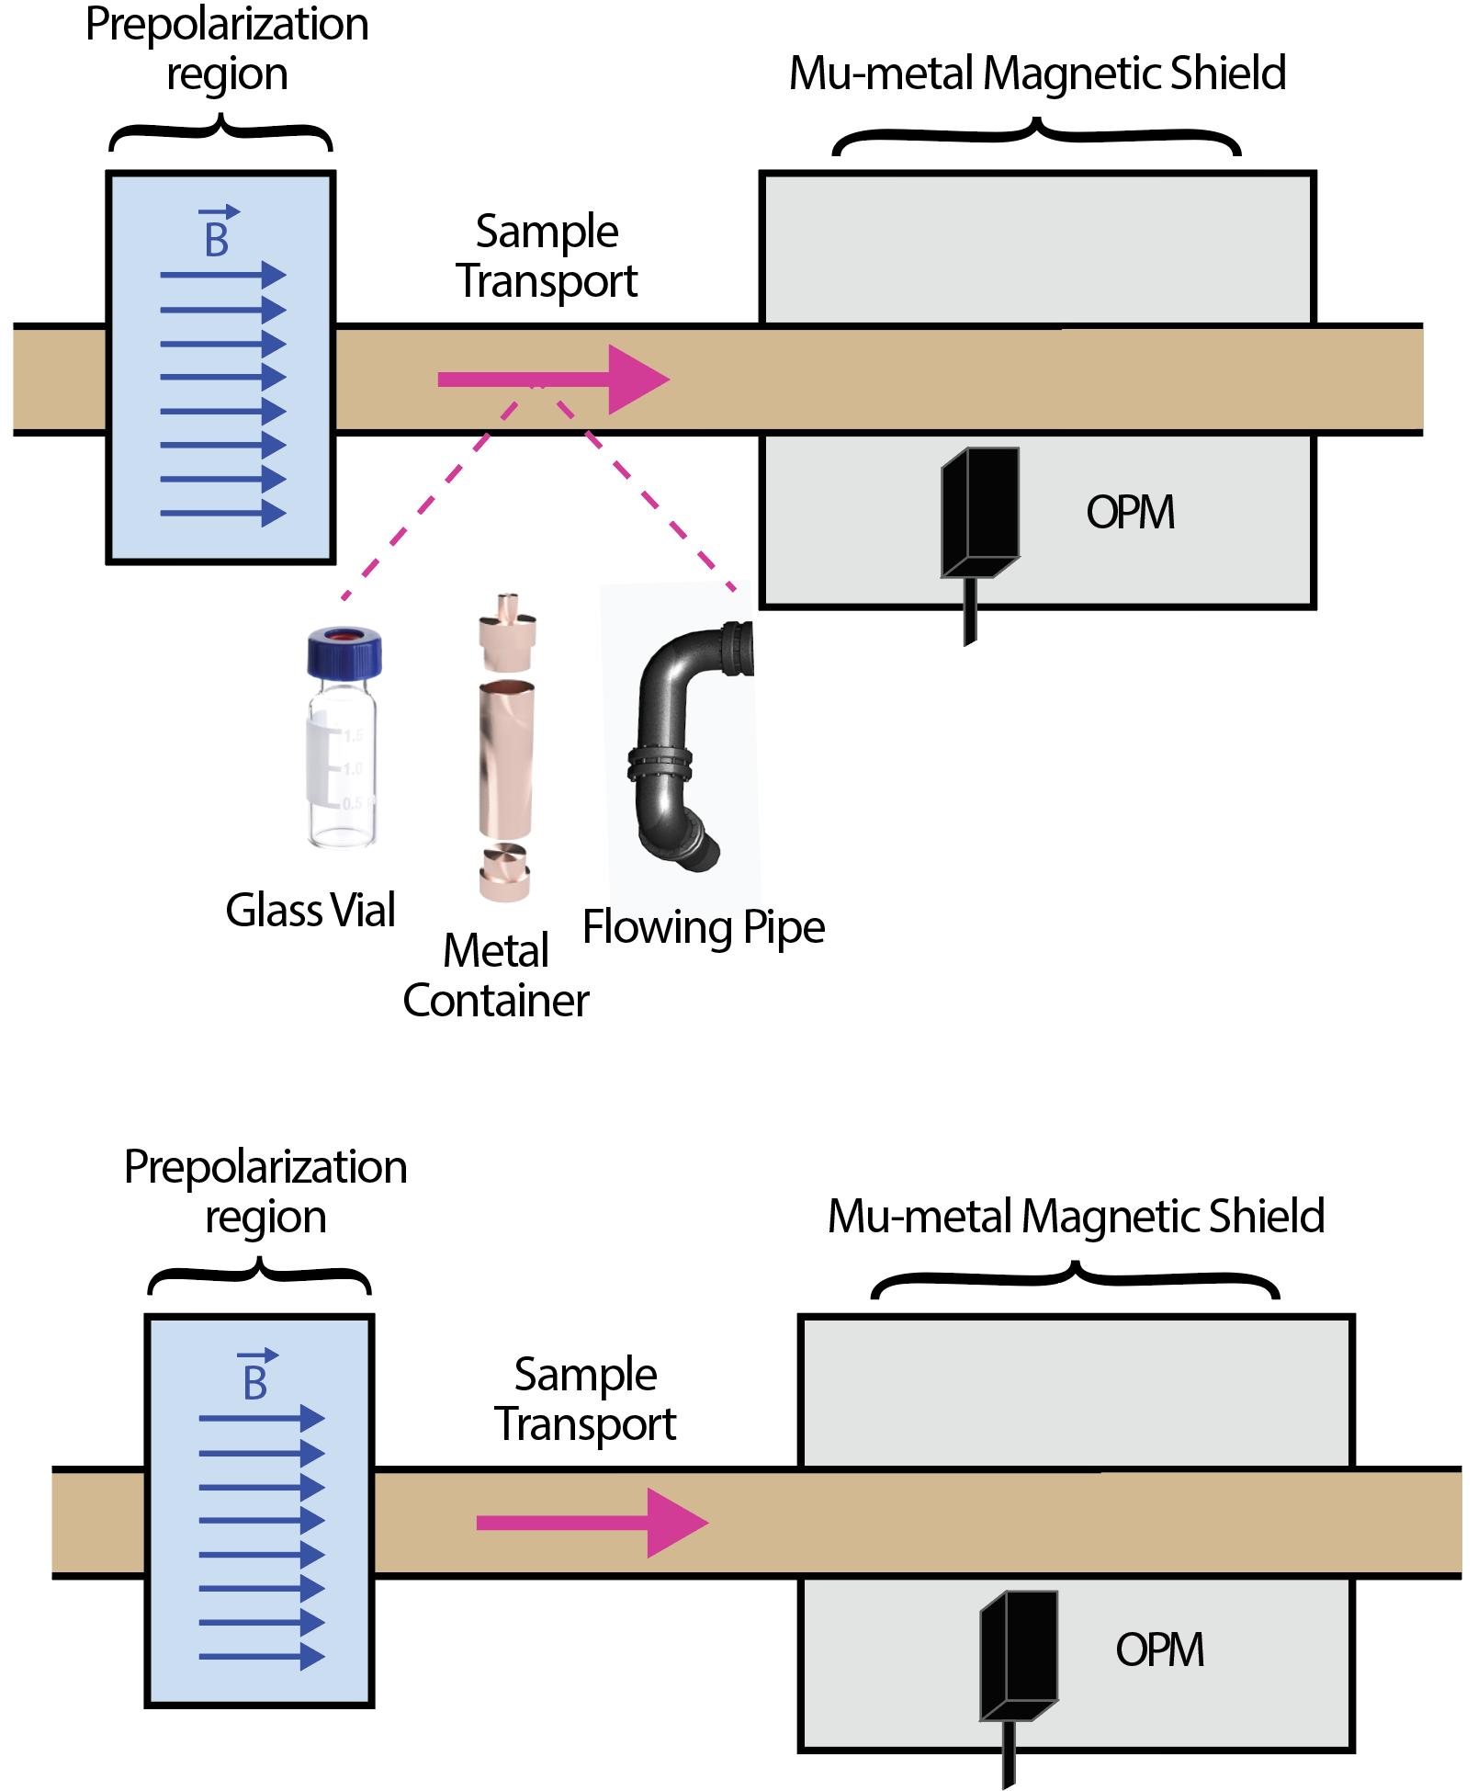
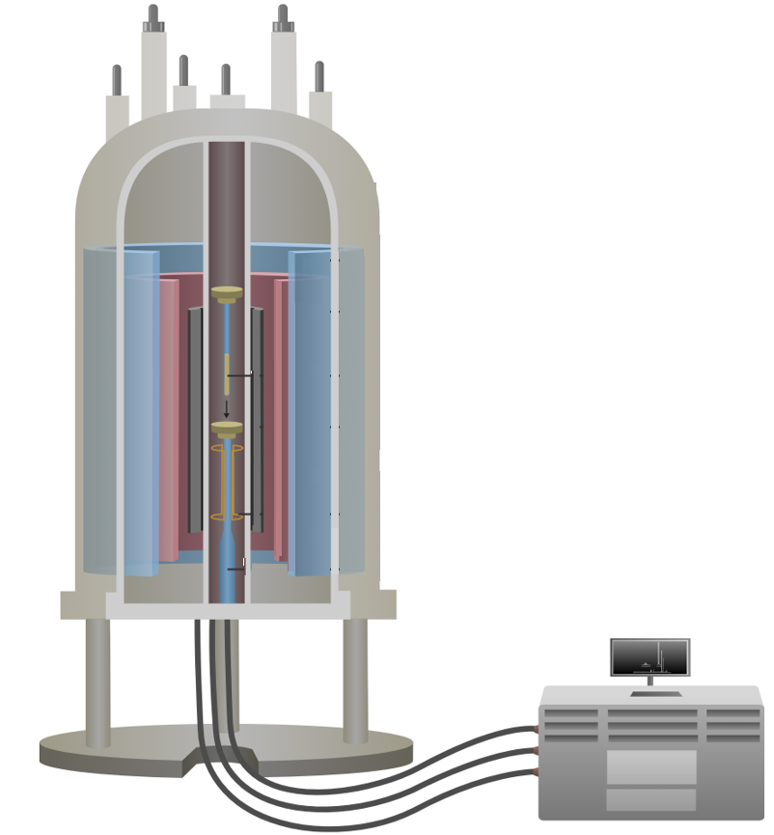
What is Zero-Field (ZF) NMR?
OPM NMR measurements are performed at zero magnetic field (<10nT).
- Zero-field NMR (ZF NMR): high-field preparation and zero-field detection.
- Measured through a variety of materials.
ZF NMR
Conventional NMR
Homogeneous
“Sweet Spot”
Slide 5

Slide 6
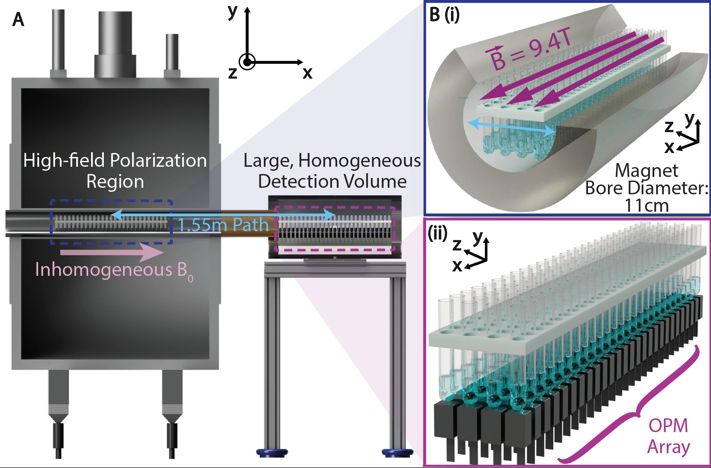
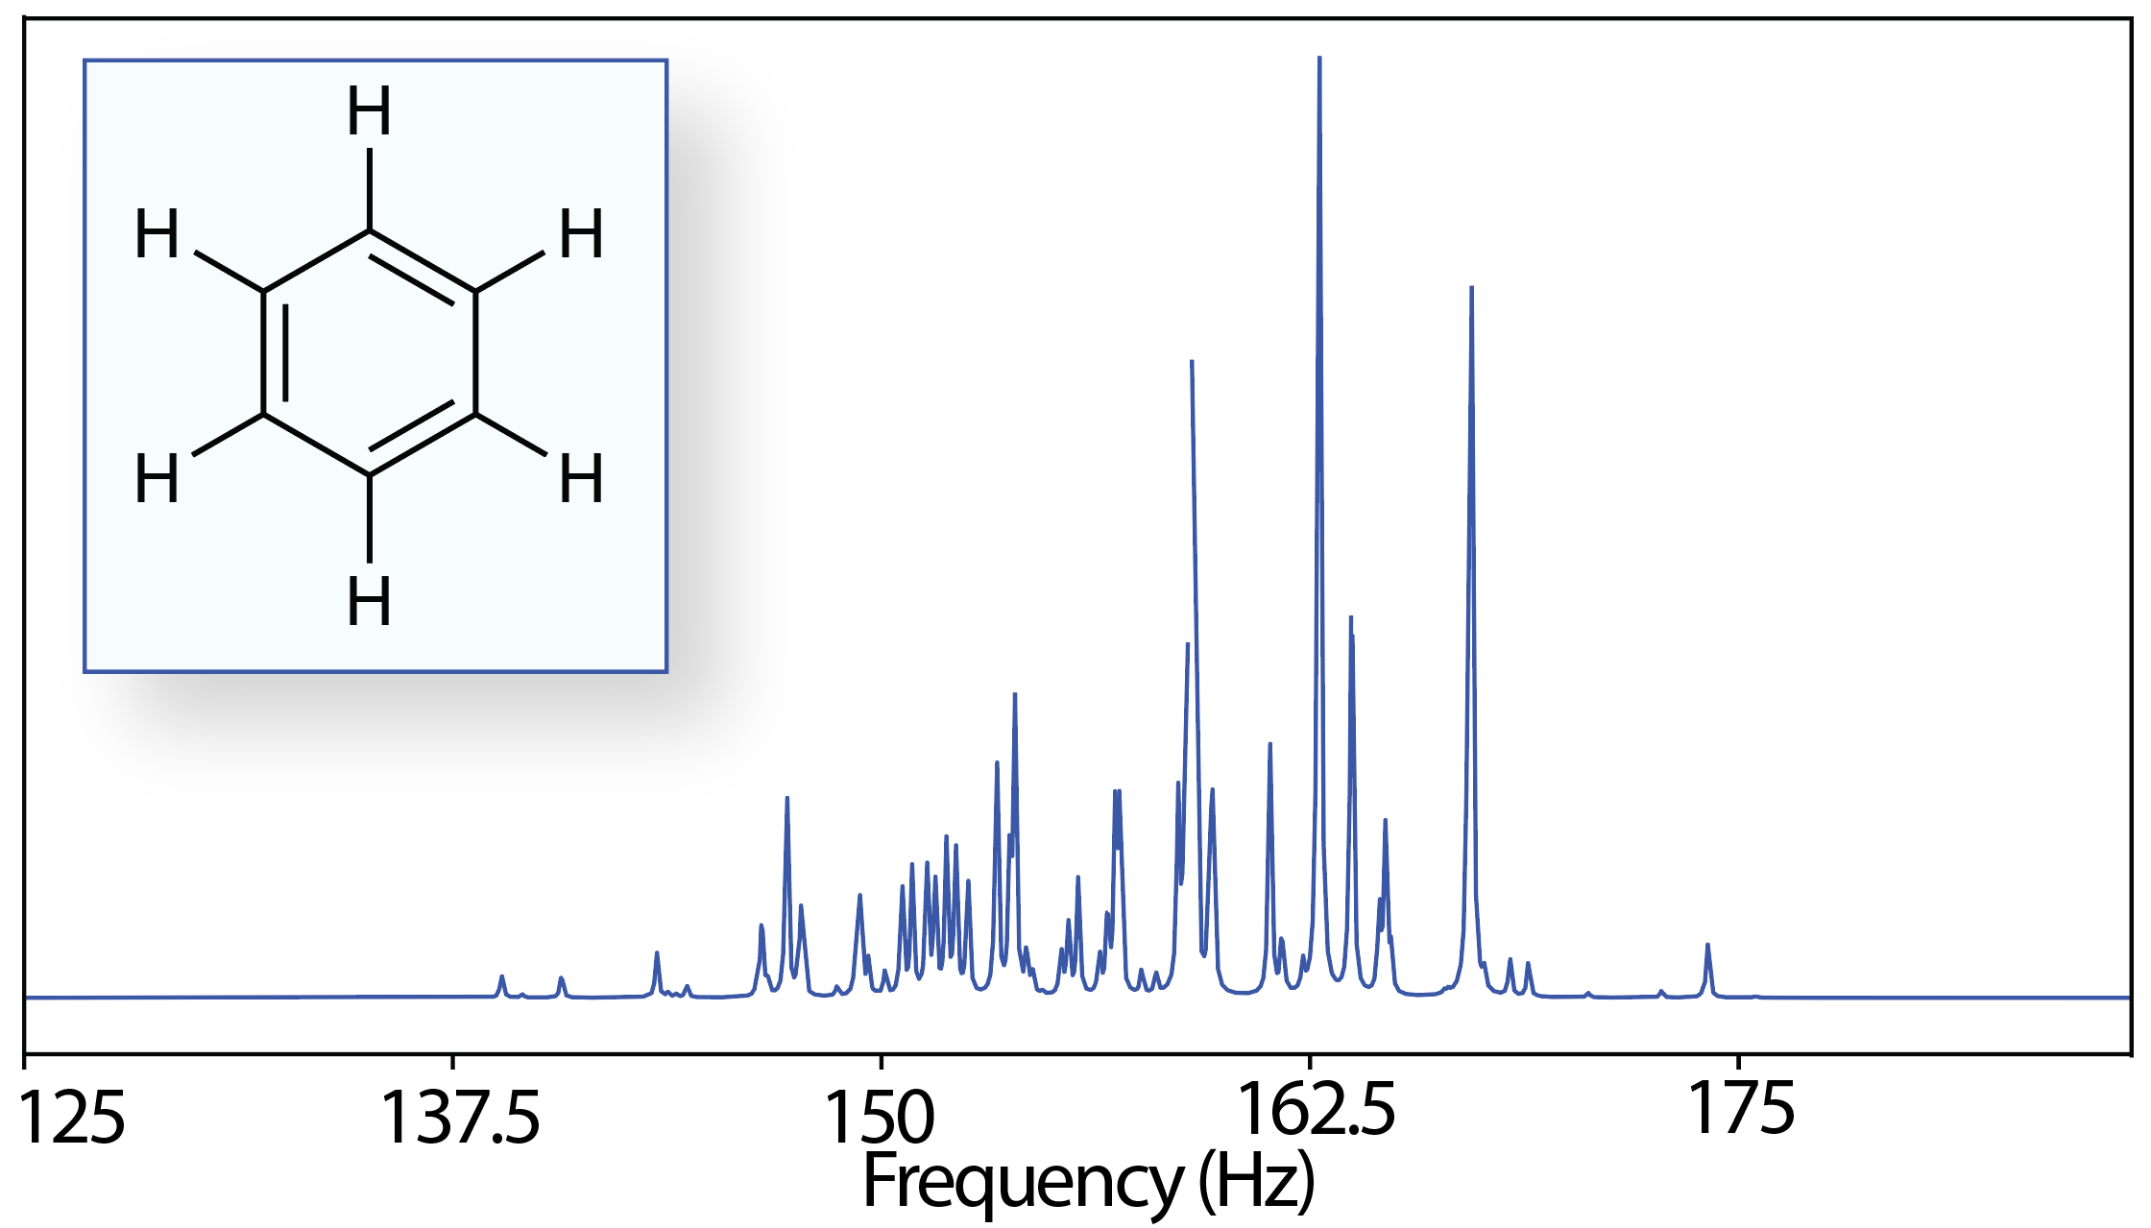
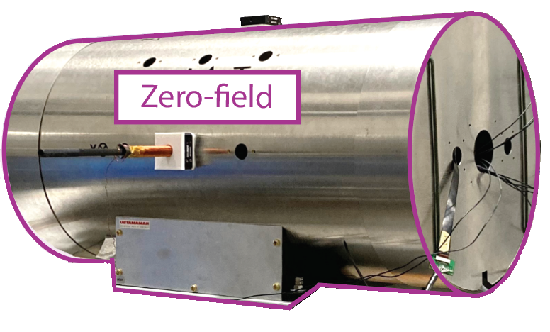
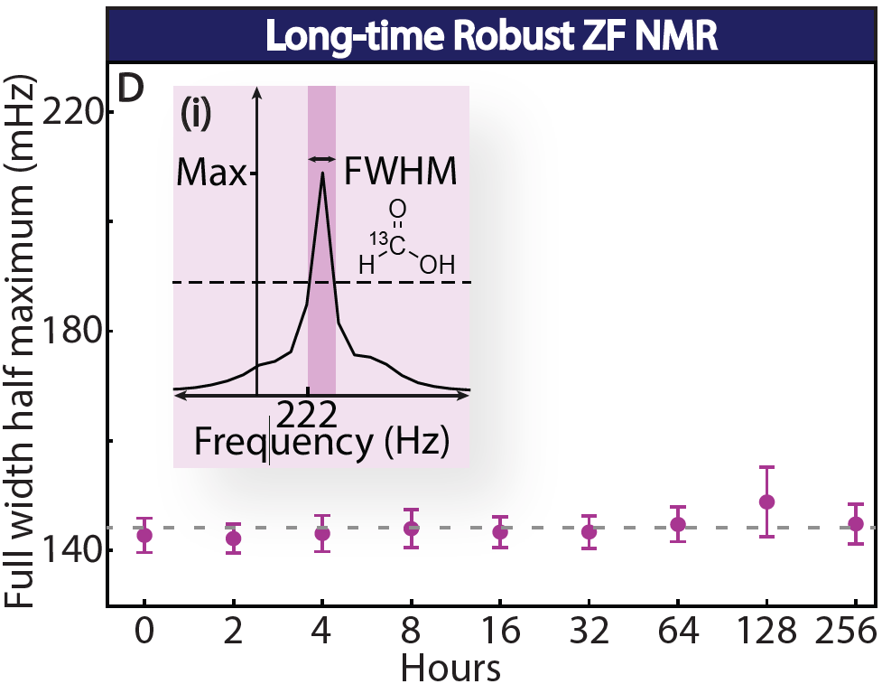
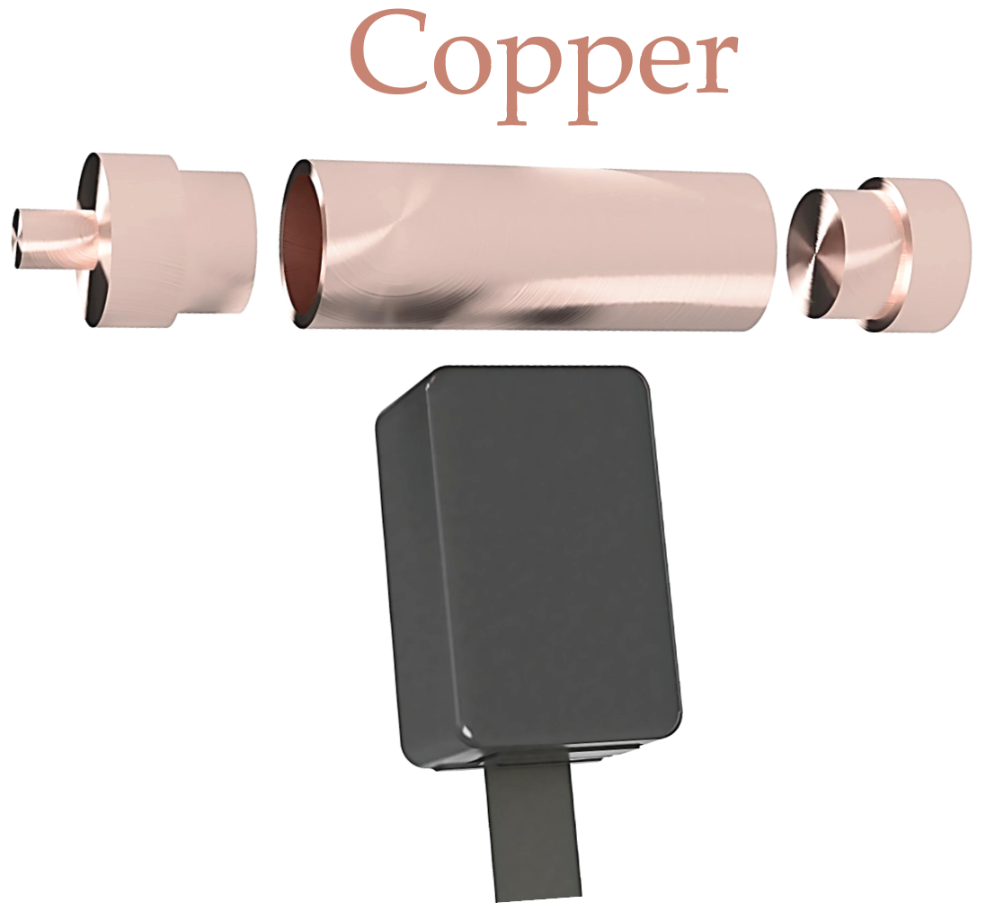
Advantages of ZF NMR via OPM
Sensitive chemical fingerprint
Large homogeneous volume
Stability without calibration
>10 days!
Truly noninvasive
D. Burueva. Angew. Chem. Int. Ed. 59, 17026 – 17032 (2020).
Slide 6

Slide 7
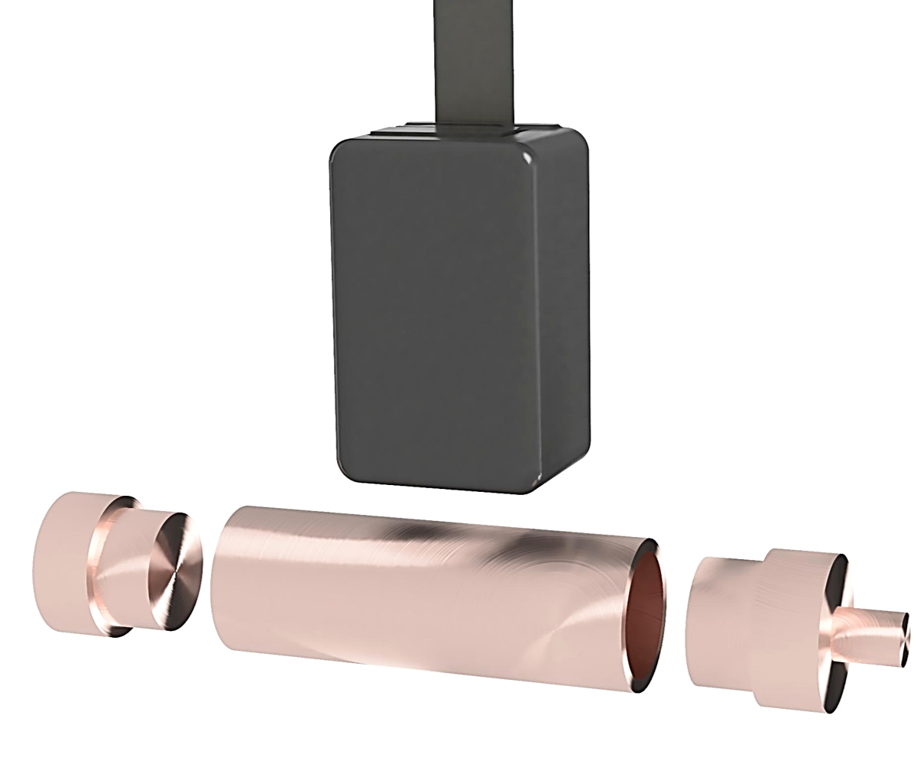
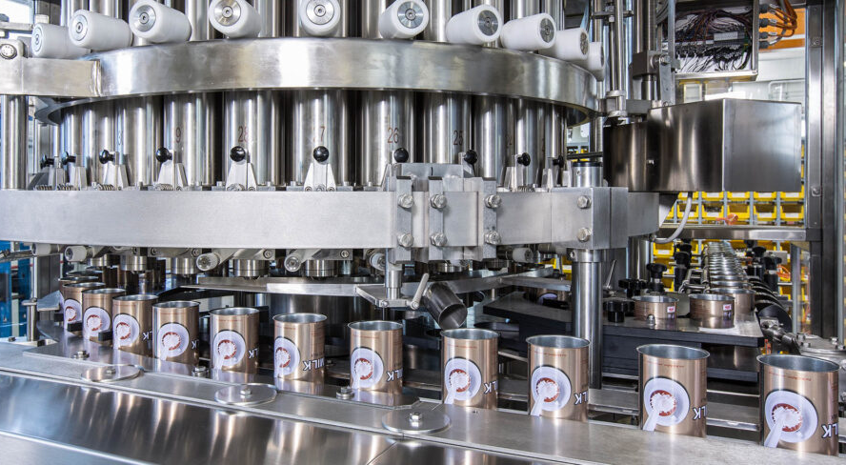
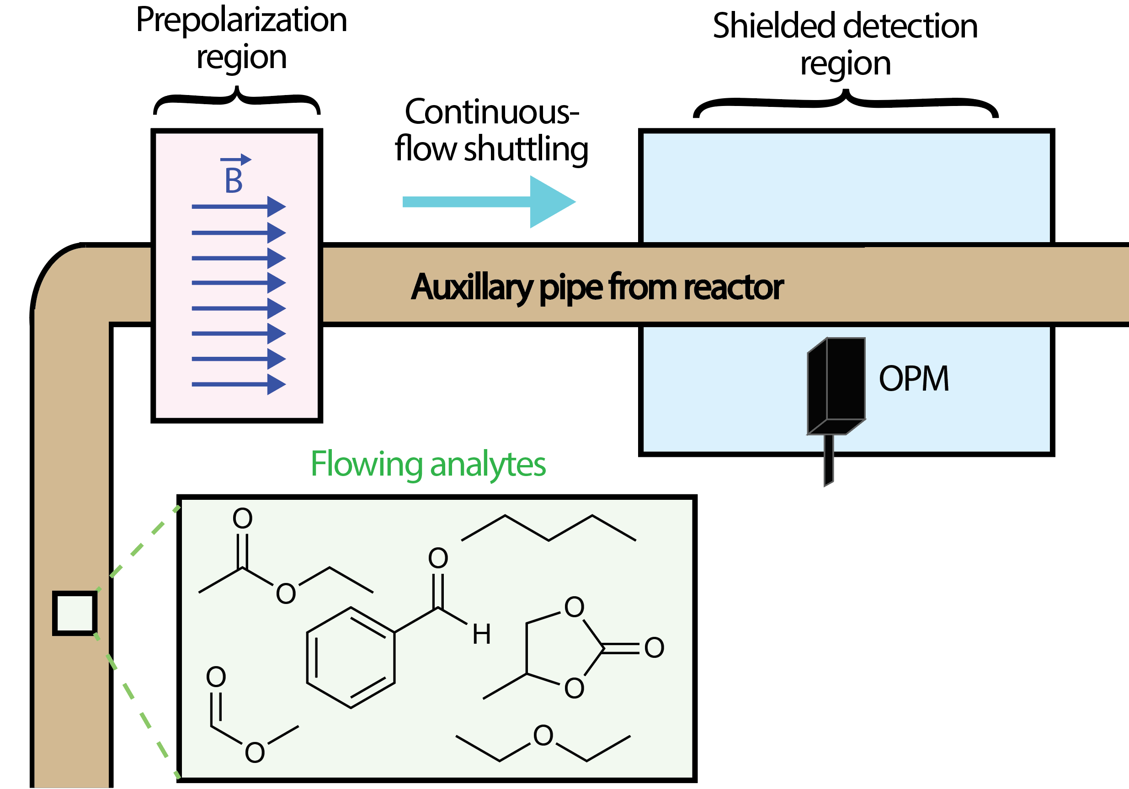
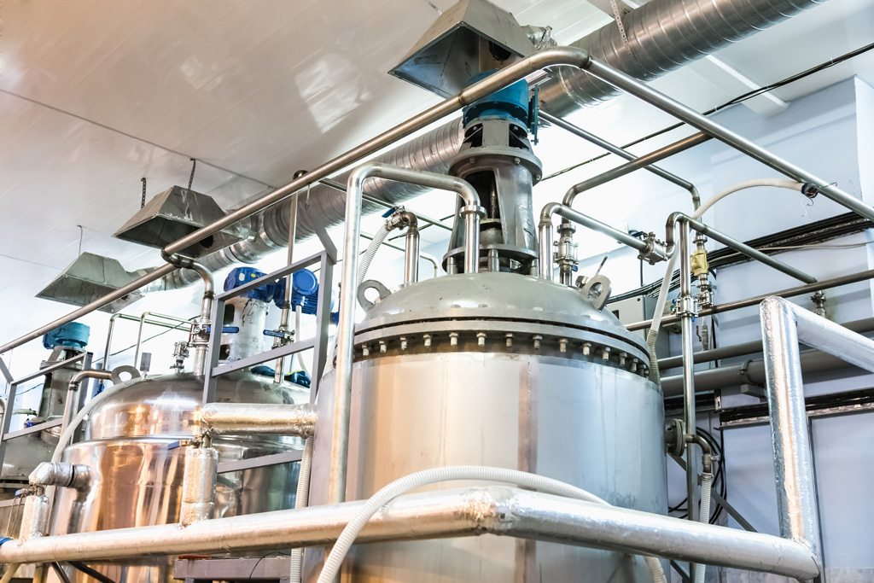
Implications of ZF NMR
Freedom from the NMR tube enables practical measurements.
Food QC post-packaging
Agricultural and food industry is the fastest growing customer segment.
Noninvasive Monitoring
Slide 7

Slide 8
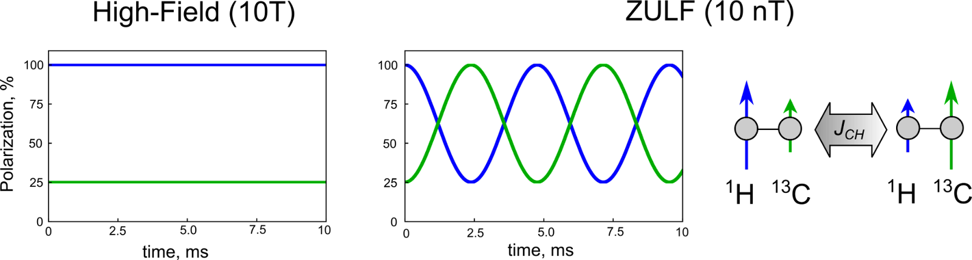
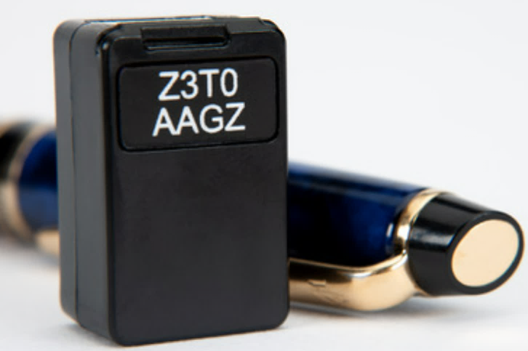

Signals at ZF
- Intramolecular interactions (J-couplings) dominate.
- Signals are delocalized polarization passing modes (total angular momentum).
- Weak couplings: frequencies are low (10-300Hz).
D. Barskiy, et al., Prog. NMR. Spectrosc. 148-149, 101558 (2025).
Slide 8

Slide 9

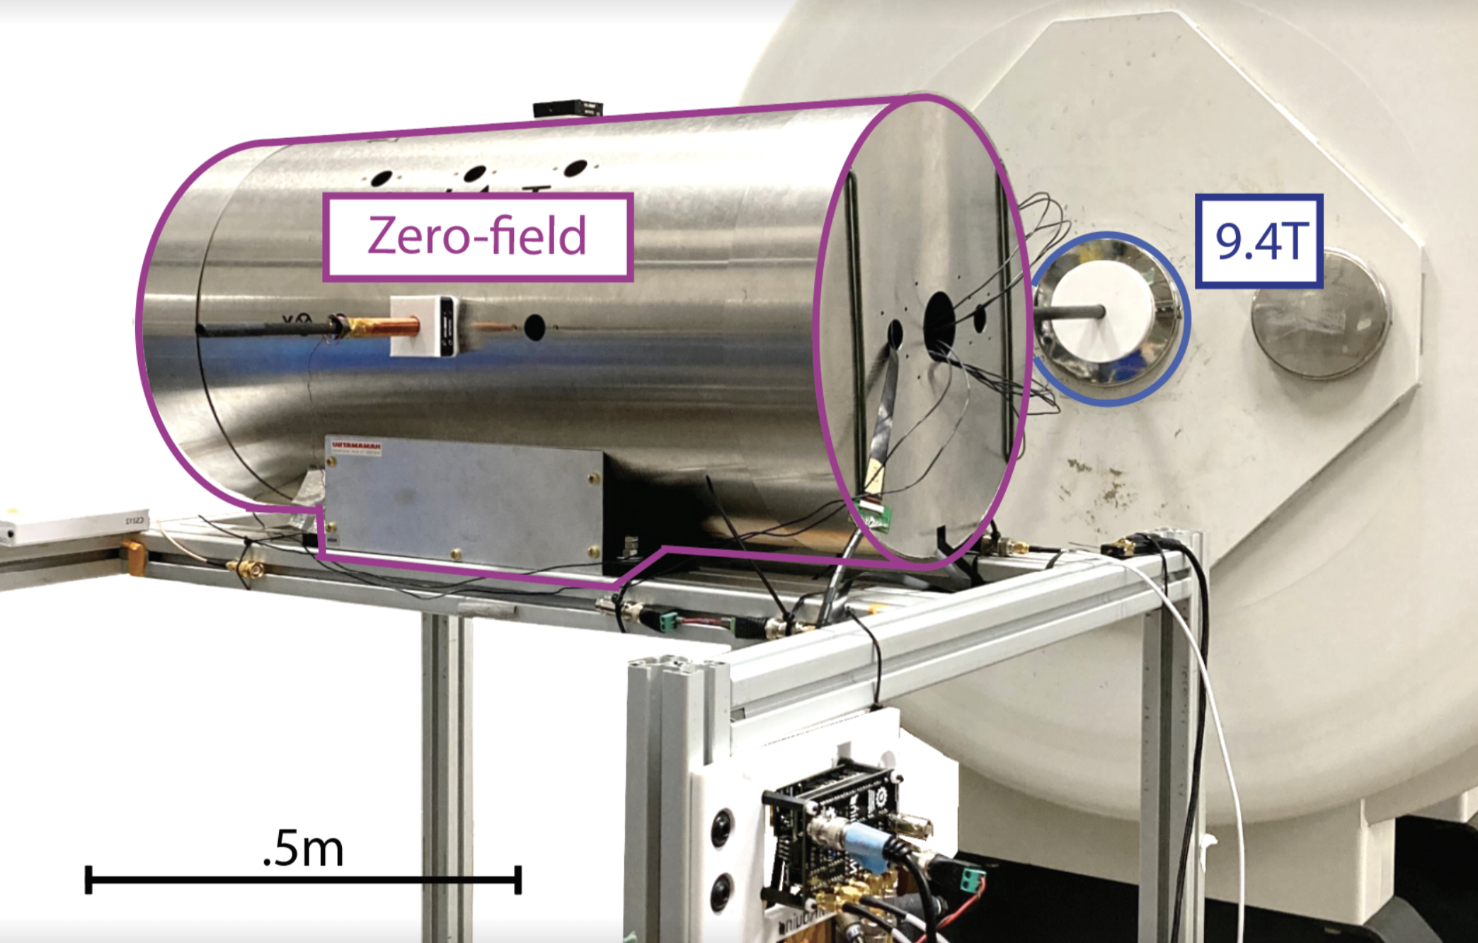
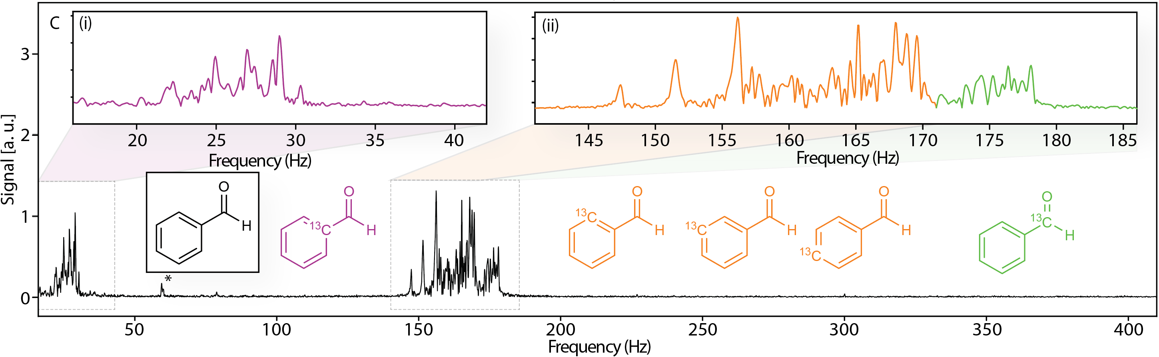
ZF NMR at Berkeley
In the Ajoy Lab, we’ve performed the most sensitive ZF NMR.
- Can collect high resolution spectra with low noise.
- Noise suppression, specialized hardware, and stronger magnets. 270x better!
Blake Andrews, et al., PNAS Nexus, 4, 6, pgaf187 (2025).
Slide 9

Slide 10
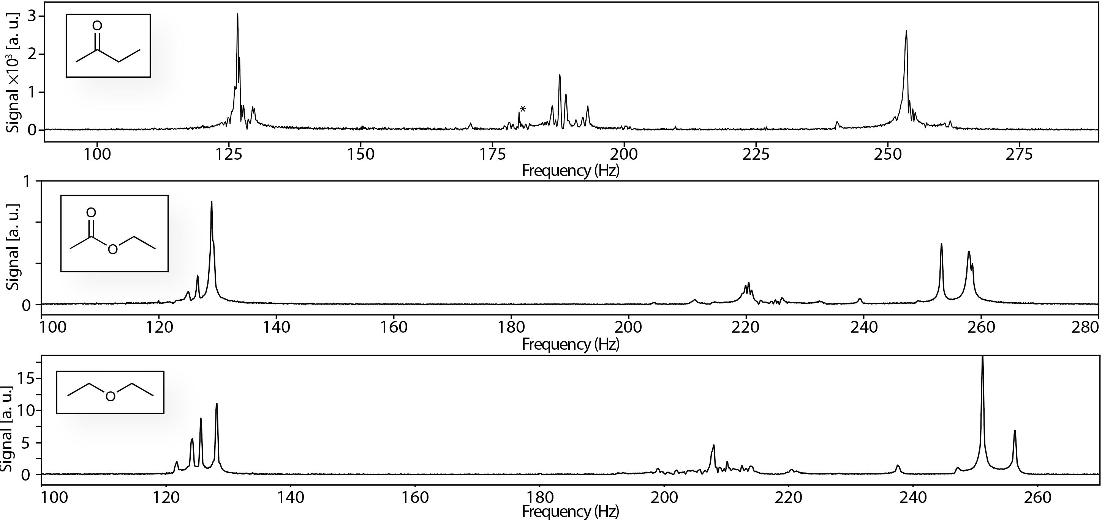
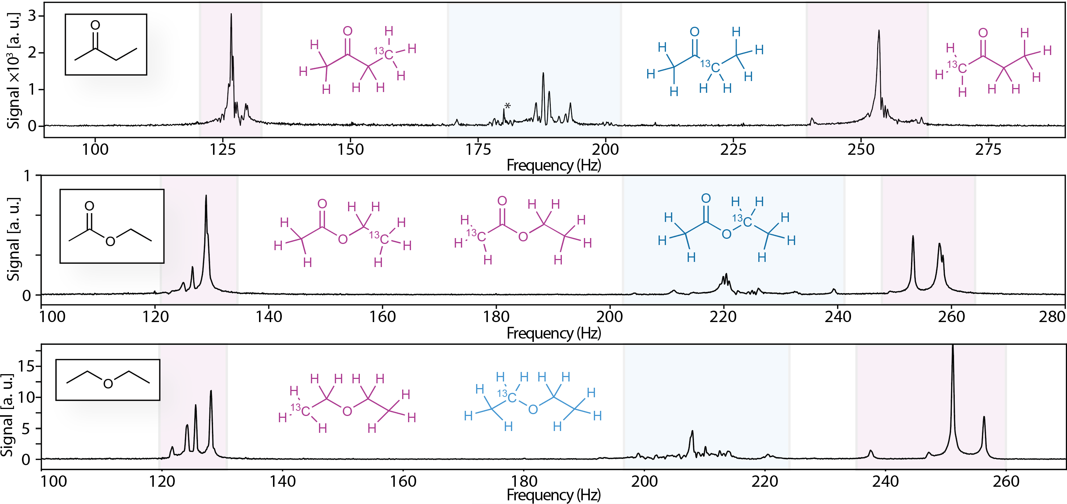
First Natural Abundance Measurement
In nature, NMR active Carbon-13 (ubiquitous in chemistry) is only present in 1.1%.
- Measured for the first time! (Previously reported artificially enriched compounds in 99%.)
- Each carbon produces a unique spectrum. More information
-”Off-the-shelf” chemical samples (>15 and counting!). Real world applications!
crucial for real-world applications.
Blake Andrews, et al., PNAS Nexus, 4, 6, pgaf187 (2025).
Slide 10

Slide 11
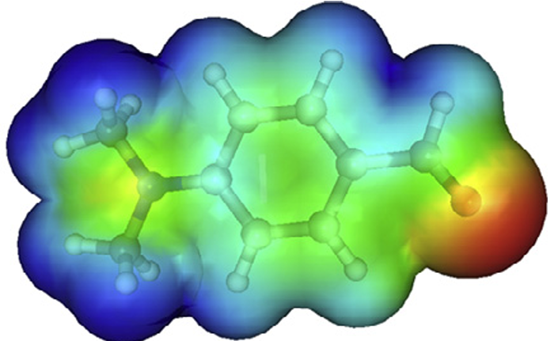
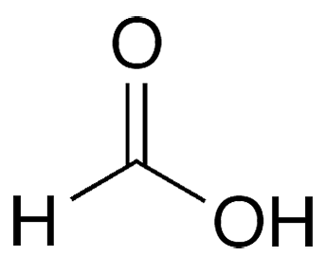
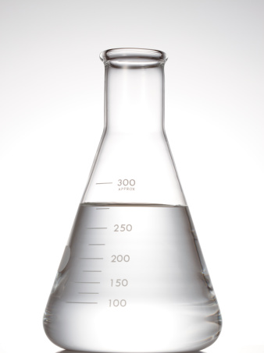
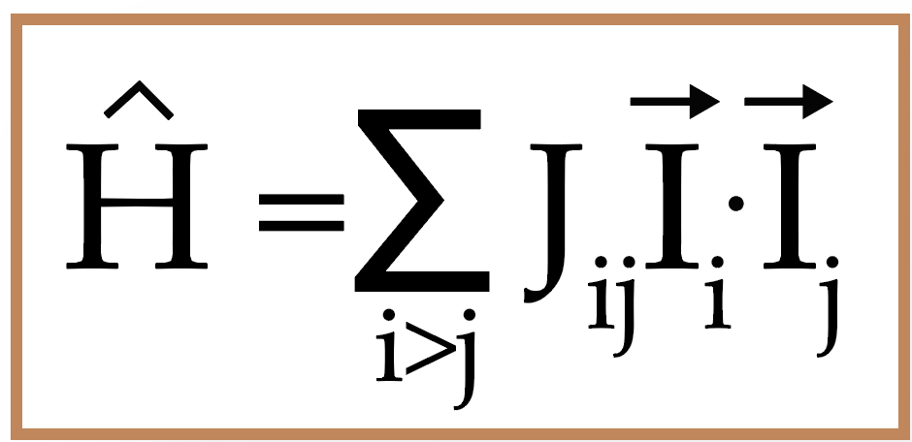
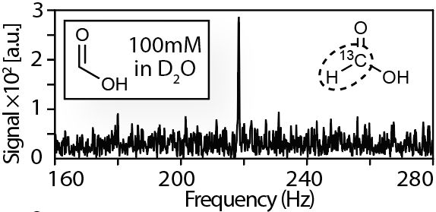
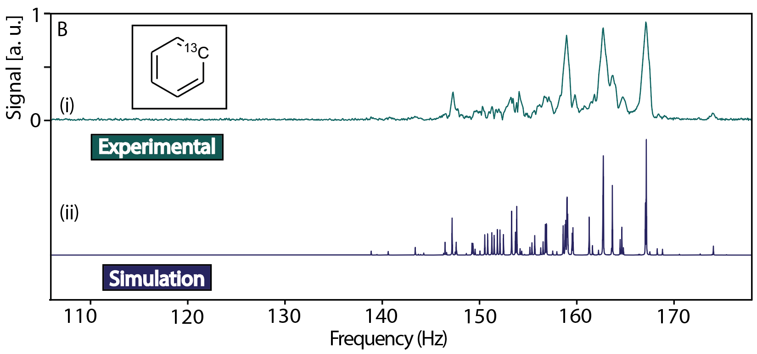
Roadmap
(I) Dilute or rare abundance species
(II) Theoretical Interpretation Tools
(III) Multichannel NMR
Blake Andrews, et al., PNAS Nexus, 4, 6, pgaf187 (2025).
Slide 11

Slide 12
Roadmap
(I) Dilute or rare abundance species
(II) Theoretical Interpretation Tools
(III) Multichannel NMR
Blake Andrews, et al., PNAS Nexus, 4, 6, pgaf187 (2025).
Slide 12

Slide 13
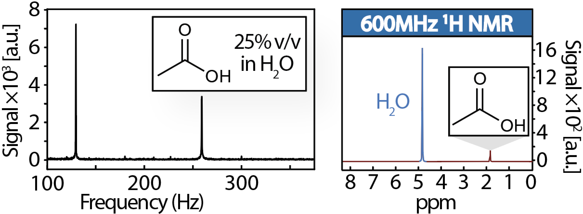
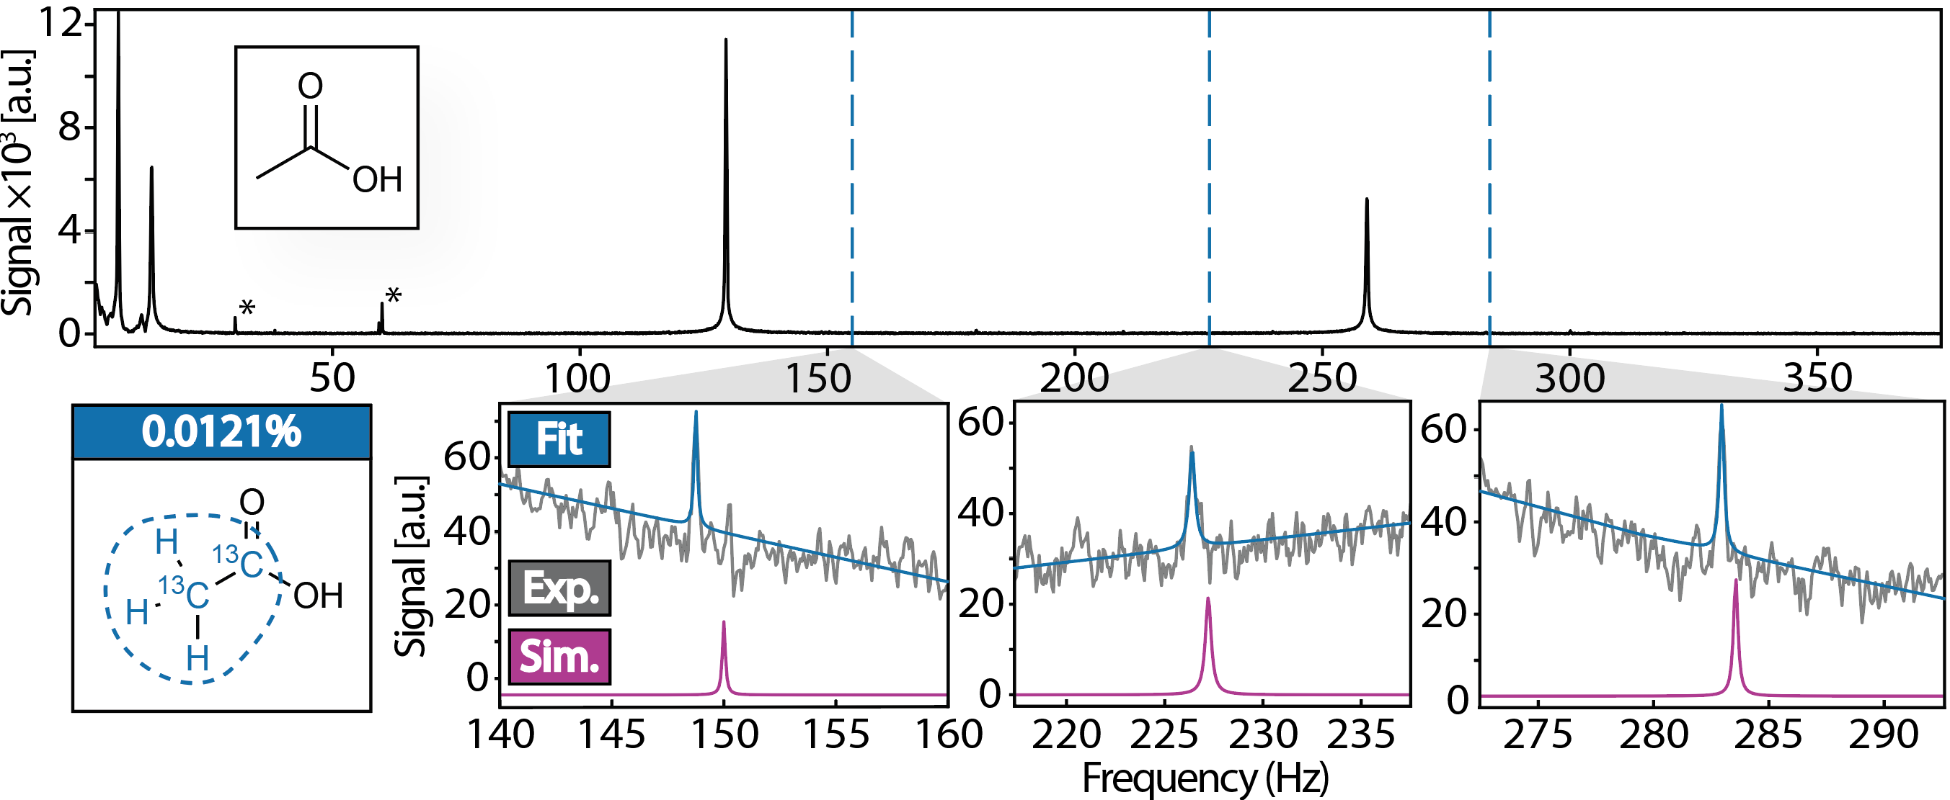

(I) Dilute or Rare Abundance Species
With our apparatus, dilute analytes can be resolved.
-Diluted natural abundance compounds
-No water due to lack of carbon:
profound impact on medical diagnostics
-Rare double isotopic labeling (1% of 1%!).
Slide 13

Slide 14
Roadmap
(I) Dilute or rare abundance species
(II) Theoretical Interpretation Tools
(III) Multichannel NMR
Blake Andrews, et al., PNAS Nexus, 4, 6, pgaf187 (2025).
Slide 14

Slide 15
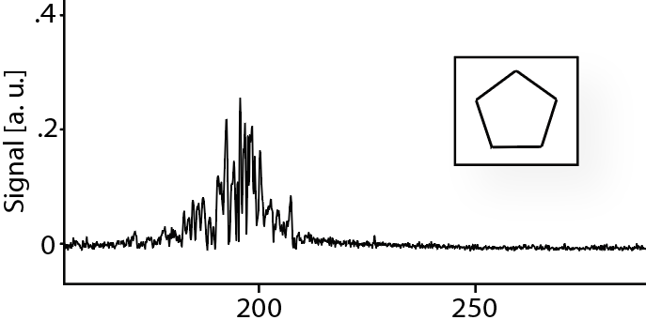
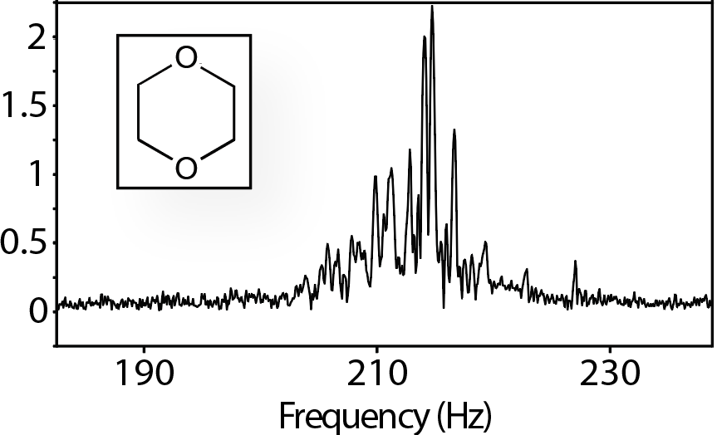
(II) Theoretical Interpretation Tools
Obtaining ZF Spectra is now possible, but what do they mean?
?
Information richness is a challenge!
Simple Hamiltonian with only couplings:
no experimental parameters.
Slide 15

Slide 16

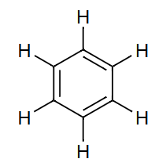
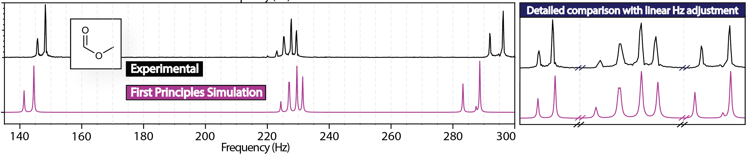
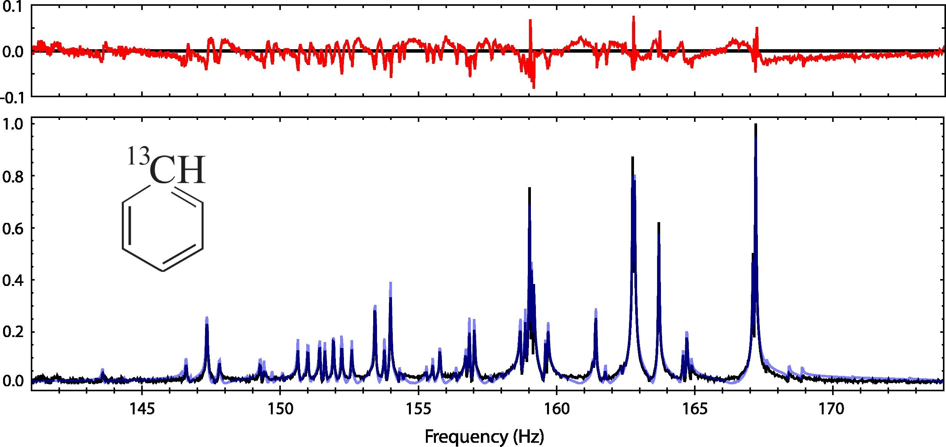
(II) Theoretical Interpretation Tools
Interactions (J_{ij}) can be predicted from first principles.
-Only the molecular structure is assumed, allowing molecular identification.
Xiao Liu
Head-Gordon Group
UC Berkeley
Unprecedented accuracy!
Simulation can be optimized against experimental spectrum
Precise Intramolecular Coupling Values!
Legend: Residuals Experimental Optimized Simulation
A. Wilzewski, S. Afach, J.W. Blanchard, D. Budker. J. Magn. Reson, 284, 66-72 (2017).
Slide 16

Slide 17
Roadmap
(I) Dilute or rare abundance species
(II) Theoretical Interpretation Tools
(III) Multichannel NMR
Blake Andrews, et al., PNAS Nexus, 4, 6, pgaf187 (2025).
Slide 17

Slide 18
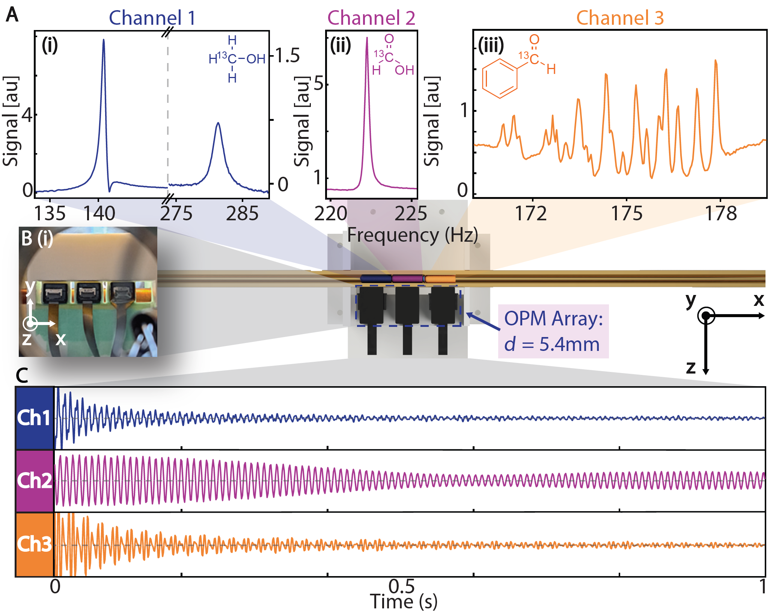
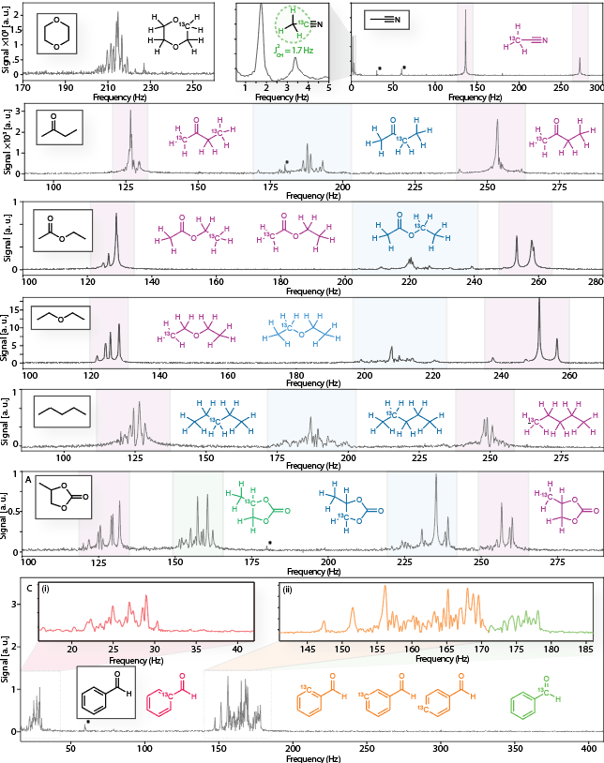
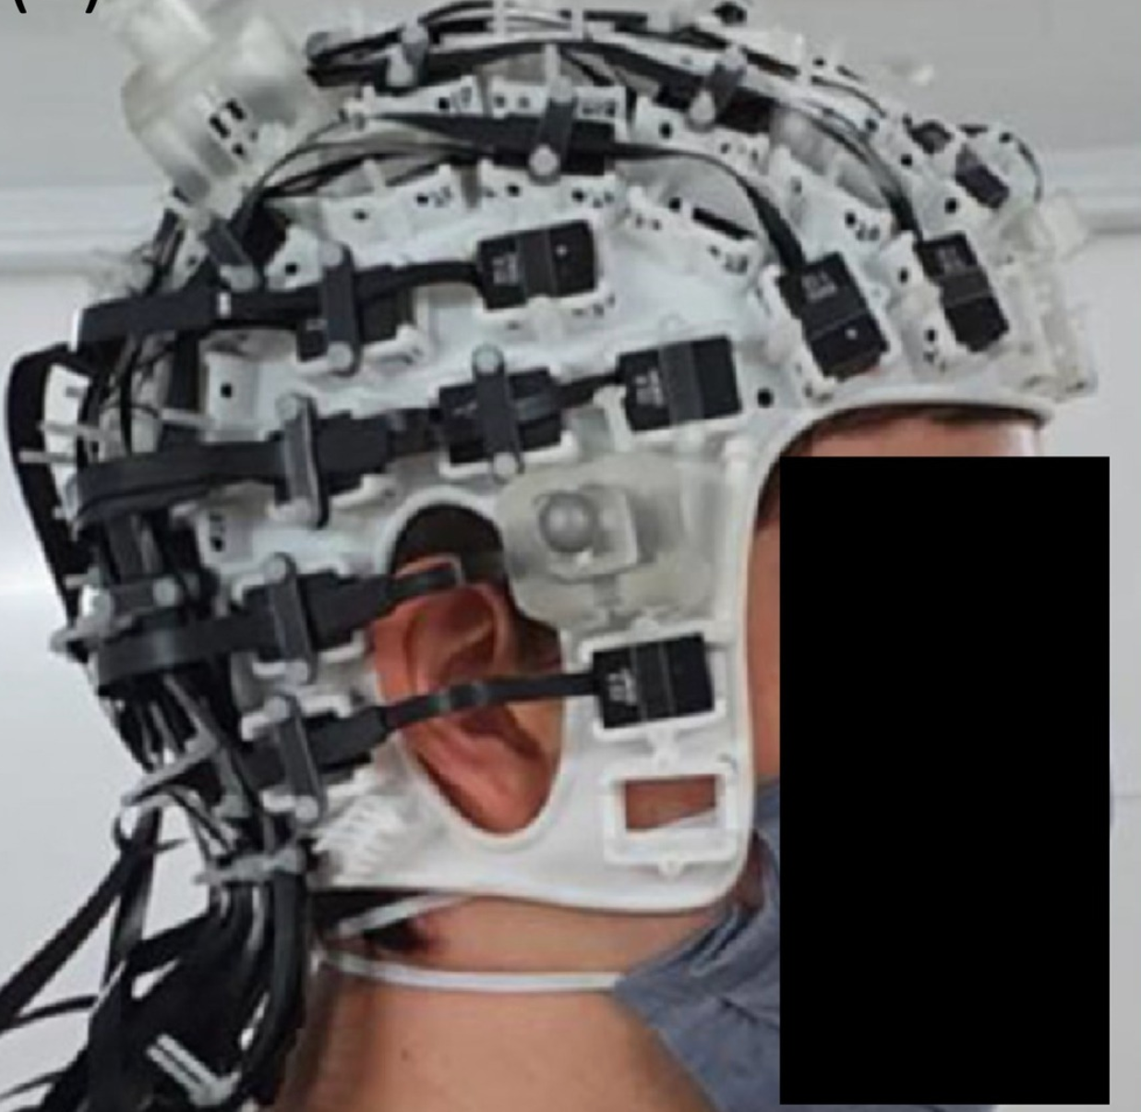
(III) Multichannel NMR
In the Ajoy Lab, we’ve successfully achieved multichannel ZF NMR Detection.
- 3x1 OPM array measure distinct chemicals
Potential for Machine Learning!
-Representative building block of larger array (>100 OPMs)
Multichannel Design draws inspiration from MEG applications.
Inhomogeneous magnet is used.
Cost comparable to conventional NMR
Blake Andrews, et al., PNAS Nexus, 4, 6, pgaf187 (2025).
Slide 18

Slide 19

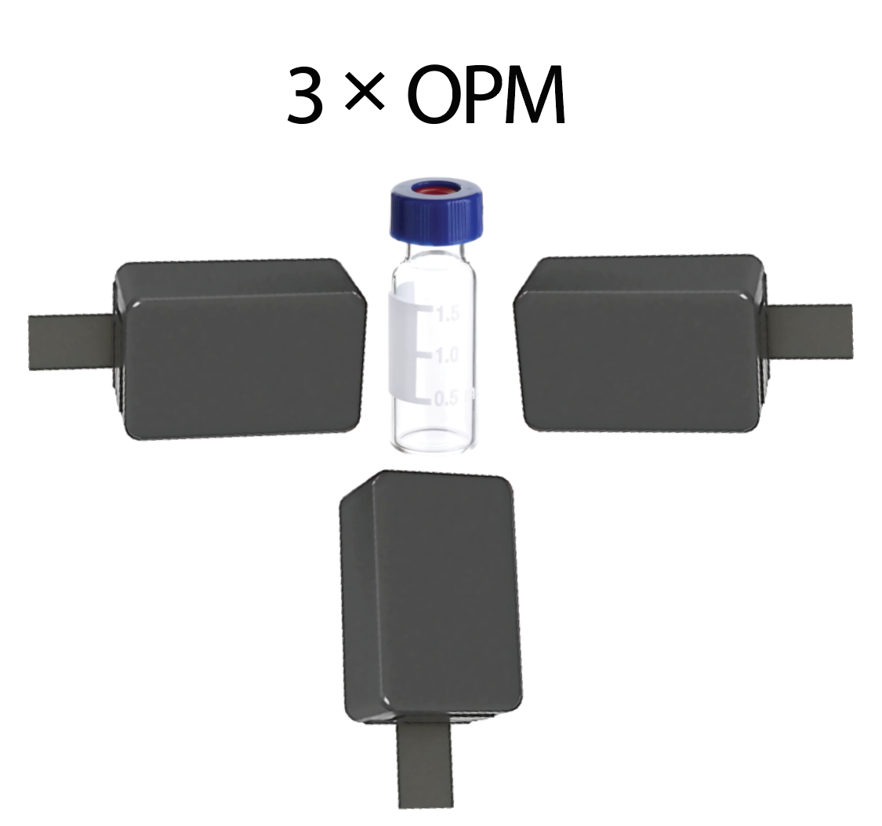
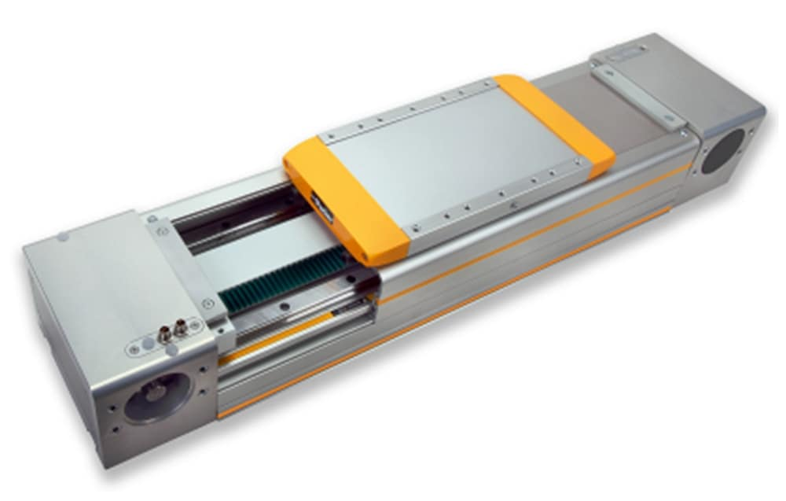
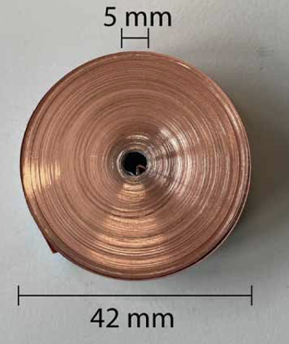
Outlook
There are still many avenues for sensitivity gains to be made.
Potential 22 - 55x sensitivity boost
(~500-3000x boost in measurement time)
Further sensitivity gains by modifying OPM!
Ferrite Core Magnetic shield
4-10x boost
Optimized Signal Capture
1.73x boost
23T watch-sized Magnet
Faster Transport
We believe ZF NMR can make greater strides in the future if chemists and OPM researchers work together.
1.3x boost
2.45x boost
C. Gao, et al., Supercond. Sci. Technol. 37, 065018 (2024).
Slide 19

Slide 20
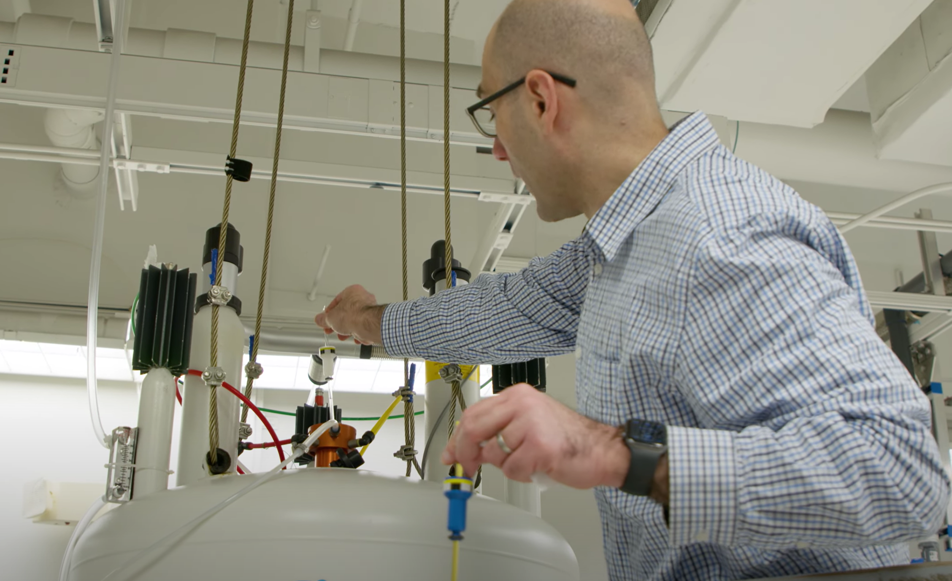
Outlook
OPMs extend the power of NMR to novel regimes.
Sample
Throughput
Hasan Celik, facility manager UC Berkeley, 2024.
Slide 20

Slide 21
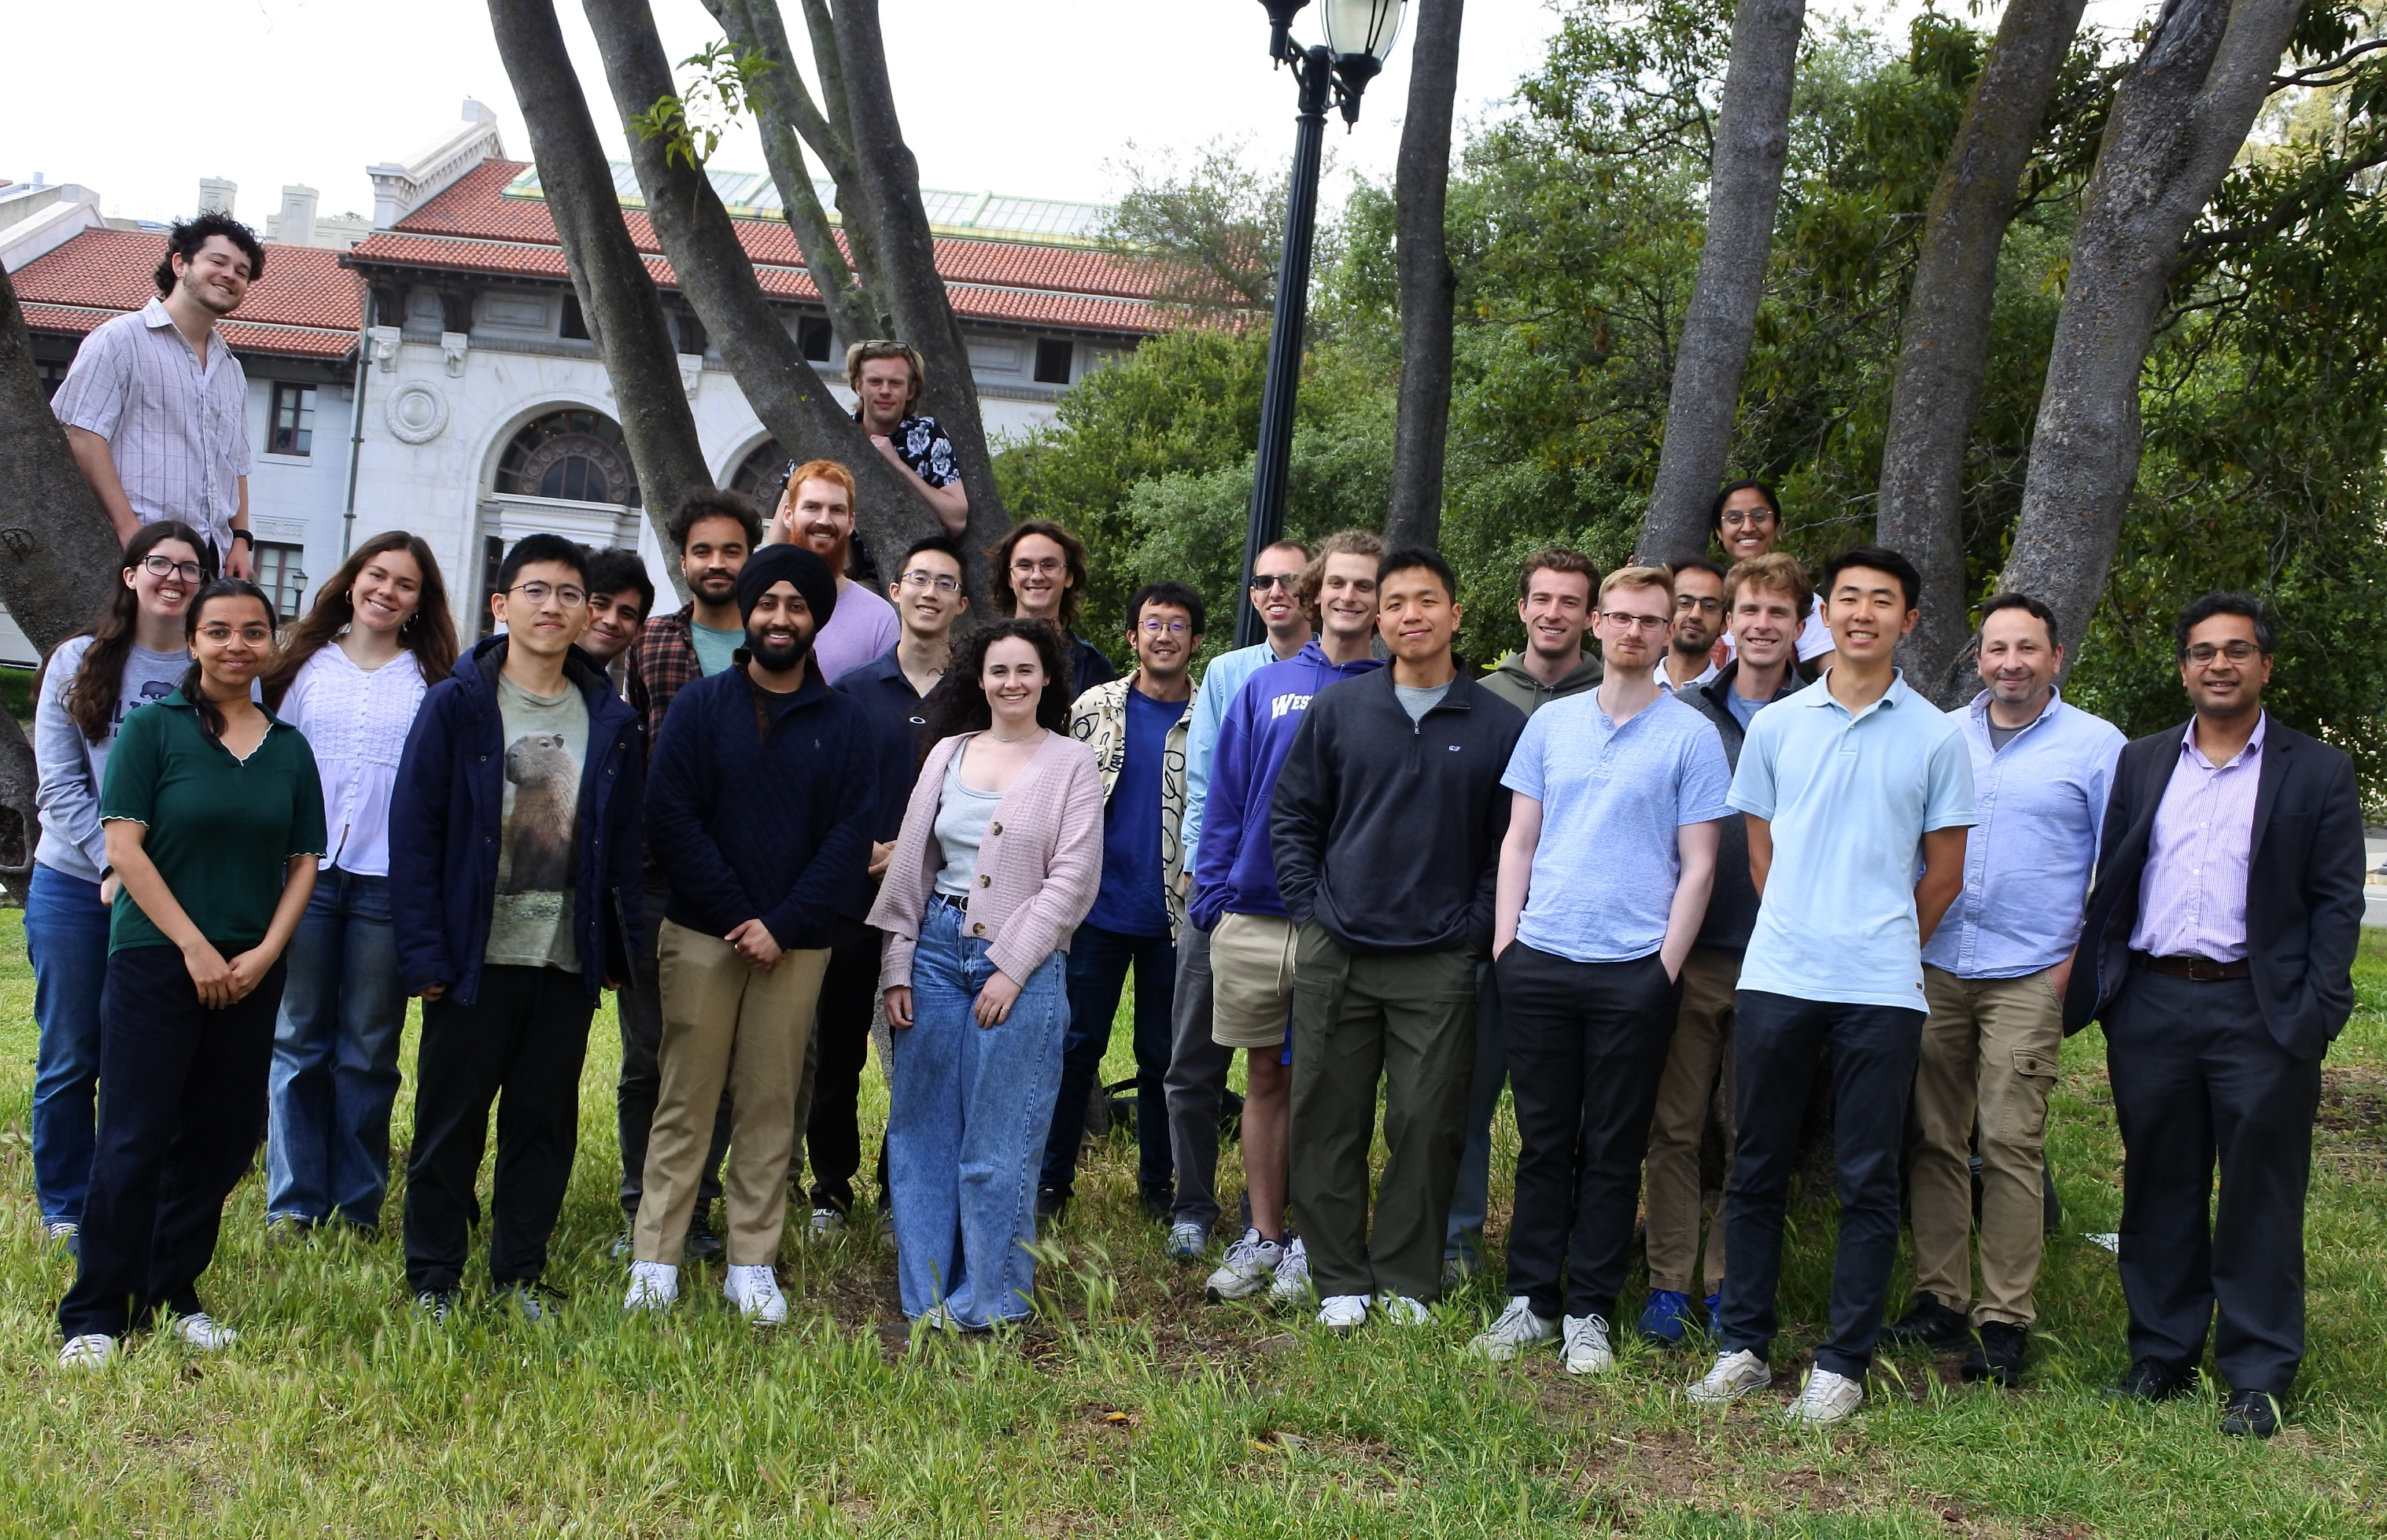






Thank you for listening!
I’m thankful for the work of others on the zero-field NMR project
Matthew Lai – UC Berkeley, Post Baccalaureate
Norihisa Kato – Hamamatsu, Visiting Scholar
Zhen Wang – University of Science and Technology of China, Undergraduate
Raphael Zumbrunn – ETH Zurich, Undergraduate
I also want to thank Michael Tayler at the Institute of Photonic Sciences in Barcelona for letting me use his custom hardware.
Calvin Lee – UC Berkeley,
Undergraduate
Slide 21

Slide 22


Abounding Complexity
Complexity grows rapidly with number of spins.
-Spectrum is sensitive even to smallest coupling!

Slide 23

Crosstalk Characterization
Crosstalk reaches a minimum at 15.4mm separation.

Slide 24

Crosstalk Characterization
Natural Abundance Library

