Slide 1

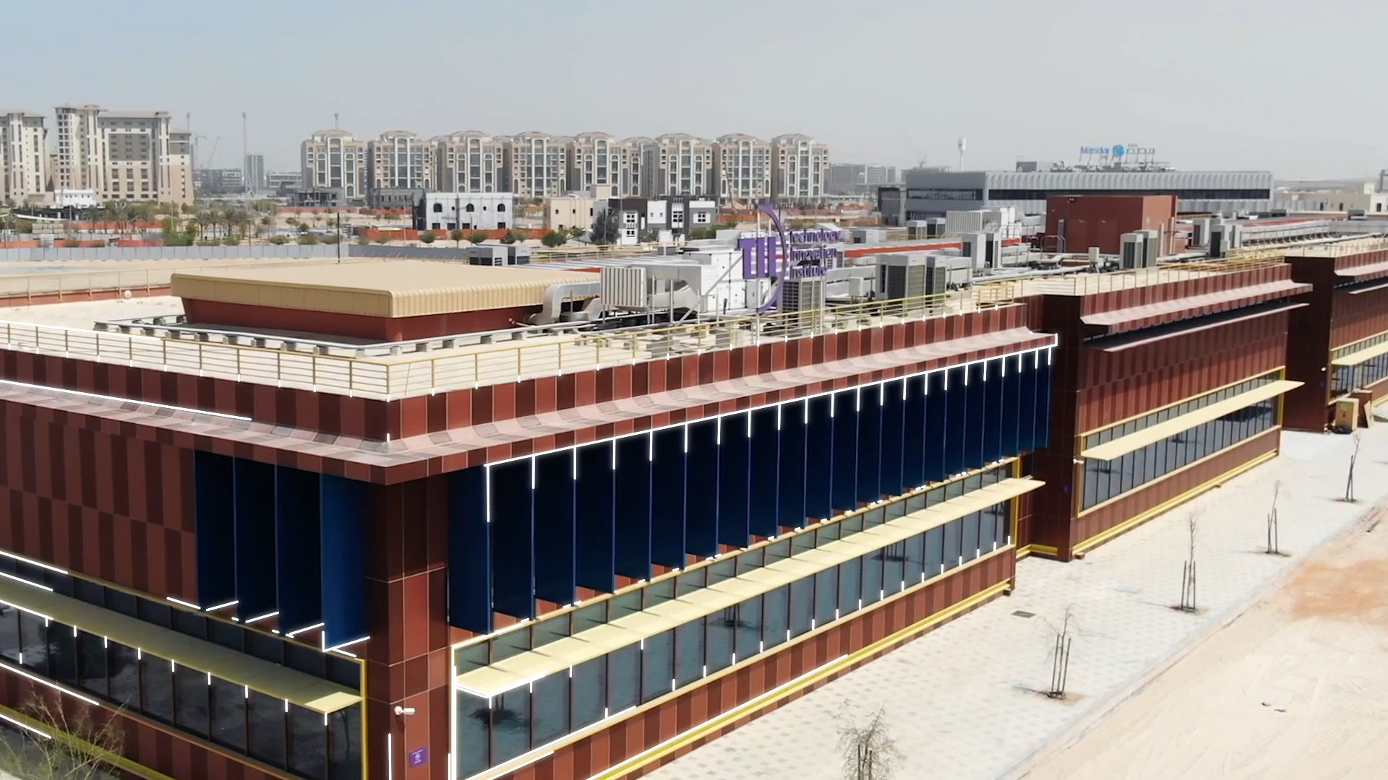


Towards Optimal Atomic Magnetometry for Practical Applications: Examining Scheme, Laser Source, and Vapor Cell Interplay
Workshop on optically-pumped magnetometers 2025
8th of August 2025
Rafael Rothganger de Paiva – Lead Researcher
Quantum Sensing – QRC
rafael.rothganger@tii.ae

Slide 2

Technology Innovation Institute (TII) - Overview
Established in 2020, TII is a government-funded research center under Abu Dhabi’s Advanced Technology Research Council (ATRC). It focuses on applied R&D.
Goals:
  Create a dynamic R&D ecosystem.
  Position Abu Dhabi as a world-leading R&D hub.
  Contribute to Abu Dhabi’s knowledge economy
  Develop local and global partnerships
Key Achievements:
  Developed the Falcon series of open-source AI models.
  Launched the Abu Dhabi Quantum Optical Ground Station
Research areas:
  Advanced Materials
  AI & Digital Science
  Autonomous Robotics
  Cryptography
  Directed Energy
  Propulsion & Space
  Quantum
    Sensing
    Communications
    Physics
    Computing
    Middleware
    Algorithms
  Renewable & Sustainable Energy
  Secure Systems
2

Slide 3
From Lab to Real World Application
Transitioning laboratory-developed setups to real-world applications involves overcoming several critical challenges:
System Complexity and User Friendliness: Laboratory setups are typically operated by highly trained researchers familiar with complex experimental parameters.
3

Slide 4
From Lab to Real World Application
Transitioning laboratory-developed setups to real-world applications involves overcoming several critical challenges:
System Complexity and User Friendliness: Laboratory setups are typically operated by highly trained researchers familiar with complex experimental parameters.
Cost and Scalability: High-precision components used in labs are expensive and may not scale well for mass production.
.
4

Slide 5
From Lab to Real World Application
Transitioning laboratory-developed setups to real-world applications involves overcoming several critical challenges:
System Complexity and User Friendliness: Laboratory setups are typically operated by highly trained researchers familiar with complex experimental parameters.
Cost and Scalability: High-precision components used in labs are expensive and may not scale well for mass production.
Performance Trade-offs: Laboratory experiments maximize certain metrics which may not align with real-world application needs such as higher bandwidth, dynamic range, or operational flexibility.
5

Slide 6
From Lab to Real World Application
Transitioning laboratory-developed setups to real-world applications involves overcoming several critical challenges:
System Complexity and User Friendliness: Laboratory setups are typically operated by highly trained researchers familiar with complex experimental parameters.
Cost and Scalability: High-precision components used in labs are expensive and may not scale well for mass production.
Performance Trade-offs: Laboratory experiments maximize certain metrics which may not align with real-world application needs such as higher bandwidth, dynamic range, or operational flexibility.
Complexity
Sensitivity⁻¹
6

Slide 7
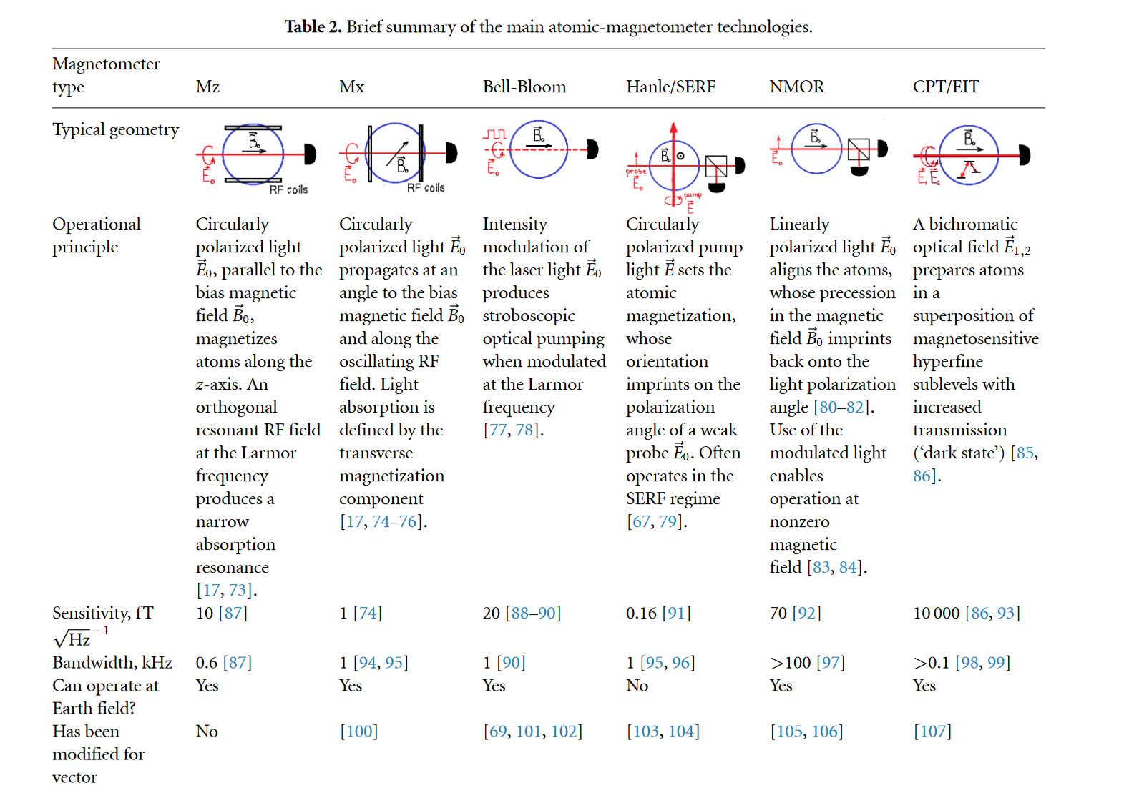
Challenges in Comparing OPM Schemes
DOI:10.1088/1367-2630/acb840
7

Slide 8

Challenges in Comparing OPM Schemes
DOI:10.1088/1367-2630/acb840
8

Slide 9
Challenges in Comparing OPM Schemes
Accurate comparison across published results is difficult due to variations in system-specific parameters:
  Laser frequency and linewidth
  Relative intensity noise (RIN)
  Vapor cell type and preparation
  Cell heating methods
  Magnetic shielding environment
  Data acquisition and analysis routines
  Electronic noise and signal conditioning
DOI:10.1088/1367-2630/acb840
9

Slide 10
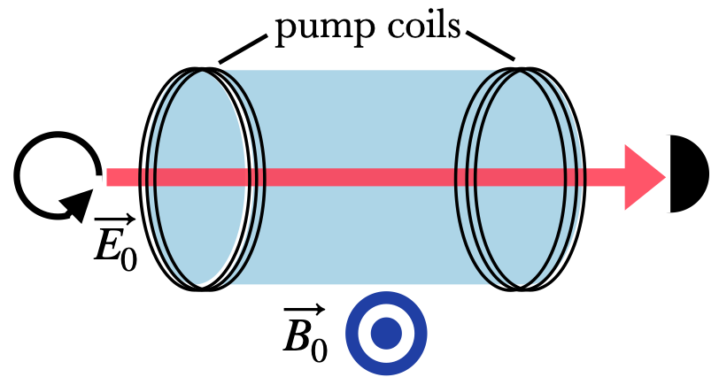
OPM Schemes
FID
Free-Induction-Decay
  1 laser beam
  Circular polarization
  1 Detector
Simplest scheme for integration.
Complexity
10

Slide 11
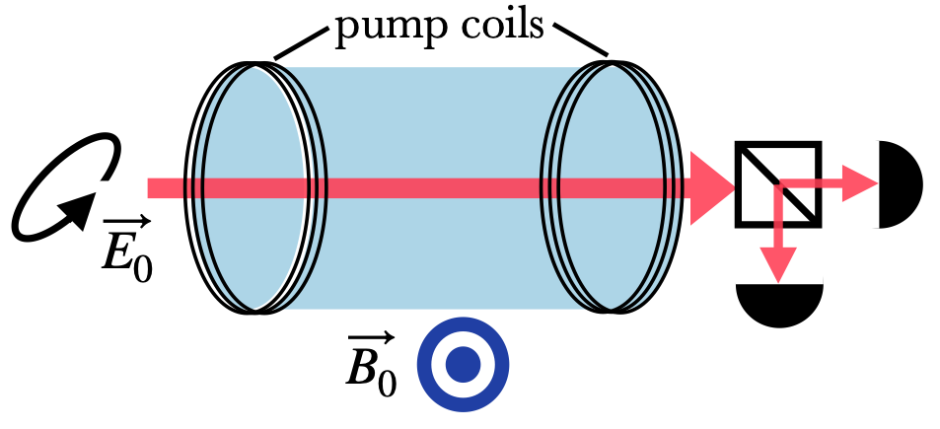
OPM Schemes
FID
FR
Free-Induction-Decay
  1 laser beam
  Circular polarization
  1 Detector
Simplest scheme for integration.
Faraday Rotation
  1 laser beam
  Elliptical polarization
  2 Detector
Balance detection increases SNR
Complexity
11

Slide 12
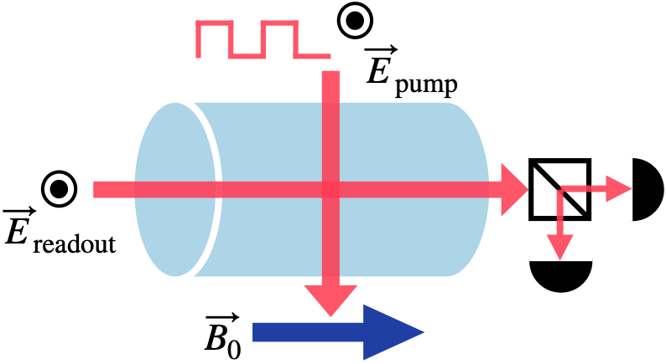
OPM Schemes
FID
FR
Bell-Bloom
Free-Induction-Decay
  1 laser beam
  Circular polarization
  1 Detector
Simplest scheme for integration.
Faraday Rotation
  1 laser beam
  Elliptical polarization
  2 Detector
Balance detection increases SNR
Amplitude Modulated Bell-Bloom
  2 laser beam
  Amplitude modulation
  2 Detector
Magnetic silent
Complexity
12

Slide 13
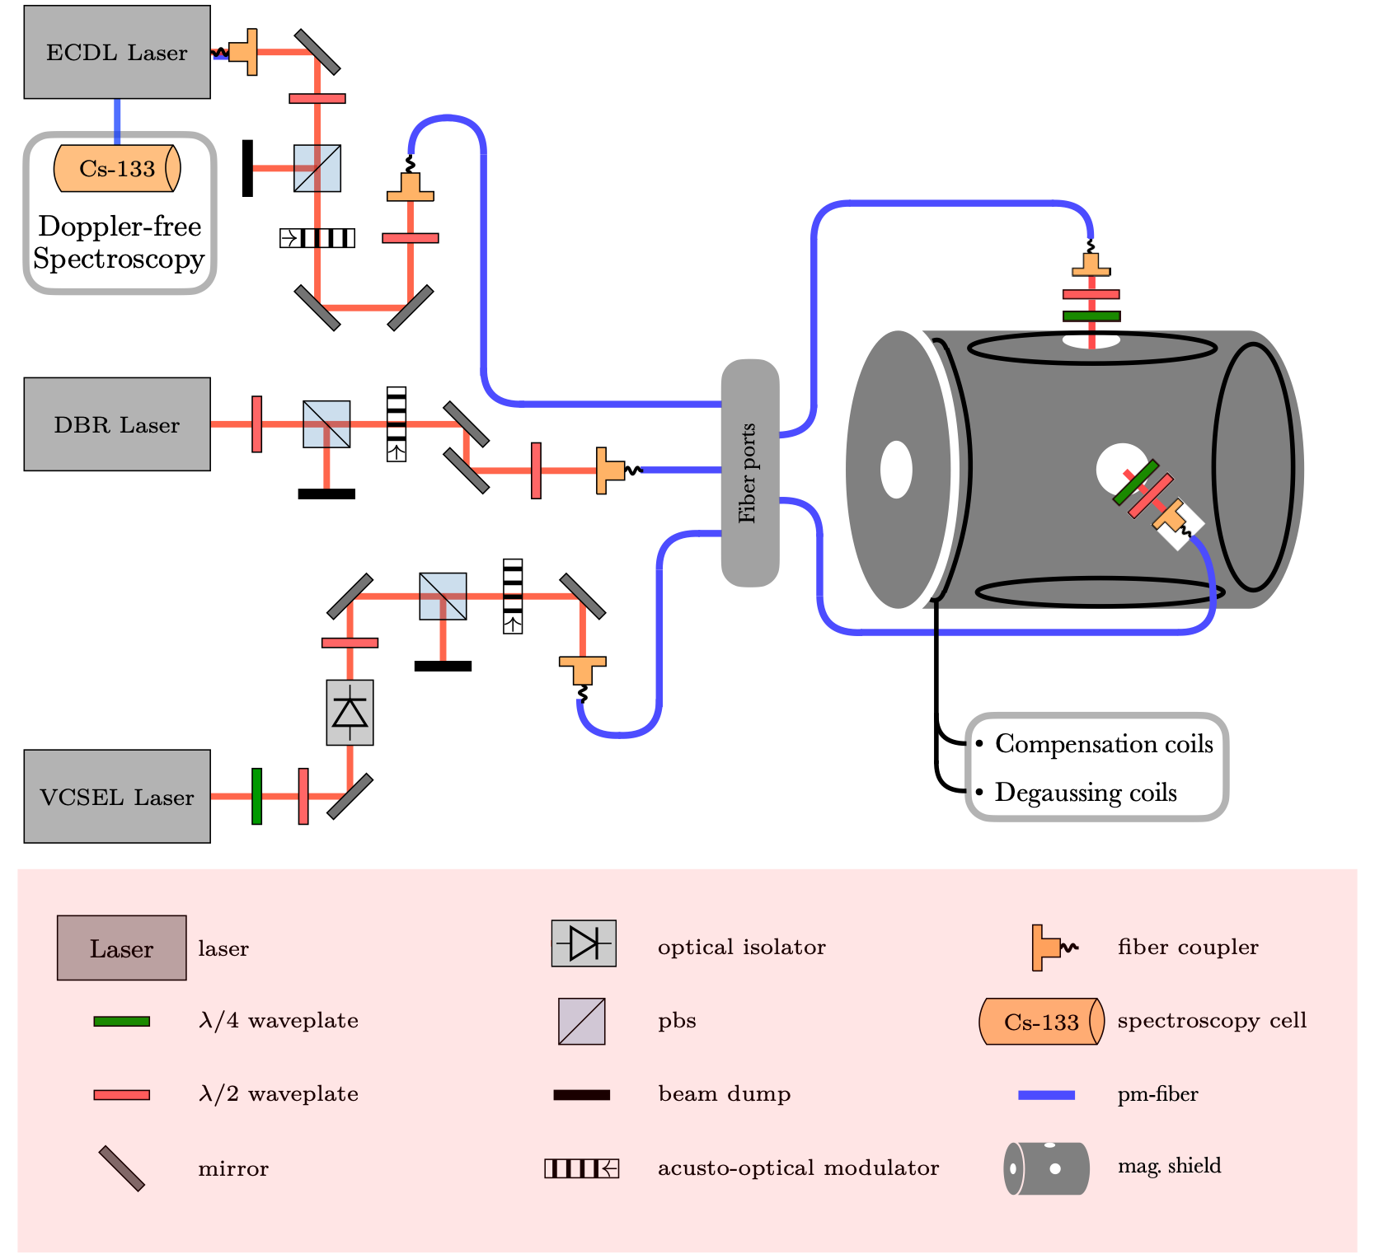
Test Bed Description
13

Slide 14
Test Bed Description
3 Laser systems, amp. modulated via AOM’s
4 Layer mu-metal shield
  30fT/√Hz noise floor (DC - 100 Hz), < 1 nT DC field
Active field compensation and degaussing
Cs-133, multiple cell types (ARC and buffer gases)
Fully controllable via ARTIQ
14

Slide 15
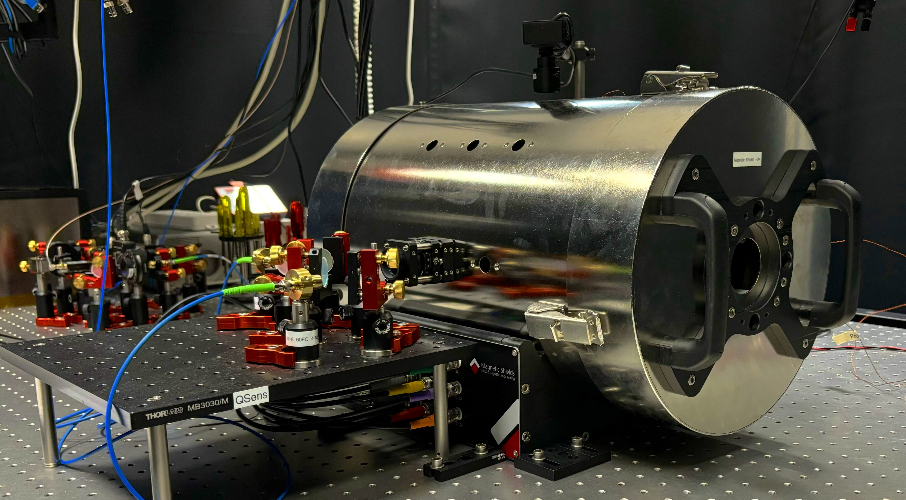
Test Bed Description
3 Laser systems, amp. modulated via AOM’s
4 Layer mu-metal shield
  30fT/√Hz noise floor (DC - 100 Hz), < 1 nT DC field
Active field compensation and degaussing
Cs-133, multiple cell types (ARC and buffer gases)
Fully controllable via ARTIQ
15

Slide 16
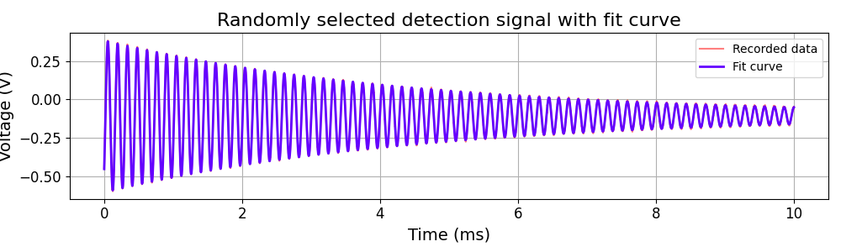
Data acquisition and analysis
$$A(t)=A_{0}+A_{1}e^{−γ_{1}t}+A_{2}e^{−γ_{2}t}sin(ω_{L}t+φ)$$
16
Notes:
OPM/measurements/Sensitivity/2024-11-28/12-02-38/Analysed_data.hdf5

Slide 17
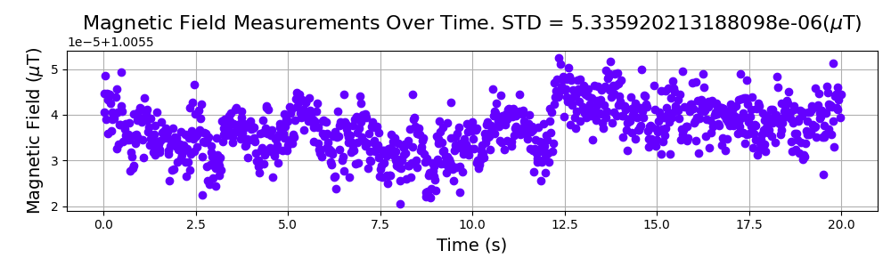
Data acquisition and analysis
$$A(t)=A_{0}+A_{1}e^{−γ_{1}t}+A_{2}e^{−γ_{2}t}sin(ω_{L}t+φ)$$
17
Notes:
OPM/measurements/Sensitivity/2024-11-28/12-02-38/Analysed_data.hdf5

Slide 18
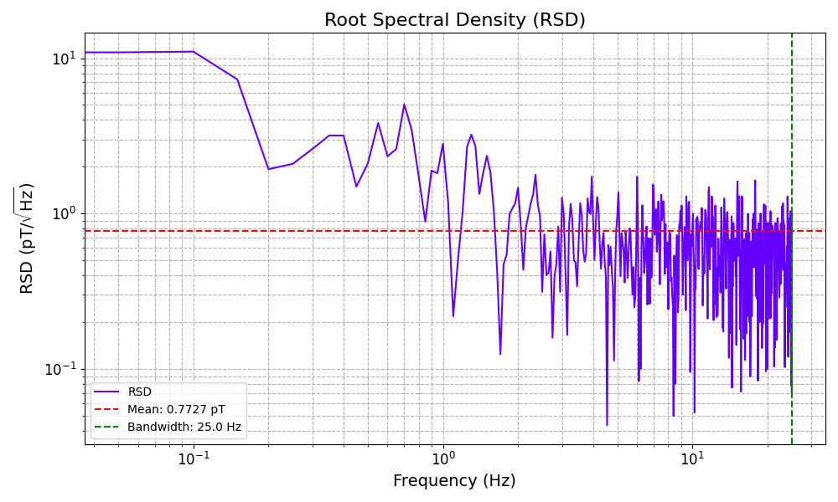

Data acquisition and analysis
$$A(t)=A_{0}+A_{1}e^{−γ_{1}t}+A_{2}e^{−γ_{2}t}sin(ω_{L}t+φ)$$
$$∫_{0}^{BW}RSDd\sqrt{f}=σ_{B}$$
18
Notes:
OPM/measurements/Sensitivity/2024-11-28/12-02-38/Analysed_data.hdf5

Slide 19
Data acquisition and analysis
$$A(t)=A_{0}+A_{1}e^{−γ_{1}t}+A_{2}e^{−γ_{2}t}sin(ω_{L}t+φ)$$
 | FID | FR | Bell-Bloom
Field | 1µT | 1µT | 1µT
Laser | VCSEL | DBR | ECDL, DBR
Sensitivity | 25 pT/√Hz | 1 pT/√Hz | 500 fT/ √Hz
Bandwidth | 125 Hz | 25 Hz | < 25 Hz
$$∫_{0}^{BW}RSDd\sqrt{f}=σ_{B}$$
19
Notes:
OPM/measurements/Sensitivity/2024-11-28/12-02-38/Analysed_data.hdf5

Slide 20

Scheme Comparison
 | FID |  | FR |  | Bell-Bloom
Field | 100 nT | 10 µT | 50 nT | 100 µT | 50 nT | 25 µT
Cell / Laser | Paraffin / VCSEL | Paraffin / VCSEL | Paraffin / DBR | Paraffin / DBR | Paraffin / all | Paraffin / all
Sensitivity | 15 pT/√Hz | 90 pT/√Hz | 2 pT/√Hz | 70 pT/√Hz | 500 fT/ √Hz | 60 pT/√Hz
Bandwidth | 15 Hz | 250 Hz | 10 Hz | 1000 Hz | 10 Hz | 1000 Hz
Notes | Limited SNR, electronic processing more elaborate |  | Long atomic coherence time, high SNR |  | pumping dependent on B-field, limited dyn. Range
20
Notes:
C. Troullinou, Phys. Rev. Lett. 131, 133602 (2023

Slide 21
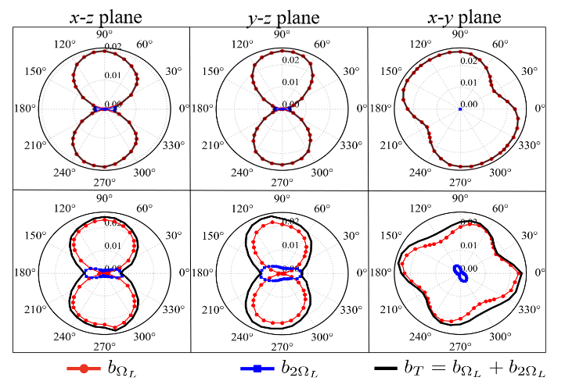
Dead Zone Free Scheme
The schemes I presented suffers from a dead zone when the sensor pumping axis is aligned with the measurement magnetic field
One Solution: Excite a mixture of linear and circular polarizations amplitude modulated with 𝜔_{𝐿} and 2 𝜔_{𝐿} can generate a magnetic resonance signal at 𝜔_{𝐿} for the external magnetic field perpendicular to the light propagation direction, and 2 𝜔_{𝐿} when the external magnetic field is parallel to the direction of light propagation
https://doi.org/10.1063/5.0248330
21
Notes:
C. Troullinou, Phys. Rev. Lett. 131, 133602 (2023

Slide 22
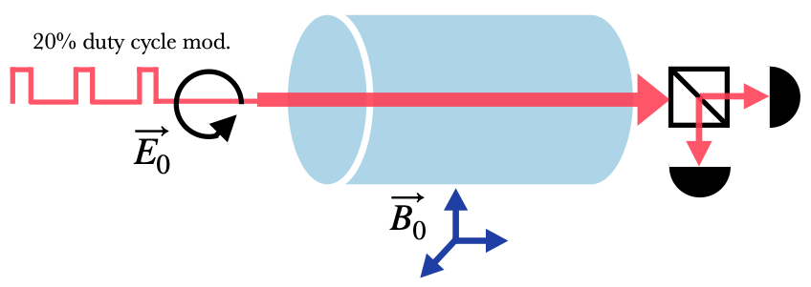
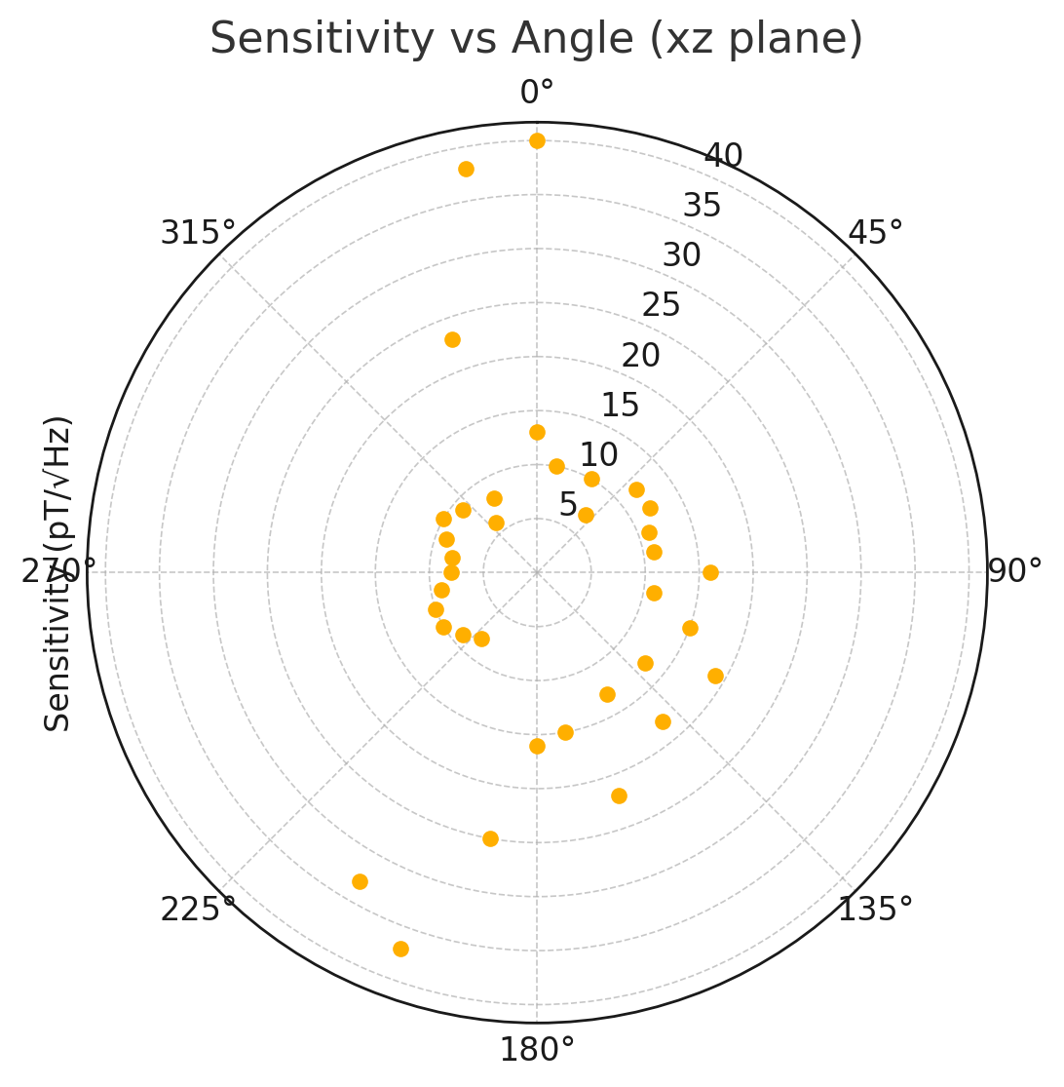
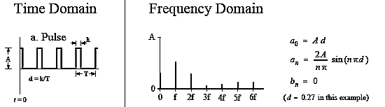
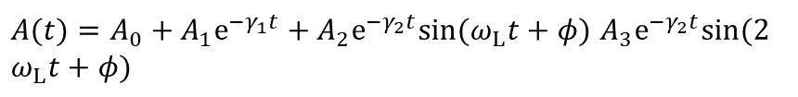
Dead Zone Free Scheme
$A(t)=A_{0}+A_{1}e^{−γ_{1}t}+A_{2}e^{−γ_{2}t}sin(ω_{L}t+φ)$ $A_{3}e^{−γ_{2}t}sin(2ω_{L}t+φ)$
22
Notes:
C. Troullinou, Phys. Rev. Lett. 131, 133602 (2023

Slide 23
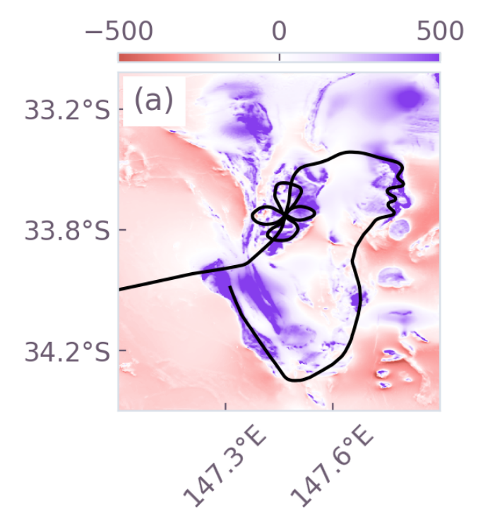
Practical Application: GNSS-free Navigation
Navigation without Satellite position: Use Earth’s magnetic field as a natural map. The Earth’s crust has subtle magnetic anomalies (variations) unique to locations
Magnetic fingerprinting: A vehicle with a sensitive magnetometer can measure the local magnetic field and compare it to a pre-recorded magnetic anomaly map to determine its location (like matching a fingerprint)
Use cases: Critical for GPS-denied environments – e.g. submarines (underwater, no GPS), aircraft in polar regions or in combat zones with GPS jamming, underground navigation
https://arxiv.org/pdf/2504.08167
23

Slide 24
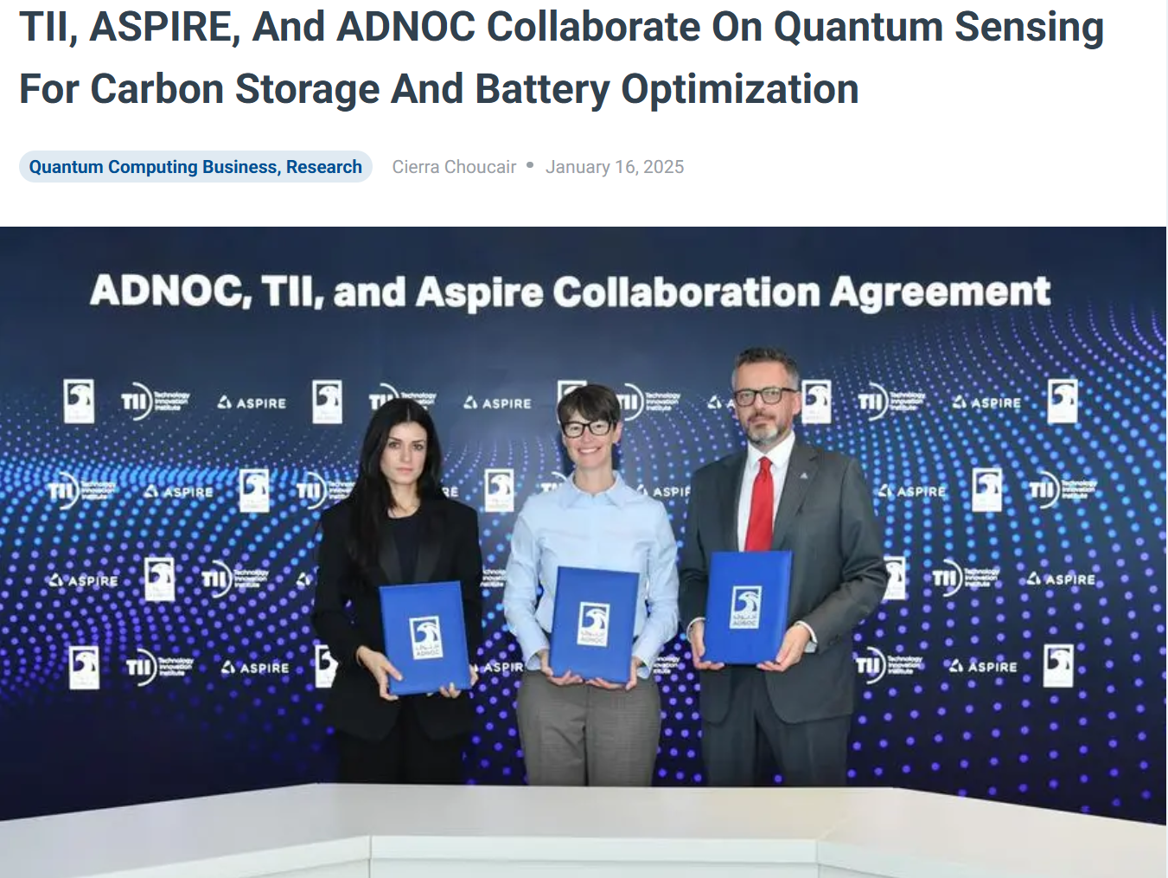
Collaboration with ADNOC
24

Slide 25

Practical Application: Monitoring Carbon Capture & Storage
25

Slide 26
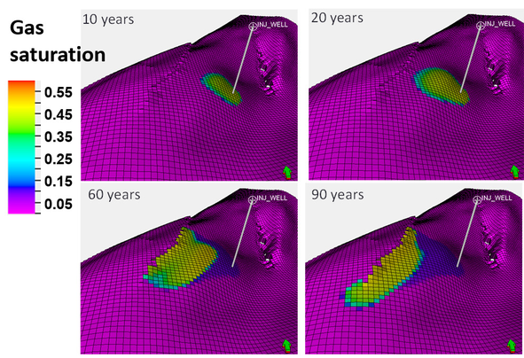
Practical Application: Monitoring Carbon Capture & Storage
DOI:10.1016/j.egypro.2014.11.505
26

Slide 27
Practical Application: Monitoring Carbon Capture & Storage
Magnetometers in action: Ultra-sensitive mags (like SQUIDs and OPMs) have been tested for CCS monitoring.
Advantage of OPM: Room-temperature quantum sensors could be deployed on drones or networks around a site for continuously monitoring.
Impact: Adds an extra layer of safety for CCS projects – early anomaly detection can prompt intervention, building confidence in carbon sequestration as a climate solution
DOI:10.1016/j.egypro.2014.11.505
27

Slide 28
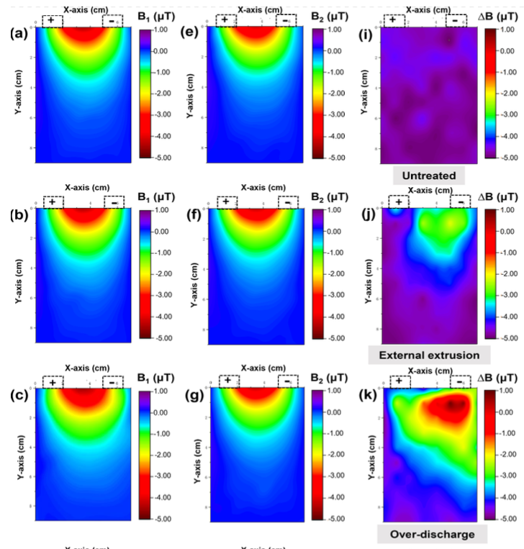
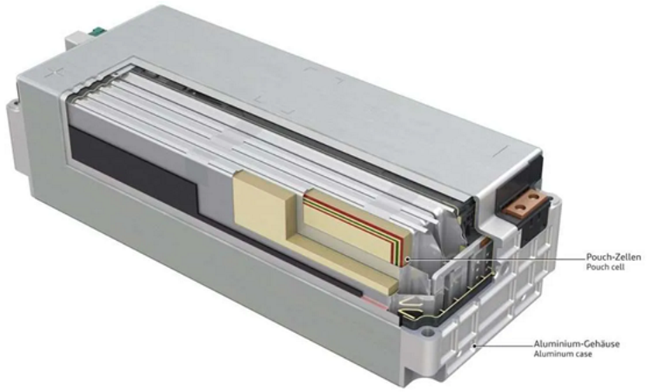
Battery State-of-Charge and Health Diagnostics
Practical Application: Battery State-of-Charge and Health Diagnostics
Need for battery diagnostics: Lithium-ion batteries (EVs, grid storage) require monitoring of state-of-charge (SoC) and state-of-health (SoH). Internal issues (degradation, shorts) are hard to detect without disassembly
State-of-charge mapping: A fully charged cell vs a discharged cell produces different magnetic signatures. Researchers demonstrated that by analyzing the external magnetic field, they could determine the battery’s SoC and even identify damaged sections​
28

Slide 29
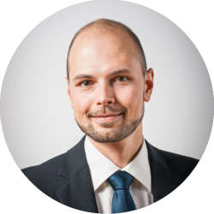
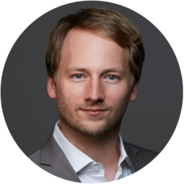
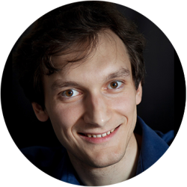
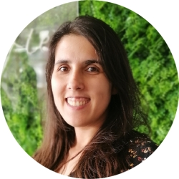
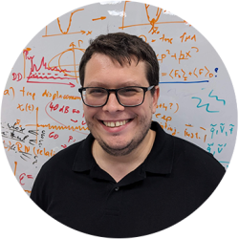


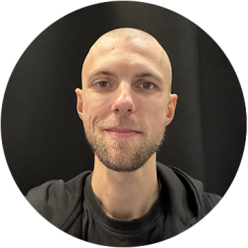

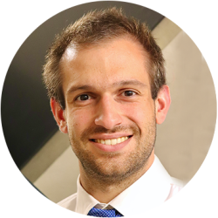
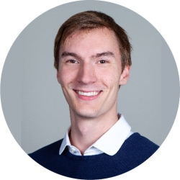
QSens team
Rene Reimann
Senior Director
Karsten Pyka
Lead Technology Development
Konstantin Katamadze
Lead Researcher
Raquel Flores
Senior Researcher
Stephen Vintskevich
Senior Researcher
Tiantian Zhang
Senior Researcher
Tingpeng Luo
Senior Researcher
Dmitrii Grigorev
Associate Software Engineer
Hitheswar Prasad
Associate Researcher
Marco Decker
Associate Researcher
Philip Verwegen
Associate Researcher
rafael.rothganger@tii.ae
29

