Slide 1
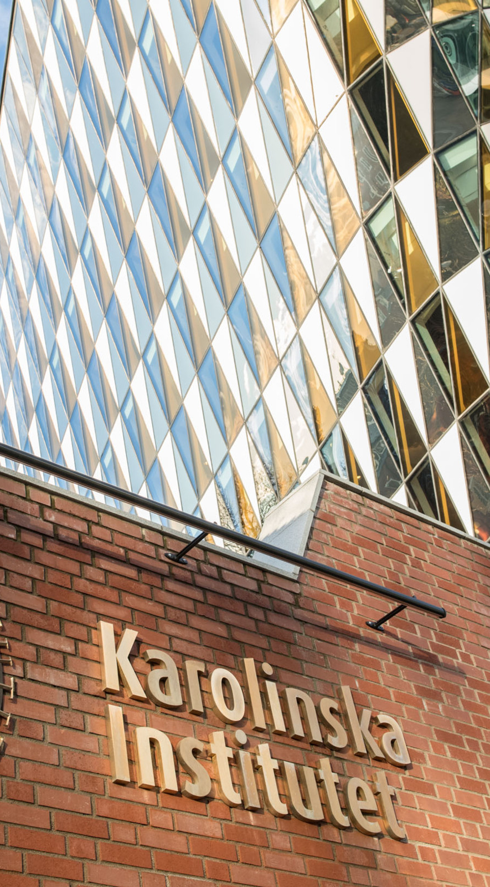
Evaluating interference suppression algorithms for OPM-MEG
Christoph Pfeiffer
Assistant Professor and Head of the
Swedish National Facility for MEG (NatMEG)
Deptartment of Clinical Neuroscience

Slide 2
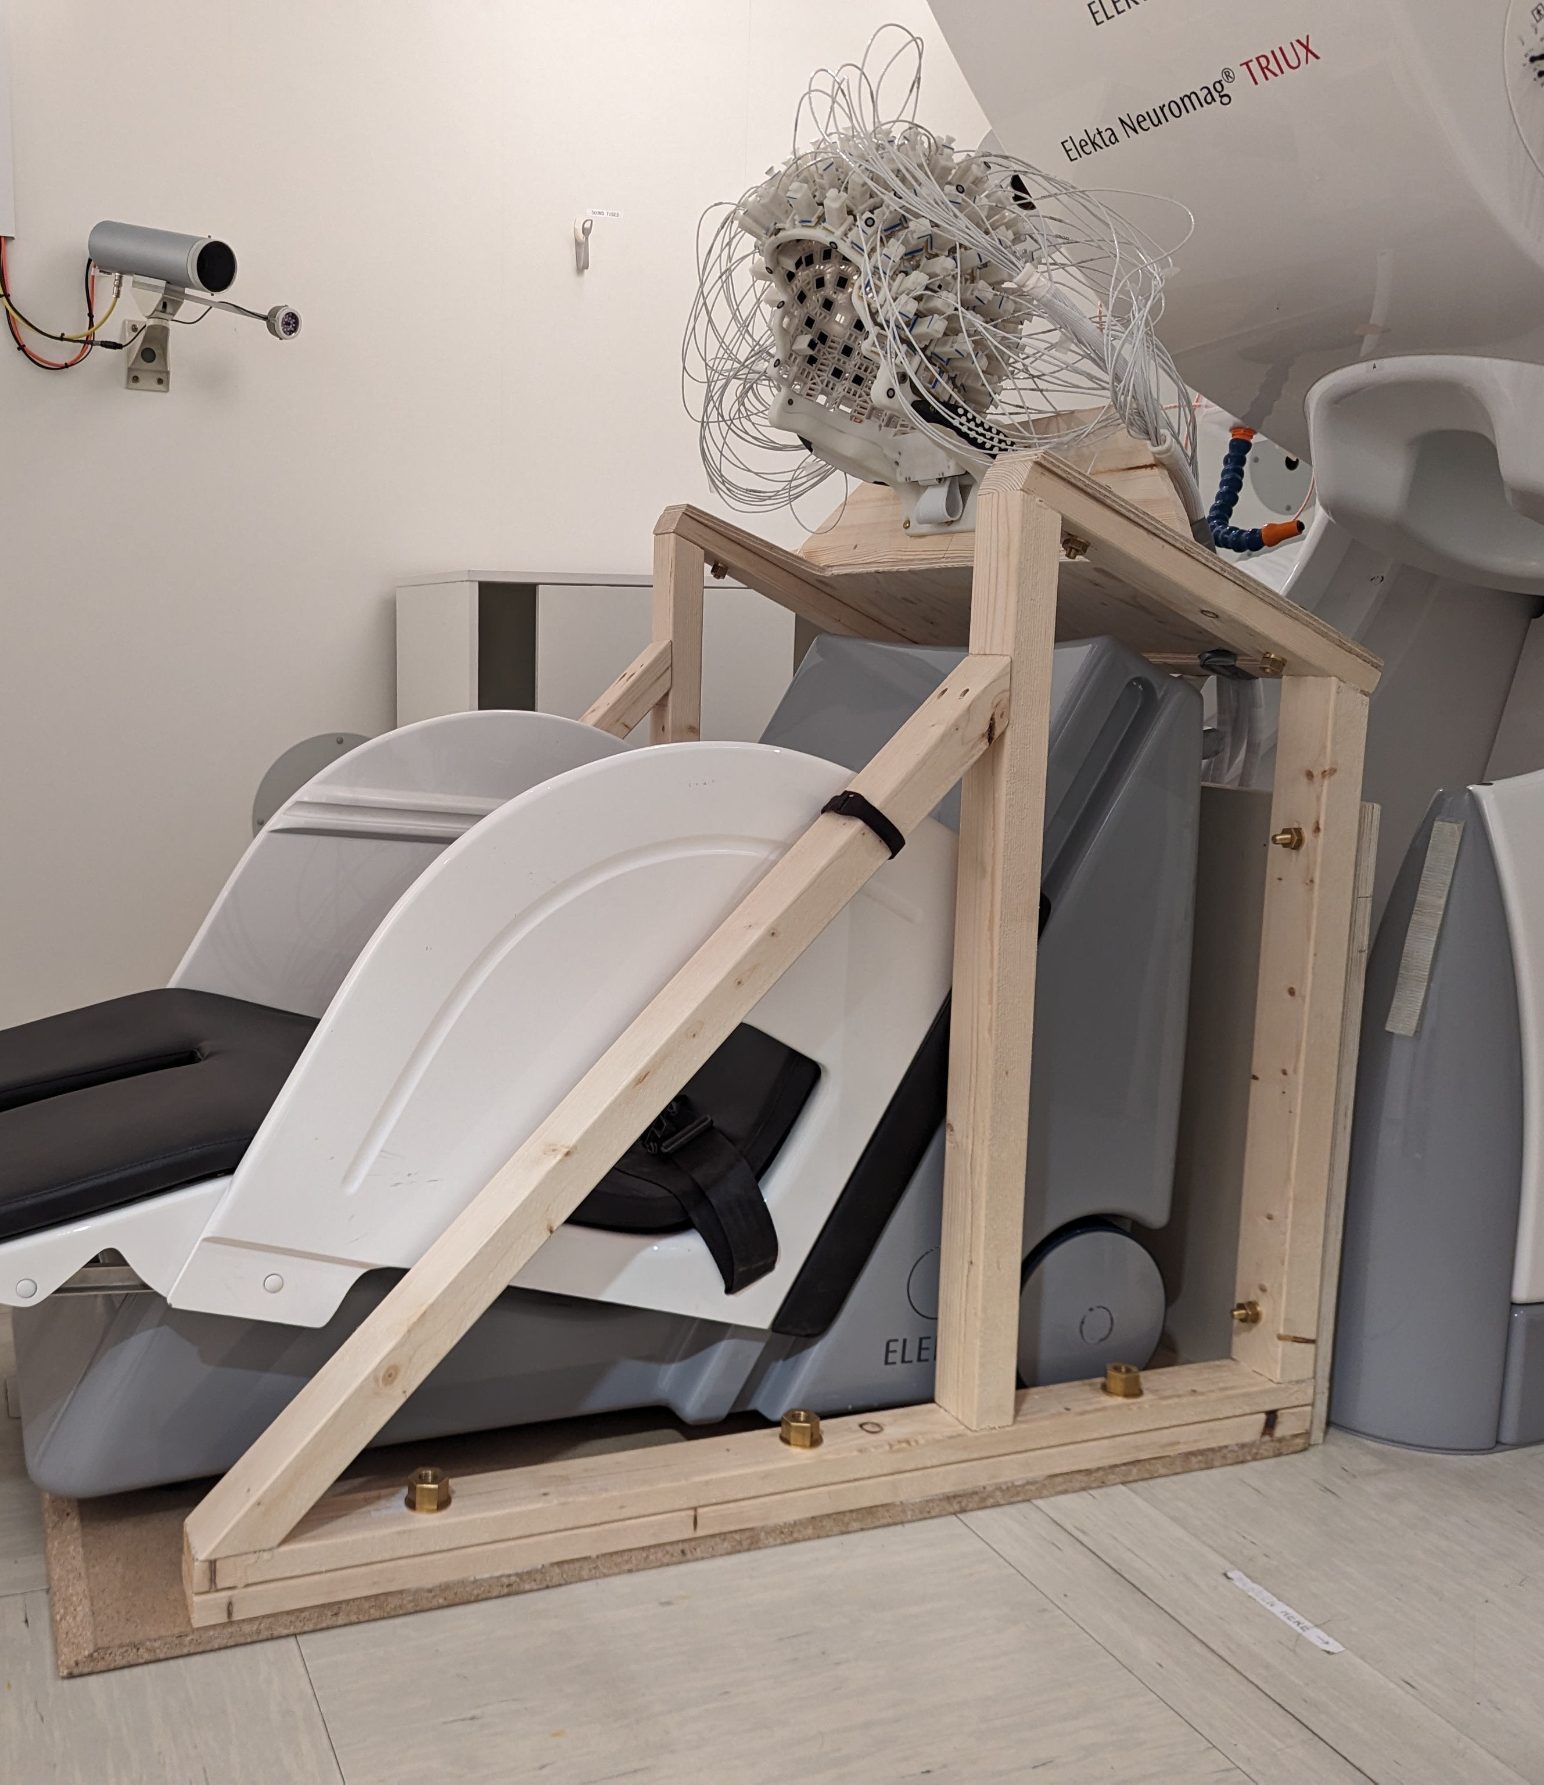
(OPM-)MEG at KI
Primarily used for clincial and cognitive neuroscience
SQUID-MEG interference suppression: IAS + MaxFilter
Since 2024: Whole-head OPM-MEG with 136 sensors (Fieldline HEDSCAN) & smart helmet
IAS + MaxFilter does not work for OPM-MEG

Slide 3
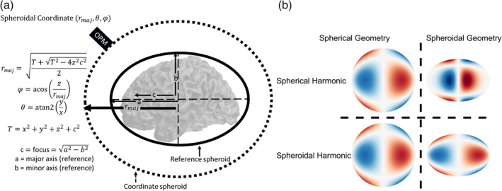
Algorithms
Homogenous Field Correction (HFC)
Tierney et al., NeuroImage, 2021
Signal Space Separation (SSS) and
iterative implementation
Taulu and Kajola, J. Appl. Phys., 2005;
Holmes et al., Sensors, 2023
Adaptive Multipole Model (AMM)
Tierney et al., Hum. Brain Mapp., 2024
Signal Space Projection (SSP)
Uusitalo and Ilmoniemi, Med. Biol. Eng. Comput., 1996
Hum Brain Mapp. 2024 Mar 4;45(4):e26596

Slide 4
Simulated data

Slide 5
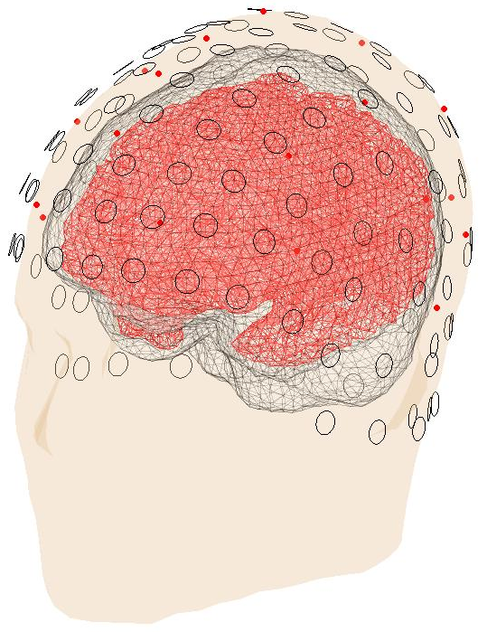
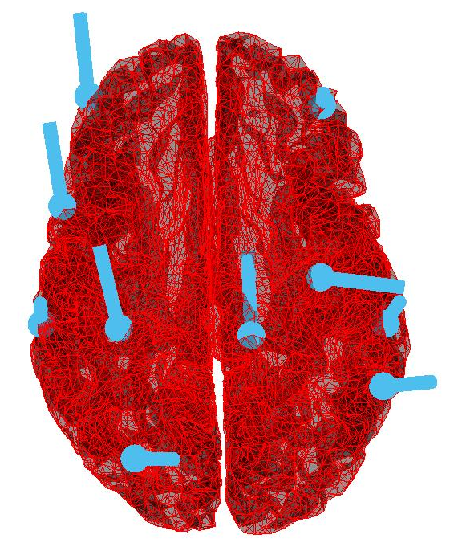
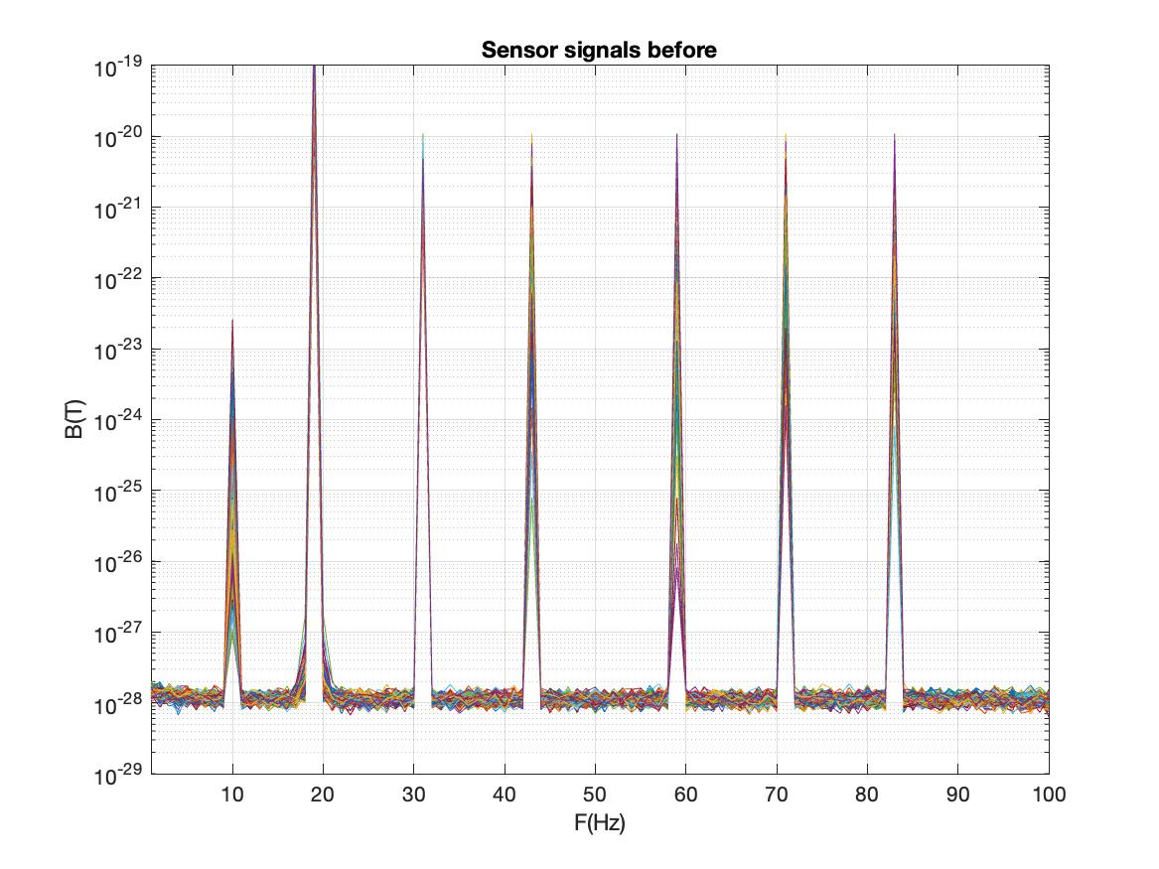
Simulation
Implemented in Fieldtrip/MATLAB
Sensor array (130 sensors, single-axis mode), head and sourcemodel from a real recording
Signals= sensor noise + brain signal + noise signals
  Sensor noise (white + pink) with amplitudes matched to recorded data
  Brain signal: 10 highly coupled current dipole sources (±10 pT, single-shell headmodel)
  Noise signals: magnetic dipoles (±141 pT)
    Dental noise source @0.14 m
    Chest noise source @0.3 m
    Close environmental noise sources @1 and 2 m
    Far environmental noise sources @3 and 5 m
Empty room without brain, dental and chest sources
brain
3 m
dental
PSD (T²)
chest
1 m
2 m
5 m
Notes:
.

Slide 6
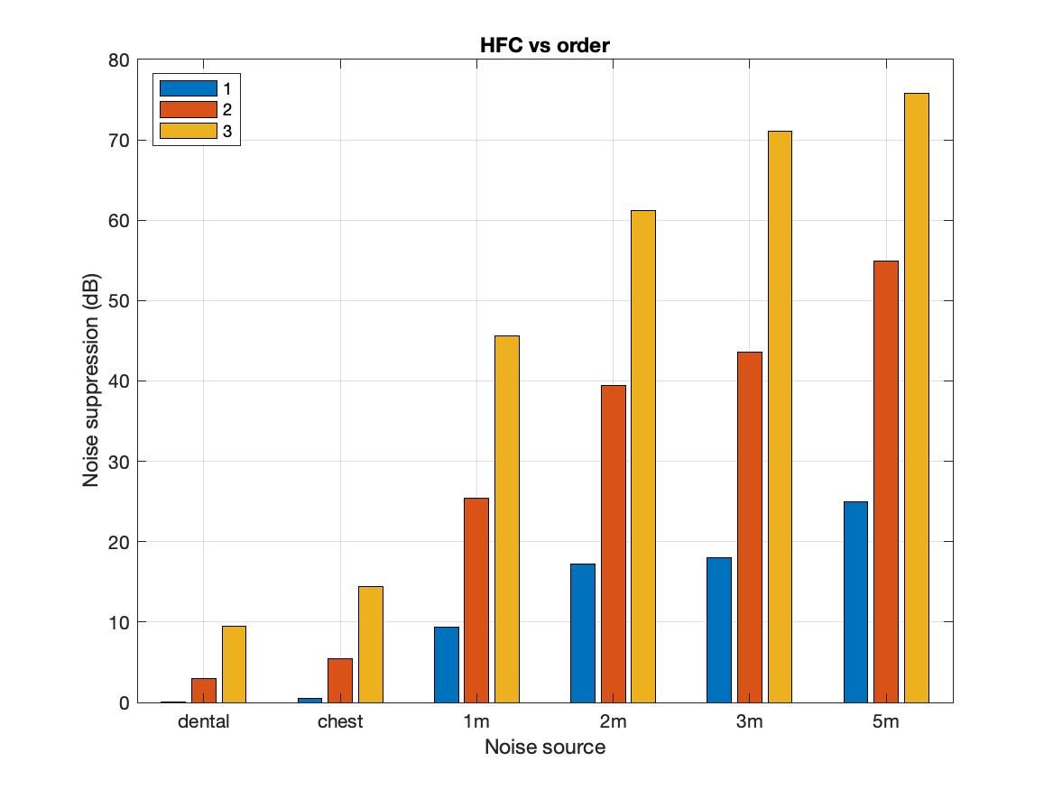
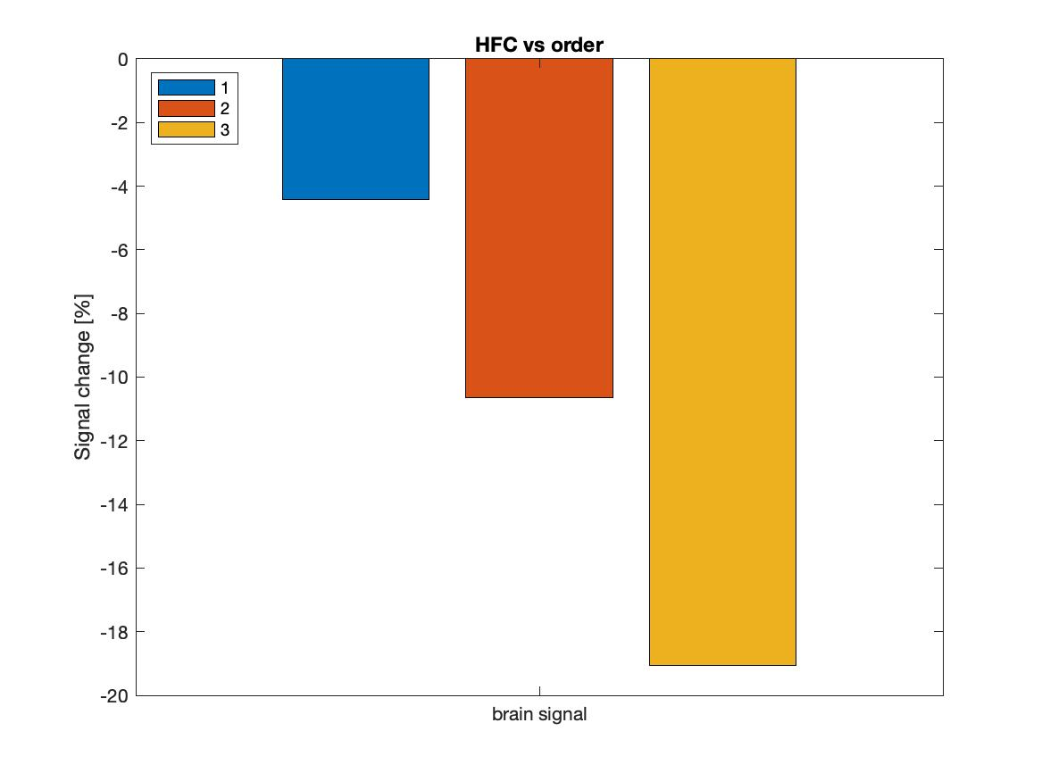
Homogenous Field Correction (HFC)
Noise suppression (dB)
Signal change (%)

Slide 7
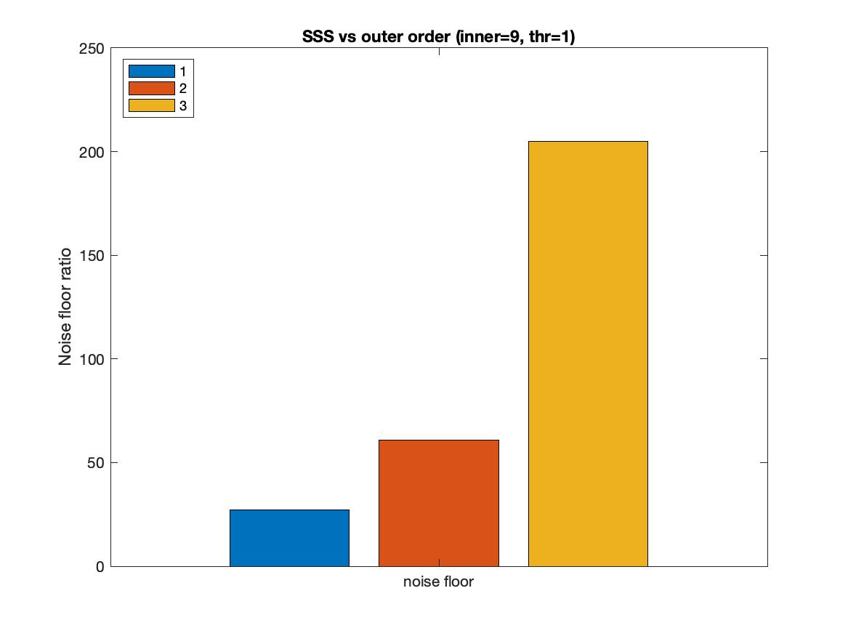
Signal Space Separation (SSS)
Unstable!
Noise floor ratio
order

Slide 8
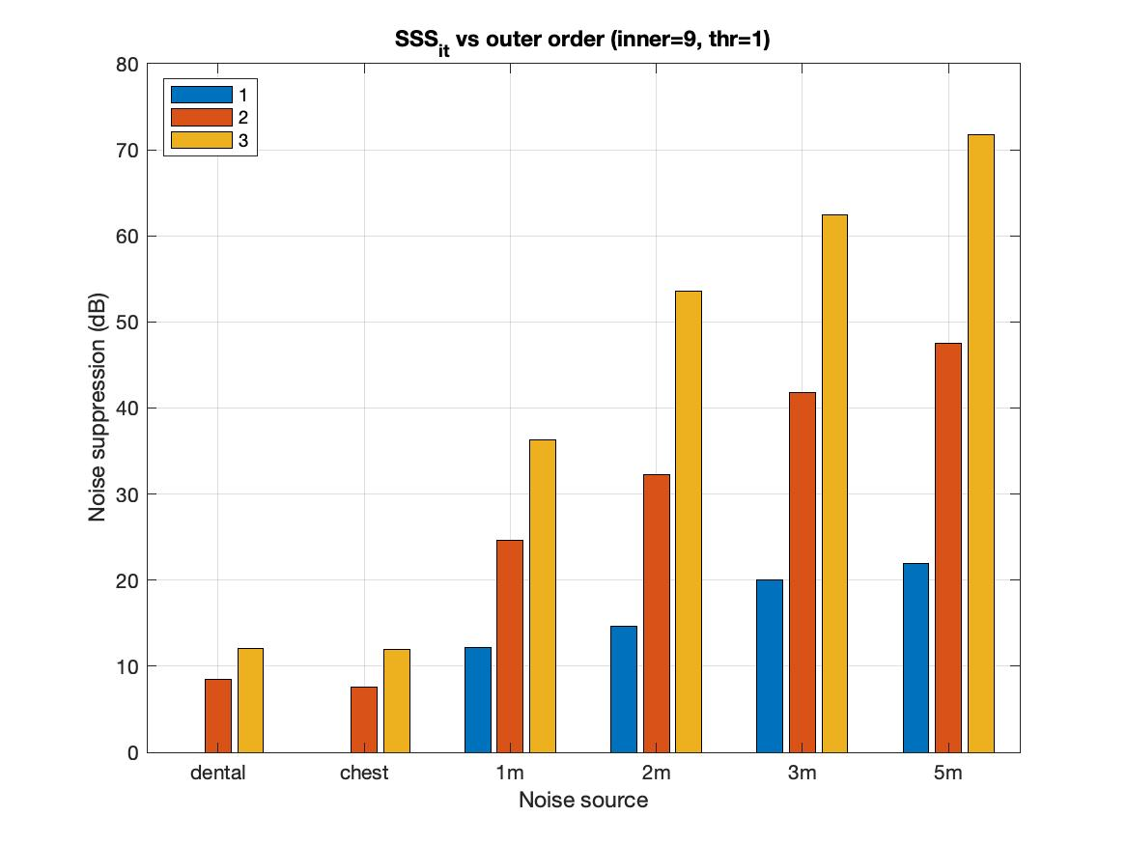
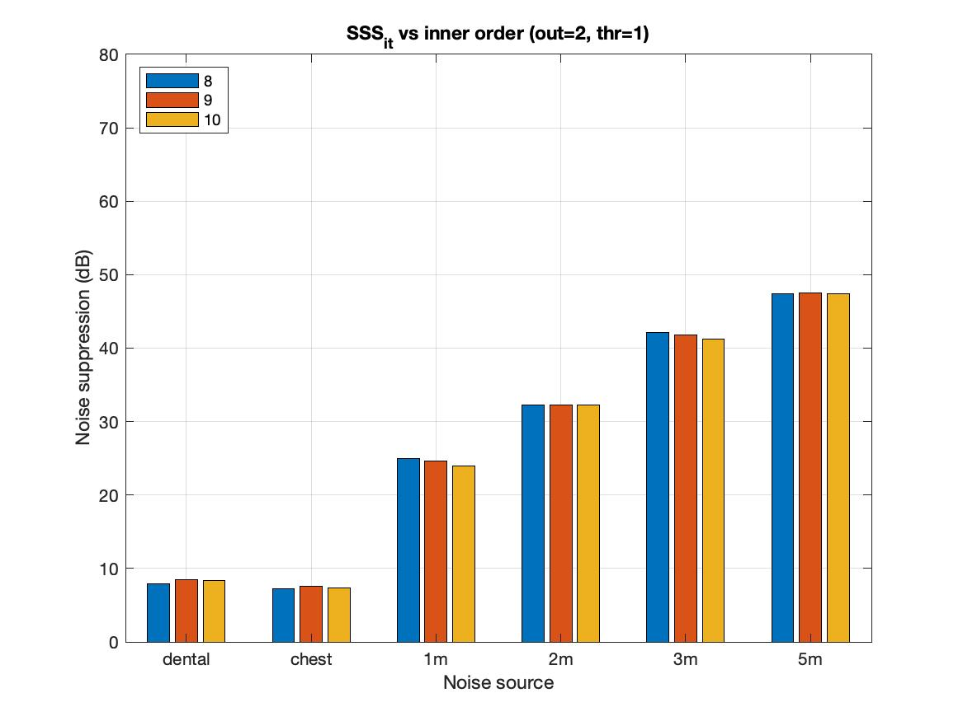
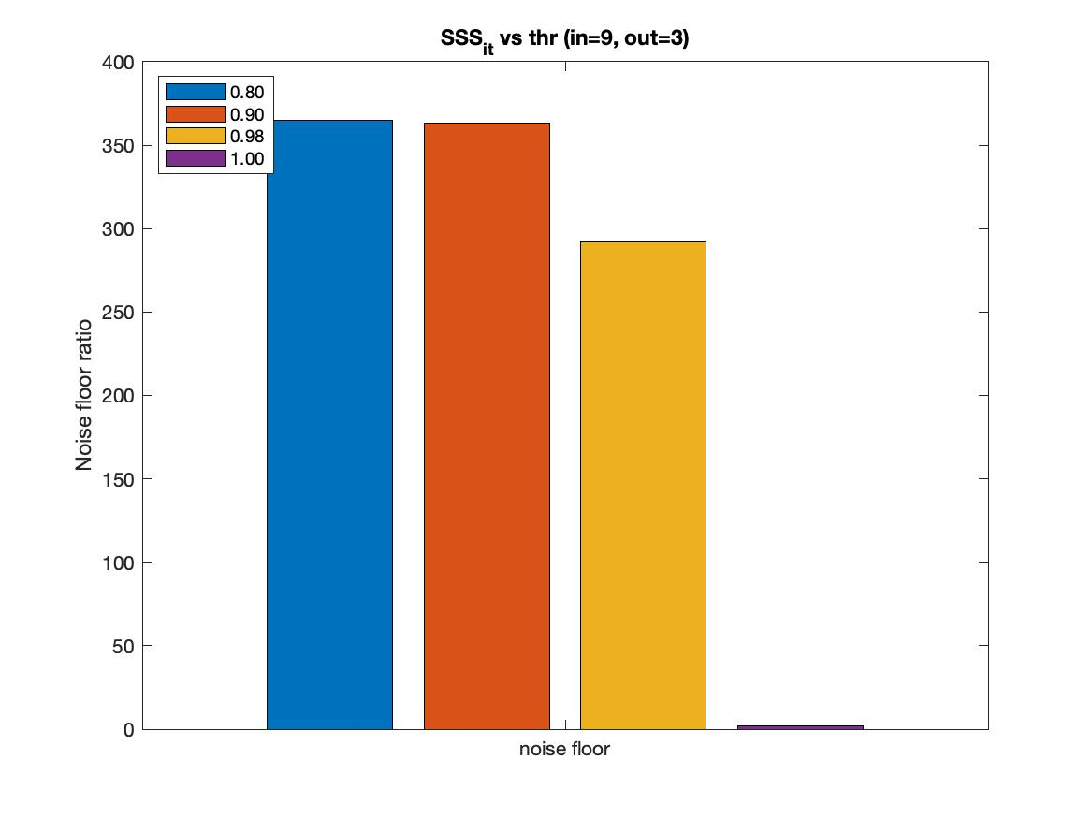
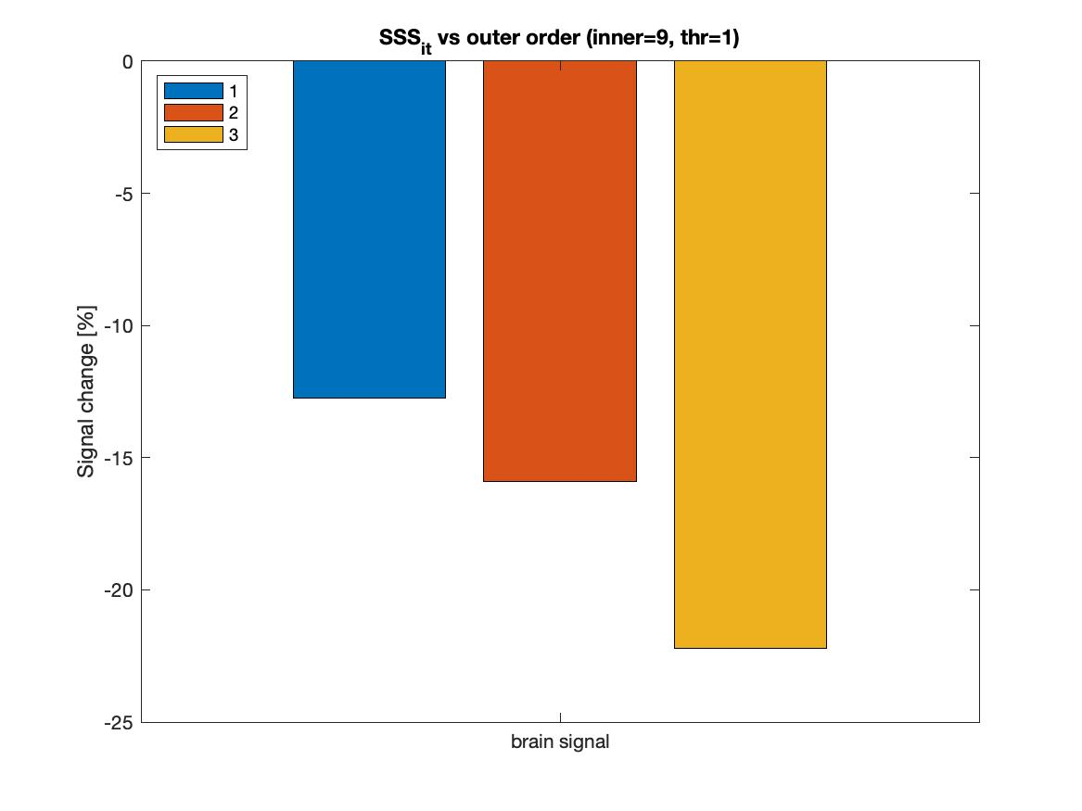
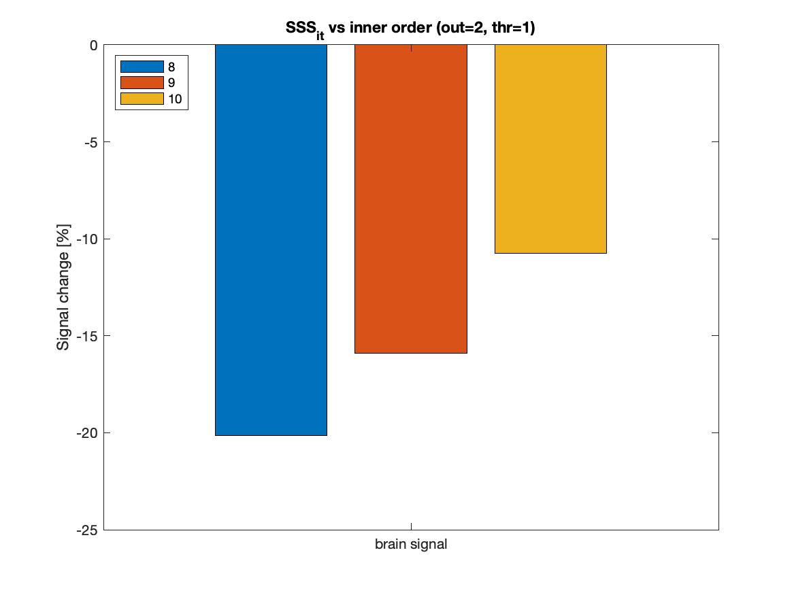
Iterative Signal Space Separation (SSS_{it})
Unstable!

Slide 9
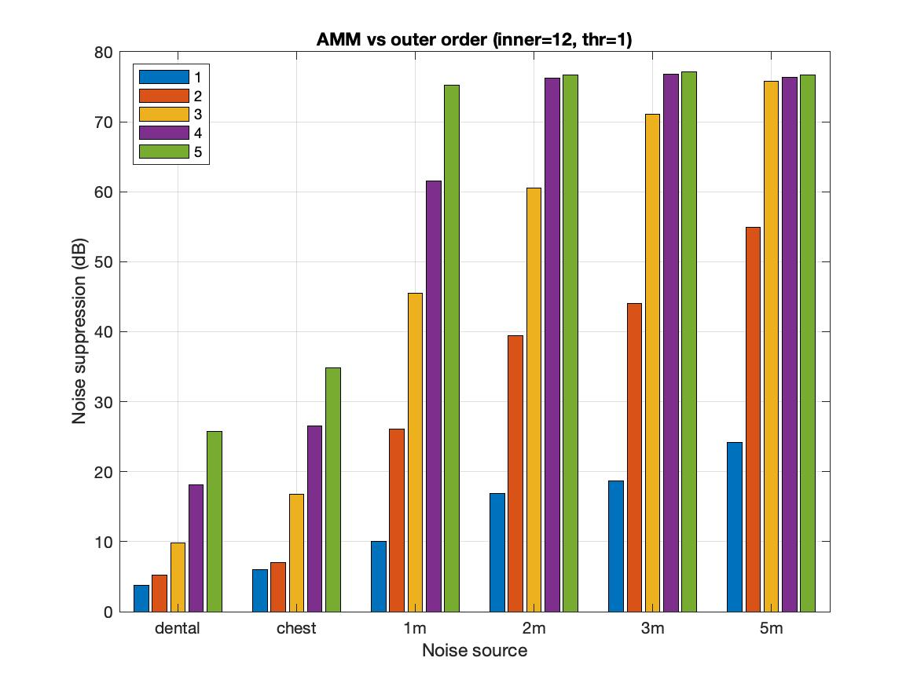
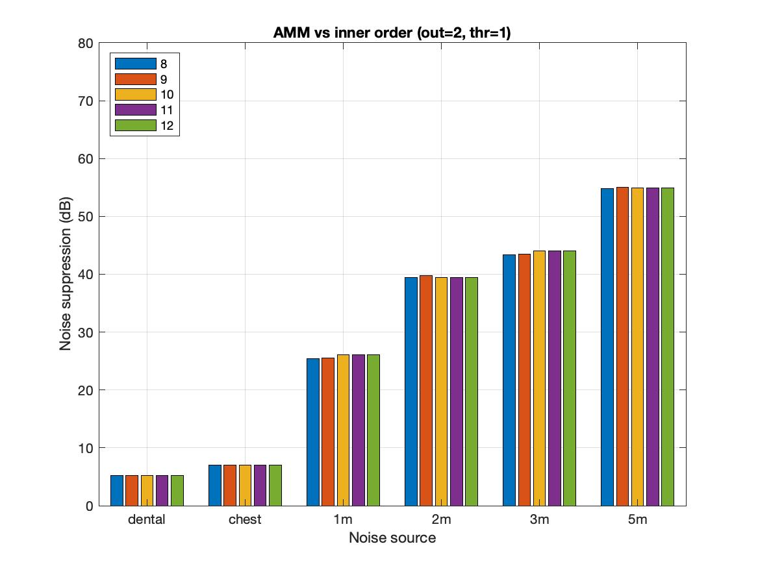
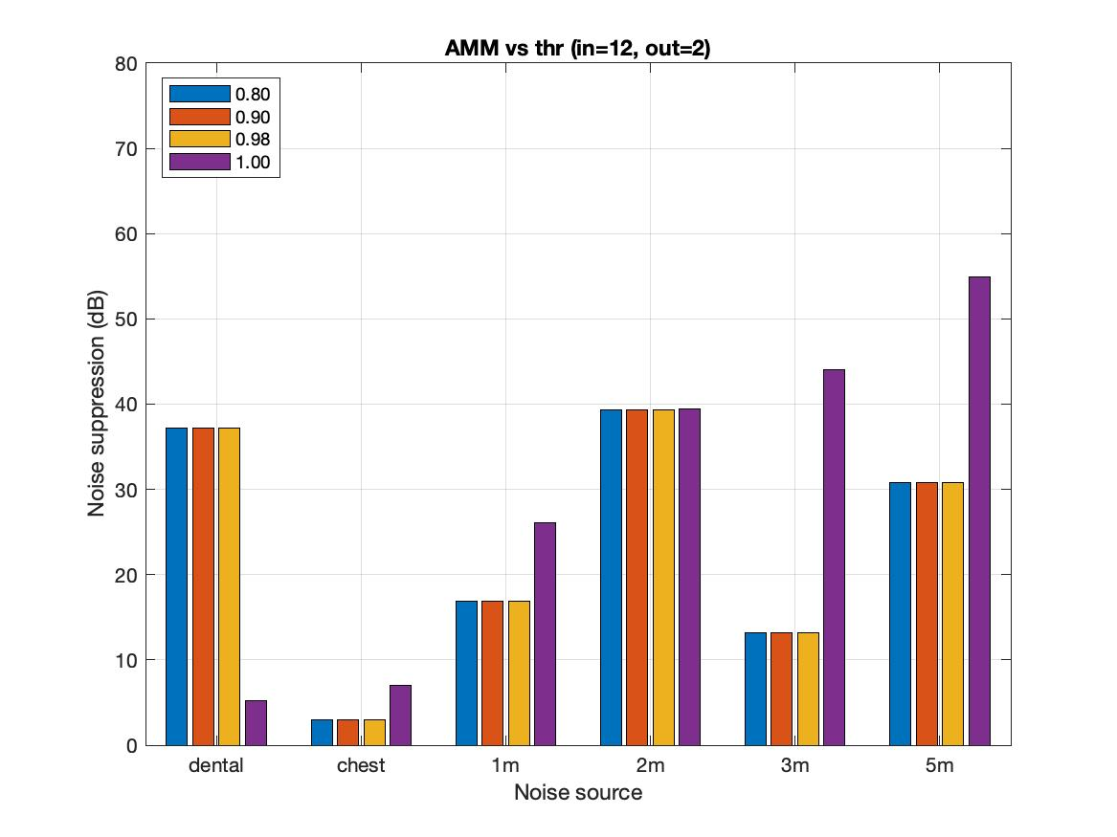
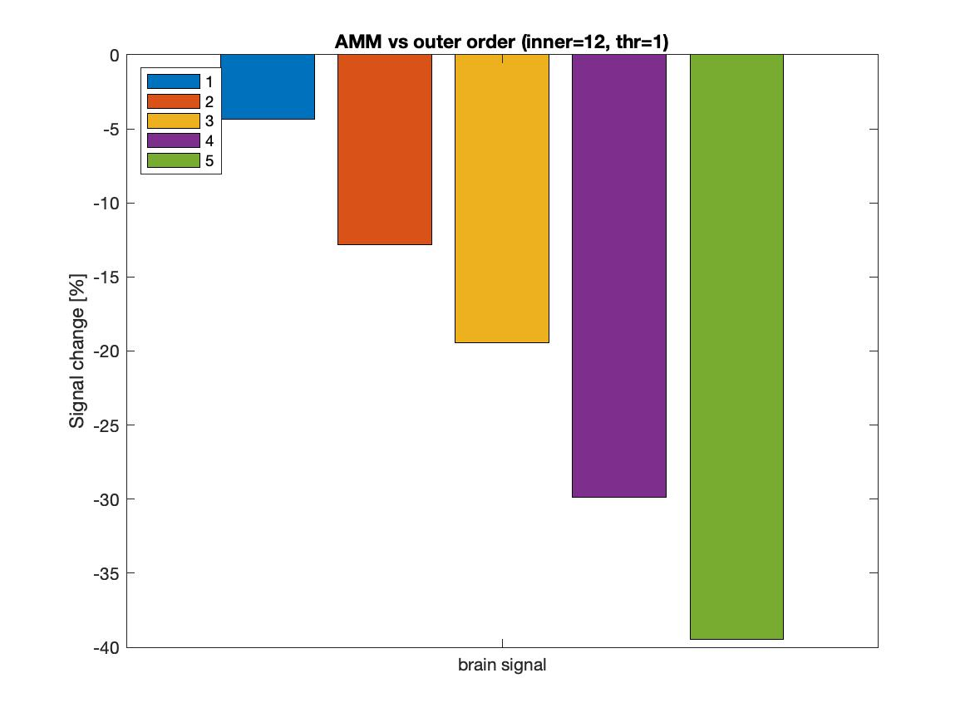
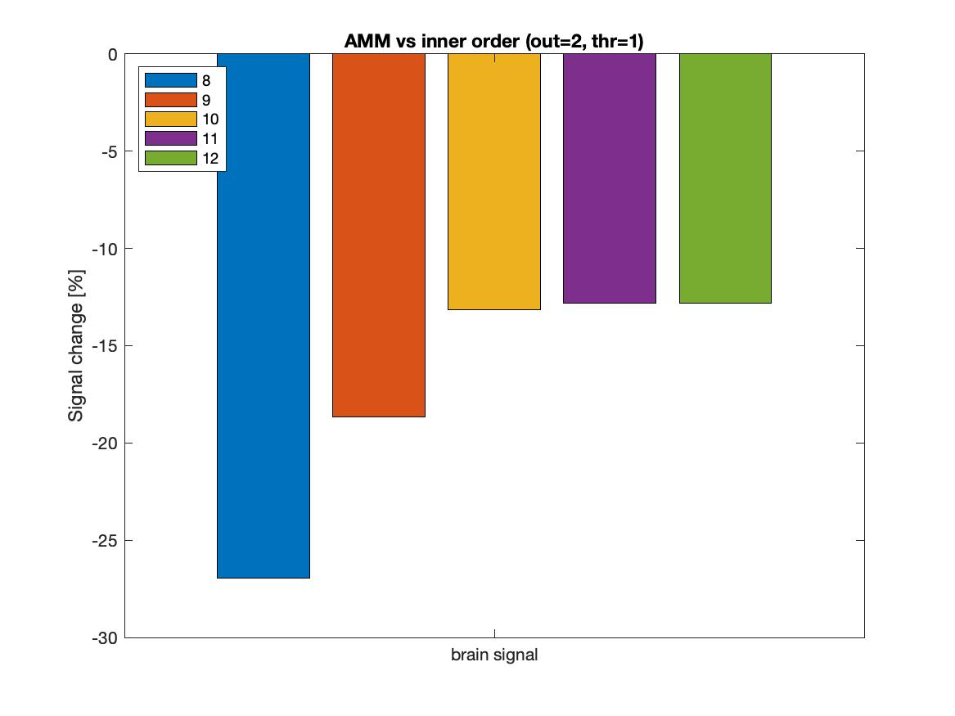
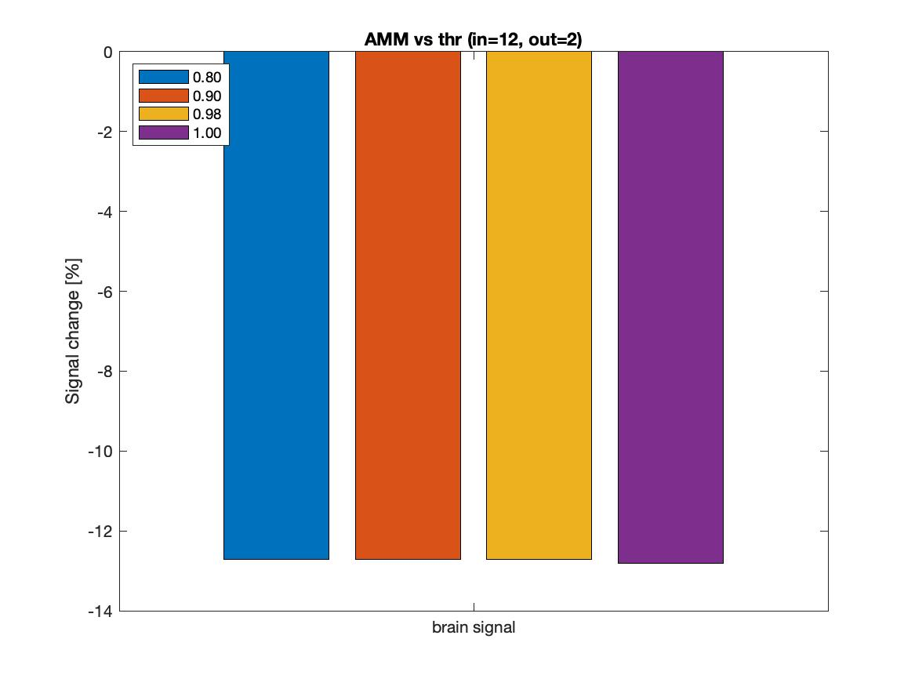
Adaptive Multipole Models (AMM)

Slide 10
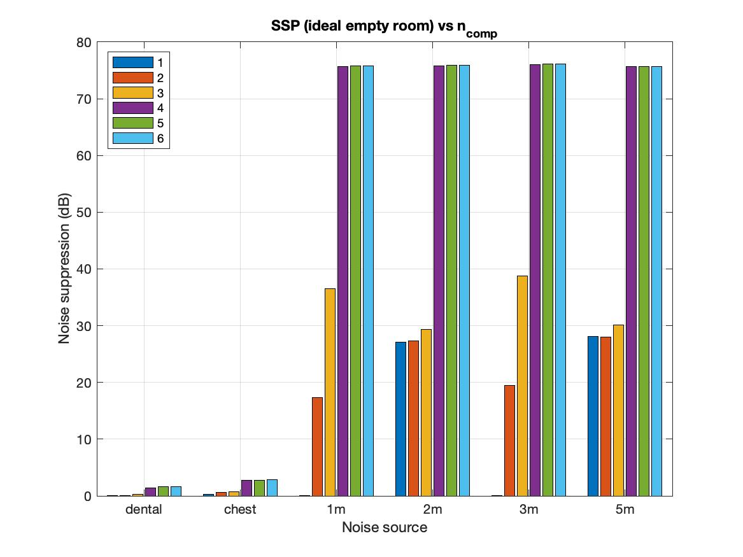
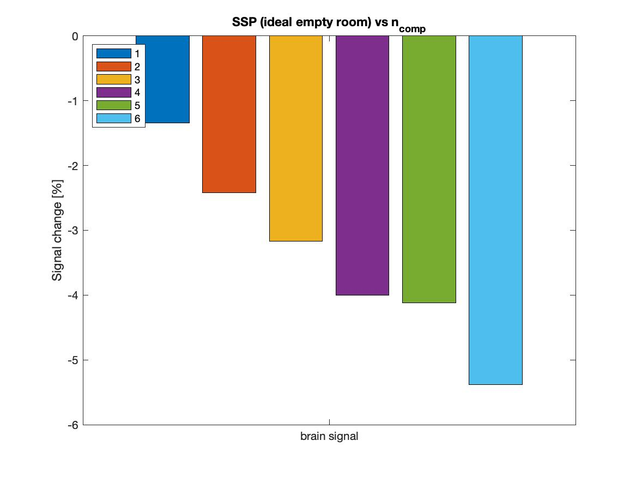
Signal Space Projection (SSP)

Slide 11
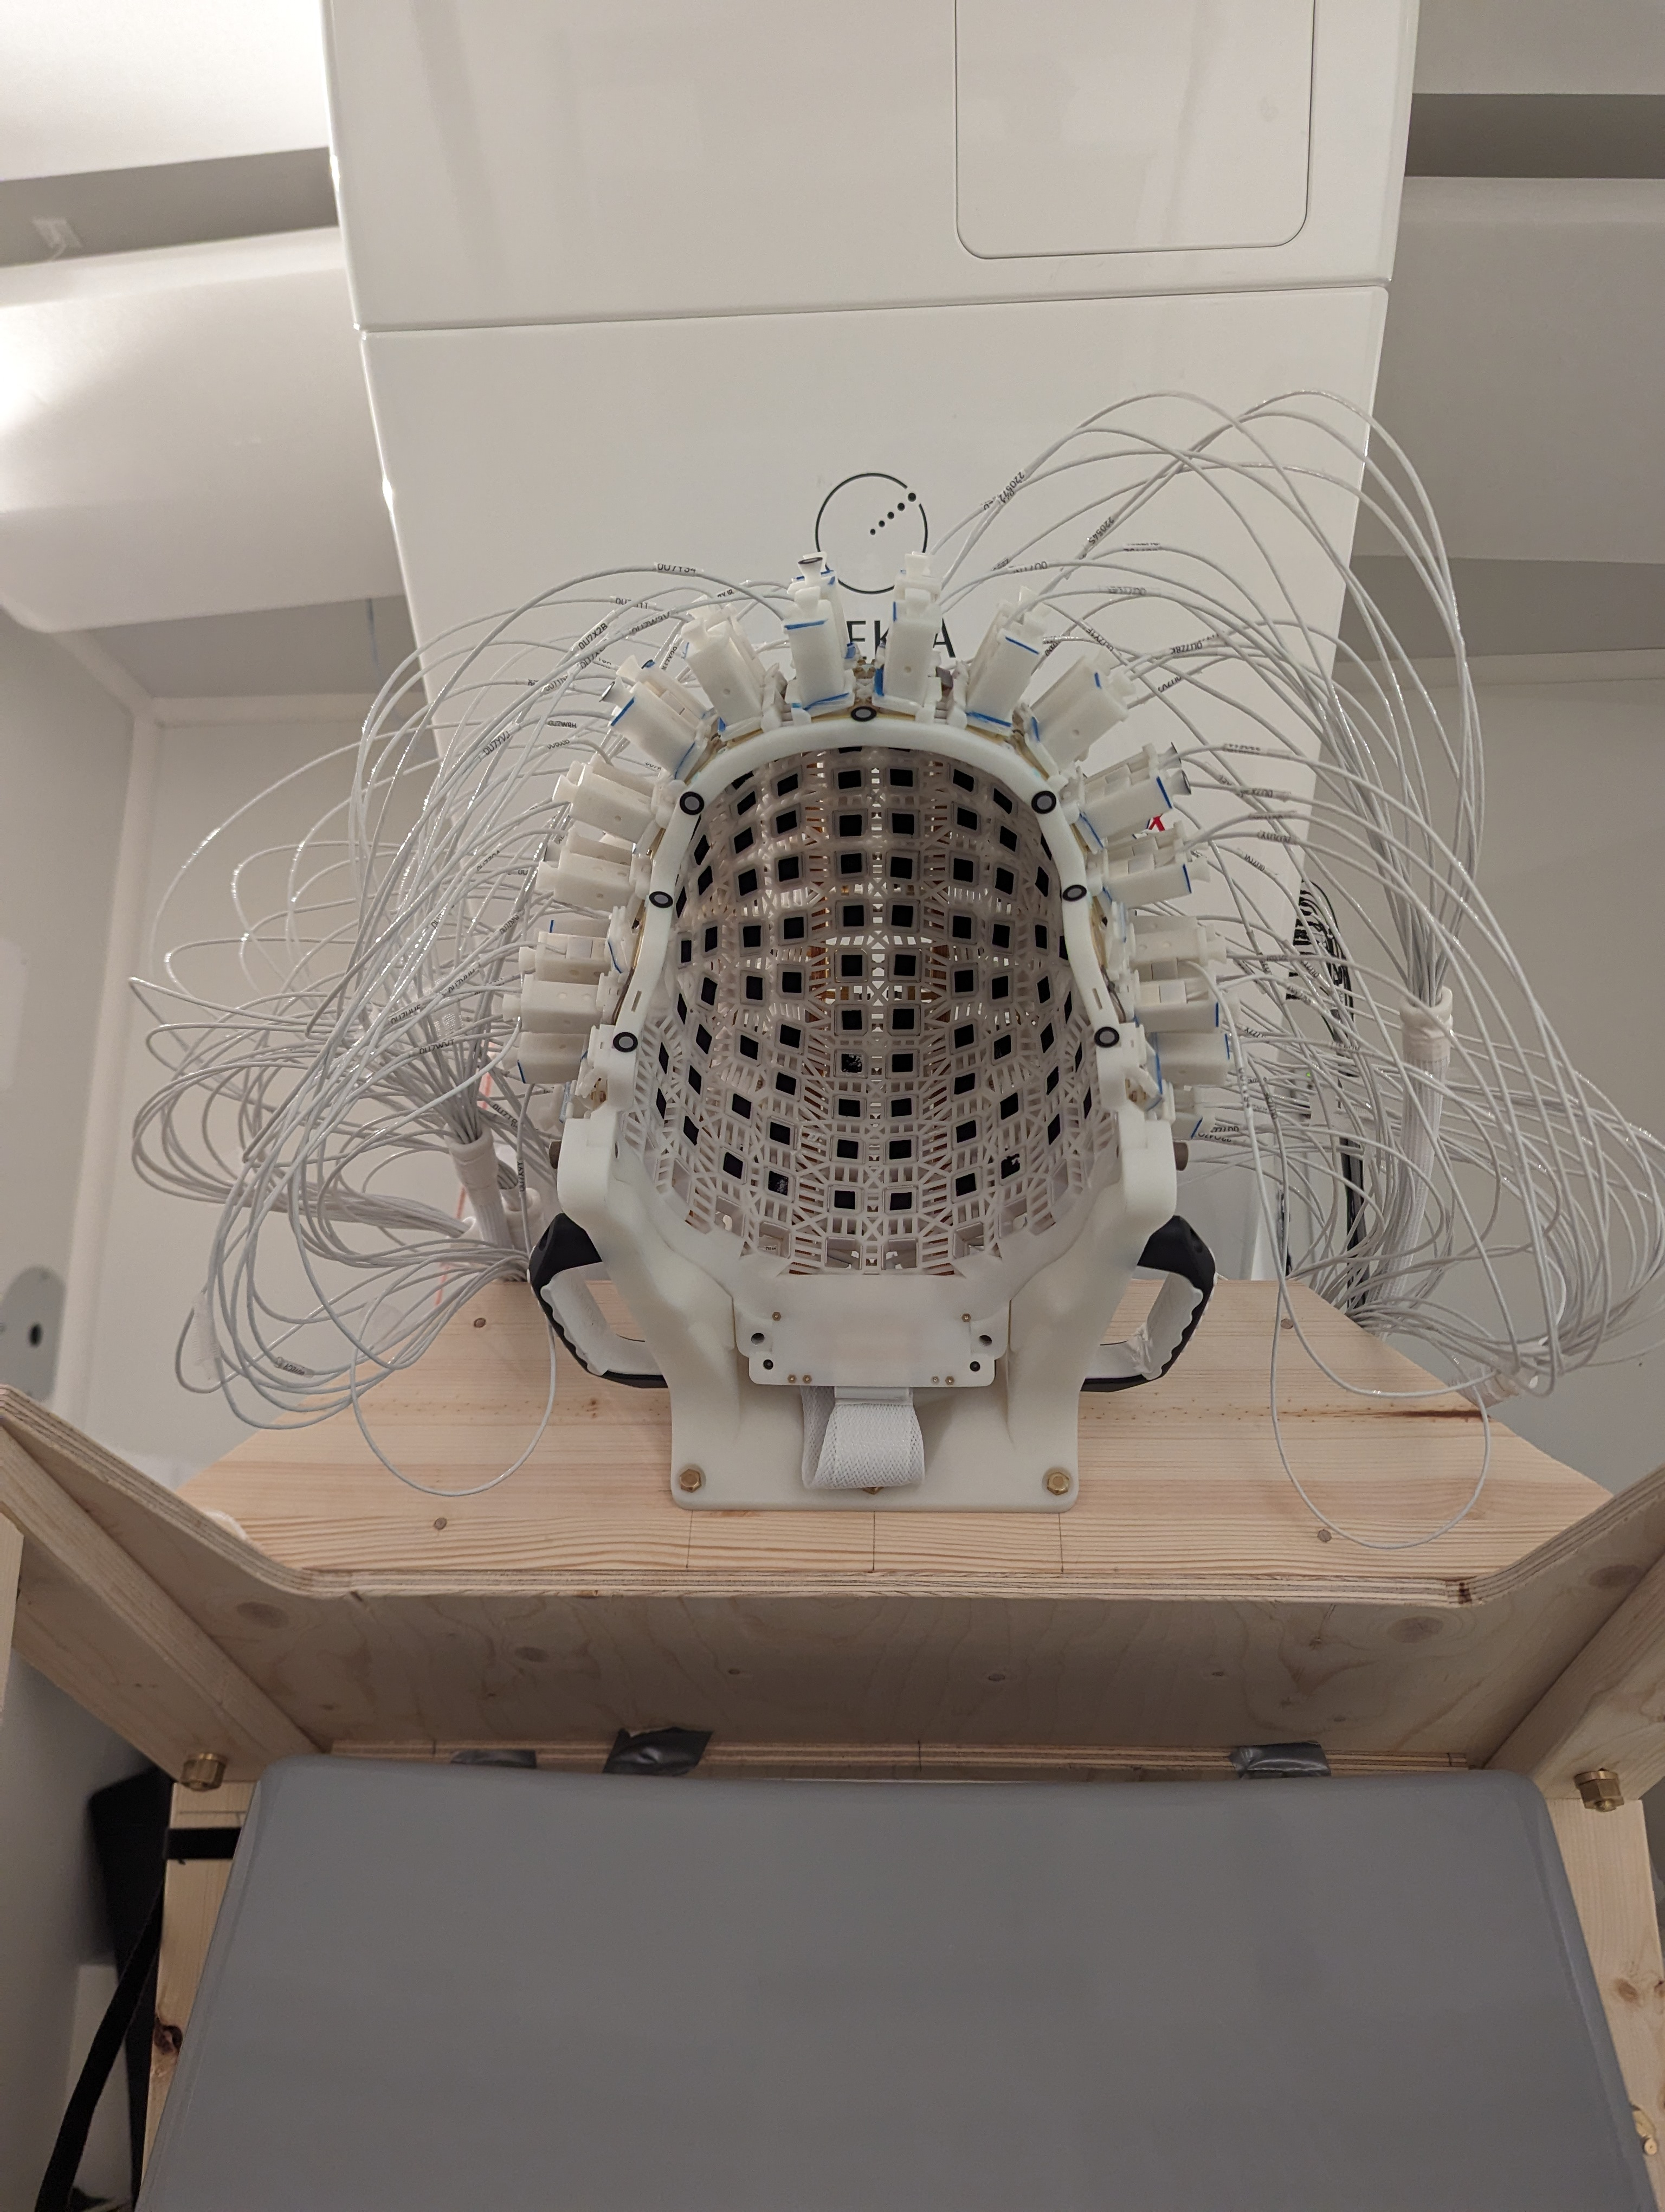
(OPM-)MEG at KI
Primarily used for clincial and cognitive neuroscience
SQUID-MEG interference suppression: IAS + MaxFilter
Since 2024: Whole-head OPM-MEG with 136 sensors (Fieldline HEDSCAN) & smart helmet
IAS + MaxFilter does not work for OPM-MEG

Slide 12
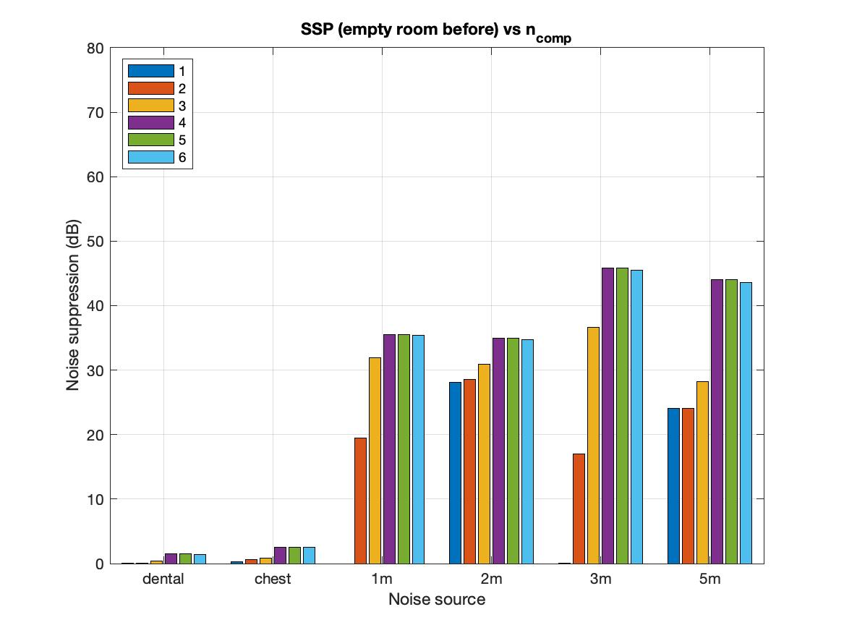
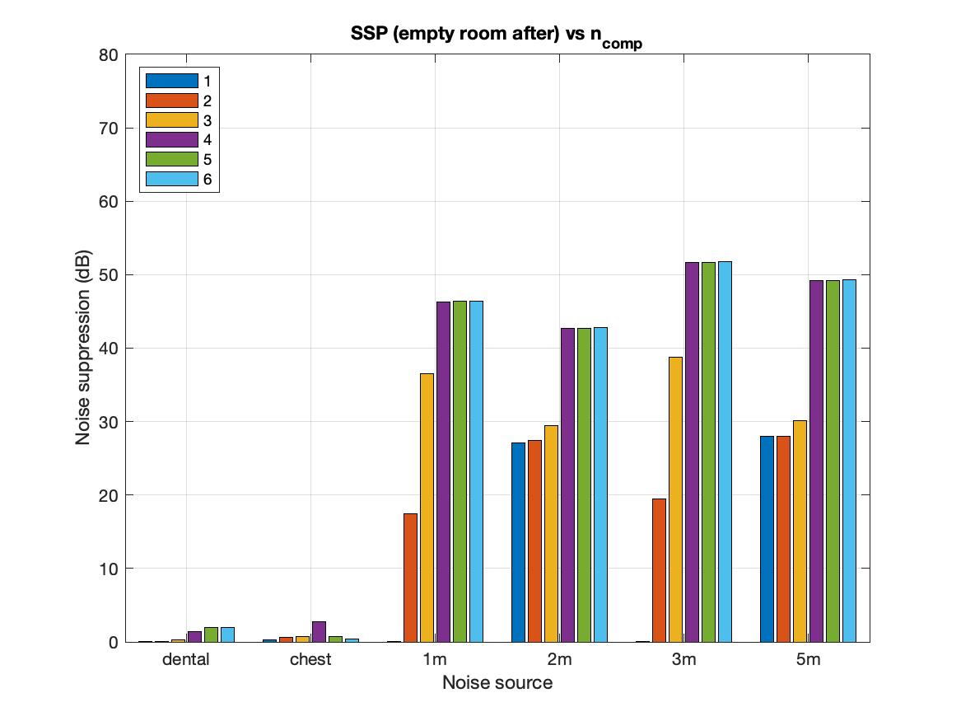
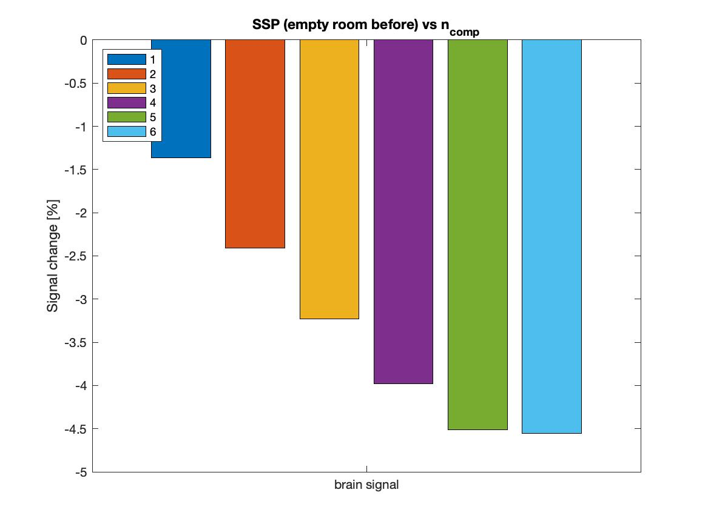
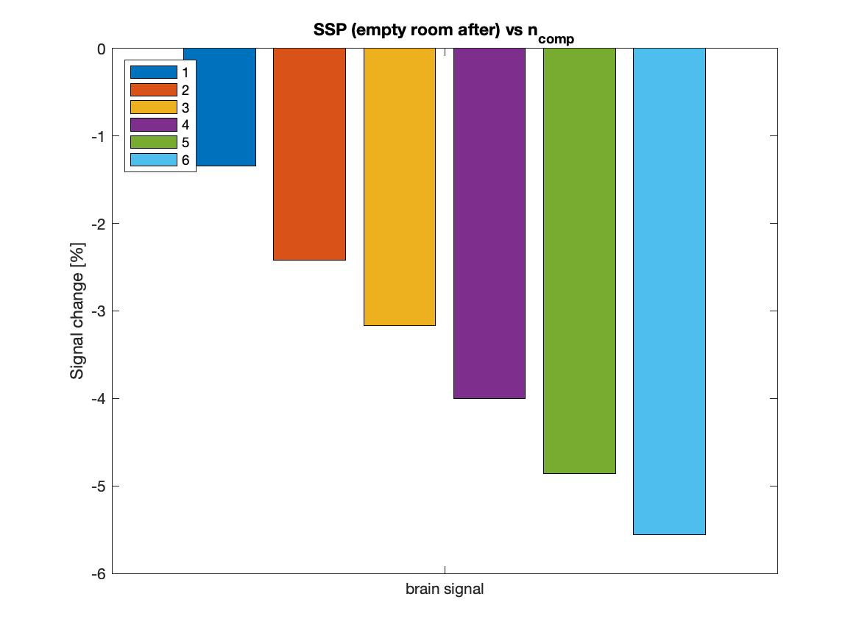
Signal Space Projection (SSP)

Slide 13
Recorded data
Notes:
Alright. Now let’s look at some real data.

Slide 14
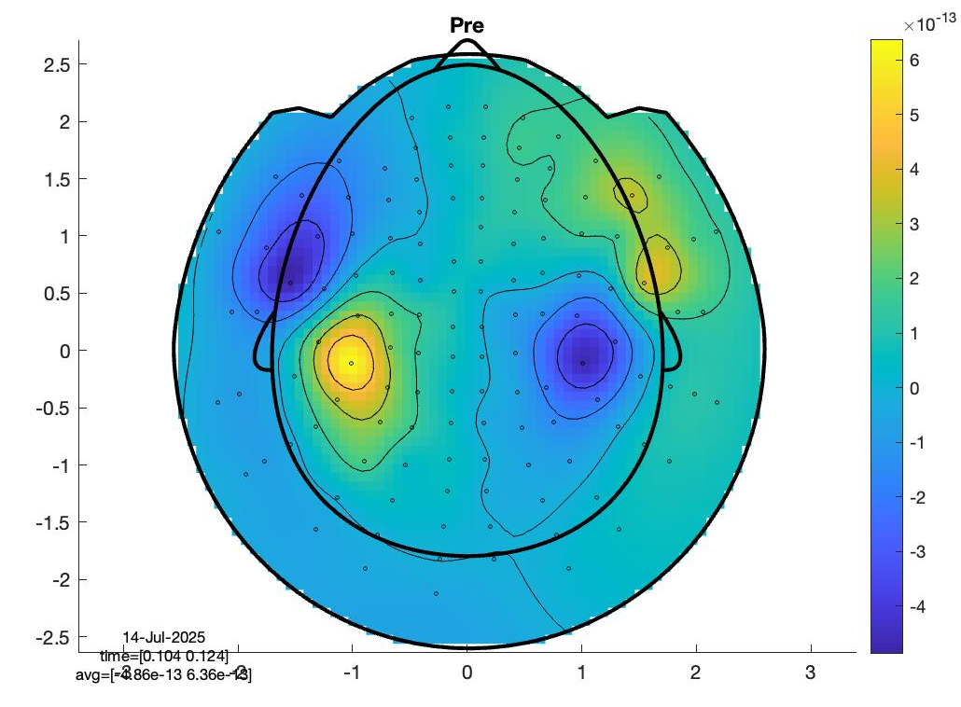
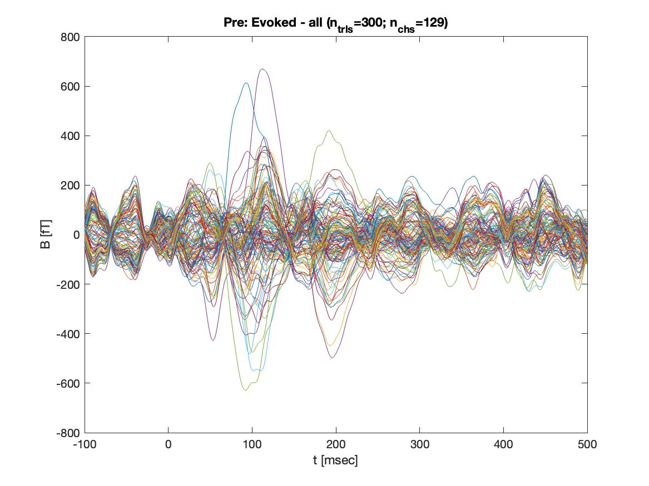
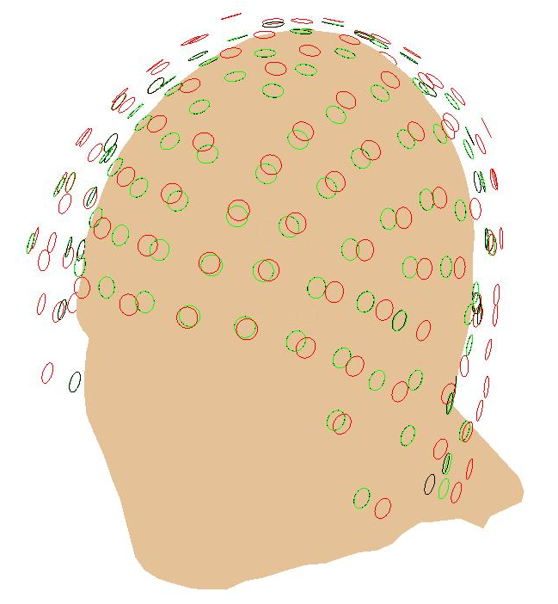
Recording
Single participant (left-handed, no dental wire)
130 single-axis sensors
Paradigms:
  Auditory task
  Tapper (index finger)
Empty room before (sensors
flush with helmet)
Empty room after (minimal
sensor move)
Recording
Empty room before
Empty room after

Slide 15
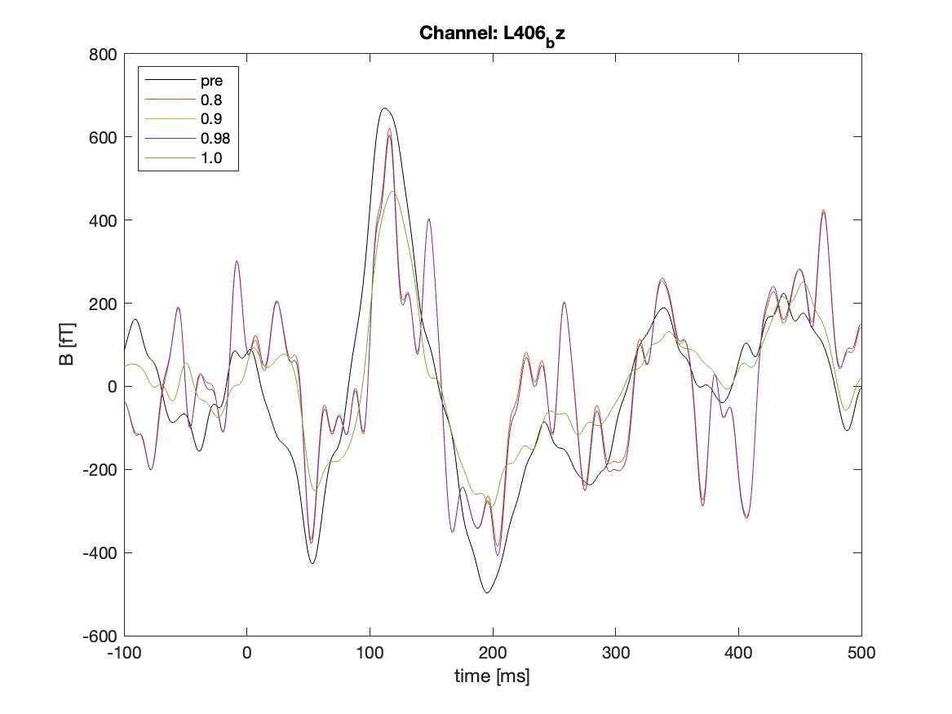
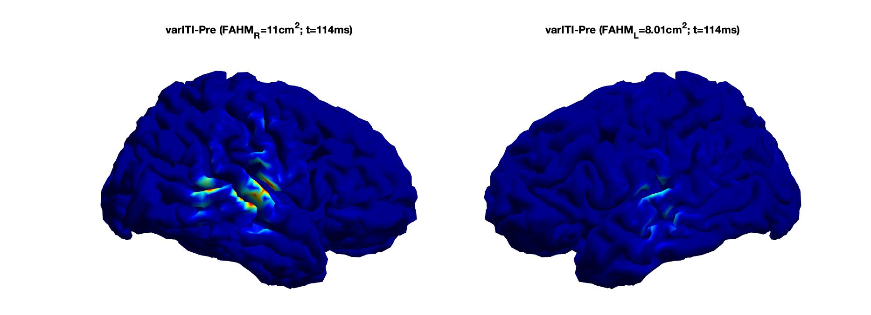
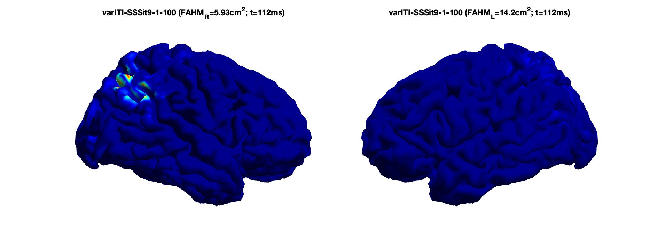
Results
ItSSS-temporal: Peak channel
Iterative SSS:
  Temporal: unstable
  Spatial: problems with source reconstruction

Slide 16
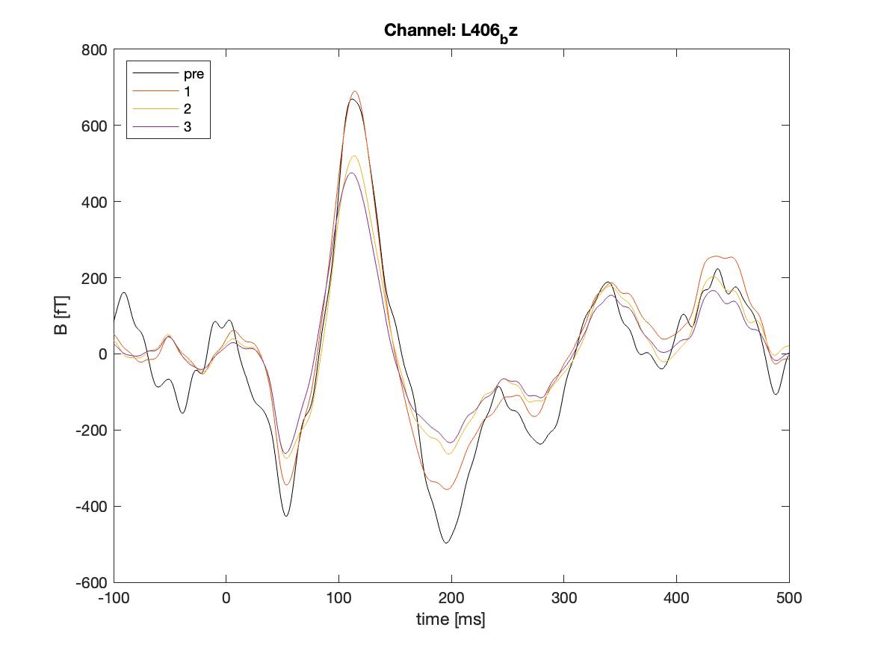
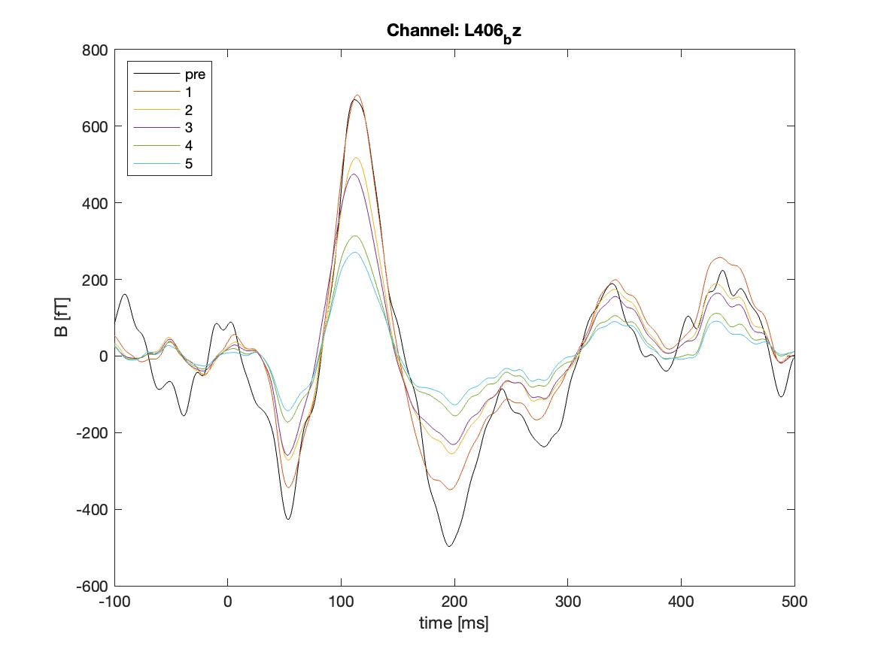
Results
HFC:
Peak channel vs order
Iterative SSS:
  Temporal: unstable
  Spatial: problems with source reconstruction
HFC+AMM:
  Signal drop at high order/L_{out}
AMM:
Peak channel vs L_{out}

Slide 17
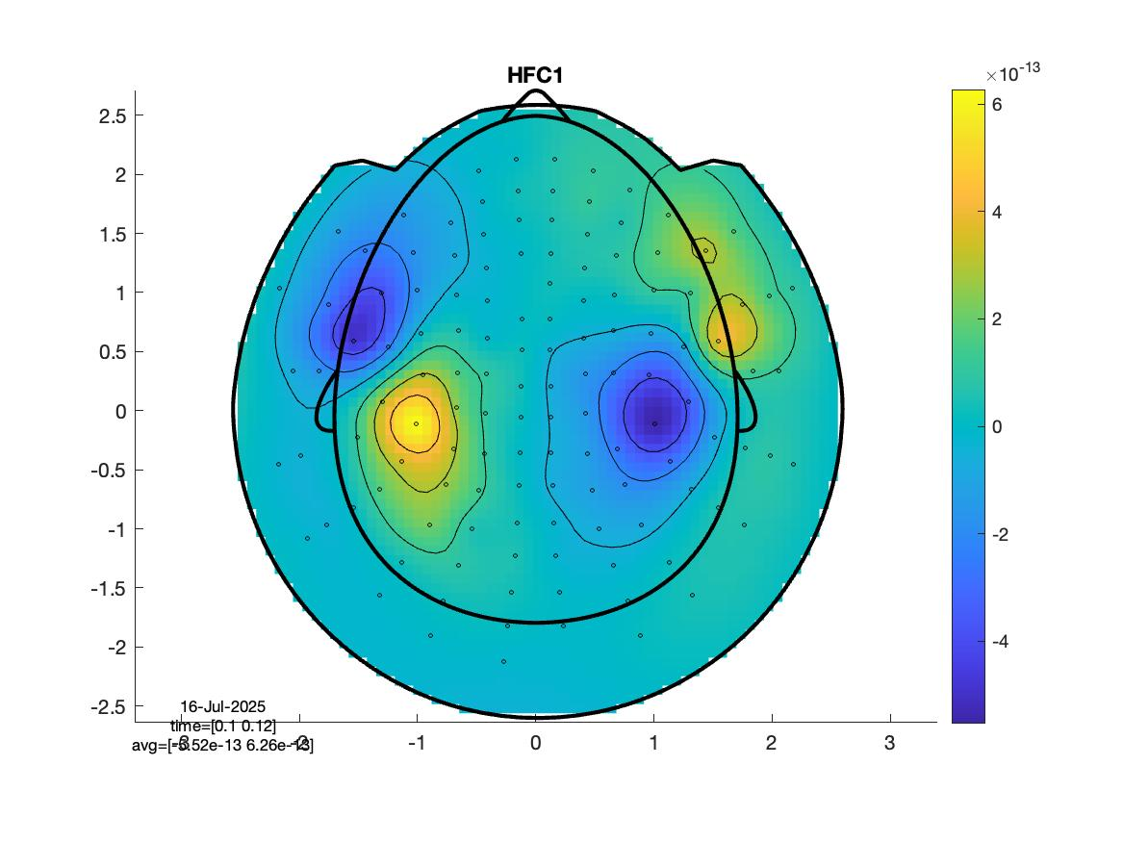
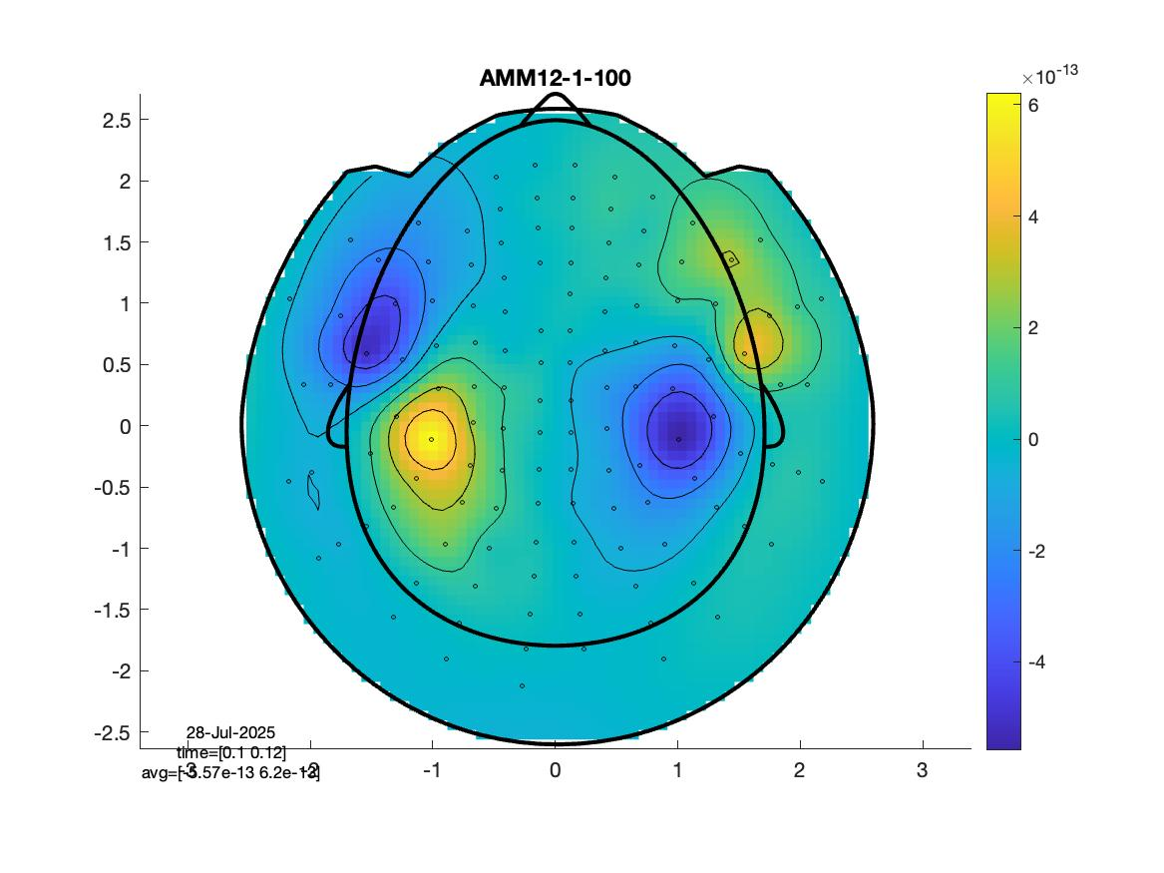
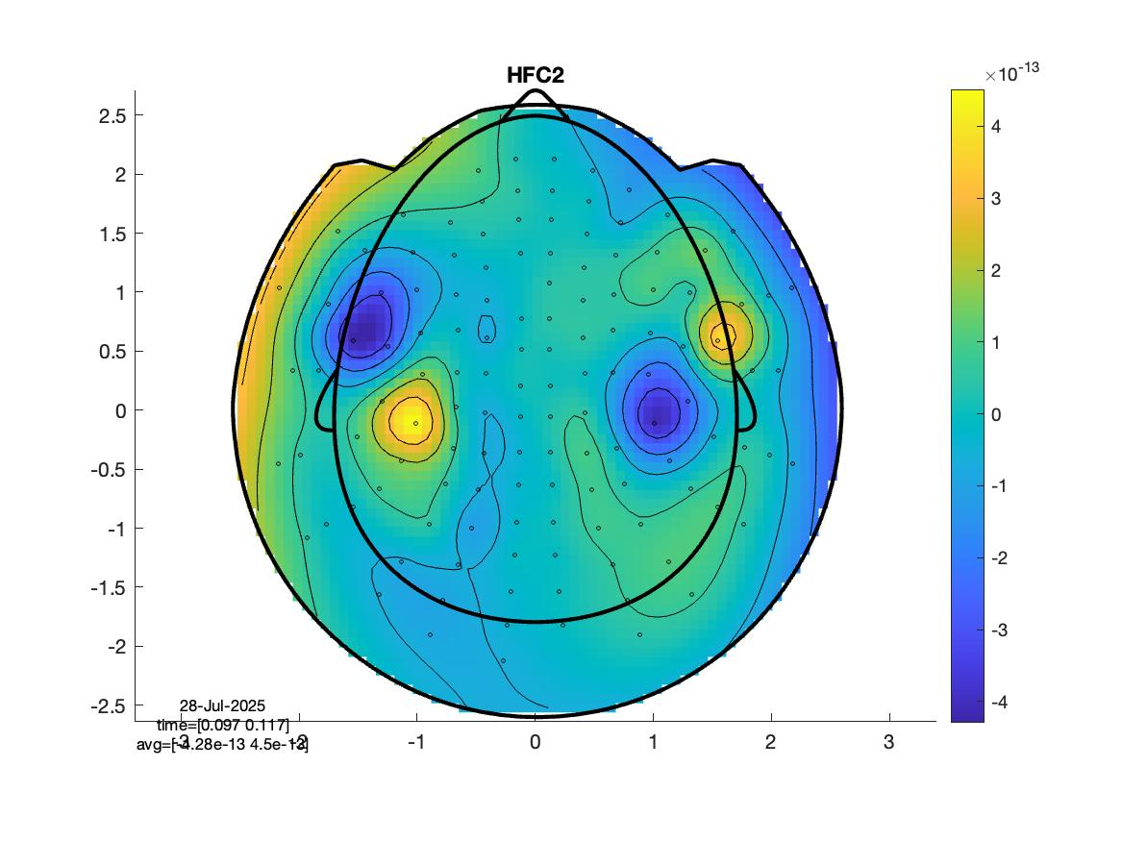
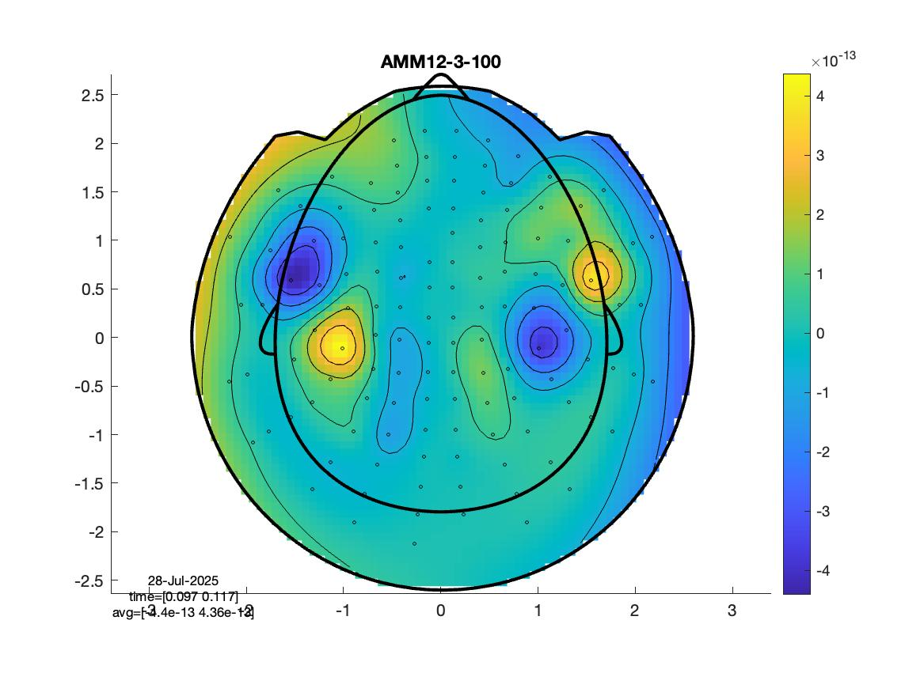
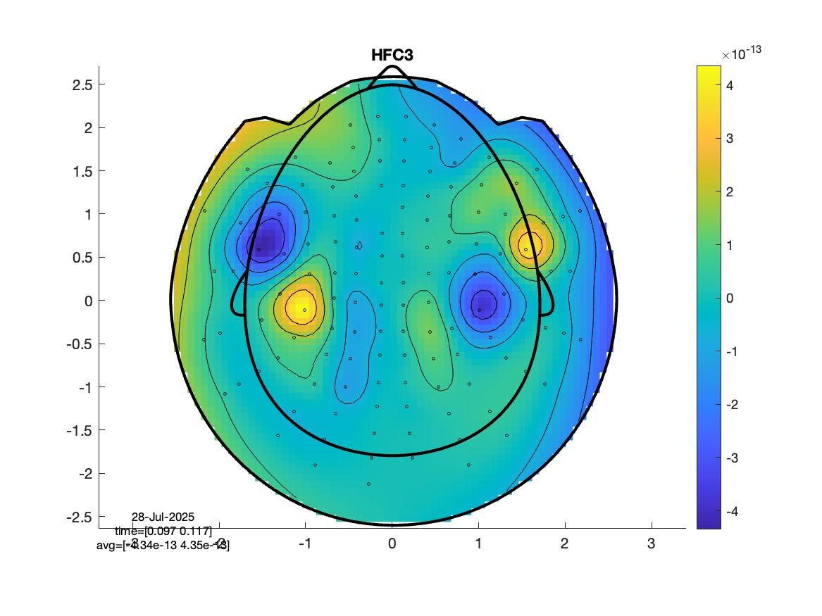
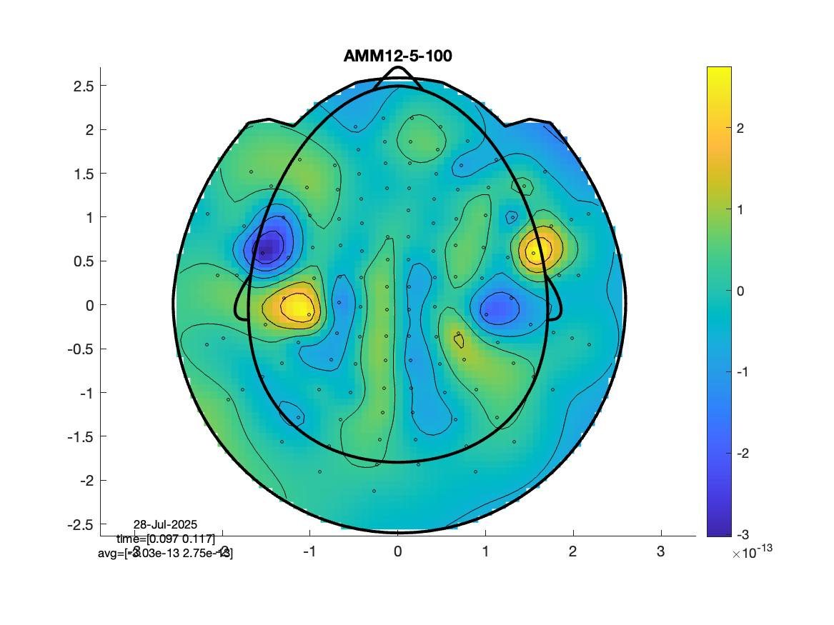
Results
Iterative SSS:
  Temporal: unstable
  Spatial: problems with source reconstruction
HFC+AMM:
  Signal drop at high order/L_{out}
  Oscillatory spatial patterns appear at higher order/L_{out}

Slide 18
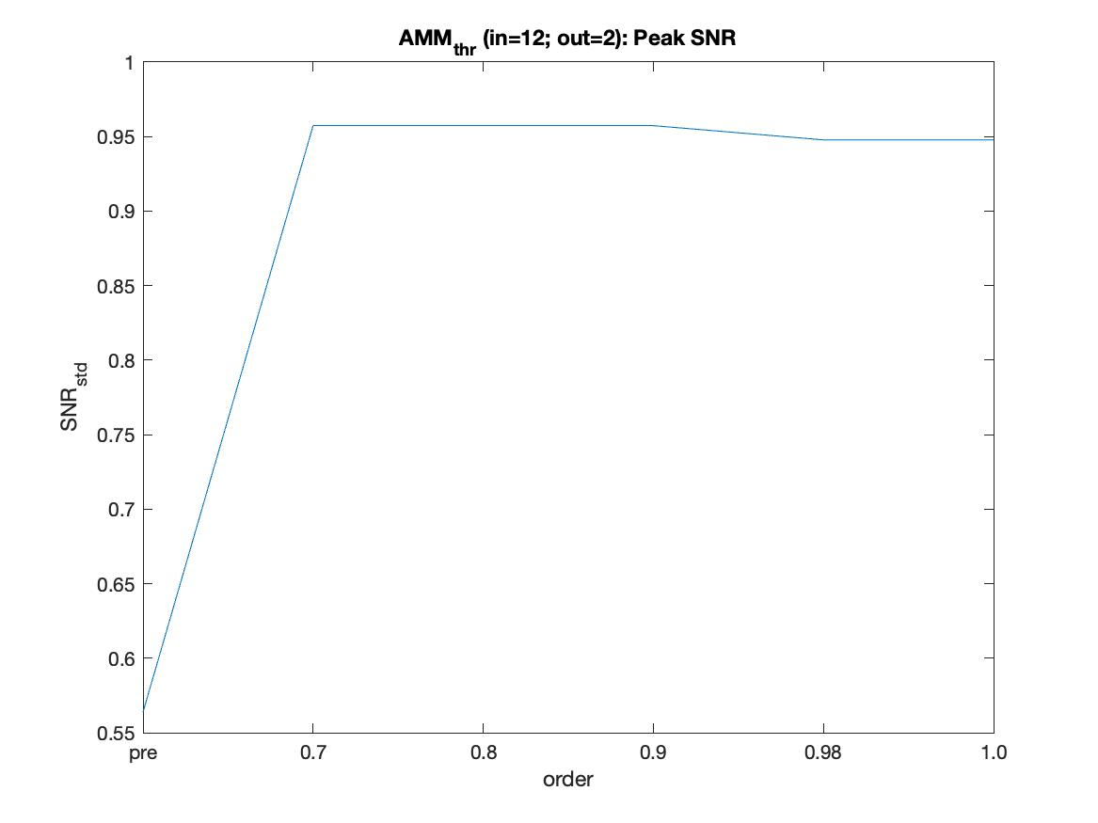
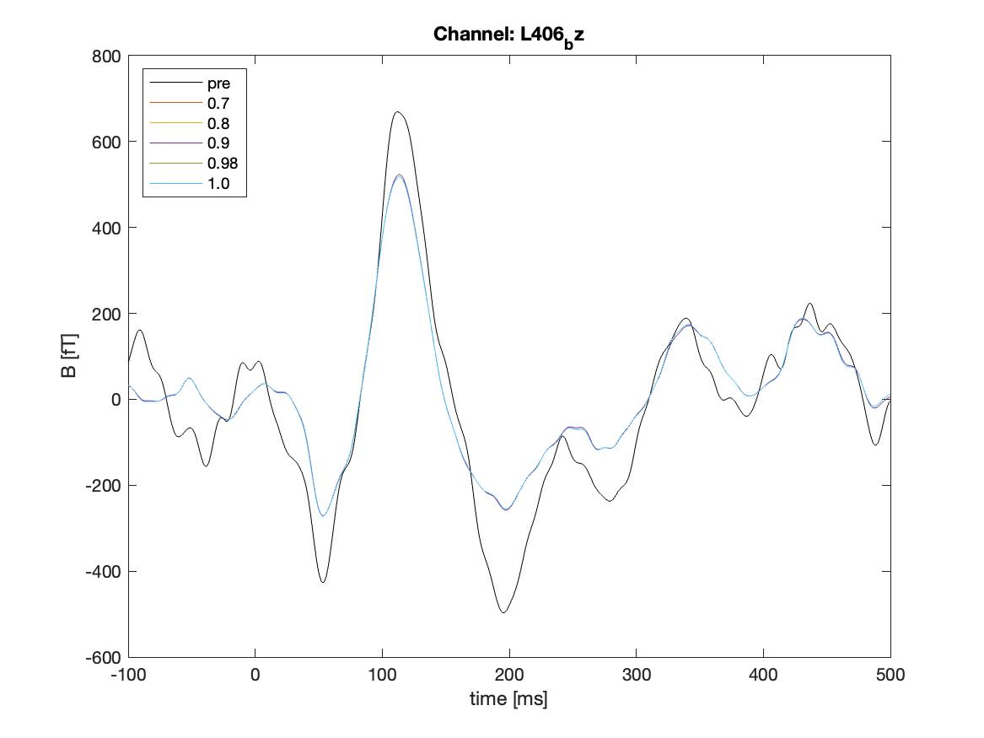
Results
Signal-to-Noise Ratio
Iterative SSS:
  Temporal: unstable
  Spatial: problems with source reconstruction
HFC+AMM:
  Signal drop at high order/L_{out}
  Oscillatory spatial patterns appear at higher order/L_{out}
AMM (temporal):
  Minor SNR increase at lower thresholds
tAMM: Peak channel vs thr

Slide 19
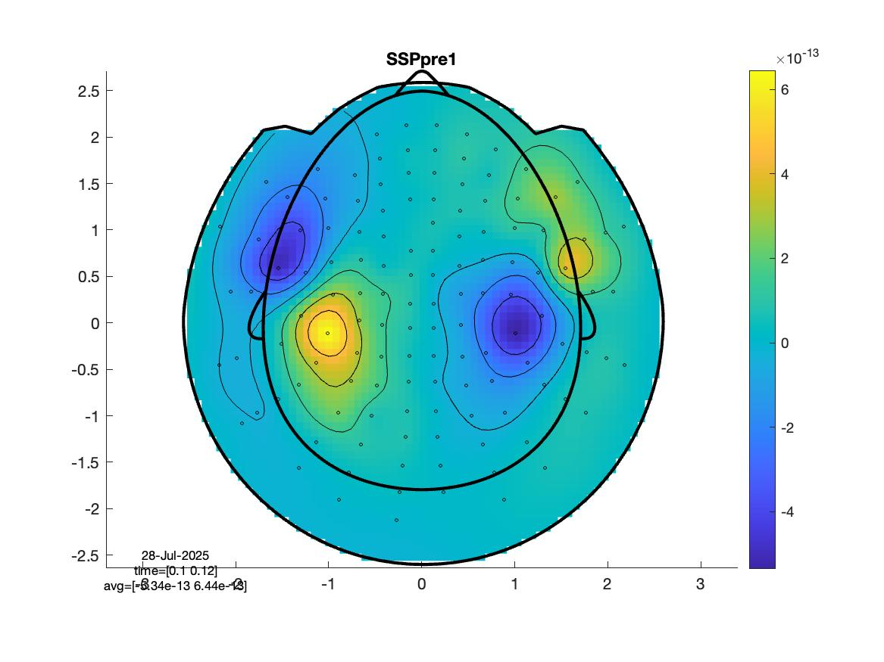

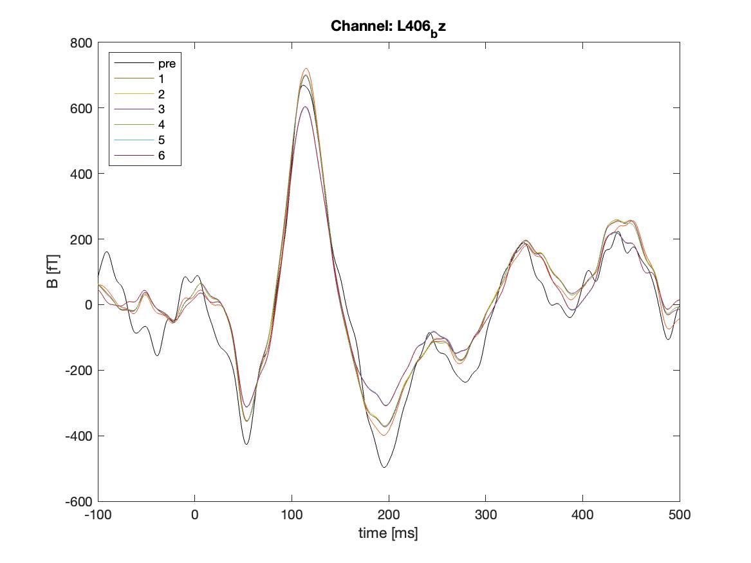
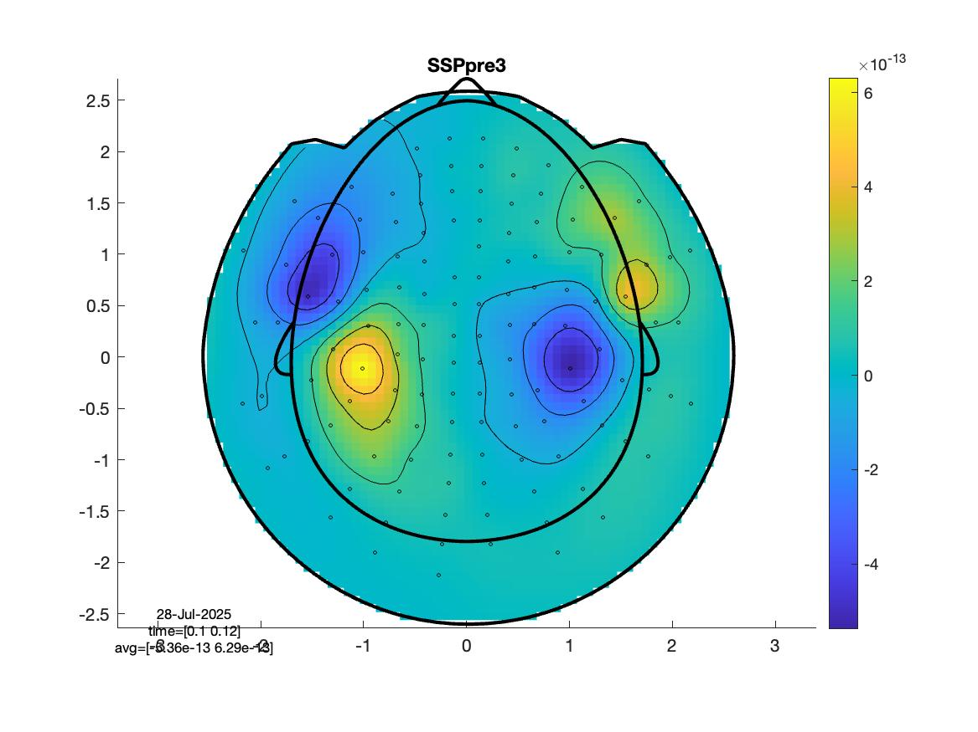
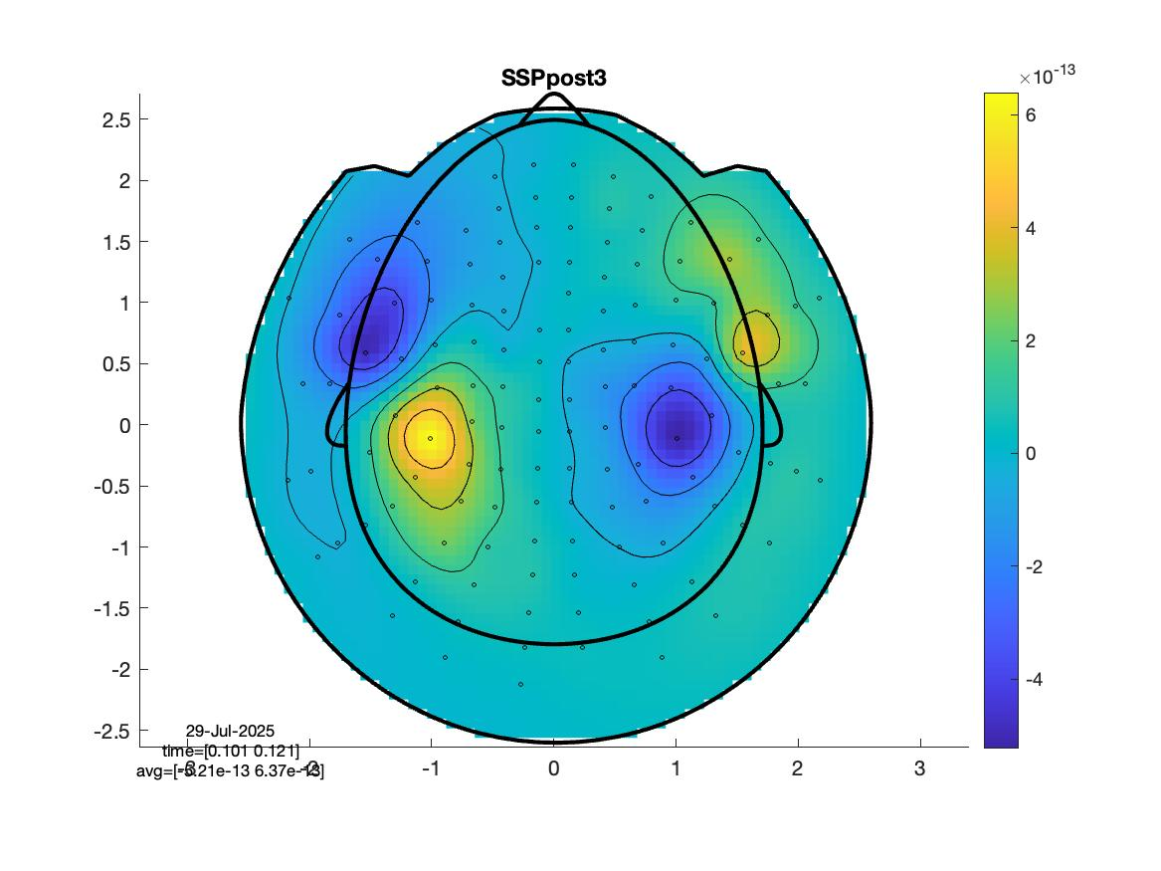
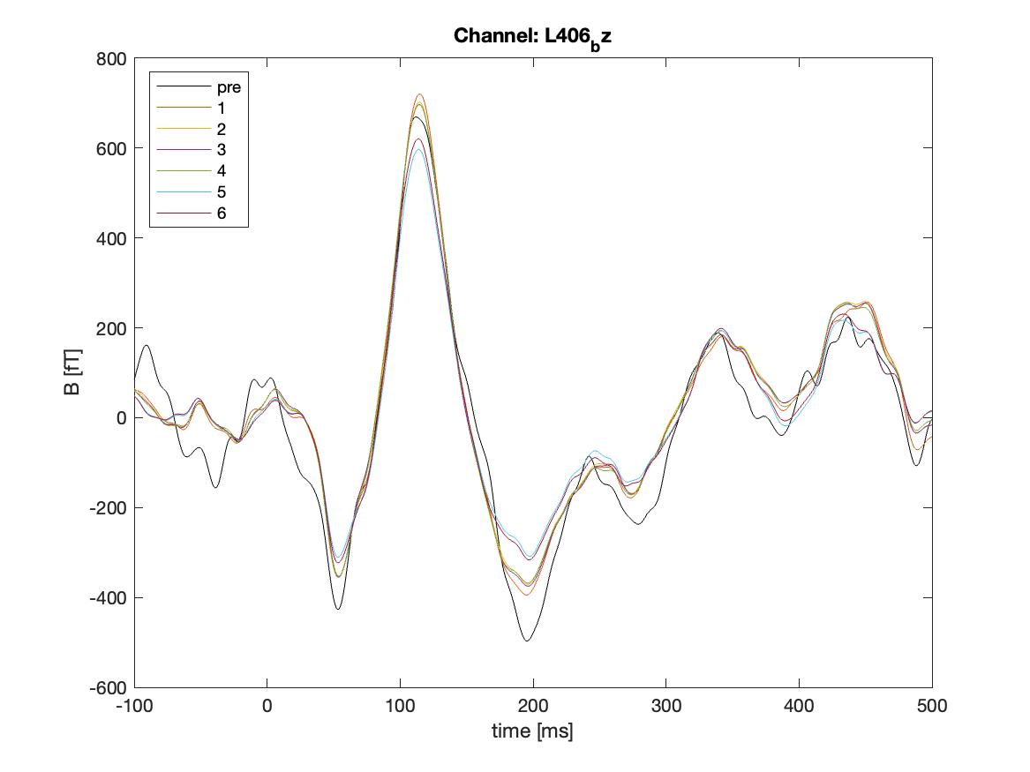
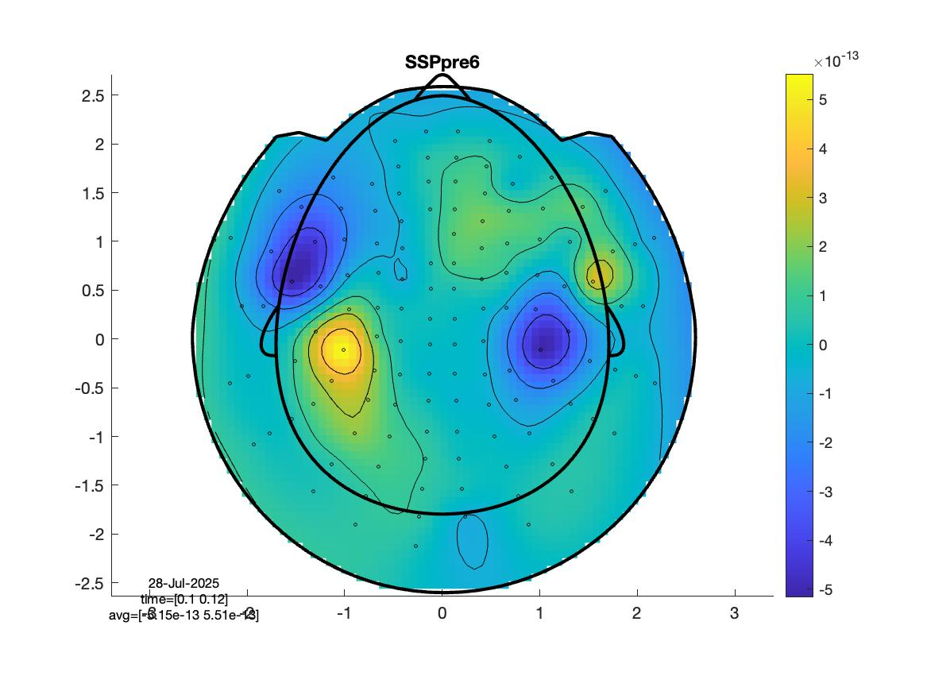
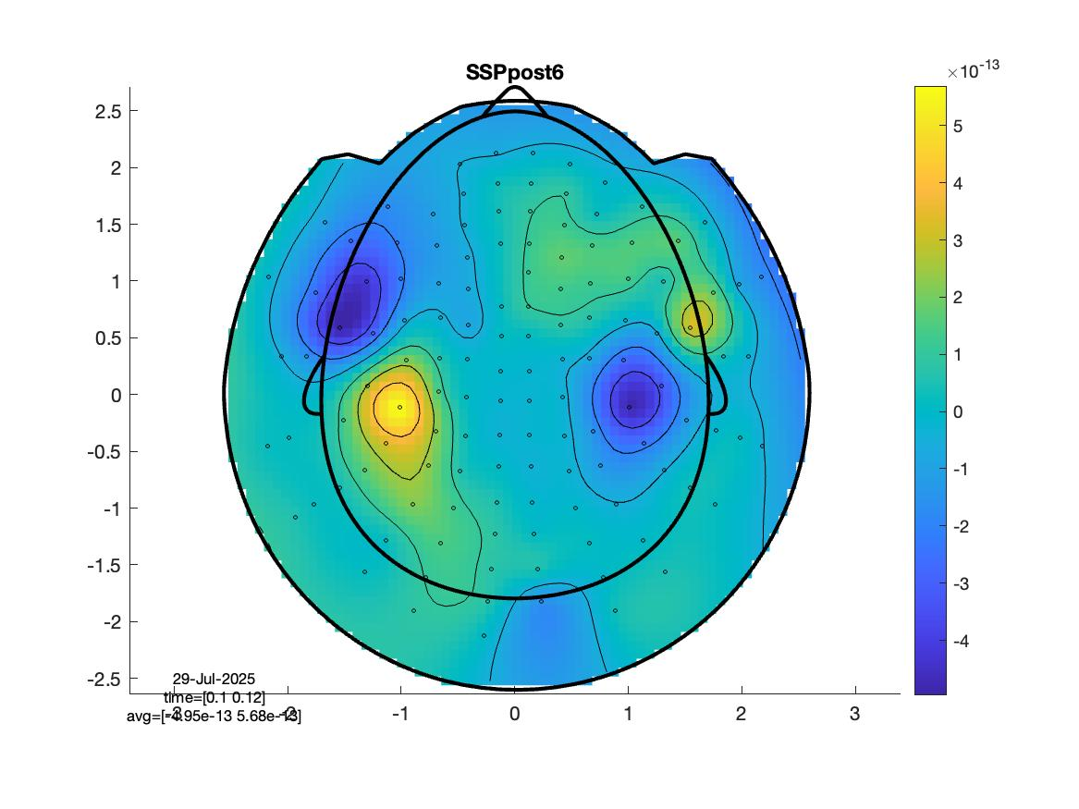
Results
SSP_{before}:
Peak channel vs n_{comp}
SSP:
  Good signal integrity
  Minor differences between empty room before and after
SSP_{after}:
Peak channel vs n_{comp}
08/08/2025
19

Slide 20
Conclusions/Recommendations

Slide 21
Conclusions/Recommendations
HFC, AMM and SSP perform well but parameter choice important
Avoid SSS/tSSS (for now)
If signal amplitudes or topography are important, less is more:
  1st order HFC, AMM with L_{out} = 1, or SSP (≤4 components)
When using AMM: L_{in}≥10
For high participant noise, e.g., dental wire: tAMM (i.e., thr < 1)
For strong noise sources:
  SSP if interference is present in reference data
  Otherwise: AMM with high L_{out}, but: beware of spatial filtering artifacts and amplitude changes

Slide 22
Conclusions/Recommendations
Record empty room after (moving sensors as little as possible)
Limitation: Tested only for Fieldline Hedscan
Next:
  Real data with dental noise
  Dual and triaxial data

Slide 23








Thank you!

