Slide 1

Fast total field OPM for muscle measurements: first in vivo recordings in MyoQuant project
Victor Lebedev (PTB, Berlin)
13th Workshop on optically-pumped magnetometers
2025-08-08

Slide 2
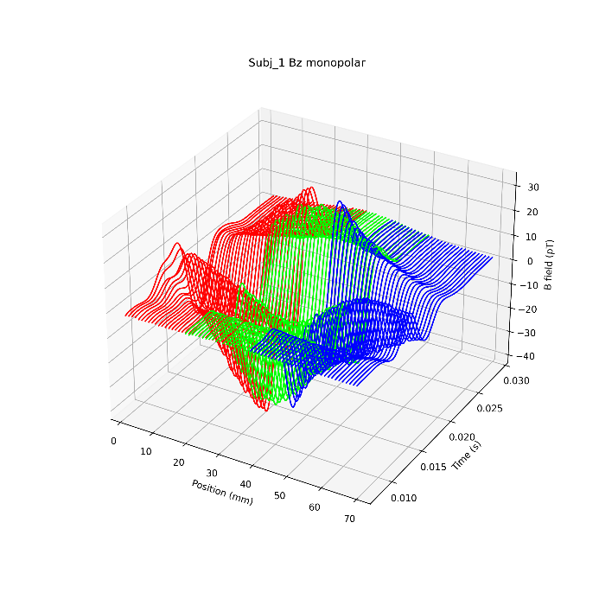
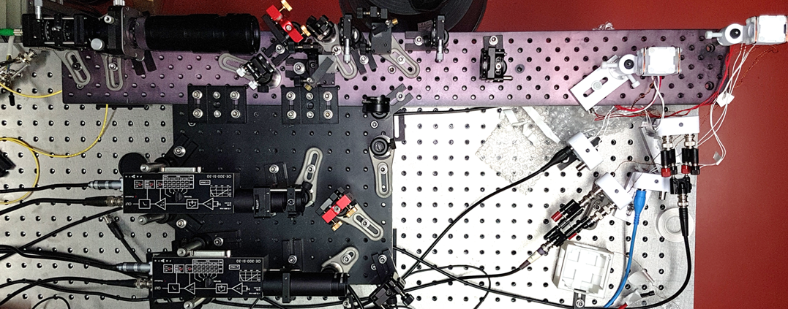
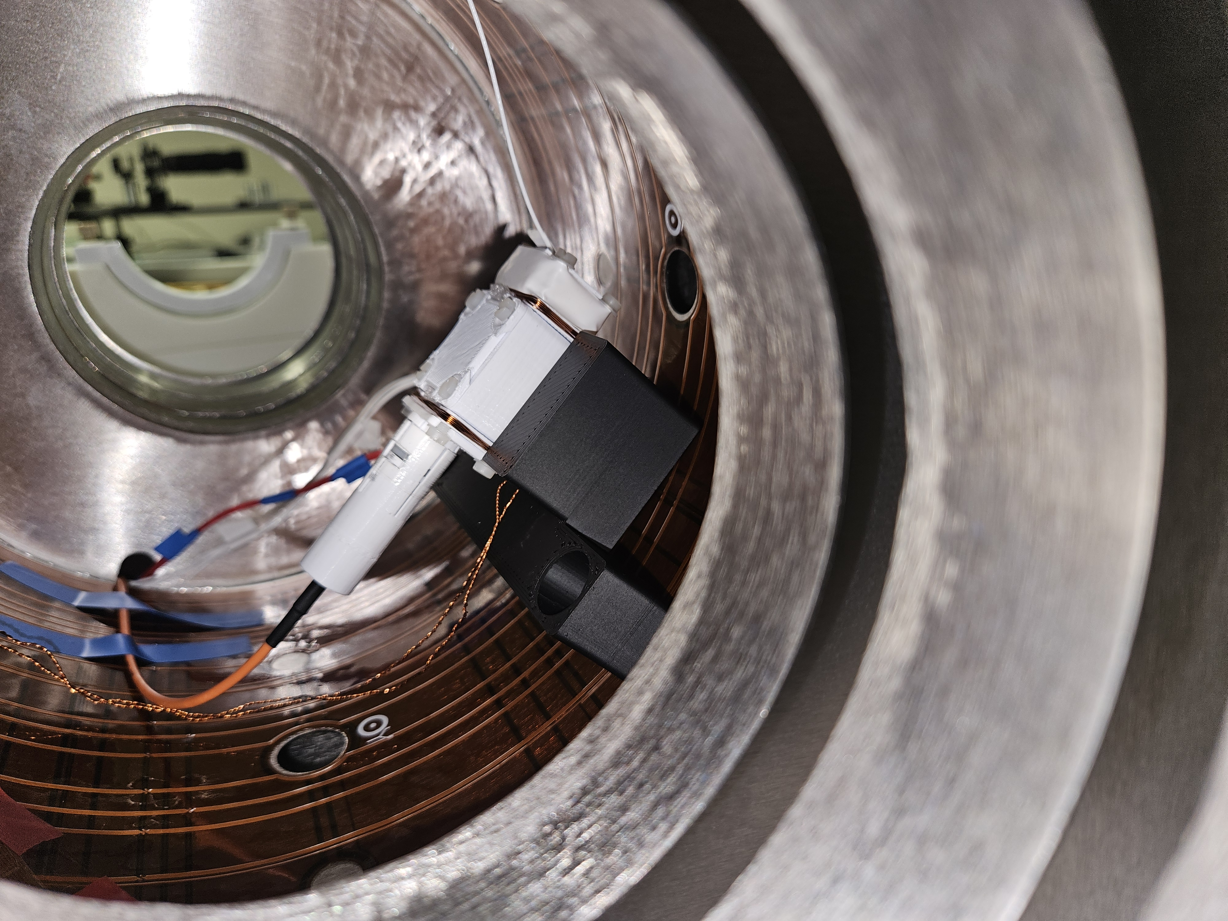
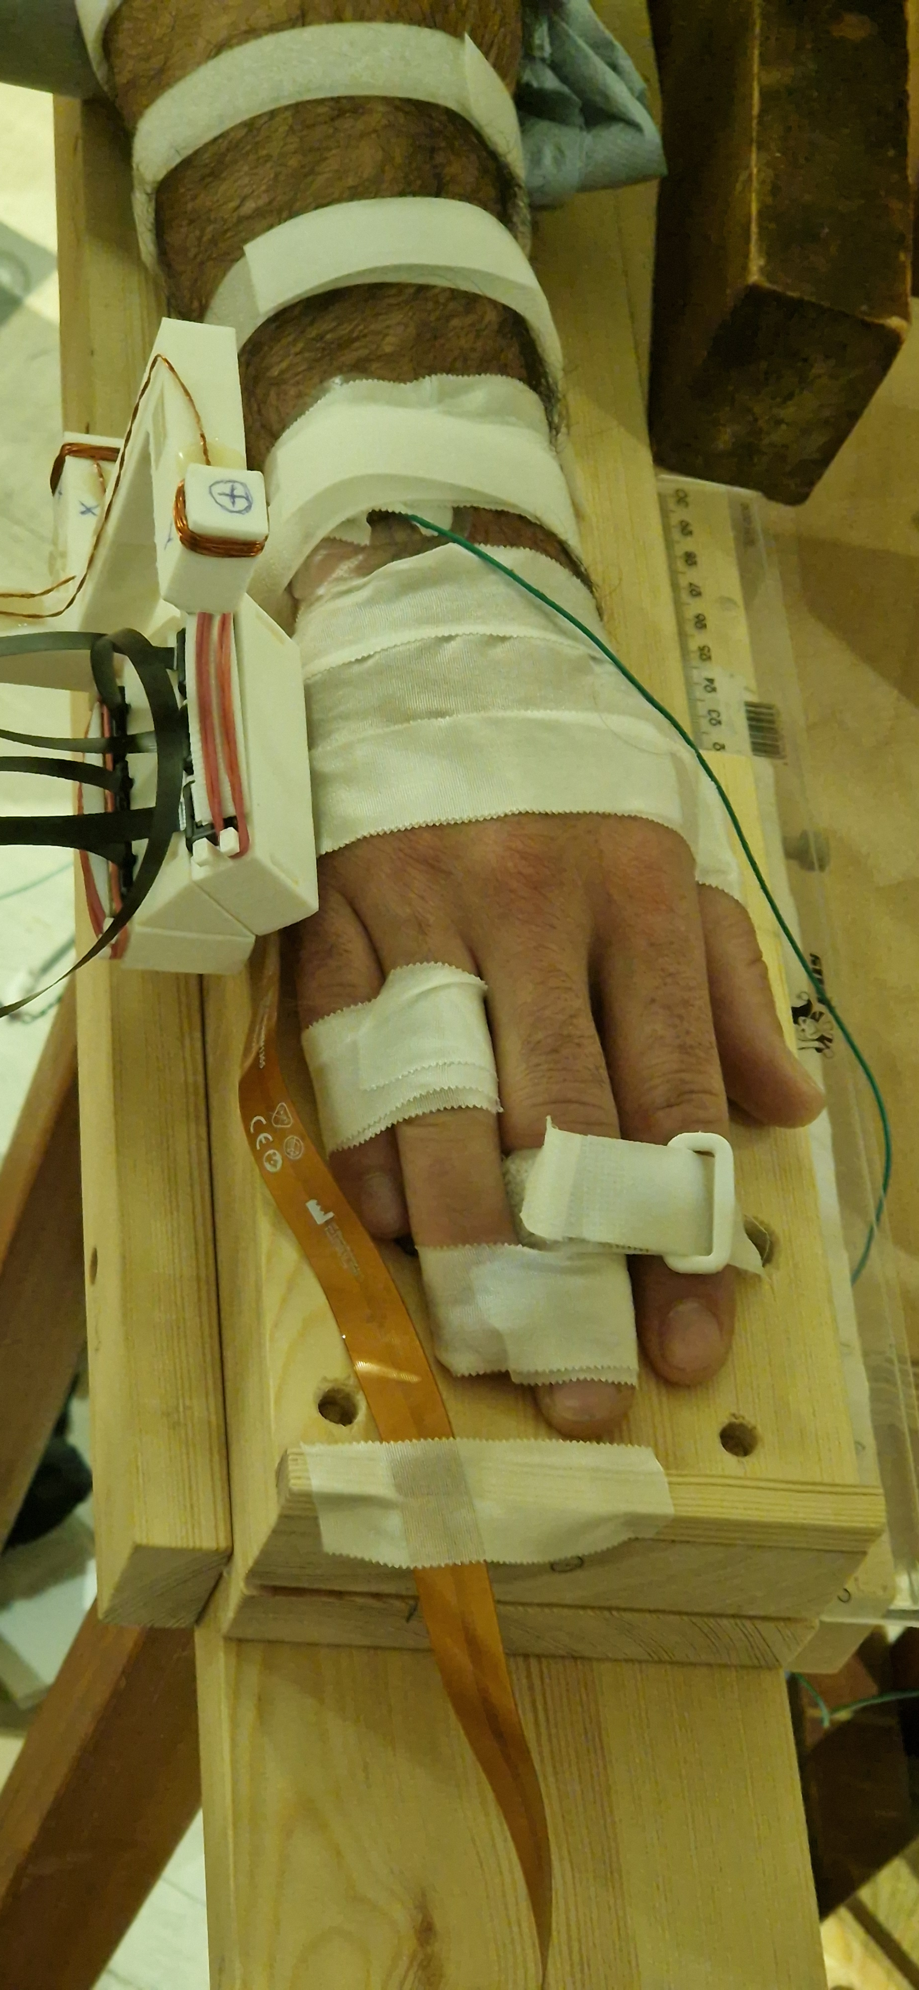
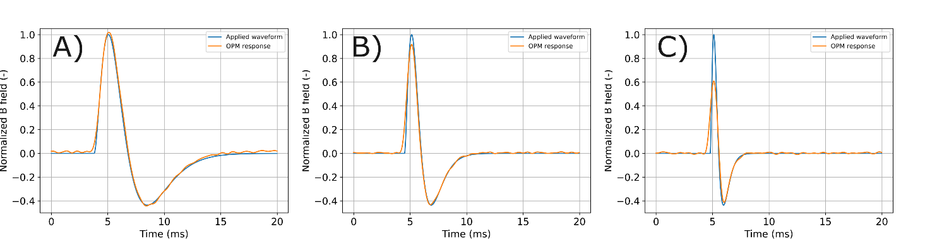
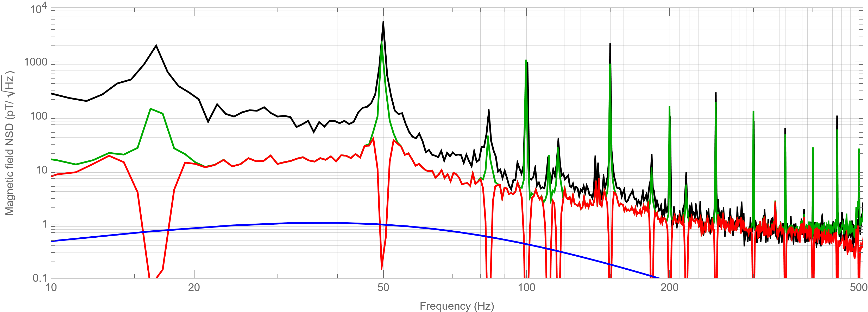
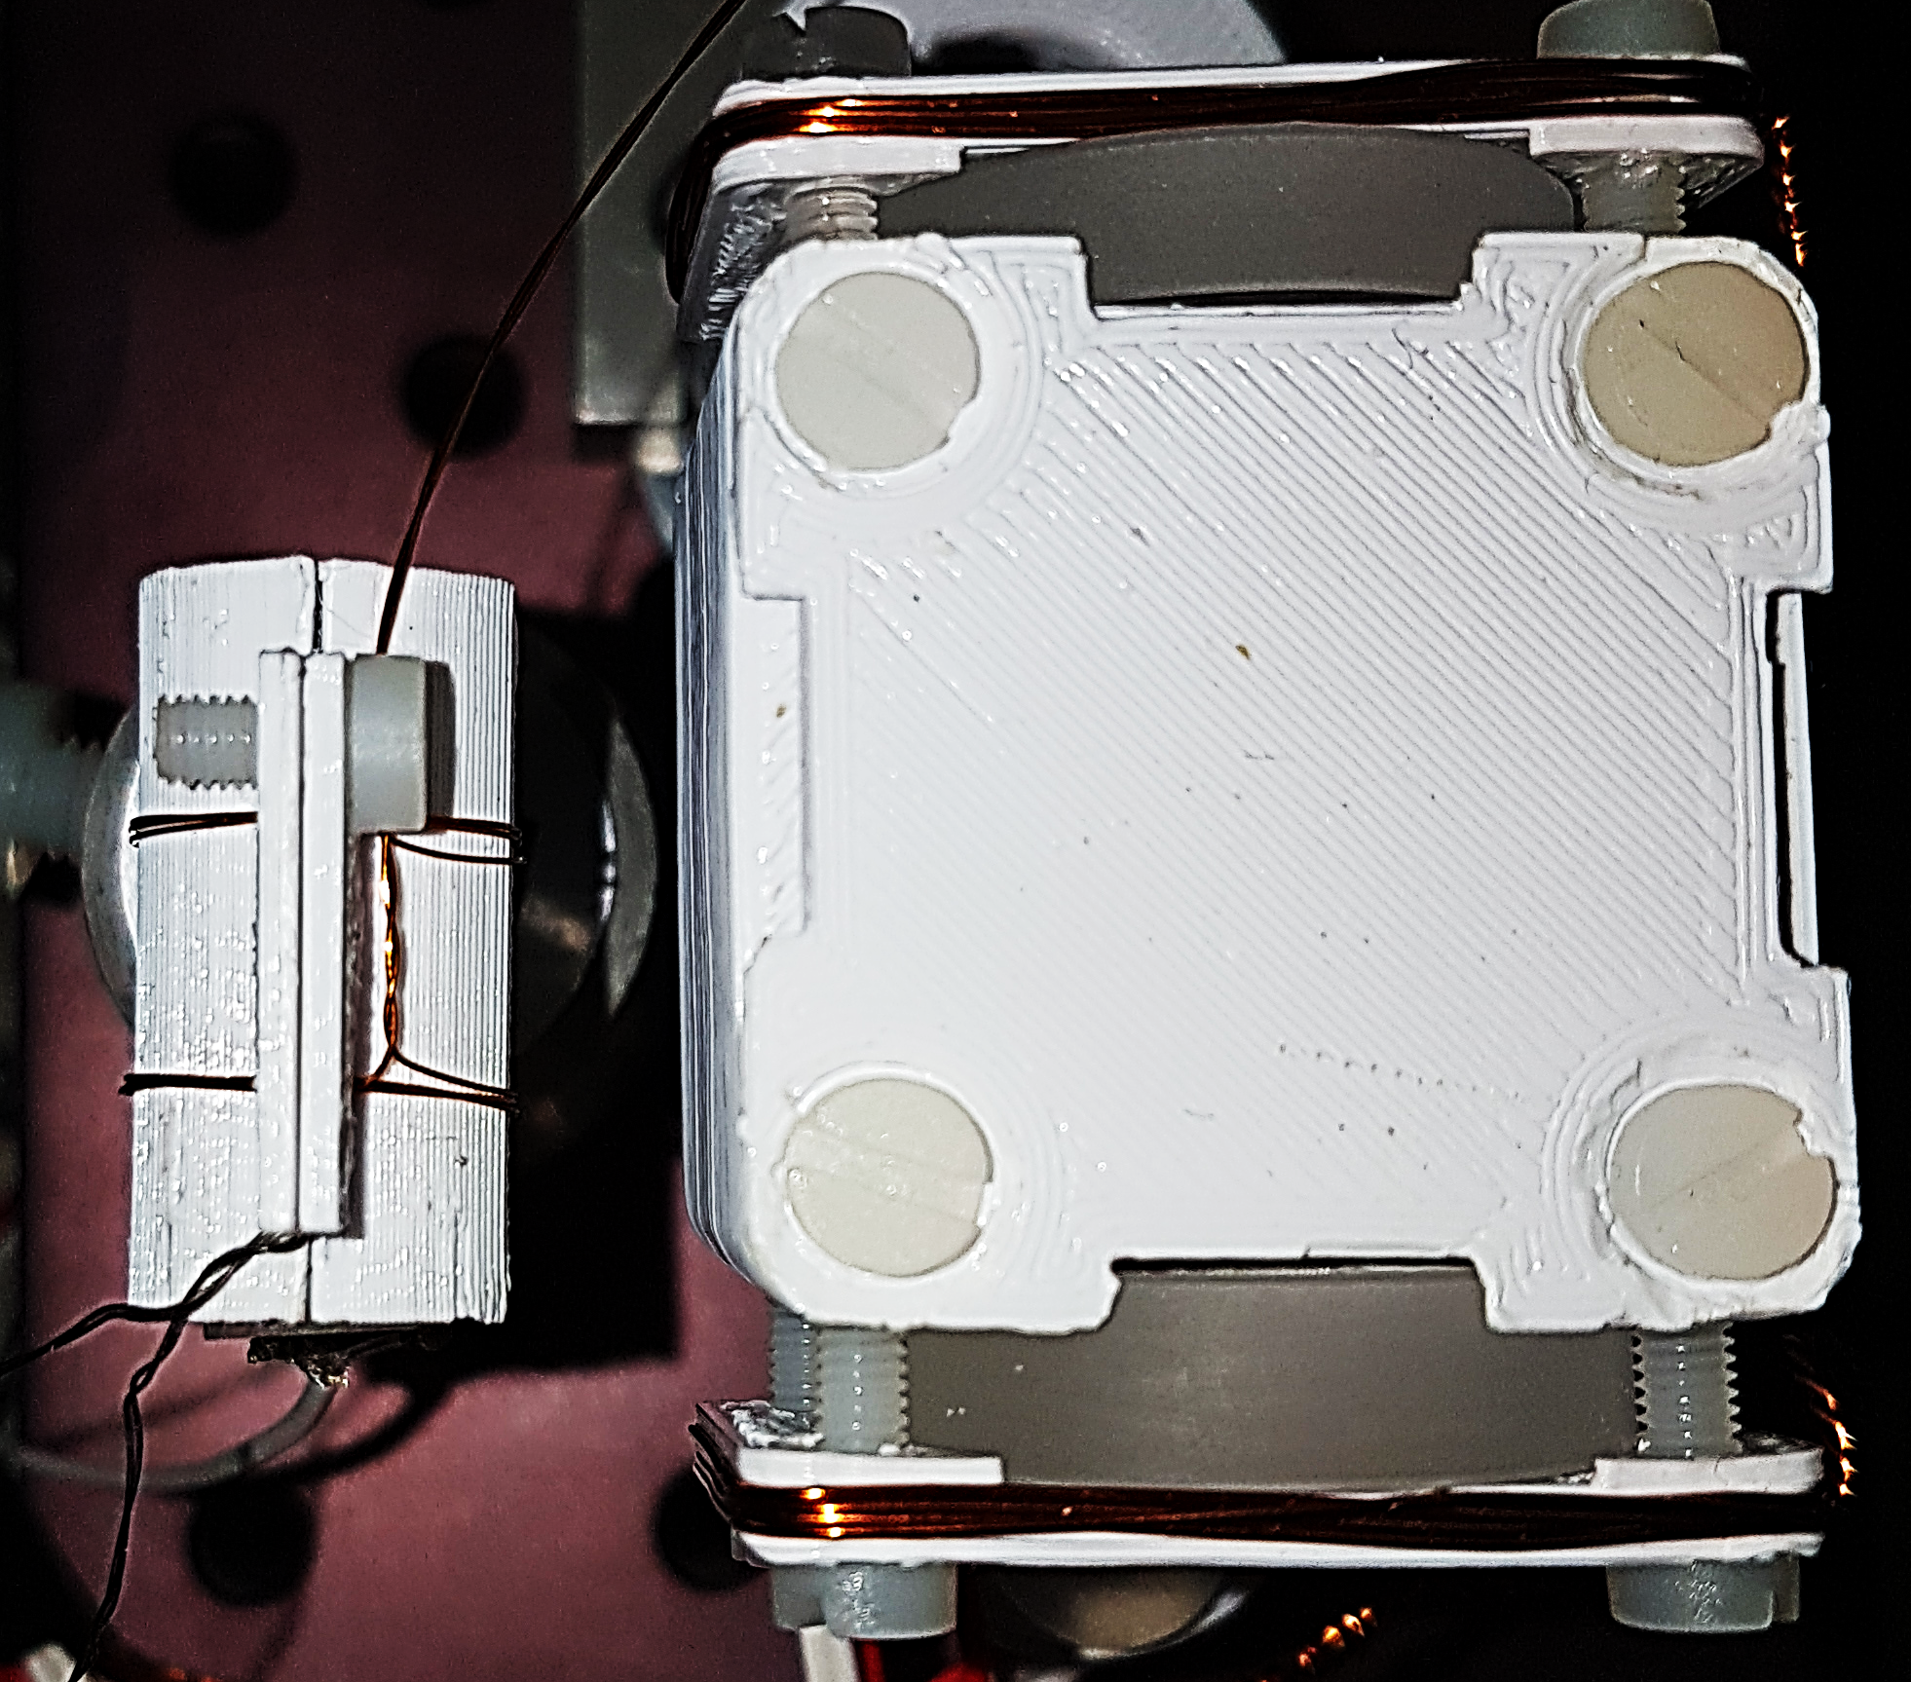
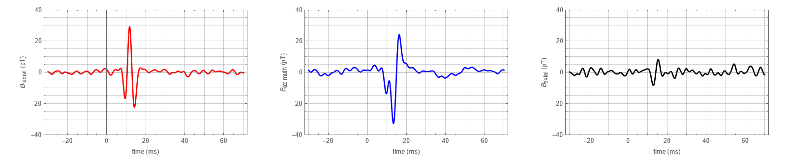
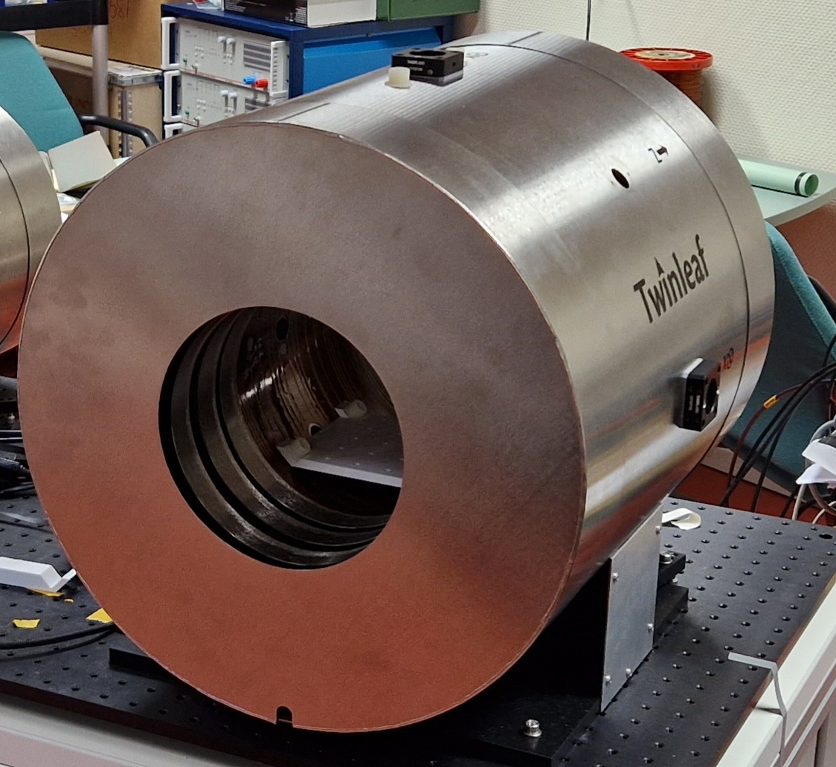
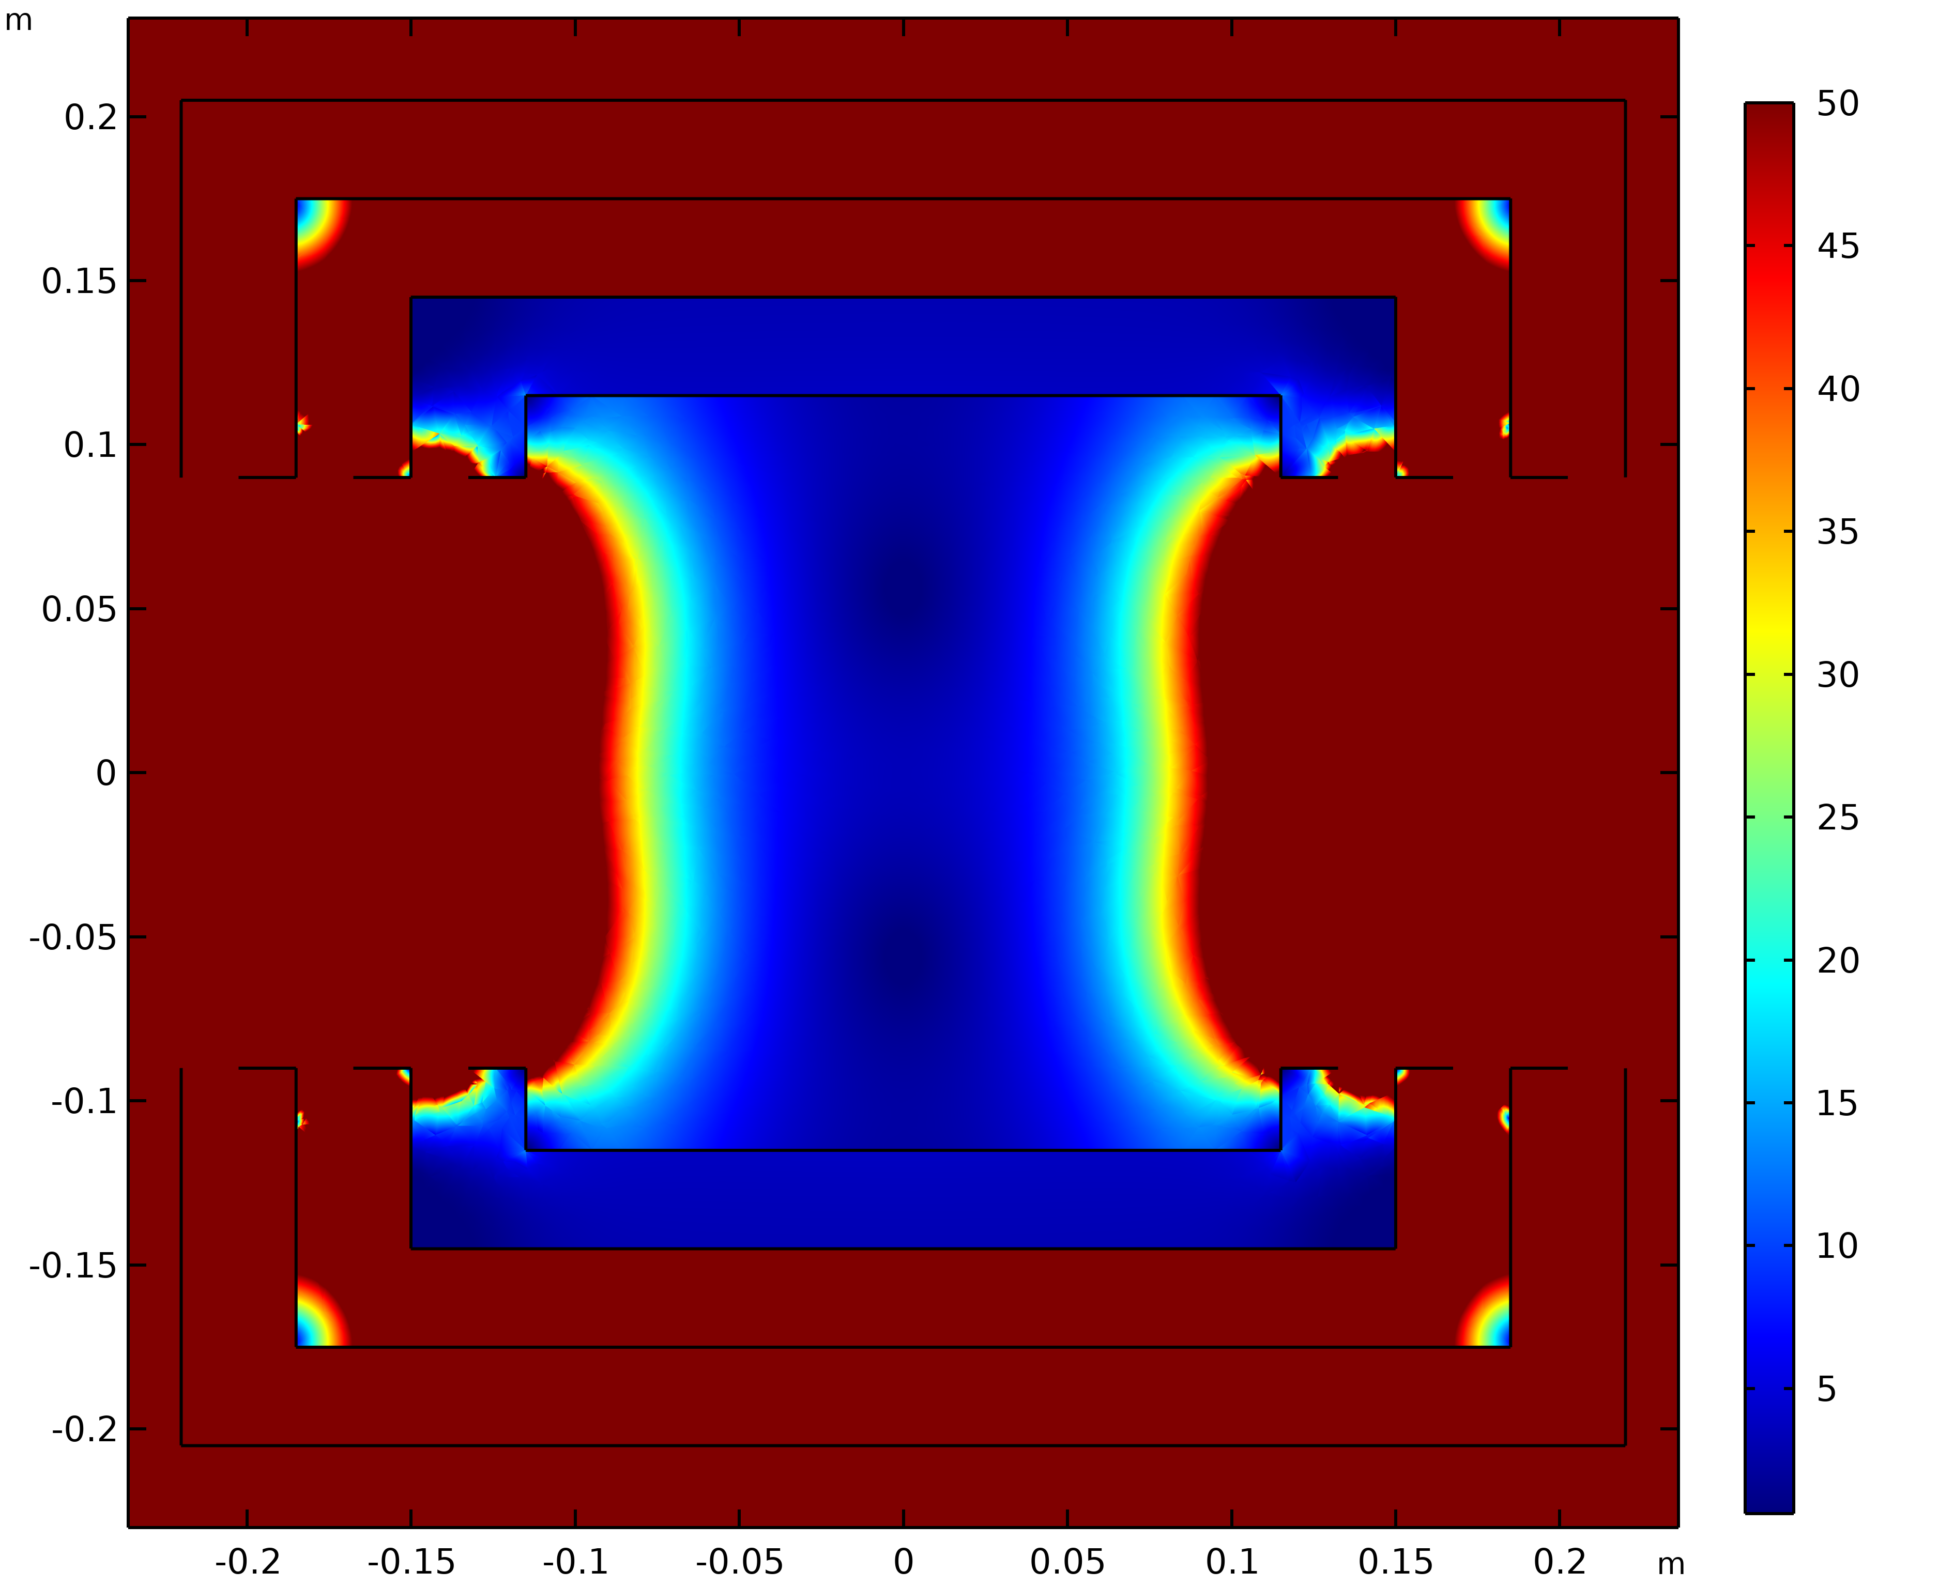
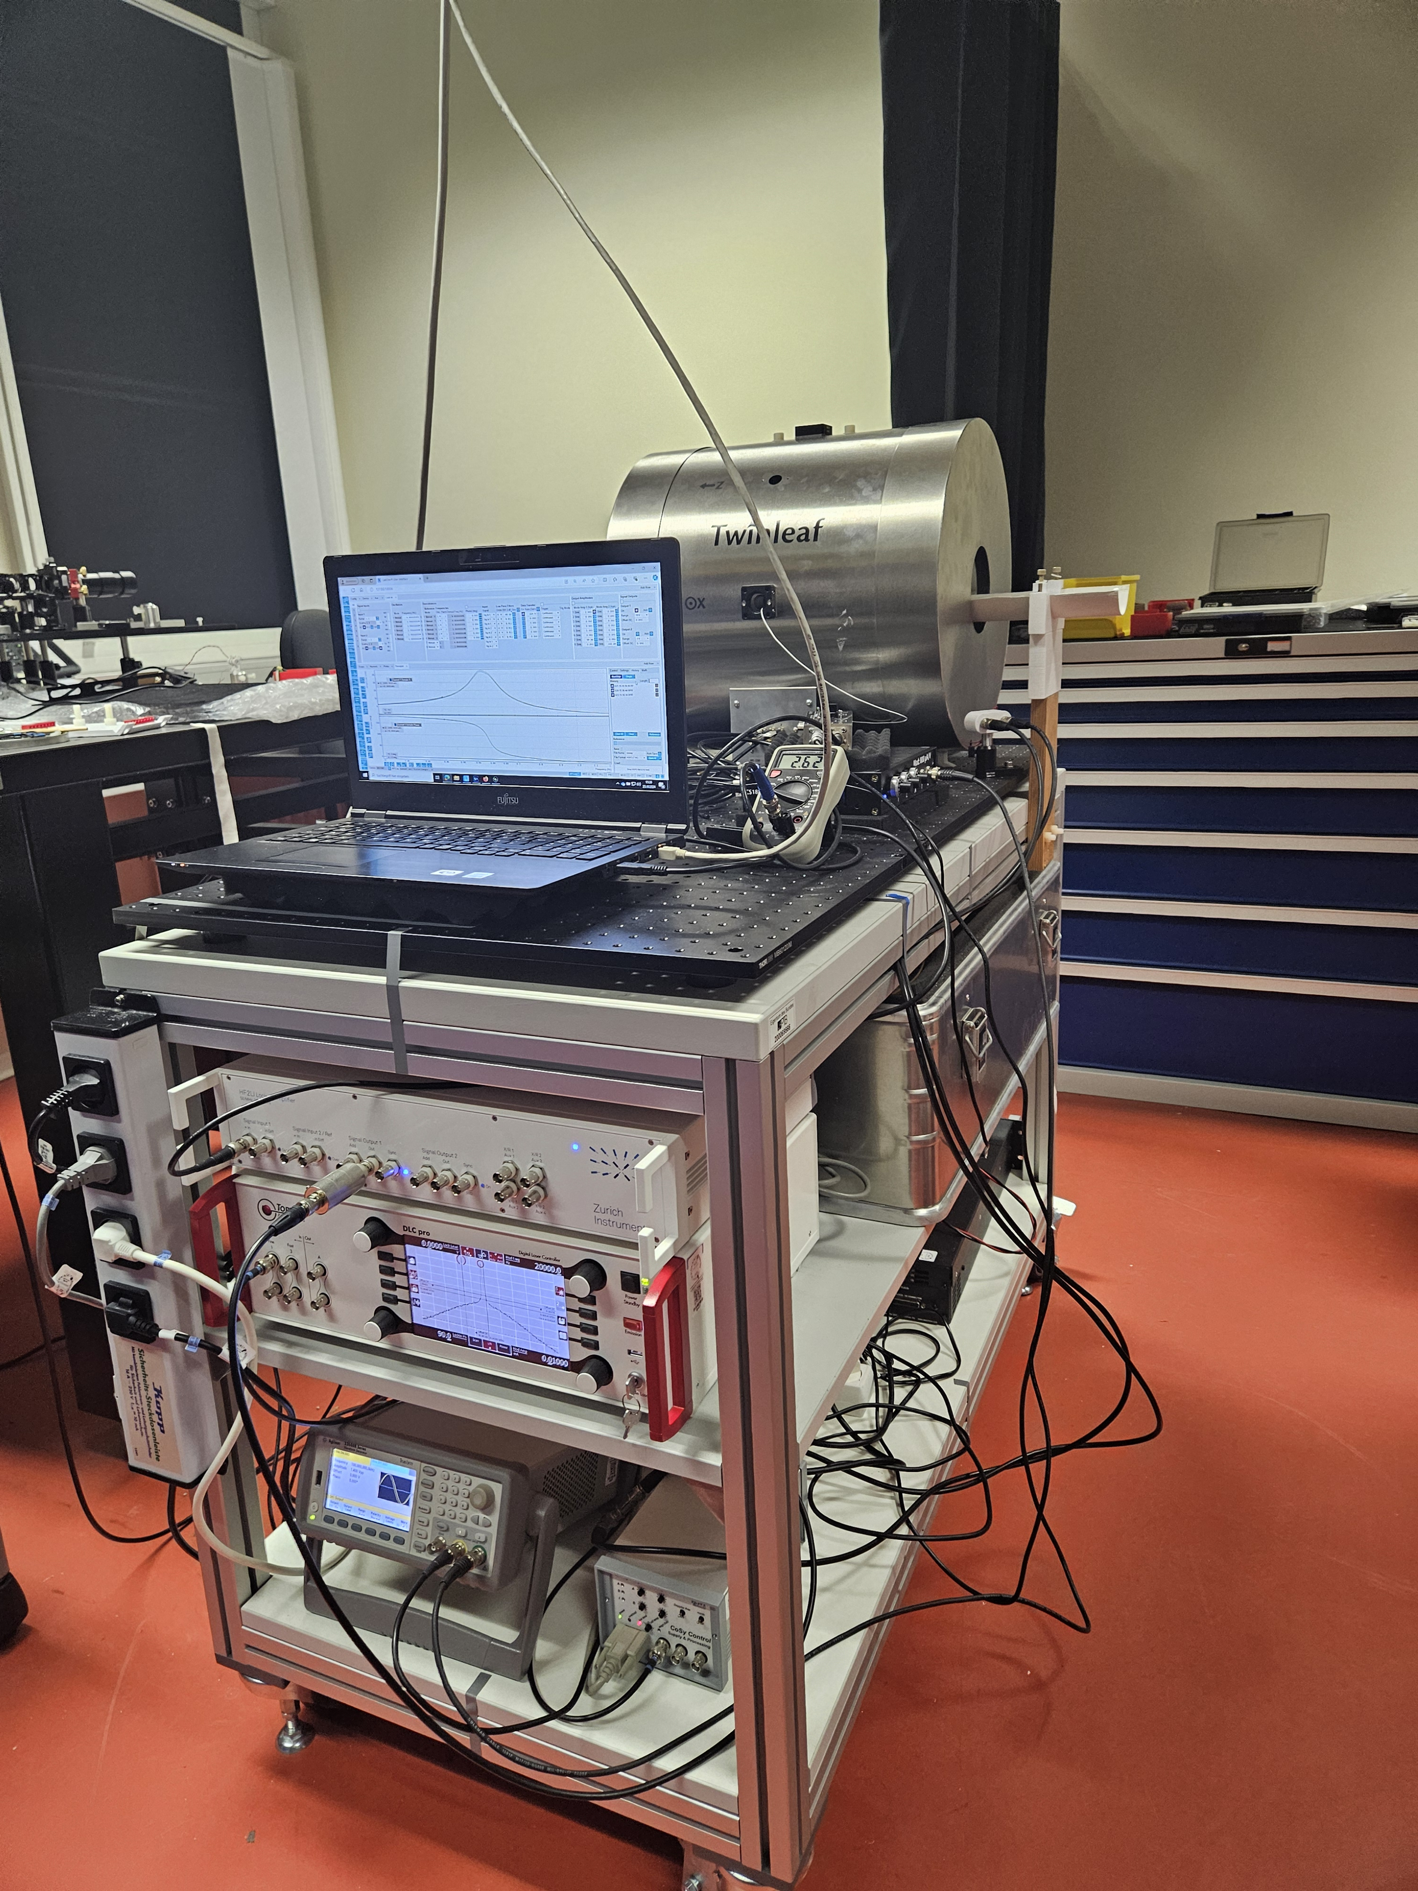
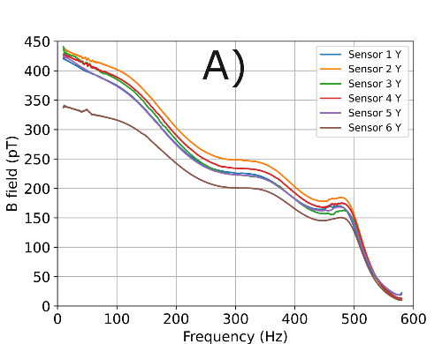
MyoQuant – Myography with OPMs
Exploration of EMG & MMG
Lab-based setups and evaluation
Miniaturization of the probing unit
This talk: high-density MMG & EMG
8 cm
SQUID-MMG: Poster by Stefan Hartwig
Earlier works:
Kruse et al. 2025 https://dx.doi.org/10.1088/2057-1976/adaec5
Noury et al. 2025 http://iopscience.iop.org/article/10.1088/1741-2552/adeaeb
1 cm
Commercial sensor characterization
Shield design & feasibility validation of mobile magnetomyography (MMG)
System integration MyoQuant demonstrator
MMG in demonstrator
Nordenström et al. 2025,
https://doi.org/10.1117/12.3043675
Nordenström et al. 2024, https://www.nature.com/articles/s41598-024-69829-y

Slide 3
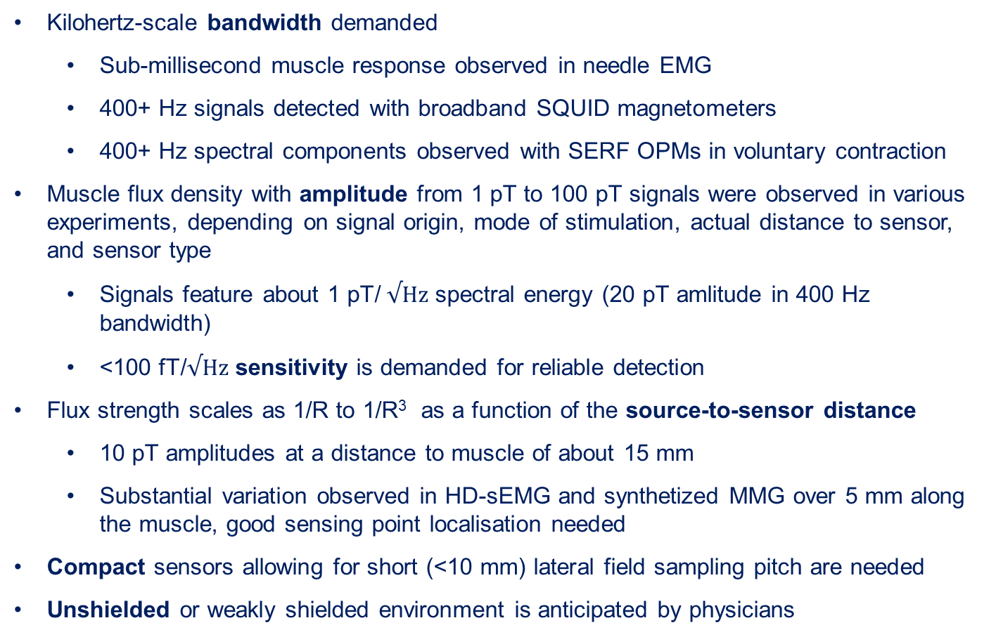
Magnetic sensor requirements
Kilohertz-scale bandwidth demanded
  Sub-millisecond muscle response observed in needle EMG
  400+ Hz signals detected with broadband SQUID magnetometers
  400+ Hz spectral components observed with SERF OPMs in voluntary contraction
Muscle flux density with amplitude from 1 pT to 100 pT signals were observed in various experiments, depending on signal origin, mode of stimulation, actual distance to sensor, and sensor type
  Signals feature about 1 pT/ $√Hz$ spectral energy (20 pT amlitude in 400 Hz bandwidth)
  <100 fT/$√Hz$ sensitivity is demanded for reliable detection
Flux strength scales as 1/R to 1/R³ as a function of the source-to-sensor distance
  10 pT amplitudes at a distance to muscle of about 15 mm
  Substantial variation observed in HD-sEMG and synthetized MMG over 5 mm along the muscle, good sensing point localisation needed
Compact sensors allowing for short (<10 mm) lateral field sampling pitch are needed
Unshielded or weakly shielded environment is anticipated by physicians
poster by S.Hartwig

Slide 4

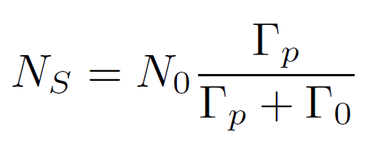
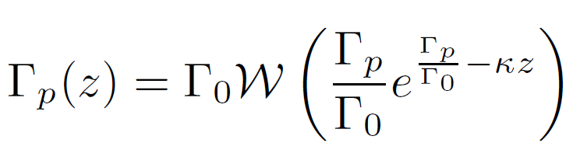
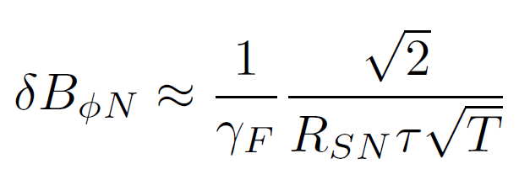
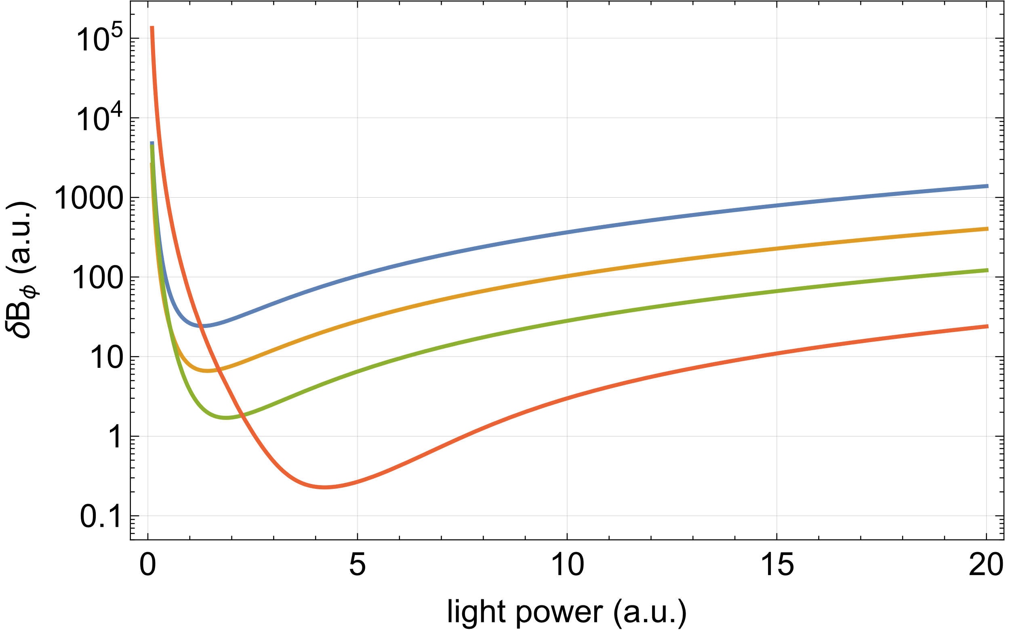
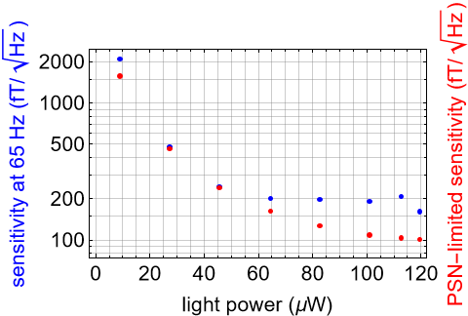
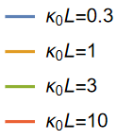
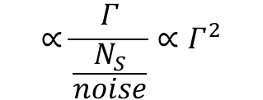
OPM in moderately optically dense vapor
Bandwidth expansion via laser power broadening
Degree of spin polarization is maintained/improved
Pumping rate in optically dense medium
$$∝\frac{Γ}{\frac{N_{S}}{noise}}∝Γ^{2}$$
Cramer-Rao phase noise limit is yet nonlinear
Experimental and
photon-shot-noise limited senitivities
Theoretical phase noise limited sensitivity

Slide 5
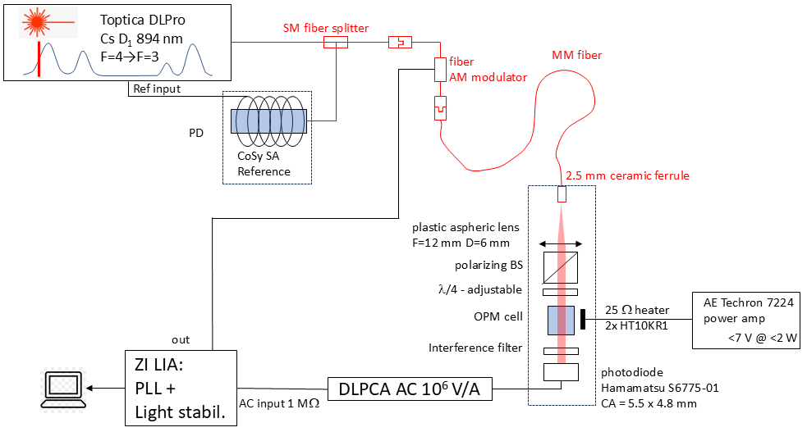
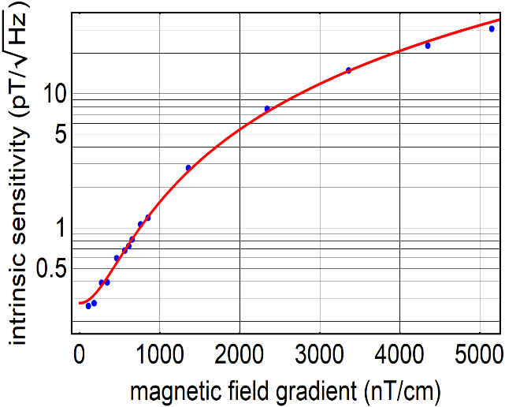
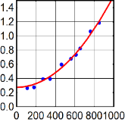
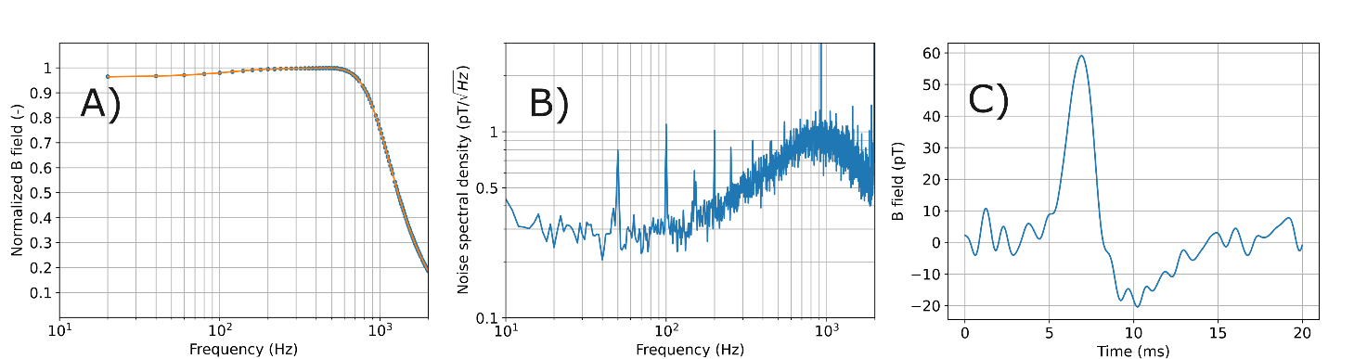
OPM with miniature probe
Gradient robustness
Quadratic fit
Frequency response
Sensitivity
Test signal (≈ 60 averages)
≈ 300 fT/√Hz
Bandwidth ≈ 1000 Hz

Slide 6
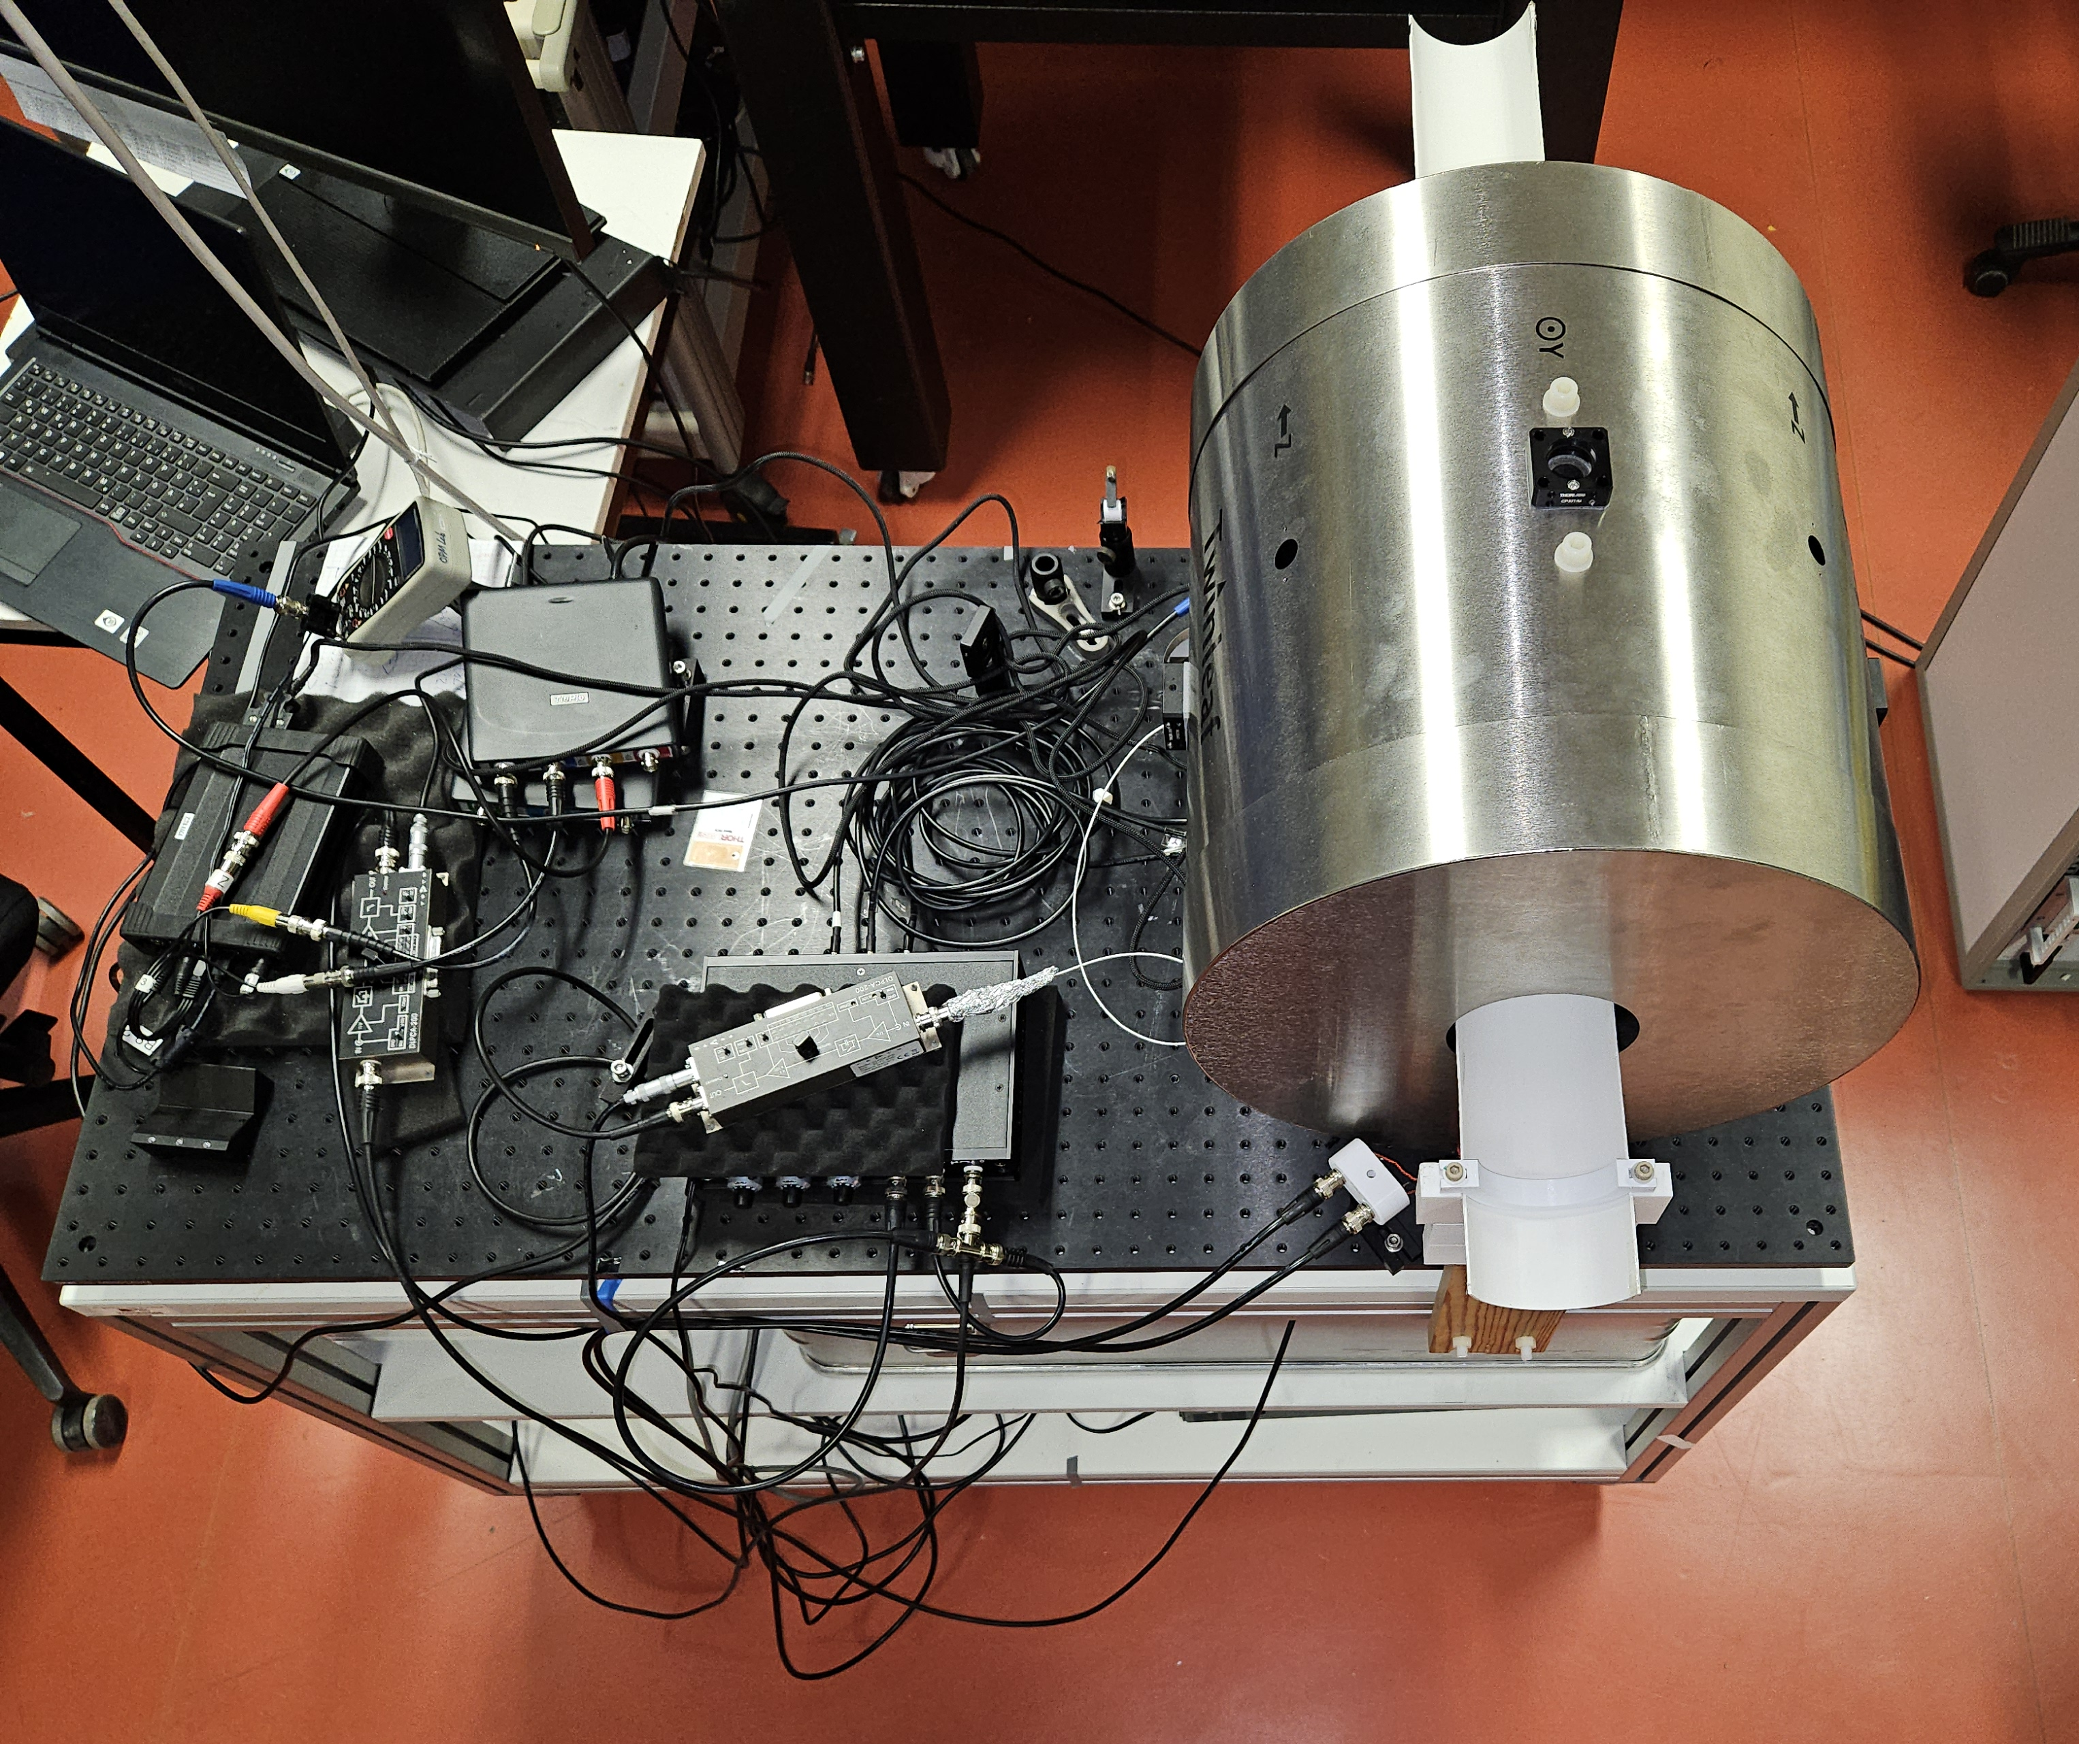
MyoQuant MMG OPM demonstrator
Decoupled arm rest
MyoQuant shield
Laser and optics box
Power amp for heating
Controller laptop
Lock-in amplifier
Laser controller
Waveform generator
Laser stabilization unit
OPM prototype
OPM mount

Slide 7
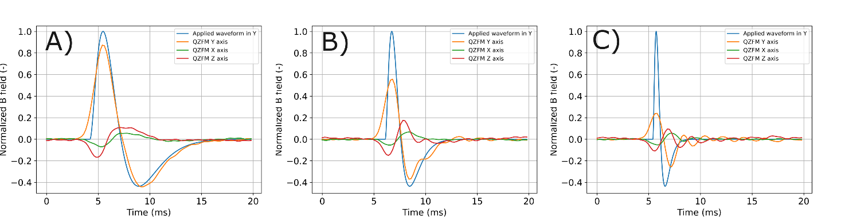
Commercial vs MyoQuant OPM
Test signals applied (Rosenfalck functions, blue) to built-in coils of shield
Slow
Intermediate
Fast
QuSpin
SERF
OPM
MyoQuant
OPM
MyoQuant prototype: much higher fidelity in measuring intermediate and fast signals

Slide 8
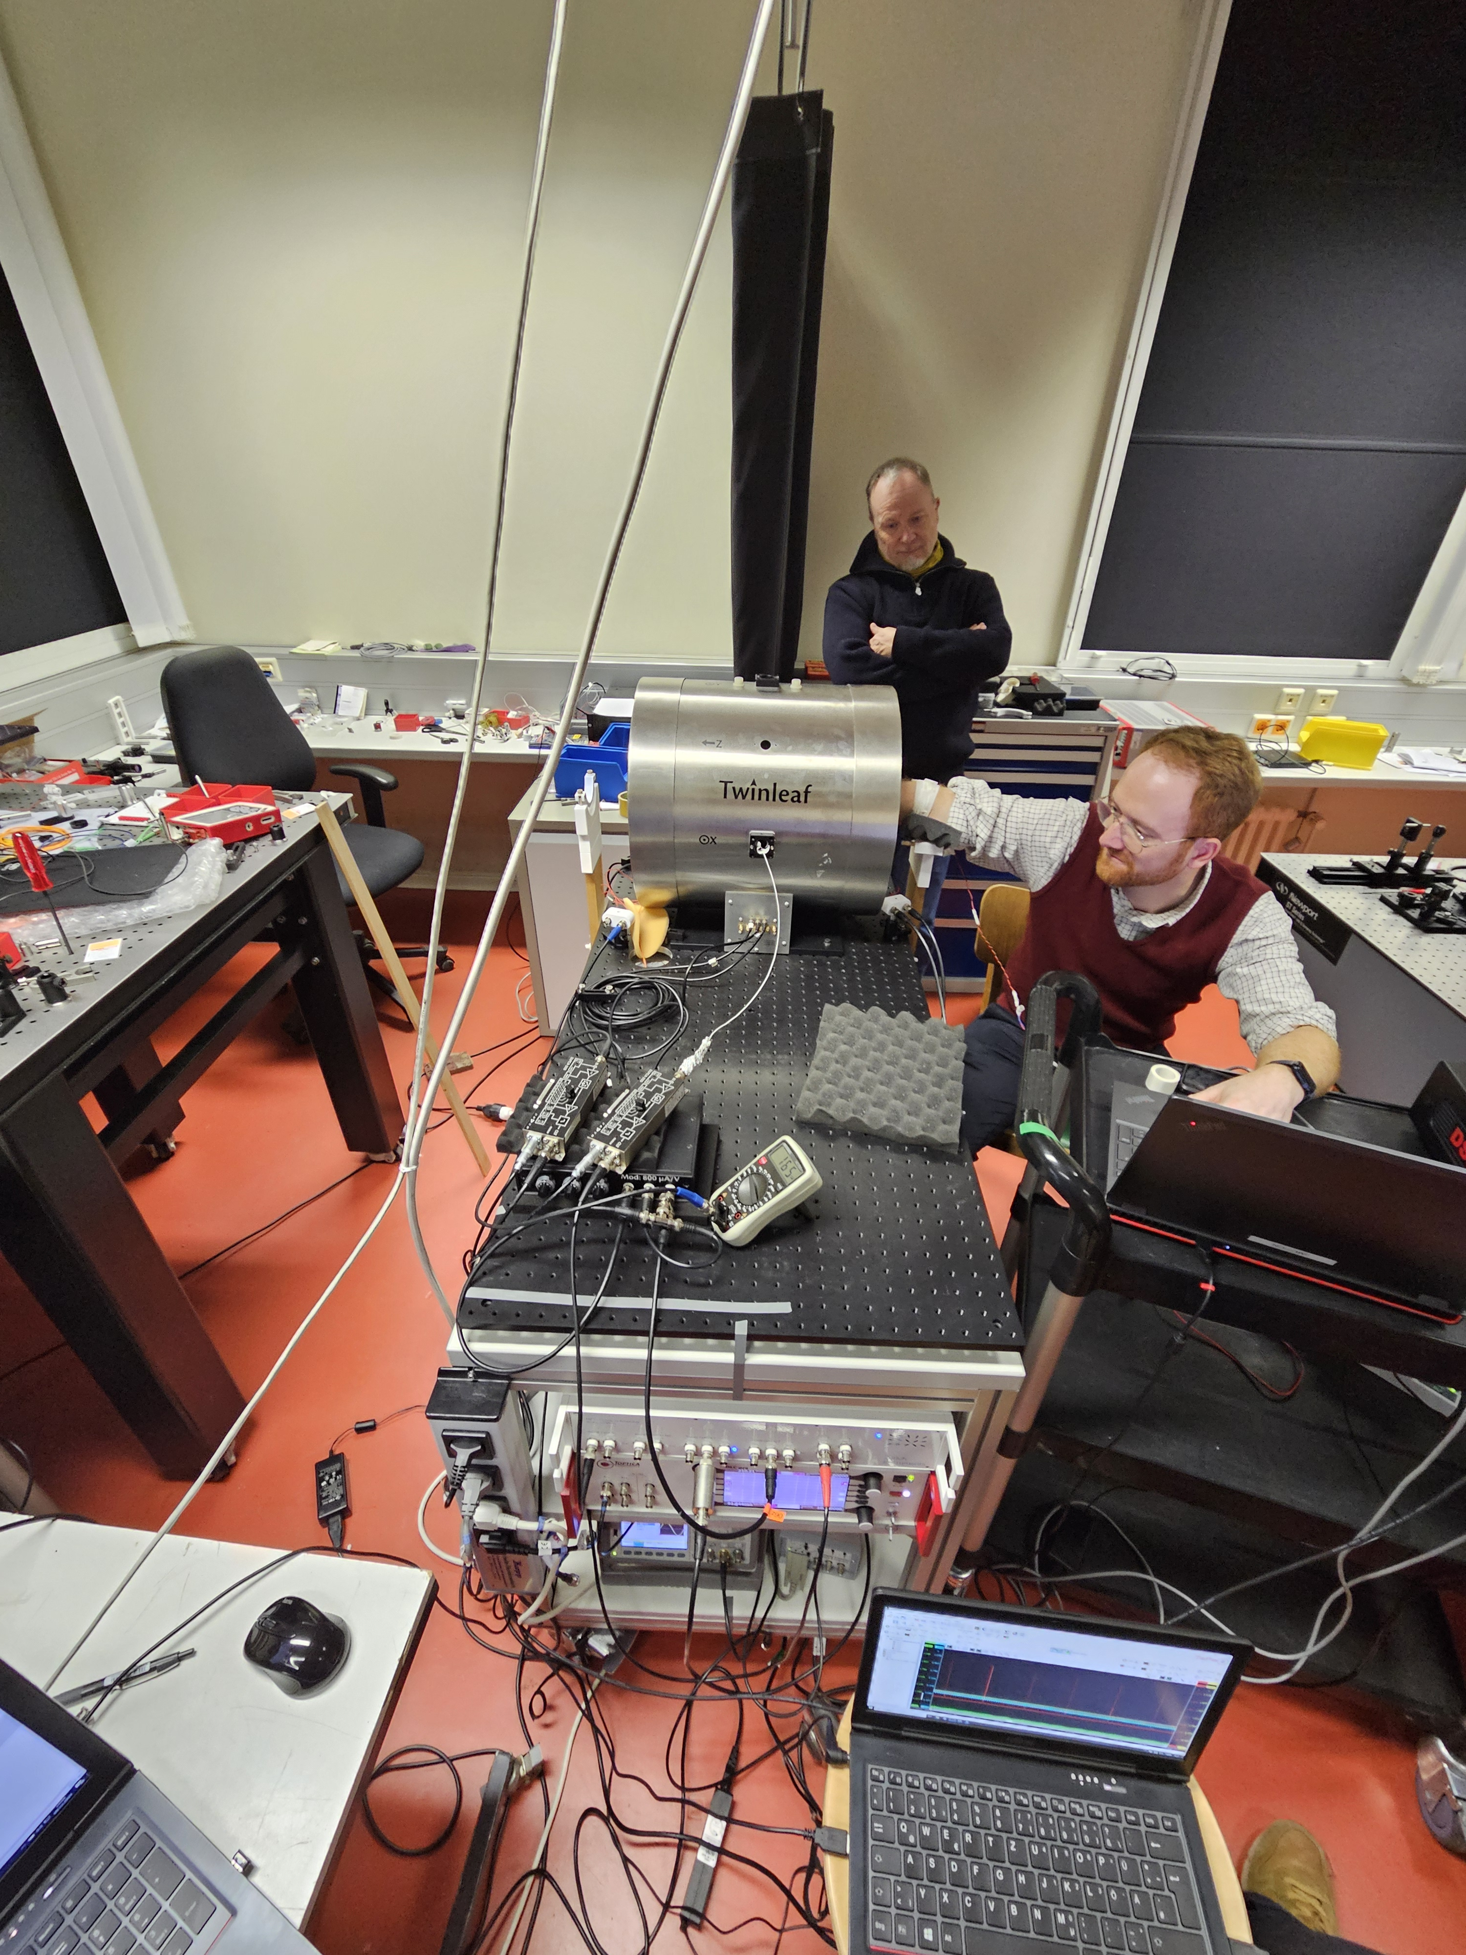
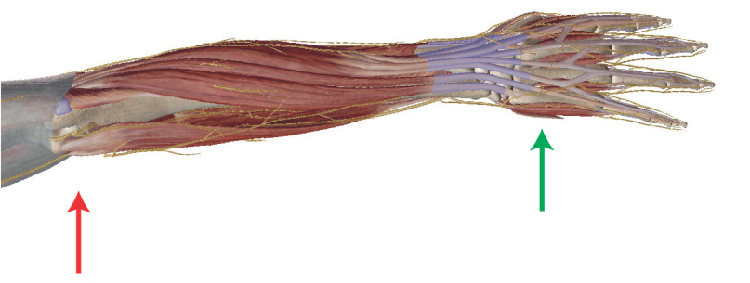
Proof-of-principle MMG in demonstrator
electrical stimulation
Sensitivity:
>0,3 pT/√Hz
at T_{int} = 70 °C,
T_{sensor} = 30 °C
Bandwidth:
1060 Hz
Stimulated ADM muscle,
60/100 Epochs
abductor
digiti minimi
muscle
(ADM)
radial
azimuthal
axial
B (pT)
B (pT)
B (pT)
≈ 60 averages
≈ 60 averages
≈ 100 averages
time (ms)
time (ms)
time (ms)
Myomagnetic fields successfully measured in vivo with MyoQuant OPM prototype and shield!

Slide 9
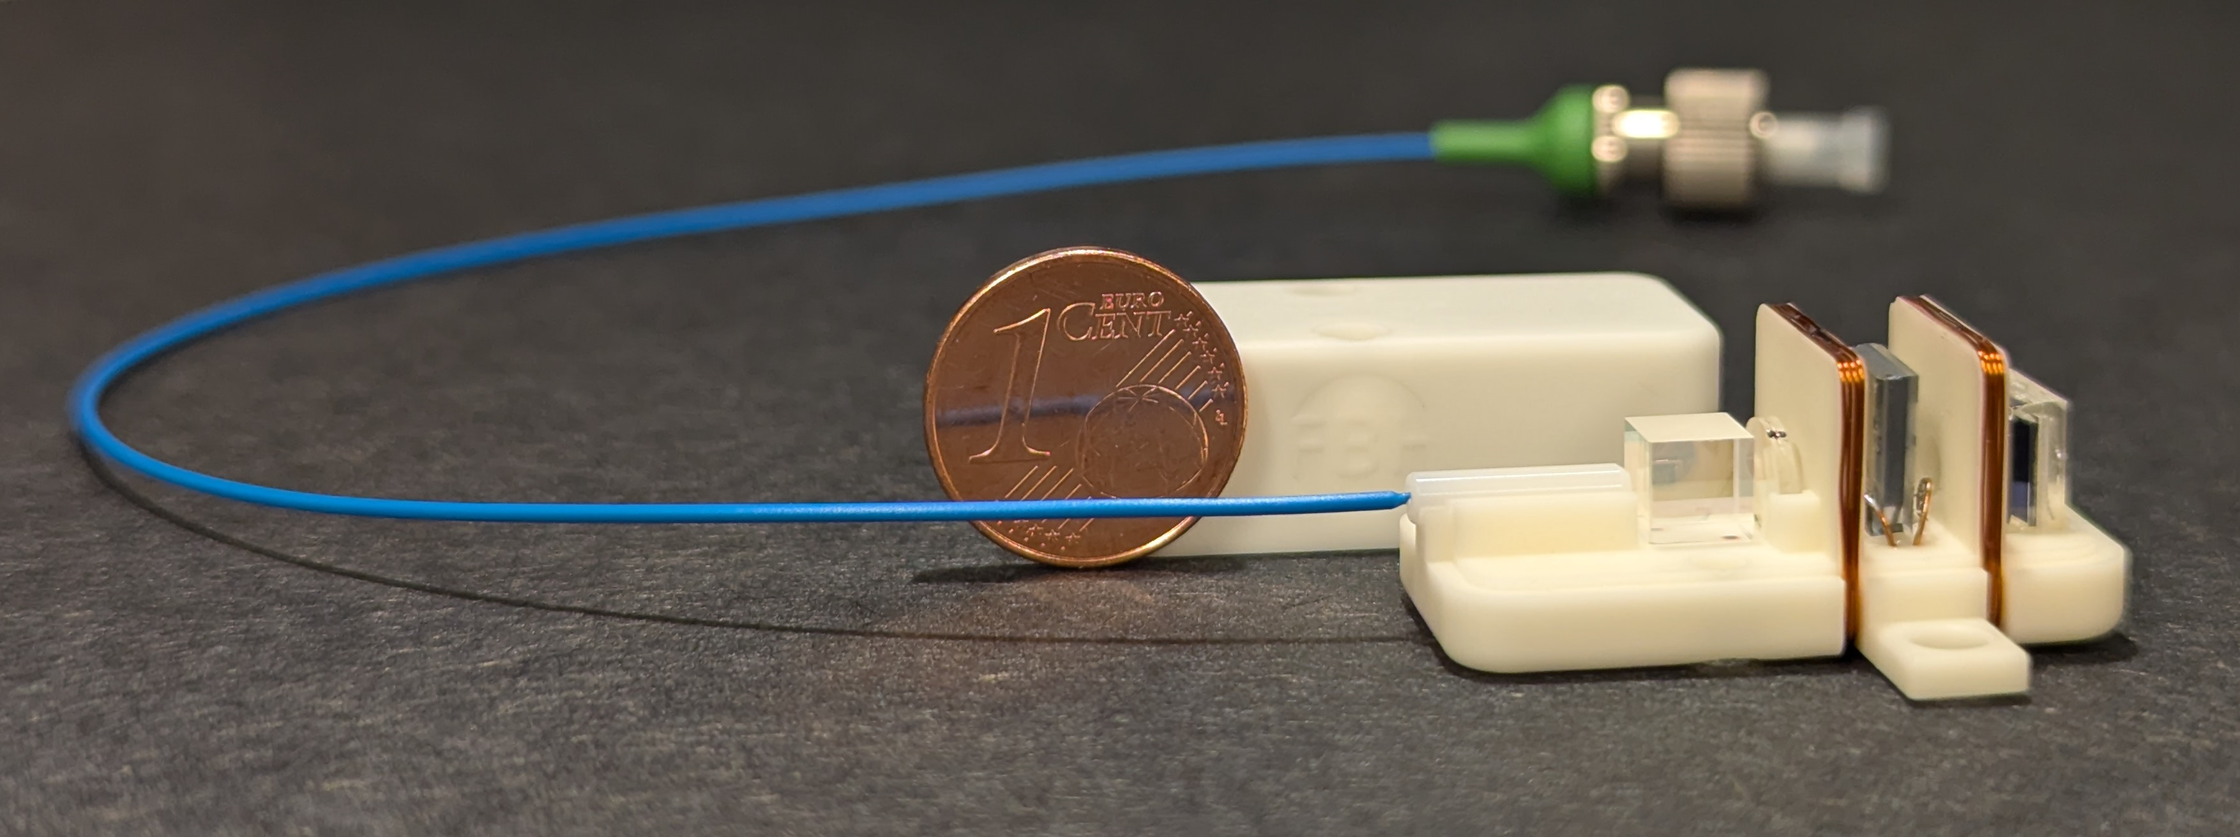

Summary
Functional OPM prototype with 1000+ Hz 3 dB bandwidth und sub-pT/√Hz practical noise
OPM integrated in custom shield for the MMG measurement of the hand muscles
Demonstrated improved linearity in recording the phantom magnetic flux
First in vivo recording confirms the applicability and performance in practice
Outlook
Outlook:
further micro-integration of OPM
Systematic case studies with developed sensor
Transfer to medical partner for preclinical tests
High reliability towards space-borne platform

Slide 10






Thanks!
Victor Lebedev
Simon Nordenström
Stefan Hartwig
Marlen Kruse
Thomas Middelmann
Peter Krüger
Justus Marquetand
Nima Noury
Christoph Braun
Markus Siegel
Sascha Neinert
Kirti Vardhan
Marc Christ
Markus Krutzik
Philip Broser

