Slide 1




Mobile total field optically pumped magnetometers for navigation
D. Nightingale, T. Coussens, M. T. M. Woodley, D. Nicolau, L. Page, P. Krüger, F. Oručević
Quantum Systems and Devices Group
University of Sussex

Slide 2

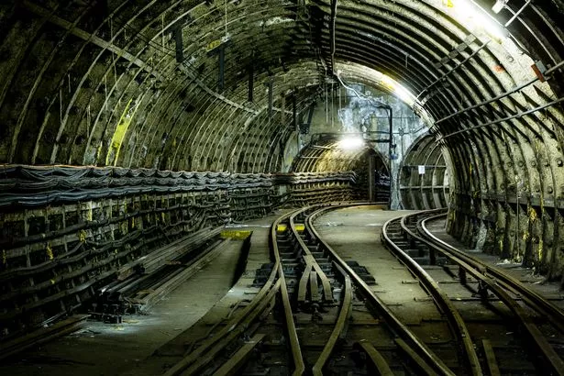

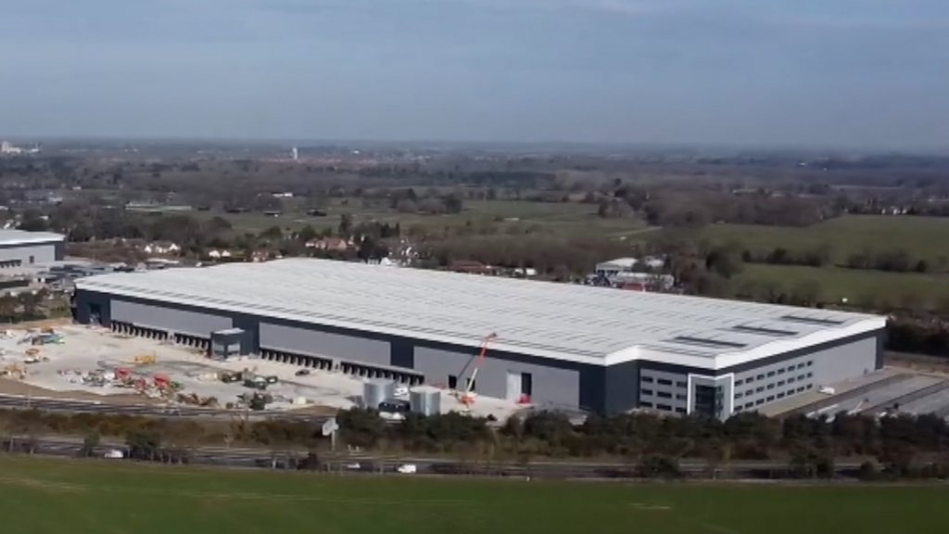
GNSS-free navigation
Global navigation satellite systems (GNSS) widely used in everyday devices
Situations with no direct line of sight to satellites, other solutions are needed:
  Underground, tunnels and buildings

Slide 3
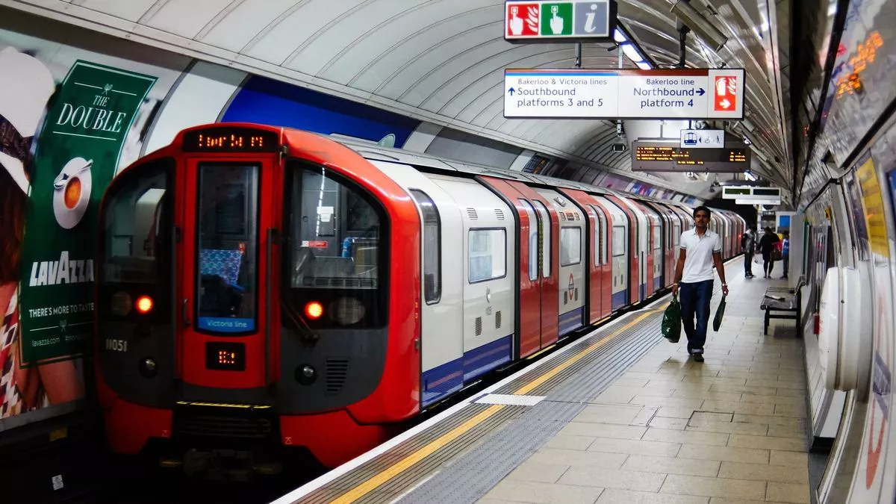
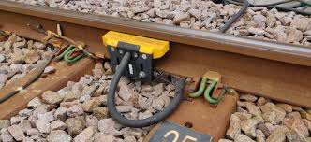
Alternatives – GNSS-free navigation
Precise localisation of trains allows for decreased train spacing - increases passenger capacity
Better precision identifying faults on the track
Currently done using external infrastructure
  Absolute block – between signal boxes
  Axle counter
  Track circuit
  Induction loops
  RFID tags
On train device with better resolution – cheaper to install and maintain
0.1 - 10 km

Slide 4
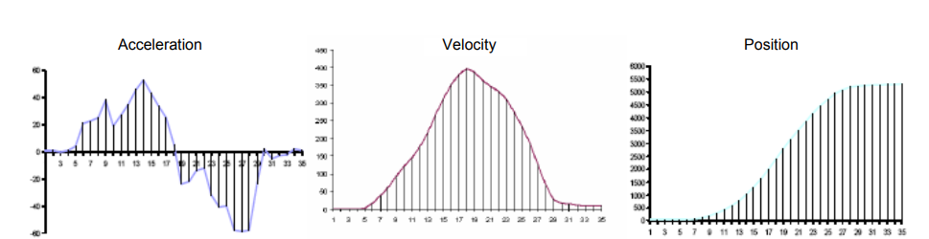
Accelerometer
Calculates position from integrating acceleration
Drifts over time
Integrate
Integrate
Notes:
Uses maps of local magnetic field anomalies
Local variation in magnetic fields is due to remnant and induced magnetisation in the Earth’s crust
The local magnetic field is measured using a portable magnetometer and map matching algorithms are applied to determine location
Field changes are of the order of hundreds of nanotesla
Used in combination with inertial systems to determine position

Slide 5
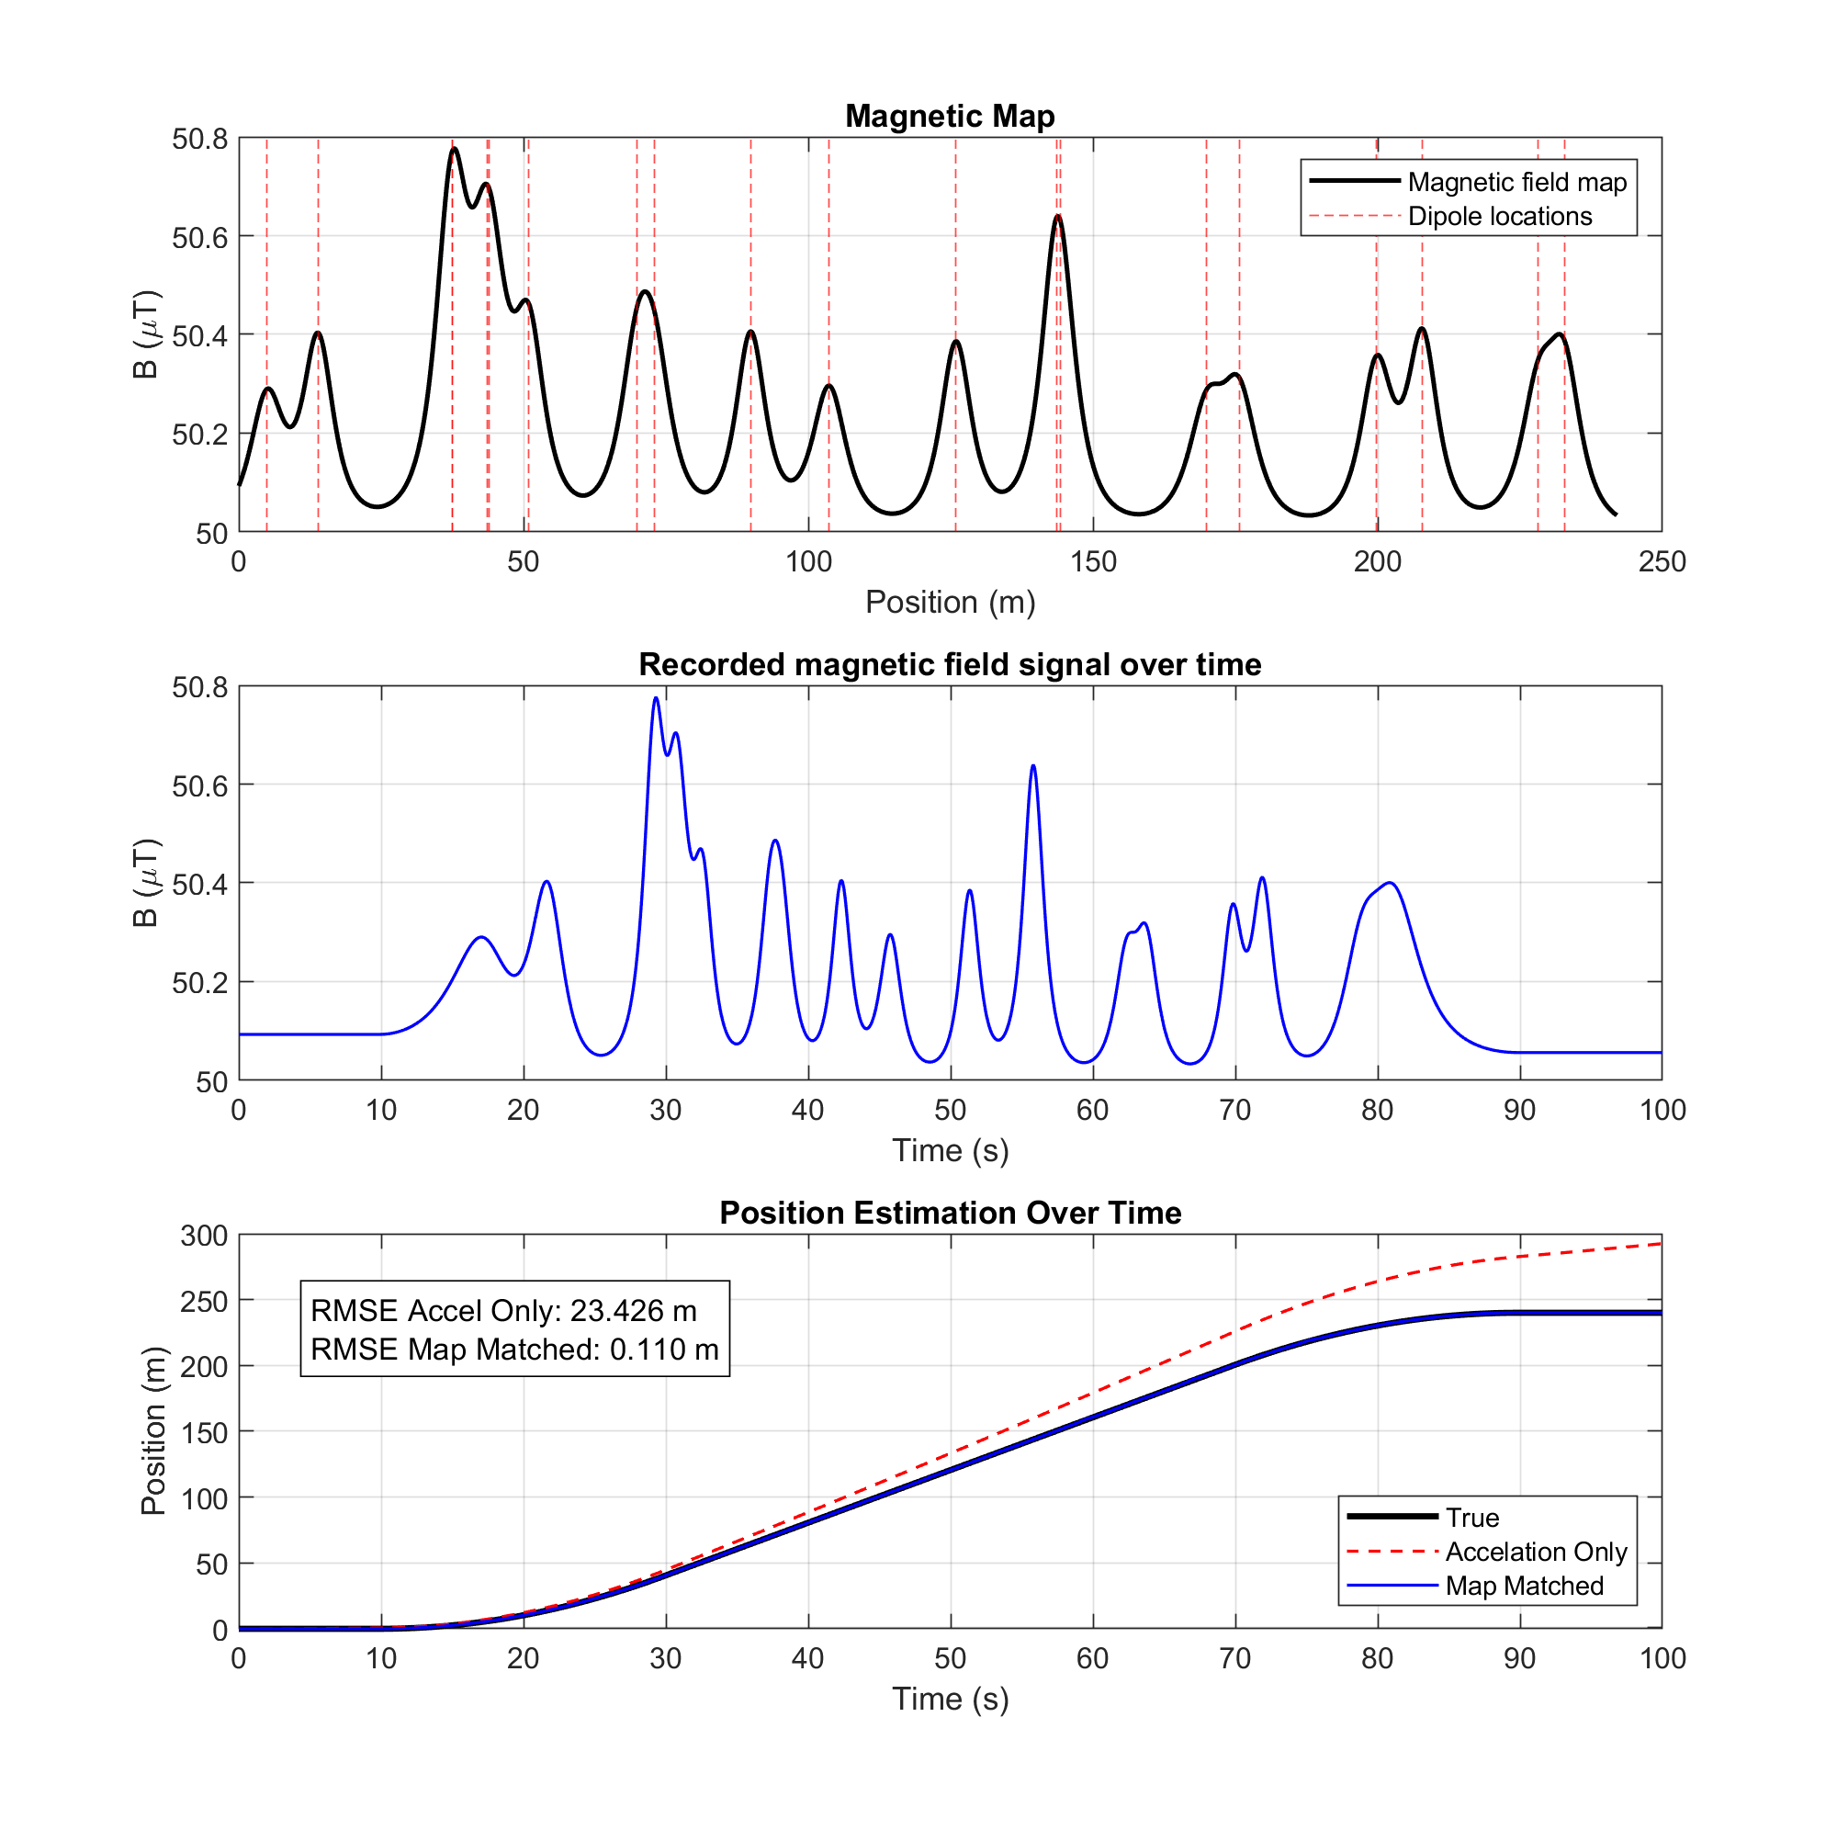
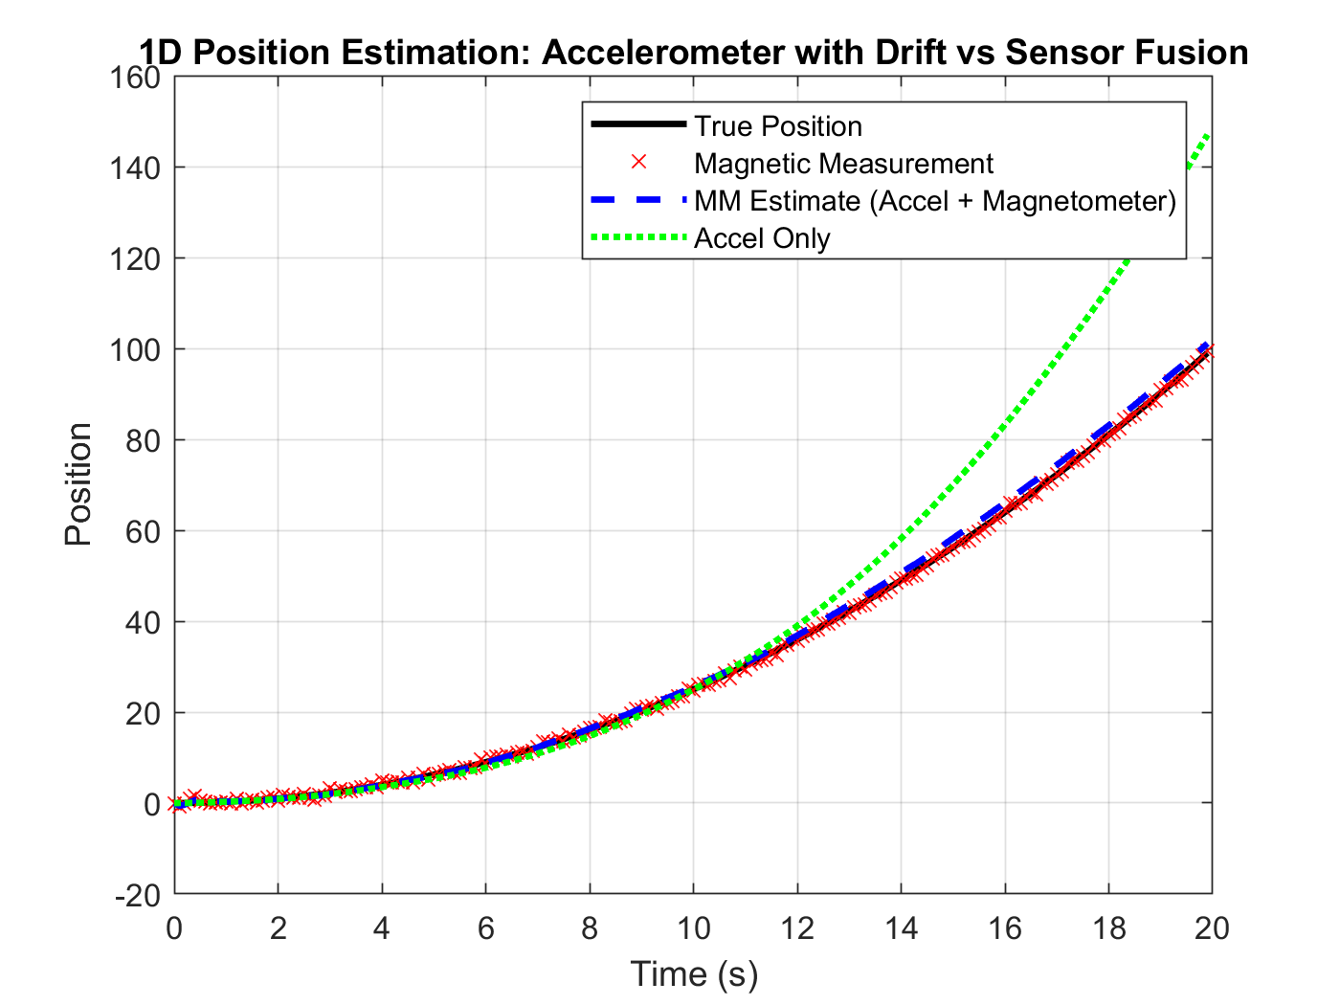
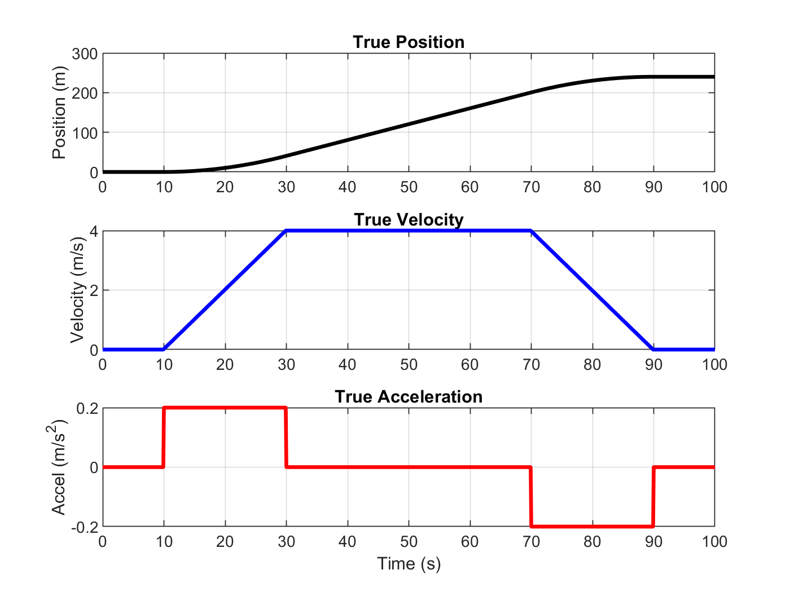
Magnetometer-accelerometer fusion
Known references to correct for accelerometer drift
This can be done with magnetic maps
Notes:
Uses maps of local magnetic field anomalies
Local variation in magnetic fields is due to remnant and induced magnetisation in the Earth’s crust
The local magnetic field is measured using a portable magnetometer and map matching algorithms are applied to determine location
Field changes are of the order of hundreds of nanotesla
Used in combination with inertial systems to determine position

Slide 6
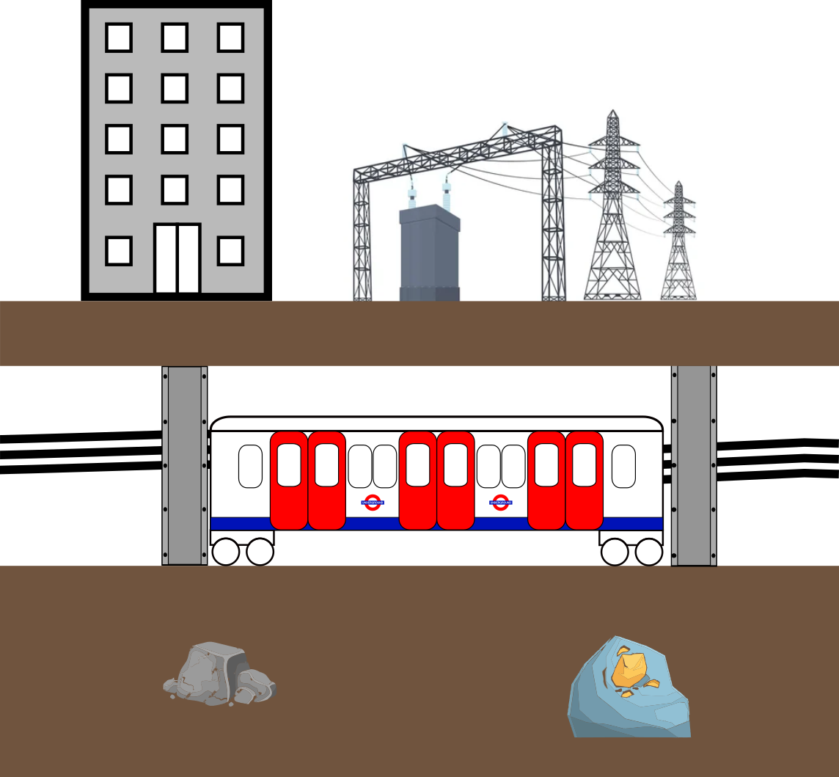

What do we measure?
Signal dependence:
Geo-magnetic field variation
Deposits of ferromagnetic minerals.
Man-made ferromagnetic infrastructure (e.g, steel beams in buildings).
Power networks (underground or overhead).
Localisation:
Create localised magnetic field maps.
Using readings from magnetometers and accelerometers, map-matching algorithms can be used to determine location.
Precise magnetic field measurement required for localisation.
Notes:
Uses maps of local magnetic field anomalies
Local variation in magnetic fields is due to remnant and induced magnetisation in the Earth’s crust
The local magnetic field is measured using a portable magnetometer and map matching algorithms are applied to determine location
Field changes are of the order of hundreds of nanotesla
Used in combination with inertial systems to determine position

Slide 7
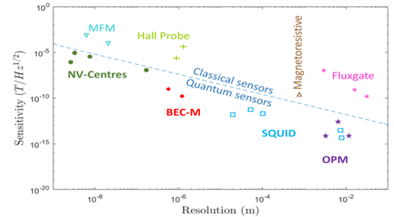
Why OPMs?
Operational magnetic navigation relies on:
  Map matching algorithms
  Magnetic maps and models
  Sensitivity of sensors

Slide 8
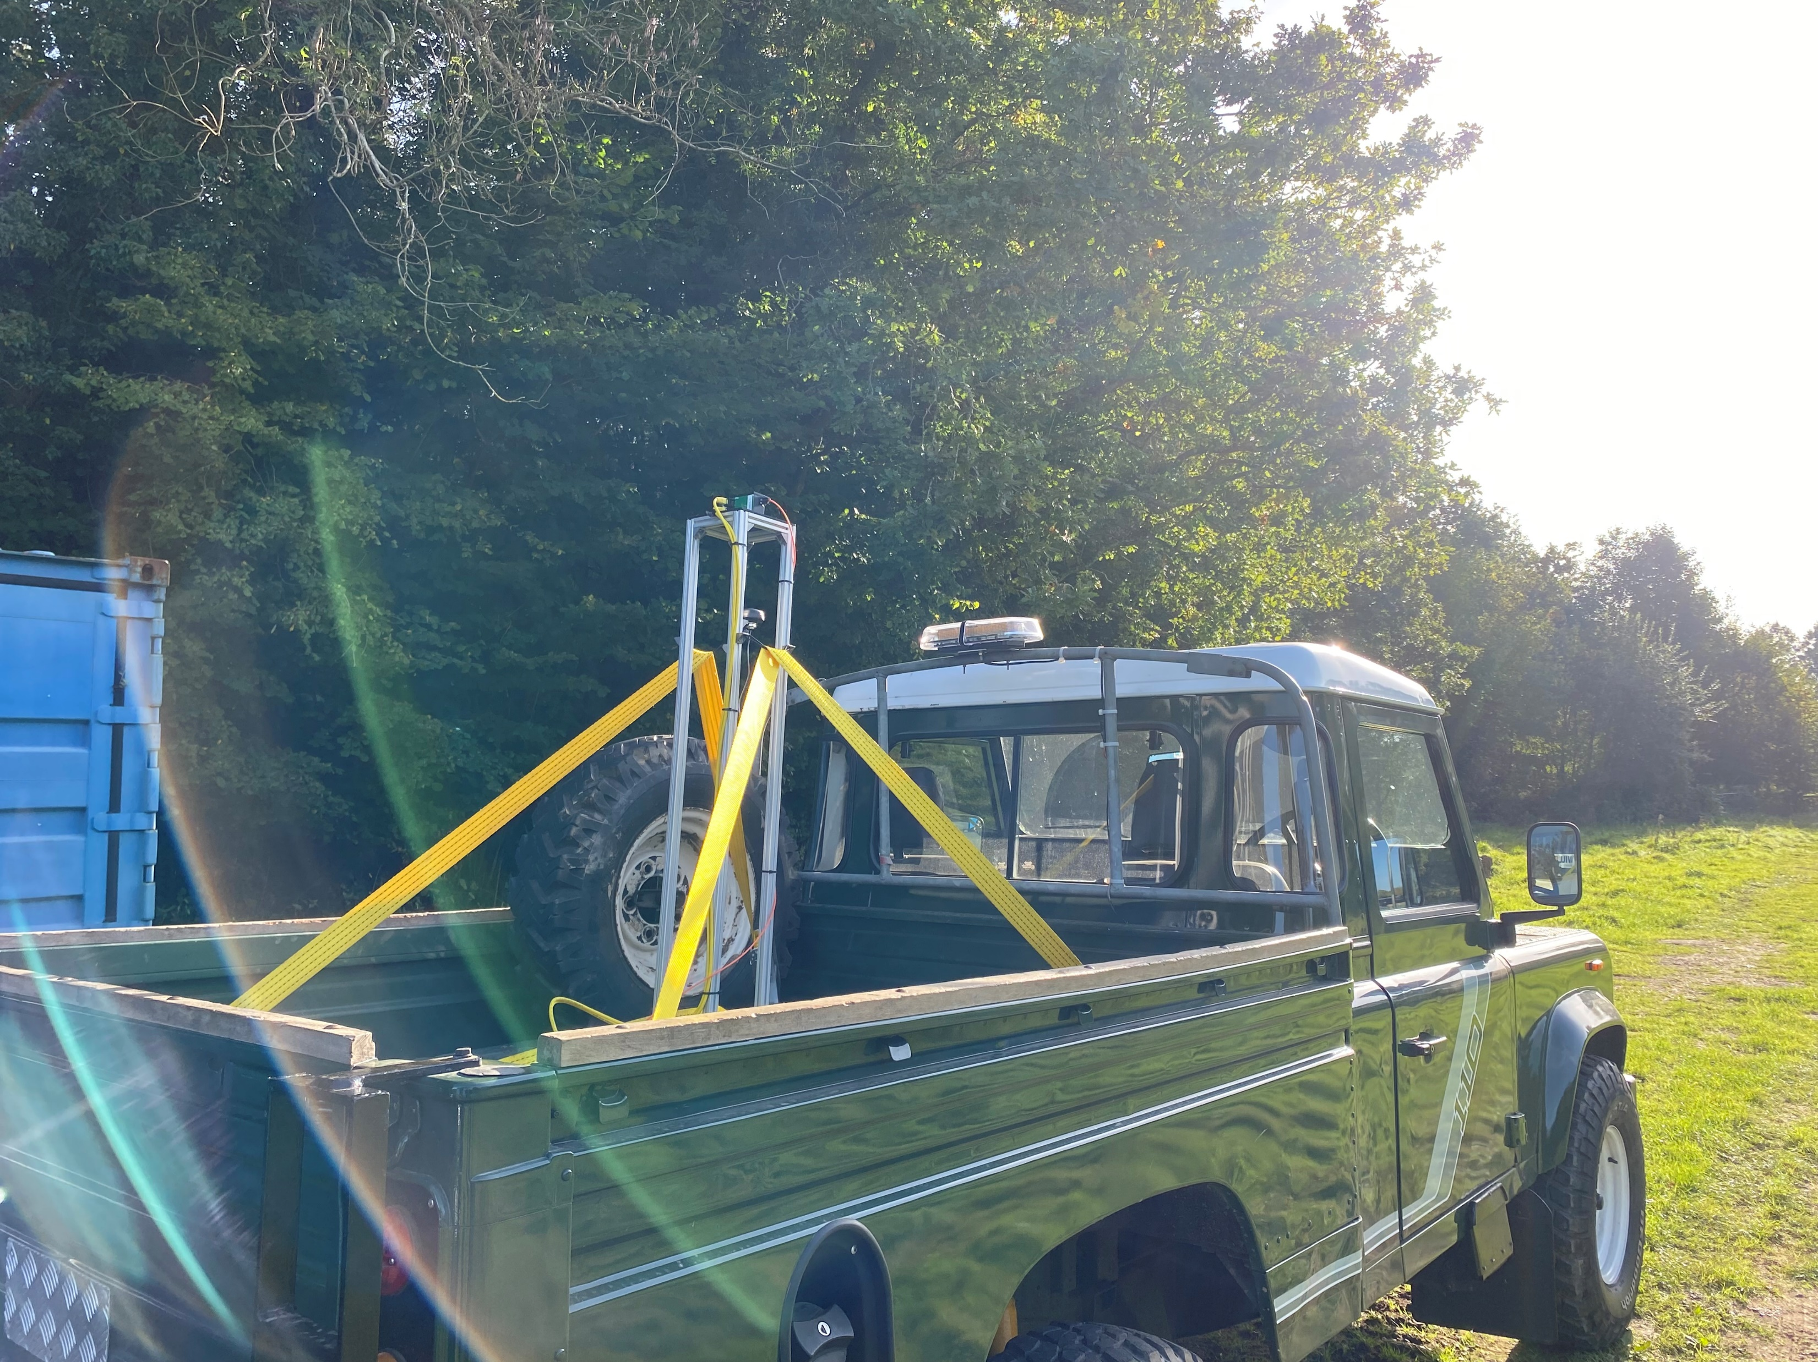
Challenges
Platform orientation and contribution to measured field
Static platform contribution
Platform noise
Fast changing fields
Dead-zones

Slide 9
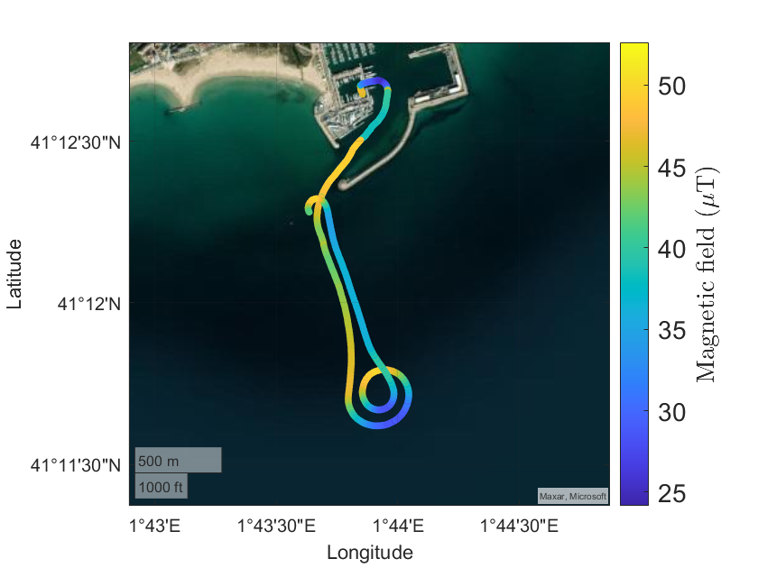
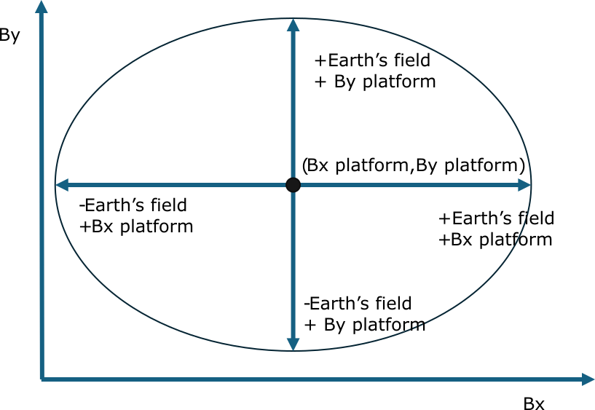
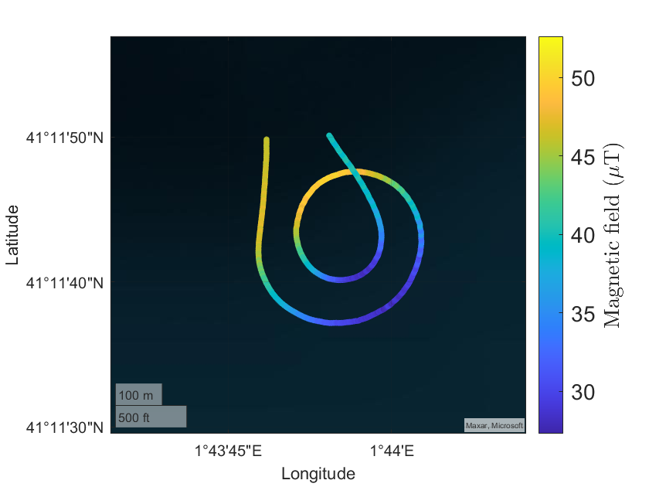
Challenges
Platform orientation and contribution to measured field
Scalar field changes as the train turns - gyroscopes
Static platform contribution

Slide 10
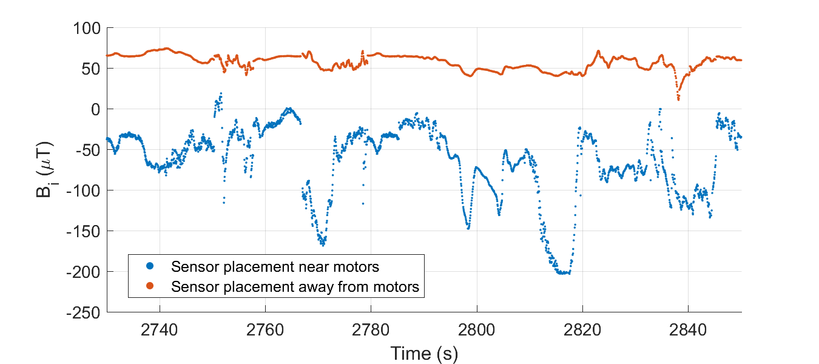
Challenges
Platform noise – noise from metallic/electronic elements in the platform
Differentiate between near and far field using spatial measurements
Similar issue as in MEG where a number of algorithms can be used principal component analysis, gradiometers, spatial filters, beam forming
High slew rate sensor to track large changes in field
Consider sensor placement to noise sources
Notes:
Similar issue as with MEG where a number of algorithms can be used principal component analysis, gradiometers, spatial filters, beam forming

Slide 11
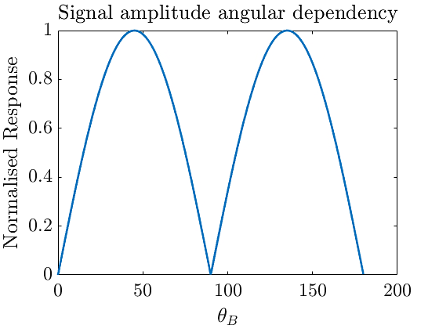







Mx scheme – angular dependence
Single beam Mx magnetometer (one beam for pumping and probing)
Total field scalar measurement
Angular dependency:
When the magnetic field vector is aligned parallel or at 90 degrees to the pumping beam the sensitivity degrades.
This can be mitigated by placing two magnetometers at 45 degrees to each other
$$\hat{y}$$
$$B_{0}$$
$$\hat{x}$$
$$θ_{B}$$
$$σ^{+}$$
PD
$$\hat{z}$$
$$B_{RF}$$

Slide 12
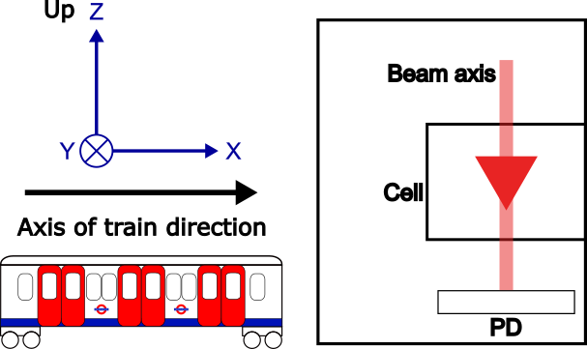
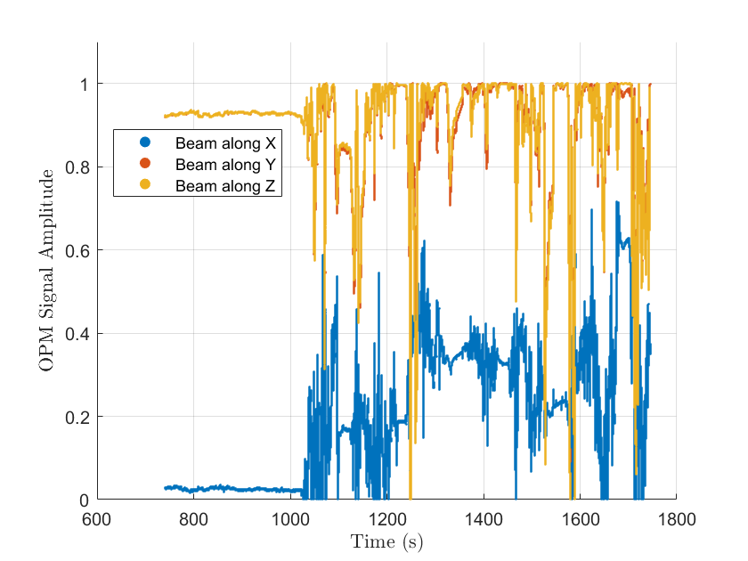
Mx Scheme – Angular Dependence
OPM signal based on measured fields
98% above 0.5 signal strength

Slide 13
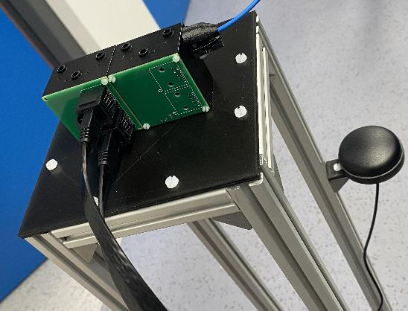
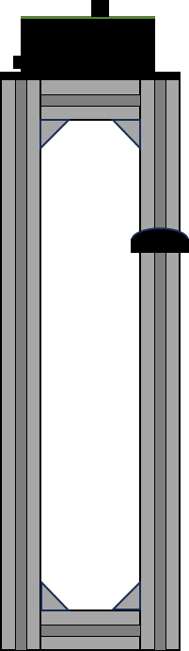
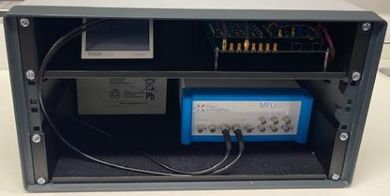
V1 system
Pump beam and RF axis
OPM Sensor
Weight approx. 32kg
GNSS antenna
Single board computer
Laser and driver
Electronics control board
THORLABS
YUCEL
Lock-in amplifier
Batteries
MFLI
Notes:
Noise floor measured a 3-layer mu metal magnetic shield with sensitivity of 1.9 ${\text{pT}\text{·}\text{Hz}}^{\text{−1/2}}$

Slide 14

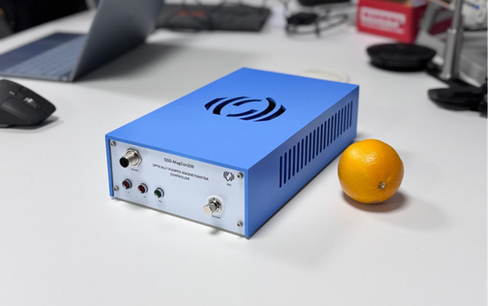
New system
Miniaturisation of the system by replacing off-the-shelf elements with in-house control electronics
Size: 52 x 40 x 28 cm
Size: 17 x 28 x 8 cm

Slide 15
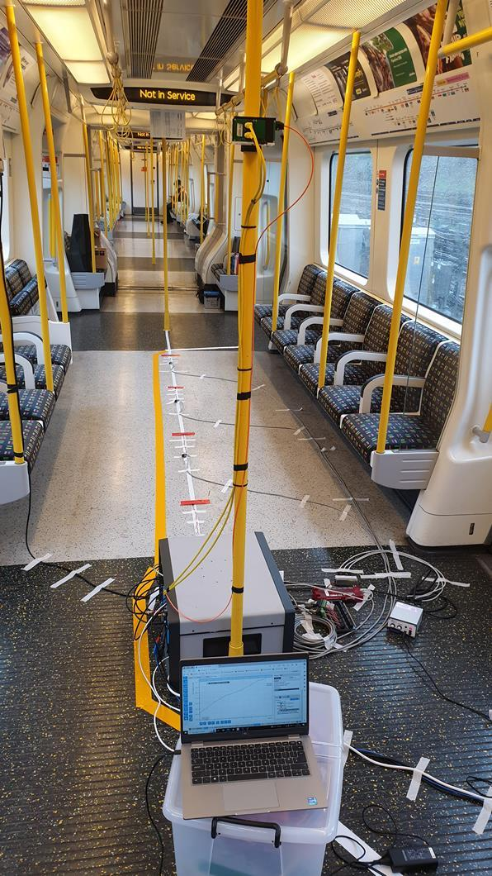
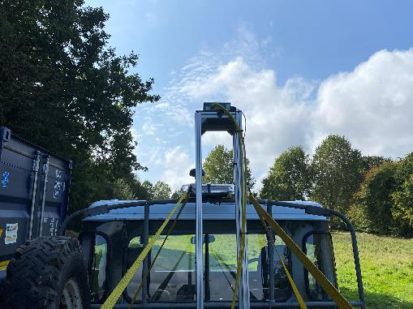



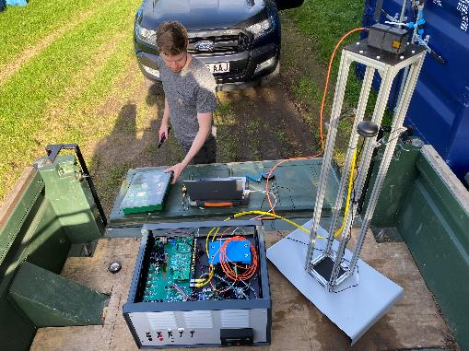
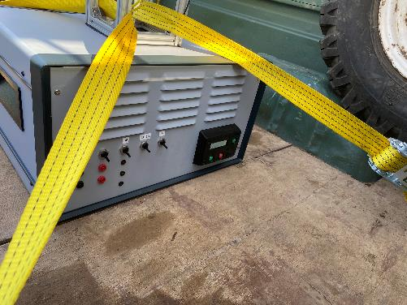
In field demonstration

Slide 16
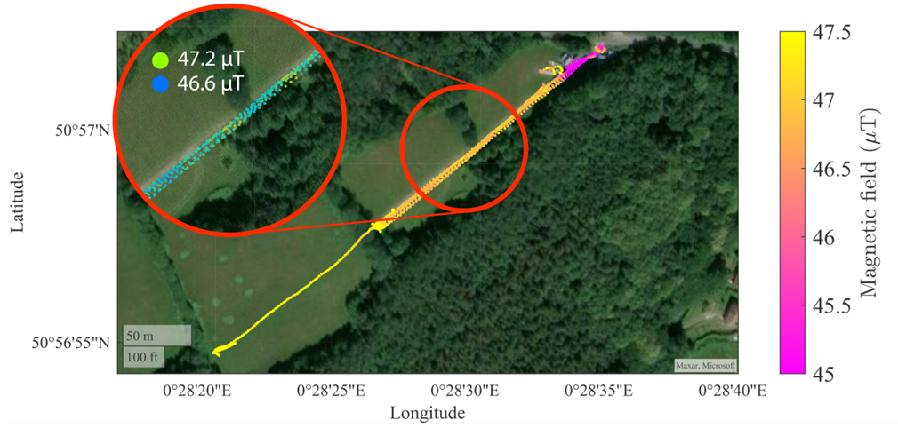
Initial trial
Initial test of the system outside of lab
Magnetic signature of shipping containers
Repeatable sub-microtesla variation

Slide 17


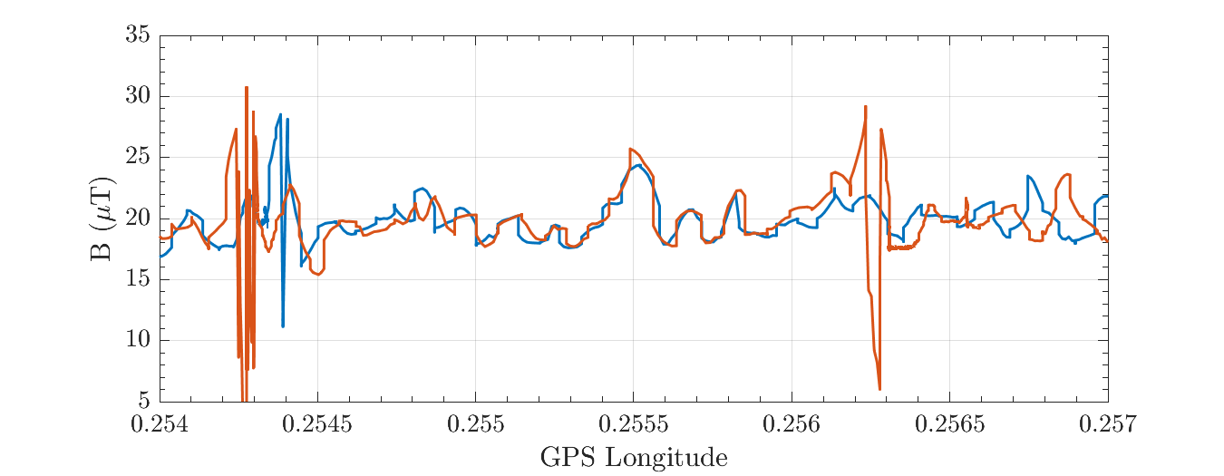
Train trial
Noisier environment
Repeatable features
Spikes due to train motors
GNSS uncertainty
Limited by GNSS update frequency

Slide 18
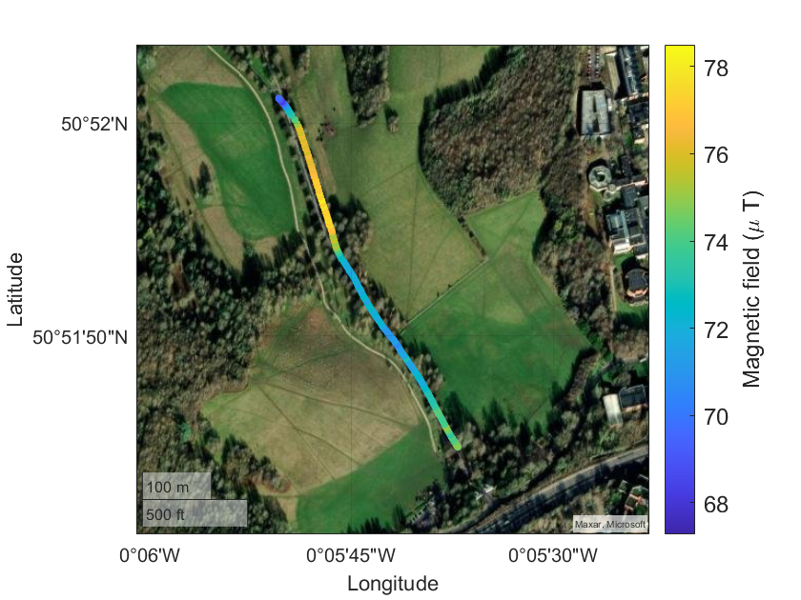
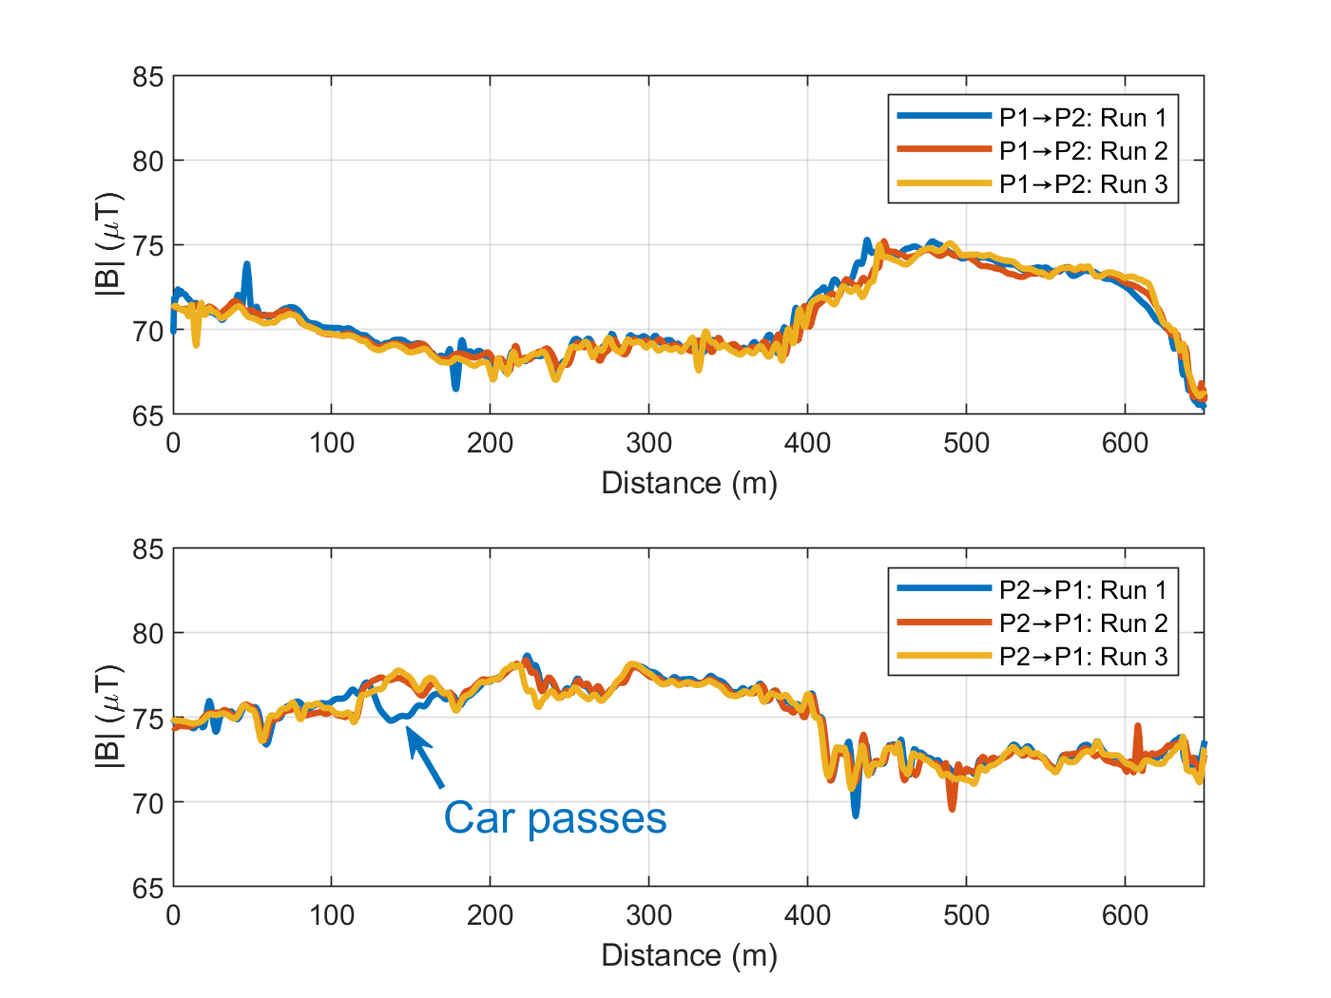


Car trial
$${\text{P}}_{\text{2}}$$
$${\text{P}}_{\text{1}}$$
Notes:
GNSS only accurate to ~10 m

Slide 19
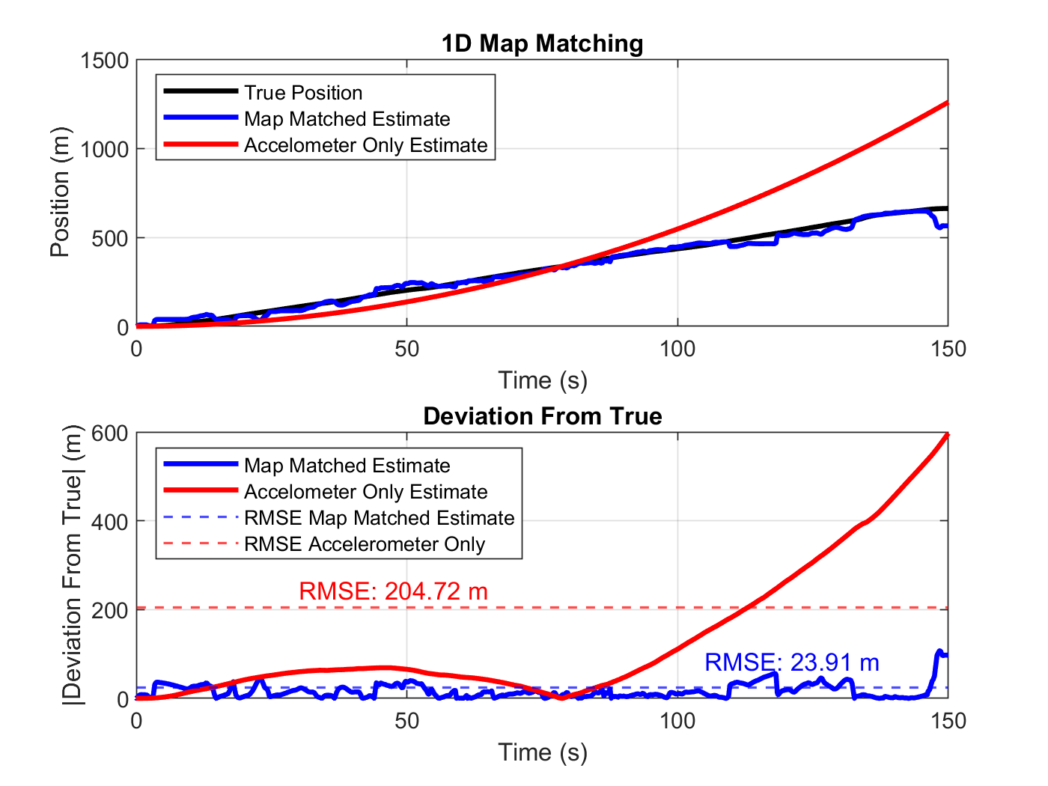
Map matching
True position given by GNSS
Accelerometer estimate
Map matched estimate using magnetometer and accelerometer data
GNSS accuracy 10 - 20 m
Notes:
GNSS only accurate to ~10 m

Slide 20
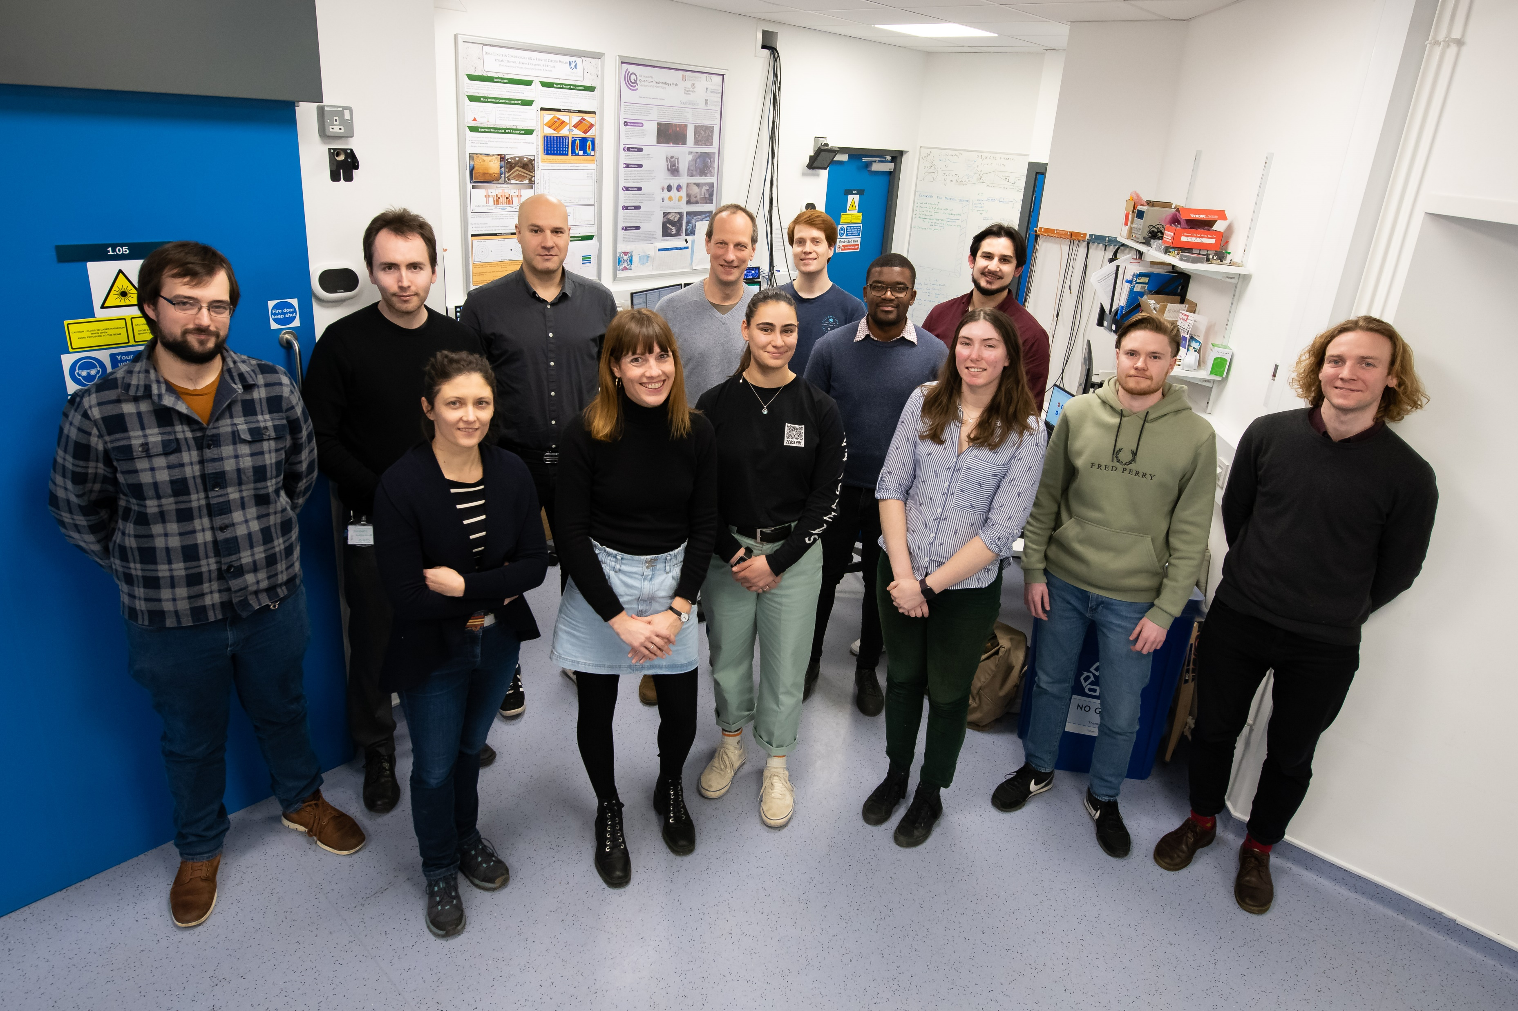






Outlook
Optimisation of the new system
Noise mitigation strategies with multi-sensor data fusion
Applying map matching algorithms

