Slide 1

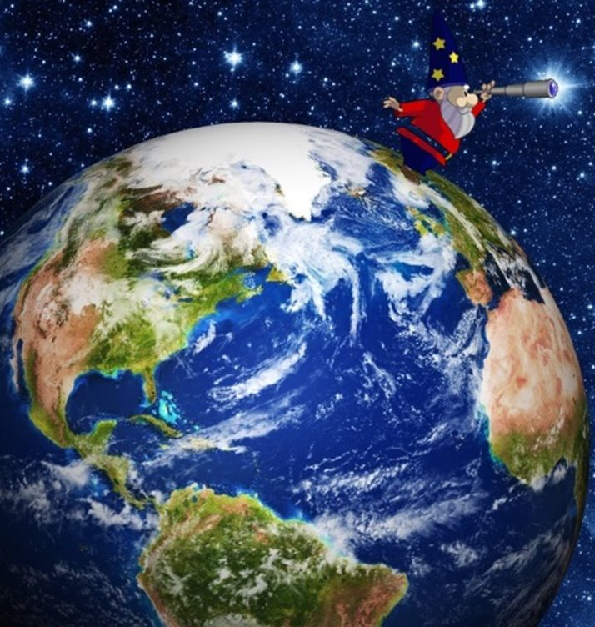
Searching for dark matter with comagnetometers
GNOME (Global Network of Optical Magnetometers for exotic physics)
August 8 2025
WOPM 2025 @ PSI
Daniel Gavilán-Martin & Grzegorz (Greg) Łukasiewicz​
Notes:
My name is Grzegorz. Thank you so much for having me here. It's my true pleasure to tell you a little bit about about GNOME.

Slide 2

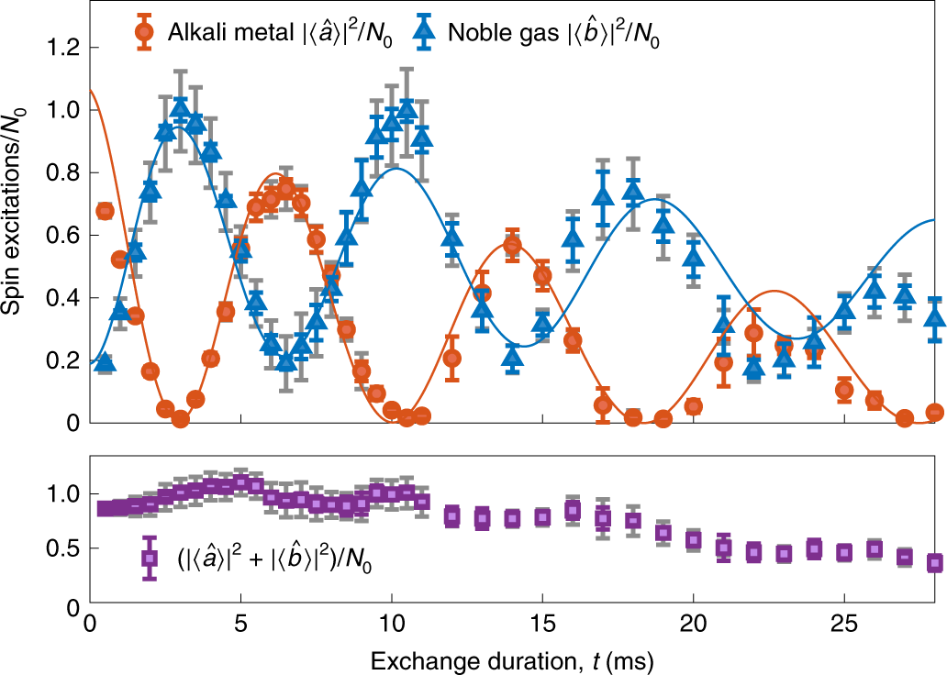
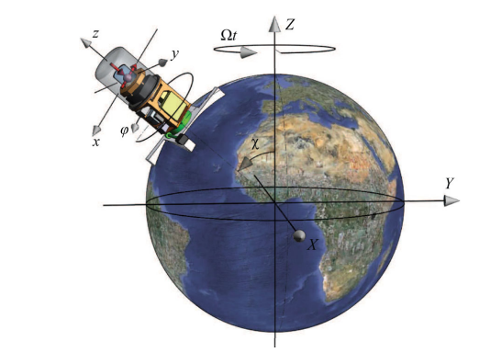
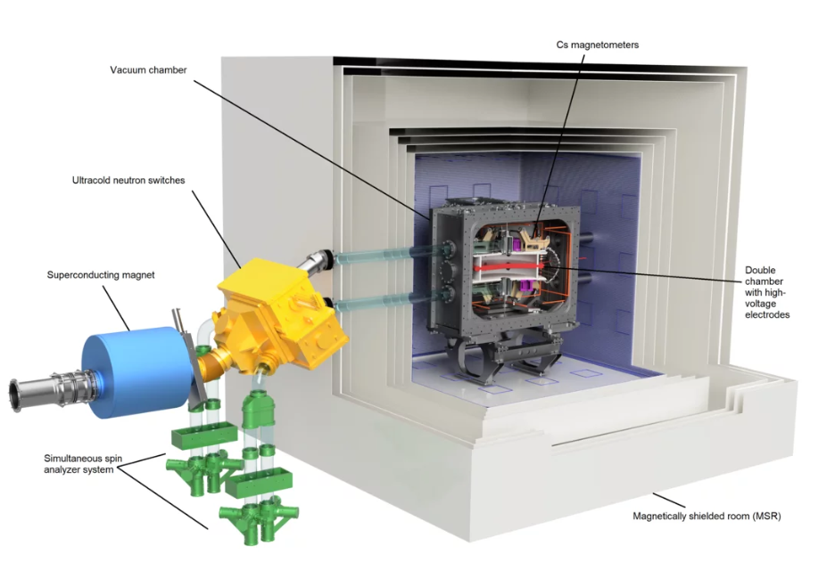
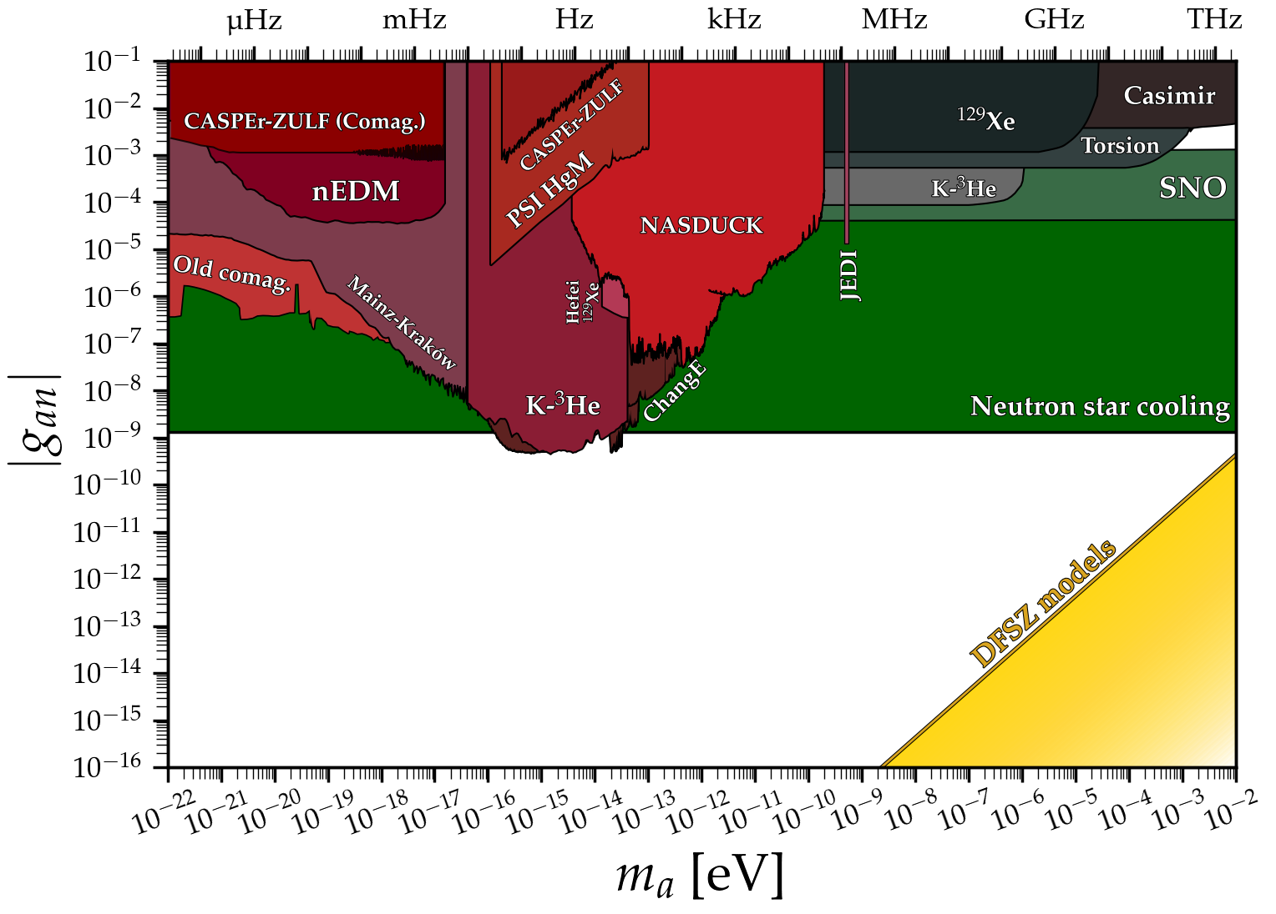
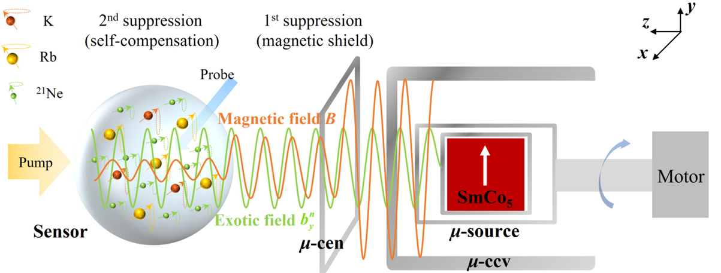
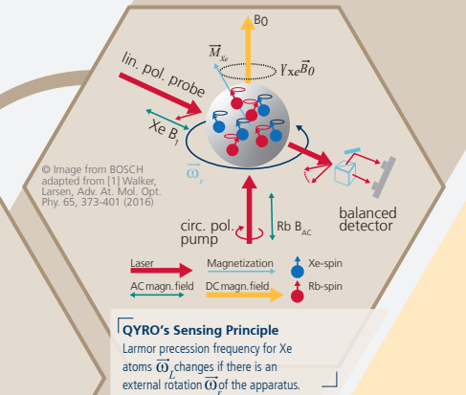
Motivation for comagnetometry
Comagnetometers exploit multiple spin ensembles for sensing beyond the reach of each individually
FUNDAMENTAL
APPLIED
Lorentz invariance
nEDM
quantum
memory
dark matter
5th force
inertial navigation
Princeton, PSI, NPL, Weizmann, Beijing, Hangzhou, Hefei, Canberra, GNOME and others…
Z. Xu et al., Phys. Rev. Lett. 134, 181801 (2025)
R. Shaham et al., Nat. Phys. 18, 506–510 (2022).
https://www.psi.ch/en/nedm
cajohare.github.io/AxionLimits
https://qant.com/atomic-gyroscope/
M. Smiciklas et al., Phys. Rev. Lett. 107, 171604 (2011)
Motivation

Slide 3
Motivation for comagnetometry
Co-located spin ensambles (including long-lived nuclear spins) for magnetic noise suppresion
FUNDAMENTAL
APPLIED
Lorentz invariance
nEDM
quantum
memory
dark matter
5th force
inertial navigation
Princeton, PSI, NPL, Weizmann, Beijing, Hangzhou, Hefei, Canberra, GNOME and others…
Z. Xu et al., Phys. Rev. Lett. 134, 181801 (2025)
R. Shaham et al., Nat. Phys. 18, 506–510 (2022).
https://www.psi.ch/en/nedm
cajohare.github.io/AxionLimits
https://qant.com/atomic-gyroscope/
M. Smiciklas et al., Phys. Rev. Lett. 107, 171604 (2011)
Motivation

Slide 4
Outline
GNOME & intro to self-comepnsating comagnetometers
Sensor optimization
Calibration routine
Dark matter search
Comagnetometer decoupling (preliminary)
GNOME (Global Network of Optical Magnetometers for exotic physics)
Outline
S. Afach et al., Nat. Phys. 17, 1396–1401 (2021)

Slide 5

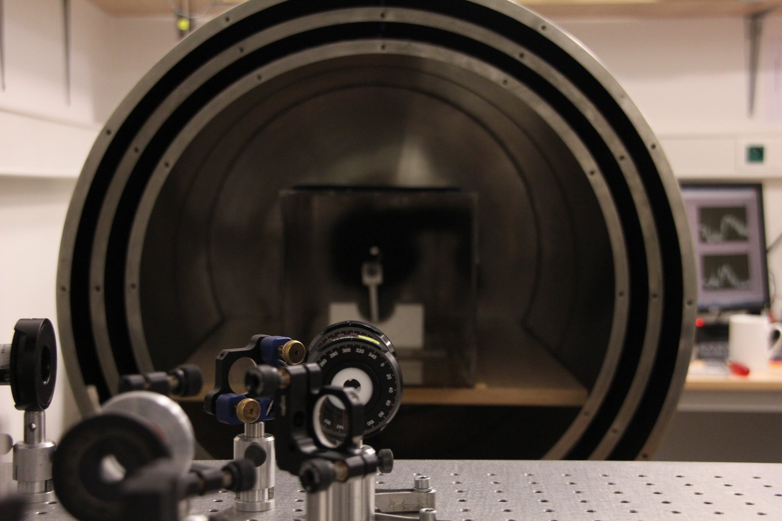
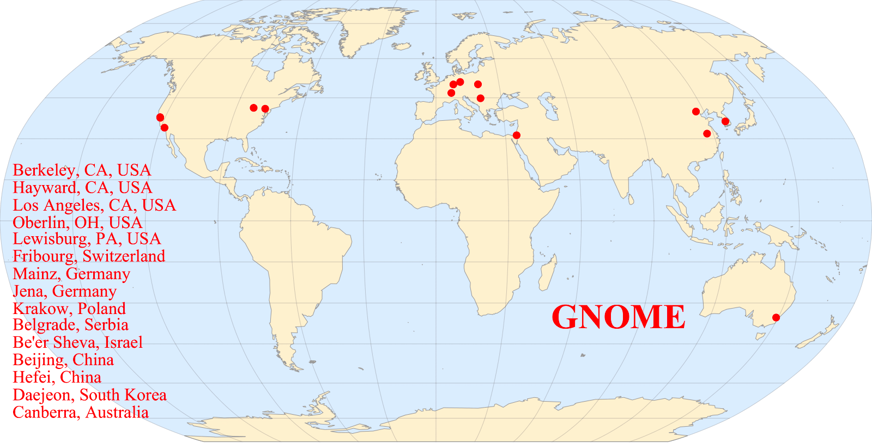
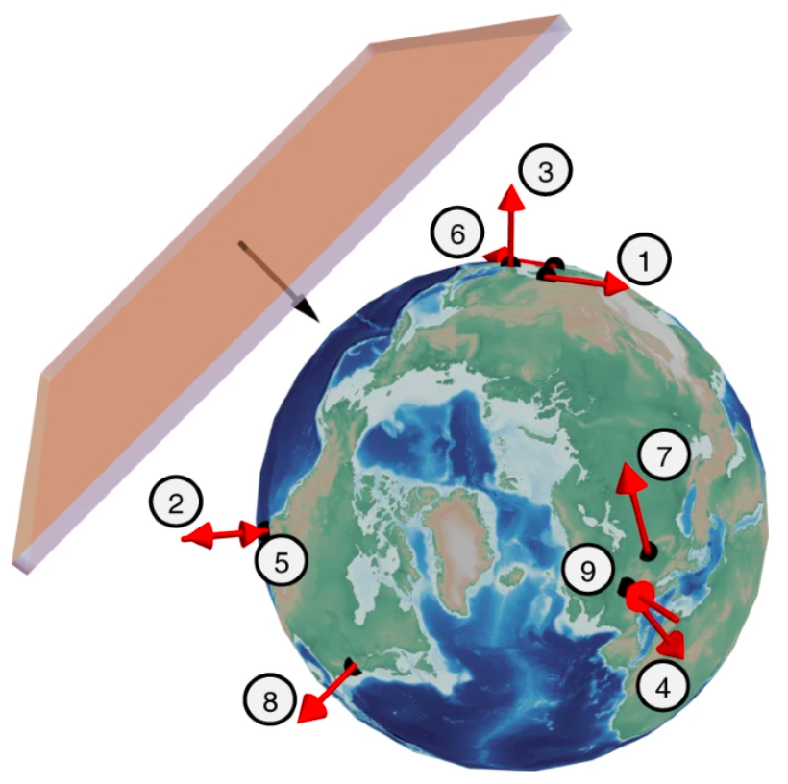
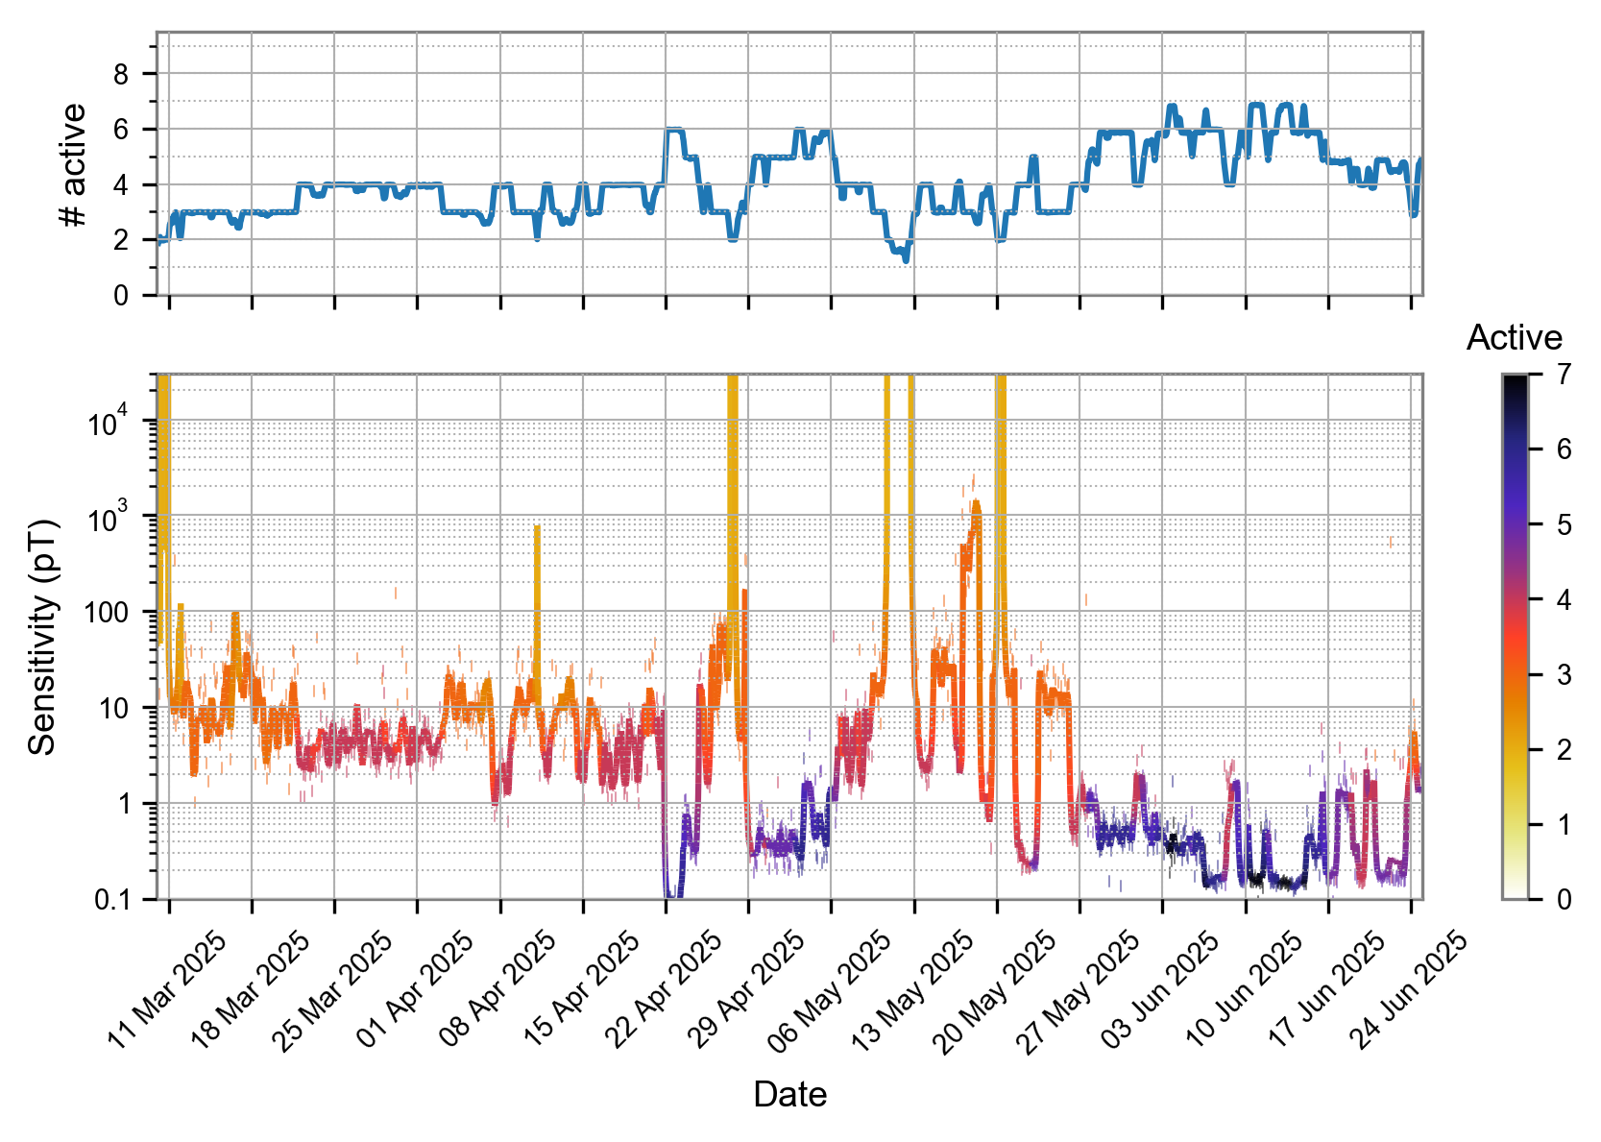
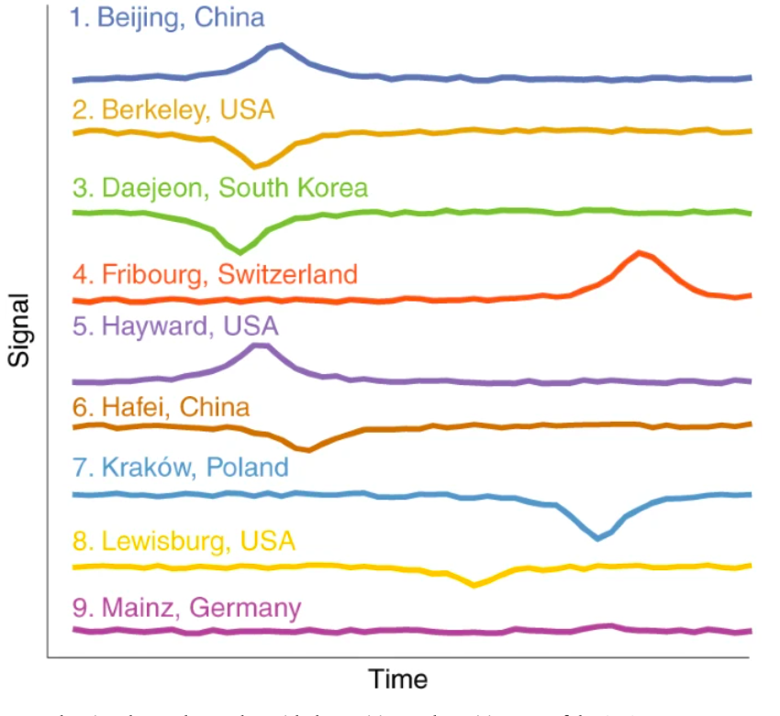
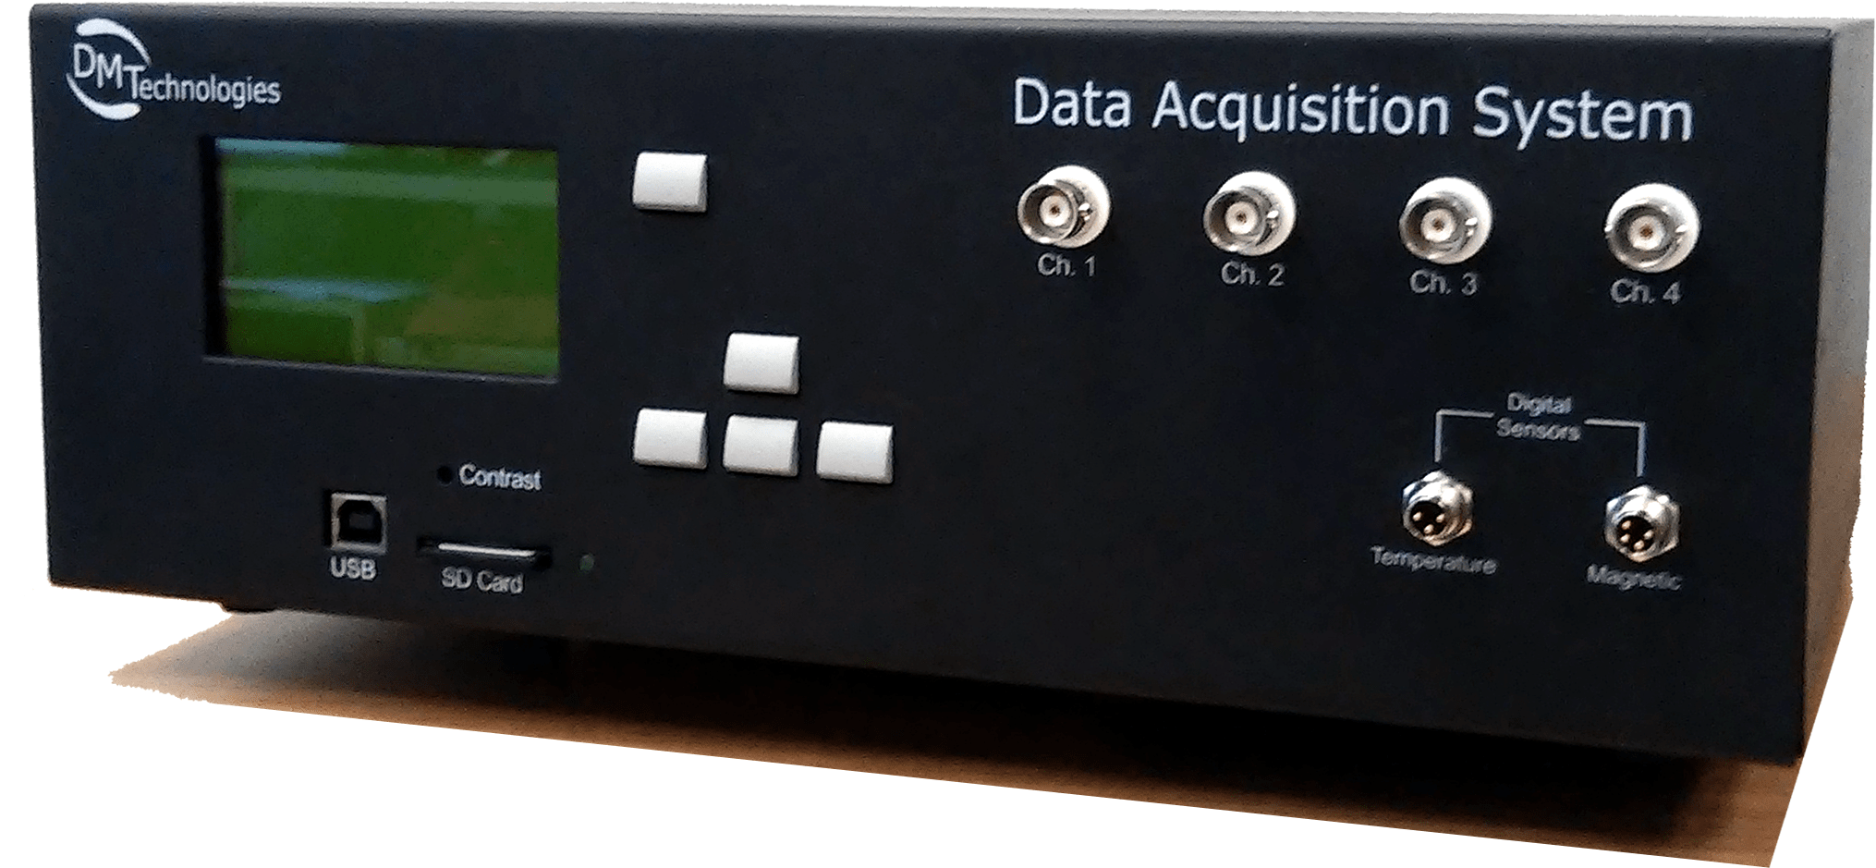
GNOME infrastructure
Global Network of Optical Magnetometers for Exotic physics searches
Sensors of different types
1 or 2 sensitive axes
Bandwidth: DC-100 Hz
Data acquisition system
Common data storage
DM Technologies
Global Network of Optical Magnetometers for Exotic physics searches
S. Afach et al., Nat. Phys. 17, 1396–1401 (2021)

Slide 6
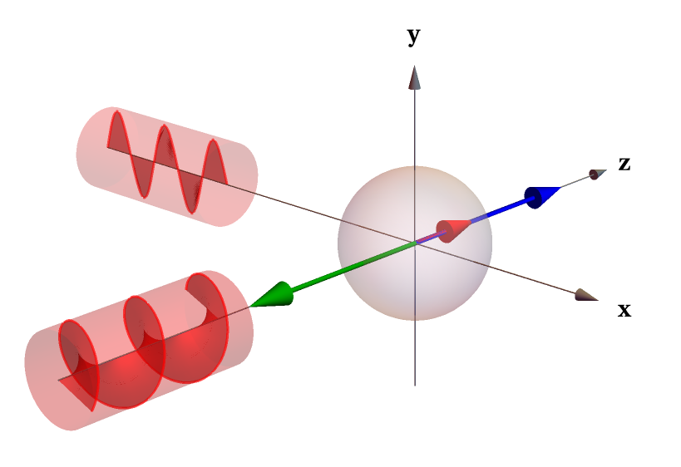
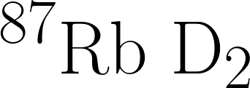
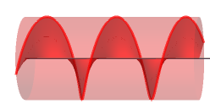


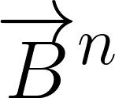

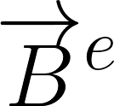
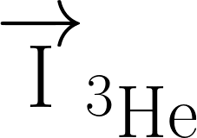
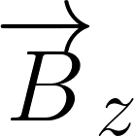
Self-compensated comagnetometer
Mixture of alkali metals and noble gas atoms (Rb-K-³He)
SERF regime (190ºC), 3.5 amg of ³He
electronic magnetization
(alkali atoms)
nuclear magnetization
(noble gas atoms)
pump beam
probe beam
spin-exchange
collisions
pump beam
bias field
Inspired by Michael Romalis
T. W. Kornack & M.V. Romalis, Phys. Rev. Lett. 89 (2002)
Self-compensated atomic comagnetometer

Slide 7
Coupled spin dynamics
nuclear magnetization
(noble gas atoms)
electronic magnetization
(alkali atoms)
perturbation
Dynamics analyzed in transverse xy plane
Coupled spin dynamics

Slide 8
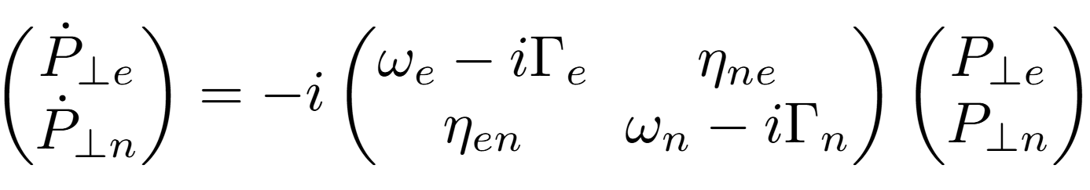
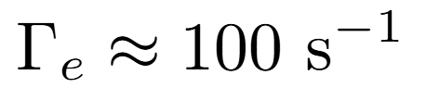
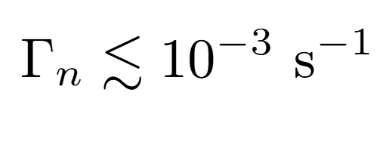
Coupled spin dynamics
Coupled Bloch equations
nuclear magnetization
(noble gas atoms)
electronic magnetization
(alkali atoms)
perturbation
Dynamics analyzed in transverse xy plane
Coupled spin dynamics

Slide 9
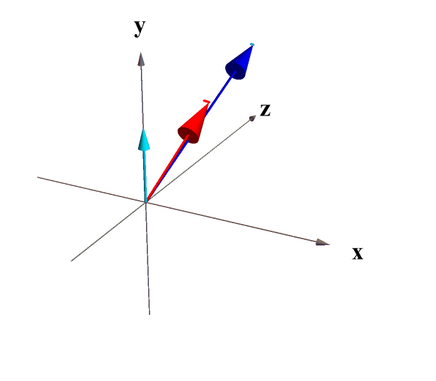

Coupled spin dynamics
Coupled Bloch equations
nuclear magnetization
(noble gas atoms)
electronic magnetization
(alkali atoms)
perturbation
Dynamics analyzed in transverse xy plane
Decoupled dynamics
(Oversimplification, in reality alkalis feel precessing ³He as effective rotating magnetic field and provide indirect optical readout of ³He magnetization state)
Coupled spin dynamics

Slide 10
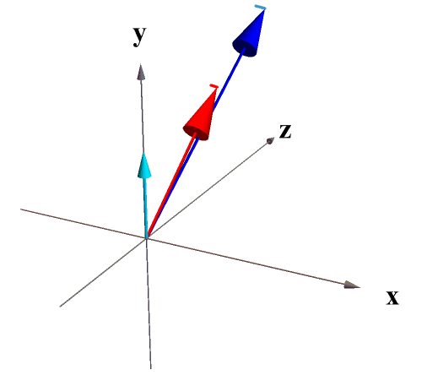

Coupled spin dynamics
Coupled Bloch equations
Nuclear magnetization
(noble gas atoms)
Electronic magnetization
(alkali atoms)
perturbation
Coupled spin dynamics

Slide 11
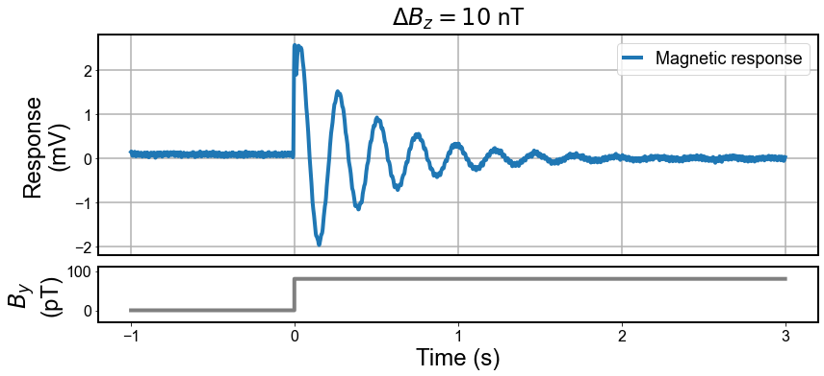
Coupled spin dynamics
Coupled Bloch equations
Nuclear magnetization
(noble gas atoms)
Electronic magnetization
(alkali atoms)
perturbation
Coupled spin dynamics

Slide 12
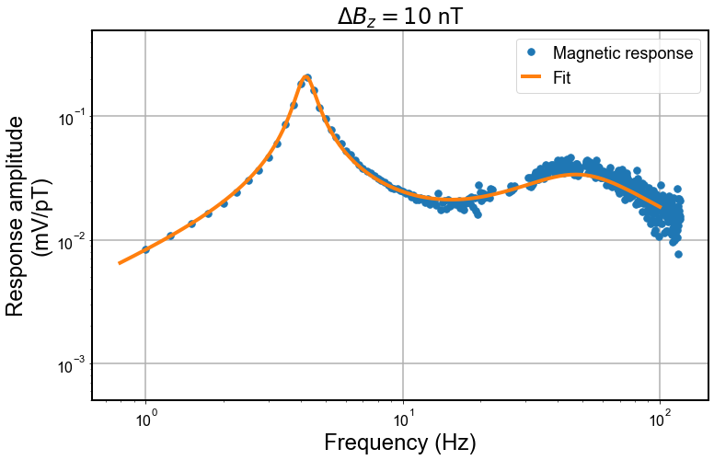
Coupled spin dynamics
Coupled Bloch equations
Nuclear magnetization
(noble gas atoms)
Electronic magnetization
(alkali atoms)
perturbation
Coupled spin dynamics

Slide 13
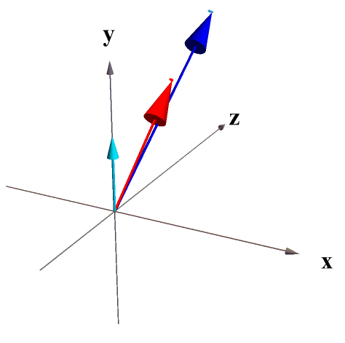

Coupled spin dynamics
Coupled Bloch equations
Nuclear magnetization
(noble gas atoms)
Electronic magnetization
(alkali atoms)
perturbation
Coupled spin dynamics

Slide 14
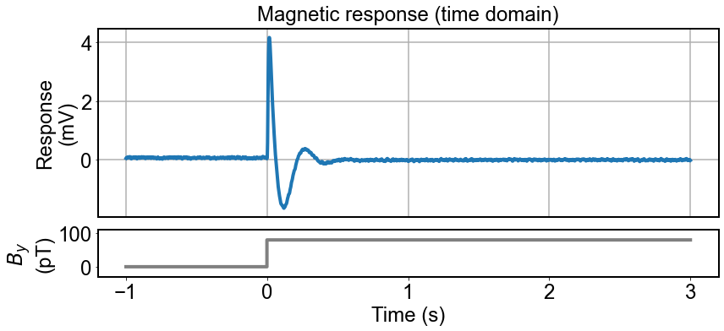
Coupled spin dynamics
Coupled Bloch equations
Nuclear magnetization
(noble gas atoms)
Electronic magnetization
(alkali atoms)
perturbation
Coupled spin dynamics

Slide 15
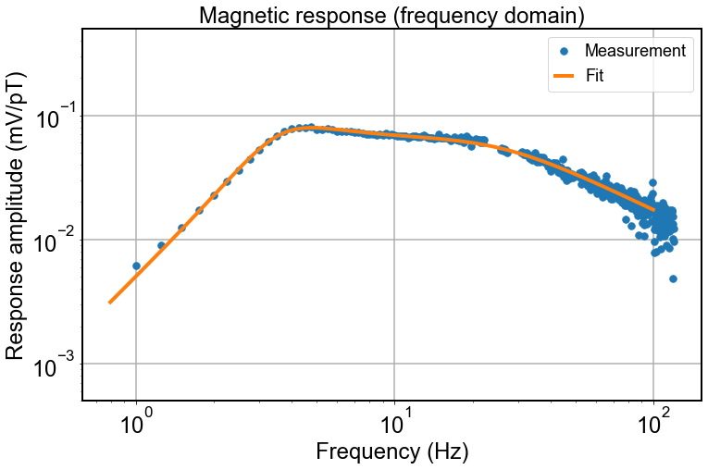
Coupled spin dynamics
Coupled Bloch equations
Nuclear magnetization
(noble gas atoms)
Electronic magnetization
(alkali atoms)
perturbation
Coupled spin dynamics

Slide 16
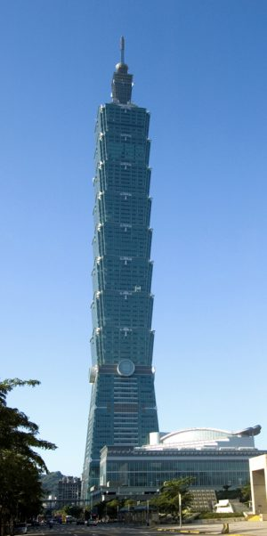
Coupled spin dynamics analogy
Taipei 101 by Alton Thompson, 2007
Coupled spin dynamics

Slide 17
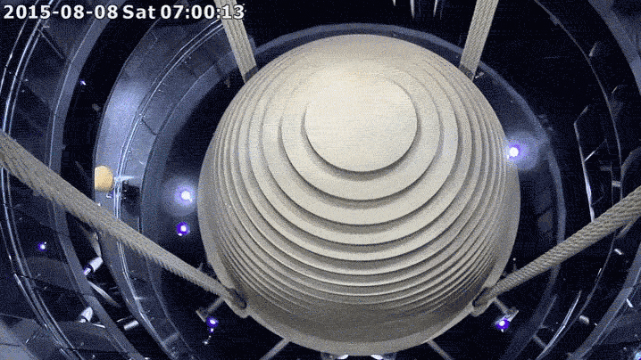
Coupled spin dynamics analogy
Tuned Mass Damper
Taipei 101 by Alton Thompson, 2007
https://99percentinvisible.org/episode/supertall-101/
Coupled spin dynamics

Slide 18
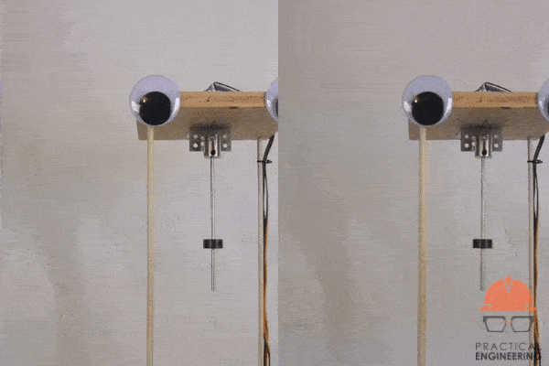
Coupled spin dynamics analogy
Tuned Mass Damper
Taipei 101 by Alton Thompson, 2007
https://99percentinvisible.org/episode/supertall-101/
Coupled spin dynamics

Slide 19
Coupled spin dynamics analogy
Nuclear magnetization
(noble gas atoms)
Electronic magnetization
(alkali atoms)
Alkali (electronic) polarization acts as tuned mass damper for long-lived nuclear spins.
perturbation
Tuned Mass Damper
Taipei 101 by Alton Thompson, 2007
https://99percentinvisible.org/episode/supertall-101/
Coupled spin dynamics

Slide 20
Compensation point
Strong coupling regime to ensure fast damping
Geometrical steady state analysis
Nuclear magnetization
(noble gas atoms)
Electronic magnetization
(alkali atoms)
probe beam
pump beam
bias field
Compensation point

Slide 21
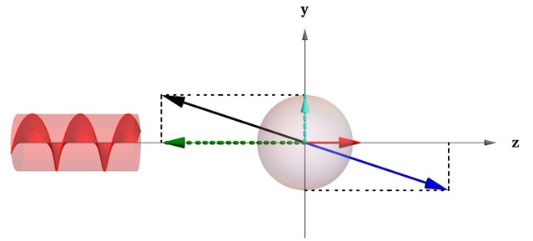
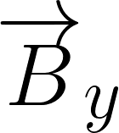
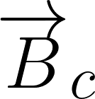
Compensation point
Strong coupling regime to ensure fast damping
Geometrical steady state analysis
Nuclear magnetization
(noble gas atoms)
Electronic magnetization
(alkali atoms)
probe beam
perturbation
pump beam
bias field
Compensation point

Slide 22
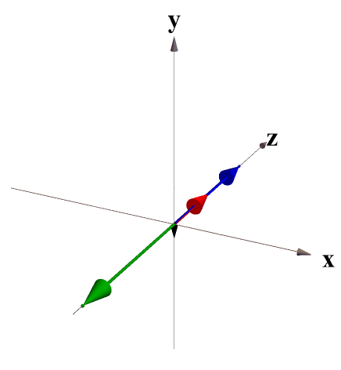
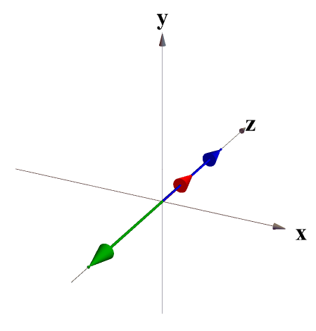

Compensation point
Due to strong damping nuclear magnetization follows magnetic field changes
Nuclear magnetization
(noble gas atoms)
Electronic magnetization
(alkali atoms)
Compensation point = bias field that enables suppressesion of alkali magnetization response to magnetic fields
perturbation
outside comp. point
inside comp. point
Compensation point

Slide 23
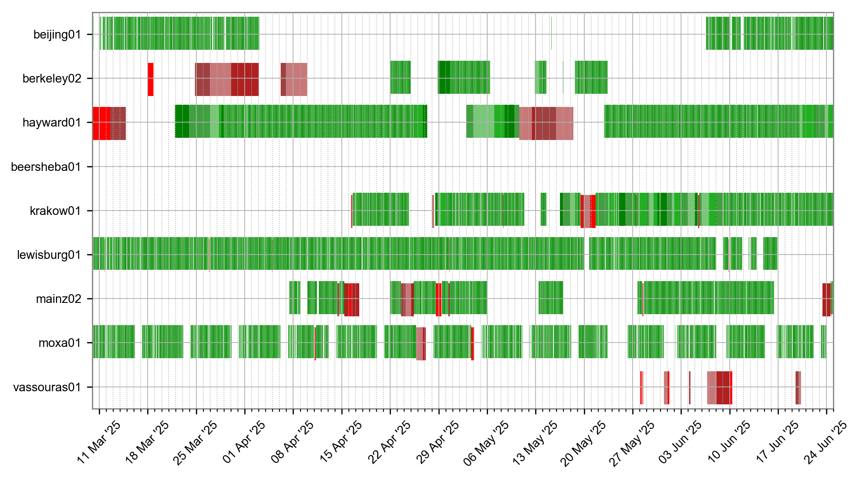
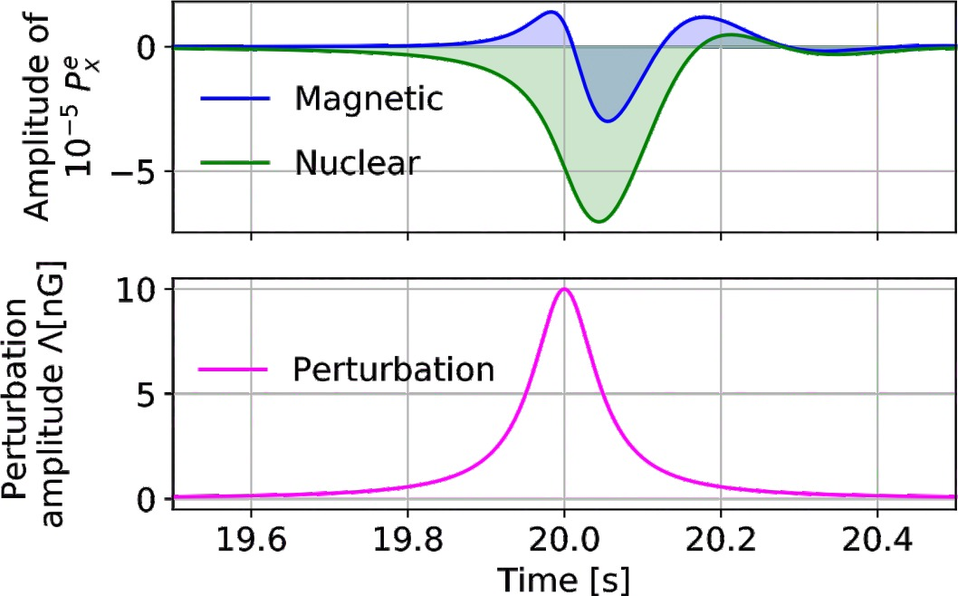
GNOME sensor requirements
Stable operation
Frequency-dependent calibration to generic spin perturbations
Advanced GNOME sensors

Slide 24
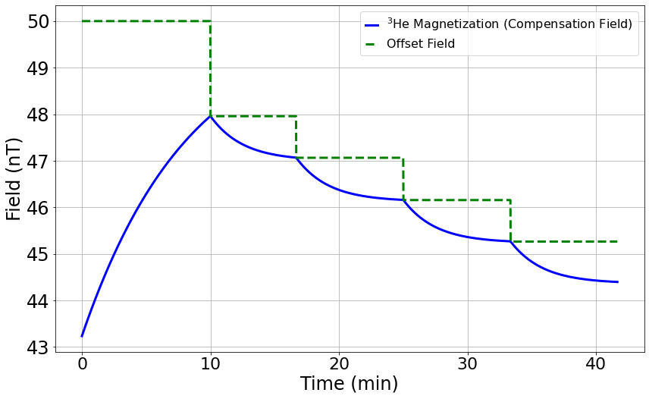
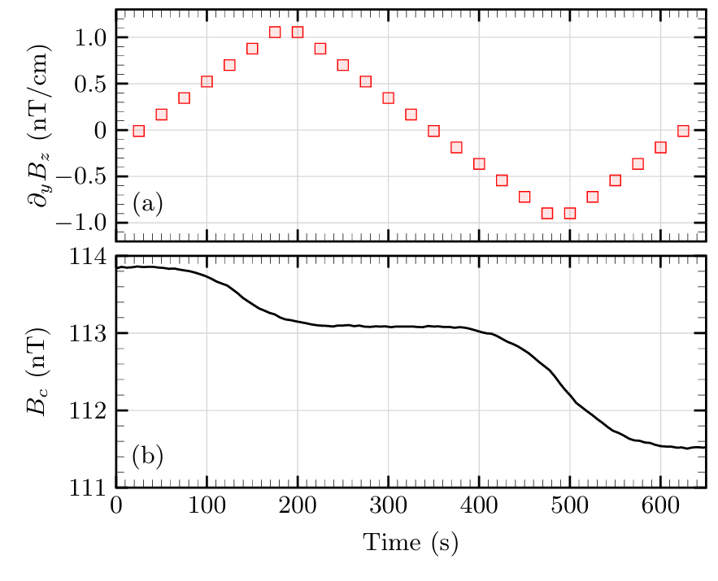


Stability optimization
The self-compensating point shifts over time due to nuclear spin relaxation, leading to drift in magnetic field compensation.
Problem: ³He magnetization drift
Solution: gradient optimization
Effect: Continuous sensor operation over weeks (with stable nuclear magnetization)
E. Klinger et al., Phys. Rev. Appl. 19, 044092 (2023).
Stability optimization

Slide 25
Question: How would a comagnetometer respond to exotic spin coupling?
Frequency response determination
M. Padniuk, E. Klinger, et al., Phys. Rev. Research 6, 013339
Frequency response determination

Slide 26
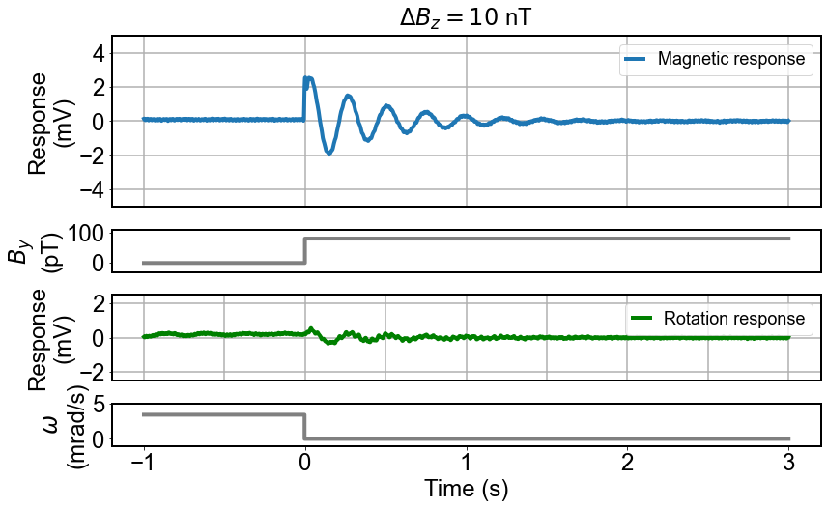
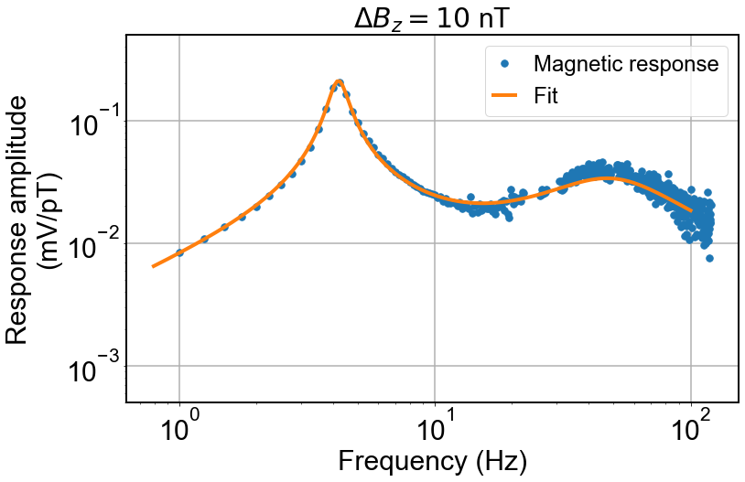

FFT
magnetic response fit
single shot step response measurement
Frequency response determination
M. Padniuk, E. Klinger, et al., Phys. Rev. Research 6, 013339
Frequency response determination

Slide 27
FFT
magnetic response fit
single shot step response measurement
Frequency response determination
M. Padniuk, E. Klinger, et al., Phys. Rev. Research 6, 013339
Frequency response determination

Slide 28
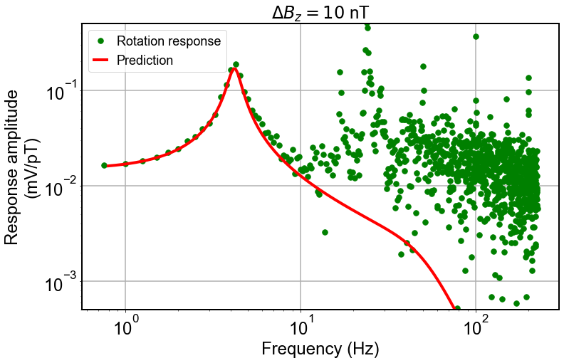
FFT
magnetic response fit
FFT
single shot step response measurement
rotation response prediction
& comparison with the measurement
Frequency response determination
M. Padniuk, E. Klinger, et al., Phys. Rev. Research 6, 013339
Frequency response determination

Slide 29


Outline
GNOME & intro to self-comepnsating comagnetometers
Sensor optimization
Calibration routine
Dark matter search
Comagnetometer decoupling (preliminary)
GNOME (Global Network of Optical Magnetometers for exotic physics)
Outline
S. Afach et al., Nat. Phys. 17, 1396–1401 (2021)

Slide 30
Outline
GNOME & intro to self-comepnsating comagnetometers
Sensor optimization
Calibration routine
Dark matter search
Comagnetometer decoupling (preliminary)
GNOME (Global Network of Optical Magnetometers for exotic physics)
Outline
S. Afach et al., Nat. Phys. 17, 1396–1401 (2021)

