Slide 1



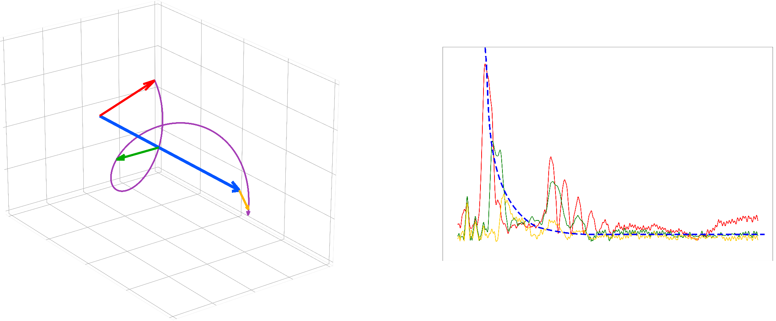
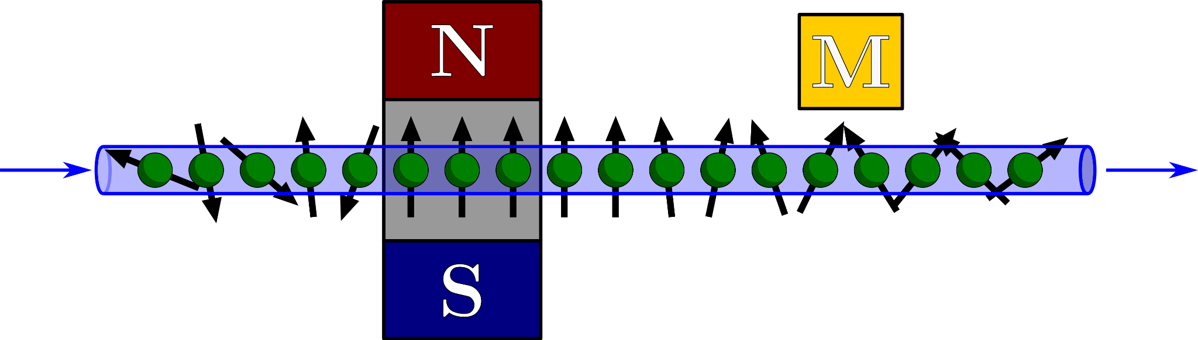
WOPM 2025
L. Page, M. T. M. Woodley, T. Coussens, D. Nightingale, D. Nicolau, P. Krüger and F. Oručević
08/08/2025
Blood flow monitoring using OPMs
Blood flow monitoring using OPMs

Slide 2

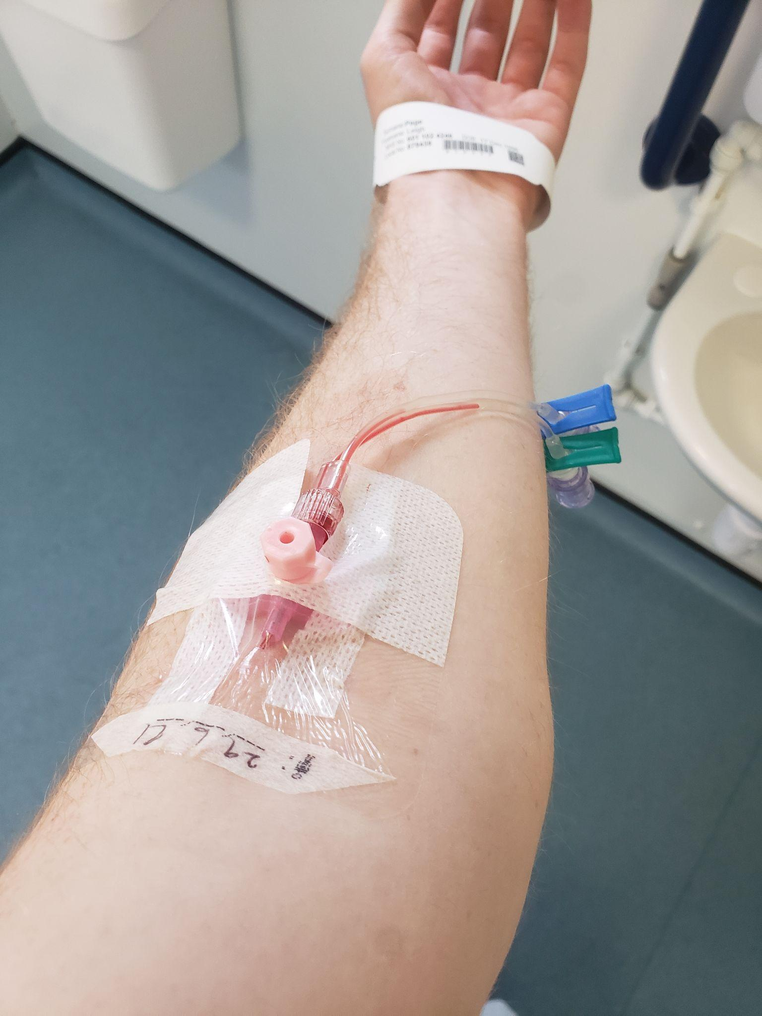
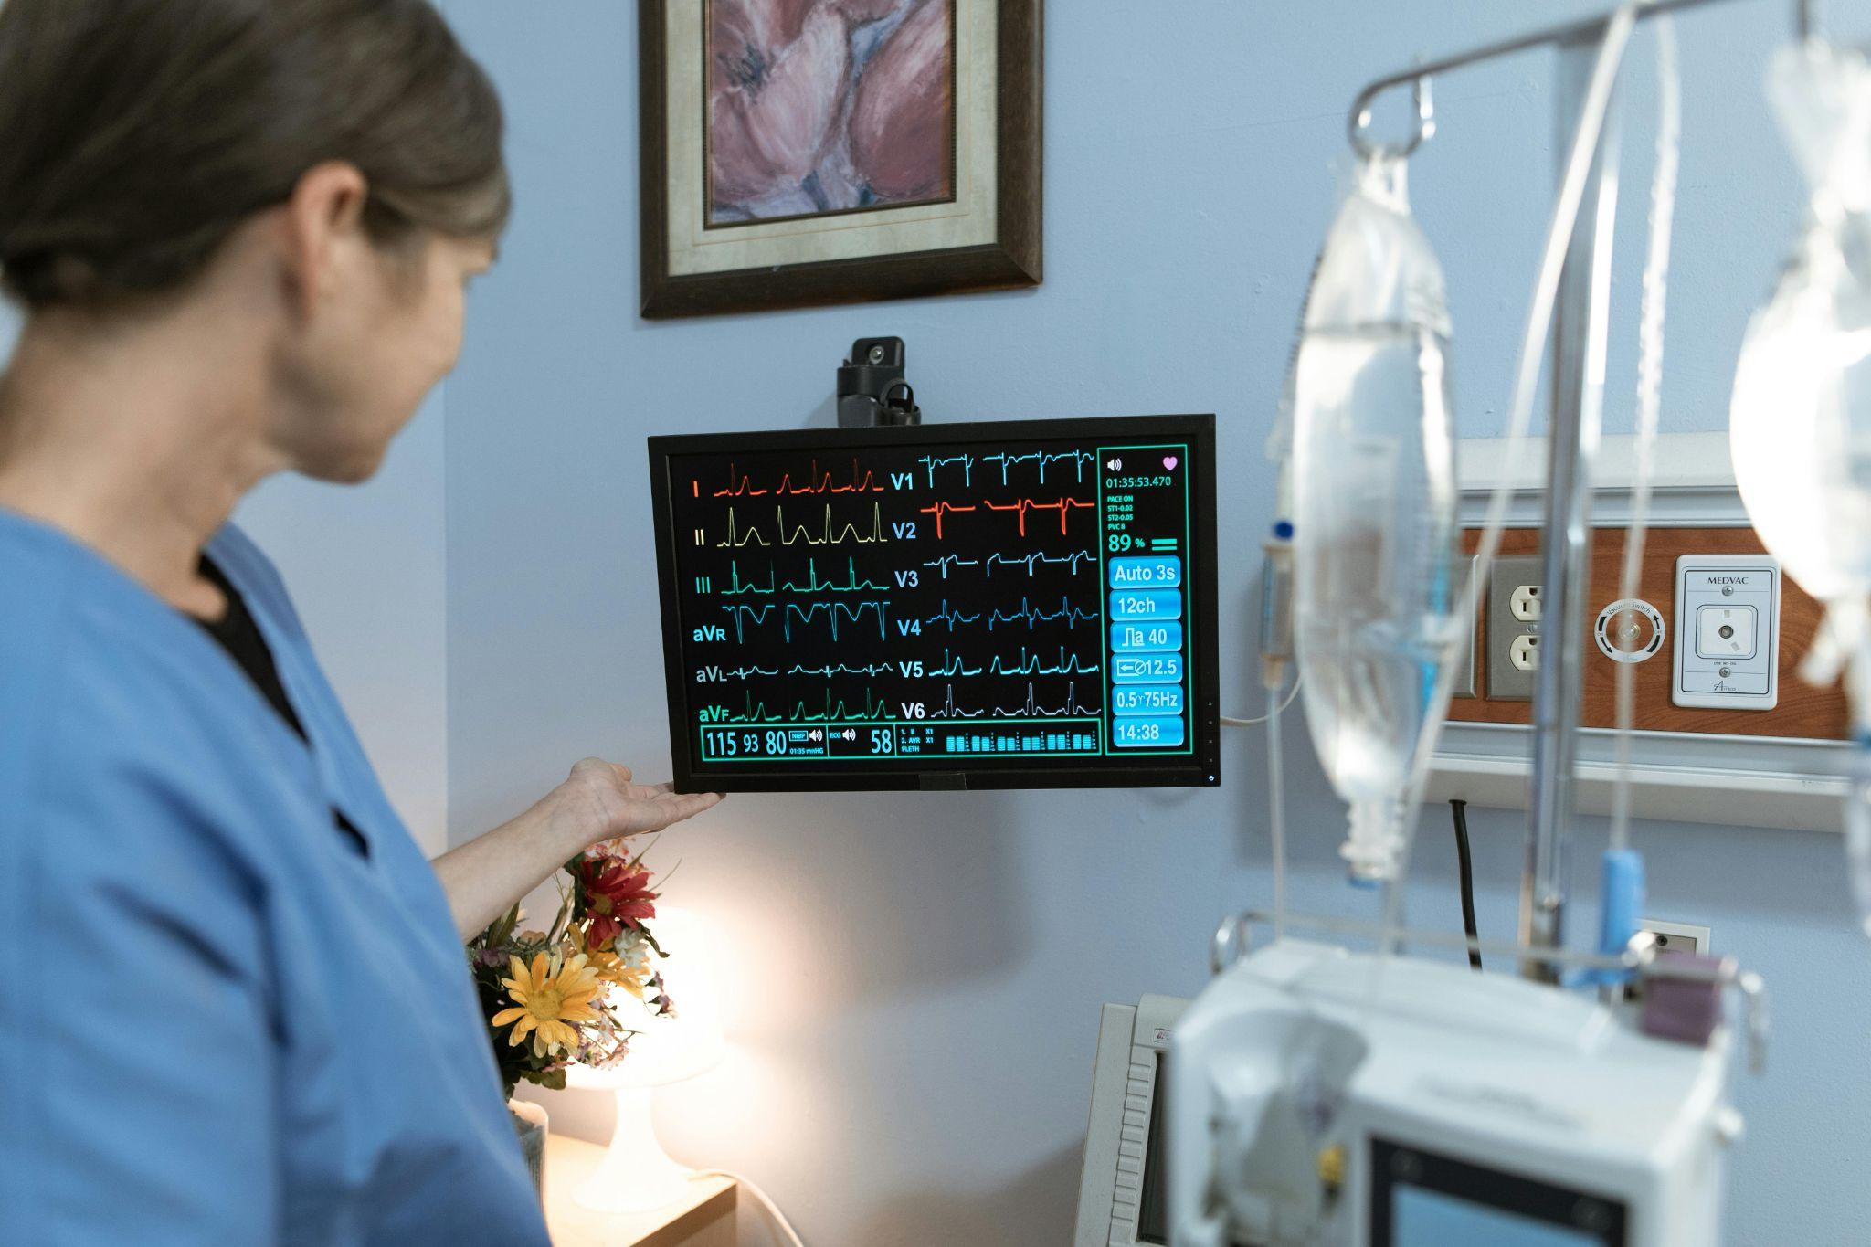
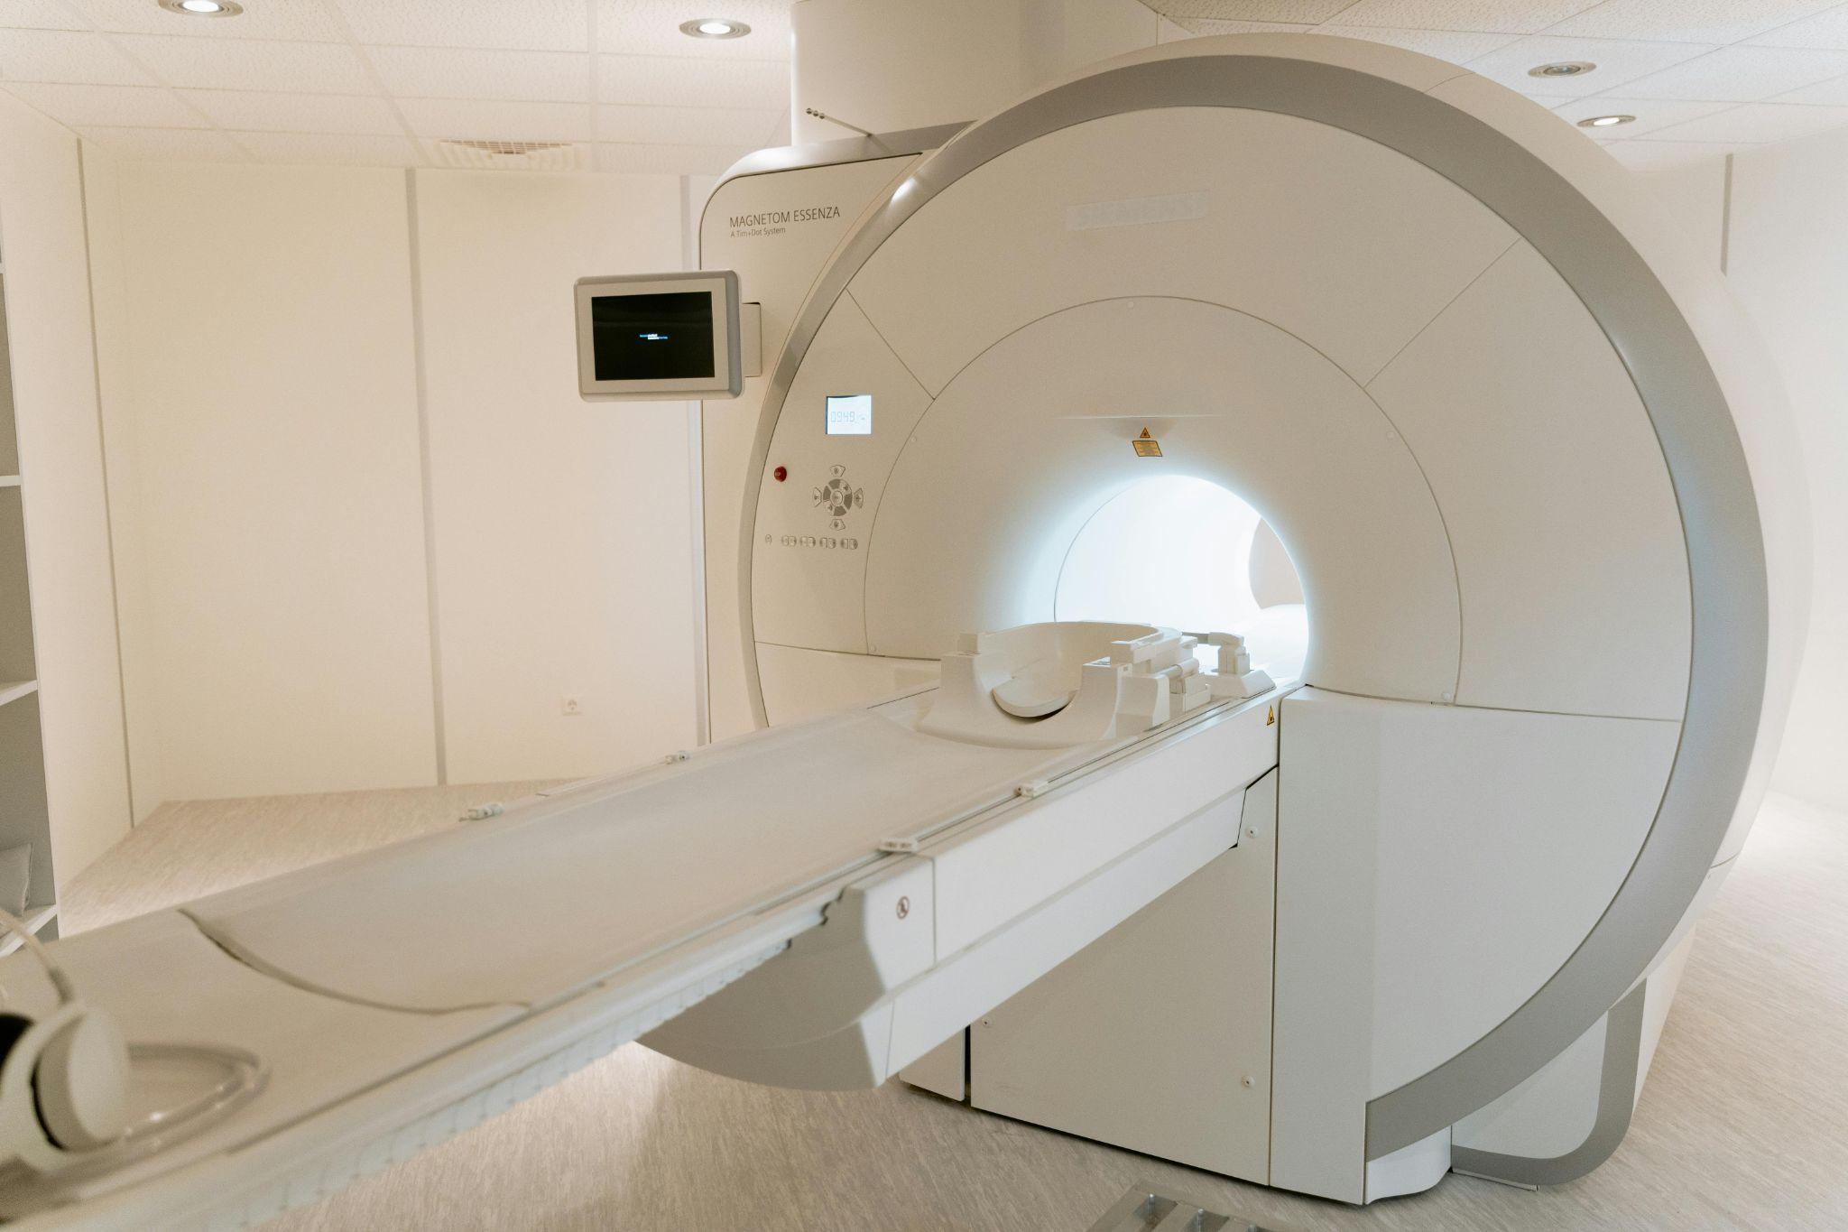
Introduction: blood flow monitoring
Blood flow measurement important for continuous monitoring
Monitoring: heart rate, blood pressure, oxygenation, red blood cell concentration
1/19
Notes:
Why is it important?
What parameters are important to monitor?

Slide 3
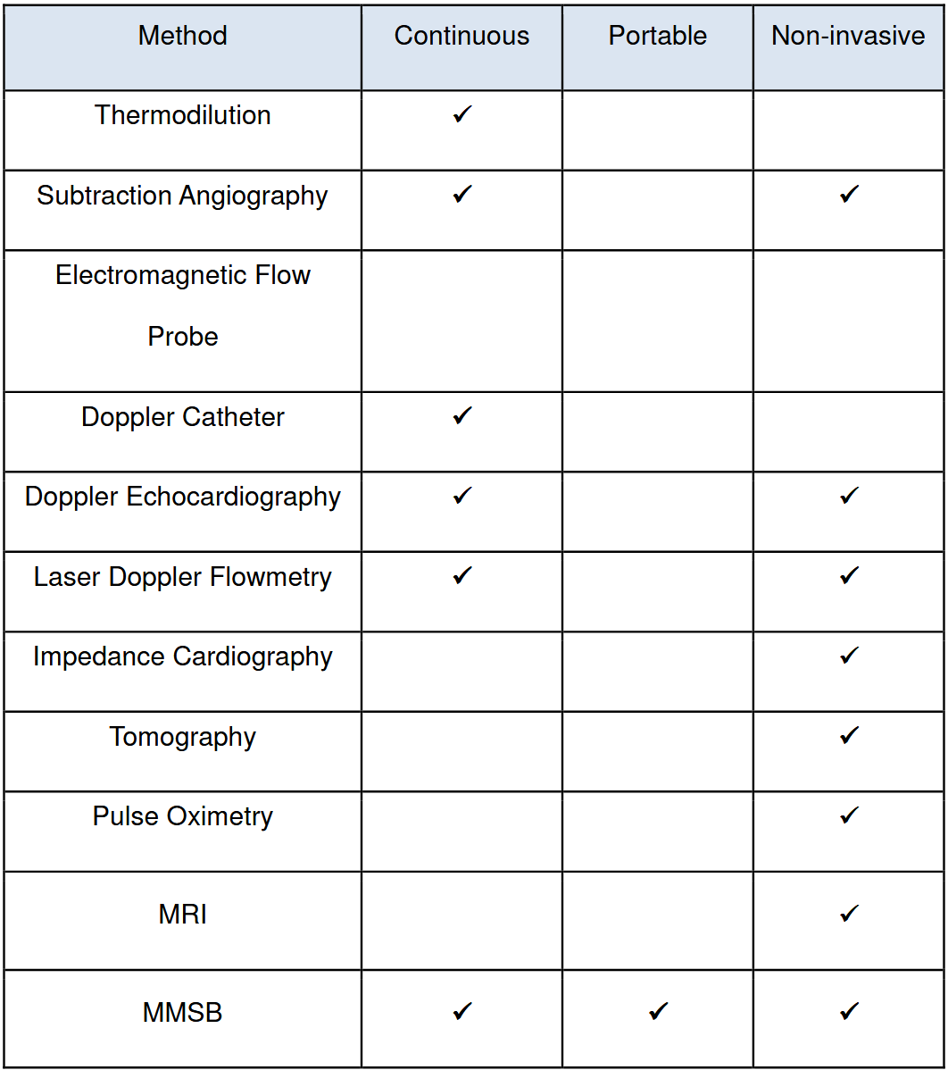
Current blood flow technologies
* Pulse oximetry only works on extremities, and has limitations working with different skin pigmentations, contributing to healthcare disparities
Magnetically detecting bloodflow and other characteristics using OPMs has the potential to improve upon existing techniques
*
✓
✓
F. L. Sinatra et al. “Understanding the Interaction Between Blood Flow and an Applied Magnetic Field” (2010).
2/19
Notes:
Comment on columns, not specific technologies

Slide 4
Principle
Liquid starts randomly polarised
Magnet polarises the liquid
Polarisation decays over time
Magnetometer measures polarisation
3/19

Slide 5
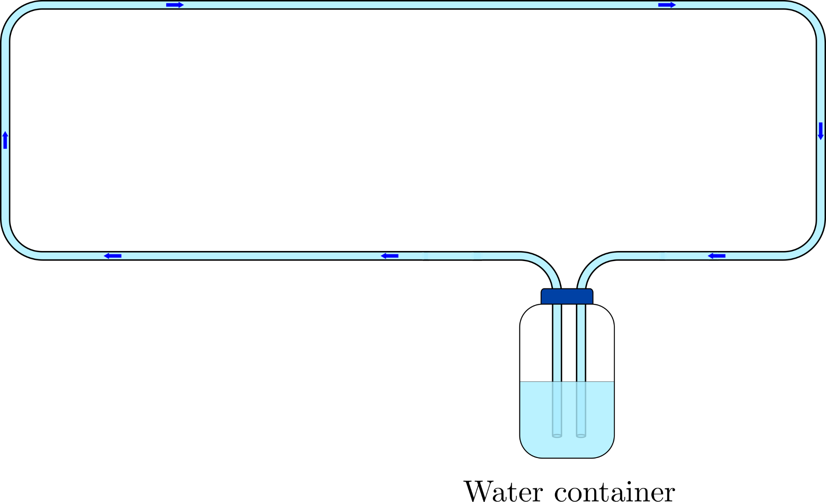

Experiment: setup
4/19
Notes:
Water instead of blood as it’s easier to access/get a hold of and work with

Slide 6
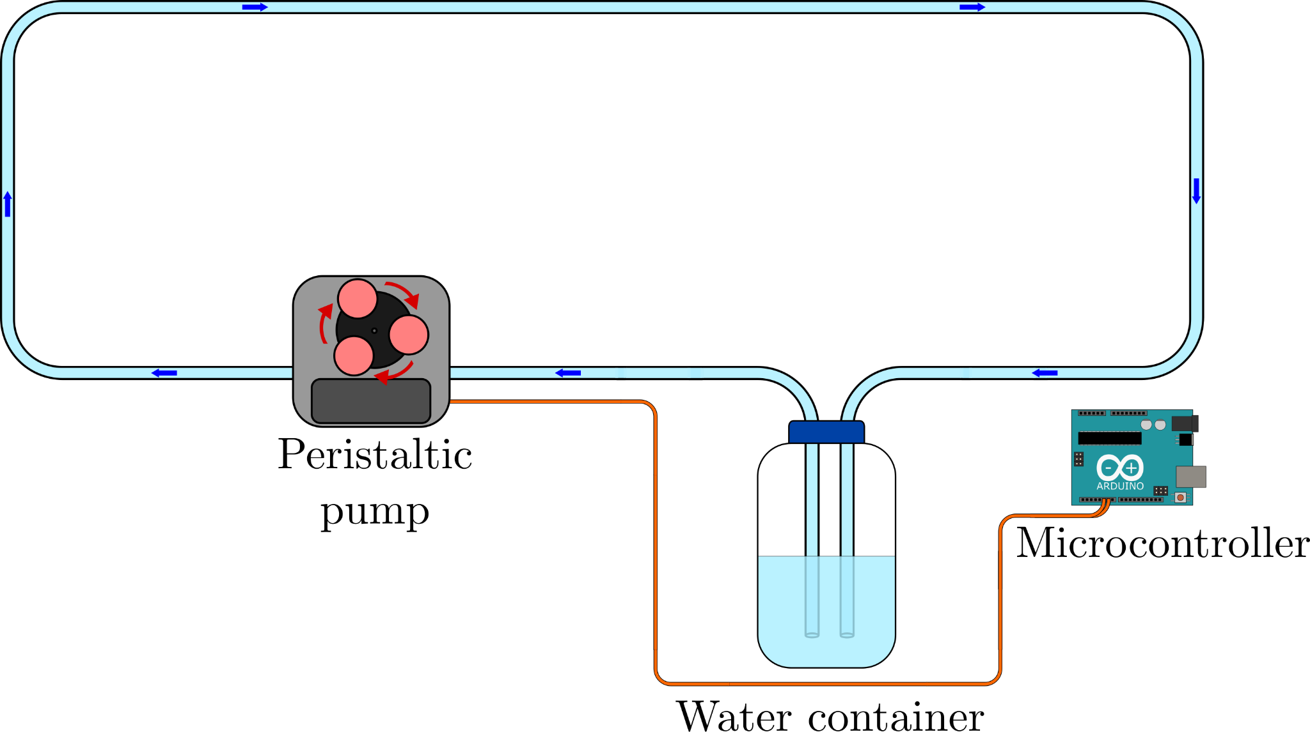
Experiment: setup
4/19
Notes:
Use peristaltic pump to replace heart – controlled by microcontroller

Slide 7
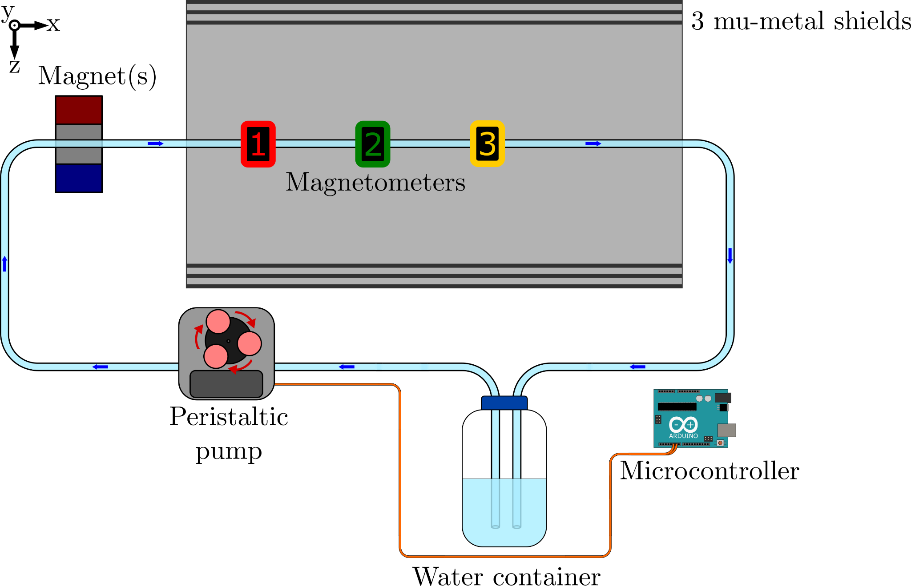
Experiment: setup
4/19
Notes:
Magnet and magnetometers in series to measure the decay as the water travels
Shielding for the magnetometers

Slide 8
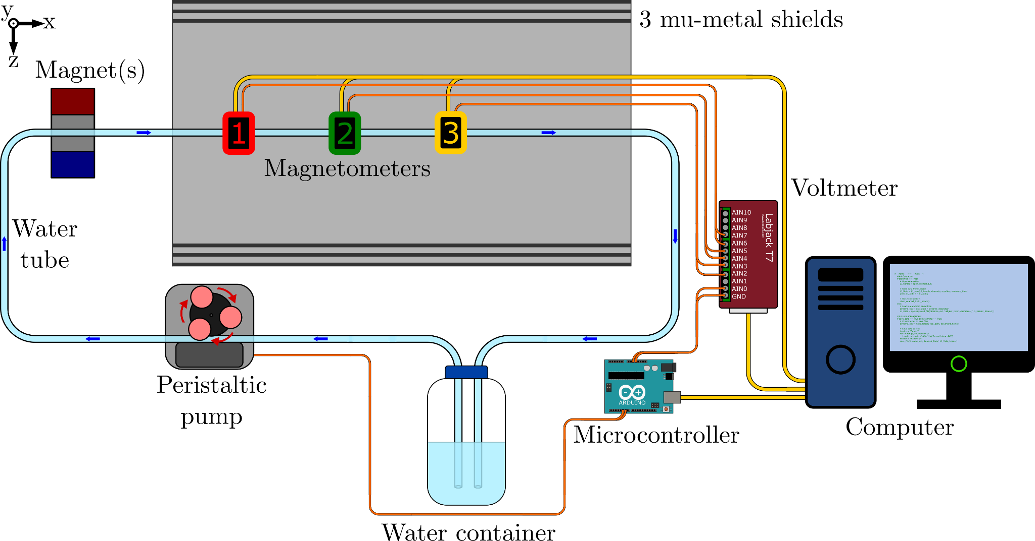
Experiment: setup
4/19
Notes:
Controlled from computer which collects all the data via a voltmeter

Slide 9
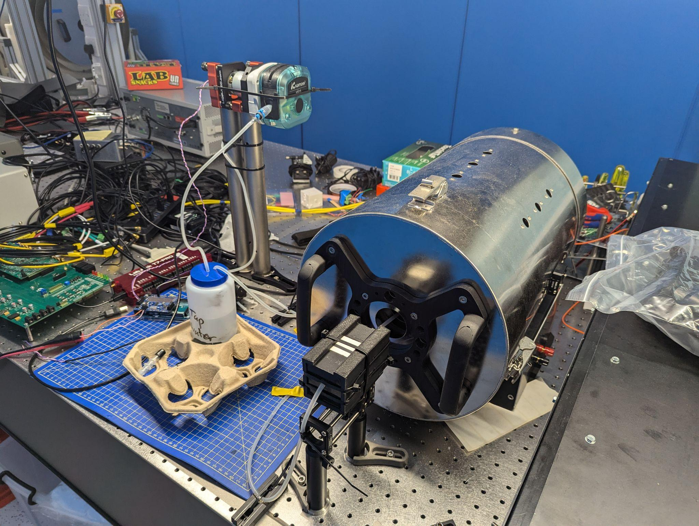
Experiment: setup
Pump
Shield
Water
container
Magnets
5/19
Notes:
Messy

Slide 10
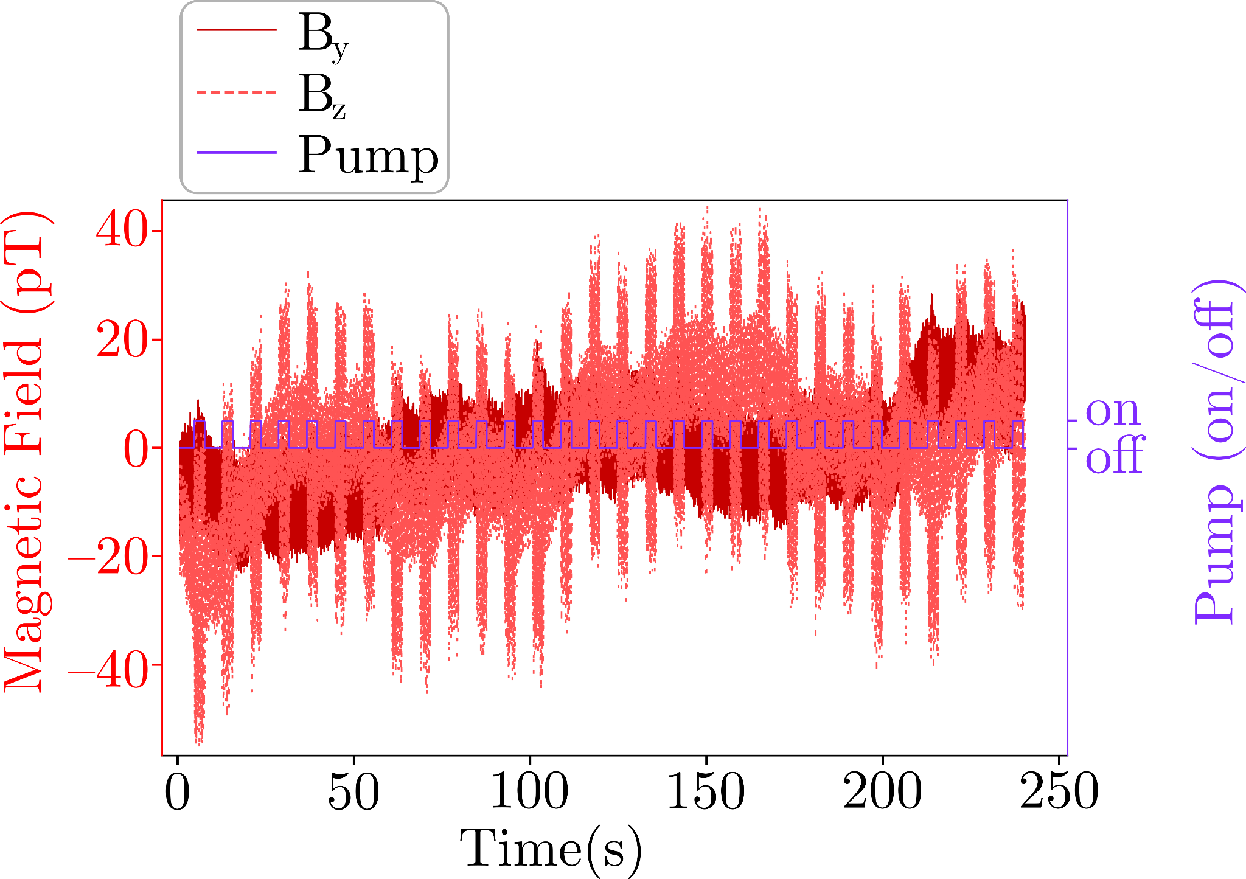
Signal detection
Magnetometer 1 raw data
Square wave is signal from Arduino indicating pump status
Magnetic field data too noisy
6/19

Slide 11
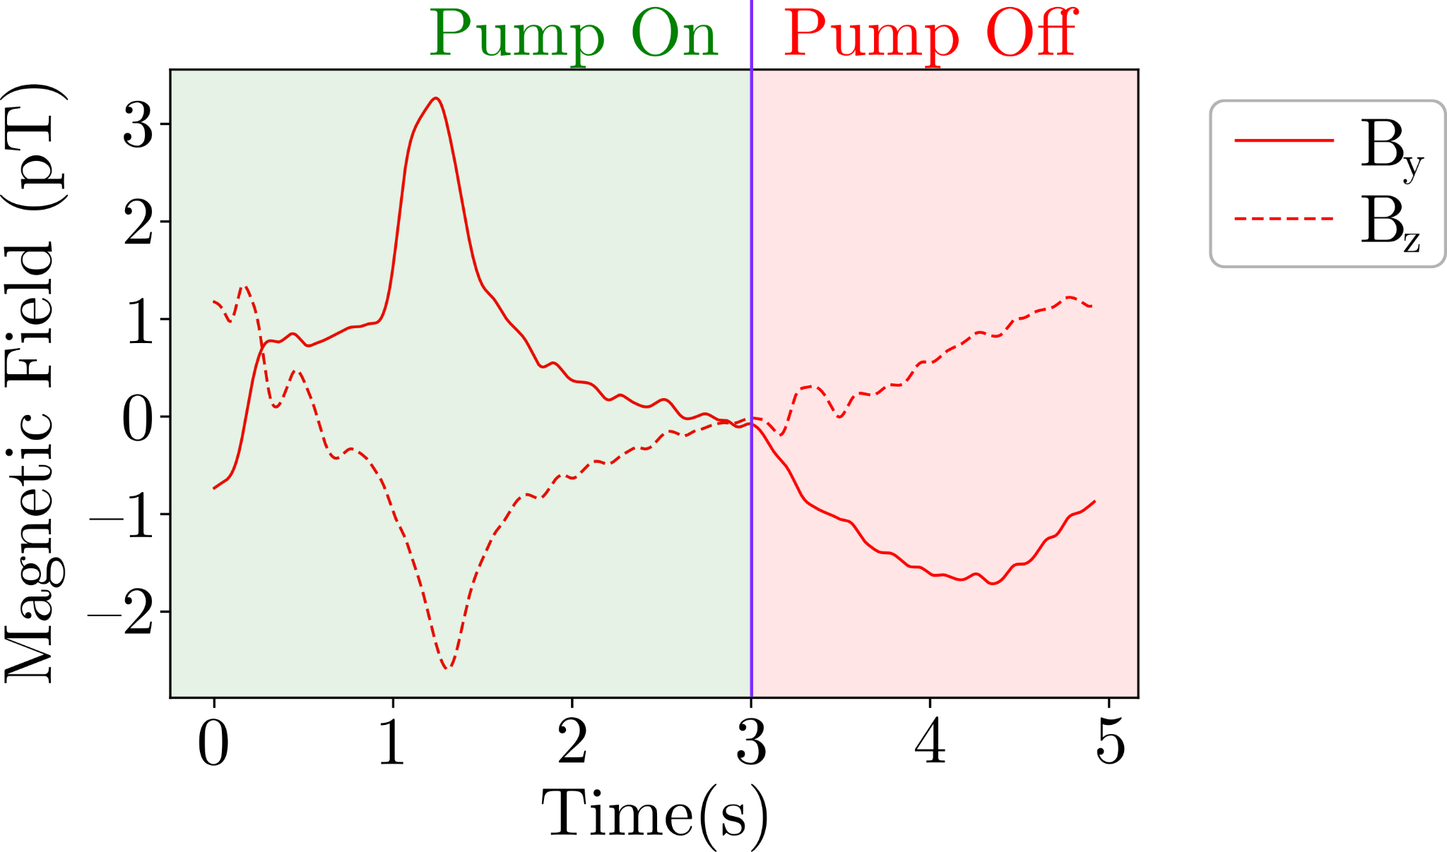
Signal detection
Magnetometer 1 filtered and averaged data
Green half is when the pump is on, and off for red
More noise when pump switches
Clear peaks visible
7/19
Notes:
Clearly see peaks

Slide 12
Signal detection
8/19

Slide 13
Signal detection
8/19
Notes:
Close to expected time differences

Slide 14
Signal detection
9/19

Slide 15
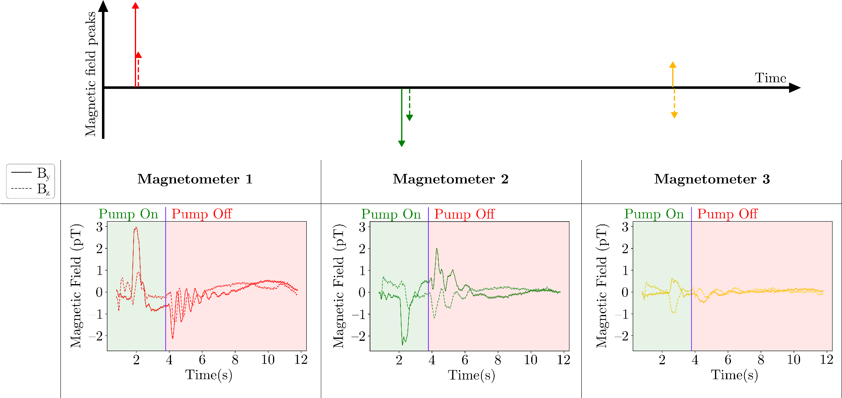
Polarisation precession
10/19
Notes:
We also noticed some changes in the vector distribution, which pointed towards precession

Slide 16
Polarisation precession
Polarisation precession around residual magnetic field along x axis
Precession frequency of ~2.5 Hz implies ~60 nT magnetic field
11/19

Slide 17



Variables
Explore variables:
Flow speed
Number of magnets
Magnetisation time
Fluid composition
12/19

Slide 18
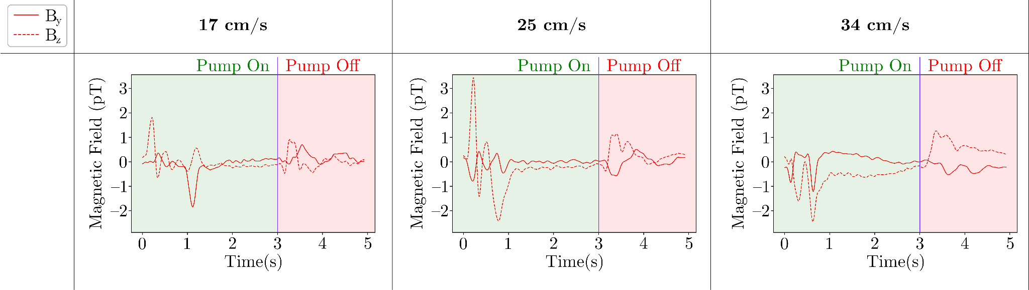
Variables: pump speed
?
?
Signals shift left with higher pump speed
Noise increases with higher pump speed, masking the signal
17 cm/s is good for signal to noise ratio
13/19

Slide 19
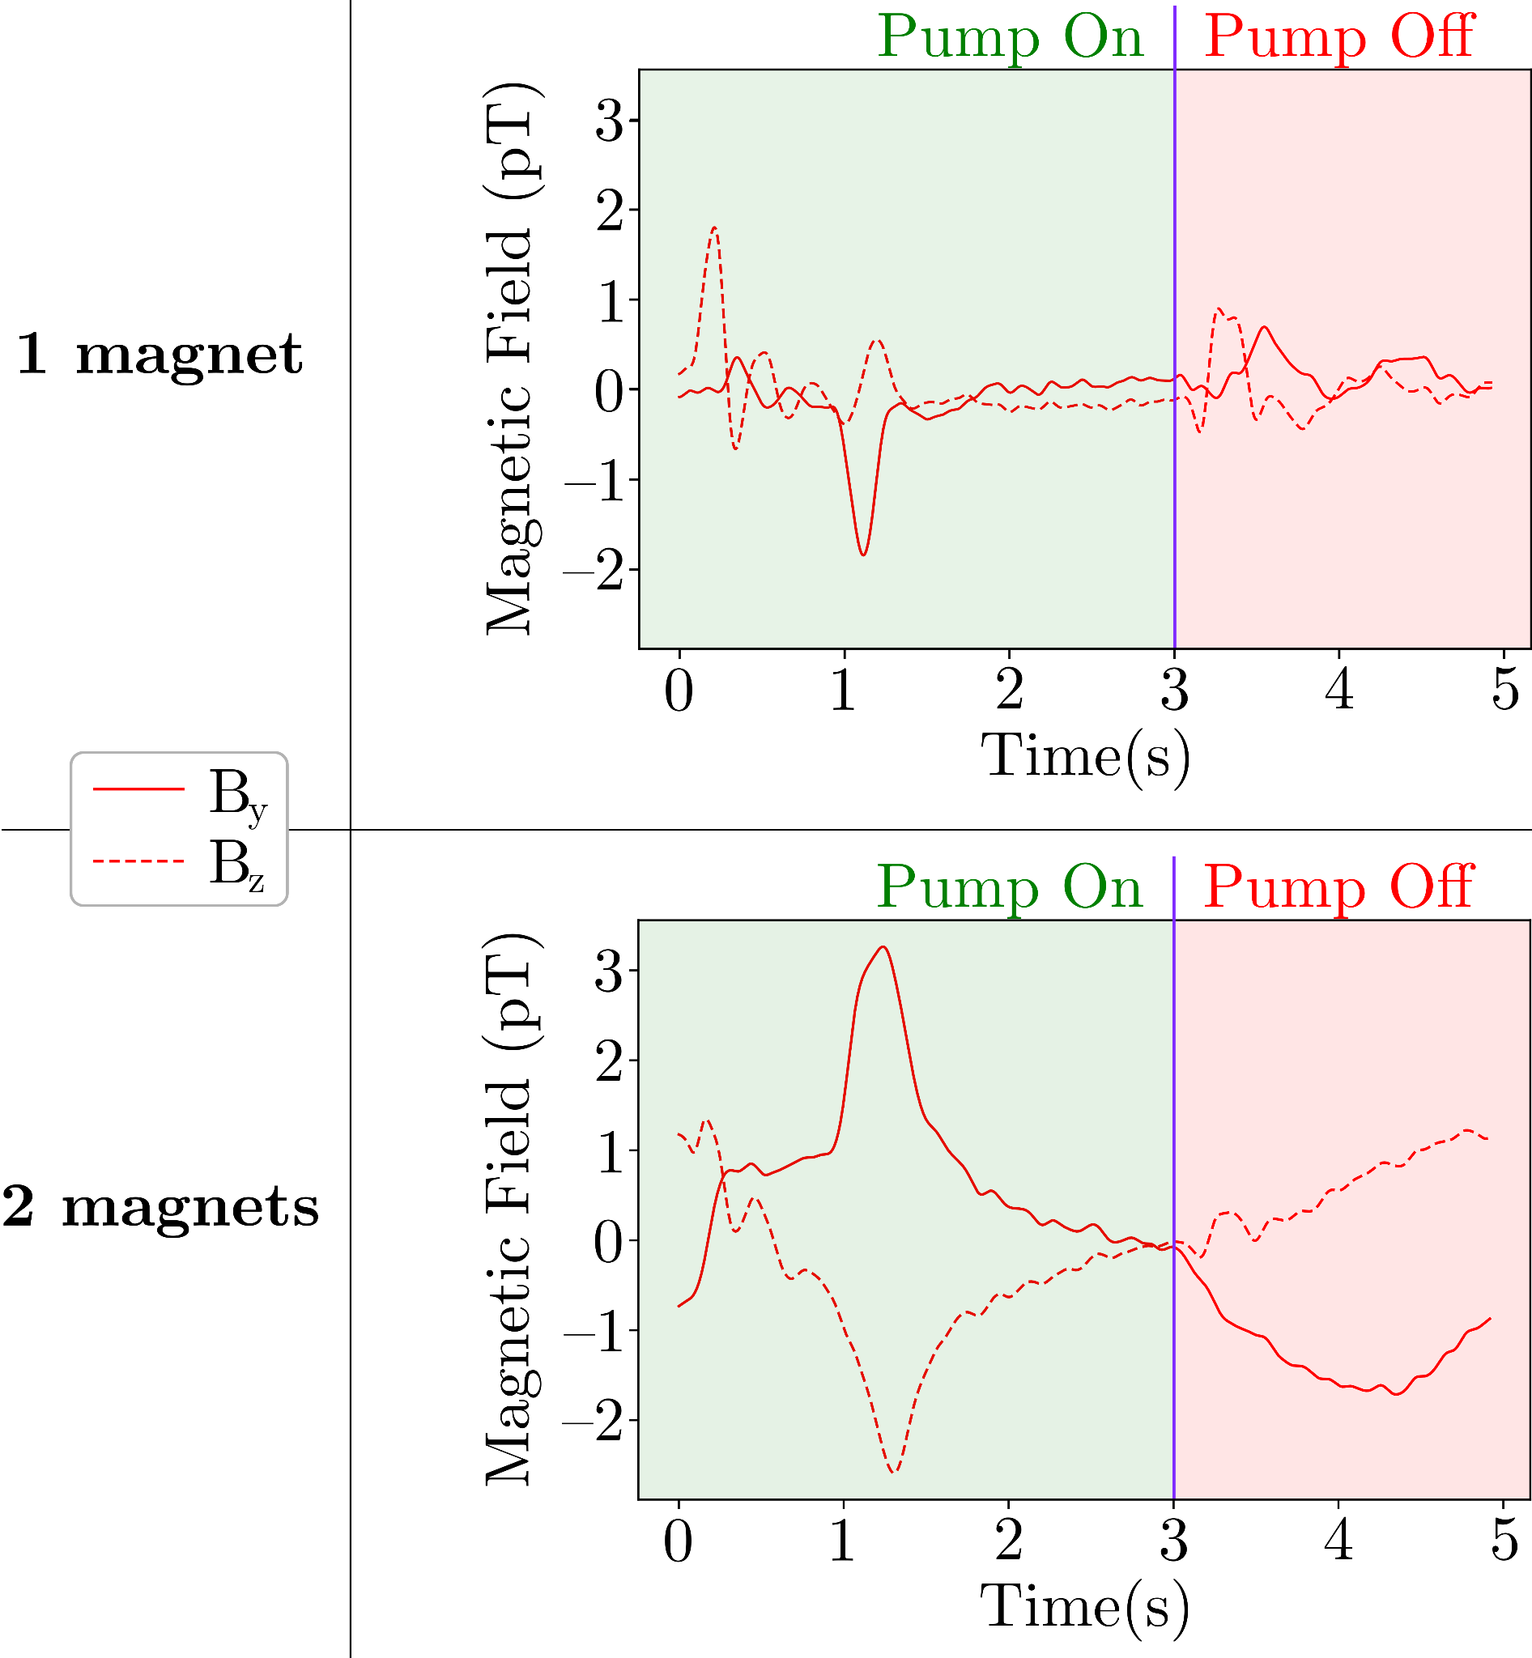
Variables: magnets
Extra magnets increase the magnetisation (or polarisation) of water
Signal inversion likely caused by polarisation precession following a change in the residual magnetic field from the new magnet setup
Peak magnitude increased with extra magnet
14/19

Slide 20
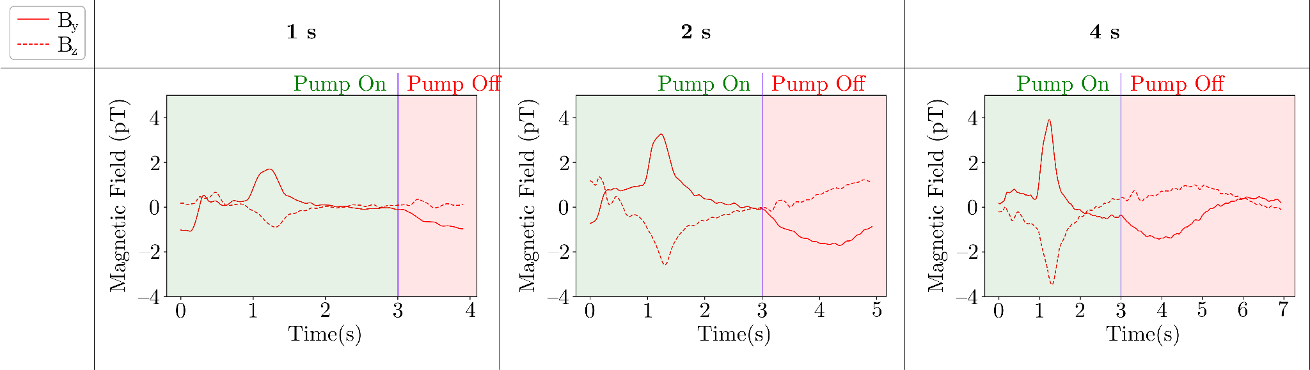
Variables: magnetisation time
Most of the water magnetisation occurs during the intervals when the pump is turned off
Longer time under magnets creates a larger signal
15/19

Slide 21
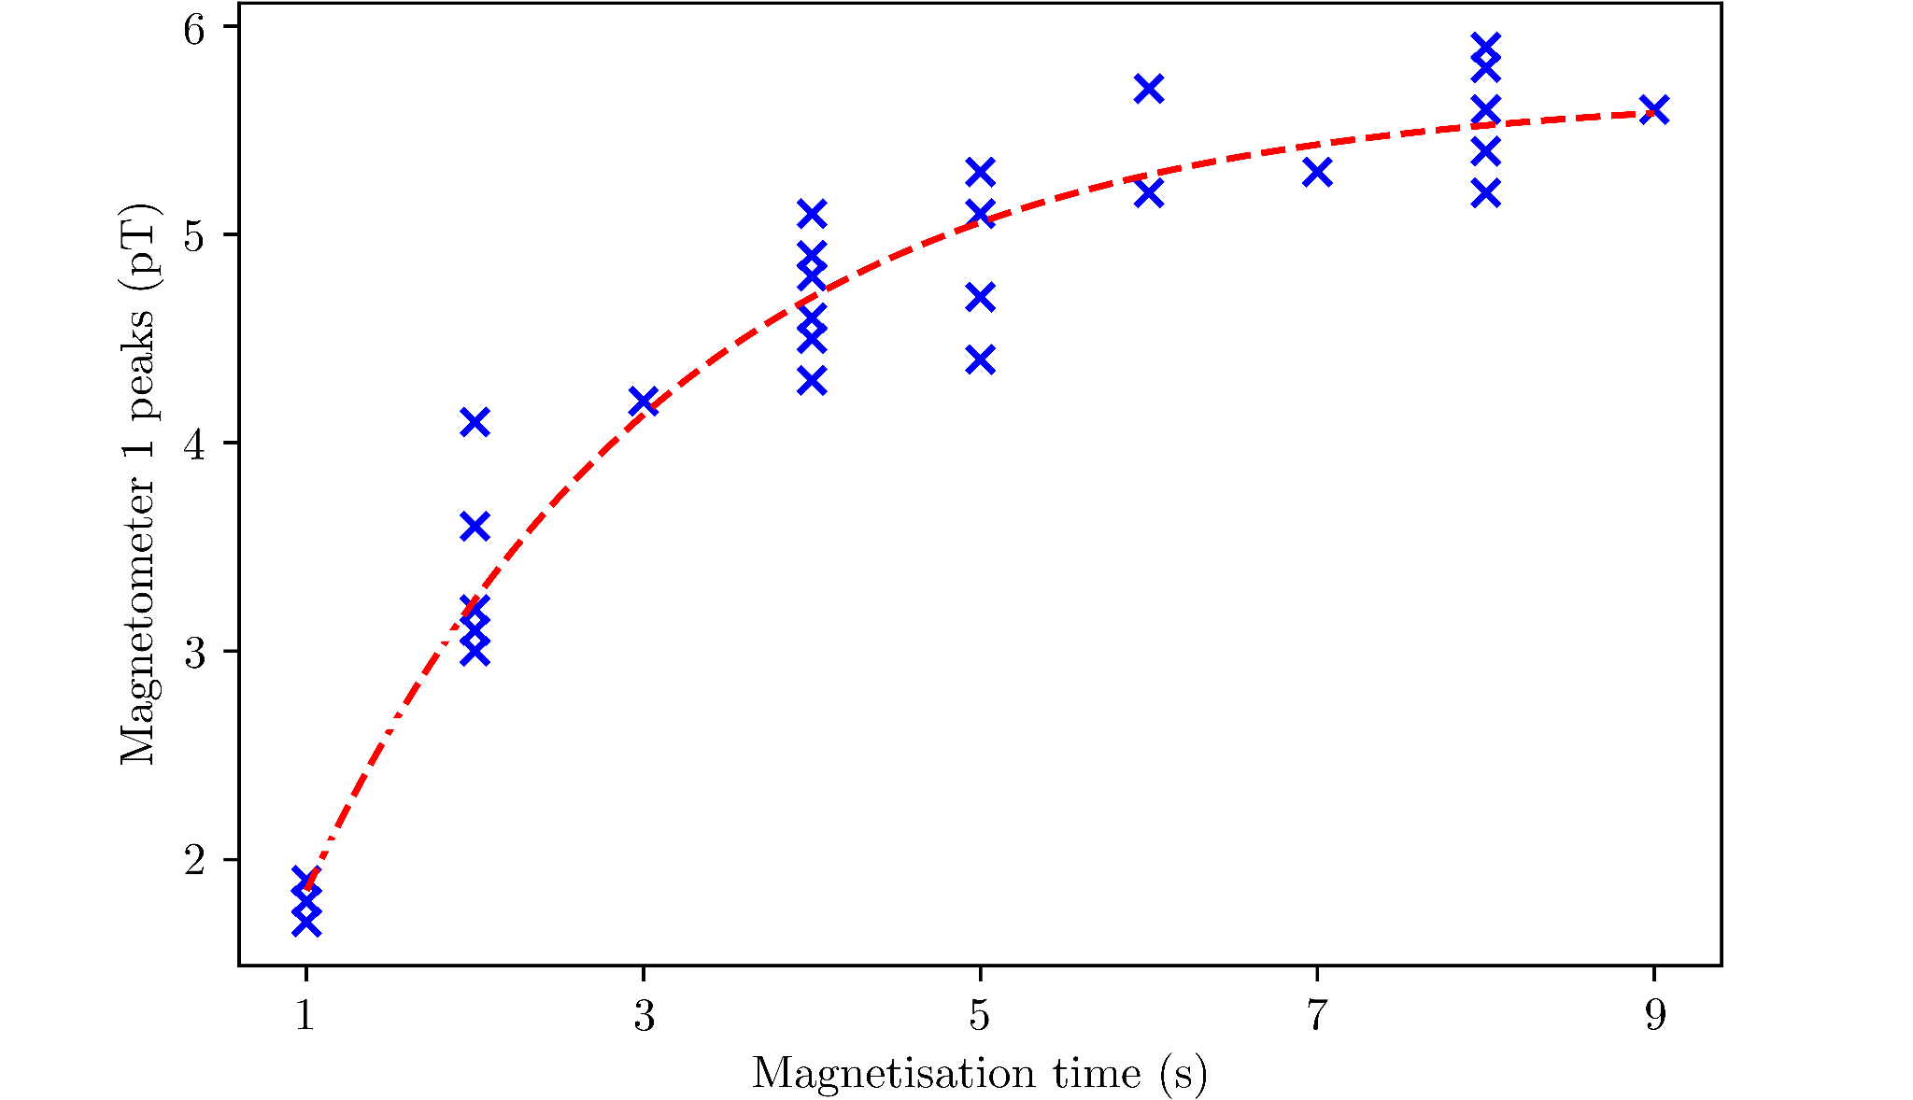

Variables: magnetisation time
The data can be fitted using the Bloch equation
T is the time constant
The measured magnetisation time of ~2.2 s is comparable to the T1 relaxation time of polarised hydrogen nuclei in MRI systems
1
16/19
Notes:
T1 = spin-lattice relaxation time constant

Slide 22
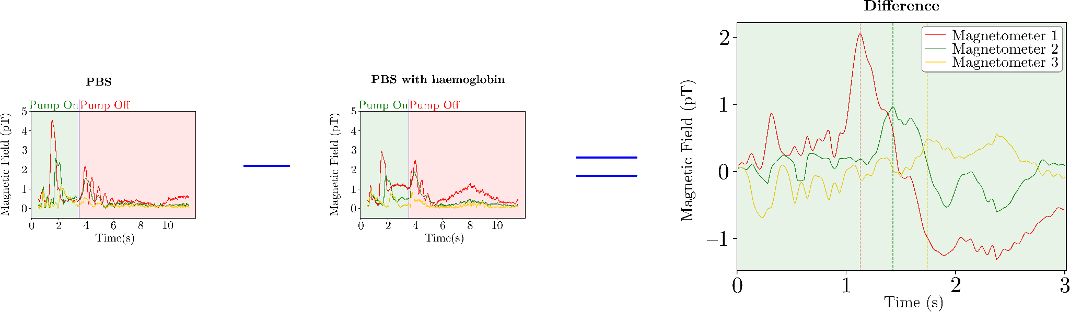
Variables: haemoglobin
*
PBS is diamagnetic, while methaemoglobin are paramagnetic
Taking the difference between the two measurements gives the haemoglobin signal
The haemoglobin concentration used in this experiment is 10-15 times lower than that found in human blood
*PBS = Phosphate Buffered Saline
17/19
Notes:
PBS to maintain a stable pH and osmolarity for the haemoglobin
10 g/L vs. 120-180 g/L
Shows that even small changes in composition can be detected

Slide 23


Future work
Reduce mechanical noise originating from the fluid flow system (e.g. pump, tubing)
Investigate polarization precession
with controlled magnetic fields
Configure polarisation magnets in a Halbach array to minimise residual magnetic fields
Test on humans
18/19
Notes:
Don’t say ‘not finished’

Slide 24
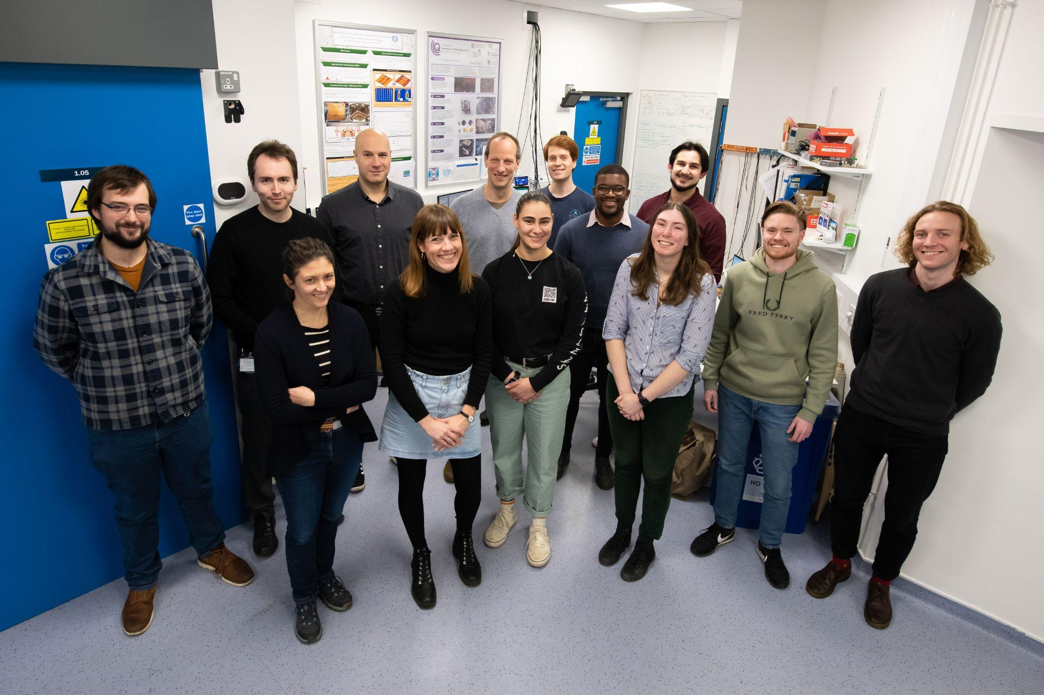



Summary
Summary:
Non-invasive OPM-based fluid flow monitoring achieved
Information about the medium can be determined
Room for further optimisation of setup
Potential for application in a range of medical and industrial fields
19/19
Notes:
Thank you for listening
Do you have any questions?

