Slide 1

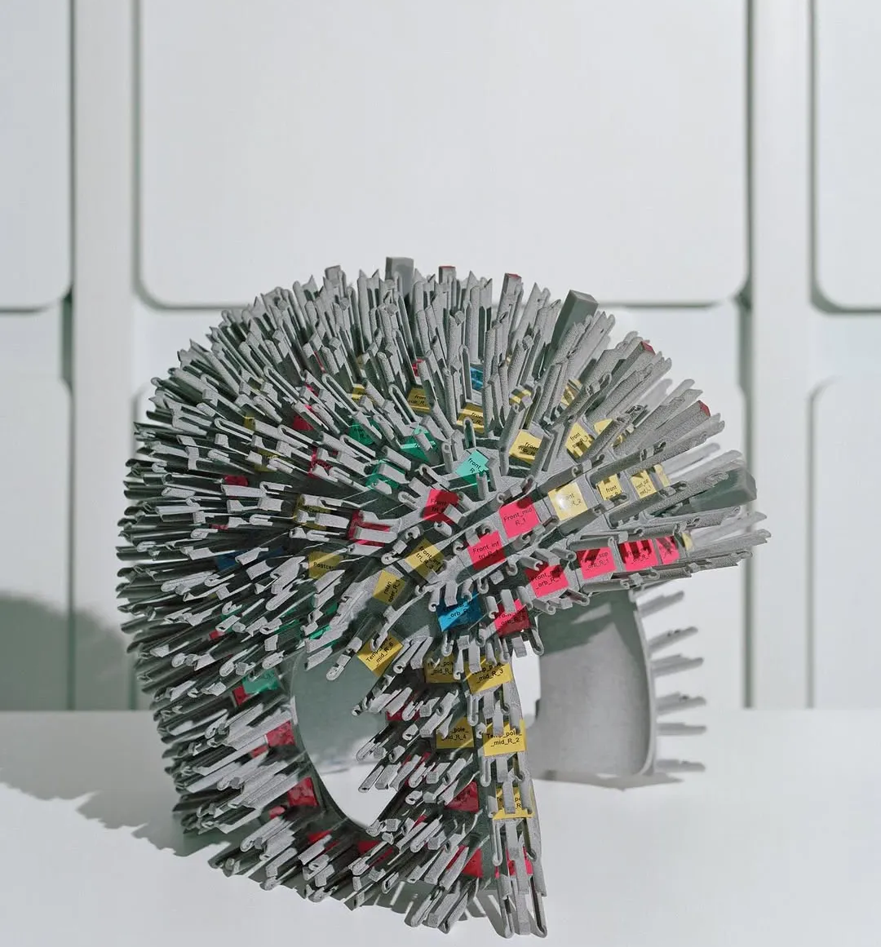

High-Density OPM-MEG
Joe Gibson
WOPM 2025
Joseph Gibson¹, Holly Schofield^{1,2}, Ewan Kennett¹, Niall Holmes^{1,2}, Ryan M. Hill^{1,2}, Matthew J. Brookes^{1,2}
¹Sir Peter Mansfield Imaging Centre, School of Physics and Astronomy, University of Nottingham, Nottingham, United Kingdom
²Cerca Magnetics Limited, 7-8 Castlebridge Office Village, Kirtley Drive, Nottingham, United Kingdom

Slide 2
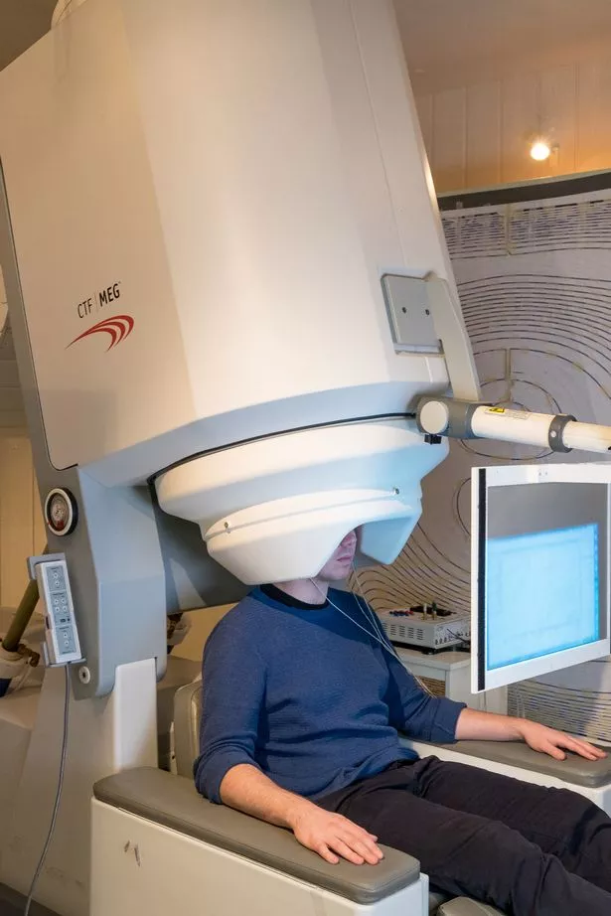
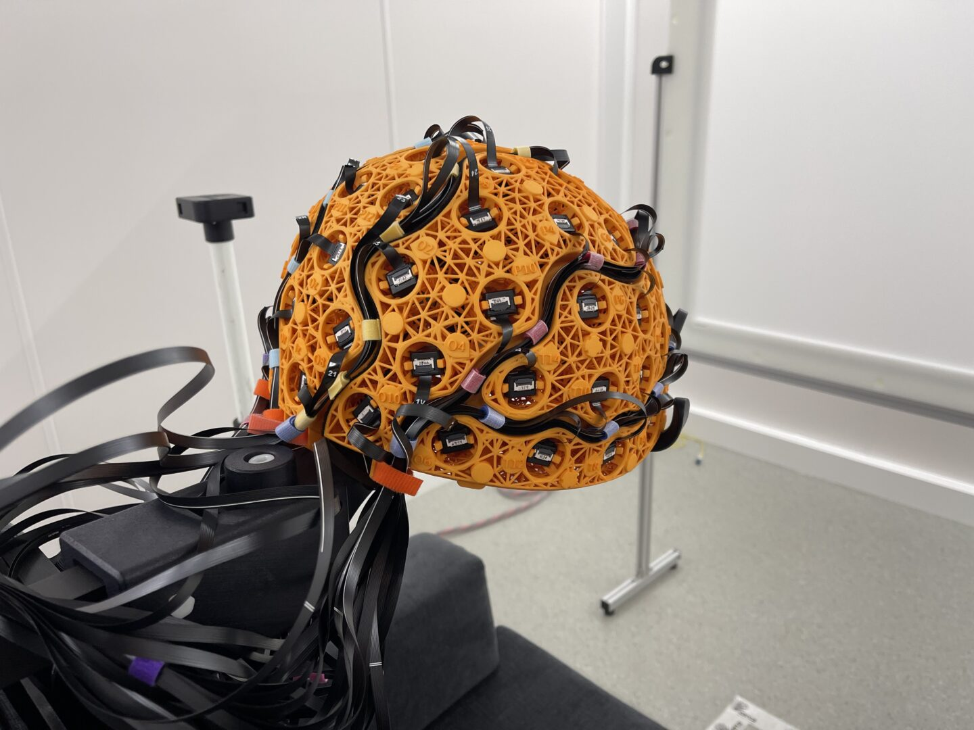
SQUID system
OPM system
>300 Channels
<200 Channels

Slide 3
Overview
High density OPM-MEG improves spatial resolution and sensitivity
Accurate array calibration is important for high density OPM-MEG
Increasing channel count is necessary to maintain high density coverage and reduce spatial leakage

Slide 4
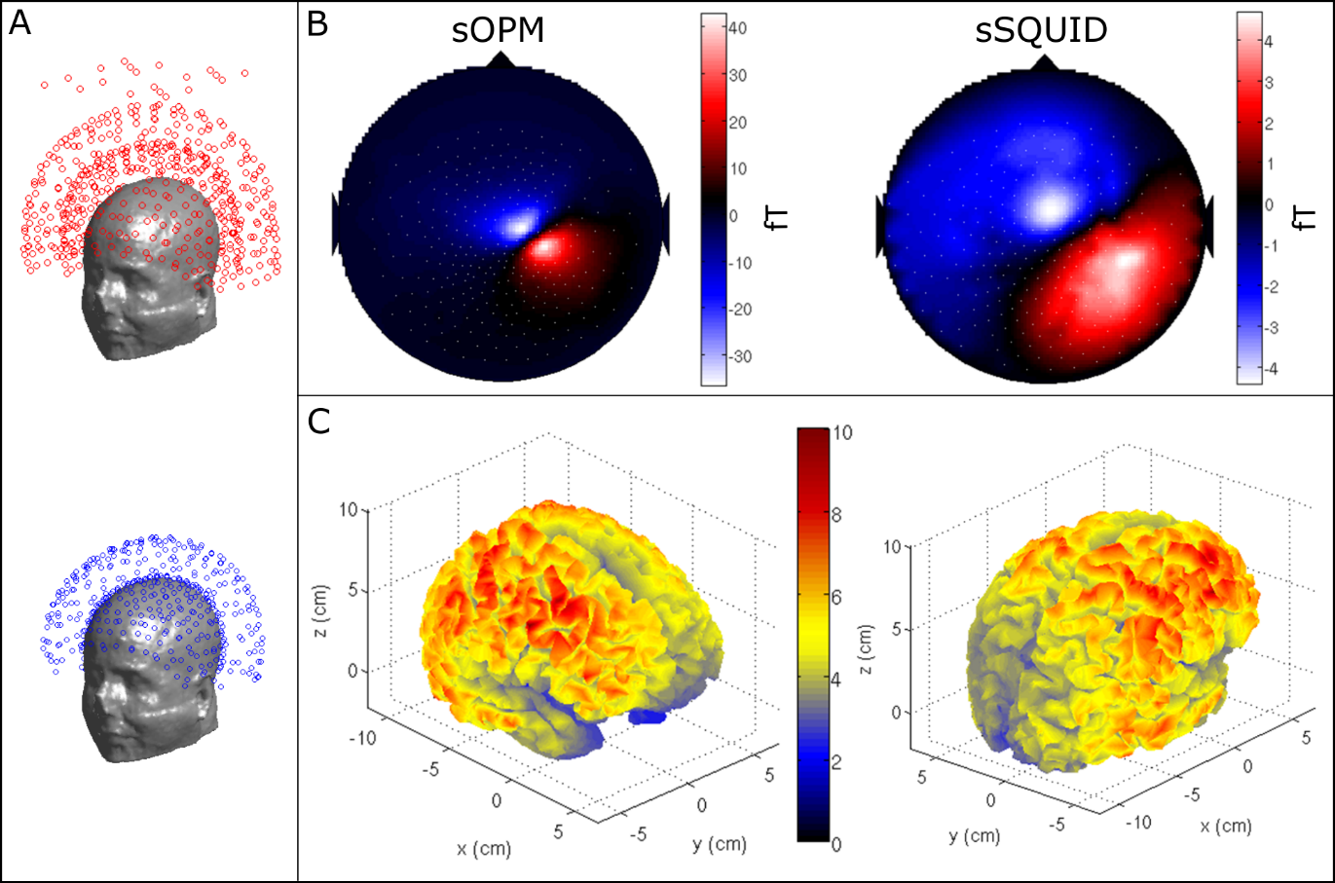
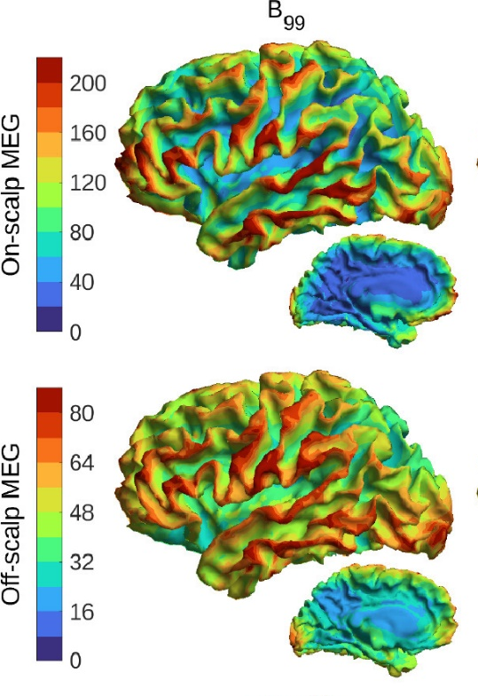
Moving closer to the scalp
Sensitivity and spatial resolution improve closer to the scalp
200
40
4
Effective number of spatial components
80
-40
-4
Boto et al., 2016 10.1371/journal.pone.0157655
Iivanainen et al., 2021 10.1016/j.neuroimage.2021.118747

Slide 5
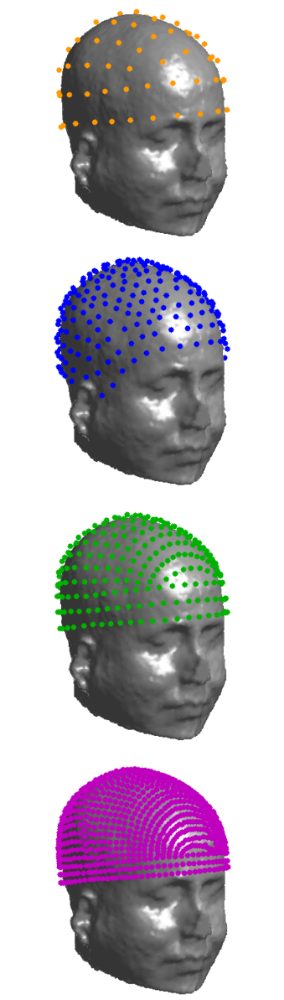

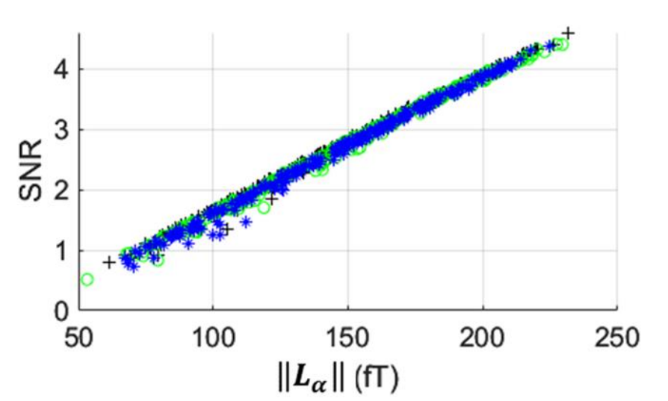
Moving to higher density
Sensitivity and spatial resolution improve at higher density
Boto et al., 2016 10.1371/journal.pone.0157655
Hill et al., 2025 10.1162/imag_a_00535

Slide 6

Where we are
Where we want to be
Heating
Coregistration
???
Cost
Interference rejection
Sensor footprint
Crosstalk
Electronics

Slide 7
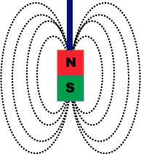
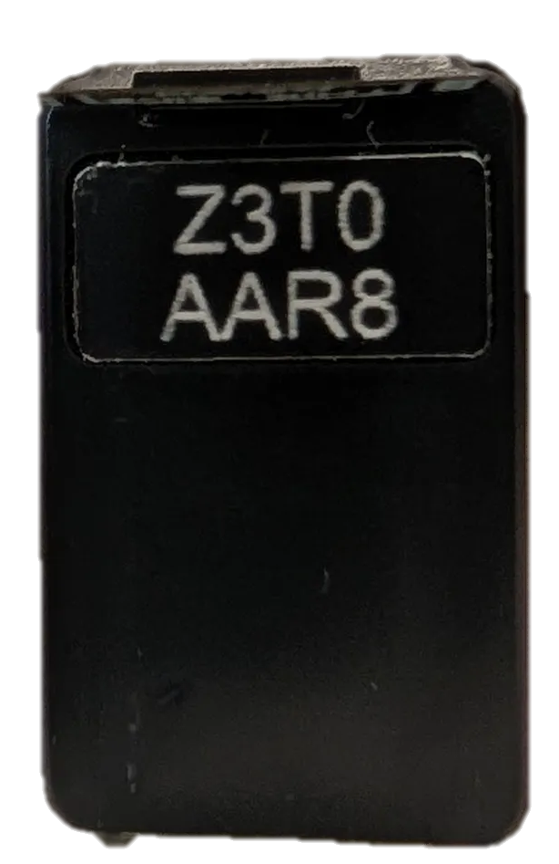
Crosstalk
Interference effect between close OPMs
Can alter gains and sensitive orientations
With higher density arrays, we need a way to characterise and account for crosstalk

Slide 8
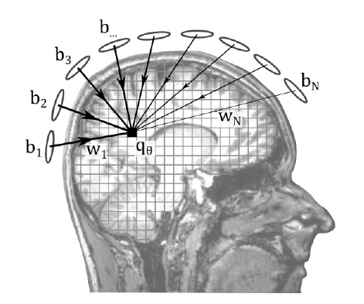
Calibration Methods
Source localisation requires accurate knowledge of array geometry
More crosstalk = reduced source localisation accuracy

Slide 9
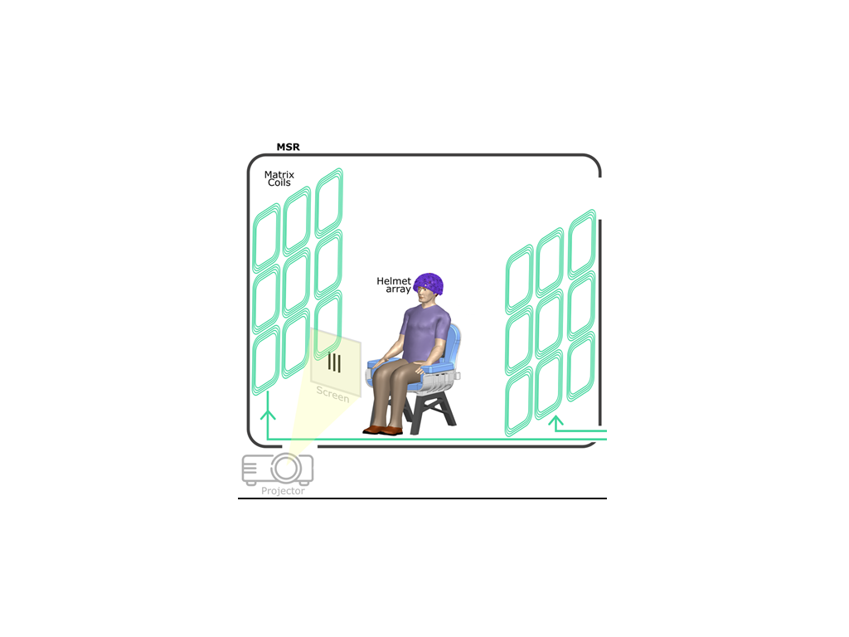
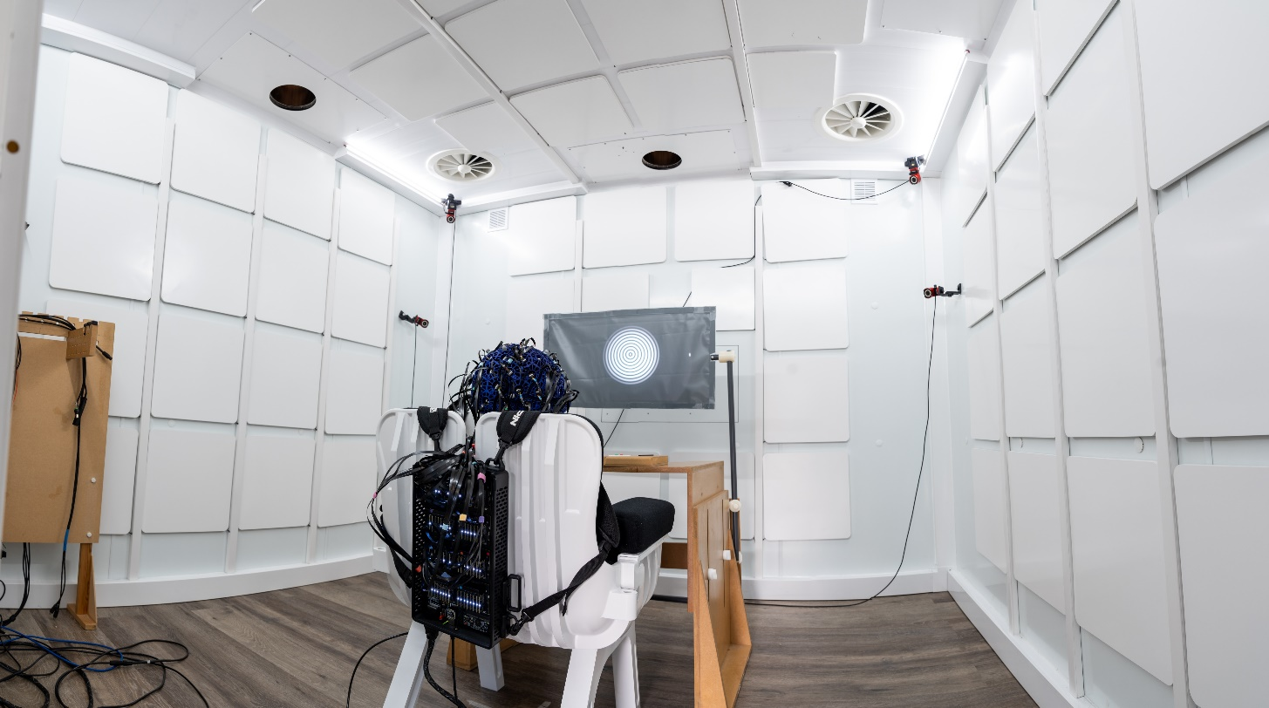
Calibration Methods
Matrix coils used to create known fields (96 coils around the room)
Use these fields to derive positions, orientations and gains of the sensors
Iivanainen et al., 2022 10.3390/s22083059

Slide 10
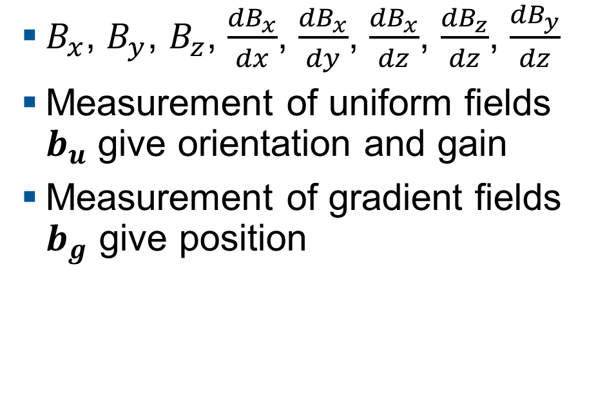
Calibration Methods
Create fields to represent 3 uniform fields and 5 gradient fields at different frequencies
$B_{x}$, $B_{y}$, $B_{z}$, $\frac{{dB}_{x}}{dx}$, $\frac{{dB}_{x}}{dy}$, $\frac{{dB}_{x}}{dz}$, $\frac{{dB}_{z}}{dz}$, $\frac{{dB}_{y}}{dz}$
Measurement of uniform fields $b_{u}$ give orientation and gain
Measurement of gradient fields $b_{g}$ give position
Iivanainen et al., 2022 10.3390/s22083059
Hill et al., 2025 10.1162/imag_a_00535
Schofield et al., 2025 (in review)

Slide 11
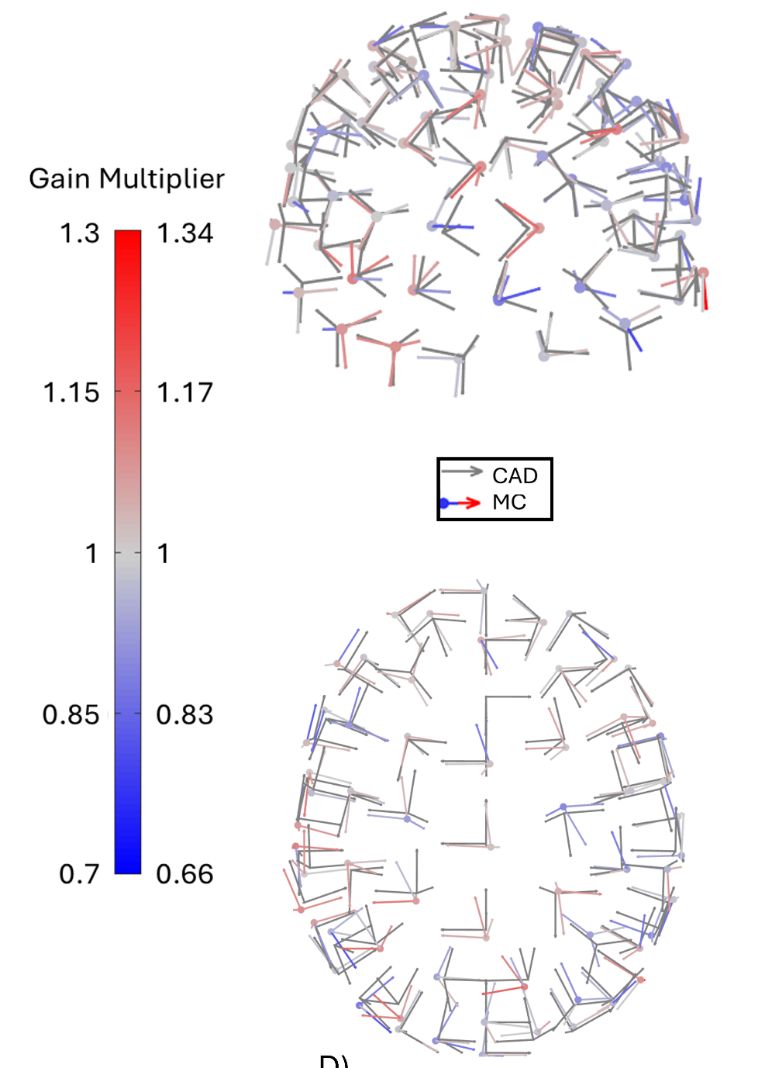
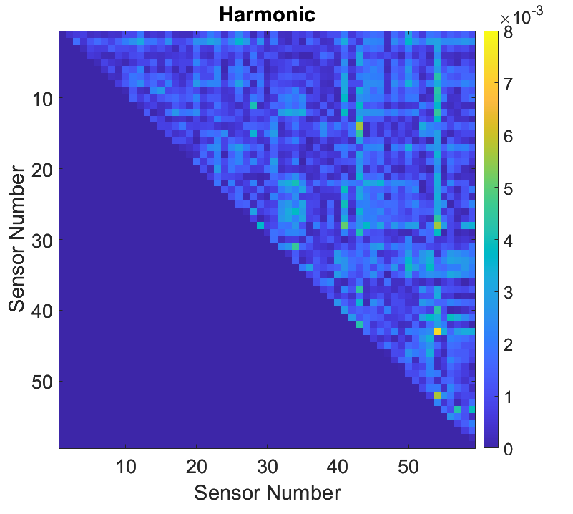
Calibration Methods
Calibration gives accurate geometry
Short waveform (down to 1s)
Quick to solve (~1s)
Residuals from CAD positions
1.3 ± 0.9 mm
Iivanainen et al., 2022 10.3390/s22083059
Hill et al., 2025 10.1162/imag_a_00535
Schofield et al., 2025 (in review)

Slide 12
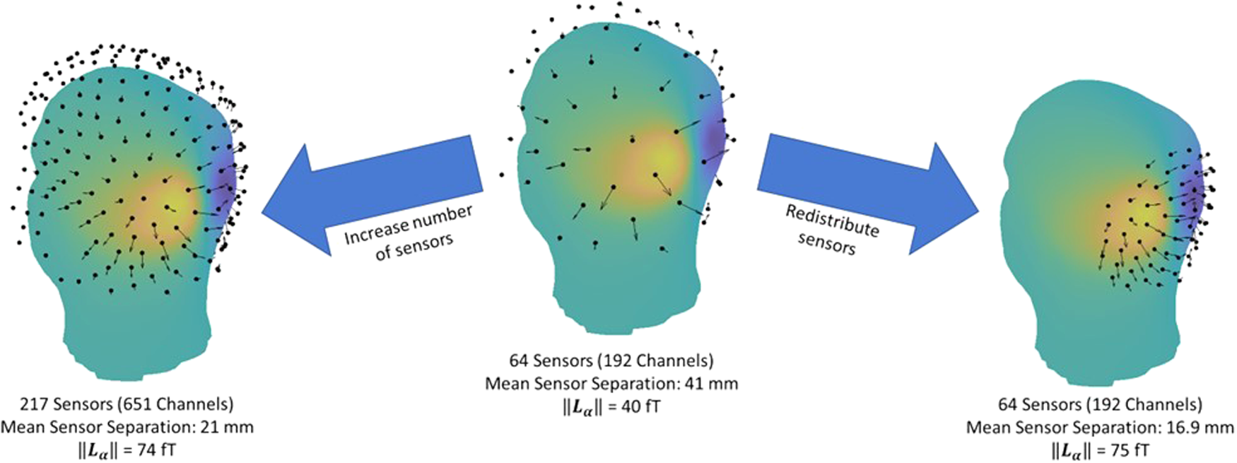
Hill et al., 2024 10.1162/imag_a_00112

Slide 13
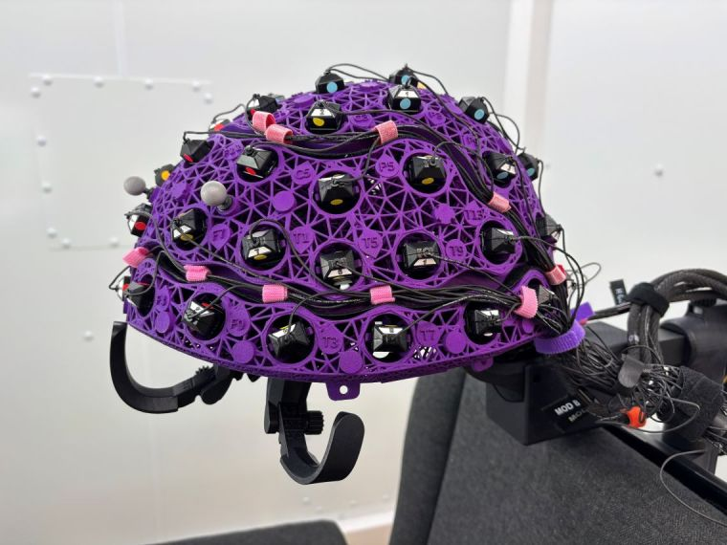
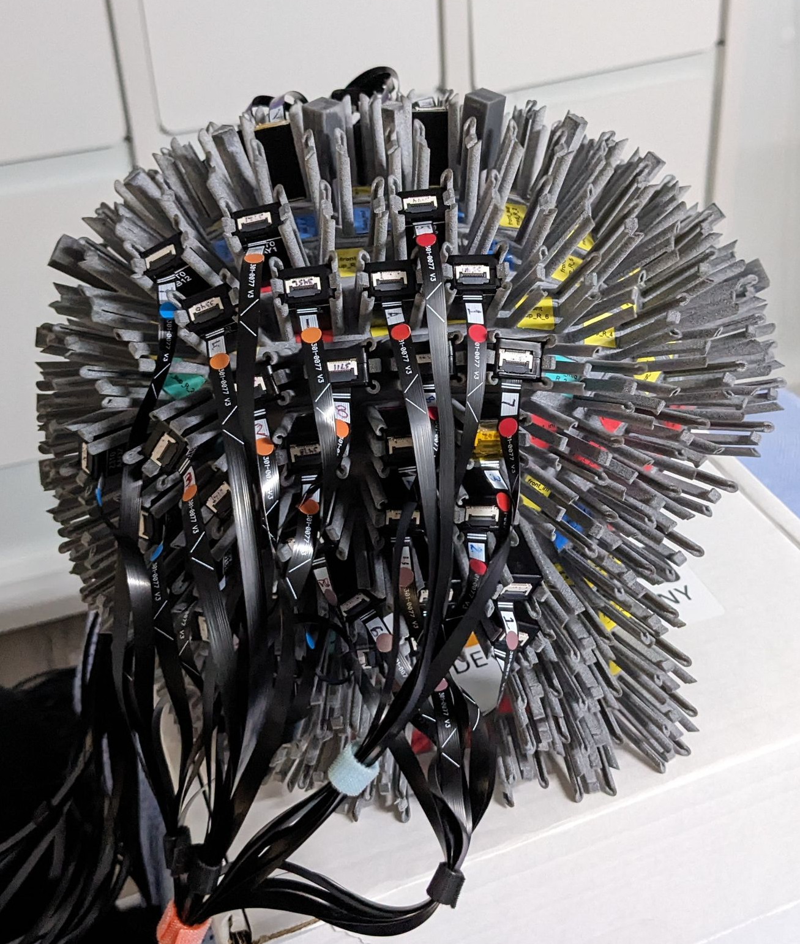
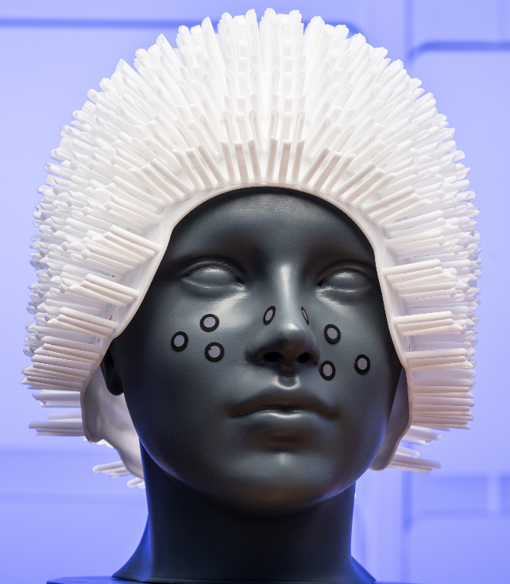
High Density Methods
High density helmets allow for changing array geometry
  Bespoke helmets from MRI for accurate coregistration
Sensors can be packed over relevant areas for different paradigms

Slide 14
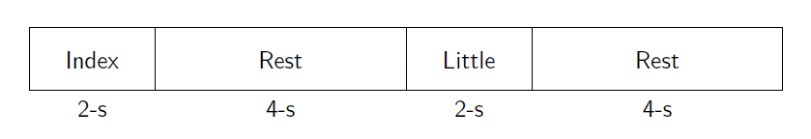
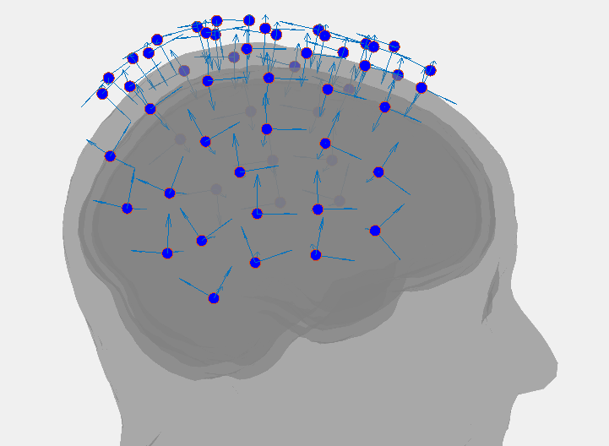
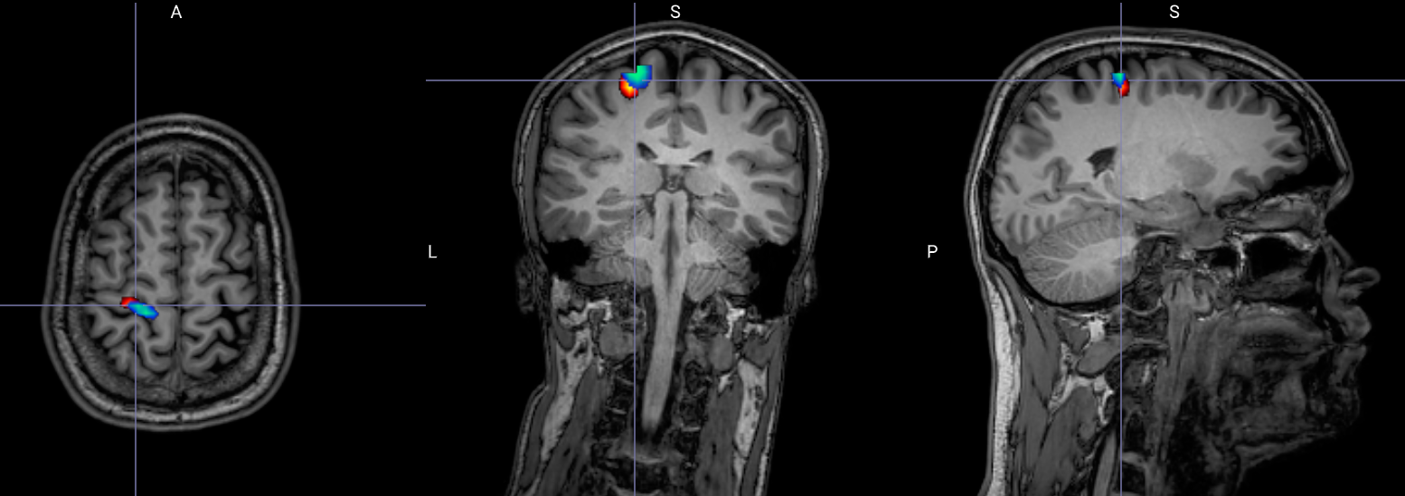
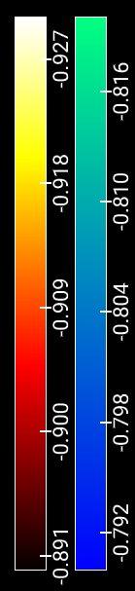
Spatial Resolution – pilot
Finger abduction paradigm
Localised to motor cortex
Different for two digits
Index
Little

Slide 15
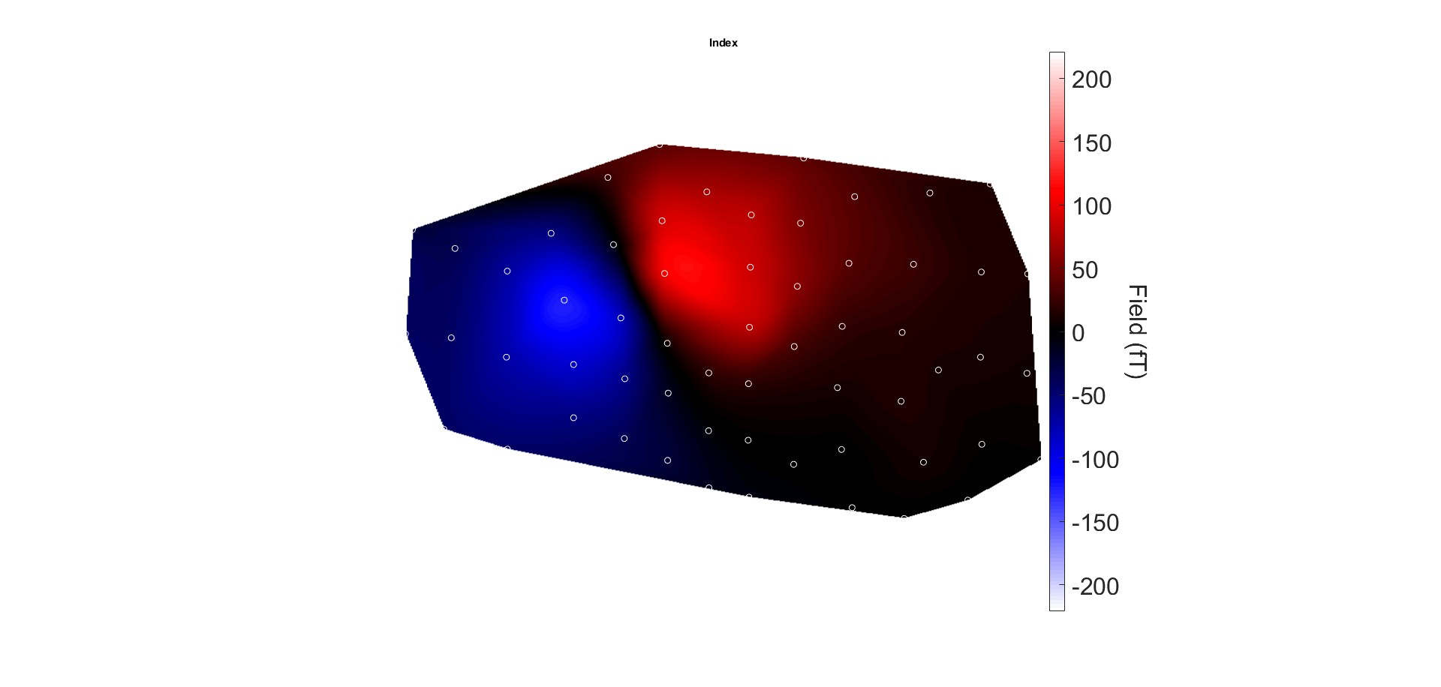
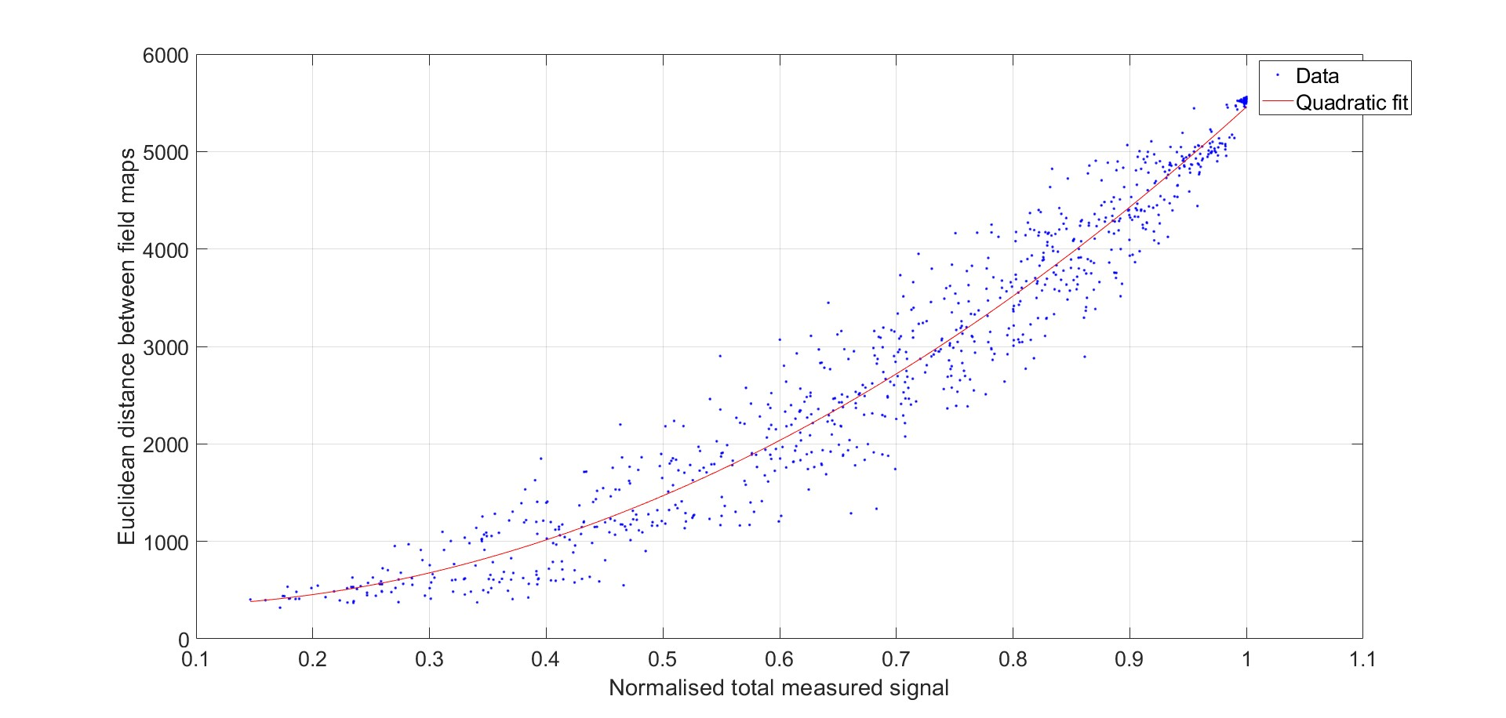
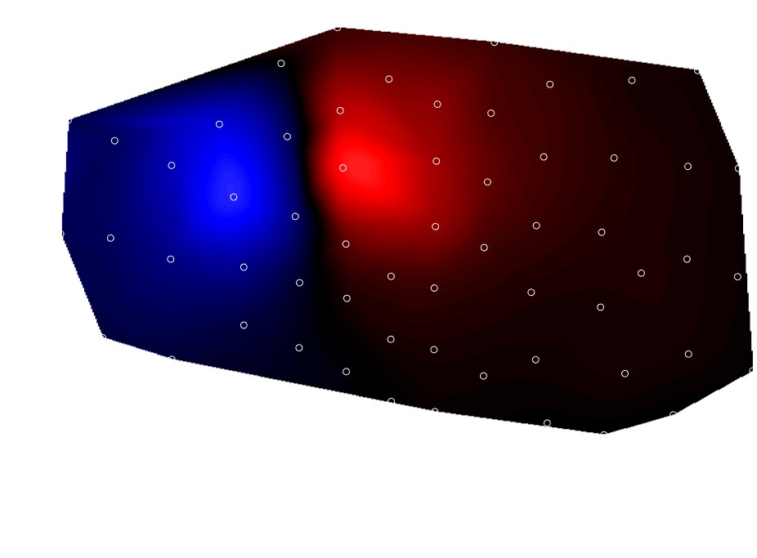
Spatial Resolution – pilot
Index
Increasing sensor density
Little
Turn off random channels in analysis
Non linear relationship between fieldmap similarity and measured field

Slide 16
It works! But…
Only image specific regions of the brain
Limited by sensor footprint
Hill et al., 2024 10.1162/imag_a_00112

Slide 17
Hill et al., 2024 10.1162/imag_a_00112

Slide 18
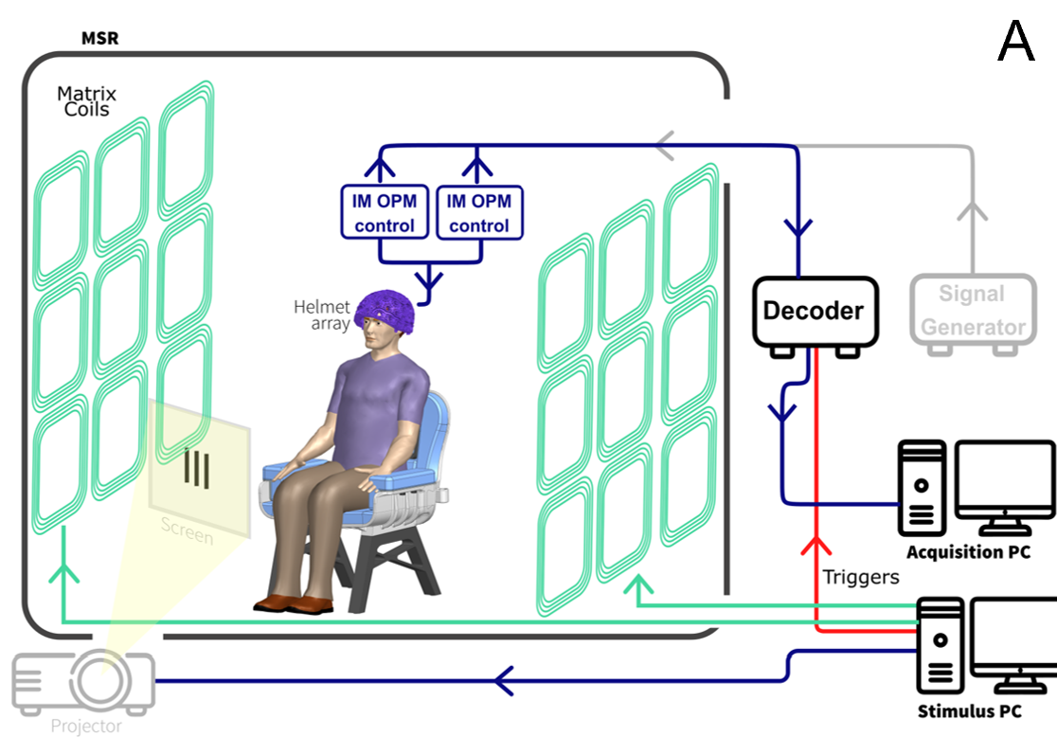
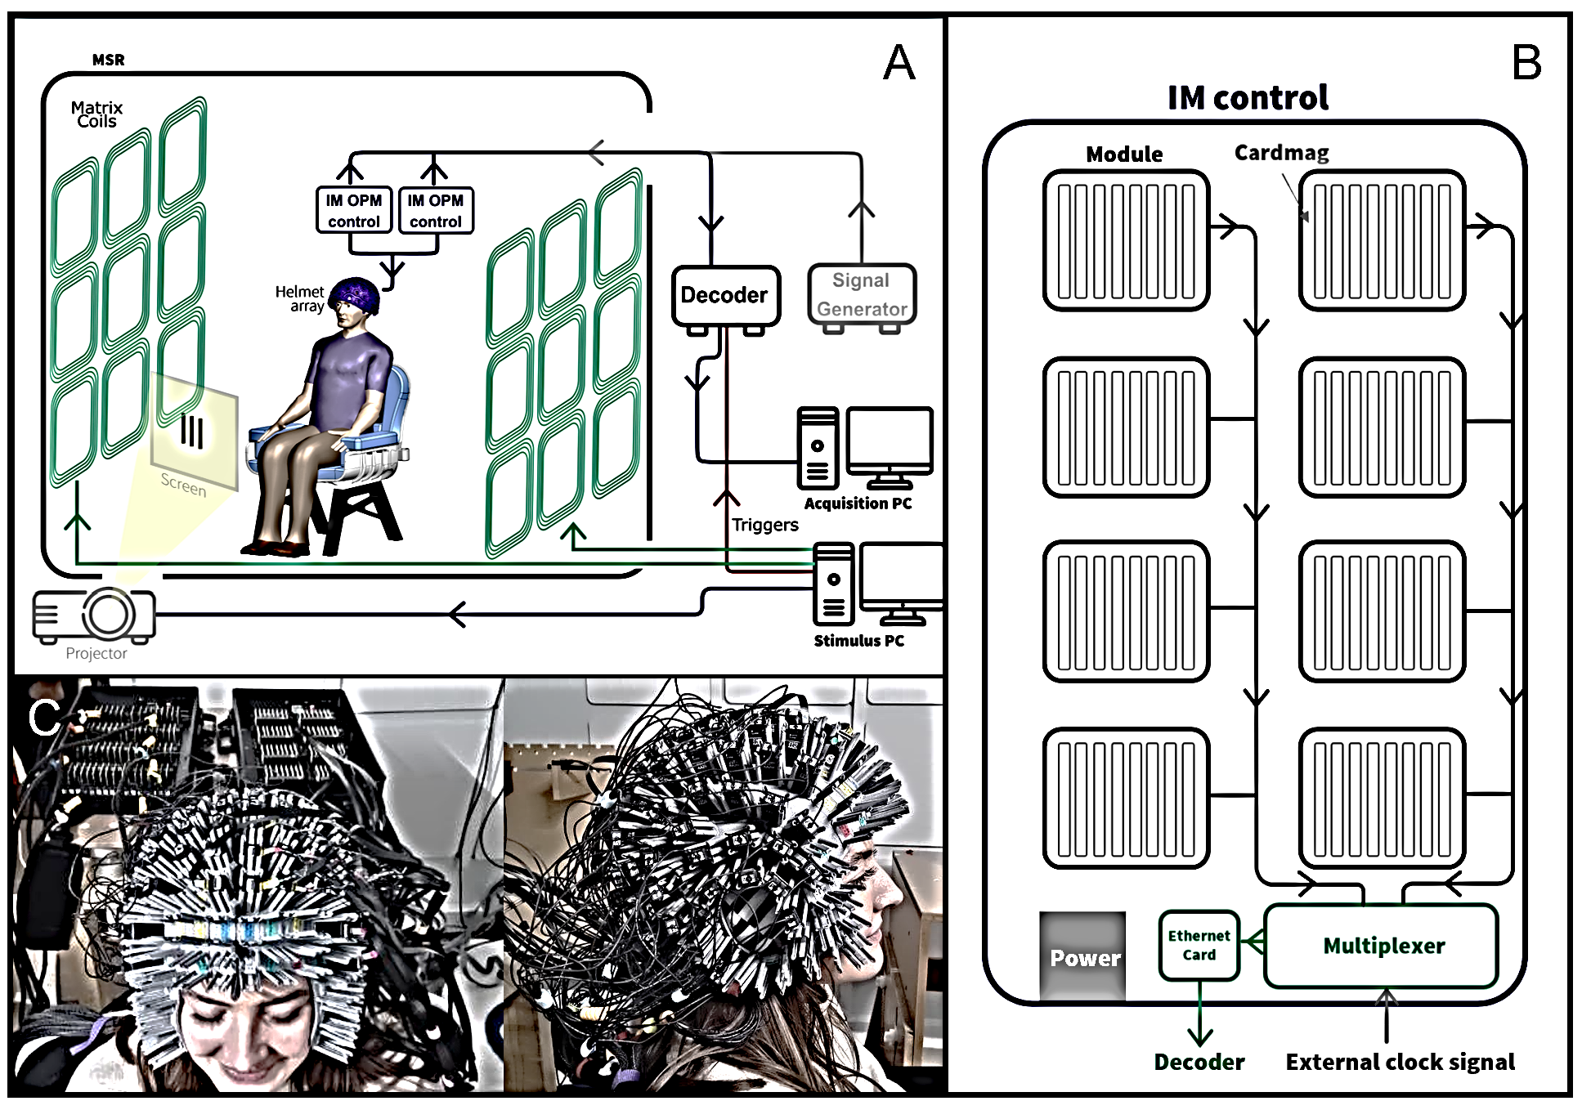
384 channel Methods
128 triaxial QuSpin OPMs (384 channels)
2 x Neuro-1 electronics
Synchronised by external clock signal (provided by signal generator)
Schofield et al., 2024 10.1162/imag_a_00283
Schofield et al., 2025 (in review)

Slide 19
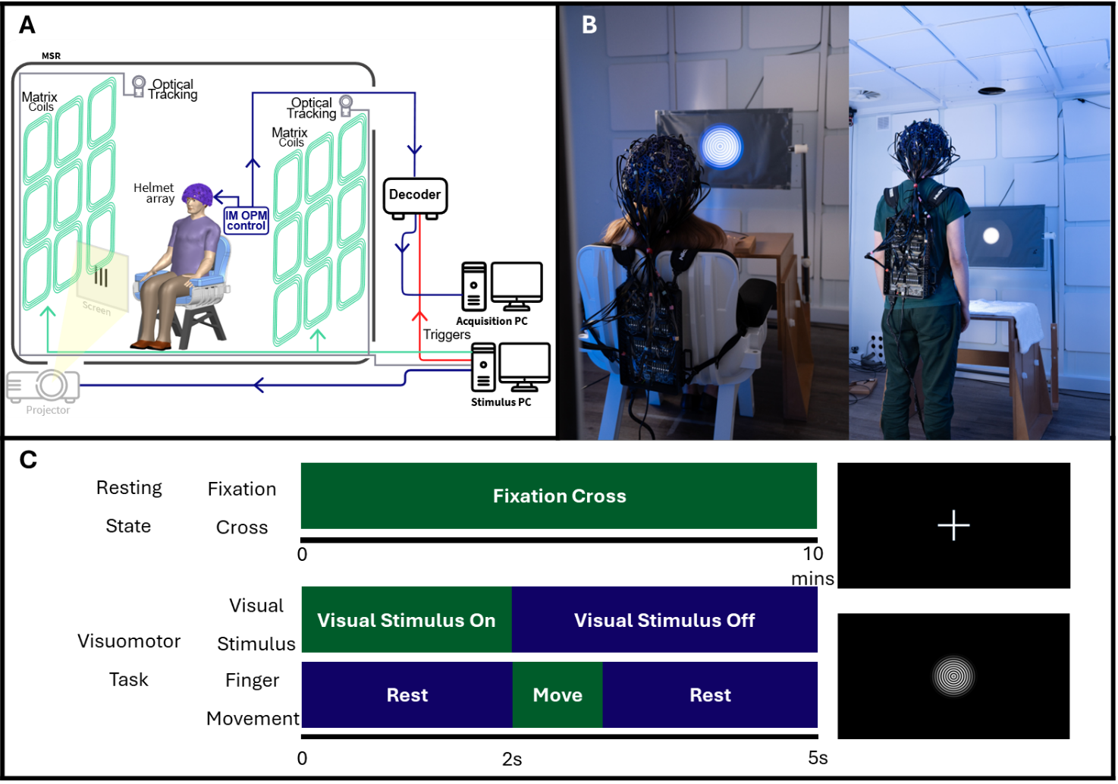
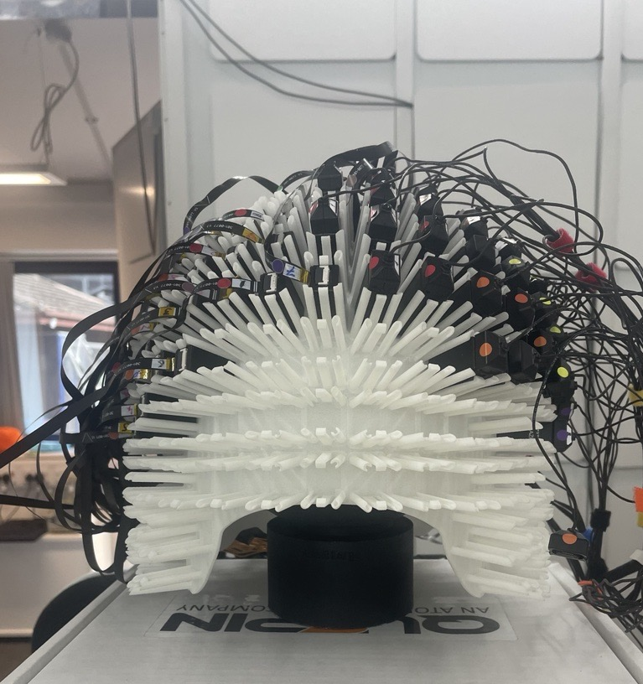
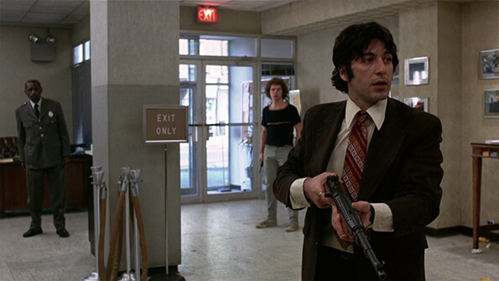
384 channel Methods
Visual grating task
Gamma band Sensitivity
Movie watching task
Spatial resolution
Phantom experiment
Localisation accuracy and crosstalk effects
Schofield et al., 2025 (in review)

Slide 20
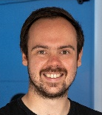
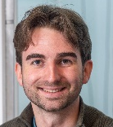
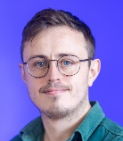

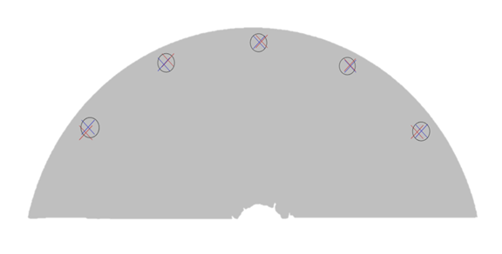
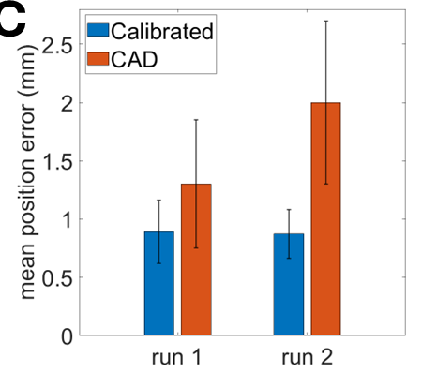
384 channel Results – Phantom
Holmes & Kennett, UoN
Tyler, Cerca Magnetics
X – CAD
X – Calibration
Phantom - 5 PCB coils energised sequentially
Dipole fit to localise and find inter-coil distance
Able to localise to within <1mm of error.
High spatial resolution and able to characterise cross-talk effects
Schofield et al., 2025 (in review)

Slide 21
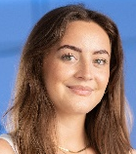
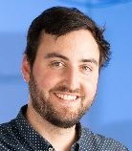
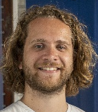
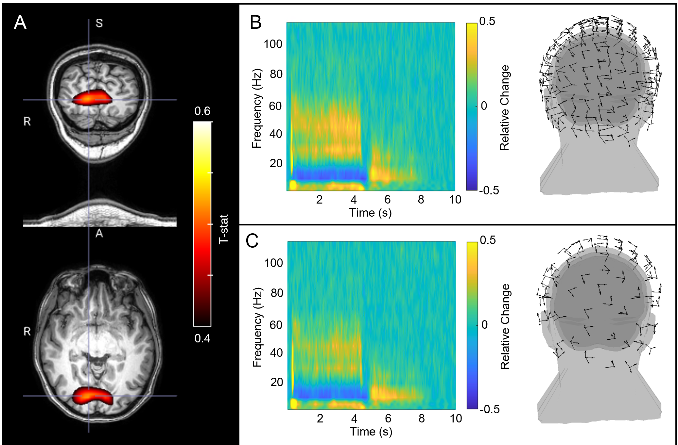
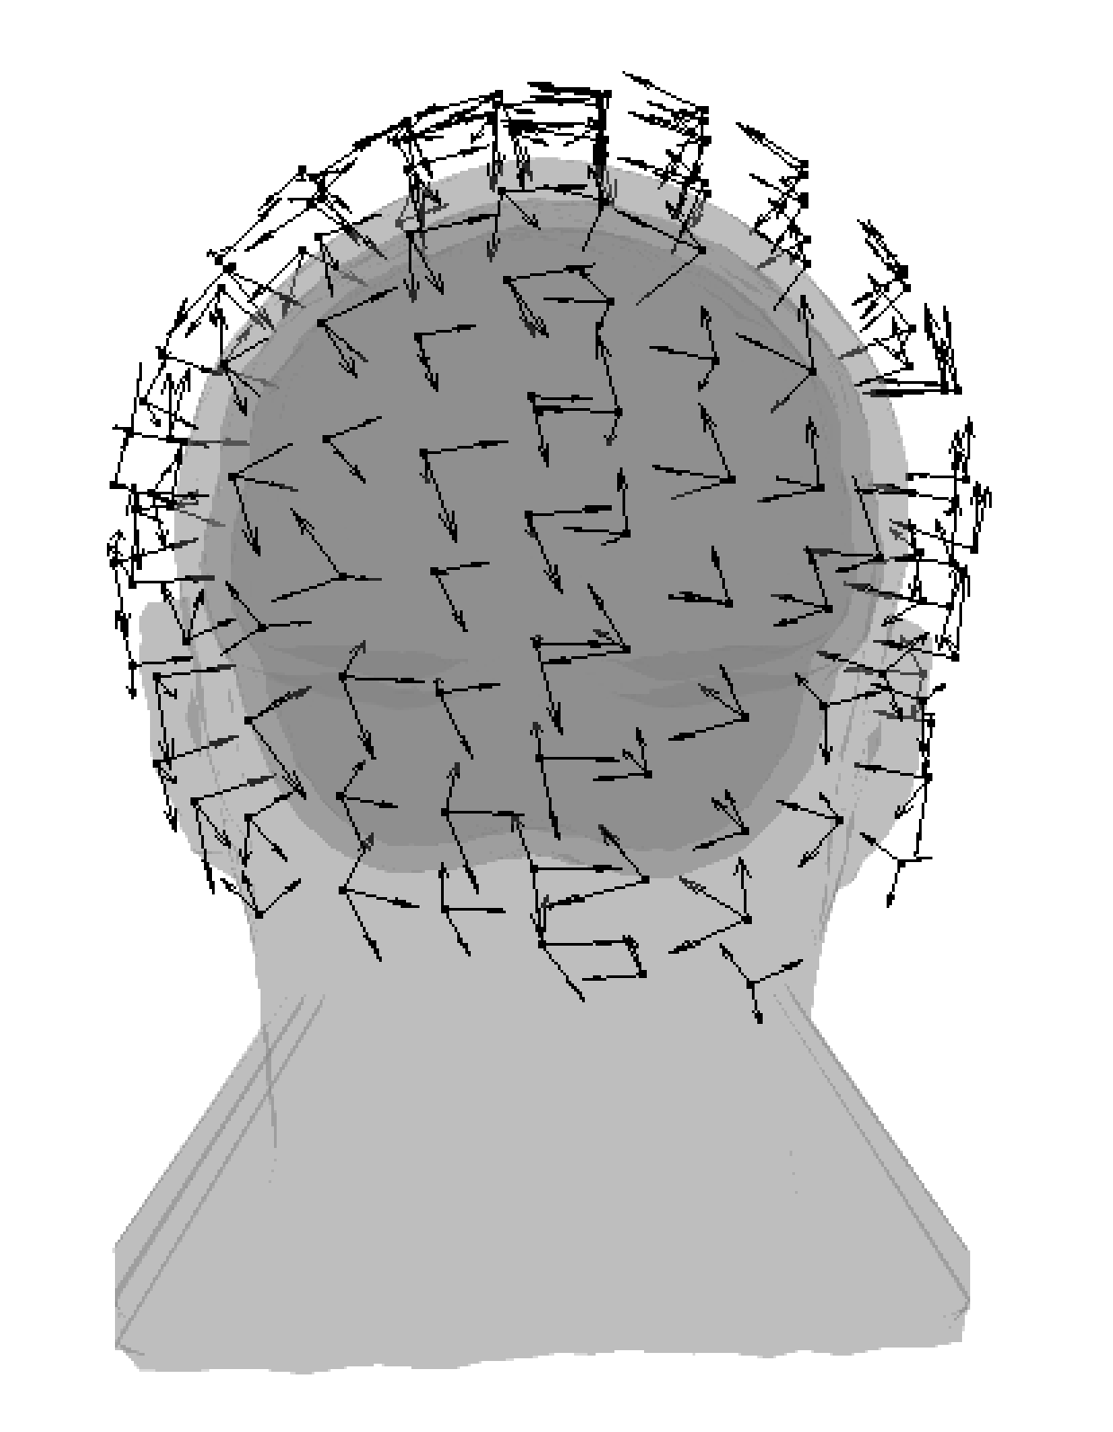
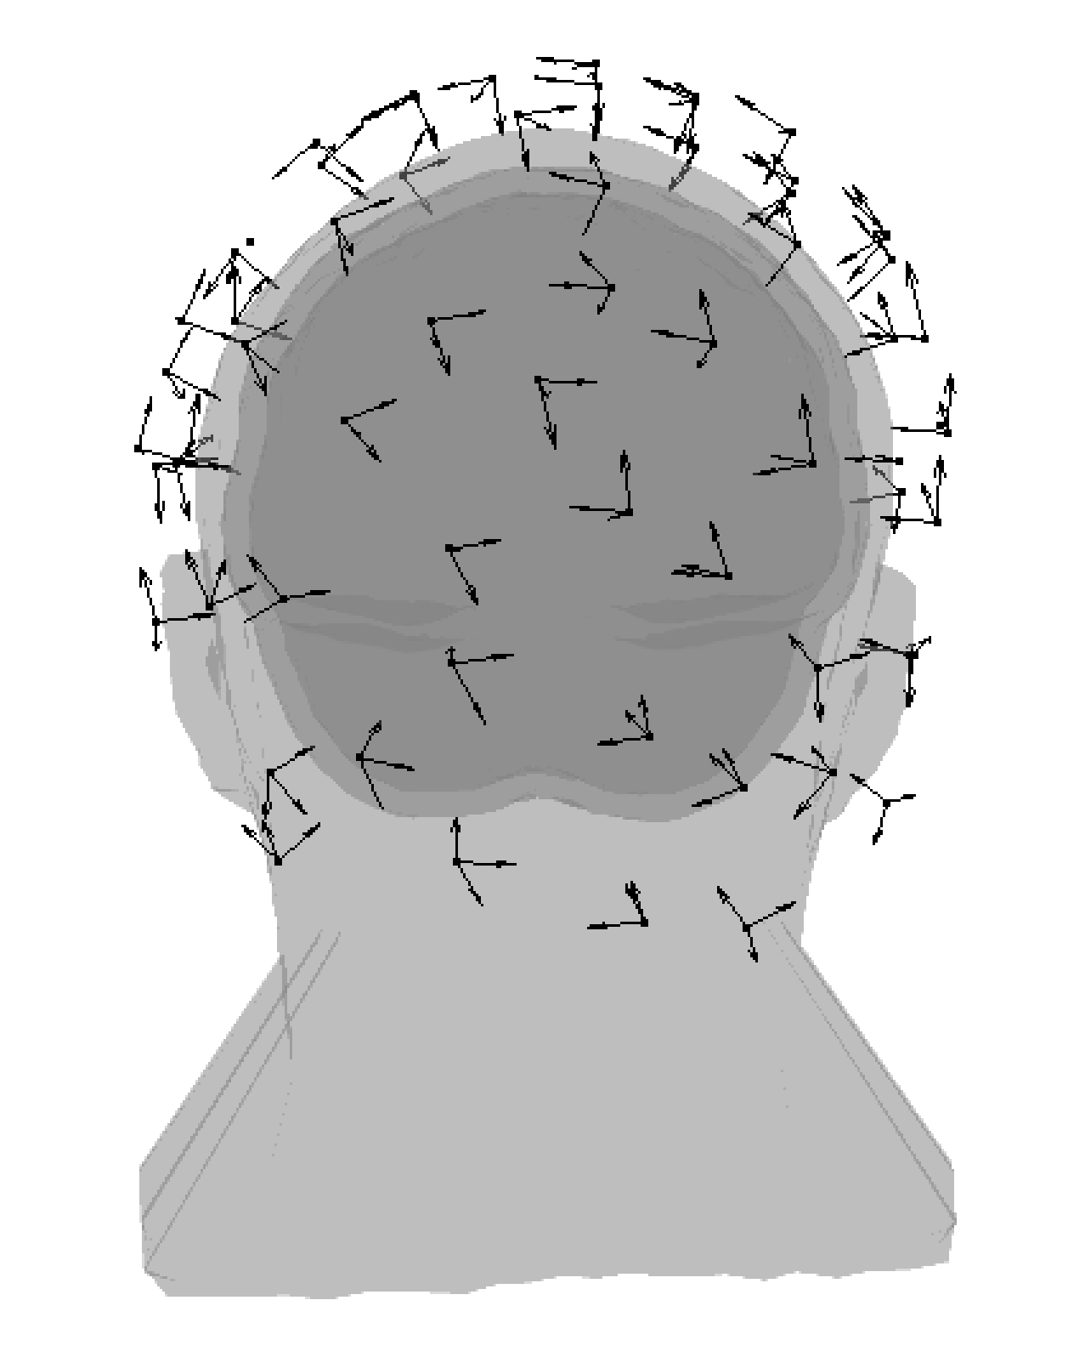
384 channel Results – Visual Grating
Schofield,
Rier & Hill, UoN
See expected localisation and gamma band synchronisation during grating presentation
1.3x increase in amplitude with full array
Schofield et al., 2025 (in review)

Slide 22
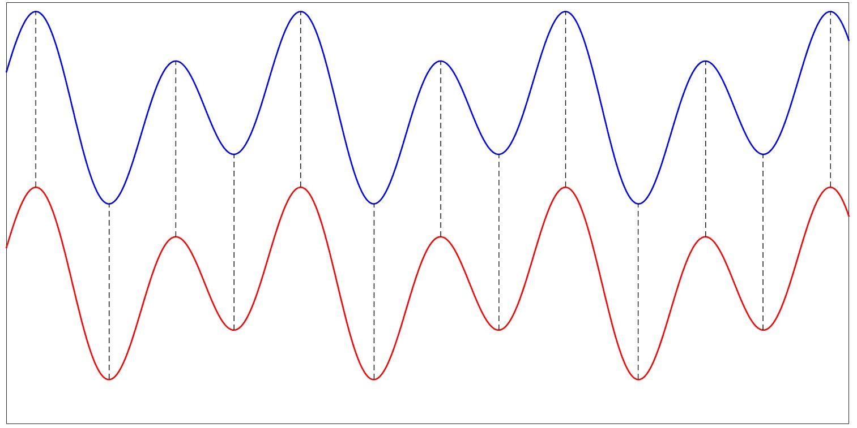
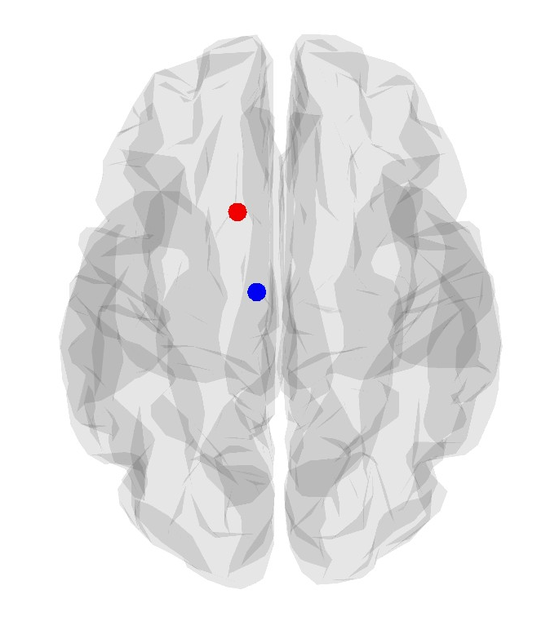
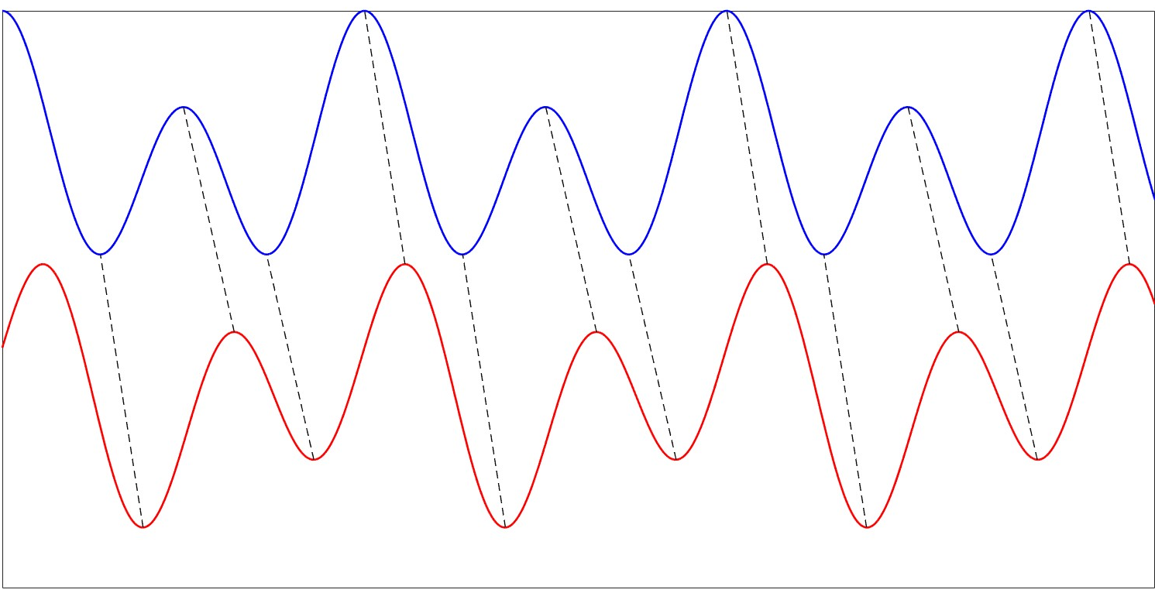
384 channel Results – Spatial Leakage
Schofield,
Rier & Hill, UoN
Zero phase lag contributions between the two signals assumed to be leakage between the neighboring regions
Higher density should result in lower spatial leakage

Slide 23
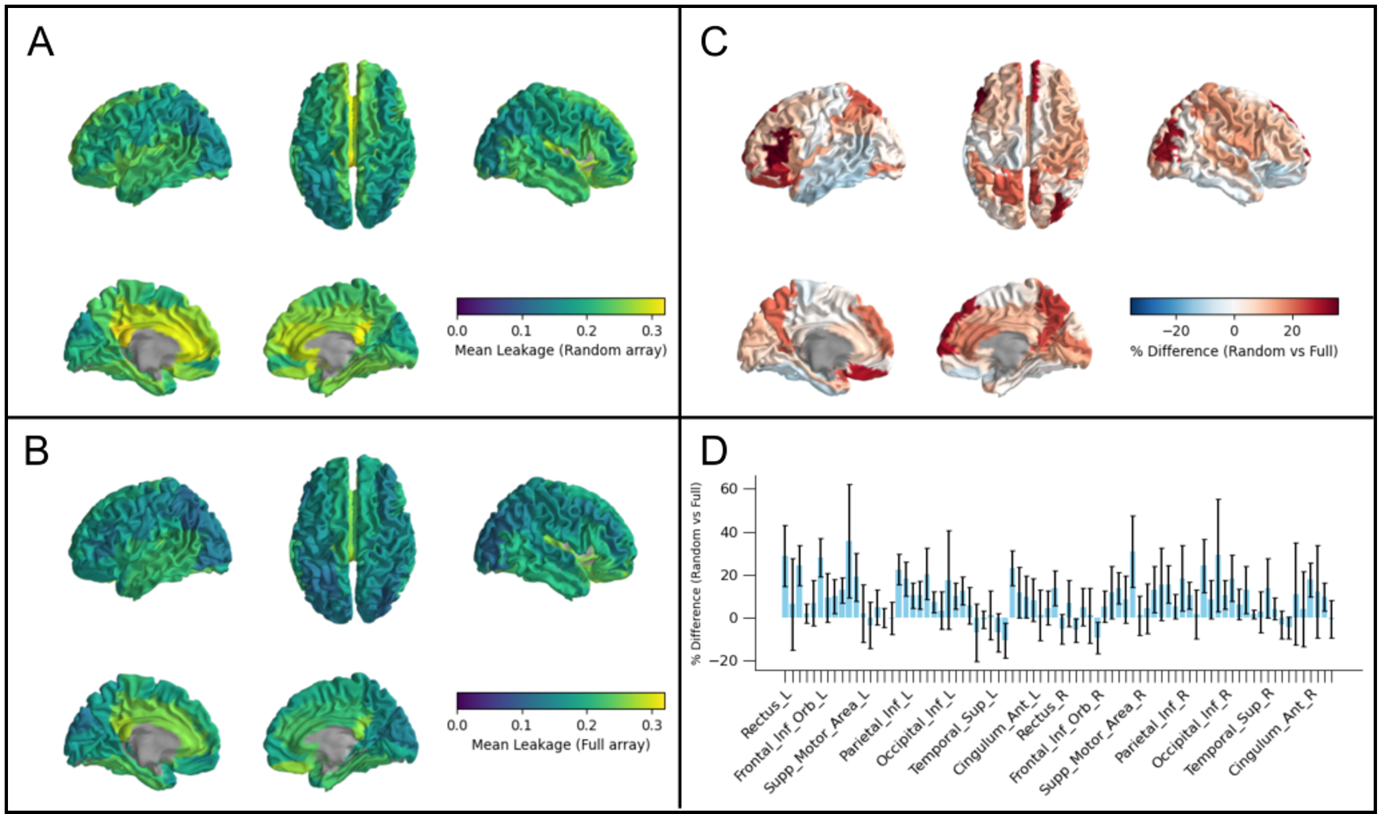
384 channel Results – Spatial Leakage
Schofield,
Rier & Hill, UoN
Zero phase lag signal leakage shows >30% improvement with full array in some regions
Generally most improves areas with lower coverage and deeper regions
Schofield et al., 2025 (in review)

Slide 24
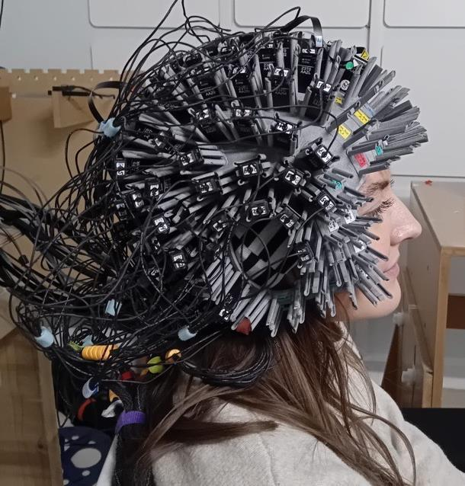
Summary
High density OPM-MEG works!
Improves sensitivity
Improves spatial resolution
Accurate calibration is important
Higher channel counts maintain high density coverage

Slide 25

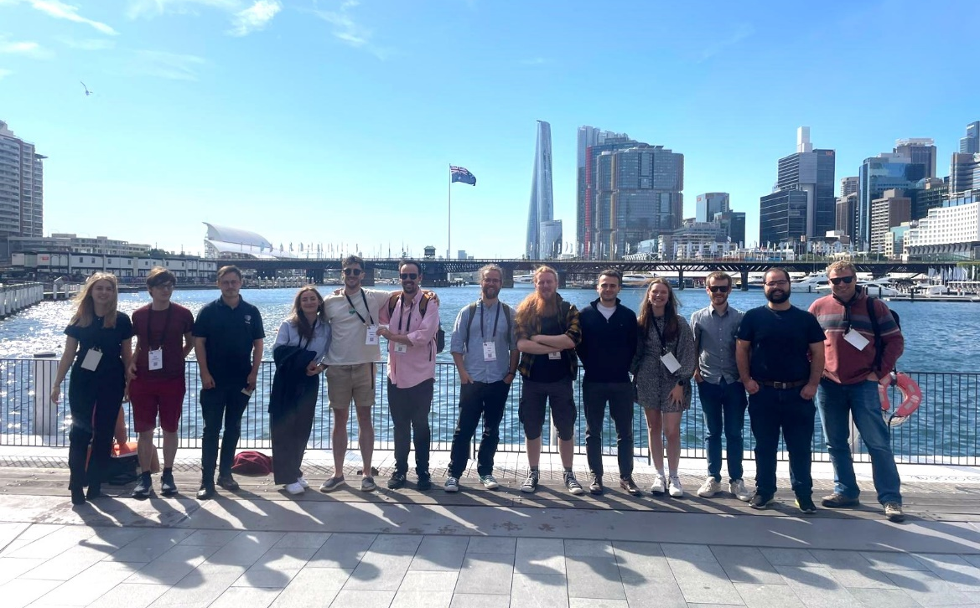



Acknowledgements
Contact:
ppyjg12@nottingham.ac.uk
Matt Brookes
Richard Bowtell
Mark Fromhold
Karen Mullinger
Matias Ison
Ryan Hill
Niall Holmes
Lukas Rier
Lauren Gascoyne
Jim Leggett
Jessikah Fildes
Dan Ferring
Dan Ford
Ewan Kennett
Gonzalo Reina Rivero
Ben Sanders
Clarise Castleman
Aditi Jain
Dominic Sims
Vishal Shah
James Osborne
Cody Doyle
David Bobela
David Woolger
Elena Boto
Eliot Dawson
Frank Worcester
Molly Rea
Holly Schofield
Zoe Tanner
This work was supported by an Innovate UK biomedical catalyst grant (10037425) awarded to Cerca Magnetics Limited. We also acknowledge support from the UK Quantum Technology Hub in Sensing and Timing, funded by EPSRC (EP/T001046/1), the National Institutes of Health (Grant Number R01EB028772), an Innovate UK Collaborative R&D Award (Grant Number 104604), a Medical Research Council (MRC) Mid-Range Equipment grant (MC_PC_MR/X012263/1) and an Engineering and Physical Sciences Research Council (EPSRC) Healthcare Impact Partnership Grant (EP/V047264/1). Sensor development was made possible by funding from the National Institutes of Health (R44MH110288). We also acknowledge a Wellcome Collaborative Award in Science (203257/Z/16/Z and 203257/B/16/Z).

