Slide 1

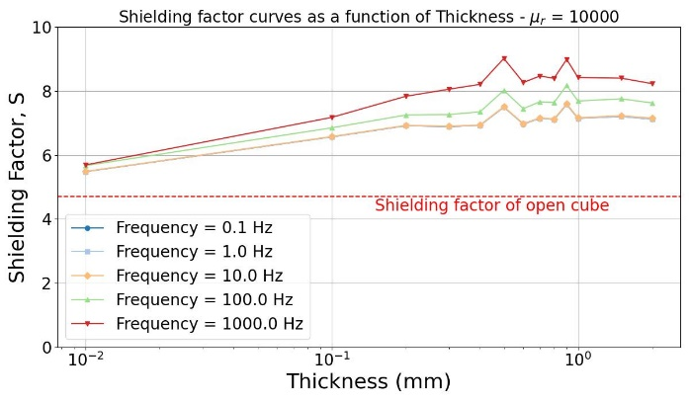
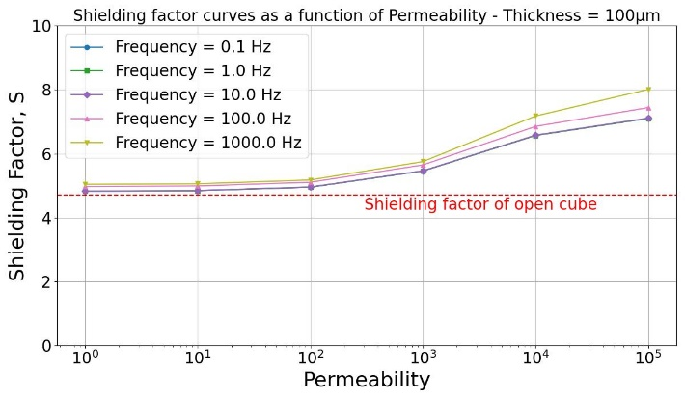
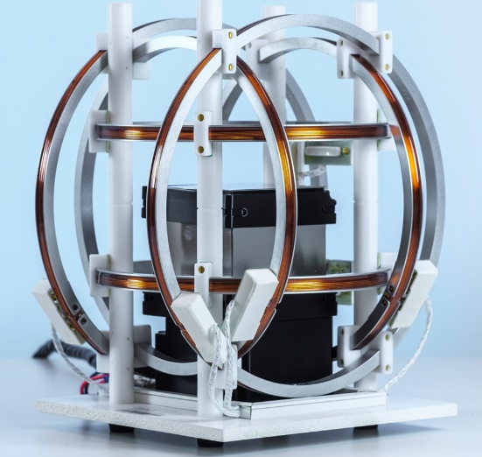
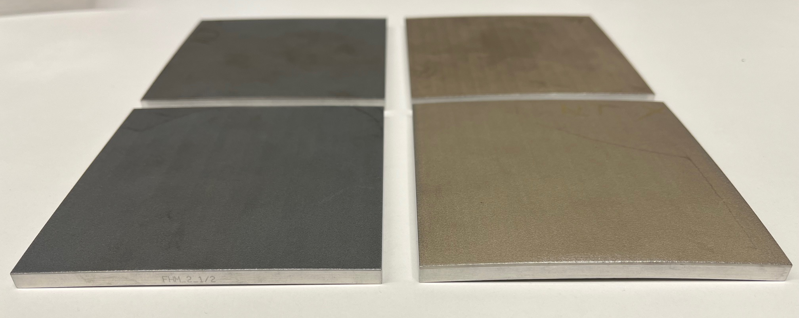
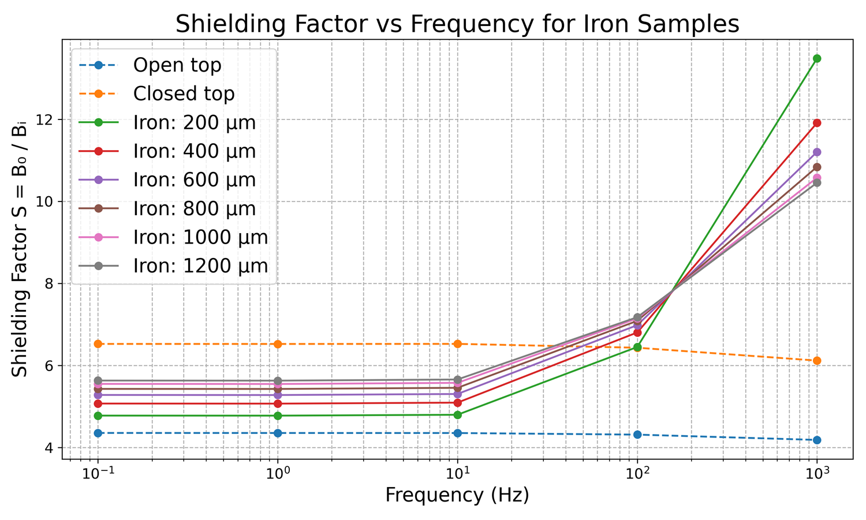
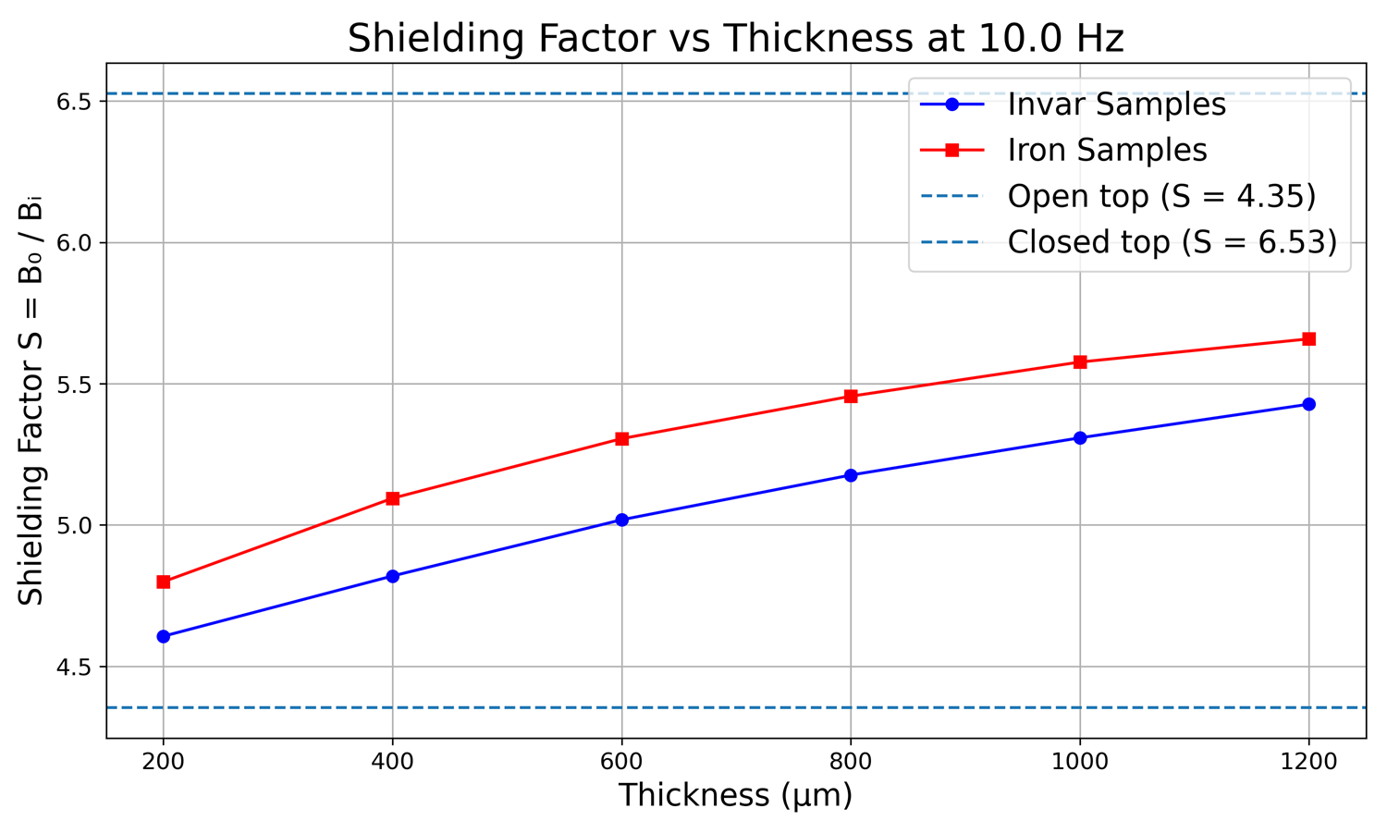
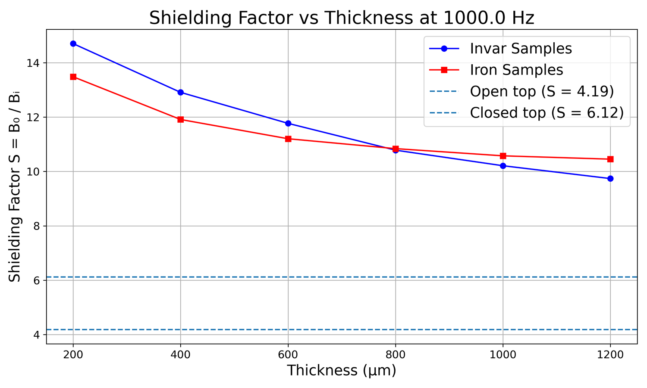
Magnetic shielding performance
with spray coating
  —
      Peter A. Koss¹, Emre-Mirza Kaya¹, Stephan Busch², Martin Schimmerohn², Benedikt Schug³, Rafael R. Nunes⁴
      ¹Fraunhofer Institute for Physical Measurement techniques (IPM), Freiburg, Germany
      ²Fraunhofer Institute for High-Speed Dynamics (EMI), Freiburg, Germany
      ³Fraunhofer Institute for Silicate Research (ISC), Würzburg, Germany
      ⁴ESA ESTEC, Noordwijk, Netherlands
We are investigating the potential of novel spray-coated materials for shielding against magnetic (≤10 Hz) and electromagnetic (>10 Hz) interference. After a long period of disappointing results, we have finally found a spray-coating method that produces materials with significant shielding properties.
  Experimental setup
      The experimental setup was designed to precisely measure the magnetic shielding effectiveness of the spray-coated samples and to compare it to a reference material (mu-metal). A cubic shielding structure was constructed using six individual mu-metal plates, each 10 cm × 10 cm in size and 1 mm thick (figure below).
    Measurement procedure
      The experimental procedure involved several configurations to establish reference measurements:
      Background Measurement: Conducted without any shielding material, with only a fluxgate magnetometer at the center of the Helmholtz coil system. This established the baseline magnetic field environment.
      High Reference (Fully Enclosed Cube): All six mu-metal plates were assembled to form a complete cube, serving as the benchmark for optimal shielding performance.
      Low Reference (Open Cube): The cube was assembled with only five mu-metal plates, leaving the top open. This configuration acted as the minimal shielding reference. Therefore, the shielding curve of a new material would lie anywhere between the low reference and the high reference.
      Sample Measurement: The top mu-metal plate was replaced with the spray-coated sample. This allowed for direct comparison of the sample's shielding effectiveness against the references. No shielding effect from the sample would yield a measurement curve which lies on the curve for the low reference.
  Results
Result of a COMSOL simulation of the experimental setup showing the effect of the thickness (left) and the permeability (right) of the sample on the shielding factor (here using Mu-metal as material).
Picture of novel spray coated samples which show a significant magnetic shielding effect. The darker samples on the left are pure iron and the lighter samples on the right are invar. These samples were sprayed on an Aluminum substrate.
The shielded cube was placed within a three-axis Helmholtz coil system capable of generating a controlled, uniform magnetic field of up to 25 µT over a frequency range of 0.1 Hz to 1 kHz. A Fluxgate magnetometer measures the residual field inside of the shielded cube. This entire setup was placed inside of a magnetically shielded room.
These novel spray coated samples show a significant shielding effect. In total 6 samples with iron were produced with varying thicknesses. From 100 Hz upward the spray-coated samples shield much better because the Aluminum substrate significantly contributes to the shielding.
The shielding improves with the thickness of the layer and seems to saturate at high thicknesses like in the simulation. At 1000 Hz the shielding factor decreases with the thickness of the layer. This is because the layer increases the distance of the Aluminum substrate to the rest of the shielding cube.
Relevant References:
[1] Mishra, Raghvendra Kumar, et al. "Electromagnetic interference shielding materials for aerospace application: A state of the art." Advanced Materials for Electromagnetic Shielding: Fundamentals, Properties, and Applications (2018): 327-365.
[2] Wang, Xiao-Yun, et al. "Electromagnetic interference shielding materials: recent progress, structure design, and future perspective." Journal of Materials Chemistry C 10.1 (2022): 44-72.
[3] Koss, Peter A., et al. "Designing magnetic shielding for space applications using spray coating technology." International Astronautical Congress (2024): IAC-24,C2,6,3,x82727 .
[4] R. Ashtari and D. H. Jones, "Low-Frequency Magnetic Shielding," 2019 IEEE International Symposium on Electromagnetic Compatibility, Signal & Power Integrity (EMC+SIPI), New Orleans, LA, USA, 2019, pp. 72-77, doi: 10.1109/ISEMC.2019.8825190.
[5] Cummings, Jeremy T. Magnetic Shielding with Soft Magnetic Alloys. No. SAND-2019-15248. Sandia National Laboratories (SNL), Albuquerque, NM, and Livermore, CA (United States), 2019.
[6] V. V. Polyakov and A. V. Egorov, "Dependence of the Magnetic Permeability of Ferromagnetic Powder Materials on Particle Size," Powder Metallurgy and Metal Ceramics, vol. 33, nos. 1-2, pp. 9-11, 1994.

