Slide 1
Introduction to Optically Pumped Magnetometers (OPMs) For MEG
Peter D. D. Schwindt

Slide 2
Outline
Introduction to MEG
SERF OPMs: What is SERF?
  Specific examples of SERF OPMs
How MEG measurements are made
  Sandia example
  Calibrating OPM arrays
  Coregistration
Other OPMs for MEG
Conclusion
  Comparison of MEG technologies

Slide 3
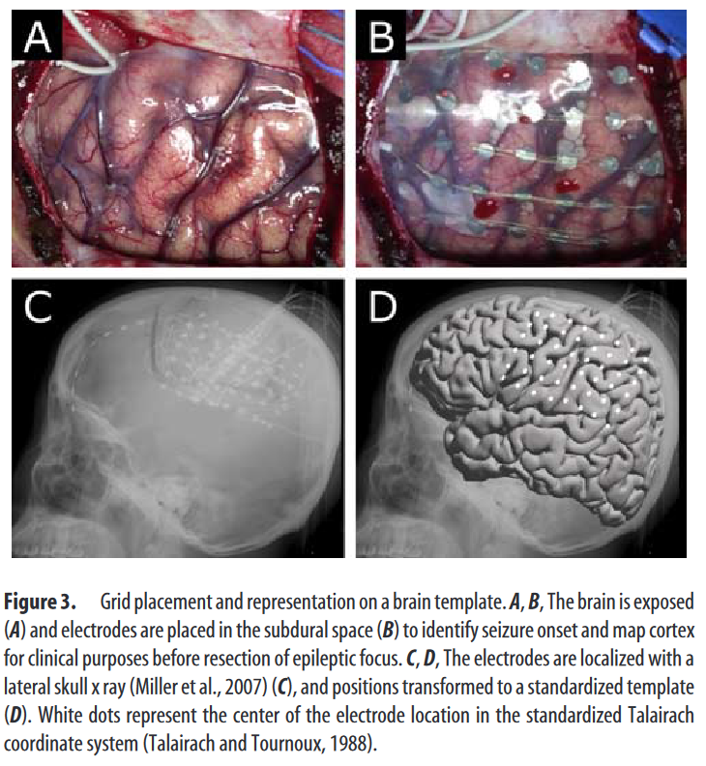
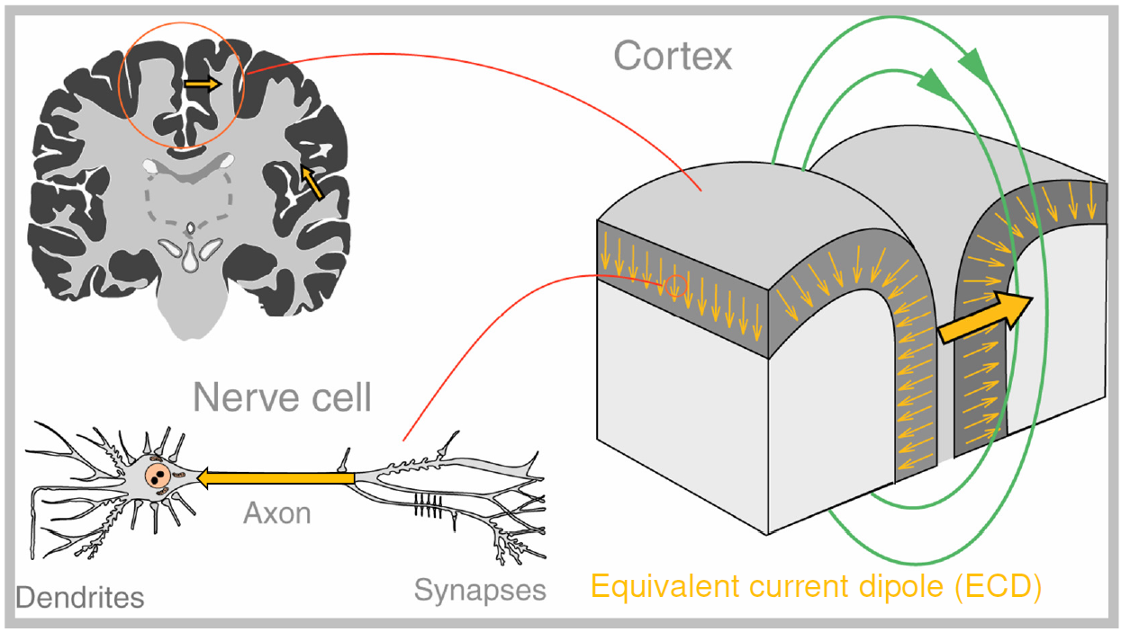
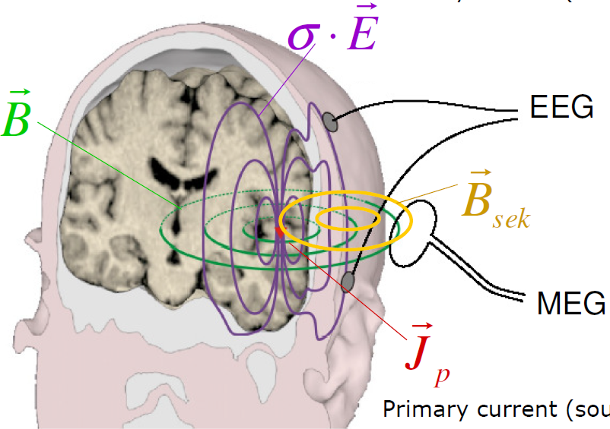
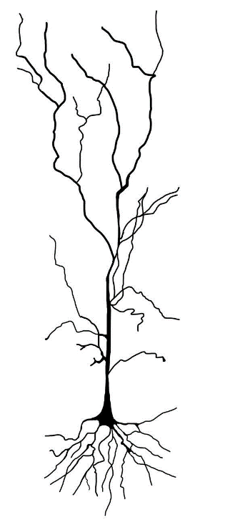
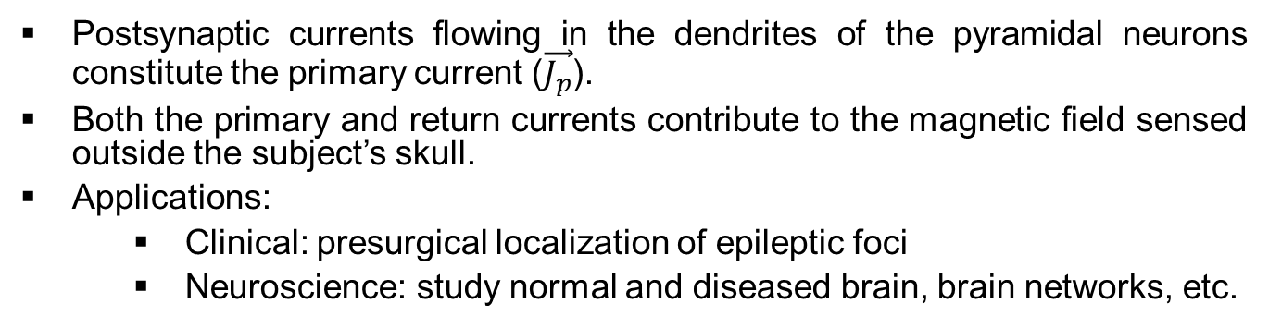
Magnetoencephalography (MEG)
Nerve Cell
Dendrites
Axon
Synapses
B. Maess, MPI for Human Cognitive and Brain Sciences
Lauri Parkkonen (Aalto University)
Postsynaptic currents flowing in the dendrites of the pyramidal neurons constitute the primary current ($\vec{J_{p}}$).
Both the primary and return currents contribute to the magnetic field sensed outside the subject’s skull.
Applications:
  Clinical: presurgical localization of epileptic foci
  Neuroscience: study normal and diseased brain, brain networks, etc.
Journal of Neuroscience 2007, 27 (9) 2424-2432

Slide 4
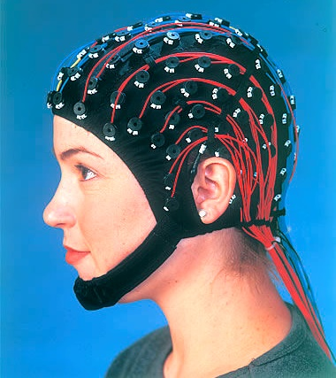
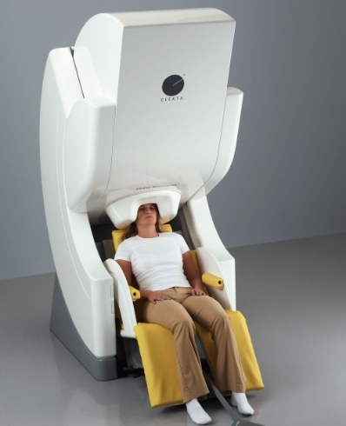
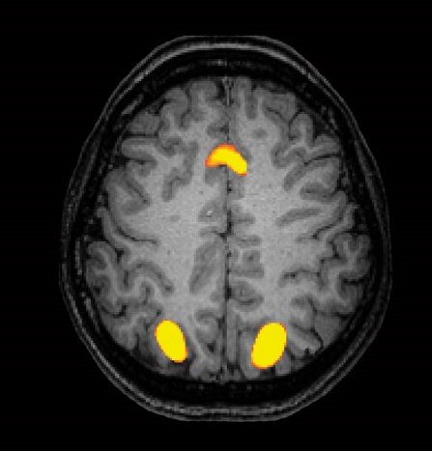
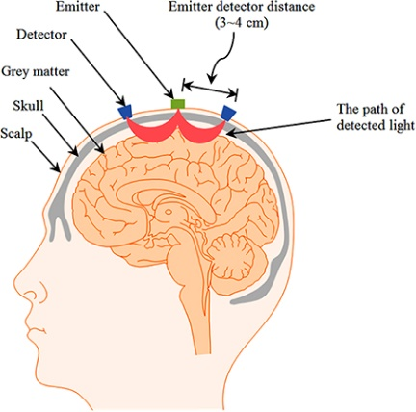
Functional Neural Imaging Technologies
EEG
MEG
fMRI
fNIRS
Poor
(~cm)
Good
(mm to cm)
Great
(~mm)
Good
(mm to cm)
Poor depth
Spatial
Resolution
Temporal
Resolution
Great
(~ms)
Great
(~ms)
Poor
(~s)
Poor
(~s)
Measurement
Paradigm
Neural
Activity
Neural
Activity
Blood
Flow
Blood
Flow
Cost
$
$$$→$$
$$$
$$
Naseer Noman, Hong Keum-Shik,”NIRS-based brain-computer interfaces: a review,” Frontiers in Human Neuroscience, 9 (2015)
Notes:
Where MEG fits in with familiar neuroimaging techniques.
Problems with EEG – skull distortions.
Problems with fMRI – slow hemodynamic response, indirect measurement of brain activity

Slide 5
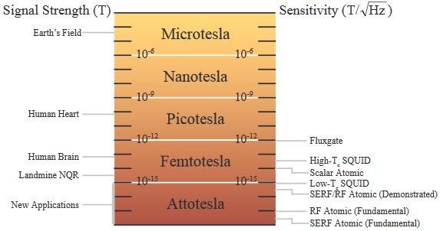
Field strength
S. Seltzer Ph.D. thesis (2008)

Slide 6
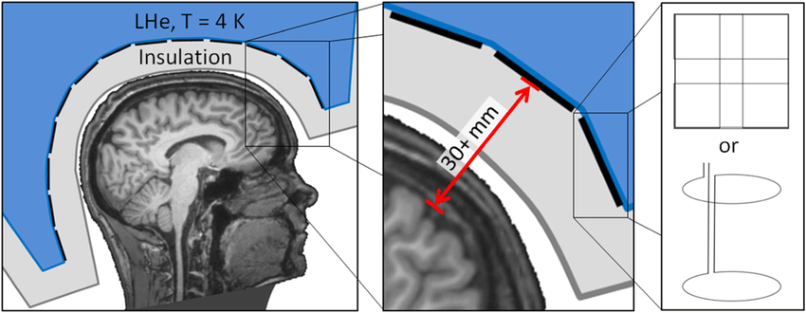
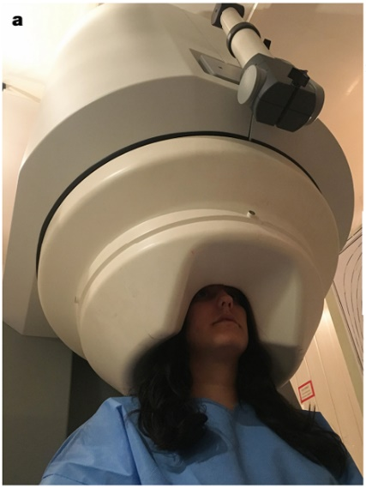
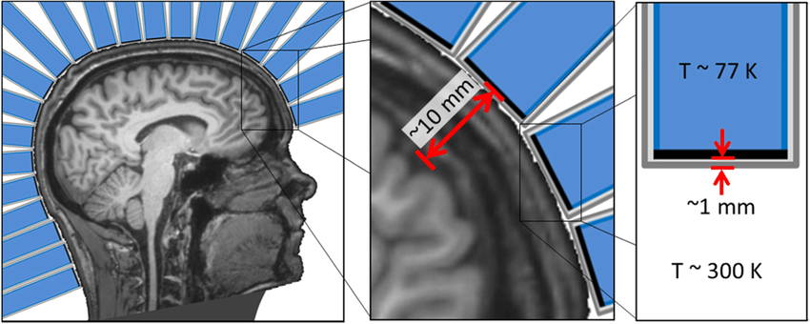
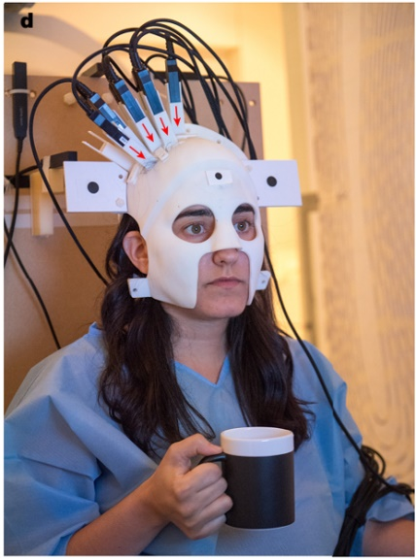

Traditional SQUID MEG vs. On-Scalp MEG
[1]
[2]
SQUIDs require liquid He (4 K).
Rigid helmet manufactured to fit 95% adult male subject’s head size.
Large sensor-source distance
  Diminished signal
  Less spatial complexity
On-scalp MEG enhances spatial resolution
Potentially wearable systems
  New research paradigms
Applications:
  Neuroscience research
  Brain Computer Interface (BCI)
  Clinical, e.g. epilepsy
[1]-modified
[2]
T ~ 180 C
~ 15 mm
~ 10 mm
[1] Rainer Körber et al, “SQUIDs in biomagnetism: A roadmap towards improved healthcare,” in Superconductor Science and Technology 29(11):113001, DOI: 10.1088/0953-2048/29/11/113001
[2] Boto E, Holmes N, Leggett J, Roberts G, Shah V, Meyer SS, et al. Moving magnetoencephalography towards real-world applications with a wearable system. Nature. 2018;555(7698):657.

Slide 7
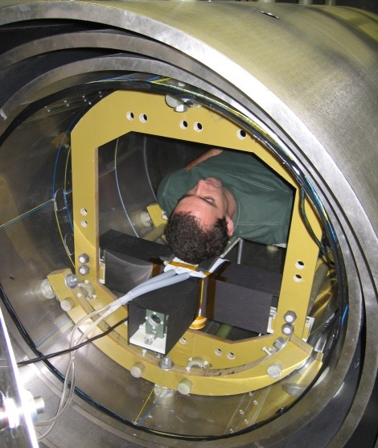
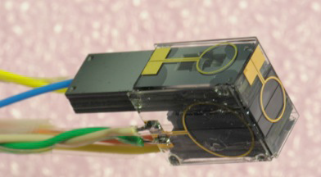
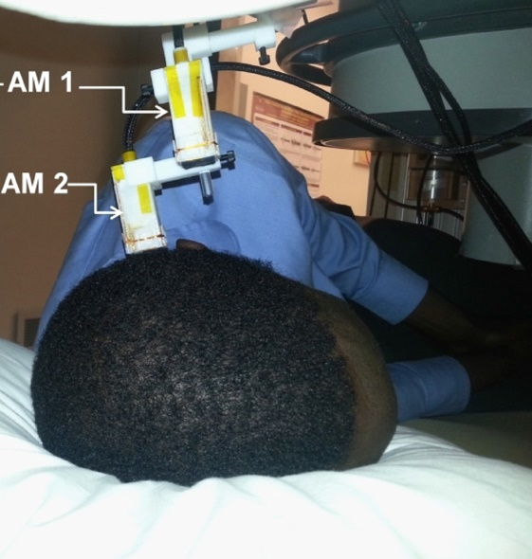
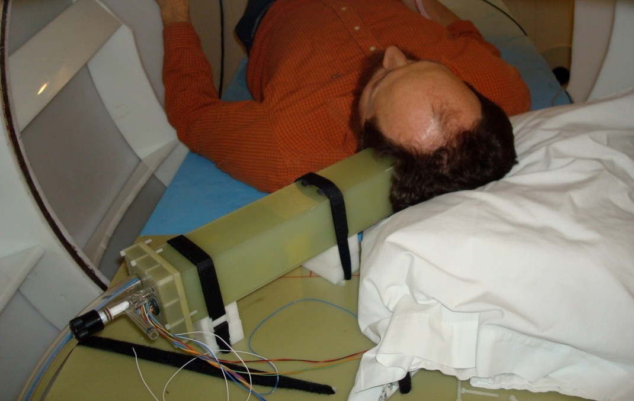
OPMs for MEG: Early work
Princeton/Twinleaf OPM MEG System
2006
NIST Miniature Magnetometer 2012
-now FieldLine Inc.
Sandia Atomic
Magnetometer
2010
2013
QuSpin Inc. Magnetometer

Slide 8
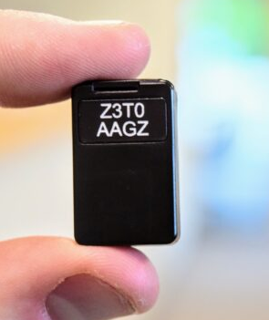


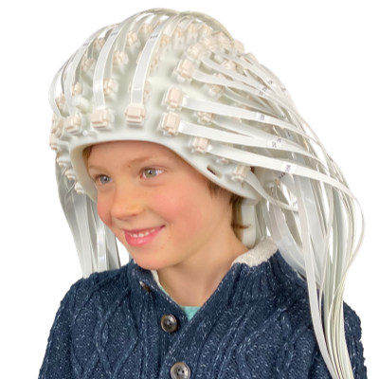


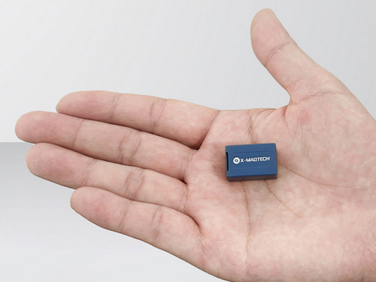

Emerging Companies Using Zero-Field/SERF OPM
*
*Assuming this is a zero-field/SERF OPM

Slide 9
Outline
Introduction to MEG
SERF OPMs: What is SERF?
  Specific examples of SERF OPMs
How MEG measurements are made
  Sandia example
  Calibrating OPM arrays
  Coregistration
Other OPMs for MEG
Conclusion
  Comparison of MEG technologies

Slide 10
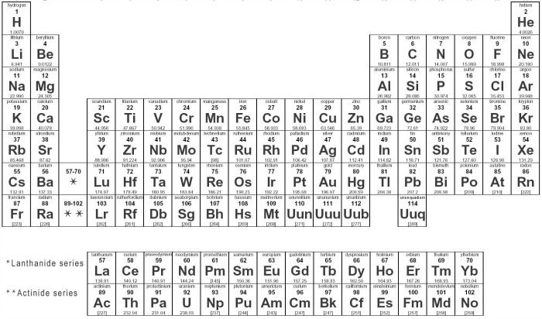
Atoms Used in OPMs

Slide 11
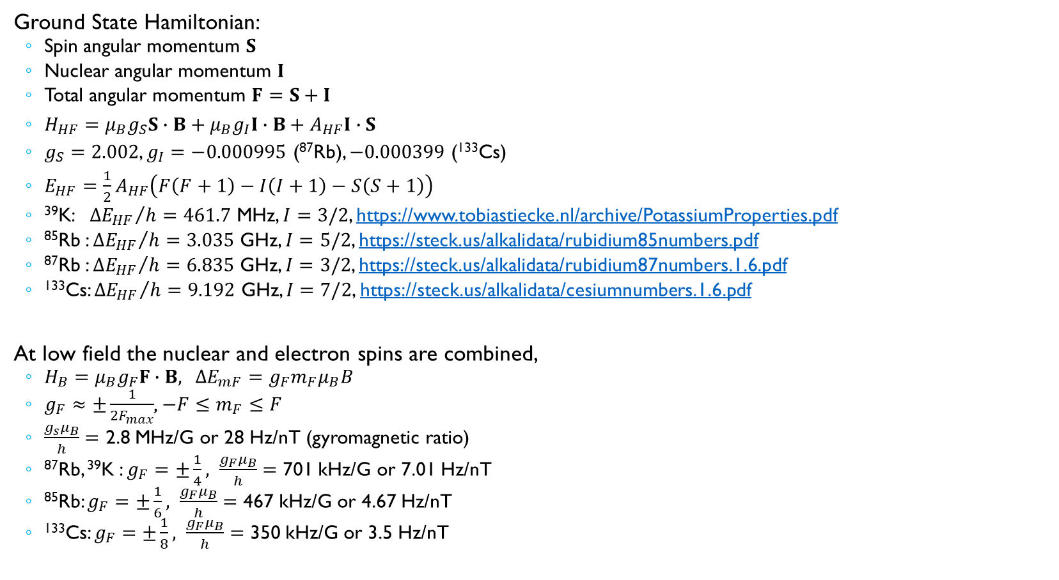
Hyperfine Ground State
Ground State Hamiltonian:
  Spin angular momentum $S$
  Nuclear angular momentum $I$
  Total angular momentum $F=S+I$
  $H_{HF}=μ_{B}g_{S}S∙B+μ_{B}g_{I}I∙B+A_{HF}I∙S$
  $g_{S}=2.002$, $g_{I}=−0.000995$ (⁸⁷Rb), $−0.000399$ (¹³³Cs)
  $E_{HF}={\frac{1}{2}A}_{HF}\left(F\left(F+1\right)−I\left(I+1\right)−S\left(S+1\right)\right)$
  ³⁹K: ${{∆E}_{HF}}/h=461.7$ MHz, $I=3/2$, https://www.tobiastiecke.nl/archive/PotassiumProperties.pdf
  ⁸⁵Rb : ${{∆E}_{HF}}/h=3.035$ GHz, $I=5/2$, https://steck.us/alkalidata/rubidium85numbers.pdf
  ⁸⁷Rb : ${{∆E}_{HF}}/h=6.835$ GHz, $I=3/2$, https://steck.us/alkalidata/rubidium87numbers.1.6.pdf
  ¹³³Cs: ${{∆E}_{HF}}/h=9.192$ GHz, $I=7/2$, https://steck.us/alkalidata/cesiumnumbers.1.6.pdf
At low field the nuclear and electron spins are combined,
  $H_{B}=μ_{B}g_{F}F∙B$, $∆E_{mF}=g_{F}m_{F}μ_{B}B$
  $g_{F}≈±\frac{1}{{2F}_{max}}$, $−F≤m_{F}≤F$
  $\frac{g_{s}μ_{B}}{h}=$ 2.8 MHz/G or 28 Hz/nT (gyromagnetic ratio)
  ⁸⁷Rb, ³⁹K : $g_{F}=±\frac{1}{4}, \frac{g_{F}μ_{B}}{h}=$ 701 kHz/G or 7.01 Hz/nT
  ⁸⁵Rb: $g_{F}=±\frac{1}{6}, \frac{g_{F}μ_{B}}{h}=$ 467 kHz/G or 4.67 Hz/nT
  ¹³³Cs: $g_{F}=±\frac{1}{8}, \frac{g_{F}μ_{B}}{h}=$ 350 kHz/G or 3.5 Hz/nT

Slide 12
OPMs: Three main physical effects
Atom-magnetic field interaction
  Zeeman effect
  Larmor precession
Atom-light interaction
  Optical pumping
  Faraday rotation
Decoherence effects
  Collisions
  Light
  Gradients

Slide 13
The Rubidium-87 Ground State
Hyperfine
splitting
F = 2
ћω_{L} = 1/4μ_{Β}Β
F = I + S
I = 3/2, S = 1/2
ћω_{HF}
Zeeman splitting
Atom Energy
F = 1
-2 -1 0 +1 +2
m_{F}
Clock—measure hyperfine frequency
Magnetometer—measure Zeeman splitting
Gyromagnetic Ratio = 2π 7 Hz / nT

Slide 14
Optical Pumping
²P_{1/2}
Lifetime ~ 27 ns
²P_{1/2}
σ₊
σ₊
²S_{1/2}
²S_{1/2}
m_{S} = -½
m_{S} = ½
m_{S} = -½
m_{S} = ½

Slide 15
Decoherence:
Spin Exchange Relaxation Free (SERF)
⁸⁷Rb Ground States
T₂ often limited by spin exchange collisions.
Near zero field and at high density, spin exchange rate >> spin precession frequency
  More F = 2 states, so on average atoms precess in F = 2 direction
  Precession rate is slowed down by nuclear spin and incomplete optical pumping
Record sensitivity: 160 aT / Hz^{1/2}
  Atom shot noise: ~0.1 fT / Hz^{1/2}
SERF in a ~6 mm³ scale cell: 5 fT / Hz^{1/2}
F = 2
F = 1
-2 -1 0 +1 +2
m_{F}
High-Field Regime
SERF Regime
Ensemble
Average
Single
Atom
Single
Atom
Ensemble
Average
Single
Atom
Spin Exchange
Collision
Spin Exchange
Collision
H. D. Dang, A. C. Maloof, M. V. Romalis, Applied Physics Letters 97, 151110 (2010)
W. C. Griffith, S. Knappe, and J. Kitching, Optics Express, 18, 27167-27172 (2010).

Slide 16
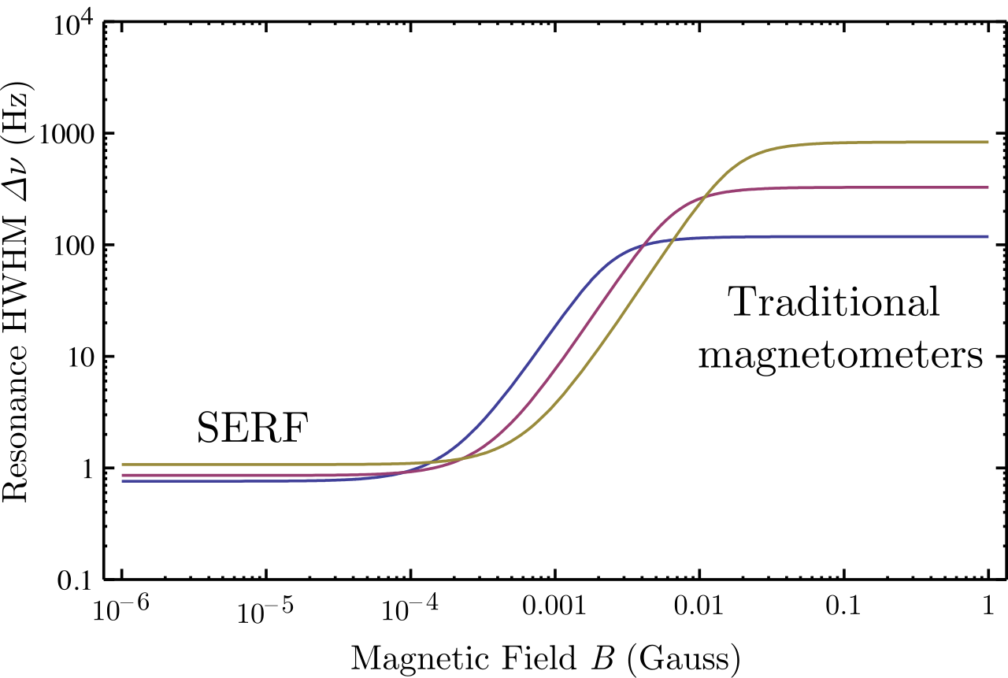

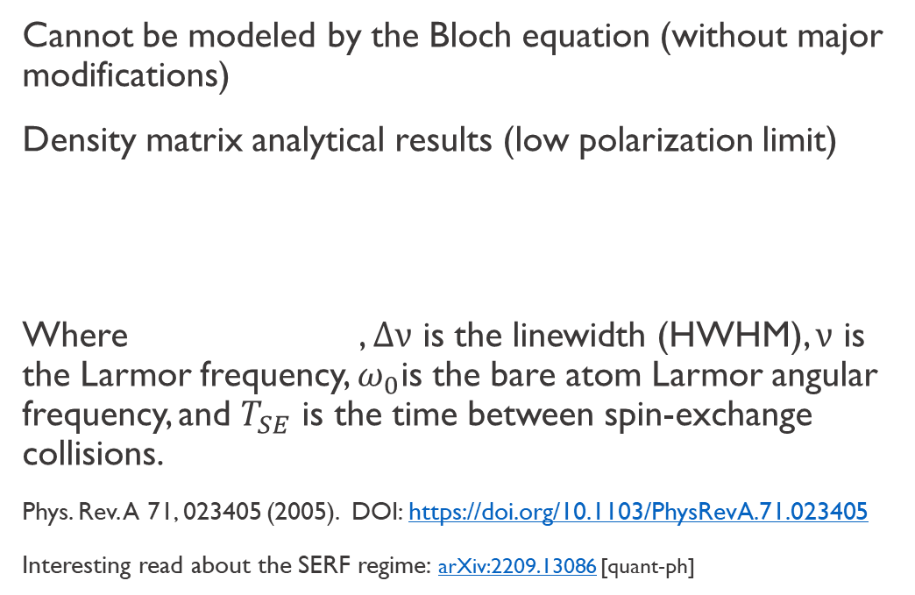
Transition between SERF and high-field regime
Rubidium relaxation cross sections
σ_{SE} = 2 x 10⁻¹⁴ cm²
σ_{SD} = 9 x 10⁻¹⁸ cm²
Cannot be modeled by the Bloch equation (without major modifications)
Density matrix analytical results (low polarization limit)
Where , $Δν$ is the linewidth (HWHM), $ν$ is the Larmor frequency, $ω_{0}$is the bare atom Larmor angular frequency, and $T_{SE}$ is the time between spin-exchange collisions.
Phys. Rev. A 71, 023405 (2005). DOI: https://doi.org/10.1103/PhysRevA.71.023405
Interesting read about the SERF regime: arXiv:2209.13086 [quant-ph]
Potassium vapor at 160, 180 and 200 °C
Twarge, CC BY-SA 4.0, https://creativecommons.org/licenses/by-sa/4.0, via Wikimedia Commons

Slide 17
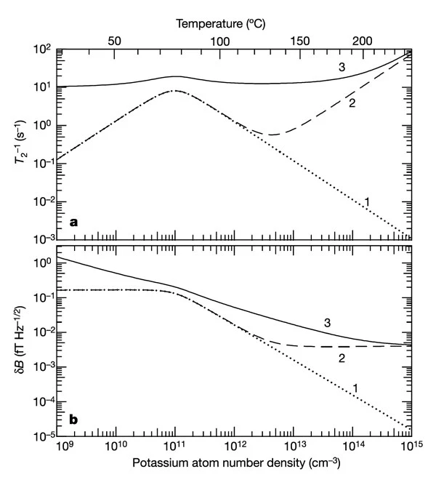
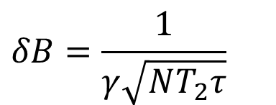
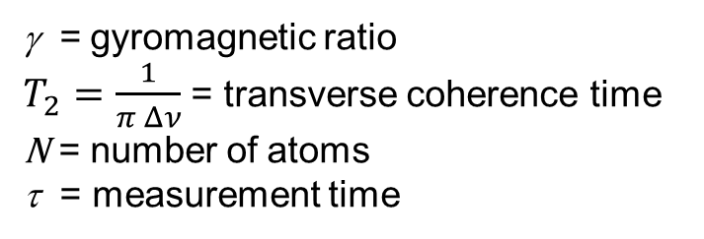
Optimizing sensitivity
$$δB=\frac{1}{γ\sqrt{NT_{2}τ}}$$
γ = gyromagnetic ratio
$T_{2}=\frac{1}{π Δν}$ = transverse coherence time
N = number of atoms
τ = measurement time
1-spin exchange
2-add alkali spin destruction
3-add buffer gas spin destruction and diffusion
Kominis, Iannis K., Thomas W. Kornack, Joel C. Allred, and Michael V. Romalis. "A subfemtotesla multichannel atomic magnetometer." Nature 422, no. 6932 (2003): 596-599.

Slide 18
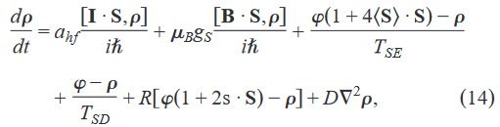
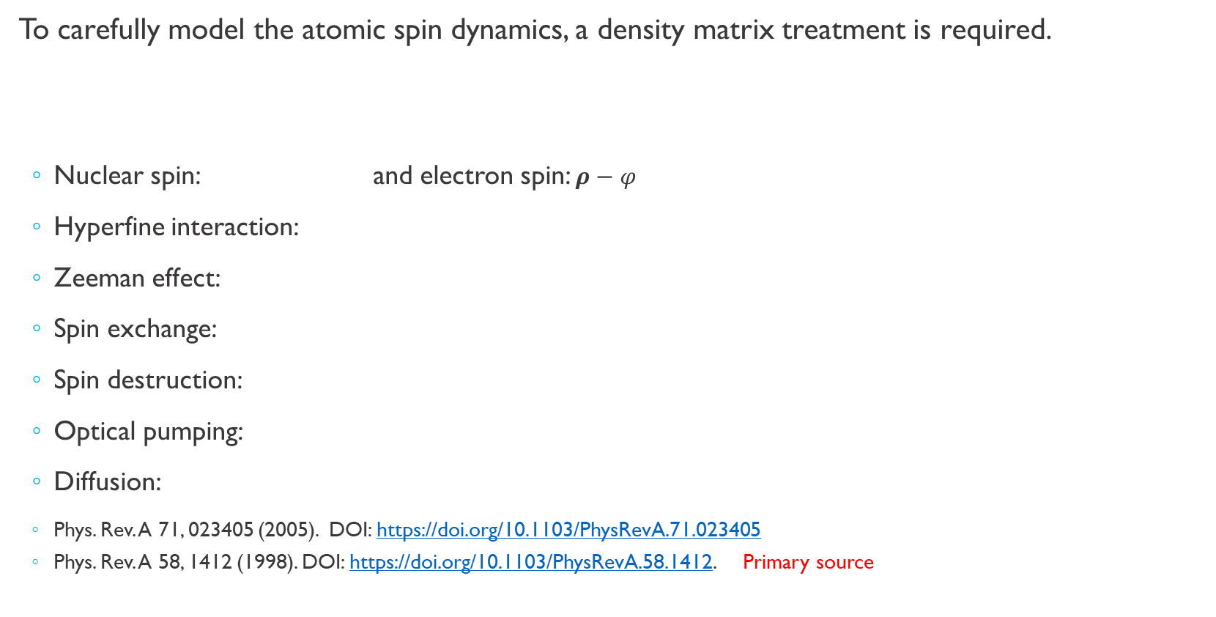
Density matrix for an atomic vapor-cell system
To carefully model the atomic spin dynamics, a density matrix treatment is required.
  Nuclear spin: and electron spin: $ρ−φ$
  Hyperfine interaction:
  Zeeman effect:
  Spin exchange:
  Spin destruction:
  Optical pumping:
  Diffusion:
  Phys. Rev. A 71, 023405 (2005). DOI: https://doi.org/10.1103/PhysRevA.71.023405
  Phys. Rev. A 58, 1412 (1998). DOI: https://doi.org/10.1103/PhysRevA.58.1412. Primary source

Slide 19
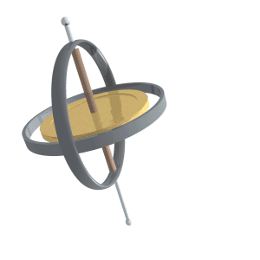
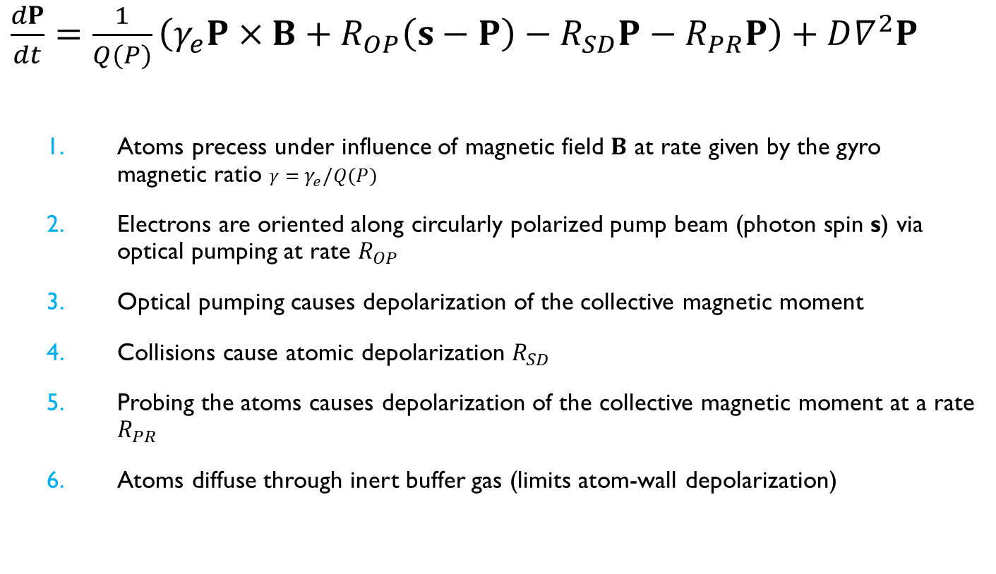
Bloch Equations for an OPM
$\frac{dP}{dt}=\frac{1}{Q(P)}\left(γ_{e}P×B+R_{OP}\left(s−P\right)−R_{SD}P−R_{PR}P\right)+D∇^{2}P$
  Atoms precess under influence of magnetic field $B$ at rate given by the gyro magnetic ratio $γ=γ_{e}/Q(P)$
  Electrons are oriented along circularly polarized pump beam (photon spin s) via optical pumping at rate $R_{OP}$
  Optical pumping causes depolarization of the collective magnetic moment
  Collisions cause atomic depolarization $R_{SD}$
  Probing the atoms causes depolarization of the collective magnetic moment at a rate $R_{PR}$
  Atoms diffuse through inert buffer gas (limits atom-wall depolarization)
By Lucas Vieira - Own work, Public Domain, https://commons.wikimedia.org/w/index.php?curid=1528090

Slide 20
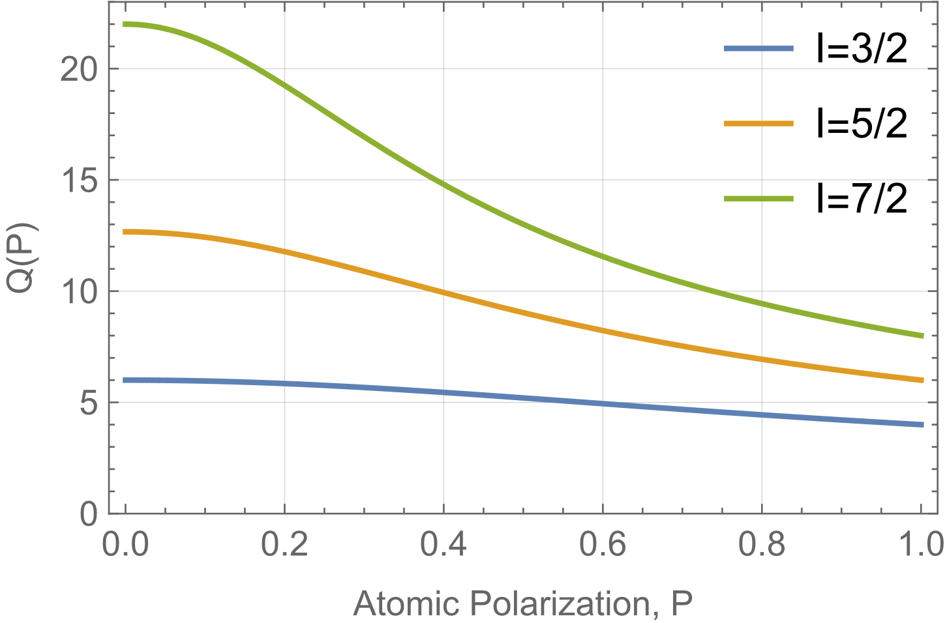
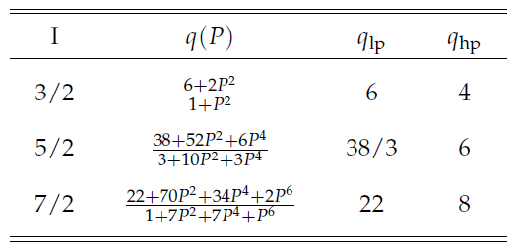
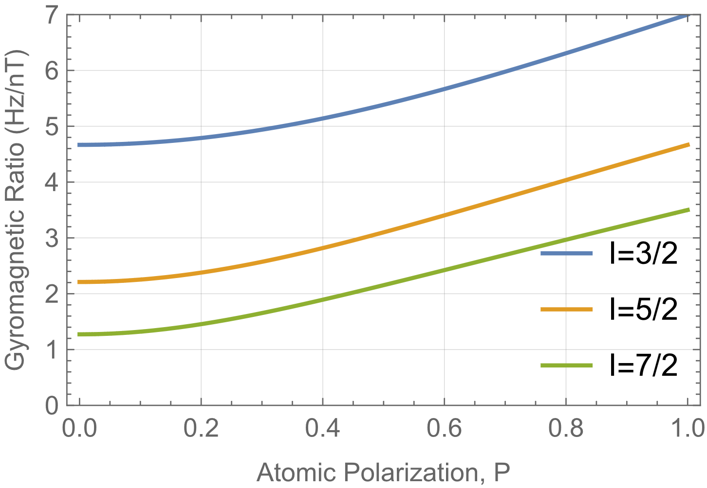
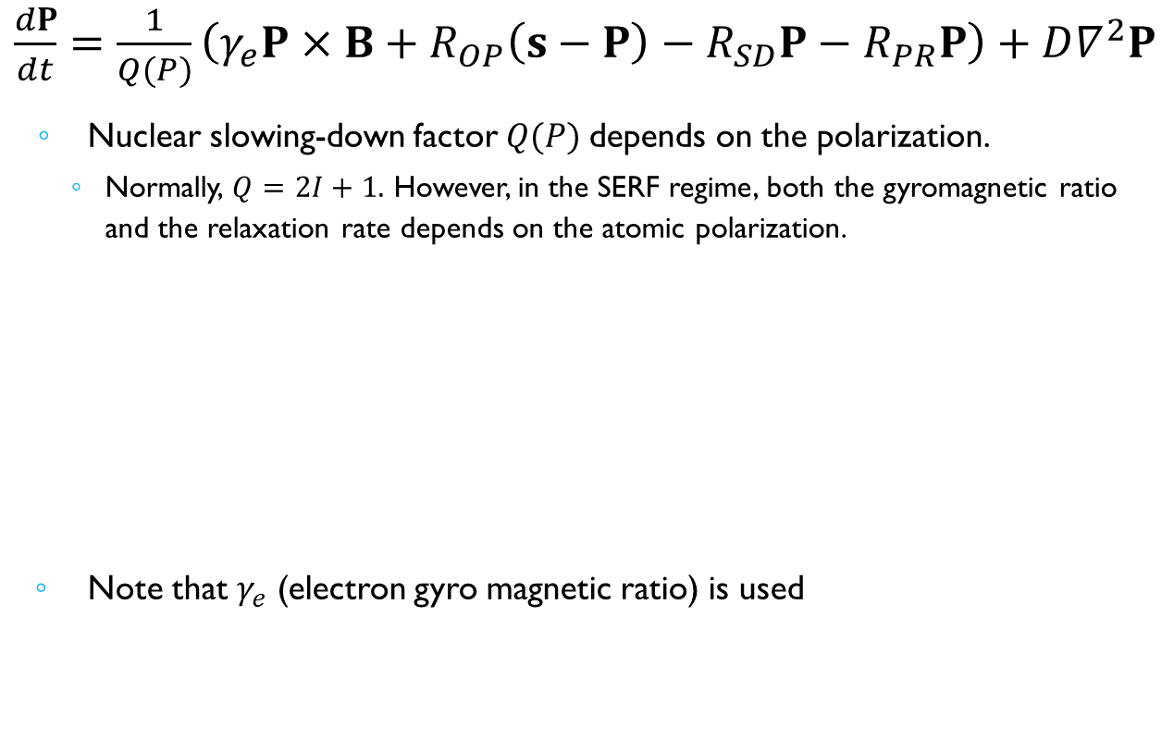
Bloch Equation for a zero-field SERF OPM
$\frac{dP}{dt}=\frac{1}{Q(P)}\left(γ_{e}P×B+R_{OP}\left(s−P\right)−R_{SD}P−R_{PR}P\right)+D∇^{2}P$
  Nuclear slowing-down factor $Q(P)$depends on the polarization.
    Normally, $Q=2I+1.$ However, in the SERF regime, both the gyromagnetic ratio and the relaxation rate depends on the atomic polarization.
  Note that $γ_{e}$ (electron gyro magnetic ratio) is used
Scott Seltzer, “Developments in alkali-metal atomic magnetometry,” Thesis (Ph.D.), Princeton University, 2008.
Thomas Kornack, “A test of CPT and Lorentz symmetry using a potassium-helium-3 co-magnetometer,” Thesis (Ph.D.), Princeton University, 2005.

Slide 21
Sensitivity Limits
Magnetic
Sensitivity
Atom shot noise limit
Decoherence limits noise to 1/N^{1/2} scaling
Sensitivity improved by increasing T₂ or N
Most AMs do not operate at this limit.
Photon shot noise limit
Most OPMs operate at or near the photon shot noise limit
Probe intensity contributes to T₂ so N_{ph} cannot be made arbitrarily high.
γ = gyromagnetic ratio
T₂ = transverse coherence time
N = number of atoms
τ = measurement time

Slide 22
Zero-Field/SERF Magnetometer (Vector)
Alkali Vapor Cell
Optical pumping
Circular
polarization
Pump beam
Randomly oriented atomic spins
Spins align with the pump beam
Apply Small Magnetic Field
Detect with probe beam
Probe beam
Output polarization
B
B
Spins precess due to magnetic field
Oriented spins rotate the polarization (Faraday rotation)
Input polarization
Out of
plane

Slide 23
Signals to Detect
Spin Polarization Bloch Equation
x
z
Transverse Pump
y
Probe beam
B
Bx = Bz = 0 Steady State Solution
Detect the Pump
Atomic Polarization, P_{z}
Pump Transmission
Atomic Polarization, P_{x}
or Angle of Light Polarization
B₀+B₁sin(ωt)

Slide 24

Zero-Field SERF Magnetometer

Slide 25
Outline
Introduction to MEG
SERF OPMs: What is SERF?
  Specific examples of SERF OPMs
How MEG measurements are made
  Sandia example
  Calibrating OPM arrays
  Coregistration
Other OPMs for MEG
Conclusion
  Comparison of MEG technologies

Slide 26
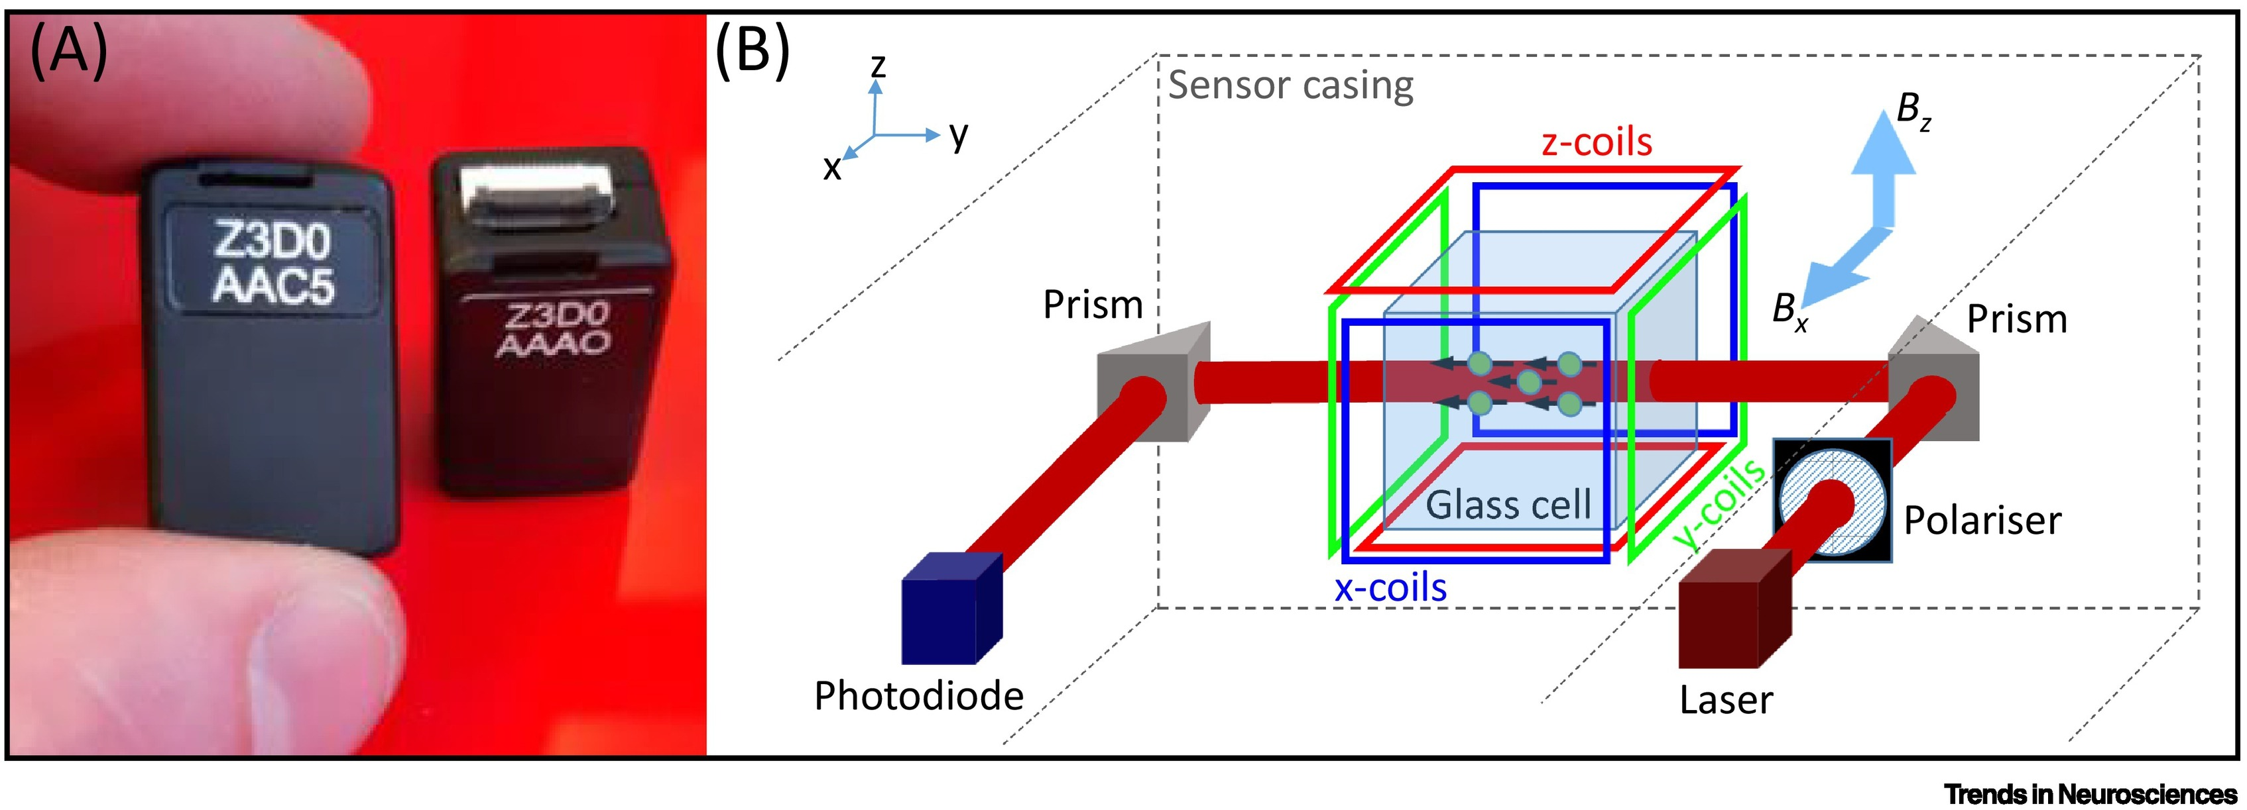
Single beam SERF OPM
Quarter Wave Plate
Magnetoencephalography with optically pumped magnetometers (OPM-MEG): the next generation of functional neuroimaging
Brookes, Matthew J. et al. Trends in Neurosciences, Volume 45, Issue 8, 621 - 634

Slide 27
Two-color pump/probe scheme
Two optical resonances in Rubidium (fine structure)
  Use D1 for optical pumping and D2 for probing
  Based on: V. Shah and M. V. Romalis, PRA 80, 013416 (2009)
⁸⁷Rb Fine Structure
Field modulation/phase sensitive detection
required to extract dispersive lineshape
5²P_{3/2}
Multiorder
Waveplate
Dichroic optical components
Detect on D2
Optically pump on D1
5²P_{1/2}
To analyzer
To analyzer
D1
795 nm
Input polarization
Output polarization
D2
780 nm
Linearly polarized 780 nm probe beam
Oriented spins rotate the polarization
Circularly polarized D1 pump beam
B₀+B₁sin(ωt)
D1 λ/4
D2 λ/2
780 nm
bandpass filter
D1 λ/4
D2 λ/2
780 nm
bandpass filter
5²S_{1/2}

Slide 28
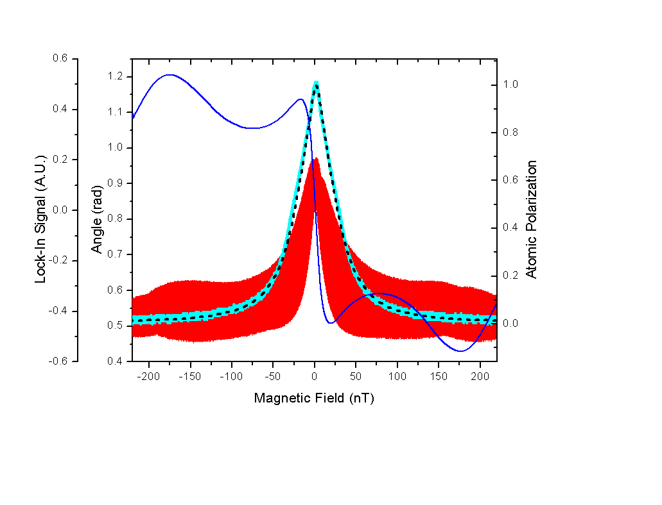
Magnetometer Signals
Blue trace: Magnetometer (lock-in) signal

Slide 29
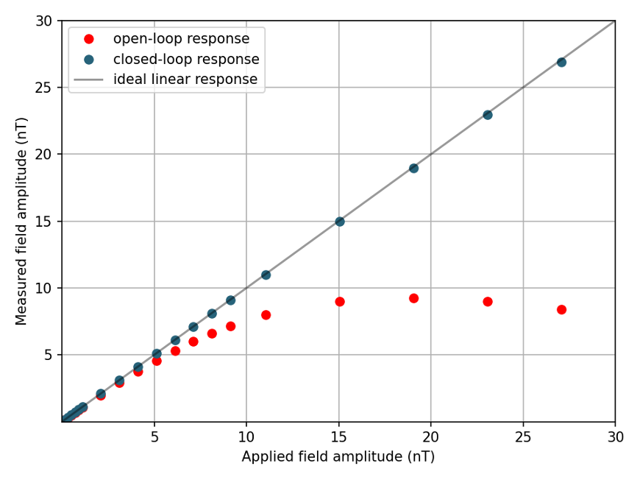
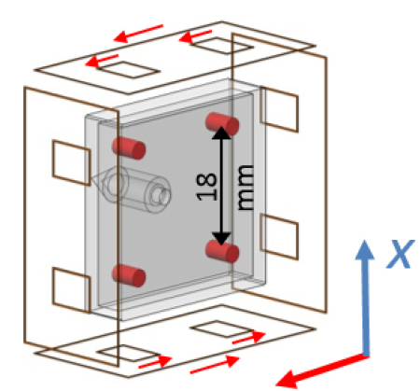
Linearity of OPMs
B_{x}
B_{y}
From Svenja Knappe

Slide 30
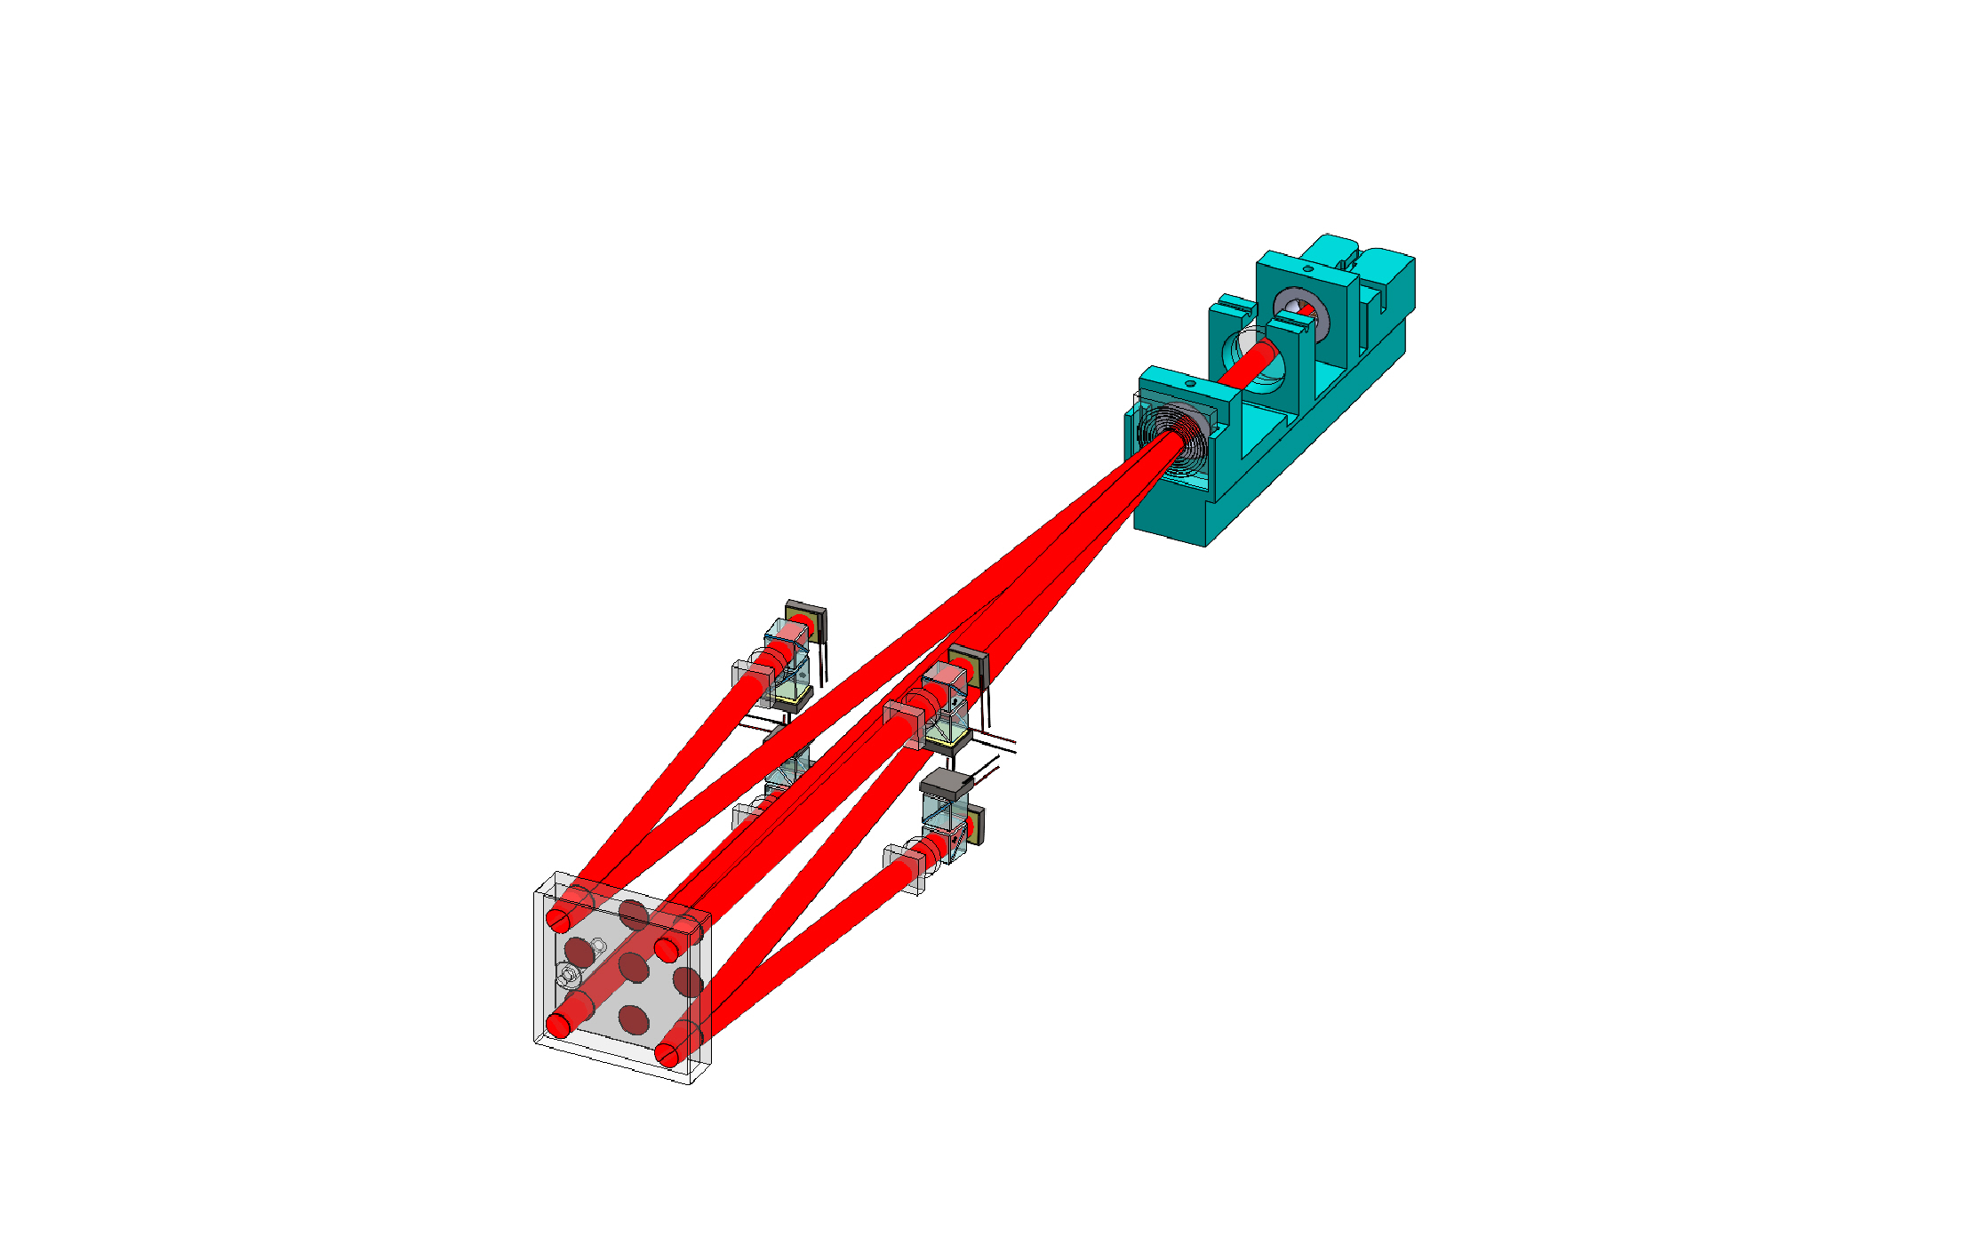
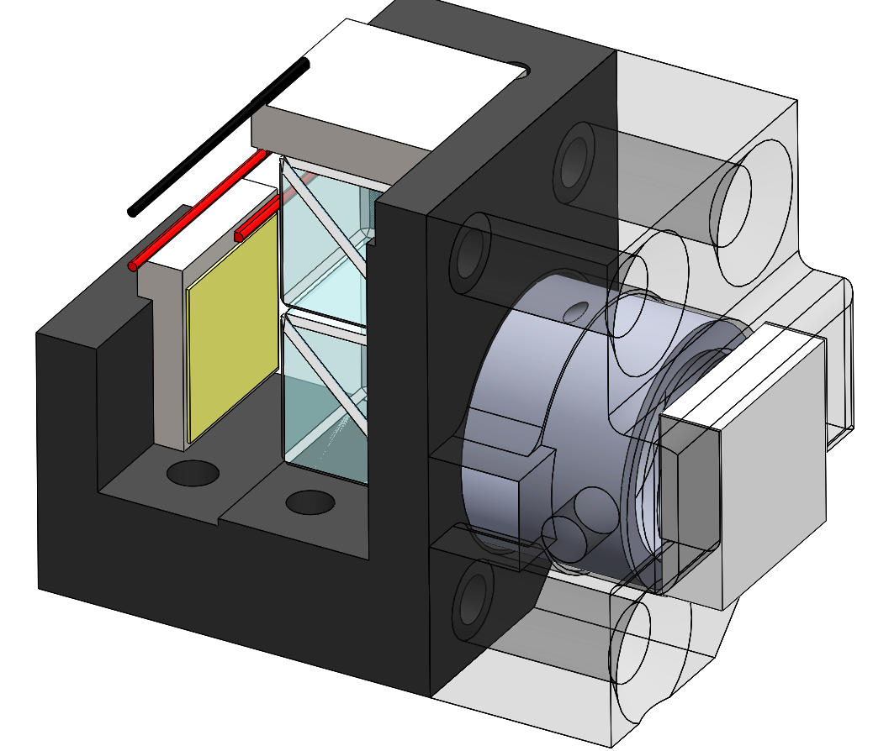
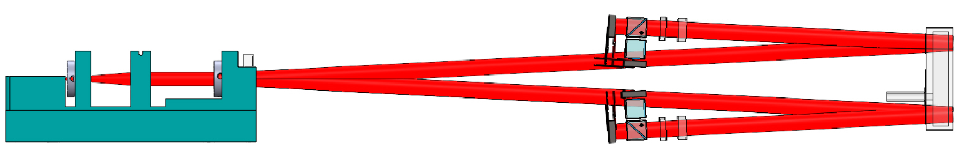
Gen 2 Sensor Design
Other design changes:
  Reduced beam size: 2.5 mm FWHM to 2 mm
  Reduced nitrogen buffer gas: 600 Torr to 300 Torr
Result:
  Reduced temperature: 145 °C to 130 °C
  Reduced optical power:
    Pump: 38 mW to 4 mW
    Probe: 14 mW to 4 mW
Photo-
diodes
PBS
Filter:
Pass
780 nm
PBS
λ/2
PM fiber for 780 & 795 nm laser
Lens
λ/2: 780 nm λ/4: 795 nm
DOE
18 mm
Side View
Detection Optics
Vapor Cell

Slide 31
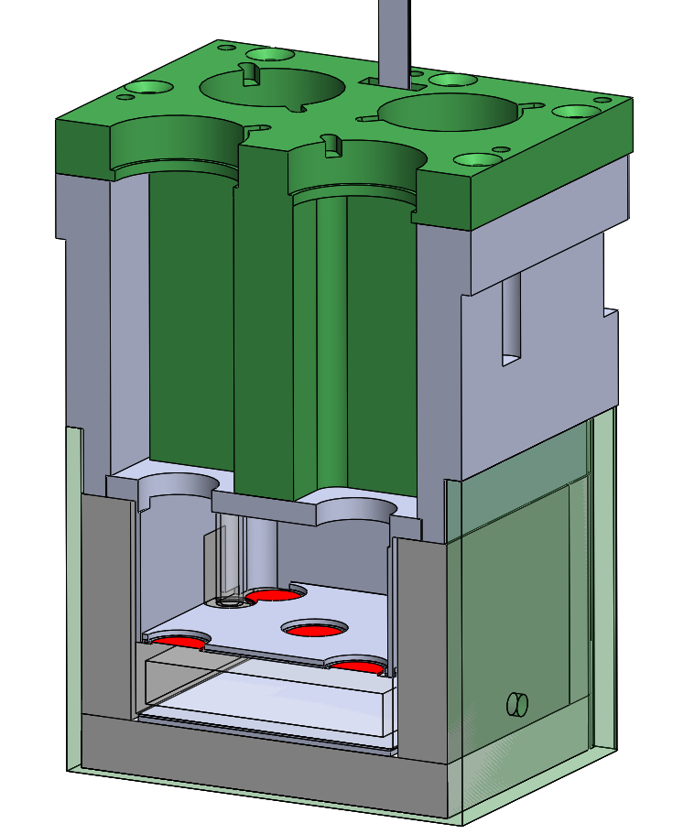
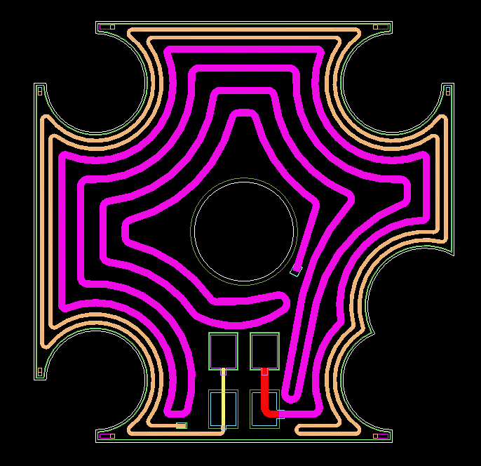
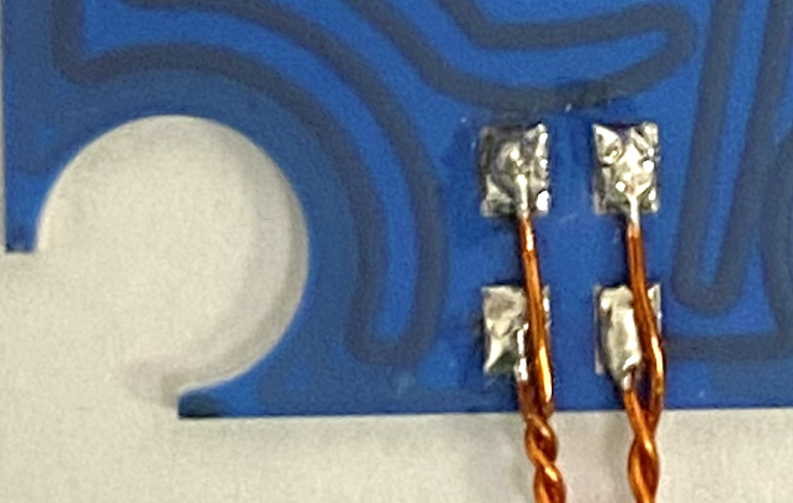
Gen 2 Oven design
Thin walled 3D printed oven walls
Aspen Aerogel Cryogel insulation: 5 mm
  15-25 mW/m/K (temperature dependent)
Distance from vapor cell center to external wall: 9 mm
Heating element:
  Co-fired ceramic heater
Demonstrated operating conditions:
  Power consumption: 6.1 W → ~3 W (all Cyrogel)
  Temp. underside: 178 °C
  Temp. stem: 151 °C
  Temp. outside: 47 °C → 37 °C when against back of hand
Volume filled with foam except for beam paths
Insulation
9 mm
Top co-fired ceramic heater

Slide 32
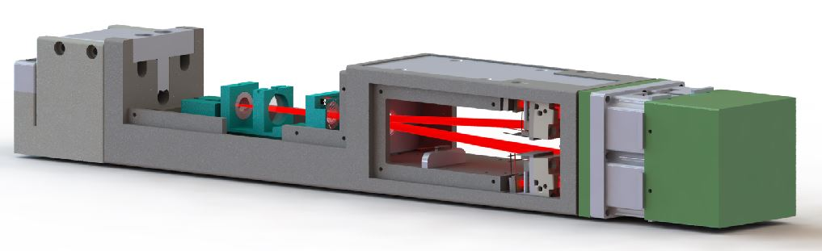
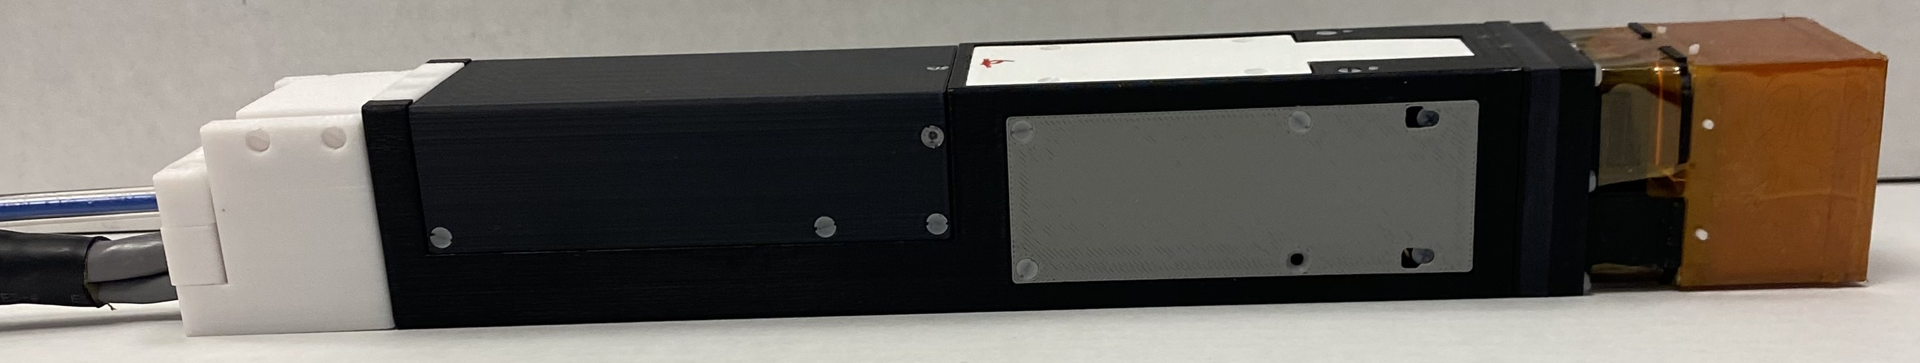
Gen 2 Module Design
40 mm
266 mm

Slide 33
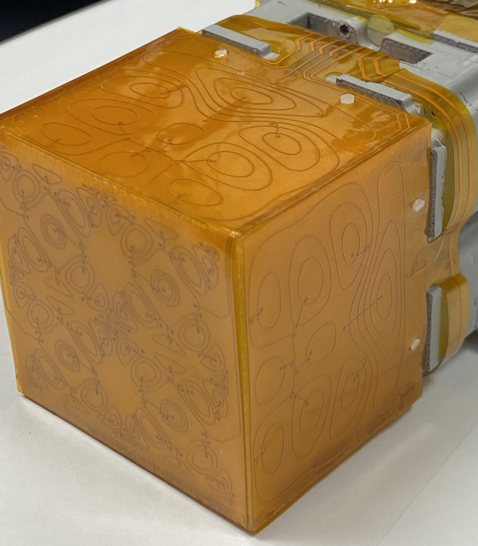
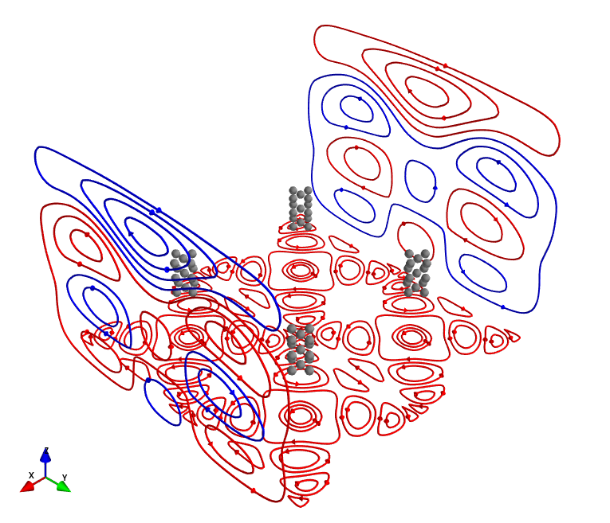
On-Sensor coils for the Gen 2 Sensor
Designed by Joonas Iivanainen with bfieldtools
Coils:
  X: 2 coils
  Y: 2 coils
  Z: 4 coils
Channel
Locations

Slide 34

Bandwidth
 | Ch 1 | Ch 2 | Ch 3 | Ch 4
3-dB BW (Hz) | 91 | 94 | 94 | 102

Slide 35

Gen 2 Sensor Performance
 | Ch 1 | Ch 2 | Ch 3 | Ch 4
3-dB BW (Hz) | 92 | 88 | 98 | 87
Mag. Noise (fT/rt-Hz, 10-44 Hz) | 12.3 | 10.3 | 10.3 | 10.6
Grad. Noise (fT/rt-Hz, 10-44 Hz) | 6.9 | 6.3 | 5.4 | 5.3
Table Vibration

Slide 36


MEG System: Block Diagram
24-ch, 6 sensor, OPM array
Human-sized magnetic shield
Custom laser source
Custom electronics
Custom LabView-based data acquisition and control software
Custom Matlab-based MEG data analysis pipeline

Slide 37


MEG System: The 24-Channel Array
6-sensor, 24-channel array
Partially covers the left hemisphere

Slide 38
MEG System: Signal Processing Pipeline
INPUT
MEG Signal Processing
Read the Recorded MEG data (V)
Time Locked MEG Signal
OUTPUT
ECD [3]
Source Location
Read the Recorded HPI Data (V)
LCMV [4]
ECD [3]
Volume Conduction Model
Magnetic Resonance Image
A Combination of custom Matlab code and Fieldtrip toolbox [1]
[1] R. Oostenveld, P. Fries, E. Maris, and J.-M. Schoffelen, "FieldTrip: Open Source Software for Advanced Analysis of MEG, EEG, and Invasive Electrophysiological Data," Computational Intelligence and Neuroscience, vol. 2011, p. 9, 2011.
[2] G. Nolte, "The magnetic lead field theorem in the quasistatic approximation and its use for magnetoencephalography forward calculation in realistic volume conductors," Physics in Medicine and Biology, Article vol. 48, no. 22, pp. 3637-3652, Nov 2003.
[3] Lutkenhoner B. "Dipole source localization by means of maximum likelihood estimation I. Theory and simulations,“ Electroencephalography and Clinical Neurophysiology, Volume 106, Issue 4, April 1998, Pages 314-321.
[4] B. D. Van Veen, W. van Drongelen, M. Yuchtman, and A. Suzuki, "Localization of brain electrical activity via linearly constrained minimum variance spatial filtering,“ IEEE Transactions on Biomedical Engineering, Article vol. 44, no. 9, pp. 867-880, Sep 1997.

Slide 39

20-Channels: 40 Measurements
Sequentially measure two transverse components
Calibrate each sensor to know its sensitive direction
Neighboring sensors interfere to change sensitive direction

Slide 40








Summary of the method
A magnetic field sensor
  Gain $g$ (V/T)
  Orientation $n$
  Position $r$
A set of N magnetic field generators $\{Bi\left(r\right)\}$
Measure the sensor response to the ith generator
Model magnetic fields of the generators $\{Bmi\left(r\right)\}$
Minimize the sum of squared errors between the measurements and the models to obtain $g$, $n$ and $r$
Sensor output:
$$b=g B(r)∙n$$
Iivanainen, Joonas, et al. "Calibration and localization of optically pumped magnetometers using electromagnetic coils." Sensors 22.8 (2022): 3059.
Ryan M. Hill, et al.
‘Determining sensor geometry and gain in a wearable MEG system.” Imaging Neuroscience 2025; 3 imag_a_00535.
$$bi=g Bi(r)∙n$$
$$b_{i}^{m}=g B_{i}^{m}(r)∙n$$
$$\underset{g, n, r}{argmin}{\sum_{i=1}^{N}{\left(bi−bim\right)2}}$$

Slide 41


MRI Co-registration and Forward Model
Head Localization Coils
Four head localization coils close to the array
Polhemus Fastrak system to digitize
Relative sensor positions from CAD model

Slide 42

Optical coregistration
Zetter, R., Iivanainen, J. & Parkkonen, L. Optical Co-registration of MRI and On-scalp MEG. Sci Rep 9, 5490 (2019). https://doi.org/10.1038/s41598-019-41763-4

Slide 43









































Somatosensory/Auditory Evoked Magnetic Fields:
Spatial Topographies
500 fT
500 fT
y
y
x
x
SEF
AEF

Slide 44
OPM SEF/AEF Spatial Topography
N20m peak (~ 20 ms)
N100m peak (~ 100 ms)

Slide 45
Source Localization: SEF
Red dot: Elekta Neuromag system and software. White dot: OPM data and Fieldtrip analysis software

Slide 46






SERF OPMs: Formulating Gain/Sense-Angle Error
$$B_{x}=\hat{B_{xs}}\left(t\right)+B_{m}\sin{(ω_{m}t)}$$
$$P_{z}≈\frac{R_{op}}{R_{op}+R_{rel}}J_{0}\left(\frac{γB_{m}}{{qω}_{m}}\right)J_{1}\left(\frac{γB_{m}}{{qω}_{m}}\right)\sin\left(ω_{m}t\right)\left[\frac{\frac{γ\hat{B_{xs}}\left(t\right)}{\left(R_{op}+R_{rel}\right)}}{1+{\left(\frac{γ\hat{B_{xs}}\left(t\right)}{\left(R_{op}+R_{rel}\right)}\right)}^{2}}−{J_{0}}^{2}\left(\frac{γB_{m}}{{qω}_{m}}\right)\left\{\frac{\frac{γ^{2}B_{y}B_{z}}{{\left(R_{op}+R_{rel}\right)}^{2}}}{1+{\left(\frac{γ\hat{B_{xs}}\left(t\right)}{\left(R_{op}+R_{rel}\right)}\right)}^{2}}+\frac{\frac{γ\hat{B_{xs}}\left(t\right)}{\left(R_{op}+R_{rel}\right)}}{{\left(1+{\left(\frac{γ\hat{B_{xs}}\left(t\right)}{\left(R_{op}+R_{rel}\right)}\right)}^{2}\right)}^{2}}\left.\left({\left(\frac{γB_{y}}{\left(R_{op}+R_{rel}\right)}\right)}^{2}+{\left(\frac{γB_{z}}{\left(R_{op}+R_{rel}\right)}\right)}^{2}\right)\right.\right\}\right]$$
$$G_{OPM}$$
$$G_{2}$$
$$G_{3}$$
Cross Axis Projection Error (CAPE) Effects
$φ_{i}≈arctan\left(\frac{−G_{2}B_{i}}{G_{OPM}}\right), i=y or z→$Rotation of the sensitive axis
$→$Reduction of gain
Phase errors
  Amir Borna, Joonas Iivanainen, Tony R. Carter, Jim McKay, Samu Taulu, Julia Stephen, Peter D.D. Schwindt, “Cross-Axis projection error in optically pumped magnetometers and its implication for magnetoencephalography systems,” NeuroImage, 247, 118818 (2022).

Slide 47


Sensitive Axis Rotation: Simulation vs. Measurement
$$φ_{z}≈arctan\left(\frac{−G_{2}B_{z}}{G_{OPM}}\right)$$
CAPE rotates the sensitive axis by 2.86 °/nT (measured) and 3.33 °/nT (simulated).
The slight difference between the two is attributed to different relaxation rates.

Slide 48



Mitigation of CAPE
Sandia Person-Sized Shield Coils
Zero the fields (easier)
  Zero the field at each sensor (< nT)
  Zero the field in the shield
Closed-loop, 3-axis OPM (harder)
  Upside: It’s a 3-axis measurement!
    Can we maintain good sensitivity?
  Upside: Fixed gain. Sensors are always calibrated.
  Downside: cross-talk between sensors.
Nottingham Biplanar Coils
NeuroImage, 181, 760-774 (2018)
QuSpin Gen 3 QZFM
Triax Variant: <23 fT/√Hz in 3-100 Hz band (typical 15 fT/√Hz all axis simultaneous)
Uses 2 perpendicular beams
NeuroImage, 236, 118025 (2021)
NeuroImage, 252, 119027 (2022)

Slide 49
Interference and crosstalk
Interference
  Leakage of the modulation field from one sensor to another
  Can easily be ameliorated through sensor calibration
Crosstalk in closed loop system
  Cancelling field at one sensor is sensed by another sensor
  Mitigation: Design feedback coils that minimize cross talk.
  Mitigation: A cross-talk matrix may need to be measured for each sensor configuration.

Slide 50
Outline
Introduction to MEG
SERF OPMs: What is SERF?
  Specific examples of SERF OPMs
How MEG measurements are made
  Sandia example
  Calibrating OPM arrays
  Coregistration
Other OPMs for MEG
Conclusion
  Comparison of MEG technologies

Slide 51






Other types of OPM
Helium-4 OPM
Unshielded MEG using scalar OPM
Sensitivity: 50 fT/rt-Hz
Closed-loop, triaxial operation
No cell heating: 10 mW RF discharge
Gradiometric Sensitivity: 15 fT/cm/rt-Hz
Measure field component parallel to ambient field
No crosstalk / magnetically silent
William Fourcault, et al., Opt. Express 29, 14467-14475 (2021)
Limes, M.E., et al., Phys. Rev. Appl. 14, 011002 (2020)

Slide 52








Helium-4 OPM - principle
Linear polarization
$$x$$
pump/probe
laser beam
$$\vec{E}$$
$$\vec{e_{x}}b_{x}cos\left(Ωt\right)$$
photo-detector
6 cm
$$z$$
demodulation
$$\vec{e_{z}}b_{z}cos\left(ωt\right)$$
$$\vec{B_{y}}$$
$$\vec{B_{x}}$$
$$∝B_{x}$$
$$∝B_{y}$$
$$∝B_{z}$$
$$∝B_{y}$$
2x2 cm
$$\vec{B_{z}}$$
-1
$$Ω$$
$$ω$$
$$ω−Ω$$
$$ω+Ω$$
-2
Signal (Arb. Units)
Parametric resonances
along each direction
with 2 rf fields
and 1 laser beam
-3
Magnetic ALIGNED
state
-100
-50
0
50
100
Magnetic field amplitude (nT)
F. Beato et al. Phys. Rev. A 98, 053431 (2018)

Slide 53



Pulsed Pump Magnetometer
High performance Optical Magnetic Gradiometers
Zero field
SERF OPM
Operate at nonzero background field
Probe
~1 ms
θ∝B
Pump
<1 µs
f = ɣB
Measure
spin angle
⁸⁷Rb Spin
Probe
Measure
spin frequency
⁸⁷Rb Spin
By
⁸⁷Rb Spin
By
σ+ Pump
σ+ Light
Extraordinary sensitivity without magnetic shielding
Free-induction decay frequency
PUMP PULSE
PUMP PULSE

Slide 54
Outline
Introduction to MEG
SERF OPMs: What is SERF?
  Specific examples of SERF OPMs
How MEG measurements are made
  Sandia example
  Calibrating OPM arrays
  Coregistration
Other OPMs for MEG
Conclusion
  Comparison of MEG technologies

Slide 55

SQUID vs OPM
SERF OPM
SQUID
B_{x}
B_{y}
http://hyperphysics.phy-astr.gsu.edu/hbase/Solids/Squid.html
Integrates over volume of laser beam
Sensitive axis determined by field modulation (Some SERF designs use laser beam geometry to define sensitivity axis.)
Integrates over the area of pickup loop
Sensitive axis determined by loop geometry

Slide 56
SQUID vs OPM
 | Sensitivity | Bandwidth | Sensitive axis | Dynamic range (Max field)
Zero field, SERF OPM | 5-20 fT/rt-Hz | 80-150 Hz (open loop) 350 Hz (closed loop)** | 1, 2, or 3 axis (3rd axis from 2nd OPM) | ±2 nT (80 nT) open loop* ±150 nT (150 nT) closed loop**
He OPM | 50 fT/rt-Hz | 2 kHz (open loop) 1.35 kHz (closed loop) | 3 axis (3rd axis 6x worse sensitivity) | ±300 nT (unknown)
Scalar OPM gradio-meter—Unshielded | 15 fT/cm/ rt-Hz | 300 Samples/s (adjustable) | Parallel to am-bient bias field | Unknown (Earth’s field)
SQUID | 2-3 fT/rt-Hz | 1–5 kS/s (adjustable) | Normal to pickup loop | ±20 nT (Unshielded operation possible)
*Quspin Neuro-1: Neuro-1 flyer
**Fieldline: Alem O, et al.,Front. Neurosci. 17, 1190310 (2023)
Unknown = Unknown to this author

Slide 57
Reporting results
Sensitivity results should be normalized by the bandwidth.

Slide 58


Reporting results
Table Vibration
Gradiometrically inferred sensitivity = (Ch1 – Ch2)/$\sqrt{2}$
Gradiometer sensitivity = (Ch1 – Ch2)/1.8 cm
1.8 cm = gradiometer baseline

Slide 59

Detection of epilepsy in children with OPMs
Odile Feys, Pierre Corvilain, Alec Aeby, Claudine Sculier, Niall Holmes, Matthew Brookes, Serge Goldman, Vincent Wens, and Xavier De Tiège, “On-Scalp Optically Pumped Magnetometers versus Cryogenic Magnetoencephalography for Diagnostic Evaluation of Epilepsy in School-aged Children,” Radiology 304:2, 429-434 (2022).

Slide 60

Detection of epilepsy in children with OPMs

Slide 61
Conclusions
OPMs are fundamentally different than SQUID sensors
  OPMs integrate field over a volume, not an area
  Bandwidth reduced compared to SQUID, at least for SERF OPMs
  Sensitivity of today’s OPM are reduced compared to SQUIDs
    Mitigated by being closer to the head
    Prospects for better OPM sensitivity: Best OPM 0.16 fT/rt-Hz
  OPM respond to all components of the field
    “Vectorization” methods needed to read out specific field components
    Three-axis detection possible
    Systematic errors arise from offset field
SERF and He OPM need a low-field environment
Scalar gradiometer operates in Earth’s field
OPMs are making a real world impact!
[1]
[1]-modified
T ~ 180 C
~ 15 mm
~ 10 mm

Slide 62


Other references
Budker D, Jackson Kimball DF, eds. Optical Magnetometry. Cambridge University Press; (2013).
Labyt, Etienne, S. Tilmann, and Ronald Wakai. "Flexible High Performance Magnetic Field Sensors." Labyt, E., Sander, T., Wakai, R., Eds (2022).
Fabricant, Anne, Irina Novikova, and Georg Bison. "How to build a magnetometer with thermal atomic vapor: a tutorial." New Journal of Physics 25, no. 2 (2023): 025001.
Kimball, DF Jackson, E. B. Alexandrov, and D. Budker. "A Brief History of Optical Magnetometry." D. Budker (Cambridge University Press, Cambridge, UK, 2013) Chap 1: 1-10.

Slide 63
Back up slides

Slide 64
Properties of a Neutral Atoms
Quantized energy levels
n = 3, l = 0,1,2
e⁻
n = 2, l = 0,1
p⁺
Photon
n = 1, l = 0

Slide 65
Properties of a Neutral Atoms
Spin and magnetic moment
  Electron spin
  Nuclear spin
n = 3, l = 0,1,2
n = 2, l = 0,1
e⁻, ½
B
F = 1
n = 1,
l = 0
p⁺
, ½
s = ½
s = -½
m = -1
m = 0
n = 1, l = 0
F = 0
m = 1
Zeeman effect

Slide 66






Vapor cell optimization
Decoherence processes
  Diffusion (simplified to a lowest order rate)
    $R_{diff}={3\left(\frac{π}{L}\right)}^{2}D_{0}\frac{P_{0}}{P_{fill}}{\left(\frac{T}{T_{0}}\right)}^{1/2}$, cubic cell of length $L$
    $D_{0}$ is the diffusion constant, $P_{0}$ and $T_{0}$ are the pressure and temperature at which $D_{0}$ is measured, $P_{fill}$ is the buffer gas pressure at $T_{0}$, and $T$ is the cell operating temperature
  Alkali-alkali spin destruction
    $R_{Rb}=n_{rb}σ_{rb}v$
    $n_{rb}$ is the Rb density, $σ_{rb}$ is the Rb-Rb spin destruction cross section, and $v$ is the relative velocity
  Alkali-buffer-gas spin destruction
    $R_{Rb}=n_{buff}σ_{buff}v$ ${\left(\frac{T}{T_{σ}}\right)}^{3.7}$
    $n_{buff}$ is the buffer gas density, $σ_{buff}$ is the Rb-buffer-gas spin destruction cross section, $v$ is the relative velocity, and $T_{σ}$ is the pressure at which the cross section is measured
  Noble gases typically have lower $σ_{buff}$ but excited state depolarization reduces optical pumping efficiency and allow radiation trapping
  Nitrogen has higher $σ_{buff}$ but advantageously quenches the excited state
Alkali-Alkali
Spin Destruction
$L$ = 5 mm
$P_{Ne}$ = 700 Torr
$P_{N2}$ = 30 Torr
Diffusion
Buffer gas
Spin Destruction
$L$ = 5 mm
$P_{N2}$ = 30 Torr
$T$ = 150 C
J. C. Allred, R. N. Lyman, T. W. Kornack, and Michael V. Romalis. "High-sensitivity atomic magnetometer unaffected by spin-exchange relaxation." Physical review letters 89, no. 13 (2002): 130801.

Slide 67


Internal coils of the shield
Use the coils of the human-sized shield for calibration
Fluxgate measurement of the magnetic fields of the 18 shield coils
  Three-axis measurement at 108 positions around the sensor array
Model the magnetic fields using vector-spherical harmonics (VSH) expansion
  Maximum degree l = 5

Slide 68



VSH model allows to calculate the currents to generate homogeneous and gradient fields

Slide 69


Calibration algorithm
Get initial estimate on the sensor orientation $n0$, gain $g0$ and position $r$₀
  Use the 18 shield coils to excite homogeneous fields along x, y, and z
  Solve initial sensor orientation $n0$ and gain $g0$ by a matrix inversion
  Excite the five first-order gradients
  Given $g0 and n0$, solve initial sensor position $r$₀ by a matrix inversion
Get final estimate on sensor orientation, gain and position
  Excite all 18 coils
  Solve the optimization problem using $g0,n0$ and $r$₀ as the initial guess
    Use the full VSH models to take into account the whole spatial structure of the fields
$$\underset{g, n, r}{argmin}{\sum_{i=1}^{N}{\left(bi−bim\right)2}}$$

Slide 70




Validation of the method
Place three-axis fluxgate inside the sensor array
Use the algorithm to find the fluxgate parameters
Six positions inside the sensor array
  6×3 = 18 measurements (or sensors to calibrate)
The gains and relative positions/orientations of the fluxgate channels are known
  Gain (0.1 ±0.1%) V/µT
  Orthogonality ±0.5°
Mean = 0.8%
Mean = 0.1°
Mean = 0.8 mm
Sensys GmbH

Slide 71

Simulation vs. Measurement, CAPE
OPM’s cross-axis projection error for a 25 Hz, sinusoidal signal with an amplitude of 0.33 nT.

Slide 72

Impact of CAPE on MEG Signals: M20 Median Nerve Response
Wide bandwidth of SEF response at 20 ms (M20) reveals possible effects of CAPE.

Slide 73


Impact of CAPE on OPM-MEG Systems’ Localization Capability
Poster Number: IM-29
Amir Borna
The mean and standard deviation (bars) for source localization error; the x-axis is the standard deviation of the remnant static magnetic field on the laser propagation axis selected from a normal gaussian distribution.

