Slide 1


Status of Work on
Permanent Magnets (PerMaLIC)
and
Harmonic Cavities (HarmonLIP)
Francis Perez
on behalf of
PerMaLIC and HarmonLIP collaborations
LEAPS WG2 Meeting
Nijmegen, October 23rd, 2024

Slide 2

What it is?
  PerMaLIC is a LEAPS Internal Collaboration,
  i.e. a collaboration between the institutes of the LEAPS Consortium (https://leaps-initiative.eu),
  about development of Permanent Magnets for the future, ultralow emittance, light sources.
PerMaLIC
  The use of Permanent Magnets in the new light sources has mainly two advantages: in the one hand, it allows a more compact distribution of magnets, since there is no need of coils and water cooling; in the other hand, it allows to reduce the running costs and the carbon footprint of the facility thanks to the removal of the power supplies associated to conventional electromagnets.
  However, the use of Permanent Magnets also presents some serious challenges. These challenges include the loss of flexibility for the correction of errors, correction that it is needed to ensure the proper beam dynamics performance and stability, and the long term stability of the magnets themselves due to the risk of radiation-induced demagnetization.
Motivation

Slide 3
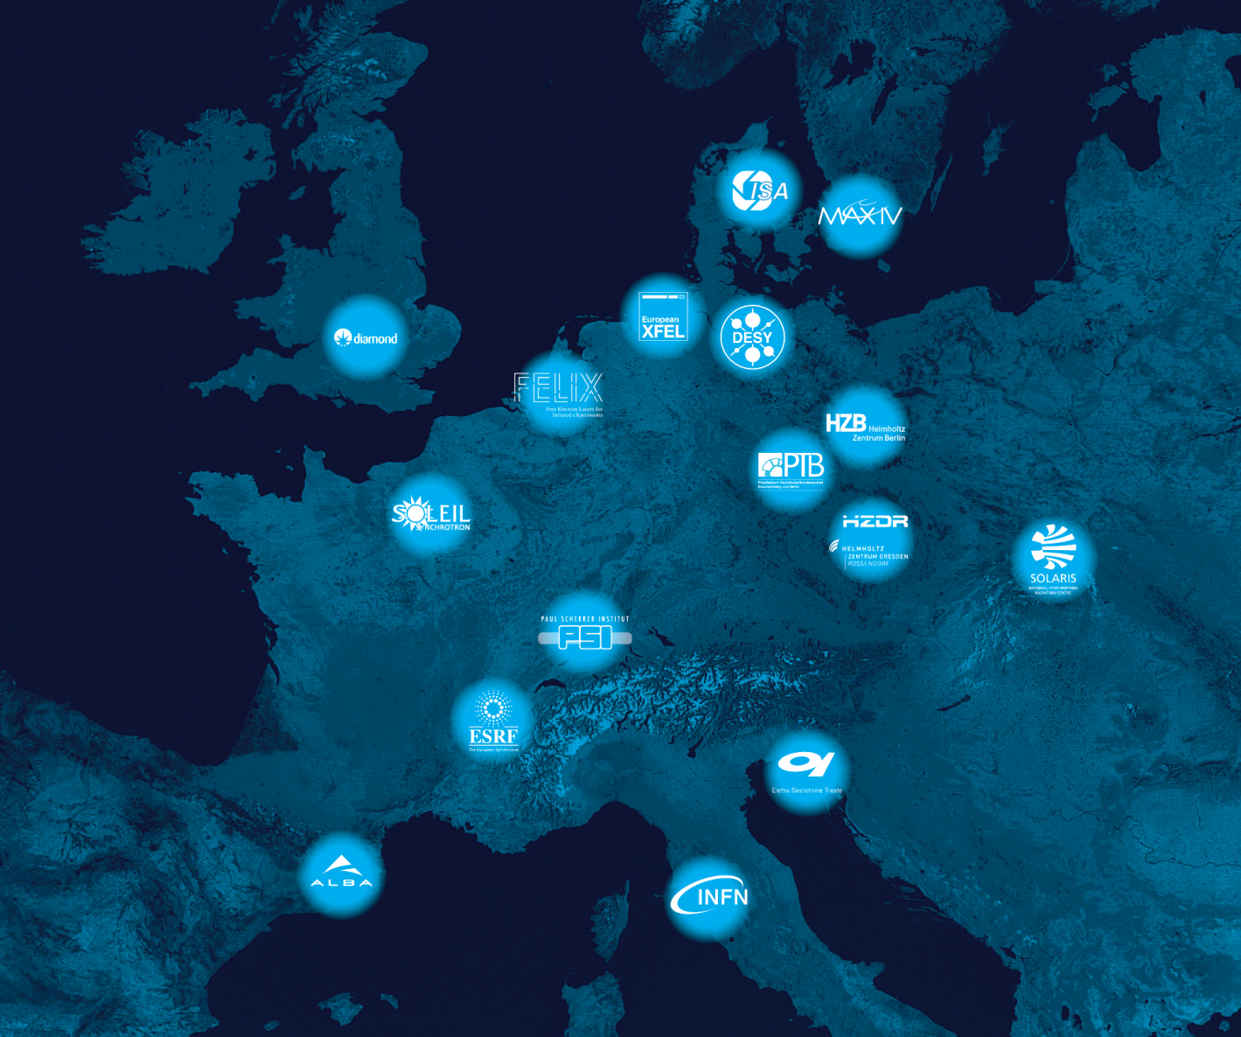

PerMaLIC
Institutions : 13
Participants : 35

Slide 4
Online seminars:
Permanent Magnets developments at STFC. Achievements and lessons learned. By Ben Shepherd - STFC – Daresbury, on December 3rd, 2021.
Permanent Magnet Longitudinal Variable Dipole: Design, Construction and Test. By Manuel Dominguez - CIEMAT – Madrid, on March 24th, 2022.
SIRIUS Superbend: Design, Construction, Instalation and Tests. By James Citadine - SIRIUS – Brazil, on June 9th, 2022.
Radiation Effects of Permanent Magnets. By Ben Shepherd - STFC – Daresbury, on March 31st. 2023.
Activities

Slide 5
Workshops:
1st PerMaLIC Workshop, September 22nd, 2021. Remote. https://indico.cells.es/event/623/.
2nd PerMaLIC Workshop, November 3rd-4th, 2022. ALBA. https://indico.cells.es/event/1229/.
Low Emmitance Ring – Permanent Magnets Workshop, November 14th-15th, 2023. Trieste. https://indico.cells.es/event/1373/.
  Organized together LEAPS and iFAST.
Activities

Slide 6

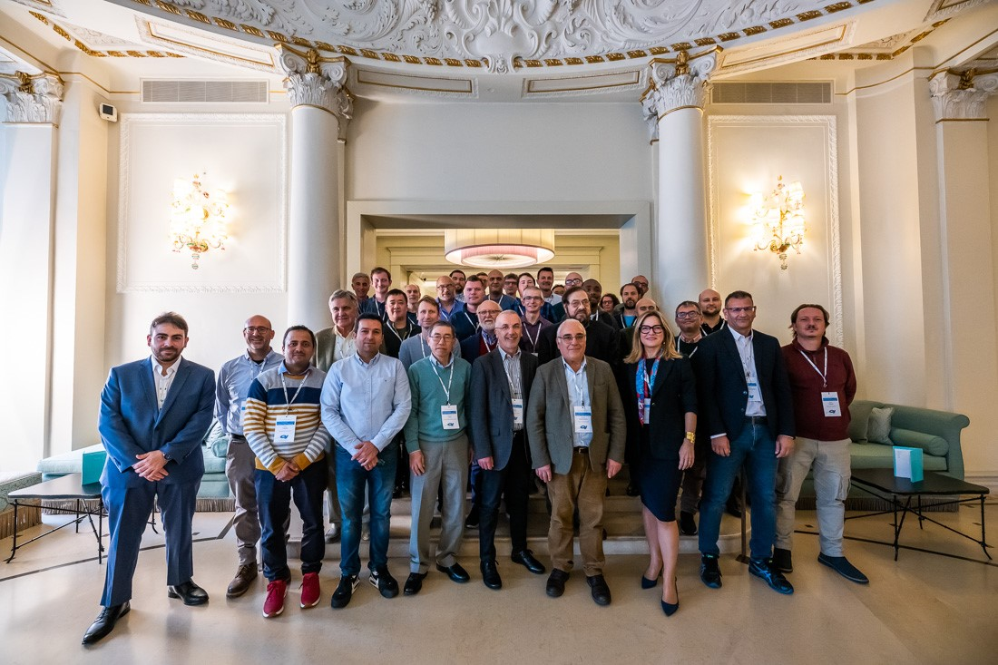
Activities
42 participants
20 institutions
5 companies
November 14th-15th, 2023. Trieste.

Slide 7
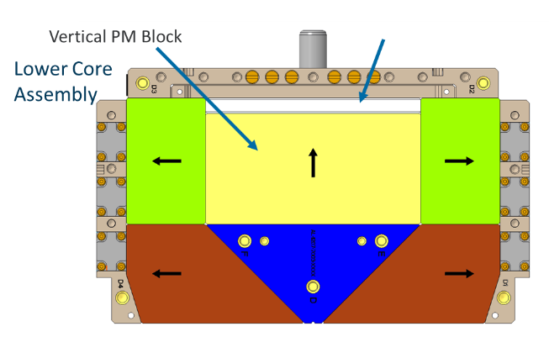
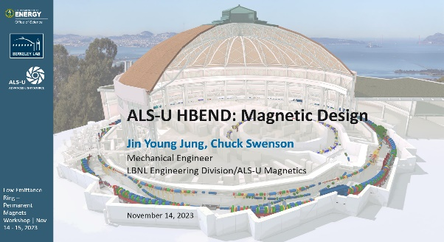
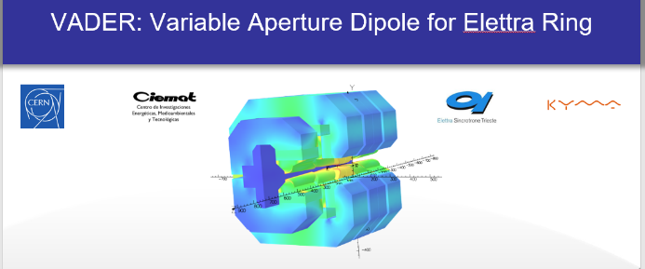
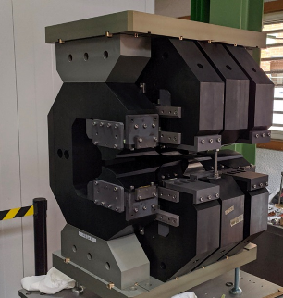
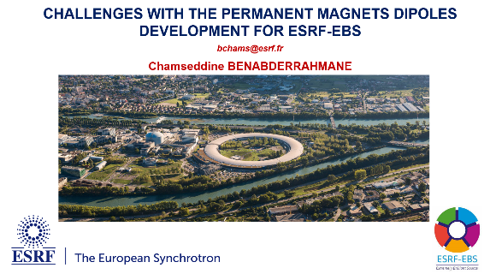
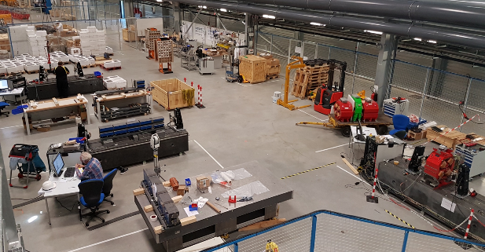

Activities
Sessions on:
Magnets design
Magnets prototyping
PM Technical challenges
Industry and Projects

Slide 8
PermaLIC activities are a success.
Active engagement of the participants in the intense discussions confirm that Permanent Magnets is a interesting topic.
PMs are being important to the current upgrade projects, as well as to future generation storage rings, for saving energy concerns.
Continue with remote seminars.
Continue with Permanent Magnet workshops.
  Proposed for Spring 2025
  After the successful workshop on November at ELETTRA, the intention is to organize it again together with iFAST. It is considered a very useful workshop by the participants, and there is a broad support to repeat it.
Proposals for activities

Slide 9
HarmonLIP
Workshops on Harmonic Cavity Systems at Fourth and Future Generation Storage Rings
HarmonLIP
HarmonLIP
Workshop Objectives
  To foster information exchange and joint research efforts amongst the LEAPS members for the further development of harmonic cavity/bunch lengthening systems for present and future ultralow emittance storage rings.
  Provide a forum for communications amongst various already existing multi-lab collaborations on the topic.

Slide 10
HarmonLIP
Workshops:
Acitivites
HarmonLIP 2022 Workshop, October 10-12, 2022. MAX IV. https://indico.maxiv.lu.se/event/5098/.
HarmonLIP 2024 Workshop, May 18-20, 2024. ESRF. https://indico.esrf.fr/event/122/overview.

Slide 11
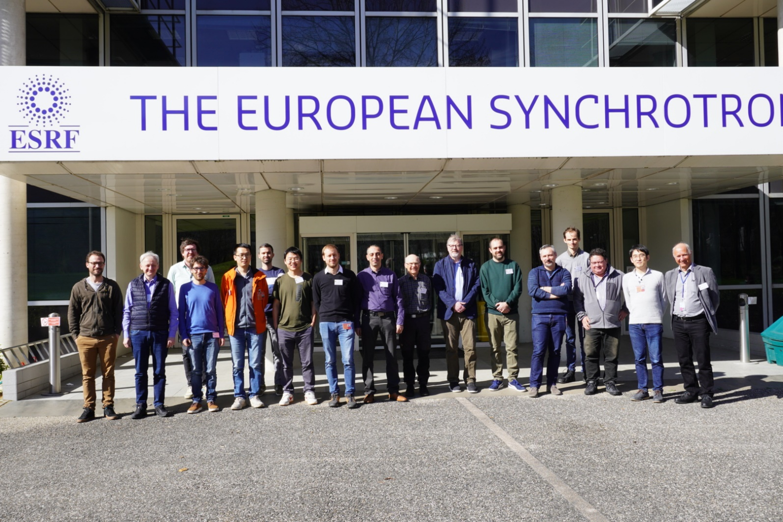
HarmonLIP
2024 Workshop:
Acitivites
54 registered
17 in person
15 institutions

Slide 12
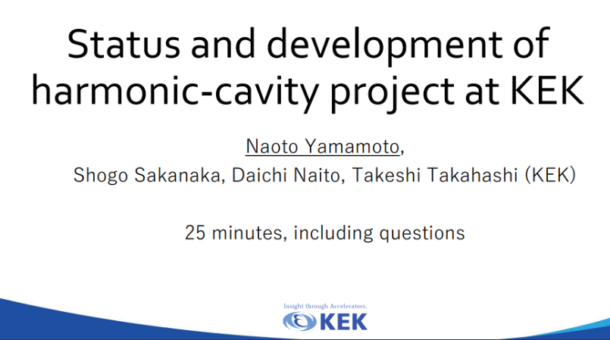
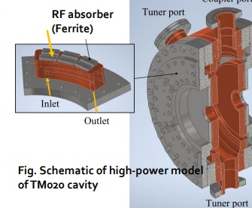
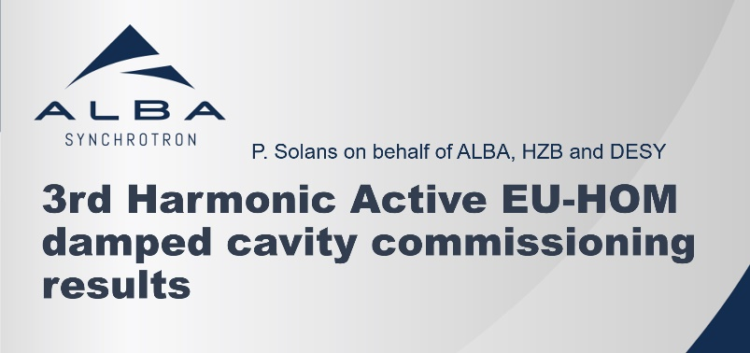
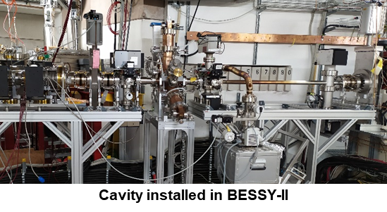
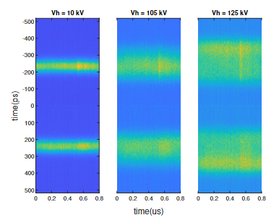
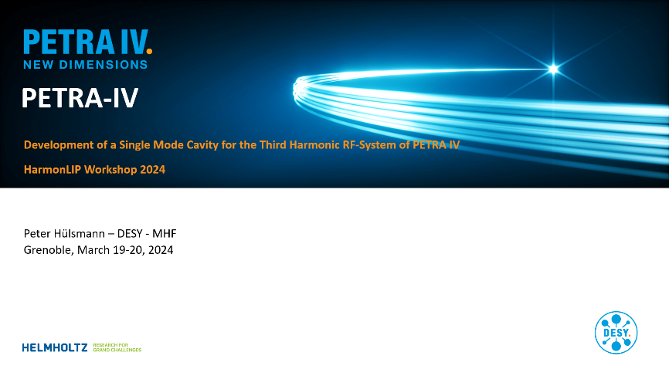
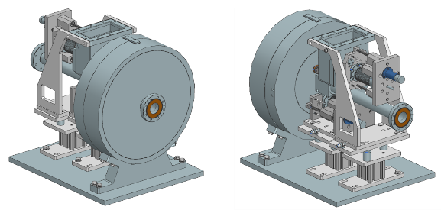
HarmonLIP
2024 Workshop:
Sessions on:
Project Overview
Beam Dynamics
Engineering R&D
Acitivites
TM020 type
Harmonic Cavity
DESY type
Shintake Cavity
Prototype

Slide 13
HarmonLIP
HarmonLIP 2022 & 2024 were a success.
The active engagement of the participants in the intense discussions confirm that Harmonic Cavity Systems is indeed a very hot topic, crucial to the current upgrade projects as well as to future generation storage rings.
The HarmonLIP community wishes the project to be continued.
The next proposed event is HarmonLIP 2025, to be help in autunm 2025, at ALBA.
Proposal for activities

Slide 14

HarmonLIP
Conclusions
Both collaborations are active and very useful to the community.
Both will greatly benefit by a continuation of the finantial support by LEAPS.

Slide 15
HarmonLIP
Thanks!

