Slide 1
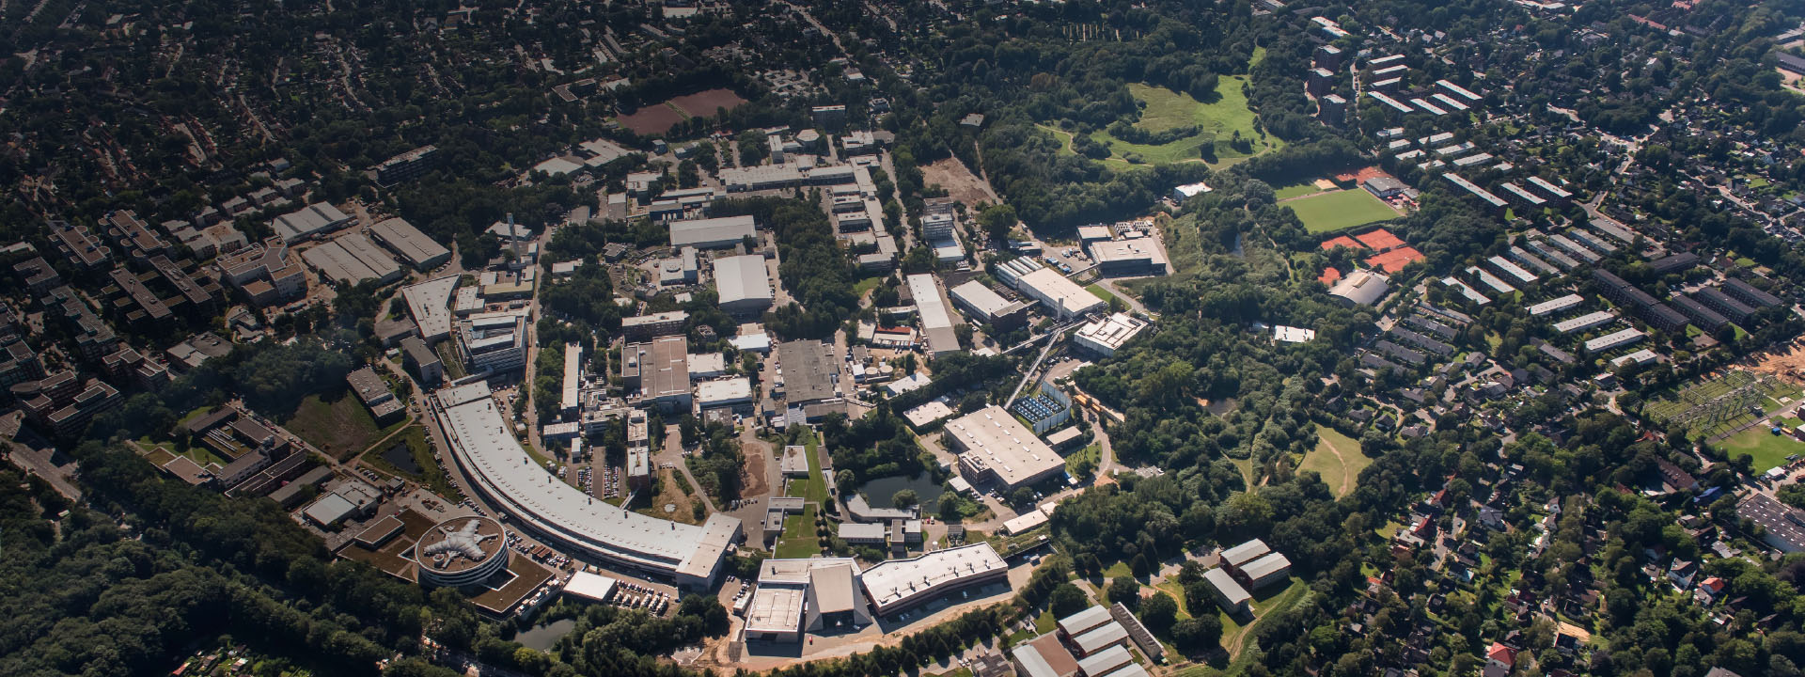
Collaboration between DESY and CERN on Androids
Extension to LEAPS
Rainer Wanzenberg
7th LEAPS Annual Meeting 2024
October 23 – 25, 2024
HFML-FELIX, Radboud University Campus, Nijmegen.
https://indico.psi.ch/event/16717/

Slide 2
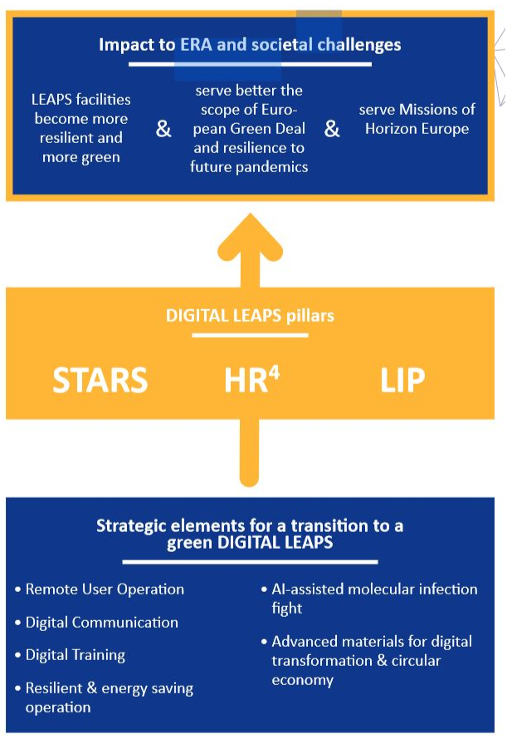
Digital LEAPS
In 2021 WG2 has identified several topics /work packages in the framework of the Digital LEAPS initiative
LEAPS Integrated Platform
facility independent interface system to access and operate
our facilities
Scientific Computing
Machine Learning (ML)
Virtual Diagnostic (VD)
Androids for Remote Access (ARA)
WP6: Remote Training (RT)
Working Group 2: Photon Sources
https://www.leaps-initiative.eu/digital-leaps/
Notes:
PIA bypass is under development, but not an reliable alternative:
Currently not operational: too long pulses from Gun fills several 2 ns buckets around main bunch in PETRA
Not able to reach nominal beam current: limited feedback bandwidth and slow filling
Issue for experiments
Gun delivering shorter pulses is under development

Slide 3
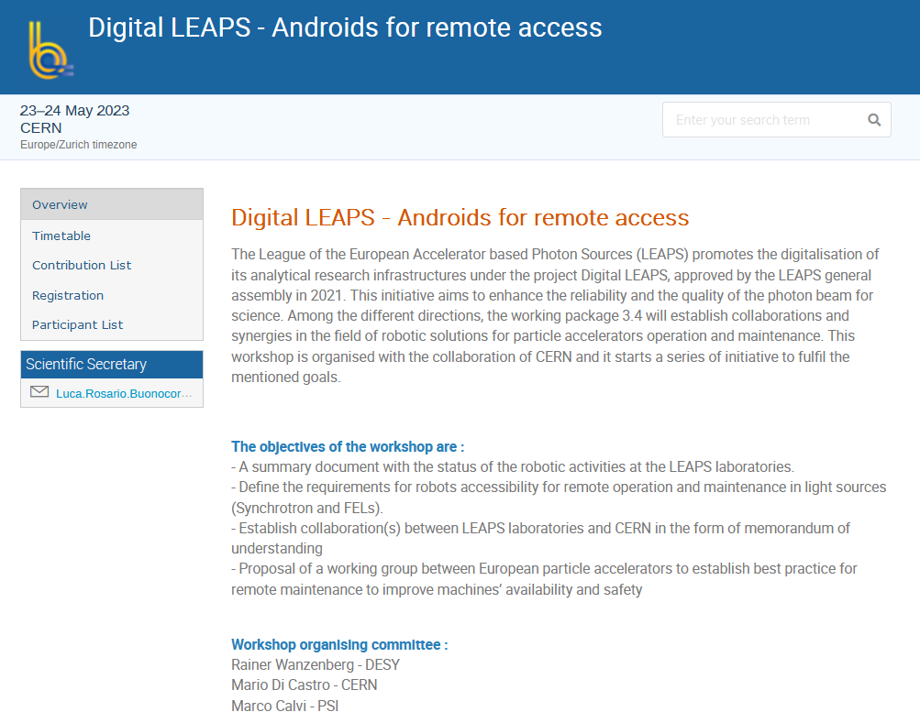
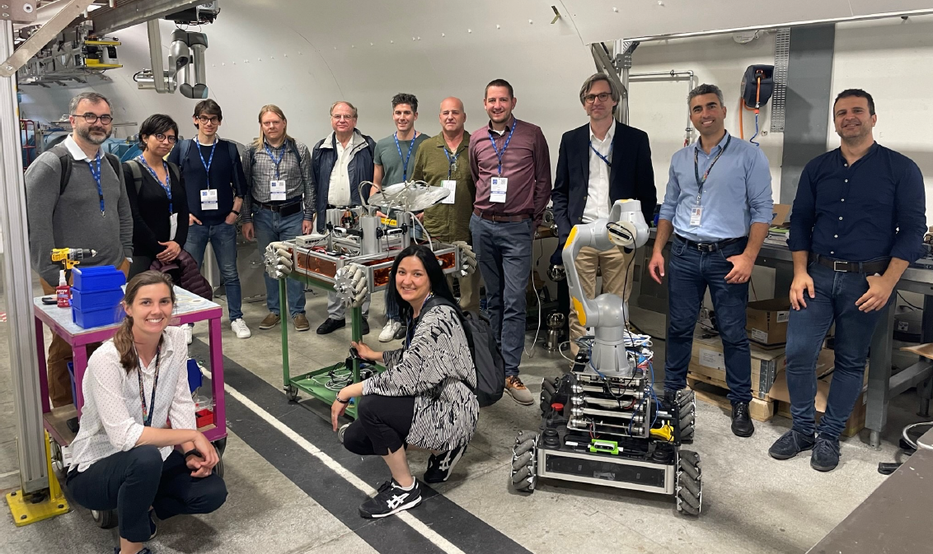
Androids for remote access
CERN workshop, May 23/24, 2023
Agenda:
Presentations about activities
at CERN, DESY, ELETTRA, EUXFEL,
INFN Legnaro, MAX IV, PSI, SOLEIL
and
CERN Lab Visit
https://indico.psi.ch/event/14358/
Notes:
PIA bypass is under development, but not an reliable alternative:
Currently not operational: too long pulses from Gun fills several 2 ns buckets around main bunch in PETRA
Not able to reach nominal beam current: limited feedback bandwidth and slow filling
Issue for experiments
Gun delivering shorter pulses is under development

Slide 4


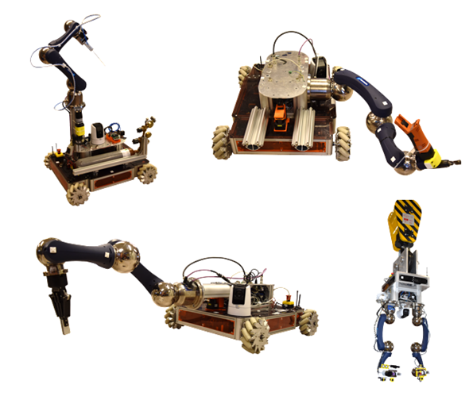
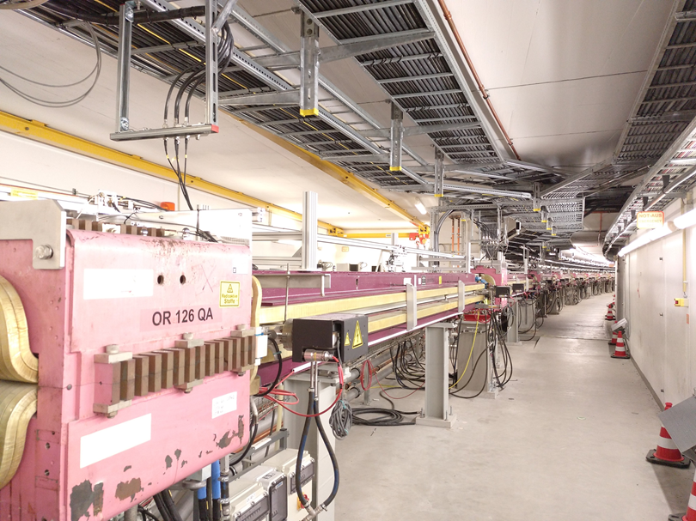
Collaboration between DESY and CERN on Androids
Spin off of the workshop at CERN
The Controls Electronics & Mechatronics group
develops and maintains a centralized competence in controls hardware custom design, low-level software & infrastructure support, electronic development/production & radiation tolerance, mechatronics & robotics, tests and measurement systems.
Strong interests for Androids for remote access at PETRA III; possible tasks
General inspection tours using various interchangeable sensors, e.g. 3D optical camera, thermal camera, radiation detector
Maintenance and repair tasks of electronics, e.g. visually monitoring status LEDs of electronic board
Maintenance of water pipes, leak detection
Notes:
PIA bypass is under development, but not an reliable alternative:
Currently not operational: too long pulses from Gun fills several 2 ns buckets around main bunch in PETRA
Not able to reach nominal beam current: limited feedback bandwidth and slow filling
Issue for experiments
Gun delivering shorter pulses is under development

Slide 5
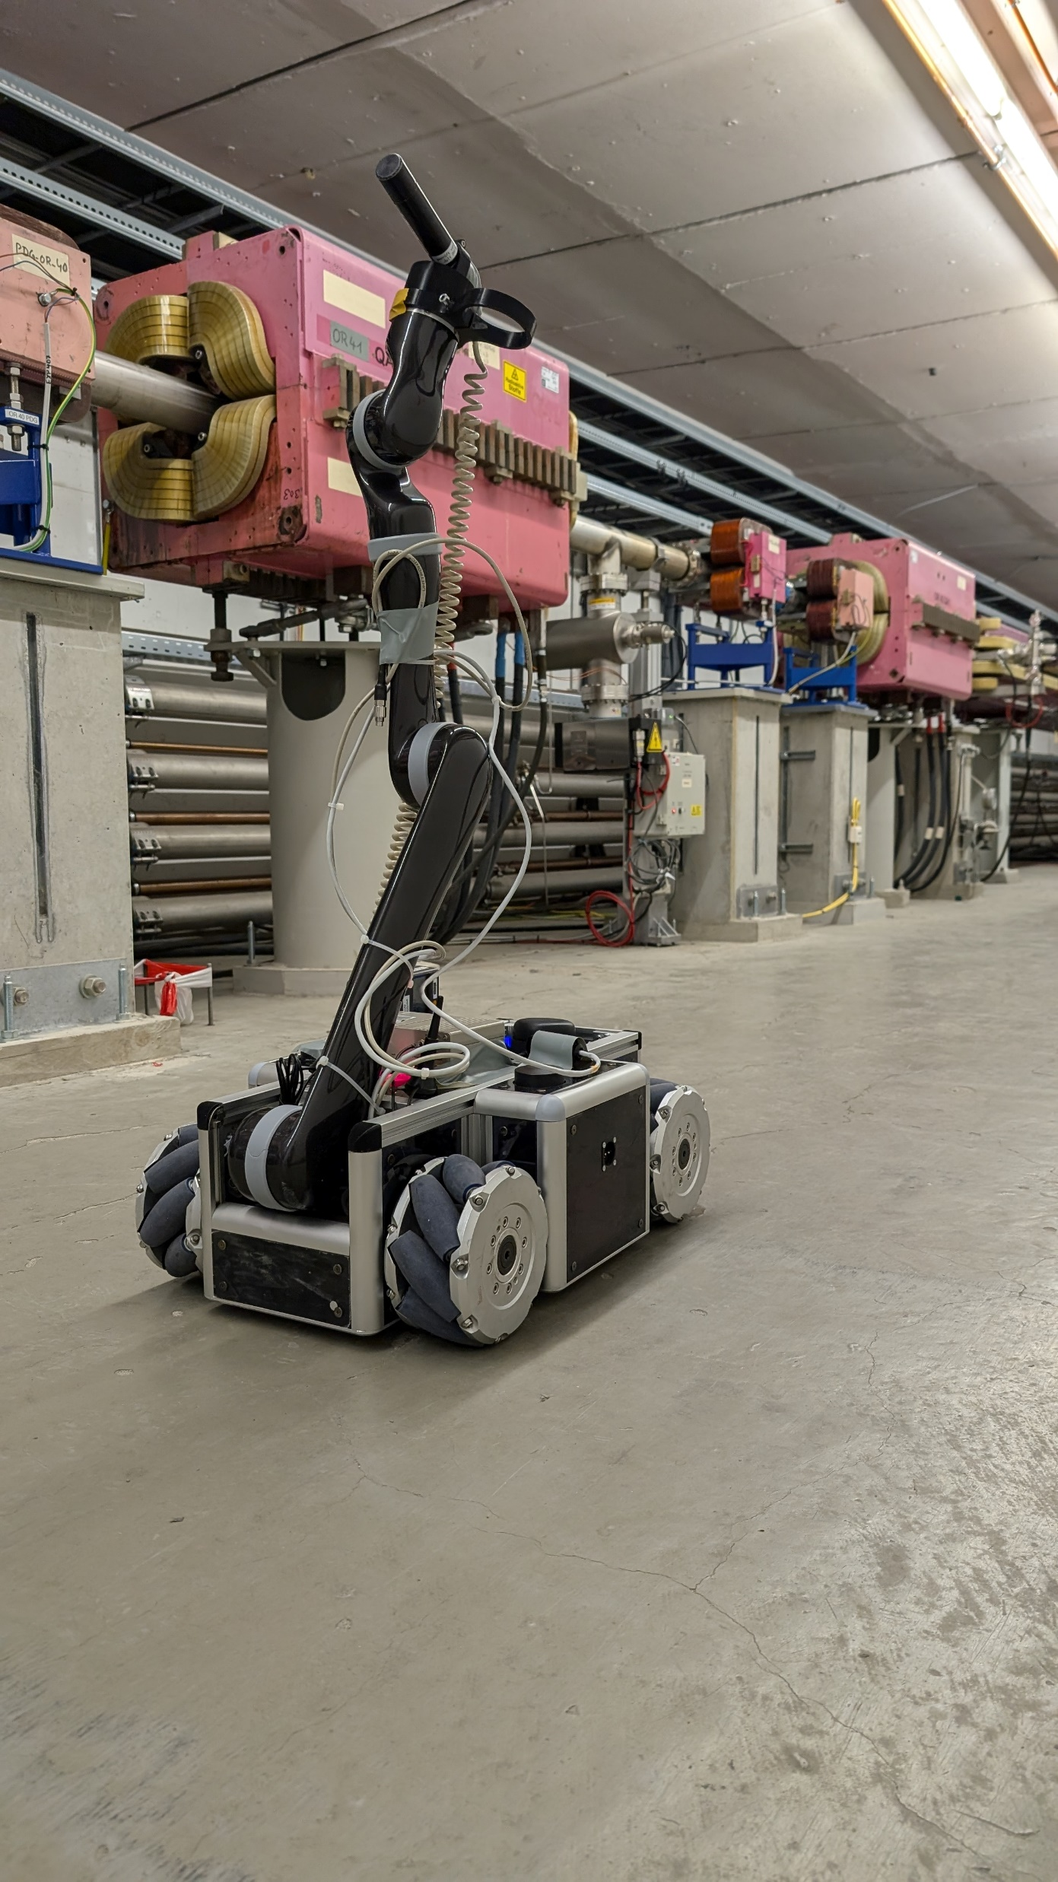
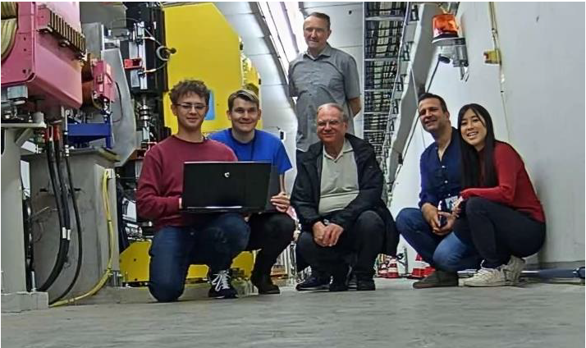
First test of the MIRA robot at DESY was a success
The test took place in 01-03 July 2024
MIRA robot
The team seen through the camera of the robot
Luca Buonocore, David Forkel, Konrad Chrostowski (CERN)
Andreas Labudda, Ke Li, R.W. (DESY)
Notes:
PIA bypass is under development, but not an reliable alternative:
Currently not operational: too long pulses from Gun fills several 2 ns buckets around main bunch in PETRA
Not able to reach nominal beam current: limited feedback bandwidth and slow filling
Issue for experiments
Gun delivering shorter pulses is under development

Slide 6
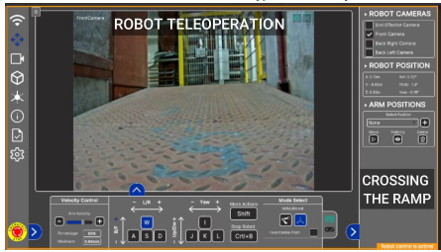
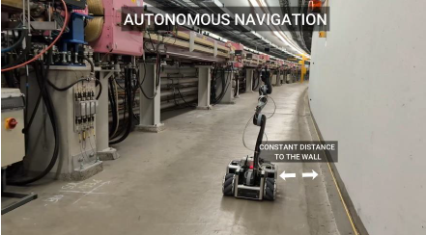
Objectives of the Android Test in the PETRA III tunnel
The study in the PETRA III was the first step for a further collaboration
Teleoperation of the MIRA robot
Autopilot testing of the MIRA robot
Network infrastructure assessment
in the PETRA III tunnel
Evaluation and future work
Notes:
PIA bypass is under development, but not an reliable alternative:
Currently not operational: too long pulses from Gun fills several 2 ns buckets around main bunch in PETRA
Not able to reach nominal beam current: limited feedback bandwidth and slow filling
Issue for experiments
Gun delivering shorter pulses is under development

Slide 7

Teleoperation and Autopilot testing of the MIRA robot
The movie
Notes:
PIA bypass is under development, but not an reliable alternative:
Currently not operational: too long pulses from Gun fills several 2 ns buckets around main bunch in PETRA
Not able to reach nominal beam current: limited feedback bandwidth and slow filling
Issue for experiments
Gun delivering shorter pulses is under development

Slide 8
General challenges for the CERN – DESY collaboration
We successfully mastered many little obstacles
Shipping of sensitive equipment
  Packing of components
  Impact indicators
  Custom rules
  Communication with shipping departments
  Onside transport of the equipment
Safety trainings for collaborators
  General safety
  Radiation safety in an accelerator tunnel
  IT safety / network access
Network Configuration & Testing
  WLAN in the accelerator tunnel
  Availability of a 5G net
  Compatability of the robot with the
  local WLAN requirements
Radiation Sensor was damaged during transport,
A Geiger counter was provided by DESY as a
replacement and mounted on the robot.
All trainings could be finished in time. Nevertheless,
some improvements in the procedures are desireable.
It was not possible to integrate the robot into the DESY office/controls Network. But 3 CERN Teltonika Wifi routers were prepared and place in PETRA III at intervals within their signal range.
The public 5G network of several providers extends into the tunnel due to its proximity to the surface. But DESY is presently not working with 5G networks in the tunnel.
Notes:
PIA bypass is under development, but not an reliable alternative:
Currently not operational: too long pulses from Gun fills several 2 ns buckets around main bunch in PETRA
Not able to reach nominal beam current: limited feedback bandwidth and slow filling
Issue for experiments
Gun delivering shorter pulses is under development

Slide 9
Achievements during the test in July 2024
All objectives could be explored
Teleoperation of the MIRA robot,
  finally worked with a local WLAN
  Integration into the office/controls network was not yet achieved
Autopilot testing of the MIRA robot
  Successful, robot move along the tunnel wall
Network infrastructure assessment in the PETRA III tunnel
  Public 5G network is available in most of the tunnel
  DESY has not yet used 5G Networks
Evaluation and future work
  The successful teleoperation and the autopilot test of MIRA3 robot demonstrates that the
  robotic hardware and software developed at CERN can also be used in other similar
  tunnel scenarios and semi-structure environments
  Improvement of the PETRA III net work infrastructure is needed
  Remote operation of fire doors will be required to enable the robot access to the full tunnel
Notes:
PIA bypass is under development, but not an reliable alternative:
Currently not operational: too long pulses from Gun fills several 2 ns buckets around main bunch in PETRA
Not able to reach nominal beam current: limited feedback bandwidth and slow filling
Issue for experiments
Gun delivering shorter pulses is under development

Slide 10

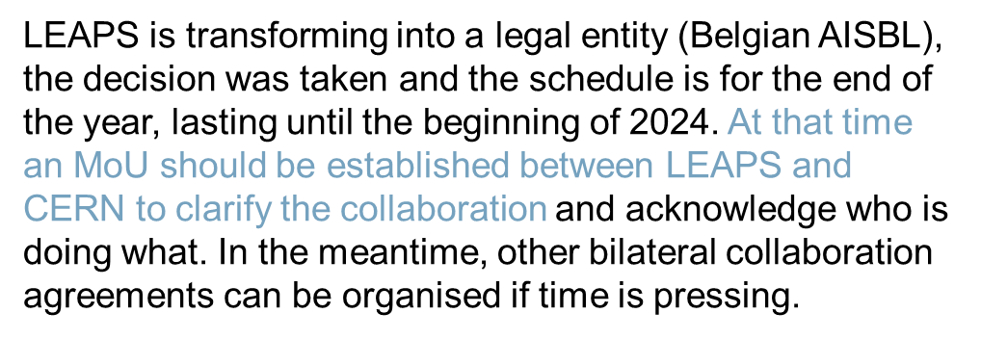
Digital LEAPS and CERN
Androids for Remote Access (ARA)
The Inputs from CERN are very precious, they have a large experience in highly activated environments which could be transferred to our facilities to run robots in the accelerator bunker during its operation. Moreover, CERN is a strategic partner also considering the new eligibility criteria of some EU call (like for instance the next INFRATEC-2024 and -2025).
LEAPS is organising a proposal for infratech 2024 and a third for infratech 2025. We will suggest considering the activity “androids for remote access” in the infratech 2025.
Notes:
PIA bypass is under development, but not an reliable alternative:
Currently not operational: too long pulses from Gun fills several 2 ns buckets around main bunch in PETRA
Not able to reach nominal beam current: limited feedback bandwidth and slow filling
Issue for experiments
Gun delivering shorter pulses is under development

Slide 11
Proposal for an MoU between LEAPS and CERN
LEAPS member could join via appendices
MoU between LEAPS and CERN
Framework agreement
Scope: areas of activities
Implementation through appendices
Intellectual property
…
Publications
Exchange and status personnel
…
LEAPS members
Appendix
Scope of the Specific Cooperation
  The objective of the specific cooperation is to conduct robots assisted studies at LEAPS member laboratory
  CERN is planning to use robots for inspection, environmental measurements, in-situ maintenance and early intervention in the FCC tunnel and is interested to test existing robots in different accelerator environments.
Contributions of the Parties
  CERN will provide …
  LEAPS member laboratory will provide …
Notes:
PIA bypass is under development, but not an reliable alternative:
Currently not operational: too long pulses from Gun fills several 2 ns buckets around main bunch in PETRA
Not able to reach nominal beam current: limited feedback bandwidth and slow filling
Issue for experiments
Gun delivering shorter pulses is under development

Slide 12
Rainer Wanzenberg
MPE
Rainer.wanzenberg@desy.de
++49 40 8998 2496

