Slide 1
Workshop Overview
Longitudinal Electron beam Dynamics for Coherent Light Sources
Thomas Geoffrey Lucas (Workshop Chair), Rasmus Ischebeck, Paolo Craievich (PSI), and Simone Di Mitri (Elettra Sincrotrone Trieste)

Slide 2
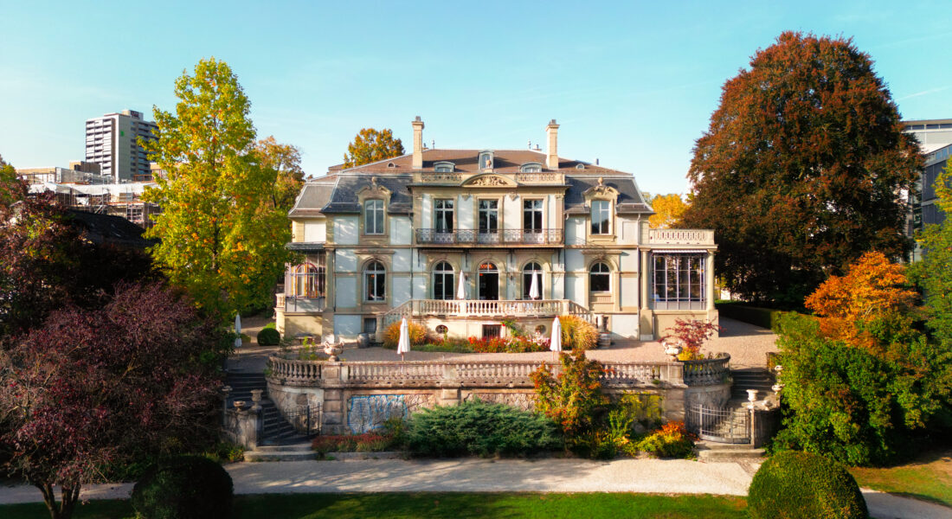
Overview
Location: Haus der Universität, Bern, Switzerland.
Dates: 17th-20th September
Scope: Workshop discussing high brightness beams in linear and circular electron accelerators, primarily focusing on light sources. Sessions focused on certain phenomena that limit the beam brightness or may be used to improve it through special operational modes.
Website: https://indico.psi.ch/event/15973/
Venue for the Workshop.

Slide 3
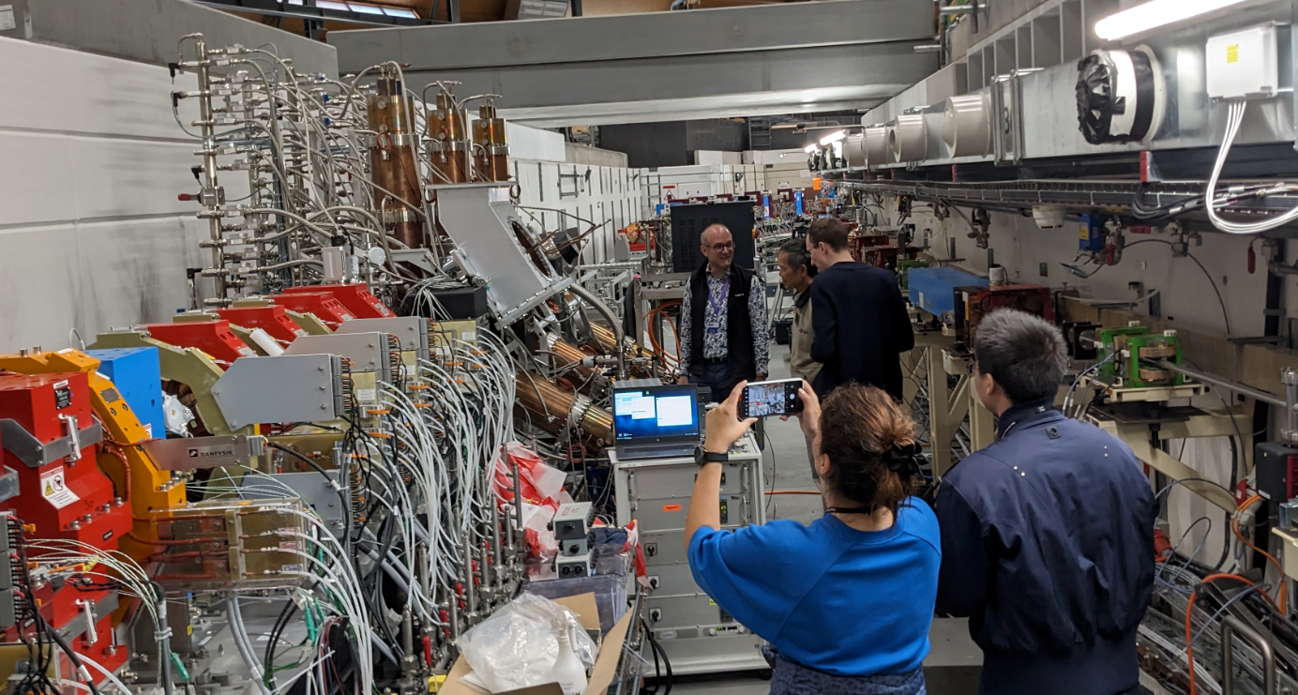
Facility Visit and Social Activities
Facility visits at the Paul Scherrer Institut:
  HIPA Proton Source
  WLHA electron source test stand
  SLS 2.0 Ring
Events during workshop:
  Dinner on the Aare River
  Visit to Einstein Museum
  BBQ on the Aare.

Slide 4
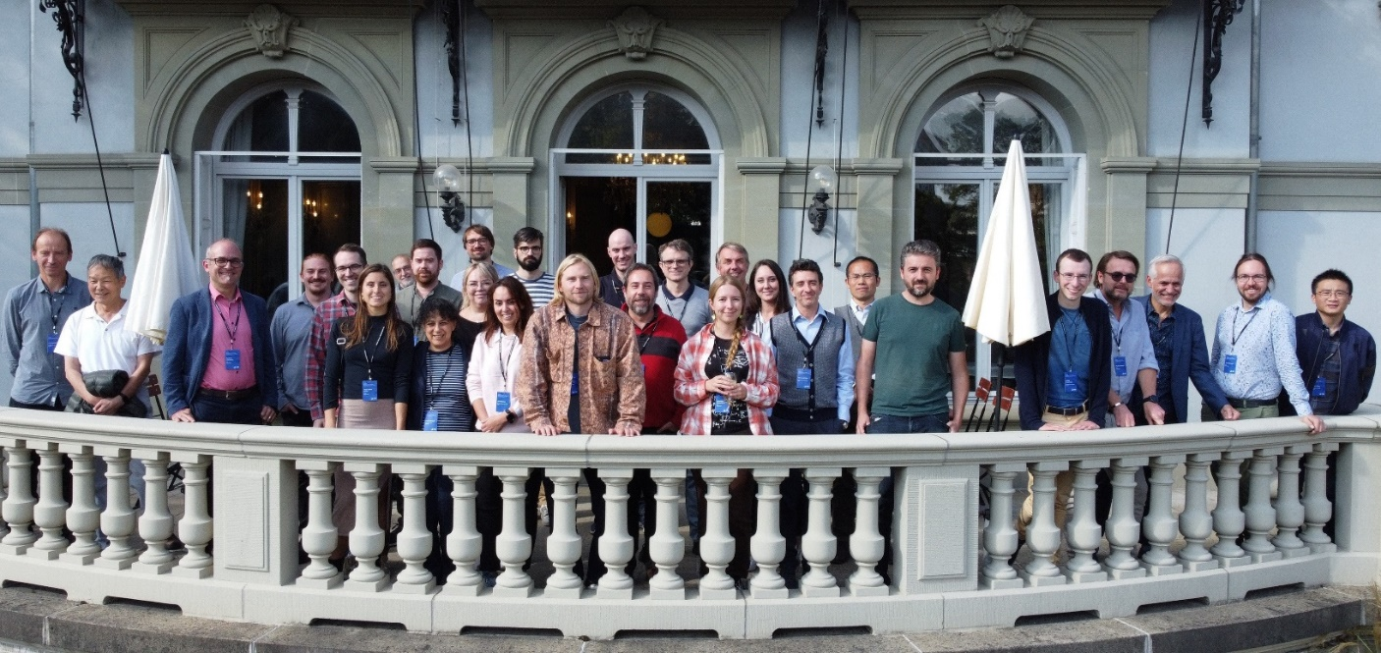
Participants and Collaborations built
33 participants from a total of 8 different countries, including Switzerland, Germany, China, Italy, US, France, Japan, Sweden.
Discussion time that has led to future collaborations:
  PSI and CERN on IBS calculations
  Elettra and CERN on IBS modelling
  Supportive action by some Institutions to a Swiss call for funds, to build and characterize (with beam!) an innovative TW S-band Gun test facility.

Slide 5
Conclusions and Outlook
Longitudinal e-beam dynamics and manipulation is highly relevant to remove show-stoppers for full coherence in soft X-rays, e.g., seeded FELs.
Additional benchmarking of modelling and measurements, both at low and high energy, and for relatively complex transport lines in the presence of microbunching instability, are required to boost the accuracy of control and prediction of e-beam parameters as required by new FEL schemes and specifications.
New numerical and experimental data are expected to be collected in < 2 years from now, at different linac facilities.
SSMB studies, both numerical and experimental (MLS, Berlin), have confirmed coherent emission, but at micron scale, and on a few-turn basis only, at this stage. Next phases require a dedicated facility.
A «LEDS» mailing exists, and will be used in the following months to update the LEDS participants about new initiatives, scientific activities, results.

