Slide 1


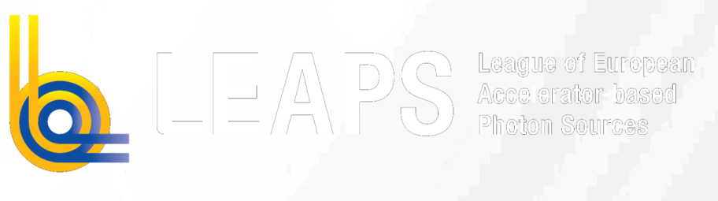

LEAPS-INNOV
WG2 Kick-off Meeting
WP6 „LIDs“ Status Report
23.10.2024
S. Di Mitri (Elettra) on behalf of WP6
This project has received funding from the European Union´s Horizon 2020 research and innovation programme under grant agreement No. 101004728

Slide 2
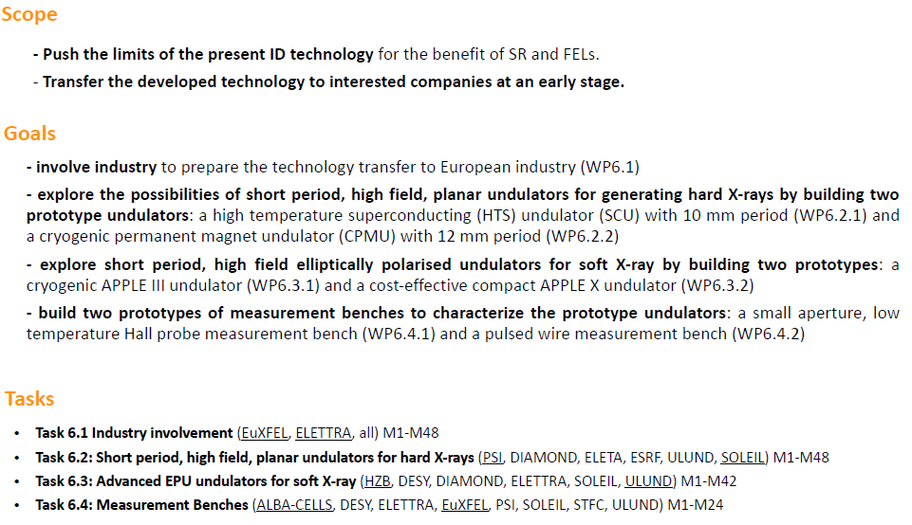
Overview
WP6
Introduction

Slide 3
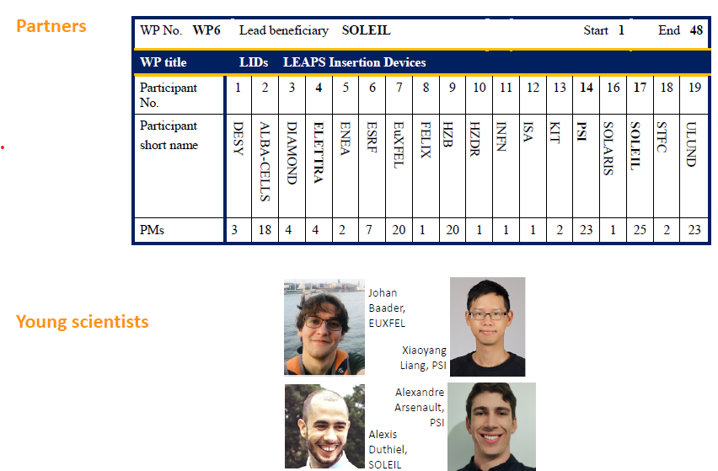
Beneficiaries
(over the last 4 years)

Slide 4
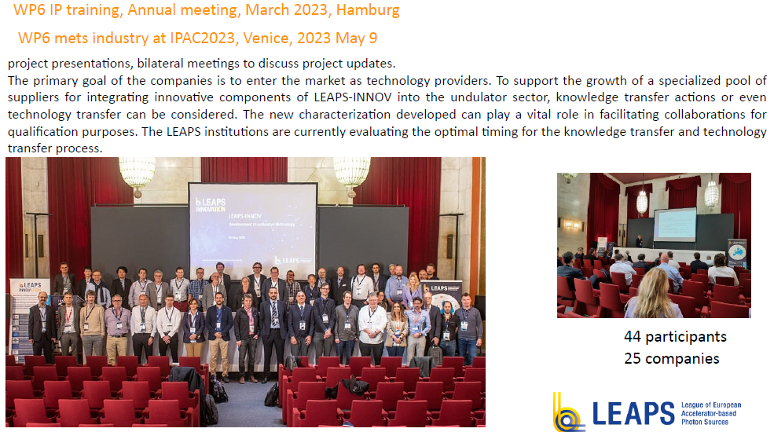
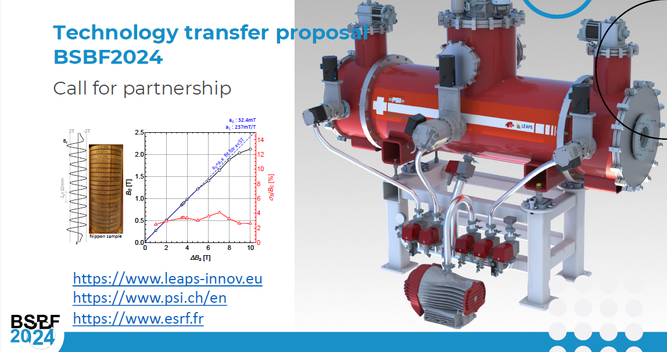
Industry involvement – ref. A. Bonucci (EU-XFEL) & M. Peloi (Elettra)
WP6
Task 6.1

Slide 5
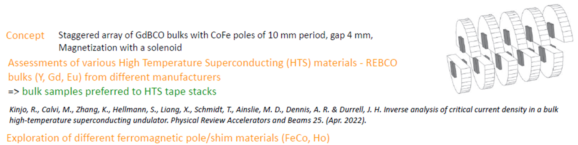
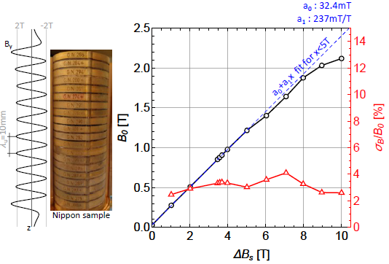
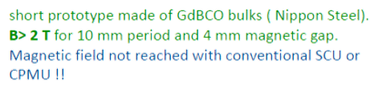
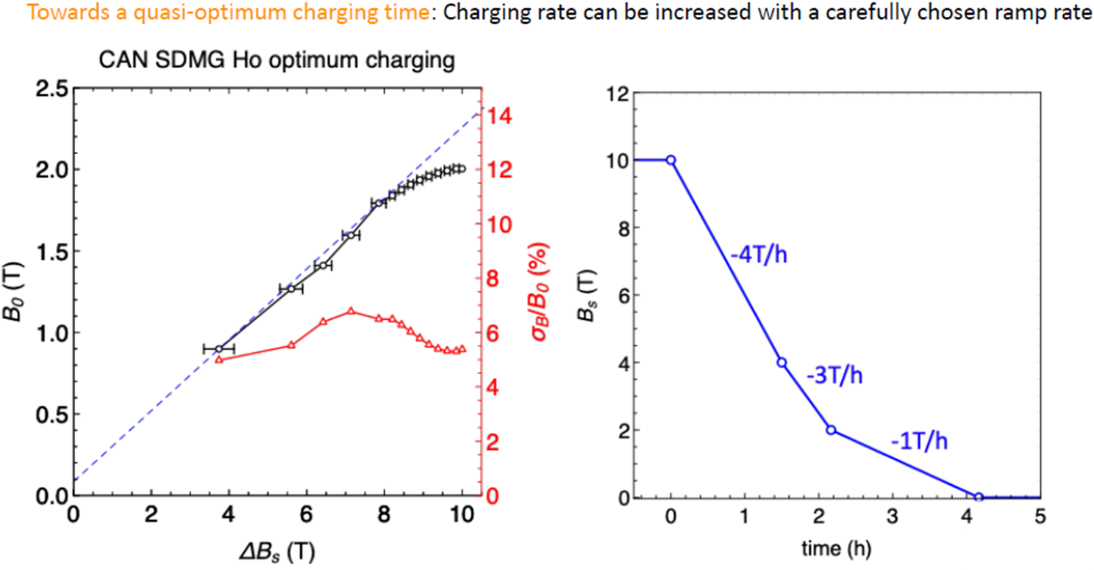
HTSU – ref. Marco Calvi (PSI)
WP6
Task 6.2
Short period high field planar undulator

Slide 6
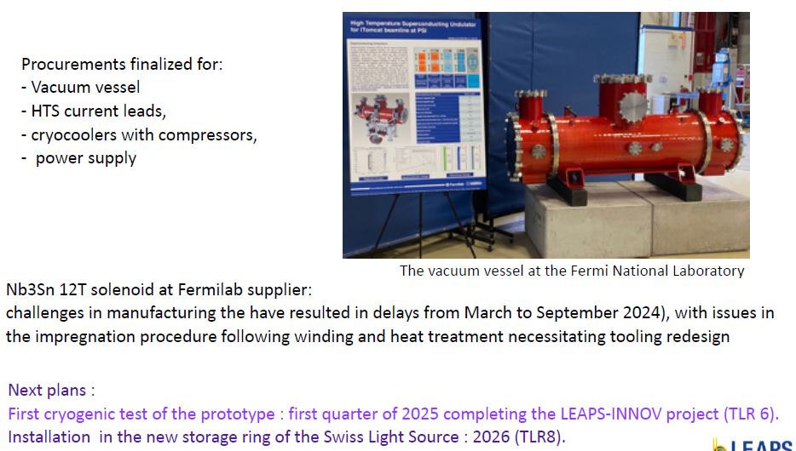
Procurements and plan to finalization

Slide 7


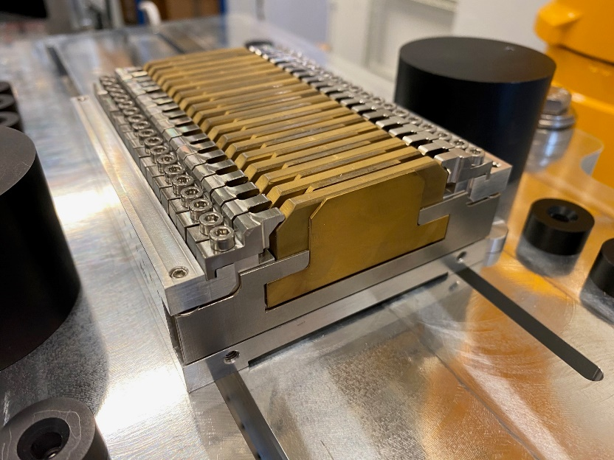
Delivery of parts
WP6
Task 6.2
CPMU – ref. Mathieu Valleau (SOLEIL)
Magnets and poles delivered on July 2024 (2 month delayed due to magnets exceeding tolerances)
Girders have been machined, drilled and LN2 connections have been soldered (1month delayed due to a leakage under pressure)
All the mechanical pieces for the supermodules
assembly have been received on time by mid-July
The carriage is aligned on the measurement bench
All the pieces have been cleaned for UHV compatibility
Short period high field planar undulator

Slide 8
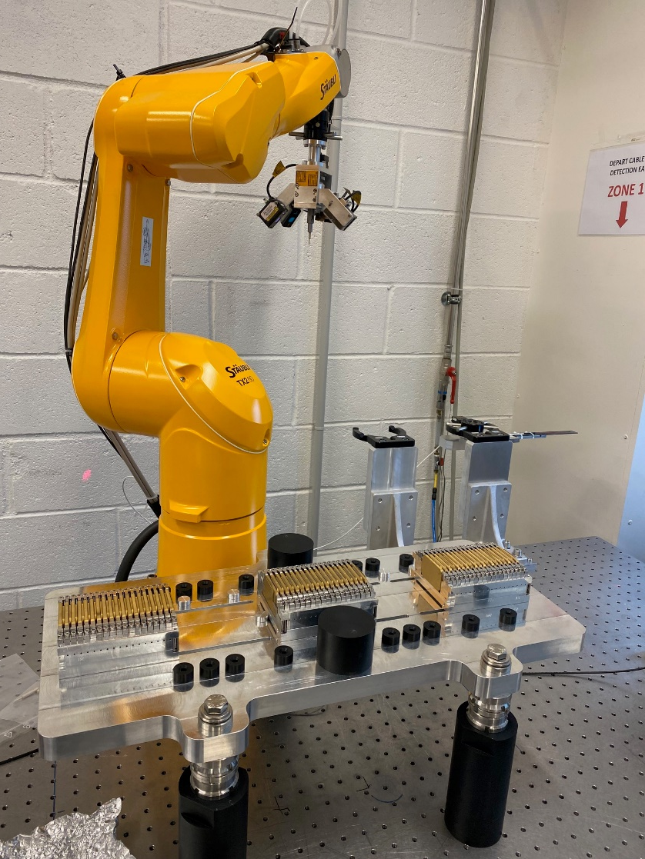
Prototype assembly
Magnets have been measured on :
  Helmholtz coil bench
  Field mapper
  Rotating coil bench
4 Supermodules have been assembled
(21 remaining)
The bench for the robotic arm is operational
Robotic application for the supermodule optimisation
in automatic mode is nearly finalized

Slide 9
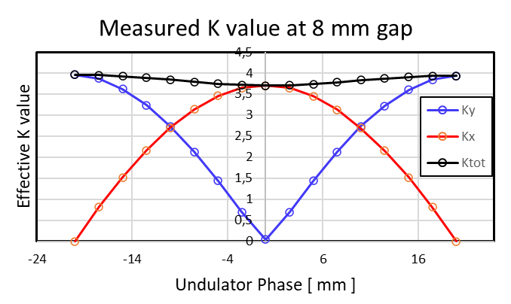
Compact APPLE X Undulator – ref. Hamed Tarawneh (MAX IV)
WP6
Task 6.3
Compact low cost undulator based on APPLE concept ensuring full polarization control.
The project scope ranges from simulation and design (mechanical, electrical, control) via documentation, production & procurement to assembly and testing of a full-scale 2-meter-long undulator in MAX IV.
Procurements of undulator parts started in Q1, 2022.
Undulator assembly and tuning started in July 2023. ´Magnetic measurement and characterization finished in March 2024.
Main findings;
Photon energy range has been fulfilled as specified for all polarization modes of operation.
Cost-effective solution for mass production. Up to 44% reduction in material cost in comparison to the APPLE II undulator built at MAX IV.
Magnetic-mechanical shimming and tuning in circular mode could be the best compromise, magnetic force direction, and distribution (lateral slit).
Advanced EPU

Slide 10
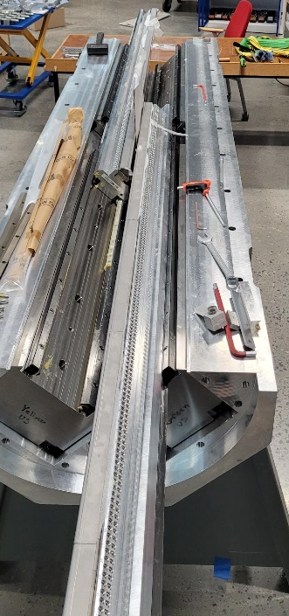
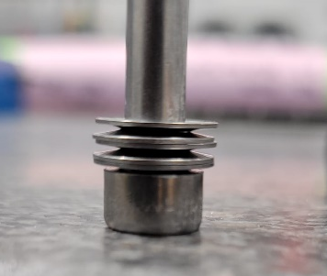
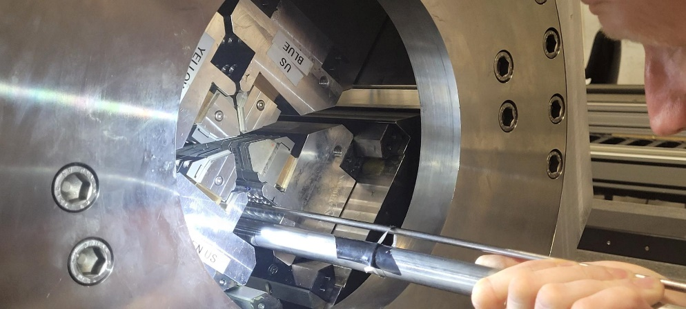
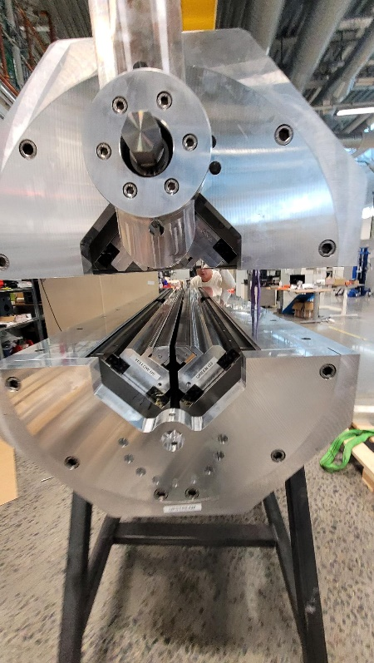
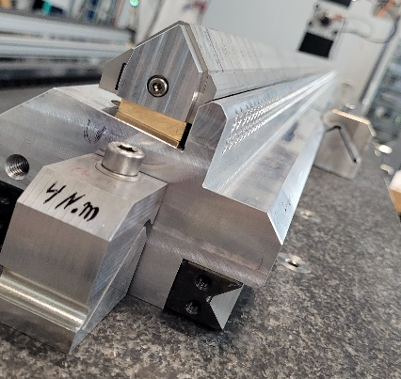
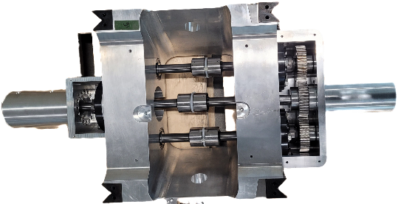
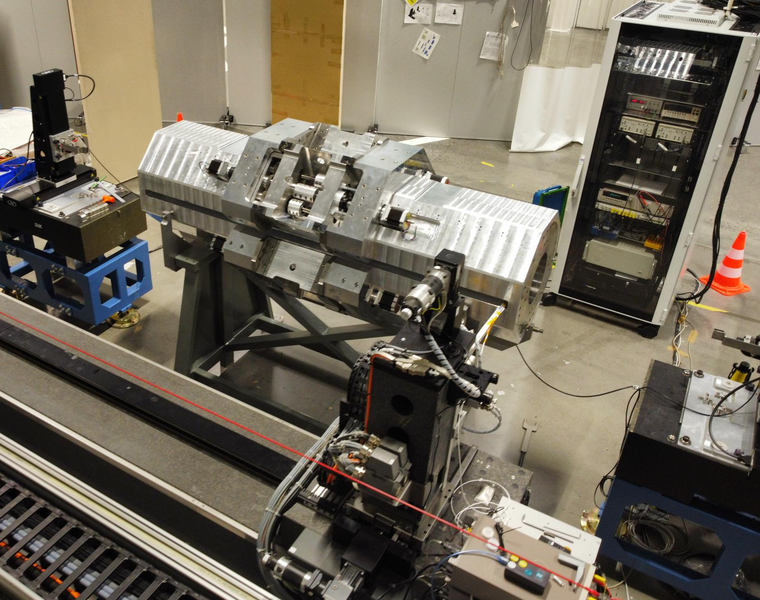
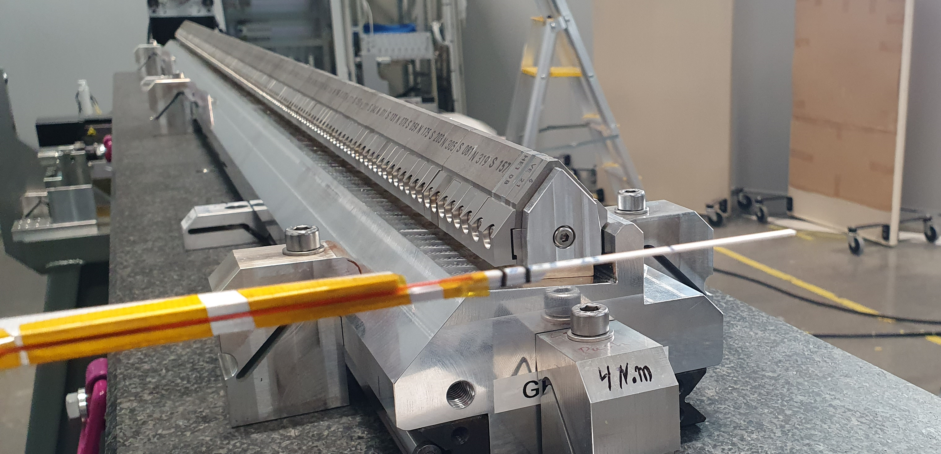
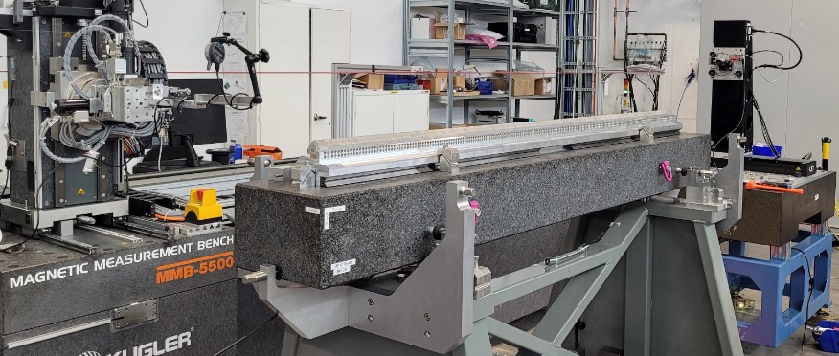
APPLE X Prototype Assembly &
Characterisation
Two
Girders
Into
Half
strongback
Shimming magnet
blocks
Assembly of two halves
Spring to hold magnet keeper
One girder aligned at stone
Prototype during magnetic measurement in magnet lab
Motion
Unit
assembly
Magnetic tuning of single girder with Hall probe
Alignment of single girder

Slide 11
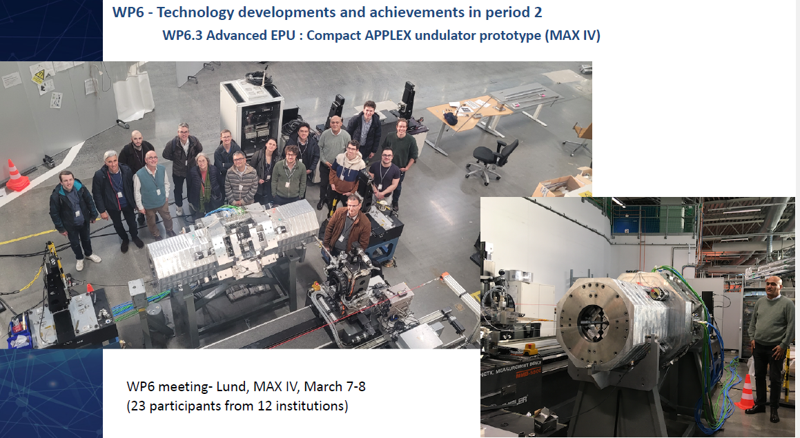

Slide 12
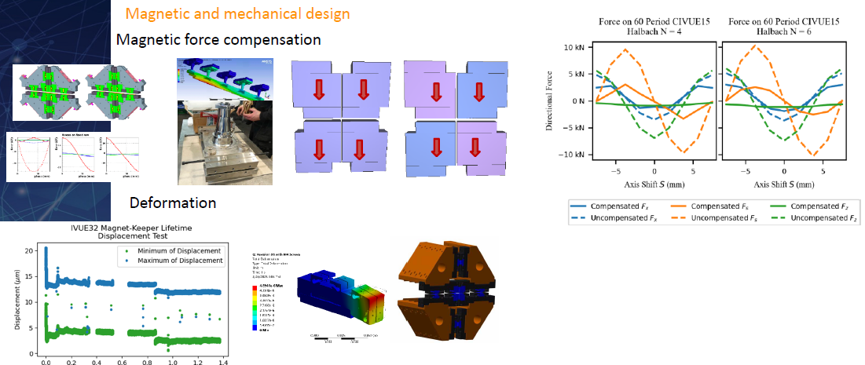
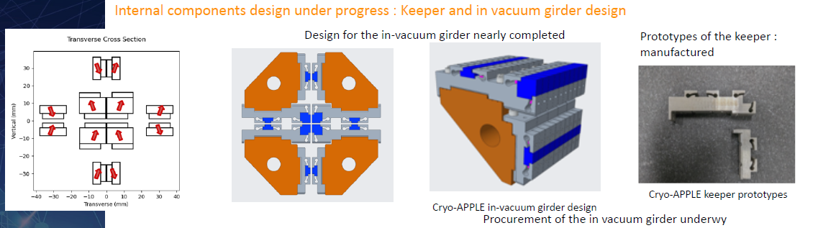
WP6.3 Advanced EPU : Cryogenic APPLE III – ref. Ed Rial (HZB)
WP6
Task 6.3
Advanced EPU

Slide 13
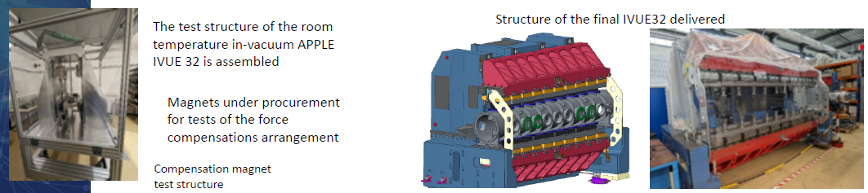
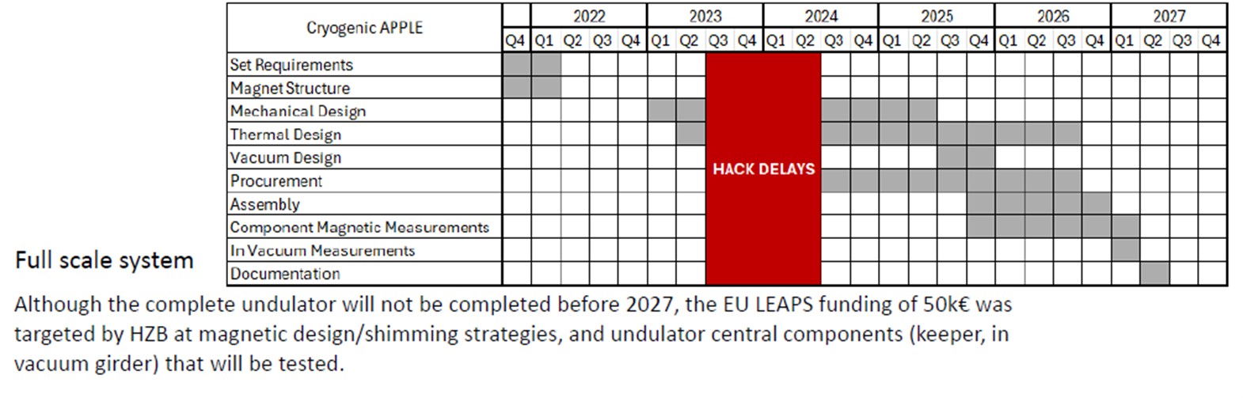

Slide 14
Small aperture Hall probe – ref. Jordi Marcos Ruzafa (ALBA)
WP6
Task 6.4
Project status:
All the material for the adaptation was received by Feb’24.
However, it was decided to put its implementation on-hold until a suitable test structure is available.
The design of the test structure is almost finished, but it has not been possible to proceed with the procurement of parts due to the lack of engineering resources to prepare the manufacturing drawings. We hope to do so before the end of 2024.
The assembly of the final system will be determined by those items of the test structure with the longest lead-time (most likely, the cryo-coolers), but we expect to be able to complete it during the first half of 2025.
Magnetic measurement benches

Slide 15
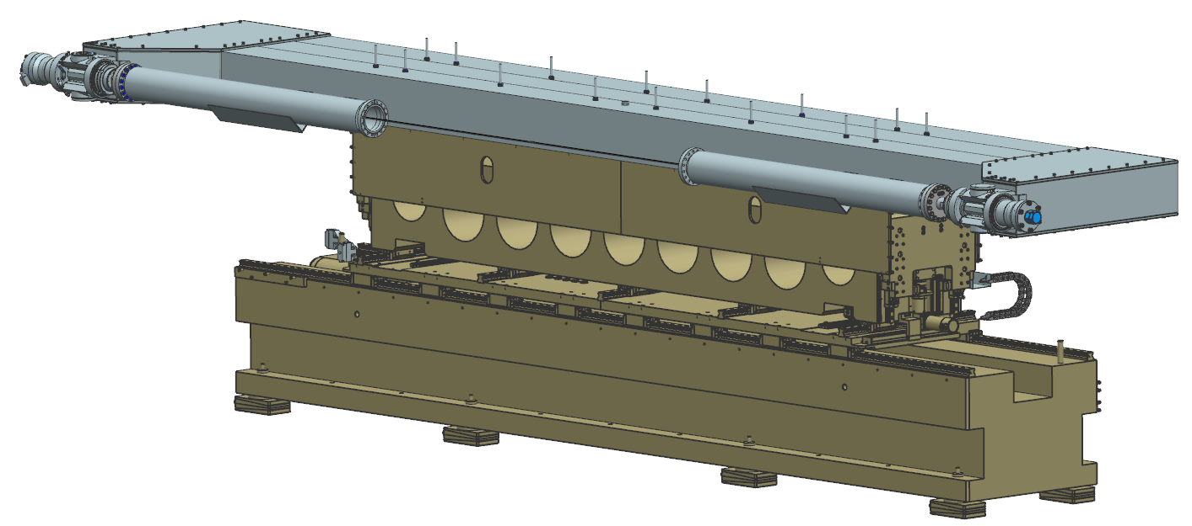
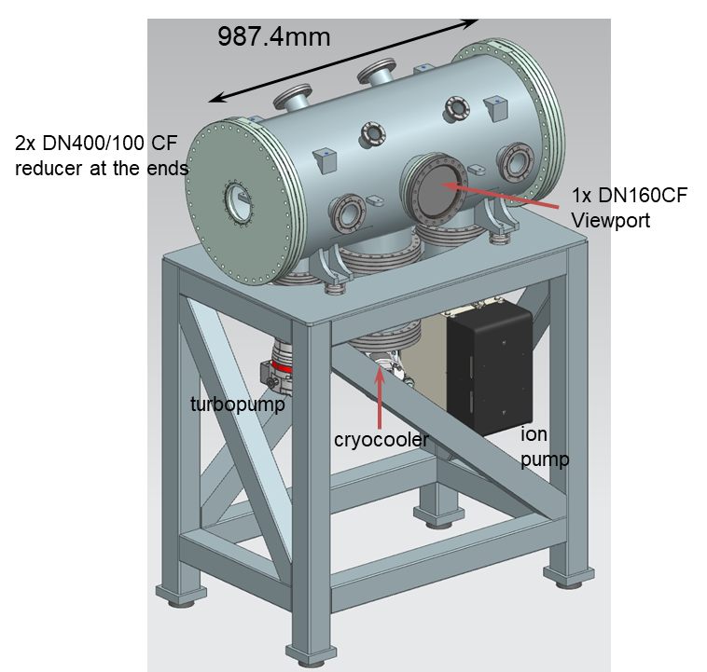
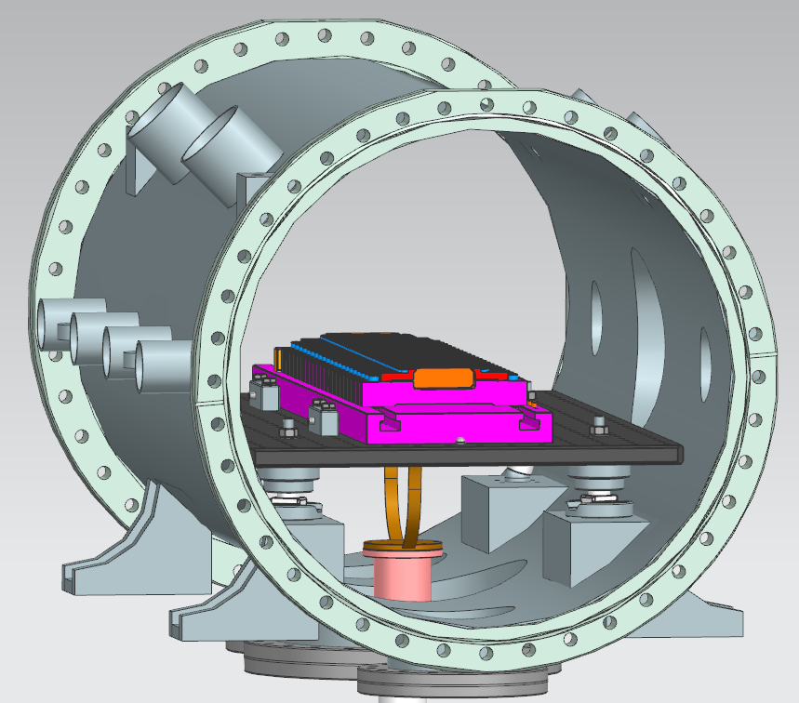
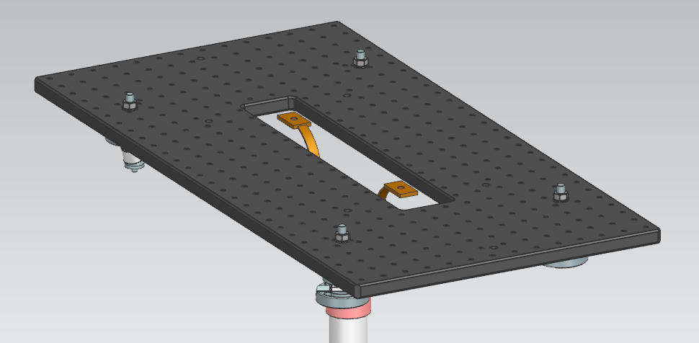
Drawings
General view of bench with bellows
Portion of undulator
Details of the test structure
Cu strips
Base for the undulator array
cryohead

Slide 16
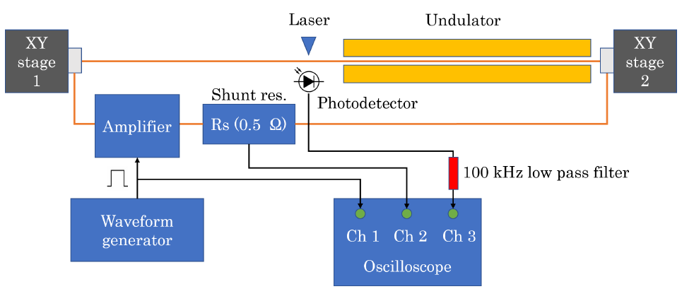
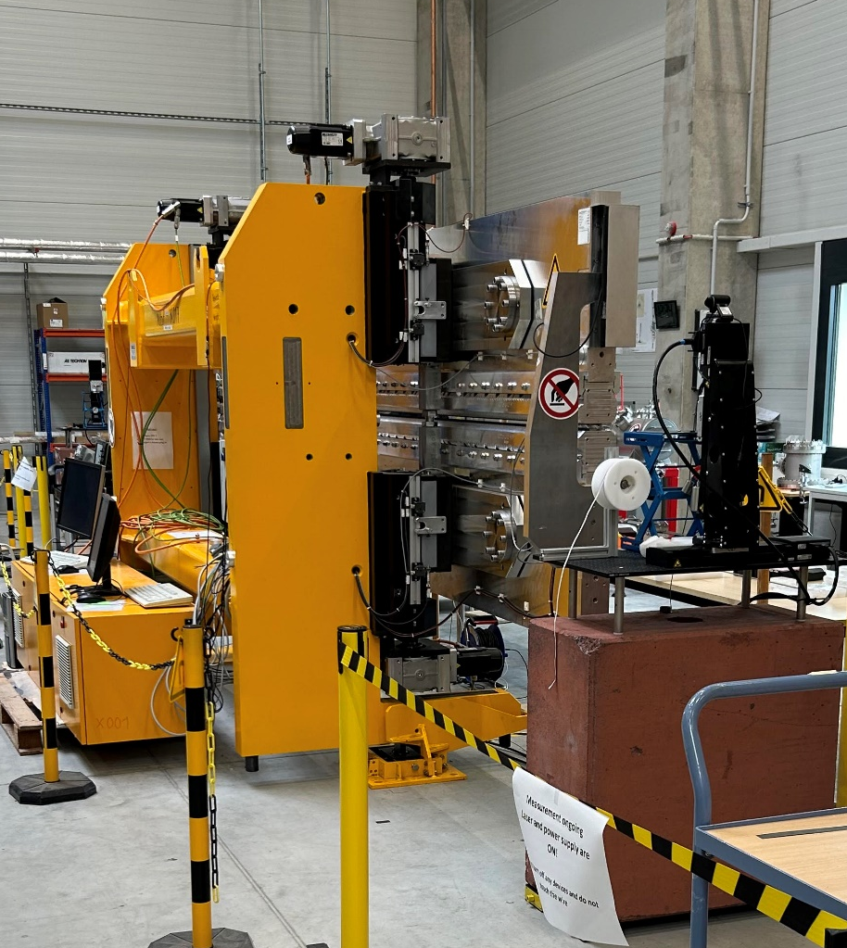
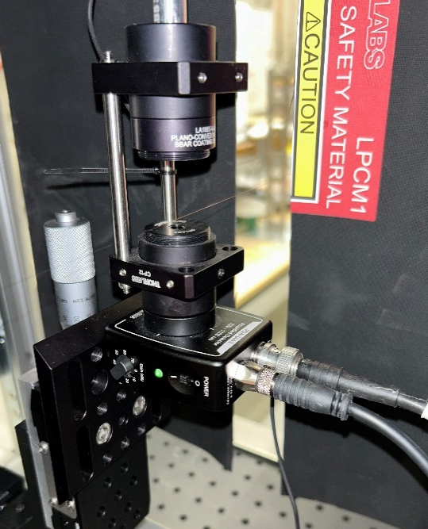
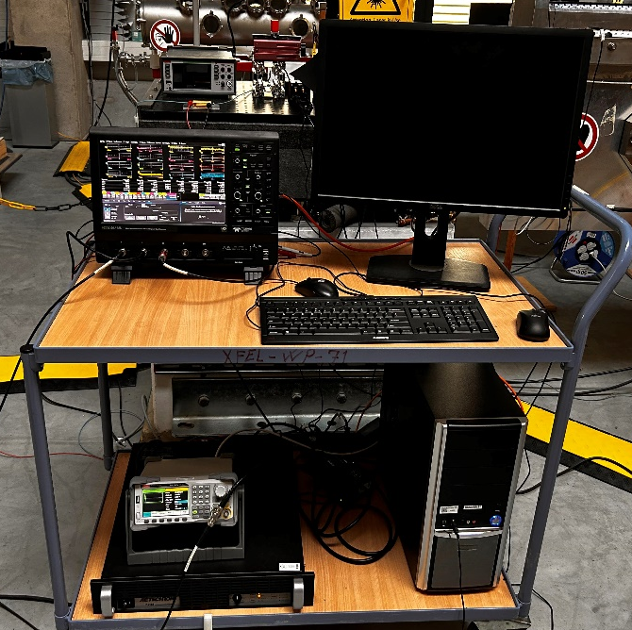
WP6
Task 6.4
Pulsed wire – ref. Sara Casalbuoni and Johan Baader (EU-XFEL)
Set-up
U40 undulator
Magnetic measurement benches
Newport stages
Thorlabs CPS532
Lecroy HDO6104A-MS
J. Baader et al., IMMW23
RSDG2122X
Thorlabs PDA100A2
AeTechron 7234

Slide 17
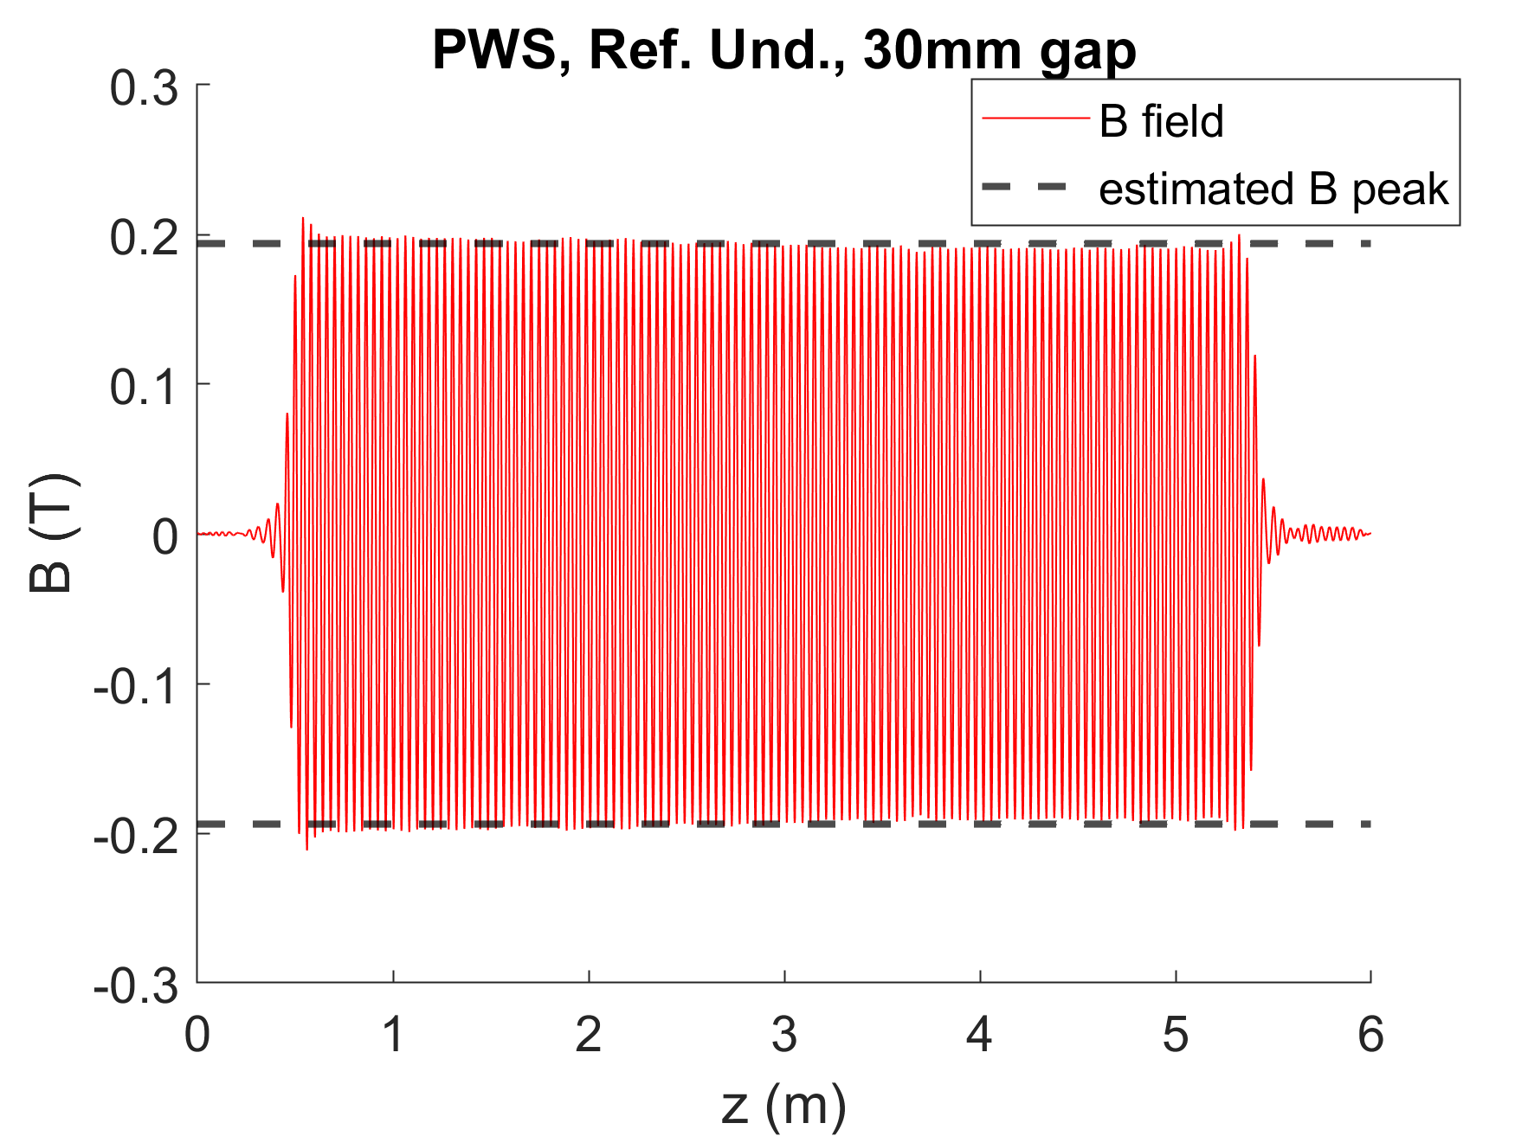
Preliminary results
Wire parameters: 125 µm BeCu wire, 10.8 m long, stretched at 9.1 N
4x Newport M-ILS200LM-S stages used to place the wire
Pulse parameters: pulse width of 20 µs; pulse amplitude of 520 mA; rise/fall time of 1 µs; overshoot <3%; pulse period of 30 s
Magnetic field profile calculated by deriving I1 with respect to the longitudinal axis position
J. Baader et al., IMMW23

Slide 18
LEAPS-INNOV project extension proposal
WP6
+ 6 months, deliverables, milestones and budget shifts → project ends on 1st October 2025.
Which tasks will benefit from an extension and why?
Task 6.2: HTSU, CPMU
Task 6.3: Cryogenic APPLE-III → adaptation of the task
What led to the delay?
Subtask 6.2.1 – HTSU. Challenges in manufacturing the Nb3Sn 12T solenoid at Fermilab have resulted in delays, with issues in the impregnation procedure following winding and heat treatment necessitating tooling redesign (+ 6 months, from March to September 2024).
Subtask 6.2.2 – CPMU. The challenge of holding and adjusting the half-poles at the extremity of the undulator (0.9mm thickness). The mechanical solution found and proven.
Subtask 6.3.2 – Cryogenic APPLE-III. The project has been delayed by a cyberattack to HZB.
Status and outlook
Which work will be done in the additional 6 months?
Subtask 6.2.1 – HTSU. Procurement of the solenoid components and assembly. Cryogenic test of the fully assembled prototype.
Subtask 6.2.2 – CPMU. The CPMU will be assembled and characterized at room and cryogenic temperature before the end of the contract. However, an extension of at least 6 months would provide more margin for the project, in the sense of minimizing the risks associated to the procurement of all the components.
Subtask 6.3.2 – Cryogenic APPLE-III. All the components needed to the construction of the prototype will be procured. The mechanical supports will be made in-house.

Slide 19
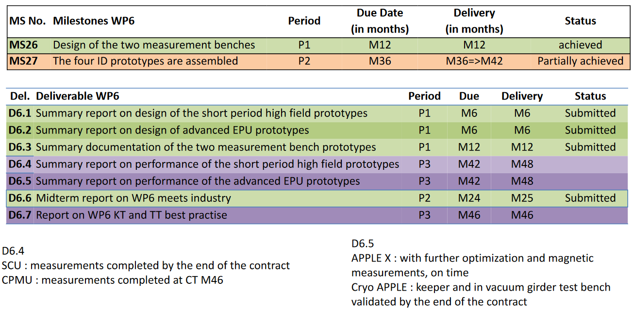
Milestones and Deliverables
(September’24)
(March’25)
(Genuary’25)
Change of M27:
ORIGINAL: “The four ID prototypes are assembled”
NEW: “the ID prototypes APPLE-X, CPMU and HTS, Cryo-APPLE III, and the two Test Benches are assembled”
Change of D6.5:
ORIGINAL: “Summary report on performance of the advanced EPU prototypes”
NEW: “Summary report on the performance of the ID prototypes APPLE-X, CPMU and HTS, and validation of the components of the Cryo-APPLE III”

Slide 20
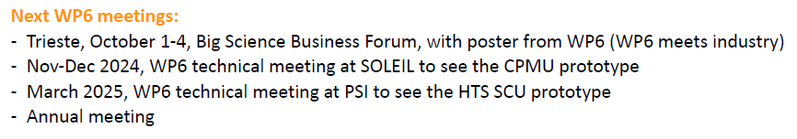

WP6
Meetings

Slide 21

Tak
Tack
Thanks
“ Foster open innovation for accelerator-based lightsources in Europe”
Bedankt
Dziękuję
Danke
Merci
Grazie
Gracias
https://leaps-initiative.eu
This project has received funding from the European Union´s Horizon 2020 research and innovation programme under grant agreement No. 101004728
شك

