Slide 1
python accelerator middle layer
pyAML
S.White (ESRF) on behalf of the pyAML Collaboration

Slide 2
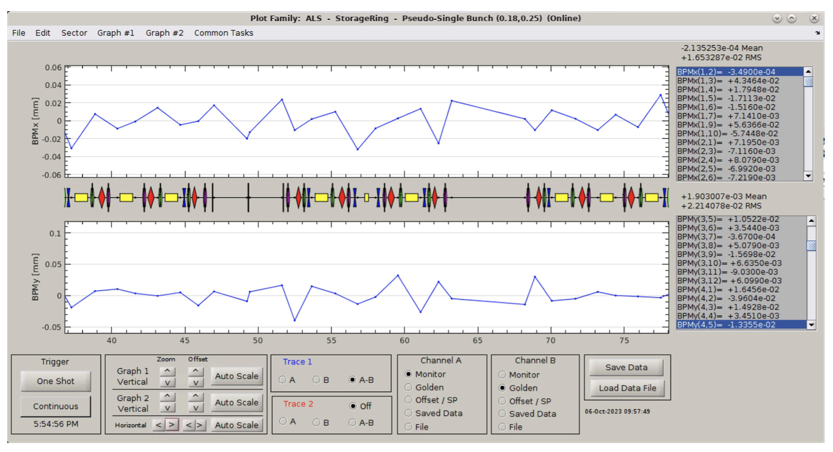
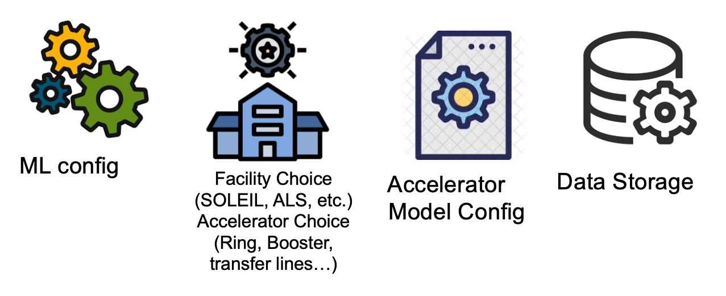
Matlab middle layer
MIDDLE LAYER
Software tools usable by any accelerator:
  Control agnostic
  Accelerator naming/layout agnostic
Easy to use, includes high level graphical application
“Easy” to set up
Tested in many labs: Robust and Reliable
No need of additional resources to set up standard tools
Easy scripting language
Integration of accelerator model (digital twin)
Gives access to not trivial to implement software, such as LOCO (linear optics from closed orbit)
1994, SLAC + ALS, Matlab
https://indico.desy.de/event/43233/contributions/169040/attachments/90944/122729/OperationML_nadolski.pdf
https://indico.esrf.fr/event/123/contributions/623/attachments/377/750/2023%20-%20MML%20History%20-%20AT%20Workshop.pdf

Slide 3
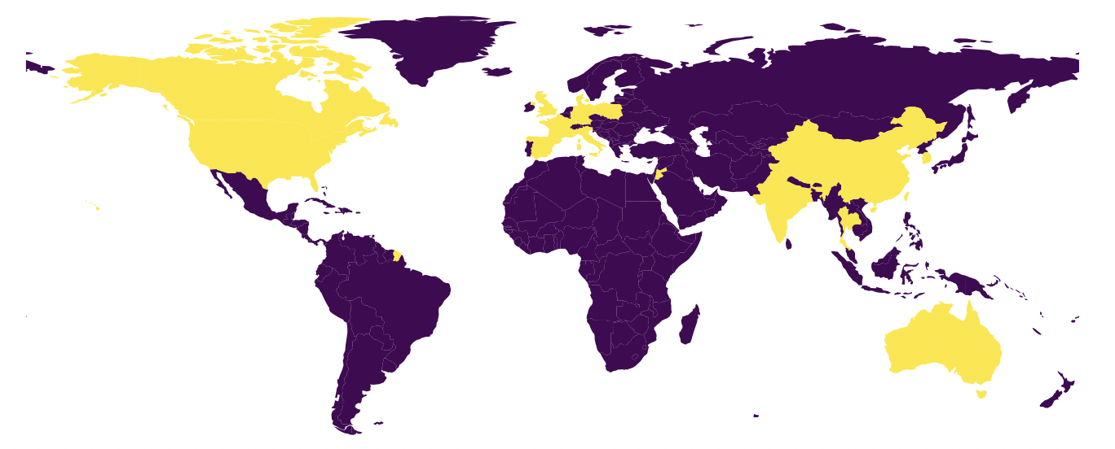
Matlab Middle layer
Matlab Middle Layer
Matlab is a proprietary programming language
Collaborative development very difficult: last update in 2018, diverged in many private versions
Does not benefit from modern computing, not possible to interface with more recent developments
Does not implement scientific open data management
MML will soon become obsolete
Operation of many facilities at risk
Users community looking for long term alternatives
has World wide users (incomplete list)
USA: ALS, Stanford (Spear3), Duke FEL, Brookhaven (VUV or X-Ray rings), B-Factory
Canada: CLS
Europe: SOLEIL (France), DIAMOND (England), ALBA (Spain), Solaris (Poland), MAX-IV (Sweden)
Asia: PLS2 (Korea), SLS (Thailand), SSRF (Shanghai), NSRRC (Taiwan)
Middle East: SESAME (Jordan)
Australia: ASP

Slide 4

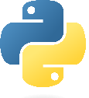

Proposal for Python digital-twin
Python is among the most used software language in the world. Free and open-source. Very large users/developers community
Huge number of scientific libraries.
>>> switch_to_hardware()
Python Accelerator Middle Layer (pyAML)
The python digital twin would provide a long term solution in an open source license free environment:
Simplified collaborative development, integrate modern CI/CD approach
Clean and simple installation procedure
Easy to interface with others recent developments using modern techniques such as advance commissioning simulations (pySC) or AI/ML (Badger/Xopt)
Clear automatically generated documentation
Works for any accelerator (ring, linac, transfer lines) and control systems
Python
Accelerator Toolbox simulations
Operation phase
Development phase
Home made
>>> switch_to_physics()

Slide 5
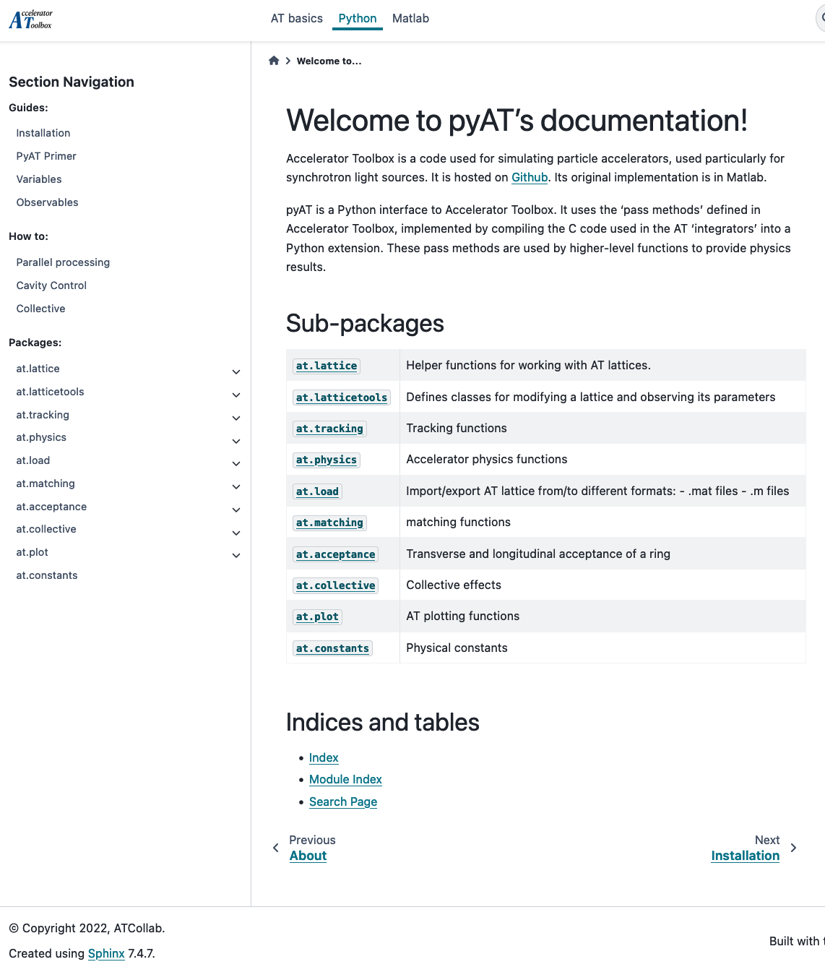
Where do we start?
A solid and benchmarked python Accelerator Toolbox (pyAT) package for storage ring simulations, with active users and developers
Very wide user experience from MML and (py)AT within a well established collaborative environment
Very strong experiment in development on lattice correction and optimization algorithms:
      Well established and tested methods: ESRF-EBS commissioning
      Python Simulated Commissioning (outcome of EURIZON ~ 1year of collaboration ESRF-DESY)
      Python virtual accelerators ESRF-EBS, Diamond (UK), Sirius (Brasil),...
      Fully benchmarked python optimization algorithms and software (Badger, Xopt developed at SLAC)
Standalone laboratory specific applications.
Building a joint technology platform to merge and integrate all these developments and coordinating the effort in a collaborative manner would bring strong benefits for the whole community

Slide 6
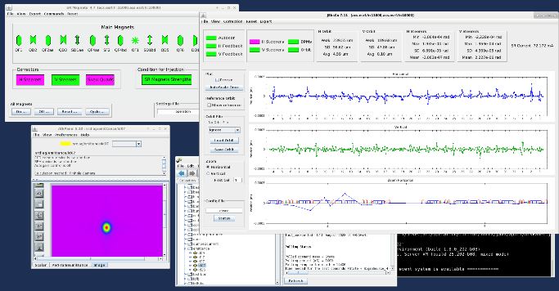
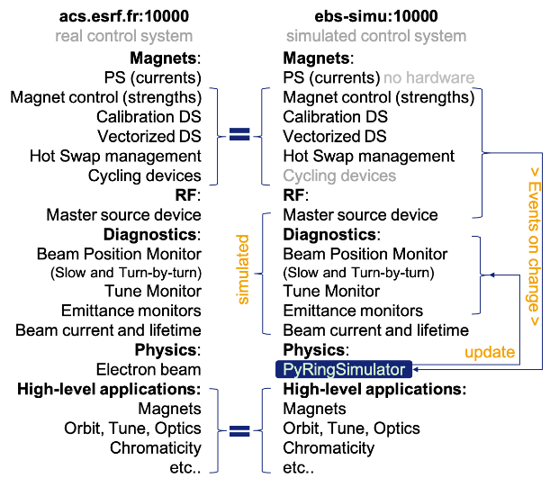
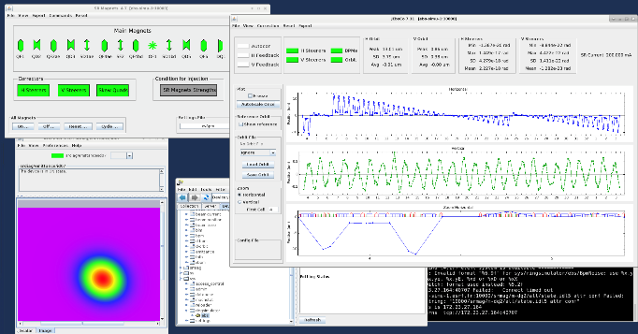
Example: ESRF-EBS virtual accelerator
REAL CONTROL
SIMULATED CONTROL

Slide 7
Python Accelerator Middle Layer
Will provide as MML:
abstracted interaction with different control systems
abstracted naming conventions for all devices
Work for transfer-lines, linear and circular accelerators, ramped accelerators
Digital twin
Tools for orbit, trajectory, linear and non-linear optics corrections
Will provide ADDITIONALLY:
Fully open source
High Performance Computing (HPC) clusters for commissioning simulations
GPUs and analytic Jacobians)
Enable easy and user-friendly connection to any control system including commands, properties and timing features
OPENDATA and FAIR data
data labelling for machine learning and artificial intelligence algorithms
off-line digital twin for tuning tools development
on-line digital shadow for monitoring of indirect observables and anomaly detection
Python based Artificial Intelligence and Machine Learning tools (e.g.: pytorch , Badger/Xopt )
Enforce thorough documentation
Provide a virtual accelerator environment to train students or newcomers to the field
See in the next slide a schematic view of the pyAML joint technology platform

Slide 8
What we want to obtain: pyAML joint technology platform
Large statistics
New developments
Indirect measurements
Accelerator operation
com. simulations
digital twin
digital shadow (online DT)
operation
User interfaces
User interfaces
Middle layer
Middle layer
Calibrations
Calibrations
Digital Twin
Digital Twin
New in pyAML
Threading
Orbit
LOCO
Artificial Int.
Mach. Learn.
Non-linear optics optimizations
etc..
tuning tools
python Accelerator Middle Layer
OPEN FAIR DATA
OPEN FAIR DATA
OPEN FAIR DATA
Commissioning sequence
Automated Commissioning
Automated Commissioning
Anomalies
Anomalies
Real accelerator and/or HDB
Real accelerator
Computing clusters
Computing clusters
N Lattices with errors
Lattice model with errors
Lattice model with errors
pyAT
pyAT
pyAT
Simulated
Expected
Expected
Measured
training tools

Slide 9
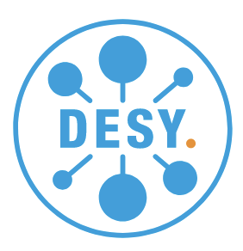



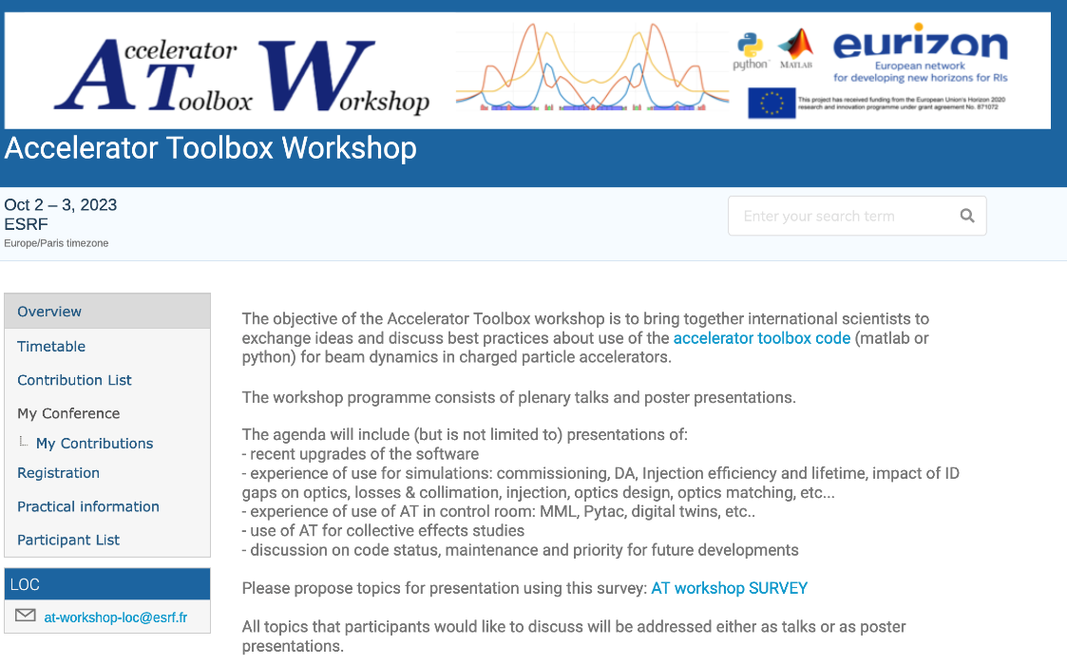
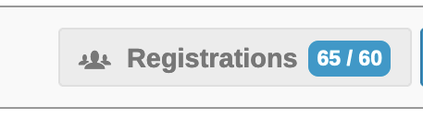
Construction and consolidation of the AT collaboration
Extremely positive, active and fruitful collaboration within EU project. TO BE CONTINUED and EXTENDED.
Expression of interest from many institutes, contact person identified:
ESRF: Simone Liuzzo, S.White, L.Farvacque
DESY: Ilya Agapov, Lukas Malina, Yong-Chul Chae
SOLEIL: Laurent Nadolski, Alexis Gamelin
ALBA: Zeus Marti, Gabriele Benedetti
MAXIV: Marco Apollonio, Magnus Sjostrom
HZB: Teresia Olsson, Pierre Schnizer
IJClab-ThomX: Vyacheslav Kubytskyi
DIAMOND: Hung-Chun Chao, Tobyn Nicolls, Martin Gaughran, Richard Fielder
ELETTRA: Stefano Krecic
SOLARIS: Jacek Biernat
SESAME (Jordan): Samira kasaei
ALS LBNL (USA): Thorsten Hellert
IHEP (China): Daheng Ji, Mengyu Su
ANSTO (Australia): Paul Bennetto
NSLS-2 (USA): Xi Yang
PSI (Switzerland): Jonas Kallenstrup
CLS (Canada): Michael Bree
Korea 4GSR (Korea): Chong Shin Park
Signed project summary shared with LEAPS RDB
25 world-wide laboratories

Slide 10
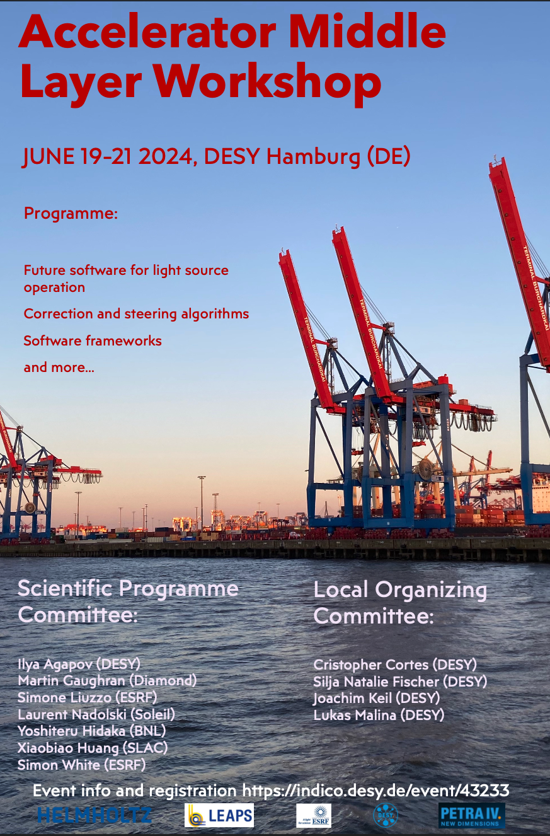

Accelerator middle layer workshop, DESY, Hamburg, June 2024
Contributions from many labs.
Discussion about
AGILE developments
Definition of specifications
Definition of use-cases
New software architectures
Fully python based facilities (such as Sirius in Brasil)
EU grant possibilities
Outcome:
Submit proposal for COST action (DONE)
Proceed with exploratory tests (DONE, continues)
Define specifications/use-cases documents (to start in November)
Next workshop in HZB (Berlin) February-March 2025
FUNDS needed. COULD LEAPS SUPPORT US?

Slide 11
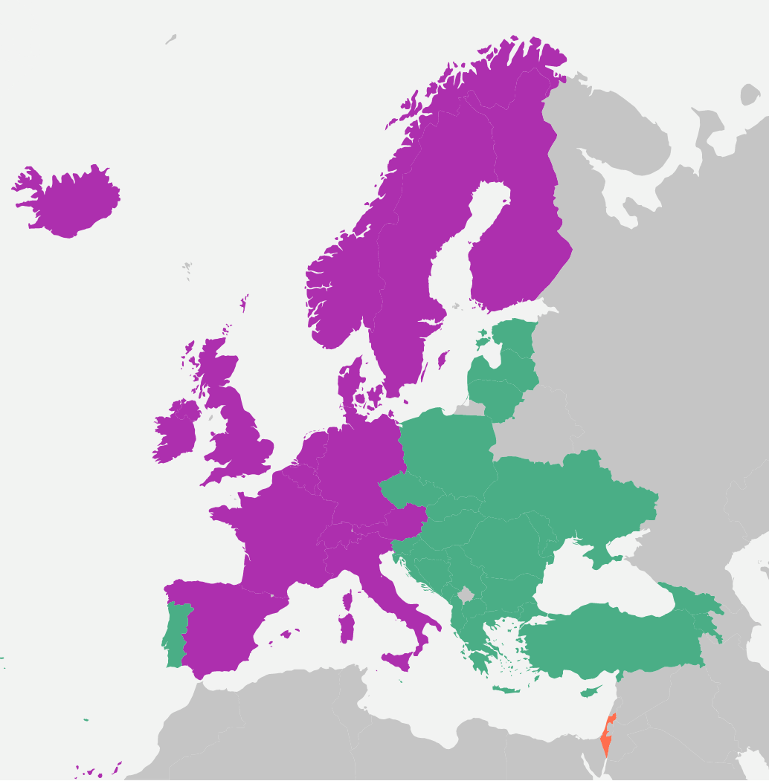
COST: Cooperation for Science and Technology
~ 150kEuro / year for 4 years for “networking”
Must involve 50% ITC countries
All country/lab gets payed trips to conferences, trainings, exchanges, summer schools, coding workshops.
Non-EU countries (USA, Brazil, etc.) collaborators can be paid as expert giving a presentation or a training.
Green == ICT (inclusiveness target country)
~50% success rate
Sweden
MAXIV
Gemany
DESY
HZB
KIT
UK
Diamond
Poland
Solaris
Ukraine
KIPT
pyAML-Net COST Action Proposal submitted
France
ESRF
Soleil
Czech Rep.
ELI-beamlines
Switzerland
PSI
Armenia
Candle
Slovenia
Cosy lab
Bosnia-E. Univ. Of Sarajevo
Reply expected June 2025
If approved, start activity in October 2025
Spain
Alba
Italy
Elettra
Turkey
Turkish Light Source
Once approved anyone will be able to join the network!
www.cost.eu

Slide 12
ongoing Exploratory work: test and evaluate existing solutions
pyTAC : Diamond light source, UK, in use, EPICS based
bluesky : NSLS-II, US, in use by many user beamlines world wide, EPICS based
pyacal : SIRIUS, Brazil, in use (adapted from existing tools to be used by other labs), EPICS based
Run an orbit response matrix measurement
The above tools have been tested at ESRF (TANGO), HZB (EPICS), MAXIV (TANGO)
Easy to set up?
Handles calibrations?
How is data stored/managed?
User friendly?
Graphical interfaces are available?
What measurements can be done?
Digital twin/shadow?

Slide 13
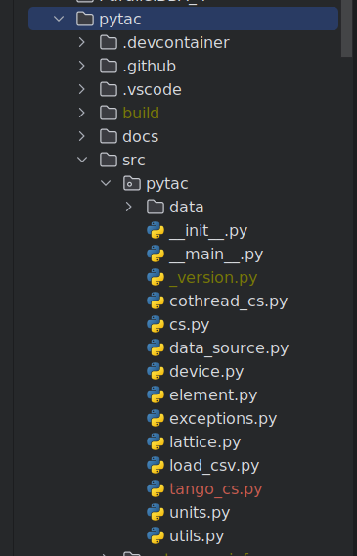
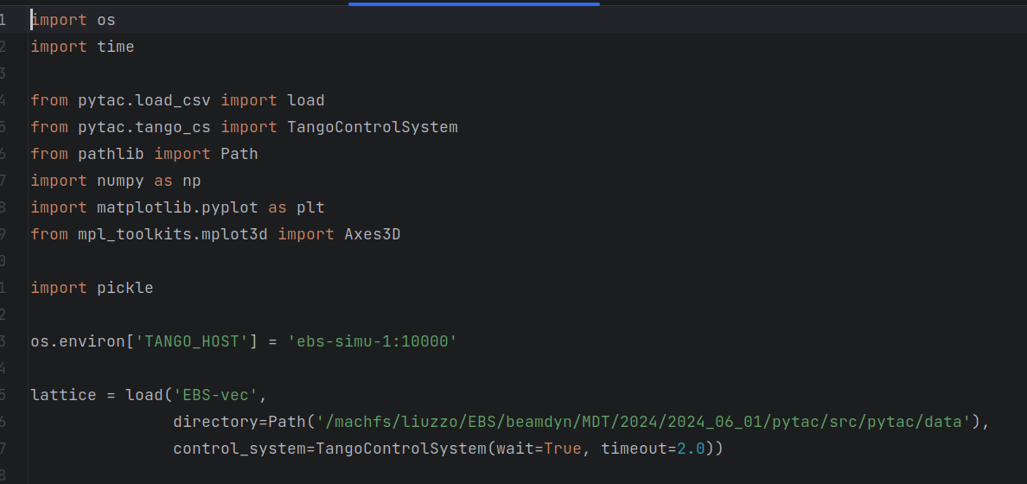
pyTAC tango interface: 1 file
Jean-Luc Pons, ESRF
pyTAC already ready for other CS.
set_single and read_single methods are the only control system dependent methods.

Slide 14
Code comparison (imports, measurement, data, plot)
pyTAC ORM
Bluesky + pyTAC ORM
import os
import time
from pytac.load_csv import load
from pytac.tango_cs import TangoControlSystem
from pathlib import Path
import numpy as np
import matplotlib.pyplot as plt
from mpl_toolkits.mplot3d import Axes3D
import pickle
# os.environ['TANGO_HOST'] = 'ebs-simu-1:10000'
lattice = load('EBS-vec',
directory=Path('/machfs/liuzzo/EBS/beamdyn/MDT/2024/2024_06_01/pytac/src/pytac/data'),
control_system=TangoControlSystem(wait=True, timeout=2.0))
dk = 1e-5
df = 100
horStrs = lattice.get_elements("SF2A")
verStrs = lattice.get_elements("SF2A")
oh = lattice.get_value('orbit_h')
nbpm = len(oh)
NHst = len(horStrs)
NVst = len(verStrs)
orm = dict(HorSteererHorBPMs=np.empty((NHst, nbpm)),
VerSteererHorBPMs=np.empty((NVst, nbpm)),
HorSteererVerBPMs=np.empty((NHst, nbpm)),
VerSteererVerBPMs=np.empty((NVst, nbpm)),
RFHorBPM=np.empty((1, nbpm)),
RFVerBPM=np.empty((1, nbpm))
)
def get_orbit():
return lattice.get_value('orbit_h'), lattice.get_value("orbit_v")
def get_resp(s, kick='y_kick', sleeptime = 3, dk=dk):
n = s.get_pv_name(kick, 'readback')
print(f'response for {n}')
s0 = s.get_value(kick)
s.set_value(kick, s0 + dk)
time.sleep(sleeptime)
(horb_stp, vorb_stp) = get_orbit()
s.set_value(kick, s0 - dk)
time.sleep(sleeptime)
(horb_stm, vorb_stm) = get_orbit()
s.set_value(kick, s0)
time.sleep(sleeptime)
hr = [(p - m) / (2*dk) for p, m in zip(horb_stp, horb_stm)]
vr = [(p - m) / (2*dk) for p, m in zip(vorb_stp, vorb_stm)]
return hr, vr
for i, h in enumerate(horStrs):
hr, vr = get_resp(h, kick='x_kick')
orm['HorSteererHorBPMs'][i, :] = hr
orm['HorSteererVerBPMs'][i, :] = vr
for i, h in enumerate(verStrs):
hr, vr = get_resp(h, kick='y_kick')
orm['VerSteererHorBPMs'][i, :] = hr
orm['VerSteererVerBPMs'][i, :] = vr
# # dispersion
freq = lattice.get_elements("RFCavity")
hr, vr = get_resp(freq[0], kick='f', dk=df) # all cavities point to the same master source device
orm['RFHorBPM'][0, :] = hr
orm['RFVerBPM'][0, :] = vr
# store in file all information required for optics FIT
orm_for_fit = dict(
H2H=orm['HorSteererHorBPMs'],
V2H=orm['VerSteererHorBPMs'],
H2V=orm['HorSteererVerBPMs'],
V2V=orm['VerSteererVerBPMs'],
dh=orm['RFHorBPM'],
dv=orm['RFVerBPM'],
tunes=[lattice.get_value('tune_x'), lattice.get_value('tune_y')],
hor_steerers= [h.get_pv_name('x_kick', 'readback') for h in horStrs],
ver_steerers= [v.get_pv_name('y_kick', 'readback') for v in verStrs],
bpms=lattice.get_element_pv_names('BPM', 'y', 'readback'))
pickle.dump({'orm': orm}, open('ORMdata_pyTAC.pkl', 'wb'))
# Set up grid and test data
S=orm['HorSteererHorBPMs'].shape
nx, ny = S[0], S[1]
x = range(nx)
y = range(ny)
X, Y = np.meshgrid(x, y) # `plot_surface` expects `x` and `y` data to be 2D
plt.style.use('_mpl-gallery')
fig, ax = plt.subplots(nrows=2, ncols=2, subplot_kw={"projection": "3d"}, figsize=(10, 10))
ax[0, 0].plot_surface(X, Y, orm['HorSteererHorBPMs'].T)
ax[0, 0].set_ylabel('Hor BPM')
ax[0, 1].plot_surface(X, Y, orm['VerSteererHorBPMs'].T)
ax[1, 0].plot_surface(X, Y, orm['HorSteererVerBPMs'].T)
ax[1, 0].set_xlabel('Hor steerers')
ax[1, 0].set_ylabel('Ver BPM')
ax[1, 1].plot_surface(X, Y, orm['VerSteererVerBPMs'].T)
ax[1, 1].set_xlabel('Ver steerers')
plt.savefig('ORM_pyTAC.png')
plt.show()
"""
Todo:
Review if ophyd tango should be used
"""
import time
from typing import List, Dict, Any
from ophyd.status import Status
from ophyd import BlueskyInterface
import numpy as np
from collections import OrderedDict
from ophyd.device import OrderedDictType
# temporary for safe-test purposes: force commands to simulator only.
import os
os.environ['TANGO-HOST'] = 'ebs-simu-1:10000'
__author__ = 'Pierre Schnizer (HZB), Simone Liuzzo (ESRF)'
__data__ = 'March 2024'
class BPMs(BlueskyInterface):
"""
Read BPM values
Parameters
----------
name : string
Example
-------
"""
def stage(self, **kwargs):
super().__init__(**kwargs)
pass
def unstage(self) -> List[object]:
pass
def describe(self):
"""Return an OrderedDict with exactly the same keys as the ``read``
method, here mapped to per-scan metadata about each field.
"""
return dict(positions={'source': 'bpms', 'dtype': 'array', 'shape': (320,)})
def describe_configuration(self) -> OrderedDictType[str, Dict[str, Any]]:
res = OrderedDict()
res.update({'position': {'source': 'bpms', 'dtype': 'array', 'shape': (320,)}})
return res
def trigger(self):
return Status(success=True, done=True)
def read(self):
"""Return an OrderedDict mapping string field name(s) to dictionaries
of values and timestamps and optional per-point metadata.
"""
vals = np.vstack([
self.lattice.get_value('orbit_h'),
self.lattice.get_value('orbit_v')
])
return dict(positions=dict(value=vals, timestamp=time.time()))
def read_configuration(self) -> OrderedDictType[str, Dict[str, Any]]:
res = OrderedDict()
res.update({'positions': {'value': [], 'timestamp': []}})
return res
def __init__(self, name, lattice, **kwargs):
"""
Args:
name: either a string attribute for tango or a pytac lattice
random_state:
**kwargs:
"""
self.name = name
self.lattice = lattice # pyTAC lattice
self.parent = None
if __name__ == "__main__":
from pytac.load_csv import load
from pytac.tango_cs import TangoControlSystem
from pathlib import Path
import logging
import os
os.environ['TANGO-HOST'] = 'ebs-simu-1:10000'
machine = 'ebs'
logger = logging.getLogger(f"{machine}-bluesky-orm")
lattice = load('EBS-vec',
directory=Path('/machfs/liuzzo/EBS/beamdyn/python_LOCO_for_CTRM/pytac/src/pytac/data'),
control_system=TangoControlSystem(wait=True, timeout=2.0))
# test steerer directly with pyTAC
h_orbit = lattice.get_value("orbit_h")
v_orbit = lattice.get_value("orbit_v")
bpms = BPMs(name="bpms", lattice=lattice)
status = bpms.trigger()
# I guess your bpms are much faster ...
status.wait(1.0)
data = bpms.read()
print(data)
print('hor bpm reading')
print(data['positions']['value'][0])
print('ver bpm reading')
print(data['positions']['value'][1])
# print(f'time: {timestamp}')
from bluesky.utils import ProgressBarManager
import time
from bluesky import RunEngine
from bluesky.callbacks.best_effort import BestEffortCallback
from databroker import Broker
from bluesky.plans import scan, rel_scan
from bluesky.simulators import summarize_plan
import numpy as np
import logging
from pytac.load_csv import load
from pytac.tango_cs import TangoControlSystem
from pathlib import Path
import bpm
import steerer
import pickle
# work in EBS simulator
import os
# os.environ['TANGO-HOST'] = 'ebs-simu-1:10000'
def measure_orm(lattice, settle_time=6):
"""
run a response matrix measurement
"""
# initialize RM data structure
orm = dict(HorSteererHorBPMs=[],
VerSteererHorBPMs=[],
HorSteererVerBPMs=[],
VerSteererVerBPMs=[])
# use bluesky run engine to run measurement
# define some additional metadata
md = dict(
machine=machine,
nickname="orm",
measurement_target='Orbit Response Matrix',
target="orbit response measurement",
comment="",
)
# initialize run engine
RE = RunEngine(md)
# # add to each measurement additional data: current, tunes, emittances at every measurment
# sd = SupplementalData()
# RE.preprocessors.append(sd)
# sd.baseline = [det1, det2, det3, motor1, motor2]
# Send all metadata/data captured to the BestEffortCallback
bec = BestEffortCallback()
RE.subscribe(bec)
# Insert all metadata/data captured into a temporary db.
db = Broker.named('temp')
RE.subscribe(db.insert)
# # set up a progress bar manager
RE.waiting_hook = ProgressBarManager()
det = bpm.BPMs(name='bpms', lattice=lattice)
# horStrs = lattice.get_elements("HorSteerers")
# verStrs = lattice.get_elements("VerSteerers")
horStrs = lattice.get_elements("SF2A")
verStrs = lattice.get_elements("SF2A")
# test
ste = steerer.Steerer(name=horStrs[0].get_pv_name('x_kick', 'setpoint'),
pytacsteerer=horStrs[0],
field='x_kick', settle_time=settle_time)
print(det.read())
print(ste.read())
DK=1e-5
Nsteerers = len(horStrs)
def scan_steerers():
# steerer_devs = lattice.get_element_pv_names('SH1A', 'x_kick', 'readback')
# steerer_devs = lattice.get_element_pv_names('HorSteerers', 'x_kick', 'readback')
for s in horStrs:
yield from rel_scan([det],
steerer.Steerer(name=s.get_pv_name('x_kick', 'setpoint'),
pytacsteerer=s,
field='x_kick',
settle_time=6),
-DK, DK, 2)
# steerer_devs = lattice.get_element_pv_names('VerSteerers', 'y_kick', 'readback')
for s in verStrs:
yield from rel_scan([det],
steerer.Steerer(name=s.get_pv_name('y_kick', 'setpoint'),
pytacsteerer=s,
field='y_kick',
settle_time=6),
-DK, DK, 2)
# print what the plan will do
summarize_plan(scan_steerers())
print('wait 3s')
time.sleep(3)
# run measurement
RE(scan_steerers())
# collect data from databroker
hor_st_hor_cod_resp = np.zeros((Nsteerers, 320))
hor_st_ver_cod_resp = np.zeros((Nsteerers, 320))
ver_st_ver_cod_resp = np.zeros((Nsteerers, 320))
ver_st_hor_cod_resp = np.zeros((Nsteerers, 320))
for k in [n+1 for n in range(Nsteerers*2)]:
header = db[-k] # last, so order is swapped... very cumbersome way to "save" data in a way it will be useless forever after
t = header.table()
# +DK - -DK / DK
hor_resp = t.positions[2][0] - t.positions[1][0] / DK
ver_resp = t.positions[2][1] - t.positions[1][1] / DK
#
if k in [n+1 for n in range(Nsteerers)]:
ver_st_hor_cod_resp[Nsteerers - k, :] = hor_resp
ver_st_ver_cod_resp[Nsteerers - k, :] = ver_resp
else:
hor_st_hor_cod_resp[Nsteerers*2 - k, :] = hor_resp
hor_st_ver_cod_resp[Nsteerers*2 - k, :] = ver_resp
name_file = header.start['motors'][0]
pickle.dump({'hor': hor_resp, 'ver': ver_resp, 'table': t, 'steer': header.start['motors']},
open(f'ORMdata_{name_file}.pkl', 'wb'))
orm['HorSteererHorBPMs'] = hor_st_hor_cod_resp
orm['VerSteererHorBPMs'] = ver_st_hor_cod_resp
orm['HorSteererVerBPMs'] = hor_st_ver_cod_resp
orm['VerSteererVerBPMs'] = ver_st_ver_cod_resp
pickle.dump({'orm': orm}, open('ORM_bluesky_pyTAC.pkl', 'wb'))
return orm
if __name__ == '__main__':
# os.environ['TANGO-HOST'] = 'ebs-simu-1:10000'
machine = 'ebs'
logger = logging.getLogger(f"{machine}-bluesky-orm")
lattice = load('EBS-vec',
directory=Path('/machfs/liuzzo/EBS/beamdyn/MDT/2024/2024_06_01/pytac/src/pytac/data'),
control_system=TangoControlSystem(wait=True, timeout=2.0))
from os.path import exists
ormfile = '/machfs/MDT/2024/2024_06_01/ORM_bluesky_pyTAC.pkl'
if not(exists(ormfile)):
print(f'{ormfile} file does NOT exist')
orm = measure_orm(lattice, settle_time=6)
else:
print(f'load existing {ormfile} file')
d = pickle.load(open(ormfile, 'rb'))
orm = d['orm']
import matplotlib.pyplot as plt
from mpl_toolkits.mplot3d import Axes3D
# Set up grid and test data
S=orm['HorSteererHorBPMs'].shape
nx, ny = S[0], S[1]
x = range(nx)
y = range(ny)
X, Y = np.meshgrid(x, y) # `plot_surface` expects `x` and `y` data to be 2D
plt.style.use('_mpl-gallery')
fig, ax = plt.subplots(nrows=2, ncols=2, subplot_kw={"projection": "3d"})
ax[0, 0].plot_surface(X, Y, orm['HorSteererHorBPMs'].T)
ax[0, 0].set_ylabel('Hor BPM')
ax[0, 1].plot_surface(X, Y, orm['VerSteererHorBPMs'].T)
ax[1, 0].plot_surface(X, Y, orm['HorSteererVerBPMs'].T)
ax[1, 0].set_xlabel('Hor steerers')
ax[1, 0].set_ylabel('Ver BPM')
ax[1, 1].plot_surface(X, Y, orm['VerSteererVerBPMs'].T)
ax[1, 1].set_xlabel('Ver steerers')
plt.savefig('ORM.png')
plt.show()
"""
fig, ax = plt.subplots(nrows=2, ncols=2)
ax[0, 0].pcolormesh(orm['HorSteererHorBPMs'].T)
# ax[0, 0].set_xlabel('Hor steerers')
ax[0, 0].set_ylabel('Hor BPM')
ax[0, 1].pcolormesh(orm['VerSteererHorBPMs'].T)
ax[1, 0].pcolormesh(orm['HorSteererVerBPMs'].T)
ax[1, 0].set_xlabel('Hor steerers')
ax[1, 0].set_ylabel('Ver BPM')
ax[1, 1].pcolormesh(orm['VerSteererVerBPMs'].T)
ax[1, 1].set_xlabel('Ver steerers')
plt.savefig('ORM.png')
plt.show()
"""
import time
from typing import Dict, Any, List
from ophyd import BlueskyInterface
from ophyd.status import Status
from collections import OrderedDict
from ophyd.device import OrderedDictType
# temporary for safe-test purposes: force commands to simulator only.
import os
# os.environ['TANGO-HOST'] = 'ebs-simu-1:10000'
__author__ = 'Simone Liuzzo (ESRF), Pierre Schnizer (HZB)'
__data__ = 'March 2024'
class Steerer(BlueskyInterface):
"""
Read and set a steerer
Parameters
----------
name : string
Example
-------
"""
settle_time = 6
def stage(self, **kwargs):
super().__init__(**kwargs)
pass
def unstage(self) -> List[object]:
pass
def trigger(self):
return Status(success=True, done=True)
def describe(self):
"""Return an OrderedDict with exactly the same keys as the ``read``
method, here mapped to per-scan metadata about each field.
"""
return dict(strength={'source': 'steerer', 'dtype': 'number', 'shape': []})
def describe_configuration(self) -> OrderedDictType[str, Dict[str, Any]]:
res = OrderedDict()
res.update({'strength': {'source': 'steerer', 'dtype': 'number', 'shape': []}})
return res
def read(self):
"""Return an OrderedDict mapping string field name(s) to dictionaries
of values and timestamps and optional per-point metadata.
"""
print(self.name)
val = self.pytacsteerer.get_value(self.field, "setpoint") # we want to make sure that we use the set points
# bpms = self.name.get_elements('BPM') # using pyTAC
return dict(strength=dict(value=val, timestamp=time.time()))
def read_configuration(self) -> OrderedDictType[str, Dict[str, Any]]:
res = OrderedDict()
res.update({'strength': {'value': [], 'timestamp': []}})
return res
def set(self, val):
print(self.pytacsteerer)
print(self.pytacsteerer.get_pv_name('x_kick', 'readback'))
# os.environ['TANGO-HOST'] = 'ebs-simu-1:10000'
th = os.environ['TANGO_HOST']
print(f'tnago hosty{th}')
self.pytacsteerer.set_value(self.field, val)
print(f'set {self.field} to {val}. now wait for {self.settle_time}')
# AttributeProxy(self.name.replace(' ', '/')).write(val)
time.sleep(self.settle_time) # hard coded for test
return Status(success=True, done=True)
def locate(self):
return dict(readback=self.pytacsteerer.get_value(self.field, "readback"),
setpoint=self.pytacsteerer.get_value(self.field, "setpoint"))
def __init__(self, name, pytacsteerer, field, settle_time, **kwargs):
"""
Args:
name: either a string attribute for tango or a pytac lattice
random_state:
**kwargs:
"""
super().__init__( **kwargs)
self.name = name.replace('/', ' ')
self.pytacsteerer=pytacsteerer # pytac element, used to set/get strengths
self.field = field
self.parent = None
self.settle_time = settle_time
if __name__ == "__main__":
from pytac.load_csv import load
from pytac.tango_cs import TangoControlSystem
from pathlib import Path
import logging
import os
# os.environ['TANGO-HOST'] = 'ebs-simu-1:10000'
machine = 'ebs'
logger = logging.getLogger(f"{machine}-bluesky-orm")
lattice = load('EBS-vec',
directory=Path('/machfs/liuzzo/EBS/beamdyn/python_LOCO_for_CTRM/pytac/src/pytac/data'),
control_system=TangoControlSystem(wait=True, timeout=2.0))
print(os.environ['TANGO-HOST'])
time.sleep(10)
# test steerer directly with pyTAC
horStrs = lattice.get_elements("HorSteerers")
print(f'readback from pyTAC: {horStrs[0].get_value("x_kick", "readback")}')
print(f'setpoint from pyTAC: {horStrs[0].get_value("x_kick", "setpoint")}')
time.sleep(10)
initval = horStrs[0].get_value("x_kick", "setpoint")
horStrs[0].set_value("x_kick", initval+1e-6)
time.sleep(2)
print(f'setpoint modified by pyTAC: {horStrs[0].get_value("x_kick", "setpoint")}')
horStrs[0].set_value("x_kick", initval)
time.sleep(2)
print(f'setpoint restored by pyTAC: {horStrs[0].get_value("x_kick", "setpoint")}')
# bluesky interface for pyTAC steerer
steerer = Steerer(name="srmag/hst-sh1/c01-a/Strength",
pytacsteerer=horStrs[0],
field="x_kick", settle_time=10)
# test bluesky interface to steerer
data = steerer.read()
print(data)
timestamp=data['strength']['timestamp']
print(f'at time: {timestamp}')
print(f'steerer initial from bluesky {steerer.name} set point')
print(data['strength']['value'])
initval=data['strength']['value']
steerer.set(data['strength']['value'] + 1e-6)
time.sleep(2)
datam = steerer.read()
print(datam)
print(f'steerer modified by bluesky {steerer.name} set point')
print(datam['strength']['value'])
# restore initial value
steerer.set(data['strength']['value'])
dataf = steerer.read()
print(dataf)
print(f'steerer restored by bluesky {steerer.name} set point')
print(dataf['strength']['value'])
ORM measurement
Steerer ophyd
BPM ophyd

Slide 15
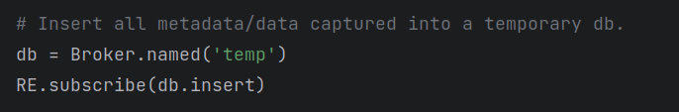
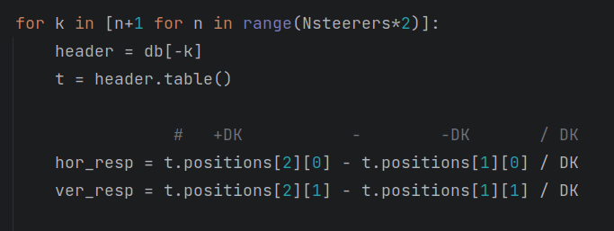
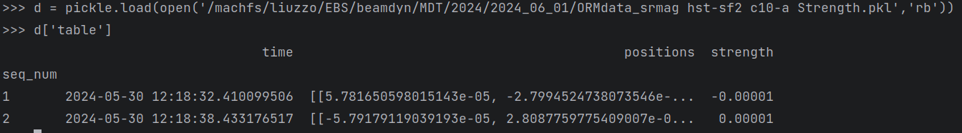
Data LOOK
pyTAC
Bluesky
numpy.arrays
Database
db is the database
first index in database is the most recent, must read it backward
determined by Steerers Ophyd device
H
V
MUST RECALL/UNDERSTAND the order of the scan. First –DK then +DK
N.B. db object may not be pickled (saved to file)

Slide 16
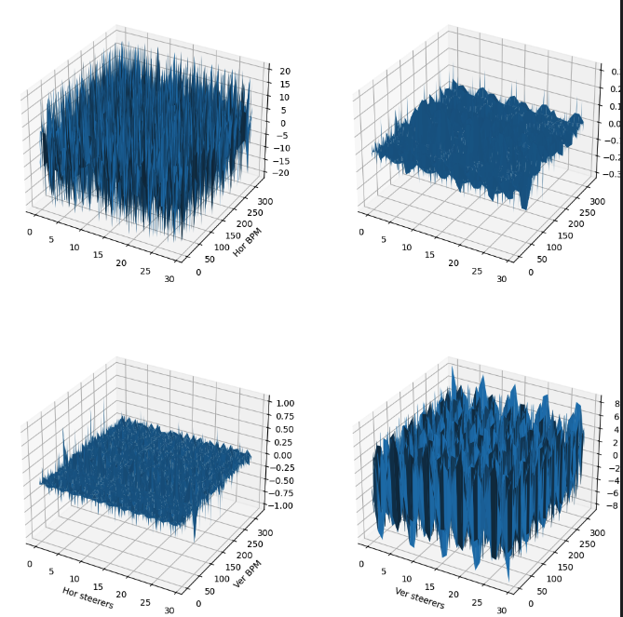
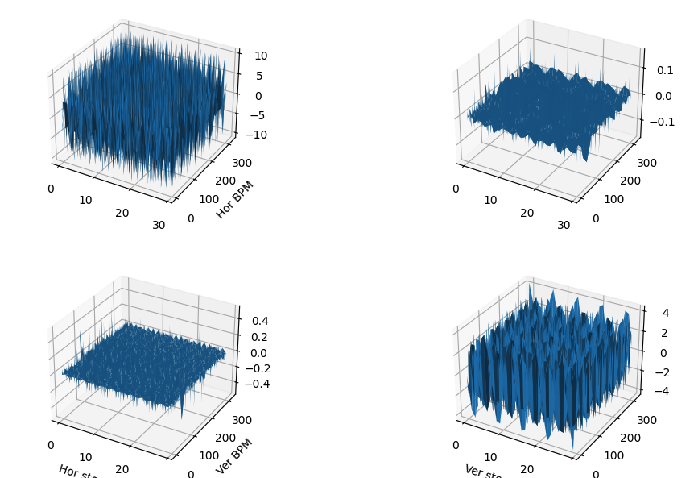
Simulations
pyTAC
pyTAC + Bluesky
pyTAC == Bluesky + pyTAC == Matlab measurement

Slide 17
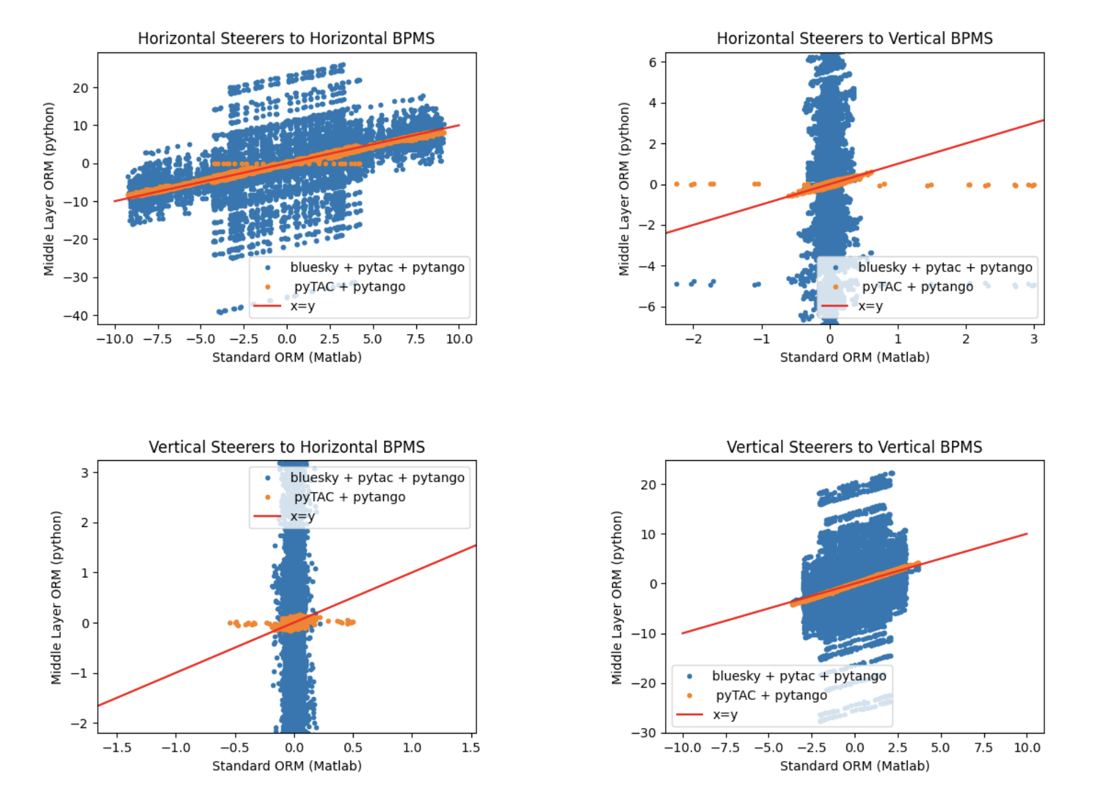
MEASUREMENT with beam, 2nd June 2024
MEASUREMENT
Issue with data saving/synchro in bluesky.
No idea where to look to fix it.

Slide 18
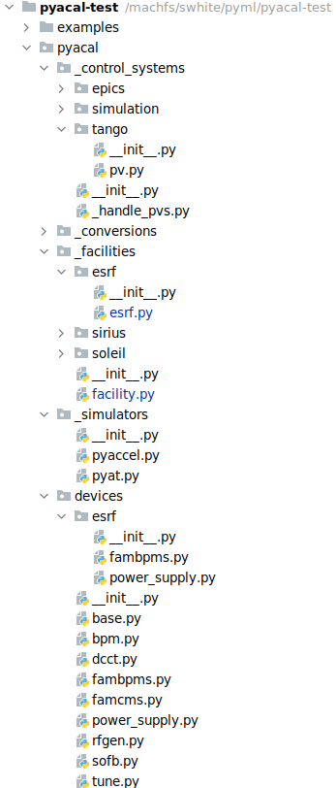
Pyacal adapted for ESRF
To get it working at ESRF few features had to be added modified:
It took a total 3 days of work + 1 meeting for the SIRIUS team to have some thing running on the ESRF simulation
New features:
  TANGO interface
  pyAT interface
  ESRF facility definition
  ESRF specific devices
Few additional minor modifications to load AT model from file for example
This implementation should be usable by any TANGO/pyAT users as long as the facility is defined in the subpackage facilities

Slide 19
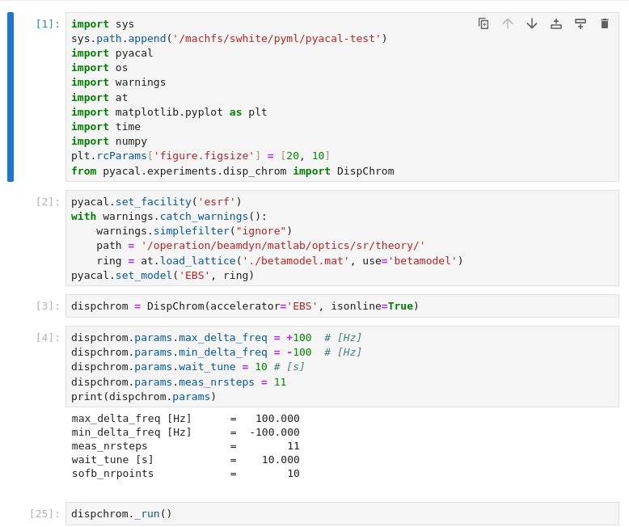
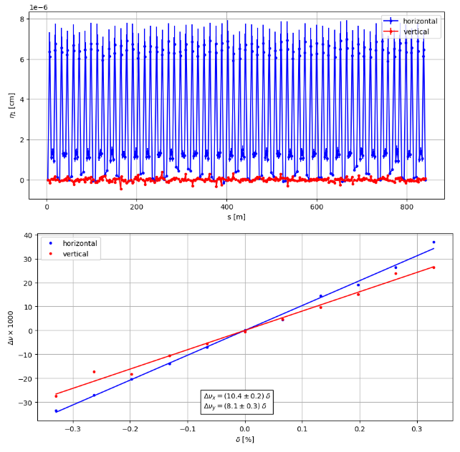
Test of pyACAL at ESRF
Once debugged on the ESRF simulator PYACAL could be launched on the ESRF-EBS machine without any further modifications
Tested 2 experiments:
ORM measurement
Dispersion and chromaticity measurement
Those are the simplest examples provided
Chromaticity and dispersion measurement notebook and results

Slide 20
Conclusions and remarks
pyAML is a project to replace and improve MML. The collaboration is growing and the collaboration is actively participating to the software development.
Networking funds proposal has been submitted. Reply expected in 1 year from now.
On going exploratory tests and detailed definition of specifications and use cases.
Some remarks:
      It was relatively straight forward to adapt pyTAC and PYACAL to ESRF-EBS.
      pyTAC was also adapted to HZB, pyACAL was also adapted to MAXIV.
      pyTAC calibration and set up is based on files, rather easy to interpret and user friendly
      pyTAC + bluesky resulted in very high level of complication. The easy scripting friendliness is not evident for this case.
      For PYACAL once the TANGO and pyAT interface had been implemented all “higher” level applications worked out of the box
      PYACAL was developed with EPICS in mind with the present architecture we cannot profit form certain TANGO features such as Devices or Family Devices: for the test workaround were implemented to make it work
      PYACAL give access to a full suite of measurements and controls scripts with potentially minor or no modifications needed
Next steps:
      Run more complex experiments: BBA, Orbit feedback?
      We would be very interested in testing pyQT GUI at ESRF
      Can we run experiments on the model? Is the switch to simulation implemented in the test version?

