Slide 1
Update muX meeting 08/11
Michael Heines

Slide 2
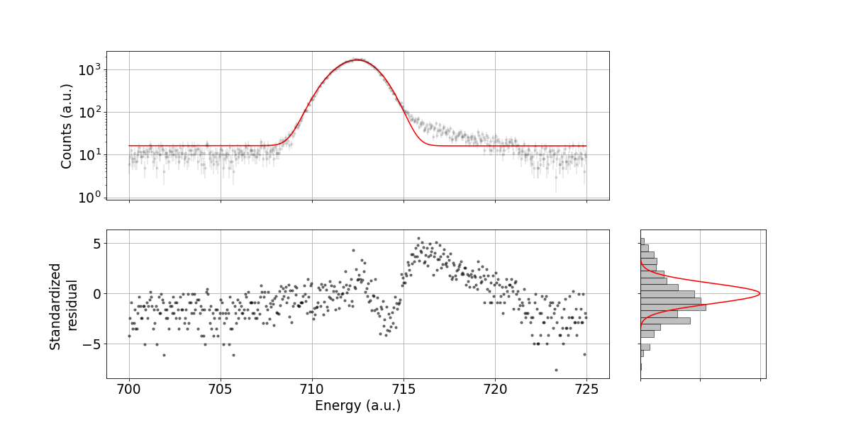
High-E tail in Ge08

Slide 3
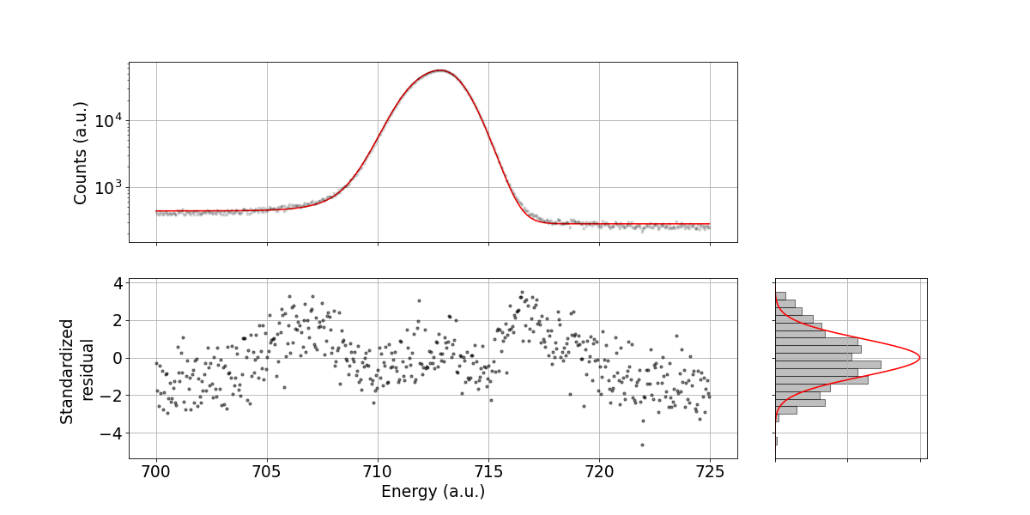

Fitted lines
³⁹K, highest $χ^{2}$

Slide 4
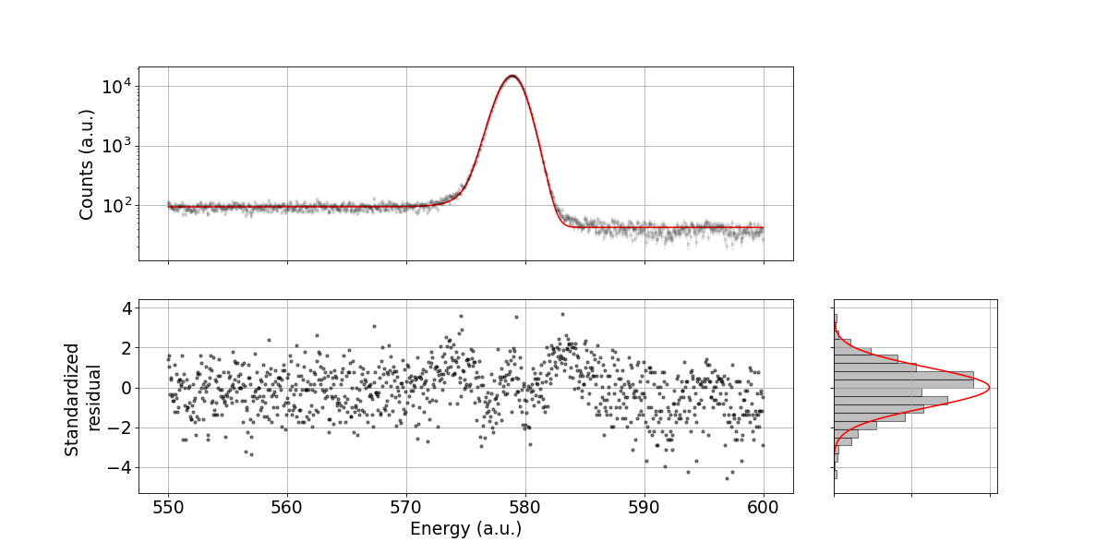
Fitted lines
³⁵Cl

Slide 5
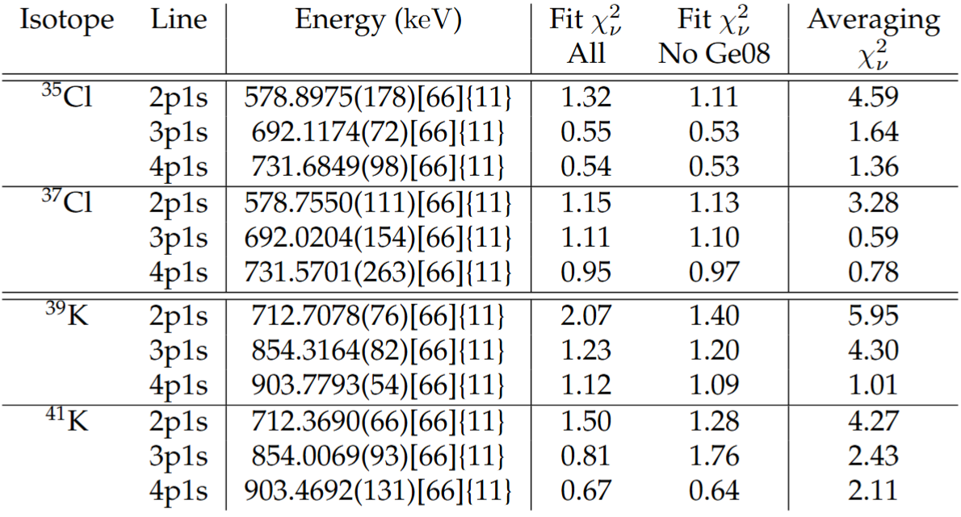
Results
After averaging over detectors

Slide 6
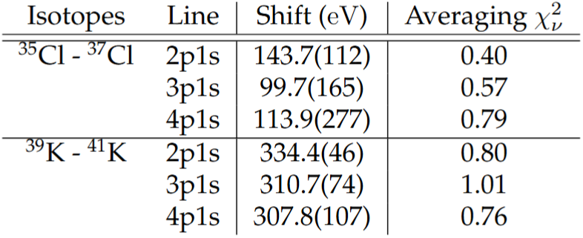
Results
After averaging over detectors
Not sure I understand the change in isotope shift, but it agrees with Paul’s calculations

Slide 7
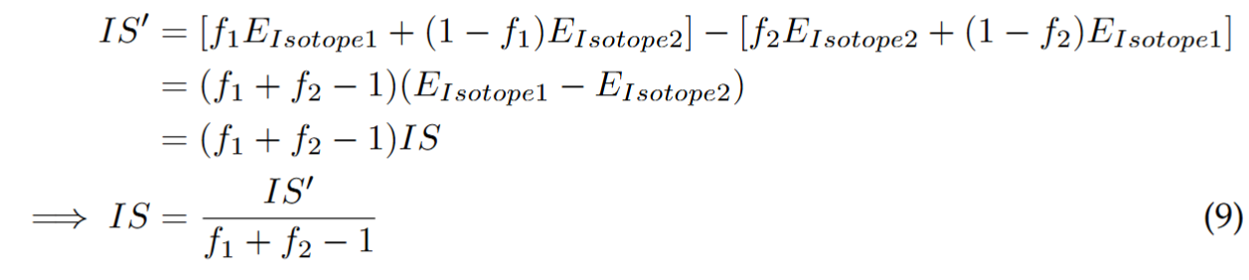
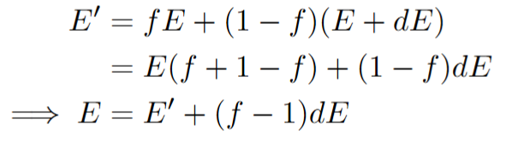
Effect of impurities

Slide 8
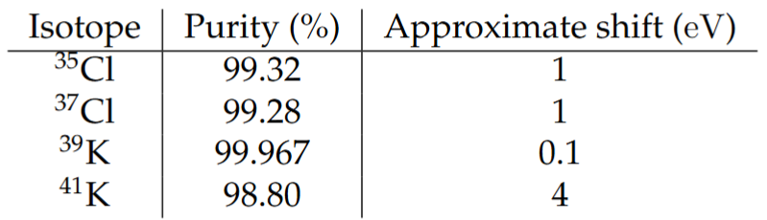
Effect of impurities
Not all purity measurements give errors → Assumed error of 0.05% on all (same as those where it’s given)

Slide 9
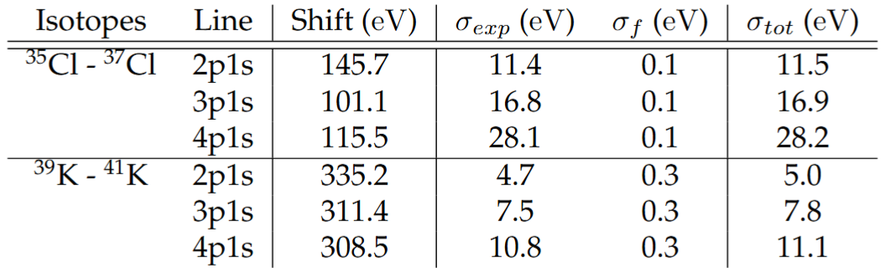
Results after correction - IS

Slide 10
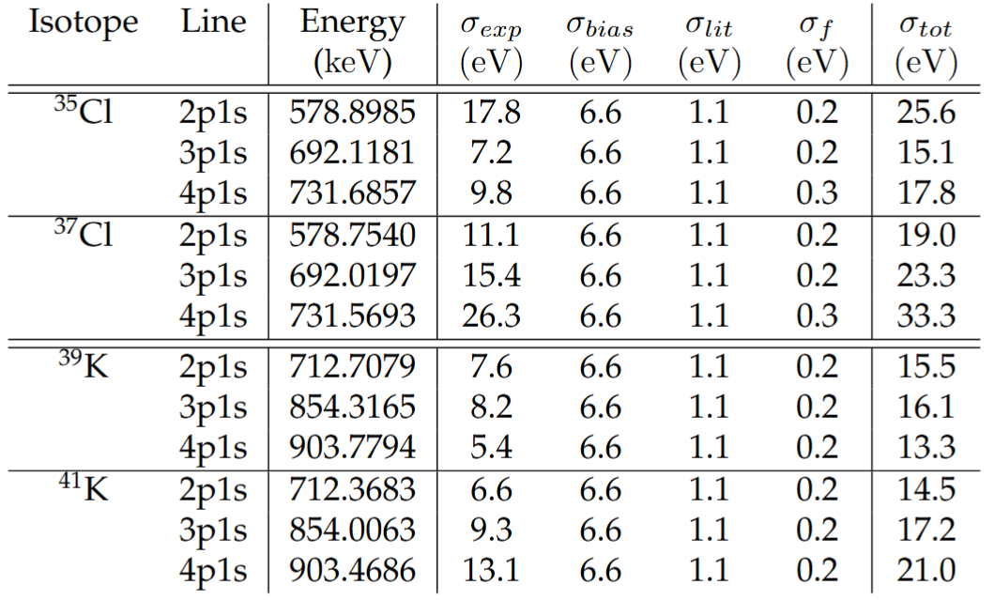
Results after correction – Absolute energy

Slide 11
Other things
Yesterday the pull request on mudirac was finally accepted → R and t change now possible there
Writing analysis document describing the different steps → Will send out to PIs hopefully early next week

