Slide 1
EIDO Update
11 November 2024

Slide 2
SLS

Slide 3
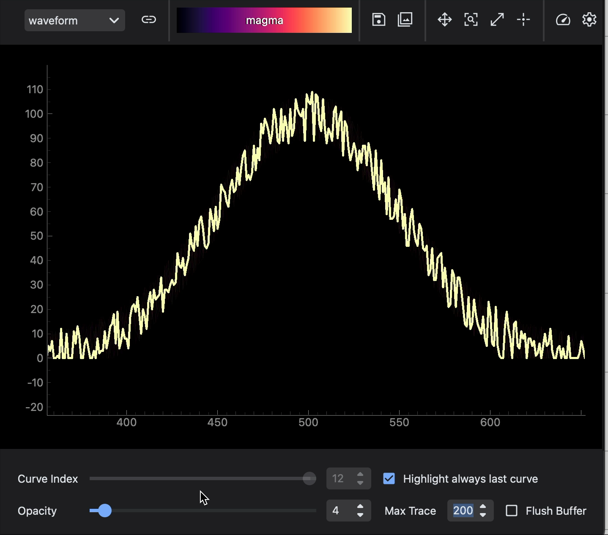
BEC update
BEC Widgets
Release of v1.0
New tools:
  Queue widget
  Bespoke alignment GUI
  Multi-waveform widget
Improvements to the documentation (RTD)
Refactoring of the plotting tools
Performance improvements

Slide 4
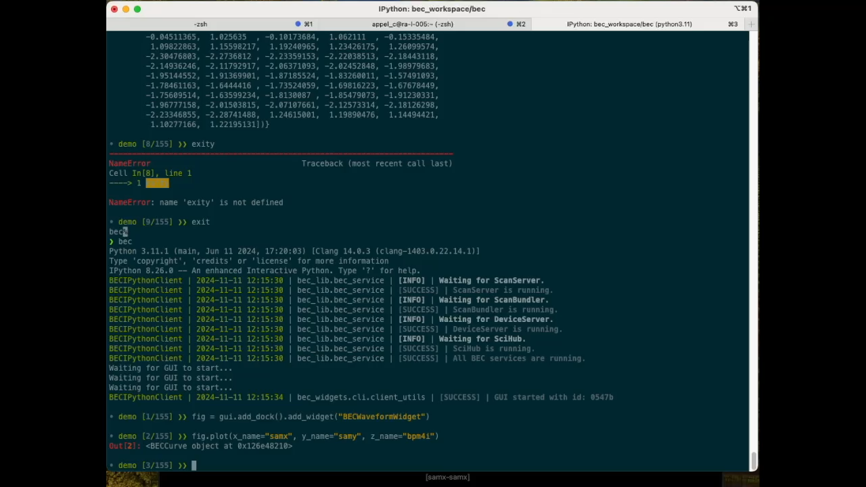
BEC update
BEC Core
Blissdata integration WIP
BEC v3.0 release scheduled for end of Nov
  (Local) data access
  File writing
  Scan API

Slide 5
BEC update
Rollout
cSAXS, Debye work continues
  BLs continue (partially) independent
First session with SuperXAS
“Getting started” with MX
  Follow-up with some beamline scientists
JungfrauJoch at cSAXS
  First tests look promising
  Integration work continues with Filip

Slide 6
SwissFEL

Slide 7

SwissFEL
Joins our group at SwissFEL
Work together on software that enables experiments
Work on the full software stack from data taking to analysis
Help end station staff and users to implement their tools within our framework
Welcome to Natalia! ☺

Slide 8
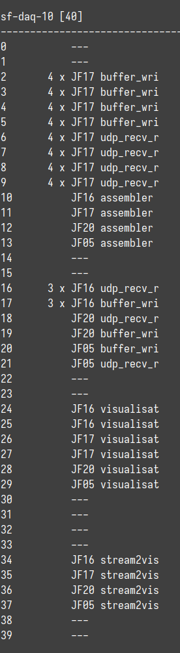
SwissFEL
sf-daq (Data Acquisition)
Deployment
  Re-written and simplified
  All bash scripts converted to “strict mode”: set –xeuo pipefail
  Speed up: restart was 55 mins, now 7 mins
Wrote tools to map out used CPU cores, IPs, ports, MAC addresses
Detector changes:
  New single module “I0” for Cristallina
  New special vacuum module for Furka
  One detector moved from Bernina to Cristallina
→ New deployment made this considerably easier, still needs more automation!

Slide 9
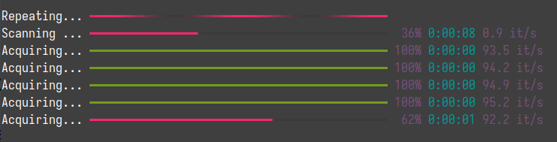
SwissFEL
sf-daq (Data Acquisition) cont’d
Run two sf-daq instances to support two different detector firmware versions
dap (Detector Analysis Pipeline)
Tests after full re-write:
  Results are the same
  Memory consumption is reduced by 20%
  Metrics for throughput missing → need to add!
slic
  Started work on better nested progress display
  Use rich (but keeping tqdm as alternative/backup)
  Investigating slow down issues when ~10 rich progress bars are visible ☹

