Slide 1
November 12 Shift Report
SPM Meeting 3 December 2024
P. Craievich , F. Demurtas , P. Dijkstal , F. Marcellini , E. Prat, S. Reiche

Slide 2
Shift 12 November Report
Slice Emittance Measurements
Measured the Slice Emittance in x when streaking along y direction and slice emittance in y when streaking in x direction
Two different phase advance scan were done, one with 8 points and the other with 15 points to compare the two analysis
Comparison between the case with the cycling of the quadrupoles ON and OFF in every step
PolariX Calibration Measurement
We have done the calibration for different polarizations :
0, 30, 45, 60 ,90 deg

Slide 3
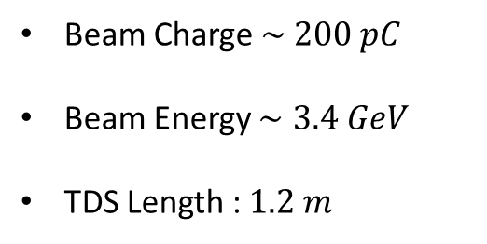
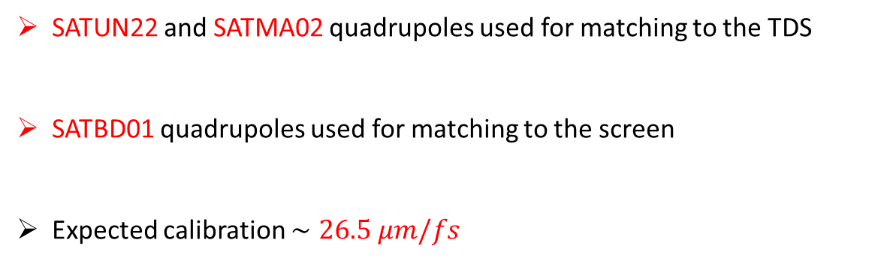
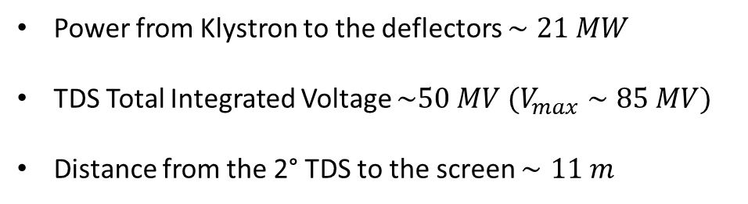
Athos Diagnostics Layout
Beam Charge $\sim 200 pC$
Beam Energy $∼3.4 GeV$
TDS Length : $1.2 m$
Power from Klystron to the deflectors $∼21 MW$
TDS Total Integrated Voltage $\sim 50 MV$ $(V_{max}∼85 MV)$
Distance from the 2° TDS to the screen $∼11 m$
DSCR120
TDS 1
TDS 2
SATBD01 Quadrupoles
SATUN22 and SATMA02 Quadrupoles
SATUN22 and SATMA02 quadrupoles used for matching to the TDS
SATBD01 quadrupoles used for matching to the screen
Expected calibration $∼26.5 μm/fs$

Slide 4
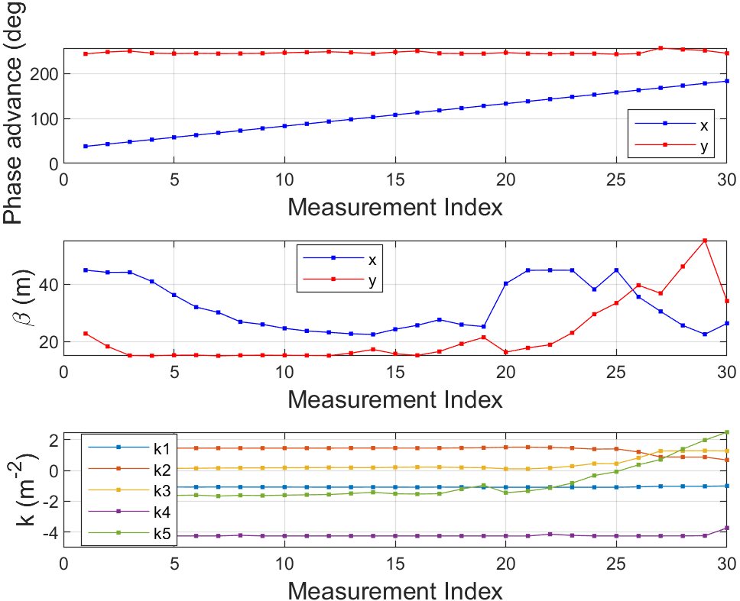
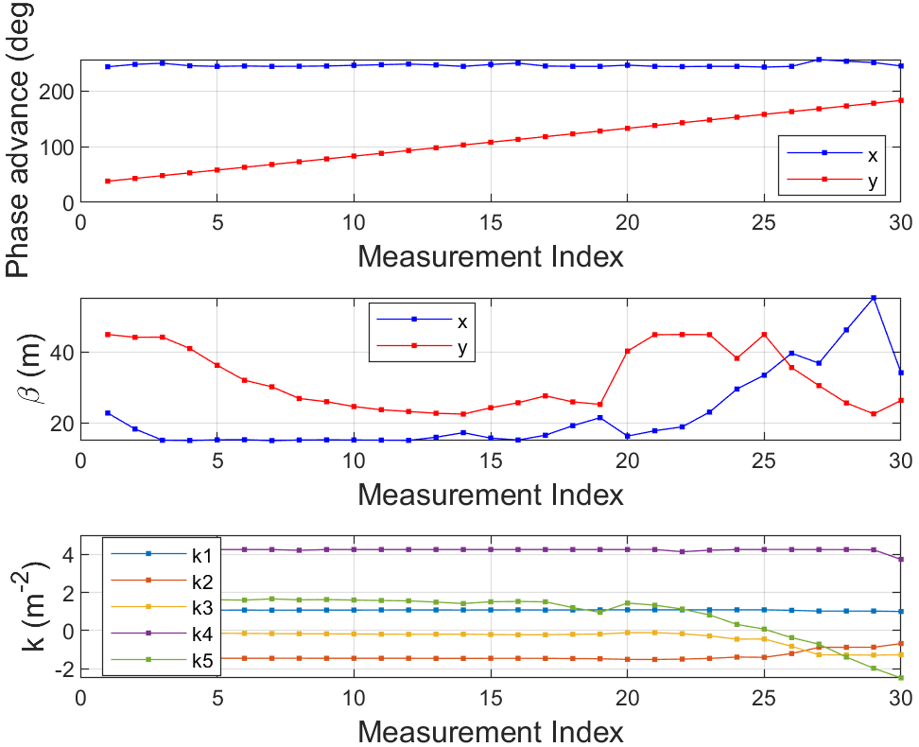
Optics Calculations
Optimazed the SATBD01 quadrupoles for the measurement
Optics calculated to scan the phase advance in the measurement plane and to keep constant the phase advance in the other plane and to keep the beta function up to a reasonable limit

Slide 5
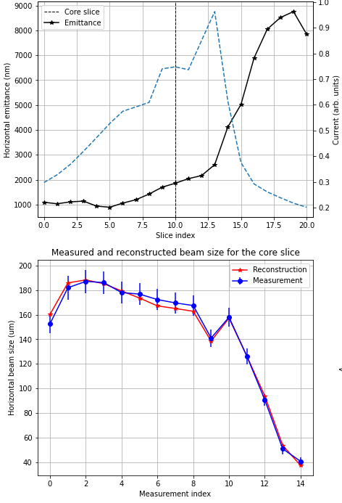
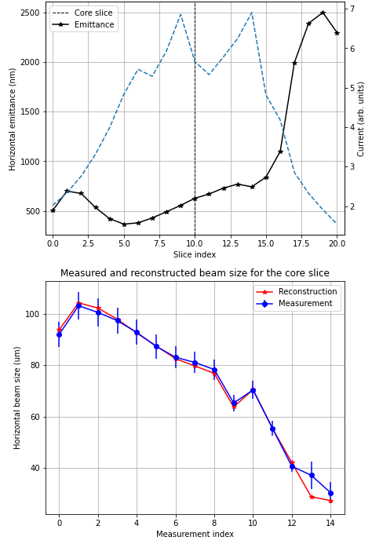
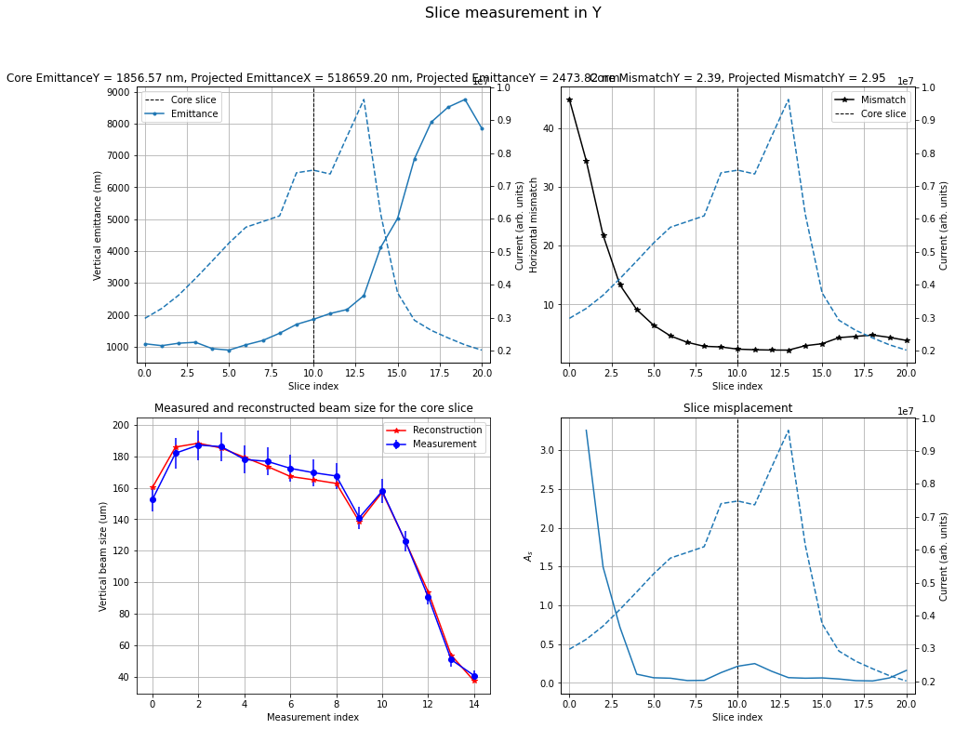
Y Slice Emittance Measurement
After the first scan in y the beam has been further optized by improving matching and compression of the beam

Slide 6
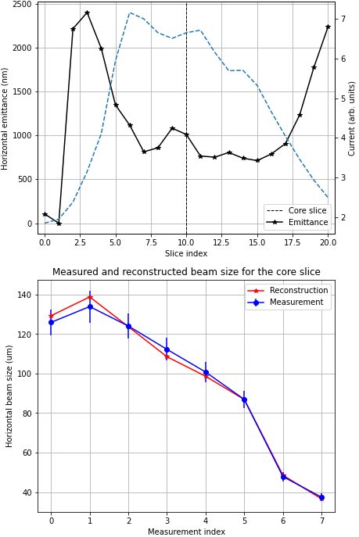
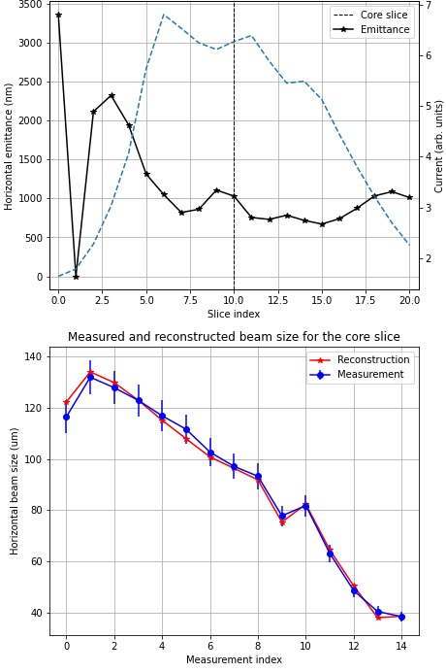
X Slice Scan Comparison
8 points scan
15 points scan

Slide 7
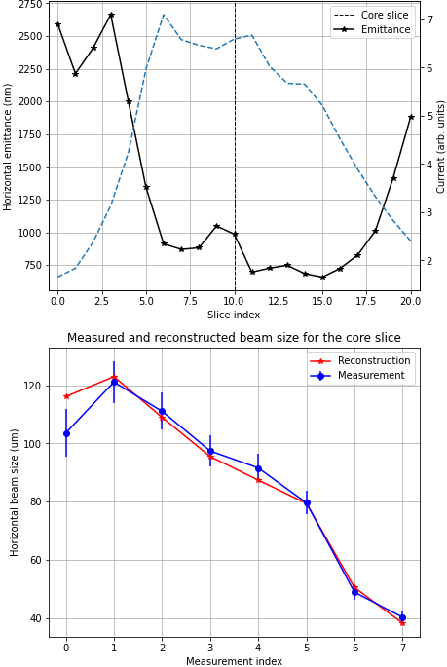
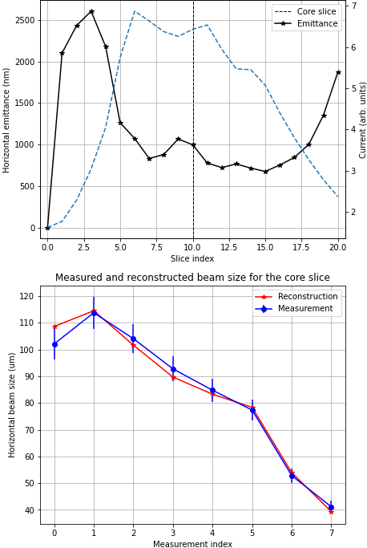
Quadrupoles Cycling Comparison
Slice Emittance in X when cycling the quadrupoles after each scan step
Cycle
No Cycle
For the SATBD01 quadrupoles the reconstructions in the two cases have given a comparable result $→$ there is no need to cycle the SATBD01 quadrupoles every step

Slide 8


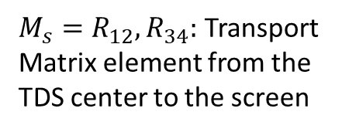


PolariX Calibration Measurement
PolariX TDS calibration for different streaking angles $→$ Measured the Centroid Shift when changing the cavity phase
$V_{0}:$Integrated Voltage
$M_{s}=R_{12},R_{34}:$ Transport Matrix element from the TDS center to the screen
Calibration Factor :
$$C=\frac{eV_{0}M_{s}}{E}2πν [μm/fs]$$
$E:$Beam Energy
$ν :$ Cavity Frequency
Measurement performed with the quadrupoles after the TDS on$→$Optics chosen to have $|sin{μ|}≈1$ and equivalent beta function in X and Y
The polarization has been changed without lowering the RF power $→$ Important for the 5D Reconstruction Measurement planned for 2025

Slide 9
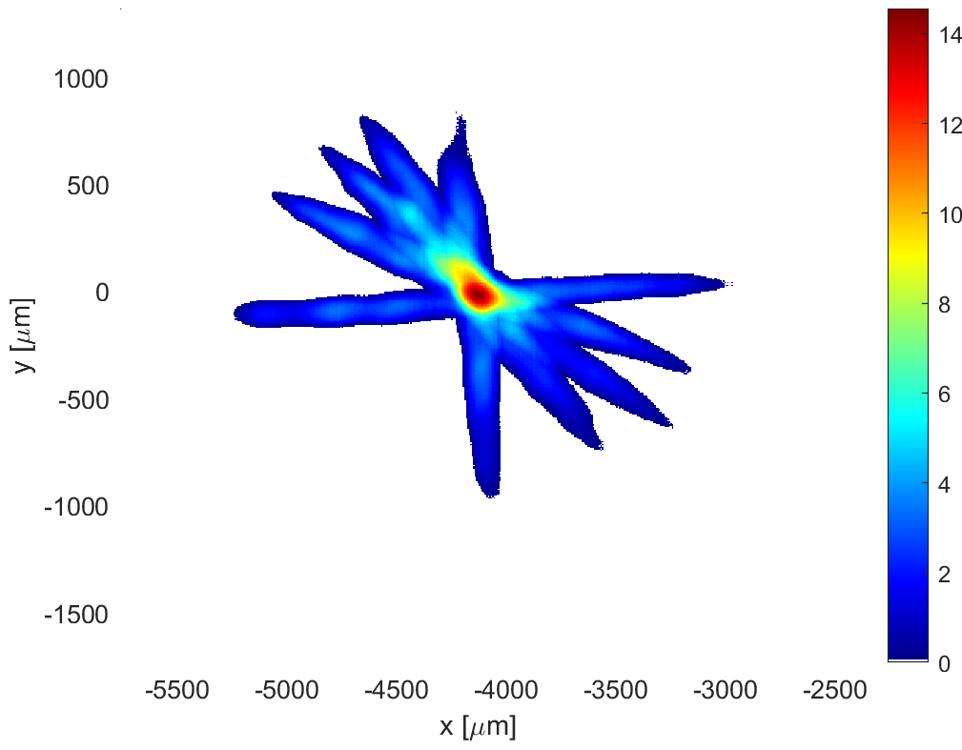

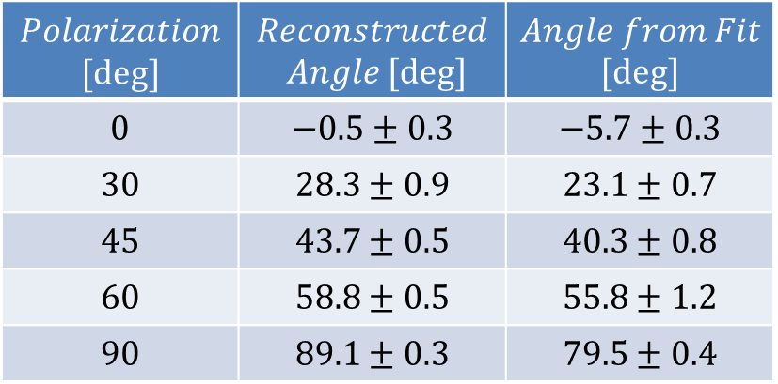
PolariX Streaking Angles
60
90
$$Polarization$$ $$[deg]$$ | $$Reconstructed$$ $$Angle [deg]$$ | $$Angle from Fit$$ $$[deg]$$
$$0$$ | $$−0.5±0.3$$ | $$−5.7±0.3$$
$$30$$ | $$28.3±0.9$$ | $$23.1±0.7$$
$$45$$ | $$43.7±0.5$$ | $$40.3±0.8$$
$$60$$ | $$58.8±0.5$$ | $$55.8±1.2$$
$$90$$ | $$89.1±0.3$$ | $$79.5±0.4$$
45
30
0
$$θ=\tan^{−1}⁡(\frac{C_{y} }{C_{x}})$$
The angles reconstructed from the centroids are in agreement with the set polarization
The beam has an initial tilt that is visible from the different streaking direction
Observed also a change in the zero-crossing phase when changing the polarization and a kick in the plane perpendicular to the streaking

Slide 10
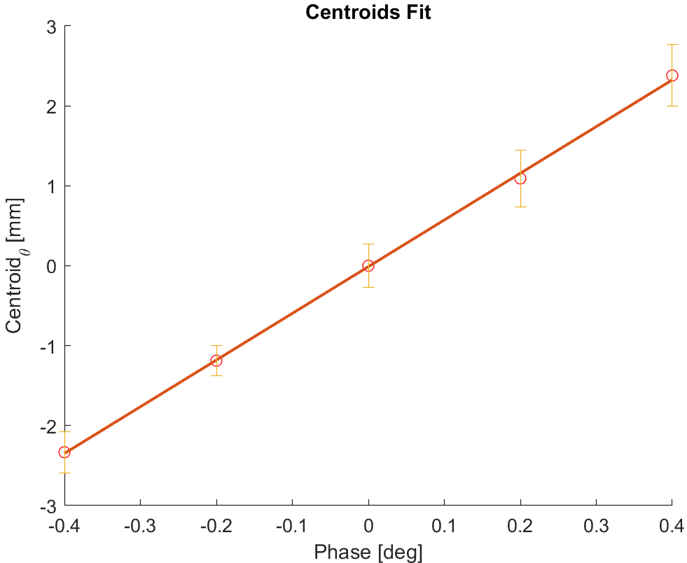
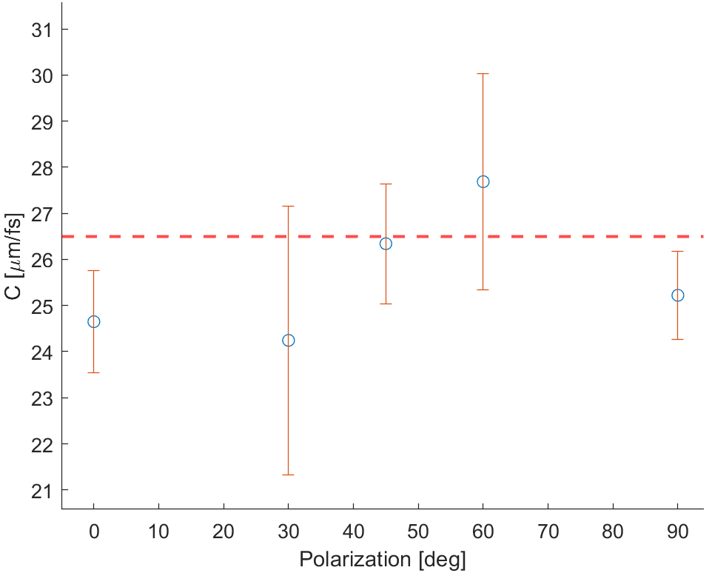
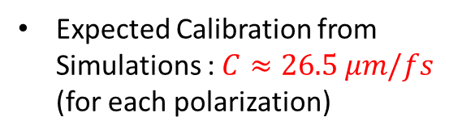
PolariX Calibration Results
5 Phase Points per Correlation in range [-0.4,0.4] deg with respect to the zero-crossing phase
10 Images per Point
90 deg polarization
Expected Calibration from Simulations : $C≈26.5 μm/fs$ (for each polarization)

Slide 11
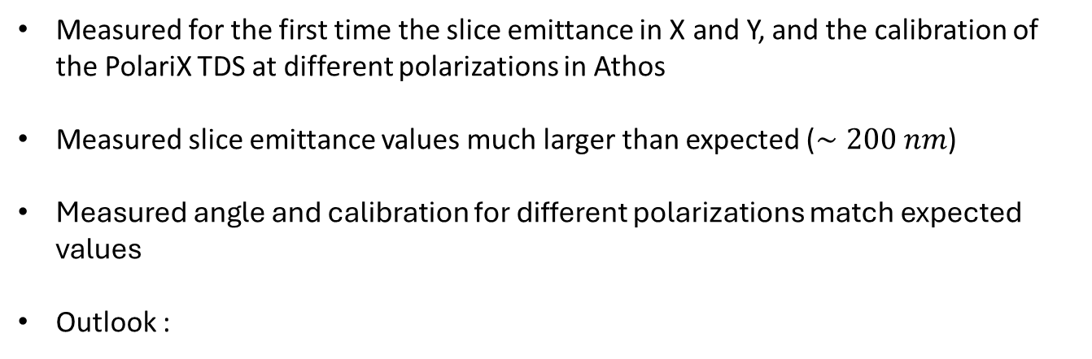
Conclusions
Measured for the first time the slice emittance in X and Y, and the calibration of the PolariX TDS at different polarizations in Athos
Measured slice emittance values much larger than expected ($∼200 nm$)
Measured angle and calibration for different polarizations match expected values
Outlook :
Measurements at higher power
Investigate the large emittance values
3D Beam Charge Reconstruction
5D Phase Space Reconstruction

Slide 12
Thank you for your attention

