Slide 1
Bunch switching and diagnostics
This is tougher than it looks
Pavle Juranić
PSI, 03.12.2024

Slide 2
The Problem
Normal mode:
Gas detector view:
Bunch switching confuses the gas detector
The gas detectors were coded to look at bunch 1 on Aramis, and bunch 2 on Athos. Various alarms and features depend on seeing a charge or frequency.
If you switch the bunches, Aramis is getting information from Athos and vice versa for this, causing possible issues.
Bunch 1 Freq and charge
Aramis Freq and charge
Athos sees Athos freq and charge
Aramis sees Aramis freq and charge
Bunch 2 Freq and charge
Athos Freq and charge
Bunch Switch mode:
Athos sees Aramis freq and charge
Athos sees Athos freq and charge
Bunch 1 Freq and charge
Aramis Freq and charge
Bunch 2 Freq and charge
Athos Freq and charge

Slide 3
The solution for gas detectors … or so we thought
We create PVs that can be looked at by devices that we put in the bunch 1 or bunch 2 properties in.
We tried it, and it looked OK! When the beam goes off, gas detector goes off on the right beamline.
However, an issue pops up when we have different rep rates in different beamlines.
Bunch 1 Freq and charge
Aramis Freq and charge
Athos sees Athos freq and charge
Aramis sees Aramis freq and charge
Bunch 2 Freq and charge
Athos Freq and charge
Bunch 1 Freq and charge
Aramis Freq and charge
Athos sees Athos freq and charge
Aramis sees Aramis freq and charge
Bunch 2 Freq and charge
Athos Freq and charge

Slide 4
The solution for gas detectors … or so we thought
We create PVs that can be looked at by devices that we put in the bunch 1 or bunch 2 properties in.
We tried it, and it looked OK! When the beam goes off, gas detector goes off on the right beamline.
However, an issue pops up when we have different rep rates in different beamlines.
Bunch 1 Freq and charge
Aramis Freq and charge
Athos sees Athos freq and charge
Aramis sees Aramis freq and charge
Bunch 2 Freq and charge
Athos Freq and charge
Bunch 1 Freq and charge
Aramis Freq and charge
Athos sees Athos freq and charge
Aramis sees Aramis freq and charge
Bunch 2 Freq and charge
Athos Freq and charge
Many thanks to Didier Voulot for creating the PV’s, and Scott Stubbs for adapting the IOC’s. Thanks to Philipp Dijkstal for the bunch switching and overall coordination.

Slide 5

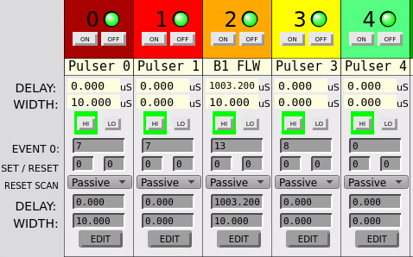
Event triggers are hard-coded
All EVRs are looking at the events for their timing. Cameras, ADC, etc. The two events looked at are Generic B1 Follow (13) and Generic B2 Follow (52).
To change the EVRs, you need to change all of them one by one for the bunch switching. This is a pain.
So, if the rep rates are different, the fast signals get very confused at all diagnostics devices. You can make them work on a case-by-case basis.

