Slide 1
MuX meeting 29/11/2024
Marie Deseyn

Slide 2
Geant4 update

Slide 3
Geant4 simulations - status
Update of my simulations (big clean-up) | Done, everything can now easily be done with json files for different types of detectors, for scintillators, for beamlinepieces, … + energy deposition in all elements is possible now
Simulation of the array of last year | Not yet finished, all detectors are in but not miniball and the drawing-less detectors: Lege, Telescope, Leuven90 (waiting for the drawing from Reinaud), miniball (translate from my old simulation, should go rather quick as I don’t want this to be very adaptable) + need to compare to the calibration spectra
Scintillator design | Did very basic simulations (see later) Working on the bremsstrahlung tracking (not fully needed, but would be nice to see where brem is coming from)
Gradient descent for position optimization | Not much progress (to fix the 6e8 combinations in python and subsequent crashing)
New cluster | To make compatible with cluster, I now stopped using root in G4 simulations but I used G4 functions + fixed associated problems with multithreading (bremcode not yet updated)
Geant4 simulations for stepheight of hypermet | In progress

Slide 4
Angle conventions
Thetax = 30
Thetax = 0
Thetax = -30
Side view
Side view
Side view
Northern hemisphere
Soutern hemisphere
Thetay = 0
Thetay = 90
Thetay = 100
Top view
Top view
Top view
downstream
upstream

Slide 5
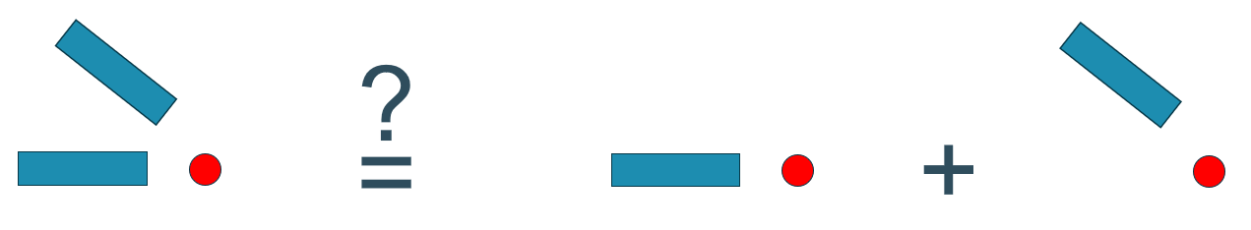
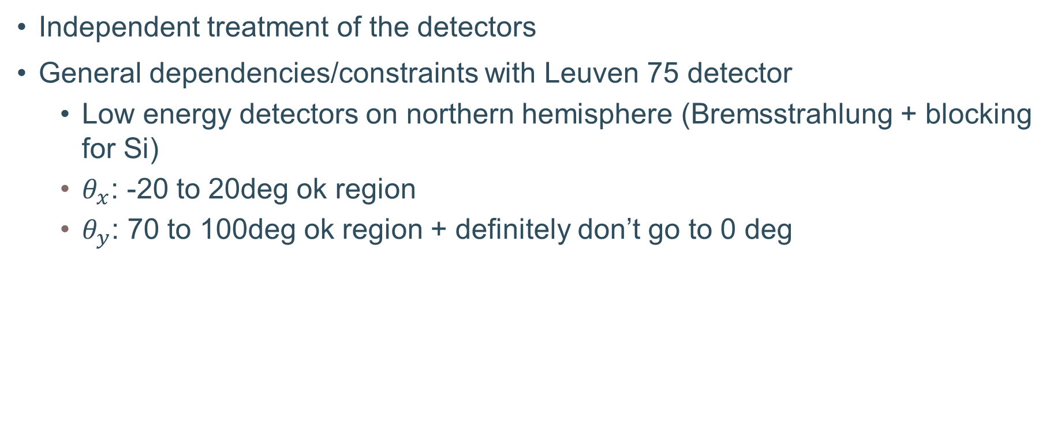
Main conclusions from the beamtime preparation work
Independent treatment of the detectors
General dependencies/constraints with Leuven 75 detector
  Low energy detectors on northern hemisphere (Bremsstrahlung + blocking for Si)
  $θ_{x}$: -20 to 20deg ok region
  $θ_{y}$: 70 to 100deg ok region + definitely don’t go to 0 deg

Slide 6
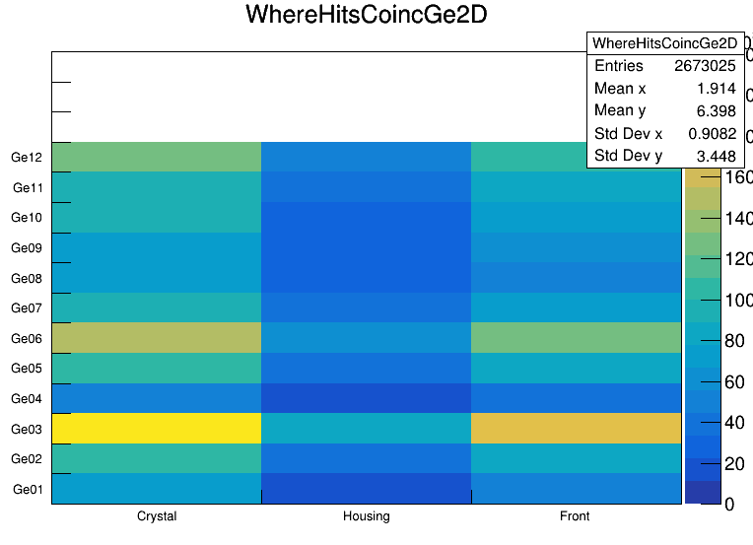
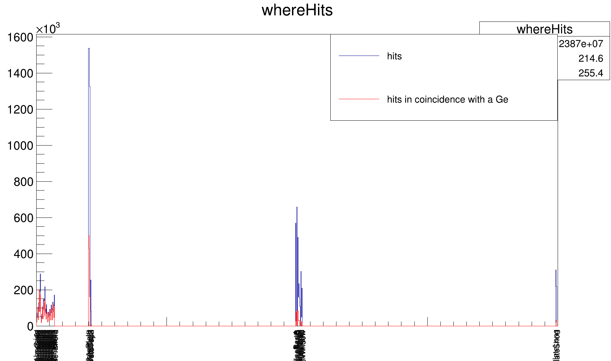
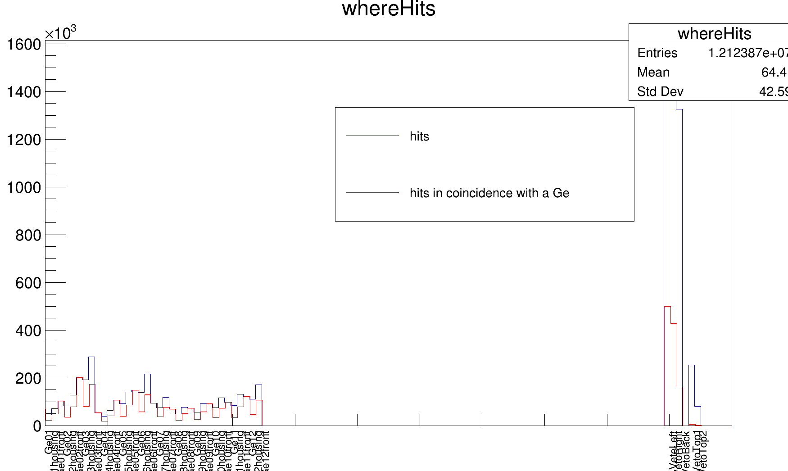
Examples of what I can do now

Slide 7
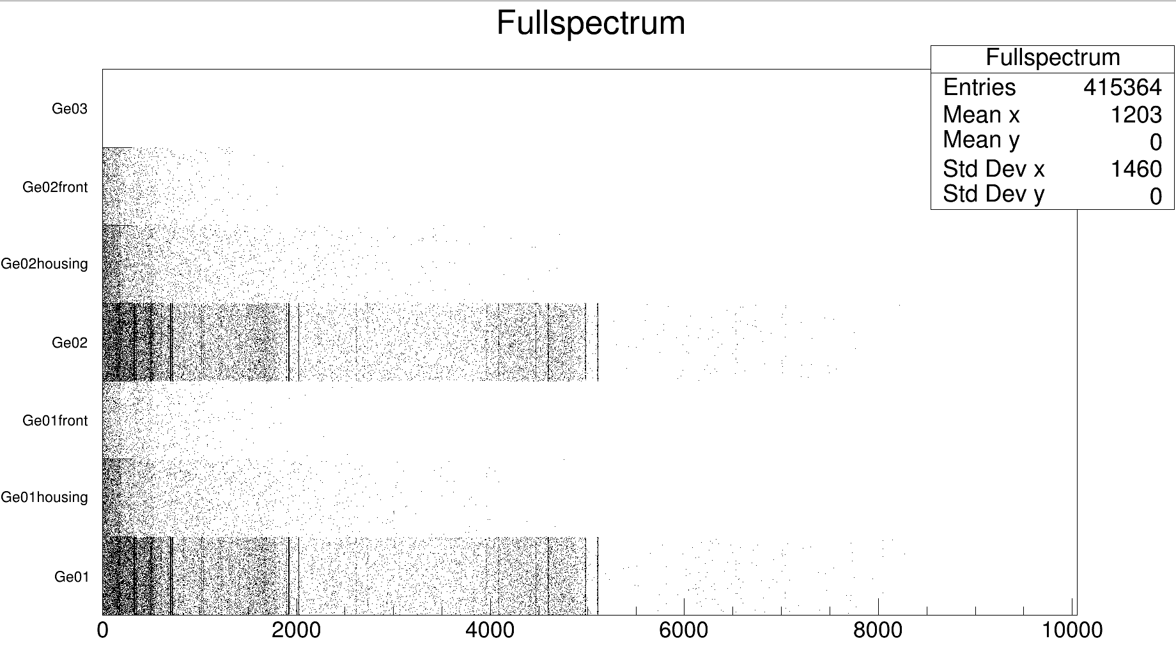
Examples of what I can do now

Slide 8
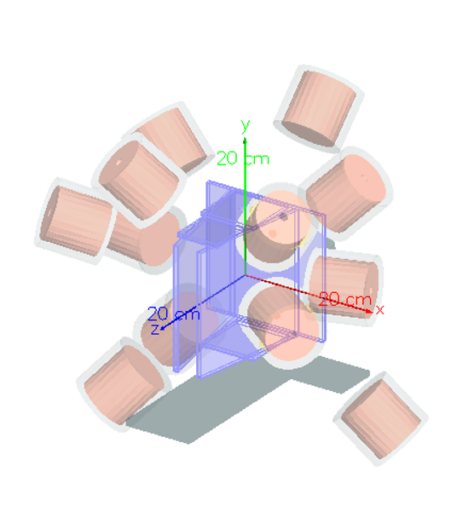
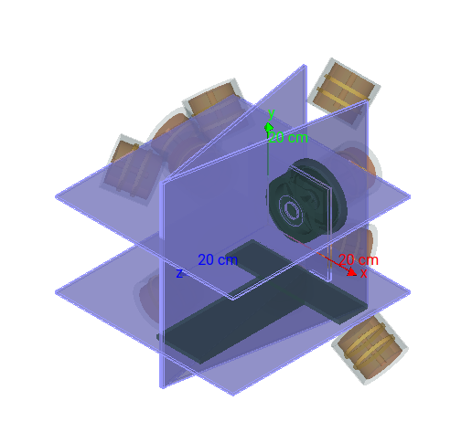
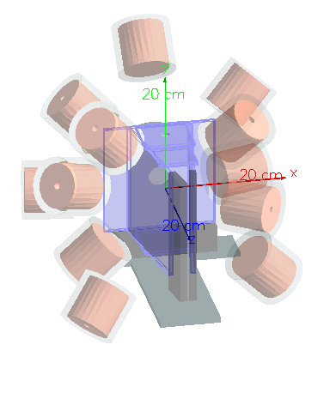
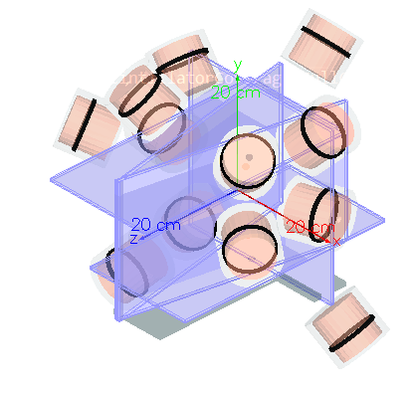
Scintillators

Slide 9
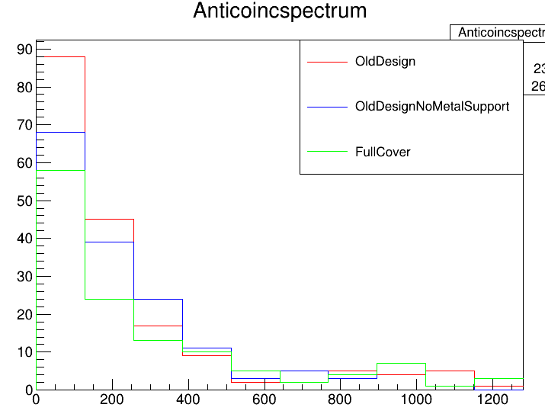
Scintillators
Integral ([0,4000]) of OldDesign spectrum: 203
Integral ([0,4000]) of OldDesignNoMetalSupport spectrum: 179
Integral ([0,4000]) of FullCover spectrum: 164

Slide 10
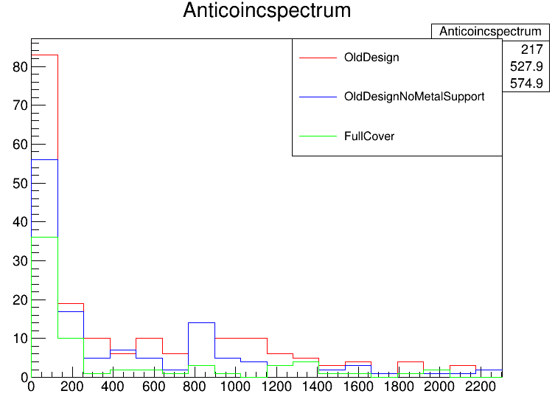
Scintillators
Integral ([0,4000]) of OldDesign spectrum: 212
Integral ([0,4000]) of OldDesignNoMetalSupport spectrum: 143
Integral ([0,4000]) of FullCover spectrum: 72

Slide 11
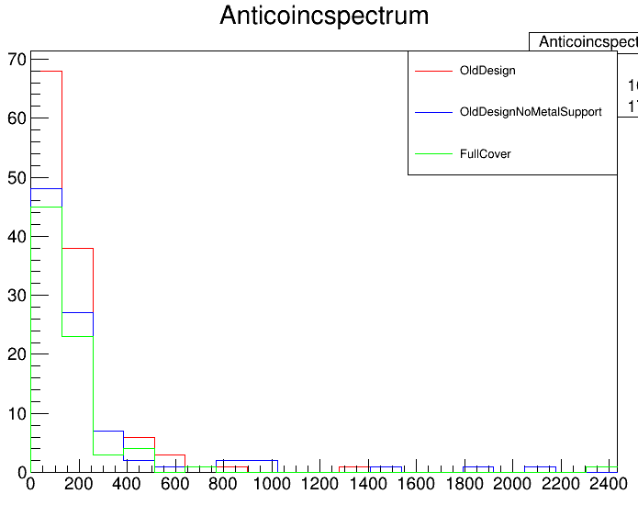
Scintillators
Integral ([0,4000]) of OldDesign spectrum: 127
Integral ([0,4000]) of OldDesignNoMetalSupport spectrum: 99
Integral ([0,4000]) of FullCover spectrum: 78

Slide 12
Idea with Razvan and Christian
Before each germanium detector: put a scintillator detector with 3D printed endcap to fit on all snouts
Redesigning the scintillators around the target
Guided by Geant4 simulations

Slide 14
Si data

Slide 15
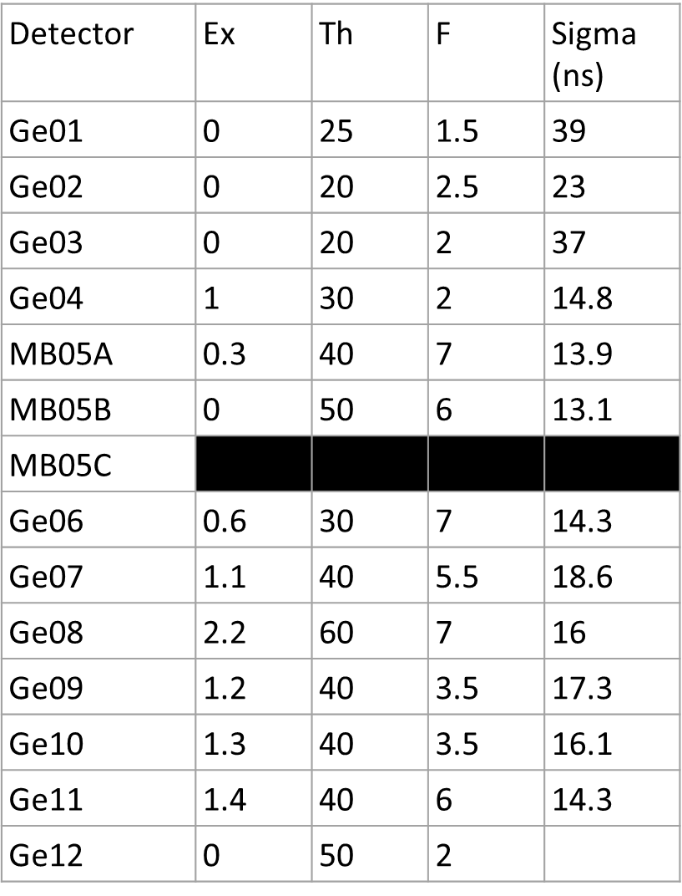
ELET
ELET overview table:
(USING RUN 71290 - 71295)

Slide 16
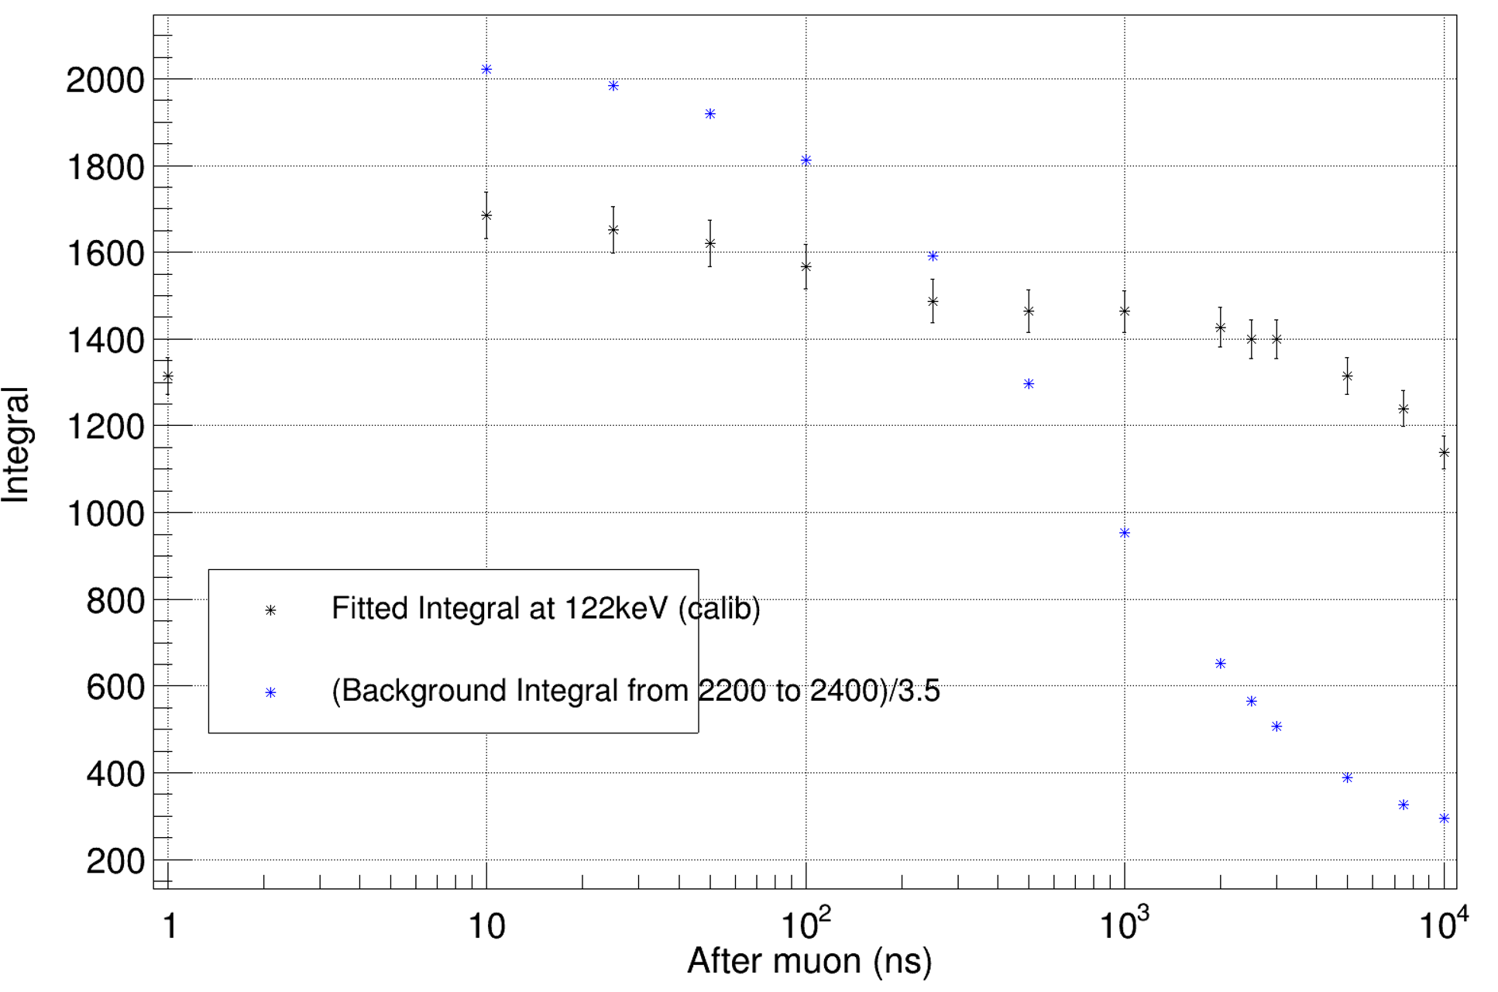
Anticoincidence windows
For negative time → Decided to look at background content vs. calibration line content
Decided on -3000ns

Slide 17
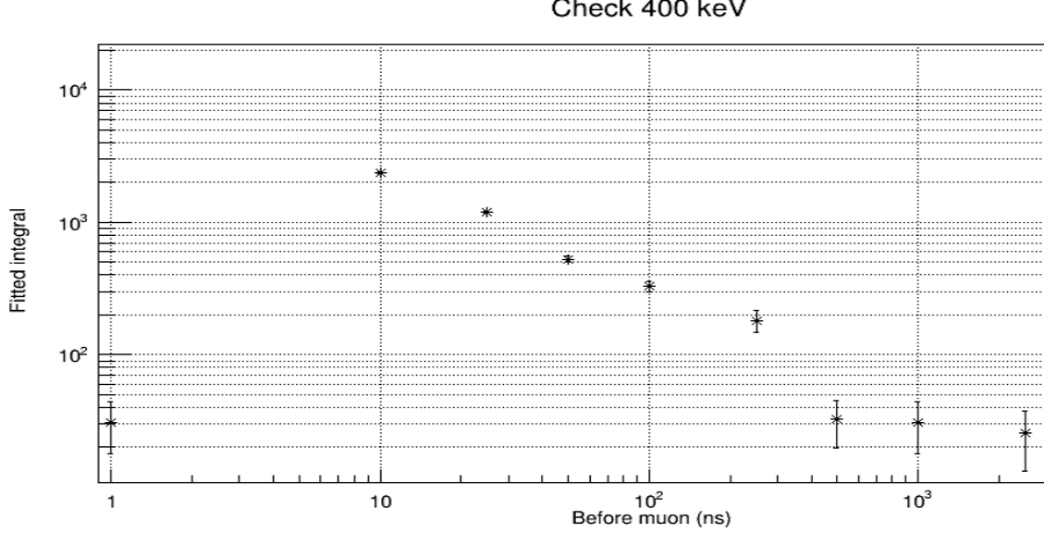
Anticoincidence windows
1000ns to be conservative (Because there is miniball who has this periodic noise that might trigger before the real muonic x ray is emitted)
Muonic x ray at 400keV

Slide 18
Used lines
Energy [keV] | Origin
1173.228 | Co60
1332.492 | Co60
302.8508 | Ba133
383.8485 | Ba133
1460.820 | K40
661.657 | Cs137
344.2785 | Eu152
778.9045 | Eu152
121.7817 | Eu152
867.380 | Eu152
1112.076 | Eu152
1408.013 | Eu152
Separate for Batch1 (Al and empty run); Leuven90 and Lege

Slide 19
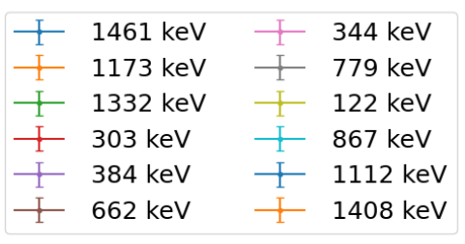
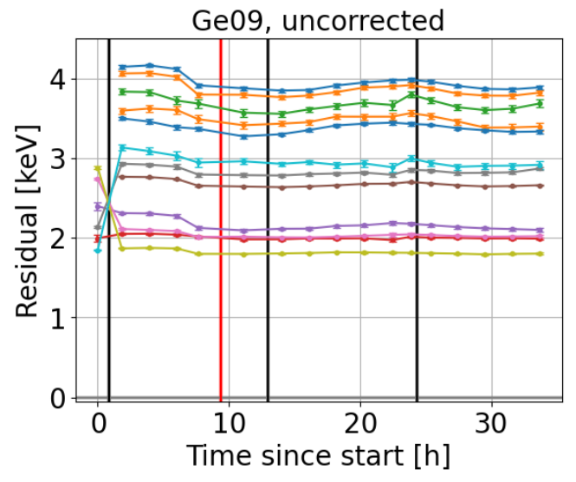
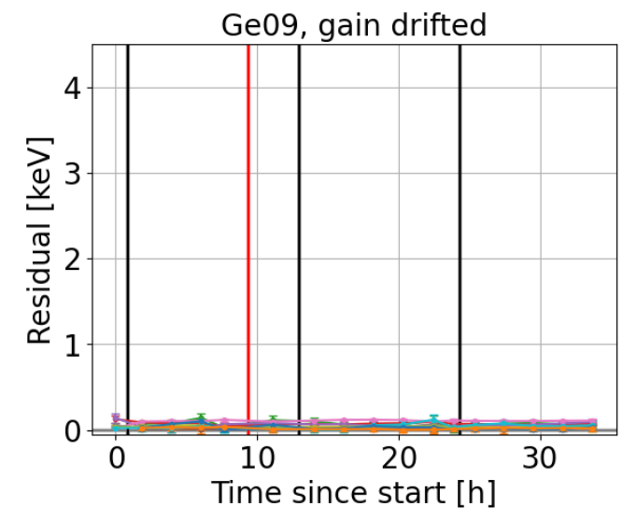
Evaluation of the gain drift

Slide 20
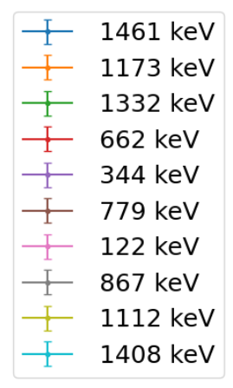
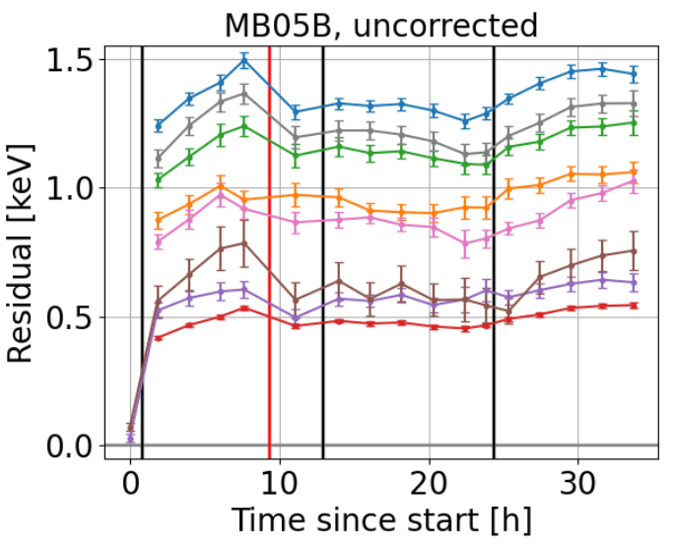
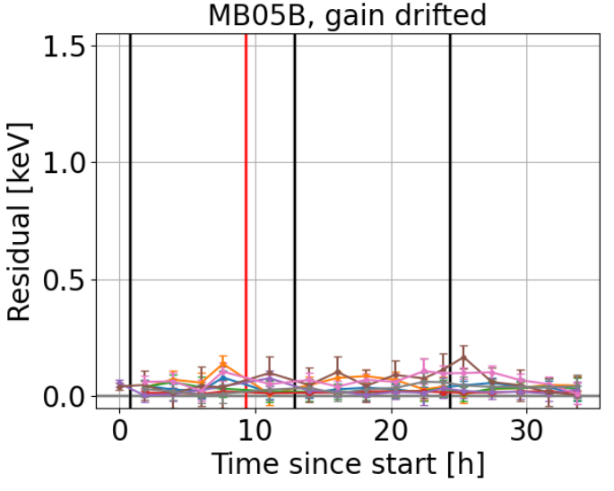
Evaluation of the gain drift

Slide 21
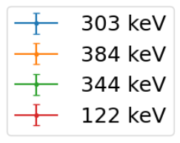
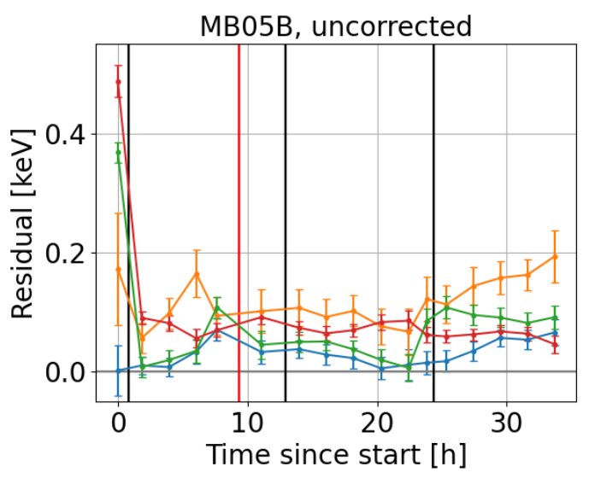
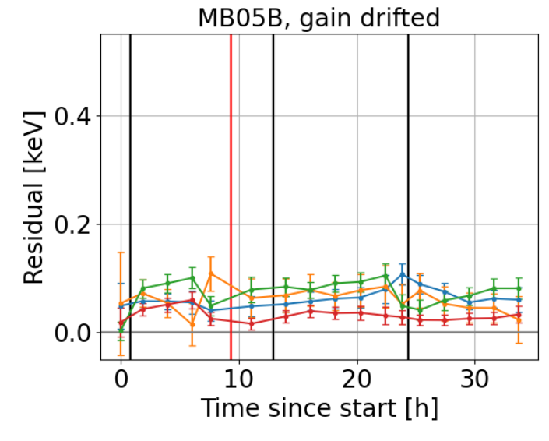
Evaluation of the gain drift

Slide 22
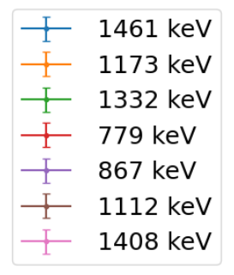
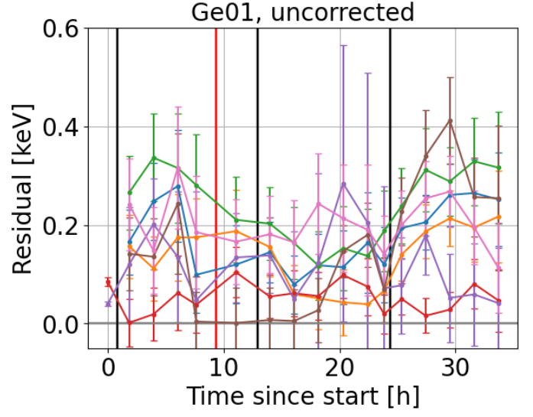
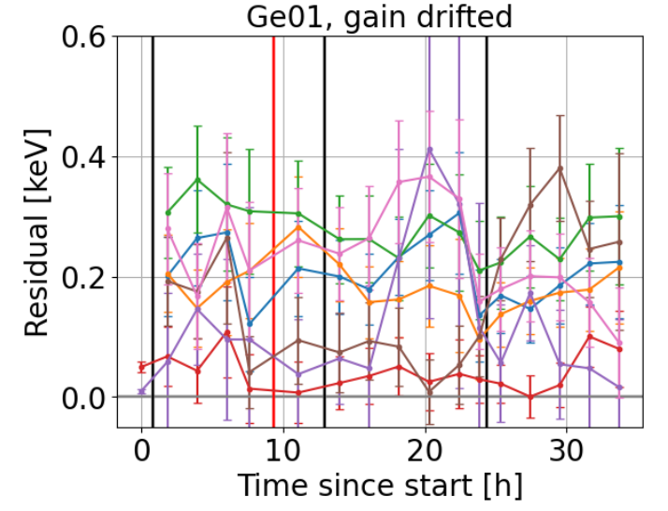
Evaluation of the gain drift

Slide 23
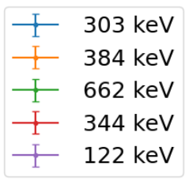
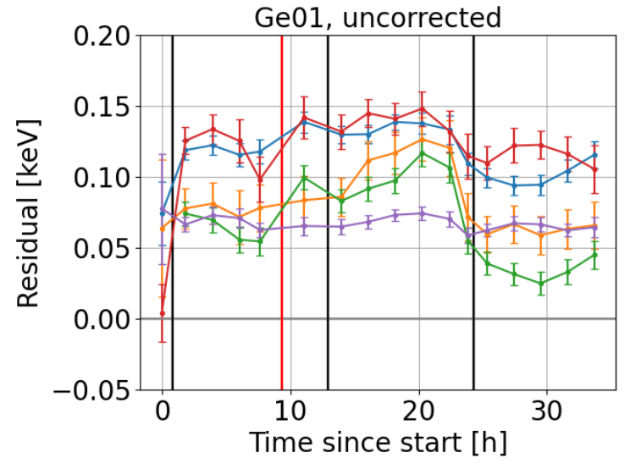
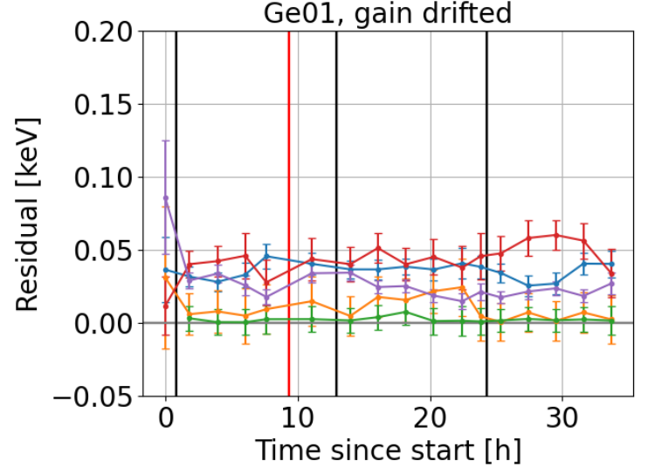
Evaluation of the gain drift

Slide 24
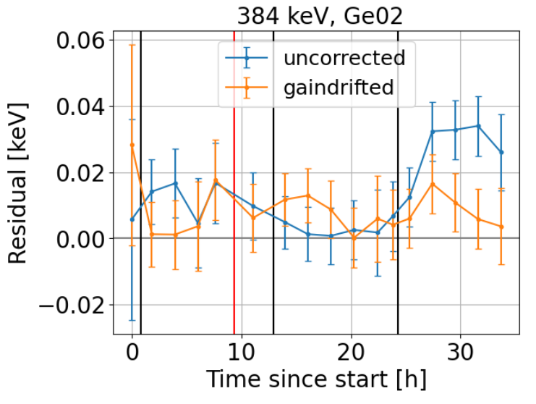
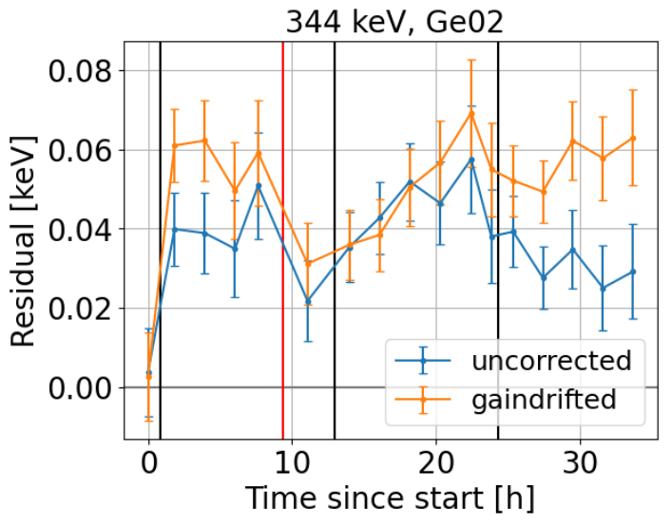
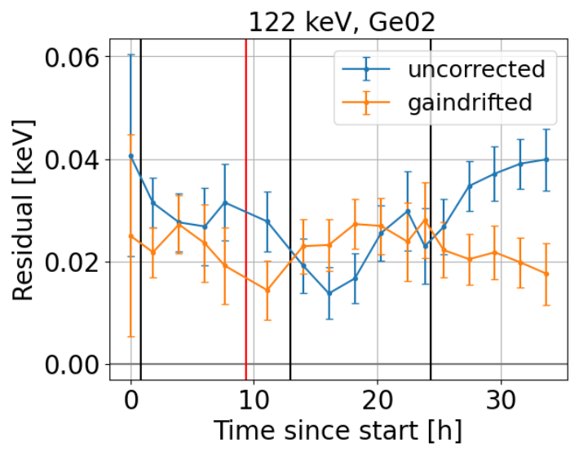
Evaluation of the gain drift

Slide 25
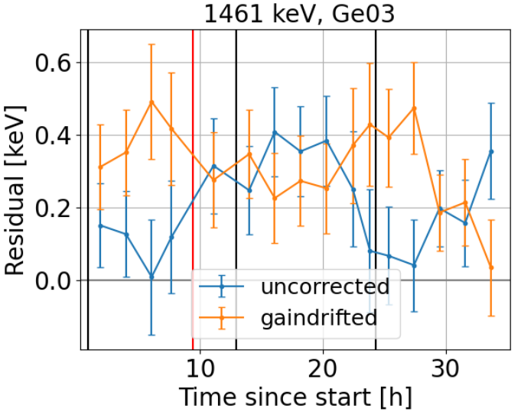
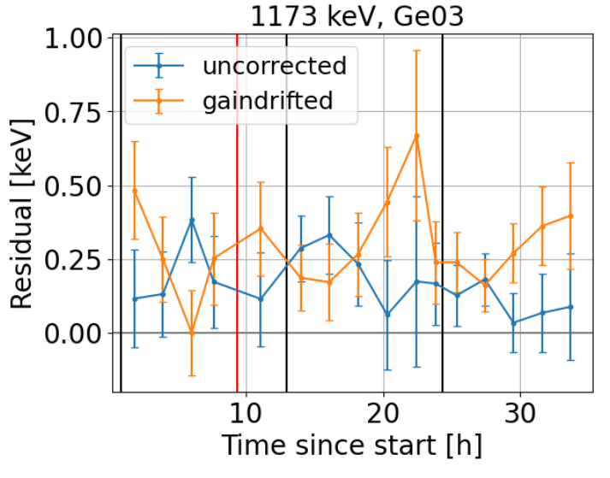
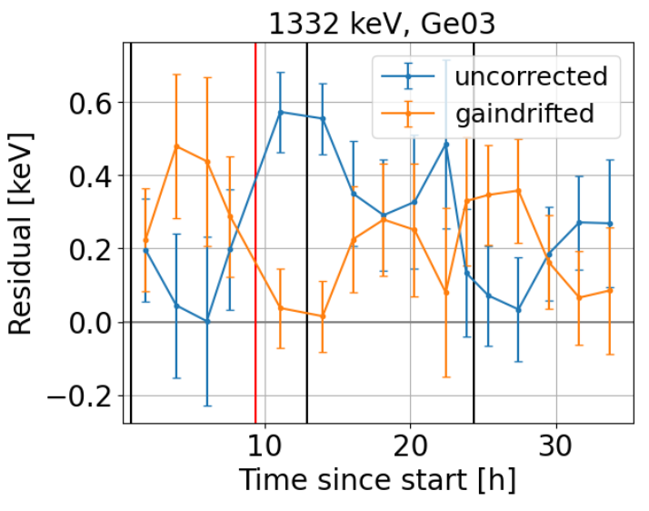
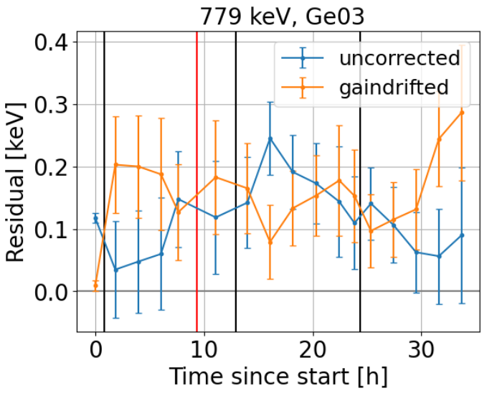
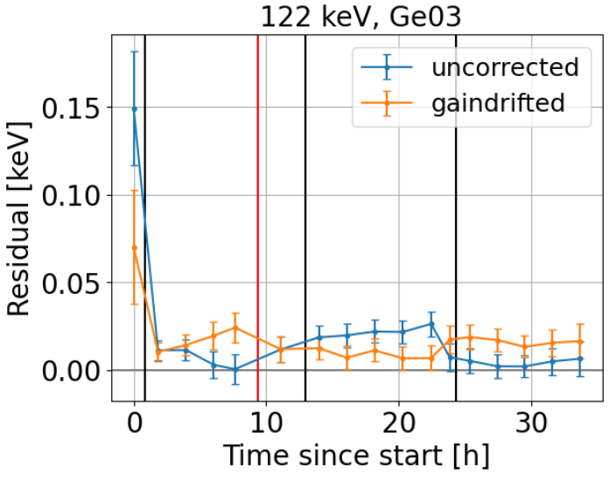
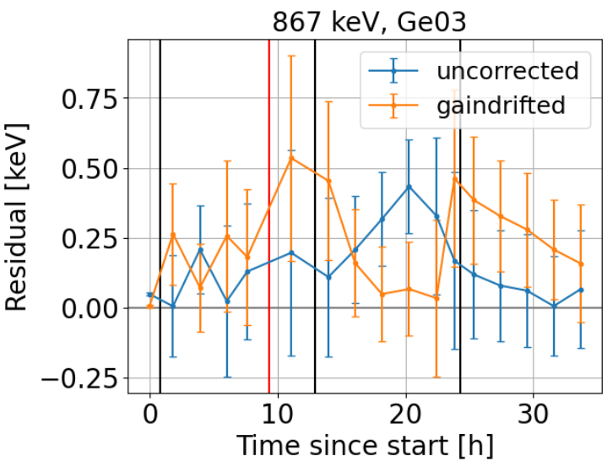
Evaluation of the gain drift

Slide 26
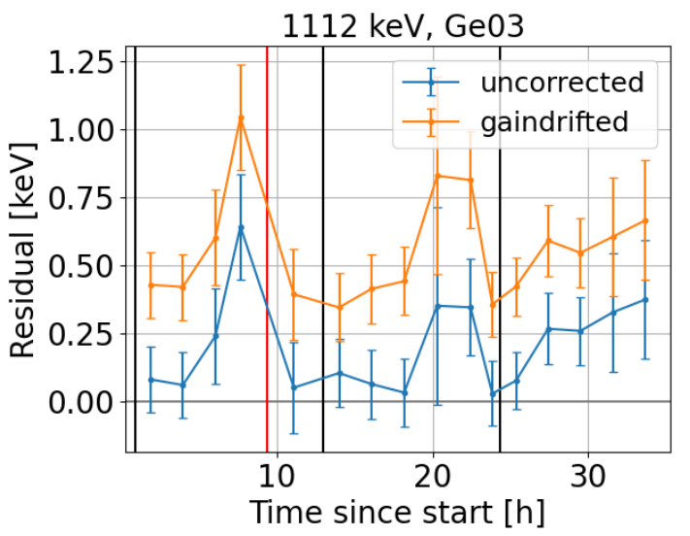
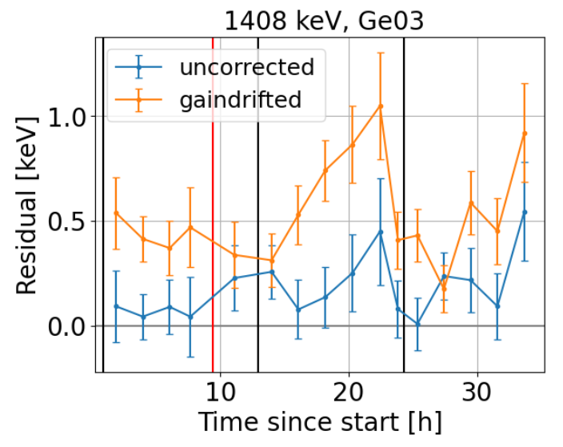
Evaluation of the gain drift

Slide 27
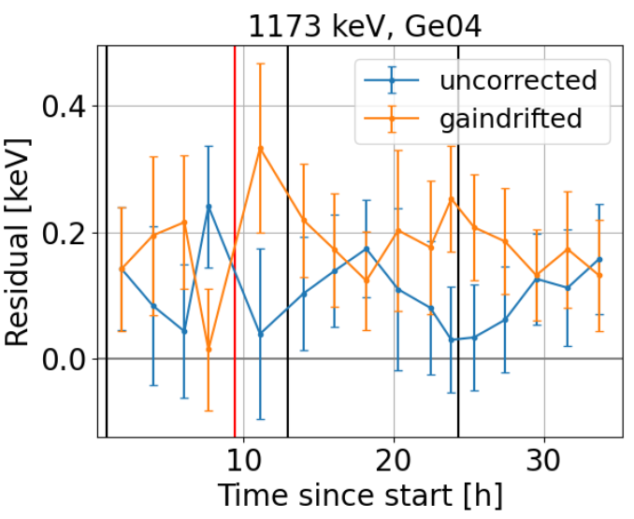
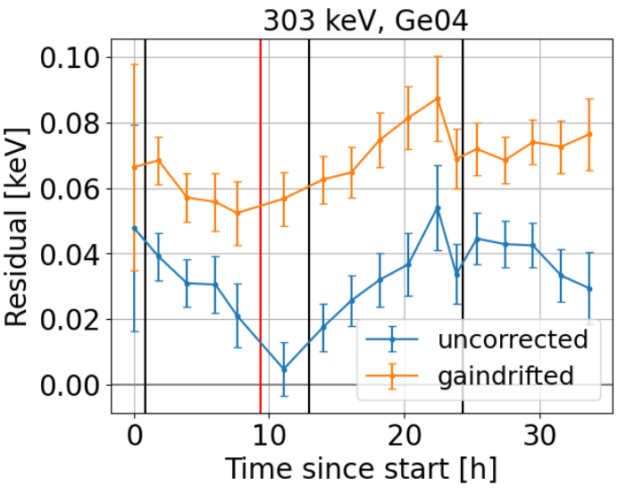
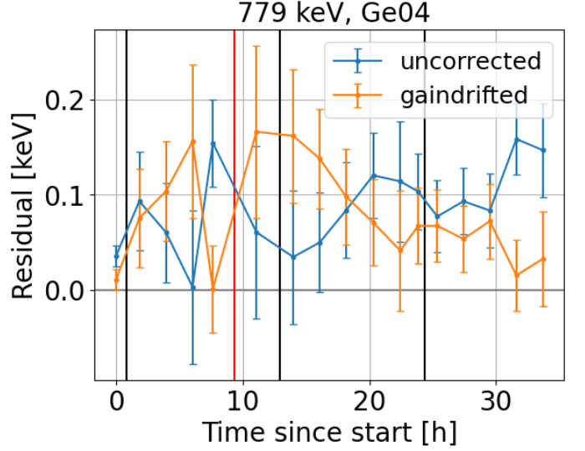
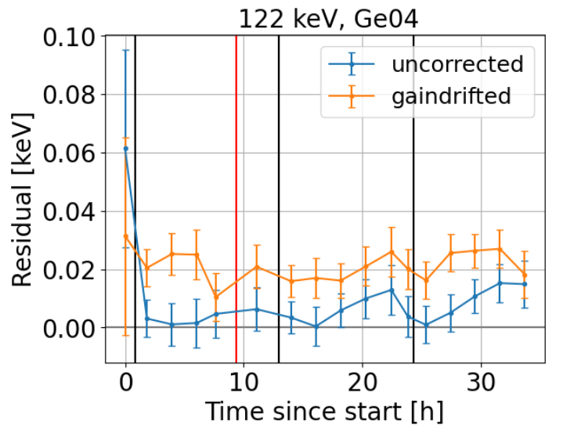
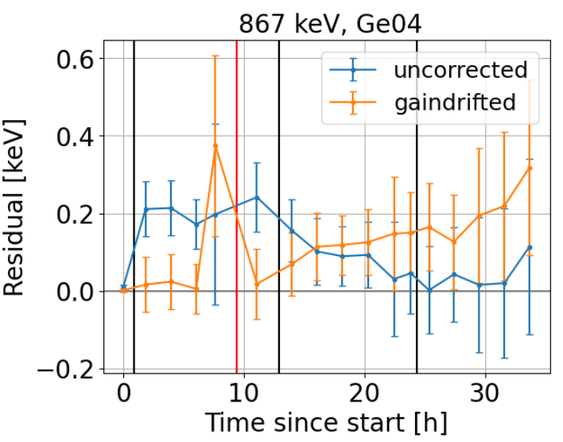
Evaluation of the gain drift

Slide 28
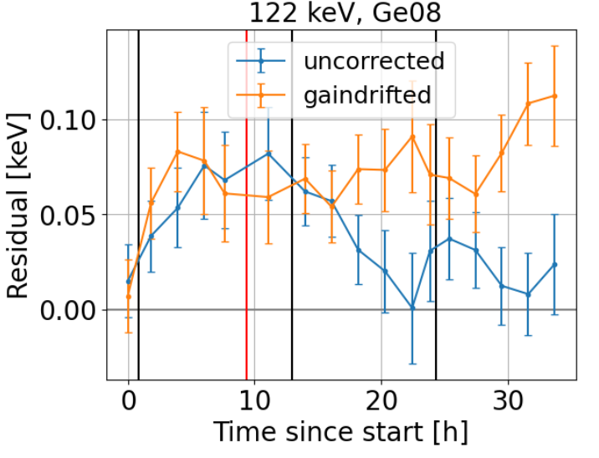
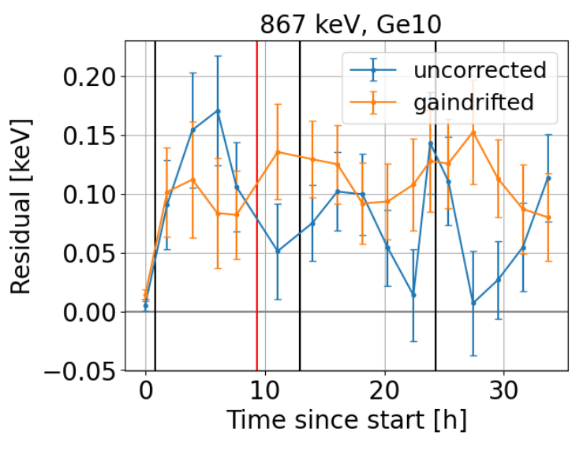
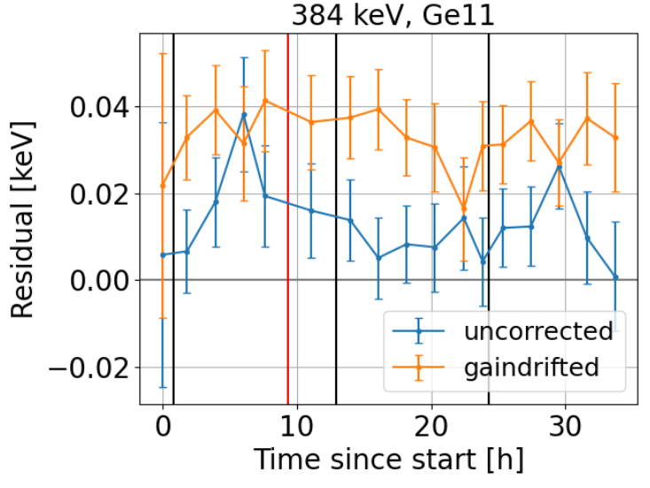

Evaluation of the gain drift

Slide 29


