Slide 1
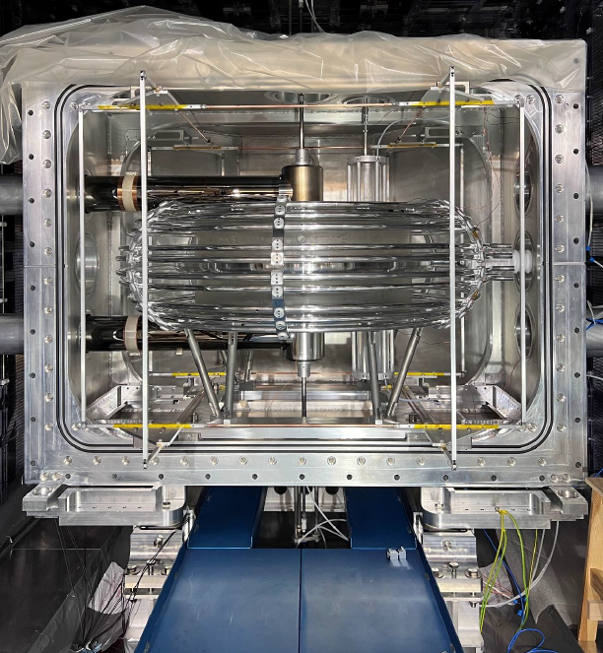
Status of the n2EDM experiment (2024)
Towards a new measurement of
the neutron Electric Dipole Moment
Thomas Lefort on behalf of the nEDM collaboration
Notes:
Very low pressure to prevent Hg depolarization due to the presence of residual gases (H20 for instance)

Slide 2
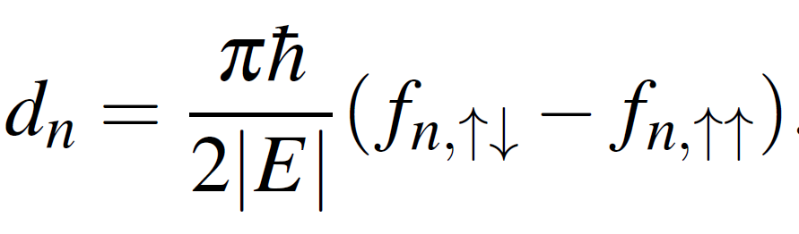
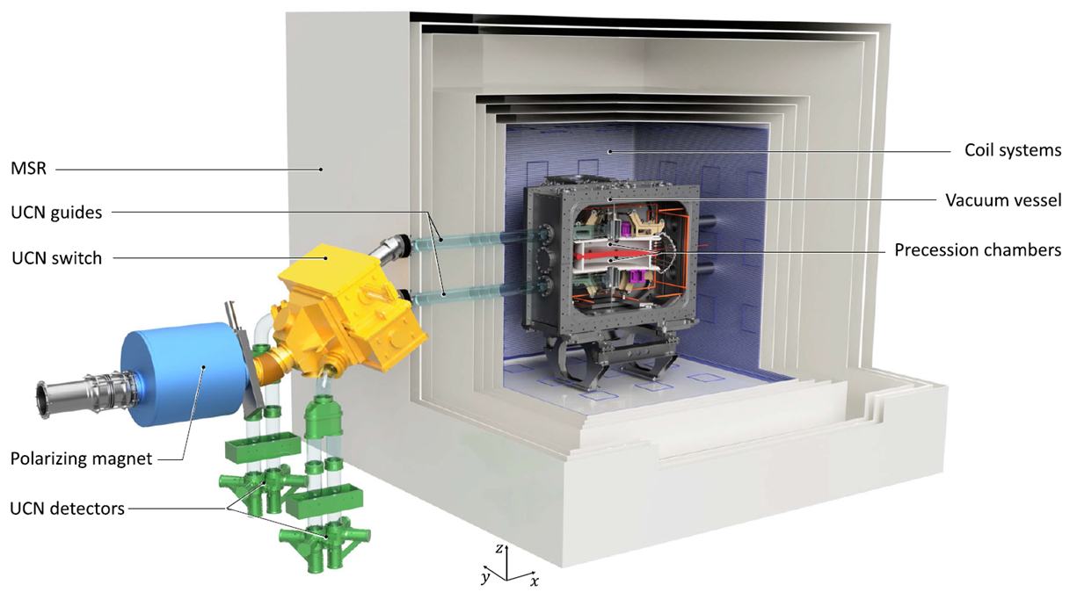
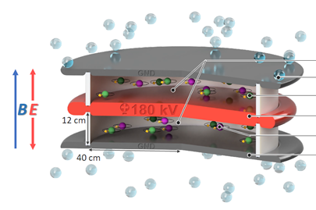
The n2EDM experiment design
From the measurement of two frequencies (parallel and antiparallel fields configurations)
→ Ramsey’s method: required polarized neutrons
Storage chambers where neutron frequency measurement is performed
Two main challenges
neutron statistic & magnetic field uniformity and stability

Slide 3
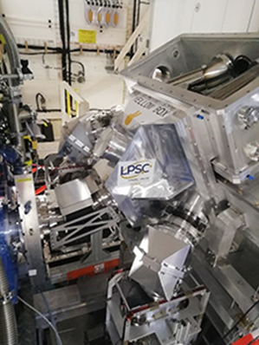
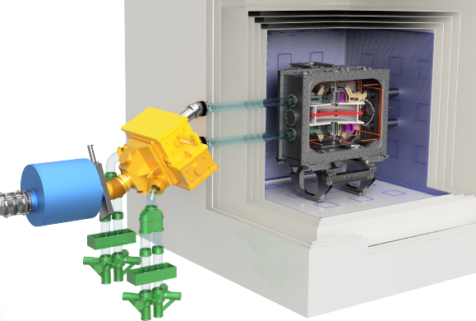
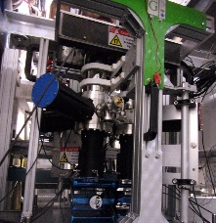
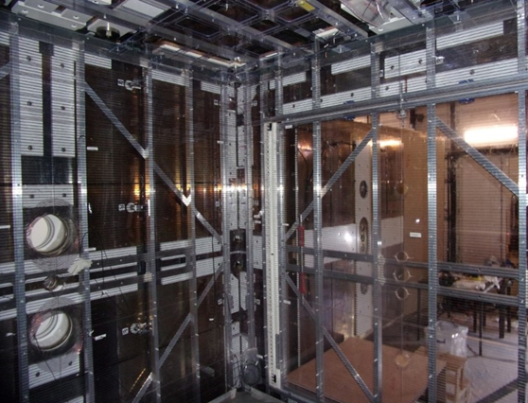
2023: short reminder
- First UCN in the fully assembled apparatus
- Neutron frequency measured (Ramsey’s method)
Switch box
Precession chambers in the vacuum tank
UCN detectors and spin analyzers
Internal coils system
UCN statistic: 10,000 per chamber (factor 6 below design goal)
Missing crucial subsystems:
- Magnetometry (Hg, Cs): still under development
- HV: bipolar power supply failed (no electric field) !
2024 goal: first nEDM measurement

Slide 4
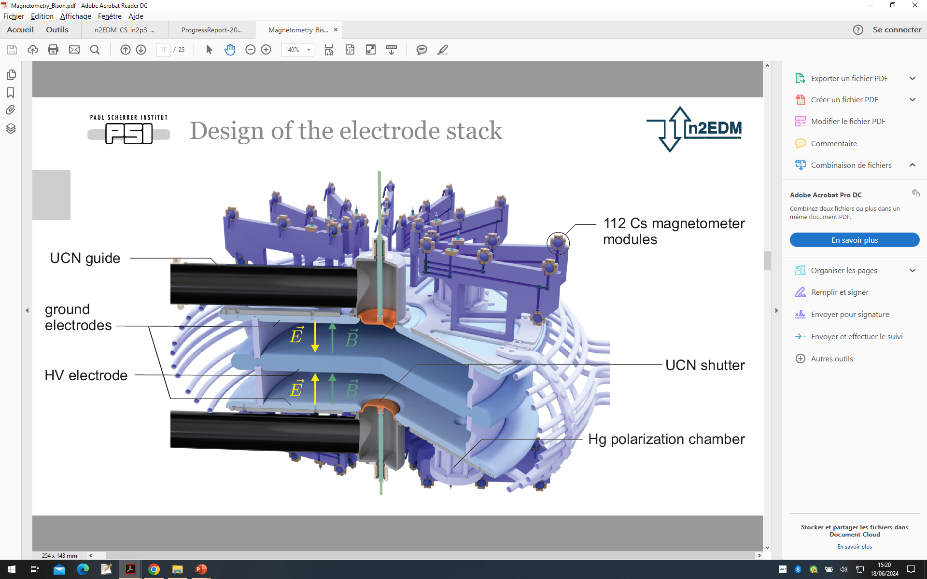
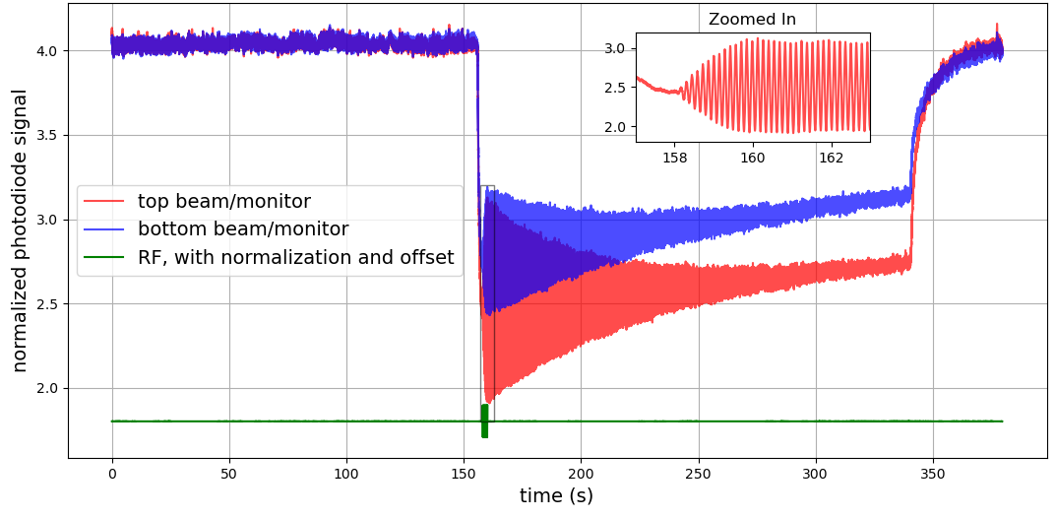
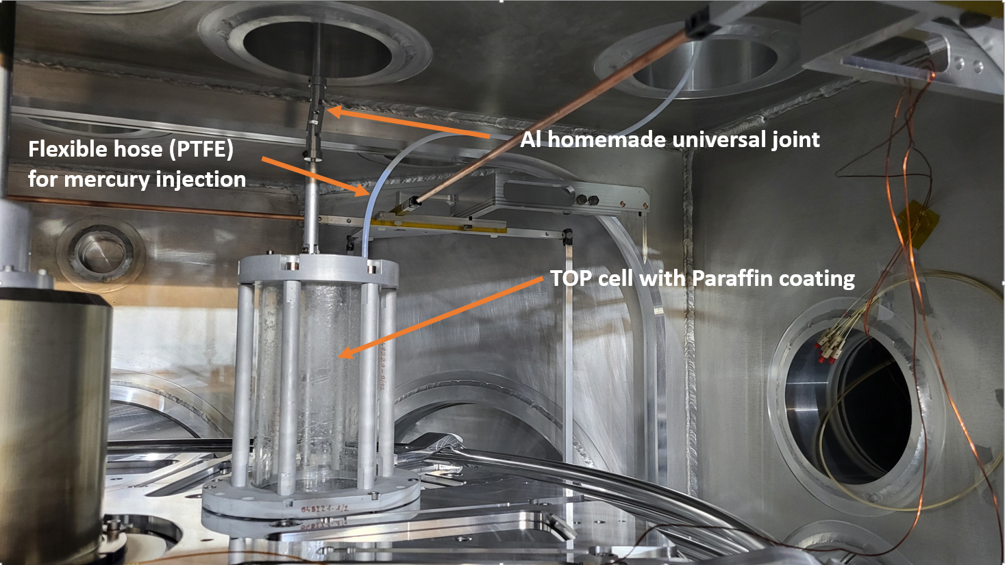
2024 achievements: Hg co-magnetometer
Online monitoring of the magnetic field drift in the chambers: mandatory for nEDM measurement (R = f_{n}/f_{Hg})
Hg co-magnetomer operational over weeks:
T₂ (TOP) = 50 s ; T₂ (BOT) = 80 s
Performance still be improved but nearly at the design goal sensitivity (factor ~ 4 missing)
Operational for nEDM measurement (but sensitivity to improve)
Hg polarization chamber)

Slide 5
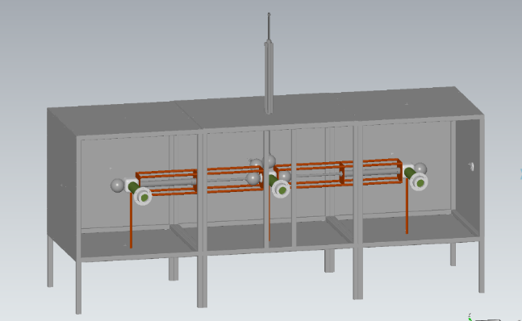
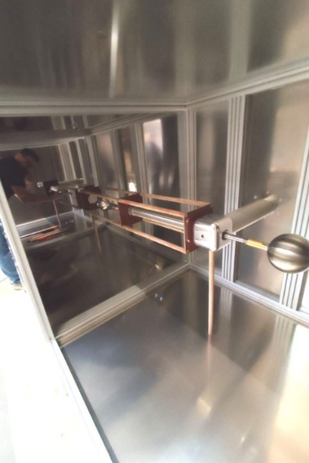
2024 achievements: high voltage
Electric field generation: mandatory for nEDM measurement
Bipolar power supply replaced by two unipolar supplies (300 kV)
Full setup tested for the first time in 2024
Performance:
Stable (sparkless) operation at 150 kV (E= 12.5 kV/cm) : ready for data taking !
Up to 180 kV (design goal) but sparkling (conditioning procedure to improve)
Polarity switcher needed: development started in 2024
Commissioning during 2025 shutdown
Goal: remote control of polarity changes (switcher) ready before restart of data taking

Slide 6
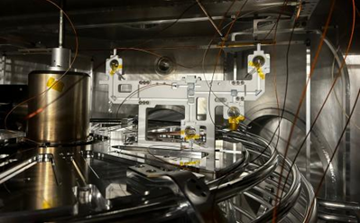
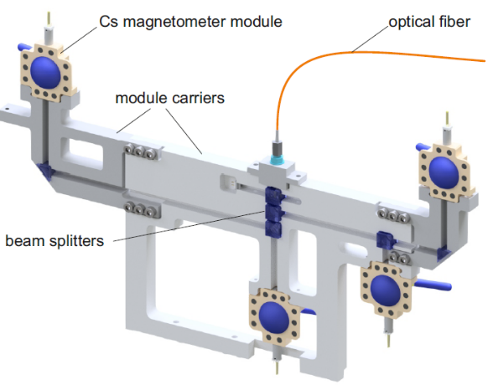
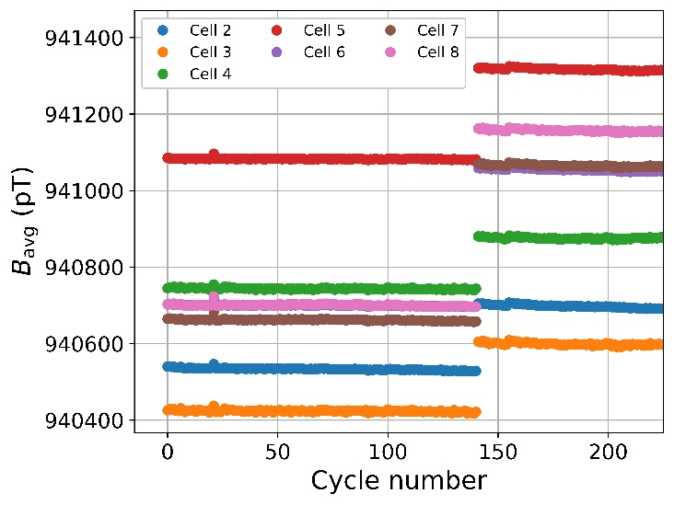
2024 achievements: Cs magnetometers
Online monitoring of field non uniformities (G₃₀): systematic assessment
Two Cs units installed in 2024: steady operation over weeks
One Cs unit (4 cells)
Cs magnetometry planning:
2025: half of Cs setup installed (56 cells) before data taking
2026: full Cs setup installed (112 cells)

Slide 7
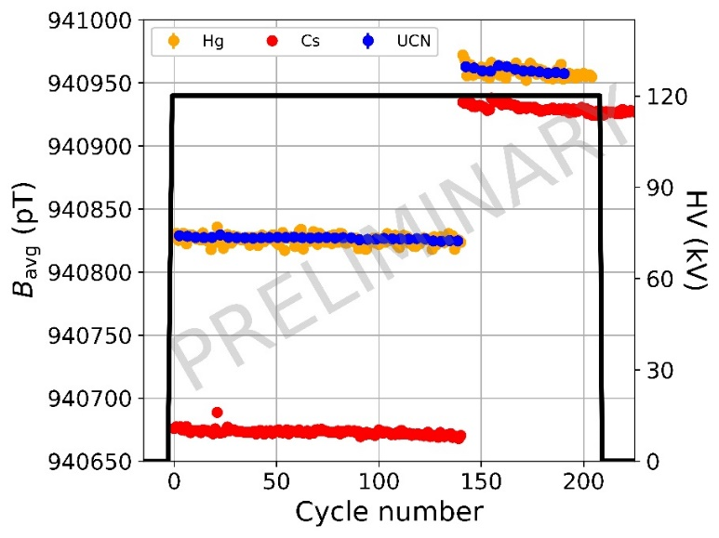
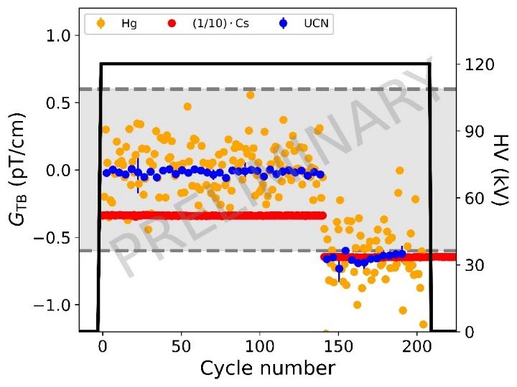
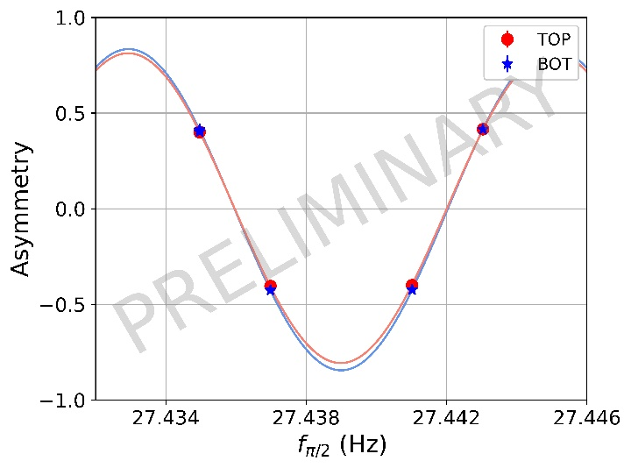
First test-EDM run
Four systems (UCN + Hg + Cs + HV) simultaneously operating: → test-EDM run can be performed (~1 day)
Average magnetic field sampled by neutron, Hg and Cs over a run (~ 1 day):
- high stability observed by the three magnetometers
- neutron in agreement with Hg
- Cs offset due to incomplete array (under investigations)
Vertical gradient (G_{TB}): < 0.6 pT/cm (within specifications)
- similar field in both chambers: common RF pulse can be applied

Slide 8
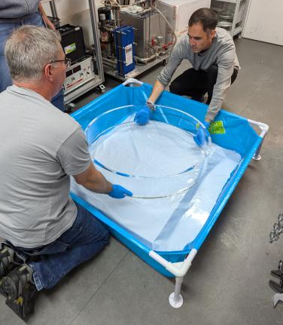
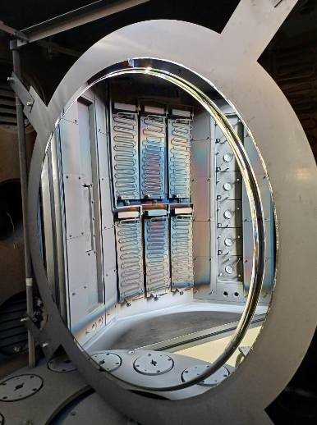
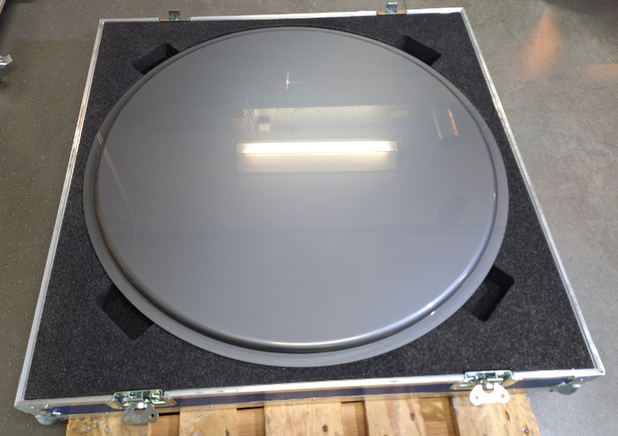
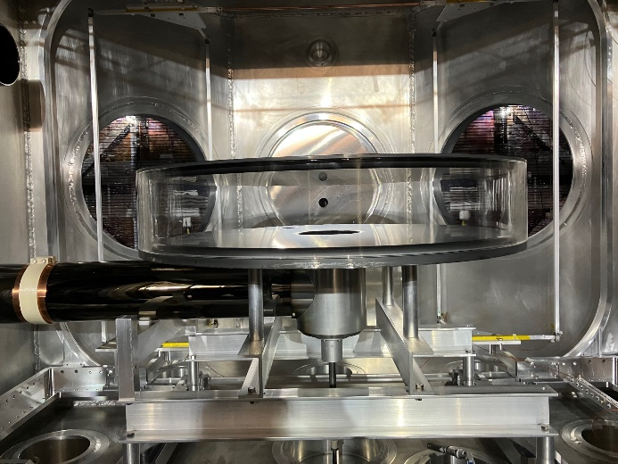
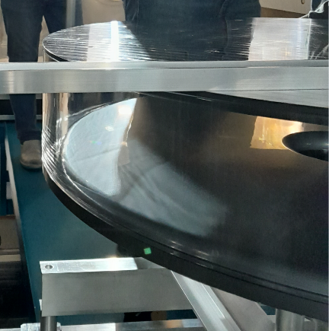
UCN statistic (2024)
Lot of efforts to improve our storage capability:
- Two culprits (2023): coatings of electrodes (DLC) & insulator ring (DPS)
New insulator ring (quartz)
Mirror polished test electrode
Test electrode DLC coated
Test of a new UCN storage chamber:
- new insulator rings (quartz instead of Rexolite)
- test electrodes: higher surface quality (polishing) + DLC
UCN transport: + 40% with new UCN guides
Uncoated quartz ring + test electrodes + new guides
42,000 in the test chamber (x4 / 2023)
Test chamber
Test chamber

Slide 9
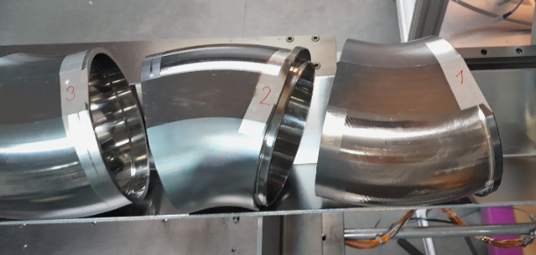
UCN statistic in 2025-2026
Manufacturing (x2) in 2025
Test chamber
Manufacturing of new electrodes: (improved) design done
- goal: ready for summer
Uncoated quartz ring + new DLC coated electrodes
84,000 for two chambers (66 % of design goal)
Still room for improvements in 2025:
- Insulator ring: coating with deuterated paraffin (V_{F} = 90 neV → 160 neV)
ongoing development (ready in 2025 ?)
- A few new UCN guides towards detectors
New UCN guides

Slide 10
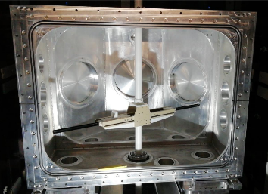
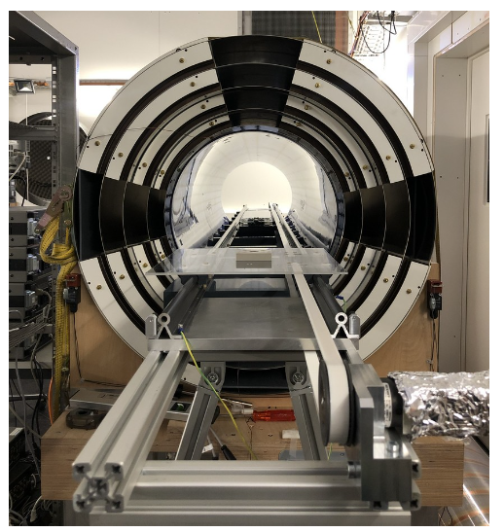
Main actions in 2025
Still a lot of work …. before restart of data taking
Field mapping during winter: field reproducibility (offline corrections of systematic effects)
Implementation of the blinding procedure: directly in the DAQ system
Installation of half of the Cs array (56 cells): online assessment of higher order gradients
Improvements of the Hg co-magnetometer sensitivity: ongoing study
Substantial effort to get a magnetically clean environment:
Small pieces scanned with PSI gradiometer (cleaned or replaced)
Large pieces (i.e. electrodes): scanned at PTB (cleaned)
and many others tasks …
Mapping robot
Gradiometer

Slide 11
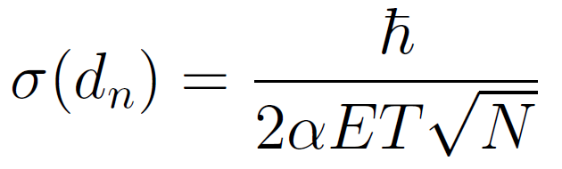
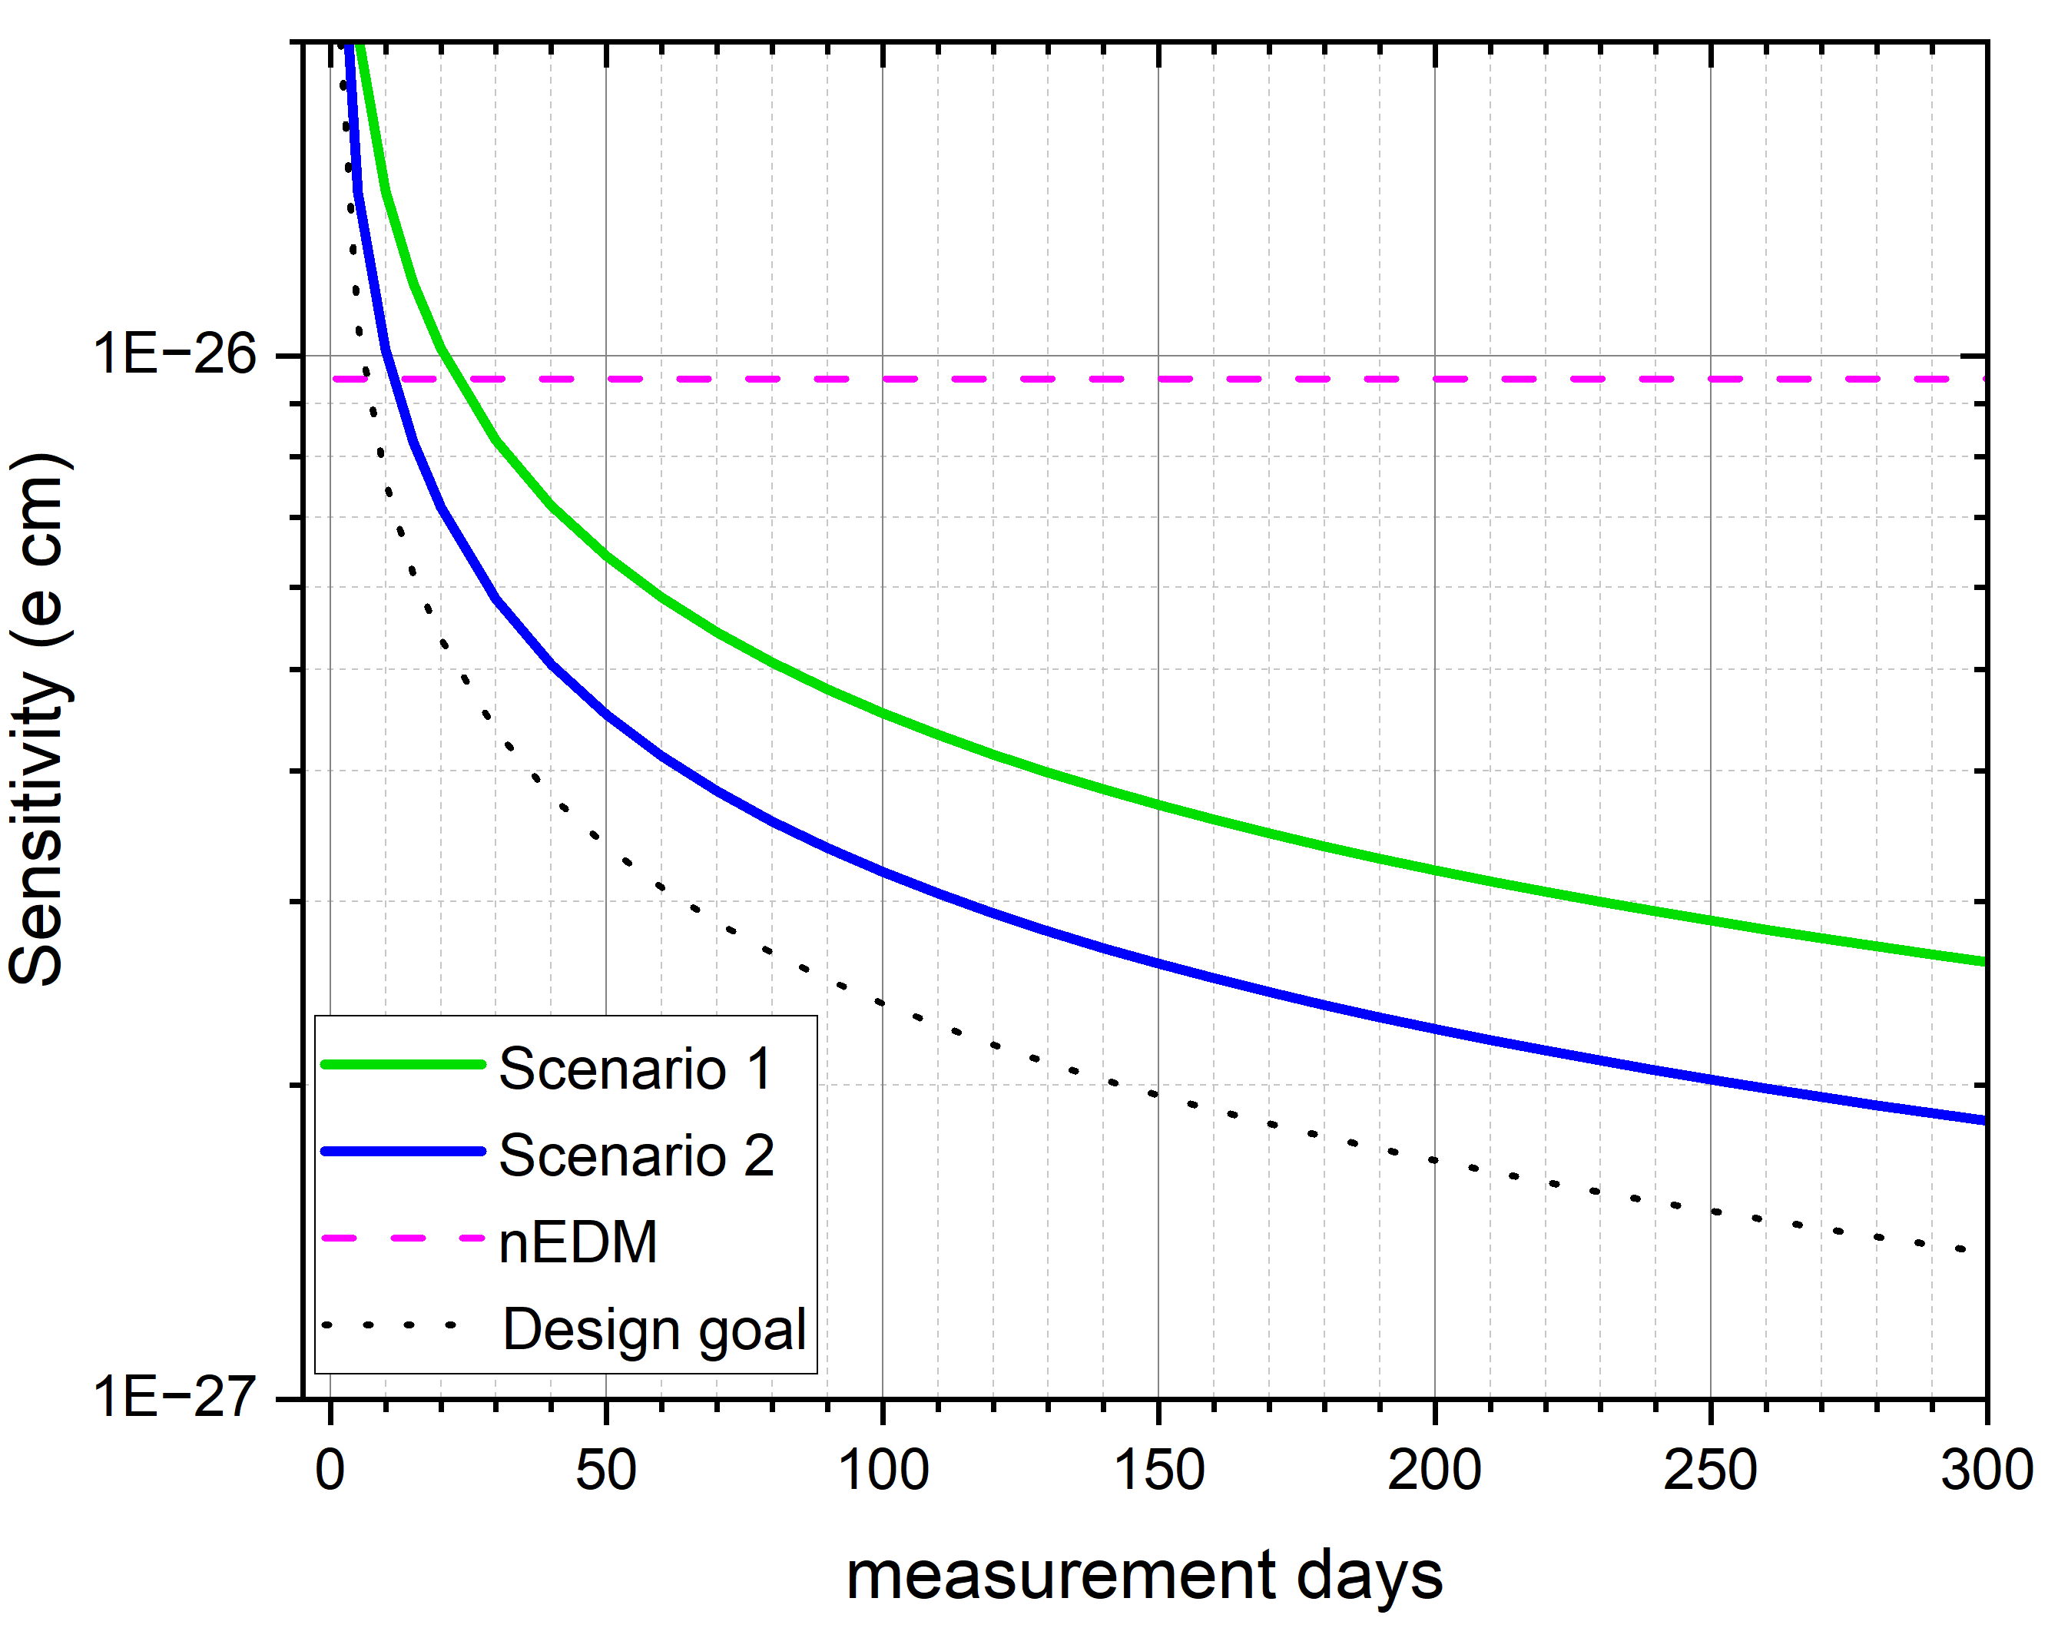
Current n2EDM sensitivity
Experiment sensitivity σ(d_{n})
Current sensitivity: improved by a factor 2.4 / nEDM experiment
~ 30 days required to reach previous experiment sensitivity
Components | nEDM (2016) | n2EDM (2024) | Design goal
Precession time (T) | 180 s | 180 s | 180 s
Neutrons statistic (N) | 15,000 | 64,000 * | 120,000
High Voltage (E) | ± 11 KV/cm | ± 12.5 KV/cm | ± 15 KV/cm
Polarisation (α) | 0.75 | 0.82 - 0.85 | 0.80
Daily sensitivity (σ) | 11. 10⁻²⁶ ecm | 4.5 10⁻²⁶ ecm | 2.6 10⁻²⁶ ecm
Uncoated quartz rings
* Former electrodes
Room for improvement: UCN statistic (ring coating) + High Voltage (conditioning)
→ towards the design goal sensitivity
2025: first measurement in the 10⁻²⁷ e cm range ?

Slide 12
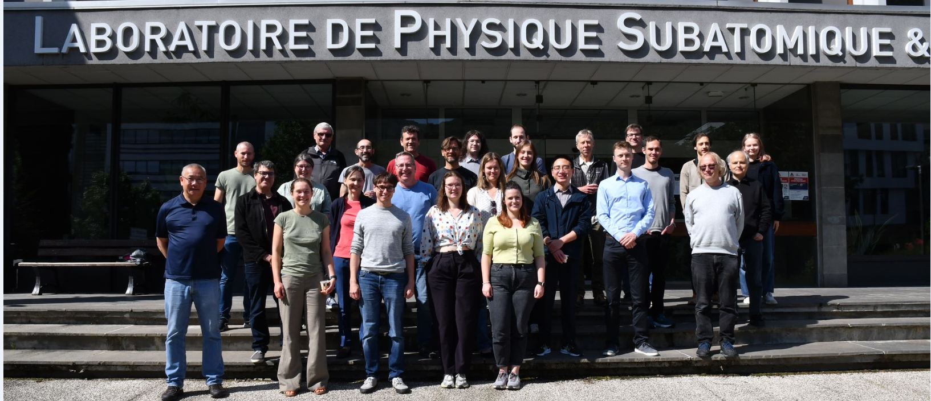
Thank you

Slide 13
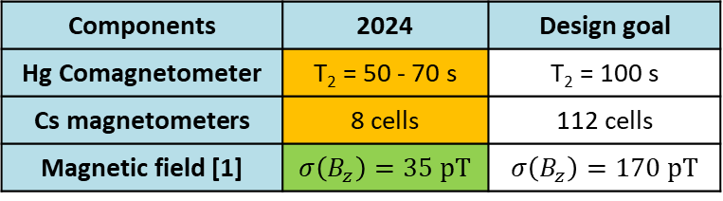
n2EDM sensitivity
Current sensitivity σ(d_{n})
Current sensitivity:
- improved by a factor 2 / nEDM experiment
- missing a factor 2 / design goal
Components | nEDM (2016) | n2EDM (2024) | Design goal
Precession time (T) | 180 s | 180 s | 180 s
Neutrons statistic (N) | 15,000 | 60,000 | 120,000
High Voltage (E) | ± 11 KV/cm | ± 12.5 KV/cm | ± 15 KV/cm
Polarisation (α) | 0.75 | 0.82 - 0.85 | 0.80
Daily sensitivity (σ) | 11. 10⁻²⁶ ecm | 5. 10⁻²⁶ ecm | 2.6 10⁻²⁶ ecm
With current sensitivity:
15 to 30 days required to reach previous experiment sensitivity
Magnetometry:
Components | 2024 | Design goal
Hg Comagnetometer | T₂ = 50 - 70 s | T₂ = 100 s
Cs magnetometers | 8 cells | 112 cells
Magnetic field [1] | $σ\left(B_{z}\right)=35 pT$ | $σ\left(B_{z}\right)=170 pT$
Room for improvement: UCN statistic (ring coating) + High Voltage (conditioning)
[1] “Generating a highly uniform magnetic field inside the magnetically shielded room of the n2EDM experiment” accepted in EPJC (2025)

Slide 14
The n2EDM experiment in the coming years
2027
2030
2025
2026
2028
2029
PSI shut
down
UCN
UCN
UCN Source repair (x1.3)
UCN
UCN
UCN
n2EDM
~ 5 10⁻²⁷ e cm
n2EDMagic
10⁻²⁷ e cm

Slide 15
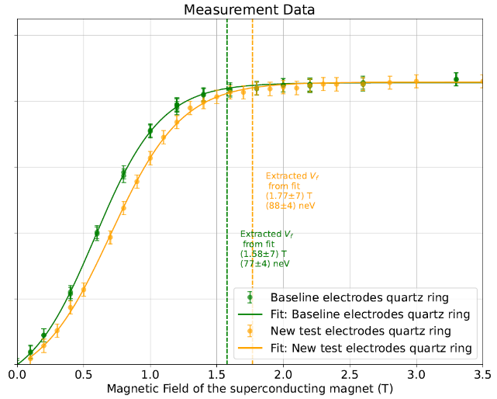
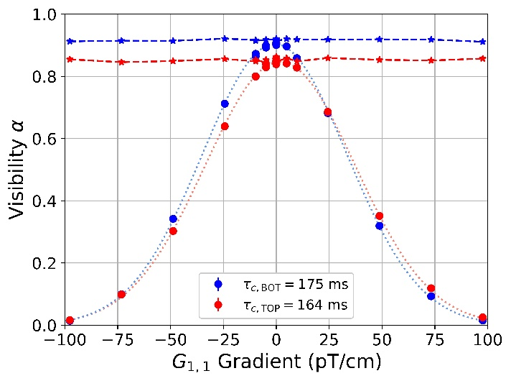
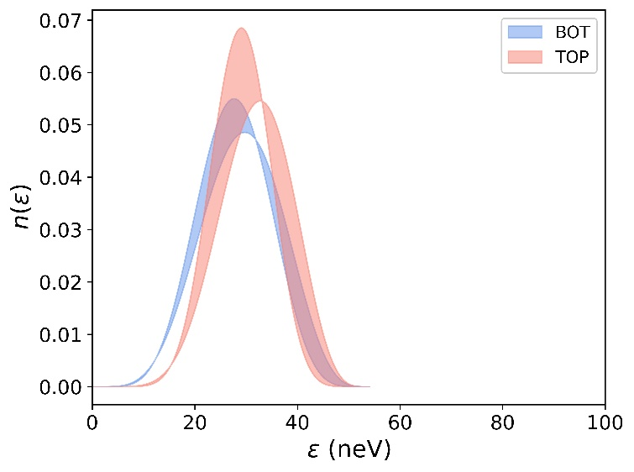
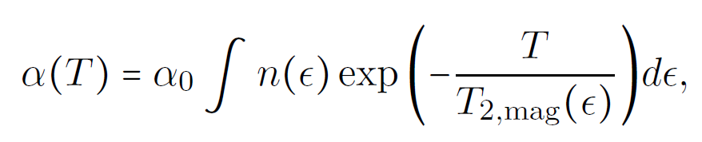
Measuring the energy spectrum of stored UCN
Super Conducting Magnet (SCM) scan:
UCN polarized up to a given energy E_{max} (a given SCM field strength)
- Polarized UCN: E < E_{max} ; unpolarized UCN: E > E_{max}
UCN polarization measured at the end of the storage period
- low polarization → high energy (unpolarized) UCN are stored
- large polarization → high energy (unpolarized) UCN are lost during storage
E_{max} is a measurement of the lowest Fermi potential in the chambers
UCN polarization
Results confirm that coating of electrodes and rings were not performant
Magnetic field strength (T)
Magnetic field gradient scan:
Depolarization rate depends on:
- UCN energy spectrum & field non uniformities
Method:
apply different field gradients and measure UCN polarization
Depolarization give access to UCN energy spectrum

Slide 16
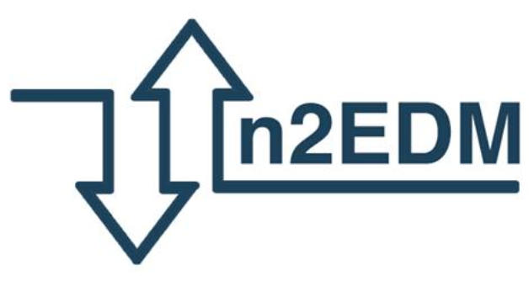
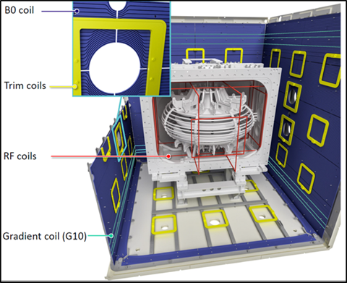
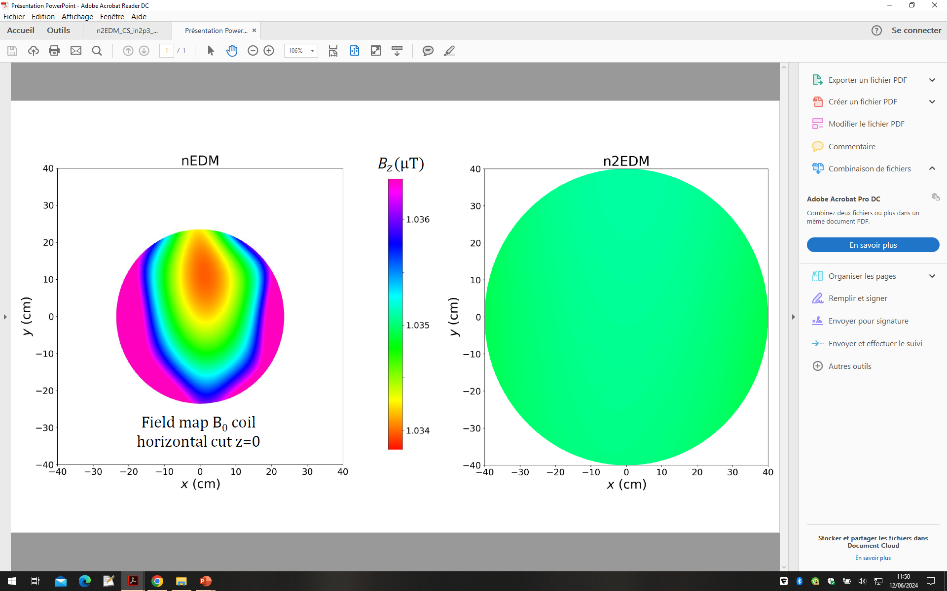
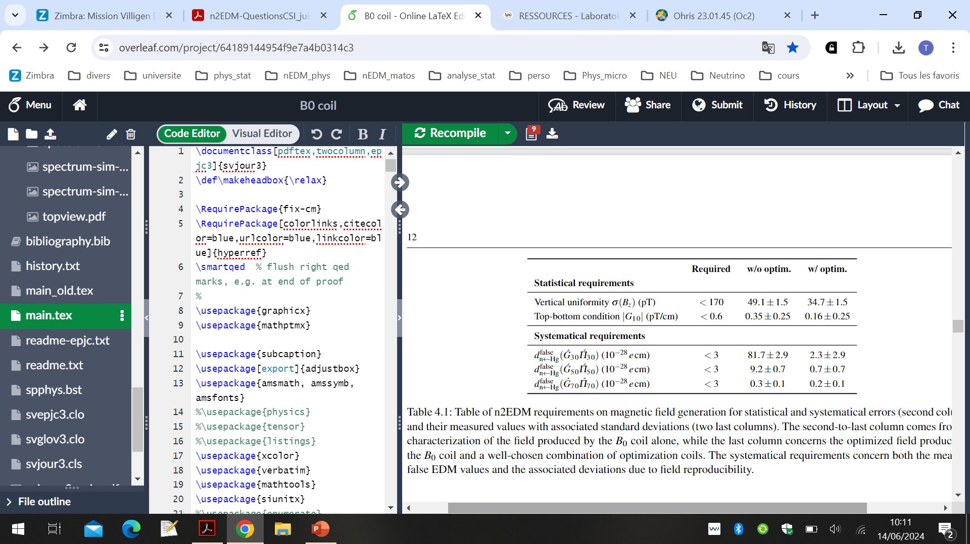


Magnetic field commissioning
Magnetic field characterization (2021-2022): close collaboration between LPC and LPSC
- internal coils system simulated, built and installed by LPC
- field characterization performed by LPSC
$$σ\left(B_{z}\right)=900 pT$$
$$σ\left(B_{z}\right)=50 pT$$
Performances are excellent
Part of the systematics already below requirements
T. Bouillaud, P. Flaux, “An exceptionally uniform magnetic field for the n2EDM experiment” (LPC-LPSC); internal review.

