Slide 1
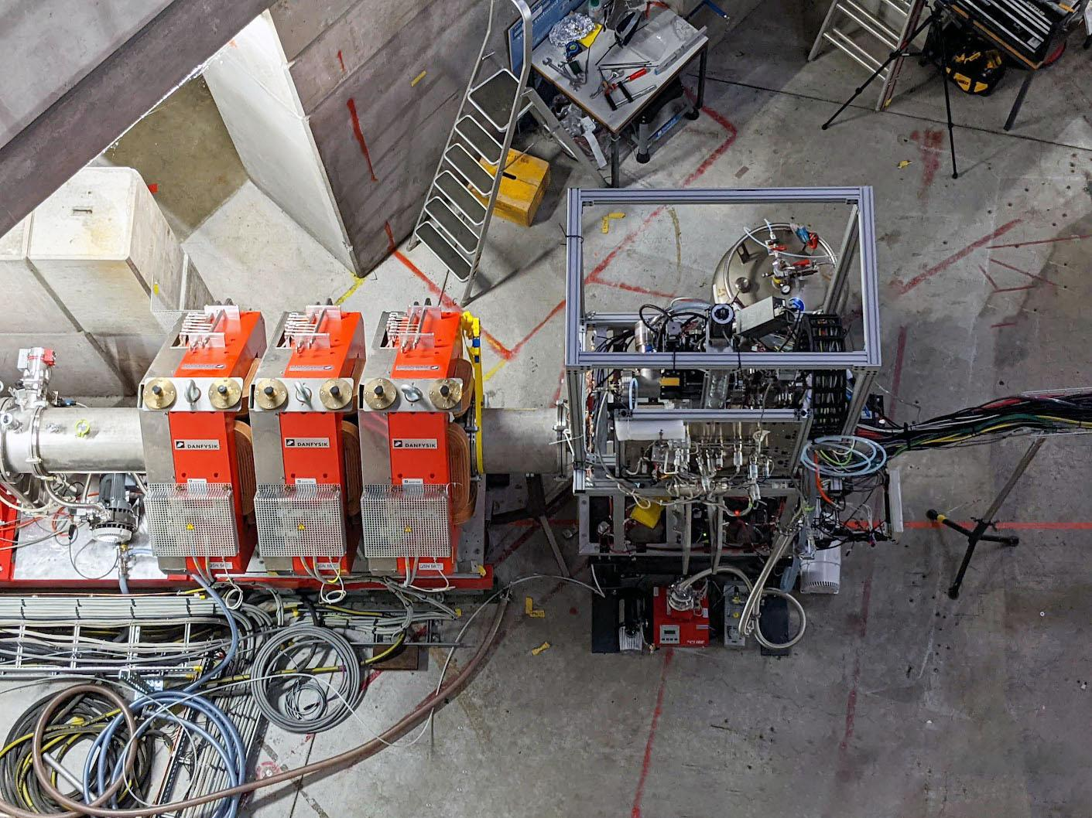
















Diamond Anvil Measurement of Muon-Catalyzed
Fusion Kinetics
The MuFusE Collaboration
PSI BVR 56 Progress Report
February 11, 2025
Ara Knaian

Slide 2


Fusion is a safe, abundant source of clean energy
Introduction
Fusion of the deuterium in a stream of tap water could power a city.

Slide 3
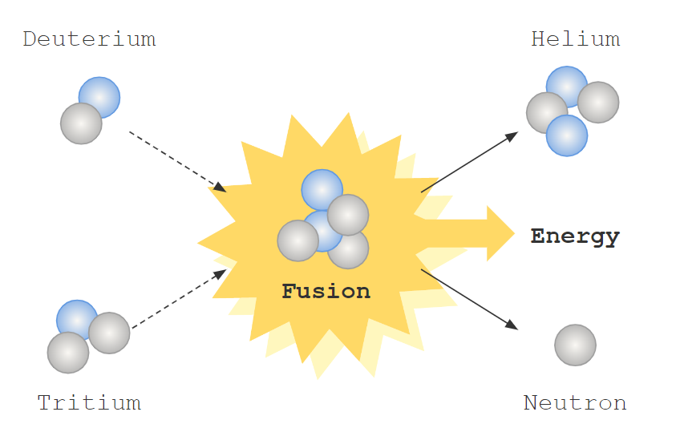
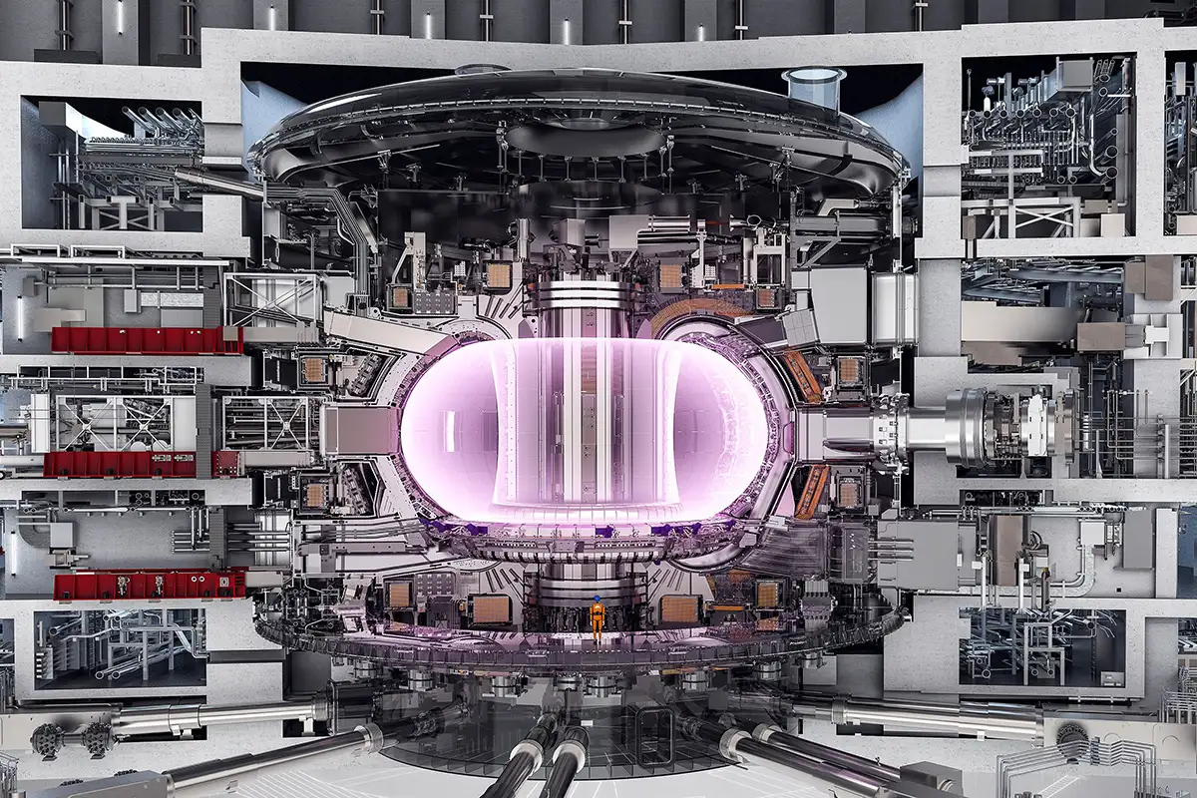
Plasma fusion requires stable 100,000,000 ⁰C plasma
Introduction
The deuterium-tritium fusion reaction has the highest cross section.
A cutaway view of the ITER tokamak, scheduled to burn DT in 2039.

Slide 4

Muons can catalyze
nuclear fusion reactions
at lower temperature
Introduction
Muon forms chemical bond between Deuterium atom and Tritium atom
µ
t
µ
t
Muon comes into orbit
d
Negatively-charged muon enters
µ
Squeezes nuclei together and fusion occurs
Energetic neutron
Muon Recycling
Muon Reactivation
Nuclear fusion
µ
99%
Energetic alpha
1%
Sometimes muon sticks to the alpha particle product of the fusion

Slide 5
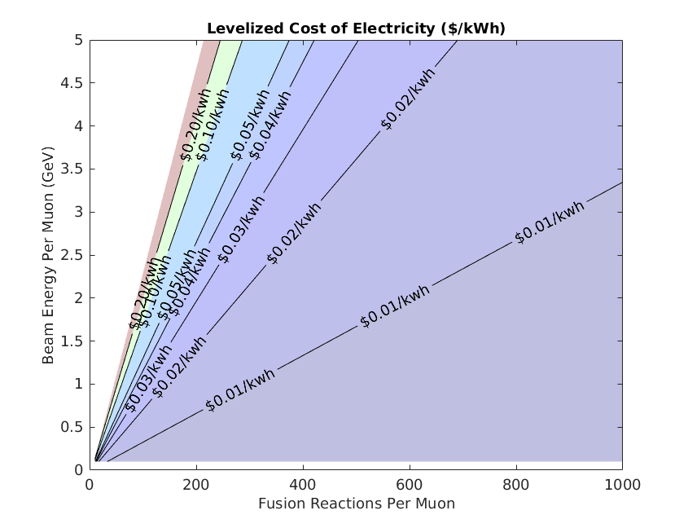
Cost of electricity versus physics parameters
Motivation
Engineering breakeven
Cost of baseload power
by source, $/kWh (1)
Coal $0.089
Biomass $0.077
Nuclear fission $0.071
Gas: $0.043
Target operating point:
Fusion (?): $0.025
Target operating point for a reactor
(Using a superconducting accelerator, Brayton cycle balance of plant, and revenue from heat sales.)
(1) Levelized Costs of New Generation Resources in the Annual Energy Outlook 2023, US Energy Information Administration, Document #AEO2023

Slide 6
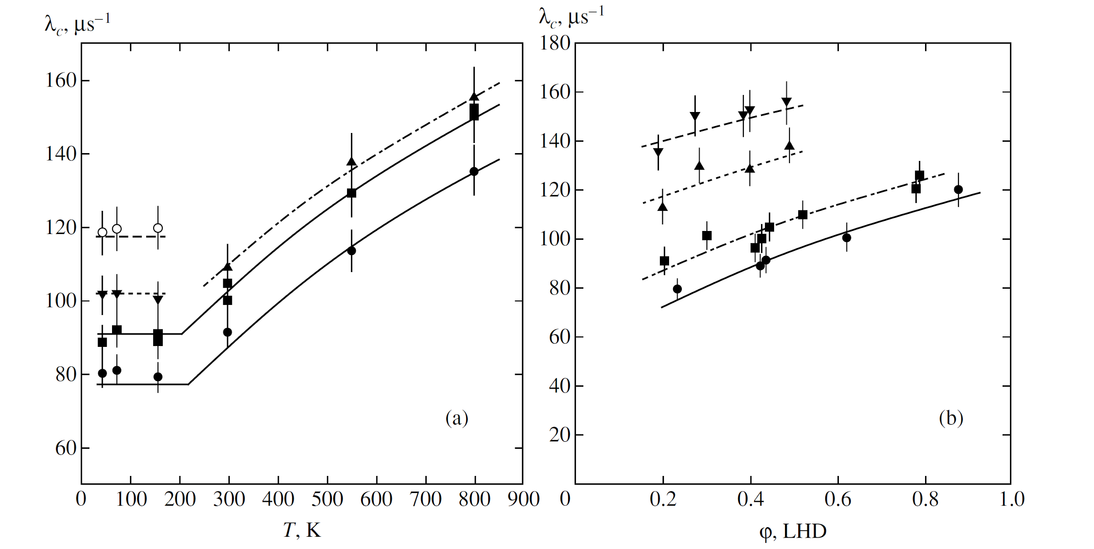
Fusion rate increases with temperature and density
Background
Experimental Data from JINR measurements on DT
Ref: V.R. Bom et. al, JETP, 2005

Slide 7
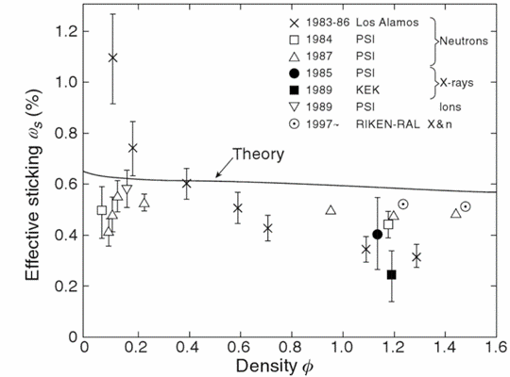
Sticking may decrease with density
Background
Both experiment and theory predict that sticking decreases with density.
Data from four experimental groups is shown.
At high density, the measured sticking is uniformly lower (better) than predicted by theory
Density is stated as a fraction of liquid hydrogen atomic number density.
100
H. Rafelski theory
Sticking limit on the number of fusions per muon
170
200
250
330
500
1000
Ref: K. Nagamine, 2008

Slide 8
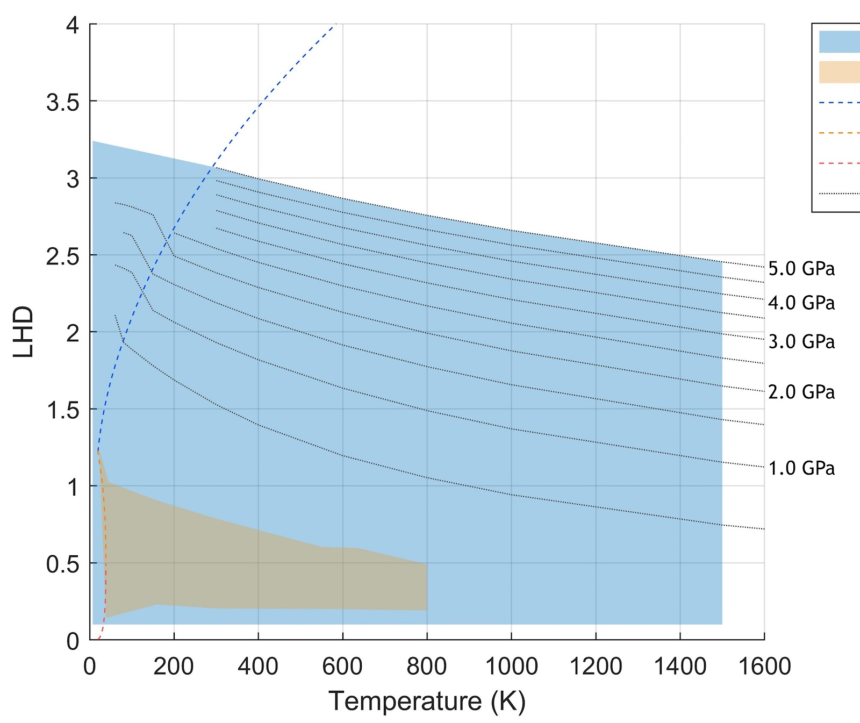
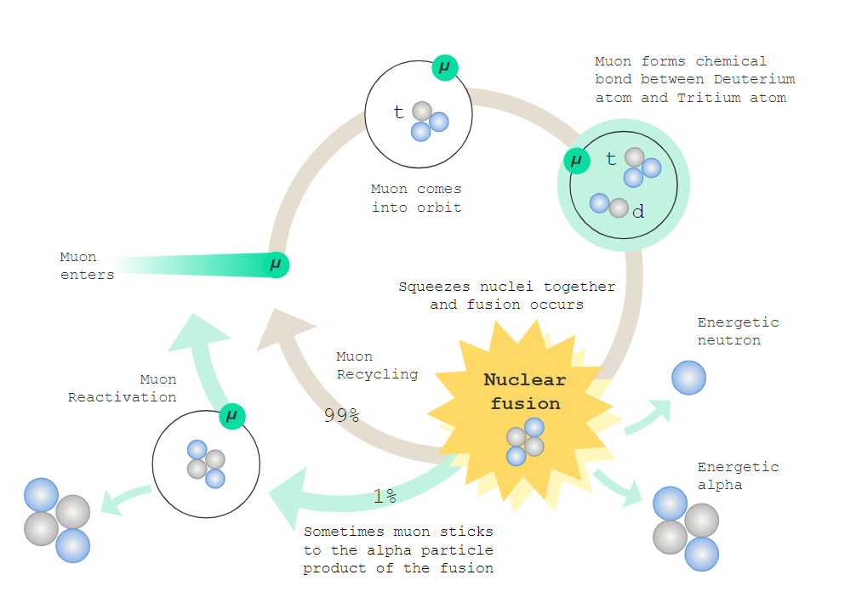
Goals of our collaboration:
MuFusE — Muon-Catalyzed Fusion Experiment
1. Measure DT cycling rate and sticking fraction at high density and temperature
2.Create open-source physics process models for GEANT4
Design range of our anvil cell target
Range measured historically

Slide 9
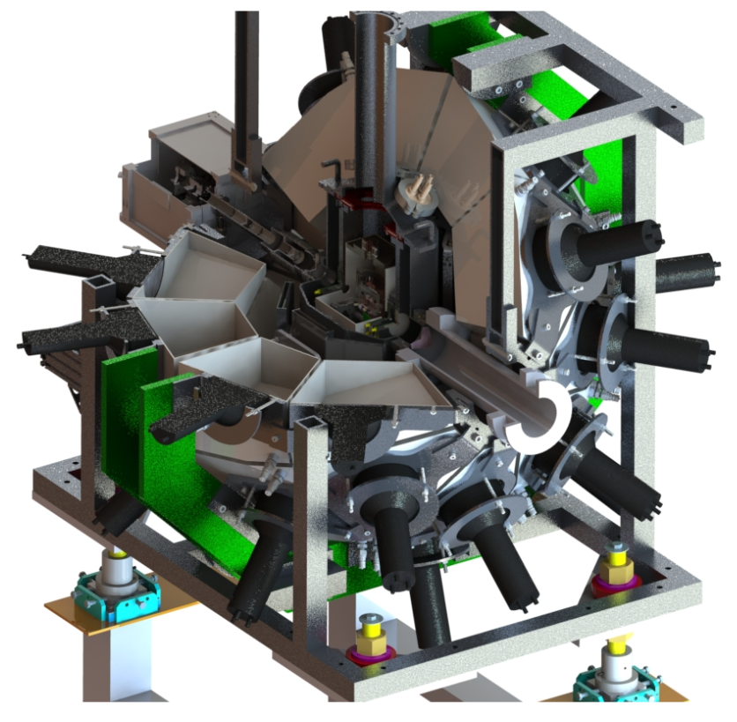
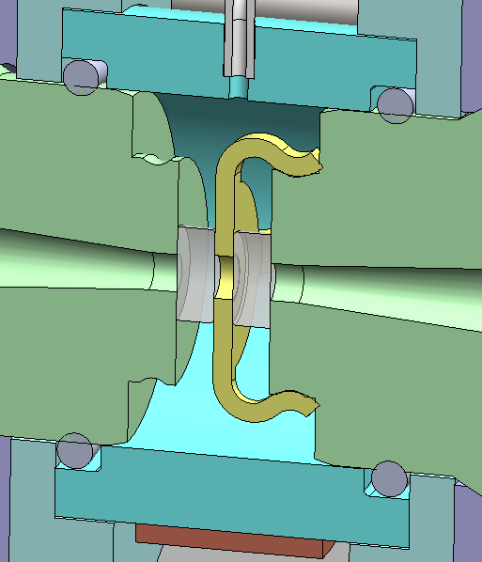
Optics System
Design overview
DT
Diamond
Anvil
Cell
Muon Beam
Muon Beam
Diamonds
Neutron detectors

Slide 10
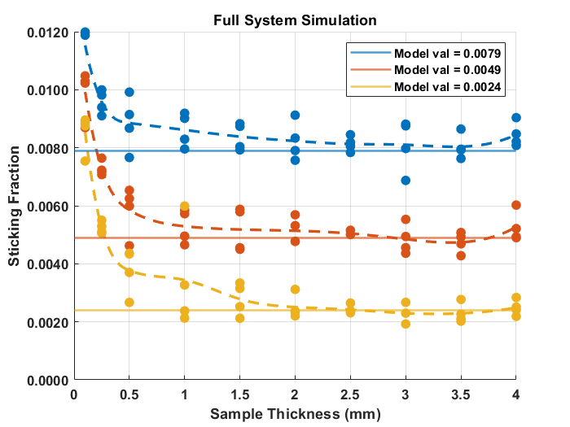
End-to-end simulation: sticking fraction vs cell size

Slide 11
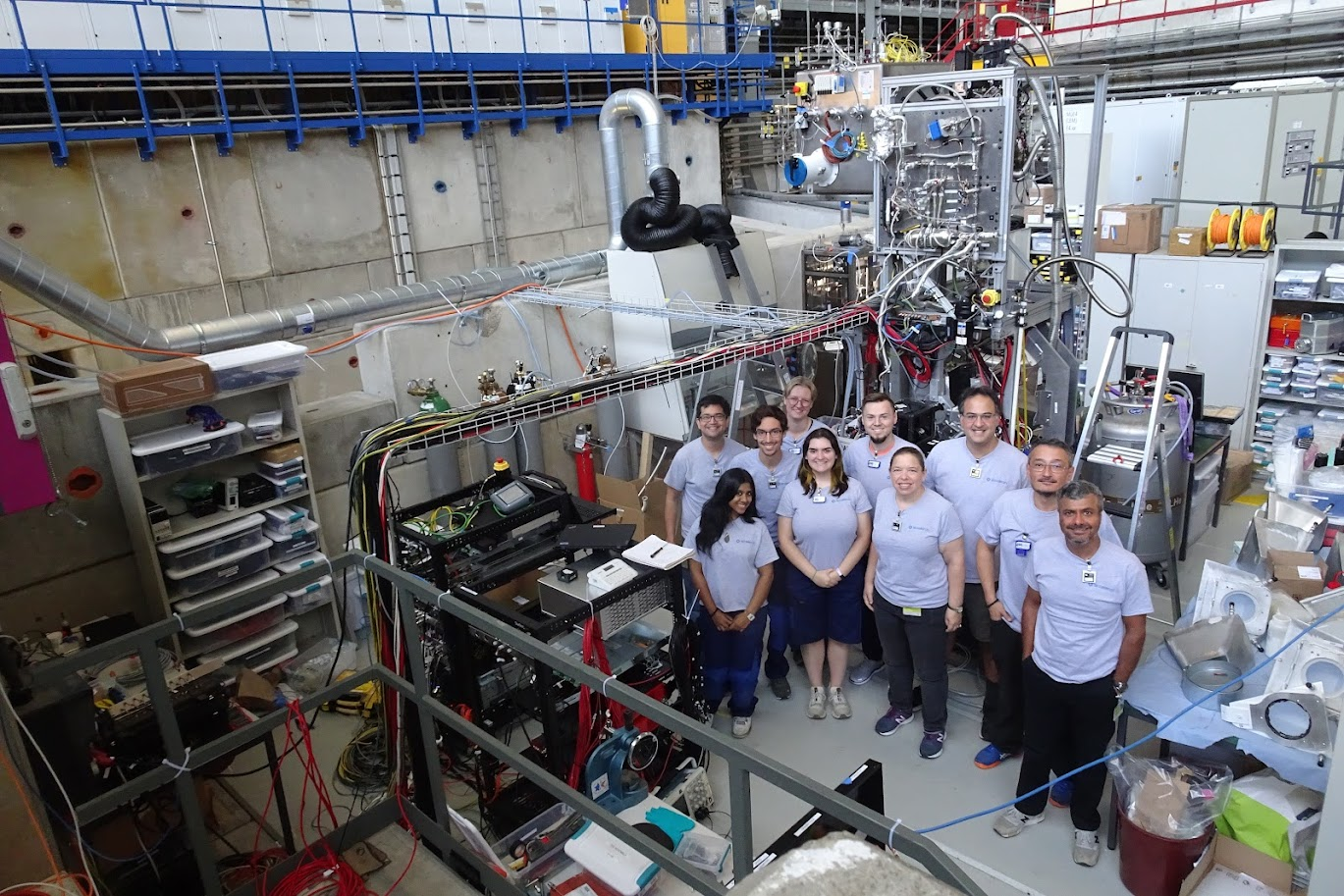

Slide 12
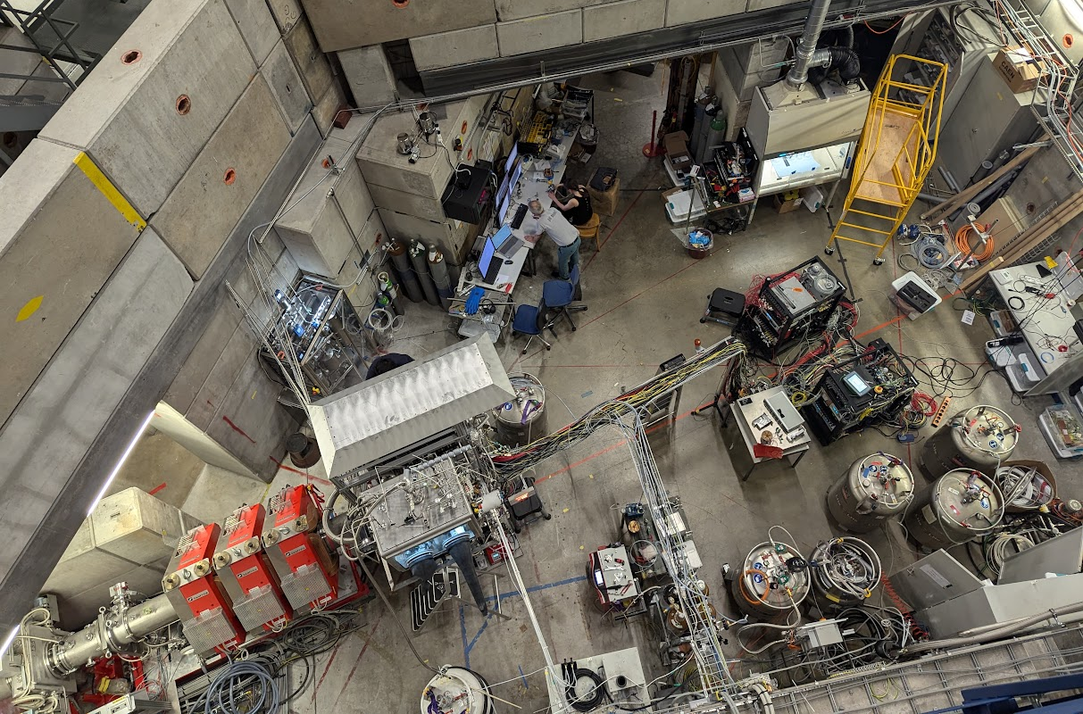
Elena and George
Fume Hood
Tritium Monitor
𝜋E1.2 Beam
Area
VAC-SEC
Digitizers
Detectors and target
Liquid Helium
Muon beamline
DT Glovebox

Slide 13
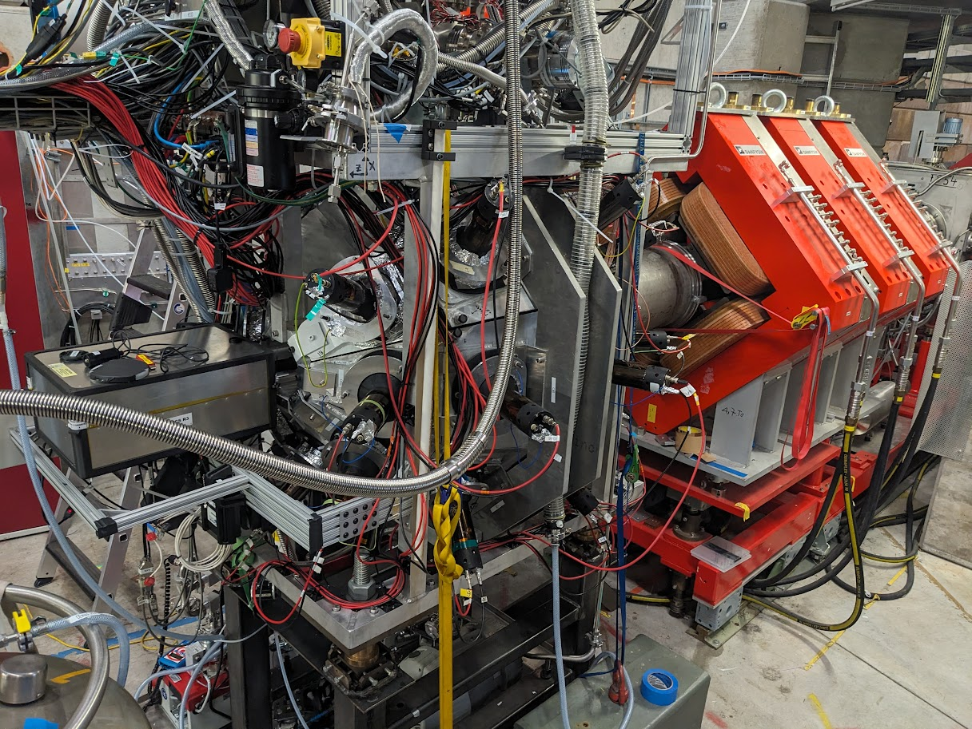
Muon beamline
Neutron detector array
Optical diagnostics

Slide 14
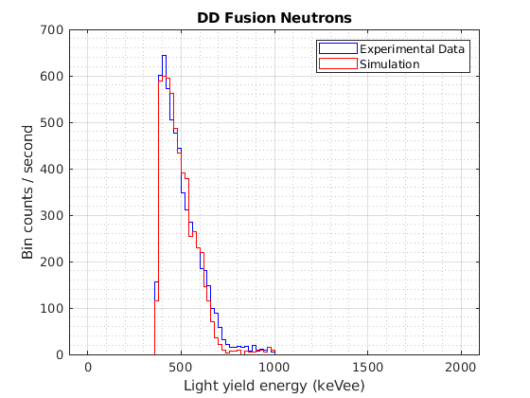
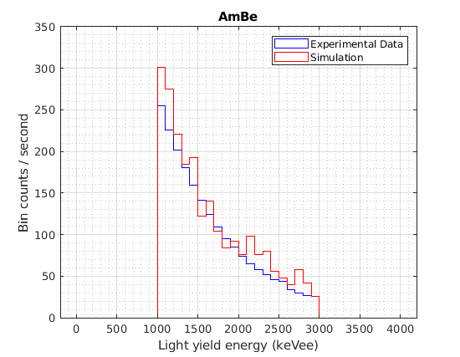
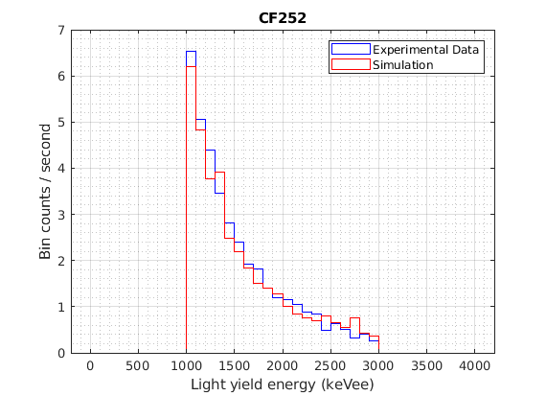
Measured spectra and rates align with simulation
Detector and Simulation Performance
CF-252
Neutron Source
D-D Muon Catalyzed Fusion Neutrons
AmBe
Neutron Source
+14%
-9%

Slide 15
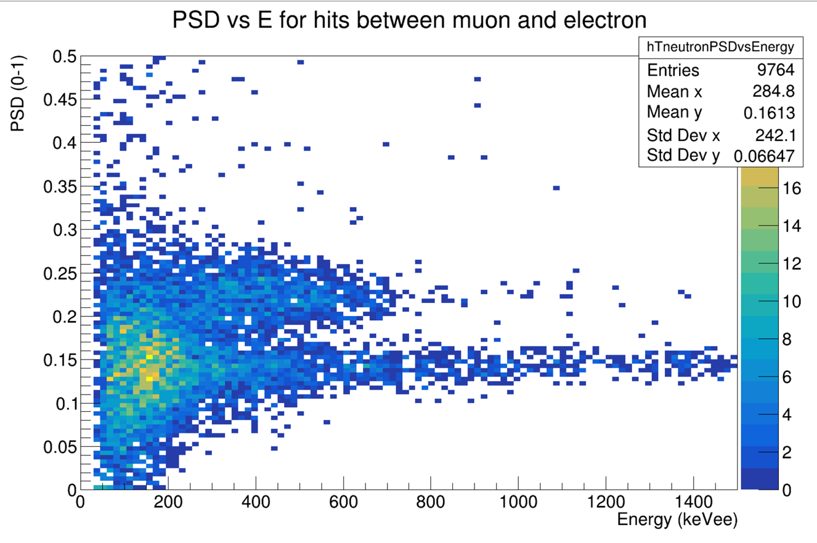
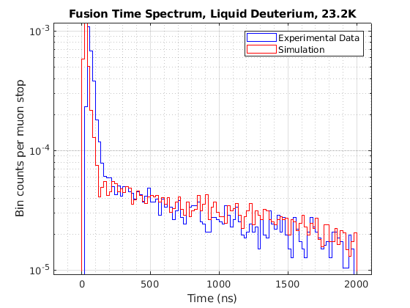
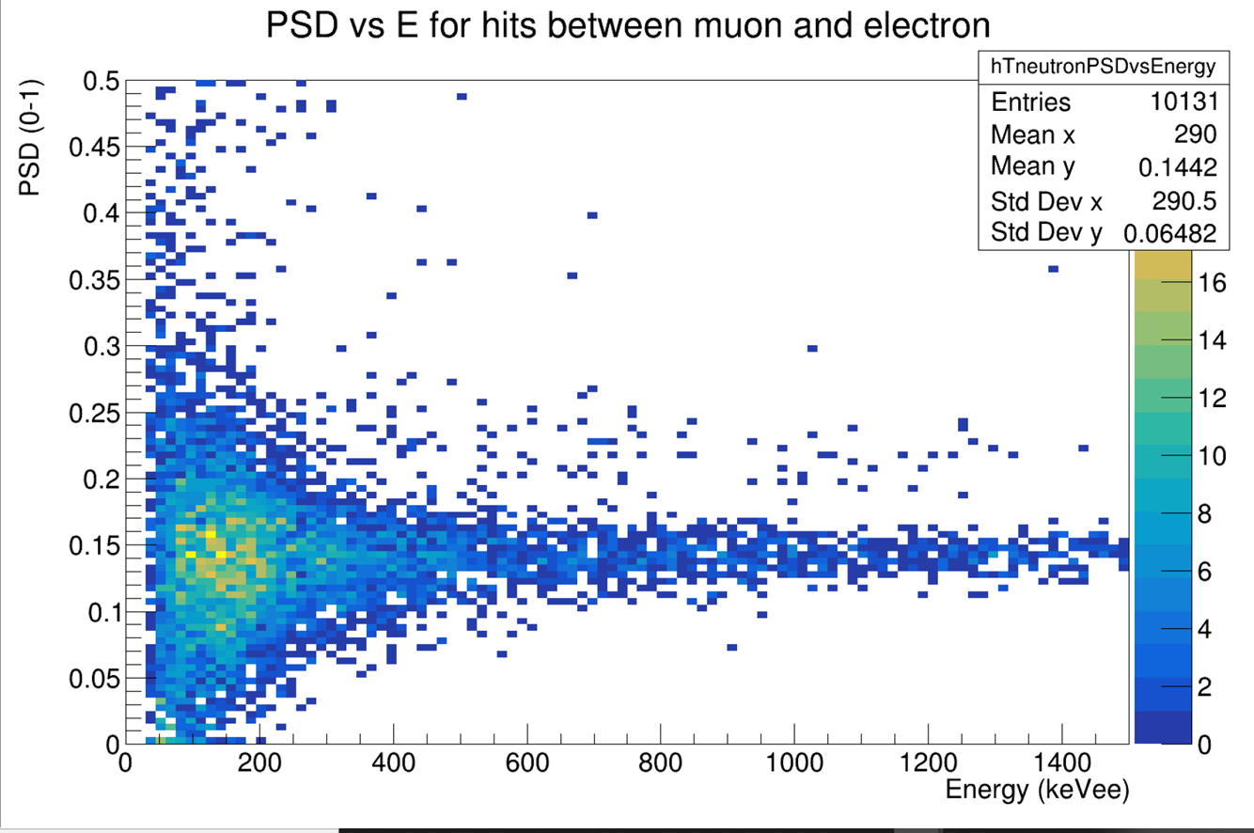
Neutron detection between the muon and electron
Results
Fusion
Liquid Deuterium
Liquid Hydrogen

Slide 16
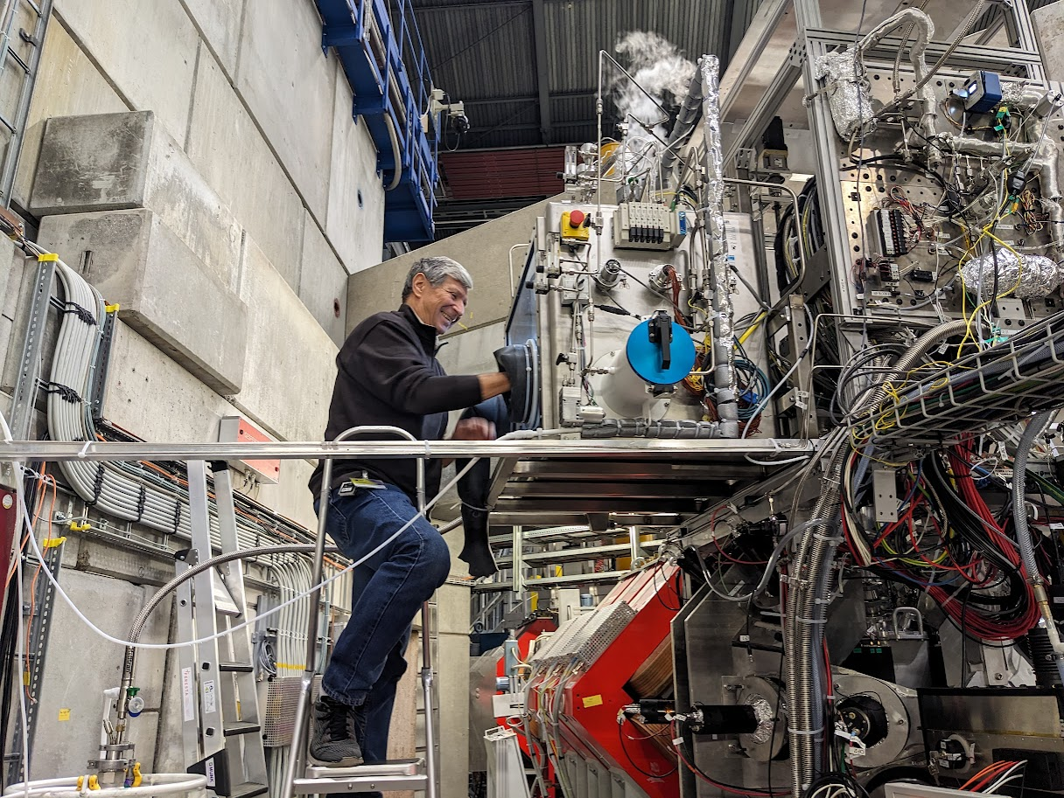
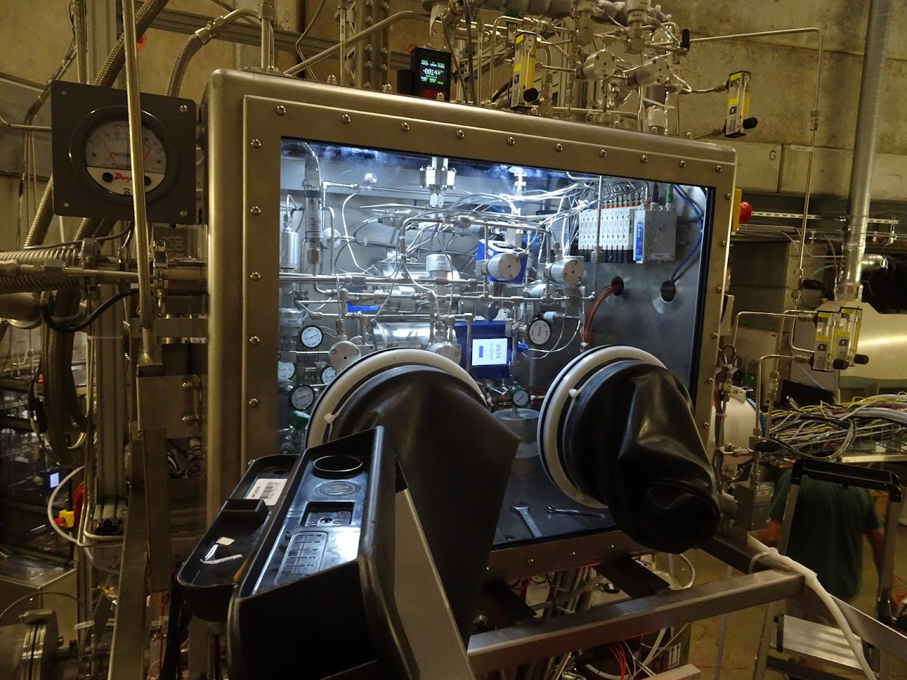
Loading the
tritium into
the U-beds
Materials and Methods

Slide 17
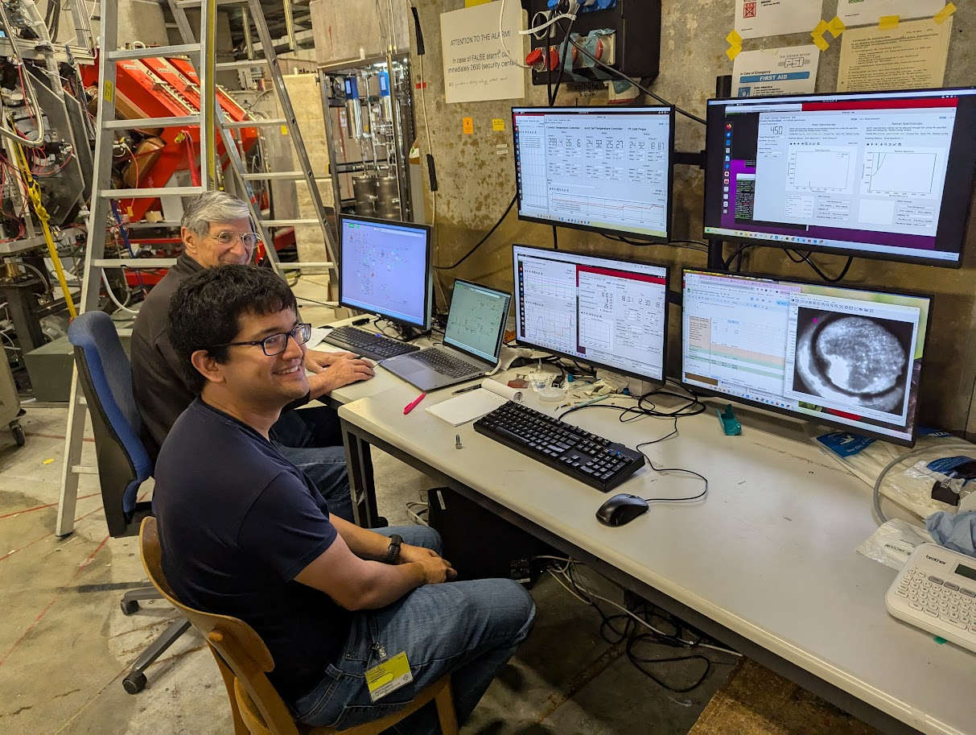
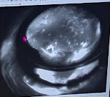
Loading the cell with liquid DT
Materials and Methods

Slide 18
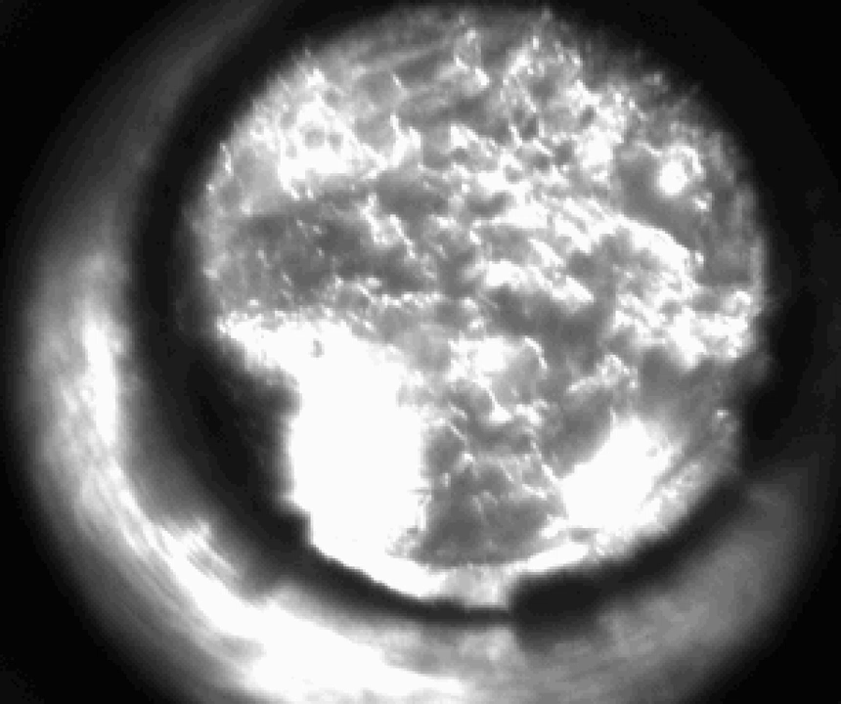
Compression of the liquid DT to a solid
Materials and Methods

Slide 19
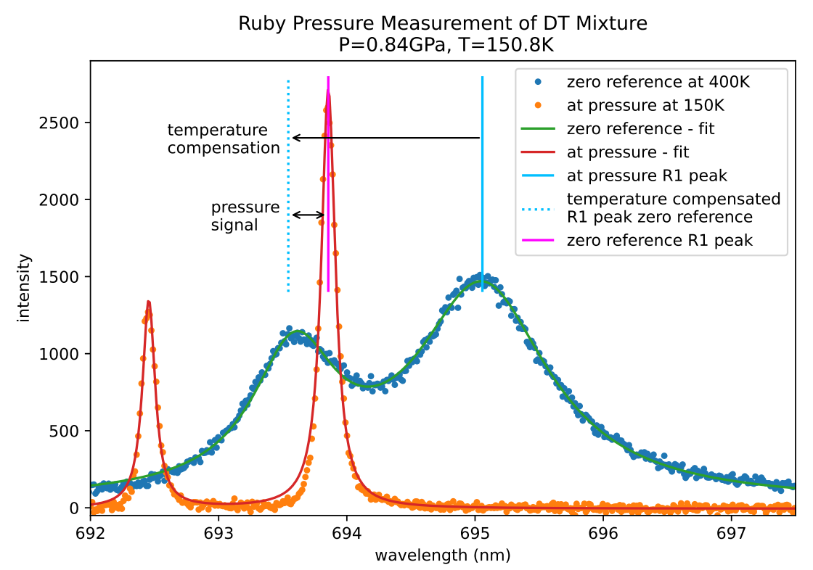
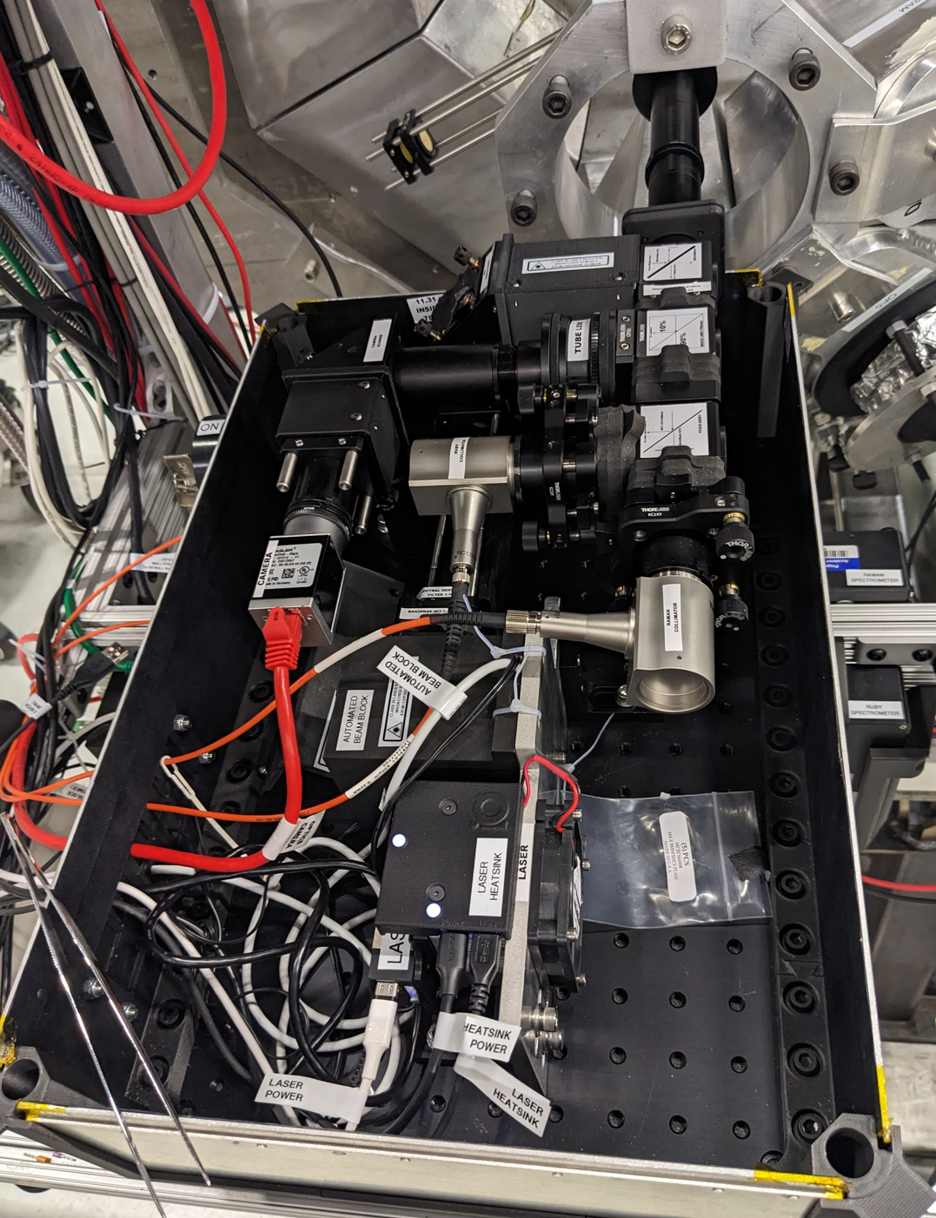
Optical pressure measurement via ruby fluorescence
Results

Slide 20
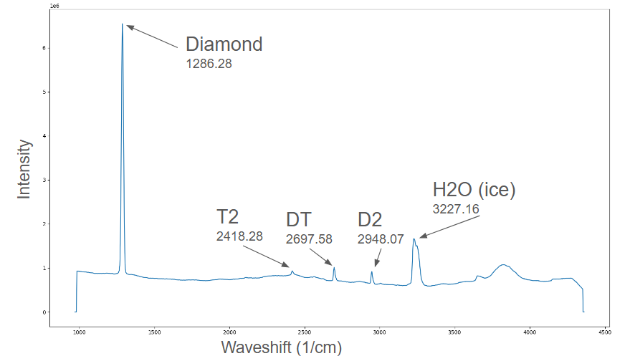
Real-time gas analysis via Raman spectroscopy
Results

Slide 21
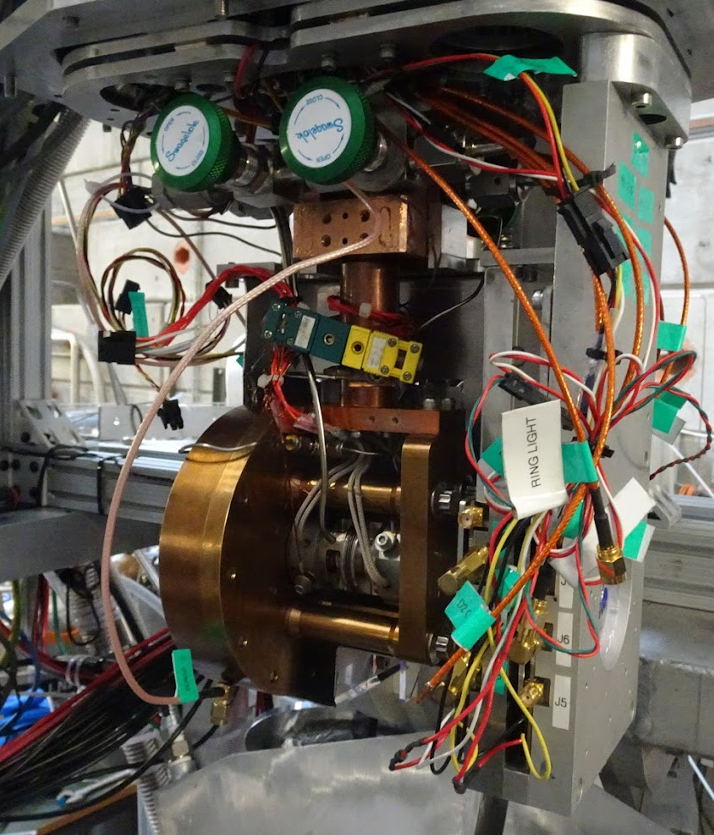
Pressure and temperature reached
Results
Melting curve
Area we plan to map
Oct 2024 run with 60/40 DT
Range previously measured
Diamond anvil cell

Slide 22
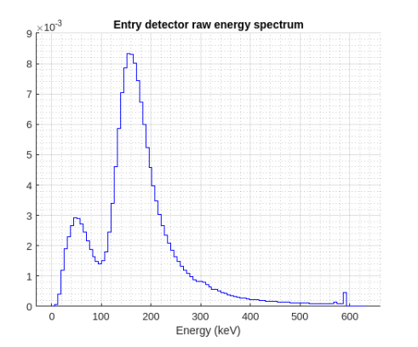
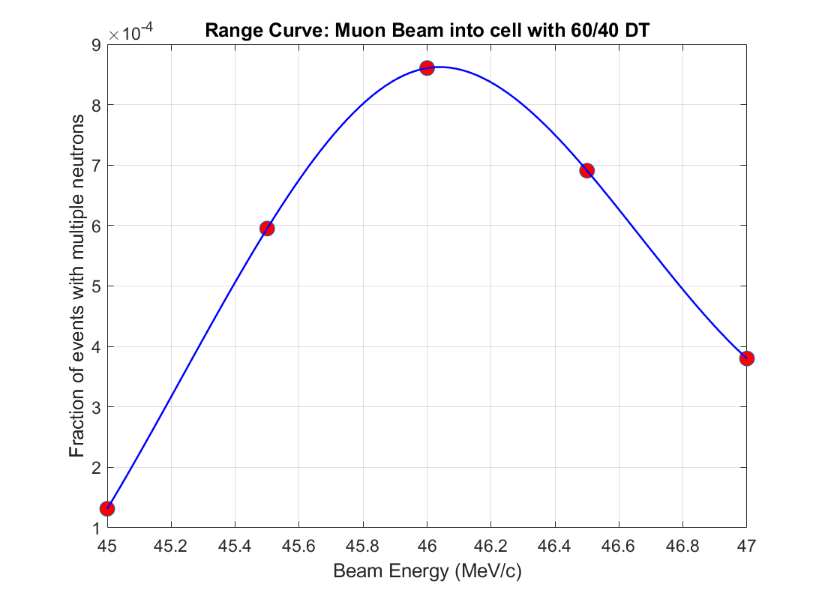
Hits classified as fusion neutrons peak at 46 MeV/c
muon momentum, matching simulation
Results

Slide 23
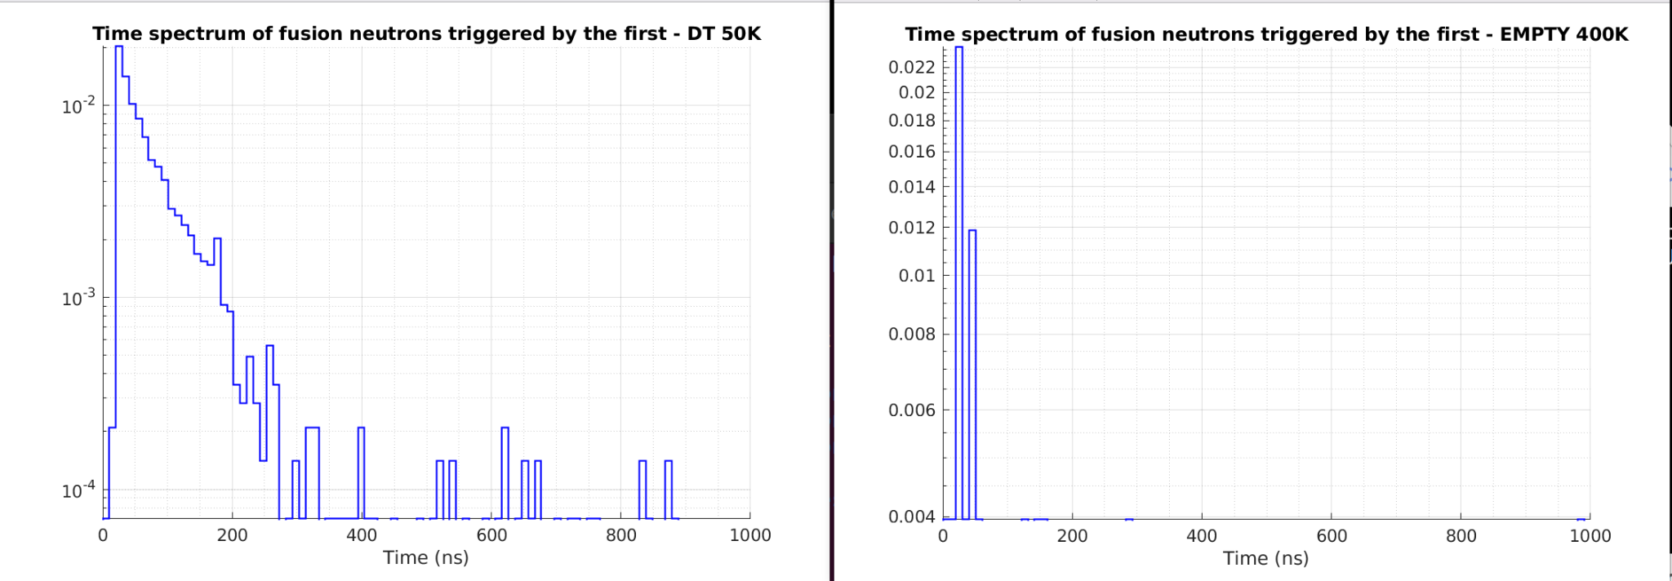
Time spectrum of hits classified as fusion neutrons
Results
60/40 solid DT, 50K, at 2.2 LHD
Empty target

Slide 24
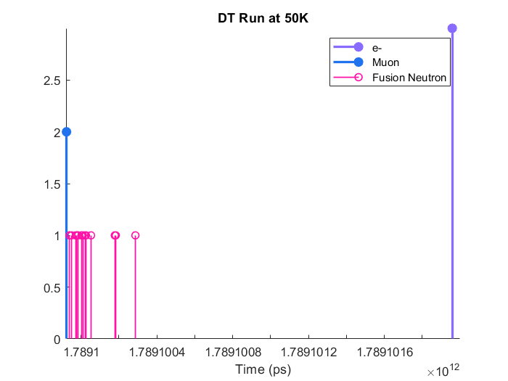
Snapshot of a typical DT fusion event
Results

Slide 25
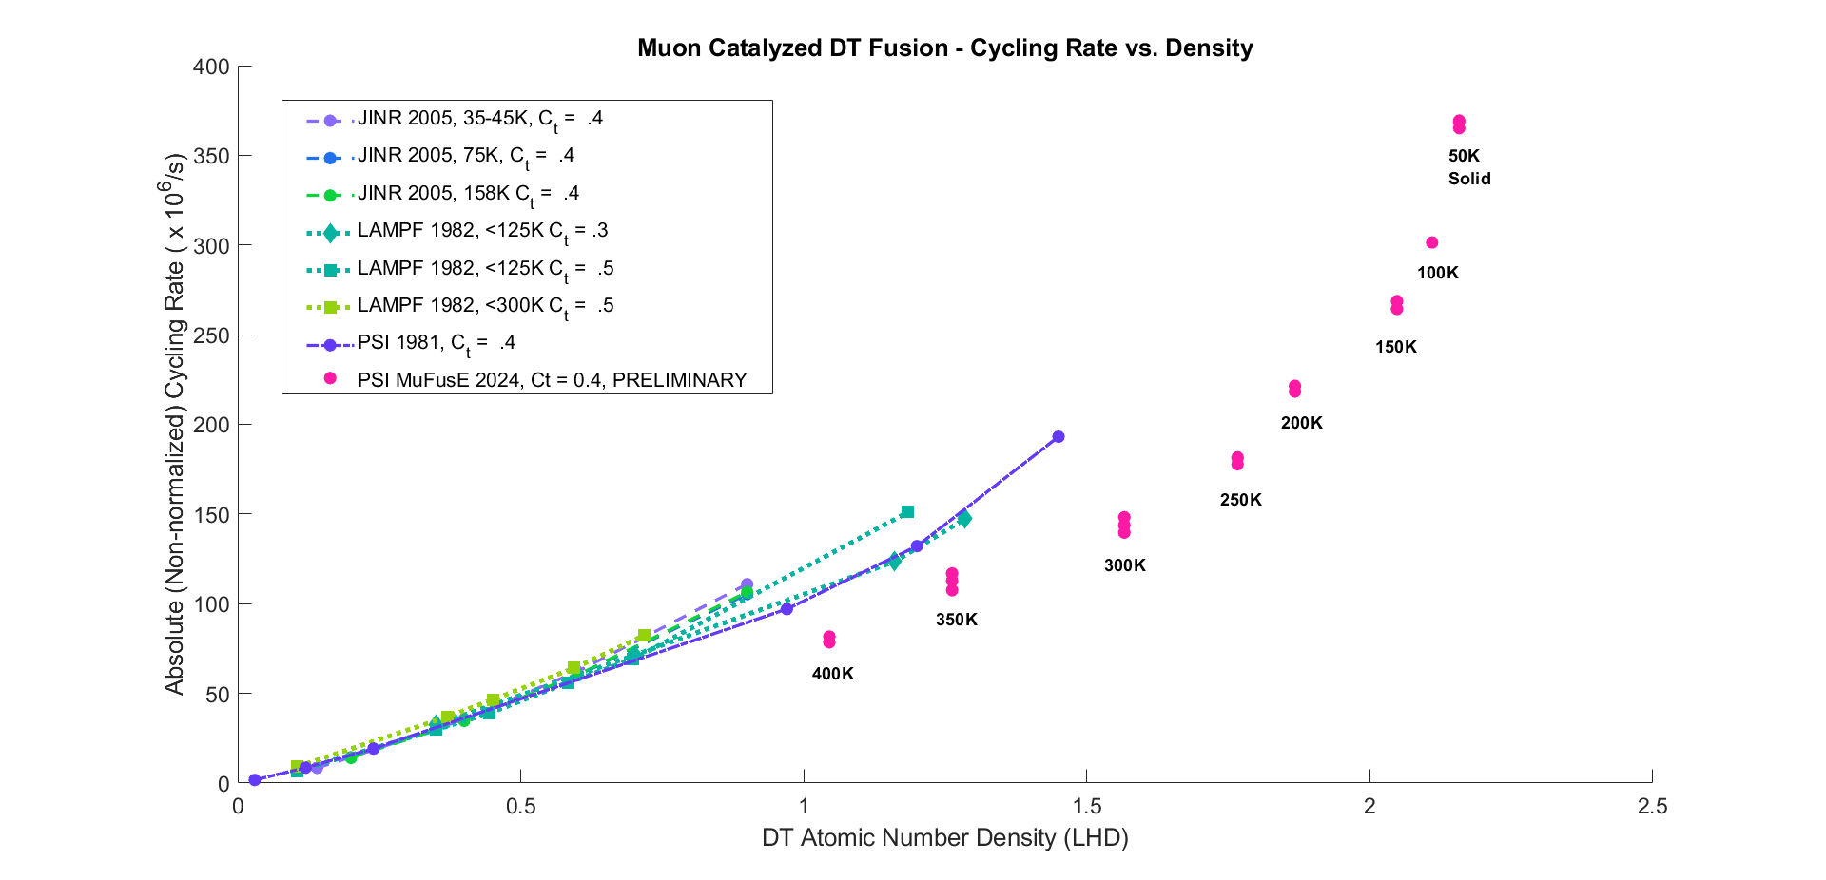
PRELIMINARY data on DT cycling rate to 2.2 LHD (2024)
Results
*Work is ongoing to characterize and correct for systematic errors and to properly size the error bars.

Slide 26
2025 Timeline and Beam Request
Planning
Data analysis
Cell improvements and test compressions
Detector and DAQ improvements
Bakeout and gas analysis procedure improvements
Setup and onsite testing at PSI
Beam
Jan
Feb
Mar
Apr
May
Jun
Jul
Aug
Sep
Oct
Nov
Dec
Thanksgiving Nov 28

Slide 27
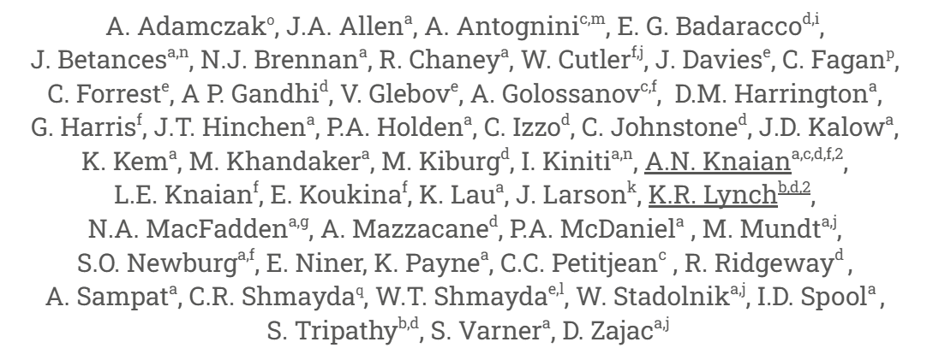
Acknowledgements

