Slide 1
APRENDE workshop
- from the experiment to the evaluation
Grant agreement 101164596
WP2 – WP4 meetings #1
IPHC, Strasbourg, 26-27 / 02 / 2025
Maëlle Kerveno, CNRS/IPHC
Dimitri Rochman, PSI
Daniel Cano Ott, CIEMAT

Slide 2
WELCOME !!
General goals of this series of meetings
Create a space where experimentalists and evaluators can exchange about
their practices
their expertise
to better understand the constraints, the needs, etc of each other
Enhance links between communities to
better know each other
share, as much possible as, common objectives

Slide 3
WELCOME !!
Goals of this first meeting
Sharp overview of main WP2 & WP4 thematics to better know who is doing what
Pedagogic presentations of experimental & evaluation issues for the main reaction channels
Share good practices to tend to efficient evaluations

Slide 4


PRACTICAL INFORMATION
Zoom link and Wifi
Zoom
https://cern.zoom.us/j/69699794706?pwd=rB2GUSb4FI8K9EilPQJVmxUdRJERTy.1
ID de réunion: 696 9979 4706
Code secret: 893318
WIFI eduroam
local IPHC-Visitor
Login : conf-aprende
Password : aprende2025

Slide 5
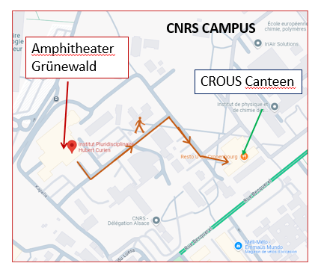
PRACTICAL INFORMATION
Coffee breaks
At the entrance of the amphitheater
Lunches
At the « CROUS » canteen
Lunch 26/02 offered by APRENDE
Lunch 27/02 to be paid by participants

Slide 6
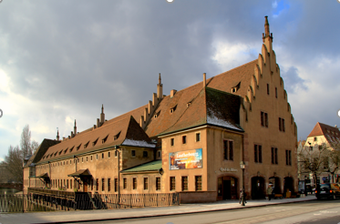

PRACTICAL INFORMATION
Diner 26/02 – 19h30
Restaurant l’Ancienne Douane
6 rue de la Douane, Strasbourg
Aperitives and desert offered by DNR team@IPHC
For each participant 20 € to pay directly this evening to the restaurant
Remember your choice !
Choucroute Strasbourgeoise 4 Garnitures or Baeckeoffe or Bibeleskaes, Pommes Sautées (Vege)
***
Strudel aux Pommes et sa Crème Anglaise or Kouglof Glacé au Marc de Gewurztraminer

Slide 7
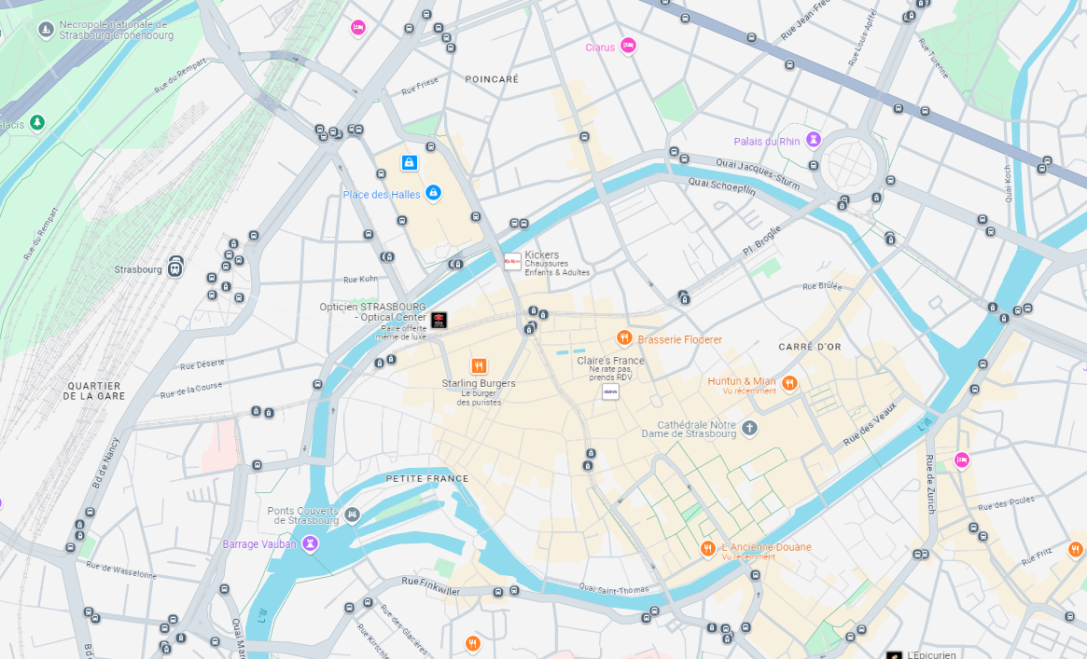
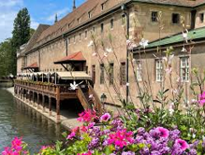
PRACTICAL INFORMATION
Diner 26/02 – 19h30
Restaurant l’Ancienne Douane
6 rue de la Douane, Strasbourg
From Train station 20 min walk
or
Tramway A or D
Stop Langstross Grand Rue
or Porte de l'Hôpital
Train station
Restaurant

Slide 8
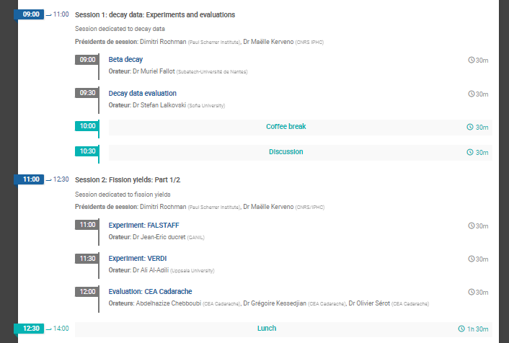
LET’S START!

Slide 9
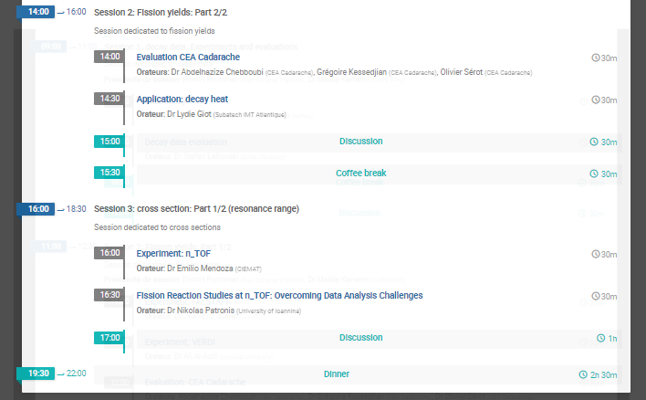
LET’S CONTINUE!

Slide 10
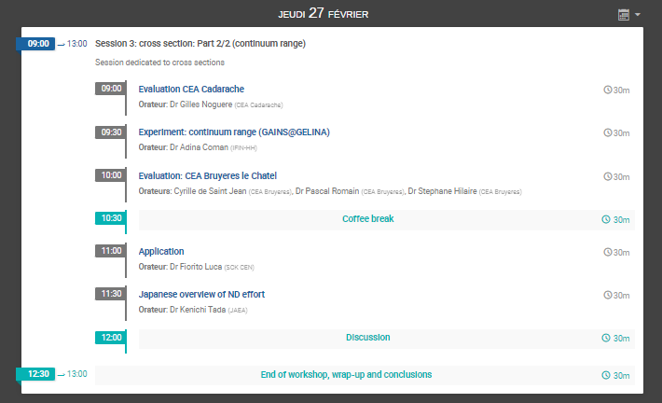
LET’S CONTINUE!

