Slide 1
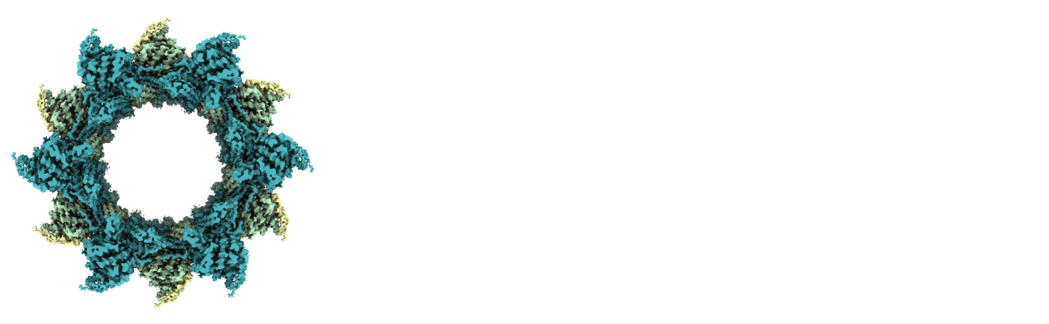
OpenEM
& SciCat
Spencer Bliven :: 7903 Scientific Data Curation
AWI Department Meeting, 10 Dec 2024

Slide 2
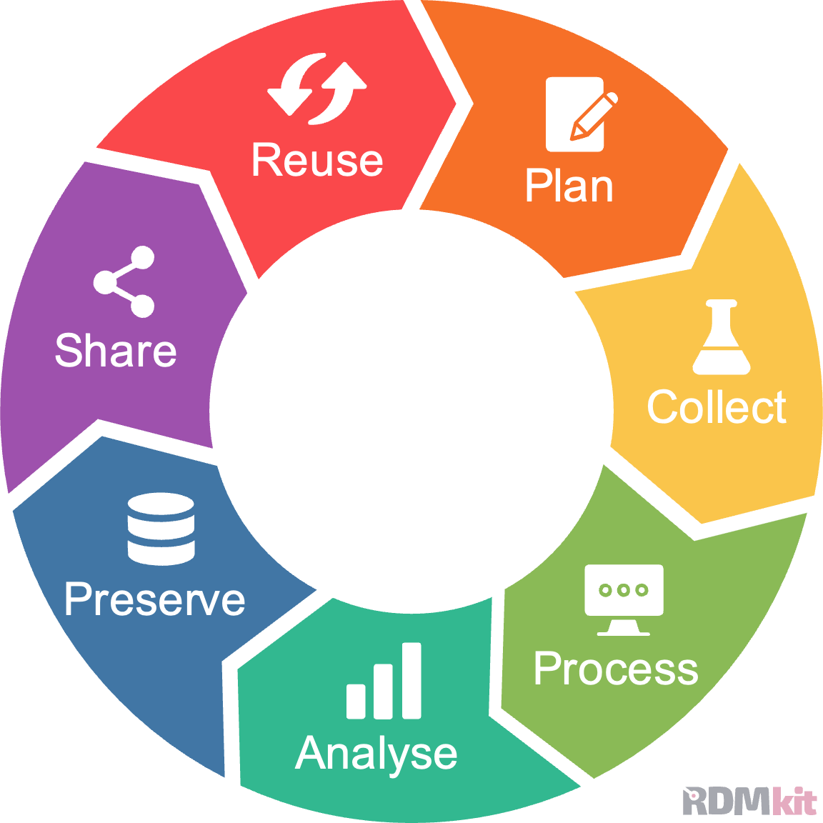
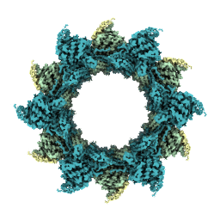

Scientific Data Lifecycle
PaNOSC, EOSC,
Google Dataset Search
Proposals (DUO)
Beamlines (microscopes),
Simulations,
Electronic Lab Notebooks
(SciLog)
Publications
DOI
Acquisition Systems (BEC)
Archiving
Workstations,
Clusters (ra/merlin)
https://rdmkit.elixir-europe.org/data_life_cycle

Slide 3
SciCat Statistics
http://metabase.psi.ch

Slide 4
SciCat Backend v4
Version 3
Loopback (javascript)
Hard-coded job actions
Code not following best practices
Flexible scientific metadata
Authentication & Authorization via PSI active directory
Archiving to CSCS Petabyte Archive
Version 4
NestJS (typescript)
Configure jobs without code changes
Better testing, CI/CD, and devops
Optional metadata schema validation
Authentication with eduGAIN federated identities
Support multiple storage systems (adding ETHZ Long Term Storage)

Slide 5
What will change?
Some changes to the REST API (renamed endpoints, added/removed properties)
Single-binary CLI replaces datasetIngestor, datasetArchiver, datasetRetriever, …
Authentication with OpenID Connect, replacing token-based login for interactive use cases (but functional accounts will still be supported)
Webpage for ingesting datasets interactively & monitoring data transfers
  Support for the Qt-based SciCat GUI will be deprecated after this is feature complete
Accept data from outside PSI (OpenEM electron microscopy facilities)
  Requires installing an ingestor service to manage data transfer
Support for Globus and S3 uploads from the internet
New v4 REST endpoint for testing: https://scicat.development.psi.ch/explorer

Slide 7
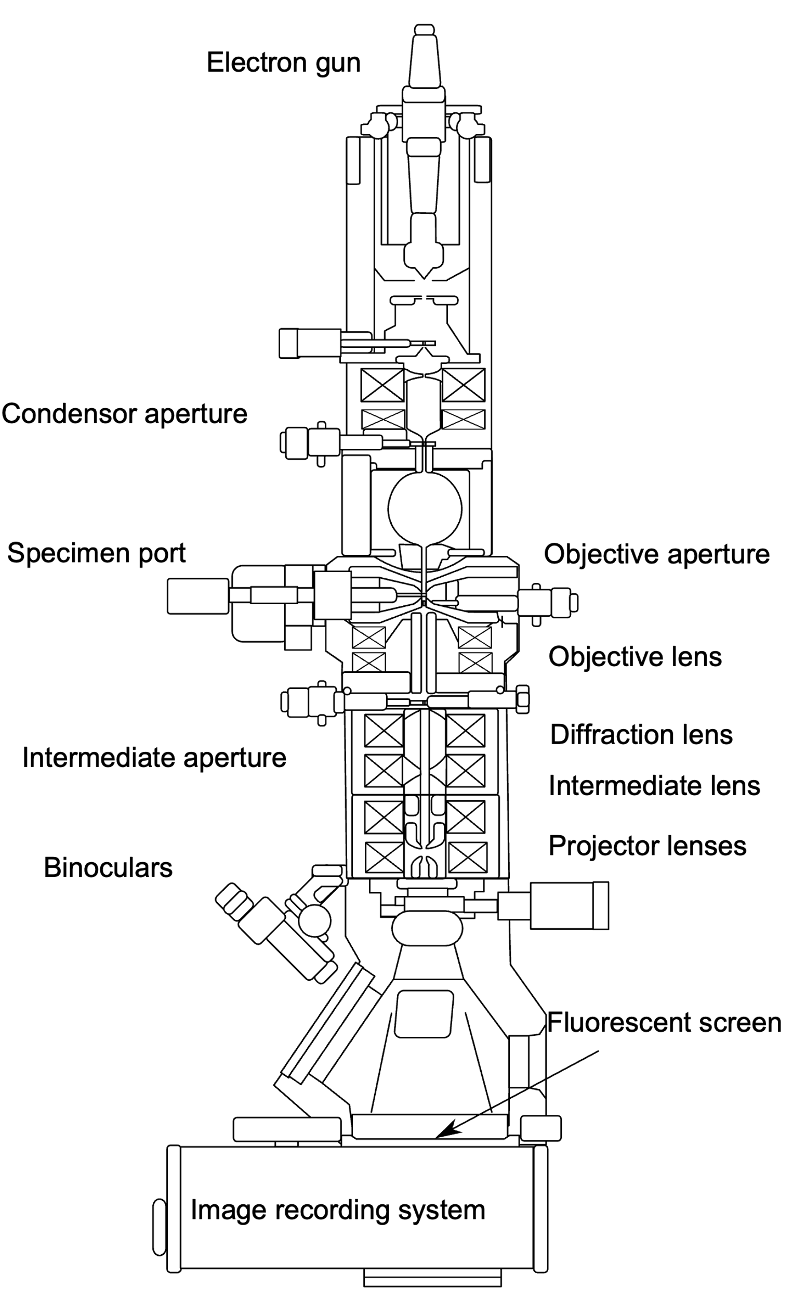
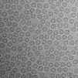
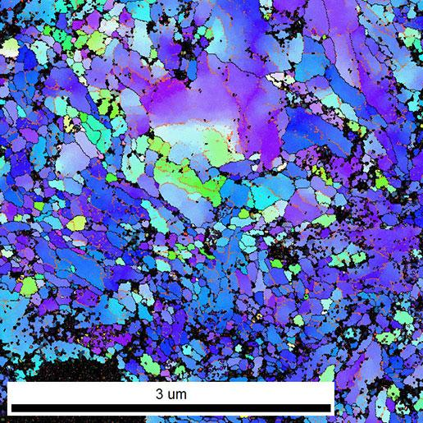
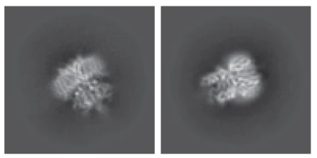
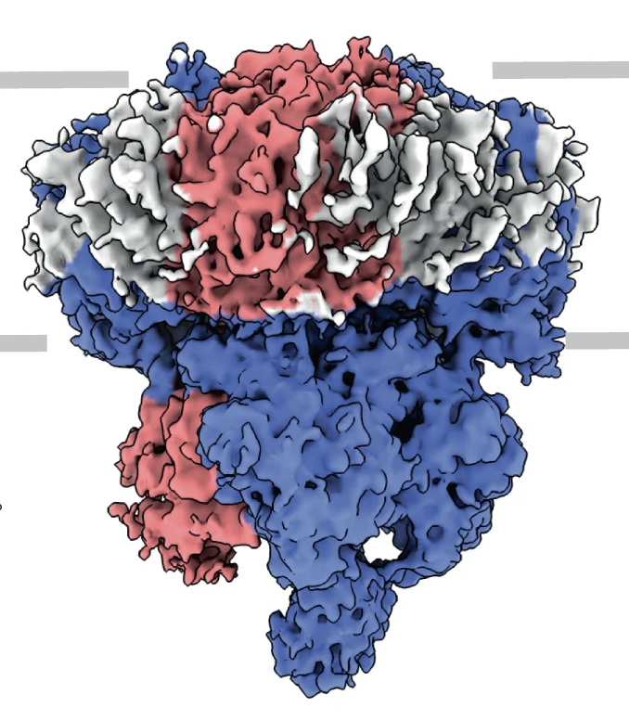
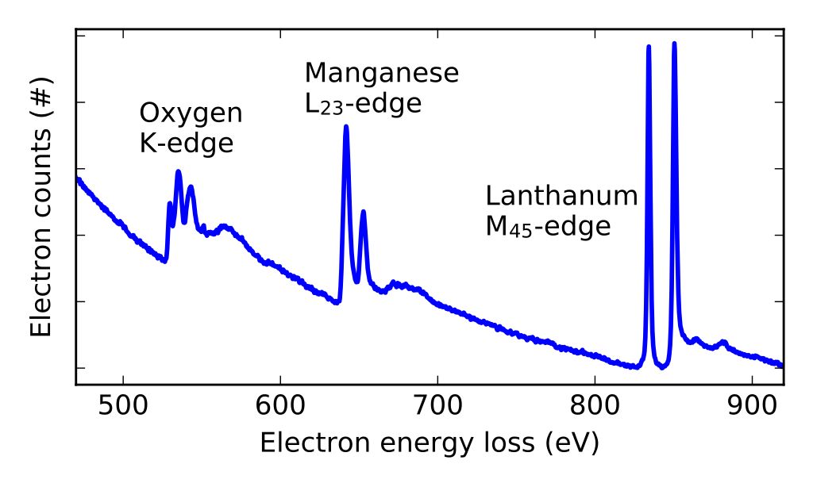
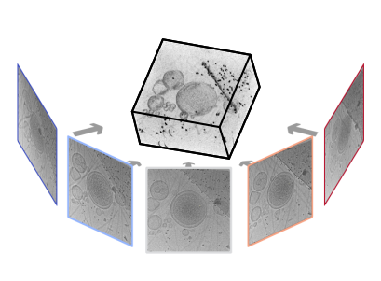
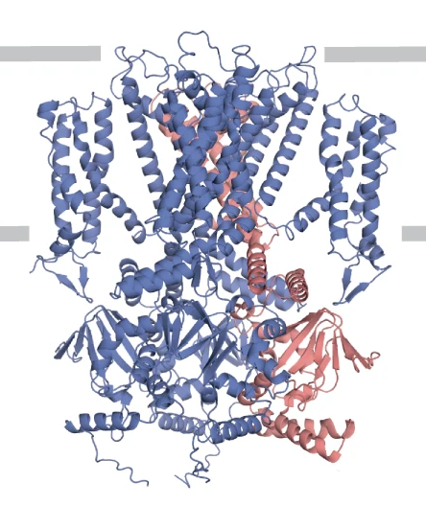
Electron Microscopy (EM)
Raw Data
Derived Data
Class averages
(Barret, PSI)
3D reconstructed volumes
2D Micrographs
Annotated Images
(EMPIAR-11016, Harder, EPFL)
(EMD-12718, Barret, PSI)
(Kunze and Sologubenko,
ETHZ)
Models
Spectrograms
(7o4h, Barret, PSI)
Magnunor, Wikimedia
Tomogram
tilt-series
teamtomo.org
More: ptychography, 4D STEM, VolumeEM, …
More: Tomographic reconstructions, segmented models, …

Slide 8
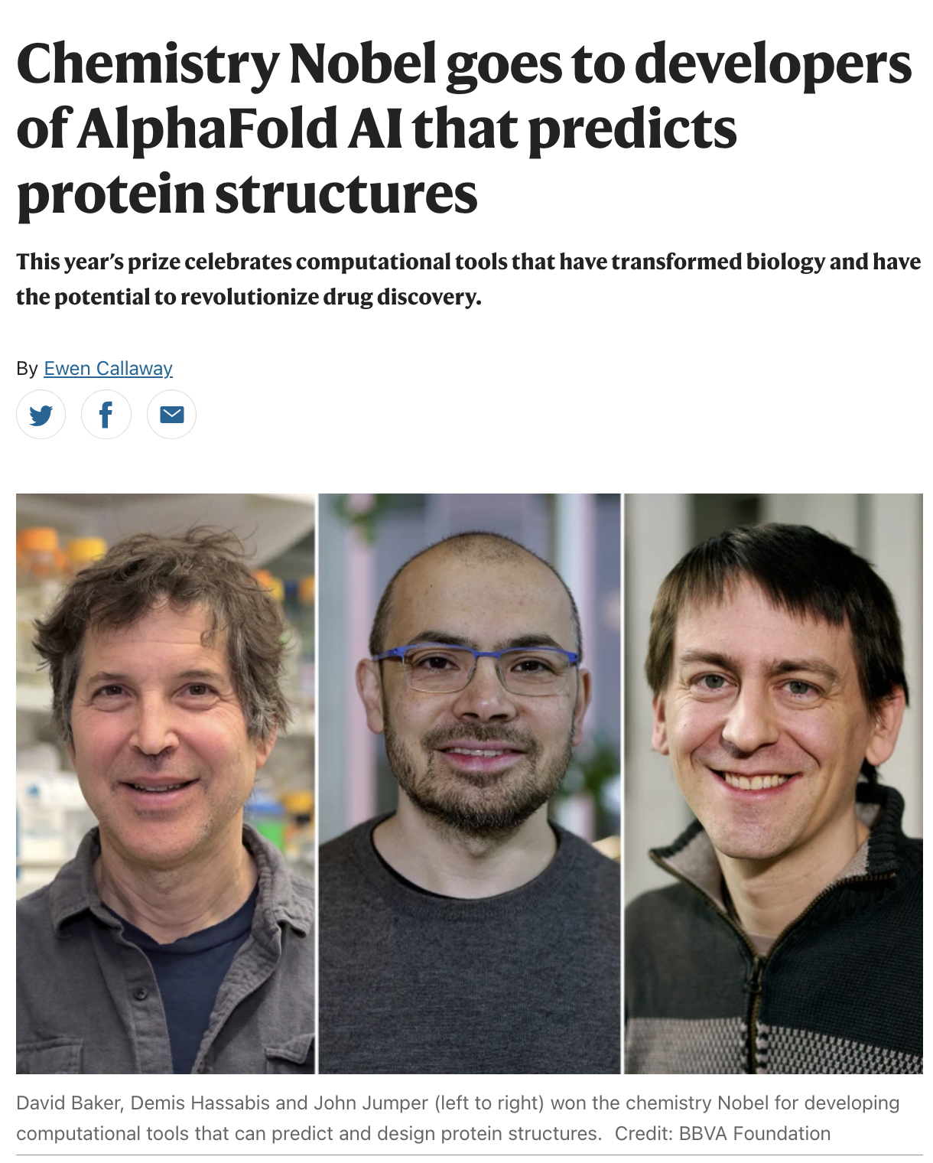
Motivation
Pressure from journals for open data
Requirements from funders & institutes
Easier data collection for microscope users
  Standardized across Switzerland
  Automatically log acquisition metadata
  Rapid deposition in field-specific repositories
Reuse
  Verify/reproduce processing
  Extracting additional results (especially from tomograms)
  Method development, e.g. AI methods ➜
  Apply novel processing methods to older data
Notes:
Source: https://www.nature.com/articles/d41586-024-03214-7

Slide 9
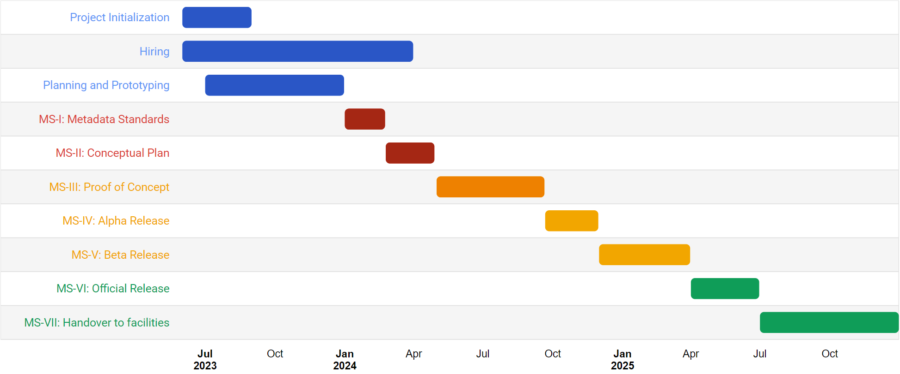
Timeline
OSC-EM Standards Workshop
Swissuniversities intermediate review
MADICES Workshop
MADICES Workshop
cryoET Workshop
ETHZ LTS support
ETH review 1
ETH review 2
SciCatCon User Meeting
First EM dataset transfered
Globus transfer

Slide 10
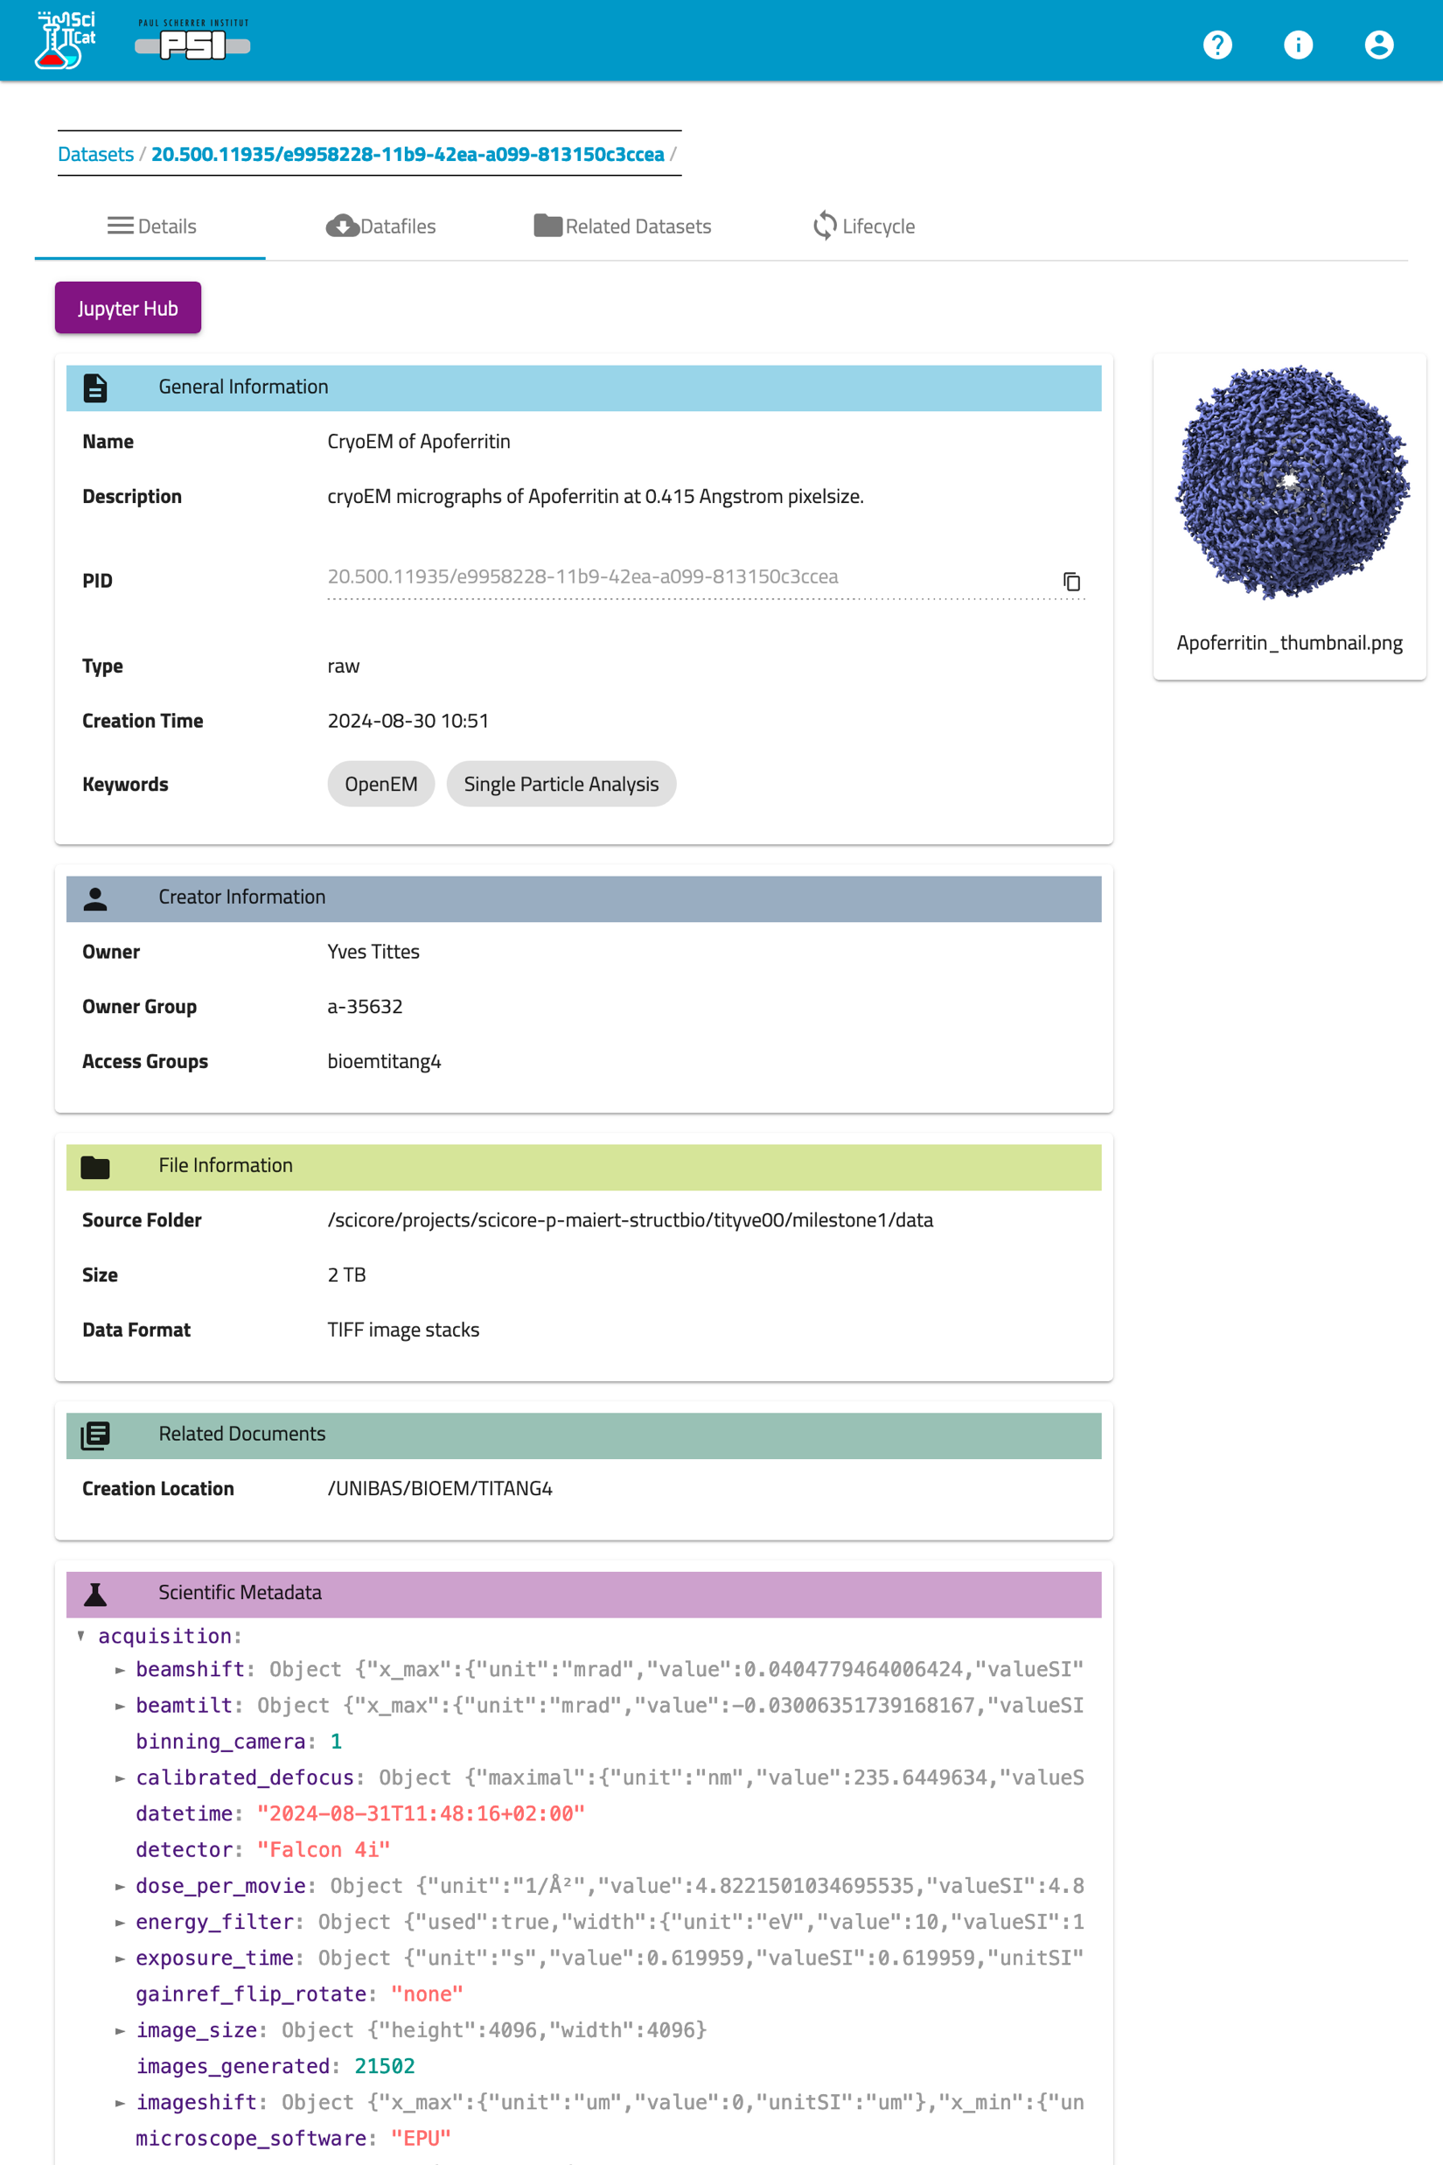
Updates
Completed “Proof of Concept” Milestone in September to acquire & publish a high-resolution protein structure (DOI:10.16907/a2ab7849-5de7-4e7f-8286-72ec73089ca8)
Deployment of “alpha release” consisting of all services to Uni Basel expected in December
Preparing for “beta release” at all facilities (including PSI) in late Q1-2025
  Workshop including microscope operators scheduled for 13 Feb 2025 in Bern
Submitted scientific & financial reports to ETH 20 Nov

Slide 11
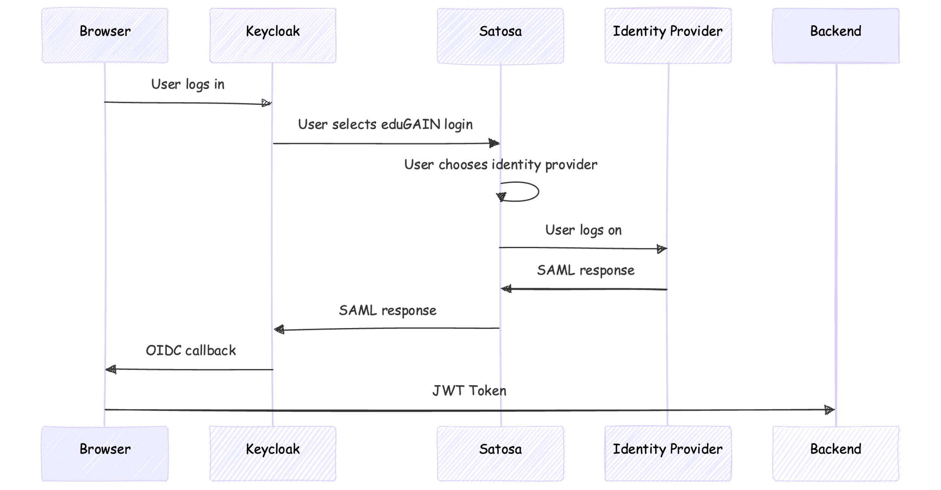
Authentication

Slide 12





Current Ingestor Architecture
PSI
Hetzner
CSCS
Instrument Storage
SciCat
Services
NFS
datasetIngestor
NFS
(or rsync)
Long-Term-
Storage
Central Storage
Arema

Slide 13
Planned Architecture for external facilities
Facility
Hetzner
ETHZ, CSCS
Web Frontend,
Single Sign-on
Instrument Storage
User Client
SciCat
Services
NFS
REST
REST
REST
PSI
Direct mount
Globus
Long-Term-
Storage
Cache Storage
Transfer Server
Ingestor-Backend
Arema
Firewall

Slide 14
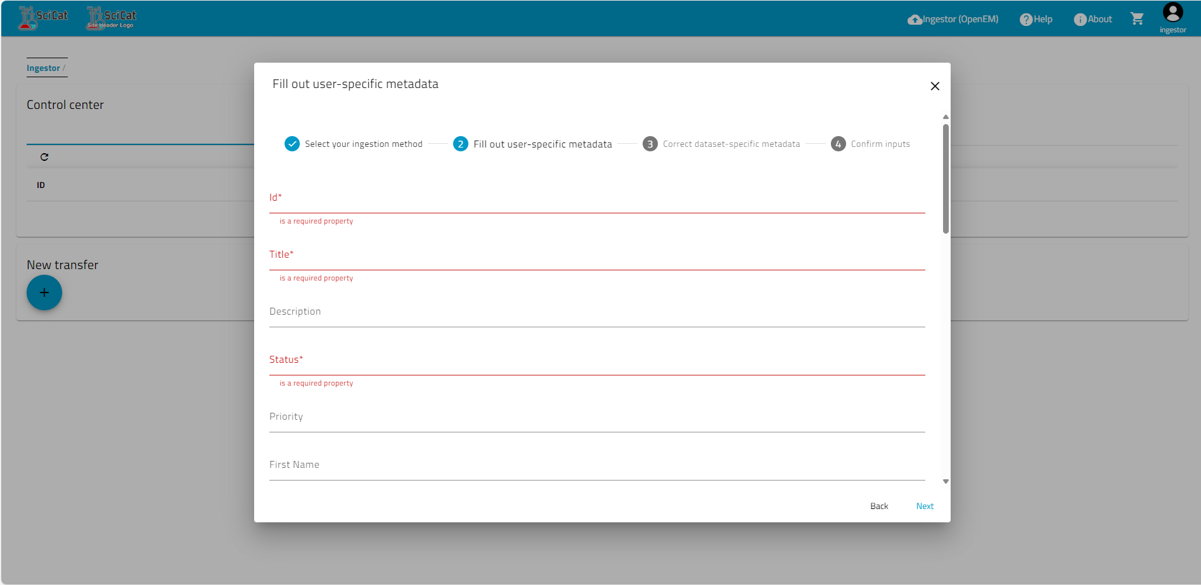
New Ingestor Frontend

Slide 15
New Ingestor Frontend
1. eduGAIN authentication
Users use home university account
2. Select Data Source/
Facility
3. Browse remote data & select data format
4. Set authorization & license
Use p-groups or add additional users
5. Proof automatically extracted metadata
Form generated from schema (JSON-Forms)
6. Submit
7. Monitor data transfer (globus)

Slide 16








Open Science Community for Electron Microscopy (OSC‑EM)
Established in 2023 to bring together electron microscopy (EM) researchers, facilities, software developers, and data repositories to standardize EM metadata needed for data collection, processing, and deposition.
Workshop 22-23 Feb 2024 with diverse participants
Aims for interoperability with other ontologies and standards: CryoEM ontology, PDBx/mmCIF dictionary, Helmholz EM Glossary, NeXus-FAIRmat NXem format and cryoET standards working group
Active contributors include OpenEM facilities (swissopenem.github.io), the Instruct Image Processing Center (I2PC), and the EM Data Bank (www.ebi.ac.uk/emdb).
Modular definition for different experimental methods and data processing stages (cryoEM, tomography, EELS, 3D reconstruction, etc).
Scipion

Slide 17
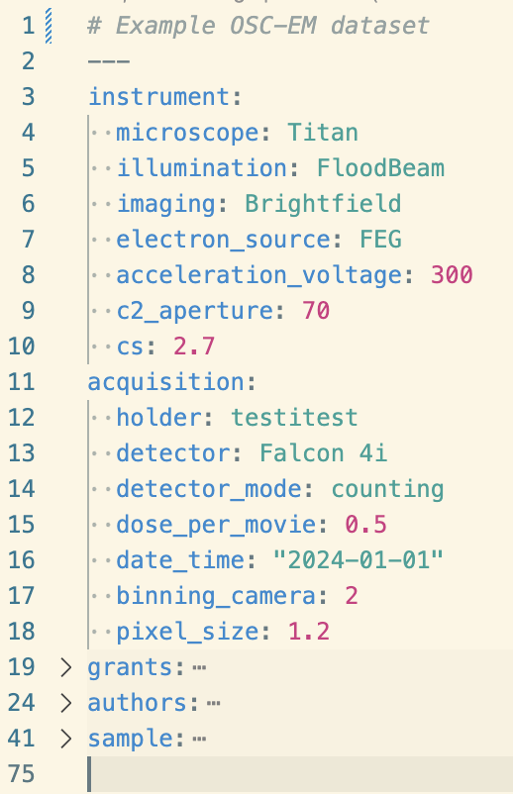
OSC-EM Schema
https://github.com/osc-em
Schema in LinkML used to automatically generate JSON Schema, JSON-LD, OWL, GraphQL, etc, as well as documentation and a python SDK.
Import from SerialEM and Thermo Fischer EPU (more coming!)
Export to mmCIF for deposition in EMDB/PDB OneDep
Suitable for inclusion in SciCat scientificMetadata field
LinkML
JSON Schema
JSON-LD
OWL
GraphQL
docs

Slide 18
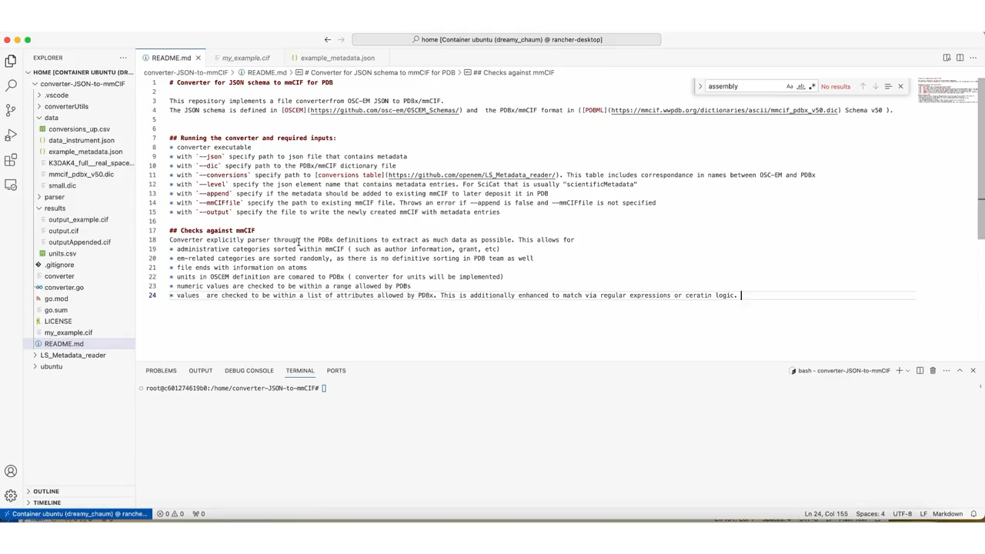
Deposition in EMPIAR, EMDB, and PDB
Export cryoEM data to EMPIAR, EMDB, and PDB
Convert OSC-EM metadata to mmCIF
Pre-fills many fields on the EMDB/PDB deposition website
Directly transfer raw data to EMPIAR deposition

Slide 19
Resources
OpenEM Websites
Public project website: https://swissopenem.github.io
ETH ORD Portal: https://open-research-data-portal.ch/projects/open-em-data-network/
Github: https://github.com/SwissOpenEM
OSC-EM Standard
https://github.com/osc-em
SciCat Data Catalog
Data repository: https://discovery.psi.ch
Published datasets: https://doi.psi.ch
SciCat website: https://scicatproject.github.io
v4 test deployment: https://scicat.development.psi.ch/explorer

Slide 20
Acknowledgements
Scientific Data Curation Group
  Leo, Carlo
  Welcome Omkar & Frédéric!
Datacenter & DB Services
  Peter Huesser, Michael Kallmeier-Glanz, Bernard Bumbak
SciCat Contributors (Max Novelli et. al)
OpenEM (PI; Core Team)
  EPFL: Marco Cantoni, Sofya Lakina, Alexander Myasnikov, Alexandra Radenovic, Henning Stahlberg
  PSI: Alun Ashton, Gregor Cicchetti, Peter Hüsser, Michael Kallmeier-Glanz, Volodymyr Korkhov, Carlo Minotti, Elisabeth Müller, Gebhard Schertler
  EMPA: Rolf Erni, Despina Adamopoulou
  ETHZ: Matthew Baker, Nicolas Blanc, Daniel Böhringer, Christophe Briand, Christophe Copéret, Miroslav Peterek, Bilal Qureshi, Andrzej J. Rzepiela, Philipp Wissmann
  UNIGE: Andreas Boland, Orsolyz Barabas, Andrew Howe, Attila Nacsa, Robbie Loewith
  UNIBAS: Mohamed Chami, Timm Maier, Yves Tittes
  UNIBE: David Kalbermatter, Benoît Zuber, David Wiessner

