Slide 1
MuX meeting (13/12/2024)
Marie Deseyn

Slide 2
Si data update

Slide 3
Gain drift
I did initial better calibration, with same lines as gaindrift
Less lines taken into account
Energy [keV] | Origin
302.8508 | Ba133
383.8485 | Ba133
661.657 | Cs137
344.2785 | Eu152
778.9045 | Eu152
121.7817 | Eu152
867.380 | Eu152

Slide 4
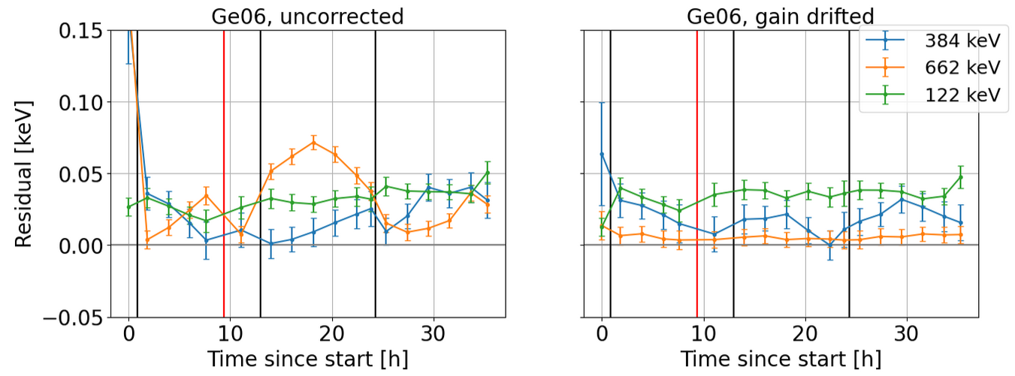
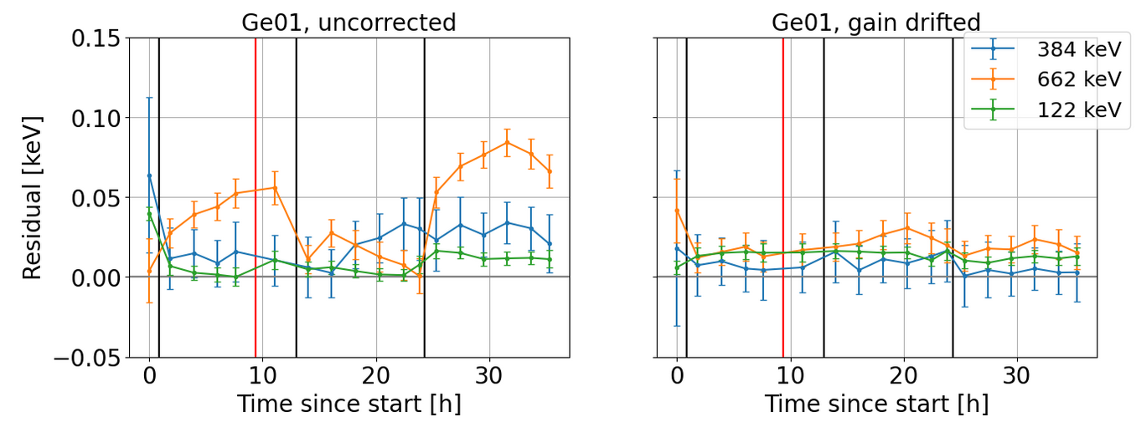
Gain drift

Slide 5
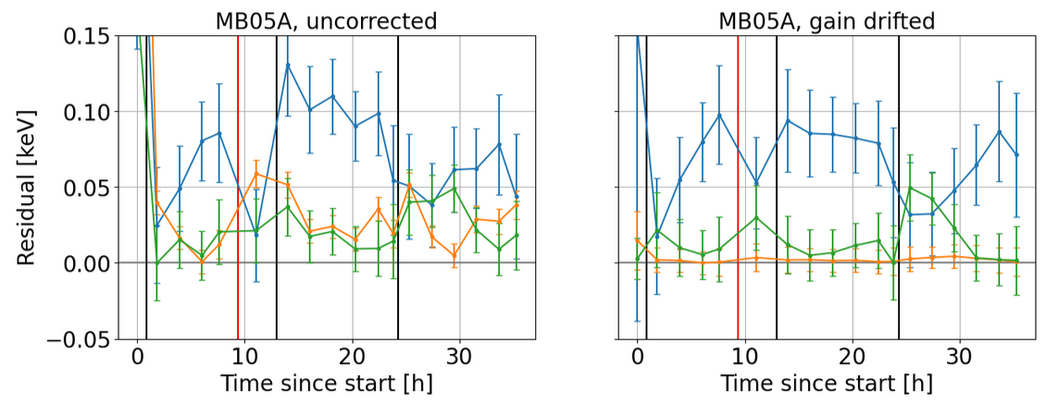
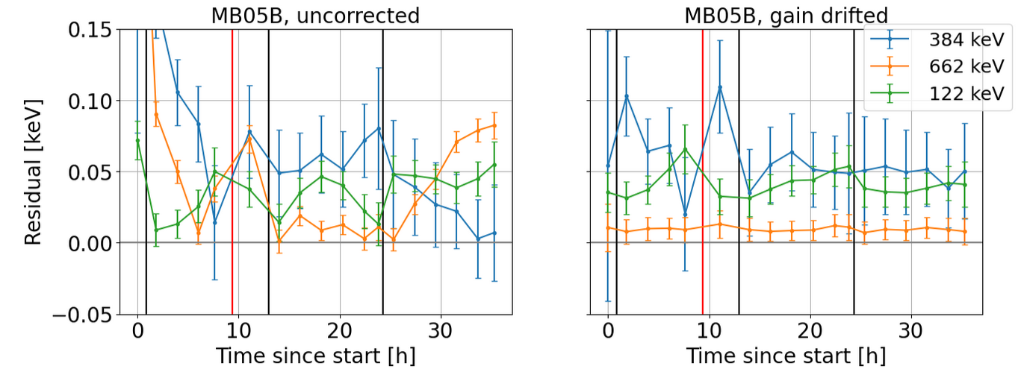
Gain drift

Slide 6
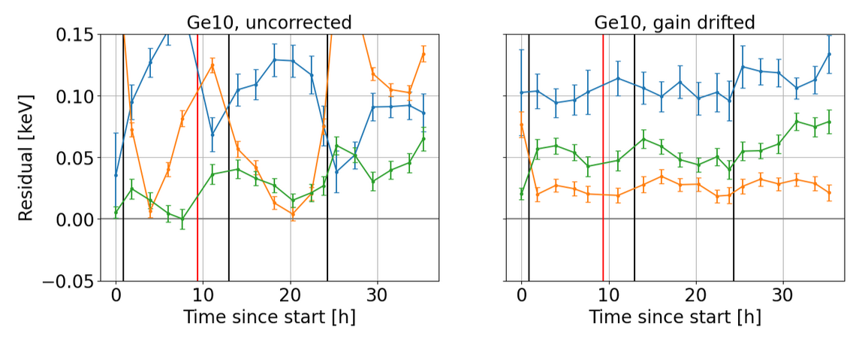
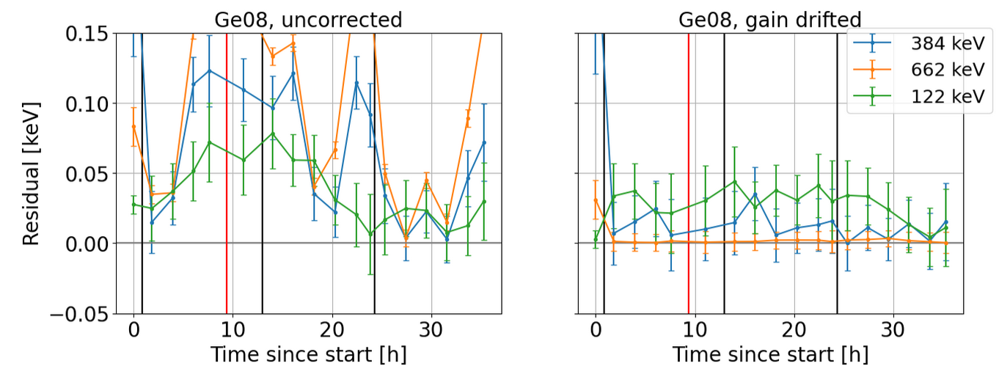
Gain drift

Slide 7
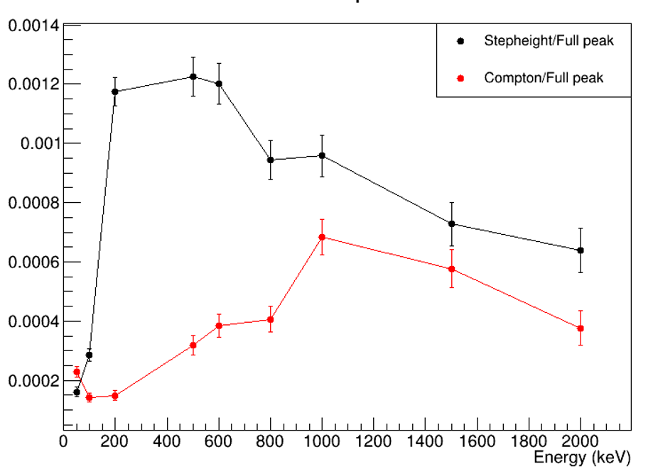
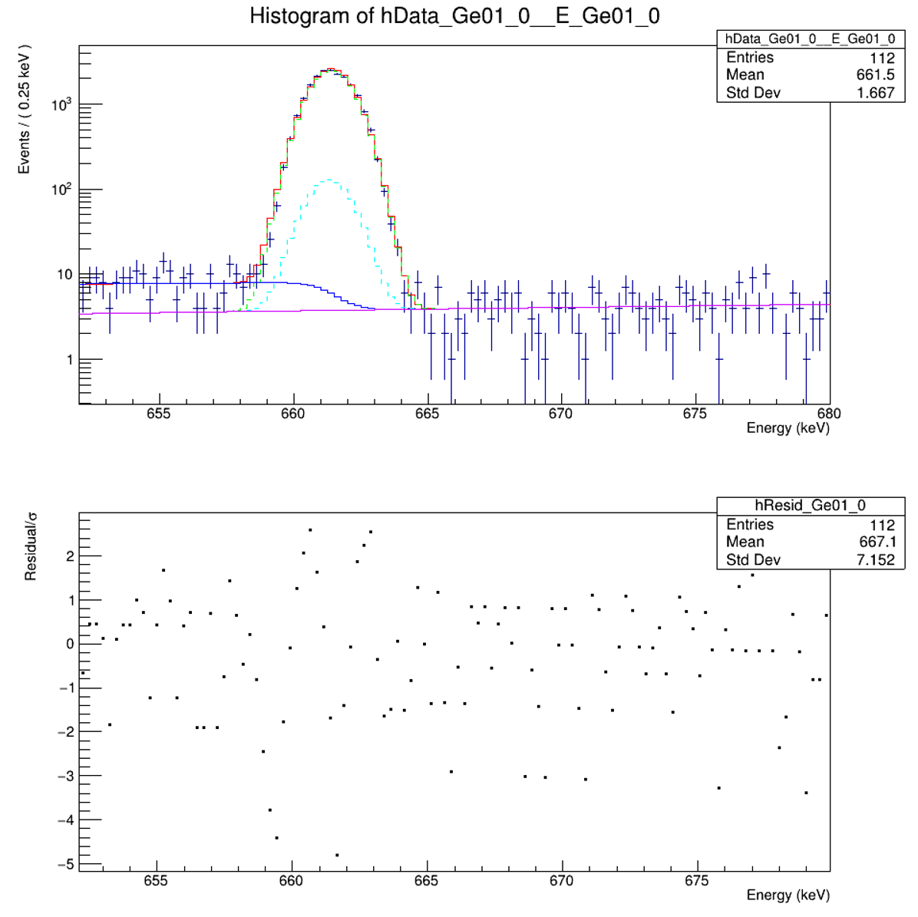
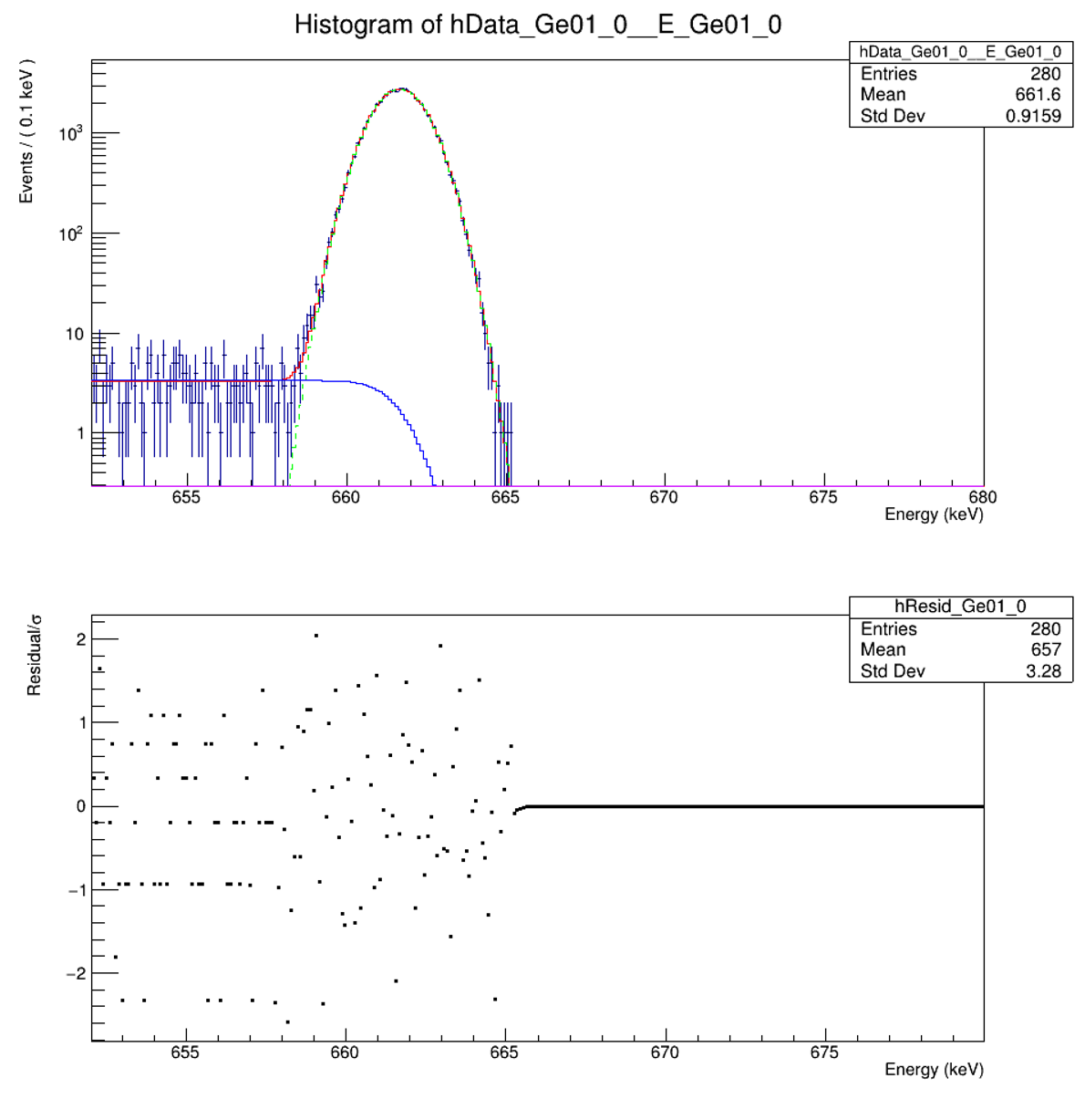
Step height
Investigating the origin of the step height and predictive power of Geant4
Very much work in progress still
Experimental spectrum:
Simulated spectrum:

Slide 8
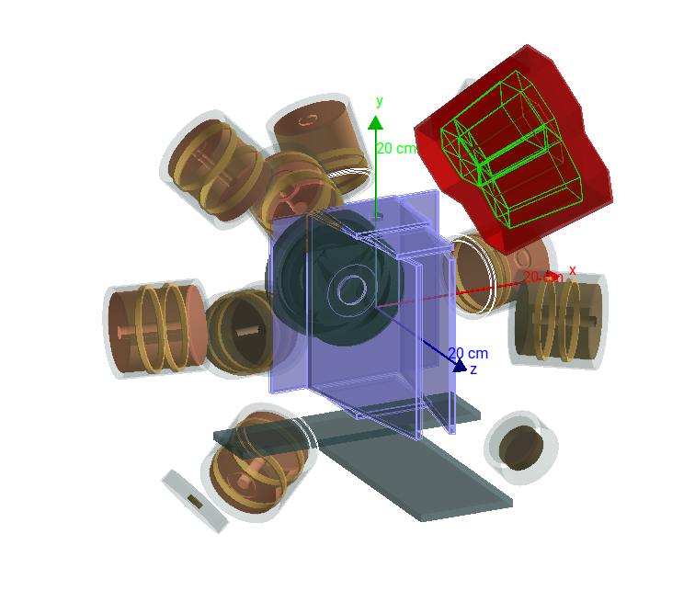
Geant4 simulations of the array of this year

Slide 9
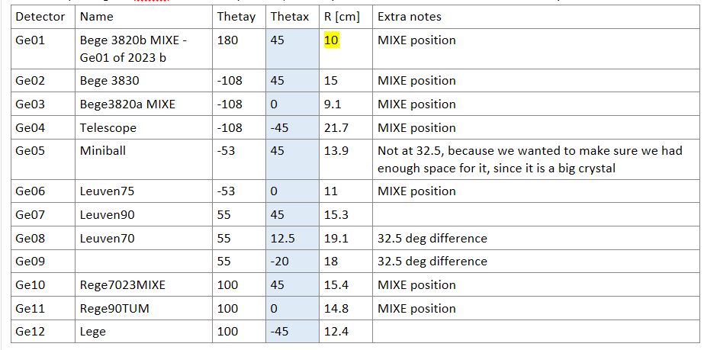
Based on the measurements we took during the switch between Au-Pb-H2O target and Al/Si
Uncertainty on R : +- 30
→ Geant4 simulations for:
    All detectors on measured R
    All detectors on measured R + 30mm
    All detectors on measured R – 30mm

Slide 10
Comparison
Scale experimental spectrum with: N_{sim}/(A*t_{exp})
Fit experimental and simulated spectrum → Get integral value
Uncertainty on simulation: from the +-3cm simulations
Uncertainty on the experiment: from the uncertainty on the activity

Slide 11
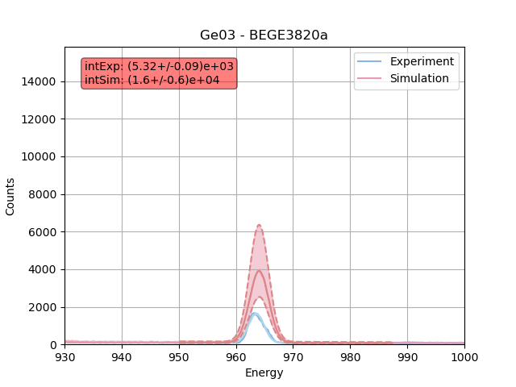
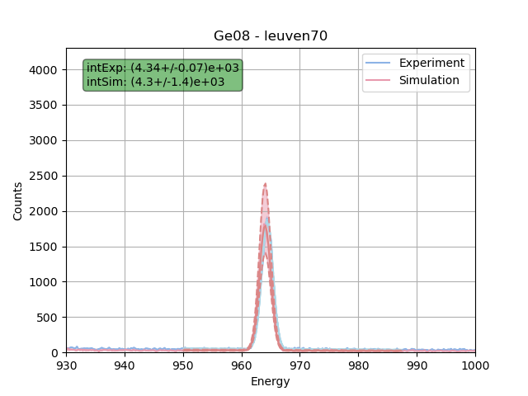
Comparison – 152Eu – 962keV line

Slide 12
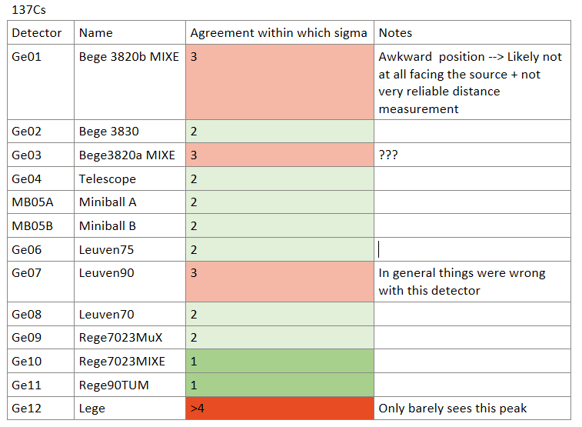
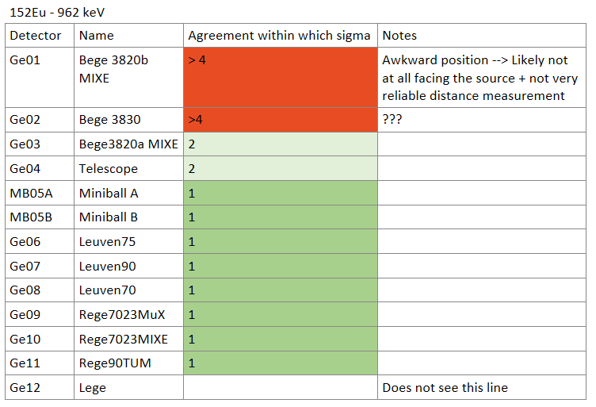
Comparison

Slide 13
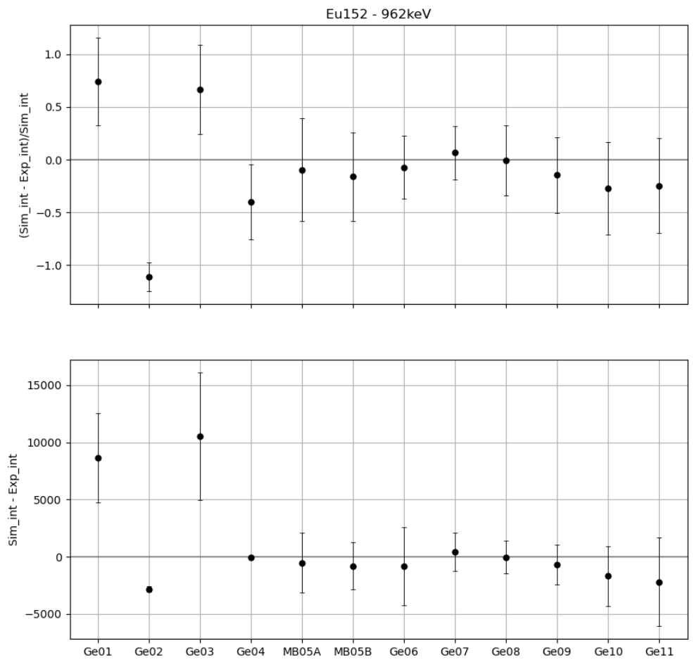
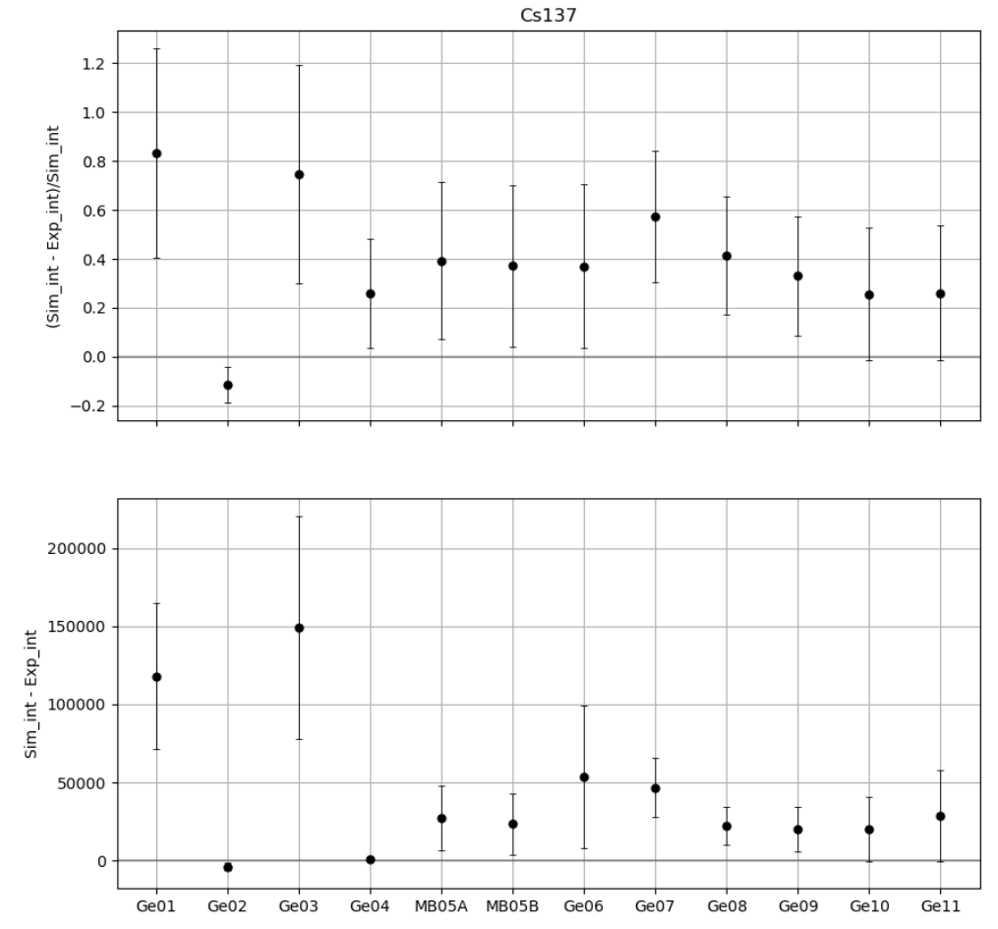
Comparison

Slide 14
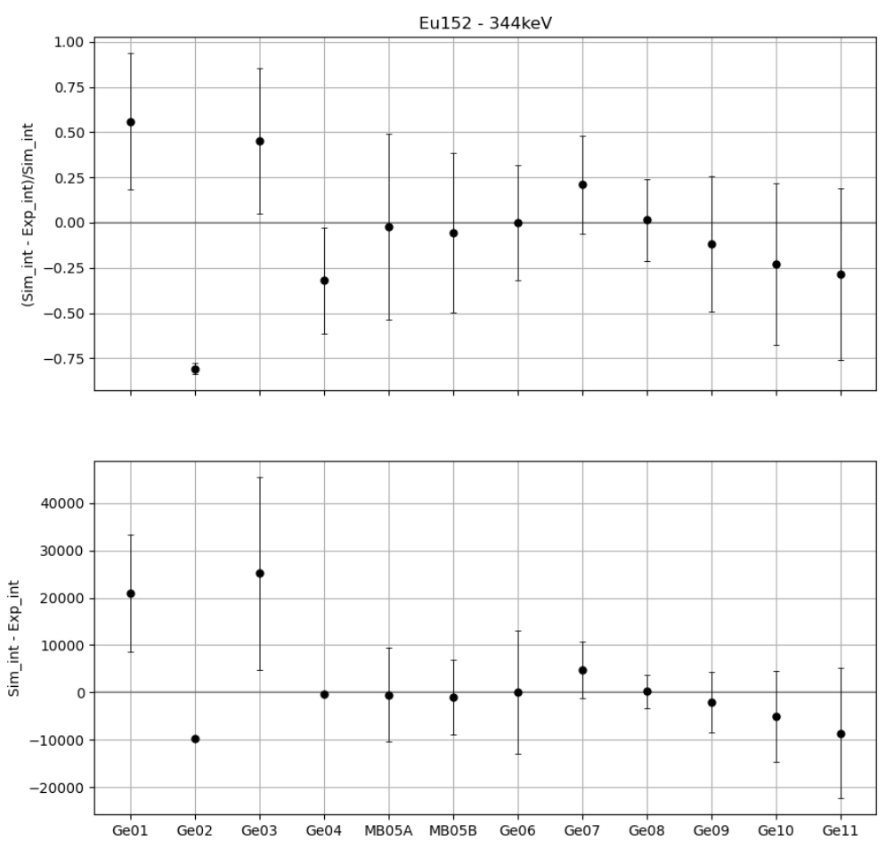
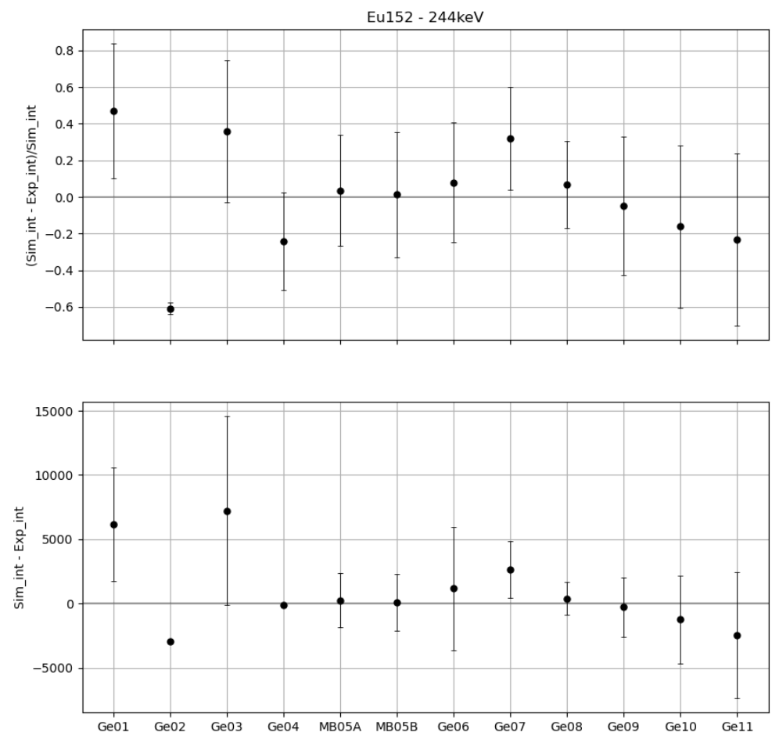
Comparison

Slide 15
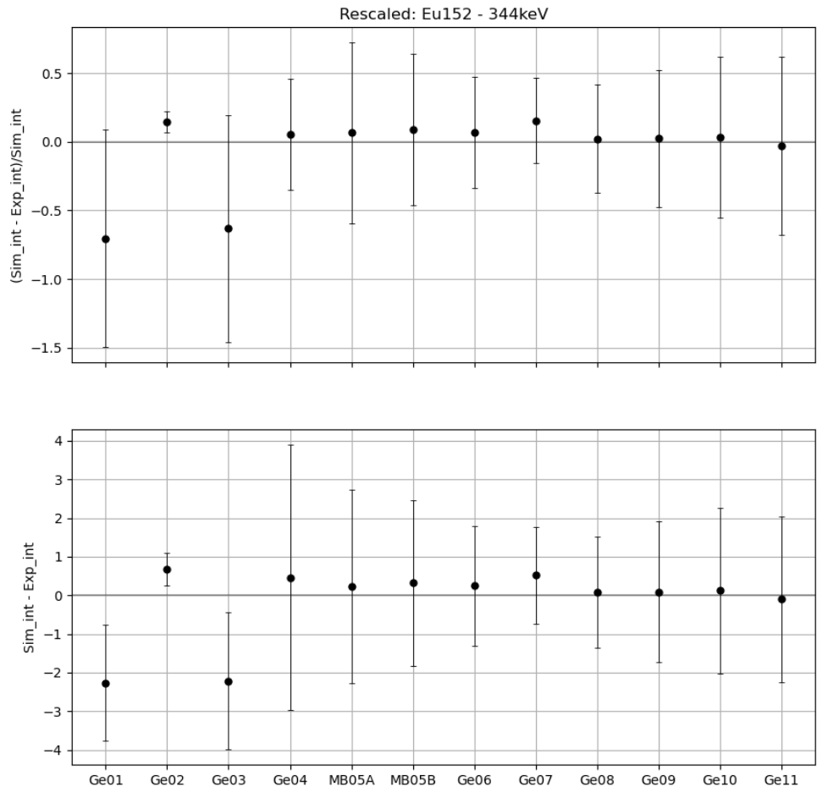
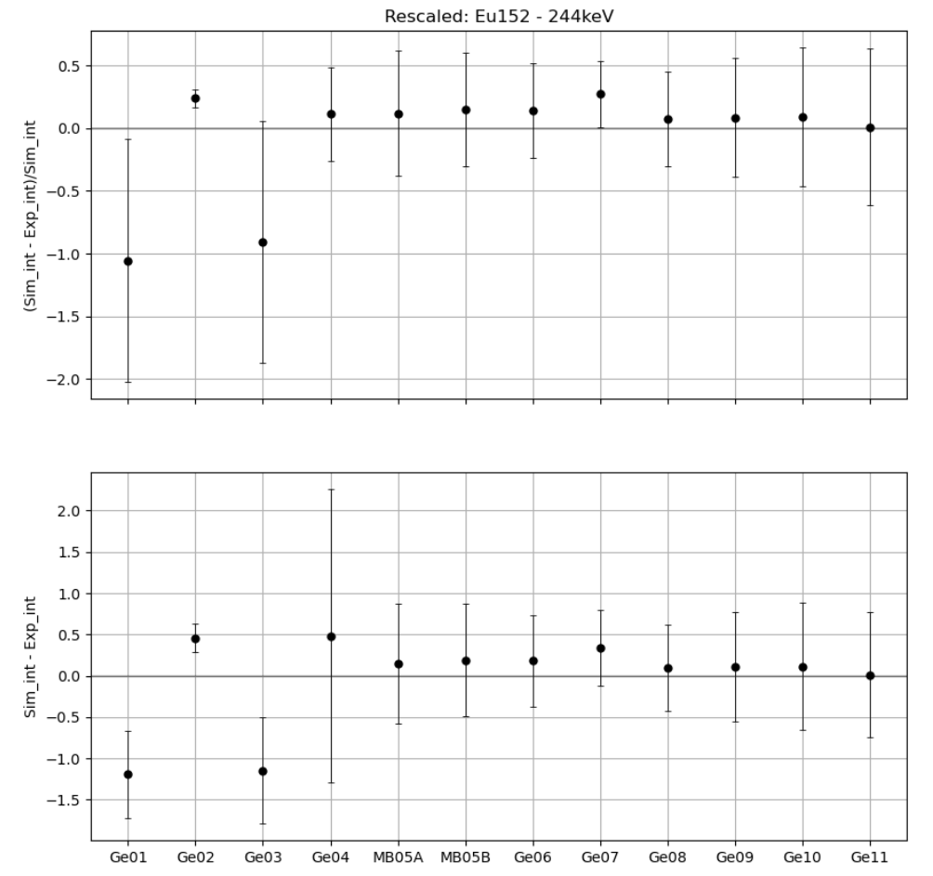
Compare – rescaled with 962keV line

Slide 16
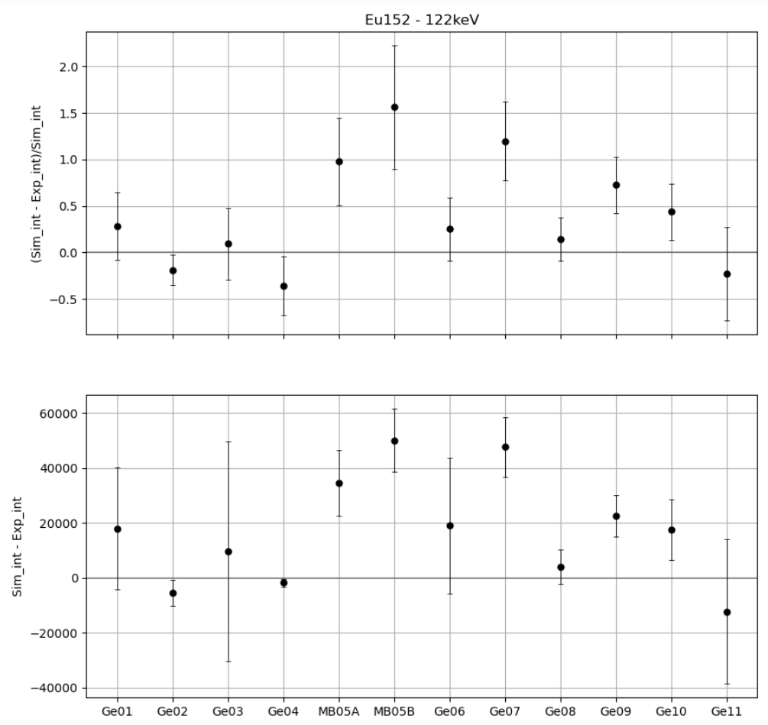
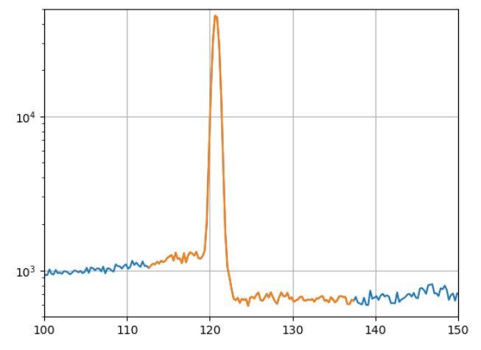
Comparison
Not very good, but quite a big step:
→Gaussian fit might not be the best

