Slide 1
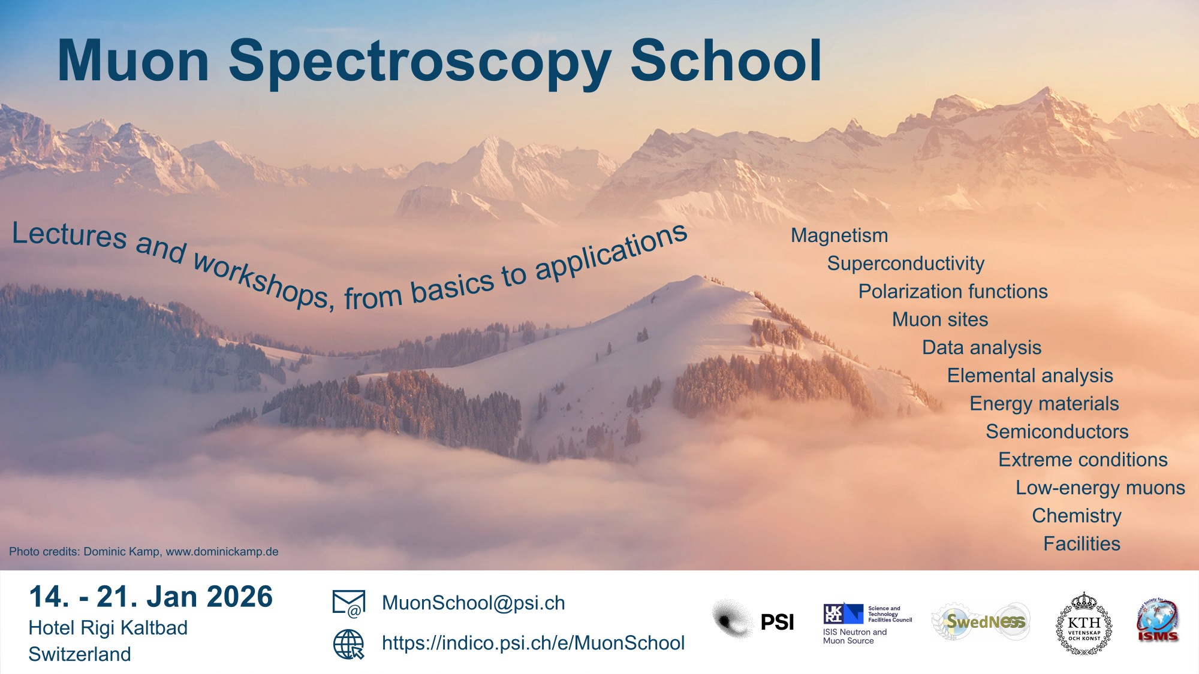
Muon Spin Spectroscopy School 2026, Jan 14 – 21
Jointly organised by PSI, ISIS, KTH
Jointly organised by PSI, ISIS, KTH

Slide 2
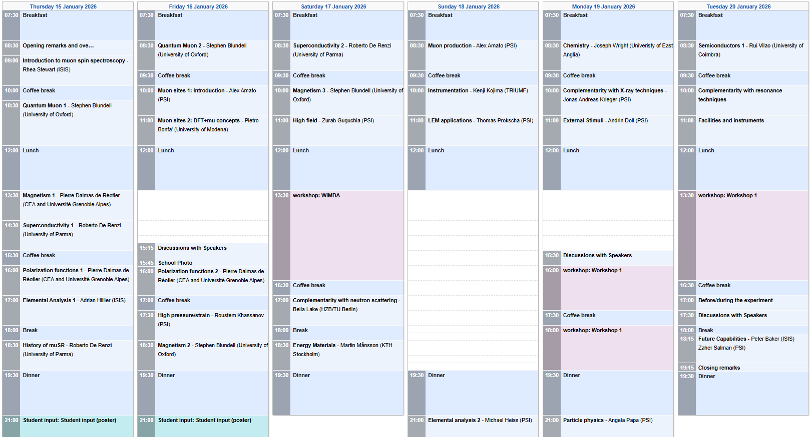
Muon Spectroscopy School 2026, Jan 14 – 21

Slide 3
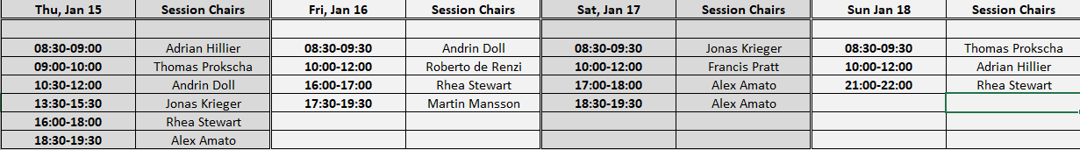
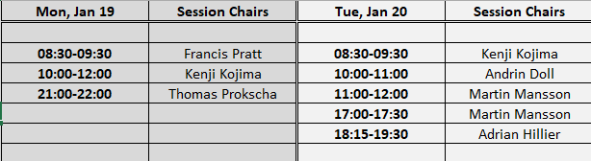
Muon Spectroscopy School 2026, Jan 14 – 21
Session chairs (in Indico: move mouse in timetable on the contribution to see the session chair)
WLAN: Hotel Rigi Kaltbad Gast, PW: 110126

Slide 4
Muon Spectroscopy School 2026, Jan 14 – 21
Workshops
Instructions and assignments have been sent by e-mail
musrfit: Rigi room (lecture room), mufinder: Kulm room 401 (4th floor)
aiidalab, MIXE, WiMDA: Scheidegg room 404, First room 405 (4th floor)
People of the organizing committee on site (for most of the time or entire duration)
Adrian Hillier, Martin Mansson, Thomas Prokscha, Andrin Doll, Jonas Krieger, Francis Pratt, Rhea Stewart
Most lecturers stay for several days or for the entire duration
Speakers: please send us your slides so that we can copy them to Indico

Slide 5
Recent history of muon schools and training courses
International Advanced School in Muon Spectroscopy, Aug 15 – 23, 2019, RAL/ISIS
Similar format to current school, jointly organized by ISIS, U Oxford, PSI, ISMS, SINE2020
Lectures and tutorials/workshops, student flash talks, facility tour
Muon science: Muons in physics, chemistry and materials, Aug 17 – 28, 1998, St. Andrews
Lectures
Proceedings of 51st Scottish Universities Summer School in Physics, NATO Advanced Study Institute

Slide 6
Recent history of muon schools and training courses
ISIS Muon Training School, biennial, 5 days in March, since 2003 (1994), ~30 participants
Lectures, workshops, facility tour
Hands-on training, student presentations
J-PARC Neutron and Muon school, annual, 5 days in Nov/Dec, since 2016, 30 – 40 participants
Lectures, facility tour
Hands-on training, student presentations

Slide 7
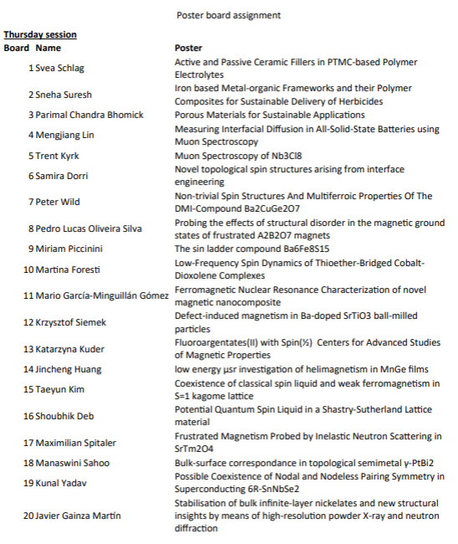
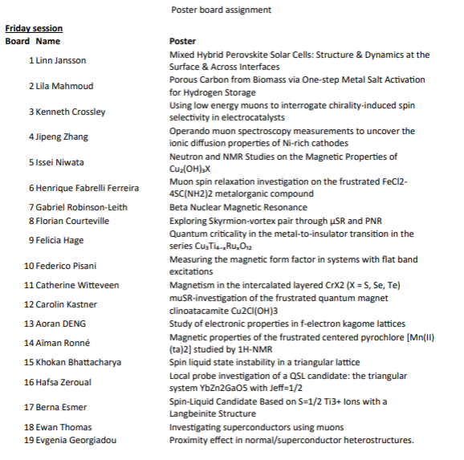
Muon Spectroscopy School 2026, Jan 14 – 21, poster assignments
Poster board assignments

Slide 8
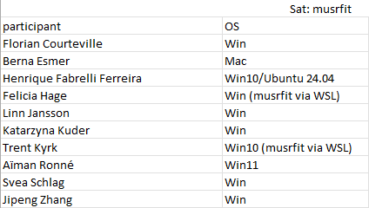
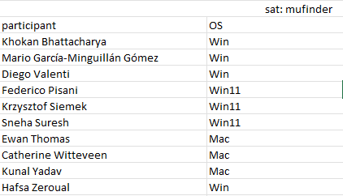
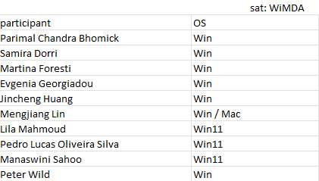
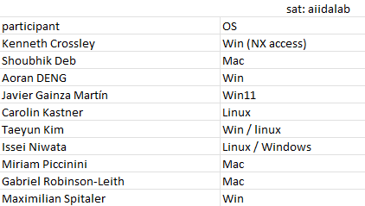
Muon Spectroscopy School 2026, Jan 14 – 21, workshops

Slide 9
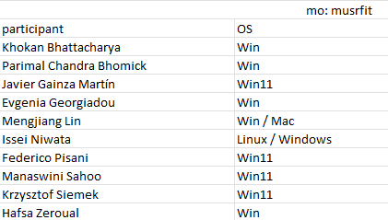
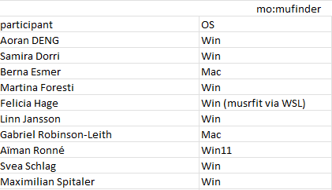
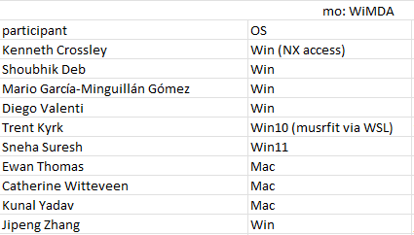
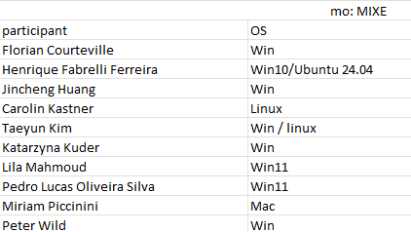
Muon Spectroscopy School 2026, Jan 14 – 21, workshops

Slide 10
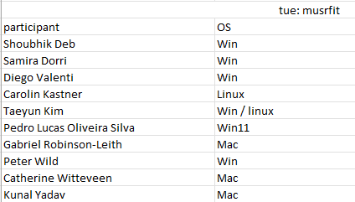
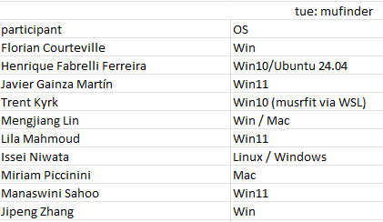
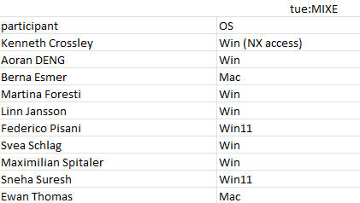
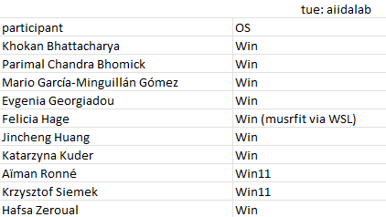
Muon Spectroscopy School 2026, Jan 14 – 21, workshops

Slide 11
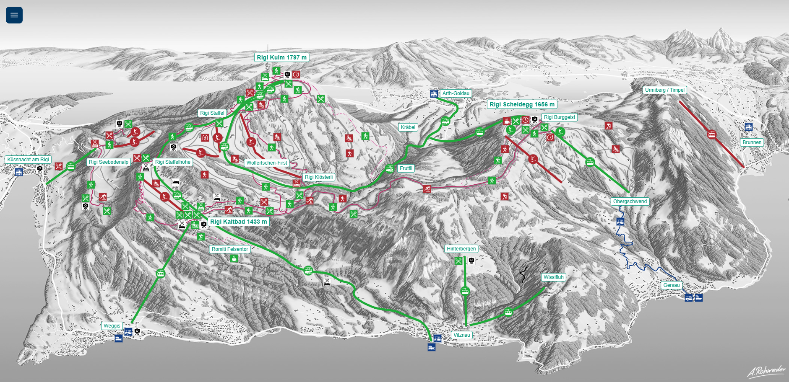
Muon Spin Spectroscopy School 2026, Jan 14 – 21
Grosser Mythen
Rigi-Kulm: sleigh rental
Zug
Schwyz
Lucerne

Slide 12
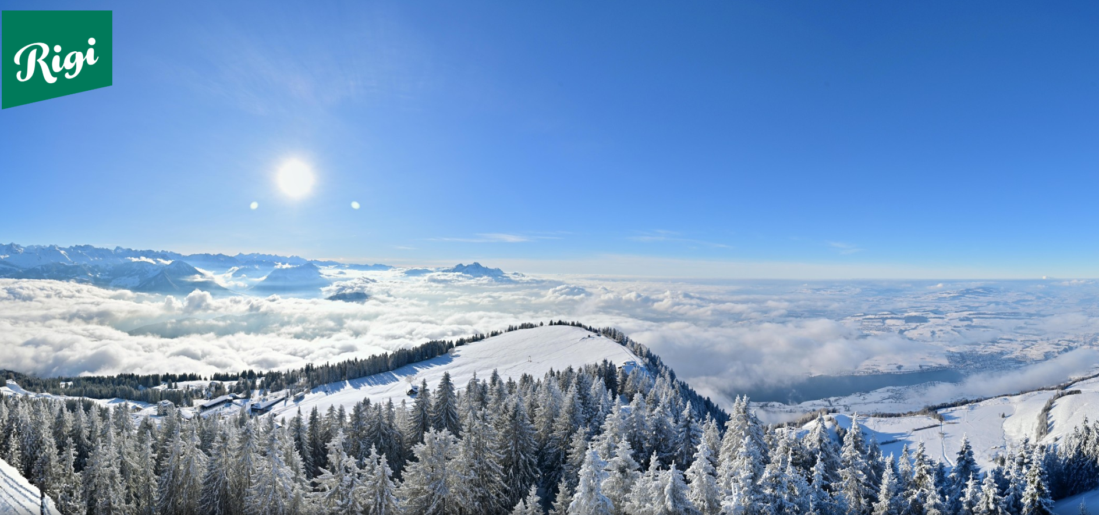
Muon Spin Spectroscopy School 2026, Jan 14 – 21
Jointly organised by PSI, ISIS, KTH
Jan 11, 2026
Pilatus
Rigi-Kaltbad

Slide 13
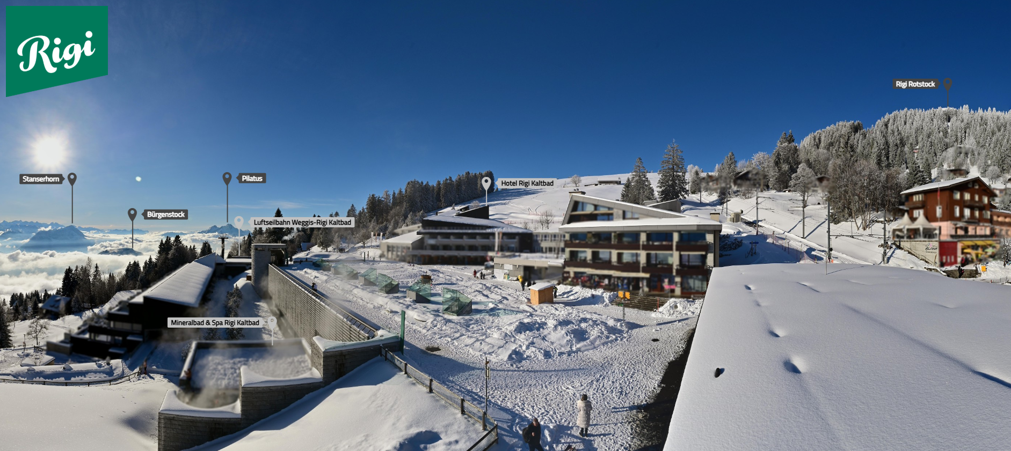
Muon Spin Spectroscopy School 2026, Jan 14 – 21
Jointly organised by PSI, ISIS, KTH
Jan 11, 2026

Slide 14
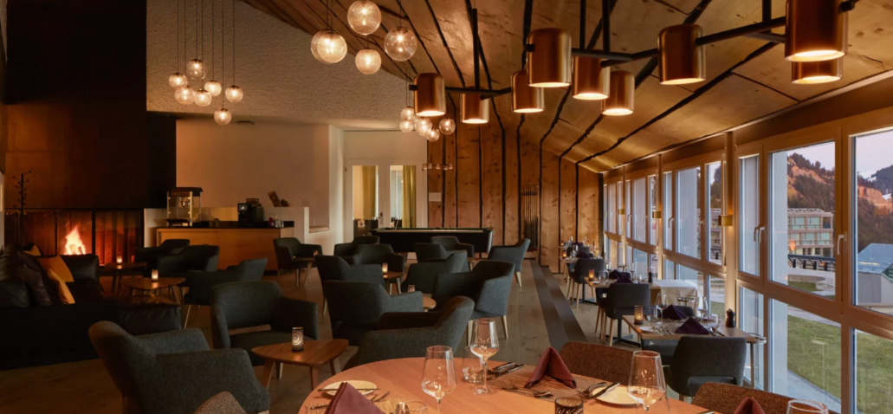
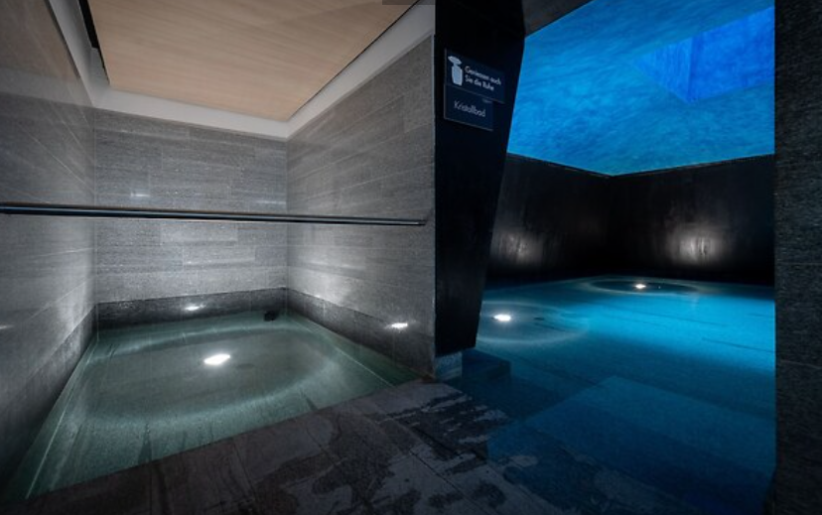
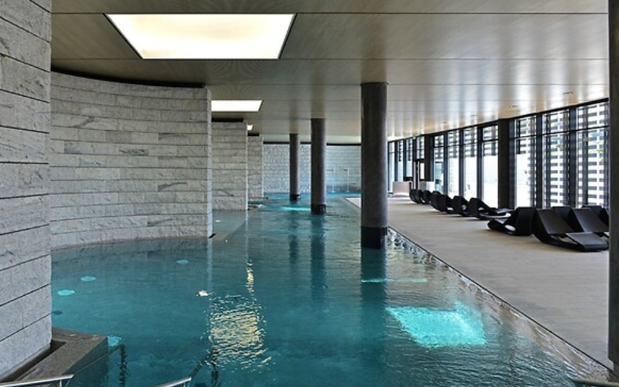
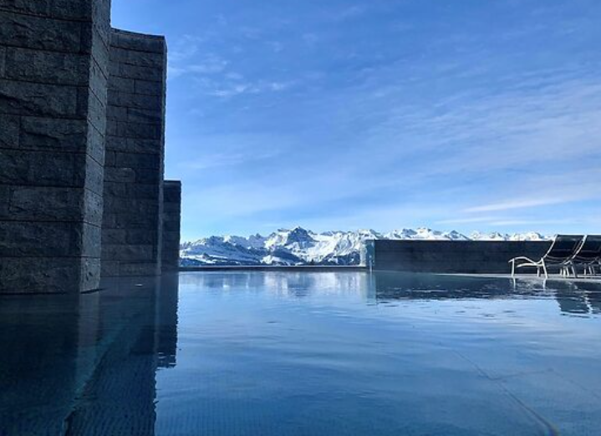
Muon Spectroscopy School 2026, Jan 14 – 21
Meals and drinks
Water and coffee during lunch and dinner included
All other drinks at lunch/dinner to be paid by participants
Drinks in the Mark-Twain Bar to be paid by participants
Spa area of the hotel
Free access for participants
The hotel provides bathrobes and towels. Disposable slippers are not provided. You are welcome to bring your own slippers or purchase them from the hotel.
Direct access from the hotel with room key. Opening hours: 8 am – 8 pm

Slide 15
Muon Spin Spectroscopy School 2026, Jan 14 – 21
Jointly organised by PSI, ISIS, KTH
We wish you a great muon school!

Slide 16
Muon Spectroscopy School 2026, Jan 14 – 21

Slide 17
Muon Spectroscopy School 2026, Jan 14 – 21
Session chairs (in Indico: click in timetable on the contribution to see the chair online)
WLAN: Hotel Rigi Kaltbad Gast, PW: 110126

