Slide 1
Introduction to Muon Spectroscopy
Rhea Stewart (rhea.stewart@stfc.ac.uk)
ISIS muon group, Rutherford Appleton Laboratory
Muon Spectroscopy School 2026
Rigi Kaltbad, 15 January 2026
“Muon Spin Spectroscopy (µSR) is a powerful technique that uses short-lived, spin-polarized muons as tiny, sensitive probes to study the magnetic and electronic properties of materials at the atomic level, revealing static and dynamic behaviors in magnetism, superconductivity, batteries, and more by detecting how the muon's spin changes within the material's local environment.”
Copilot summary

Slide 2

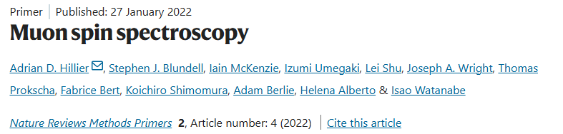

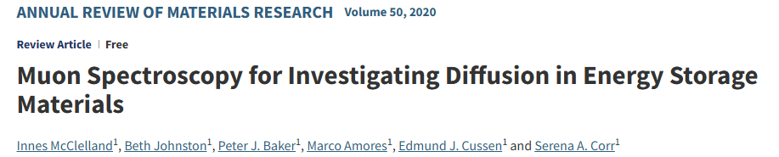

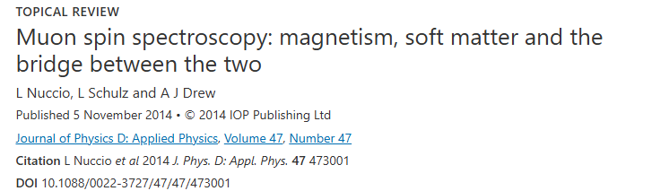
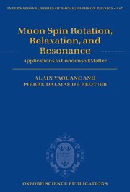

Preface – some useful references
Muon Spectroscopy: An Introduction ​​​
Stephen J. Blundell, Roberto De Renzi, Tom Lancaster, Francis L. Pratt ​​​
OUP 2022​
Along with useful review articles and online learning resources, for example:
* Some figures adapted from this book
Introduction to Muon Spin Spectroscopy ​​​
Alex Amato & Elvezio Morenzoni ​​​
Springer 2024​
Muon Spin Spectroscopy: Methods and Applications in Chemistry and Materials Science ​​​
Donald Fleming, Iain McKenzie & Paul Percival
Wiley 2024​
Muon Spin Rotation, Relaxation and Resonance
Alain Yaouanc & Pierre Dalmas de Réotier ​​​
OUP 2010​
https://e-learning.pan-training.eu/

Slide 3
Outline – a lecture in three parts
Aim: Introduce some core concepts in muon spectroscopy
Part I – Basic properties of muons and muon sources
Fundamental properties of muon particles
The asymmetry of muon decay
Muon states in matter and thermalisation
A brief comment about muon production and muon sources
Part II – Using Muons to do μSR experiments
The basics of muon spectroscopy
Experimental geometries
What do muons measure?
Muon data analysis considerations
Sensitivity to dynamics
How μSR compares to other experimental techniques
Part III – Applications of muons to materials investigation
How can muons be used for experiments on magnetic systems, superconductors, to study chemistry and the motion of ions through materials

Slide 4
Outline – a lecture in three parts
Aim: Introduce some core concepts in muon spectroscopy
Part I – Basic properties of muons and muon sources
Fundamental properties of muon particles
The asymmetry of muon decay
Muon states in matter and thermalisation
A brief comment about muon production and muon sources
Part II – Using Muons to do μSR experiments
The basics of muon spectroscopy
Experimental geometries
What do muons measure?
Muon data analysis considerations
Sensitivity to dynamics
How μSR compares to other experimental techniques
Part III – Applications of muons to materials investigation
How can muons be used for experiments on magnetic systems, superconductors, to study chemistry and the motion of ions through materials

Slide 5
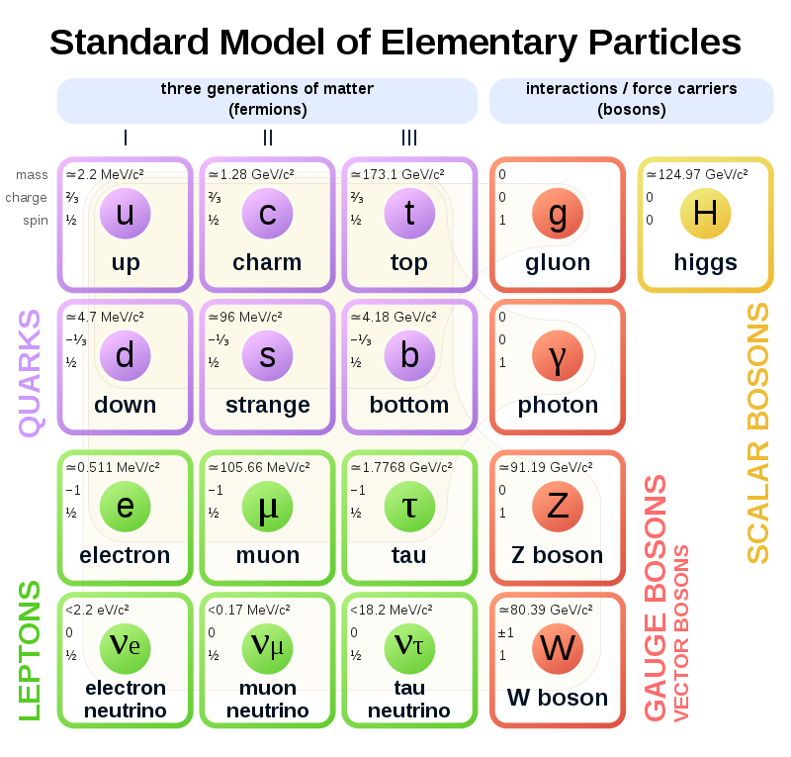
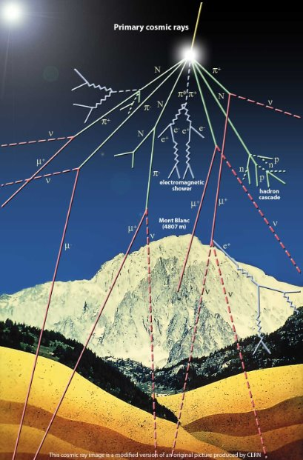
Properties of the muon
Discovered in California in 1936 by Carl David Anderson and Seth Neddermeyer via cloud chamber studies of cosmic rays
They found the new muon to be an unstable charged particle 200 times heavier than the electron
Originally categorised as a meson, now recognised as one of six leptonic elementary particles within the Standard Model

Slide 6
Properties of the muon
 | p (NMR) | µ (µSR) | e (ESR)
Charge | ±e | ±e | ±e
Spin | 1/2 | 1/2 | 1/2
Mass | 1836m_{e} =938MeV/c² | 207m_{e} =105.7MeV/c² | m_{e} =0.511MeV/c²
Lifetime | >10³³ years | 2.2µs (except for µ⁻ capture) | >10²⁶ years
Magnetic moment | µ_{p} | 3.18µ_{p} | 657µ_{p}
Gyromagnetic ratio (kHz/G) | 4.26 | 13.5 | 2800
Spin polarisation | Needs ~2.5-5T for P<73% | Produce µ⁺ with nearly P=100% | Needs some magnetic field
Major constituent of cosmic rays AND produced at accelerator facilities for particle physics and condensed matter research.

Slide 7
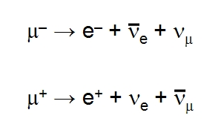
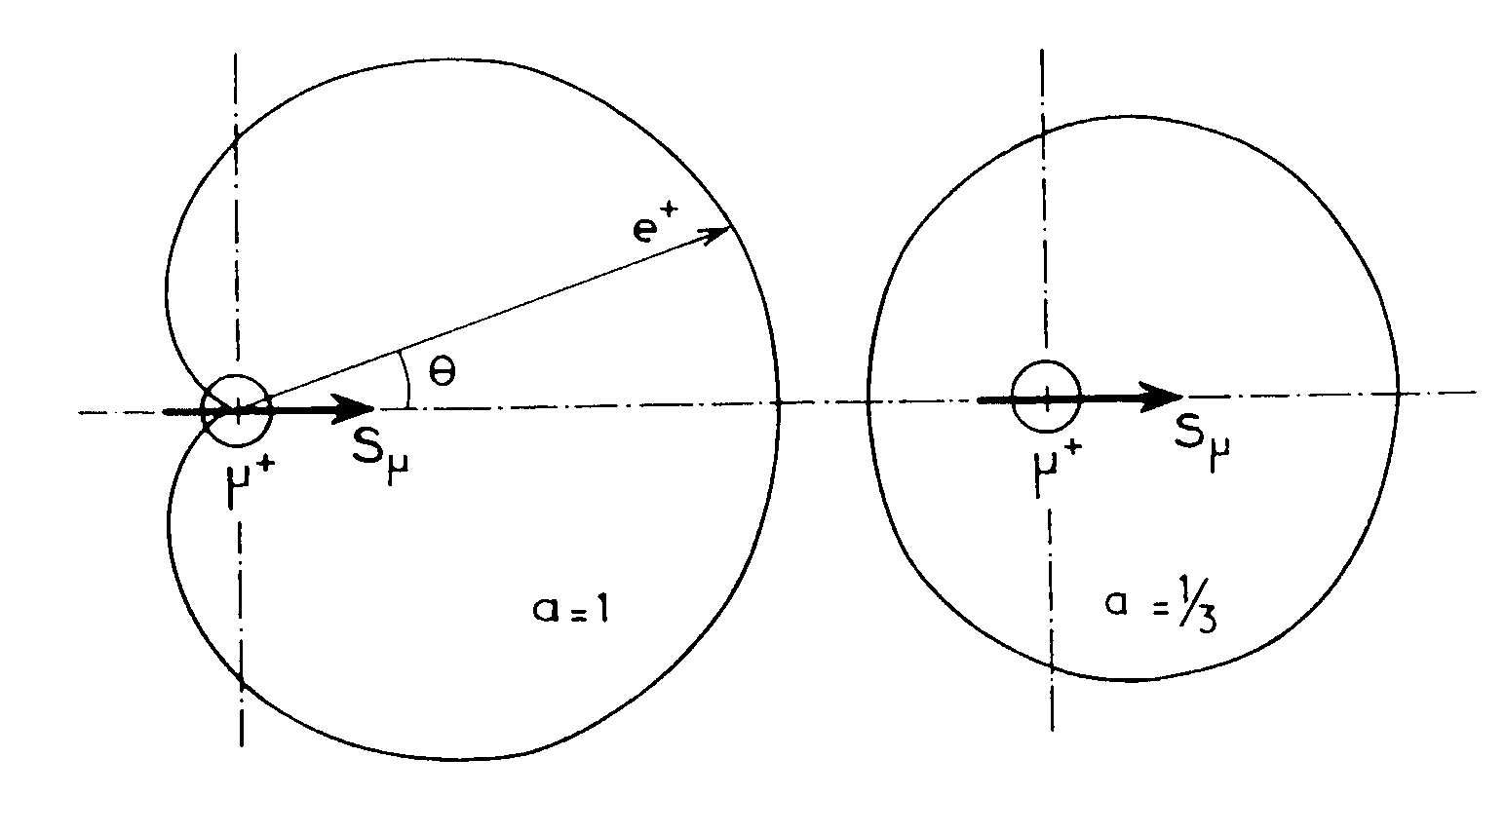
Properties of the muon III – they decay in a useful way!
The standard muon decay process produces a positron or electron and two neutrinos:
The muon decay is a result of the weak nuclear force
→ Slow decay rate
→ Asymmetric positron/electron emission from parity-symmetry violation
W(θ) = 1+ a cos θ
Taking a positive
muon
at the maximum positron energy
averaged over all positron energies

Slide 8
Properties of the muon – muon states in matter
Muons (E)
Muons incident on a sample stop in the material and rapidly thermalise

Slide 9
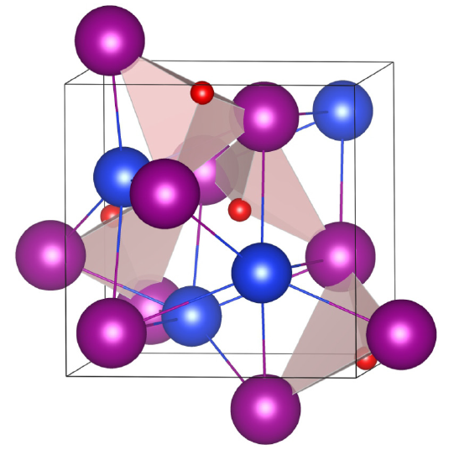
Properties of the muon – muon states in matter
Muons (E)
Muons incident on a sample stop in the material and rapidly thermalise
Muon implants at interstitial site. Attracted to regions of negative potential.
1

Slide 10
Properties of the muon – muon states in matter
Muons (E)
Muons incident on a sample stop in the material and rapidly thermalise
Muon implants at interstitial site. Attracted to regions of negative potential.
2
Diamagnetic muonium. Muon captured by electron lone pair on an atom.
1

Slide 11
Properties of the muon – muon states in matter
Muons (E)
Muons incident on a sample stop in the material and rapidly thermalise
Muon implants at interstitial site. Attracted to regions of negative potential.
2
Diamagnetic muonium. Muon captured by electron lone pair on an atom.
Paramagnetic muonium. Muon mimics hydrogen ion and interacts with sample.
1
3

Slide 12
Properties of the muon – muon states in matter
Muons (E)
Muons incident on a sample stop in the material and rapidly thermalise
Muon implants at interstitial site. Attracted to regions of negative potential.
2
Diamagnetic muonium. Muon captured by electron lone pair on an atom.
Paramagnetic muonium. Muon mimics hydrogen ion and interacts with sample.
1
3
Different muon sites and states depending on the sample material!

Slide 13
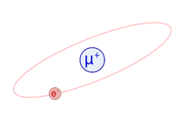
Muon stopping processes
Charge exchange
Thermal muonium
electron capture
Energy loss via atomic ionisation down to 10s of KeV
Chemical reaction
Mu formation
electron loss
Muon radicals
e⁻ emission
Muons stop within nanoseconds and the process preserves the muon spin polarisation!
ionisation
Thermal muons

Slide 14

Muon production at accelerator facilities
See muon production lecture
An energetic proton beam is focused on a muon production target (usually graphite)
First stage is the production of pions:
Single pion production (E_{p} > 280 MeV)
Double pion production (E_{p} > 600 MeV)
Pions have spin S=0 and decay with a 26 ns mean lifetime, the decay can produce 100% spin-polarised muons

Slide 15
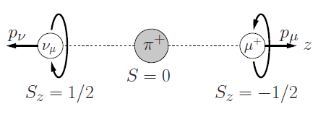

Muon production at accelerator facilities
See muon production lecture
An energetic proton beam is focused on a muon production target (usually graphite)
First stage is the production of pions:
Single pion production (E_{p} > 280 MeV)
Double pion production (E_{p} > 600 MeV)
Pions have spin S=0 and decay with a 26 ns mean lifetime, the decay can produce 100% spin-polarised muons

Slide 16
Muon production at accelerator facilities
See muon production lecture
An energetic proton beam is focused on a muon production target (usually graphite)
First stage is the production of pions:
Single pion production (E_{p} > 280 MeV)
Double pion production (E_{p} > 600 MeV)
Pions have spin S=0 and decay with a 26 ns mean lifetime, the decay can produce 100% spin-polarised muons
Muons can be produced with different energies, which means different stopping depths into materials...

Slide 17
Muon production – surface, decay and low energy muons
Surface -> 4MeV (10-100 μm)
Decay of π⁺ at rest near the target surface.
Optimal energy 4MeV (29MeV/c)
Nearly 100% spin polarised
Large fraction of muon experiments use surface muons

Slide 18
Muon production – surface, decay and low energy muons
Surface -> 4MeV (10-100 μm)
Decay -> 1-100 MeV (1-1000 μm)
Decay of π⁺ at rest near the target surface.
Optimal energy 4MeV (29MeV/c)
Nearly 100% spin polarised
Large fraction of muon experiments use surface muons
Produced when finite momentum pions leave the target and decay in flight.
Can be μ⁺ or μ⁻
Range of momentum possible (0 – 150MeV/c)
Up to 80% spin polarised
Enables measurements of samples in complex sample environments.

Slide 19
Muon production – surface, decay and low energy muons
Surface -> 4MeV (10-100 μm)
Decay -> 1-100 MeV (1-1000 μm)
Low E -> 1-30keV (1-100 nm)
Decay of π⁺ at rest near the target surface.
Optimal energy 4MeV (29MeV/c)
Nearly 100% spin polarised
Large fraction of muon experiments use surface muons
Produced when finite momentum pions leave the target and decay in flight.
Can be μ⁺ or μ⁻
Range of momentum possible (0 – 150MeV/c)
Up to 80% spin polarised
Enables measurements of samples in complex sample environments.
Surface muons can be moderated down to lower energies.
Range of energy possible by acceleration with electric fields (~ 1-30keV)
Nearly 100% spin polarised
Enables measurement of thin films, surfaces and interfaces.

Slide 20
Muon production – surface, decay and low energy muons
Surface -> 4MeV (10-100 μm)
Decay -> 1-100 MeV (1-1000 μm)
Low E -> 1-30keV (1-100 nm)
Decay of π⁺ at rest near the target surface.
Optimal energy 4MeV (29MeV/c)
Nearly 100% spin polarised
Large fraction of muon experiments use surface muons
Produced when finite momentum pions leave the target and decay in flight.
Can be μ⁺ or μ⁻
Range of momentum possible (0 – 150MeV/c)
Up to 80% spin polarised
Enables measurements of samples in complex sample environments.
Surface muons can be moderated down to lower energies.
Range of energy possible by acceleration with electric fields (~ 1-30keV)
Nearly 100% spin polarised
Enables measurement of thin films, surfaces and interfaces.
See high pressure and elemental analysis lectures
See lectures on LEM applications

Slide 21
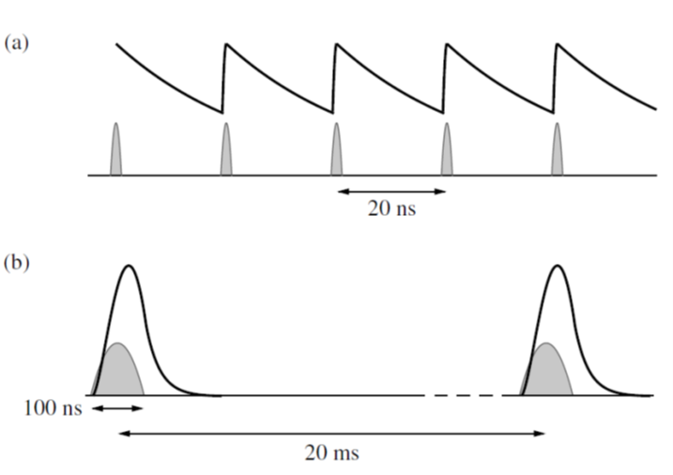
Pulsed and continuous sources of muons
Continuous source (e.g. PSI, TRIUMF)
Single muons
Higher intrinsic background
Time resolution set by electronics (~10s ps) -> fast relaxations, rapid precession
Rate limit set by single muon at a time constraint
More compact detector arrays

Slide 22
Pulsed and continuous sources of muons
Continuous source (e.g. PSI, TRIUMF)
Pulsed source (e.g. ISIS, J-PARC)
Single muons
Higher intrinsic background
Time resolution set by electronics (~10s ps) -> fast relaxations, rapid precession
Rate limit set by single muon at a time constraint
More compact detector arrays
Bursts of many muons
Low intrinsic background
Time resolution set by muon pulse width (~50ns) -> Weak relaxations, slow precession
Rate limit set by detector dead time
Big detector arrays to cope with high instantaneous rate

Slide 23
Pulsed and continuous sources of muons
See Muon Production and Future Capabilities lecture
Continuous source (e.g. PSI, TRIUMF)
Pulsed source (e.g. ISIS, J-PARC)
Single muons
Higher intrinsic background
Time resolution set by electronics (~10s ps) -> fast relaxations, rapid precession
Rate limit set by single muon at a time constraint
More compact detector arrays
Bursts of many muons
Low intrinsic background
Time resolution set by muon pulse width (~50ns) -> Weak relaxations, slow precession
Rate limit set by detector dead time
Big detector arrays to cope with high instantaneous rate

Slide 24

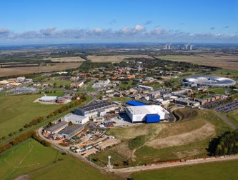
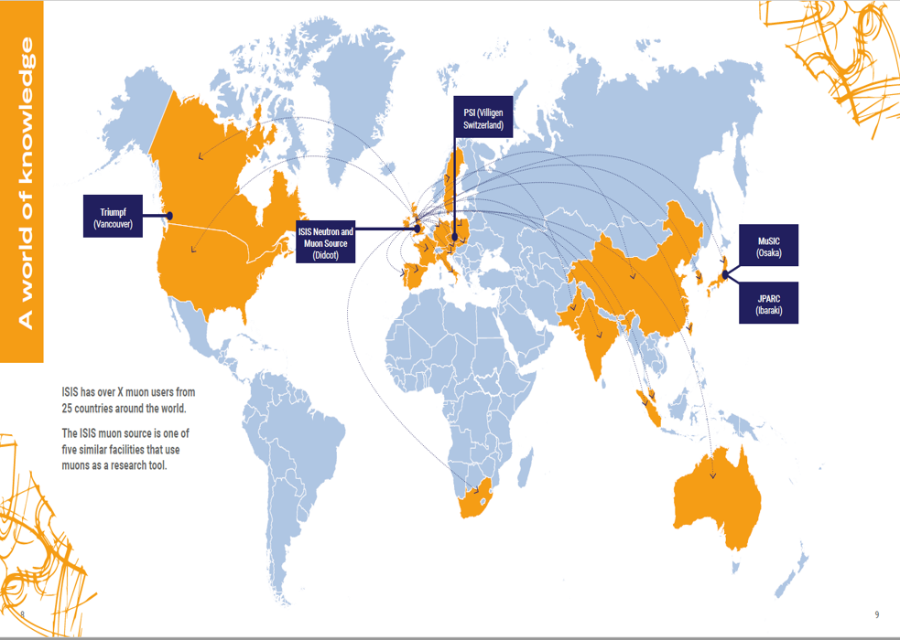

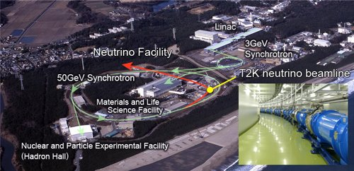







Muon facility map – present and possible future facilities
Raon (south Korea)
PSI, Switzerland​
ISIS, UK
SNS (Oak Ridge)
MELODY (CSNS)
J-PARC, Japan
TRIUMF, Canada

Slide 25
Part I – Take home messages
The muon is a spin-1/2 particle, with charge +/- e and is about 1/9th the mass of a proton.
Muons are unstable and decay with a lifetime of ~2.2μs, emitting a decay positron preferentially along the momentary muon spin direction.
Muons can be implanted into materials where they will rapidly thermalise and end up in a final state that depends on the material they have been implanted into.
Muons are produced by pion decay, where surface, decay and low energy beams can be produced at accelerator facilities. Importantly, these beams are spin polarised and each have advantages for different types of experiment (see later lectures in this school).
Muon sources can be categorised as either pulsed or continuous. These sources are complementary, with many experiments making use of both types of source.

Slide 26
Outline – a lecture in three parts
Aim: Introduce some core concepts in muon spectroscopy
Part I – Basic properties of muons and muon sources
Fundamental properties of muon particles
The asymmetry of muon decay
Muon states in matter and thermalisation
A brief comment about muon production and muon sources
Part II – Using Muons to do μSR experiments
The basics of muon spectroscopy
Experimental geometries
What do muons measure?
Muon data analysis considerations
Sensitivity to dynamics
How μSR compares to other experimental techniques
Part III – Applications of muons to materials investigation
How can muons be used for experiments on magnetic systems, superconductors, to study chemistry and the motion of ions through materials

Slide 27
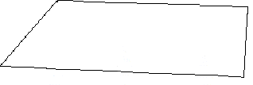
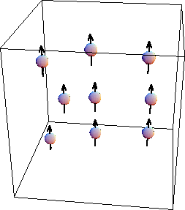
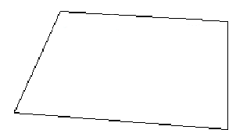
Muon spectroscopy in a nutshell
muons
detector A
magnetic field
detector B

Slide 28
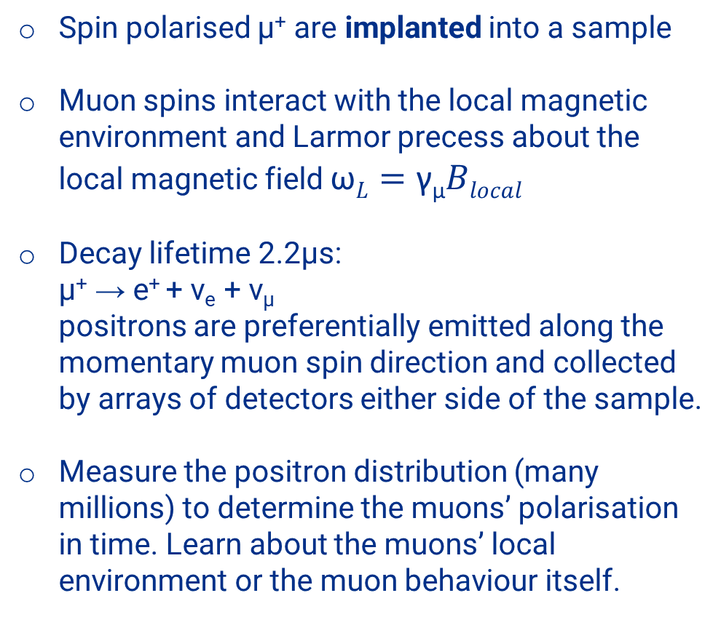
Muon spectroscopy in a nutshell
Spin polarised µ⁺ are implanted into a sample
Muon spins interact with the local magnetic environment and Larmor precess about the local magnetic field $\text{ω}L=\text{γ}\text{μ}Blocal$
Decay lifetime 2.2µs: μ⁺ → e⁺ + ν_{e} + ν_{μ} positrons are preferentially emitted along the momentary muon spin direction and collected by arrays of detectors either side of the sample.
Measure the positron distribution (many millions) to determine the muons’ polarisation in time. Learn about the muons’ local environment or the muon behaviour itself.
muons
detector A
magnetic field
detector B

Slide 29
Muon spectroscopy in a nutshell
Spin polarised µ⁺ are implanted into a sample
Muon spins interact with the local magnetic environment and Larmor precess about the local magnetic field $\text{ω}L=\text{γ}\text{μ}Blocal$
Decay lifetime 2.2µs: μ⁺ → e⁺ + ν_{e} + ν_{μ} positrons are preferentially emitted along the momentary muon spin direction and collected by arrays of detectors either side of the sample.
Measure the positron distribution (many millions) to determine the muons’ polarisation in time. Learn about the muons’ local environment or the muon behaviour itself.
muons
detector A
magnetic field
detector B
...but how does this work in practice?

Slide 30
Muon spectroscopy measurements
Backward Detector
sample
Forward Detector
In a muon spectrometer, the asymmetry of the positron decays is detected by detector banks on opposite sides of the sample. There are also several sets of magnetic field coils that can be used to apply, or cancel, magnetic fields to the sample.
positrons
W(θ) = 1+ a cos θ

Slide 31
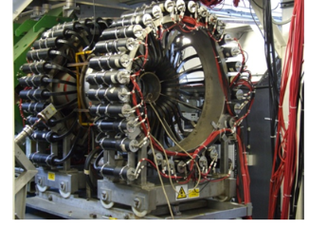
Muon spectroscopy measurements
Backward Detector
sample
Forward Detector
In a muon spectrometer, the asymmetry of the positron decays is detected by detector banks on opposite sides of the sample. There are also several sets of magnetic field coils that can be used to apply, or cancel, magnetic fields to the sample.
positrons
W(θ) = 1+ a cos θ
e.g. MUSR@ISIS

Slide 32
Muon spectroscopy measurements
Backward Detector
sample
Forward Detector
In a muon spectrometer, the asymmetry of the positron decays is detected by detector banks on opposite sides of the sample. There are also several sets of magnetic field coils that can be used to apply, or cancel, magnetic fields to the sample.
positrons
W(θ) = 1+ a cos θ
The number of events for a detector in an applied transverse field is given by:
N(t) = N₀exp(-t/τ_{μ}) [1 + a₀ P_{x}(t)]
a₀ is the initial asymmetry and P_{x}(t) is the oscillatory polarisation function:
P_{x}(t) = cos(φ_{d} + γ_{μ}B_{TF} t) G_{x}(t), with φ_{d} the detector phase and G_{x}(t) the transverse relaxation function.
e.g. MUSR@ISIS

Slide 33
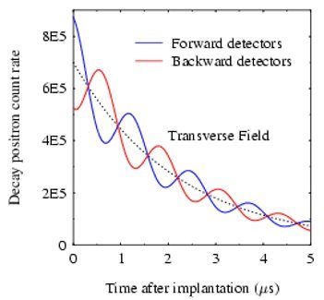
Muon spectroscopy measurements
Backward Detector
sample
Forward Detector
In a muon spectrometer, the asymmetry of the positron decays is detected by detector banks on opposite sides of the sample. There are also several sets of magnetic field coils that can be used to apply, or cancel, magnetic fields to the sample.
positrons
W(θ) = 1+ a cos θ
The number of events for a detector in an applied transverse field is given by:
N(t) = N₀exp(-t/τ_{μ}) [1 + a₀ P_{x}(t)]
a₀ is the initial asymmetry and P_{x}(t) is the oscillatory polarisation function:
P_{x}(t) = cos(φ_{d} + γ_{μ}B_{TF} t) G_{x}(t), with φ_{d} the detector phase and G_{x}(t) the transverse relaxation function.
Oscillation frequency = B_{TF}
exp decay due to muon lifetime
Damping of oscillation amplitude due to G_{x}(t)

Slide 34
Experiment Geometries
The geometry is defined by the configuration of the detector banks and applied magnetic fields relative to the direction of the muon spin.
TF
up
S
backward
forward
B_{app}
down

Slide 35
Experiment Geometries
The geometry is defined by the configuration of the detector banks and applied magnetic fields relative to the direction of the muon spin.
TF
ZF/ LF
up
S
S
backward
forward
backward
forward
B_{app}
B_{app}
down

Slide 36
Experiment Geometries
The geometry is defined by the configuration of the detector banks and applied magnetic fields relative to the direction of the muon spin.
TF
ZF/ LF
up
S
S
backward
forward
backward
forward
B_{app}
B_{app}
down
Most muon experiments make use of both experiment geometries

Slide 37
Muon asymmetry signal
Often, the signal analysed in muon experiments uses opposing sets, or groups, of detectors to normalise out the muon lifetime decay.
S
A(t) = a₀ P_{FB}(t) = [N_{F}(t) - α N_{B}(t)] / [N_{F}(t) + α N_{B}(t)]
backward
forward
N_{B}
B_{app}
N_{F}

Slide 38
Muon asymmetry signal
Often, the signal analysed in muon experiments uses opposing sets, or groups, of detectors to normalise out the muon lifetime decay.
S
A(t) = a₀ P_{FB}(t) = [N_{F}(t) - α N_{B}(t)] / [N_{F}(t) + α N_{B}(t)]
backward
forward
N_{B}
B_{app}
N_{F}
α is an experimentally determined calibration factor that accounts for any difference in counting efficiencies of the two opposing banks of detectors.

Slide 39
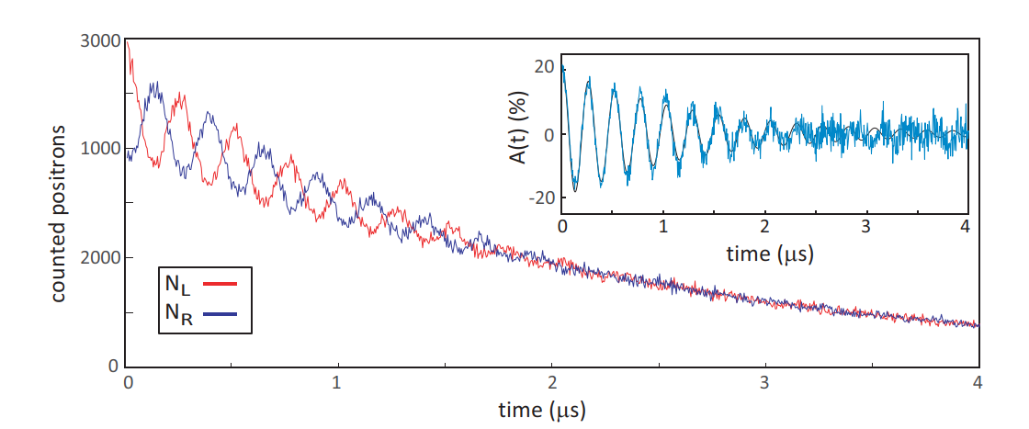
Muon asymmetry signal
Often, the signal analysed in muon experiments uses opposing sets, or groups, of detectors to normalise out the muon lifetime decay.
S
A(t) = a₀ P_{FB}(t) = [N_{F}(t) - α N_{B}(t)] / [N_{F}(t) + α N_{B}(t)]
backward
forward
N_{B}
B_{app}
N_{F}
α is an experimentally determined calibration factor that accounts for any difference in counting efficiencies of the two opposing banks of detectors.

Slide 40
Muon asymmetry signal
See polarisation functions 1 & 2 for the details.
ZF/ LF
S
A(t)/a₀ = P_{z}(t) = G_{z}(t)
P_{z}(t) is the longitudinal polarisation function
G_{z}(t) is the longitudinal relaxation function
backward
forward
B_{app}

Slide 41
Muon asymmetry signal
See polarisation functions 1 & 2 for the details.
ZF/ LF
S
A(t)/a₀ = P_{z}(t) = G_{z}(t)
P_{z}(t) is the longitudinal polarisation function
G_{z}(t) is the longitudinal relaxation function
backward
forward
B_{app}
TF
up
A(t)/a₀ = P_{x}(t) = G_{x}(t) cos(γ_{μ}B_{TF}t)
P_{x}(t) is the transverse polarisation function
G_{x}(t) is the transverse relaxation function
S
backward
forward
B_{app}
down

Slide 42
Muon asymmetry signal
See polarisation functions 1 & 2 for the details.
ZF/ LF
S
A(t)/a₀ = P_{z}(t) = G_{z}(t)
P_{z}(t) is the longitudinal polarisation function
G_{z}(t) is the longitudinal relaxation function
backward
forward
B_{app}
TF
up
A(t)/a₀ = P_{x}(t) = G_{x}(t) cos(γ_{μ}B_{TF}t)
P_{x}(t) is the transverse polarisation function
G_{x}(t) is the transverse relaxation function
S
backward
forward
B_{app}
down
Muon spectroscopy involves measuring A(t) and analysing it in terms of P_{x}(t) and P_{z}(t) or G_{x}(t) and G_{z}(t)

Slide 43
Muon data analysis considerations
B_{loc}
What form should P(t) or G(t) take for a given sample?
Sμ
μ
What are the sources of magnetic field in the sample and how are the muons sampling them?
B_{loc}
Sμ
μ

Slide 44


Muon data analysis considerations
B_{loc}
What form should P(t) or G(t) take for a given sample?
Sμ
μ
What are the sources of magnetic field in the sample and how are the muons sampling them?
B_{loc}
Externally applied fields
Fields from nuclear spins: dipolar
Fields from unpaired electronic spins: dipolar and Fermi contact (hyperfine)
Sμ
μ

Slide 45
Muon data analysis considerations
B_{loc}
What form should P(t) or G(t) take for a given sample?
Sμ
μ
What are the sources of magnetic field in the sample and how are the muons sampling them?
B_{loc}
Externally applied fields
Fields from nuclear spins: dipolar
Fields from unpaired electronic spins: dipolar and Fermi contact (hyperfine)
Depends on muon stopping site relative to the moments.
Sμ
μ
See polarisation functions and muon stopping sites lectures!

Slide 46
Key benefits of μSR over bulk probes
Measurements can be conducted in true zero magnetic field

Slide 47
Key benefits of μSR over bulk probes
Measurements can be conducted in true zero magnetic field
Good sensitivity to antiferromagnetism

Slide 48
Key benefits of μSR over bulk probes
Measurements can be conducted in true zero magnetic field
Good sensitivity to antiferromagnetism
Volume sensitivity
Muons stop regularly within the crystal structure but randomly within the volume of the sample​
Muons in different magnetic environments give different signals
Excellent probe of phase separation between ordered and disordered or non-magnetic phases​
Robust against low concentration impurity phases
≠

Slide 49
Other key features of μSR
High sensitivity: very small moments can be detected, 0.01 μ_{B} or less

Slide 50
Other key features of μSR
High sensitivity: very small moments can be detected, 0.01 μ_{B} or less
Excellent compatibility with a range of different sample environments, since both incoming muons and outgoing positrons easily penetrate the walls and windows of cryostats, fridges, furnaces etc. This means a range of different experiments are possible.

Slide 51
Other key features of μSR
High sensitivity: very small moments can be detected, 0.01 μ_{B} or less
Excellent compatibility with a range of different sample environments, since both incoming muons and outgoing positrons easily penetrate the walls and windows of cryostats, fridges, furnaces etc. This means a range of different experiments are possible.
Sample mounting and alignment straightforward

Slide 52
Some key challenges of μSR
Muon stopping sites often need to be determined to fully interpret the experimental data.

Slide 53
Some key challenges of μSR
Muon stopping sites often need to be determined to fully interpret the experimental data.
The muon itself can perturb the system being studied.

Slide 54
Some key challenges of μSR
Muon stopping sites often need to be determined to fully interpret the experimental data.
The muon itself can perturb the system being studied.
Often need more sample mass, and quite large sample sizes, compared to other measurement techniques.

Slide 55
Some key challenges of μSR
Muon stopping sites often need to be determined to fully interpret the experimental data.
The muon itself can perturb the system being studied.
Often need more sample mass, and quite large sample sizes, compared to other measurement techniques.
Data analysis and interpretation requires a range of knowledge and skills -> Hence this school!

Slide 56
Part II – Take home messages
Muons can be easily implanted into materials to provide a local spin probe – should you have access to a suitable muon source. Once implanted, muon spins will interact with the local magnetic environment until the moment they decay.
Muon spectrometers can be used to measure the positron distribution emitted from the muon decays, which encodes information about the muon spin polarisation as a function of time. This allows us to learn about the muon’s local magnetic environment.
The asymmetry signal can be extracted from the distribution of positron counts as a function of time and analysed in terms of suitable polarisation and relaxation functions, P(t) & G(t).
The form of the expected P(t) and G(t) depends on the properties of the sample and how the muons probe these. It is often essential to determine the muon stopping sites for a thorough analysis.
Muons are volume sensitive, can detect magnetic fields 0.01 μ_{B} or less and experiments can be performed in zero field. However, data analysis and interpretation can be challenging.

Slide 57
Outline – a lecture in three parts
Aim: Introduce some core concepts in muon spectroscopy
Part I – Basic properties of muons and muon sources
Fundamental properties of muon particles
The asymmetry of muon decay
Muon states in matter and thermalisation
A brief comment about muon production and muon sources
Part II – Using Muons to do μSR experiments
The basics of muon spectroscopy
Experimental geometries
What do muons measure?
Muon data analysis considerations
Sensitivity to dynamics
How μSR compares to other experimental techniques
Part III – Applications of muons to materials investigation
How can muons be used for experiments on magnetic systems, superconductors, to study chemistry and the motion of ions through materials?

Slide 58
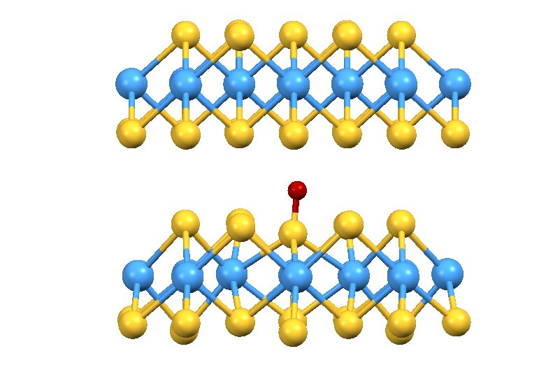
Using muons for condensed matter physics and materials science
See magnetism & superconductivity lectures.
Thermalised muons acting as local probes of static and dynamic magnetism
Static magnetism:
1) Muon as a local probe with a limited set of well-defined sites
data analysed in terms of specific sites complementary muon site calculations to aid the analysis

Slide 59
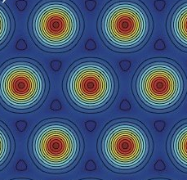
Using muons for condensed matter physics and materials science
See magnetism & superconductivity lectures.
Thermalised muons acting as local probes of static and dynamic magnetism
Static magnetism:
1) Muon as a local probe with a limited set of well-defined sites
data analysed in terms of specific sites complementary muon site calculations to aid the analysis
2) Muon as a statistical sampling probe
superconducting vortex lattices
magnetic systems with a large unit cell and many stopping sites
systems with a high degree of disorder
quantum delocalised systems

Slide 60
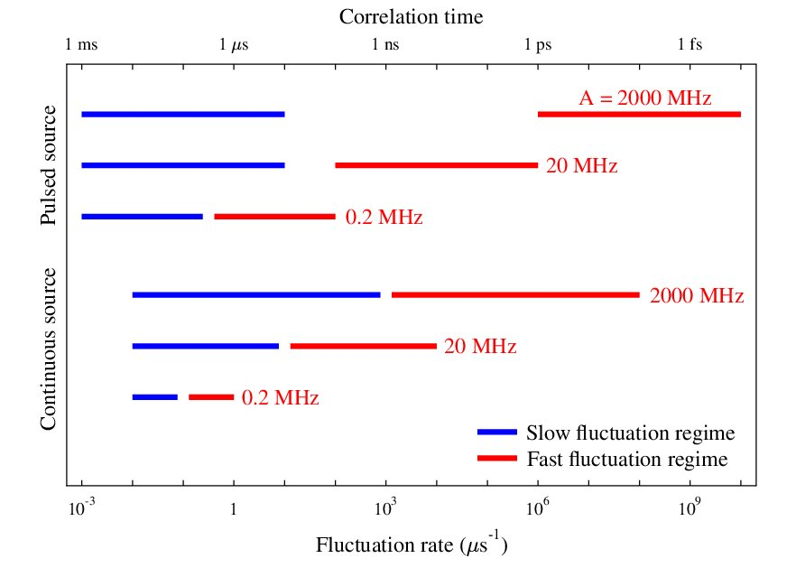
Using muons for condensed matter physics and materials science
Muon sensitivity to dynamics:
Depends on the strength of the magnetic coupling A and the characteristics of the muon source
Pulsed sources: weaker moments and mid-slow dynamics
Continuous sources: strong moments and fast dynamics

Slide 61
Using muons for condensed matter physics and materials science
Muon sensitivity to dynamics:
Depends on the strength of the magnetic coupling A and the characteristics of the muon source
Pulsed sources: weaker moments and mid-slow dynamics
Continuous sources: strong moments and fast dynamics
You need to choose the right source and instrument for your experiment – if in doubt speak to facilities staff!

Slide 62
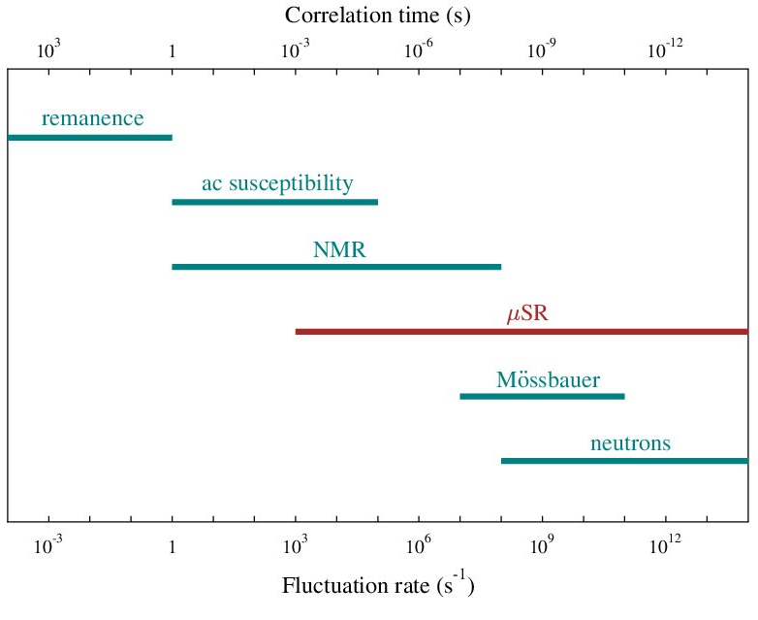
Using muons for condensed matter physics and materials science
Muon sensitivity to dynamics:
Depends on the strength of the magnetic coupling A and the characteristics of the muon source
Muons sensitive to spin fluctuations over a broad range of timescales.
A good bridge between lab-based techniques and neutron scattering

Slide 63
Using muons for condensed matter physics and materials science
See energy materials lecture
Dynamics from Ionic Motion
Spin-polarised muon stops in the sample​
Fields from nearby nuclei cause incoherent spin precession​​
Ion with nuclear moment moves near muon and flips the muon spin​ (or vice versa)
Muon decays and positron detected​
Signal depends on how often the muon spin was flipped

Slide 64
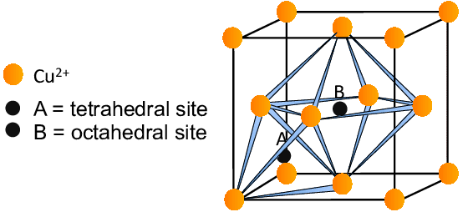
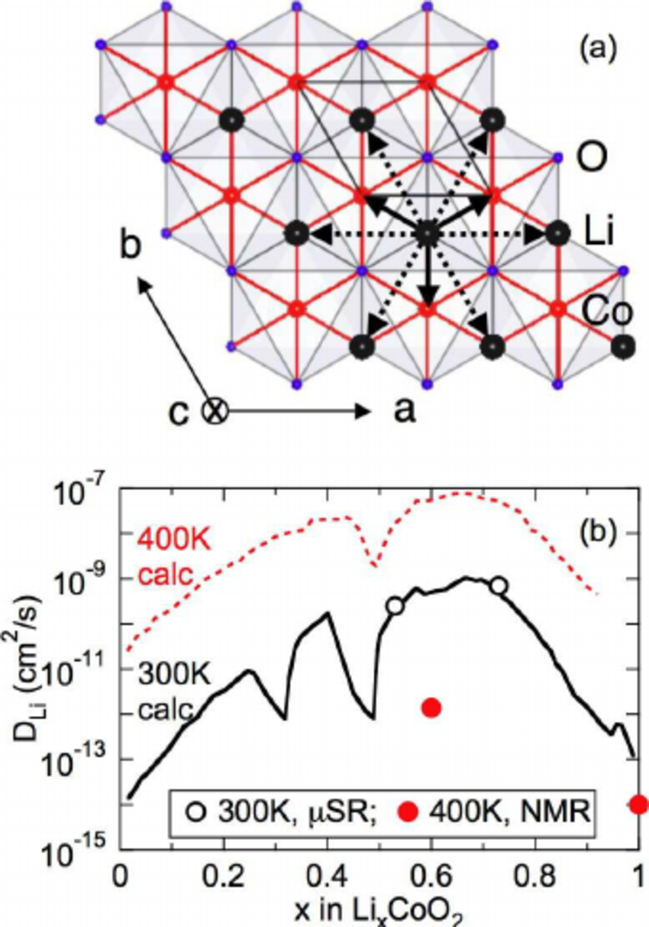
Using muons for condensed matter physics and materials science
See energy materials lecture
Dynamics from Ionic Motion
Spin-polarised muon stops in the sample​
Fields from nearby nuclei cause incoherent spin precession​​
Ion with nuclear moment moves near muon and flips the muon spin​ (or vice versa)
Muon decays and positron detected​
Signal depends on how often the muon spin was flipped
Muon motion as an analogue of hydrogen motion, e.g. in Cu
J. Sugiyama et al, Phys. Rev. Lett. 103, 147601 (2009)

Slide 65
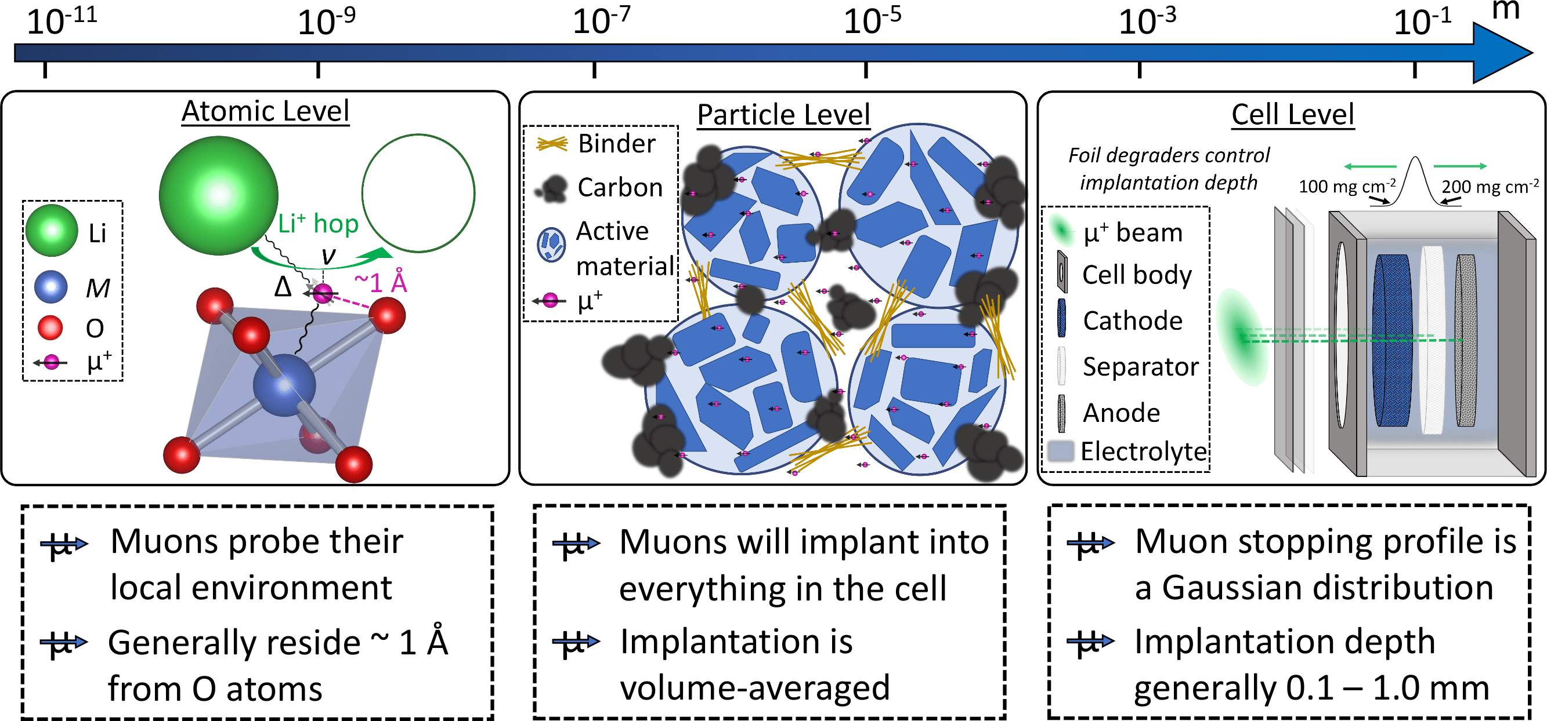
Using muons for condensed matter physics and materials science
See energy materials lecture
Dynamics from Ionic Motion
Spin-polarised muon stops in the sample​
Fields from nearby nuclei cause incoherent spin precession​​
Ion with nuclear moment moves near muon and flips the muon spin​ (or vice versa)
Muon decays and positron detected​
Signal depends on how often the muon spin was flipped
Muon motion as an analogue of hydrogen motion, e.g. in Cu
J. Sugiyama et al, Phys. Rev. Lett. 103, 147601 (2009)
Muons allow these effects to be probed over a range of lengthscales in, for example, battery materials
Figure from Innes McClelland

Slide 66
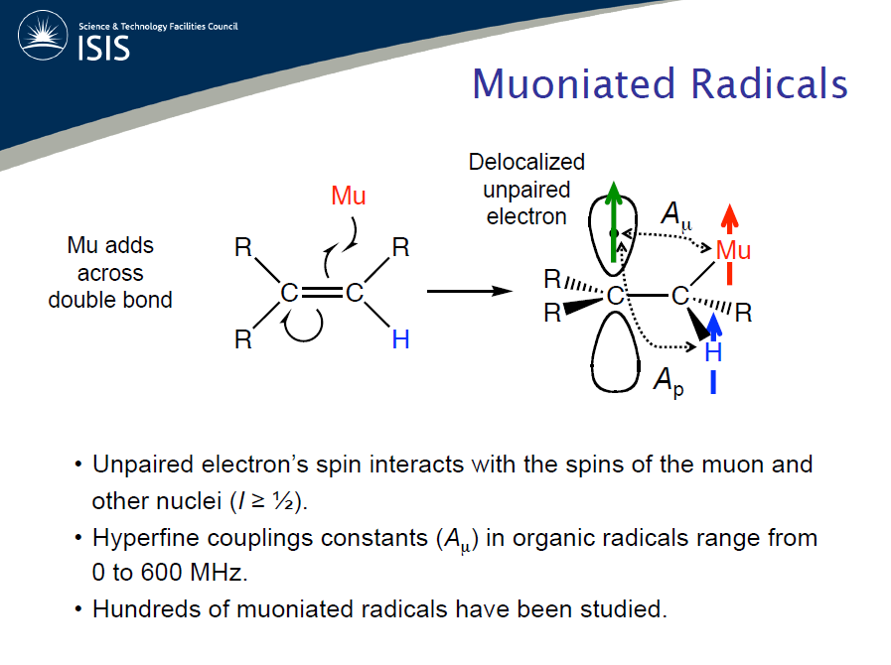
Muon Chemistry
See Joseph’s Chemistry lecture
The H atom is the simplest free radical and is highly reactive
In chemical terms muonium provides a radioactively labelled light isotope of H (similar Bohr radius, ionisation energy, reduced mass)
Studying Mu allows the time dependence of its chemical reactions to be determined

Slide 67
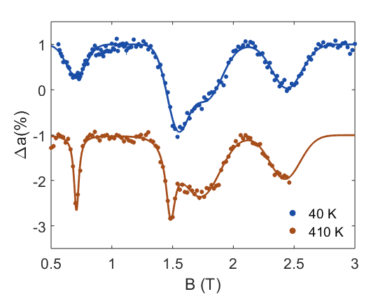
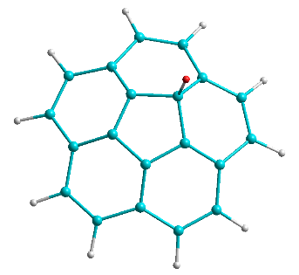
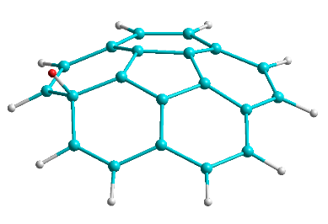
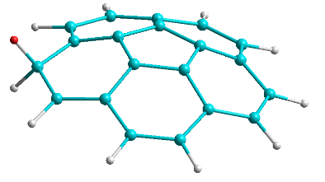
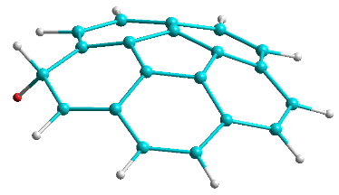
Muon Chemistry
See Joseph’s Chemistry lecture
Spectroscopic study of muoniated radicals gives information about the molecular spin distribution, molecular environment and molecular dynamics
The main spectroscopic technique is called Avoided Level Crossing (ALC)
ALC spectrum for Corannulene
R1
R2
R4
R1
R2
R3
R3
R4
M. Gaboardi et al, Carbon 155, 432 (2019)

Slide 68
Part III – Take home messages
There is an extremely wide range of applications for muon spectroscopy
They can be used to probe static & dynamic effects in a range of materials including magnetic systems, superconductors, semiconductors and energy materials.
Muons are sensitive to dynamics over a broad range of timescales and often provide complementary information to other techniques, such as neutron scattering.
See the subject specific lectures in this course for more details.

Slide 69
Summary
In this lecture we have covered:
The fundamental properties of muons and how they interact with materials
How muons can be used in muon spectroscopy experiments, some of the advantages of the technique and some of the challenges.
That muons can be used as a sensitive local probe of magnetism, superconductivity, ionic motion and chemical systems
Thank you for your attention and enjoy the rest of the school!
P.S. many of the lecturers are around for the duration of the school. Please do come and speak with us if you have questions!

