Slide 1
Instrumentation for µSR
Kenji M. Kojima
TRIUMF & UBC: 2018~present
J-PARC: 2009~2018
U-Tokyo: 1998~2009
Columbia: 1993~1998 (visiting PhD→PDF)
U-Tokyo: 1991-1993 (M.Sc)
Muon Spectroscopy school
14-21, 2026 Rigi-Kaltbad, Switzerland
https://indico.psi.ch/event/16947/

Slide 2
Key Concepts/Takeaways:
Detection Fundamentals: Explanation of scintillators, photomultiplier tubes (PMTs), and how they convert positrons and muons into measurable signals.
Data Acquisition Chain: The role of discriminators, time-to-digital converters (TDCs), and how timing and dead-time considerations impact data quality.
Detector Arrays and Geometry: How multiple detector configurations (e.g., cylindrical arrays) are used to maximize solid angle coverage and handle high counting rates.

Slide 3
Contents
Simplest µSR set up
Plastic Scintillator, PMT, Discriminator, Gate, TDC, DAQ cycle
Requirements to the detectors
DC muon beam
Pulsed muon beam
Fight against noise – what is the ground in circuits
Fight against temperature-based instability
Future capabilities in instruments
Summary

Slide 4
Cosmic-ray muon life measurement
µ⁺ or µ⁻
Signal
timing
Decay e⁺ or e⁻
Muon counter
t_0
Muon trigger
Up counter
U counter e⁺/e⁻ hit
Sample
t_hit (U)
Down counter
D counter e⁺/e⁻ hit
Plastic scintillator
PMT
t_hit(D)
µ⁺ → e⁺ + ν_{μ} + ν_{e}
N_{U}(t) or N_{D}(t)
µ⁻ → e⁻ + ν_{μ} + ν_{e}
Simplest µSR set up
τ_{µ}
= 2.2µs
*
t_hit (U or D) – t_0

Slide 5
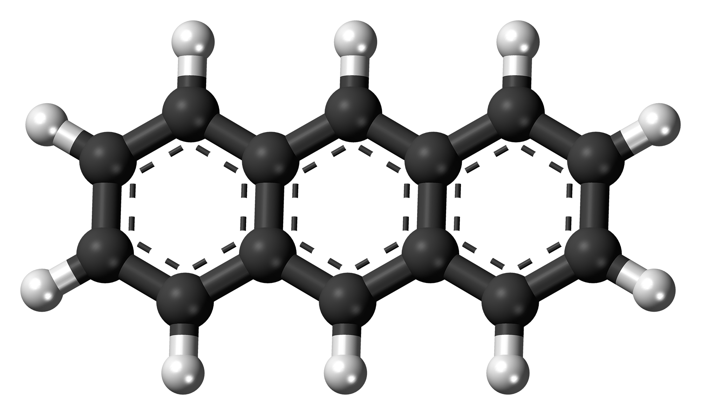
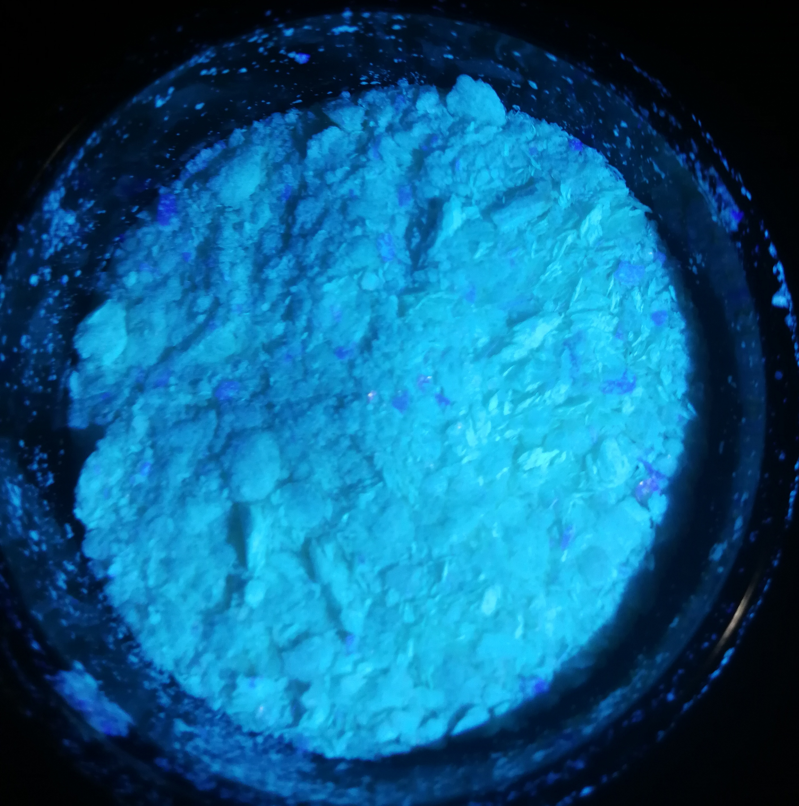
Plastic Scintillator
Bicron→Luxium solutions, Eljen, Torray, …
Anthracene dissolved in Acrylic plastic
Fast, but poor energy resolution
due to light elements
Example of
plastic scintillators
Charged particle
Plastic scintillator
+
+
+
Conduction band
LUMO
-
-
-
recombination
Valence band
HOMO
light
https://luxiumsolutions.com/radiation-detection-scintillators/plastic-scintillators/bc400-bc404-bc408-bc412-bc416
https://en.wikipedia.org/wiki/Anthracene

Slide 6
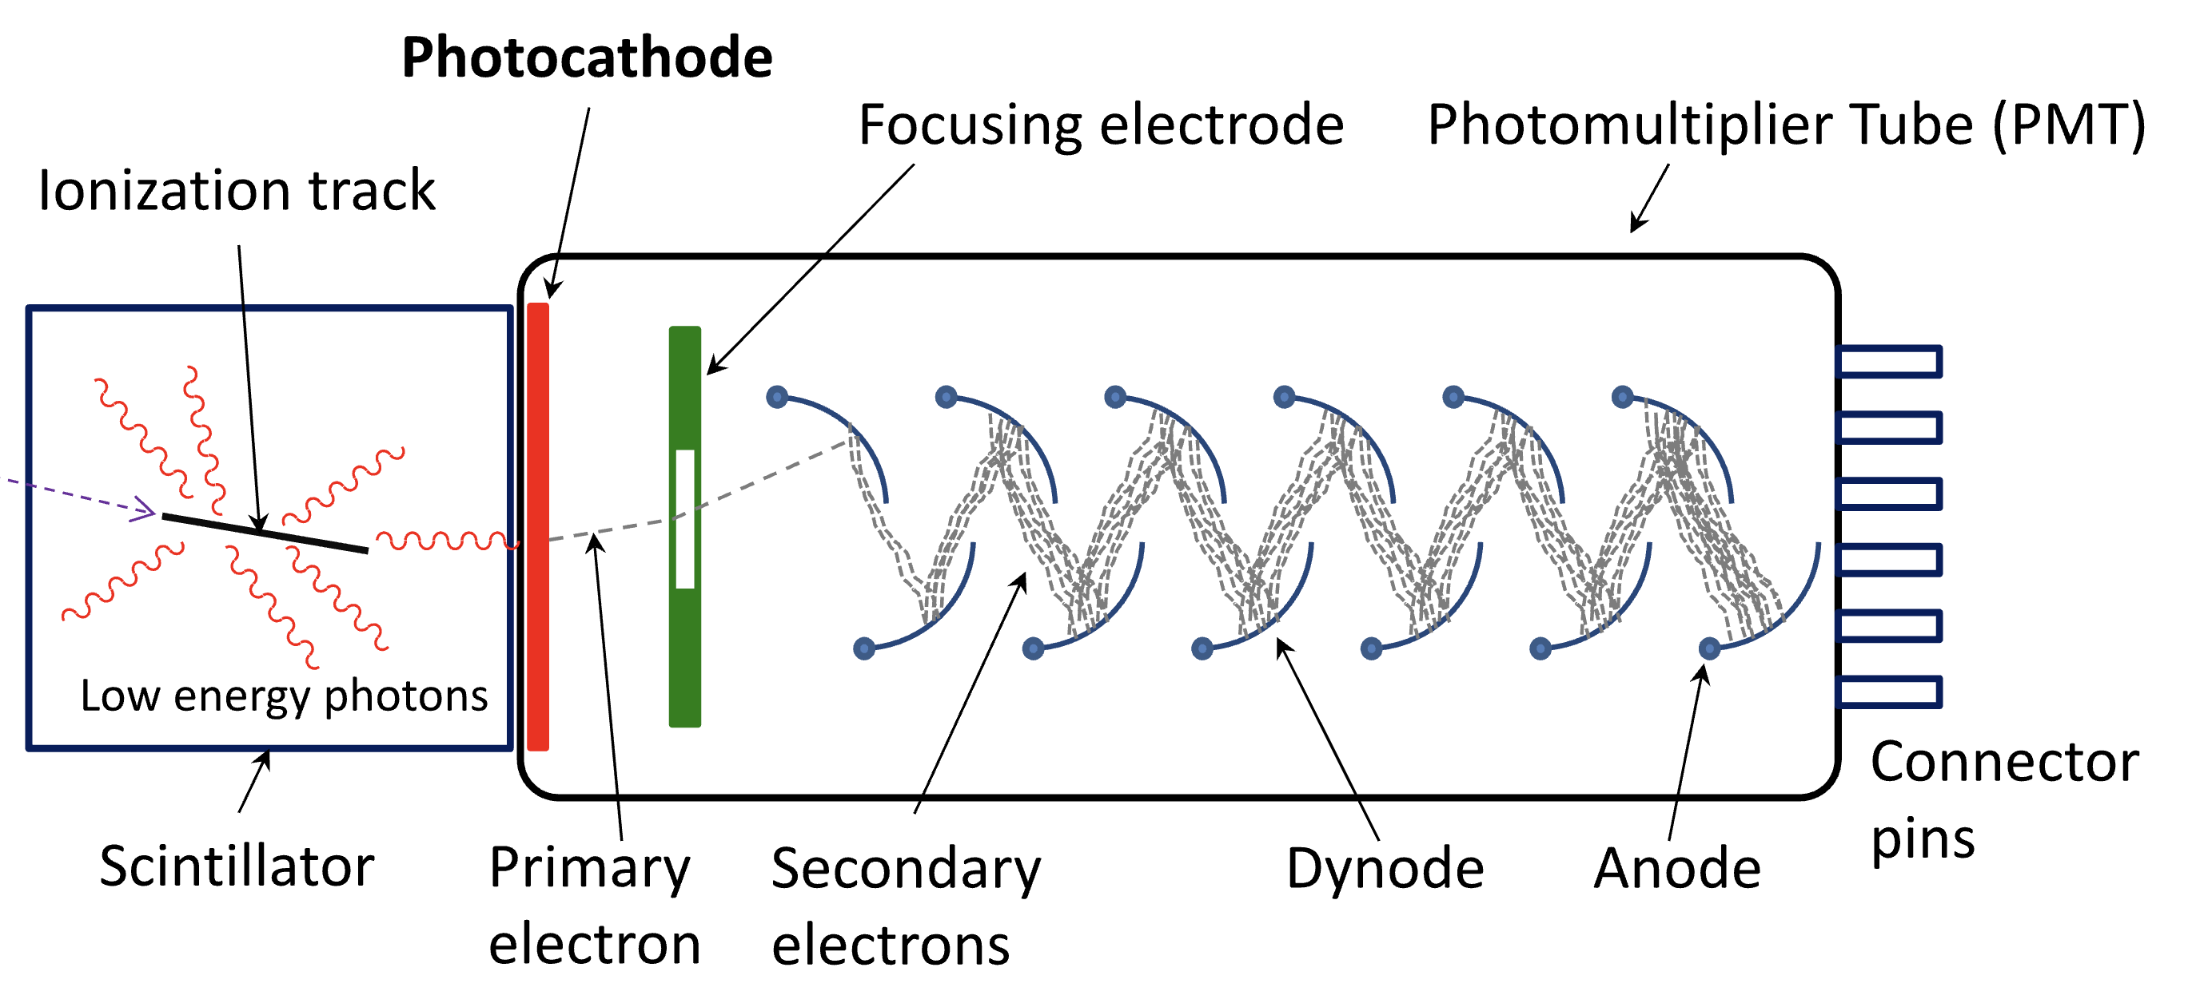
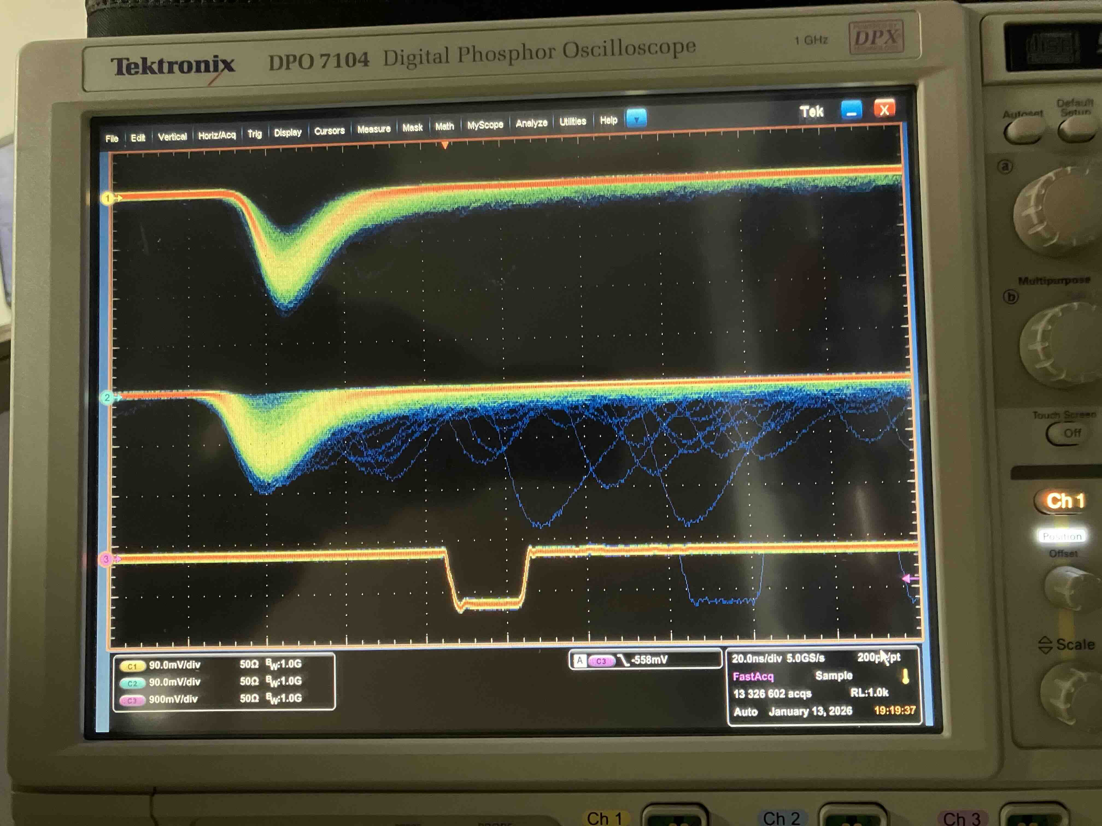
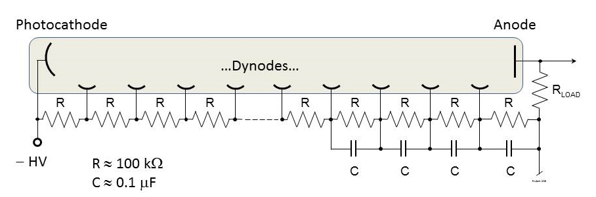
Photo multiplier tube (PMT)
Typical gain ~ 10⁶ (high)
Weak to magnetic fields
High Voltage (~1-2.5 kV)
Current ~ 300-400 µA
(Dynode: faster pulse signal)
Charged
Particle
(µ or e)
Anode: Electronic pulse signal
TM
20ns
Impedance
R=2.5kV / 0.4 mA
=6 MΩ
100mV
V
TM & V
https://en.wikipedia.org/wiki/Photomultiplier_tube

Slide 7
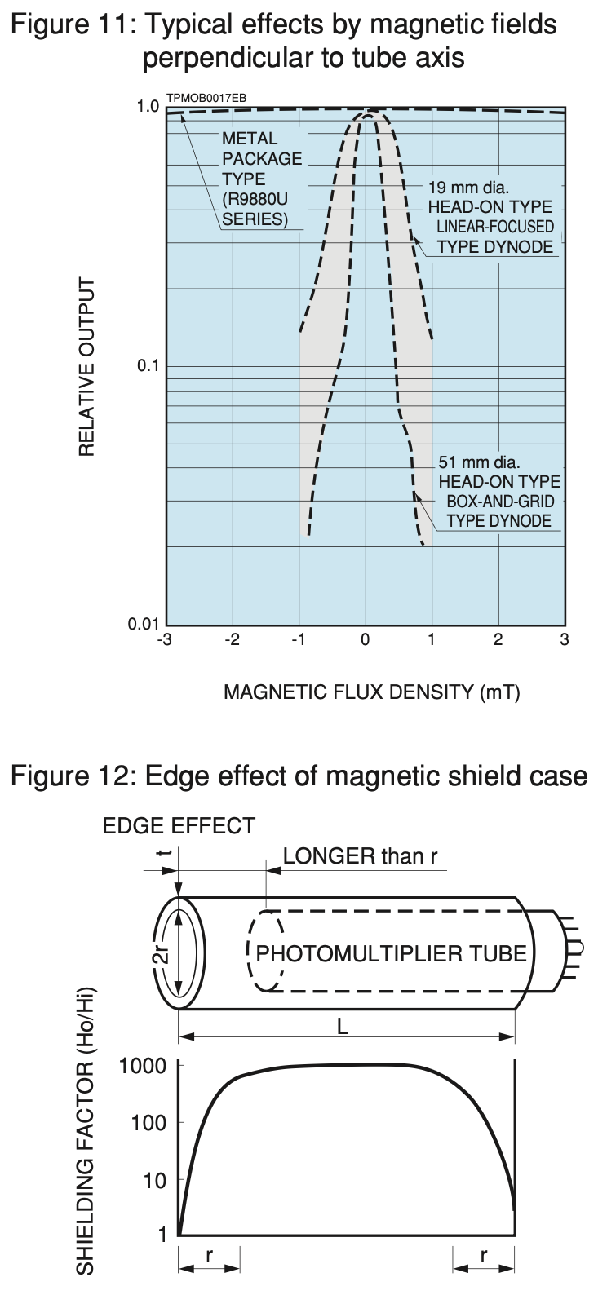
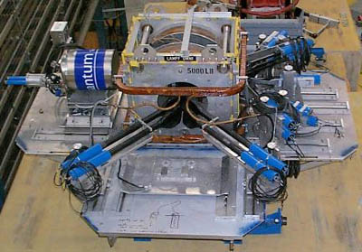
Light guide and magnetic shield
Light guide
~ 0.5m
magnetic
shield
https://www.hamamatsu.com/content/dam/hamamatsu-photonics/sites/documents/99_SALES_LIBRARY/etd/High_energy_PMT_TPMZ0003E.pdf
TRIUMF LAMPF spectrometer
0.4T max → ~1mT at PMT
https://cmms.triumf.ca/equip/lampf.html

Slide 8
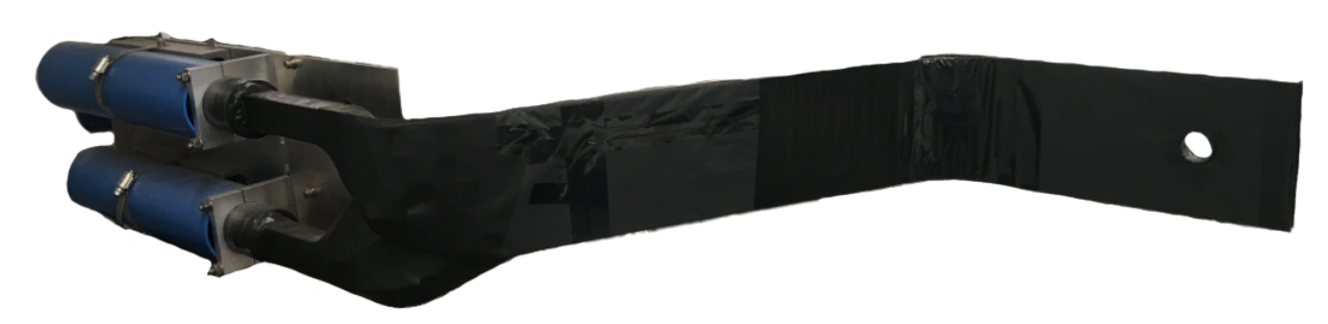
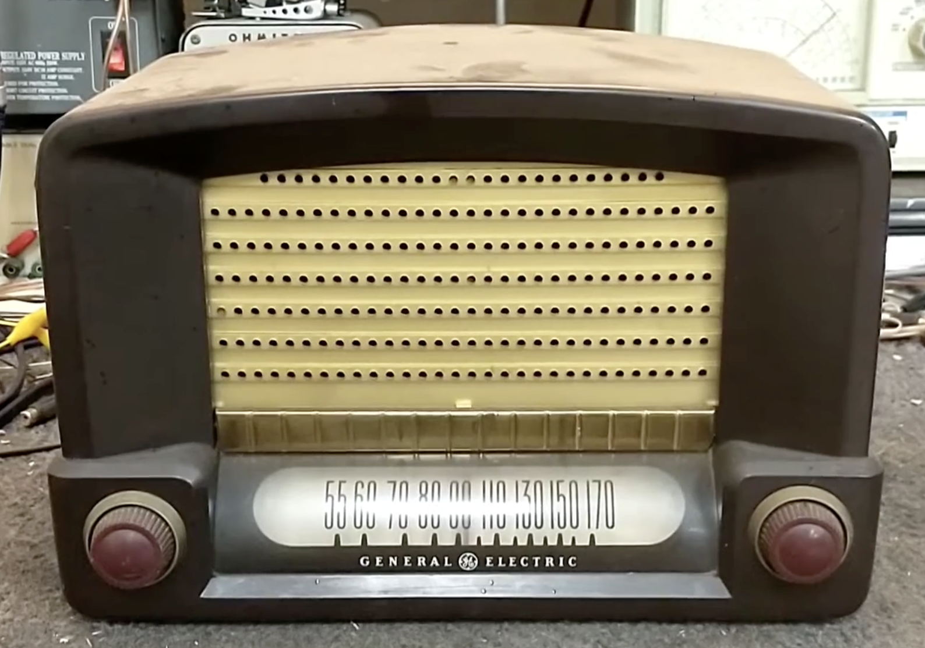
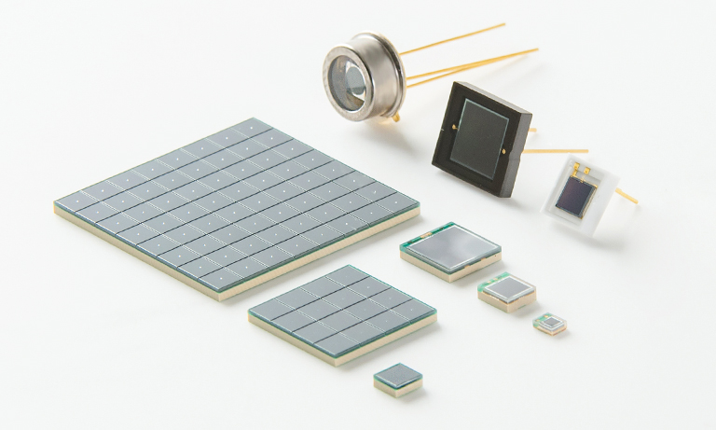
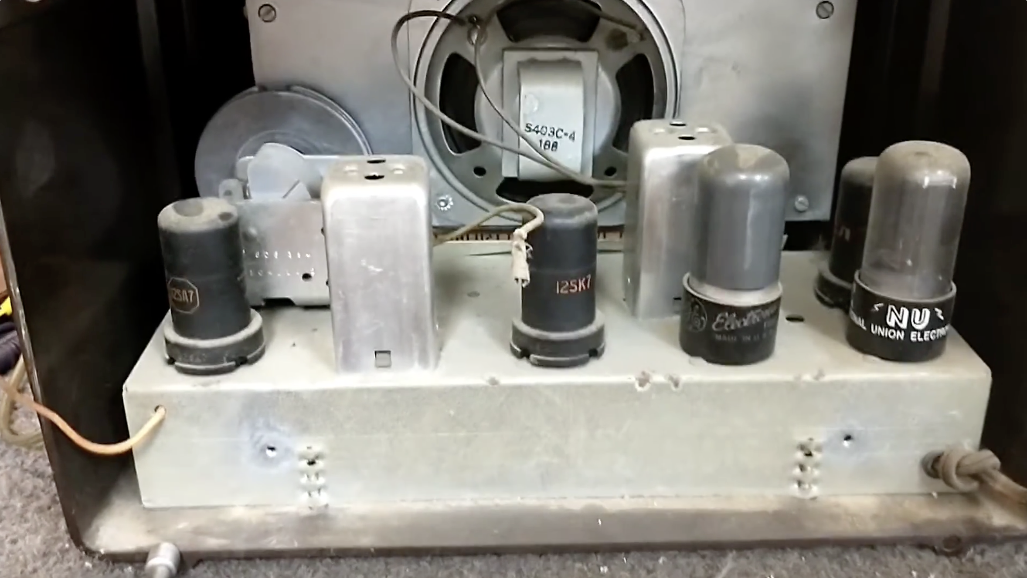
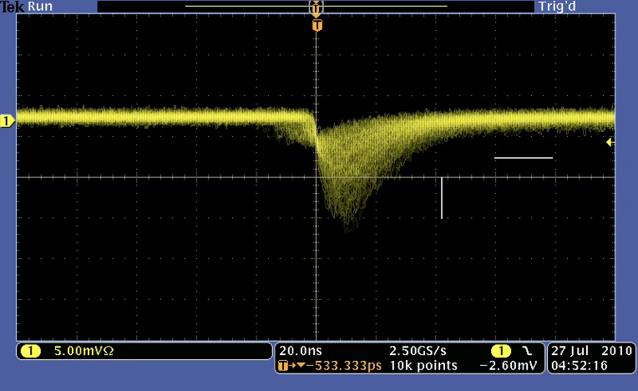
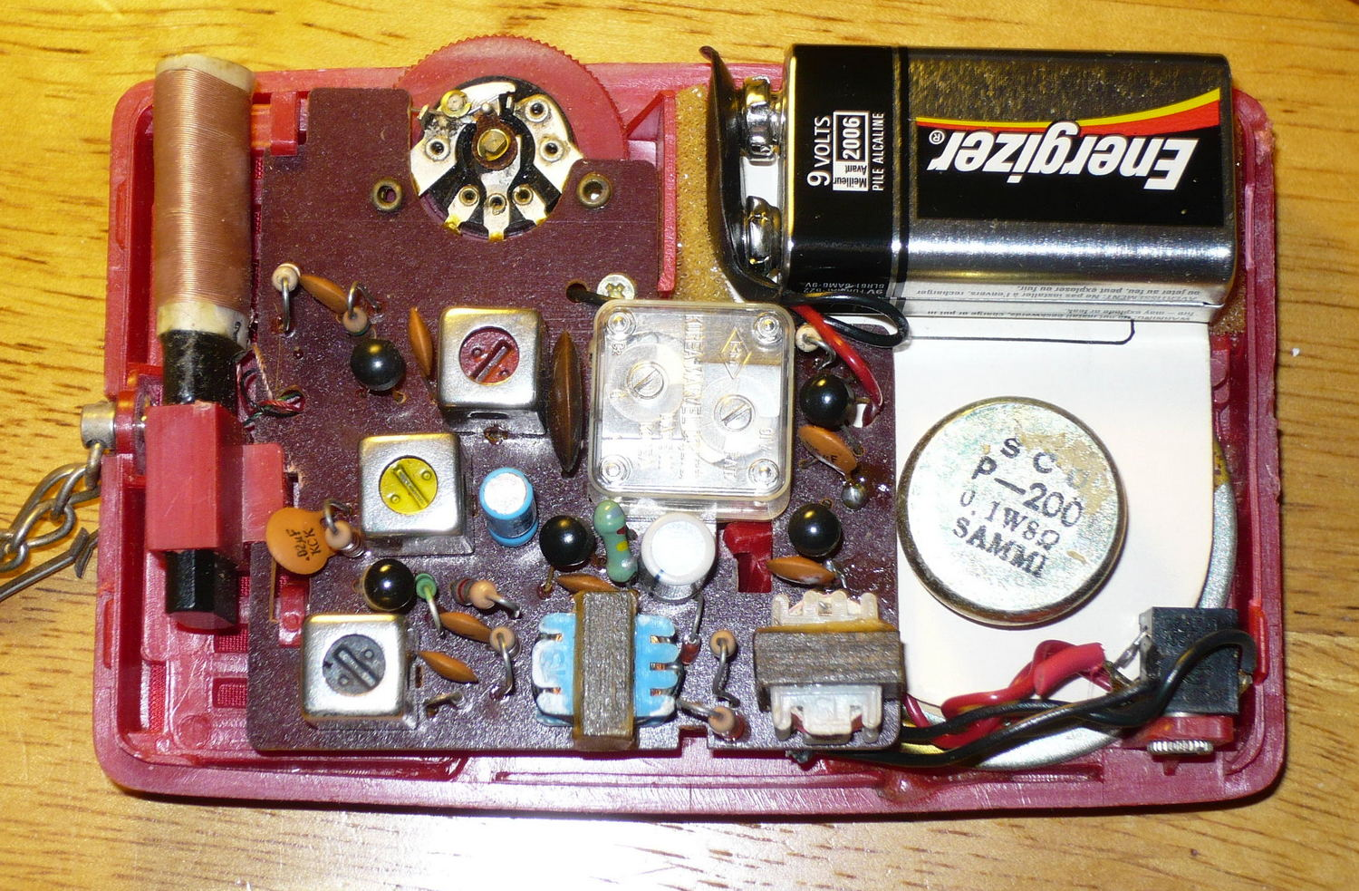
SiPM (Silicon photo multiplier)
TRIUMF LAMPF spectrometer’s B-counter
Vacuum tube to solid state
1949 General Electric 115 AA5
✅ Small & light
✅ Strong against magnetic field (~ Tesla)
✅ Low bias voltage (1-2.5kV → 30-50V)
❌ Gain is temperature dependent
bias HV: -50mV/C
Sr90β（Emax=2.28MeV） on 1cm PS
400px 1mm sq,
bias=70.0V
for 69.82V
1st gen. MPPC S10362-11-050P
20ns
Japanese 5-transistor
radio ~1970s ?
Hamamatsu MPPC
5mV
https://www.hamamatsu.com/jp/en/product/optical-sensors/mppc.html
https://www.youtube.com/watch?v=eTPN7zceBa8
https://en.wikipedia.org/wiki/Transistor_radio

Slide 9
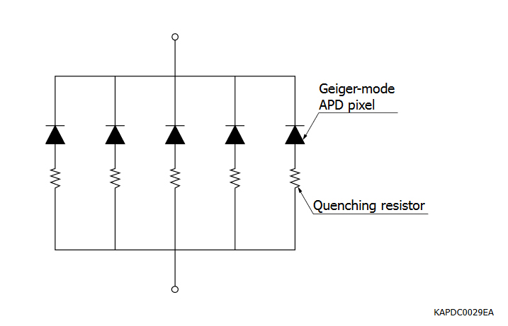
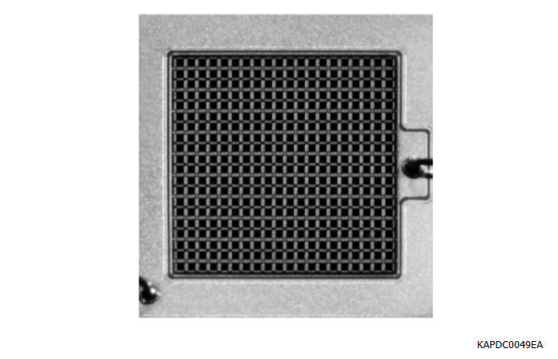
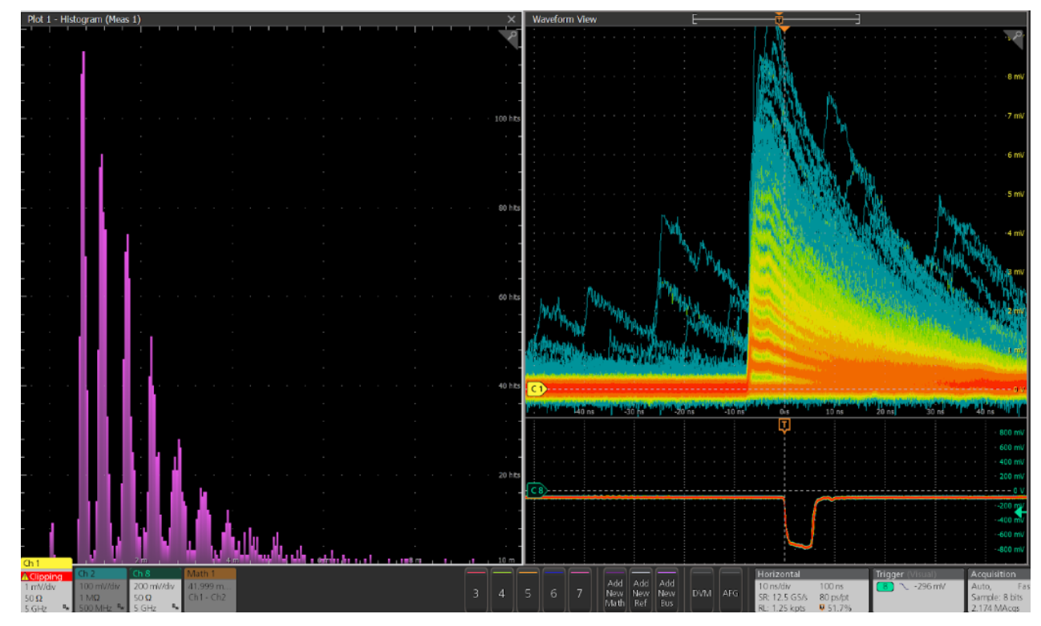
More about SiPM
https://hub.hamamatsu.com/us/en/technical-notes/mppc-sipms/a-technical-guide-to-silicon-photomutlipliers-MPPC-overview.html
Pixel array of Geiger mode APD
Impedance: 65 V / ~4µA =16 MΩ
light
-HV
M.V. de Toro Sánchez et al 2023 J. Phys.: Conf. Ser. 2462 012014
++++++++
P
Laser on 400px SiPM HV=66.63 V
for 65.03V
2nd gen S12571-050P
avalanche
- +
avalanche
N
- - - - - - - - -
GND

Slide 10
Key Concepts/Takeaways:
Detection Fundamentals: Explanation of scintillators, photomultiplier tubes (PMTs), and how they convert positrons and muons into measurable signals.
Data Acquisition Chain: The role of discriminators, time-to-digital converters (TDCs), and how timing and dead-time considerations impact data quality.
Detector Arrays and Geometry: How multiple detector configurations (e.g., cylindrical arrays) are used to maximize solid angle coverage and handle high counting rates.

Slide 11
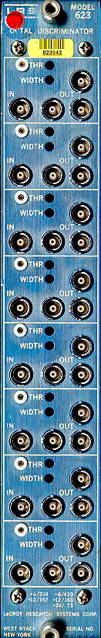
Discriminators (Analog signal to Digital timing pulse)
µ⁺ or µ⁻
Signal
timings
Lecroy 623
discriminator
Decay e⁺ or e⁻
Analog
Digital
TM counter
t_0
Muon trigger
Up counter
U counter e⁺/e⁻ hit
Discriminator
Sample
t_hit (U)
Down counter
D counter e⁺/e⁻ hit
Plastic scintillator
PMT
t_hit(D)
Misses signals in high rate
Peak detect (→ super-MuSR@ISIS)
D E Pooley et al 2023 J. Phys.: Conf. Ser. 2462 012028.

Slide 12
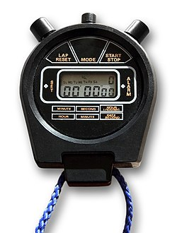

Time to Digital Converter (TDC)
https://hif.wikipedia.org/wiki/Computer
https://en.wikipedia.org/wiki/Stopwatch
Reset
Start / Stop
N_{U}(t) or N_{D}(t)
τ_{µ}
= 2.2µs
Hit data to
DAQ-computer
for analysis
*
t_hit (U or D) – t_0
Where is the reset signal ?
When do you read data?
µ⁺ or µ⁻
Signal
timings
Decay e⁺ or e⁻
Analog
Digital
TM counter
t_0
Muon trigger
→ TDC start
Up counter
Discriminator
U counter e⁺/e⁻ hit
Sample
t_hit (U)
→ TDC stops
Down counter
D counter e⁺/e⁻ hit
Plastic scintillator
PMT
t_hit(D)

Slide 13
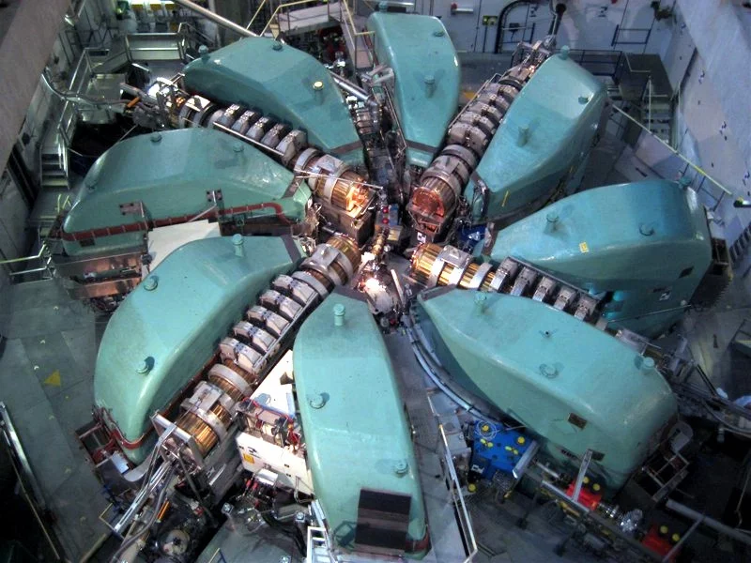
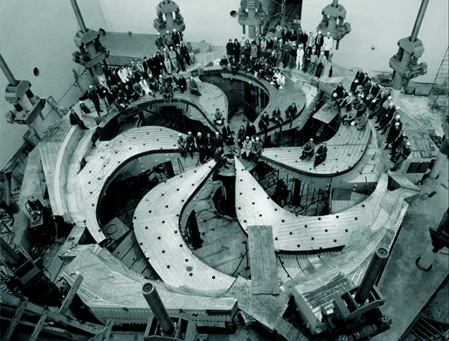
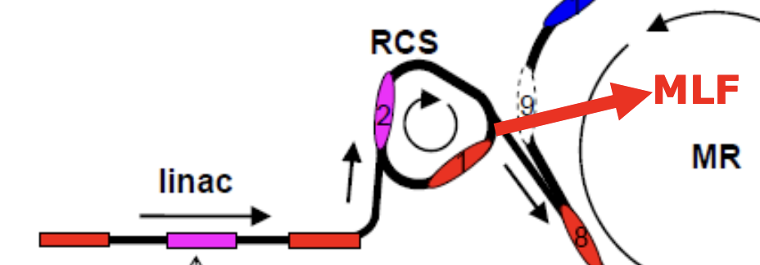
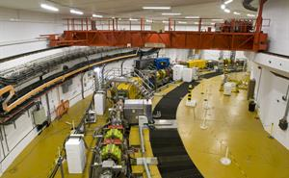
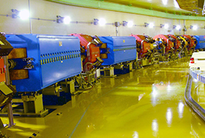
Gate signal, pile up and DAQ cycle
Cyclotrons (DC muons)
Muon with random arrival times
Limit ~40k muons/second
PSI
TRIUMF
muons
time
Gate = Time window ~10µs
TDC start
TDC stop
if there is a e⁺ hit
TDC reset
Synchrotron (Pulsed muons)
ISIS
J-PARC RCS
muons
← 20 ms (ISIS) to 40 ms (J-PARC)→
time
Thousands of muons / frame
Record times of multiple e⁺ hits
When µ⁺ dies away (~32-65µs) TDC reset
1st Muon Community Meeting (2021): https://indico.cern.ch/event/1030726/

Slide 14
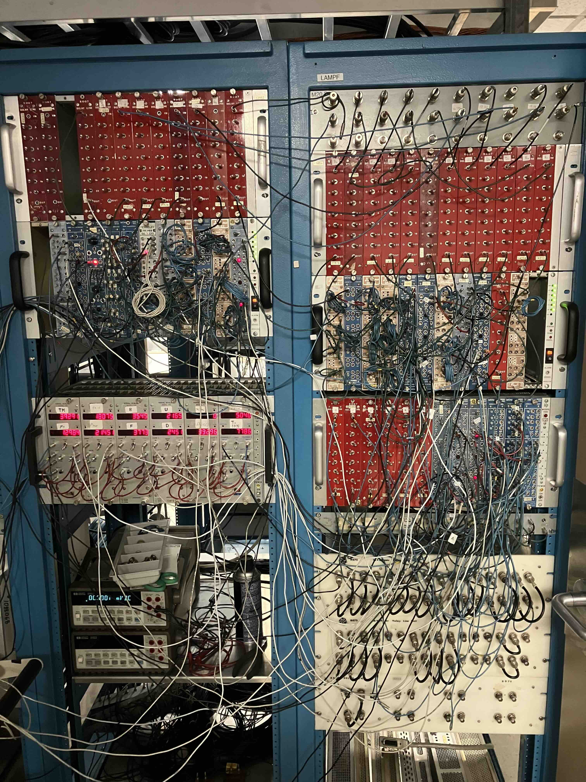
Cosmic-ray setup ≒ DC-µSR Counter geometry
PSI-GPS counter geometry
Count rate consideration
Muon counter: 40k µ+ / sec
Average 1/40k = 25µs separation
1 e+ / 1 µ+ = 40k e+/sec at most.
Signal
timings
TRIUMF LAMPF electronics with 10 counters. NIM electronics is OK.
µ⁺
e⁺
e⁺
Muon
Counter
t_0
µ⁺
Up counter
t_hit (U)
Sample
Down + veto counter
t_hit(D)
Plastic scintillator
PMT
https://www.psi.ch/sites/default/files/import/smus/InstrumentGpsEN/User_Guide_present_version.pdf

Slide 15
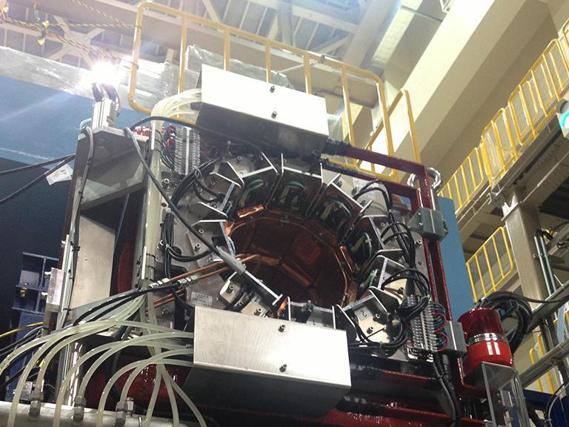
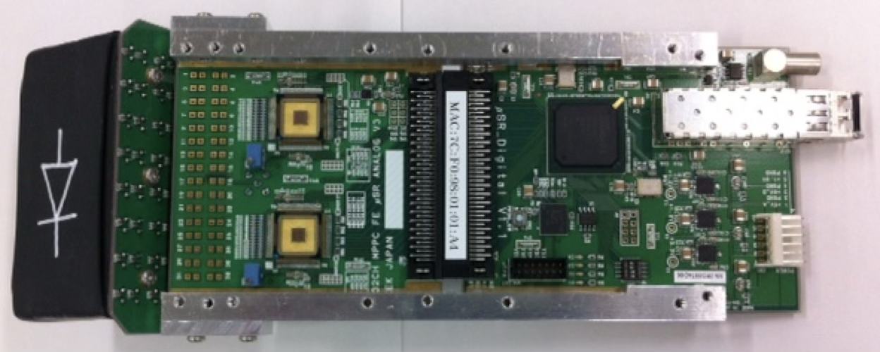
Pulsed µSR: no µ⁺ counter, but many e⁺ counters
Count rate consideration
ISIS ARGUS 40M e+/h (/3600/50Hz) ~220 e⁺ /frame
J-PARC S1/D1 200M e+/h (/3600/25Hz) ~ 2200 e⁺ / frame
These e+ are generated in ~ τ_{µ}=2.2µs:
Instantaneous rate 2200 e⁺ / 2.2µs = 1G counts / sec !
Fragments: 100 counters → 10 Mcps, or 22 e+ / frame
1000 counters → 1 Mcps or 2.2 e+ / frame
192 ch
64 ch
640 ch pair
64 ch
Kalliope
K M Kojima et al
J. Phys.: Conf. Ser. 551 012063 (2014 )
ARTEMIS (J-PARC MLF S1)
D1- spectrometer (MLF D1)
TDC + memory
ASD (Amp-Shaper-Discriminator)
10 counters → 2 racks (TRIUMF)
64 counters → 12 racks (?)
1280 counters (640 pairs) → 128 racks (!)
J-PARC MLF spectrometers uses ASIC-ASD + FPGA
32 ch of 10x10x12mm
BC408 scintillator + Y11 fibre
on a Hamamatsu MPPC sensor
SiPM

Slide 16
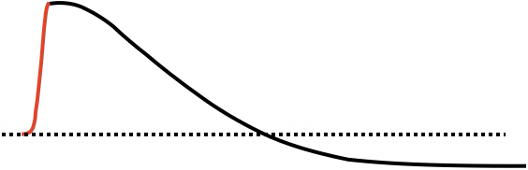
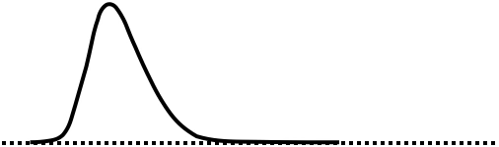
Electronics response required for DC vs. Pulsed µSR
Electronics specs | DC | Pulsed
Count rate | 40kcps, continuous a few counters ~1e+/10µs | 1 Gcps, instantaneous 100-1000s counters ~10e+/frame/counter
Rise-time resolution | very important | not important
Tail recovery time | any | as short as possible
Base-line stability | any | must be flat, no base-line shift
Desired analog pulse
Long tail is OK
Undershoot is OK
Fast tail
NO undershooting
Fast rise time
No jitter
Slow rise
is OK
CFD (Constant Fraction Discriminator)

Slide 17
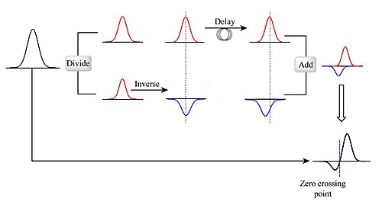
Constant Fraction Discriminator (CFD) – DC-µSR
Fixed threshold discriminator
Principle of CFD
https://en.wikipedia.org/wiki/Constant_fraction_discriminator
Time walk
Depending on the pulse height, the leading-edge timing changes
Timing of the zero-crossing point is independent to the pulse height

Slide 18
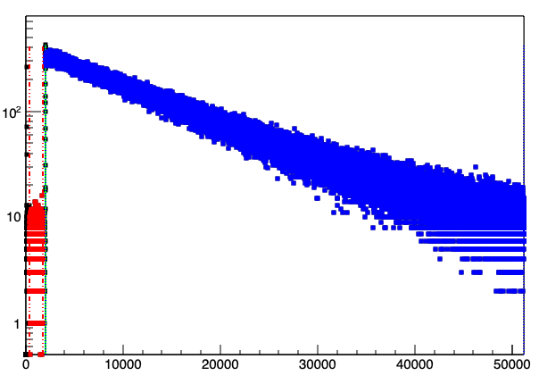
Pile up rejection (DC) vs. correction (Pulsed)
D E Pooley et al
2023 J. Phys.: Conf. Ser.
Count loss in high rate
The lost counts must be corrected, assuming a deadtime model.
Or go to peak detect scheme
Gate = Time window ~10µs
If a 2nd muon comes in within the gate window, such event must be discarded.
If more than one e+ hit is recorded within the gate window, such event must be discarded.
KMKojima et al. JPS Conf. Proc. , 011062 (2018)
Fixed deadtime τ model and correction works for Volume2014 amplifier
Ncorr = Nobs/(1-Nobs τ)
TRIUMF Dilution Refrigerator
N(t0)
B counter
Nbg
~ 3% N(t0)
Background level goes up or has time dependence, if wrong.
Time (ns)
8000

Slide 19
Counter geometry, beamline and cryostat etc.
Small counters: large asy, small rate
Large counters: small asy, large rate
Figure of merit ~ A²S
s
Beam duct for muon beam
Flypast chamber (pulse-µSR)
LF magnet coils
Cryostats
High LFs focuses the beam and
alter the e+ trajectory → alpha-shift
Full simulation of beam optics and counter geometry
→ Peter Baker’s Super-MuSR talk on last day

Slide 20
Contents
Simplest µSR set up
Plastic Scintillator, PMT, Discriminator, Gate, TDC, DAQ cycle
Requirements to the detectors
DC muon beam
Pulsed muon beam
Fight against noise – what is the ground in circuits
Fight against temperature-based instability
Future capabilities in instruments
Summary

Slide 21

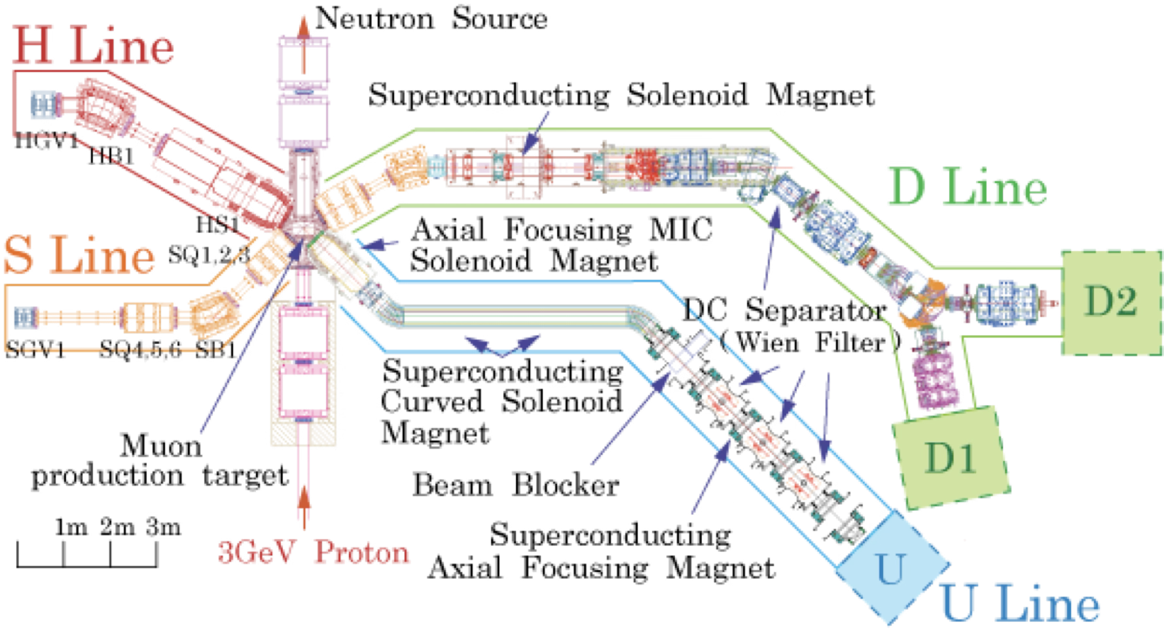
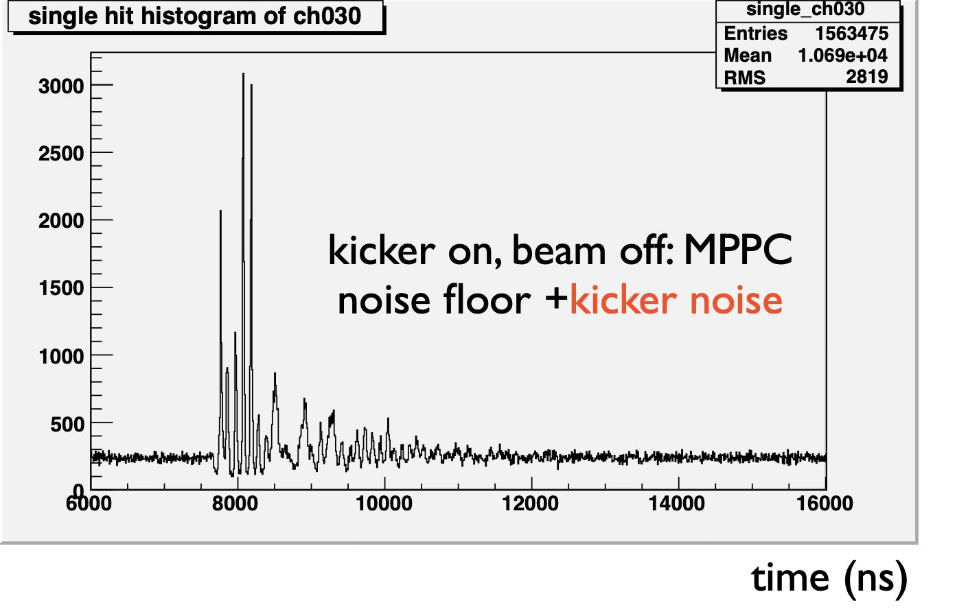
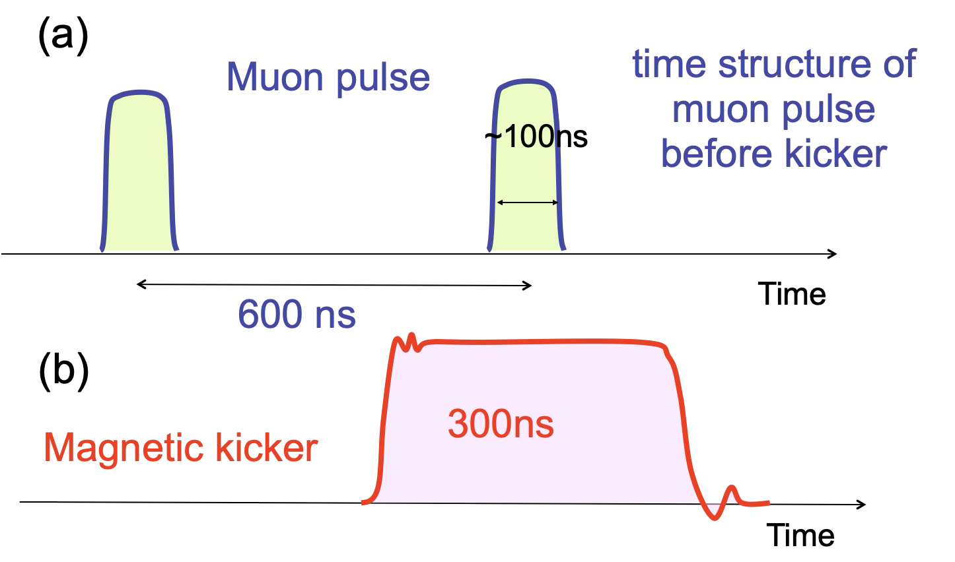
How do you define the ground of circuits ?
Worst BL component in noise: Magnetic Kicker
Where is
the ground of
my circuits??
SiPM
400 A 50 kV
=2000 kW pulse
0 4000

Slide 22
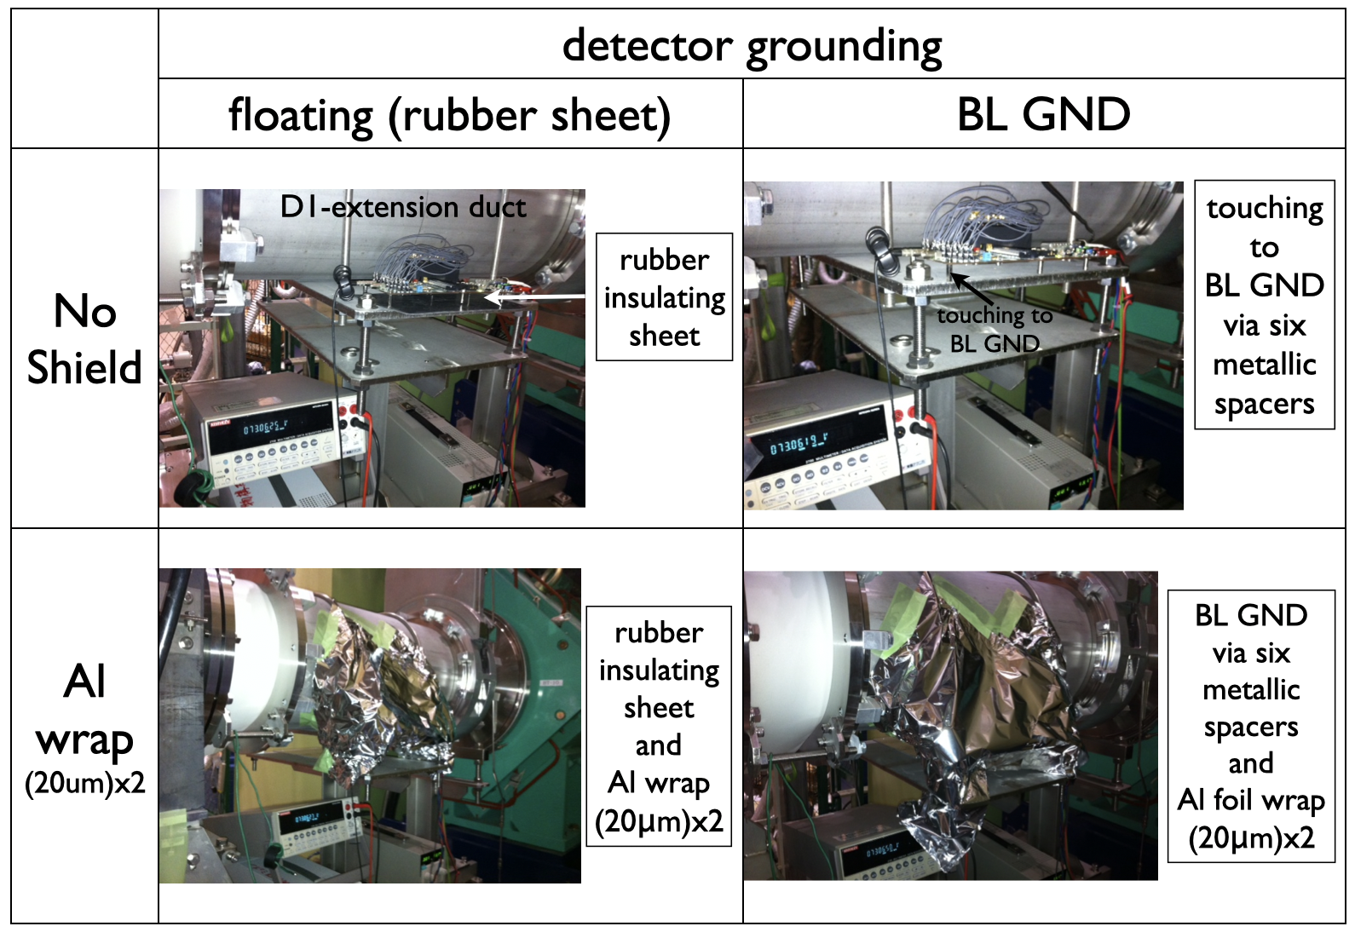
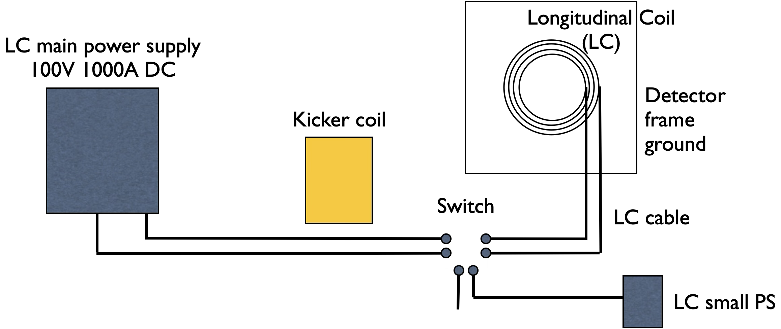
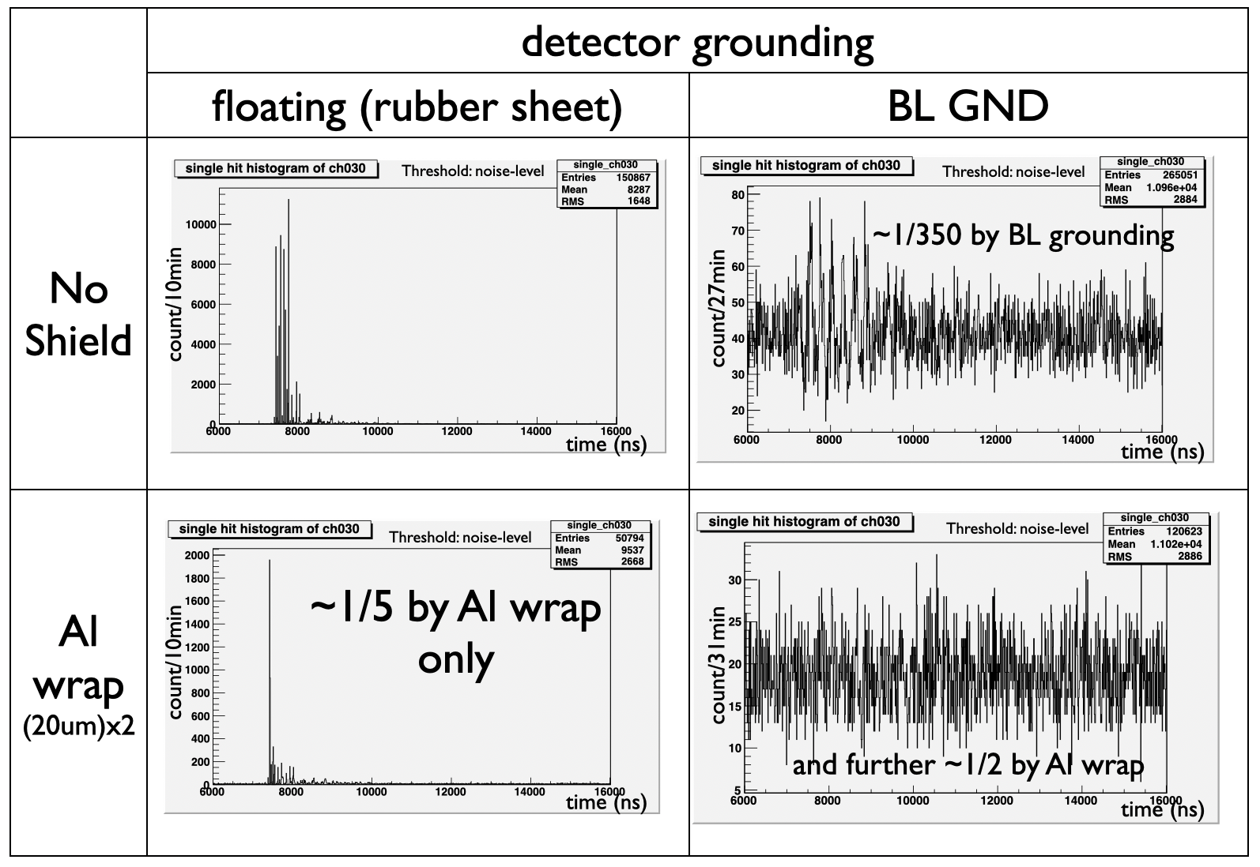
Noise propagation
LC connected to small PS → noise level 1/10
Detector connected to the BL ground → 1/350
Definition of the ground:
the largest conductor of the system
= LC (longitudinal Coil)
Can we use LC as the ground ?
(could not just connected by wire,
because LC is energized to 1000A 100V)
~1/350
~1/700

Slide 23
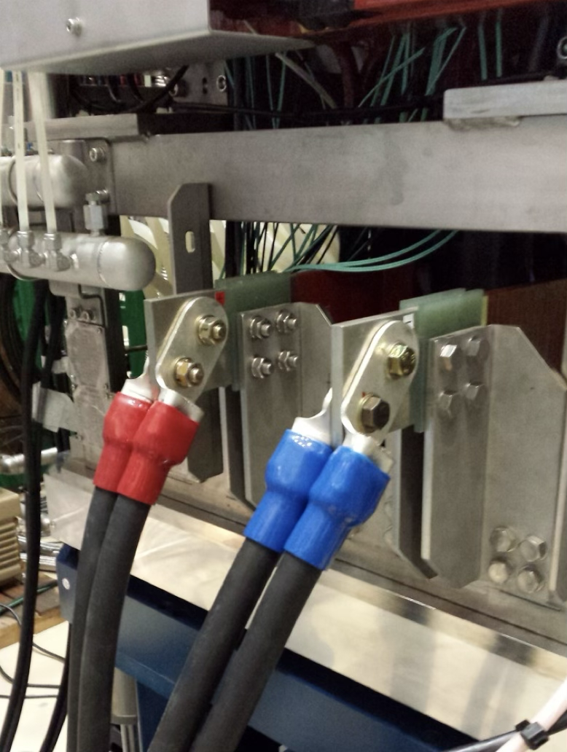
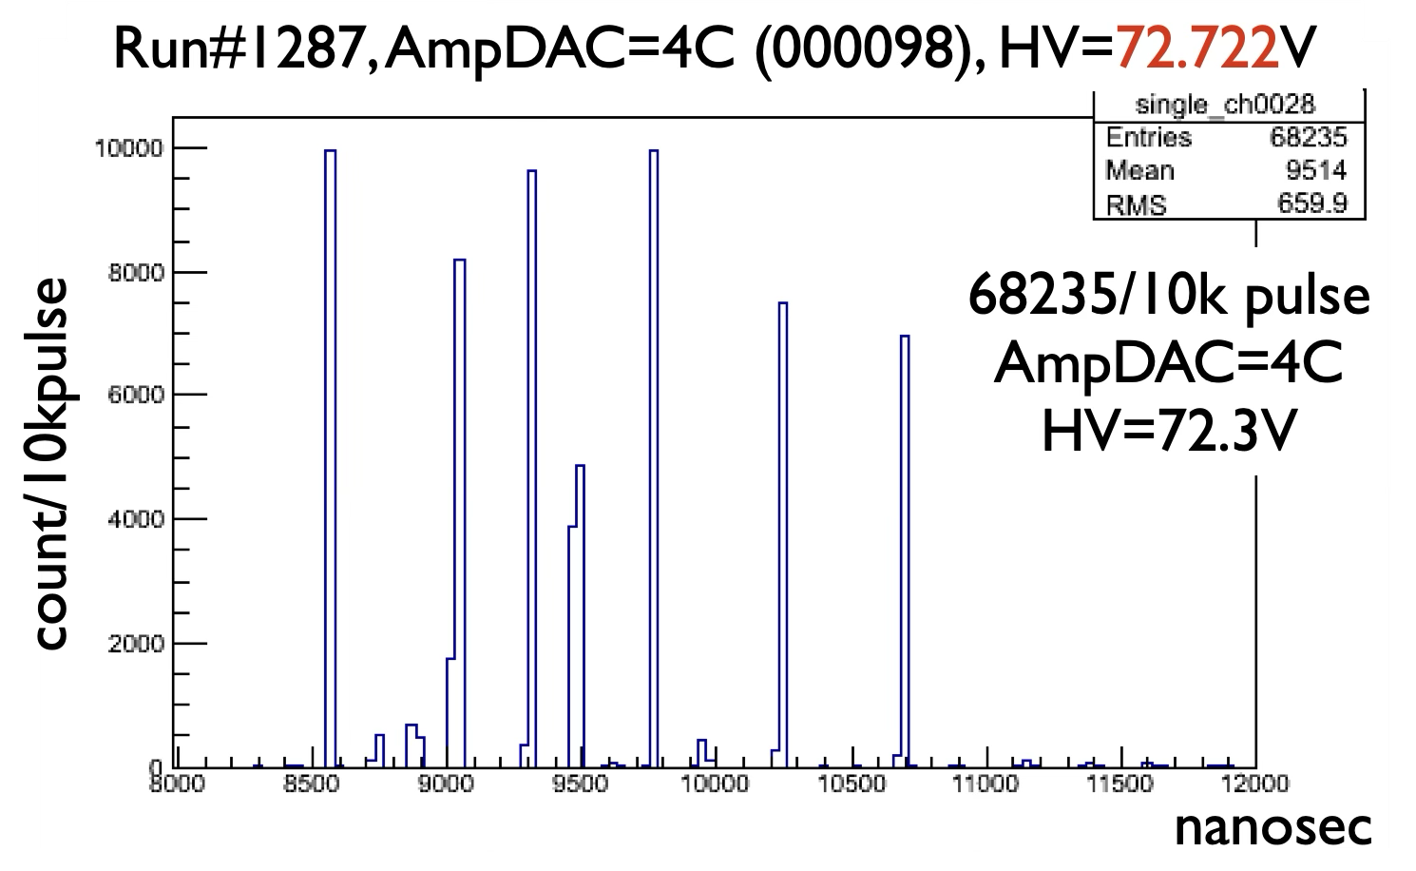

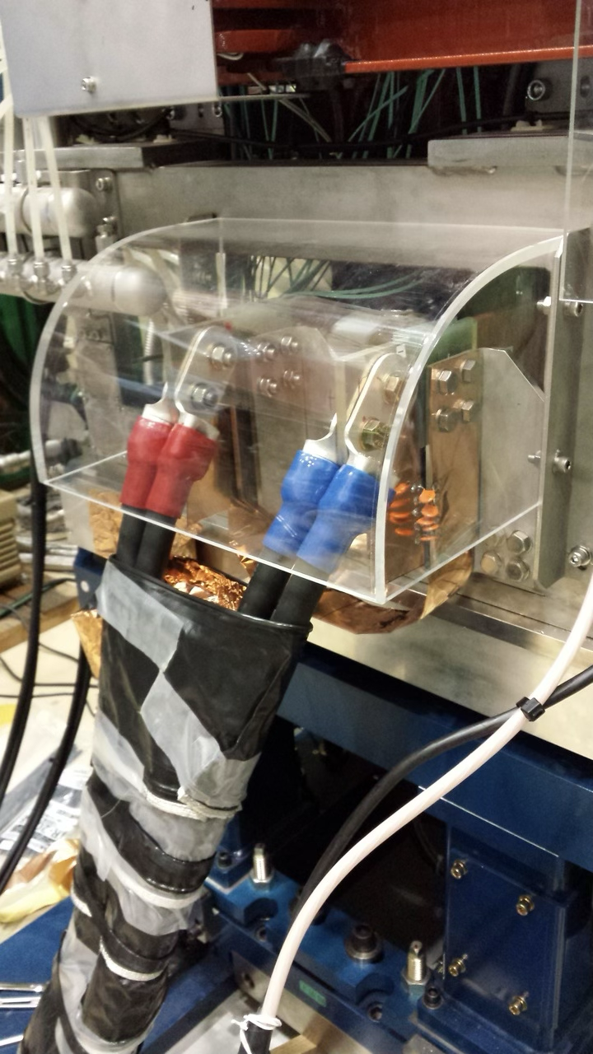
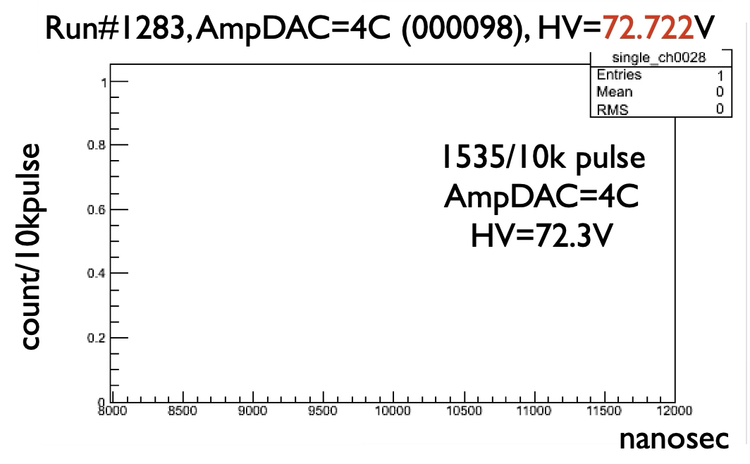
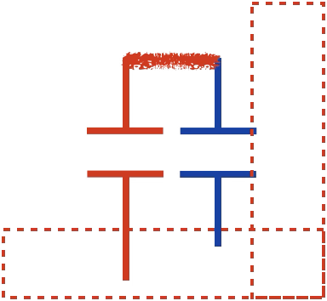
How to engage LC as the ground
10,000
Capacitor is transparent in high frequency
0
3000
Impedance Z=1/iωC
LC is capacitance-coupled to the ground, where the noise is bypassed via C.
1
L~10mH, C=100nF: Resonance f=5kHz,
ie 200µs period. Not visible to µSR (0~30µs)

Slide 24
Fighting against the T-dependent SiPM gain
When the LF coil (1000A x 100V=100kW) is energized, the spectrum start to drift, due to the thermal coefficient of SiPMs.
0.3
Coil surface: +10 ℃
SiPM: +5~10 ℃
-50mV/ ℃ x 5 = -0.25V bias change
0.1

Slide 25
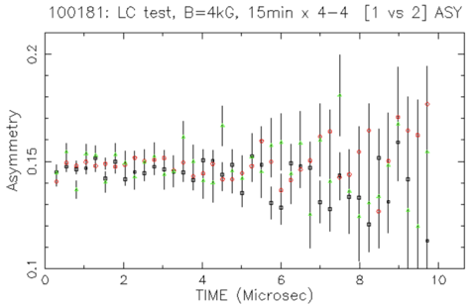
A copper can with cooling water pipes are installed inside and outside of the detector modules. With a fixed T chiller ($2k), the temperature rise was reduced to +2℃ from +10℃ of no active cooling. With a PID controlled chiller ($20k), the temperature is within 0.5K.
0.2
PID controlled chiller
0.2
0.15
0.15
No apparent drift observed

Slide 26
Future capabilities
What if Muon counters are pixeled, and
the source muon is identified for each positron?
40k muons / sec limit is lifted
Muon spin imaging will become possible
(1) Pileup limitation of 40k muons / sec.
Muons counter hits
e+
Zaher Salman’s talk
on vertex reconstructed
µSR at PSI
Gate = Time window ~10µs
TDC stop
if there is a e⁺ hit
TDC reset
e+
TDC start
Peter Baker’s talk
on super-MuSR at ISIS
(2) Maximizing the efficiency of pulsed µSR
Discriminator
Peak detect
Not just minimizing the count loss, but also maximizing the beam intensity, and optimizing the counter geometry, etc
…

Slide 27
Summary (µSR instrumentation)
Introduced:
Plastic Scintillator, PMT, Discriminator, Gate, TDC, DAQ cycle
Difference for DC and pulsed muon sources
Noise mitigation, SiPM thermal compensation
Most of the problems are already solved before the user comes.
Enjoy science based on the instruments !

Slide 28
Back ups

Slide 29
Time over threshold (TOT)
Most of the NIM discriminators
(eg. LeCroy 623) has fixed widths.
Not providing TOT.
Fixed threshold discriminator
The duration of the digital pulse reflects the pulse height, if the pulse exceeds the threshold.
Convenient method to estimate the pulse height

Slide 30
Constant Fraction Discriminator (CFD) – DC-µSR
Fixed threshold discriminator
Principle of CFD
https://en.wikipedia.org/wiki/Constant_fraction_discriminator
Time walk
Depending on the pulse height, the leading-edge timing changes
Timing of the zero-crossing point is independent to the pulse height

Slide 31
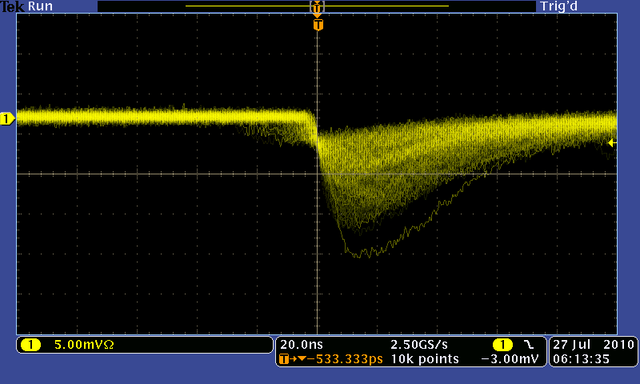
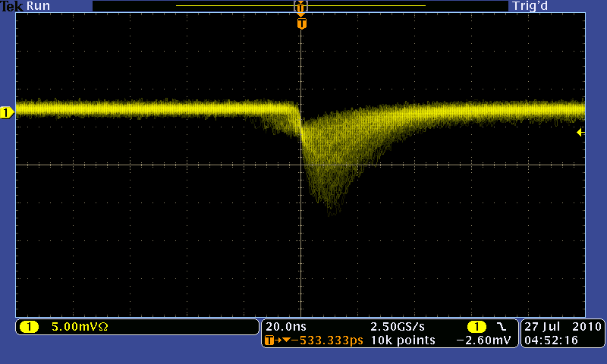
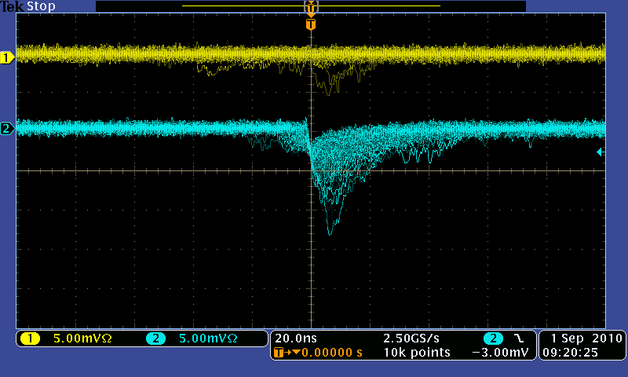
Characteristics pixel size dependence
100px, bias=70.6V
for 70.17V
Bias (-Vcc)
100µm pitch
R１
R1=10k, C1=100nF
R=10k, C=100nF
C１
C
Vout
20ns
400px, bias=70.0V
for 69.82V
5mV
Noise filter
50µm pitch
R
GND
1600px, bias=73.5V
for 71.74V
25µm pitch

