Slide 1
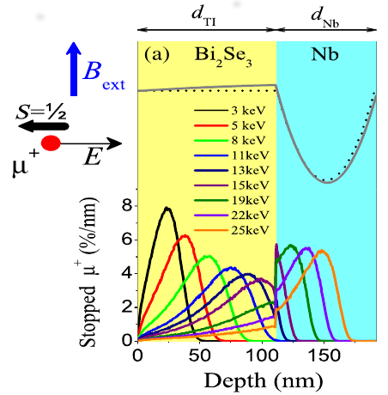
Low-energy μSR (LEM) applications
Thomas Prokscha
Muon Spectroscopy School 2026, Jan 14 – 21, Rigi-Kaltbad

Slide 2
Outline
Low-energy (keV) muons (μ⁺) basics
  The low-energy muon facility (apparatus & μSR spectrometer, LEM) at PSI
  Special features of low-energy μSR (LE-μSR) compared to standard μSR
  Implantation of low-energy μ⁺ in matter – stopping Profiles
Applications of LE-μSR: thin films and interfaces
  Superconducting and magnetic properties at surfaces and interfaces
    Meissner screening, volume fractions, proximity effects
Summary
Appendix: Depth profiling of defect regions with nm resolution at technologically relevant semiconductor interfaces (Metal-Oxide-Semiconductor, solar cells)

Slide 3
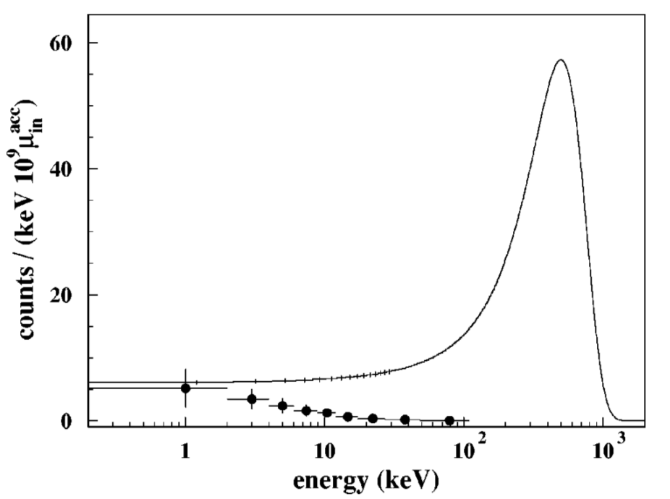
Generation of polarized epithermal (~eV) μ⁺
„Surface“ Muons
~ 4 MeV
~ 100% polarized
Energy spectrum after a degrader
Solid line: muon energy spectrum
Solid circles: energy spectrum of muonium
muonium
~100 μm Ag
Using a proper moderator:
motivated by experiments for positron moderation, a solid film of a rare-gas should work!
T. Prokscha et al., Phys. Rev. A58, 3739 (1998).

Slide 4
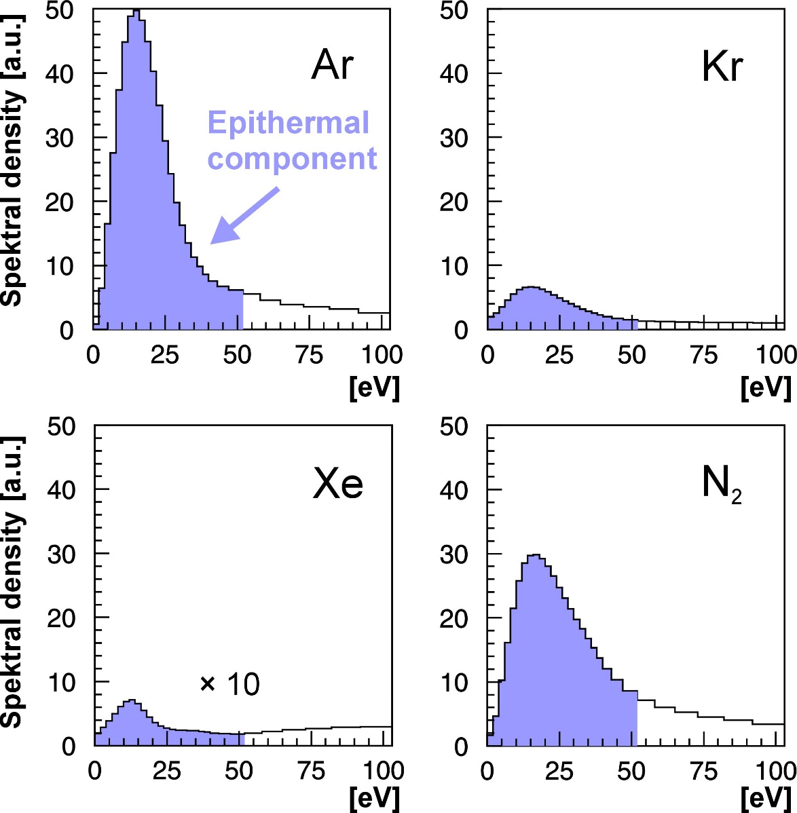
Generation of polarized epithermal (~eV) μ⁺
„Surface“ Muons
~ 4 MeV
~ 100% polarized
~100 μm Ag
~500 nm
s-Ne, Ar,
s-N₂
6 K
T. Prokscha et al., Appl. Surf. Sci. 172, 235 (2001).
T. Prokscha et al., Phys. Rev. A58, 3739 (1998).
E. Morenzoni et al., J. Appl. Phys. 81, 3340 (1997).
D. Harshmann et al., Phys. Rev. B36, 8850 (1987).

Slide 5
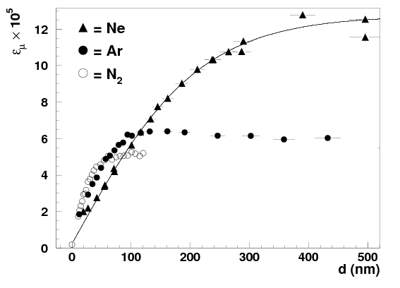
Characteristics of epithermal (~eV) μ⁺
L
AP(t)
P(0) ≅1
E. Morenzoni, T. Prokscha, A. Suter, H. Luetkens, R. Khasanov, J.Phys.: Cond. Matt. 16, S4583 (2004).
E. Morenzoni, F. Kottmann, D. Maden, B. Matthias, M. Meyberg, T. Prokscha, T. Wutzke, U. Zimmermann, PRL 72, 2793 (1994).
→ suppression of electronic energy loss for E > E_{g}, large band gap E_{g} (10-20 eV) „soft, perfect“ insulators
→ large escape depth L (10-100 nm), no loss of polarization during moderation (~10 ps)
→ moderation efficiency is low (requires highest intensities μ⁺ beams, > 10⁸ μ⁺/s, i.e. MW proton beam):
ΔΩ: probability to escape into vacuum (~50% for isotropic angular distribution)
F_{Mu}: muonium formation probability, ΔR ~ 100 μm width of muon stopping distribution in moderator
ε_{μ+} = N_{epith}/N_{4MeV} ≈ ΔΩ (1-F_{Mu} ) L/ΔR ≈ 0.25 L/ΔR ≈ 10⁻⁴ – 10⁻⁵

Slide 6
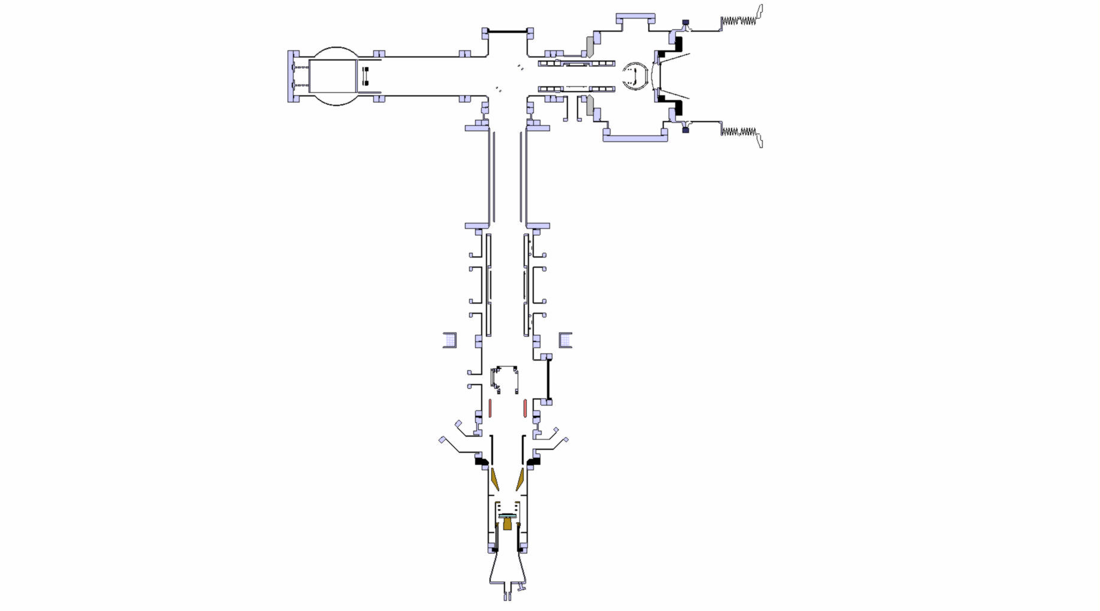
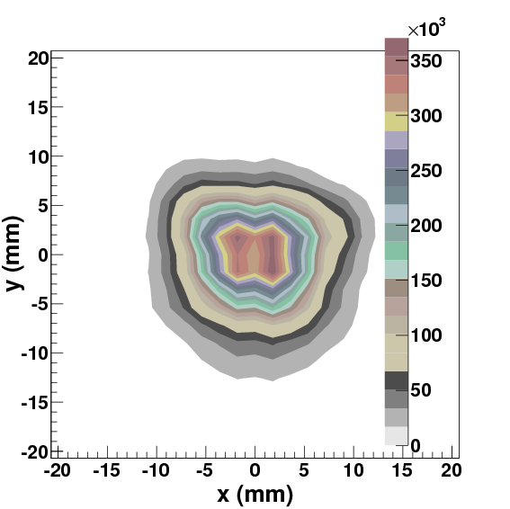
Low-energy μ⁺ facility at PSI at the μE4 surface μ⁺ beamline
Rates at 2.2 mA proton beam current (2025)
electrostatic mirror
- UHV system, 10⁻¹⁰ mbar
- some parts LN₂ cooled
μE4 “surface” μ⁺ beam, ~4 MeV, ~90% polarization
Spin
~2.7 • 10⁸ μ⁺/s
Spin-rotator (E x B)
Einzel lens
(LN₂ cooled)
moderator
Polarized low-energy μ⁺ Beam Energy: 1 - 30 keV ΔE, Δt: 400 eV, 5 ns Mean Depth: 5 – 200 nm Polarization ~90 % (surface μ⁺) Beam Spot: 12 mm (FWHM)
~ 16’000 (24’000) LE-μ⁺/s, s-Ar (s-Ne); accelerate up to 20 keV
Einzel lens
(LN₂ cooled)
Beam spot at sample
Start detector
(10 nm C-foil)
Conical lens
Sample cryostat
e+ detectors
at sample: up to ~ 6’400 (9’600) μ⁺/s, s-Ar (s-Ne)

Slide 7
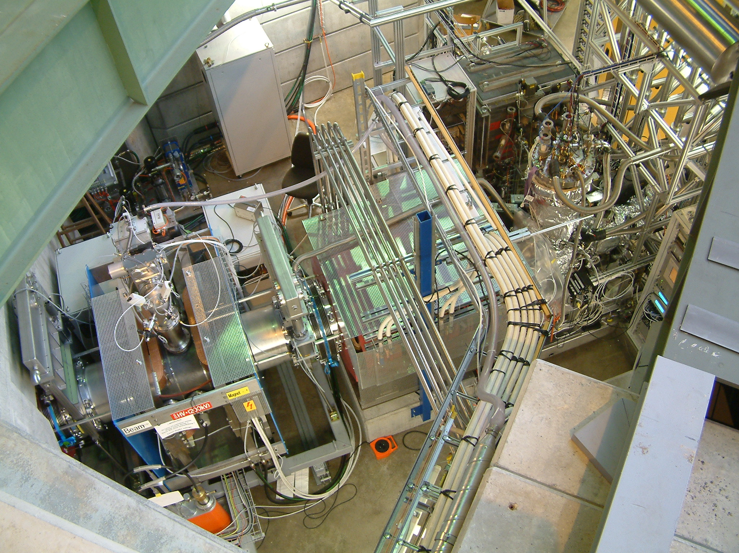
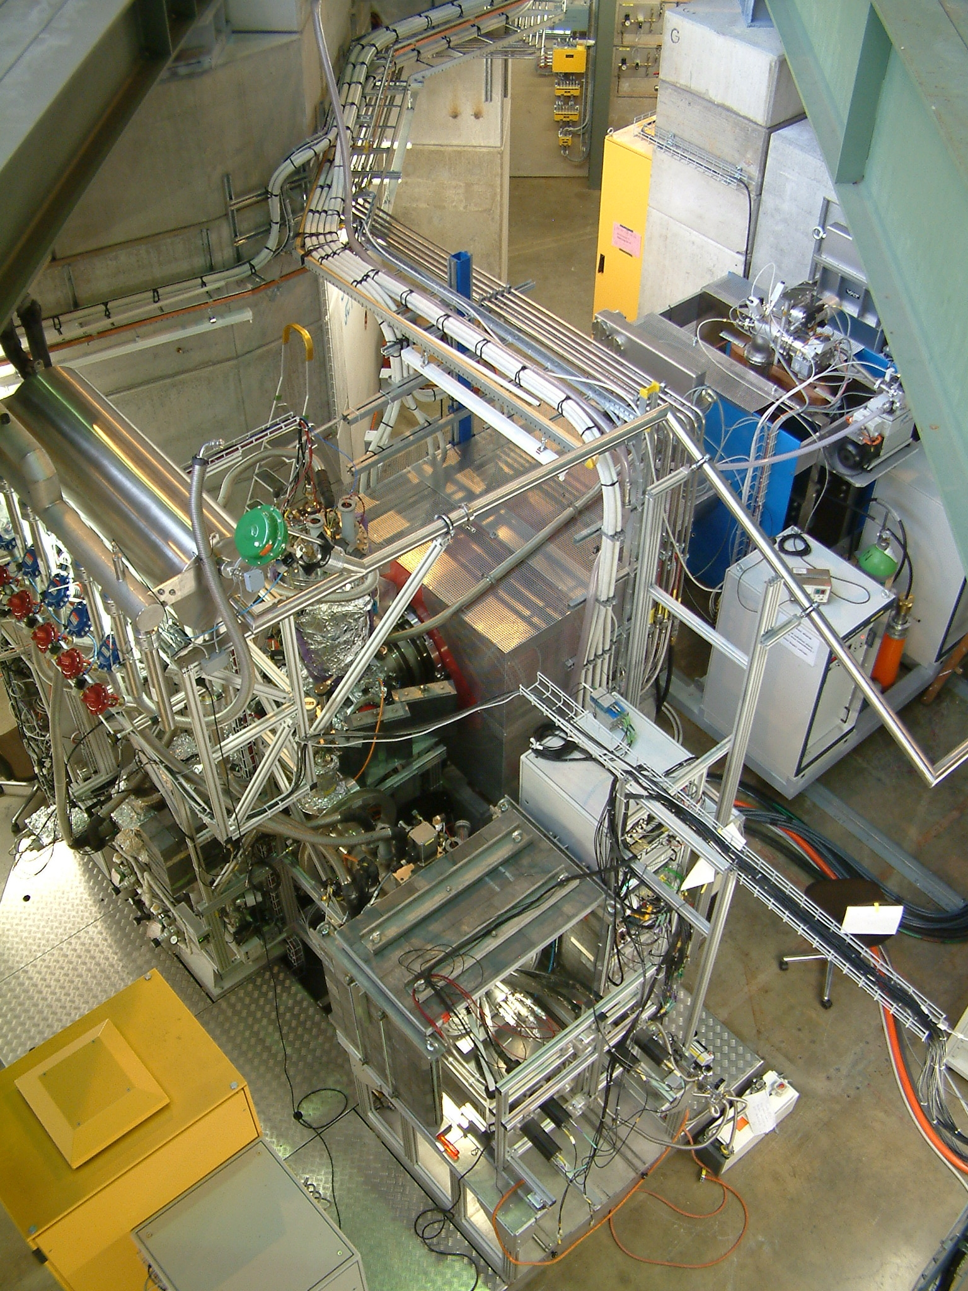
Low-energy μ⁺ facility at PSI at the μE4 surface μ⁺ beamline
At 2.2 mA proton current
~6.2 • 10⁸ μ⁺/s total, Δp/p = 9.5% (FWHM) ~2.7 • 10⁸ μ⁺/s on LEM moderator ~1.6/2.4 • 10⁴ μ⁺/s moderated (solid Ar/solid Ne)
T. Prokscha, E. Morenzoni, K. Deiters, F. Foroughi, D. George, R. Kobler, A. Suter and V. Vrankovic, Nucl. Instr. Meth. A595, 317 (2008).
Notes:
7

Slide 8
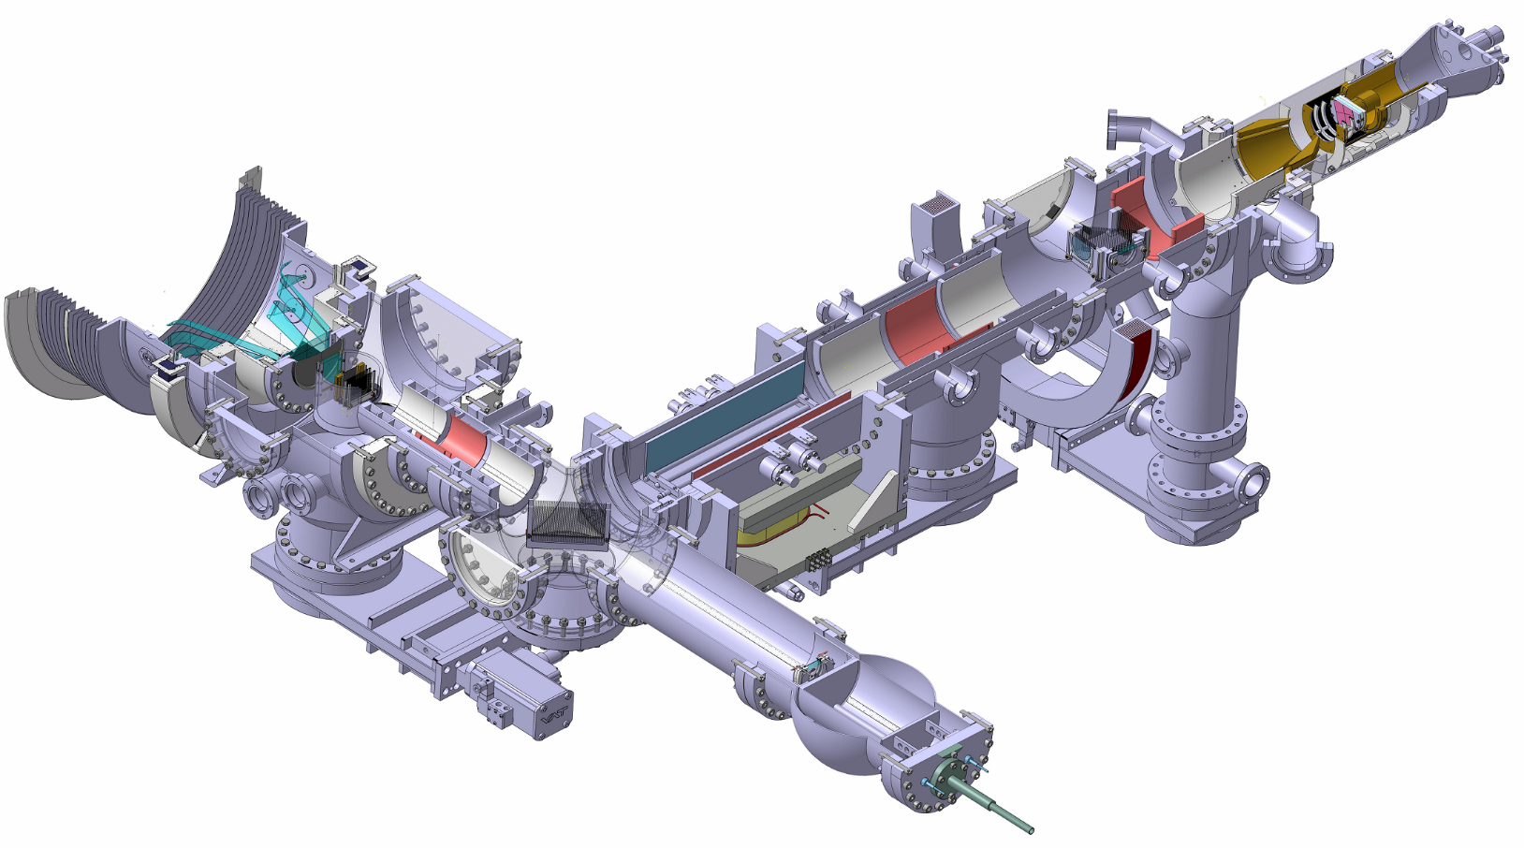
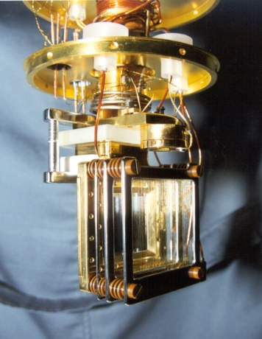
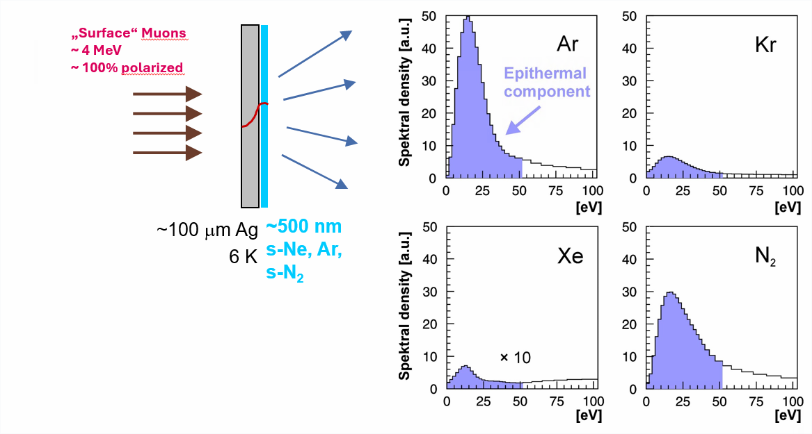
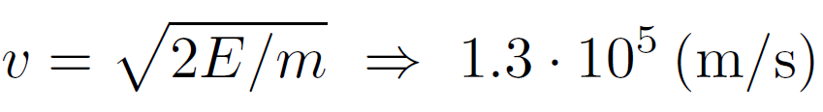

Low-energy μ⁺ beam and setup for LE-μSR
Muon Spin
Muon Momentum
Moderator
low-energy μ⁺
source
Why re-accelerate slow µ⁺?
for E ≈ 10eV
No µ⁺ left

Slide 9
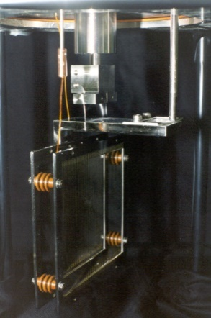
Low-energy μ⁺ beam and setup for LE-μSR
Muon Spin
Muon Momentum
Moderated
slow (keV) µ⁺
Un-moderated
fast µ⁺
Mirror
energy filter

Slide 10
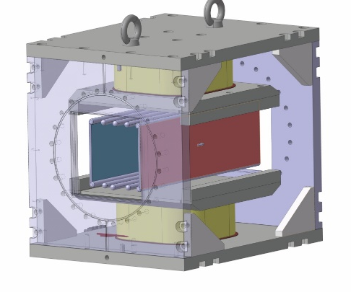
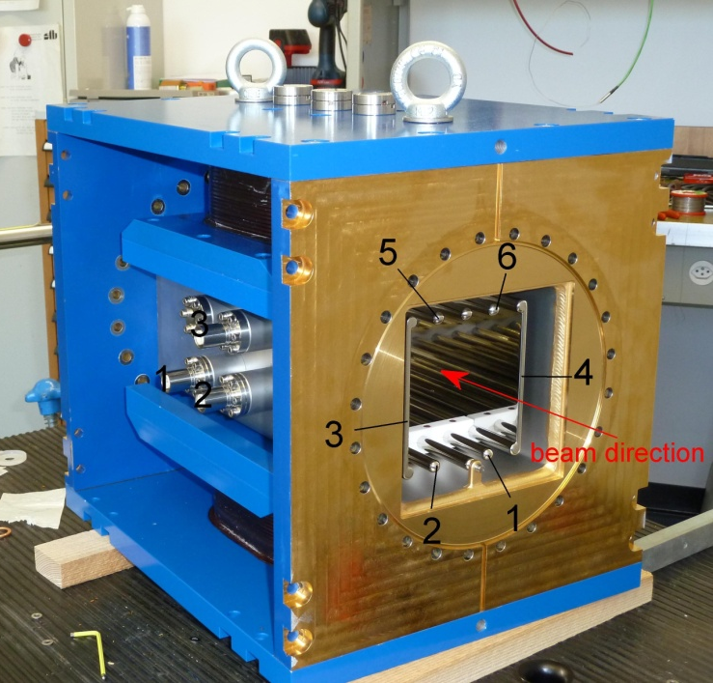
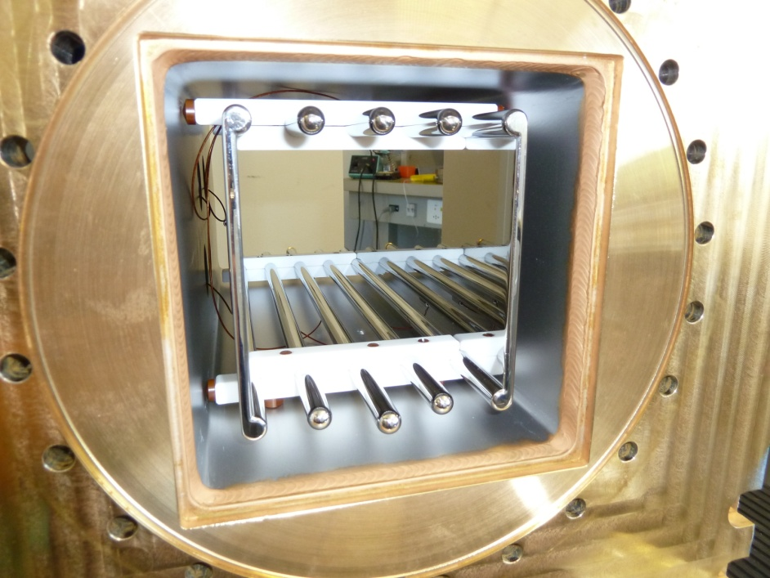
Low-energy μ⁺ beam and setup for LE-μSR
Spin-Rotator / Separator
Muon Spin
Muon Momentum
E-Field
B-Field

Slide 11
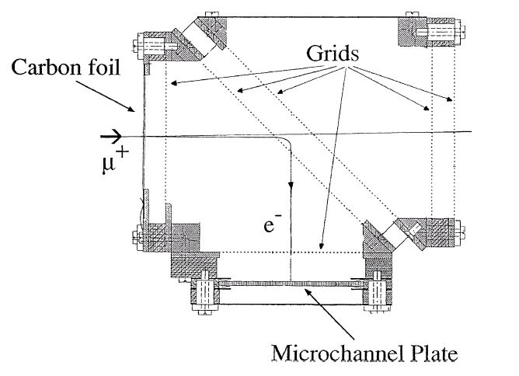
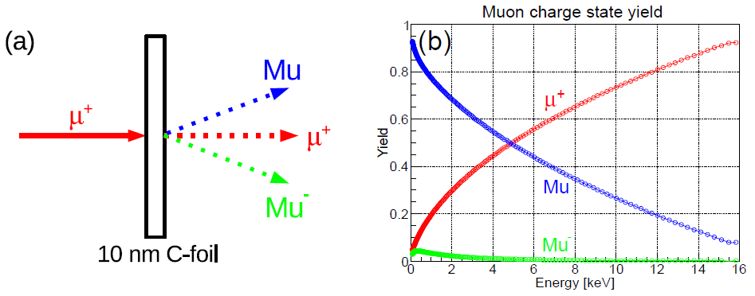
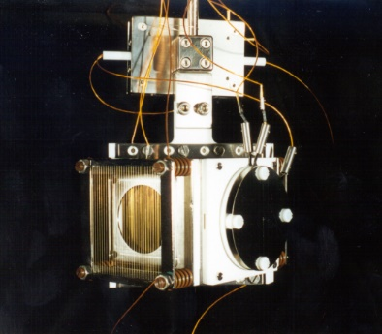
Low-energy μ⁺ beam and setup for LE-μSR
Muon Spin
Carbon foil:
≈ 1.5 - 2.5 µg/cm²
≈ 10 nm
Muon Momentum
1.7 μg/cm²
Trigger
implantation time
K.S. Khaw et al., JINST 10, P10025 (2015)
G. Janka et al., Phys. Rev. AB 27, 054501 (2024)

Slide 12
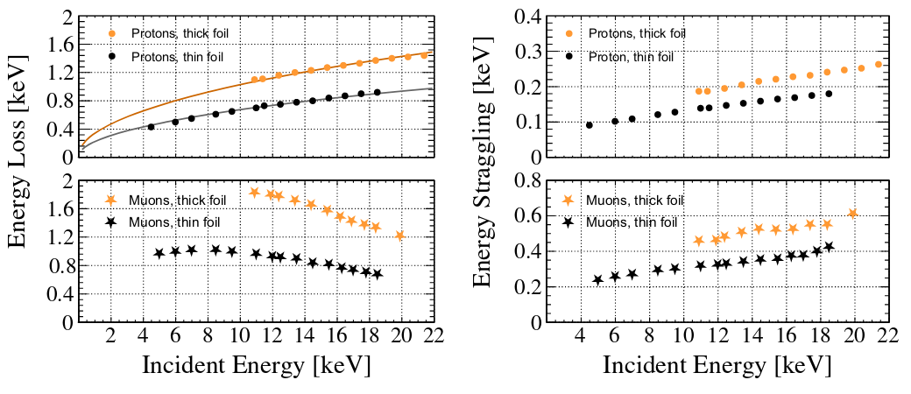
Low-energy μ⁺ beam and setup for LE-μSR
Muon Spin
Carbon foil:
≈ 1.5 - 2.5 µg/cm²
≈ 10 nm
Muon Momentum
2.6 μg/cm²
1.7 μg/cm²
1.7 μg/cm²
Trigger
implantation time
G. Janka et al., Phys. Rev. AB 27, 054501 (2024)

Slide 13
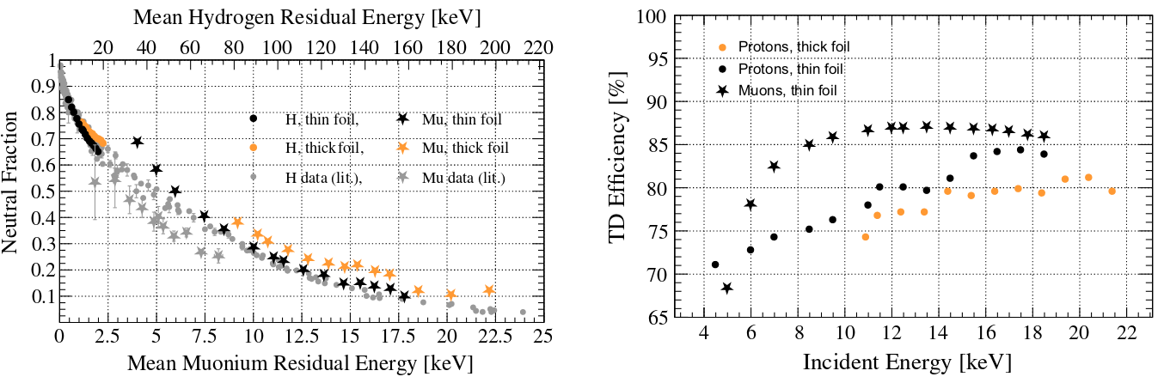
Low-energy μ⁺ beam and setup for LE-μSR
Muon Spin
Carbon foil:
≈ 1.5 - 2.5 µg/cm²
≈ 10 nm
Muon Momentum
1.7 μg/cm²
2.6 μg/cm²
1.7 μg/cm²
Trigger
implantation time
G. Janka et al., Phys. Rev. AB 27, 054501 (2024)

Slide 14
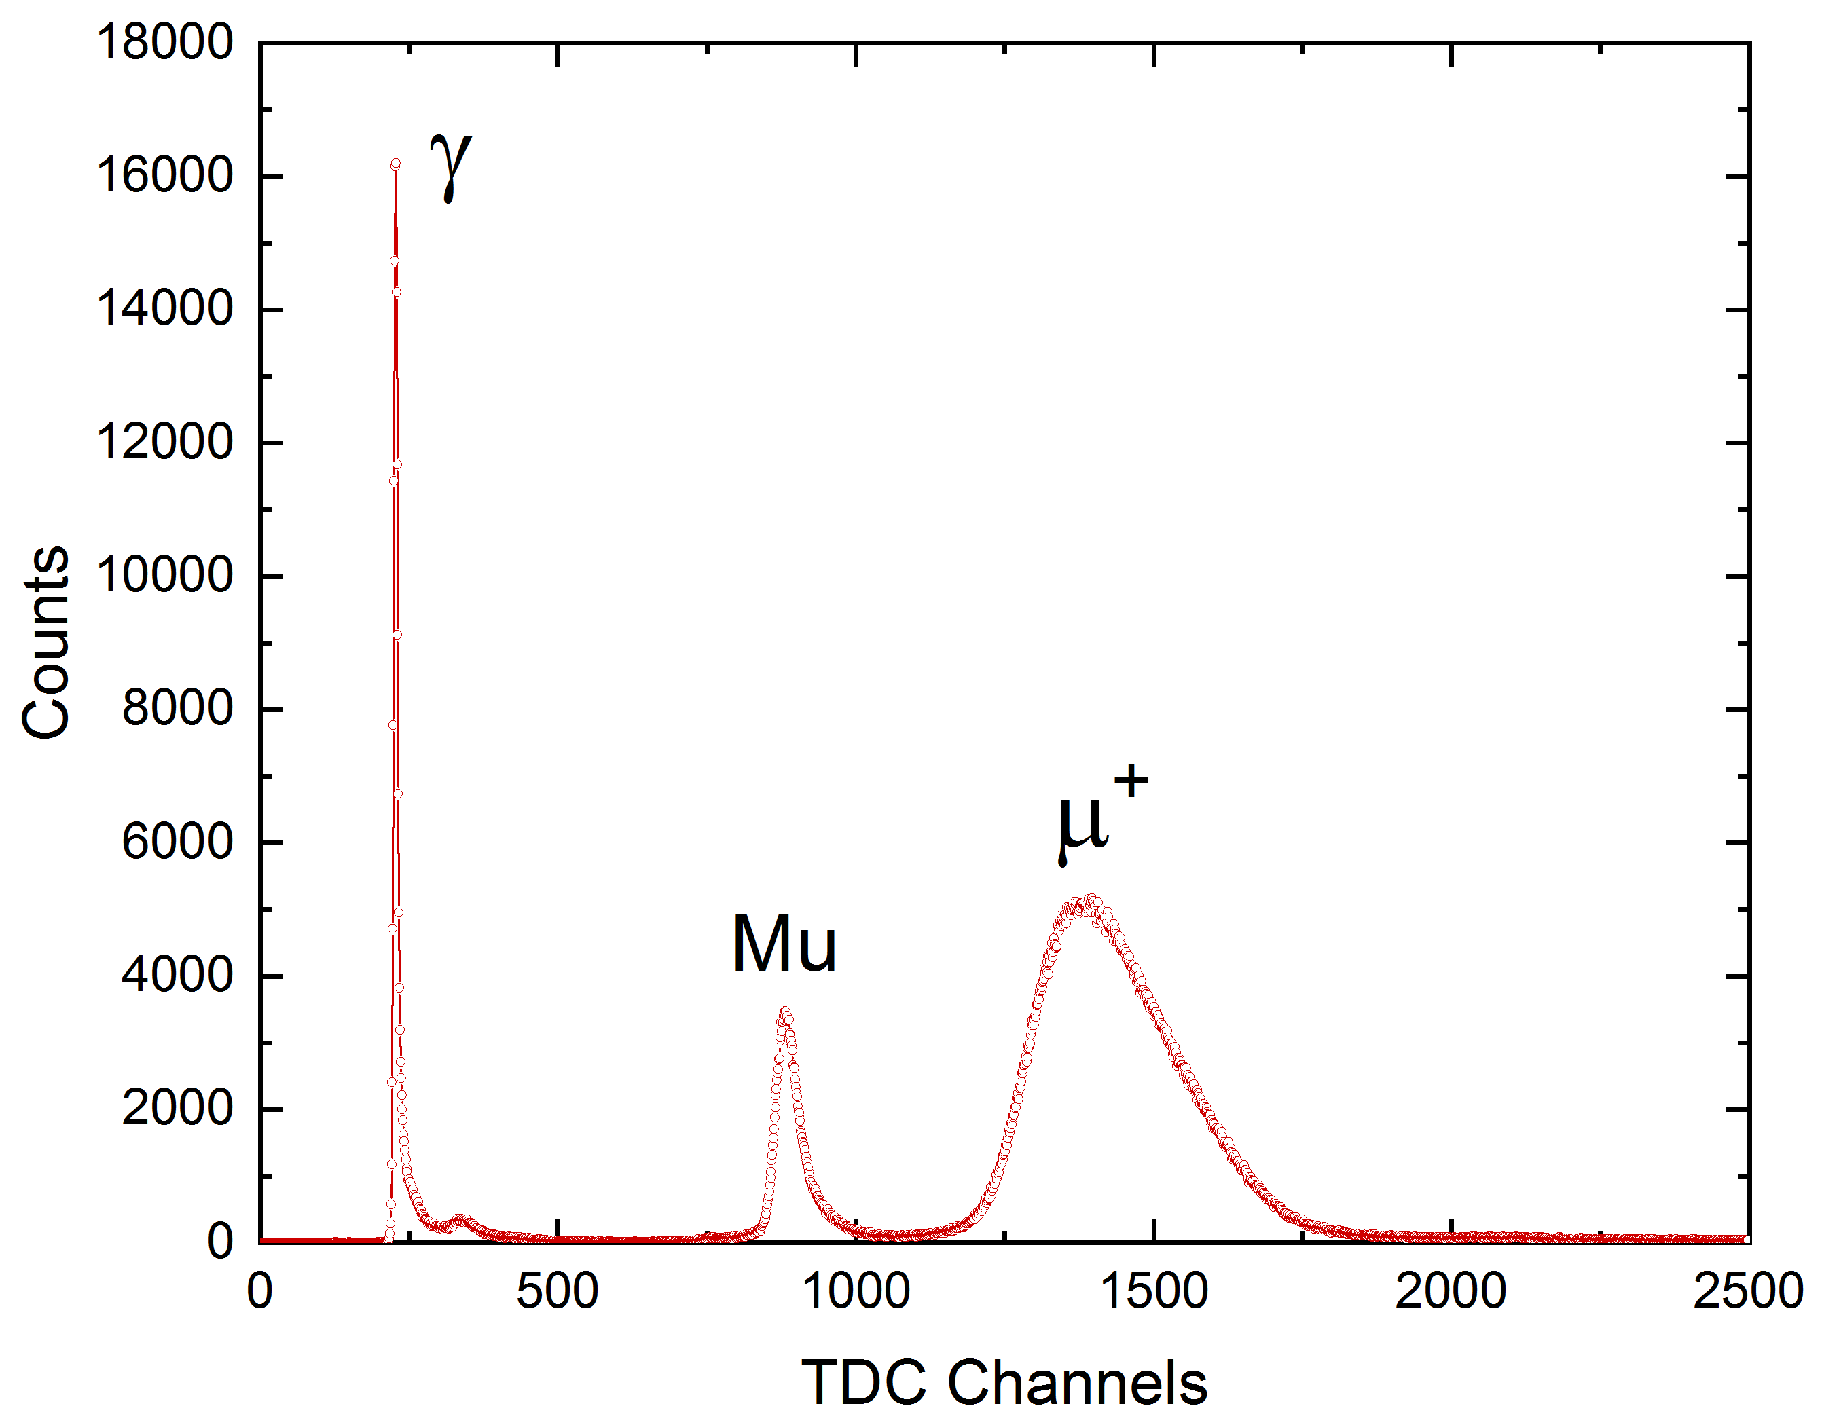
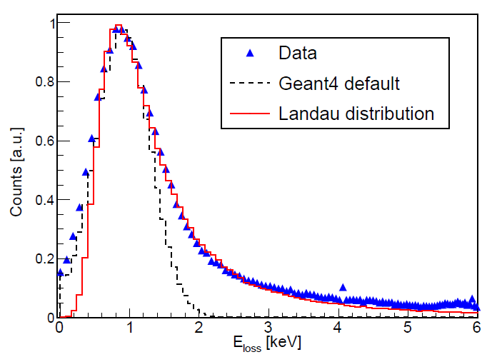
Low-energy μ⁺ beam and setup for LE-μSR
Muon Spin
Carbon foil:
≈ 1.5 - 2.5 µg/cm²
≈ 10 nm
Muon Momentum
15 keV µ⁺
Trigger
implantation time
Δt
Trigger
implantation time
This energy loss distribution (= time-of-flight
distribution with width Δt) is limiting the
frequency resolution of LEM to ≤ 50 MHz
K.S. Khaw et al., JINST 10, P10025 (2015)
G. Janka et al., Phys. Rev. AB 27, 054501 (2024)

Slide 15
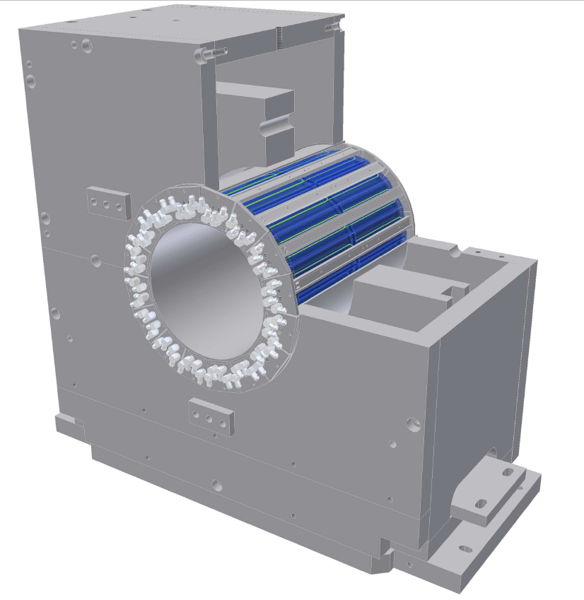
Low-energy μ⁺ beam and setup for LE-μSR
Muon Spin
Muon Momentum
0.6m

Slide 16
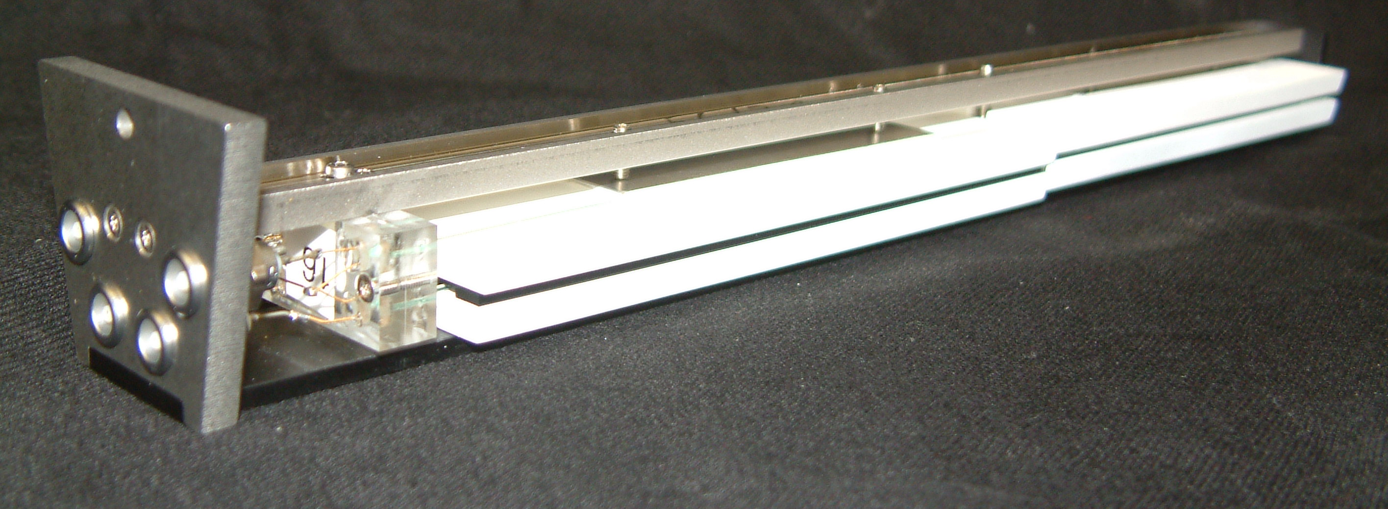
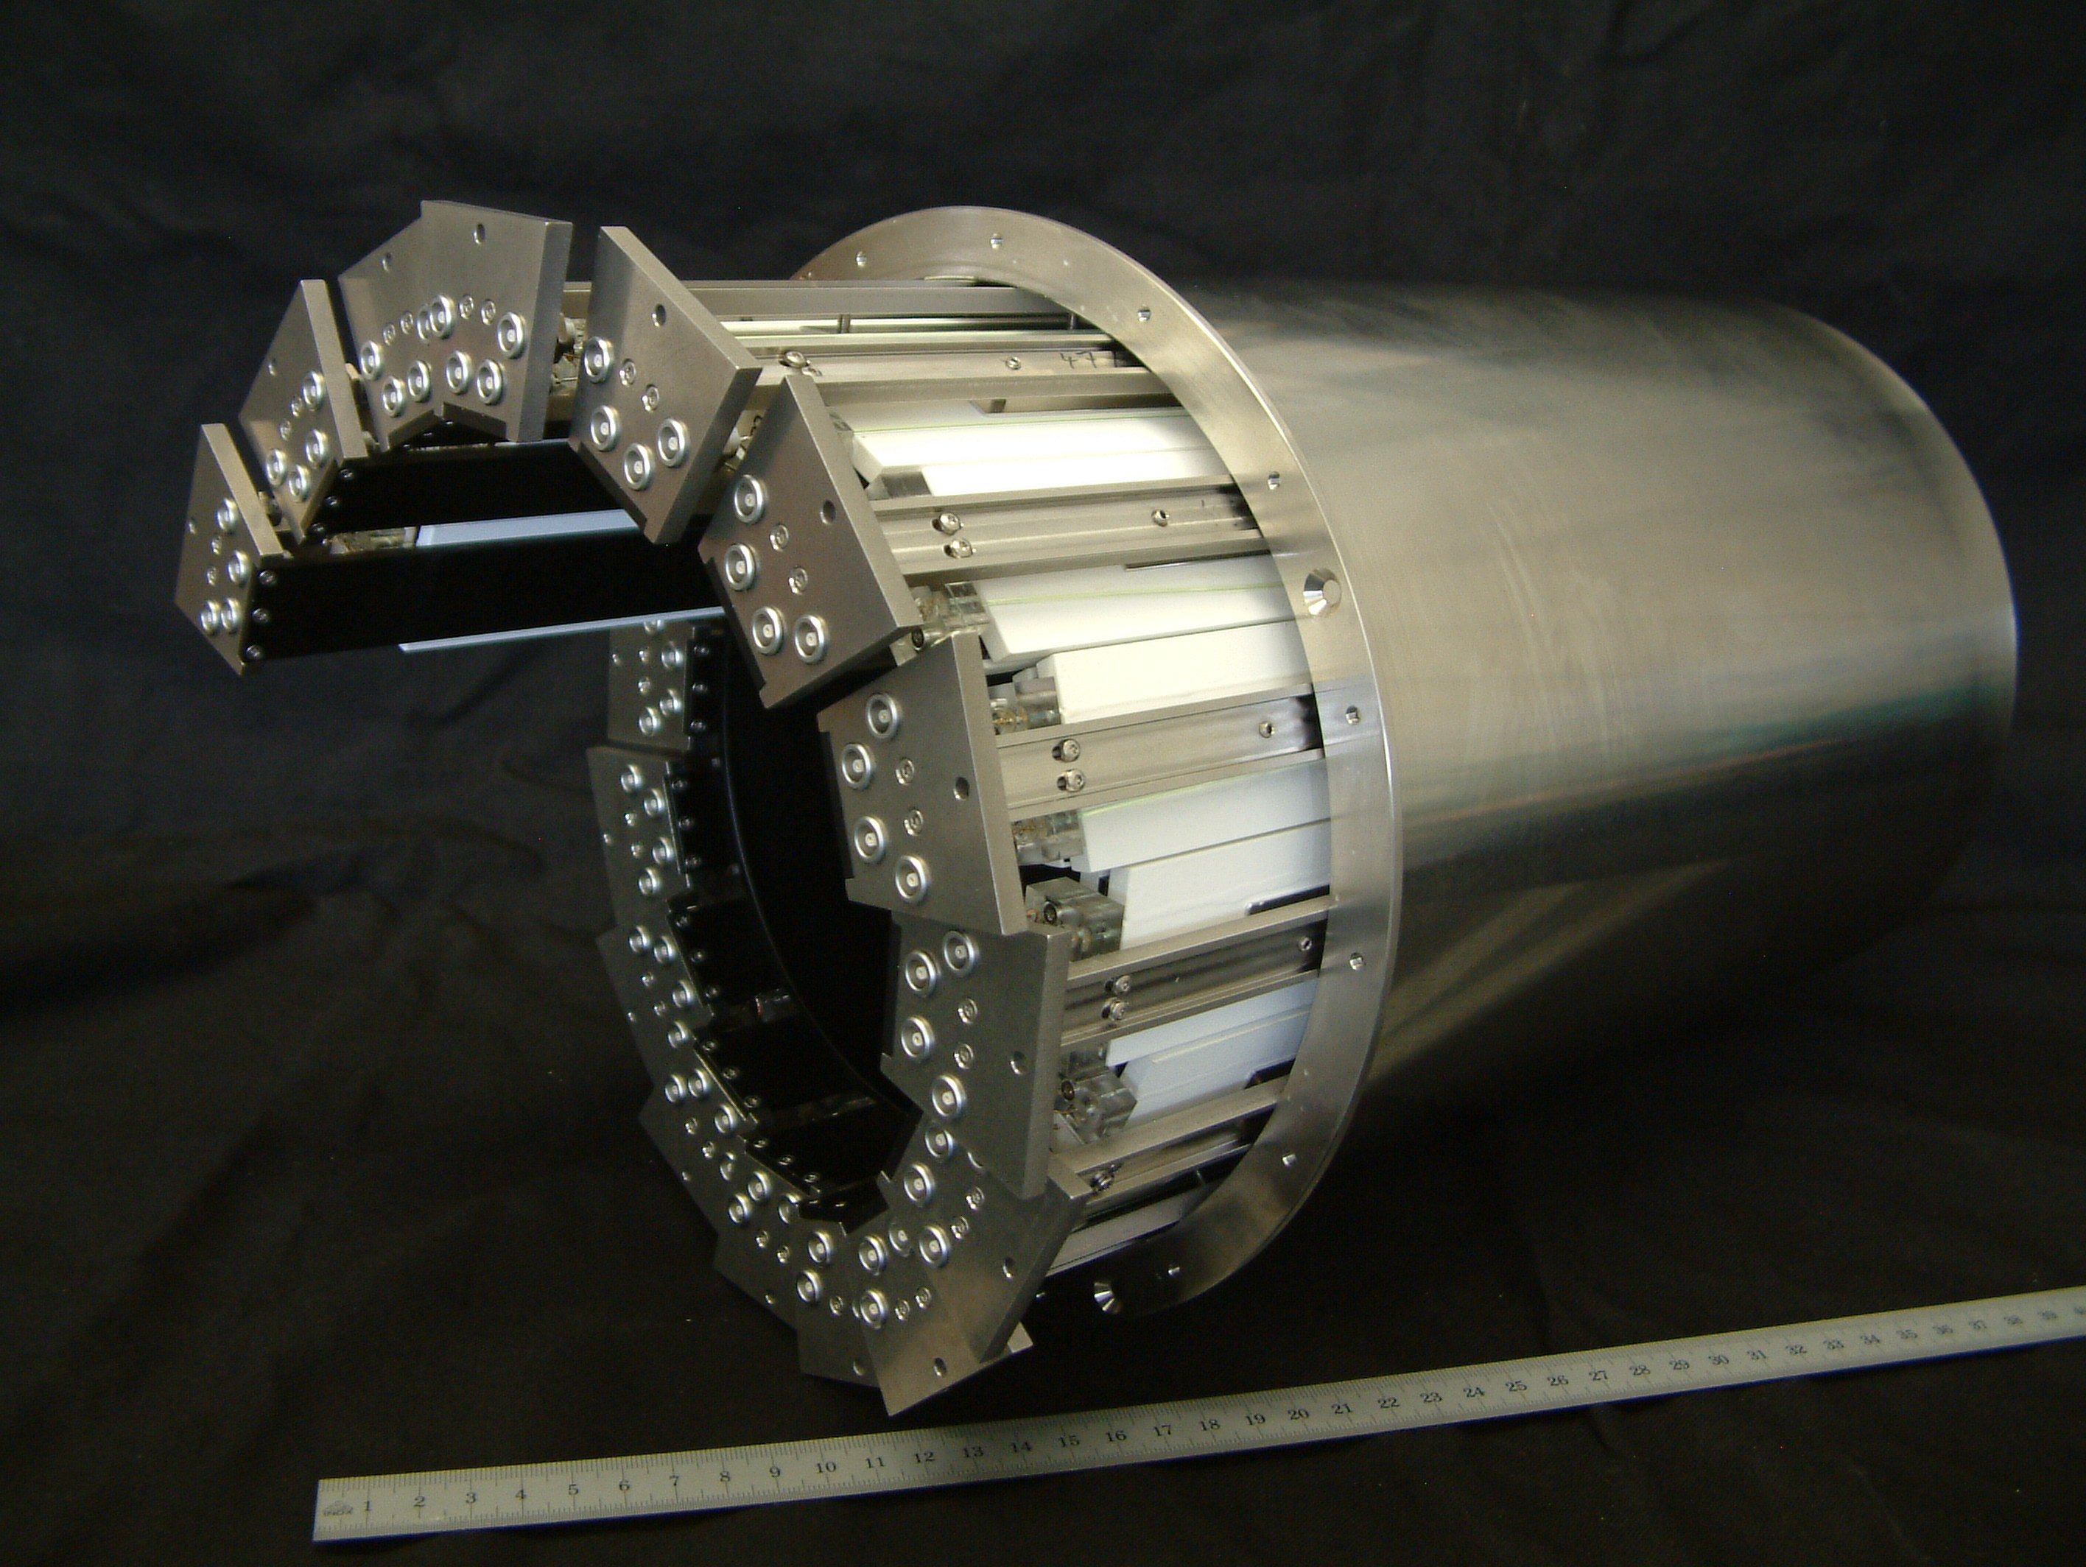
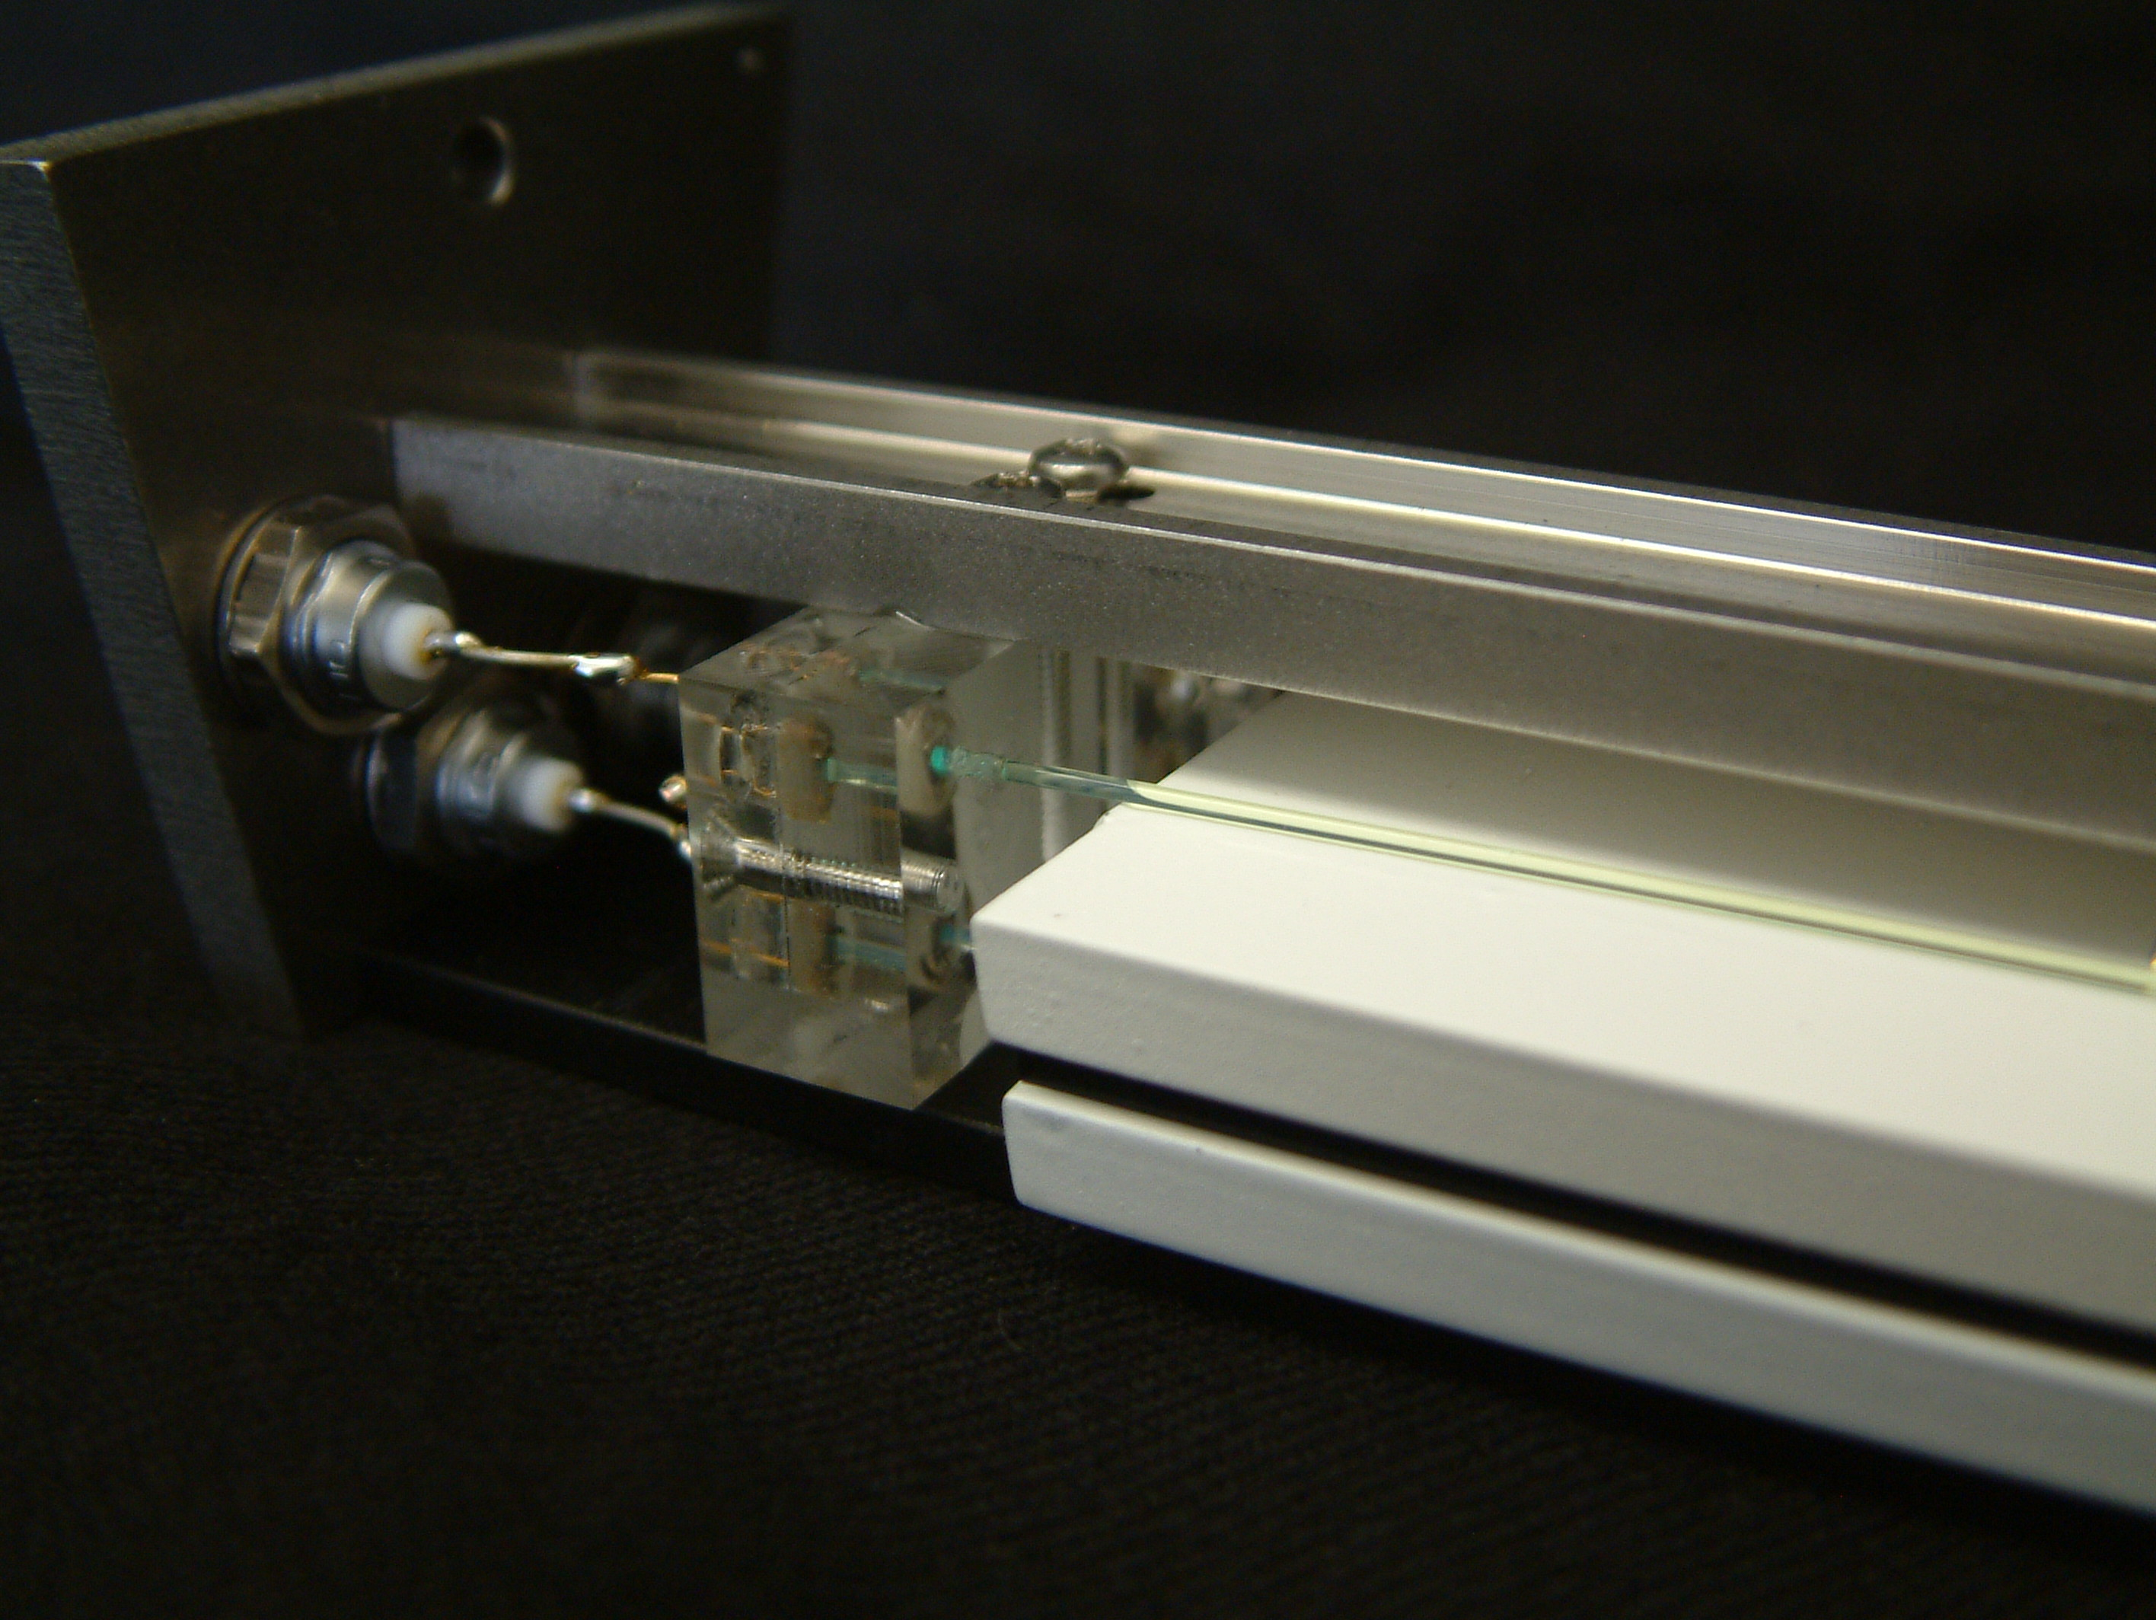
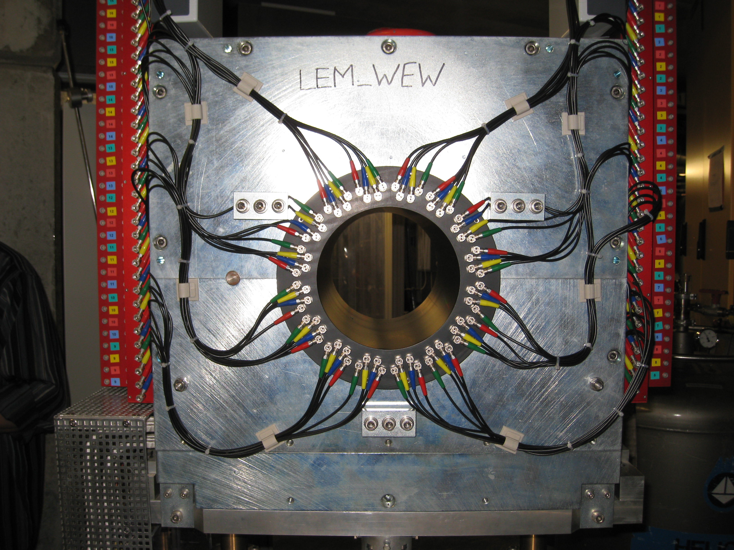
Low-energy μ⁺ beam and setup for LE-μSR, WEW magnet
0.6m

Slide 17
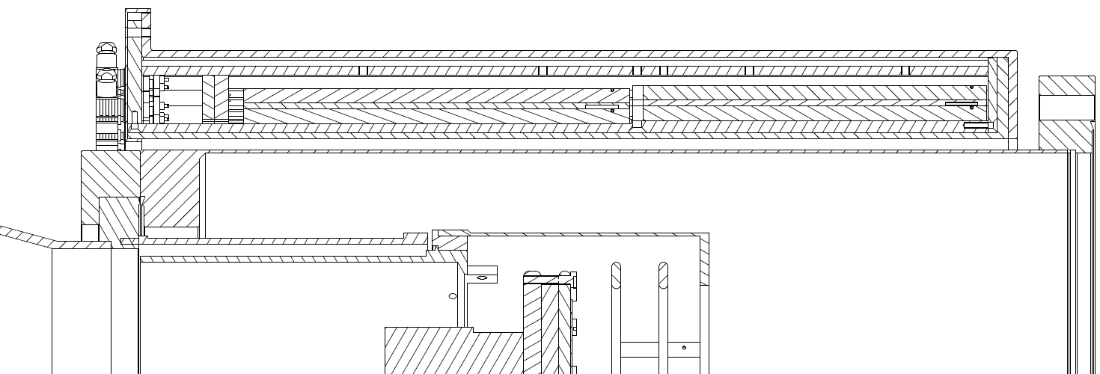
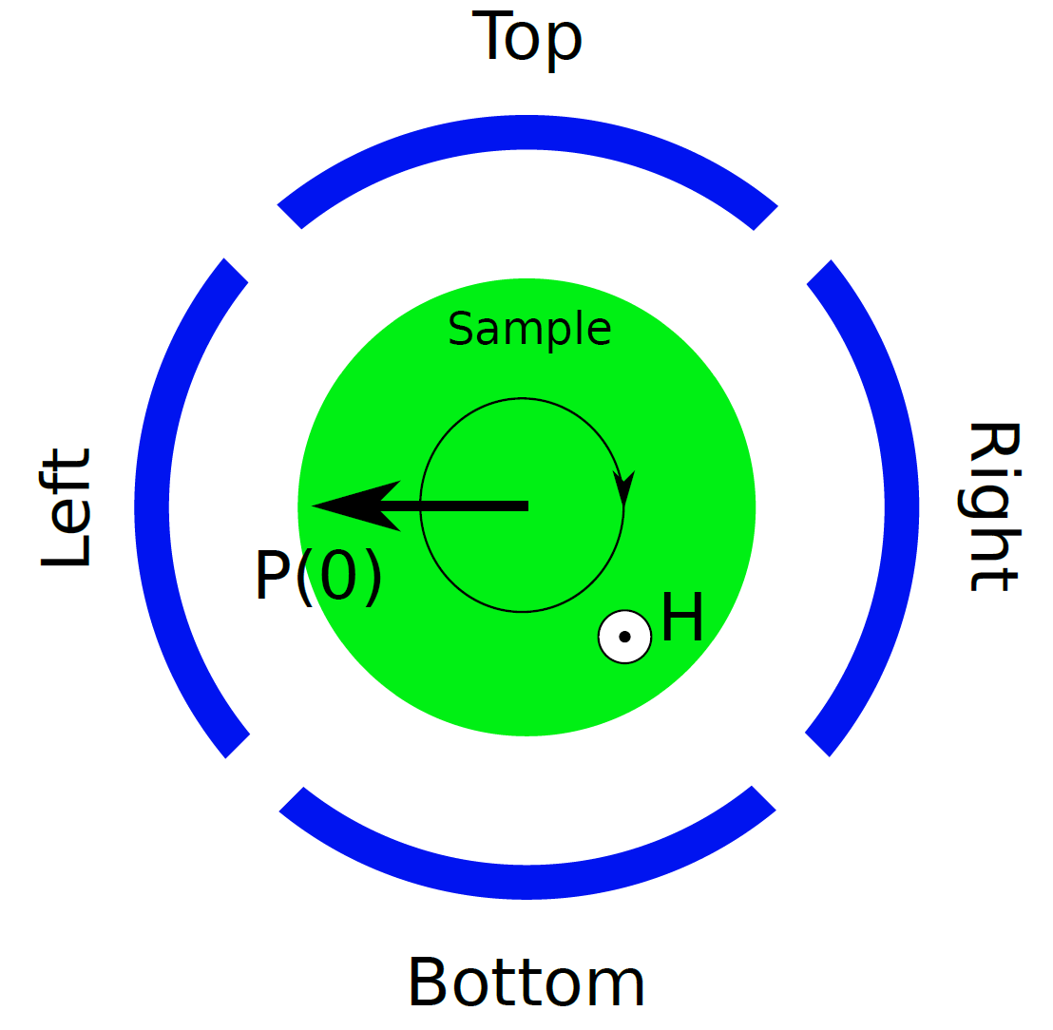
LEM experiment geometries
Side Half View
B_{par} - AEW
Downstream detectors
Upstream detectors
µ⁺ direction view
µ⁺ beam
B_{perp} - WEW
µ⁺ Spin In/Out-of-Plane WEW/AEW (TF/ZF)
B_{perp}
µ⁺ Spin anti-/parallel WEW (LF)

Slide 18
LEM experiment geometries, rates, asymmetries
Side Half View
B_{par} - AEW
Downstream detectors
LE-μSR parameter:
LEM rates (@ 2.2 mA proton current)
  WEW, ZF, TF: up to 2’600/sec, 9M/h (depending on beam transport energy)
  WEW, LF: up to 2’000/sec – 2’400/sec,7 – 8.6 M/h (depending on beam transport energy and spin direction: parallel/anti-parallel beam momentum)
  AEW, TF: up to 1’500/sec, 5.4 M/h)
Max. asymmetry:
  WEW/AEW ZF, TF: 0.24
  WEW/LF: 0.11
Upstream detectors
µ⁺ beam
B_{perp} - WEW
µ⁺ Spin In/Out-of-Plane WEW/AEW (TF/ZF)
µ⁺ Spin anti-/parallel WEW (LF)

Slide 19
Special features of low-energy μSR (LE-μSR) compared to standard μSR

Slide 20
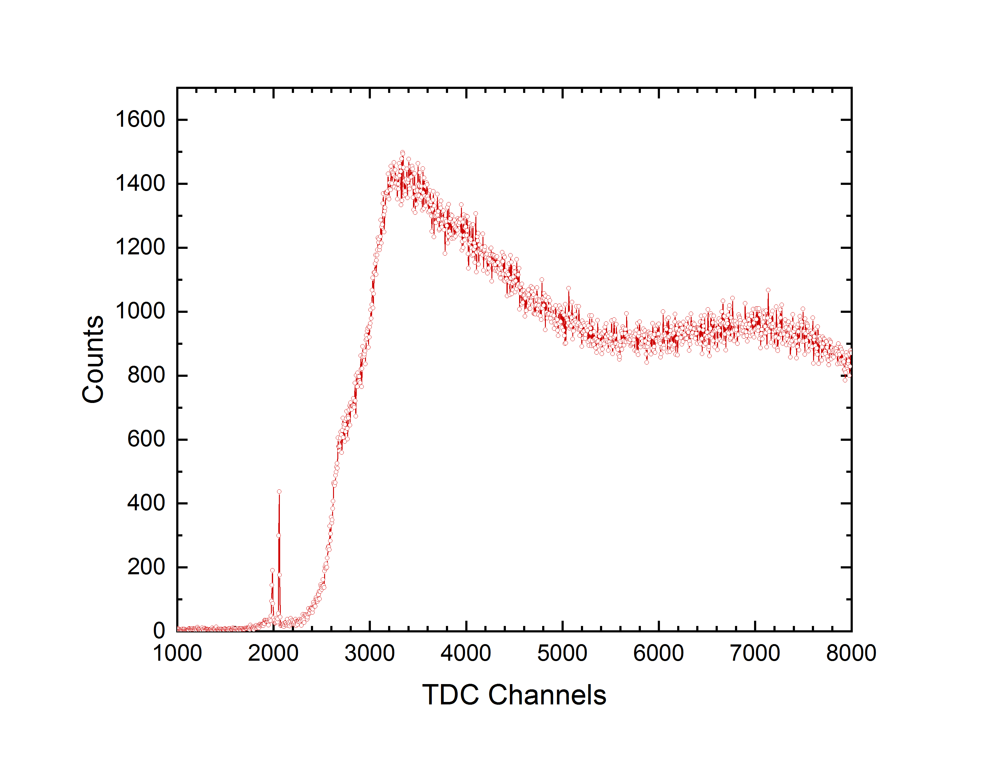
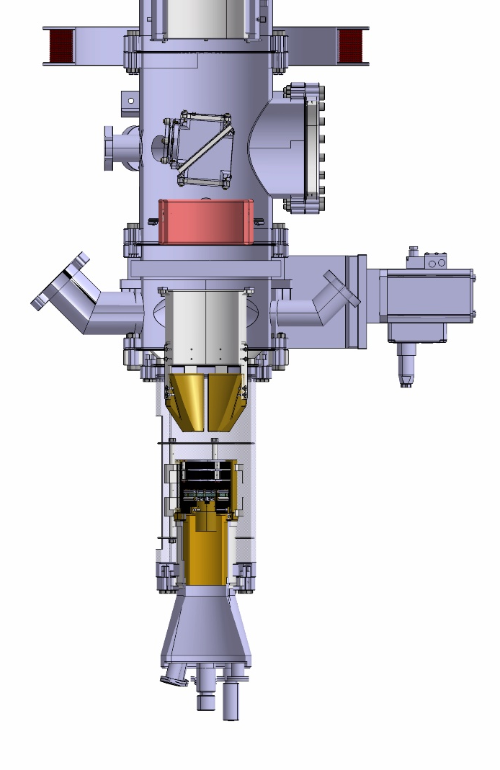
t₀ at a quasi continuous muon source – LEM
Where is the prompt peak,
and hence the t₀ TDC channel?
Trigger
or
M-Counter
?
Positron
Detector
Assembly
?

Slide 21
t₀ at a quasi continuous muon source – LEM
Where is the prompt peak,
and hence the t₀ TDC channel?
Trigger
or
M-Counter
e⁺
Positron
Detector
Assembly
Positrons
at about
the speed of light

Slide 22
t₀ at a Quasi Continuous Muon Source – LEM
Where is the prompt peak,
and hence the t₀ TDC channel?
Trigger
or
M-Counter
Mu
Mu
e⁺
Positron
Detector
Assembly
Positron

Slide 23
t₀ at a quasi continuous muon source – LEM
Trigger
or
M-Counter
Measure TOF
with an MCP
instead of Cryo
Mu
e⁺
Positron
Detector
Assembly

Slide 24
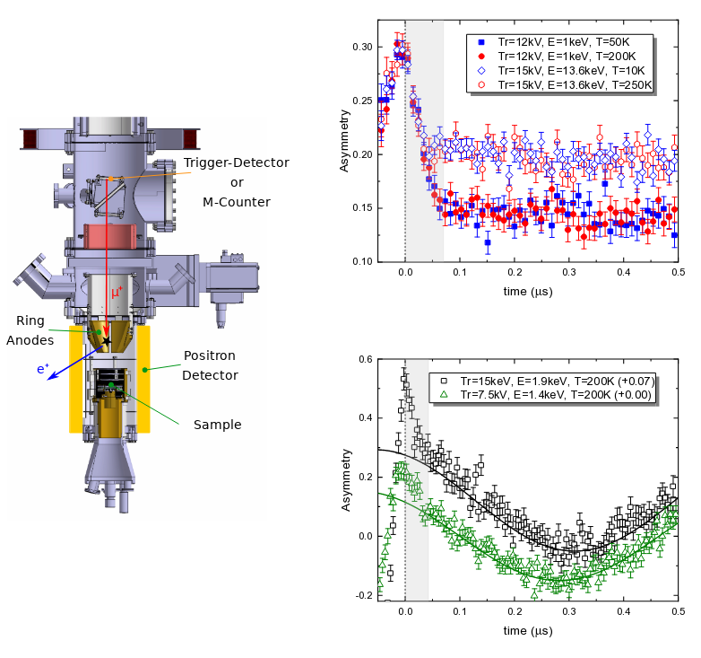
How does the beam transport affect the LE-μSR spectra?
Ag sample
Observations for different muon transport energies («Tr=7.5,12,15kV»):
The first ~70 ns are severely distorted by the time-of-flight distribution → ignore this time window when fitting LEM data!
The asymmetry at 1 keV is smaller than the asymmetry at 13.6 keV → this is due to backscattering of muons at low implantation energies, where backscattered muons form Mu
The asymmetry at 7.5 keV beam transport energy is reduced due to a higher Mu formation probability at the carbon foil of the trigger detector/M-counter
These effects – absent in standard μSR – must be taken into account when analyzing LEM data, e.g. calculating volume fractions
ZF
TF 10 mT
A. Suter et al., J. Phys.: Conf. Ser. 2462, 012011 (2023)

Slide 25
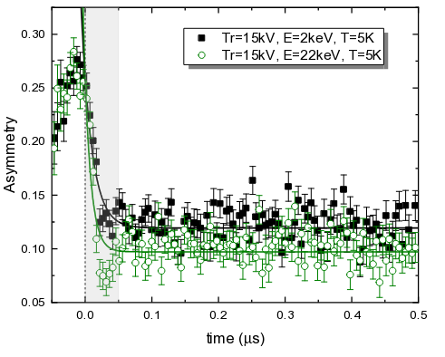
How does the beam transport affect the LE-μSR spectra?
Ag sample
Observations for different muon transport energies («Tr=7.5,12,15kV»):
The first ~70 ns are severely distorted by the time-of-flight distribution → ignore this time window when fitting LEM data!
The asymmetry at 1 keV is smaller than the asymmetry at 13.6 keV → this is due to backscattering of muons at low implantation energies, where backscattered muons form Mu
The asymmetry at 7.5 keV beam transport energy is reduced due to a higher Mu formation probability at the carbon foil of the trigger detector/M-counter
These effects – absent in standard μSR – must be taken into account when analyzing LEM data, e.g. calculating volume fractions
ZF
Ferromagnetic Ni, ZF
TF 10 mT
A. Suter et al., J. Phys.: Conf. Ser. 2462, 012011 (2023)

Slide 26
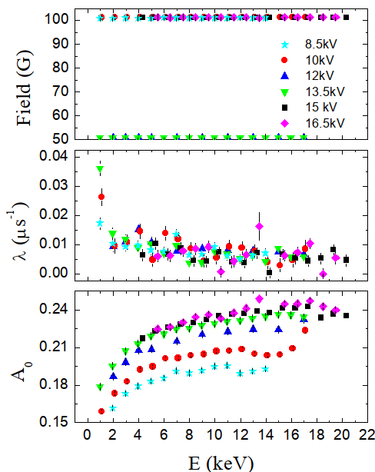
How does the beam transport affect the LE-μSR spectra?
Observations for different muon transport energies («Tr=7.5,12,15kV»):
The first ~70 ns are severely distorted by the time-of-flight distribution → ignore this time window when fitting LEM data!
The asymmetry at 1 keV is smaller than the asymmetry at 13.6 keV → this is due to backscattering of muons at low implantation energies, where backscattered muons form Mu
The asymmetry at lower beam transport energy is reduced due to a higher Mu formation probability at the carbon foil of the trigger detector/M-counter
Increase of depolarization rate below 2 keV: beam reflection!
Ag sample
Unpublished LEM data, LEM group (2023)

Slide 27
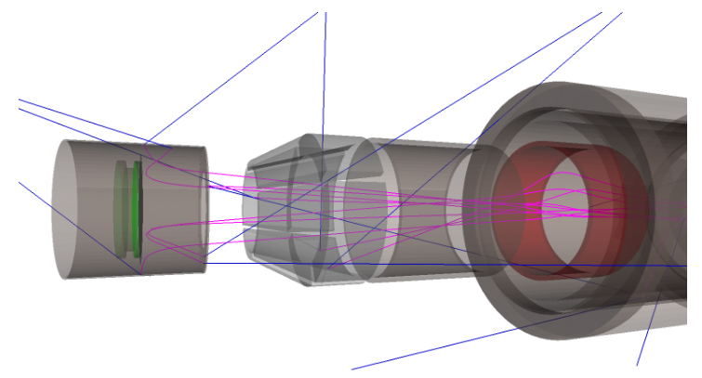
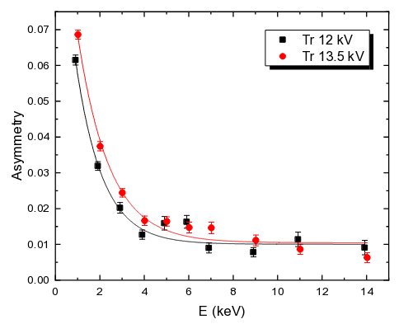
How does the beam transport affect the LE-μSR spectra?
Muon beam reflection at low implantation energies
Origin is the large, decelarating electric field in front of the sample plate, as also demonstrated by musrSim/Geant 4 simulations
In TF-μSR in a ferromagnetic Ni layer, the asymmetry increases below ~3 keV. This is due to reflected μ⁺ stopping in the non-magnetic radiation shield of the cryostat – and not due to an increase in non-magnetic volume fraction
Magenta: μ+
Blue: e+
Ferromagnetic Ni, TF 10 mT
Suter et al., J. Phys.: Conf. Ser. 2462, 012011 (2023)
musrSim: K. Sedlak et al., Phys. Proc. 30, 61 (2012)

Slide 28
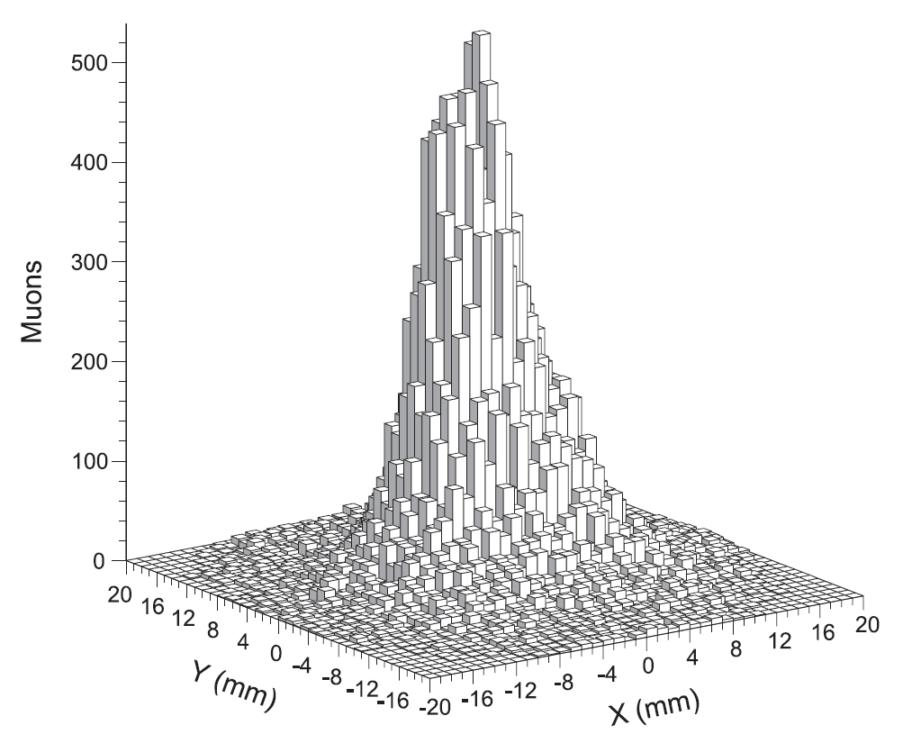
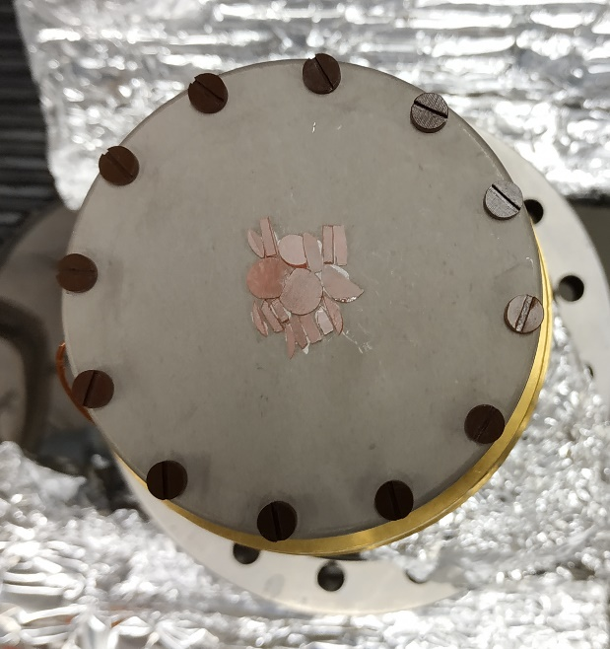
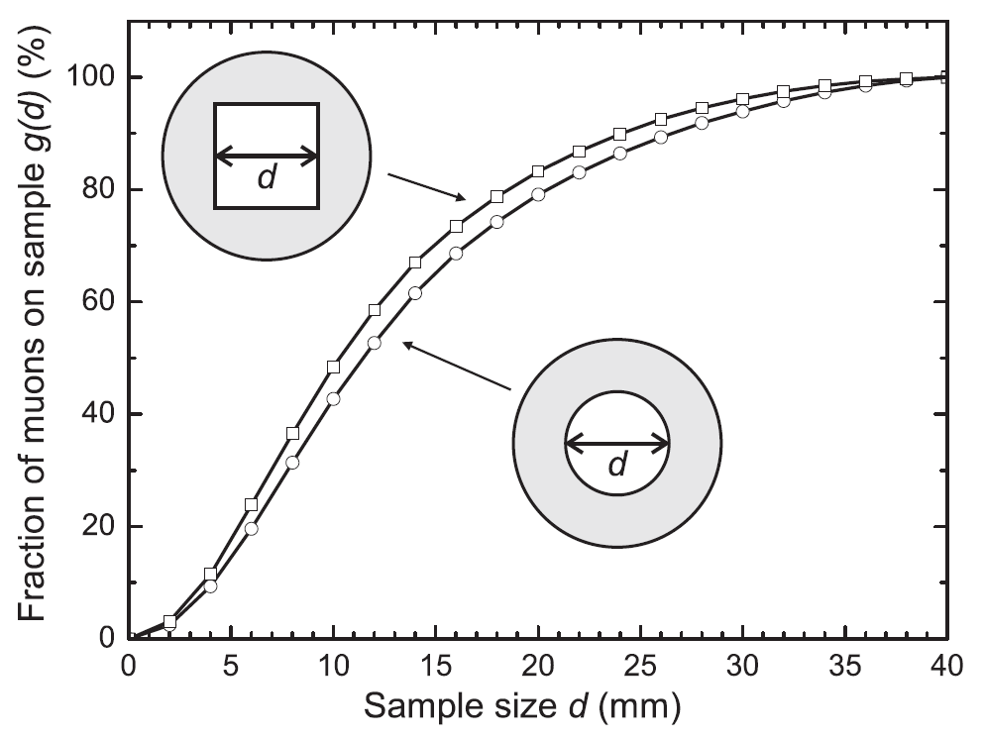
LEM – sample plates and beam spot
Sample plates:
Ag coated pure aluminum
Ni coated pure aluminum
Muon
Beam Spot
7cm
Sample size dependent
Muon fraction
How do we deal
with the background?

Slide 29
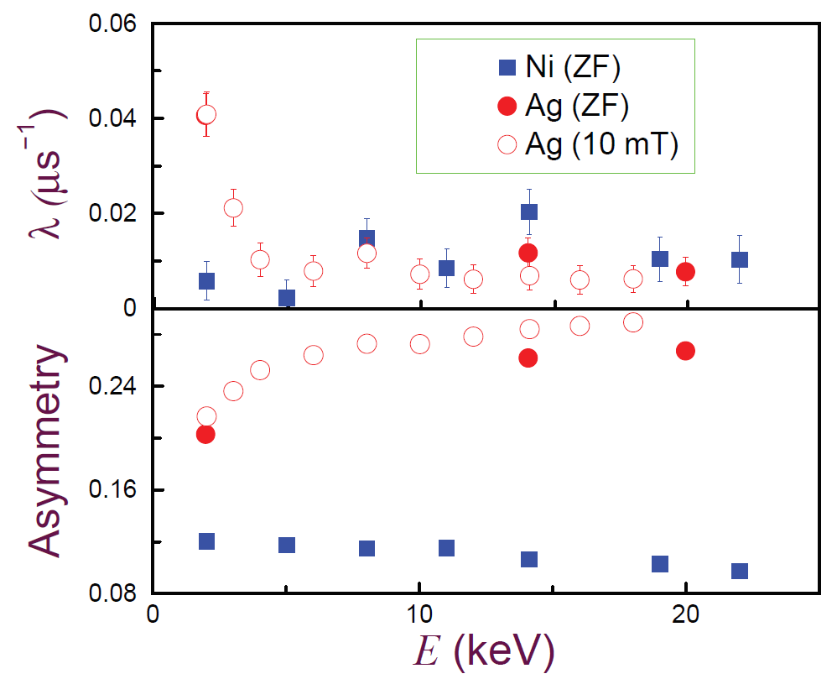
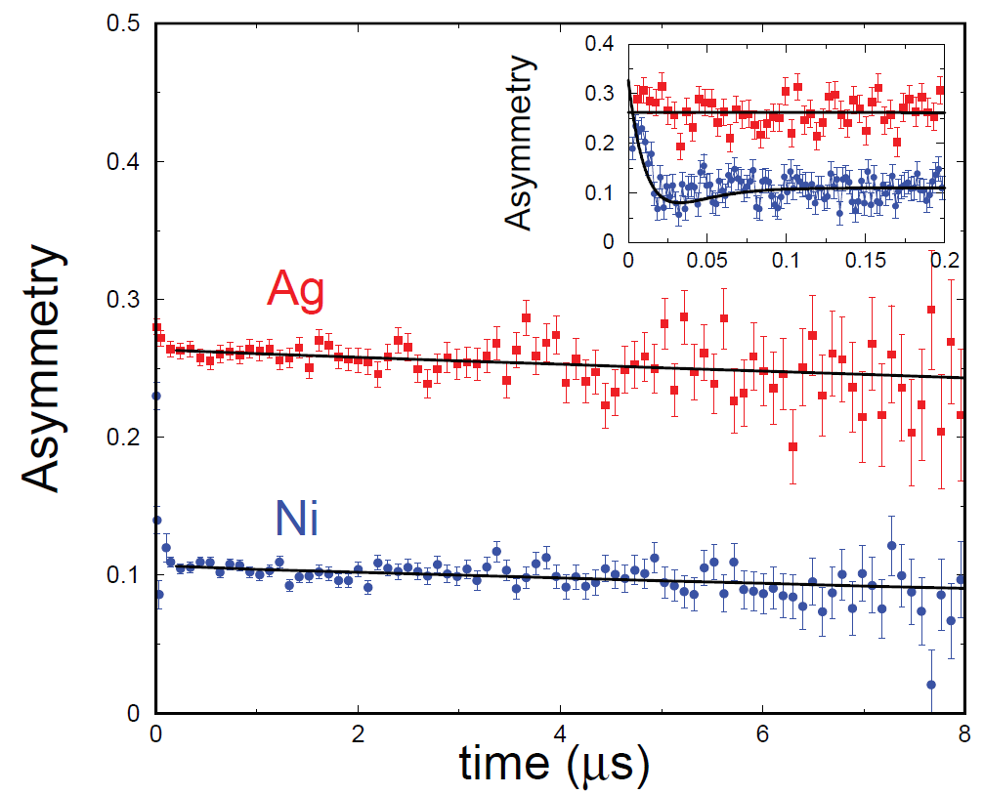
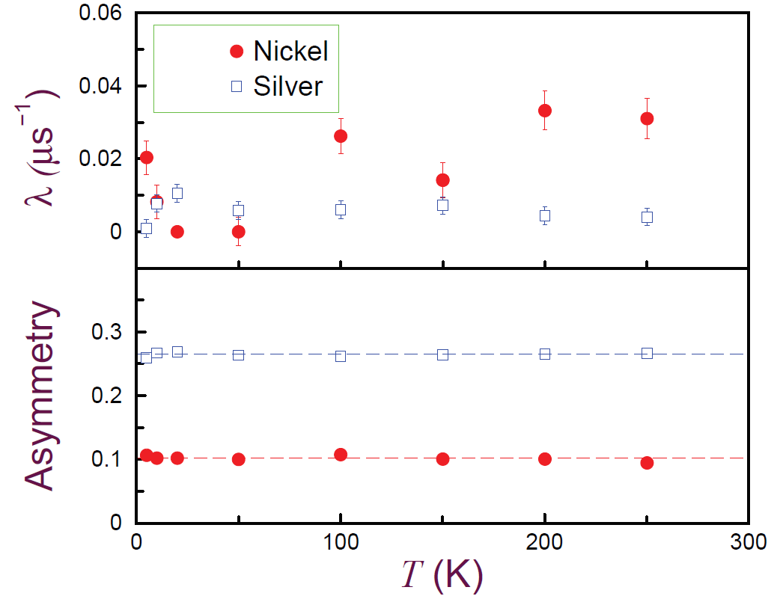
LEM – sample plates, μSR parameters
T=100K
E=14keV, T=100K
E=14keV
H. Saadaoui et al., Physics Procedia 30, 164 (2012)

Slide 30
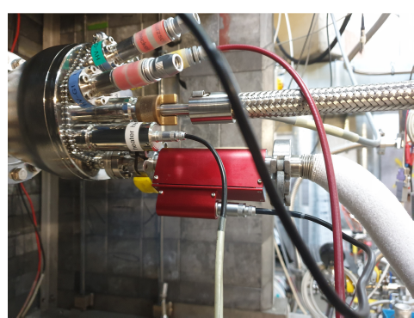
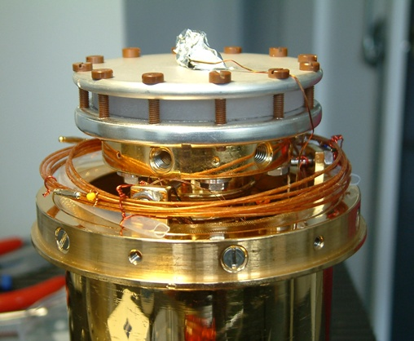
LEM cryostats – cold finger cryostats («Konti»)
Konti flow cryostats, 4 - 320 K at sample plate
Konti-1: normal operation and for special experiments
(current injection and tests)
Konti-2: normal user operation
Konti-3: normal user operation,
application of electric fields, current injection
Konti-4: normal user operation
Sample change: 2 – 3 h
Sample plate can be biased up to +/-12.5kV to adjust the muon implantation energy.
A sapphire disk is used for electric insulation and providing good thermal conductivity to the cold finger of the cryostat

Slide 31
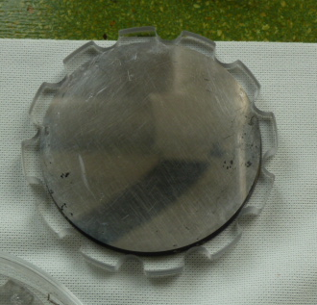
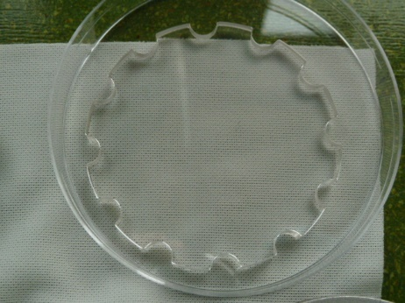
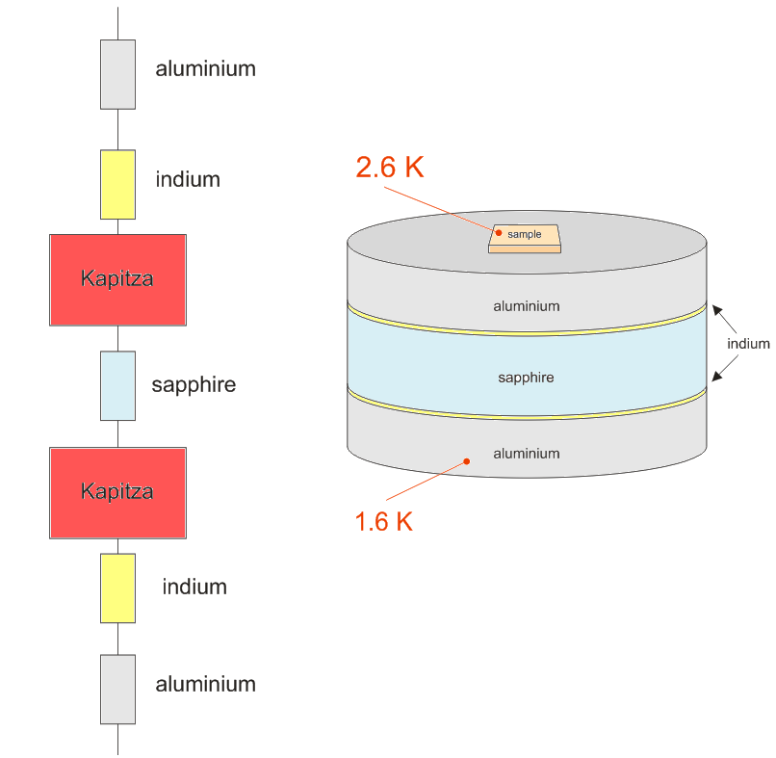
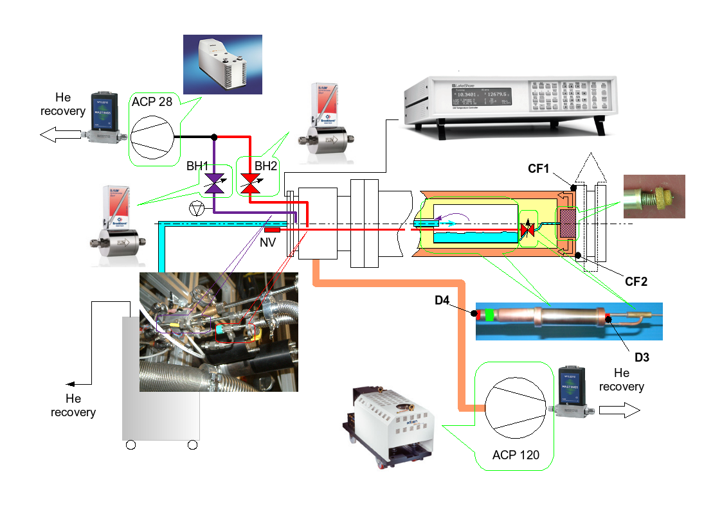

LEM cryostats – «LowTemp Cryo» with He phase separator
≈ 200 mW
2.8K
2.3K
2.1K
Sample change: 6 h

Slide 32
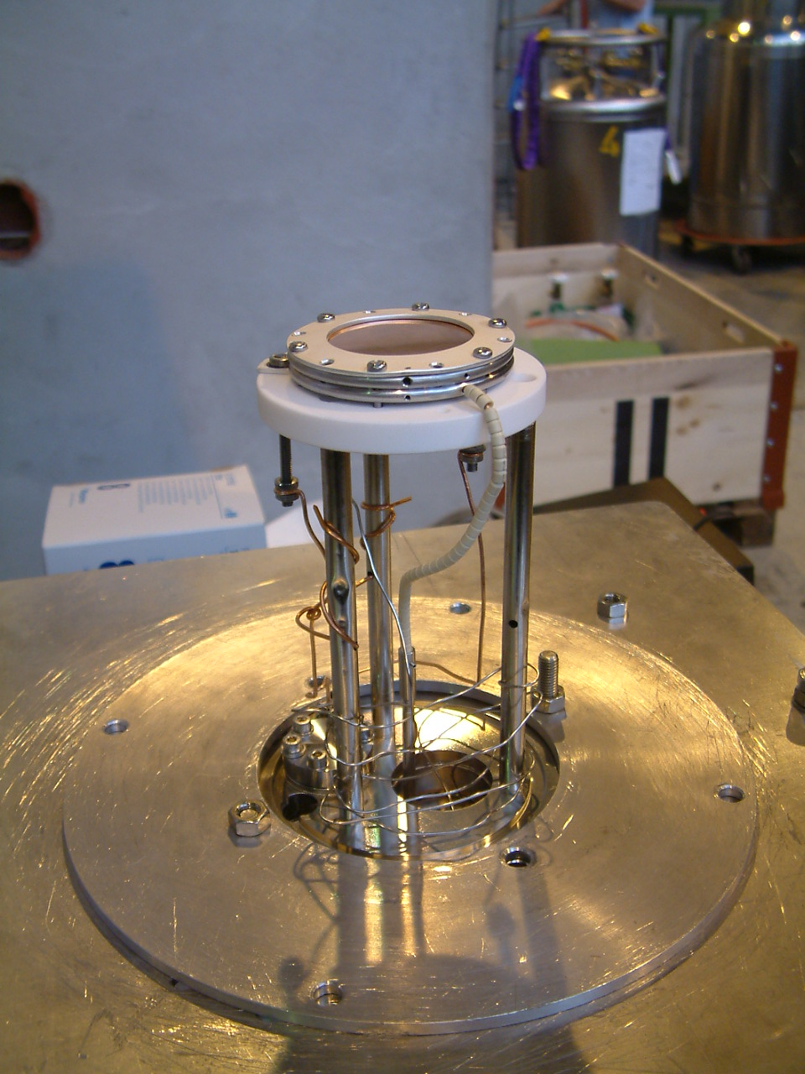

LEM – Oven
Radiation shield
missing in the picture
High voltage
lead
Macor
Boron Nitrate
heater plate
RT – 400 K with +-10 kV at sample
T > 400 high voltage might get tricky
T_{max} ~ 600 K
Sample change: 2 – 3 h

Slide 33
Implantation of low-energy μ⁺ in matter – stopping profiles

Slide 34
Different muon energies for different applications
Cu
Cosmic Muons
Bulk μSR (MeV muons):
ʻʻnormalʼʼ samples (sub-mm)
bulk samples in pressure cells or containers (e.g. liquids)
MeV muons delivered by the “secondary beam lines” connected to the proton beam (“primary beam line”) target
Low-energy μSR (LE-μSR, keV μ+):
depth-dependent investigations (≈ 5 – 300nm)
Cannot be extracted from the proton beam target
Needs an efficient conversion (“moderation”) of MeV muons to keV muons, “tertiary beam line” of keV muons
Strategy: Convert MeV muons to thermal (meV) or epithermal (eV) energies and re-accelerate up to 30 keV
Decay Beam
Bulk µSR
Surface Beam
LE-µSR

Slide 35







Particles Stopping in Matter
Energy loss of particles in matter:
Stopping Power
Bethe-Bloch
W. Eckstein, “Computer Simulation of Ion-Solid Interactions”, Springer (1991).
J.F. Ziegler, J.P. Biersack, M.D. Ziegler, “SRIM - The Stopping and Range of Ions in Matter”, Lulu Press Co.

Slide 36

Low-energy µ⁺ stopping profiles
nm
200
Calculated by the Monte Carlo code TRIM.SP
Range
150
Variance
100
YBa₂Cu₃O₇
50
0
0
5
10
15
20
25
30
35
Energy [keV]
YBa₂Cu₃O₇
TRIM.SP: W. Eckstein “Computer Simulation of Ion-Solid Interactions”, Springer (1991)

Slide 37


TRIM.SP, SRIM – check Monte Carlo Codes
Idea:
Experimental fact: in fused quartz implanted µ⁺ form
almost 100% muonium, Mu, at almost all implantation
energies.
Grow sample on SiO₂, and do the following:
E. Morenzoni et al., NIM B 192, 254 (2002).

Slide 38



TRIM.SP, SRIM – check Monte Carlo Codes
TRIM.SP
E. Morenzoni et al., NIM B 192, 254 (2002).

Slide 39
Applications of LE-μSR: thin films and interfaces
Superconducting and magnetic properties at surfaces and interfaces:
Meissner screening, proximity effects, volume fractions

Slide 40

Magnetic field profile in a superconductor
Direct, absolute measurement of
magnetic penetration depth λ
effective mass
density of supercarriers
ξ(T=0) = ħv_{f}/[πΔ(T=0)]
Direct test of theories (London, BCS)
B(z)
Determination of the coherence length ξ („size of Cooper pairs), and magnetic penetration depth λ; κ=λ/ξ (Ginzburg-Landau parameter)
Local, non-local response: local if κ >~ 1.4; if local: field profile is exponential: B(z) = B₀ exp(-z/λ)
Direct determination of temperature dependence of SC order parameter n_{s}(T) ~ 1/λ(T)²
nonlocal
local
z
Notes:
40

Slide 41

First direct study of 1D field profile by LE-μSR
A superconductor expels a magnetic field from its interior (“Meissner effect”)
July-05 2010
page 41
Notes:
41

Slide 42



In-plane anisotropy in detwinned YBa₂Cu₃O_{6.92}
samples produced by R. Liang, W. Hardy, D. Bonn, Univ. of British Columbia;
Mosaic of samples glued onto the Ni coated sample plate of the LEM cryostat.
effective mass
density of super carriers
1/λ² ~ n_{s}/m* ≡ ρ_{s}, superfluid density
T-dependence: symmetry of the SC gap
Notes:
42

Slide 43







Detwinned YBa₂Cu₃O_{6.92}, T_{c} = 94 K, B = 9.47 mT
100 K
8 K
8 K
at low T for a d-wave SC:
(ρ(z): muon stopping profile)
λ_{a} = 126(1.2)nm, λ_{b} = 105.5(1.0) nm, λ_{a}/λ_{b} = 1.19(1)
R.F. Kiefl et al, Phys. Rev. B81, 180502(R), (2010)
page 43
Notes:
43

Slide 44



Two methods to determine field profile B(z)
i) If parametrization of B(z) is known: Directly fit μSR asymmetry A(t) with the proper function [Eq. (2)].
ii) B(z) can be determined without knowledge of its functional form: Fourier-transform of A(t) to obtain μSR field distribution p(B,E) as a function of implantation energy E. For low-statistics data: use a Maximum-Entropy analysis to determine p(B,E). The following procedure works for monotonous B(z).
A(t)
n(z,E): muon stopping distribution at implantation
energy E.
(ρ(z): muon stopping profile)
R.F. Kiefl et al, Phys.Rev. B81, 180502(R), (2010).
A. Suter et al., Phys. Rev. B72, 024506 (2005).
Notes:
44

Slide 45


1st direct observation of non-local effects in Pb (κ~0.6)
Pb, 5.2 keV, 3.05 K; B(z) determined by using Eq. (13) from previous slide.
Exponential B(z) (local response); data clearly
deviate from exponential → non-local effect!!
A. Suter et al., Physical Review B72, 024506 (2005).
Notes:
45

Slide 46
Magnetic field profiles in Pb and YBa₂Cu₃O_{7-δ}
κ = λ₀/ξ₀ ~ 90
κ = λ₀/ξ₀ ~ 0.6
Non-local: non-exponential
local: exponential
1st experimental determination of ξ₀ in a non-local superconductor; confirmation of some predictions of BCS (~50 years after theory!!)
T.J. Jackson et al., Phys. Rev. Lett. 84, 4958 (2000).
A. Suter et al., Phys. Rev. Lett. 92, 087001 (2004).
A. Suter et al., Phys. Rev. B72, 024506 (2005).
Notes:
46

Slide 47


LE-μSR study of interface/proximity effects
Observation of Anomalous Meissner Screening in Cu/Nb and Cu/Nb/Co Thin films
M.G. Flokstra et al., Phys. Rev. Lett. 120, 247001 (2018)
Measure local magnetic field as function of energy/depth below and above T_{c}
Meissner screening at T < T_{c}
Normal metal (Cu) exhibits a Meissner effect when in contact with a superconductor (Nb):
results confirmed by theoretical calculations
Using LE-μSR an unexpected effect is found when adding a ferromagnetic (Co) layer: the enhancement of the Meissner effect in the non-magnetic Cu layer separated from the ferromagnetic layer by the 50-nm-thick Nb layer
S(II): Nb layer with higher purity Nb than S(I)
NS(II): Cu/Nb layer with higher purity Nb
NSF(I): Cu/Nb/Co layer with lower purity Nb
NSF(II): Cu/Nb/Co layer with higher purity Nb

Slide 48


LE-μSR study of interface/proximity effects
Manifestation of the electromagnetic proximity effect in superconductor-ferromagnet thin film structures
M.G. Flokstra et al., Appl. Phys. Lett. 115, 072602 (2019)
Unexpected results: largest flux expulsion observed when a 2.4 nm FM Co layer is added
The new, «electromagnetic proximity effect» is the origin of the enhanced flux expulsion: screening response of the SC to a vector potential near the SC/FM interface (A.F. Volkov et al., PRB 99, 144506 (2019))
Observed cooperation of SC and FM could be a key ingredient for superconducting spintronics

Slide 49


LE-μSR study of interface/proximity effects
Proximity-Induced Odd-Frequency Superconductivity in a Topological Superconductor
J.A. Krieger et al., Phys. Rev. Lett. 125, 026802 (2020)
Field enhancement in TI, «paramagnetic Meissner effect» arising from an odd-frequency SC state in the TI
1st observation of bulk odd-frequency SC in a TI
Paramagnetic Meissner effect in Au/Ho/Nb: A. Di Bernardo et al., PRX 5, 041021 (2015)

Slide 50

LE-μSR study of interface/proximity effects
Do topology and ferromagnetism cooperate at the EuS/Bi₂Se₃ interface?
J.A. Krieger et al., Phys. Rev. B 99, 064423 (2019)
unique combination of ARPES/DFT (electonic structure at interface) and LE-μSR (local magnetic properties)
comparison between EuS/Bi₂Se₃ and EuS/Ti on sapphire: observed local magnetic properties independent of topology and the electronic structure at the interface
No need to introduce interplay between topology and FM at the interface

Slide 51

LE-μSR: AFM order in ultra-thin LaNiO₃
Dimensionality Control of Electronic Phase Transitions in Nickel-Oxide Superlattices
A.V. Boris et al., Science 332, 937 (2011)
Transition metal oxides AMO₃ with perovskite structure have attracted wide-spread interest:
- Wide range of functionalities originating from interplay between lattice, electronic, and magnetic degrees of freedom
- Rare-earth nickelates RNO₃ are a prototypical case with great potential for engineering novel electronic and magnetic states
- LaNiO₃ paramagnetic metal down to lowest temperatures; all others show a MI transition, accompanied by a PM-AFM transition
Phase diagram of RNO₃, from J. Fowlie et al., PSI proposal 20190133.

Slide 52

LE-μSR: AFM order in ultra-thin LaNiO₃
Dimensionality Control of Electronic Phase Transitions in Nickel-Oxide Superlattices
A.V. Boris et al., Science 332, 937 (2011)
Superlattices (SL) of (LaNiO₃)_{N}/(LaAlO₃)_{N} with N=2 u.c. and N=4 u.c. were grown by PLD on LSAO and STO substrates (compressive and tensile strain), total SL thickness of 100 nm.
Spectral ellipsometry: dielectric permittivity for N=2 u.c. and N=4 u.c. LaNiO₃ on different substrates, showing a MI transition at 160 K (C) and 110 K (D) for N=2 u.c., but not for N=4 u.c. which remains metallic.
Expect a PM-AFM transition for the N=2 u.c. sample. But how to detect AFM order in such a thin SL?
Use LE-μ⁺SR!
T_{MI}
T_{MI}

Slide 53

LE-μSR: AFM order in ultra-thin LaNiO₃
Dimensionality Control of Electronic Phase Transitions in Nickel-Oxide Superlattices
A.V. Boris et al., Science 332, 937 (2011)
Time evolution of zero-field μSR Polarization (A) and transverse field precession amplitude (C ) with LSAO substrate:
Development of static AFM state at T < 50 K for the N=2 u.c. sample.
In agreement with the expectation: MI transition is related to a PM-AFM transition.

Slide 54


LE-μSR: AFM order in ultra-thin LaNiO₃
Dimensionality Control of Electronic Phase Transitions in Nickel-Oxide Superlattices
A.V. Boris et al., Science 332, 937 (2011)
Competition between collective quantum phases in strongly correlated electron systems depends sensitively on dimensionality, which is difficult to control by standard solid-state chemistry
Metal-oxide superlattices allow the control of the dimensionality and collective phase behavior of correlated electron systems
Magnetic volume fraction f_{m} and dielectric permittivity ε₁* showing the MI and AFM transition temperatures T_{MI} and T_{N} (tensile strain (SrTiO₃) and compressive strain (LaSrAlO₄)).

Slide 55


LE-μSR: nanometer-scale magnetic homogeneity
Evidence for the homogeneous FM phase in (Ga,Mn)(Bi,As) epitaxial layers from μSR
K. Levchenko et al., Scientific Reports 9, 3394 (2019)
Spintronics: magneto-resistive devices, based on planar Hall effect (PHE), can be made of DFS (Ga,Mn)As
Adding Bi, (Ga,Mn)(Bi,As), enhances magneto-transport effects due to strong enhancement of spin-orbit coupling
Practical limitations may arise if the system is inhomogeneous:
use LE-μ⁺SR to test magnetic homogeneity
Notes:
55

Slide 56




LE-μSR: nanometer-scale magnetic homogeneity
Evidence for the homogeneous FM phase in (Ga,Mn)(Bi,As) epitaxial layers from μSR
K. Levchenko et al., Scientific Reports 9, 3394 (2019)
Notes:
56

Slide 57



LE-μSR: nanometer-scale magnetic homogeneity
Evidence for the homogeneous FM phase in (Ga,Mn)(Bi,As) epitaxial layers from μSR
K. Levchenko et al., Scientific Reports 9, 3394 (2019)
LE-μSR shows:
Long-range FM order develops below T_{C} in full volume fraction
Weak magnetic stray fields in the substrate indicates single domain FM phase with low interface roughness (<~ 2nm)
A.J. Drew et al, Nature Materials 8, 109 (2009)
Notes:
57

Slide 58



LE-μSR: magnetic transition in multiferroics under strain
Engineering the magnetic order in epitaxially strained Sr_{1-x}Ba_{x}MnO₃ perovskite thin films
L. Maurel et al., APL Materials 7, 041117 (2019)
FIG. 2. Temperature dependence of the transverse fraction fT^{TF} of the muons normalized to the fraction at 300 K, determined from LE-μSR measurements for 10-nm-thick Sr1-xBaxMnO3 films on (a) LSAT and (b) TSO. The arrows indicate the magnetic order temperature.
Notes:
58

Slide 59
Summary
The low-energy muon facility with LE-μSR is the most complex experimental setup for μSR studies
Apparatus/experimental effects at low implantation energies makes analysis of μSR data more complicated than «standard» μSR data
  Time-of-flight distribution to the sample distorting the first 70 ns of μSR spectra, energy dependence of asymmetry, contribution of reflected muons below 3 keV
  Muon stopping distribution
Unique experimental capabilities in measuring magnetic field profiles in superconductors and superconductor heterostructures with 2-3 nm depth resolution, proximity effects, homogeneity of magnetic order in thin layers and heterostructures, dimensional effects

Slide 60

Muon Spin Spectroscopy School 2026, Jan 14 – 21
Jointly organised by PSI, ISIS, KTH
Thank you for your attention!

Slide 61
Appendix
Depth profiling of defect regions with nm resolution at technologically relevant semiconductor interfaces (MOSFETs, solar cells)

Slide 62
Why to use μ⁺ to measure defect profiles at SC interfaces?
Defects and structural changes at semiconductor interfaces are of fundamental importance for the performance of semiconductor devices. SiC-based MOSFET fabrication, for example, requires oxidation, ion-implantation and other processes creating defects in the device structure.
Standard characterization methods (DLTS, CV, IV, PL) for the investigation of process-induced defects have limited depth resolution (>100 nm) of the defect profiles close to interfaces. ARPES, TEM and EELS show large spread of data from nm to tens of nm.
Defect profile information on the nm scale is essential to better understand the relation between defects and limitations in device performance.
Low-energy muon spin rotation (LE-μ⁺SR, 1 – 30 keV, mean implantation depths 5 – 200 nm) is a powerful tool to study defect distributions with nm depth resolution.
Here: study the effect of defects in proton-irradiated Si and 4H-SiC on the formation of hydrogen-like muonium states, and apply the technique to SiO₂/Si, SiO₂/SiC interfaces and solar cell materials (CIGS).

Slide 63




Muonium complexes in Si and 4H-SiC
Si
4H-SiC
B.D. Patterson, Rev. Mod. Phys. 60, 69 (1988)
HAL-9500, PSI 2022
R. L. Lichti et al.,
Phys. Rev. B 70, 165204 (2004)
$${Mu}_{BC}^{0},{Mu}_{BC}^{+}$$
$${Mu}_{T}^{0},{Mu}_{T}^{−}$$
T
BC
T=30 K
E=15.4 keV
0.15 T
${Mu}_{1}^{0}$in AB to Si(k), ${Mu}_{}^{−}$
${Mu}_{2}^{0}$ at AB_{C}, ${Mu}_{}^{+}$
R. L. Lichti, et al., Phys. Rev. B 70, 165204 (2004)
M. E. Bathen, et al., J. Appl. Phys. 127, 085701 (2020)
Notes:
In Si, we will focus on the BC state. MuBC0 ionizes a
In 4H-SiC: Mu0 in AB to Si(k)
Which is also likely to be acceptor.

Slide 64



LE-µSR study of defects in Si (n ̴5×10¹¹ cm⁻³)
10 keV protons
10-keV proton profiles (circles) and muon stopping profiles.
4H-SiC annealed at 1150ºC after irradiation (mainly V_{C} left).
Defects ↑: A_{D} & F_{D}=A_{D}/(A_{D}+A_{Mu})↑
A_{MuBC} & A_{MuT} ↓
Identification of defect regions in Si
J. Woerle, et al., Physical Review B 100, 115202 (2019)
J. Woerle, et al., Physical Review Applied 14, 054053 (2020)
Notes:
Mu- formation
mention SIO2 side: defects

Slide 65



LE-µSR study of defects in 4H-SiC (n ̴3×10¹⁵ cm⁻³)
Carbon vacancies ↑ , A_{D} ↑
[V_{C}] > 1×10¹⁷ cm⁻³
µ+ trapping in V_{C} followed by double electron capture to form Mu⁻.
Silicon vacancies ↑ , A_{D} ↓
[V_{Si}] > 3×10¹⁴ cm⁻³
V_{Si} – Mu is energetically more favorable than isolated V_{Si}.
«Muons can distinguish V_{C} and V_{Si}»
J. Woerle, et al., Physical Review B 100, 115202 (2019)
J. Woerle, et al., Physical Review Applied 14, 054053 (2020)
Notes:
Mu- formation
mention SIO2 side: defects

Slide 66

Analysis of SiO₂/Si (n ̴5×10¹⁶ cm⁻³) interface
Model of the depth variation of the muon signal in the SiO₂/Si system obtained from the measured energy dependence.
The muon signal (diamagnetic fraction and paramagnetic fraction, F_{D}, F_{Mu}) is sensitive to the presence of free carriers and defects.
Deposited oxide (PECVD) (300ºC) on Si:
Deposition of oxide results in a sharp interface.
Deposited oxide is defect-rich.
Thermal oxidation (1050ºC) of Si leads to:
Defect-rich/strained region ( ̴20 nm) on SiO₂ side.
5 – 10 nm defective region in Si, or electron accumulation at the interface (Mu⁻ formation).
D_{it} ̴10¹² cm⁻² eV⁻¹.
Mu_{BC}⁺
Mu_{BC}⁰
Si-C: Si-B, HF, PECVD
M. Mendes Martins, et al., Adv. Mater. Interfaces 10, 2300209 (2023)
M. Mendes Martins, et al., J. Phys.: Conf. Ser. 2462, 012025 (2023)
A.F.A. Simões, et al., Rev. Sci. Instr. 91, 023906 (2019)

Slide 67

Analysis of SiO₂/4H-SiC interface
4H-SiC Si-face, epi-layer (n ̴8×10¹⁵ cm⁻³)
4H-SiC C-face: (n ̴10¹⁹ cm⁻³)
PECVD of SiO₂ and thermal oxidation (1050ºC) of 4H-SiC lead to:
SiC-A: D_{it} ~1×10¹² cm⁻² eV⁻¹, SiC-B: D_{it} ~8×10¹² cm⁻² eV⁻¹.
Si-face: more defects and oxidation induced strain in 20 nm of SiO₂, 5 nm defective region in SiC.
Si-face: higher e⁻ concentration from interface traps cause disappearance of F_{Mu} in SiC-B.
C-face: defect rich region in 10 nm of SiO₂. 30 nm defective region in SiC, formation of C-rich layer during oxidization, which persists after removal of SiO₂.
C-face: thermal growth of oxide results in a layer with more structural disorder, not suitable for device applications
M. Mendes Martins, et al., Adv. Mater. Interfaces 10, 2300209 (2023)

Slide 68
Analysis of SiO₂/4H-SiC (n~10¹⁹ cm⁻³) interface, C-face
SiC-D = SiC-C, HF, PECVD
C-face: defect rich region in 10 nm of SiO₂. 30 nm defective region in SiC, formation of C-rich layer during oxidization, which persists after removal of SiO₂.
C-face: thermal growth of oxide results in a layer with more structural disorder, not suitable for device applications
Diamagnetic Fraction
Muon implantation energy (keV)
Muon implantation energy (keV)
Deposited
Diamagnetic Fraction
Depth (nm)
Depth (nm)
M. Mendes Martins, et al., Adv. Mater. Interfaces 10, 2300209 (2023)

Slide 69





LE-µSR study of annealing effects at the SiO₂/4H-SiC interface
4H-SiC n ̴3×10¹⁵ cm⁻³
Defects created in SiO₂ increase A_{D}
In SiC:
A_{D} ↑ due to Mu⁻ formation, n ≳ 1×10¹⁶ cm⁻³ and passivation of V_{si}
A_{D} ↓ due to presence of V_{si} (Ar1300)
Annealing in NO at 1300℃ introduces N which acts as donor, and which passivates V_{Si}: A_{D} ↑
P. Kumar, et al., Phys. Rev. Applied 19, 054025 (2023)
Notes:
Mu- formation
mention SIO2 side: defects

Slide 70




Interfacial defect layers in CIGS solar cells
Near interface, lattice distortions appear in a ~50-nm wide region due to long-range strain fields caused by defects
Defects increase barrier height → F_{D} ↓
Passivation of defects by buffer layers is crucial for device performance/efficiency
LE-μSR measurements allow quantification of defect passivation effect of various buffer layers
H.V. Alberto, et al., Adv. Mater. Interfaces 9, 2200374 (2022)
Notes:
Mu- formation
mention SIO2 side: defects

