Slide 1
Muons at extreme conditions: pressure
Rustem Khasanov
Rigi Kaltbad, 16 January 2025

Slide 2
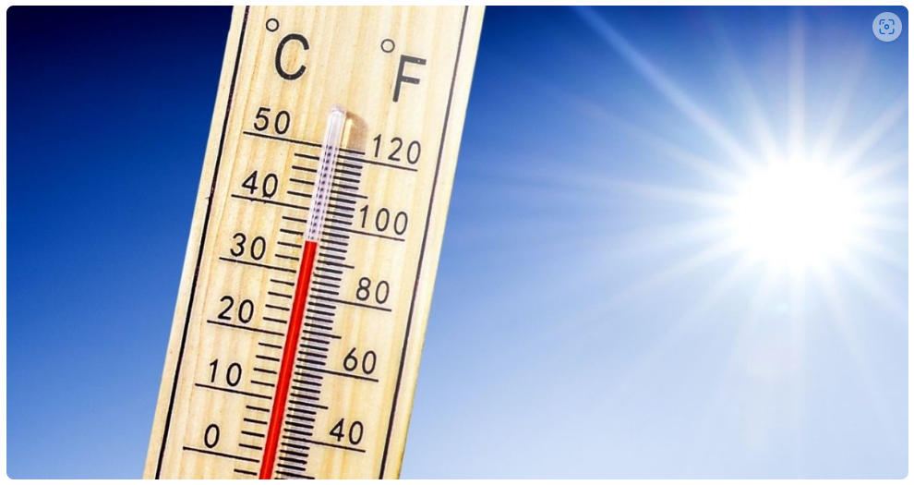
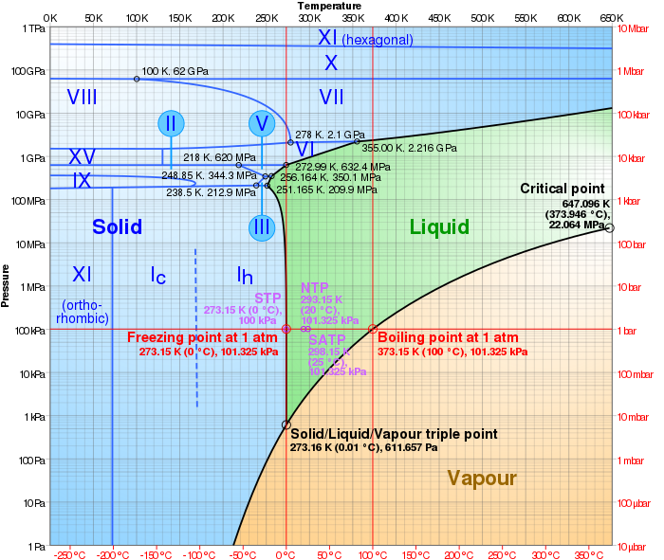
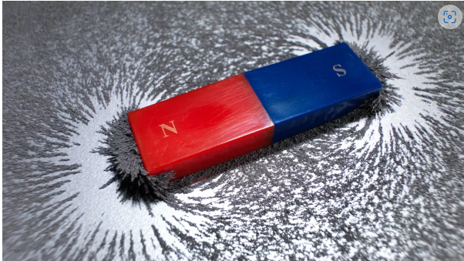
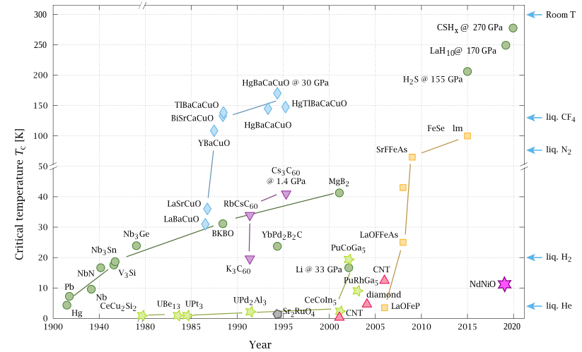
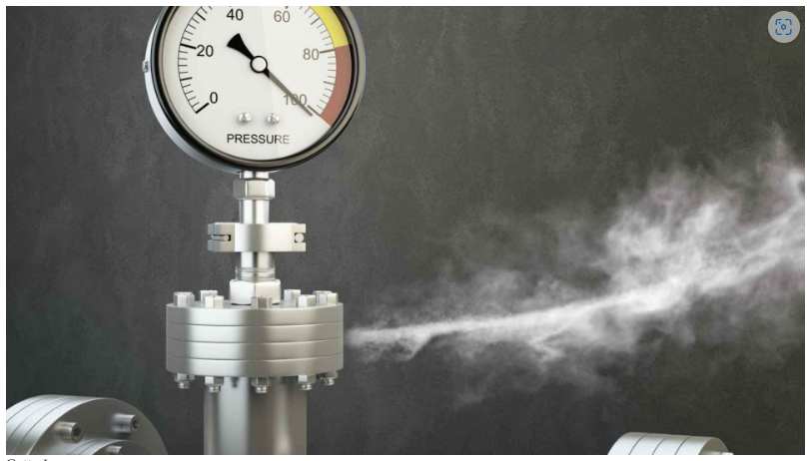
Common tuning parameters
P-T phase diagram of water
T
B
P
Room temperature superconductivity
Wikipedia

Slide 3
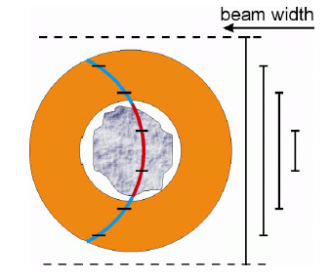
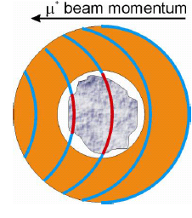
Principle of μSR under pressure experiments
Muon momentum tuning
Beam-width tuning
Courtesy of Daniel Andreica

Slide 4
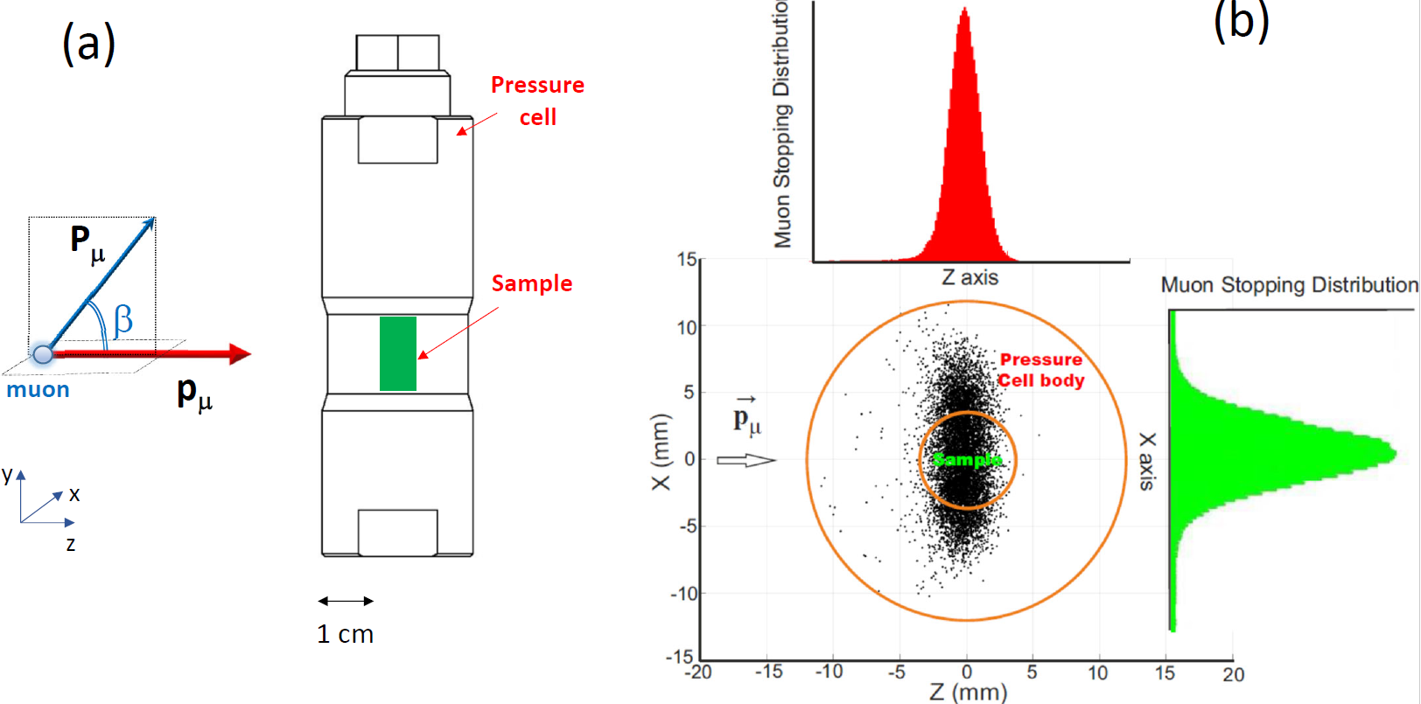
μSR under pressure: basic principles
Khasanov JAP, 132, 190903 (2022)

Slide 5
μSR under pressure
1. Muon beam-line – fast muons with tunable energy
2. μSR Spectrometer
3. μSR pressure cells

Slide 6
μSR under pressure
1. Muon beam-line – fast muons with tunable energy
2. μSR Spectrometer
3. μSR pressure cells

Slide 7
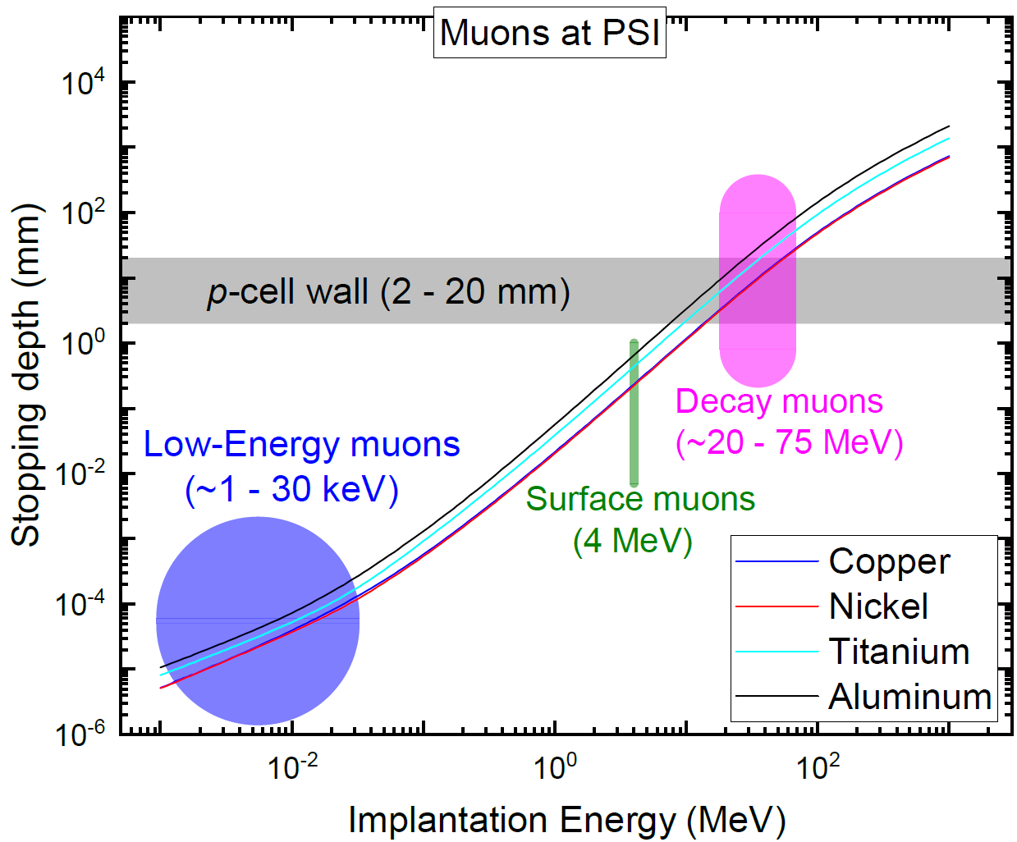
Muon beam

Slide 8
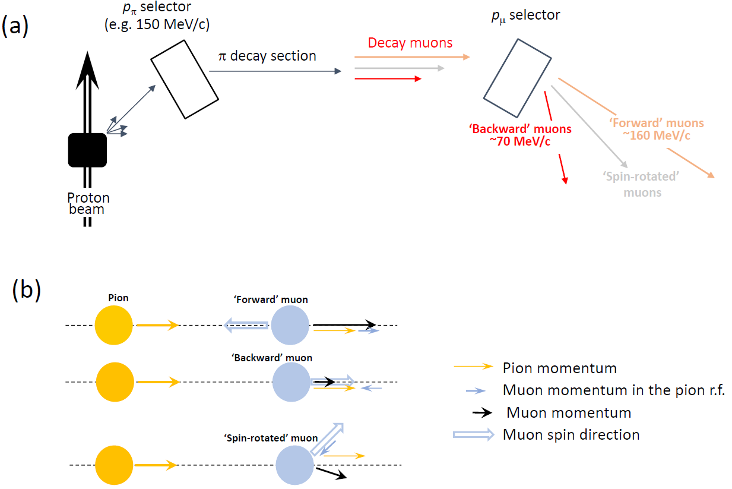
Decay muon beam-line

Slide 9
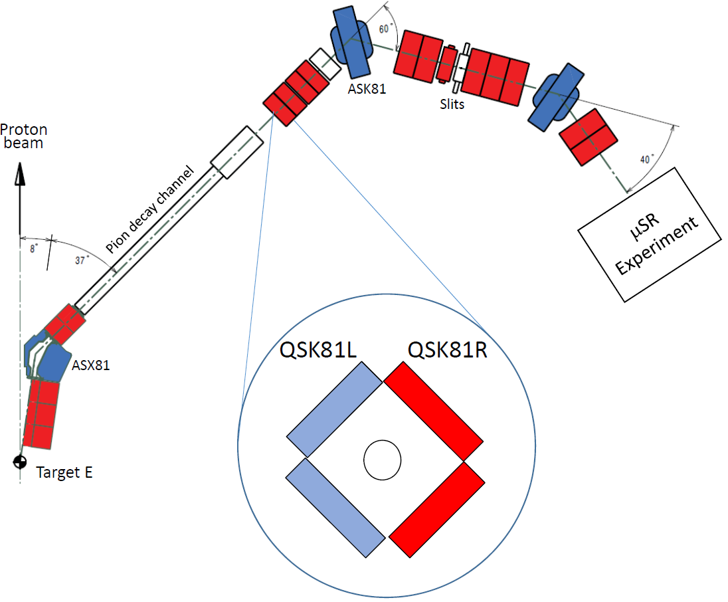
μE1 decay beam-line at PSI
Momentum acceptance (FWHM) 3%
Pion momentum range [MeV/c] 200--125
Muon momentum range [MeV/c] 125– 60
Rate of positive muon [mA⁻¹s⁻¹] 3x10⁷—6x10⁷
Spot size (FWHM) 39 x 28 mm
The use of the spllited Quadrupolar magnet (QSK81) allows to collect muons with turned spins. This a unique possibility which is accessible for decay muon beam-lines only.

Slide 10
Asymmetrically driven quadrupole
F_{L}
F_{L}
F_{L}
F_{L}

Slide 11
μSR under pressure
1. Muon beam-line – fast muons with tunable energy
2. μSR Spectrometer
3. μSR pressure cells

Slide 12
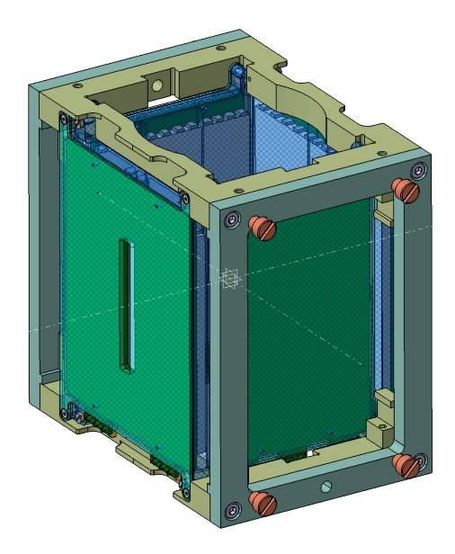
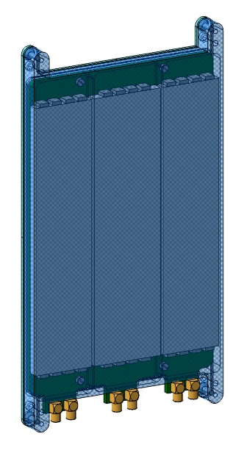
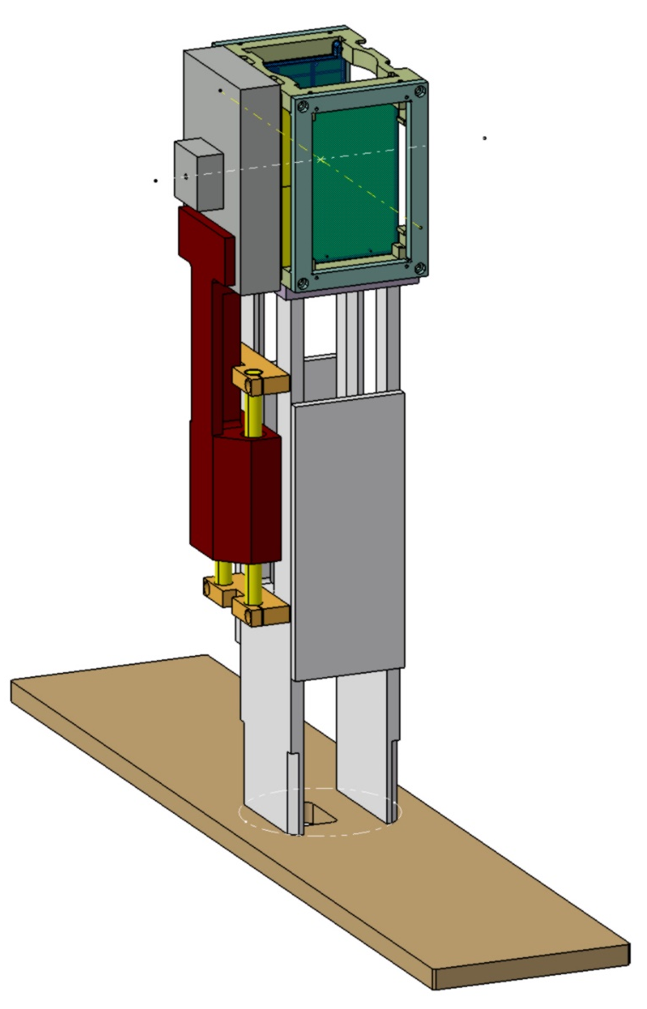
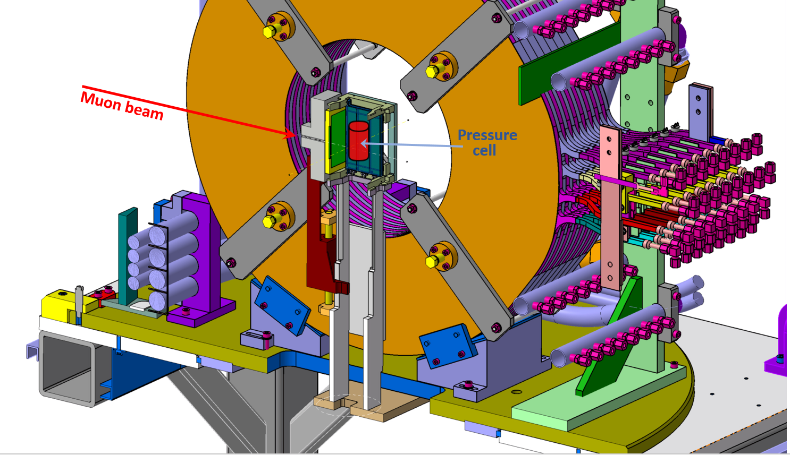
Muon spectrometer (GPD)
Individual Detector
Detector head
Detector setup
GPD spectrometer

Slide 13
μSR under pressure
1. Muon beam-line – fast muons with tunable energy
2. μSR Spectrometer
3. μSR pressure cells

Slide 14
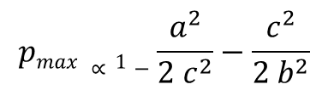
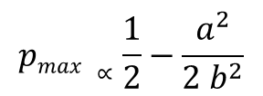

Pressure cell construction: compound cylinder
Single wall cell
Double wall cell
Three wall cell
a
c₁
b
c
c₂
$$pmax ∝\frac{1}{2}−\frac{a^{2}}{2 b^{2}}$$
$$pmax ∝1−\frac{a^{2}}{2 c^{2}}−\frac{c^{2}}{2 b^{2}}$$
$pmax ∝ \frac{3}{2}−\frac{a^{2}}{2 {c1}^{2}} − \frac{{c1}^{2}}{2 {c2}^{2}}$ $−$ $\frac{{c2}^{2}}{2 b^{2}}$
For a=6 mm and b=24 mm, p_{max}^{s} ÷ p_{max}^{d} ÷ p_{max}^{t} = 1 / 1.6/ 1.96

Slide 15
Construction material suitable for μSR
Nonmagnetic Alloys
 | CuBe | TiAl₆V₄ | NiCrAl | MP35N
Yield strength | 1.1 Gpa (300 K) | 1.05 Gpa (300 K) | 2.06 Gpa (300 K) | 2.15 GPa (300 K)
Young modulus | 131 GPa (300 K) | 97 Gpa (300 K) | 190 Gpa (300 K) | 215 Gpa (300 K)
Sintered materials
 | WC | cBN | SiC | ZrO₂-Y₂O₃ | Al₂O₃-ZrO₂ | Si₃N₄
Compressive strength | 5.0-11.0 Gpa | 2.9 GPa | 7.6-8.3 GPa | 2.20 GPa | 4.7 GPa | 5.1-5.5 GPa
Young modulus | 600-670 Gpa |  | 918 GPa | 210 Gpa | 357 GPa | 241 GPa
Strong enough to hold the pressure
Should not have “strong” μSR response
Should have temperature independent response

Slide 16
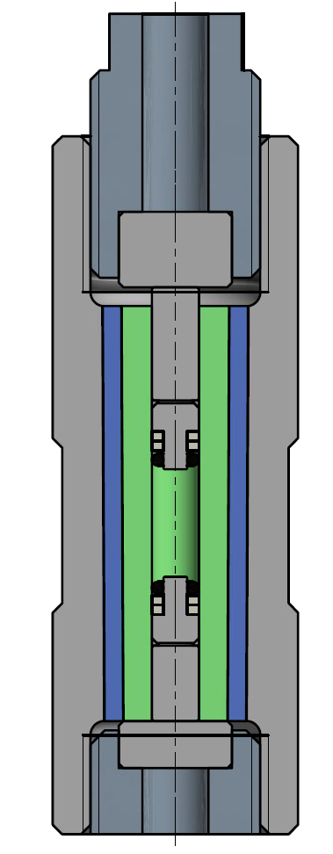
Three-wall pressure cell construction
Bottom fixation bolt
Sample volume
Top fixation bolt
Pressure seals
p_{max}(RT) ~3.3 Gpa, p_{max} (LT) ~ 3.0 GPa

Slide 17
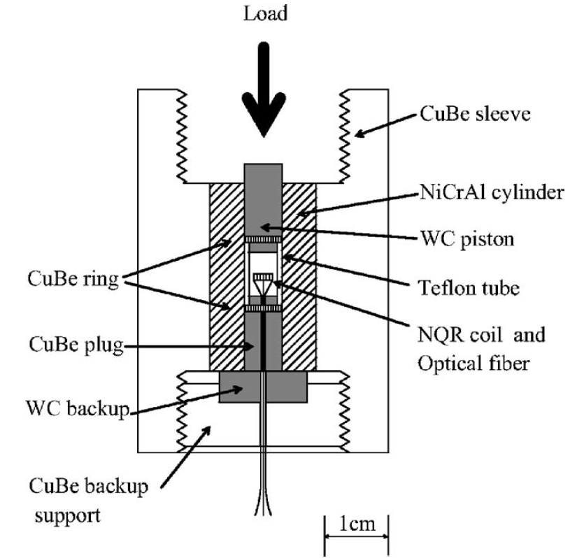
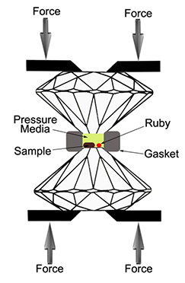
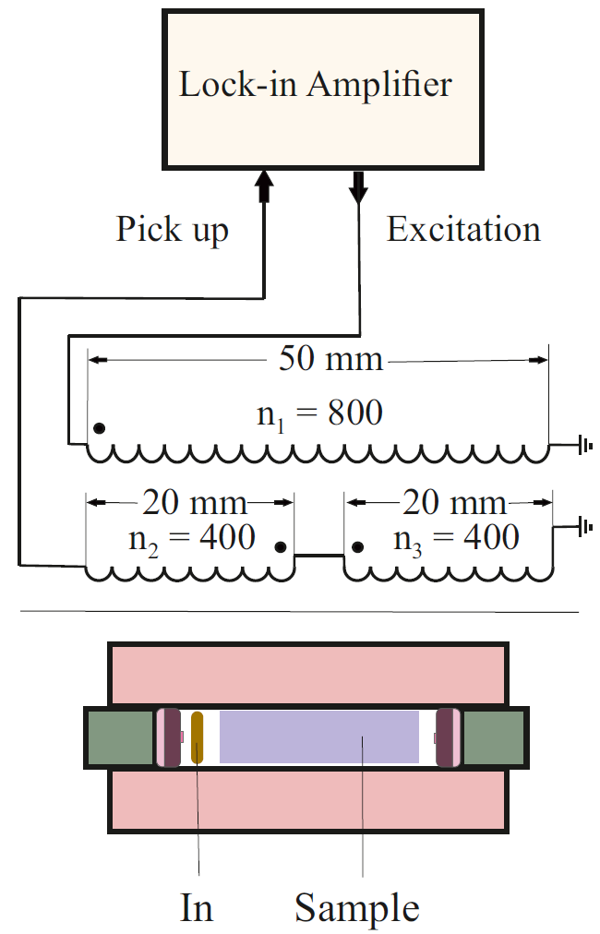
Pressure determination, pressure probes
Contact (feedthroughs)
Contactless
Resistivity, AC susceptibility, NMR, NQR,
specific heat, optical …
Optical, AC susceptibility, NMR, NQR, specific heat,
Neutron scattering (equation of state)…
Substantial part of the pressure cell volume is occupied by the pressure indicator

Slide 18
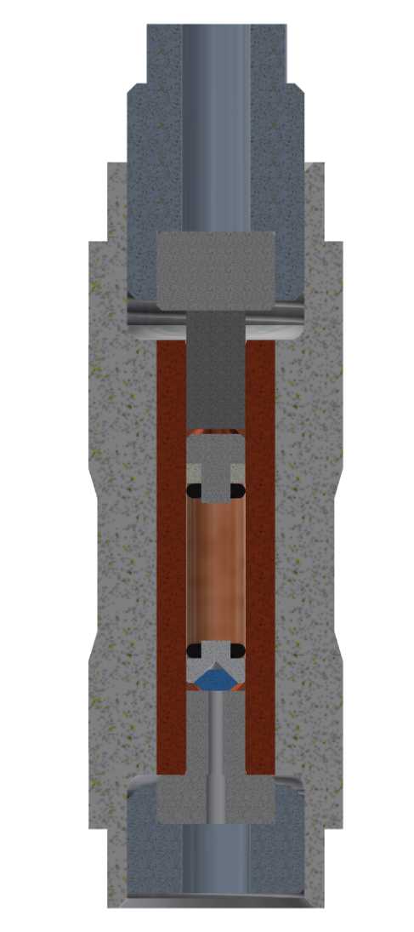
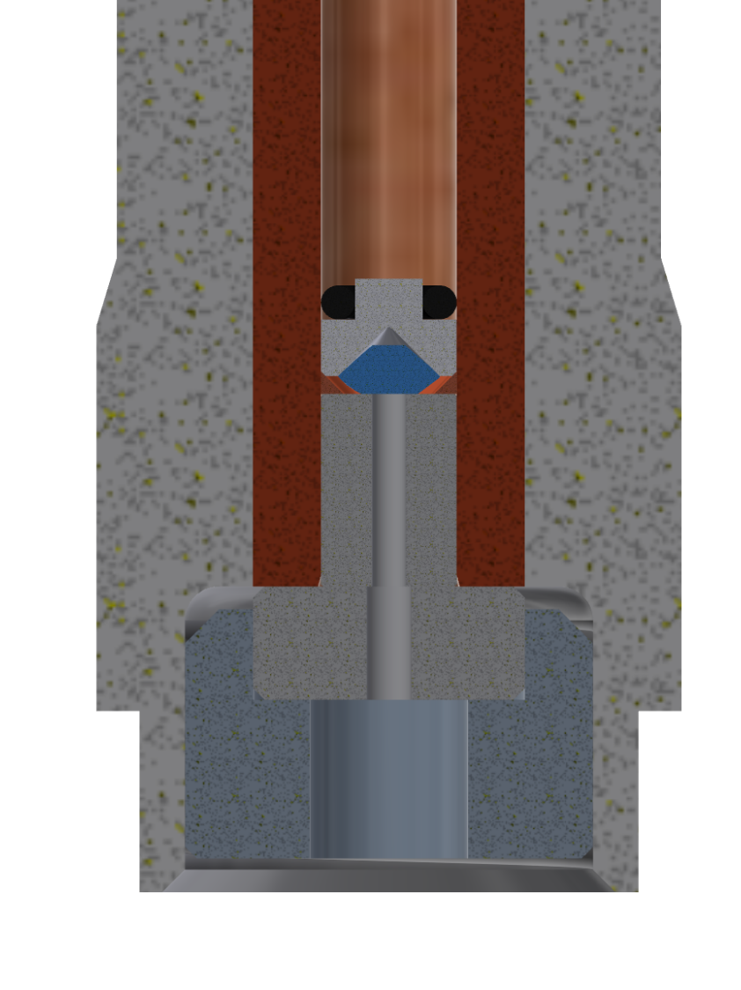
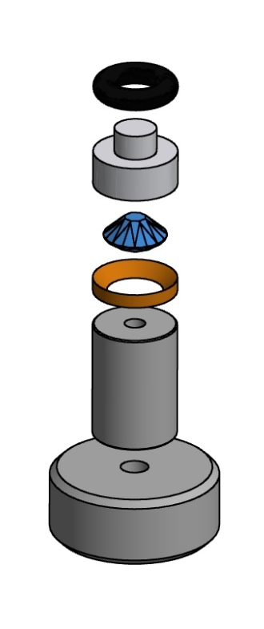
Double volume piston-cylinder cell
Sample volume
Optical volume
Teflon mushroom
Optical window
Piston

Slide 19
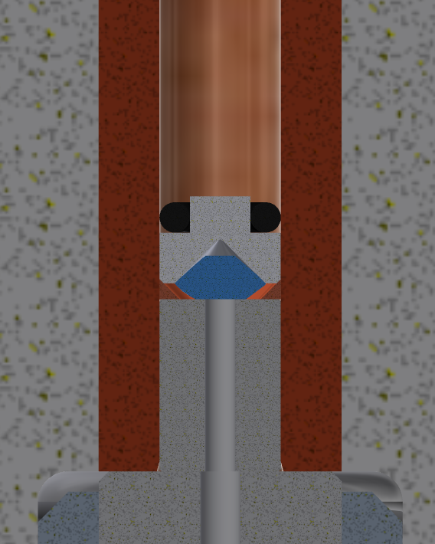
Double‐volume pressure cell
Optical spectrometer (Ocean Optics HR400 or HR4PRO)
Control PC
520 nm pigtailed laser (PLM520.0MMF01)
USB

Slide 20
Laser safety

Slide 21
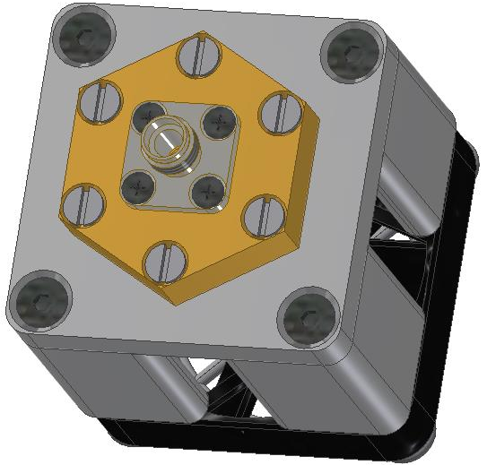
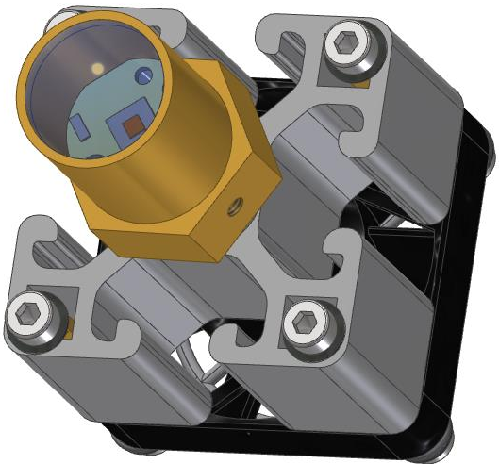
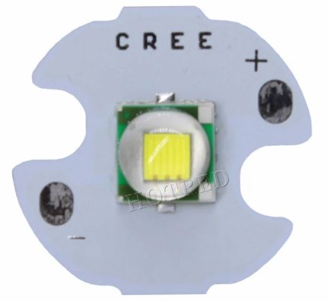
Safety concern: Laser vs. LED light
(a)
(b)
(c)
lens
LED
fiber plug
(SMA905)
lens holder
heatsink
~1.5mm
cooling fan

Slide 22
LED light sources for fluorescense

Slide 23
Ruby and Sr tetraborite

Slide 24

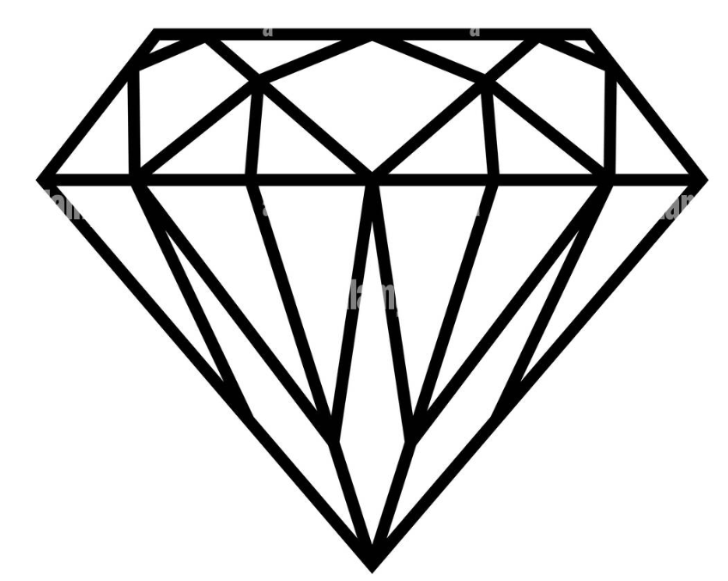
Diamond anvil setup
Optical
spectrometer
LED
source

Slide 25
Uniaxial pressure experiments

Slide 26
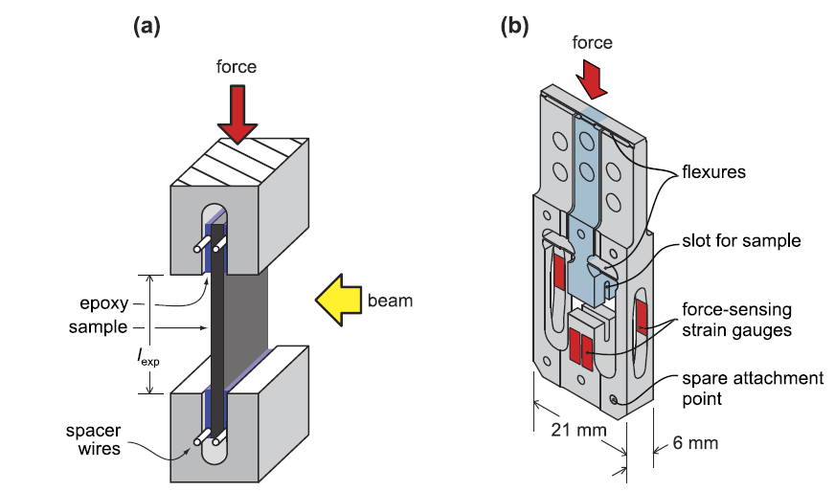
Uniaxial measurement stage
Ghosh et al., RSI 91, 103902 (2020)

Slide 27
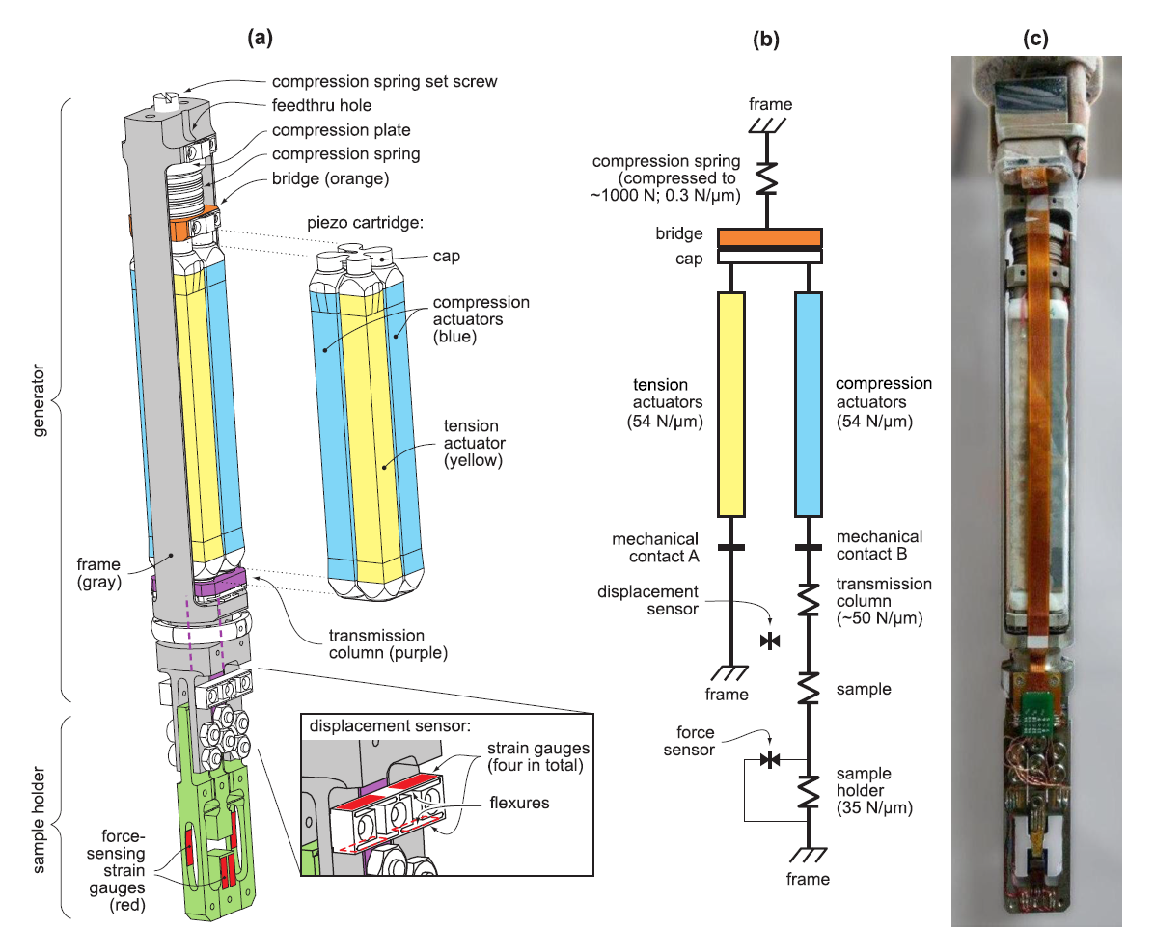
Schematic of uniaxial pressure cell
Sample holder: detachable
Maximum force: up to 1000N
Sample dimensions: down to 3x3x0.2mm³
T-range: 0.27K – 300K
Ghosh et al., RSI 91, 103902 (2020)

Slide 28
Scientific examples
1. The uniaxial and hydrostatic pressure effects on TRSB in Sr₂RuO₄
2. Pressure-induced critical and multicritical points in frustrated spin liquid
3. Pressure split of the density wave transition in RP nickelate La₃Ni₂O₇

Slide 29
Scientific examples
1. The uniaxial and hydrostatic pressure effects on TRSB in Sr₂RuO₄
2. Pressure-induced critical and multicritical points in frustrated spin liquid
3. Pressure split of the density wave transition in RP nickelate La₃Ni₂O₇

Slide 30
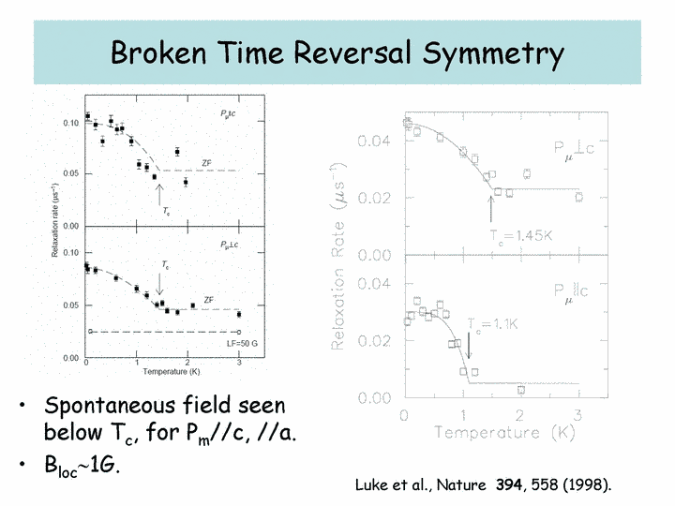
Time-reversal symmetry breaking in Sr₂RuO₄

Slide 31
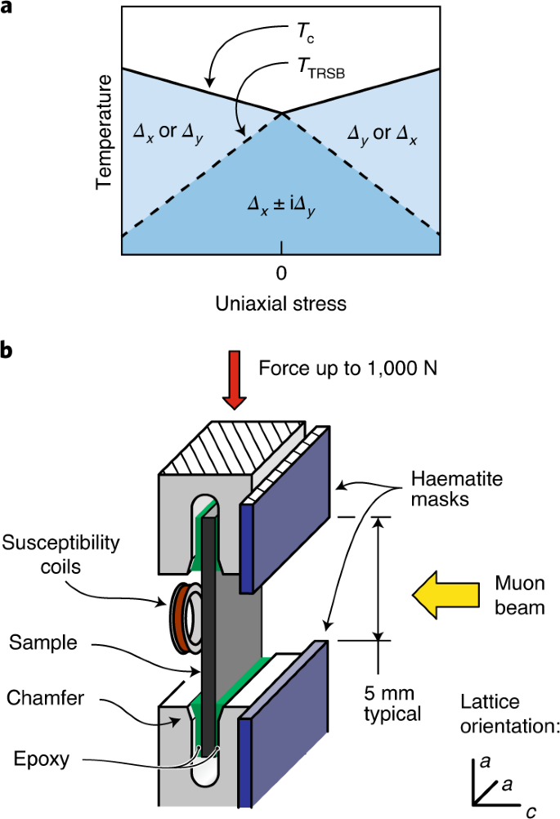
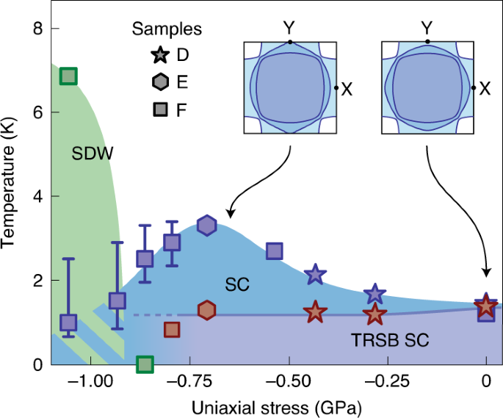
Uniaxial strain
Grinenko et al., Nature Phys. 2021

Slide 32
Hydrostatic pressure experiments
Grinenko et al., Nature Comm. 2021

Slide 33
Combined graph data

Slide 34
Scientific examples
1. The uniaxial and hydrostatic pressure effects on TRSB in Sr₂RuO₄
2. Pressure-induced critical and multicritical points in frustrated spin liquid
3. Pressure split of the density wave transition in RP nickelate La₃Ni₂O₇

Slide 35
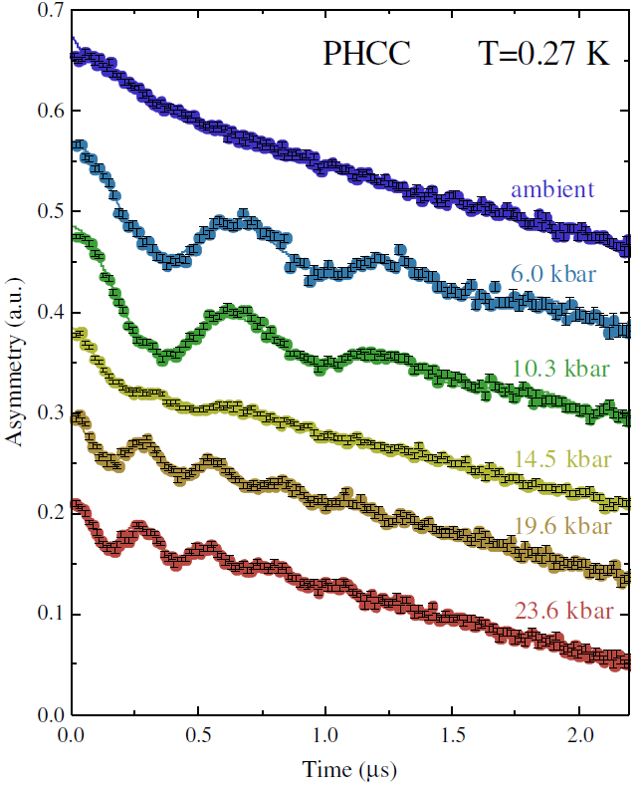
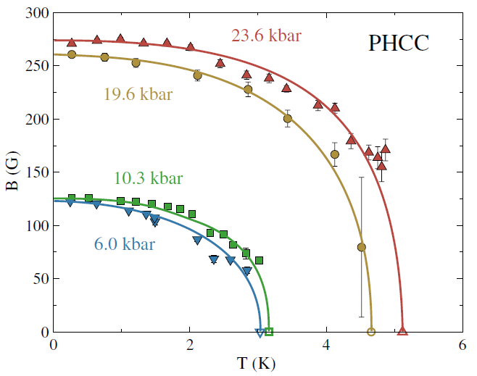
(C₄H₁₂N₂)Cu₂Cl₆ (PHCC)

Slide 36
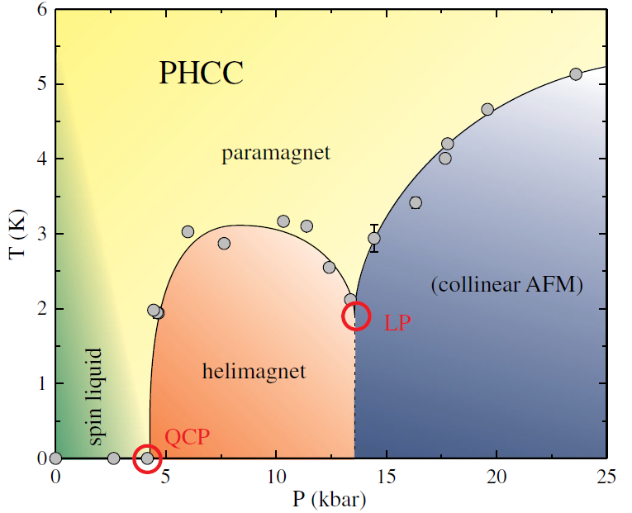
p-T phase diagram of PHCC

Slide 37
Scientific examples
1. The uniaxial and hydrostatic pressure effects on TRSB in Sr₂RuO₄
2. Pressure-induced critical and multicritical points in frustrated spin liquid
3. Pressure split of the density wave transition in RP nickelate La₃Ni₂O₇

Slide 38
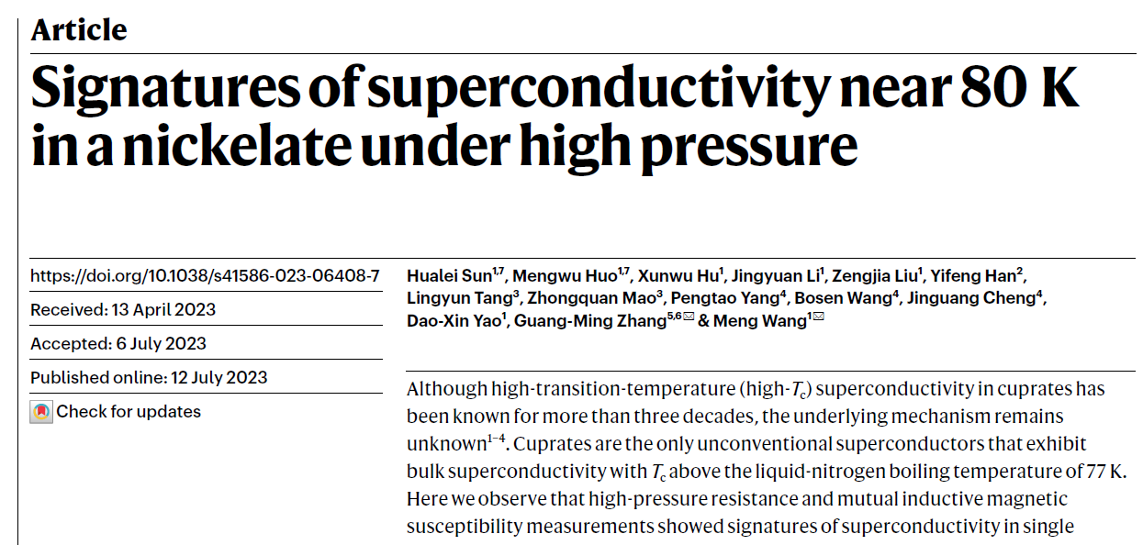
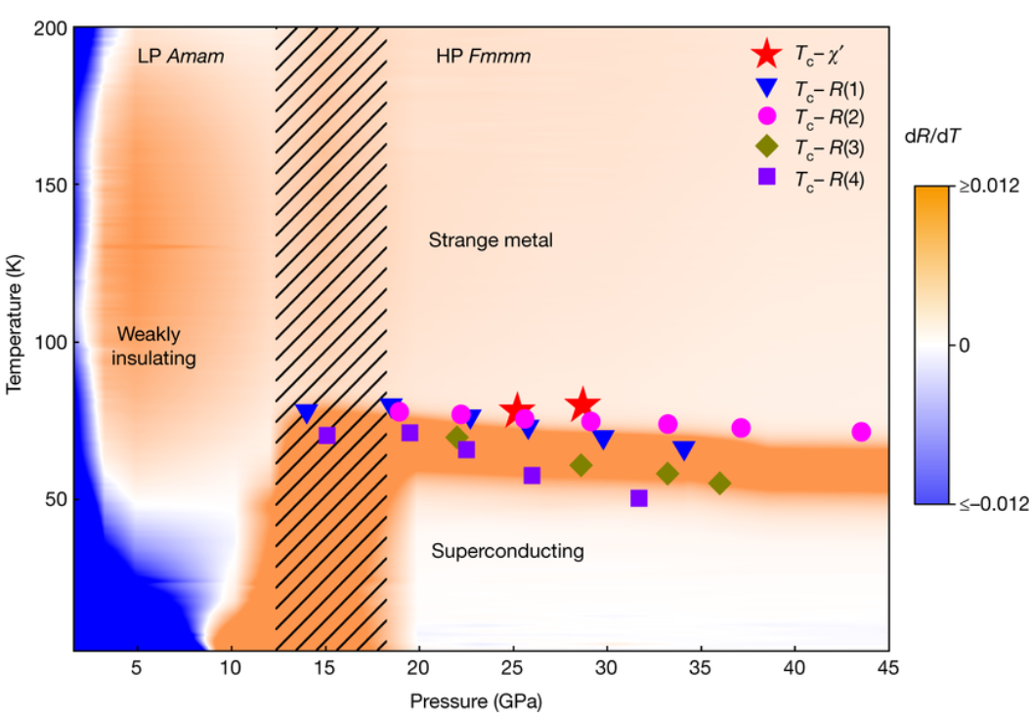
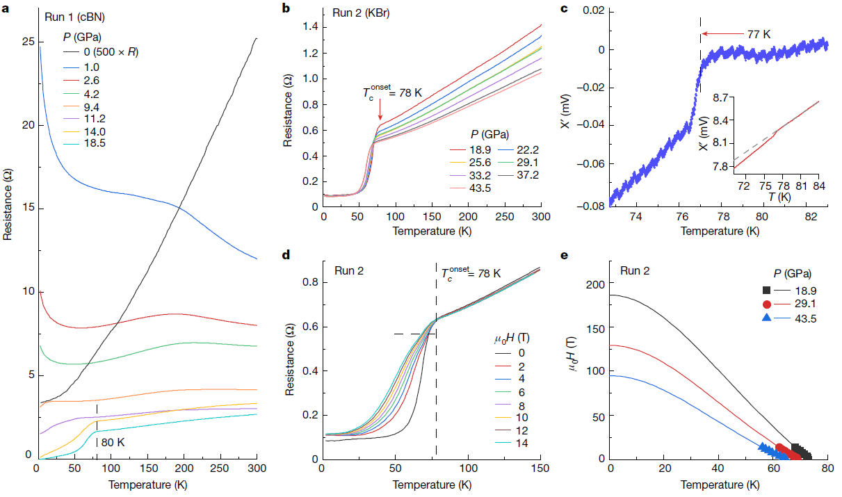
Superconductivity in La₃Ni₂O₇ – July 2023
H. Sun et al., Nature 621, 493 (2023)

Slide 39
ZF-μSR, ambient pressure
The response is typical for magnetically ordered sample
Two contributions – the fast and the slow oscillating – are present
Confirmation of the results of Lei Shu group [K.W. Chen et al., arxiv:2311.15717] with, however, some differences.

Slide 40
Commensurate vs. Incommensurate SDW order
The commensurate magnetic order is characterized by a well defined internal field value at the muon stopping site(s). The magnetic field distribution is, typically, consists of a peak(s) of Gaussian or Lorenzian shape
The incommensurate magnetic order is characterized by a zeroth-order Bessel function, or a ‘double-peak’ type of distributions
A. Amato and E. Morenzoni, Springer Verlag 2024

Slide 41
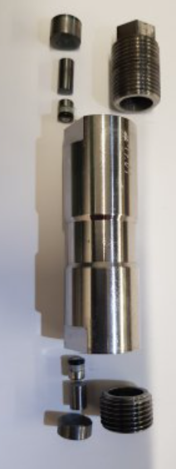
μSR experiments under pressure

Slide 42
La₃Ni₂O₇ phase diagram
The DW-like anomaly in resistivity is progressively suppressed with increasing pressure, which may suggest competition with the superconducting order.
The SDW transition temperature increases with increasing pressure
The distinctive pressure-induced response in La₃Ni₂O₇ implies the simultaneous existence of two separate orders in its ground state: magnetic and most likely charge density wave orders.
In cuprates or hole-doped nickelates like La_{2-x}Sr_{x}NiO₄, the relationship between spin and charge orders is notably intricate, with both orders being strongly intertwined and exhibiting similar responses to external parameters.

Slide 43
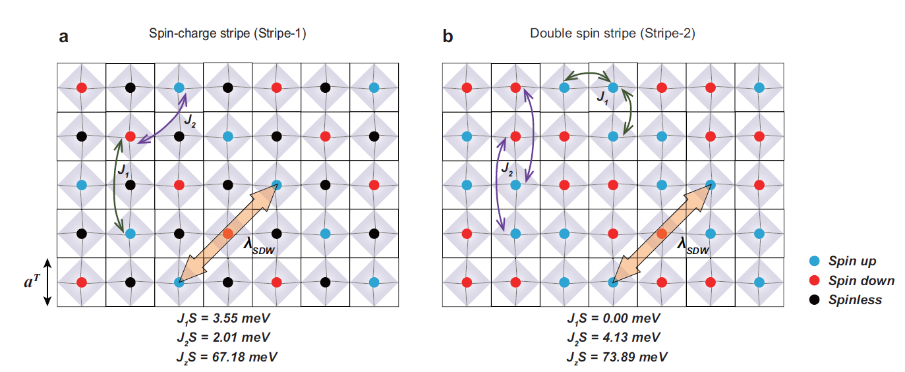
Magnetic structure(s) of La₃Ni₂O₇
Neutron scattering: T. Xie arXiv:2401.12635
RIXS: X. Chen et al., arxiv:2401.12657
NMR: Z. Dan et al., arxiv:240203952

Slide 44
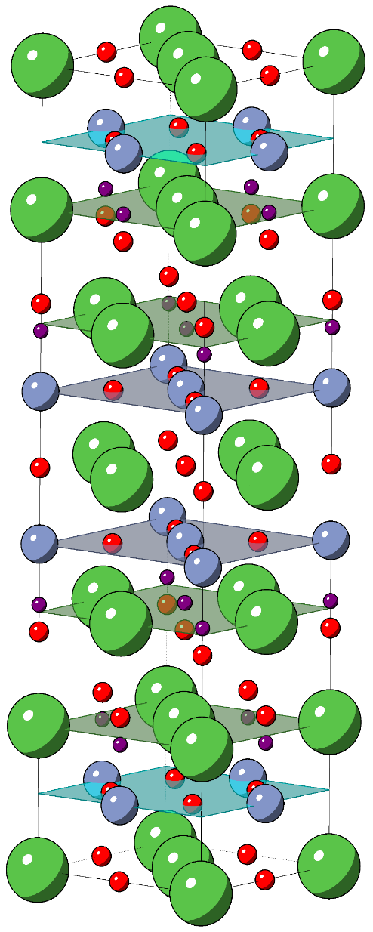
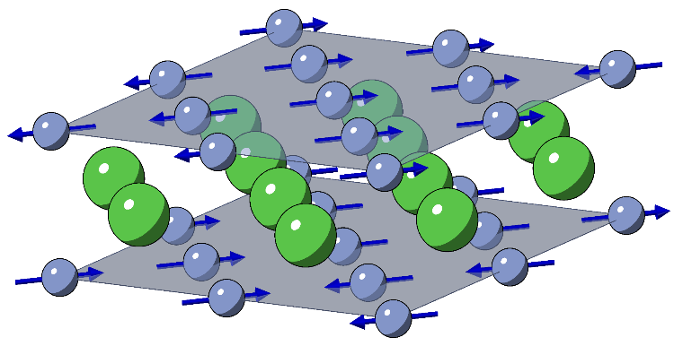
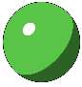
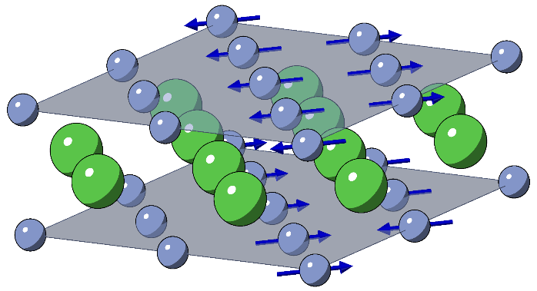
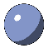
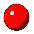
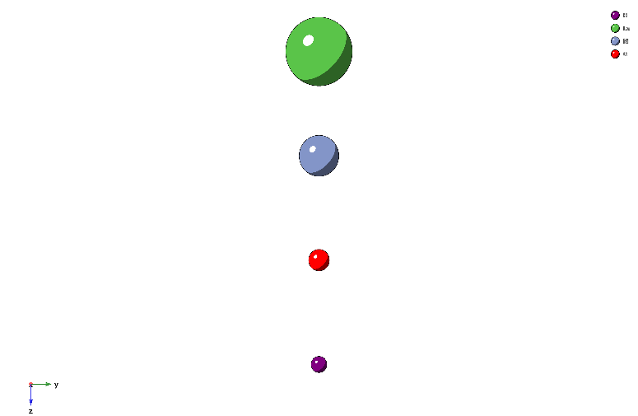
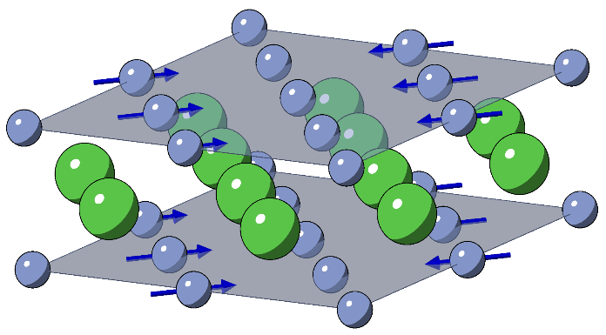
Muon sites and magnetic structures
Double-stripe (DS)
La
Ni
DS with vacancies 1
O
µ⁺
DS with vacancies 2
The DFT+μ calculations reveal the presence of one
muon stopping site at (0.495; 0.006; 0.170).

Slide 45




Field distributions and the ordered moment value
The dipole-field simulations suggests that some of the Ni sites must carry no magnetic moment, otherwise the slow precession component (corresponding to a low magnetic field at the muon site) is not observed.
La3Ni2O7 must host a decoupled charge- and spin-density wave, analogous to a stripe-type order in cuprate high-temperature superconductors.
By considering all possible configurations with missing Ni magnetic moments, an upper limit of the moment on the Ni site would stay m_{Ni} = 0.59(5) m_{B} per f.u. for DSv1 or, m_{Ni} = 0.29(5) m_{B} per f.u. for DSv2
(b)
(d)
(c)
(e)

Slide 46
My thanks go to
PSI: Matthias Elender, Zurab Guguchia, Markus Bendele, Alexander Maisuradze, Zurab Shermadini, Ritu Gupta, Stefan Hollenstein, Gediminas Simutis, Debarchan Das, Andrea Raselli, Katja Pomjakushina, Dariusz Gawryluk, Pavel Naumov, Marek Bartkowiak, Nicola Casati, Thomas Hicken, Jonas Krieger, Elvezio Morenzoni, Hubertus Luetkens, Alex Amato …..
Uni Sorbonne: Stefan Klotz
Uni Edinburgh: Konstantin Kamenev and his lab
Ill: Eddy Lelievre-Berna and his group
ISIS: Oleg Kirichek and his group
Ames Lab: Sergey Bud’ko, Paul Canfield
Institute for High Pressure: Ravil Sadykov

