Slide 1
Future Capabilities: Super-MuSR
Peter Baker
PSI-ISIS-KTH Muon School
20th January 2026

Slide 2
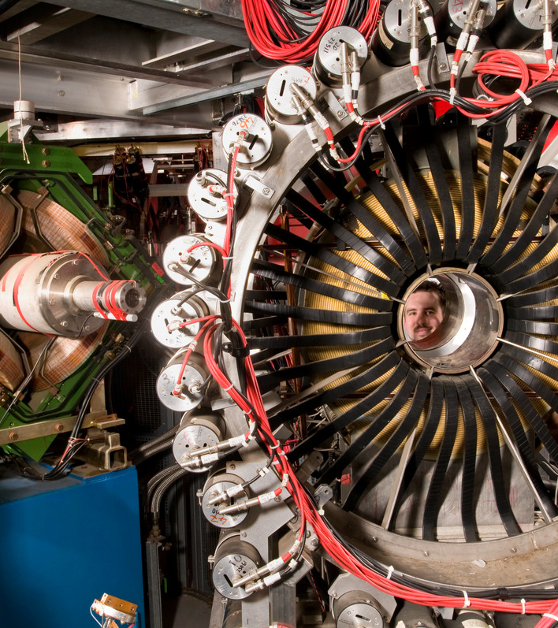
Plan of the talk
Pulsed and continuous muon sources
Super-MuSR performance goals
Super-MuSR hardware
Super-MuSR science benefits
Notes:
To replace photo with one of your own. 1) Send the geometric shape overlay to the back – Right-Click > Send to Back > Send to Back. 2) Replace image – use the guides provided to correctly position it. 3) Send your image to the back so that the geometric overlay re-appears over the image. Please remove or amend the image credit if you are using a different image to the one provided.

Slide 3

Pulsed and continuous muon sources – until the near future
Pulsed sources | Continuous sources
High data rate only limited by number of detectors | Low data rate because one muon is measured at a time
Low frequency resolution due to pulse width of source | High frequency resolution only limited by detectors
Low intrinsic background allowing long time window | Higher intrinsic background reduces time window
Can’t use active collimation for small samples | Active collimation for small samples
Can synchronise sample perturbations with muon arrival with pulsed stimuli | Can’t synchronise sample perturbations with muon arrival so stimuli are harder to pulse
These ‘future capabilities’ talks are about how these long-held world views are about to change significantly

Slide 4
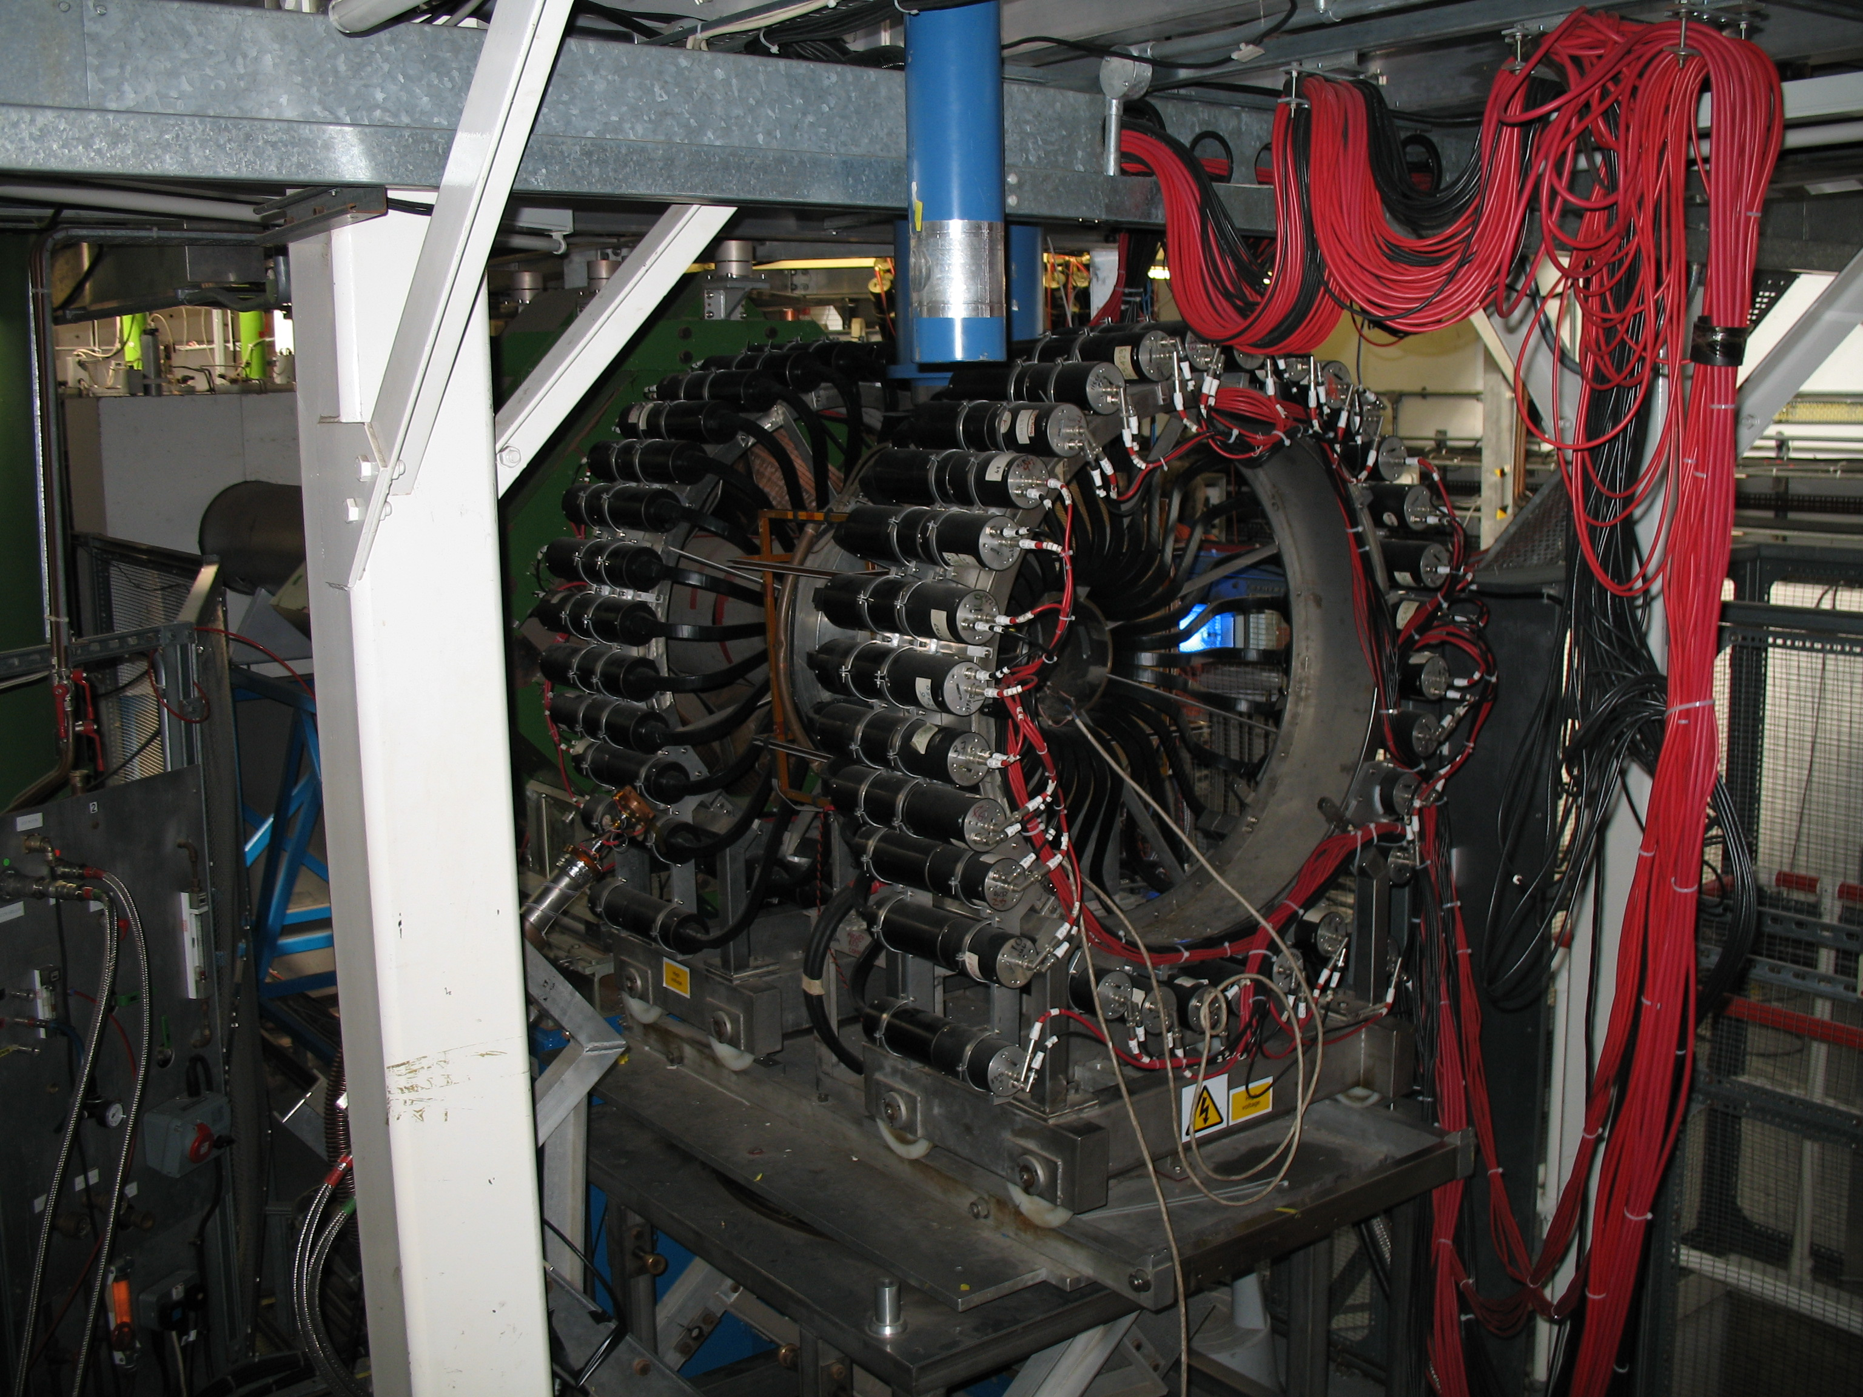
MuSR: The present instrument
First MuSR instrument was built in 1987 with 32 detectors
Upgraded in 2004 with 64 detectors
PMTs older than ISIS
Can only use about 10% of available muons
Mostly studies quantum magnets and superconductors
Experiments are often at very low temperatures:
70% dilution fridge (0.05-4K)
20% ³He cryostat (0.25-10K)
10% ⁴He cryostat (1.5-300K)
CCR, flow cryostats, and furnace barely used

Slide 5
How to design a good muon instrument (scientifically)
Think about what experiment(s) you want to do
Define a ‘Figure of Merit’ based on the information content of the data
Suppose you have a fixed time available for experiments
Higher counting rate means more data so more information
Higher decay asymmetry from the sample means more information
Leads to a Figure of Merit = (Asymmetry)² x Rate
THEN
Simulate different beamline and spectrometer designs
Try to maximise the Figure of Merit for each way of operating the instrument

Slide 6
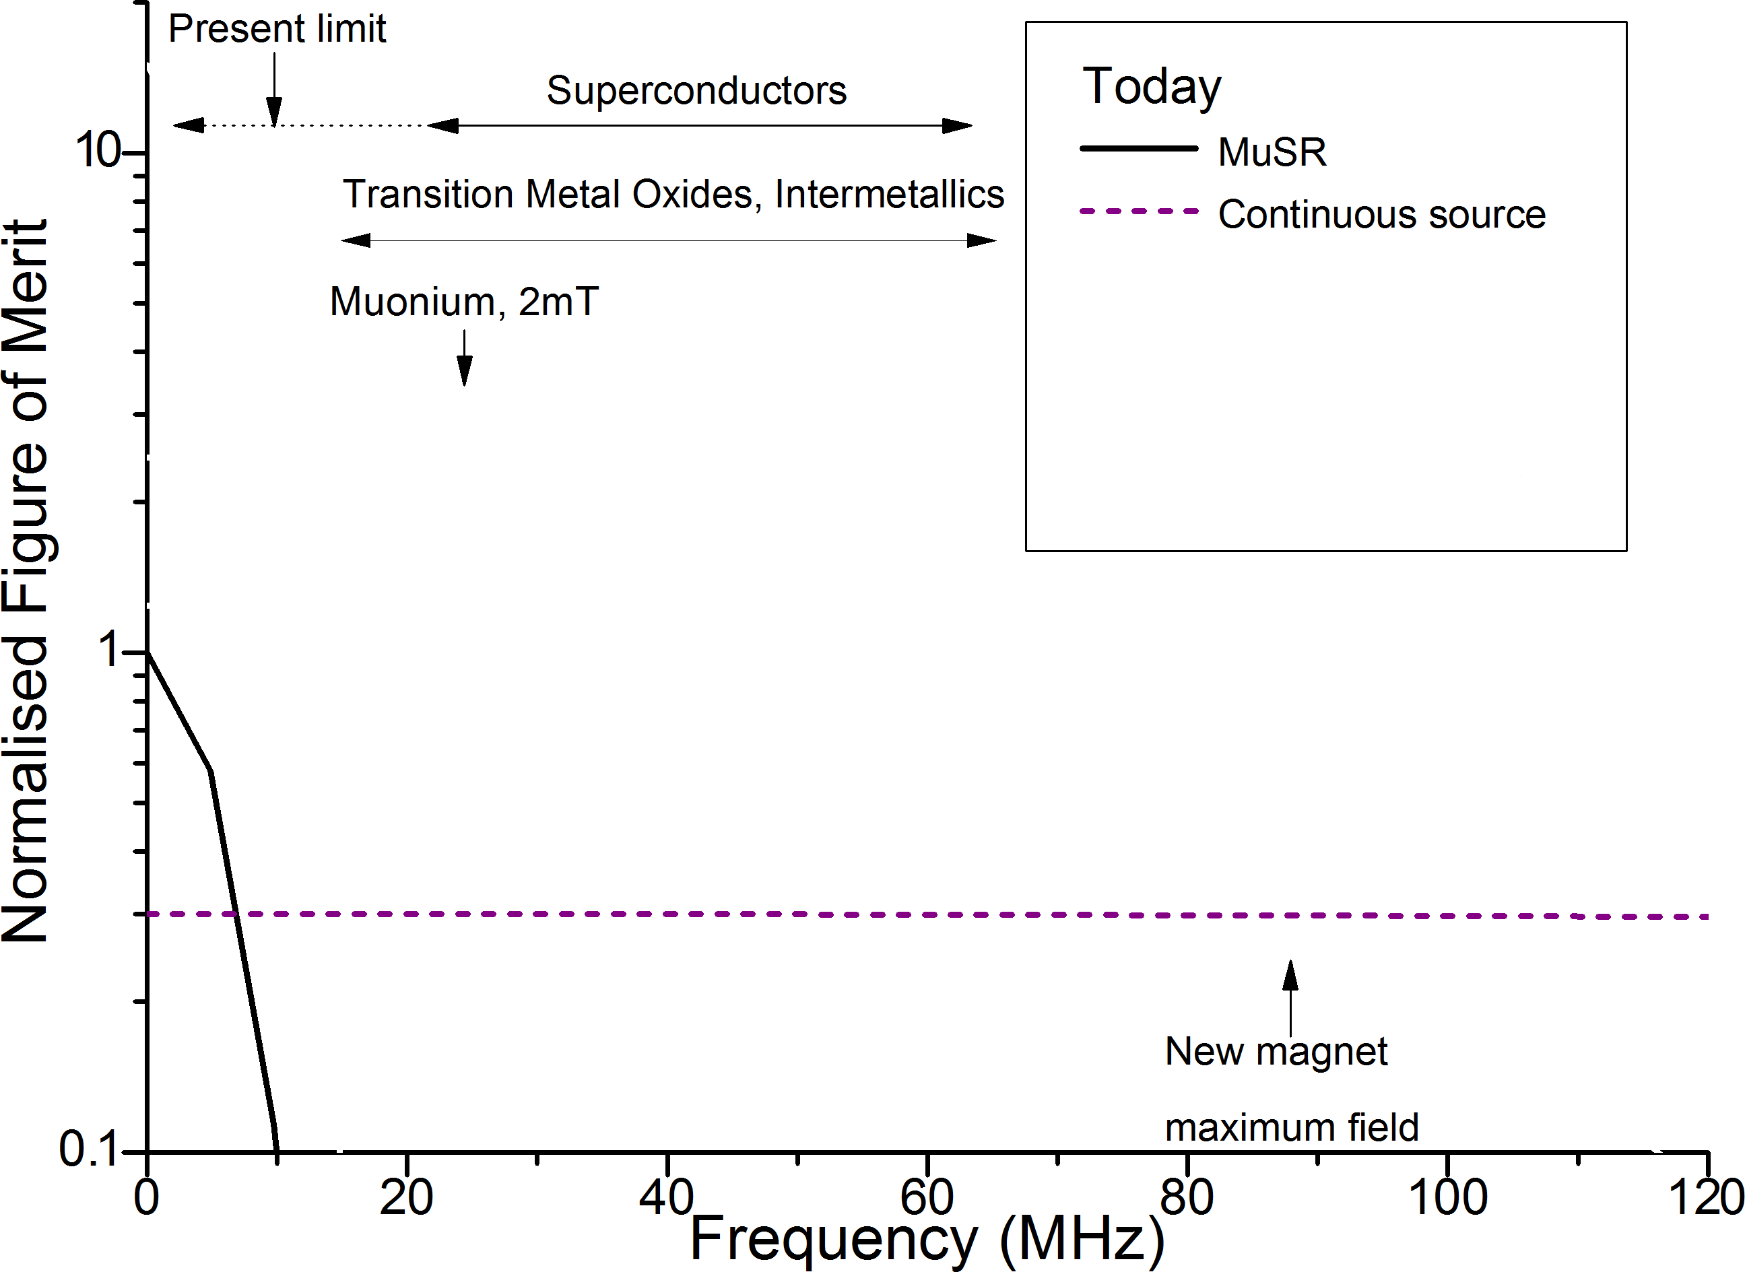
Pulsed and continuous muon sources – performance today

Slide 7
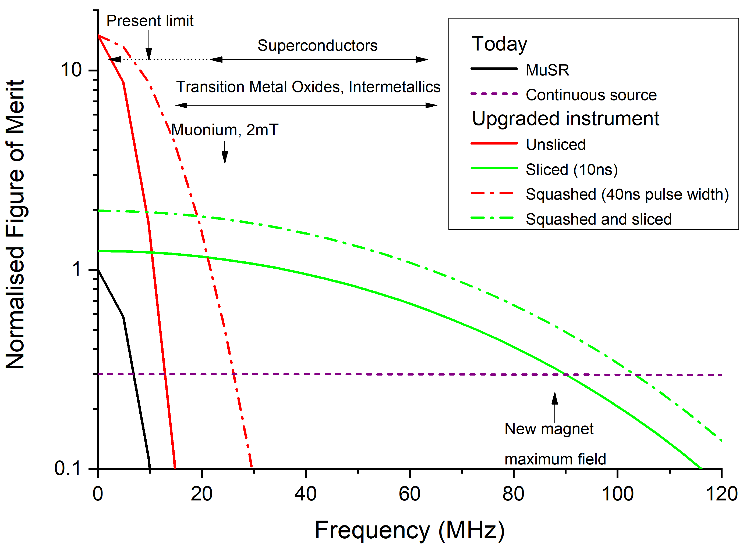
Super-MuSR performance goals
Detector
15-20x increase in count rate
Almost double the solid angle coverage
Beamline
~10x increase in frequency range
Access higher magnetic fields

Slide 8
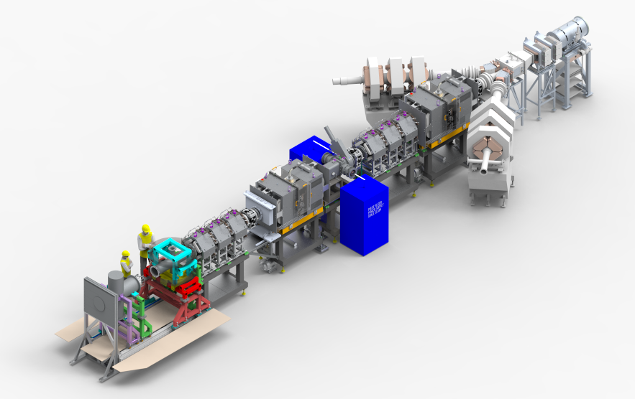
Super-MuSR hardware

Slide 9
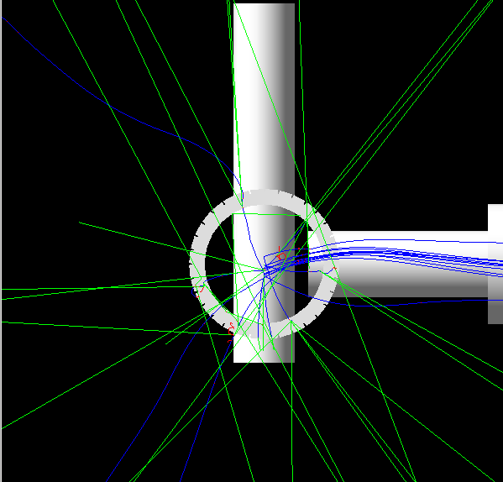
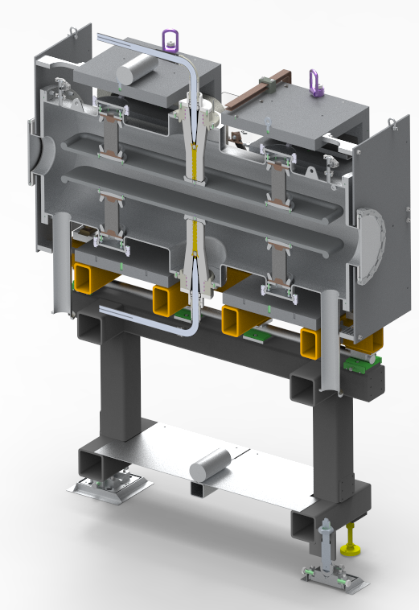
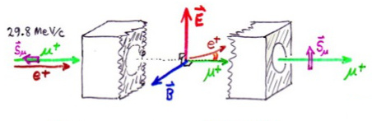
Spin rotators
What happens without spin rotators
0.25T
Two spin rotators with up to 75° spin rotation
How spin rotators work
Notes:
May want to animate the different parts

Slide 10
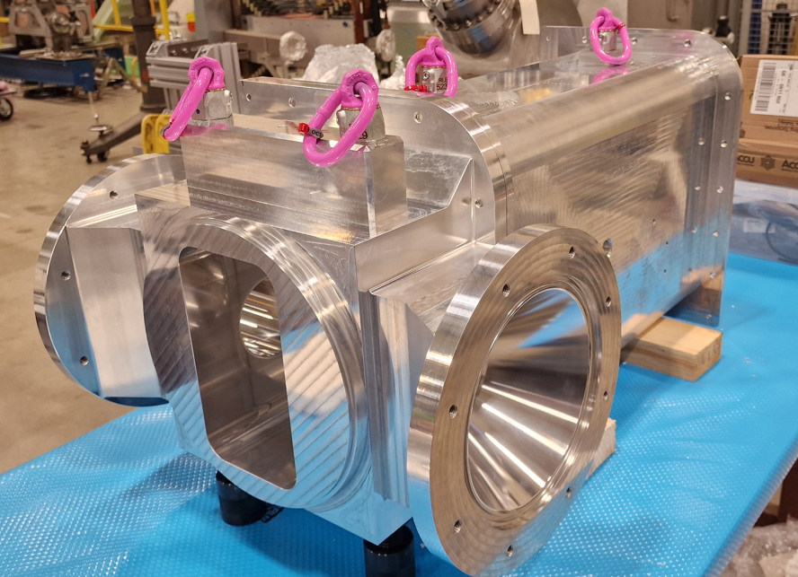
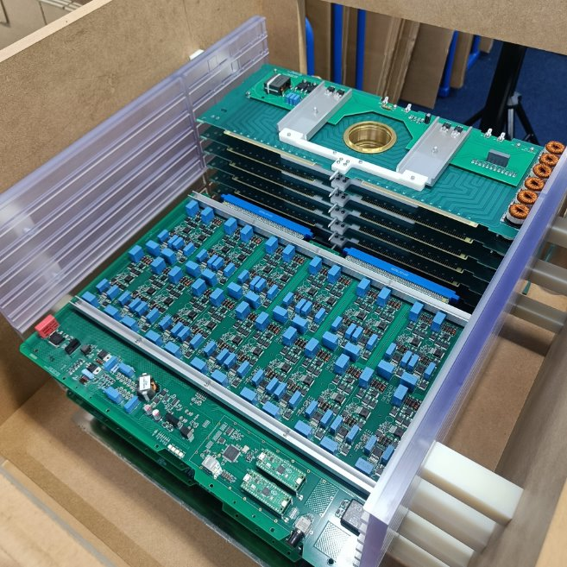
Pulse slicer
Pulse Slicer with power supplies on both sides
Pulse width adjustable between 10-50ns
Notes:
May want to animate the different parts

Slide 11
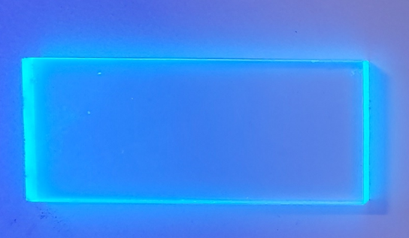
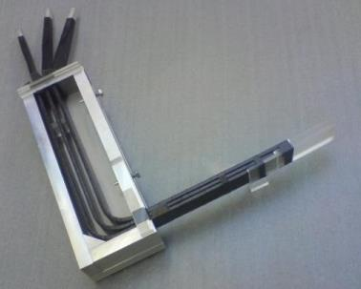
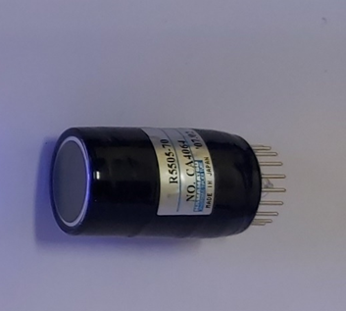
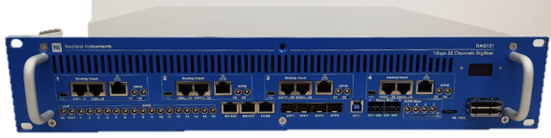
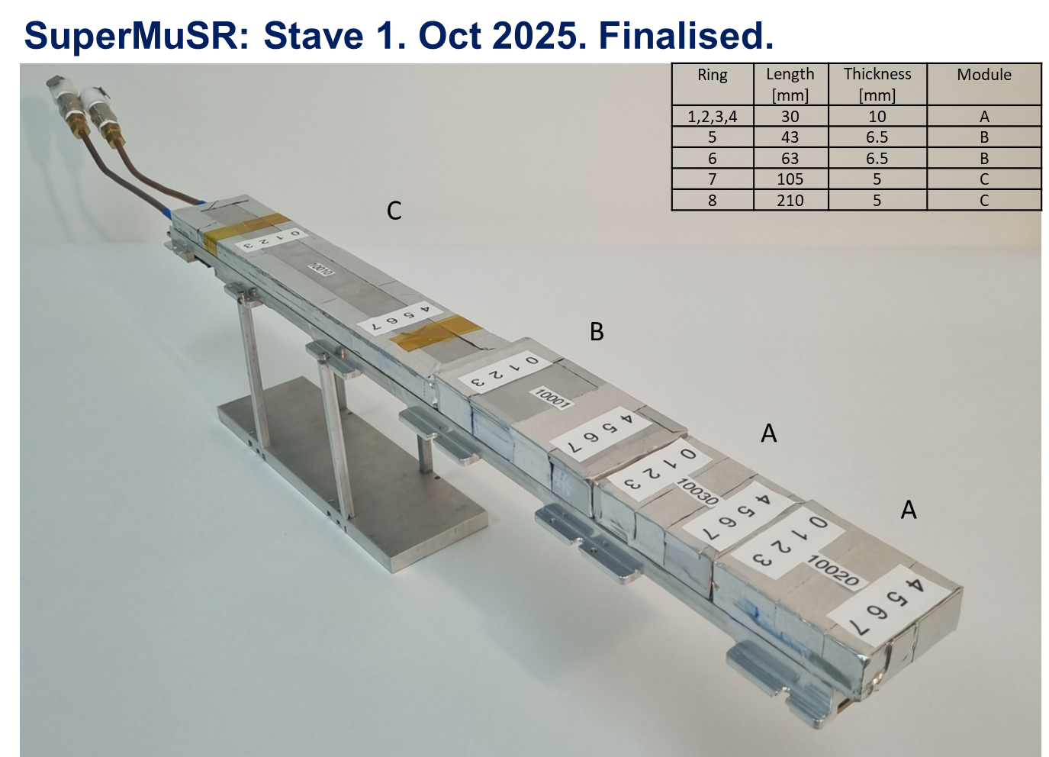
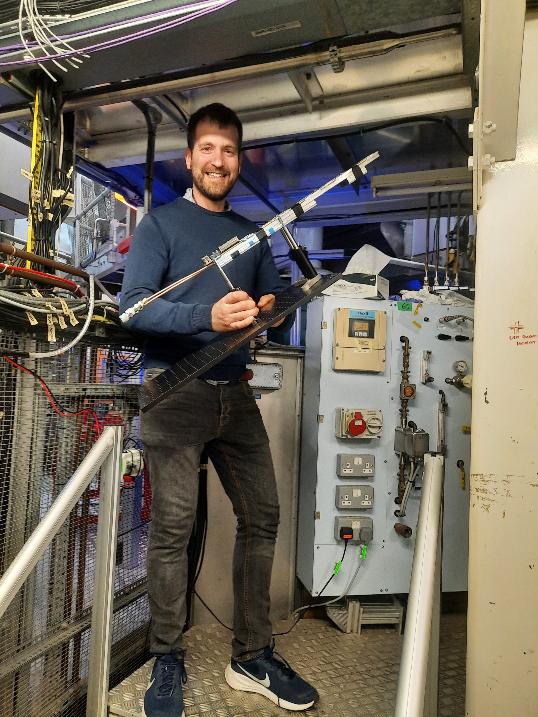
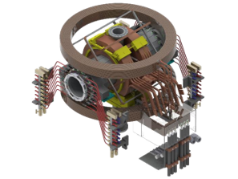
Spectrometer
FROM:
plastic scintillator
+ clear long light-guide
+ PMT
TO:
Notes:
May want to animate the different parts

Slide 12
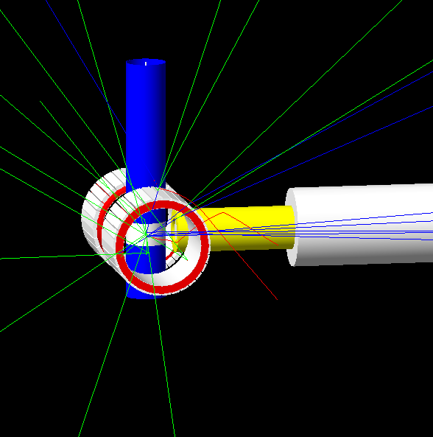
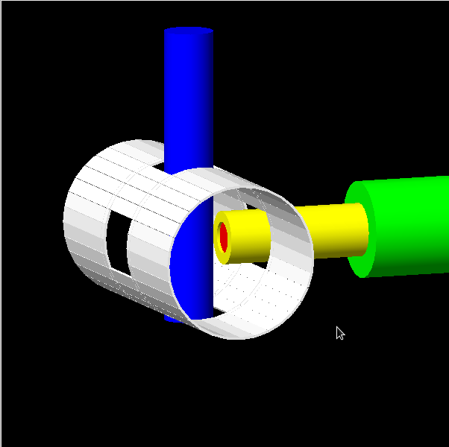
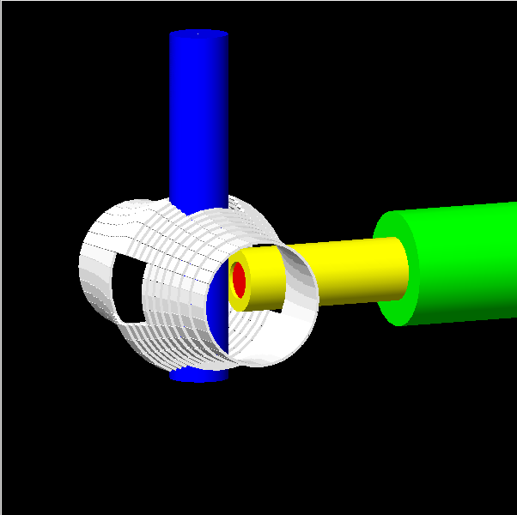
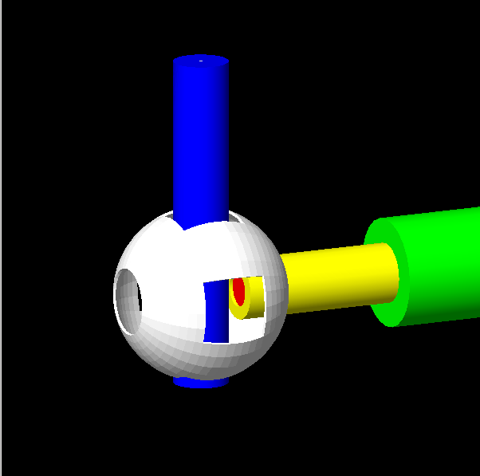
Designing an optimal detector array (Why is it cylindrical?)
Detector design | Solid angle coverage (%) | Signal collected per muon (ZF,LF) | Signal collected per muon (TF)
Pre-2014 MuSR instrument (old beam pipe, current degrader rings) | 42 | 1.00 | 1.00
Post-2016 MuSR instrument (new beam pipe, current degrader rings) | 42 | 1.13 | 1.07
Cylindrical array | 75 | 2.65 | 3.42
Stepped array | 63 | 1.66 | 2.73
Spherical array | 78 | 1.22 | 3.02
Current
Cylindrical
Stepped
Spherical

Slide 13
Positron degraders
The information carried by a positron increases with increasing energy and low energy positrons contribute negatively to the measured asymmetry
Use a degrader (metal plate) to avoid the lower energy positrons reaching the detectors
For Super-MuSR this will be 3mm of brass

Slide 14
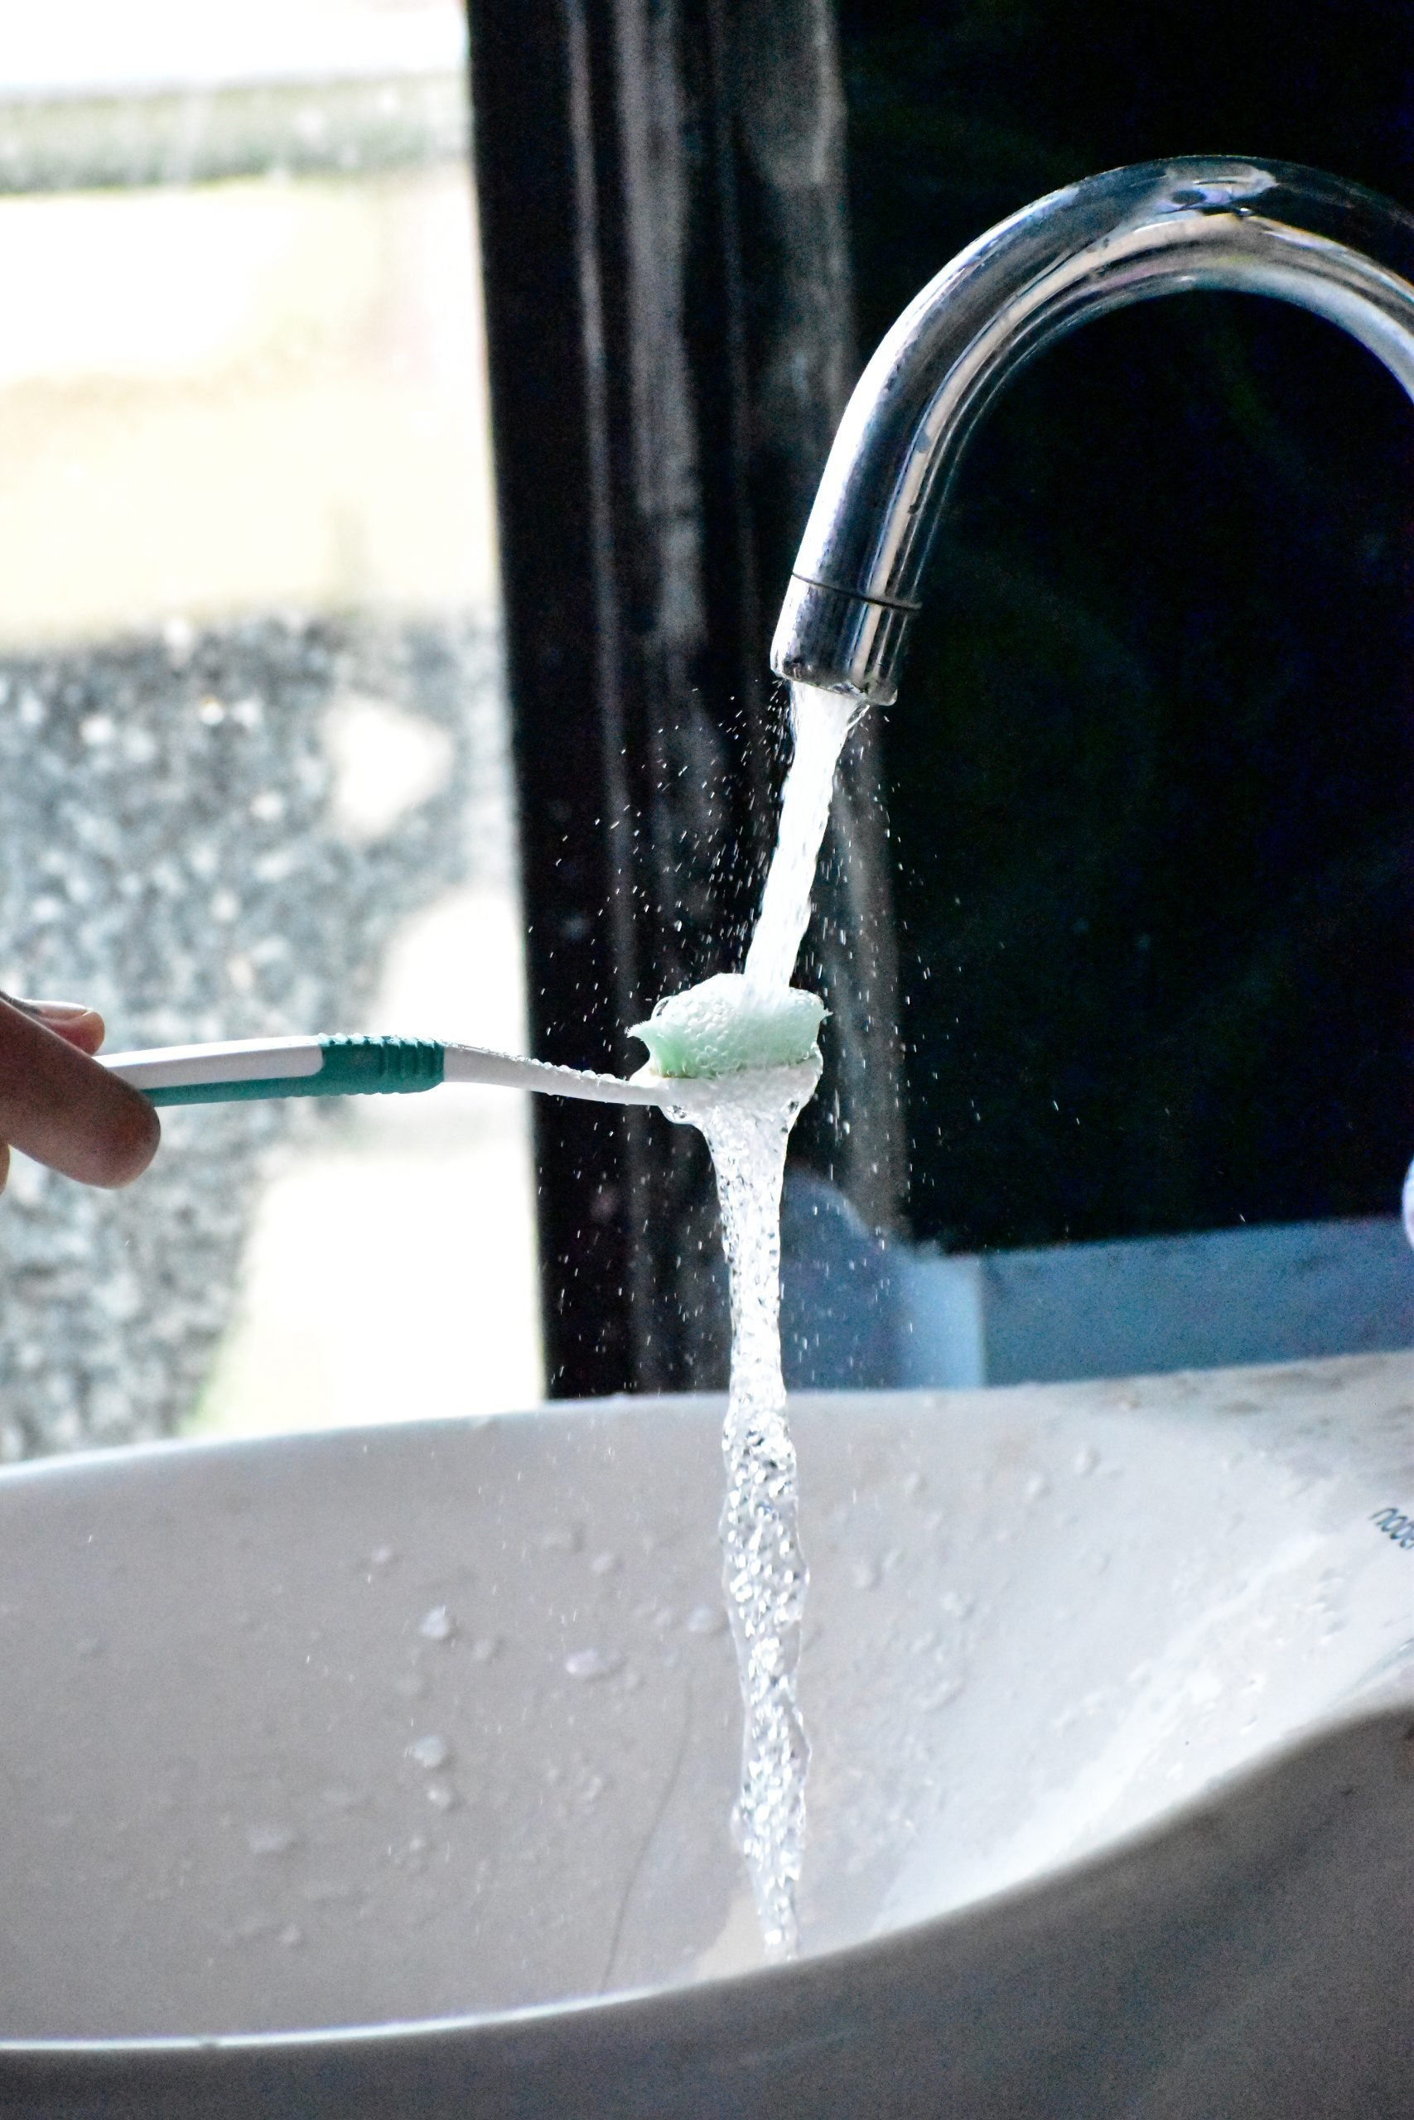


Data handling and reduction
Today’s data files: ~30MB per day
Temporary
Retained for analysis
Lake
Erie
Digitiser traces: ~100TB per day
Event mode data: ~100GB per day
Histograms: ~1GB per day
These data rates are upper bounds needed for planning –
the pulse slicer will reduce these when it is switched on

Slide 15
Super-MuSR science benefits

Slide 16
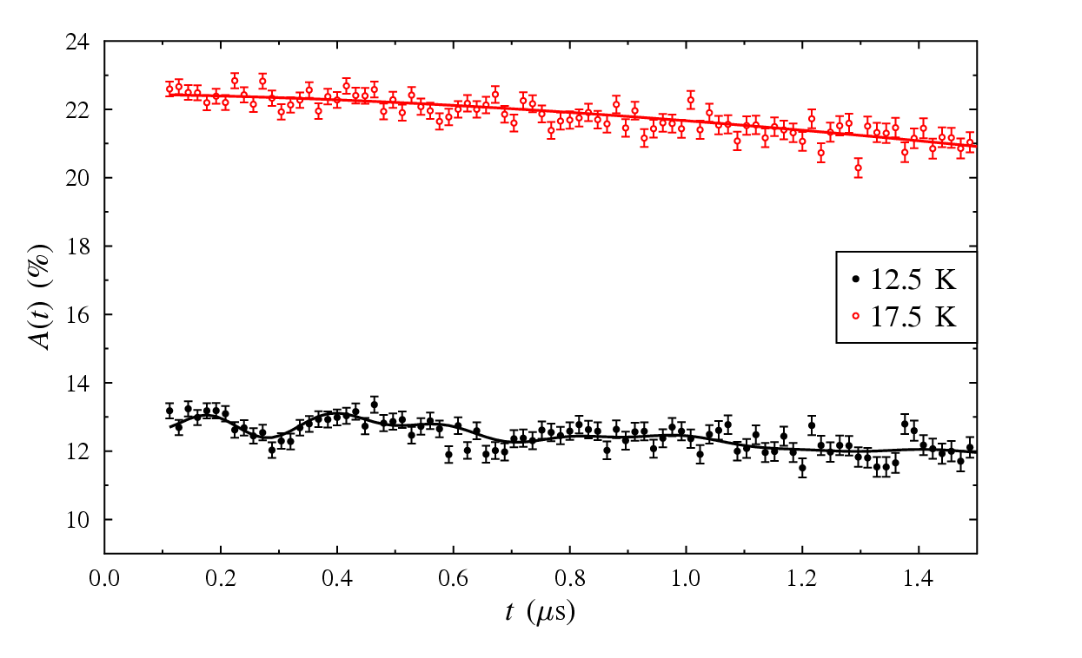
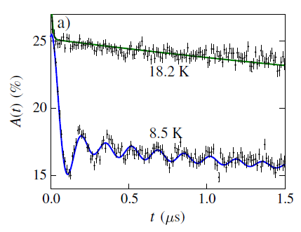
Science benefits – Higher resolution for magnetism
PSI data
ISIS data
Na₂IrO₃
EMU data sufficient to demonstrate magnetic ordering but not for publication quality data
Extra resolution needed quite modest in this case

Slide 17
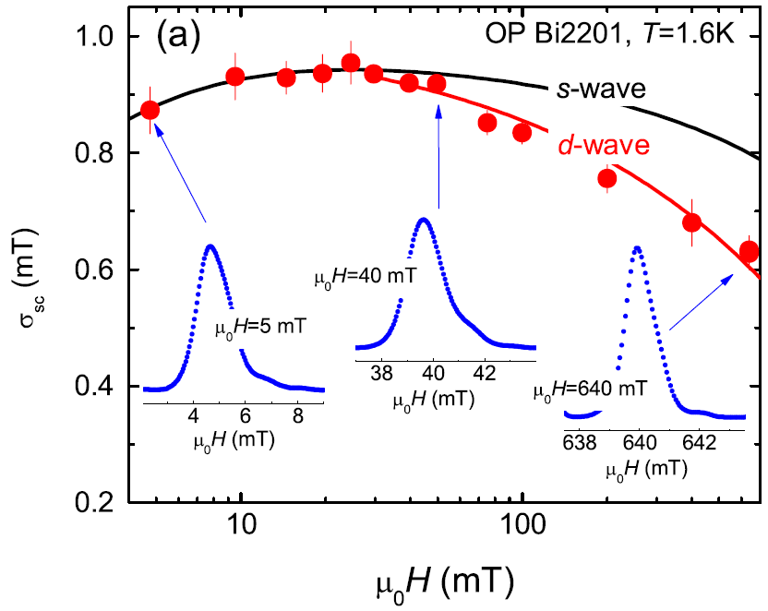
Science benefits – Higher resolution for superconductivity
Field dependence of the field distribution can depend on the order parameter
Current MuSR field limit can’t always distinguish models
Extra field range will help for experiments like this
Which curve
fits best?

Slide 18
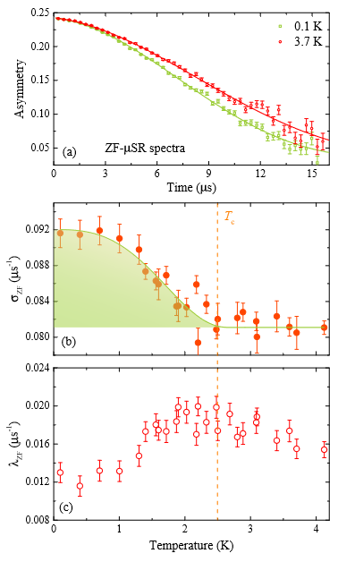
Science benefits – TRSB superconductors
Sr_{0.1}Bi₂Se₃
Tiny magnetic fields associated with time reversal symmetry breaking
Major area of muon science
Theoretical modelling of muon stopping sites continues to improve
Better data offers the prospect of greater insights

Slide 19
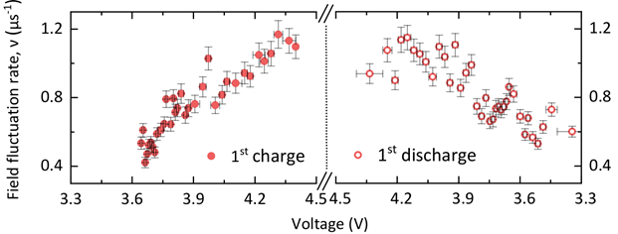
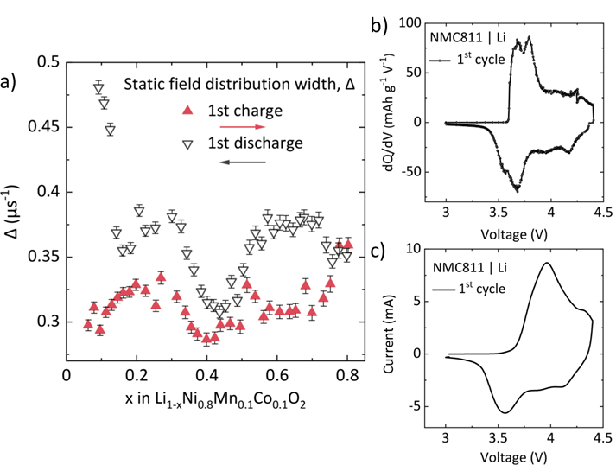
Science benefits – In-operando batteries
LiNi_{0.8}Mn_{0.1}Co_{0.1}O₂
Battery materials are most interesting when being cycled
Now doing in-operando cell measurements on EMU in bespoke cell and pouch cells
Super-MuSR’s higher rate and smaller beam spot will improve data quality >10x

Slide 20
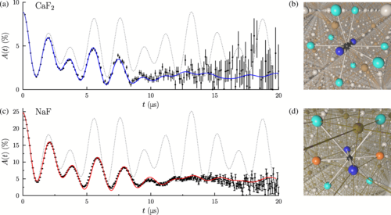
Science benefits – Quantum decoherence
Muon response to its environment is sometimes defined over many τ_{μ}
20x rate equivalent to 3τ_{μ} or 6.5μs more data of the same quality
Opportunities to extend this type of modelling beyond model systems

Slide 21
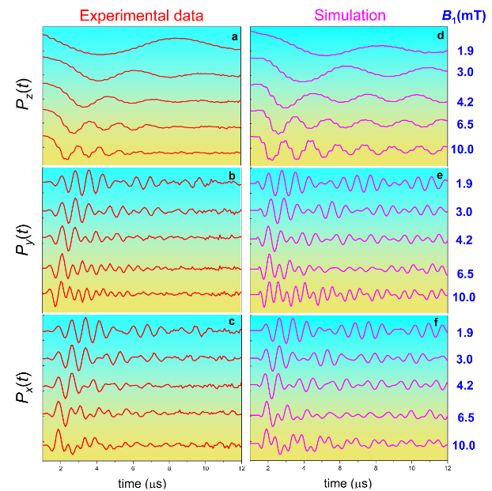
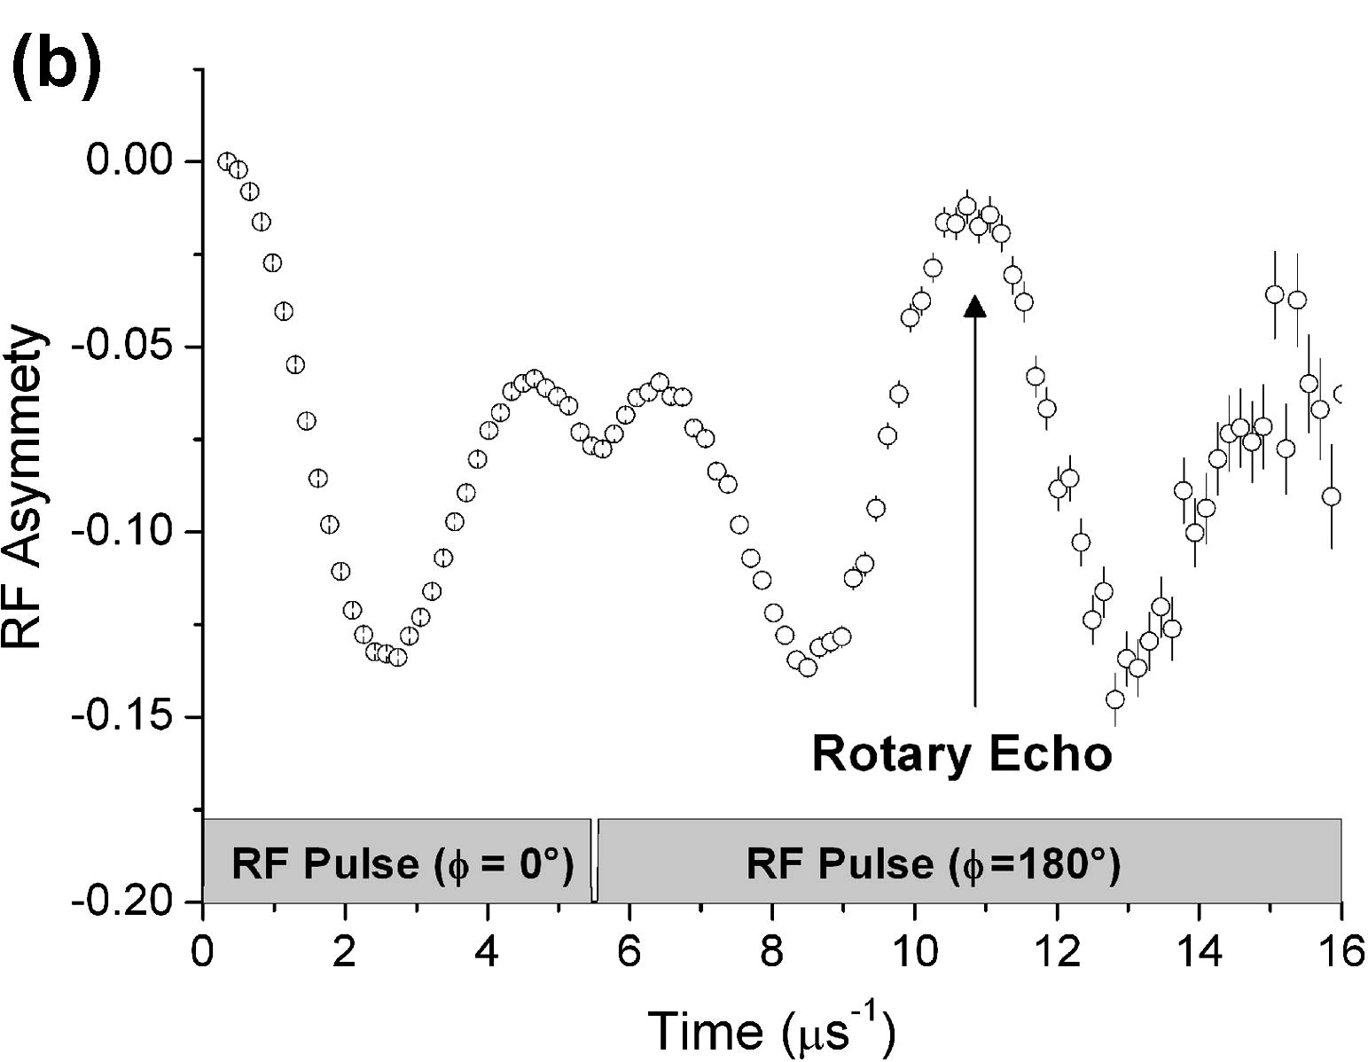
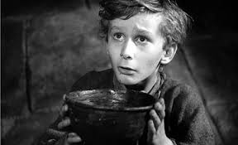
Science benefits – RF-µSR
Applying RF pulses to muon-nuclear spin systems allows more precise measurements of their interactions like NMR pulse sequences
Muon lifetime makes it challenging to do more than the most basic pulse sequences
Measurements already extend to 20μs but data collection takes several hours
Rate increase should make currently challenging experiments more routine and enable more complicated pulse sequences in future
µ

Slide 22

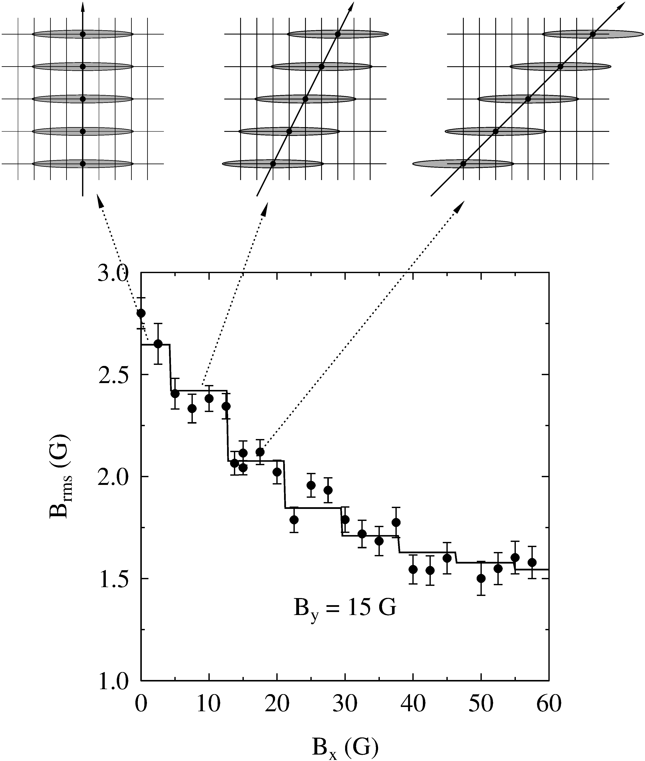
Science benefits – Vector-μSR
Aligned crystalline samples
Superconductors
Ordered magnets
With or without spin rotator
Apply B-fields on two axes
Find direction of internal fields
Underexplored area to date

Slide 23
Science benefits – The fast and the slow
Some samples need both high- and low-resolution muon data
Currently need two experiments at different muon sources
Magnetic order with:
Paramagnetic behaviour
Changing volume fractions
F-μ-F oscillations
TRSB superconductors are likely to benefit from this too
Barlowite

Slide 24
Science benefits – Measuring smaller samples
MuSR:
Muons stop in sample and holder (min. ~1cm², ~200mg)
Cryostat keeps its own vacuum, quick changes
Background can be significant on smallest samples
EMU and HiFi:
Can use small ‘flypast’ holder (min. ~0.1cm², ~20mg)
Cryostat shares vacuum with instrument, slow changes
Super-MuSR:
Both options will be possible
Flypast likely to be popular as lots of new materials only come in small quantities
Need to balance the desires of individual users with efficiently running the full programme
4x4mm sample

Slide 25
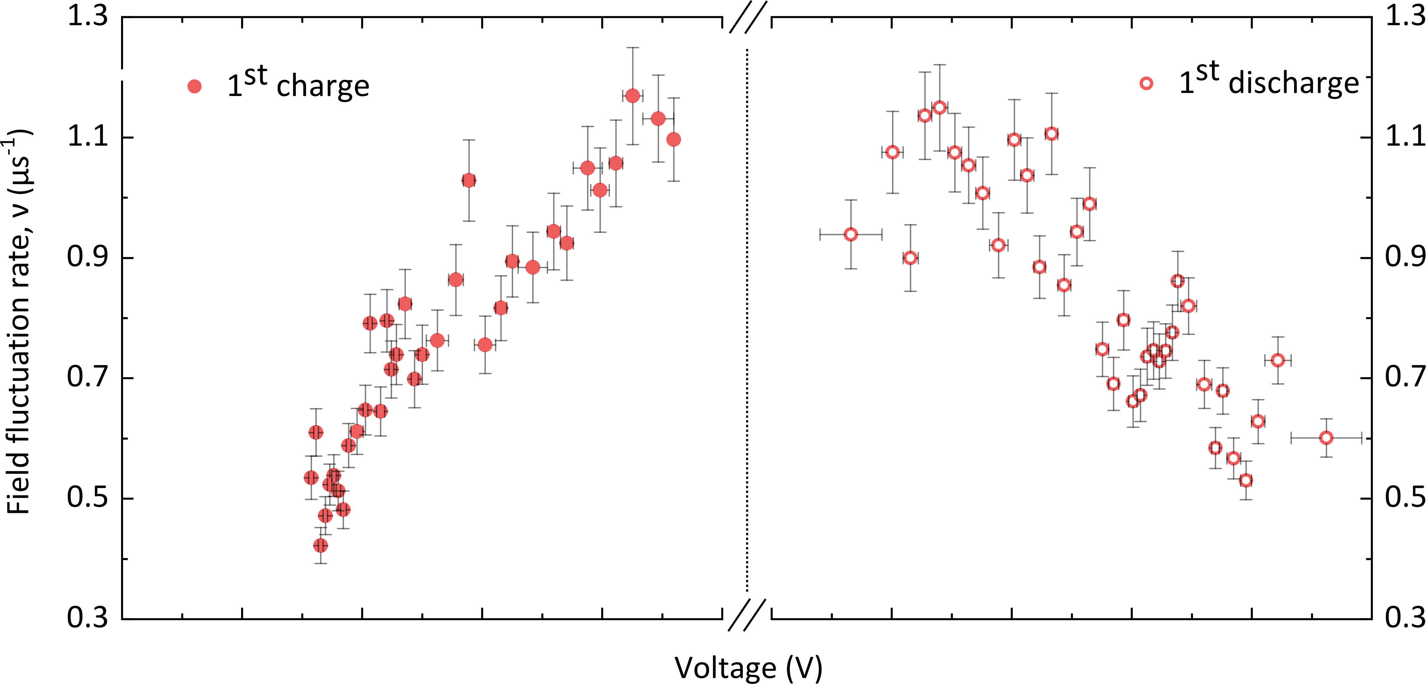
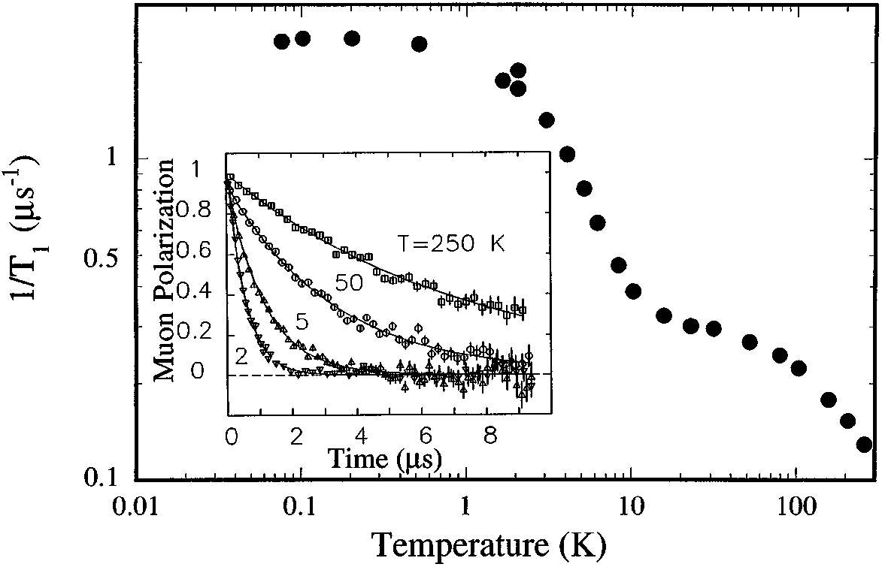
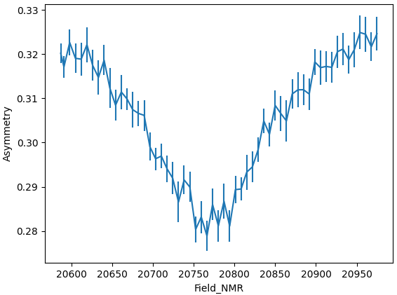
Science benefits – Transient μSR
Battery cycling
Temperature scans
Field scans
1 MuSR day
HiFi prototyping
2 EMU days
Data like this collected at commercial fast charging rates in pouch cells
Data like this could match ⁴He cryostat cooling rate
Study details afterwards
Studying muon spin resonance during magnetic field sweep
Many other types of sample can be changed over minutes or hours or repeatedly at higher rates

Slide 26
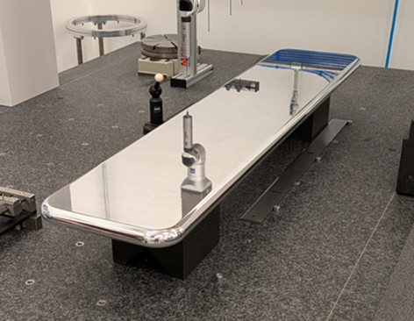
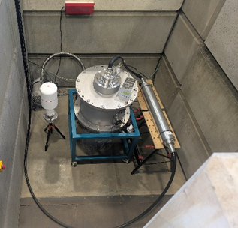
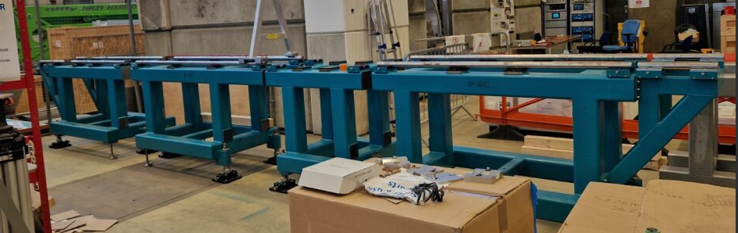
Conclusions
Super-MuSR will significantly extend the capabilities of pulsed muon sources
20x counting rate of today’s instruments with existing resolution OR
10x frequency range of existing pulsed sources with existing rate
High counting rate event mode data offers an opportunity to do experiments better
Many experimental parameters can be scanned during data taking
Might be able to dynamically adjust what data are taken next to optimally use beamtime
Super-MuSR being pre-built now, installed in 2027 and taking data in 2028

