Slide 1
Applying for Beamtime
Adrian Hillier, ISIS Muon Group
Muon School
Jan 2026

Slide 2
Applying for Beamtime
Adrian Hillier, ISIS Muon Group
The power of delegation
Muon School
Jan 2026
Rhea Stewart, ISIS Muon Group

Slide 3
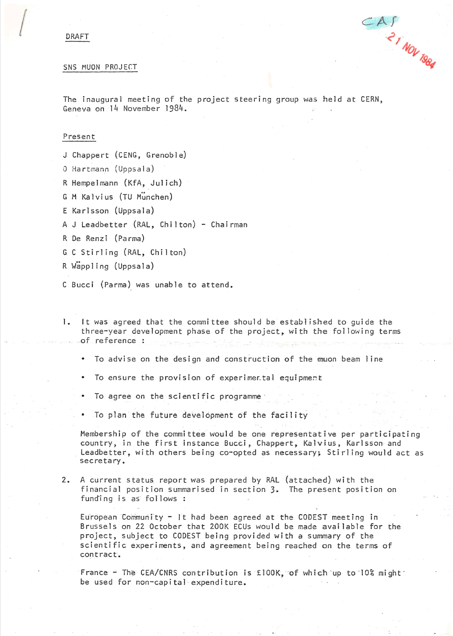
Planning the Experiment
14 November 1984 – first meeting to discuss the concept of muons at ISIS

Slide 4

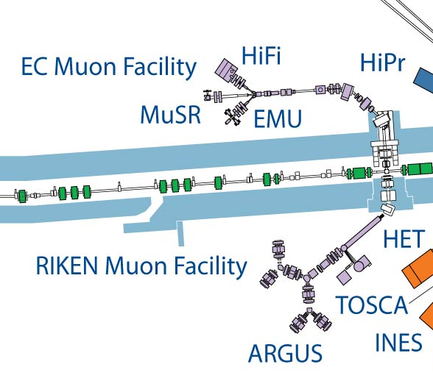
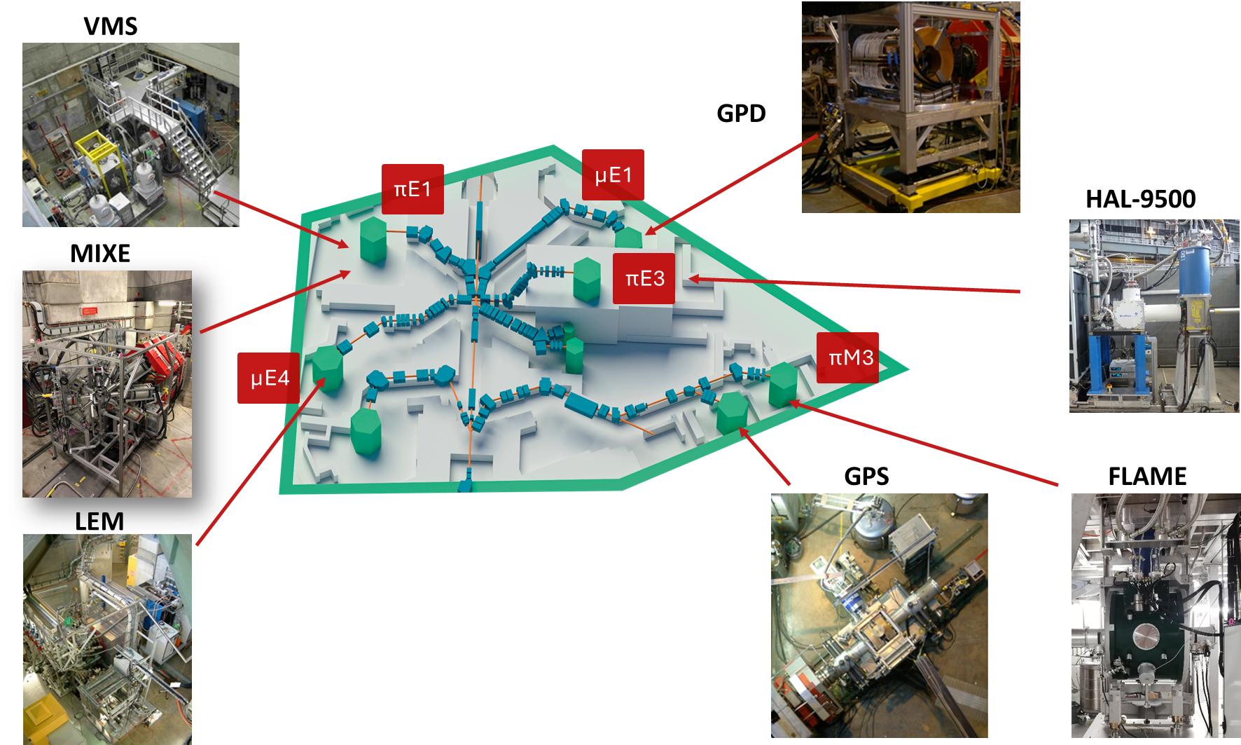
Planning the Experiment
Think about your proposal
What scientific question do you want to address
How can muons help?
What type of experiments?
Which facility/instrument?
Do you need special sample environment?
If you don’t know then please contact us

Slide 5
The Proposal Process
ISIS
PSI
2 calls per year
(deadlines April and October)
submissions via ISIS website
~110-120 proposals per round
Oversubscription ~1.8-4
6 weeks after the deadline, the selection panel meets
Results a few weeks after that (with comments)
Instrument scientist will then ask for preferred dates
Schedule produced, local contacts assigned
Run experiments!
2 calls per year (usually deadlines December and June)
All submissions via PSI digital user office (PSI-DUO)
~150 proposals submitted in round 1 and ~100 proposals in round 2
Oversubscription ~1.4 - 4
6 weeks after the deadline, the selection panel meets
Results a few weeks after that (with comments)
Schedule produced according to exclusions set by the users
Run experiments!
https://www.isis.stfc.ac.uk/Pages/Apply-for-beamtime.aspx
https://www.psi.ch/en/smus/calls

Slide 6
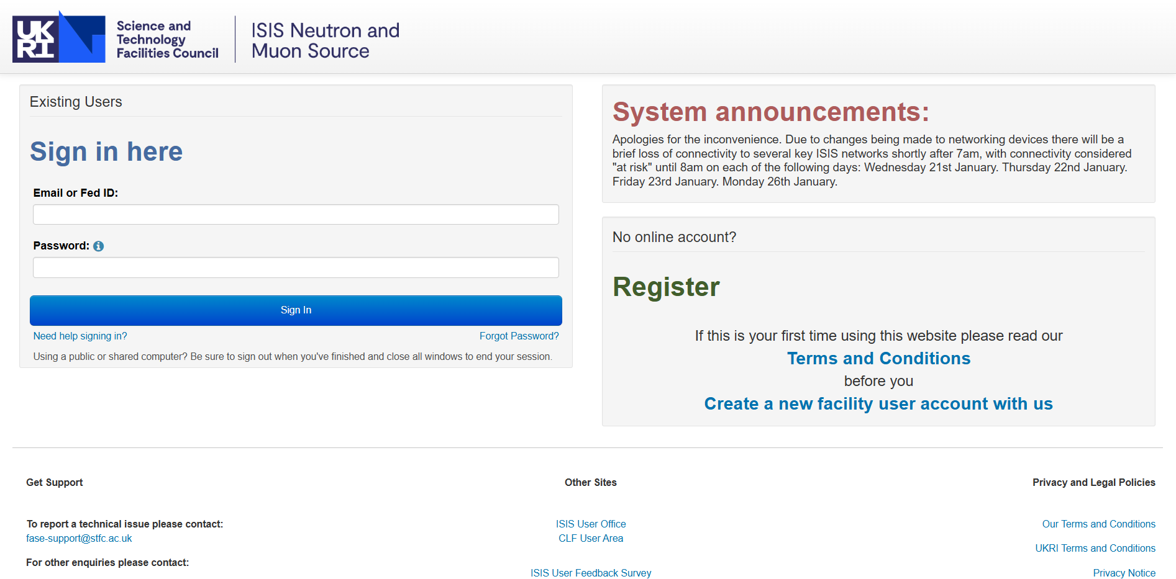
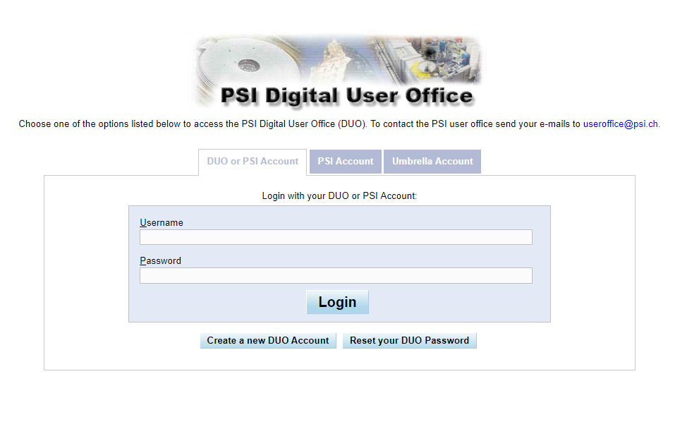
The Proposal Process
http://www.isis.stfc.ac.uk/apply-for-beamtime/
https://duo.psi.ch/duo/

Slide 7
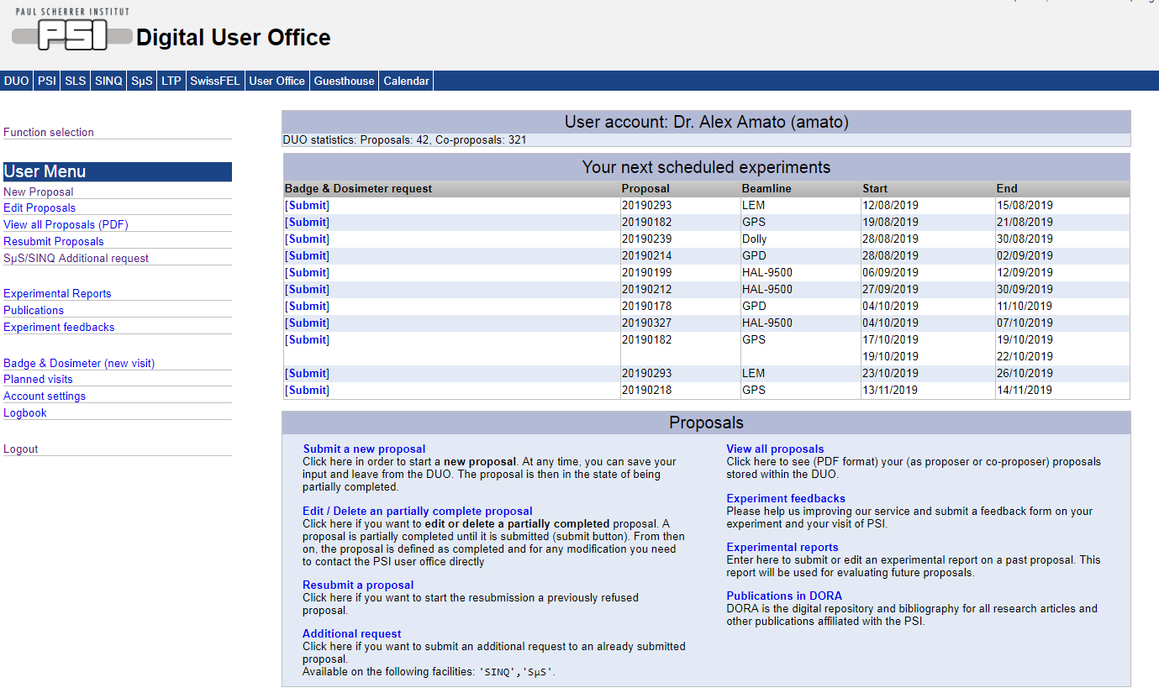
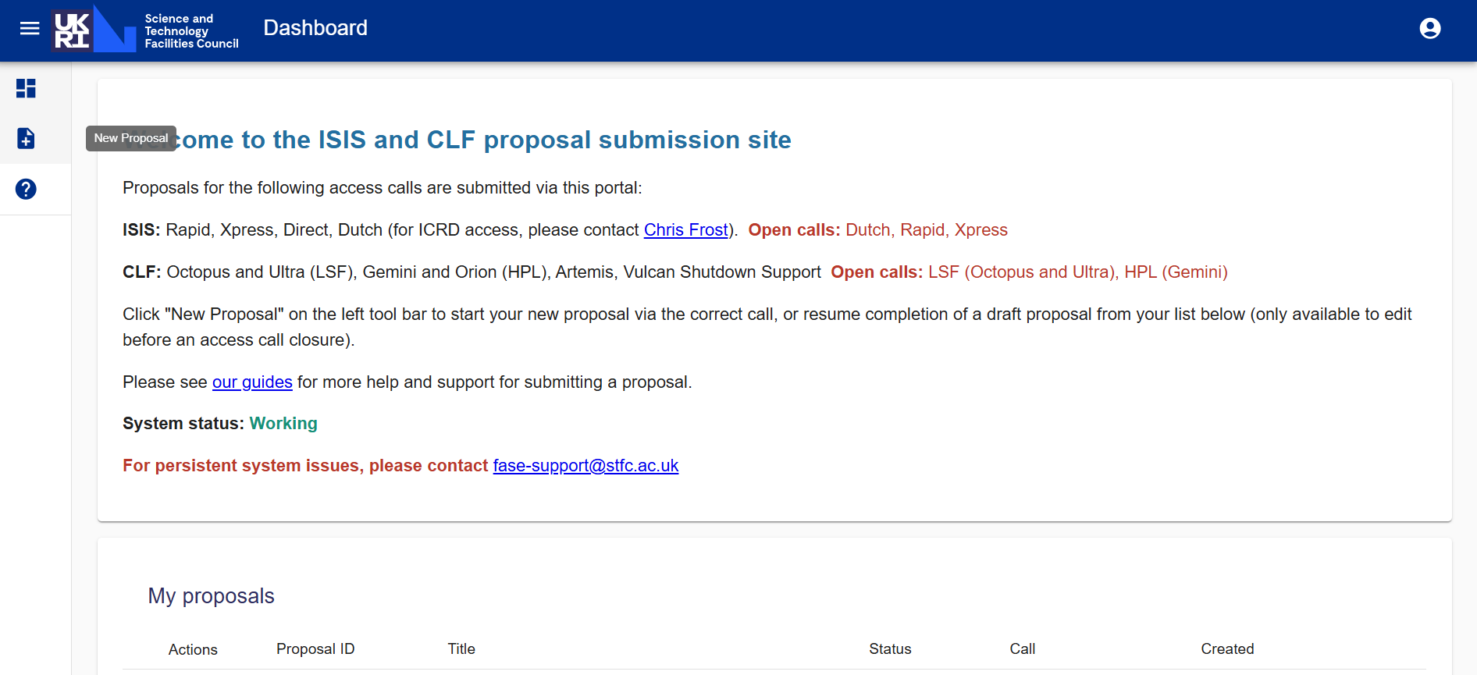
The Proposal Process
One can (re)submit a new proposal, edit a saved one, etc

Slide 8
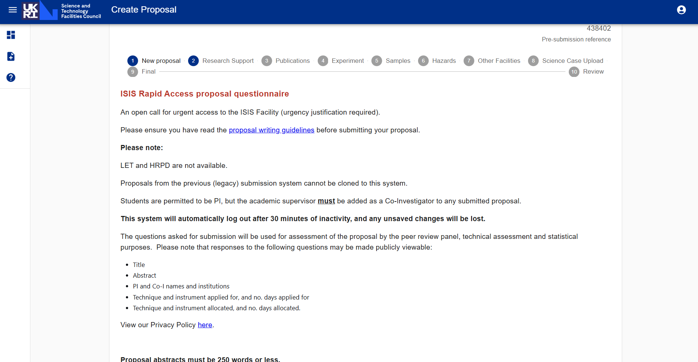
Creating a proposal and declaring funding support
How the proposal is supported (associated grants, or studentships, or industry links) is important.

Slide 9
Details of the experiment
You will then be guided through the different steps (instrument, sample environment, sample, etc).
Always contact the instrument scientists if you are unsure about instrument/sample environment or other questions
IMPORTANT:
Due to their specificities, it is important for the instruments HAL-9500 and LEM to contact the instruments scientists prior to writing/ submitting a proposal.
@PSI Define the exclusion dates for your experiment! NO further contact will be made with the proposers concerning the scheduling
@ISIS We’ll contact about scheduling if your experiment is successful

Slide 10
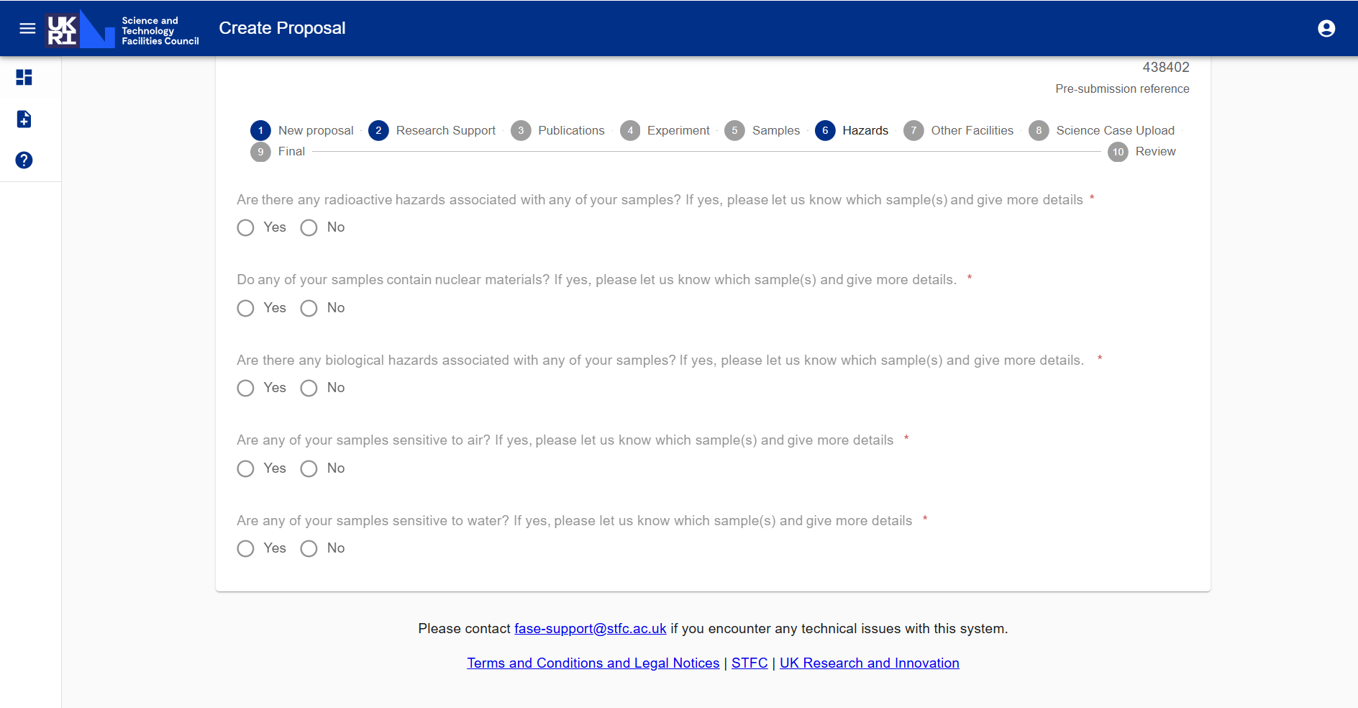
Safety
A safety assessment will be needed before the experiment will be run

Slide 11
The Science Case
Proposals judged on science
Upload a scientific case (maximum of 2 pages @ISIS, 3 pages @PSI).
Self-contained (but can include references)
Explain the background (timeliness, technological relevance, etc)
What question(s) are you trying to answer?
How will muons help – what information will you get and how?
Why muons (consider that µSR is a very expensive technique)?
Describe the measurements (number of samples, temp. / field scans)
Justify the time you are asking for (be specific)
Samples – do you have them? Say how they have been characterised and show the data
Demonstrate you’ve used previous beamtime well

Slide 12
The Science Case
Proposals judged on science
Upload a scientific case (maximum of 2 pages @ISIS, 3 pages @PSI).
Self-contained (but can include references)
Explain the background (timeliness, technological relevance, etc)
What question(s) are you trying to answer?
How will muons help – what information will you get and how?
Why muons (consider that µSR is a very expensive technique)?
Describe the measurements (number of samples, temp. / field scans)
Justify the time you are asking for (be specific)
Samples – do you have them? Say how they have been characterised and show the data
Demonstrate you’ve used previous beamtime well
It is important to write a clear and convincing science case that justifies the time requested.

Slide 13
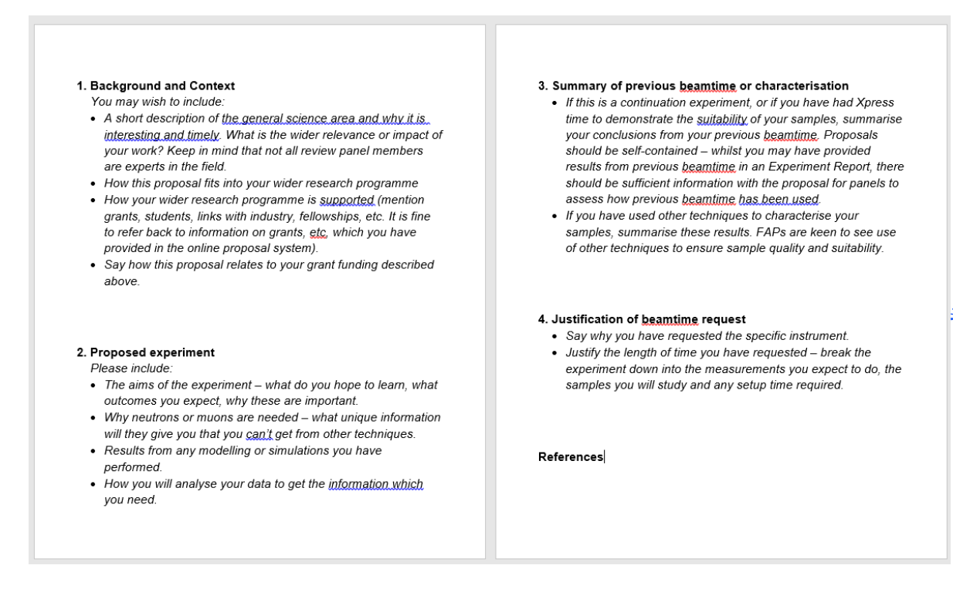
Science Case Template

Slide 14
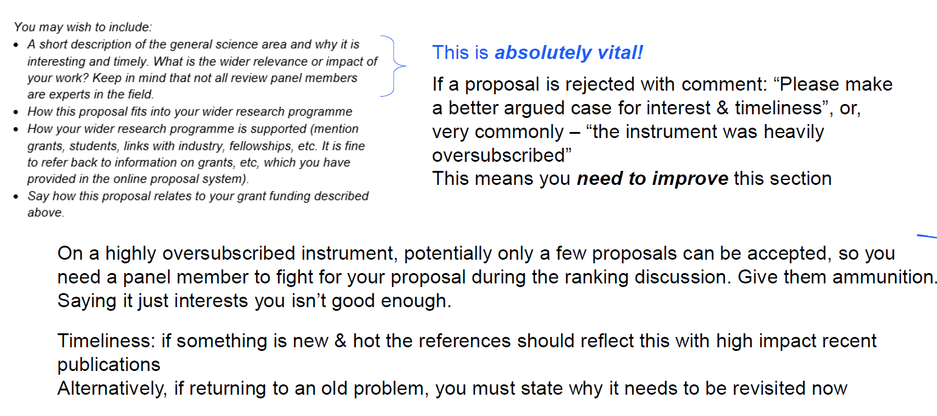
Science Case: 1 Background and Context

Slide 15
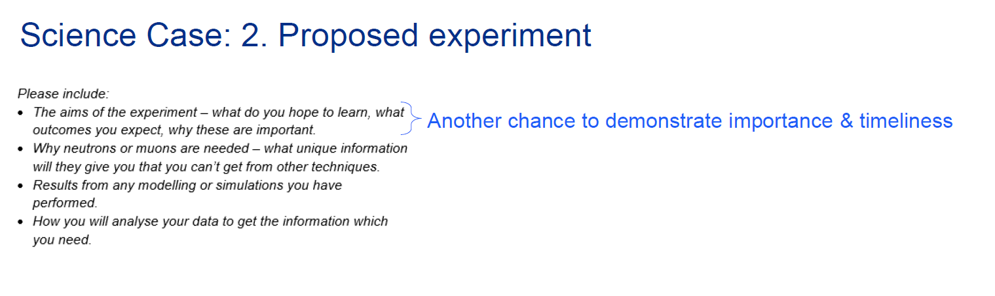
Science Case: 2 Proposed Experiment

Slide 16
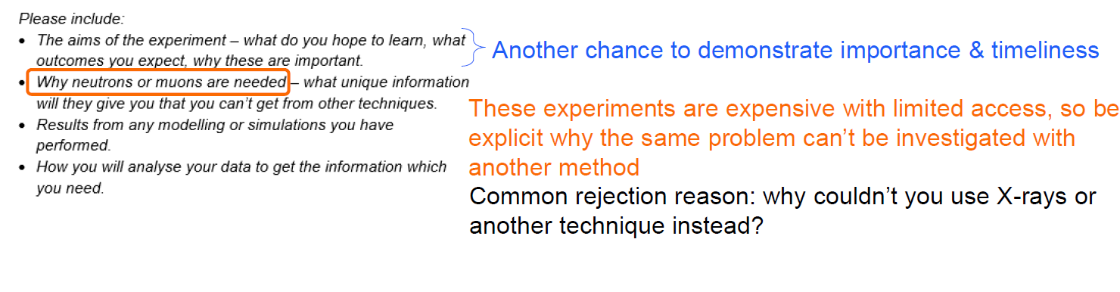
Science Case: 2 Proposed Experiment

Slide 17
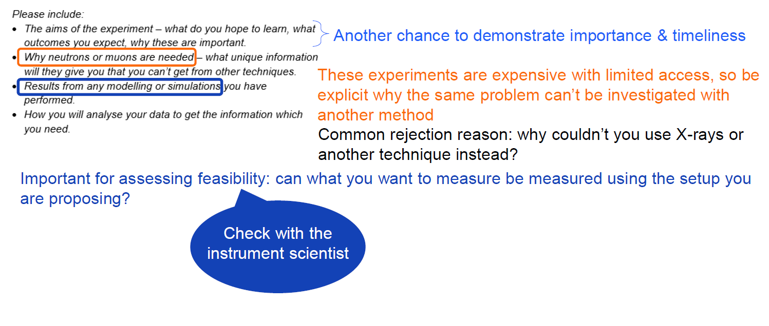
Science Case: 2 Proposed Experiment

Slide 18
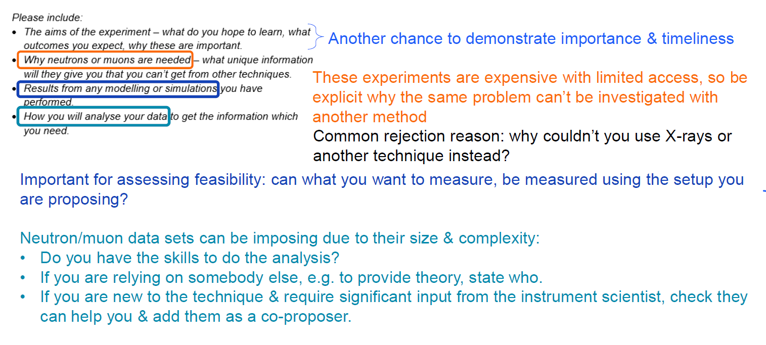
Science Case: 2 Proposed Experiment

Slide 19
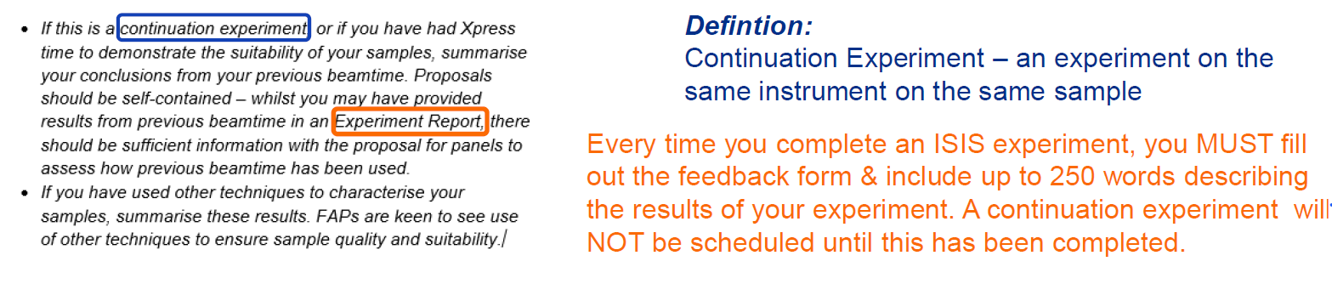
Science Case: 3 Summary of previous beamtime and/or characterisation

Slide 20
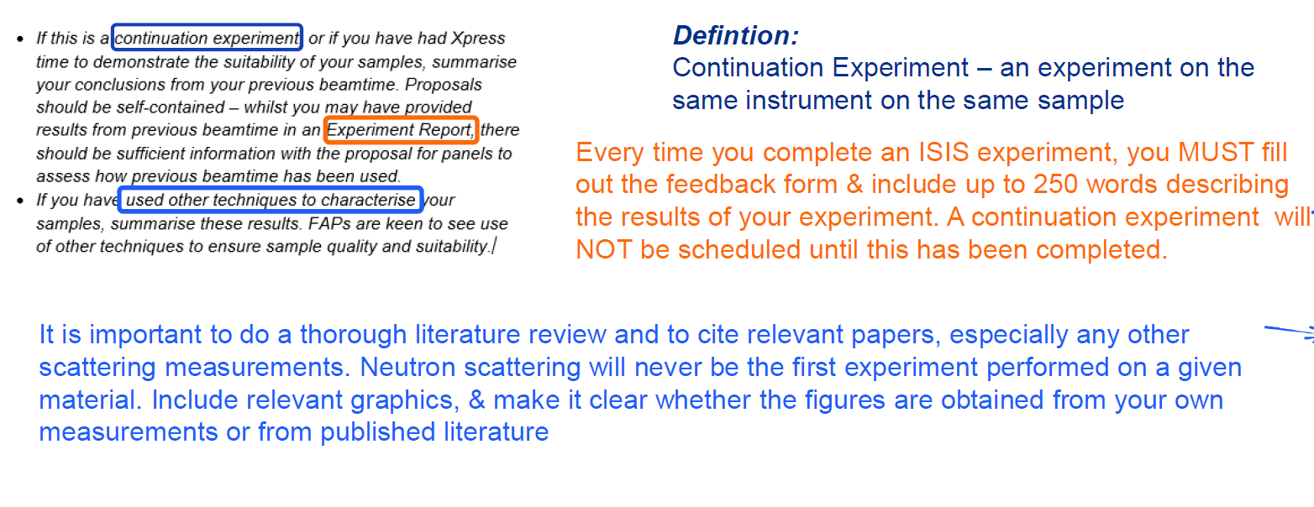
Science Case: 3 Summary of previous beamtime and/or characterisation

Slide 21
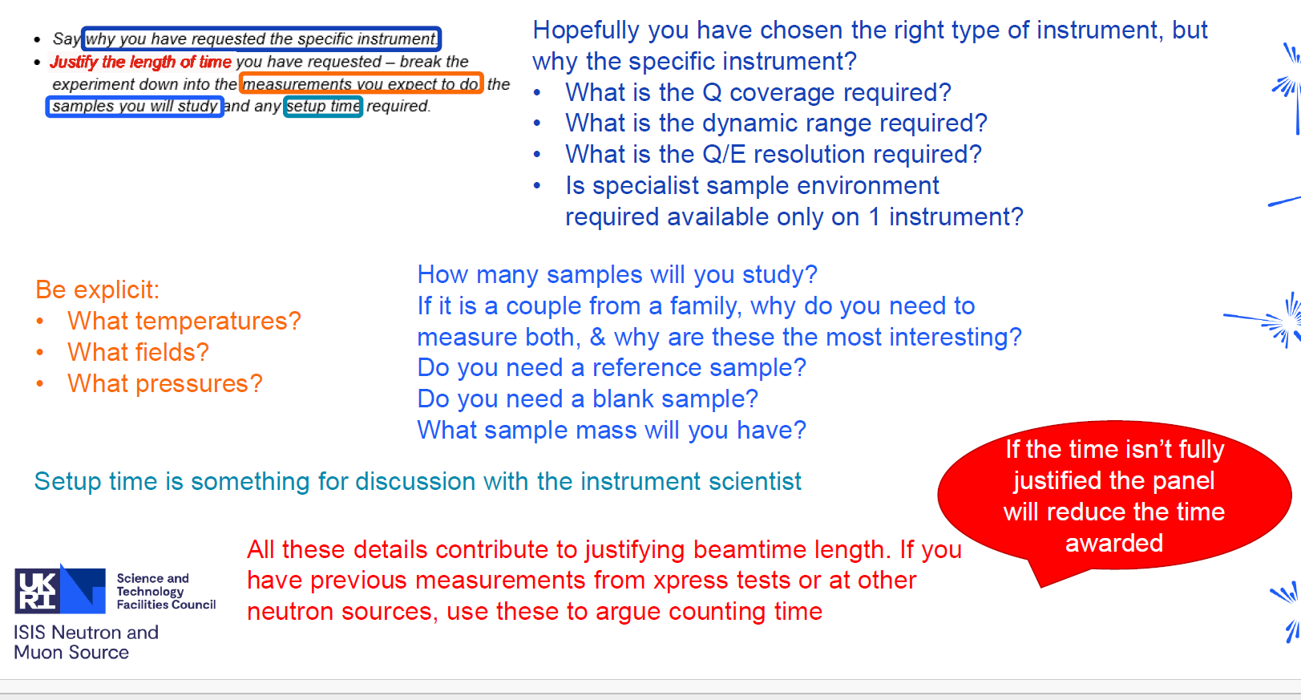
Science Case: 4 Justification of beamtime request

Slide 22
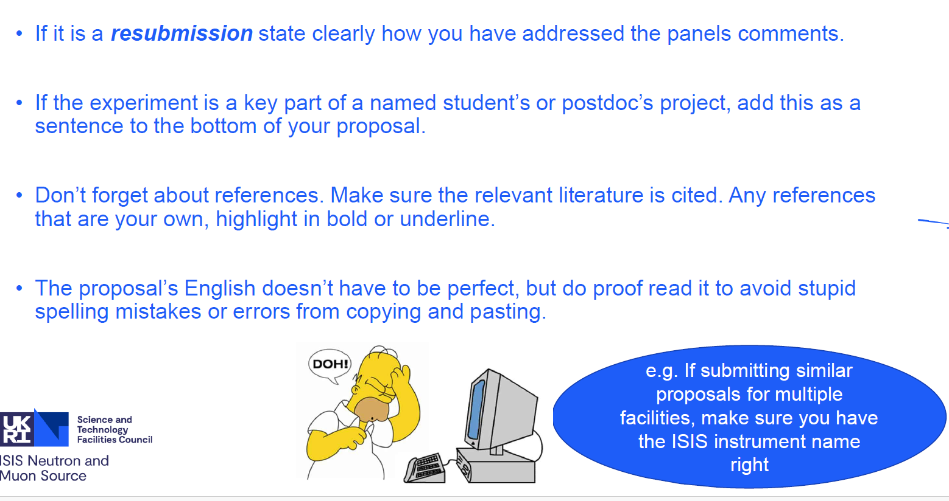
Science Case extras

Slide 23
Things to avoid . . .
‘we will search for the multi-spitoon excitations’
‘CsNiBr₃ is isomorphic to CsNiBr₃ [2]’
‘we will probe the two mango dispersion’
‘the burst of muons, rather than one muon at a time, will simulate hydrogen diffusion and encourage competition for traps . . .’
‘In the past, several of these systems have been studied by means of muSR. Reanalysing the data shows that substantial parts of the data are missing . . . . .’
‘I am overwhelmed by the feeling that I have spent longer reading this proposal than the author spent writing it’
unnamed panel member

Slide 24
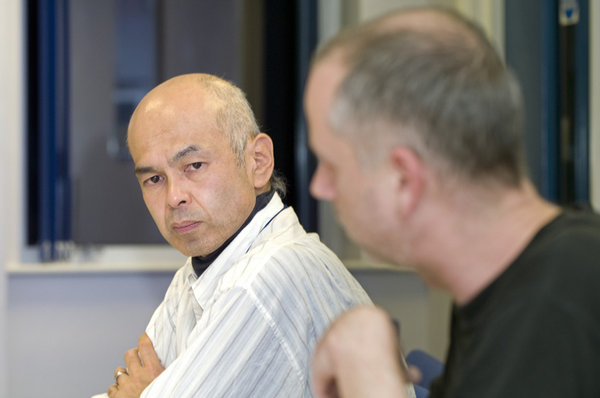
The review
External panel to advise ISIS or PSI on the science
Panel recommends a program for the facility to run

Slide 25
Other types of Proposals
Rapid Access (ISIS), Director Discretion Time (PSI)
For rapidly-moving science areas, new sample discoveries, other urgent studies
Proposals can be submitted any time
Rapidly reviewed
If awarded time, scheduled as soon as possible
Must be a clear case as to why the measurement is urgent
Xpress Access
For initial characterisation of samples or feasibility checks on samples for future beamtime
Proposals are short, and can be submitted any time
Reviewed internally
Awarded up to 5 hours of beamtime on either MuSR or EMU.
Users need not come for the measurement – can send the sample in
Proprietary Research (Industrial access)
Proprietary beam time is defined as work that will not be made available in the open literature.
Each facility has routes for this access and may incur fee

Slide 26
Data Policy
Access to Raw Data and Metadata obtained from an experiment is restricted to the Experimental Team for an embargo period of three (3) years after the end of the experiment.
Researchers who carry out analyses of Raw Data and Metadata which are openly accessible shall, to the extent practicable, contact the original PI to inform him and suggest a collaboration if required.
Raw Data and Metadata explicitly used for peer-reviewed publication will become Open Access at the time of such publication.

Slide 27
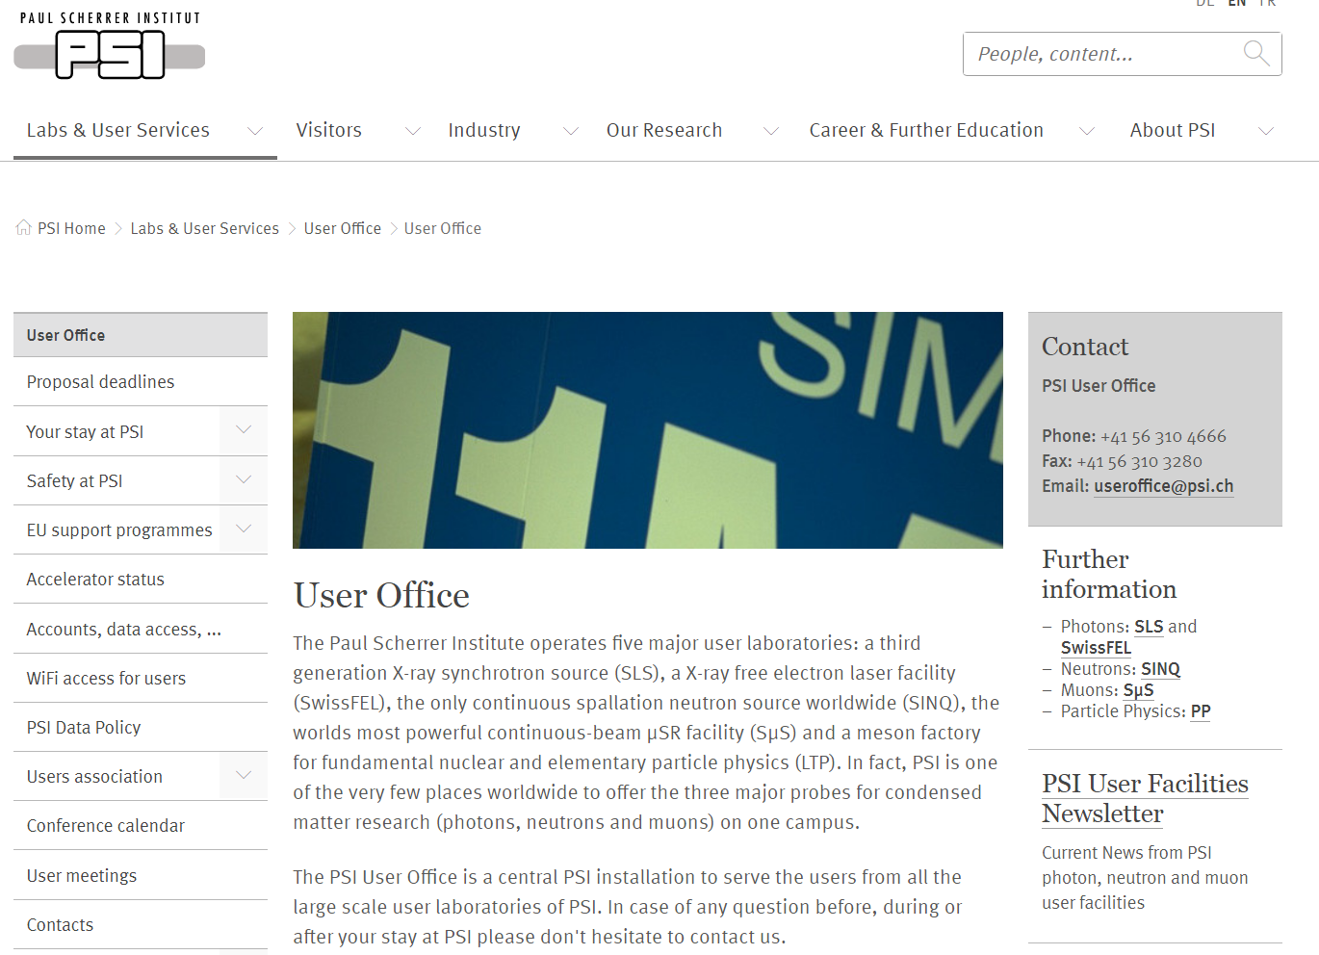

User Offices
Available to answer questions, deal with problems, etc:

Slide 28
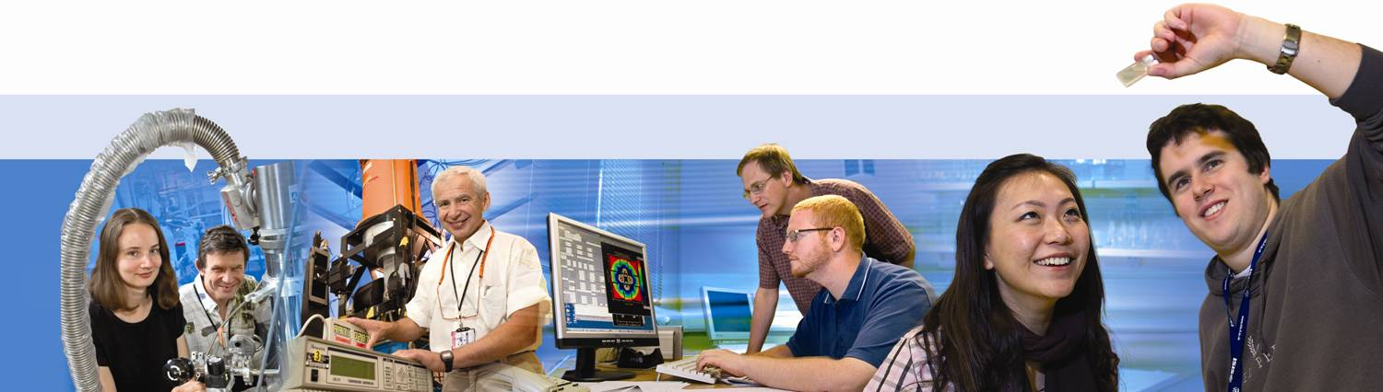
Flow chart for an ISIS experiment
Facility Access Panels
Proposal
Visitors need to:
book accommo-dation
check details
check health information
complete online safety test
User office email team members:
provide STFC logins
link to book accommo-dation
link to online registration
Experiment contact asked to:
complete ERA
list other team members
Beamtime awarded
Run the experiment!
Experimentscheduled
PSI similar

Slide 29
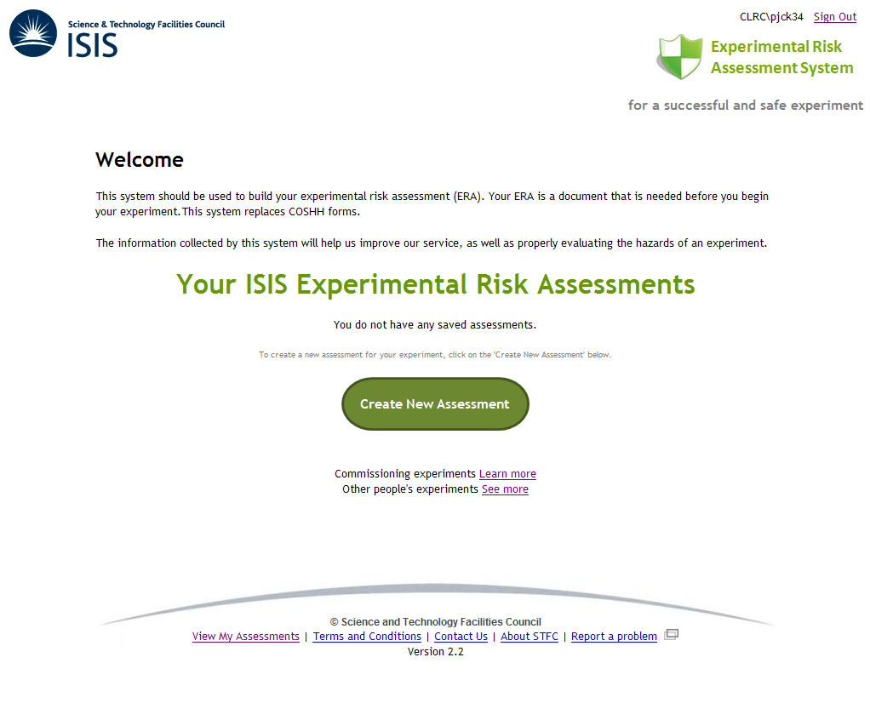
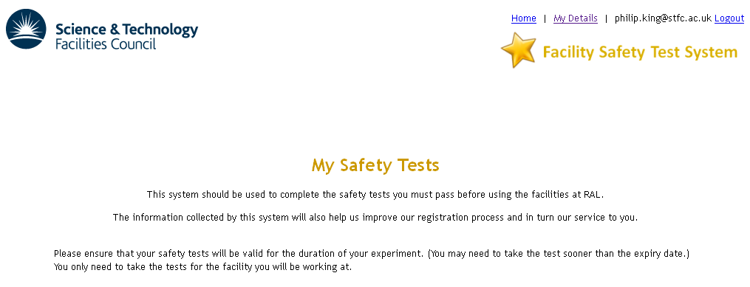
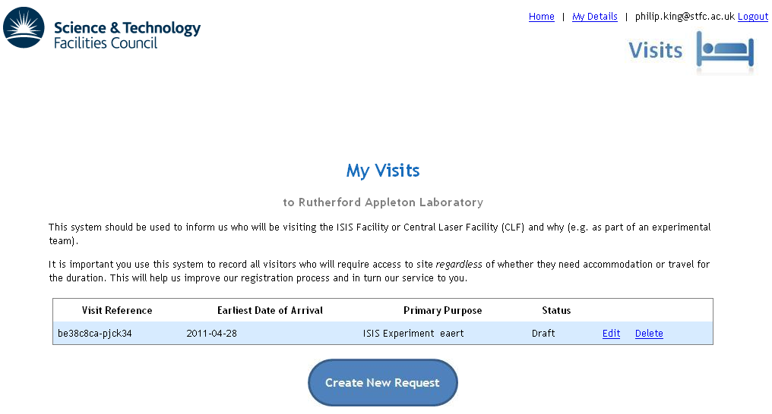
Online systems
Request Badge and Dosimeter for next schedule experiment

Slide 30
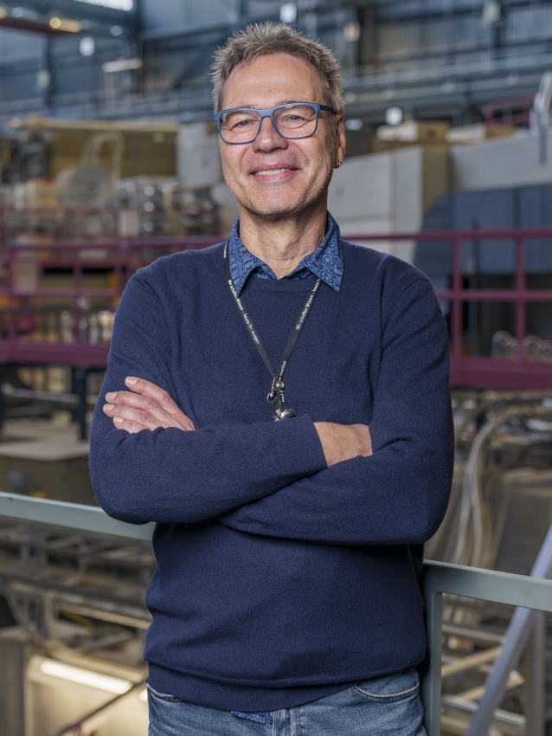
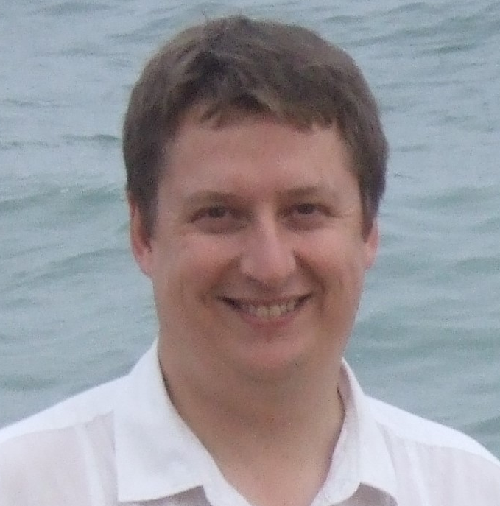
Here to help!
Contact: Dr. Adrian Hillier Muon Group Leader ISIS Neutron and Muon Facility adrian.hillier@stfc.ac.uk
Contact: Dr. Thomas Prokscha
Head of LMU Laboratory Paul Scherrer Institute thomas.prokscha@psi.ch

