Slide 1
TRIUMF and J-PARC introductions
Kenji M. Kojima
(TRIUMF & UBC) 2018~
(J-PARC) 2009~2018
Muon Spectroscopy school
14-21, 2026 Rigi-Kaltbad, Switzerland
https://indico.psi.ch/event/16947/

Slide 2
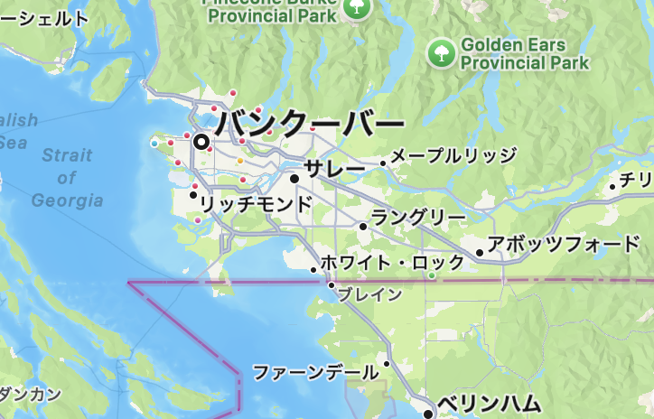
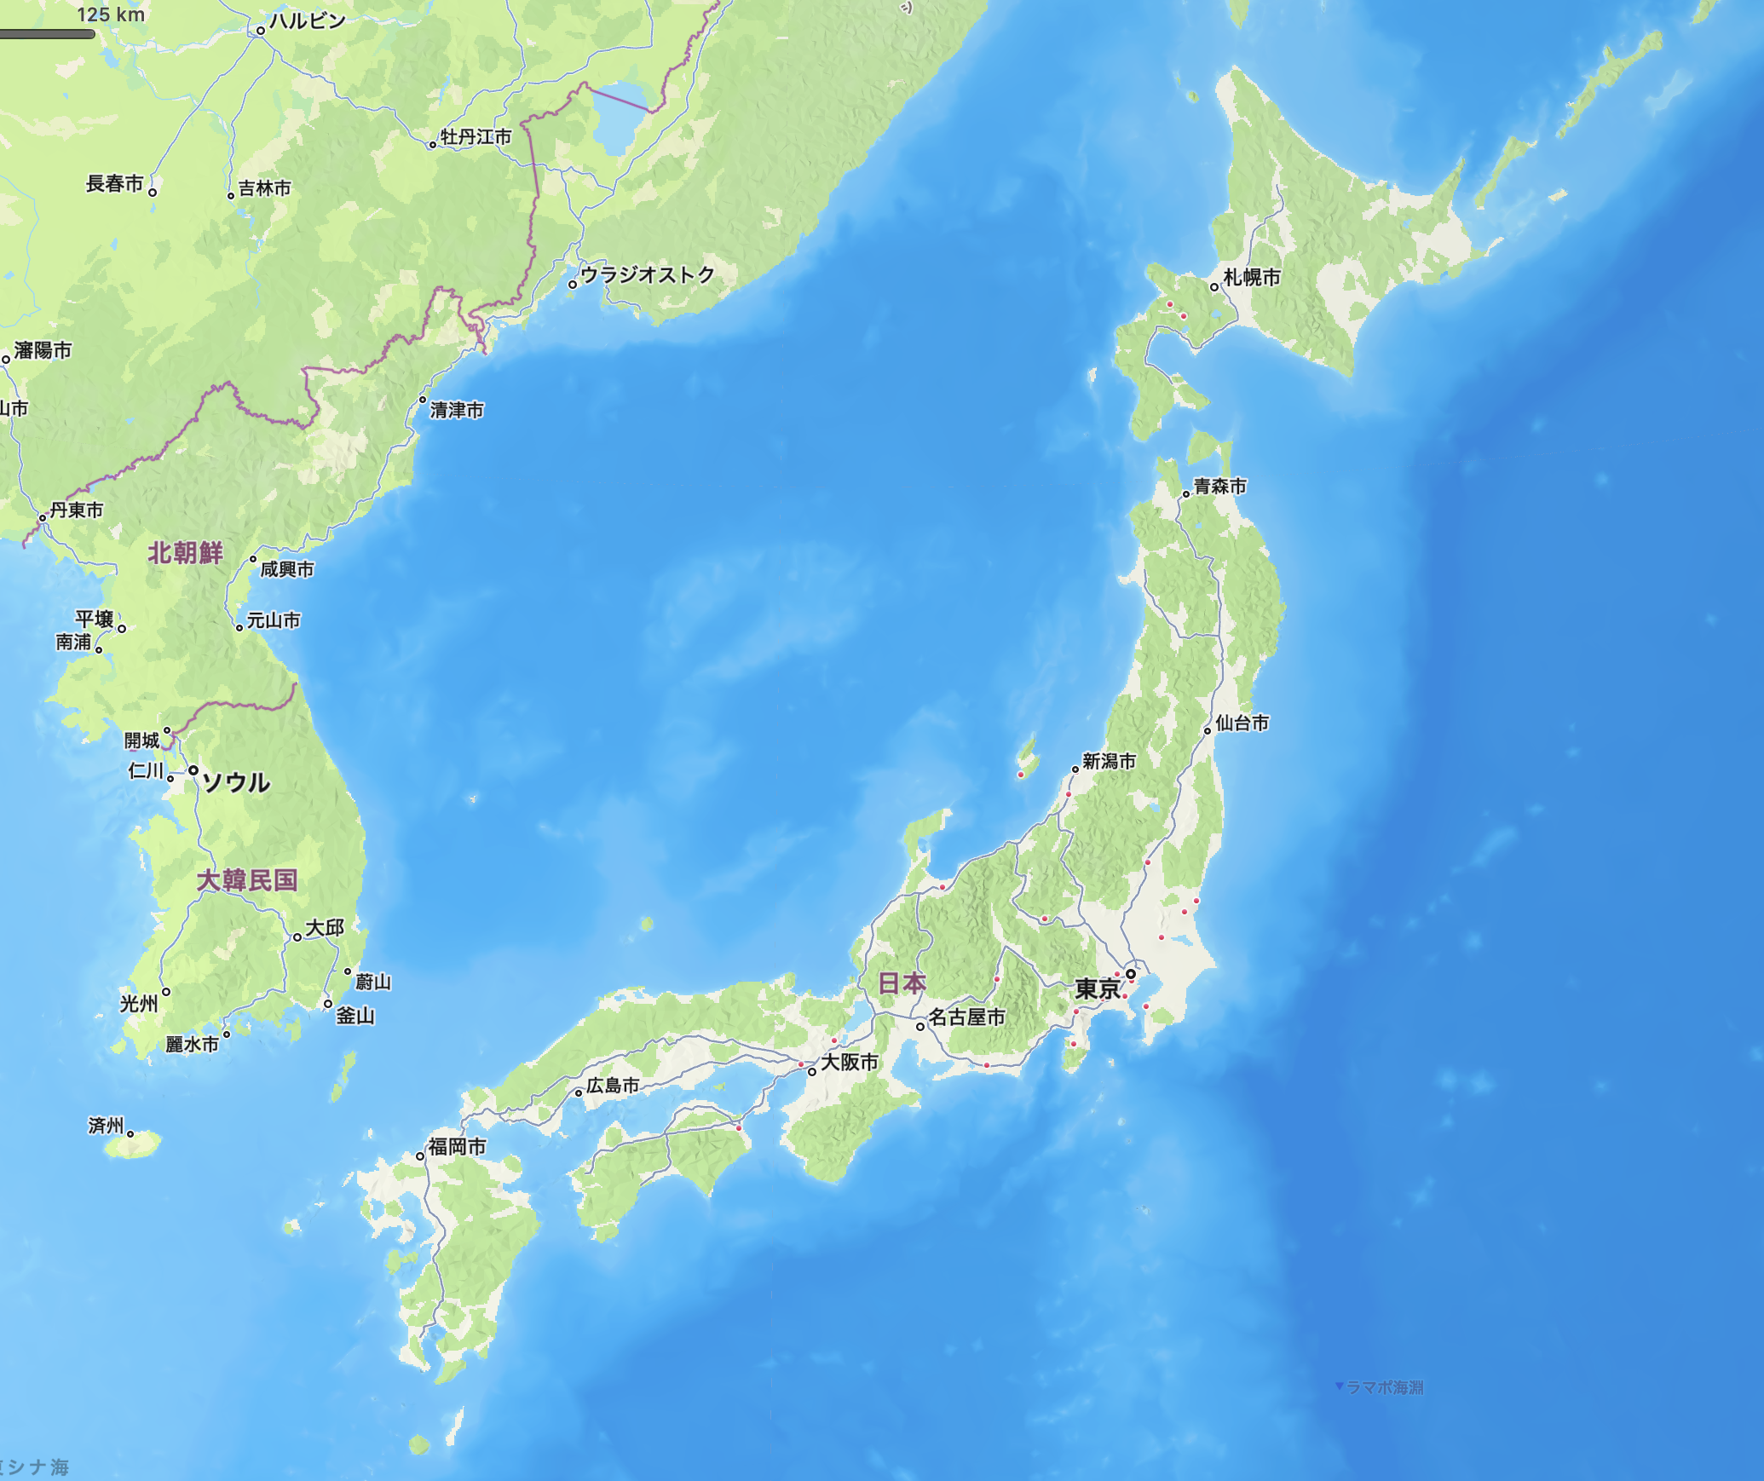
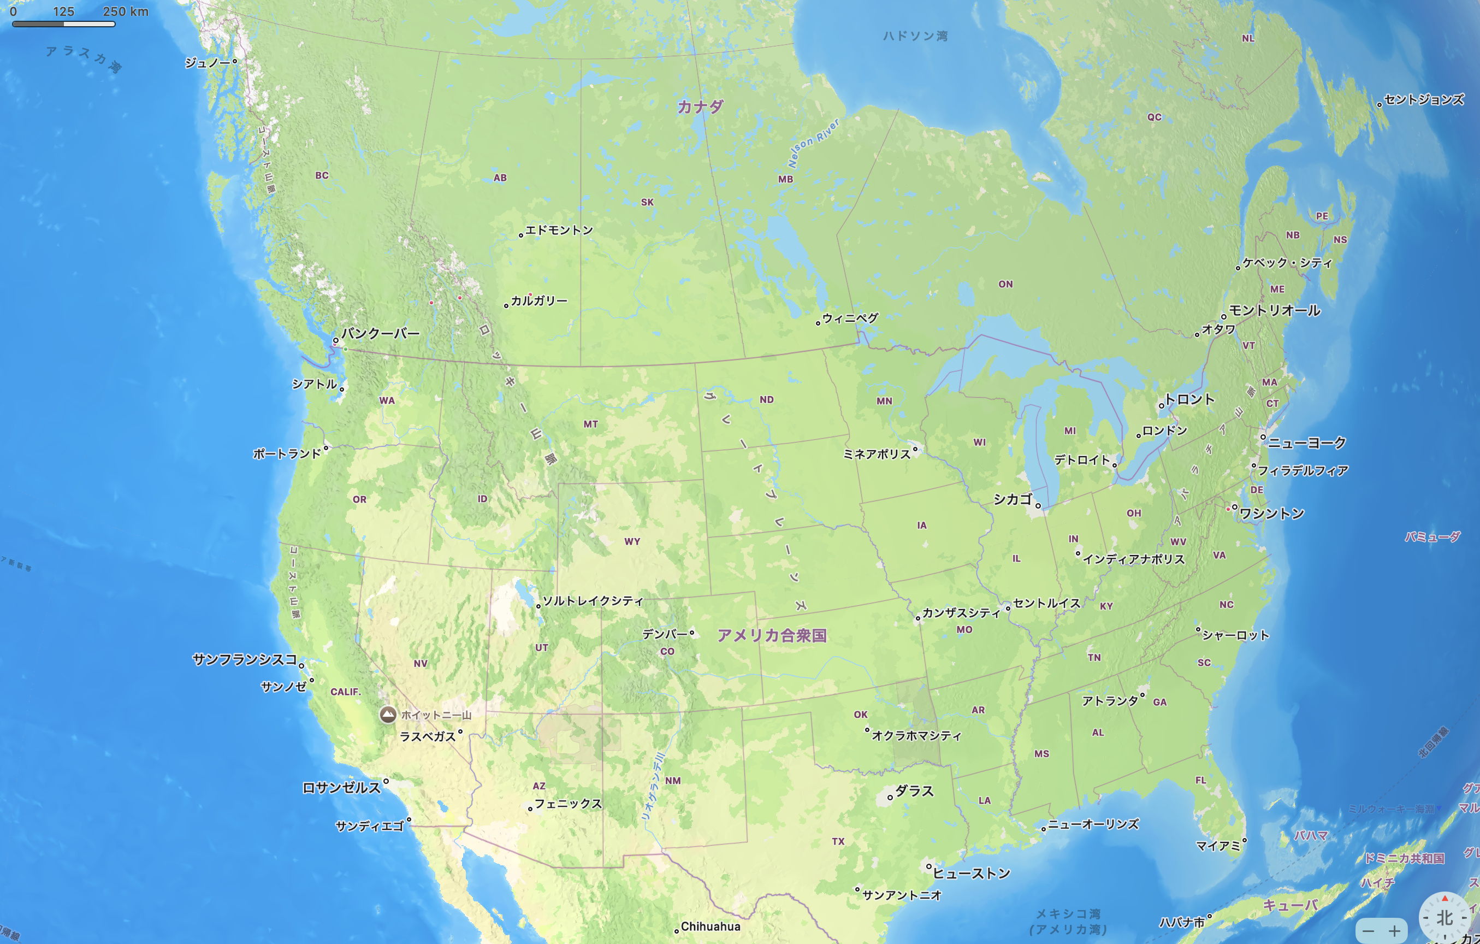
J-PARC: 1.5-2 hours train from Tokyo
3 hours train or bus from Narita / Haneda airport
TRIUMF: 30 min drive / 1 hour train+bus from airport
J-PARC
MuSIC
(Osaka U.)

Slide 3
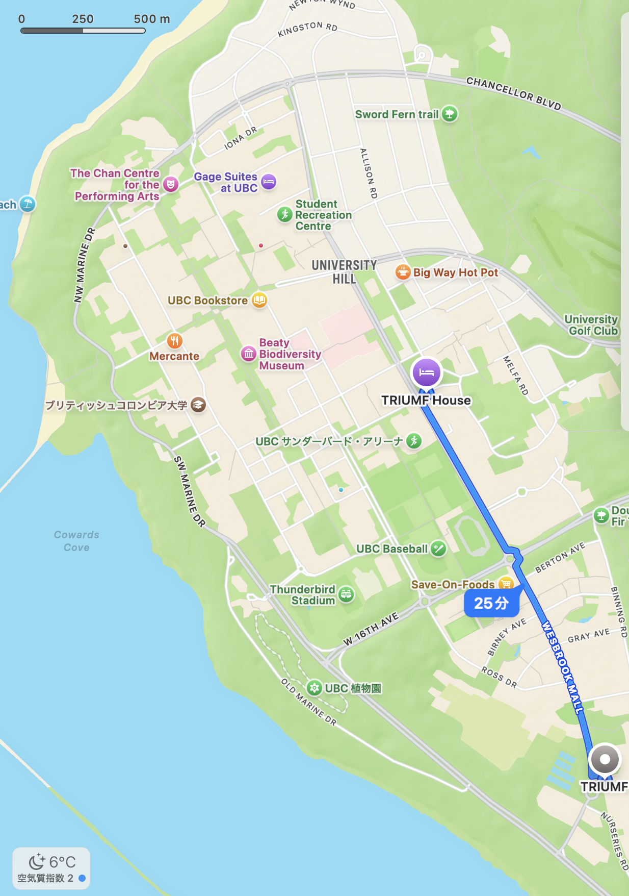
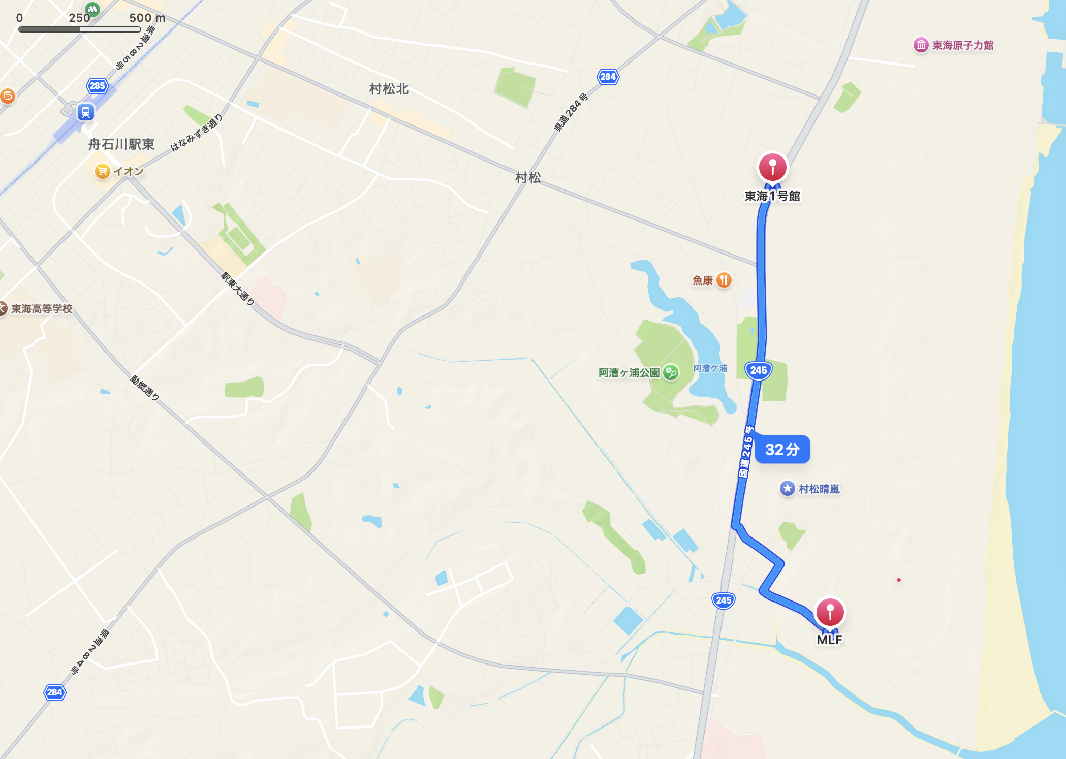
Logistics
TRIUMF
★Kasumi
J -PARC
Tokai station
7-eleven★
| security gate
SBQMI★
Safety report / sample review have to be done in advance and followed.
Accommodation (shared kitchen
Independent bathroom)
TRIUMF house: ~CHF 86/night
J-PARC dormitory: ~CHF 15/night
Supermarket
TRIUMF: Save-on-foods
J-PARC: 7-eleven / Kasumi store
Save on foods★
25 min walk
TRIUMF house - TRIUMF
34 min walk
Tokai Dormitory – J-PARC MLF

Slide 4
Key Concepts/Takeaways:
Facilities and Instruments: Reviewing unique instruments available for muon spin rotation studies at PSI, ISIS, TRIUMF and J-PARC and their respective strengths.
Facility Application Processes: Learning about proposal deadlines, oversubscription rates, and the steps required to submit.
Importance of Clear Proposals: Understanding how to formulate a concise scientific case and justify the use of muons.
Experiment Planning & Logistics: Outlining the planning stages, from selecting an instrument to scheduling and sample preparation.
Engaging with Facility Scientists: Knowing whom to contact (instrument scientists, user offices) and how to seek assistance for successful experiments.

Slide 5
Proposal-Beamtime Calendar
 |  | Oct | Nov | Dec | Jan | Feb | Mar | Apr | May | Jun | Jul | Aug | Sep | Oct | Nov | Dec | Jan | Feb | Mar
deadline |  |  |  | ~02 |  | ~05BR |  |  | ~29 |  | ~31BR |  |  |  |  | ~02 |  | ~05BR
TRIUMF
Valid 2 yr.
deadline |  |  | 07 |  |  |  |  |  | 08 |  |  |  |  |  | 07
J-PARC |  |  |  |  |  |  |  | A |  |  |  |  |  |  | B
Valid 1/2 yr.
deadline |  |  |  | 01 |  |  |  |  |  | 01 |  |  |  |  |  | 01
PSI |  |  |  |  |  |  |  |  |  | I |  |  |  | II
deadline |  | 3rd wed |  |  |  |  |  | 3rd wed |  |  |  |  |  | 3rd wed
ISIS |  |  |  |  |  |  |  |  | 1 |  |  |  |  |  | 2

Slide 6
Important: shutdown information!
TRIUMF cyclotron goes to a shutdown: 2026 Feb ~ 2027 May.
There was no call 2026-1, and there will be no call for 2026-2
The call will resume for 2027-1 (~Dec. 2026).
PSI shutdown is postponed to 2028: probably no call 2028-1.
→you should be able to submit to TRIUMF 2028-1 and 2 (deadlined ~Dec. 2027 and ~Jun. 2028)
ISIS shutdown ?

Slide 7
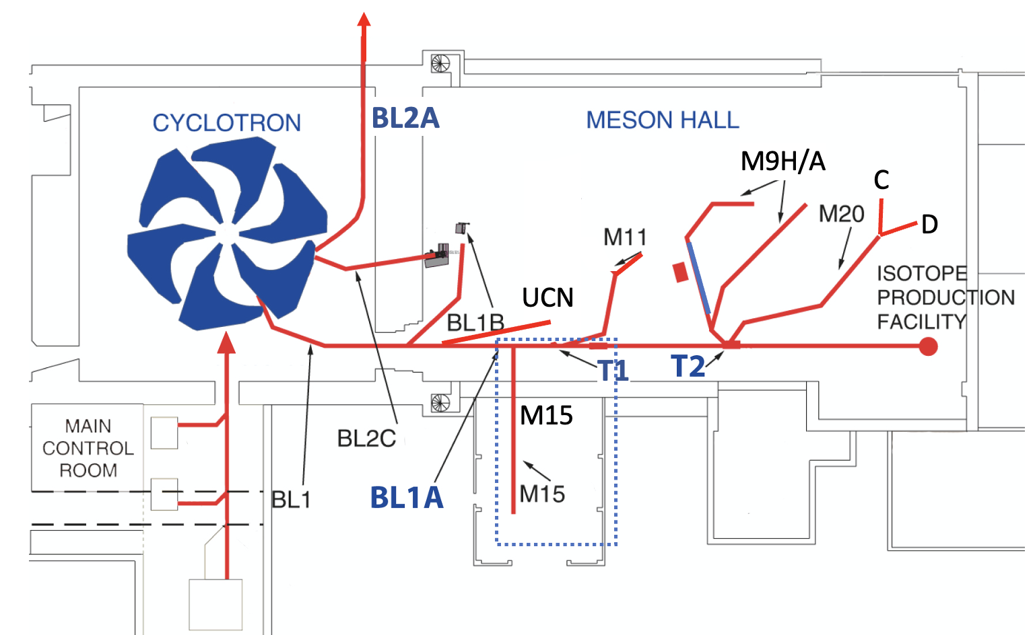
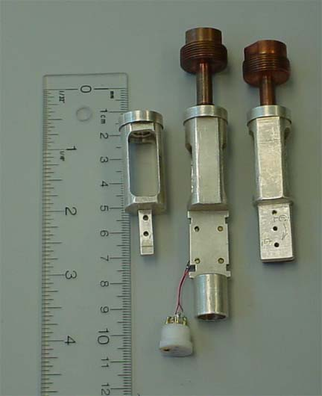
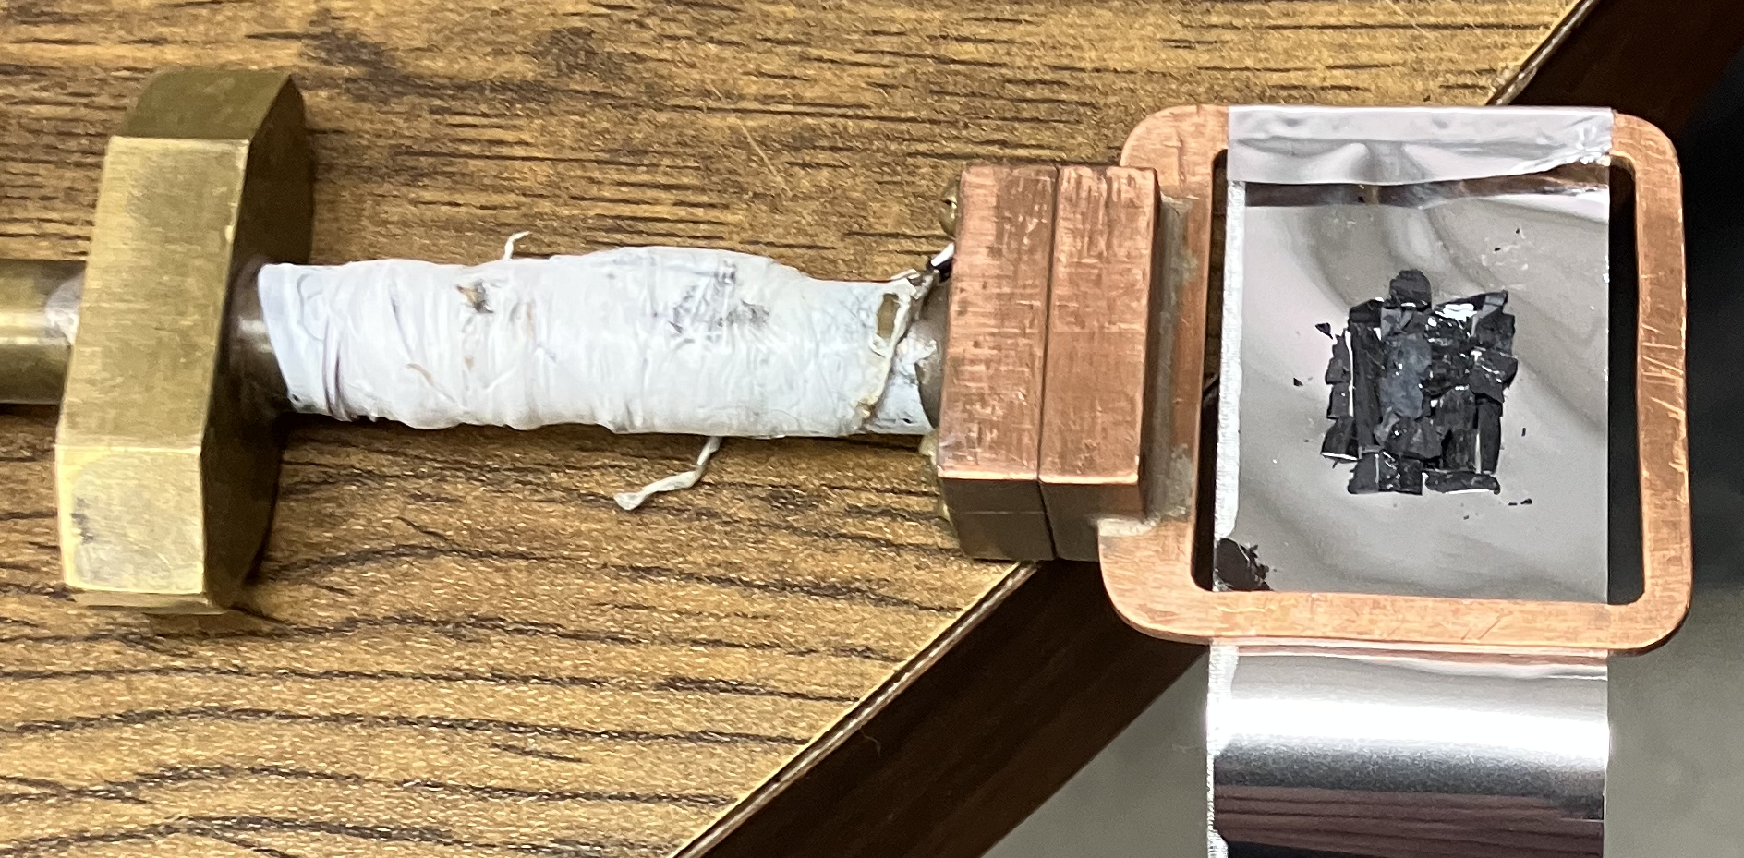
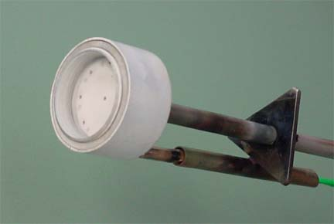
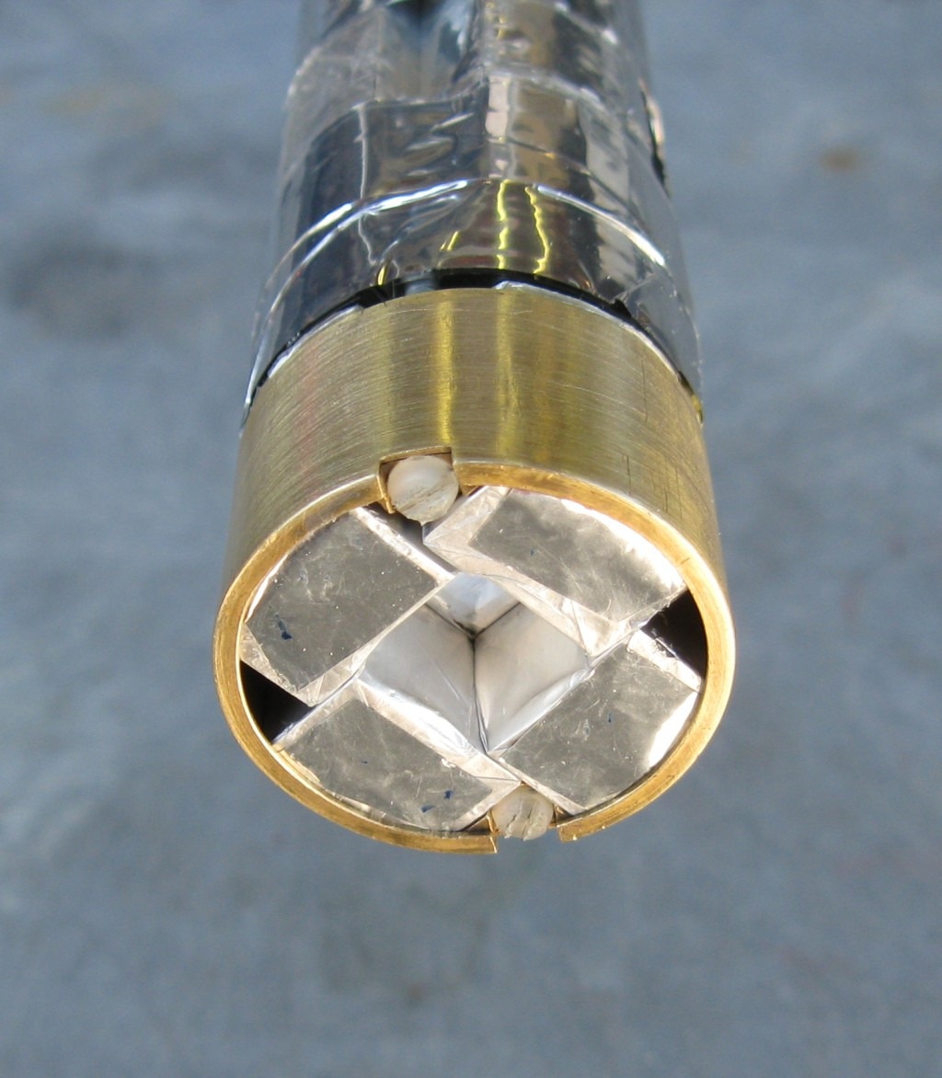
TRIUMF beamlines, spectrometers, inserts, holder
https://cmms.triumf.ca/equip/spect.html https://cmms.triumf.ca/equip/ins.html, https://cmms.triumf.ca/equip/hold/
LAMPF (M20D: 0.4T LF or TF 2 – 320K, gas flow Miss Piggy) ← covers most
SFUmu (M9A: 0.45T)
HELIOS (M9A: 5.4T LF or TF
DR (M15: 4T LF or TF, 20mK – 8K)
NuTime (M15: 6T TF, 2 – 300K)
HGas: 2.5 – 300K, Haake circulator: -40 – 200℃
Oven: RT – 800K
M9
M20
H A
DR
oven
M15
↑ LAMPF MissPiggy
20x20mm max with veto
← NuTime
Sample: 7x7mm max

Slide 8
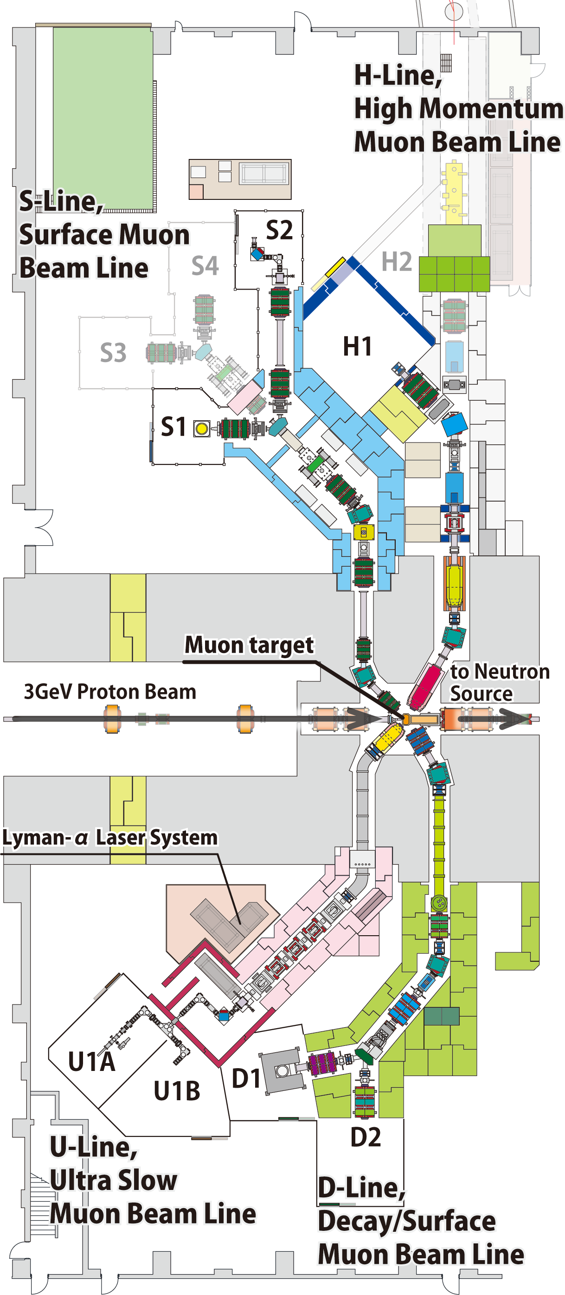
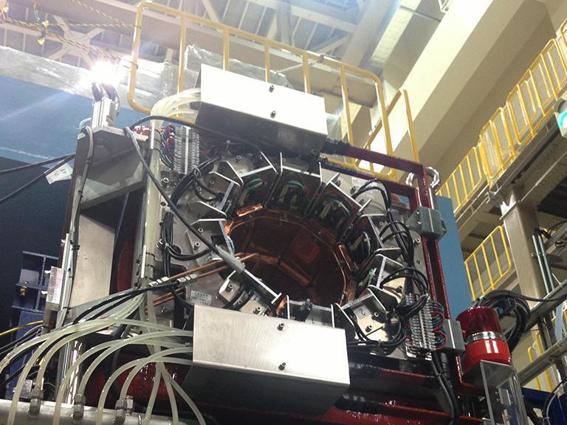
J-PARC Beamline, Instruments and contacts
https://mlfinfo.jp/en/beamlines.html
  D1 (Decay line for surface µ+ and backward µ+/-)
  S1 (Surface µ+)
  D1 and S1 has 0.4T spectrometer, both has a kicker
  D2 is for MIXE (not open), and general non-µSR
  U1A (Ultra-Slow µ+) / U1B (Muon acceleration), S2, H1 (particle physics) are not open
Sample environment
  Oxford Dilution Refrigerator (D1: 100mK – 10K?)
  Oxford 3He heliox / variox (0.3K – 300K?, cold finger)
  Oxford gas flow 2K cryostat
  Oxford mini cryostat (4-350K, cold finger) ← covers most
  IR oven (RT – 800K?)
  ICEOxford cryogen-free and 5T magnet under development (S1)
Contacts: Soshi Takeshita (D1: soshi), Izumi Umegaki
S1 / D1
0.4T LF

Slide 9
J-PARC MLF (is a user facility)
Call for proposal: twice a year, A: Nov ~7 and B: May ~8 deadlines.
Submission / visit procedure: https://mlfinfo.jp/en/mlfflow.html
Beamtime: 20xx A: April-June, and 20xxB: November-March
User Office contact: j_proposal@ml.j-parc.jp
Local contacts: Soshi Takeshita (D1), Izumi Umegaki (D2), Jumpei Nakamura (S1)
    emails: soshi.takeshita, izumi.umegaki, jumpei.nakamura @kek.jp
TRIUMF CMMS (is not a user facility: needs a local collaborator)
Call for proposal: twice a year, 1: Dec ~9 and 2: ~Jun deadlines.
Submission procedure: https://triumf.ca/experimenter-portal/planning-experiments/mms-eec-submission-process/
Beamtime: 1: May-September, and 2: October-December
Physical Science Div. Admin. Assistant (sciencediv@triumf.ca)
Local contacts: Iain McKenzie, Sarah Dunsiger and Kenji M. Kojima
          emails iainmckenzie, dunsiger, kojima @triumf.ca

Slide 10
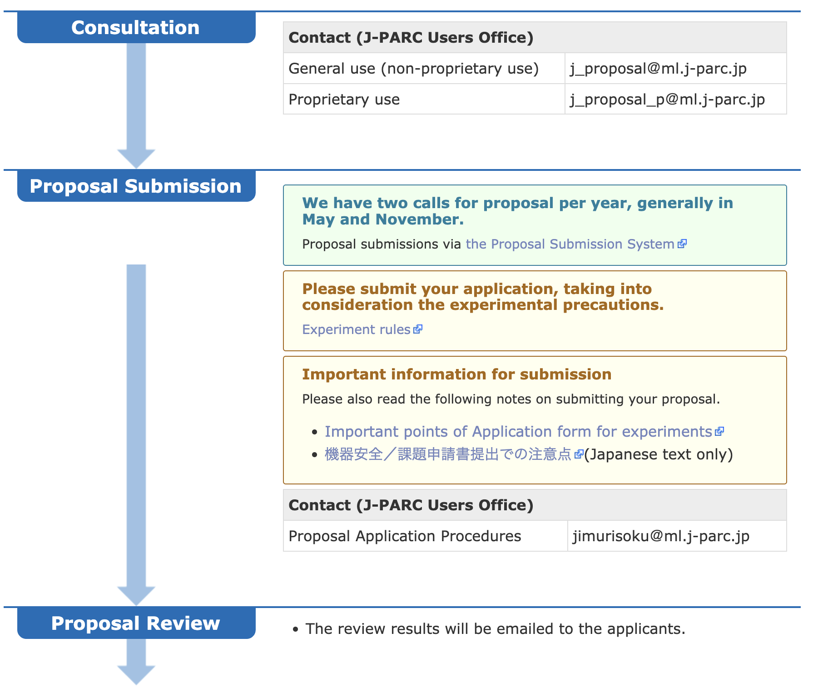
J-PARC proposals
Reviewed and scored by 3-4 external reviewers assigned by the committee
Committee (~10 people) discusses the scores, make adjustments (remove too high/low scores) and sort on the average of the reviewers.
Approved / Reserved threshold is determined by the number of days available. 2024A: 36/8, 2024B: 28/23
Oversubscription rate: 1.48
Typically, one experiment receives at most 2-3 days.
Proposal is valid for ½ year.
Web-form based with Figures.

Slide 11
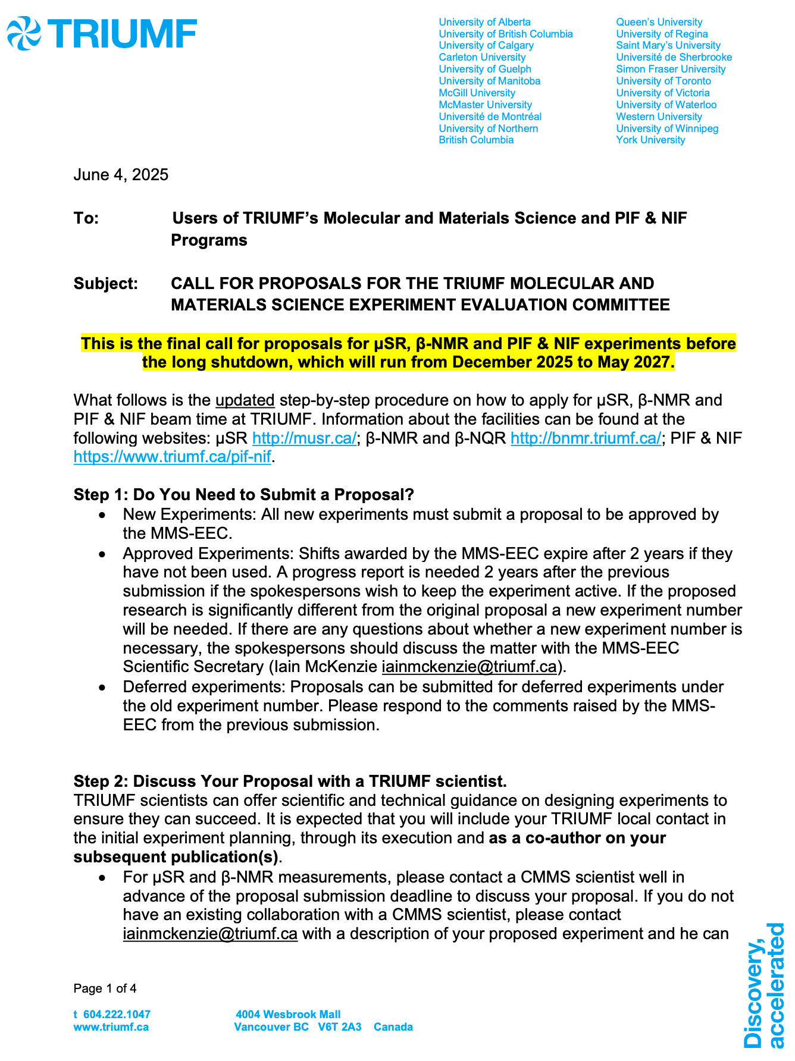
TRIUMF proposals
Call for MMS-EEC (Molecular and Materials Science
– Experiment Evaluation Committee) proposals
(0) An email is sent to those who are on
mms-experimental-program mailing list
(1) Discuss with TRIUMF local scientist
(2) and request an experiment number (e.g. M26xx)
(3) Submit a proposal and Spokesperson publication list
Proposal is 4 page long with figures (similar to PSI)
After the proposal is approved
(4) Submit a Beam Request (for beamtime allocation)
Average muSR oversubscription: 1.55
Average betaNMR oversubscription: 1.76
Average oversubscription 2012 - 2019, 2021-present

Slide 12
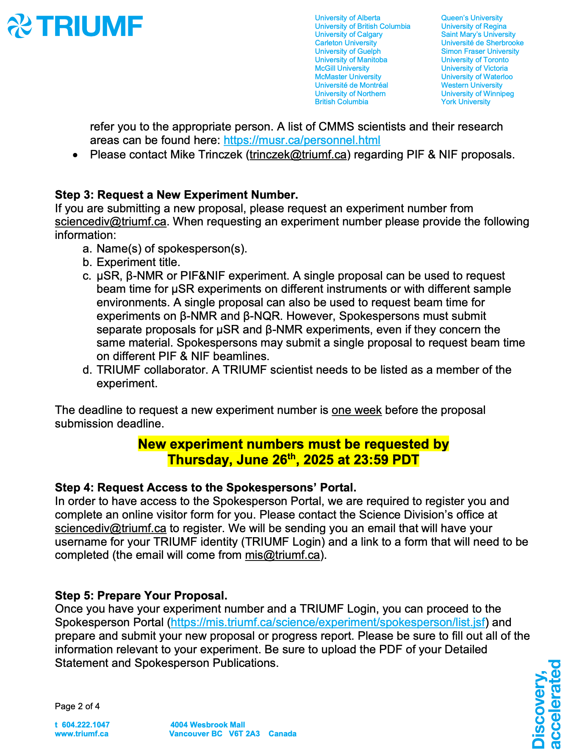
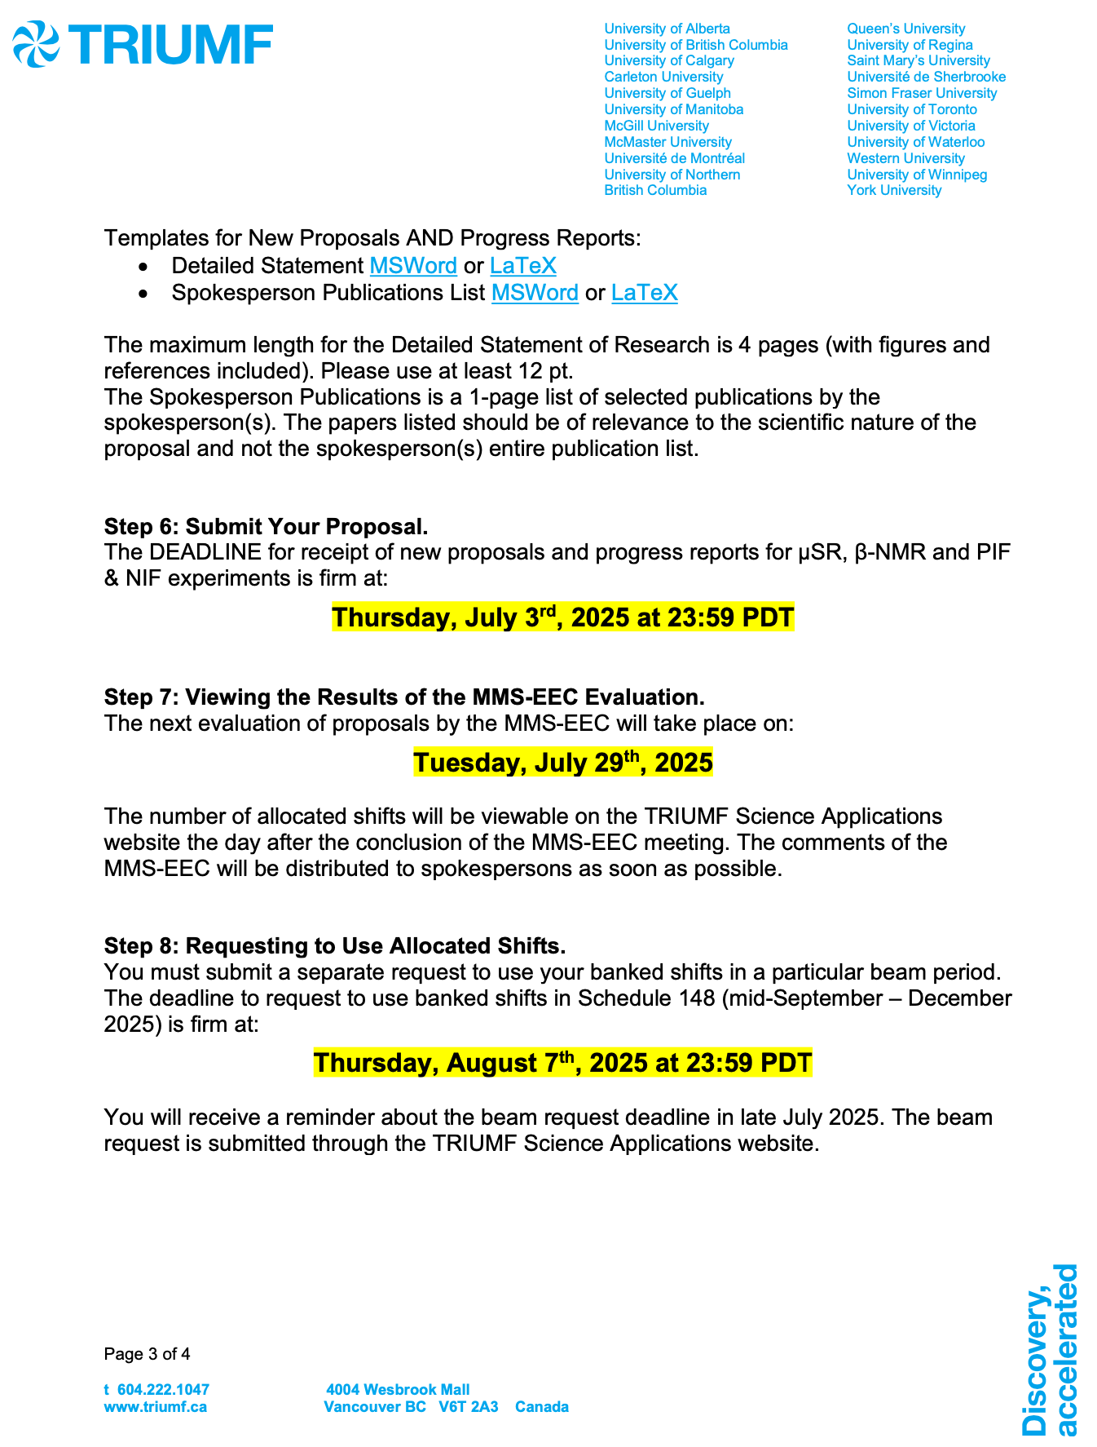
TRIUMF proposal (cont’d)

Slide 13
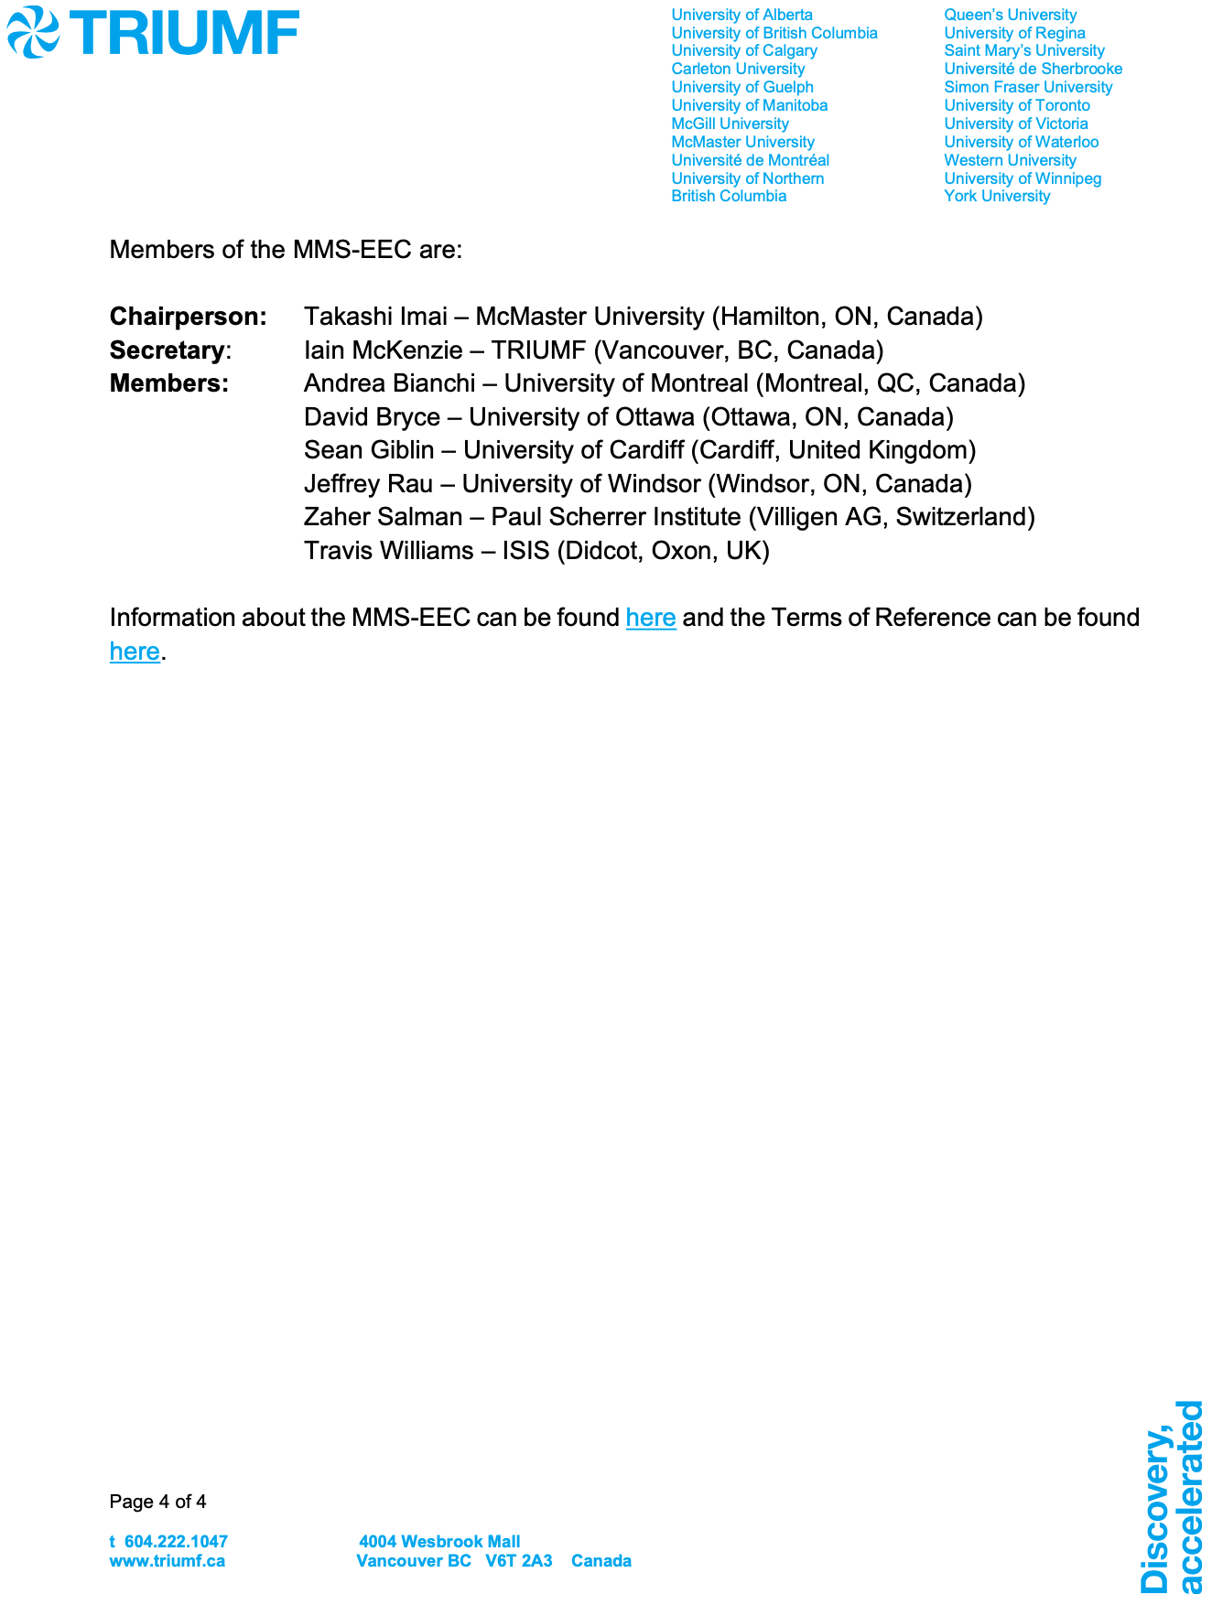
TRIUMF proposal (cont’d)
Seven panel members (as listed in the left as of 2025) will review the proposals, where two reviewers for each proposal are assigned.
MMS-EEC sends the recommendations (eg: priority: High or Medium, or deferred) to the Physical Science division head and approved.
The decisions will be sent to the Spokesperson(s) about two months after the proposal submission.
Beam request (for allocation of the beamtime) is a separate process from the proposal, and its deadline is 1-2 weeks after the decision announcement.

Slide 14
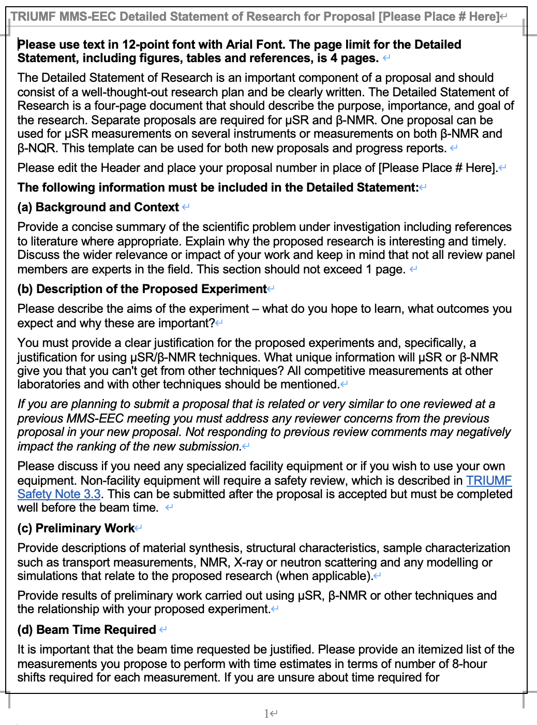
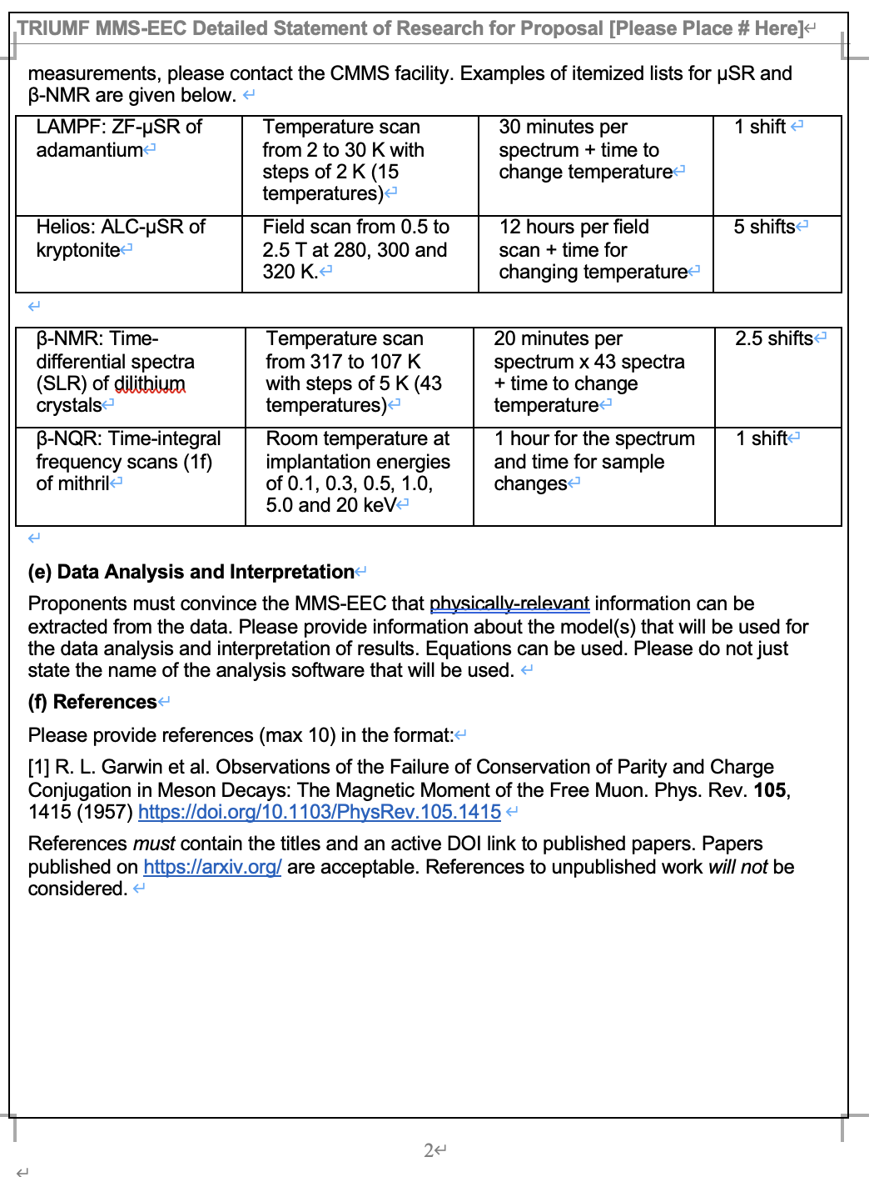
TRIUMF proposal
Template available in MSWord (→) and LaTeX
Maximum 4 pages

Slide 15
J-PARC
Proposal calls
2026A 2025.10.17 ~ 11.07 17:00 (JST) 2026.04~06
2025B 2025.04.17 ~ 05.08 17:00 (JST) (2025.11~)2026.02~03
2025A 2024.10.17 ~ 11.07 17:00 (JST) 2025.04~06
2024B 2024.04.17 ~ 05.09 17:00 (JST) 2024.11~2025.03
TRIUMF
2025/07 2025.06.04 ~ 07.03 23:59 (PDT) 148: 2025.09~2026.01(2027.09)
2025/01 2024.11.25 ~ 12.09 23:59 (PDT) 148: 2025.05~2027.05
2024/07 2024.05.08 ~ 06.12 23:59 (PDT) 147: 2024.10~2024.12
2024/01 2023.10.30 ~ 12.09 23:59 (PDT) 146: 2024.05~2024.09 (-2026.05)

