Slide 1
PSI SMACC1 Design Review
Description:
  MagDev is the magnet development activity within the CHART (Swiss Accelerator Research and Technology) network and contributes to the HFM (High-Field Magnet) Programme hosted at CERN under the agreements KE4808 and KE5943.
  During the CHART1 funding period (2016-2019), MagDev designed and built a Nb3Sn Canted–Cosine–Theta CCT magnet called CD1, with testing initiated at LBNL and concluded at CERN.
  For the CHART2 period (2020 - ongoing), MagDev was divided into two phases, primarily for better steering of the LTS program: MagDev1 (2020 - 2022) focused on short-tracking technology development for Nb3Sn Stress-Managed High-Field Magnets (HFMs) and providing a roadmap for the remainder of CHART2 and beyond; MagDev2 (2022 - ongoing) aims to implement a significant portion of the roadmap.
  This technical review of the Stress-Managed Asymmetric Common-Coils magnet (SMACC1) constitutes deliverable D1.3 of WP3.14 in the HFM Programme.
Committee:
  Paolo Ferracin (Chair, LBNL), Susana Izquierdo Bermudez (CERN), and Fernando Toral (CIEMAT)

Slide 2
PSI SMACC1 Design Review
Indico page: https://indico.psi.ch/event/16981/
Zoom link: https://psich.zoom.us/j/3656547665

Slide 3
PSI SMACC1 Design Review
Questions for the Review Committee:
  Have the goals of the project been clearly stated and explained?
  Is the design overall solid? This includes the magnetic design, protection, and mechanics.
  Are the parameters sufficient to validate the SMACC concept?
  Are there any unidentified risks associated with the design?
  Is there a sufficient level of tests and R&D?
  Does the maturity of the design presented allow for continuing the engineering design phase?

Slide 4
General comments
Thanks for inviting us to the review
  Interesting and stimulating.
Very good presentations, well organized. Thanks to the all the speakers for the excellent work
Not much time to digest the information, sorry if we missed or misunderstood something……

Slide 5
PSI SMACC1 Design Review
Some findings/comments/recommendations
Answers to the review questions

Slide 6
Overview
(by B. Auchman)
Program overview
  Findings/comments
    CHART1 2016-2019: focus on CCT
    CHART2 2020-2024
      New laboratory, 13 people working on CHART
      From CCT → Stress Managed cos-theta → Stressed Managed common coil
        “CCT, the more turns the more training, showstopper for long magnets”
      Goal: 14 T short model, material studies, powered samples, subscales
        For the 14 T, now common-coil design chosen
        Box → wax and filled wax with excellent training performance
        Compression box: filled wax similar to CTD-101K in terms of degradation stress
        Big box: single racetrack that fit BNL common-coil magnet, tested successfully at BNL
        Subscale SMACC1 tested successfully at CERN

Slide 7
Overview
(by B. Auchman)
Program overview
  Findings/comments
    CHART3
      CHART(3) 2025-2028
        Demonstrate LTS baseline technology for FCC-hh as soon as possible.
          This is what we are reviewing here.
        Develop HTS accelerator-magnet technology “as if our future depended on it.”
    The current program appears to be well defined and coherent
    With box + compression box + big-box + subscale the program can rely on extremely useful R&D tools to support the development of SMACC1 and SMACC2

Slide 8
SMACC1 conceptual design and requirements
(by D. Araujo)
Superconductor and magnetics
  Findings/comments
    SMACC1 introduces the stress management and the asymmetric concept
      Stress managements (spars) between layers
      Ribs between coil blocks
      One racetrack coil block (L1) for field quality
    Cable
      Existing cables: high field used in R2D2, low field also from R2D2 but with different wire lay-out
        The available quantity of low field cable is just enough for 4 coils (400 m)
        No clear how much cable is available for the high-field coil
    Goal: 12 T field with more than 20% of margin
      with minimum training, field quality, and aiming at tooling development, and at exploring scalability in length

Slide 9
SMACC1 conceptual design and requirements
(by D. Araujo)
Superconductor and magnetics
  Findings/comments
    As a result of strand/cable geometry and cable availability, in terms of magnetics
      5% peak field higher than bore field
        Interesting alternate ss-iron yoke design to increase the bore field at the same time keeping the peak field in high field coil
      +/- 15 units geometric_ saturation
        Looks reasonable to us
      446.6 mm straight section for 890 mm length shell
    SS shell: smaller compared to an Al shell → smaller magnet OD
      The option with Al shell with horizontal split yoke is not been presented
    QP: SMACC1 not scalable to long length (because of the cable), but the goal for SMACC2 is to be protectable in long lengths
    Intra-beam space : 250 mm as part of the requirement
      A larger inter-beam distance would help the superconductor efficiency and decrease vertical electromagnetic forces
        Availability of conductor also contribute to this choice
    Overall current density and Cu current density in the low field are very high
    Cable availability is a concern, no room for practice or spare coils
  Recommendation
    Verify the possibility of getting additional cable for the program
    Verify stability limits of the two strands/cable in operational conditions

Slide 10
SMACC1 conceptual design and requirements
Mechanics 2D
  Findings/comments
    The modeling assumptions (properties, limits, contacts) seem reasonable
    Pre-load sensitivity analysis
      Coil peak stress does not depend on pre-load
      The only component that seems to benefit from an increased pre-load is the pole
      But it is also the component that prevent from going to high pre-load because of the to peak stress at room temperature
        Not clear what happens if pole thickness is increased
      The shell stress increases with pre-load
      It looks like that the horizontal preload is just aimed at decreasing the tensile stresses at the pole.
    The bladders operate at relatively high pressure (for HL-LHC “standards”), and the additional clearance required to insert the key is traditionally hard to predict
    A SS shell of 35 mm thickness is quite hard to produce, especially if 316 LN is considered and for a long magnet (SMACC-2)
    If a large range or pre-load can be tolerated (which seems achievable without considering the pole stress), it would be possible to use a stainless steel shells welded without the need of tight tolerances to control the level of pre-load → big advantage of this specific design when looking at large scale production

Slide 11
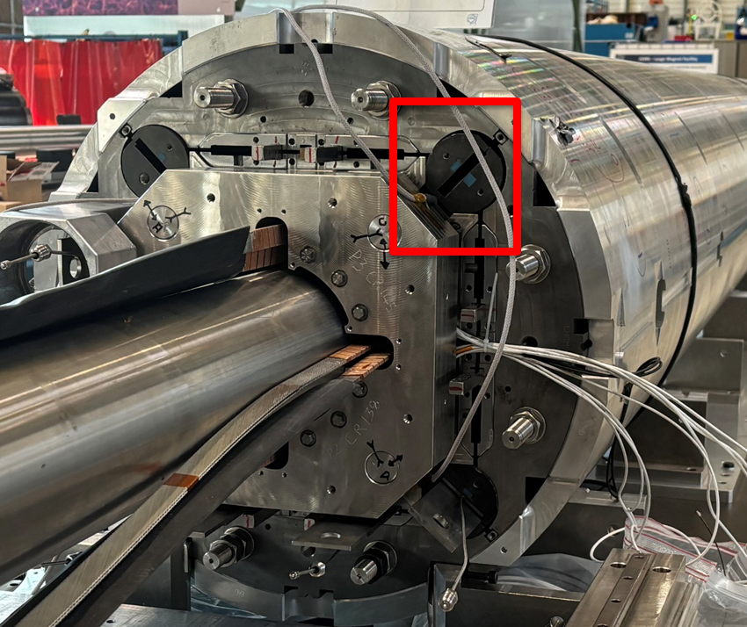
SMACC1 conceptual design and requirements
Mechanics 2D
  Recommendation
    Evaluate the coils’ displacement and its effect on field quality
    Include the computation of stresses during bladder operation in the FE analysis
    Consider the option of a “stress management design” for layer 1, to “protect” the pole
    Explore the option of Nitronic 40 for the pole, or a thicker pole
    Study the possibility of adding a bladder in the rod hole (although it may be difficult because of the end plate….)

Slide 12
SMACC1 conceptual design and requirements
Mechanics 3D
  Findings/comments
    The modeling assumptions (contacts) seem reasonable
      Same approach as in 2D (separation allowed – not-allowed)
    The end pre-load allows keeping the former in contact up to 12 T
      Axially the pre-load is the maximum achievable with the rods
    The transition between straight section and coil ends is concerning
      local increase in the axial strain in the transition of the formers
    A 3D stress management option may eliminate the need of an axial pre-load
  Recommendation
    Study what happen to the coil stress if the former opens, particularly in the transitions
    Study how the axial pre-load is distributed between the coils and the role of friction
    Explore the option of a “locked” former to intercept axial e.m. forces

Slide 13
Quench protection
(by E. Ravaioli)
Quench protection
  Findings/comments
    Cable is given, so challenging quench protection
    No quench heaters
    AC losses (former) not included since their time-constant is too large (not helpful)
    Protection studies were carried out in the sub-scale test
    We noticed that “every millisecond counts”…..
  Recommendation
    Make sure that for the next magnet (SMACC2) the cable is design to chosen also based on quench protection consideration

Slide 14
Magnet Technical Design Status
(by Thomas Michlmayr)
Magnet fabrication
  Findings/comments
    The assumption on the expansion of LF cable is based on R2D2, which uses a different strand
    The uncertainty in contraction during reaction (different strands) is resolved by starting with a larger gap, and then shim
    3 mm of clearance of the end-plates cut-outs for bladder-key seems small
    There are many parts for assembly, many in stainless steel. Be careful with differential thermal contractions during cool-down.
    There are many bladders and many keys to control
  Recommendation
    Consider a practice/spare coil for evaluating the contraction during heat treatment
      This is related to the cable availability issue
    Consider enlarging the cut-outs in the end-plate for the bladders
    Make sure to have a uniform temperature profile during cool-down and during operation (add cooling channels).

Slide 15
Winding splicing
(by T. Michlmayr and A. Stampfli)
Winding / splicing
  Findings/comments
    Well defined procedure to insert the cable in the groove of the former
    Winding tests were done with both cables
    Rollers allow coil to contract during reaction
    Tooling partially tested on subscale coil, but the coil is too short for a full validation
    Extensive testing of different splice configurations: two options considered, HTS or Nb-Ti
  Recommendation
    Consider a practice coil or a “few turns” coil to test the tooling
    Study the scenario of a quench in the HTS splice (shunt needed?)

Slide 16
Instrumentation/impregnation/electrical integrity
(by A. Stampfli and A. Brem)
Findings/comments
    Pole stress monitored with SG. It could be used to estimate the peak stress on the coil
    Then SG on shell, rods, VT to check coil voltage
    Overall, the instrumentation plan seems adequate and well validated by the subscale tests
    Bladder test: 700-800 bar, which is needed to reach 450 um key interference
    The impregnation process can be applied to long coils
    Filled wax is a better insulator than epoxy, in theory
    Good electrical results, but large spread
Recommendation
  Continue with the qualification/test/characterization of properties of filled wax, as an option for future accelerators
  Test to higher voltage the insulation material, to evaluate the limits
  Consider the option of adding a quench antenna for the axial localization

Slide 17
PSI SMACC1 Design Review
Some findings/comments/recommendation
Answers to the review questions

Slide 18
Questions for the Review Committee
Have the goals of the project been clearly stated and explained?
  Yes, all clear and well defined

Slide 19
Questions for the Review Committee
Is the design overall solid? This includes the magnetic design, protection, and mechanics.
  Yes, the design is solid
    Some weaknesses were identified
      Cable outer layer -> QP
      Pole stress
      Bladder pressure
    Some potentials also were pointed out regarding the possibility of relaxing the pre-load conditions (welded shell) and about axial “stress management”

Slide 20
Questions for the Review Committee
c. Are the parameters sufficient to validate the SMACC concept?
  The SMACC1 is a good step towards the validation of stress management common coil design for FCC-hh

Slide 21
Questions for the Review Committee
d. Are there any unidentified risks associated with the design?
  No major risks identified
    Comments and suggestions on axial loading and pre-load were provided
    Make sure that cable availability is addressed

Slide 22
Questions for the Review Committee
e. Is there a sufficient level of tests and R&D?
  Yes, definitely

Slide 23
Questions for the Review Committee
Does the maturity of the design presented allow for continuing the engineering design phase?
  Yes, go ahead!

Slide 24
Appendix

