Slide 1

HFM
High Field Magnets
MagDev2 Overview
Programme
B. Auchmann for the MagDev Teams
SMACC1 Conceptual Design Review, Jan 13-14, 2025.
This work was performed under the auspices of and with
support from the Swiss Accelerator Research and Technology
(CHART) program, http://chart.ch.

Slide 2
CHART 2016-2019

Slide 3

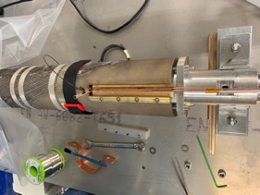
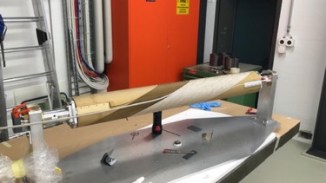
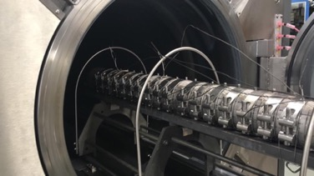
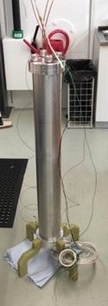
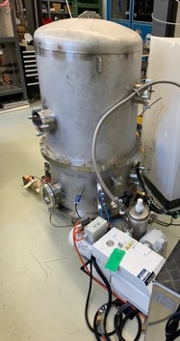
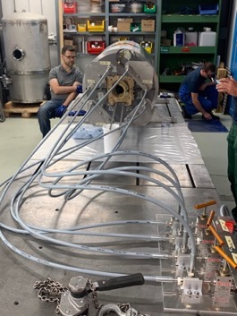
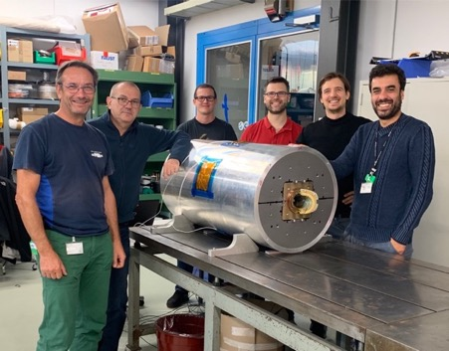
Canted Dipole 1 Built at PSI
Magnet design, lab refurbishment, equipment, and commissioning, as well as magnet construction from 02.2017 to 10.2019.
[G. Montenero et al., Coil Manufacturing Process of the First 1-m-Long Canted-Cosine-Theta (CCT) Model Magnet at PSI, IEEE Trans. on App. SC., Vol 29(5), 2019.
G. Montenero et al., Mechanical Structure for the PSI Canted-Cosine-Theta (CCT) Magnet Program, IEEE Trans. on Appl. SC., Vol 28(3), 2018.]

Slide 4
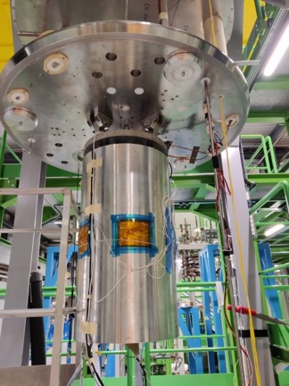
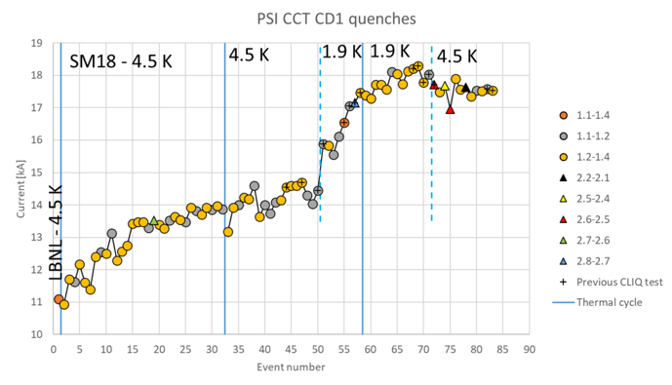
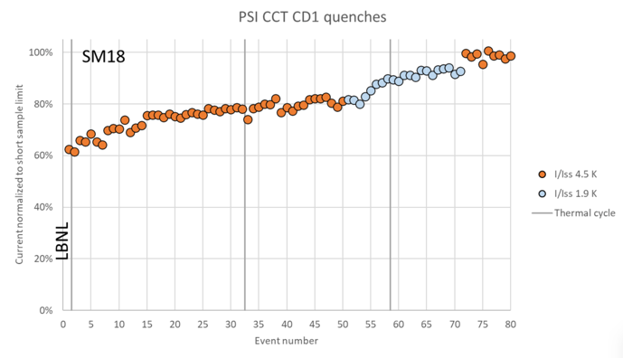
CD1 Lessons on Robustness and Performance
Magnet test in January 2023:
The magnet trained A LOT.
But, it reached 100% of maximum field at 4.5 K.
These were the first Nb₃Sn training coils at PSI:
  No conductor degradation occurred from handling, assembly, powering, or thermal cycling.
Stress-management works, CD1 is a robust magnet.
Courtesy F. Mangiarotti (CERN) and M. Daly (PSI).

Slide 5

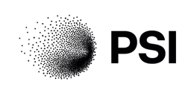
CHART1 Collaborations
CERN: co-financed MagDev0 and MagRes0; tested CD1.
ETHZ D-MAT Soft Materials Group: Characterize commonly used epoxies for fracture toughness and other properties in cryogenic conditions.
LBNL: transferred Nb₃Sn CCT technology
PSI Magnet Section: directly involved in laboratory refurbishment, magnet technical design, and magnet construction.

Slide 6
CHART 2020-2024

Slide 7
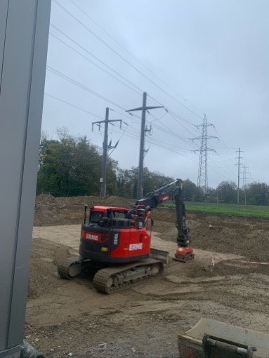
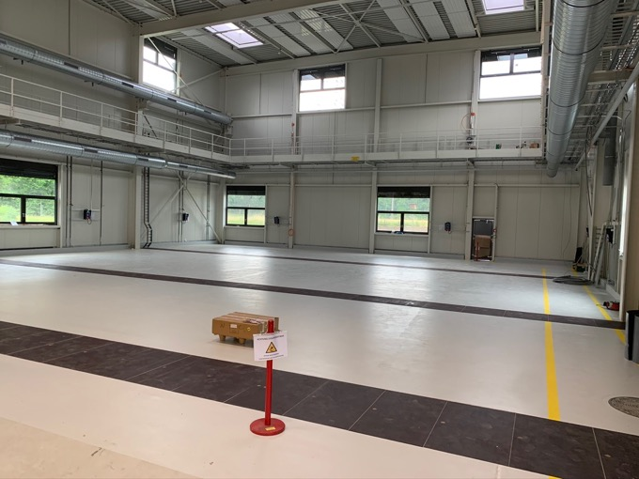
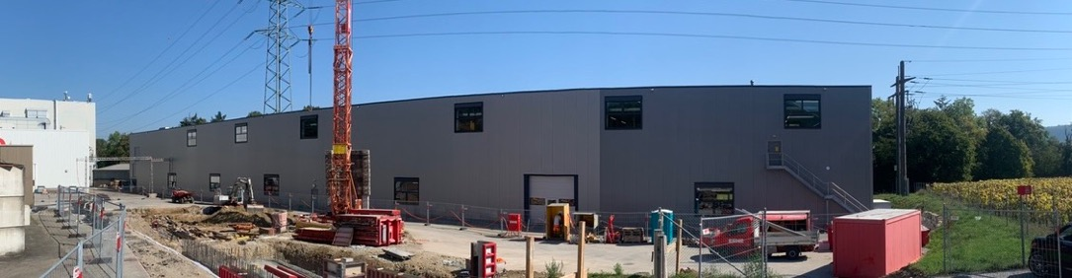
MagDev Laboratory at PSI
The lab is an extension to WLHA building, which houses normal-conducting magnet development, field quality measurements, and
undulator development.
It provides 400 m2, organized
roughly along the lines of
CERN’s 927 laboratory.
31.11.2019
30.6.2020

Slide 8

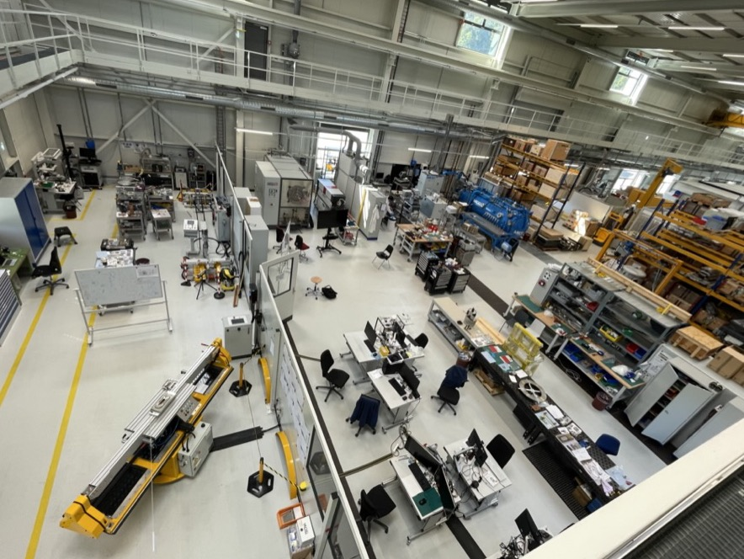












MagDev Laboratory
Douglas Araujo
Engineer LTS
Jaap Kosse
Engineer ReBCO
Thomas Michlmayr
CAD, Technical Design
Colin Müller
Mechanic LTS
Anna Stampfli
Technician Processes
Henrique Rodrigues
Process Engineer ReBCO
Jürgen Schmidt
Technician HTS
Dmitry Sotnikovs
Design Engineer ReBCO
Christina Lindner
Technician HTS
André Brem
Material Scientist
Joep Van den Eijnden
PhD Student
Kirtana Puthran
Engineer ReBCO
Matteo Crescenti
PhD Student
+ 2 more arrivals in 2025

Slide 9
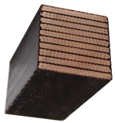


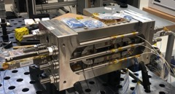
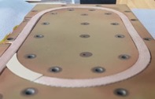
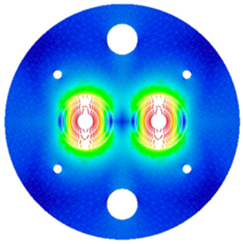
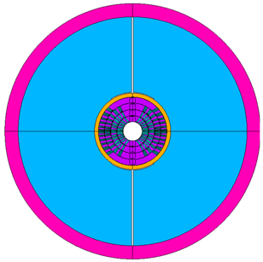
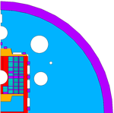


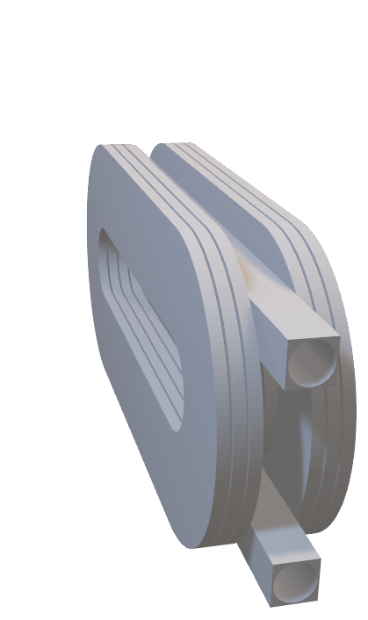
Fast-Turnaround Stress-Management R&D
HFM R&D has suffered from slow turnaround and late feedback on technology.
Minimum viable products have enabled a breakthrough in stress-managed Nb₃Sn technology.
Goal: Build industrializable Nb₃Sn high-field magnets that “just work”.
First deliverable
#Deliverables / year
2x
5x
2019
Materials and Composite Samples (not powered)
100s
2020
Powered Samples and Mechanical Models
10
2024
Sub-scale Magnets (5 T)
2-3
2025/26
Short Magnets
Ultimate Field (14…16T)
0.5-1
Courtesy M. Daly
1x
1x
Long Magnets Ultimate Field Magnets
(14…16 T)
Courtesy D. Araujo
Courtesy D. Araujo
Long-magnet infrastructure
available only at CERN.
produced in Q2/24 ...

Slide 10
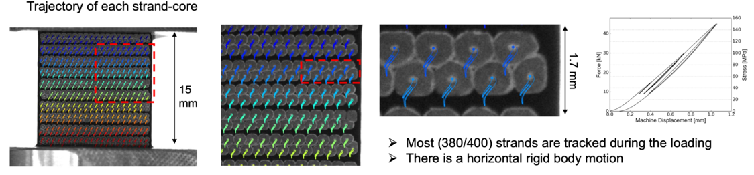
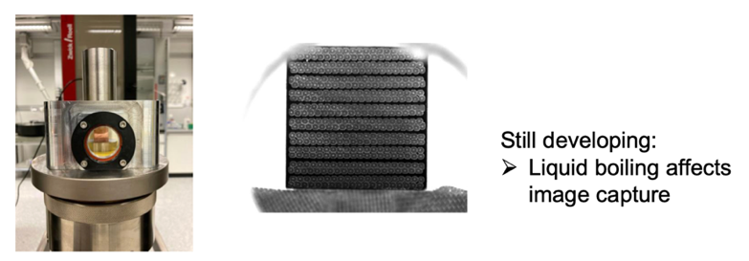
10-Stack
ETHZ: 10-stack measurements with image analysis (particle-tracking method).
  Epoxy vs. paraffin, vs. filled epoxy and paraffin.
Extraction of homogenized material description for ANSYS (or other) pending.
ETHZ D-ITET PhD thesis work on multi-scale modeling in its first year.
[X. Kong, T. Tervoort, et al.,
CHART annual meeting,
indico link, Oct. 2023.]

Slide 11

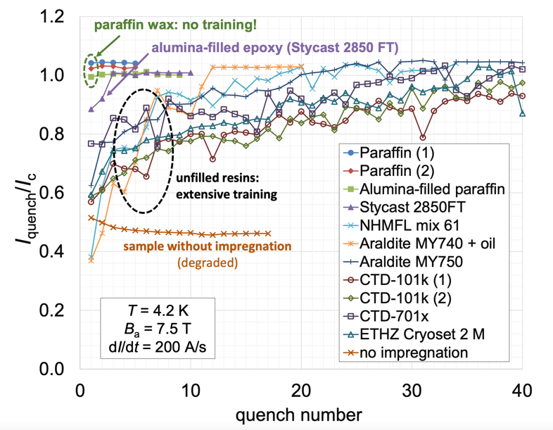
BOX
alumina-filled paraffin wax
Courtesy, A. Brem, M. Daly, S. Otten, S. Sidorov
BOX (BOnding eXperiment) program with uTwente has shown a wide variety of results, from complete conductor degradation (no impregnation) to substantial training (epoxy) to no-training (wax, Stycast, filled wax), with 21 BOX samples successfully and tested to date.
Notes:
LBNL is preparing a wax impregnated subscale CCT magnet

Slide 12
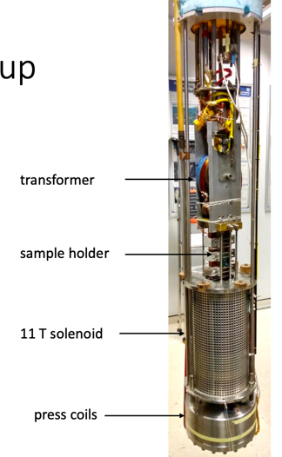
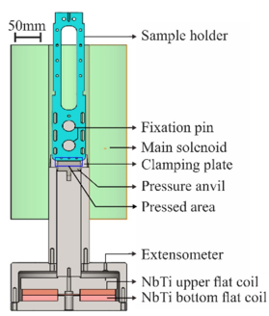
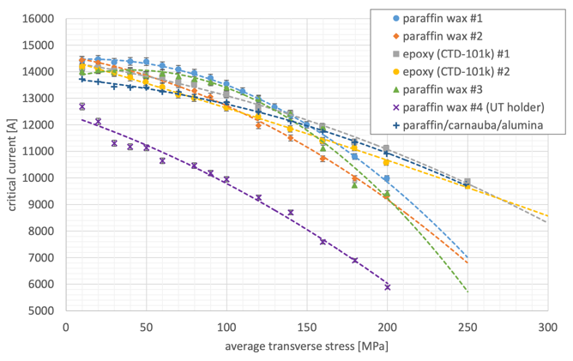
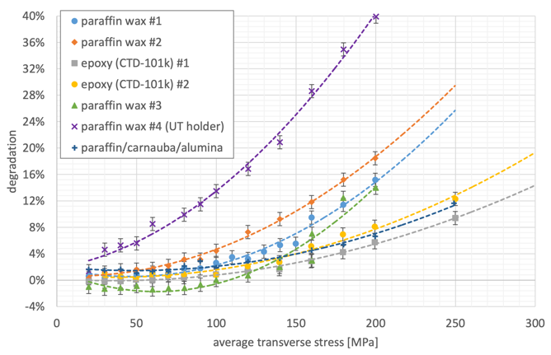
Compression BOX
Successful systems are characterized in U Twente’s transverse-compression setup.
CTD 101-K measurements reproduce previous resultsof Twente U-shaped samples.
Paraffin wax’s lower modulus and yield increase degradation. Filled wax bumps wax up to CTD 101-K support.
Courtesy M. Daly
Courtesy, A. Brem, M. Daly, S. Otten, S. Sidorov

Slide 13
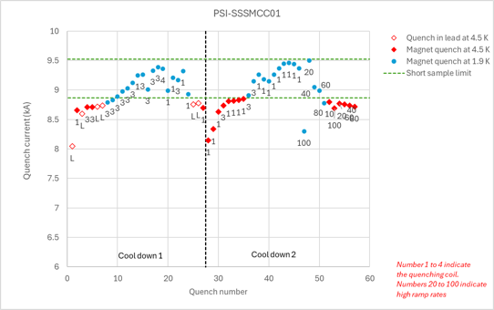
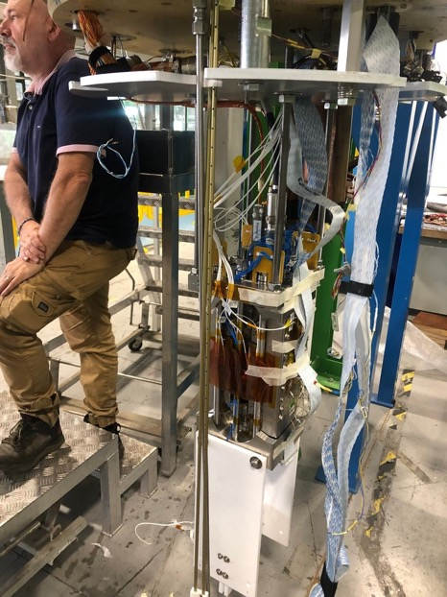
subSMCC1 Performance
[Test data courtesy of G. Willering, CERN]

Slide 14

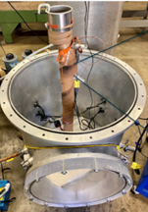
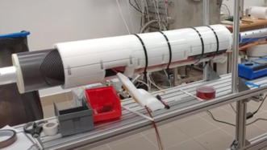
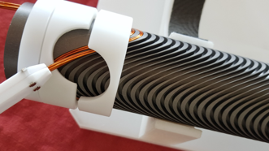
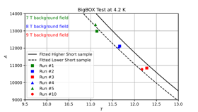
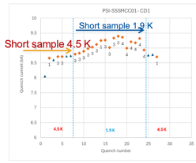
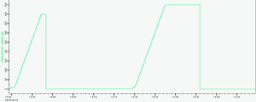
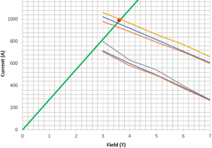
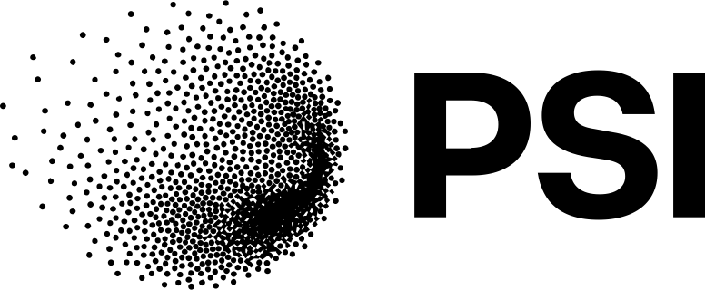


Six stress-managed R&D magnets with (almost) no Training
PSI/BNL BigBOX: a 13-turn SM racetrack.
No training with 12.3 T coil field, 170 MPa coil stress at BNL’s DCC17.
LBNL wax impregnated sub-scale (5 T) CCT.
First Nb₃Sn CCT
without training.
Alumina-filled wax subCCT with a single training quench.
Wigner Inst./CERN SuShi septum for FCC
Wax impregnated
Nb-Ti CCT, no training to nominal current.
CERN FCC-ee final focus quad demo
Nb-Ti CCT to short-sample without training.
PSI subSMCC1 2-in1 dipole (5T)
Nb₃Sn common coil R&D magnet without training at 4.5 K. Support from LBNL/CERN.
Courtesy D. Araujo et al
Courtesy J.L. Rudeiros
Fernandez, LBNL
Courtesy D. Barna et al.,
Wigner Institute
Courtesy M. Koratzinos
et al., CERN/PSI
Courtesy D. Araujo et al
D. Barna et al., Training-free performance of the wax-impregnated SuShi septum magnet, SUST 37, 2024.
D. Arbelaez et al., Training-free demonstration of a 5.4 T Nb3Sn Canted–Cosine–Theta accelerator dipole impregnated with paraffin wax, SUST 37(6), 2024.

Slide 15

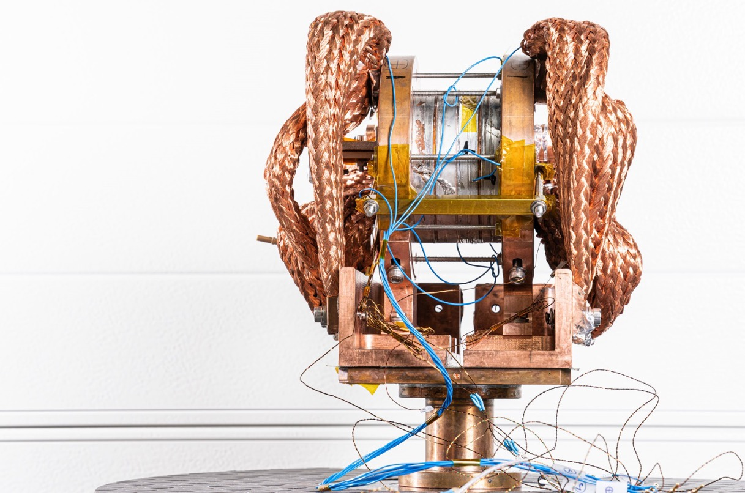
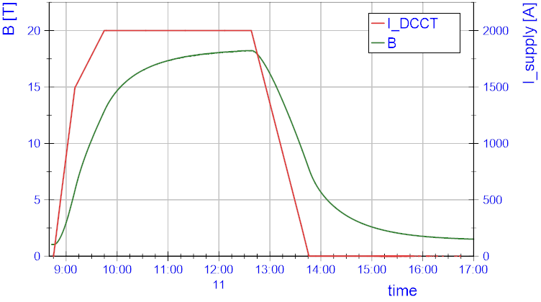


High-Temperature Superconductor: 4-Stack Technology Solenoid
inside
$$L$$
$$R$$

Slide 16
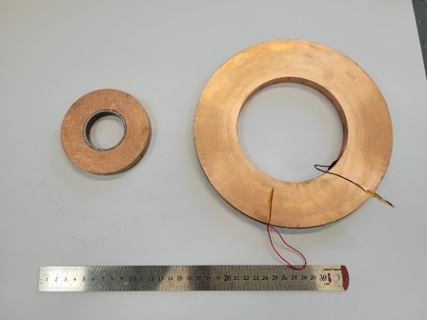
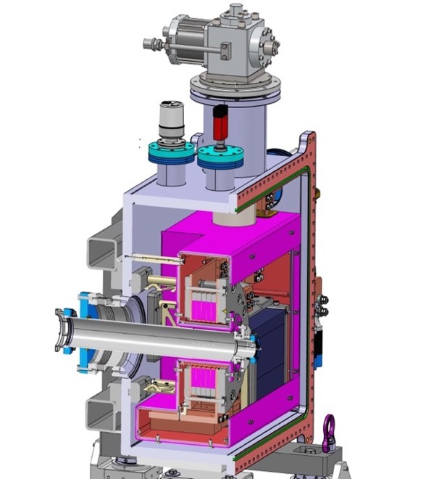
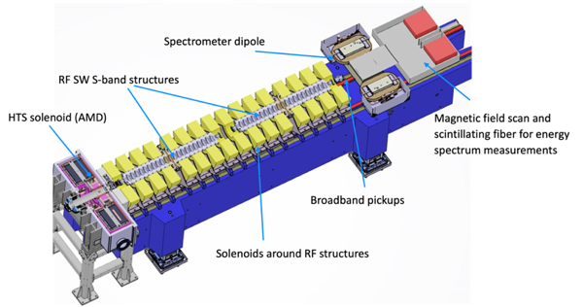
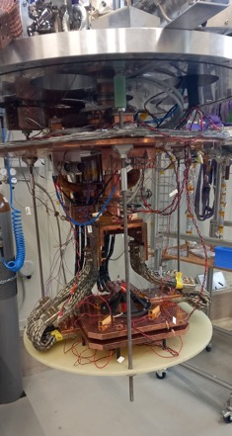
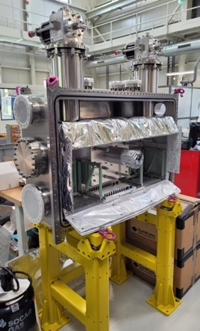

FCCee Injector Study: P3 experiment
(PSI Positron Production)
HTS no-insulation positron-capture solenoid, to demonstrate
positron source with 10x increased yield wrt. state of the art.
Manufacturing/commissioning in 2024/25.
Experiment at PSI’s SwissFEL 2025/26
15 K conduction-cooling
5 coils from 12 mm ReBCO, 110 mm ID
21 T peak field
target
Solid-state (Pb)
thermal buffer
15 T in 72 mm
warm bore
Coil technology licensed from

Slide 17
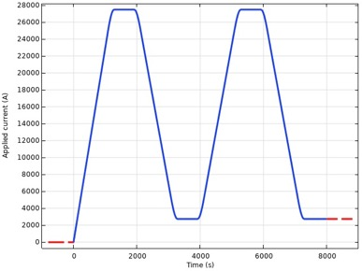
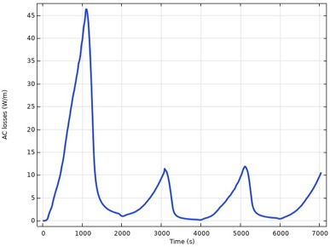







HTS ReBCO Accelerator Magnets for FCC-hh
ReBCO promises more sustainable operation, higher physics reach, and a more credible cost prospect.
Higher magnet temperature (20 K) improves power
consumption for static and beam-induced losses.
  Higher fields and collision energies could be envisaged
  but main cryo load for FCC-hh becomes synchrotron
  radiation (SR) on the beam screen.
  Increased ramp losses may (at least) in part cancel the improved cryogenic efficiency at 20 K.
    Initial estimates indicate a >2x increase in ramp losses wrt. Nb₃Sn state of the art.
Screening-current and -loss calculation
Courtesy D. Sotnikov, PSI
Power density [W/m, integrated over cable x-sec]
Screening current density [A/m²]

Slide 18






ReBCO FCC-hh Dipole Scaling Exercise
As expected, AC losses grow non-linearly with field due to larger field sweep and growth in coil-size.
In this study (for which all previous caveats and assumptions apply) AC losses increase 4-fold from 14 to 20 T.
Initial results indicate that losses decrease mildly towards lower temperatures.

Slide 19



ReBCO FCC-hh Dipole Scaling Exercise
In this study, a strong screening effect is observed. Multiple cycles are needed to reach reproducible conditions.
Experimental validation is of the essence.
Local correction schemes will be required.
How much can be achieved with beam-based feedback and possibly AI models?

Slide 20



HTS subscale preliminary work
Goals:
Re-use subSMCC design and structure for 6-8 T ReBCO magnet (6-8 tapes).
Dry or soldered ReBCO insulated tapes-stack cable.
SMCC magnet with apertures for field quality measurements.
Experimental and numerical protection studies.
Reproducibility study.

Slide 21
CHART2 Collaborations
BNL: BigBOX testing, common coil design for US-MDP 20-T design study (DA extra hours)
CEA: Rutherford cable geometrical models and meshes
CERN TE-MPE: protection simulations,
CERN TE-MSC: LTS conductor procurement and characterization, assistance in coil reaction, magnet testing,
cold magnetic measurements, BOX program, etc.
CERN TE-CRG: FCC-hh@20 K sustainability study
EPFL SPC: ASC on campus, material characterization, coil winding, pre-tinning, forced-flow cooling
ETHZ D-MAT SMG: resin development, LTS coil composite characterization and const. modeling
ETHZ D-MAVT pd|z: AM for structural coil parts in Nb3Sn magnets
ETHZ D-ITET EE: Model-Based Systems Engineering
ETHZ D-ITET PES: Cryogenic power converters
FNAL: materials exchange
LBNL: subscale cables, exchanges on materials R&D
PSI Magnet section: Laboratory construction and services, cryogen-free test station,
HTS4 FQ measurement, manufacturing aid in times of need.
PSI Spectroscopy of Quantum Materials: manipulator head for ACCESS2.0 beam line
PSI Neutron Scattering: split solenoid cryostat
UniGE: Metal-Insulator Switching Materials
uTwente: BOX program, HTS coils AC measurements

Slide 22
CHART 2025-2028

Slide 23


CHART MagDev3
Main goals:
Demonstrate LTS baseline technology for FCC-hh as soon as possible.
Develop HTS accelerator-magnet technology as if our future depended on it.

Slide 24

CHART MagDev3
Discussions with CERN- hosted HFM Programme and CHART started.

